Slide 1
CKD: Chapter 4 Cardiovascular disease in patients with CKD
United States Renal Data System
2012 Annual Data Report

Slide 2
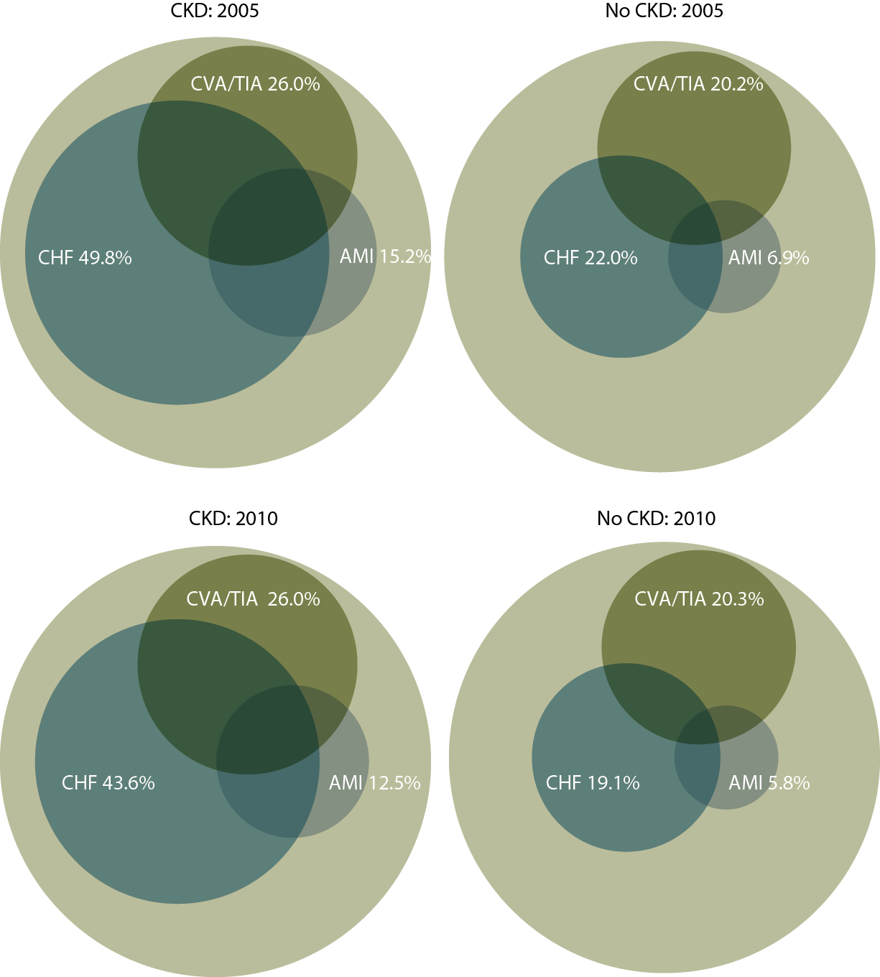
Cardiovascular disease in patients with or without CKD Figure 4.1 (volume 1)
December 31, 2005 & 2010 point prevalent Medicare enrollees, age 66 & older, with fee-for-service coverage for the entire calendar year.

Slide 3
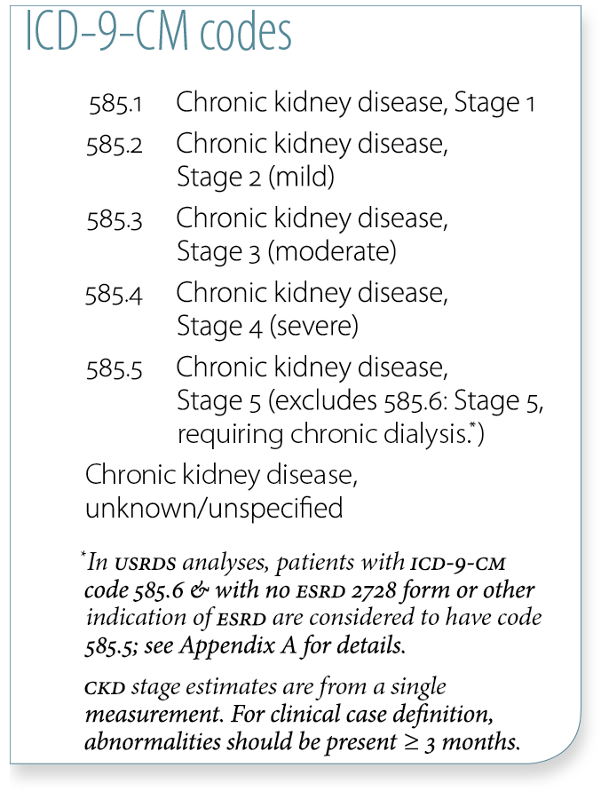
Cardiovascular disease & intervention (percent), by CKD stage, age, & race, 2010 Table 4.a (volume 1)
Caption
December 31, 2010 point prevalent Medicare enrollees, age 66 & older.

Slide 4
Cardiovascular disease & intervention (percent), by CKD stage, age, & race, 2010 Table 4.a (continued, volume 1)
December 31, 2010 point prevalent Medicare enrollees, age 66 & older.

Slide 5
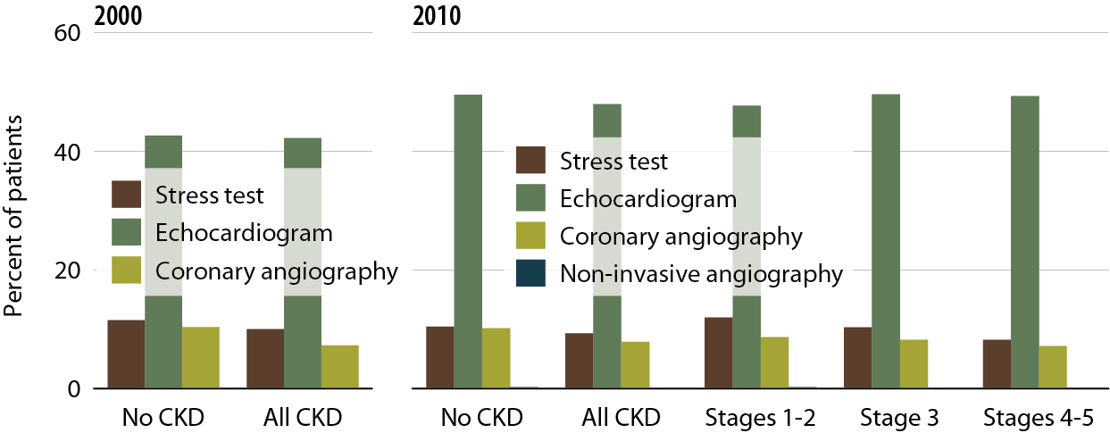
Patients with CHF who receive diagnostic testing, by CKD status Figure 4.2 (volume 1)
Jan. 1 pt. prev. Medicare pts. age 66 & older; first CHF diag. in 2000 or 2010

Slide 6
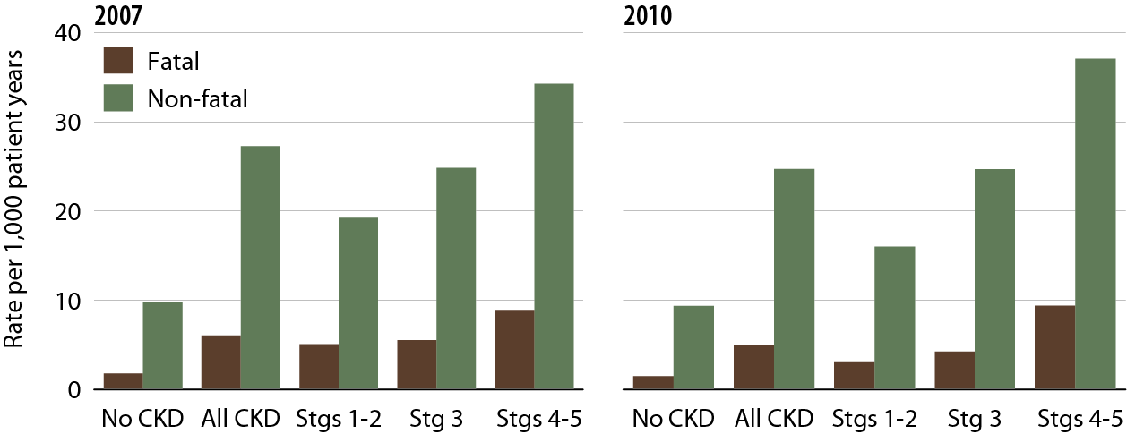
Rates of fatal & non-fatal AMI, by CKD status Figure 4.3 (volume 1)
Jan. 1 pt. prev. Medicare pts. age 66 & older; first AMI event in 2007 or 2010

Slide 7
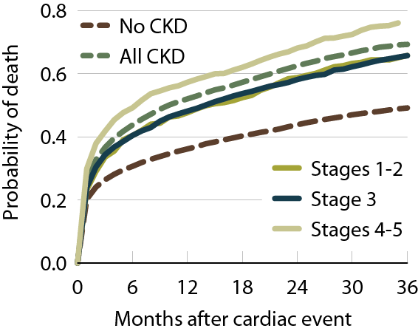
Probability of death following an AMI, by CKD status, 2010 Figure 4.4 (volume 1)
Jan. 1 pt. prev. Medicare pts. age 66 & older; first CVD diag. in 2007–2008.

Slide 8
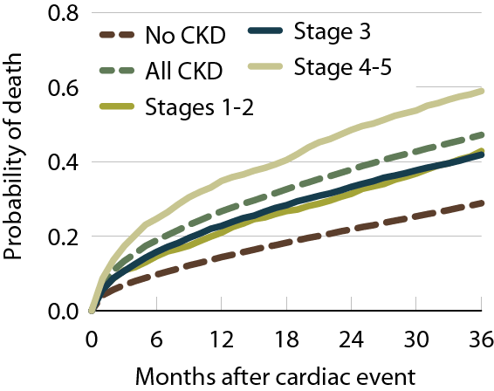
Probability of death following a CVA/TIA, by CKD status Figure 4.5 (volume 1)
Jan. 1 pt. prev. Medicare pts. age 66 & older; first CVD diag. in 2007–2008.

Slide 9
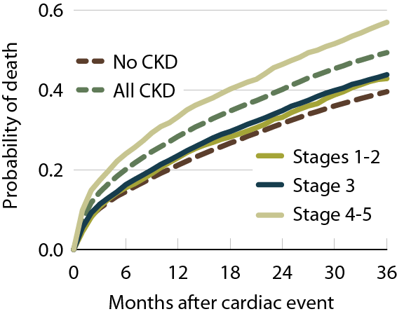
Probability of death following a diagnosis of CHF, by CKD status, 2010 Figure 4.6 (volume 1)
Jan. 1 pt. prev. Medicare pts. age 66 & older; first CVD diag. in 2007–2008.

Slide 10
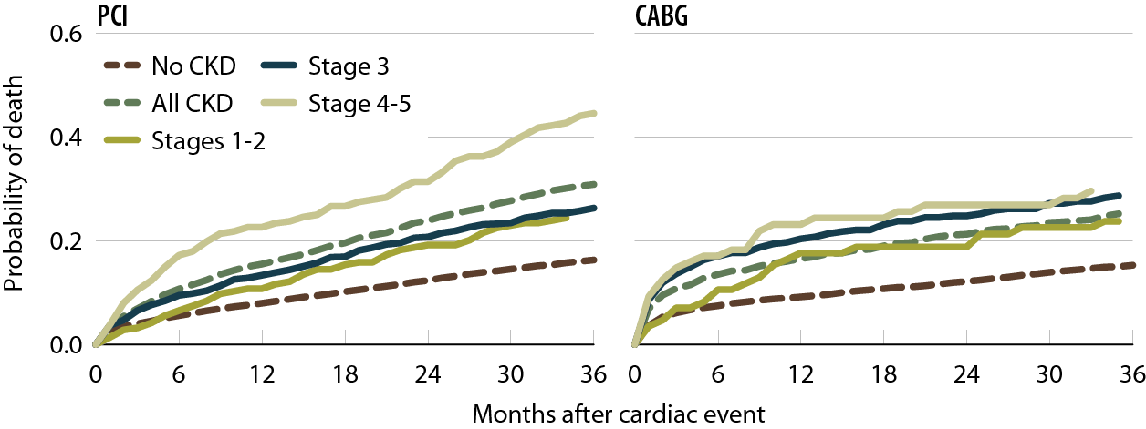
Probability of death following a CV procedure (PCI/CABG), by CKD status, 2010 Figure 4.7 (volume 1)
Jan. 1 pt. prev. Medicare pts. age 66 & older; first CVD diag. in 2007–2008.

Slide 11
Cardiovascular disease & pharmacological interventions (row percent), by diagnosis & CKD stage Table 4.b (volume 1)
January 1 point prevalent Medicare patients with Medicare Parts A, B, & D enrollment.

Slide 12
Cardiovascular disease & pharmacological interventions (row percent), by diagnosis & CKD stage Table 4.b (continued, volume 1)
January 1 point prevalent Medicare patients with Medicare Parts A, b, & d enrollment.

Slide 13
Utilization of cardiac drugs, by drug class & CKD status, 2010 Figure 4.8 (volume 1)
January 1 point prevalent patients with Medicare Parts A, B, & D enrollment, with a first diagnosis of CHF or MI in the year; patients with baseline disease are excluded.

Slide 14
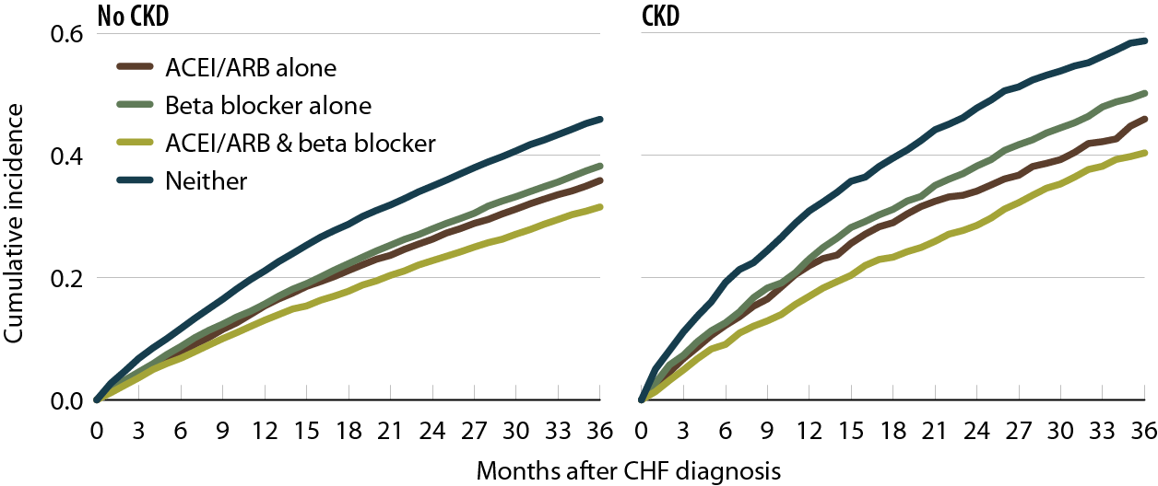
Event-free & overall survival following a diagnosis of CHF, by CKD status & drug use, 2010 Figure 4.9 (volume 1)
January 1 point prevalent patients with Medicare Parts A, B, & D enrollment, with a first diagnosis of CHF in the year; patients with baseline disease are excluded.

Slide 15
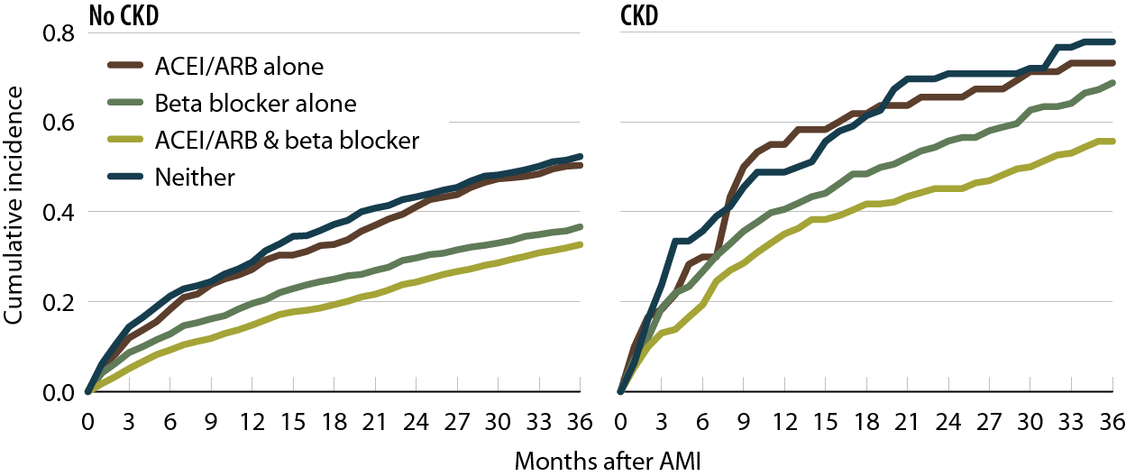
Event-free & overall survival following an AMI, by CKD status & drug use, 2010 Figure 4.10 (volume 1)
January 1 point prevalent patients with Medicare Parts A, B, & D enrollment, with a first diagnosis of MI in the year; patients with baseline disease are excluded.

