Slide 1

Kidney Sundays

Slide 2

Introduction
Kidney disease mainly develops in people over 60 and those with risk factors and may lead to kidney failure.
If kidney disease is diagnosed and treated early, kidney failure can be delayed or prevented.
Learning about kidney disease, getting tested, and following your kidney health are important steps you can take to slow the progression of kidney disease.

Slide 3
Kidney Disease and Risk Factors
Diabetes and high blood pressure are the two leading causes of kidney failure.
But there are other risk factors.
If you have any one of the following, you are at an increased risk for kidney disease:
  diabetes
  high blood pressure
  heart disease
  family history of kidney failure

Slide 4
Testing and Treatment
Testing is the only way to know if you have kidney disease.
Kidney disease usually has no symptoms.
If kidney disease is found early, there are medicines that can slow down the progression of kidney disease.
If you have even ONE of the risk factors we have talked about—get tested.

Slide 5
Protecting Your Kidneys
Managing your diabetes, high blood pressure, or heart disease is important for kidney health.
Following your doctor’s advice can help reduce stress on your heart and blood vessels, which can help protect your kidneys. That means
  taking medicines as directed,
  choosing healthy foods and drinks, and
  being more physically active.

Slide 6
Be More Physically Active
Try these to add more movement to your daily life:
Take the stairs instead of the elevator.
Get off the bus one stop early and walk to your destination.
Take a quick walk before or after work, if your schedule allows.
Try biking or swimming for a change of scenery.
Modest amounts of physical activity can improve your health.

Slide 7
Look Out for One Another
Designate a Health Leader to be a “Health Buddy”
Create a Living Healthy Committee
Make the Connection - check in on congregation members at risk

Slide 8
Learn More
Kidney Disease: www.niddk.nih.gov/health-information/kidney-disease
Diabetes: www.niddk.nih.gov/health-information/diabetes
Weight and Physical Activity: www.niddk.nih.gov/health-information/weight-management
High Blood Pressure: https://www.nhlbi.nih.gov/health-topics/high-blood-pressure
Mental Health: www.nimh.nih.gov
Centers for Medicare & Medicaid Services: www.cms.gov

Slide 9

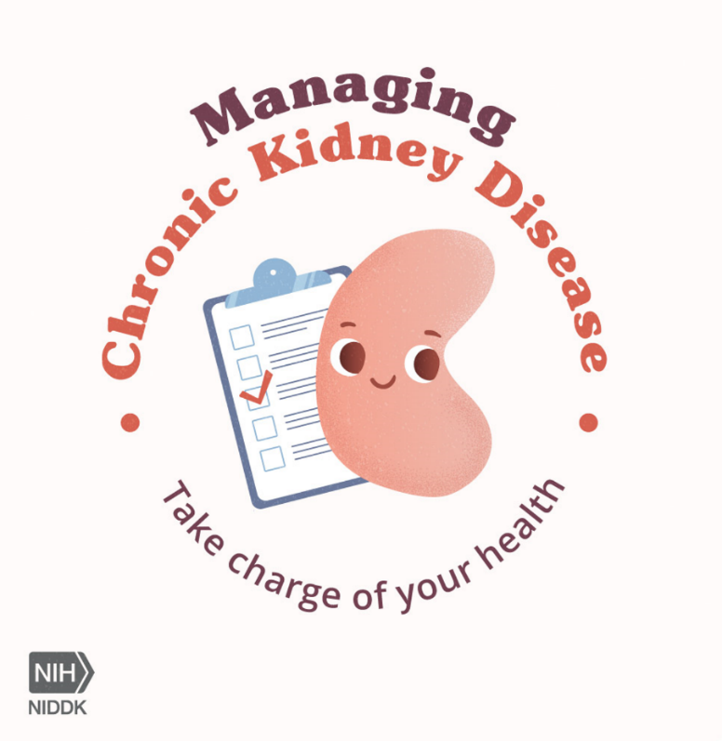
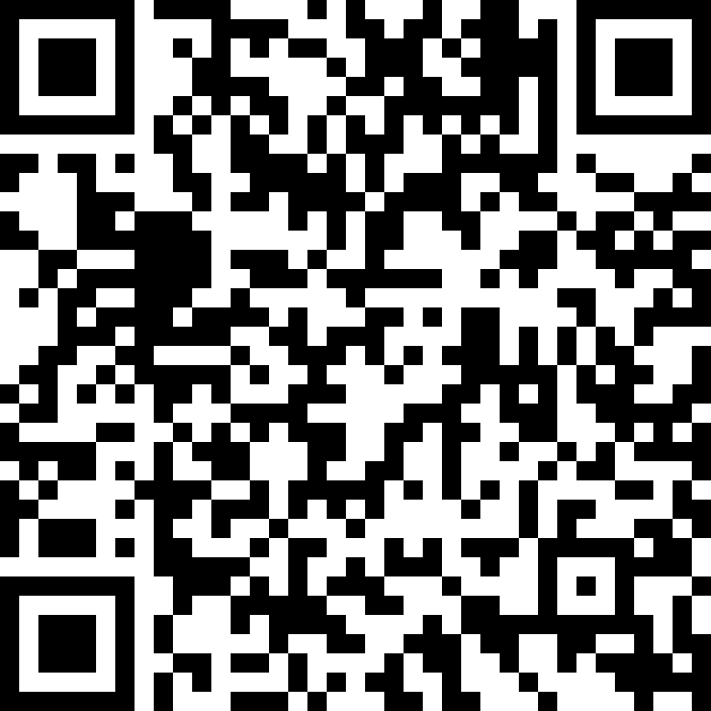
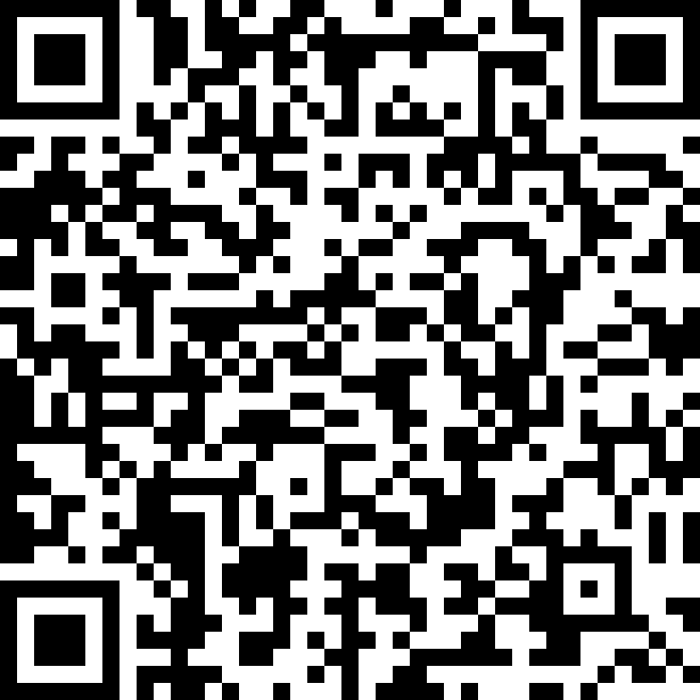
Scan the QR codes to get involved
Learn how to talk about kidney disease at your family reunion
Access a tool kit to share kidney month messages with your community

Slide 10


THANK YOU!
Visit niddk.nih.gov for more information.
Follow us @NIDDKgov

