Slide 1
Module 3: Anemia in Chronic Kidney Disease
Andrew Narva, MD, FASN &
Amy Barton Pai, PharmD, MHI, FASN, FCCP, FNKF

Slide 2
Faculty Disclosure Information
Andrew Narva, MD, FASN
No financial disclosures/conflicts of interest
Amy Barton Pai, PharmD, MHI, FASN, FCCP, FNKF
Disclosure: Consultant for Keryx
Slide 2 of 68

Slide 3
About NKDEP
This professional development opportunity was created by the National Kidney Disease Education Program (NKDEP), an initiative of the National Institute of Diabetes and Digestive and Kidney Diseases of the National Institutes of Health. With the goal of reducing the burden of chronic kidney disease (CKD), especially among communities most impacted by the disease, NKDEP works in collaboration with a range of government, nonprofit, and health care organizations to:
raise awareness among people at risk for CKD about the need for testing;
educate people with CKD about how to manage their disease;
provide information, training, and tools to help health care providers better detect and treat CKD; and
support health system change to facilitate effective CKD detection and management.
To learn more about NKDEP, please visit: http://www.nkdep.nih.gov. For additional materials from NIDDK, please visit: http://www.niddk.nih.gov.
Slide 3 of 68

Slide 4
Meet our Presenters
Amy Barton Pai, PharmD, MHI, FASN, FCCP, FNKF
Dr. Barton Pai is Chair of the National Kidney Disease Education Program’s Pharmacy Working Group
Dr. Amy Barton Pai, Pharm.D., MHI, FASN, FCCP, FNKF is Associate Professor of Clinical Pharmacy at the University of Michigan College of Pharmacy. She obtained her Bachelor of Science in Pharmacy from Albany College of Pharmacy in 1996 and then completed a Pharmacy Practice Residency at St. Peter’s Hospital in Albany, New York. She received her Doctor of Pharmacy from Albany College of Pharmacy in 1999. From 1999-2001 she was a Nephrology Research Fellow at the University of Illinois at Chicago. Dr. Pai was on faculty at the University of New Mexico College of Pharmacy and School of Medicine from 2001 to 2008 and at Albany College of Pharmacy and Health Sciences from 2008 to 2016. She earned a Master's degree in Healthcare Innovation in 2018.
Slide 4 of 68

Slide 5
Meet our Presenters
Andrew S. Narva, M.D., F.A.C.P.
Dr. Narva is the Director of the National Kidney Disease Education Program (NKDEP) at the National Institutes of Health. Prior to joining the NKDEP in 2006, he served as Director of the Kidney Disease Program for the Indian Health Service (IHS). Dr. Narva continues to serve as the Chief Clinical Consultant for Nephrology for IHS and to provide care for patients at Zuni Pueblo through a telemedicine clinic. Dr. Narva is a member of the American Board of Internal Medicine Nephrology Subspecialty Board. He has served as a member of the Eighth Joint National Committee (JNC 8) Expert Panel, the National Quality Forum Renal Steering Committee, the Kidney Disease Outcomes Quality Initiative Work Group on Diabetes in Chronic Kidney Disease, and the Medical Review Board of End Stage Renal Disease Network 15.
Slide 5 of 68

Slide 6
After completing this module, you will be able to:
Describe applications of erythropoiesis and iron metabolism in treating anemia of CKD and the role of the pharmacist in addressing current controversies in care.
Discuss how laboratory, clinical, and medication data are used to assess and monitor anemia in chronic kidney disease (CKD) and identify optimal management strategies.
Review the key differences in formulation, pharmacokinetics, pharmacodynamics and immunogenicity between the available intravenous iron products.
Integrate the evidence-base for erythropoiesis stimulating agents (ESA) into care paradigms for different CKD settings (e.g. pre-dialysis vs. dialysis vs. transplant)
Slide 6 of 68

Slide 7
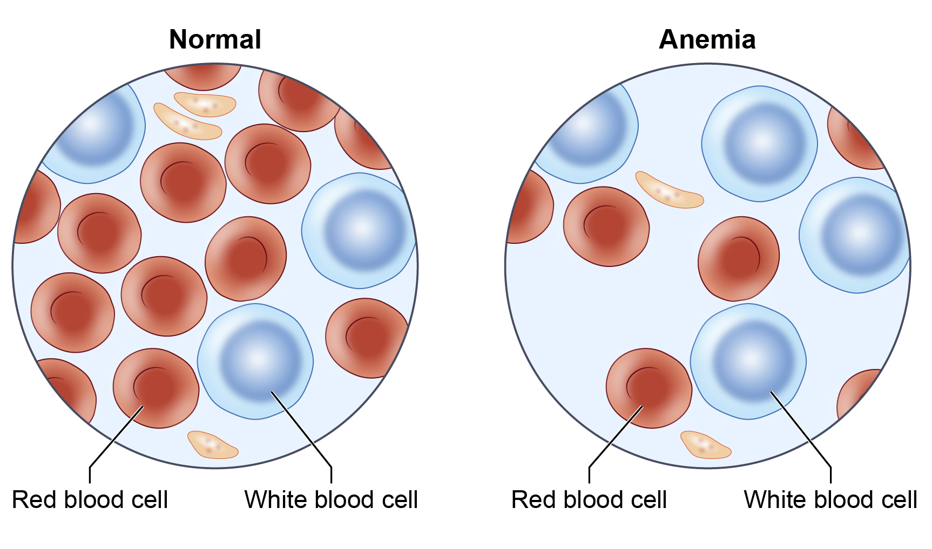
Anemia is a complication of CKD
Anemia may:
Result from inadequate erythropoietin synthesis.
Develop early and worsen as CKD progresses.
Occur earlier in people with diabetes.
Involve inadequate iron intake, impaired iron absorption and chronic inflammation.
Slide 7 of 68

Slide 8
Anemia may develop as eGFR declines
NHANES 2007-2010
Reference: Adapted from Stauffer PLoS ONE 2014
Slide 8 of 68

Slide 9
Kidneys act as oxygen sensors in the body
Renal tissue hypoxia triggers erythropoietin production.
Erythropoietin stimulates erythrocyte (red blood cell) synthesis in bone marrow.
Hemoglobin is the primary iron-containing protein in erythrocytes that transports and delivers oxygen to tissues.
Both erythropoietin and iron are required to produce hemoglobin (Hgb) and correct hypoxia.
Slide 9 of 68

Slide 10
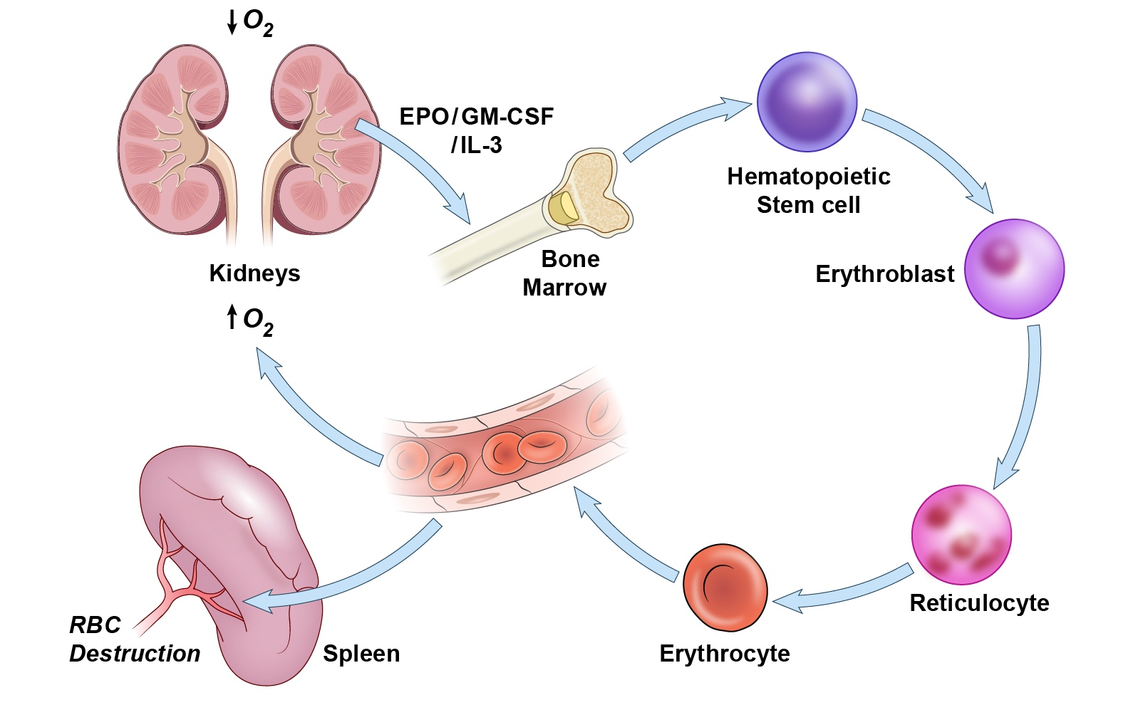
Red Blood Cell Cycle
Slide 10 of 68

Slide 11
Anemia in CKD
⬇ Erythropoietin (EPO) production/ ⬇Decreased responsiveness to EPO
⬆ Iron demands
⬇ GI absorption of iron
Anemia of CKD
Blood loss
(phlebotomy, dialysis)
Inflammation/infection
(⬆ hepcidin)
Poor nutrition
⬇ Erythrocyte half-life
Slide 11 of 68

Slide 12
Question
A 66 year old patient with an eGFR of 20 mL/min/1.73m² presents with symptoms of anemia. The patient has been taking ferrous sulfate orally and currently has a diabetic foot infection being treated with antibiotics. Which of the following is likely contributing to the patient’s anemia?
Decrease in EPO production
Decrease in iron absorption in GI tract
Infection
All of the above
Slide 12 of 68

Slide 13
Answer
A 66 year old patient with an eGFR of 20 mL/min/1.73m² presents with symptoms of anemia. The patient has been taking ferrous sulfate orally and currently has a diabetic foot infection being treated with antibiotics. Which of the following is likely contributing to the patient’s anemia?
Decrease in EPO production
Decrease in iron absorption in GI tract
Infection
All of the above
Answer: D
Anemia in CKD is often multi-factorial. The principal cause of anemia in CKD is decreased EPO production but, in this patient decreased iron absorption in GI tract and current infection are also contributors.
Slide 13 of 68

Slide 14
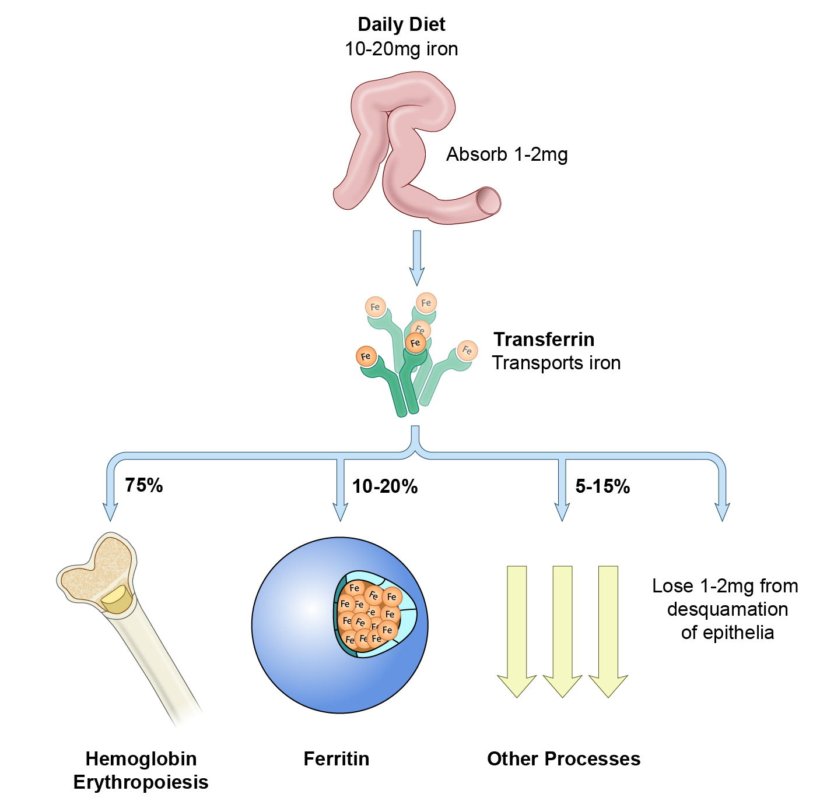
Iron transport & storage are dysregulated in CKD
Reference: http://www.cdc.gov/ncbddd/hemochromatosis/training/pathophysiology/iron_cycle_popup.htm
Slide 14 of 68

Slide 15
Additional factors for inadequate iron in CKD
Both a spontaneous decrease in intake and aversion to foods with protein may occur as eGFR declines.
Hepcidin may accumulate in CKD.
Hepcidin is the hormone that controls iron homeostasis.
This hormone regulates iron absorption in the gut and mobilization of stored iron.
Inflammation may reduce absorption of iron.
References: Kopple et al. Kidney Int 2000; 57(4):1688–1703;
Young et al. Clin J Am Soc Nephrol 2009;4(8):1384–1387.
Slide 15 of 68

Slide 16
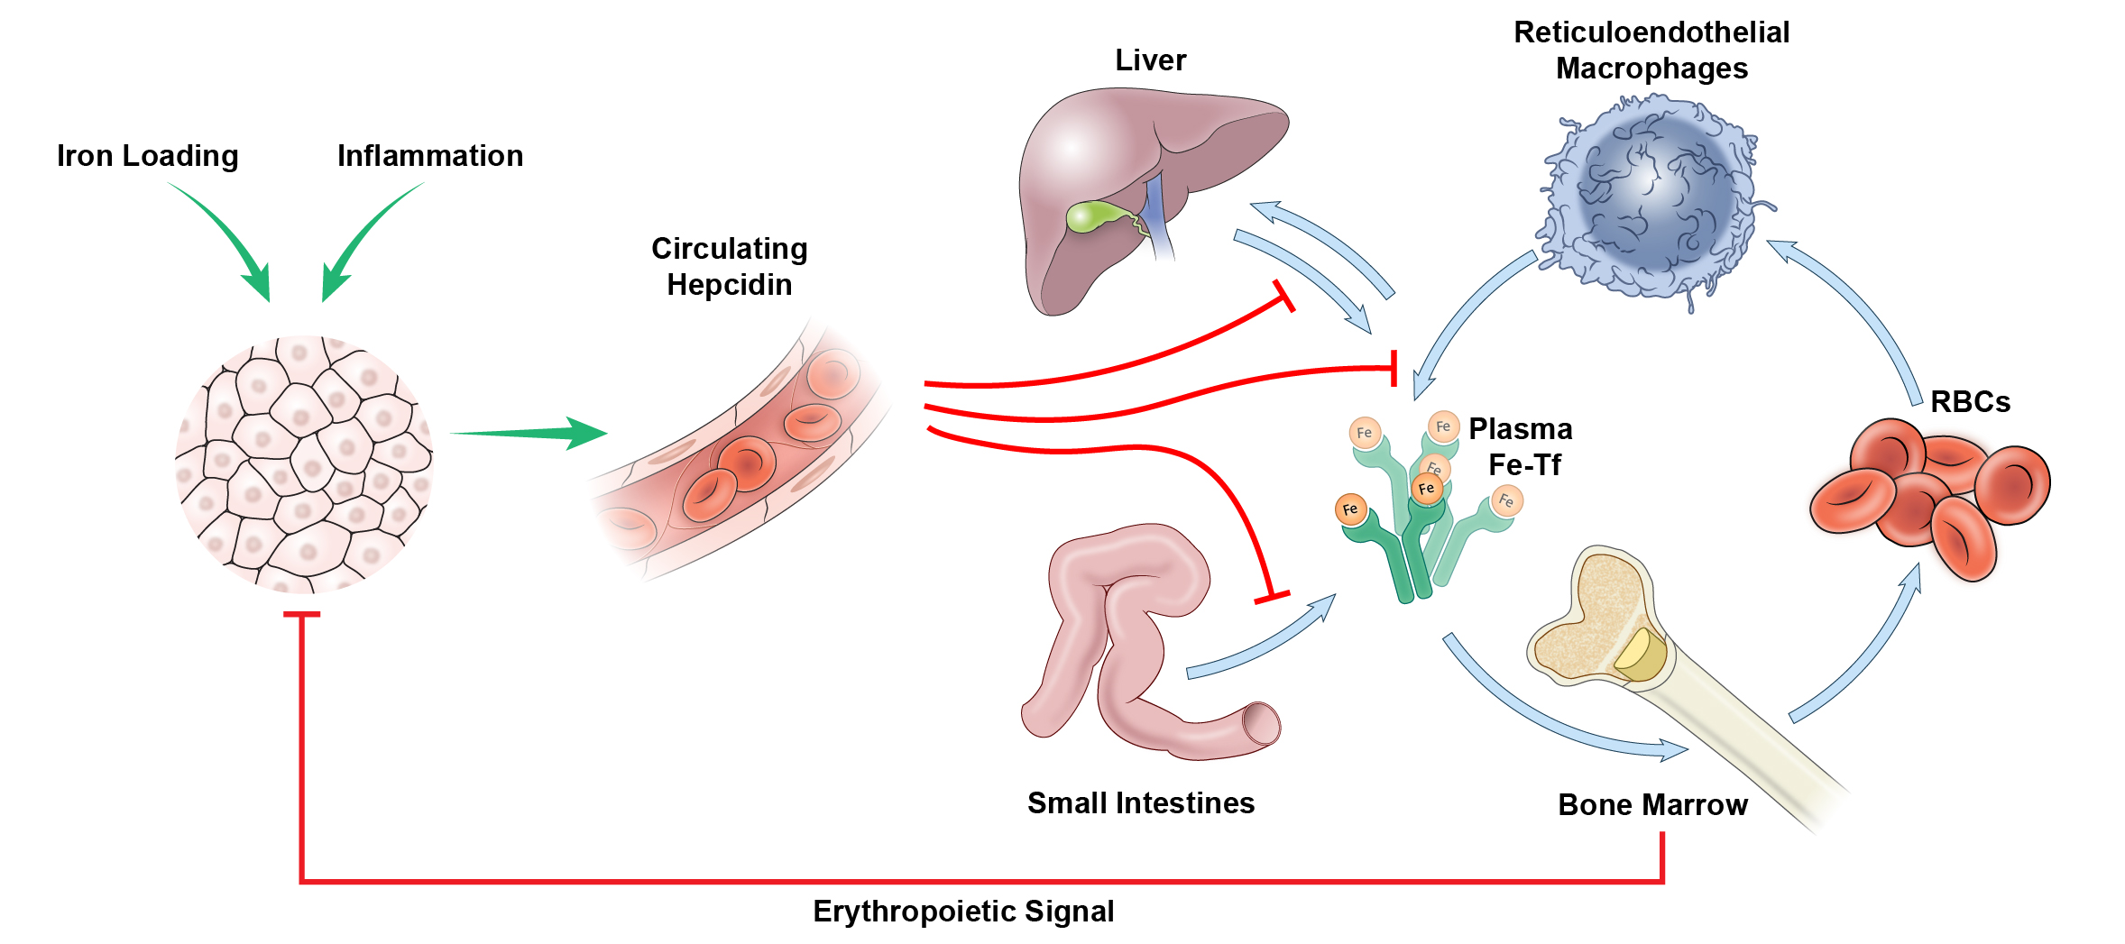
Hepcidin-Master iron regulator
Iron regulates hepcidin; increased iron levels stimulates hepcidin production
Increased erythropoietin activity reduces hepcidin levels
Inflammation and infection increases hepcidin synthesis
Hepcidin inhibits iron release from macrophages as well as intestinal iron absorption.
Slide 16 of 68

Slide 17
Anemia in CKD is associated with morbidity and mortality
Observational data show association with:
Coronary artery disease
Left ventricular hypertrophy
Hospitalization for cardiac disease
Death from congestive heart failure
All-cause mortality
Toto. Kidney Int 2003; 64(suppl 87):S20–S23.
Slide 17 of 68

Slide 18
Question
Which of the following is a possible cause of anemia in chronic kidney disease patients?
Increased GI iron absorption
Decreased erythropoietin synthesis
Increased red blood cell life span
Decreased inflammation
Slide 18 of 68

Slide 19
Answer
Which of the following is a possible cause of anemia in chronic kidney disease patients?
Increased GI iron absorption
Decreased erythropoietin synthesis
Increased red blood cell life span
Decreased inflammation
Answer: B
As kidney function declines, the kidney becomes unable to produce adequate erythropoietin and poor erythropoiesis is compounded by reduced iron absorption. Answer C and D are incorrect because red blood cell life span decreases and systemic inflammation typically increases in patients with CKD.
Slide 19 of 68

Slide 20
USING LABORATORY DATA TO GUIDE CKD MANAGEMENT
Slide 20 of 68

Slide 21
How do we know if the patient has anemia?
Diagnosis of anemia
Hemoglobin
Males: Hb <13 g/dL
Females: Hb <12 g/dL
Additional workup
CBC
RBC indices
Ferritin
Transferrin saturation (TSAT)
Stool screen for occult blood
Serum folate
Vitamin B₁₂
Slide 21 of 68

Slide 22
Symptoms and Signs
Symptoms
Signs
Fatigue
Dizziness
↓ exercise tolerance
Shortness of breath
Weakness
Palpitations
Vertigo
Pica (with iron deficiency)
Irritability
Tachycardia
Pale appearance
↓ mental acuity
Neurological symptoms (with vitamin B12 deficiency)
Slide 22 of 68

Slide 23
Assessing iron status
Serum iron
Measures ferric iron (Fe³⁺), subject diurnal variation
Total iron-binding capacity (TIBC)
TIBC measures the amount of iron binding sites available on serum transferrin.
Transferrin saturation (TSAT)
Generally reflects iron available for transport to the bone marrow
Calculated as serum iron/TIBC x 100 = TSAT
Serum ferritin
Ferritin in the liver reflects stored iron, however, serum ferritin may not be as robust in reflecting stored iron
Acute phase reactant and will be elevated in acute & chronic inflammation
http://www.cdc.gov/nutritionreport/report.html
Slide 23 of 68

Slide 24
Laboratory for healthy adults
 | Healthy Adult Male | Healthy Adult Female | Range
Hemoglobin | >13.0 g/dL | >12.0 g/dL | 12.0 – 18.0 g/dL
Serum Iron | 65 – 177 ug/dL | 50 – 170 ug/dL | 50 – 177 ug/dL
Serum Ferritin | 18 – 270 ng/mL | 18 – 160 ng/mL | 18 – 270 ng/mL
Suggested laboratory targets to initiate iron supplementation in CKD patients
Parameter | KDIGO (2012)
 | ND-CKD | HD-CKD
TSAT | <30% | <30%
Serum ferritin | ≤500 ng/mL | ≤500 ng/mL
Slide 24 of 68

Slide 25
Hemoglobin target is controversial: Boxed Warning for ESAs
Chronic Kidney Disease:
In controlled trials, patients experienced greater risks for death, serious adverse cardiovascular reactions, and stroke when administered erythropoiesis-stimulating agents (ESAs) to target a hemoglobin level of greater than 11 g/dL (5.1).
No trial has identified a hemoglobin target level, ESA dose, or dosing strategy that does not increase these risks (2.2).
Use the lowest ESA dose sufficient to reduce the need for red blood cell (RBC) transfusions (5.1).
Slide 25 of 68

Slide 26
Case
The patient is a 68 year-old male (95 kg, BMI 31kg/m²) with CKD and a history of diabetes for several years. He is a chronic smoker referred for management of anemia. He is currently on furosemide 40mg BID, metoprolol tartrate 50mg BID, aspirin 81mg once daily, and insulin glargine 15 units in the morning.
His pertinent labs include:
eGFR | Hgb | Serum ferritin | TSAT
25 ml/min/1.73 m² | 9.2 | 110 ng/ml | 21%
Slide 26 of 68

Slide 27
Question
His anemia is likely due to:
Iron deficiency
Folate/vitamin B12 deficiency
Reduced erythropoietin production
A and C
Slide 27 of 68

Slide 28
Answer
His anemia is likely due to:
Iron deficiency
Folate/vitamin B12 deficiency
Reduced erythropoietin production
A and C
Answer: D
Answer A is correct because the patient is iron deficient (TSAT <30%, Ferritin <500 ng/mL). Answer B is incorrect does not have laboratory data to support B12or folate deficiency. Answer C is correct because patient has advanced kidney disease (eGFR 25).
Slide 28 of 68

Slide 29
IRON THERAPY
Slide 29 of 68

Slide 30
Treatment Goal
Goals
Reduce blood transfusion requirements
Minimize hospitalizations
Decrease signs and symptoms of anemia
Improve quality of life
Treatment Approaches
Typically utilizes the combination of iron therapy and erythropoiesis stimulating agents (ESA)
Slide 30 of 68

Slide 31
Iron Therapy (KDIGO recommendations)
Goal: TSAT<30% and ferritin <500 ng/mL
CKD patients with anemia not on iron
Increase in hemoglobin without starting ESA desired
CKD non-dialysis patients (ND)
1-3 months of oral iron
Choice of route should be chosen based on severity of iron deficiency, ongoing blood losses, iron status tests, Hgb concentration, ESA responsiveness, ESA dose and clinical statu
Hemodialysis patients (HD)
Trial of IV iron
Slide 31 of 68

Slide 32
Amount of elemental iron differs between
oral iron supplements
Absorption: Ferrous⁺² iron > ferric⁺³ iron
A 325 mg dose of:
Ferrous fumarate has 108 mg elemental iron (33%).
Ferrous sulfate has 65 mg elemental iron (20%).
Ferrous gluconate has 35 mg elemental iron (12%).
Reference: http://www.anemia.org A Physician’s Guide to Oral Iron Supplementation. Nov 2008.
Slide 32 of 68

Slide 33
What needs to be considered before starting oral iron?
Use of Oral Iron
Pros | Cons
No IV access needed Orally absorbed (regulated) Convenient Inexpensive Utilizes normal iron physiology pathways therefore avoiding potential safety changes with IV iron | GI adverse effects common (nausea, constipation, diarrhea) Poor tolerability and adherence common Limited bioavailability of most oral iron preparations Food reduces iron absorption (need acidic gastric pH) Takes months to replete iron stores Darkens stools, may mask GI bleeding
Slide 33 of 68

Slide 34
Tips on oral iron supplements
Impaired absorption with:
Caffeinated beverages (especially tea)
Calcium (foods and beverages, supplements)
Antacids
H-2 receptor blockers
Proton pump inhibitors
Consider:
Start with half of the recommended dose, gradually increase.
Take with food.
Try different preparation.
Take in divided doses.
Stool softener may help.
Reference: http://www.anemia.org A Physician’s Guide to Oral Iron Supplementation. Nov 2008.
Slide 34 of 68

Slide 35
Take iron supplement separate from calcium-based phosphate binders
Calcium supplements may be prescribed with meals to bind dietary phosphorus.
Calcium may interfere with iron absorption.
Indications of when to take iron supplements:
Iron absorption is increased when supplement is taken between meals and separate from phosphate binders.
Slide 35 of 68

Slide 36
IV Iron may be used in CKD patients
Five formulations available in the US
IV iron formulations are nanoparticle suspensions comprised of iron oxide cores with carbohydrate shells
Limits free iron plasma, thus reducing toxicity
Metabolized via reticuloendothelial system (i.e. macrophage phagocytosis)
There are unresolved potential bioavailability and safety challenges (related to labile iron) with IV iron formulations
Bound Transferrin
Free Iron
Oxidative Damage
Iron Dissociation
(Iron released to circulation)
Phagocytosis
Macrophages
(RES)
Iron-Carbohydrate
Complex
(Iron Storage)
Zager, Clin J Am Soc Nephrol 2006; 1(suppl 1):S24–S31.
Charytan et al CJASN 2015
Slide 36 of 68

Slide 37
What do I need to consider before starting IV Iron?
Use of IV Iron
Pros | Cons
Does not require absorption from GI tract Increase iron stores and availability faster than oral preparations | Requires patient to come to clinic for several infusions Some formulations associated with anaphylactoid reactions Bioavailability from RES not well-studied Long-term safety and different dosing regimens for IV iron formulations has not been studied in a randomized controlled trial in CKD Expensive
Zager et al. Kidney Int 2004; 66(1):144–156; Zager, Clin J Am Soc Nephrol 2006; 1 (suppl 1):S24–S31; Hörl, J Am Soc Nephrol 2007; 18(2):382–393; Charytan DM, et al. J Am Soc Nephrol. 2015 Jun;26(6):1238-47; Macdougall IC et al. Kidney Int. 2016 Jan;89(1):28-39
Slide 37 of 68

Slide 38
IV Iron Formulations
Drug | Brand Name | Molecular Weight (MW) | Usual Adult Dose | Dose Ranges (mg) | Common Adverse Events
Iron dextran | INFeD (low MW) Dexferrum (high MW) | ++ | 100 mg over 2 minutes (25 mg test dose required) Test dose: 0.5 mL (25 mg) and observe for 1 hour | 25-1000 | BOXED WARNING: Anaphylactic reactions (requires test dose) Pain and brown staining at injection site, flushing, hypotension, fever, chills, myalgia
Sodium ferric gluconate Sodium ferric gluconate complex (generic) | Ferrlecit | + | HD: 125 mg elemental iron over 10 minutes per HD session; Most require cumulative dose of 1 g over eight HD sessions for a favorable response | 62.5-1000 | Hypotension, hypertension, headache, dizziness, nausea, vomiting , diarrhea
Iron sucrose | Venofer | + | HD: 100 mg over 2-5 minutes during consecutive dialysis sessions (10 doses) NON-HD: 200 mg over 2-5 minutes on five different occasions within 14 days (total dose 1,000 mg) | 25-1000 | Hypertension, nausea, muscle cramps, headaches, upper respiratory infection, edema, dizziness
Ferumoxytol | Feraheme | +++ | 510 mg over in 50-200 mL NS or D5 over 15 min, Observe patient for 30 minutes after infusion A second 510 mg dose can be given 3-8 days later | 510 mg | BOXED WARNING: Anaphylaxis, Hypotension, flushing, itching Diarrhea, constipation, dizziness, hypotension, peripheral edema
Ferric carboxymaltose | Injectafer | +++ | ≥50 kg: 750 mg IV followed by 750 mg 7 days later <50 kg: 15 mg/kg IV followed by 15 mg/kg 7 days later | 750 mg | Hypertension, flushing, itching, decreased phosphate level, nausea, headache
Slide 38 of 68

Slide 39
Question
A patient with CKD was recently diagnosed with iron deficiency anemia. The provider wants to start her on a intravenous iron product. Which of the intravenous iron products requires a test dose?
a. Ferumoxytol
b. Iron Dextran
c. Iron Sucrose
d. Sodium Ferric Gluconate
e. Ferric Carboxymaltose
Slide 39 of 68

Slide 40
Answer
A patient with CKD was recently diagnosed with iron deficiency anemia. The provider wants to start her on a intravenous iron product. Which of the intravenous iron products requires a test dose?
a. Ferumoxytol
b. Iron Dextran
c. Iron Sucrose
d. Sodium Ferric Gluconate
e. Ferric Carboxymaltose
Answer: B
Iron dextran requires a test dose because of documented anaphylactoid reactions. Ferumoxytol also has a boxed warning about hypersensitivity, however no test dose is required, infusion over at least 15 minutes is recommended with a minimum of 30 minutes of observation post infusion
Slide 40 of 68

Slide 41
Considerations for IV iron administration when inflammation is present
Administered dose of elemental iron is not able to be fully utilized (incorporated into RBCs)
Clearance of IV iron compounds is ZERO-ORDER (capacity-limited, saturable)
Clearance decreases as molecular weight increases
Slide 41 of 68

Slide 42
Question
Which of the following is true regarding IV iron formulations?
Their pharmacokinetic profiles are well-characterized
They are all colloidal suspensions of nanoparticles
The proportion of the elemental iron dose incorporated into RBCs is required by the FDA in the new drug application
All of the above
Slide 42 of 68

Slide 43
Answer
Which of the following is true regarding IV iron formulations?
Their pharmacokinetic profiles are well-characterized
They are all colloidal suspensions of nanoparticles
The proportion of the elemental iron dose incorporated into RBCs is required by the FDA in the new drug application
All of the above
Answer: B
All FDA approved IV iron formulations are iron oxide-carbohydrate nanoparticles in colloidal suspension.
Slide 43 of 68

Slide 44
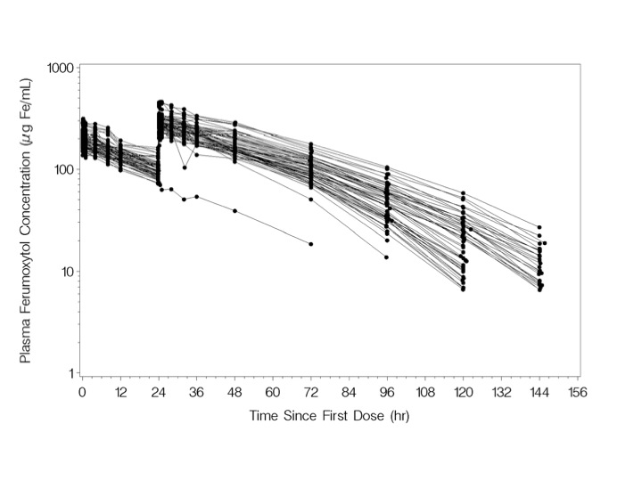
Zero order pharmacokinetic profile of ferumoxytol
Plasma ferumoxytol log concentration vs. time curve
Pai AB et al. Clin Pharmacol Ther 2010 Aug;88(2):237-42
Slide 44 of 68

Slide 45
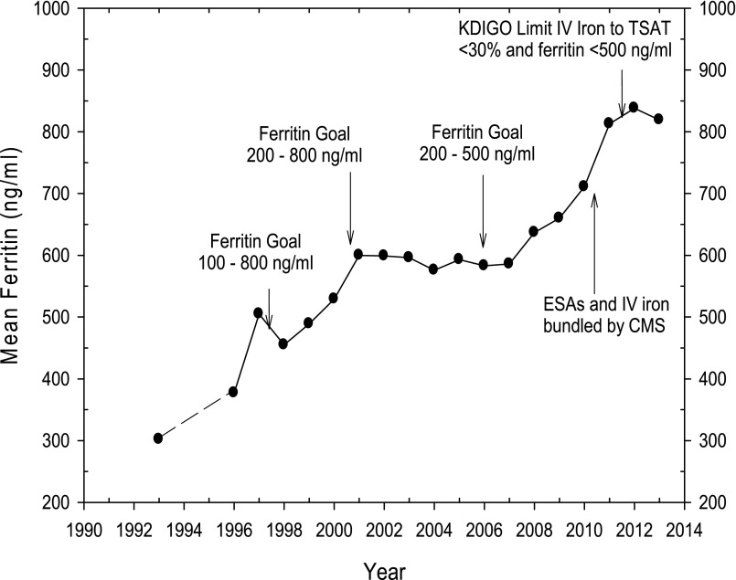
The more IV iron, the better?
Coyne DW et al. J Am Soc Nephrol 2007;18:975; Kapoian T et al. J Am Soc Nephrol 2008;`9;372; Spiegel G, Chertow G. Clin J Am Soc Nephrol 2009;41009
Slide 45 of 68

Slide 46
Comparison of catalytically active iron among available products
 | Sodium Ferric Gluconate (SFG) | Iron Sucrose (IS) | LMW Iron Dextran (ID) | Ferumoxytol (FMX)
Iron concentration (μg/mL⁻¹) | 42 (n=5) | 42 (n=5) | 42 (n=5) | 42 (n=5) | 168 (n=2)
Dose equivalent (mg) | 125 | 125 | 125 | 125 | 500
Mean (± SD) BDI (μg/mL⁻¹) | 0.41 ± 0.15 | 0.37 ± 0.10 | 0.17 ± 0.05 | 0.06 ± 0.03 | 0.28 ± 0.10
Slide 46 of 68

Slide 47
Generic IV Iron Formulations
Sodium ferric gluconate is the only US generic
Iron Sucrose: Widely available in Europe, South America and Asia
Referred to as “similars”
Less expensive and considered equivalent to Venofer®
Switches are often mandated in Europe
European Medicines Agency suggests the terminology “Non-biological Complex Drugs”
http://www.ema.europa.eu/ema/,
www.fda.gov/GDUFARegScience
Slide 47 of 68

Slide 48
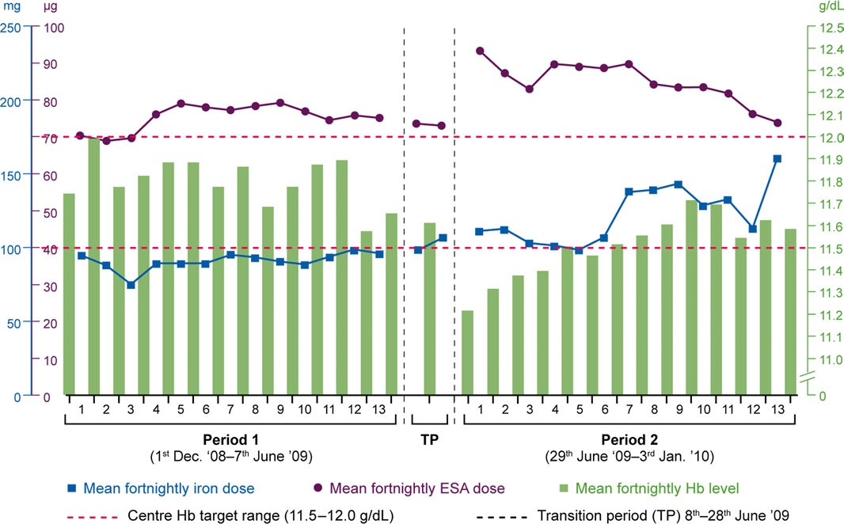
Laboratory Parameters Before and After Switching to an Iron Sucrose Similar
Rottembourg J et al Nephrol Dial Transplant. 2011 Oct;26(10):3262-7
Slide 48 of 68

Slide 49
Summary
CKD patients can be treated with oral or IV iron therapy.
Dialysis patients are usually treated with IV iron therapy.
There are gaps in knowledge regarding pharmacokinetics, pharmacodynamics and outcomes related to IV iron administration in CKD.
Clinical iron indices may be insufficient for the clinician to adequately evaluate iron storage and availability and should be used in the context of the individual patients response.
Judicious use of IV iron formulations is warranted until more prospective data clarify long-term safety and efficacy.
Slide 49 of 68

Slide 50
TREATING ANEMIA WITH ERYTHROPOIESIS STIMULATING AGENTS
Slide 50 of 68

Slide 51
Erythropoietin Stimulating Agents (ESA)
Genetically engineered forms of erythropoietin
Biological so only dosed parenterally
Must advise patient of risks and benefits
Recombinant EPO first available in 1989 to treat anemia in end-stage renal disease (ESRD)
Prior to availability, patients often symptomatic with Hemoglobin (Hb) in 6-7 g/dL range
http://www.fda.gov/drugs/drugsafety/postmarketdrugsafetyinformationforpatientsandproviders/ucm200297.htm
Slide 51 of 68

Slide 52
ESA
Drug | Brand Name | Starting Dose in Adults | Routes | Half-Life (h)
Epoetin alfa | Epogen Procrit | 50-100 units/kg once weekly or every 2 weeks (ND-CKD) 50-100 units/kg one to three times per week (HD) | IV or SQ | 8.5 (IV)/ 24 (SQ)
Darbepoetin alfa | Aranesp | 0.45 mcg/kg once every 4 weeks (ND-CKD) 0.45 mcg/kg once per week or 0.75 mcg/kg every 2 weeks (HD) | IV or SQ | 25 (IV)/ 48 (SQ)
Methoxy polyethylene Glycol-epoetin beta | Mircera | 0.6 mcg/kg SQ or IV once every 2 weeks (ND-CKD or HD) | IV or SQ | 134 (IV)/ 139 (SQ)
Slide 52 of 68

Slide 53
Dosing Conversion for ESAs
Epoetin alfa dose (units/week) | Darbepoetin alfa dose (mcg/week) | Methoxy Polyethylene Glycol-Epoetin Beta
< 8,000 | <40 | 120 mcg IV/SQ once a month or 60 mcg IV/SQ every 2 weeks
8,000 to 16,000 | 40-80 | 200 mcg IV/SQ once a month or 100 mcg IV/SQ every 2 weeks
>16,000 | >80 | 360 mcg IV/SQ once a month or 180 mcg IV/SQ every 2 weeks
Package Insert. Mircera.
Slide 53 of 68

Slide 54
Case Question
A 58 year old male (185 lb) currently receiving thrice weekly dialysis and 75units/kg of epoetin alfa three times per week is being switched to darbepoetin alfa in the hospital. What is the appropriate dose of darbepoetin alfa?
25mcg/week
40mcg/week
60mcg/week
100mcg/week
Slide 54 of 68

Slide 55
Case Answer
A 58 year old male (185 lb) currently receiving thrice weekly dialysis and 75units/kg of epoetin alfa three times per week is being switched to darbepoetin alfa in the hospital. What is the appropriate dose of darbepoetin alfa?
25mcg/week
40mcg/week
60mcg/week
100mcg/week
Answer: C
Patient weighs 83.9 kg, so his weekly dose of epoetin alfa equals 12,585 units (50 units/kg x 83.9 kg x 3times/week). This converts to 60 mcg/weekly of darbepoetin alfa by using the conversion table.
Slide 55 of 68

Slide 56
ESA
Common adverse events (≥20%)
Hypertension (most common)
Infection
Hypotension
Myalgia
Nausea
Diarrhea
Monitoring Parameters
Hemoglobin once weekly upon initiation of an ESA and until stable; then once monthly
Evaluate transferrin saturation and serum ferritin
Slide 56 of 68

Slide 57
Blood transfusions are associated with many risks
Patients required frequent blood transfusions before ESA were available.
Risks associated with blood transfusions include:
Volume overload
Iron overload
Allosensitization (i.e. sensitization to donor blood)
Transfusion reactions
Bloodborne infection
Slide 57 of 68

Slide 58
CHOIR Study
Correction of Anemia with Epoetin Alfa in Chronic Kidney Disease (CHOIR study)
Randomized Controlled Trial
N=1432 patients with CKD stage 3 and 4 patients
Dosing of epoetin alfa targeted to achieve a Hb of 13.5 vs 11.3 g/dL for an intended 36 month follow up period
Primary end point time to composite of death, MI, hospitalization for CHF or stroke
Secondary endpoints include time to RRT, hospitalization for any cause and quality of life
Singh A, et al. N Engl J Med 2006;355:2085-98.
Slide 58 of 68

Slide 59
CHOIR outcome
Early termination with median follow up of 16 months
More CV events (MI, stroke, CHF hospitalization) in higher Hgb group
Similar QOL scores between the groups
Hazard Ratio (95% CI) 1.34
(1.03-1.74) p=0.03
Slide 59 of 68

Slide 60
CREATE Study
Cardiovascular Risk Reduction by Early Anemia Treatment with Epoetin Beta
N = 603 CKD patients (primarily stage 4)
Hb 10.5-11.5 g/dL vs. 13-15 g/dL
Primary endpoint: Composite cardiovascular events
Secondary endpoint: left ventricular mass index, the progression of chronic kidney disease, and the quality of life
Drueke TB, et al. N Engl J Med 2006;355:2071-84.
Slide 60 of 68

Slide 61
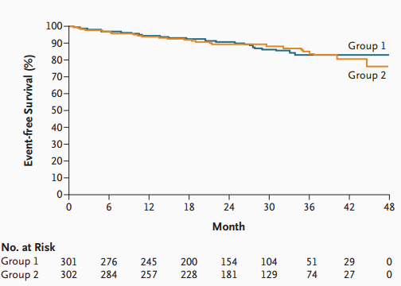
CREATE Outcome
No significant difference in the risk of a first cardiovascular (CV) event between the complete correction and partial correction groups (hazard ratio 0.78; 95% CI 0.53-1.14; P = 0.20)
More frequent dialysis initiation and hypertensive episodes and headaches were more frequently reported in the higher Hb group
Time to primary first CV event after censoring data of patients at the time of dialysis initiation
Group 1= higher Hb
Group 2= lower Hb
Slide 61 of 68

Slide 62
TREAT Study
A Trial of Darbepoetin Alfa in Type 2 Diabetes and Chronic Kidney Disease (TREAT study)
N =4038 CKD stage 3 and 4 patients with diabetes
Hgb 13 vs < 9.0 g/dL (placebo group with rescue darbepoetin when Hgb)
Primary endpoints: Time to the composite outcome of death or a cardiovascular event and the time to the composite outcome of death or ESRD
Pfeffer M, et al. N Engl J Med 2009;361:2019-32.
Slide 62 of 68

Slide 63
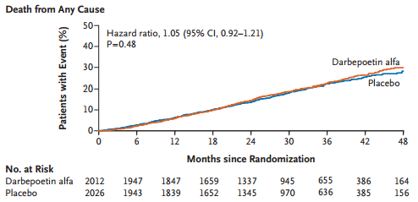
TREAT outcome
No difference in primary CV composite endpoint
Higher risks of fatal/non-fatal strokes in normal Hgb group ( 5% vs 2.6% HR 1.92, P < 0.001)
More patients in the rescue group required transfusions in the placebo group (496 vs 297 p<0.001)
Patients with a history of cancer in the higherHb group also had a higher risk of death
Slide 63 of 68

Slide 64
Hemoglobin in CKD: Guidelines Suggestions
KDIGO (2012)
ND-CKD | HD-CKD
If Hb ≥ 10 g/dL do not initiate an ESA If Hb < 10 g/dL, consider rate of fall of Hb, prior response to iron, risk of needing a transfusion, risk of ESA therapy, and presence of anemia symptoms before initiating an ESA Do not use ESAs to maintain Hb above 11.5 g/dL | Use ESAs to avoid drop in Hb to <9 g/dL by starting ESA when Hb is between 9 and 10 g/dL Do not use ESAs to maintain Hb above 11.5 g/dL
Note: Most institutions utilize their own ESA dosing protocol with more detailed dosing changes recommended based on Hb response. Some protocols have lower and upper limits of Hb that differ from guideline suggestions.
Slide 64 of 68

Slide 65
Question
A 71 year old female presents to the CKD clinic with the following laboratory data complaining of increasing fatigue and shortness of breath. She recently received 2 doses of 100 mg of iron sucrose IV.
Hb 9.2 g/dL; TSAT 40%; Ferritin 550 ng/mL
Which of the following is the most appropriate therapeutic intervention?
Ferrous sulfate 325mg PO TID
Iron sucrose 100mg IV X 5 doses
Start an ESA
No intervention necessary
Slide 65 of 68

Slide 66
Answer
A 71 year old female presents to the CKD clinic with the following laboratory data complaining of increasing fatigue and shortness of breath. She recently received 2 doses of 100 mg of iron sucrose IV.
Hb 9.2 g/dL; TSAT 40%; Ferritin 550 ng/mL
Which of the following is the most appropriate therapeutic intervention?
Ferrous sulfate 325mg PO TID
Iron sucrose 100mg IV X 5 doses
Start an ESA
No intervention necessary
Answer: C
The patient’s iron indices indicate repletion and still anemic and symptomatic therefore an ESA can be initiated
Slide 66 of 68

Slide 67
Hyporesponse to anemia treatment in CKD
Decreased responsiveness to erythropoietin
Uremia
Chronic inflammation
Severe hyperparathyroidism
Folate deficiency
Slide 67 of 68

Slide 68
Summary
ESAs should be used judiciously in CKD
Consider potential reasons for hyporesponse that may facilitate dose reductions
Doses should be individualized and the patient's clinical status desired outcomes from treatment should be integrated in goal setting
Slide 68 of 68

