Slide 1
CKD: Chapter 1 Chronic kidney disease in the general population
United States Renal Data System
2012 Annual Data Report

Slide 2
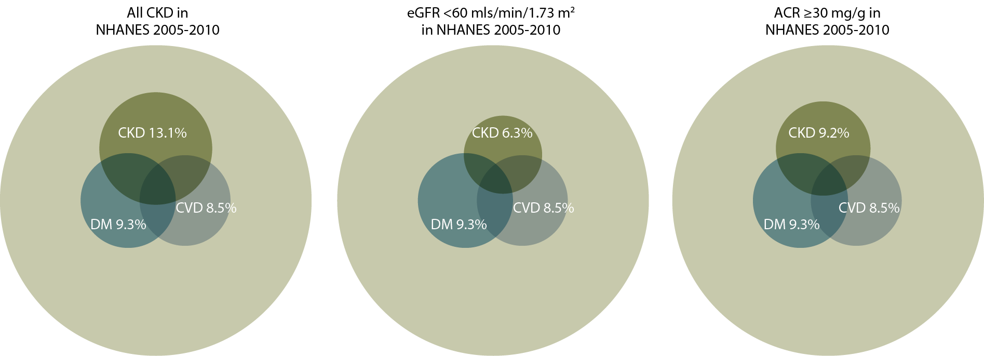
Distribution of NHANES participants with diabetes, congestive heart failure, & markers of CKD, 2005–2010 Figure 1.1 (volume 1)
NHANES participants 2005–2010, age 20 & older; eGFR calculated using CKD-EPI equation; urine albumin creatinine ratio (ACR).

Slide 3
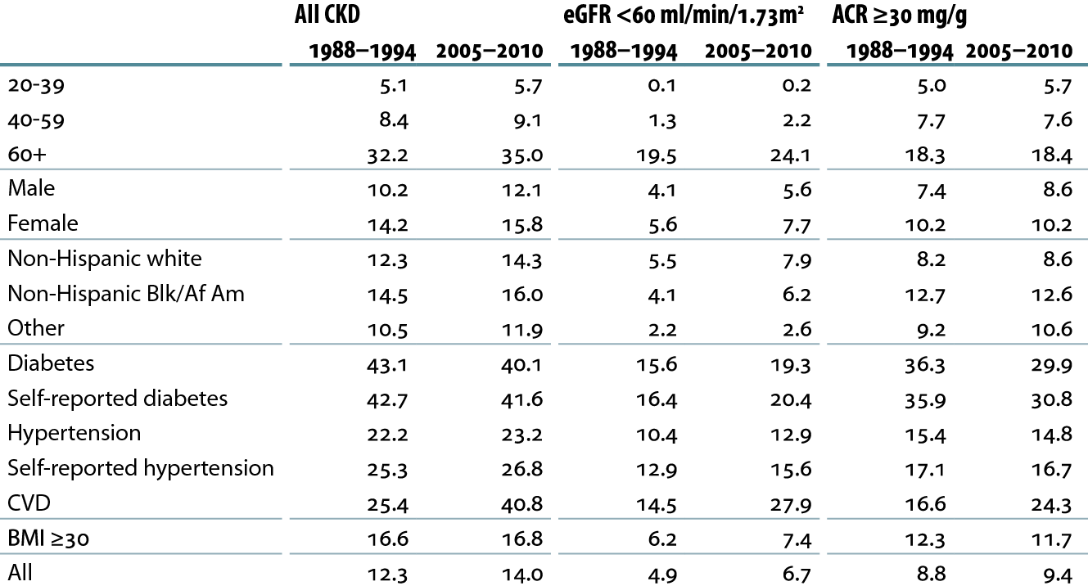
Prevalence (%) of CKD in the NHANES population within age, gender, race/ethnicity, & risk-factor categories Table 1.a (volume 1)
NHANES III (1988–1994) & 2005–2010 participants age 20 & older; eGFR calculated using CKD-EPI equation; urine albumin creatinine ratio (ACR).

Slide 4
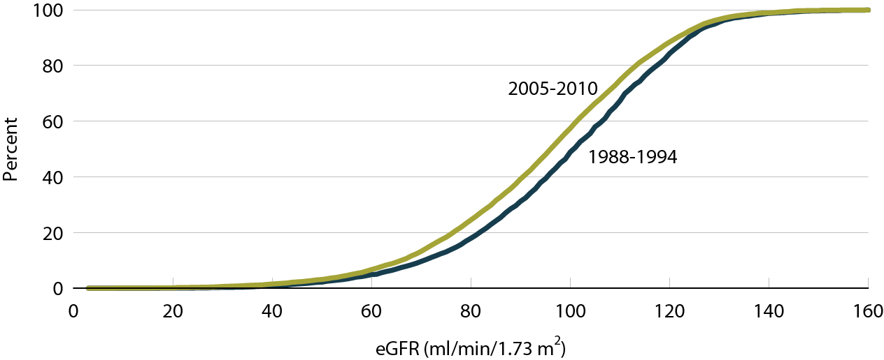
Cumulative eGFR distribution curves of NHANES participants (%) Figure 1.2 (volume 1)
NHANES III (1988-1994) & 2005-2010 participants age 20& older; eGFR calculated using CKD EPI equations

Slide 5
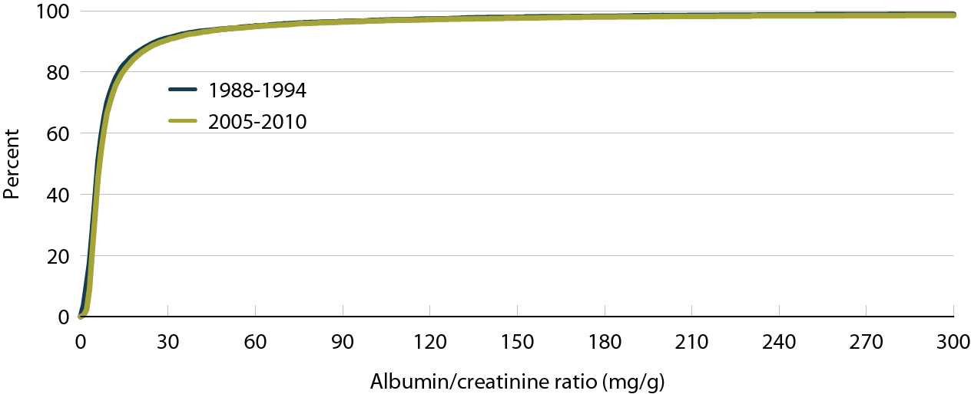
Cumulative urine albumin/creatinine ratio (ACR) distribution curves of NHANES participants Figure 1.3 (volume 1)
NHANES III (1988-1994) & 2005-2010 participants age 20& older; eGFR calculated using CKD EPI equations

Slide 6
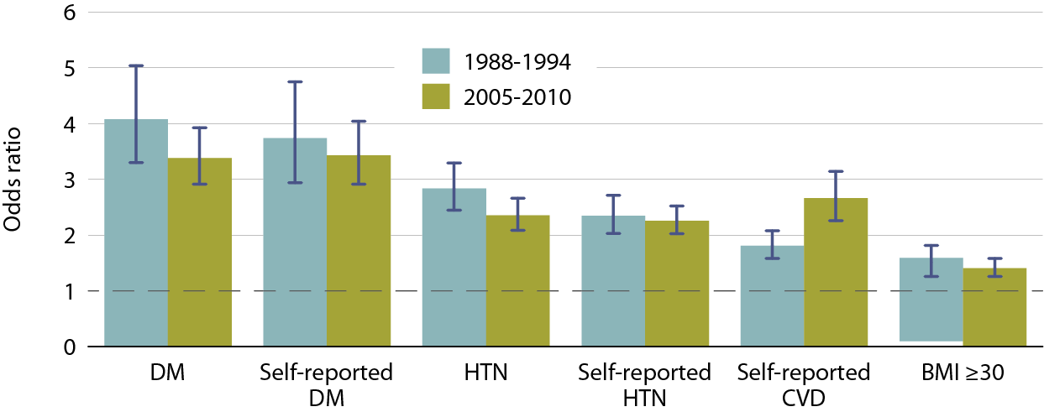
Adjusted odds ratios of CKD in NHANES participants, by risk factor Figure 1.4 (volume 1)
NHANES III (1988-1994) & 2005-2010 participants age 20& older. Adj: age, gender, & race.

Slide 7
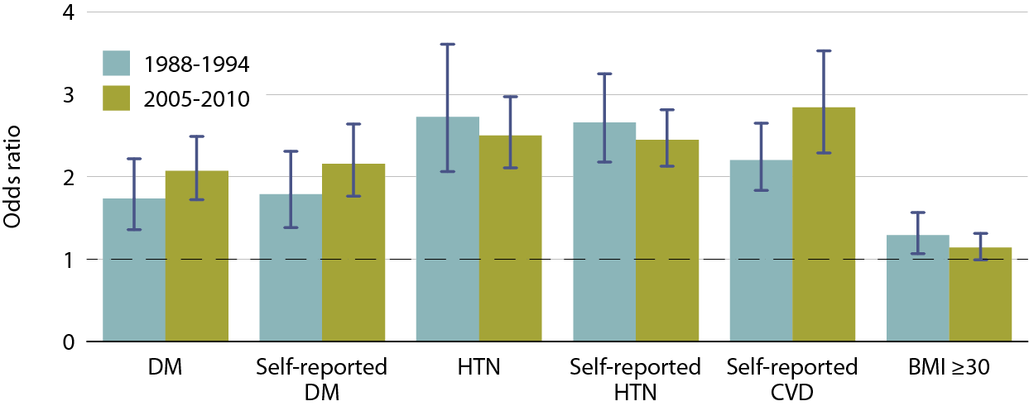
Adjusted odds ratios of eGFR <60 in NHANES participants, by risk factor Figure 1.5 (volume 1)
NHANES III (1988-1994) & 2005-2010 participants age 20& older. Adj: age, gender, race; for Figure 1.5, eGFR calculated using CKD-EPI equation

Slide 8
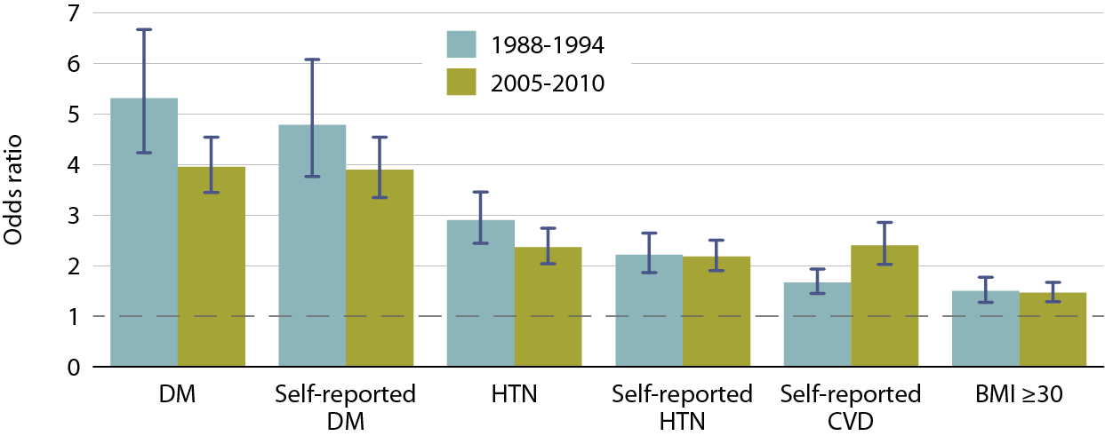
Adjusted odds ratios of urine albumin/ creatinine ratio (ACR) ≥30 mg/g in NHANES participants, by risk factor Figure 1.6 (volume 1)
NHANES III (1988-1994) & 2005-2010 participants age 20& older. Adj: age, gender, & race.

Slide 9
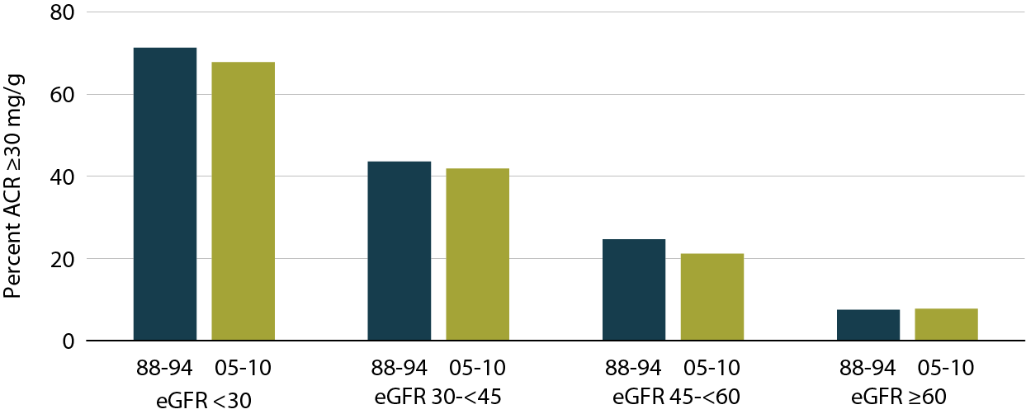
NHANES participants with urine albumin/creatinine ratio (ACR) ≥ 30 mg/g, by eGFR range Figure 1.7 (volume 1)
NHANES III (1988–1994) & 2005–2010 participants age 20 & older; eGFR calculated using CKD-EPI equation.

Slide 10
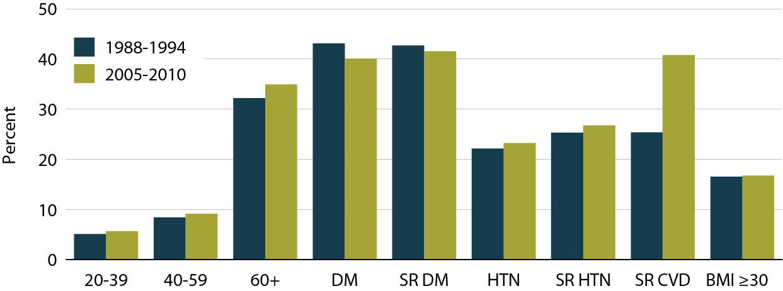
NHANES participants with CKD, by age & risk factor categories Figure 1.8 (volume 1)
NHANES III (1988–1994) & 2005–2010 participants age 20 & older; SR: self-reported.

Slide 11
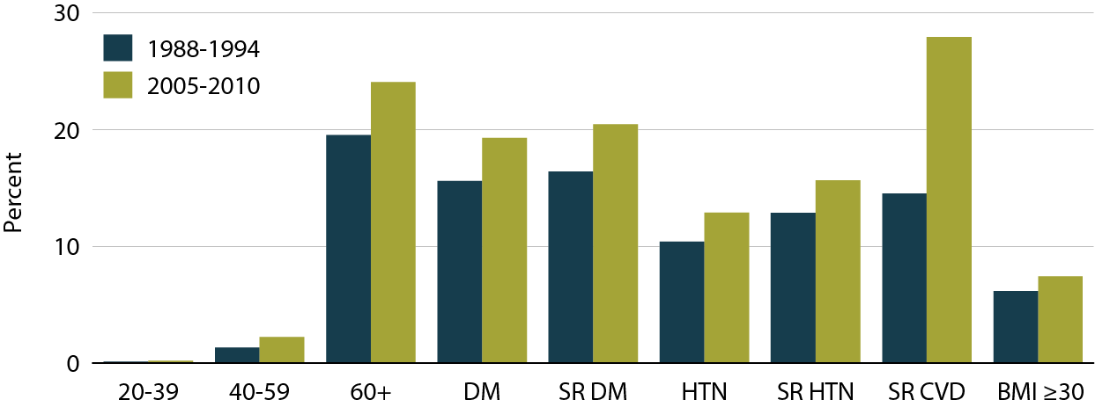
NHANES participants with eGFR < 60 ml/min/1.73 m², by age & risk factor Figure 1.9 (volume 1)
NHANES III (1988–1994) & 2005–2010 participants age 20 & older; for Figure 1.9, eGFR calculated using CKD-EPI equation. SR: self-reported.

Slide 12
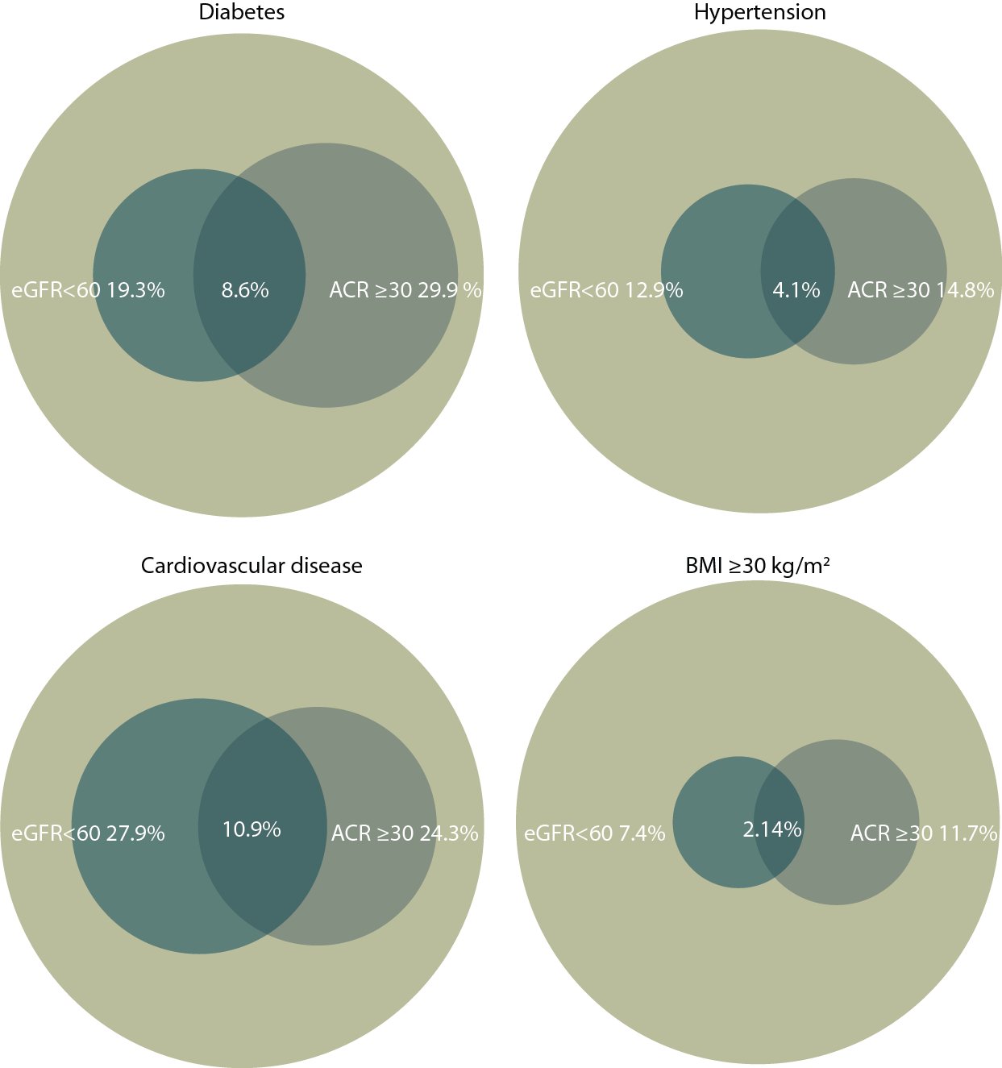
Distribution of markers of CKD in NHANES participants with diabetes & hypertension, 2005–2010 Figure 1.11 (volume 1)
NHANES III (1988–1994) & 2005–2010 participants age 20 & older; eGFR calculated using CKD-EPI equation; urine albumin creatinine ratio (ACR).

Slide 13
Distribution of markers of CKD in NHANES participants with cardiovascular disease & obesity, 2005–2010 Figure 1.11 (continued, volume 1)
NHANES III (1988–1994) & 2005–2010 participants age 20 & older; eGFR calculated using CKD-EPI equation; urine albumin creatinine ratio (ACR).

Slide 14
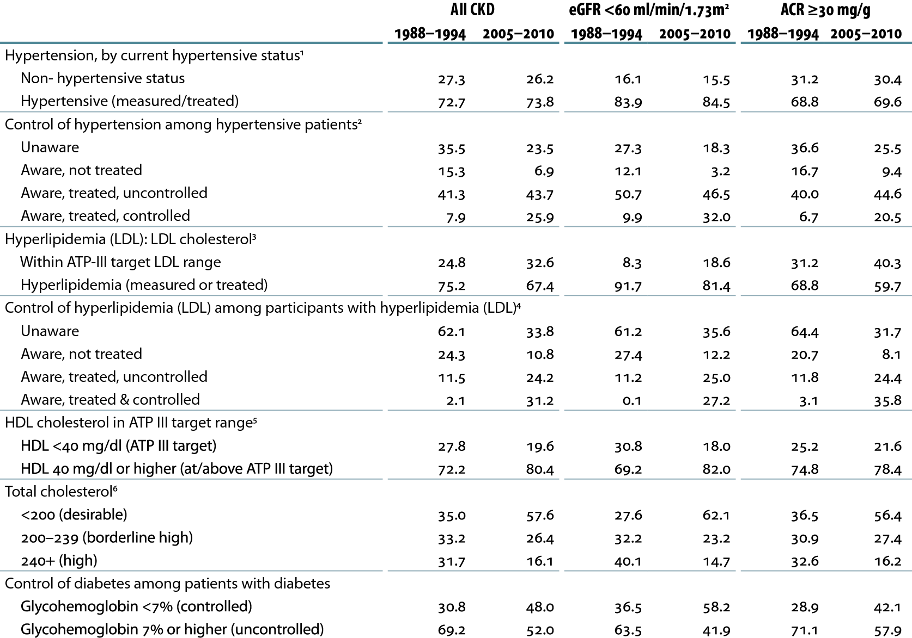
Awareness, treatment, & control of hypertension, hyperlipidemia, HDL, total cholesterol, & diabetes Table 1.b (volume 1)
NHANES III (1988–1994) & 2005–2010 participants age 20 & older; dialysis patients excluded from NHANES 2005–2010; eGFR calculated using CKD-EPI equation; urine albumin creatinine ratio (ACR).

Slide 15
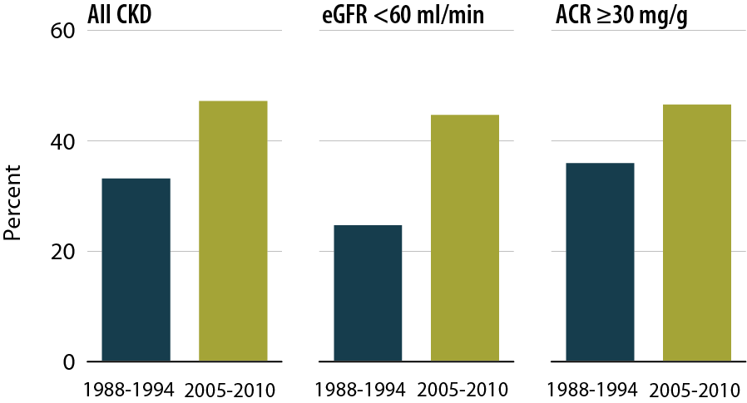
NHANES participants at target blood pressure Figure 1.12 (volume 1)
NHANES III (1988–1994) & 2005–2010 participants age 20 & older; dialysis patients excluded from NHANES 2005–2010; eGFR calculated using CKD-EPI equation; urine albumin creatinine ratio (ACR).

Slide 16
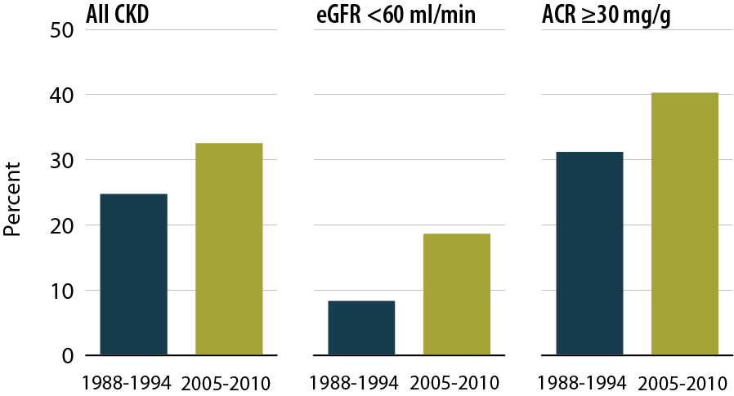
NHANES participants within LDL cholesterol target range Figure 1.13 (volume 1)
NHANES III (1988–1994) & 2005–2010 participants age 20 & older; dialysis patients excluded from NHANES 2005–2010; eGFR calculated using CKD-EPI equation; urine albumin creatinine ratio (ACR).

Slide 17
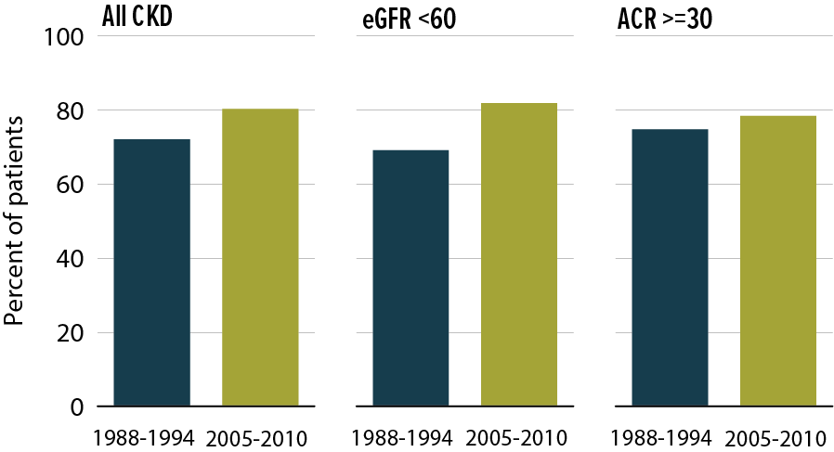
NHANES participants within HDL cholesterol target range Figure 1.14 (volume 1)
NHANES III (1988–1994) & 2005–2010 participants age 20 & older; dialysis patients excluded from NHANES 2005–2010; eGFR calculated using CKD-EPI equation; urine albumin creatinine ratio (ACR).

Slide 18
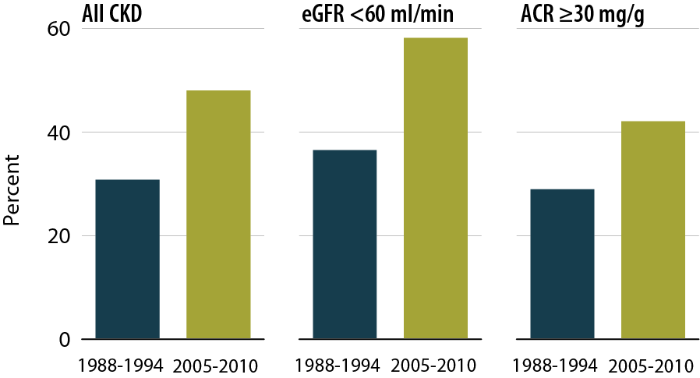
Percent of NHANES participants with glycohemoglobin <7% Figure 1.15 (volume 1)
NHANES III (1988–1994) & 2005–2010 participants age 20 & older; dialysis patients excluded from NHANES 2005–2010; eGFR calculated using CKD-EPI equation; urine albumin creatinine ratio (ACR).

Slide 19
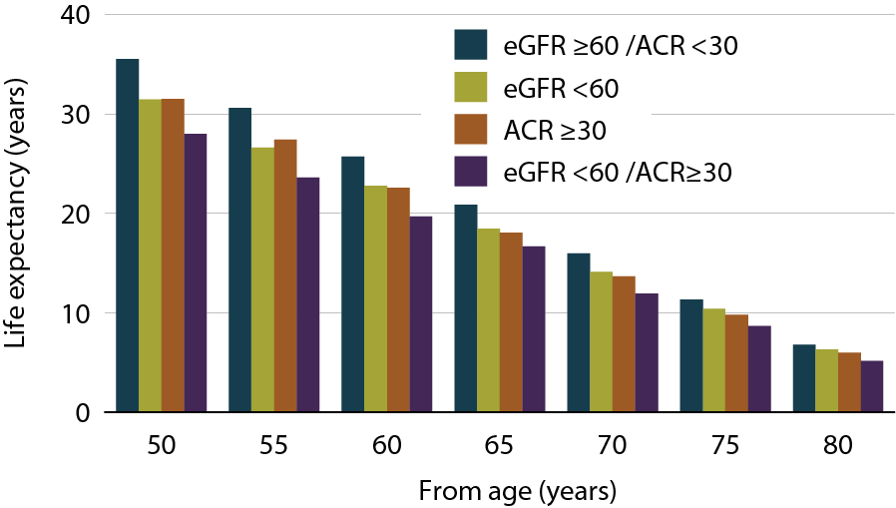
Life expectancy of NHANES participants with or without CKD, 1999–2004 Figure 1.15 (volume 1)
NHANES participants, 1999–2004; eGFR calculated using CKD-EPI equation; urine albumin creatinine ratio (ACR).

