Slide 1
CKD: Chapter 2
Identification & care
of patients with chronic kidney disease
United States Renal Data System
2012 Annual Data Report

Slide 2
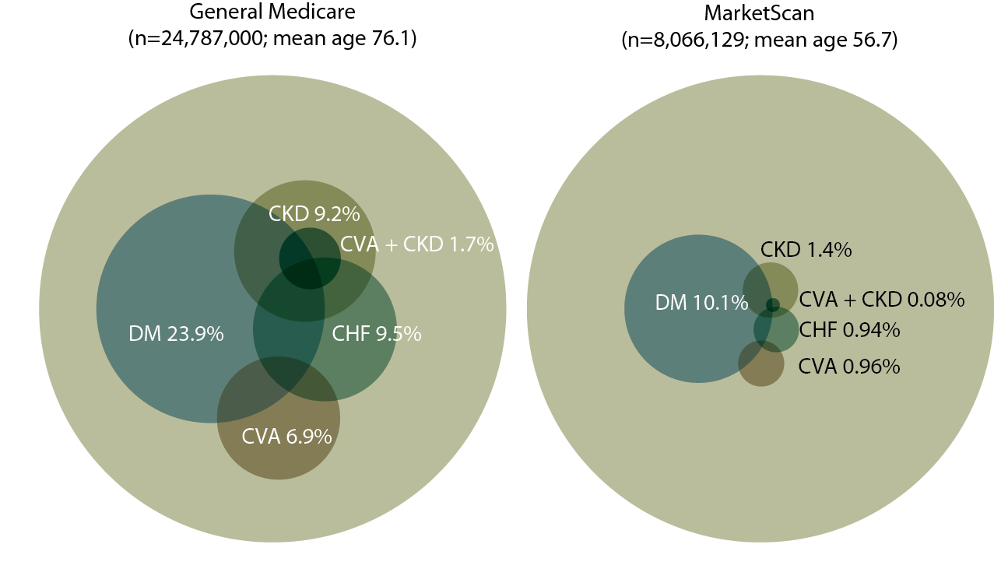
Distribution of point prevalent general Medicare
(age 65 & older) & MarketScan (age 50–64) patients with coded diabetes, CKD, CHF, & CVA, 2010
Figure 2.1 (volume 1)
Point prevalent general (fee-for-service) Medicare patients age 65 & older; point prevalent MarketScan patients age 50–64. Diabetes, CKD, CHF, & CVA determined from claims.

Slide 3
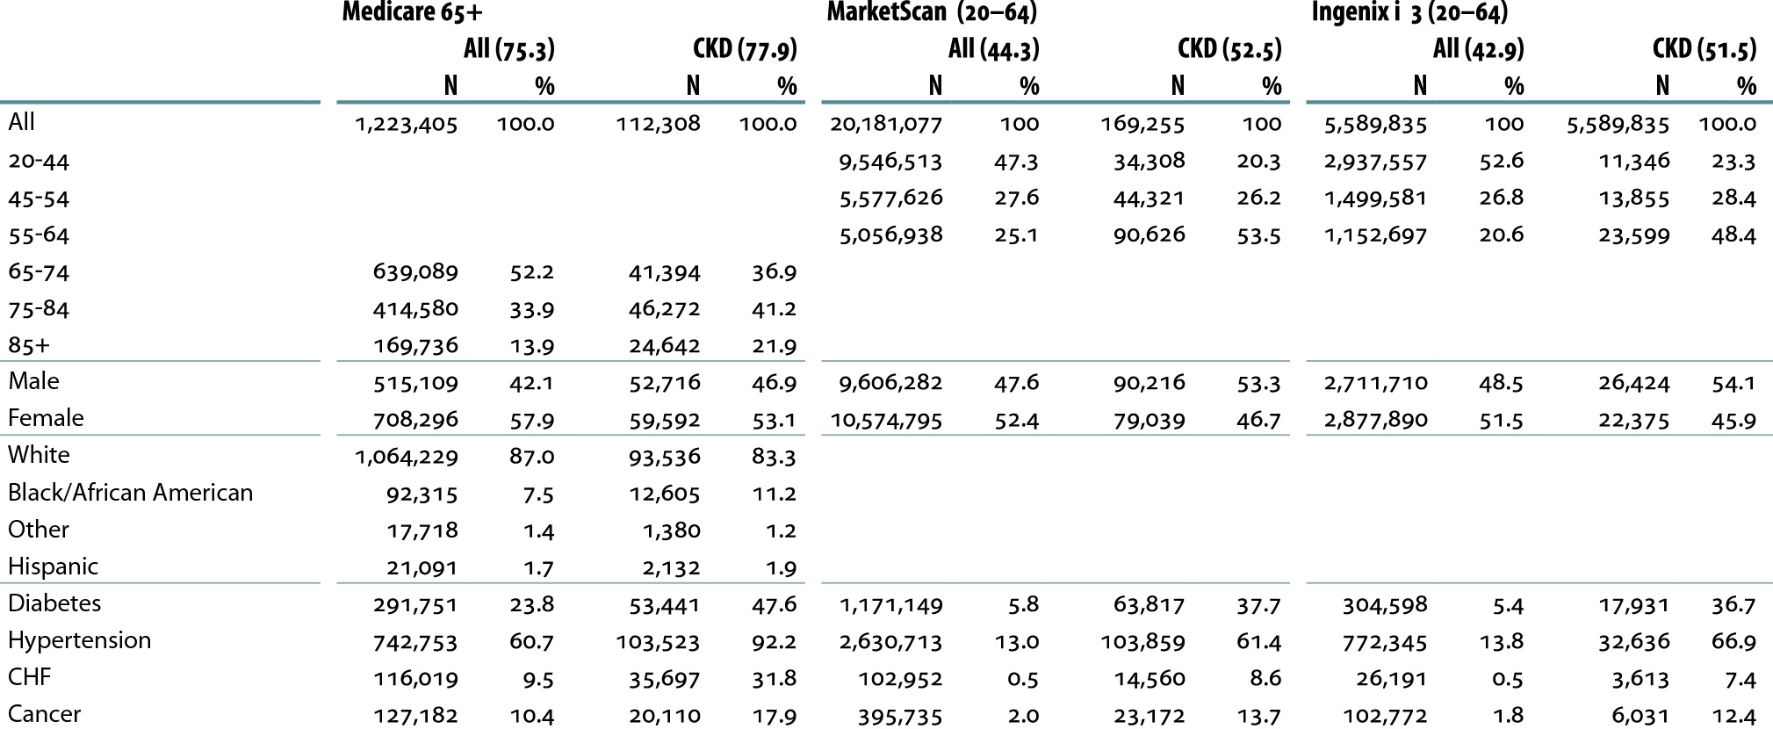
Descriptive parameters of CKD datasets, by age, gender, race, ethnicity, & coded comorbidity, 2010
Table 2.a (volume 1)
Period prevalent patients 2010, without ESRD, age 65 & older
(Medicare) & 20–64 (MarketScan & Ingenix i3).

Slide 4
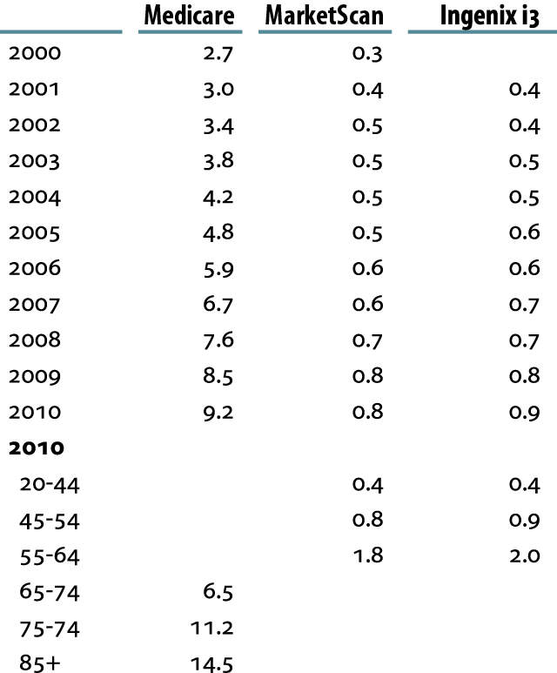
Prevalence (%) of recognized CKD, by dataset, set, & age
Table 2.b (volume 1)
Prevalent patients surviving cohort year without ESRD, age 65 & older (Medicare) & 20–64 (MarketScan & Ingenix i3).

Slide 5
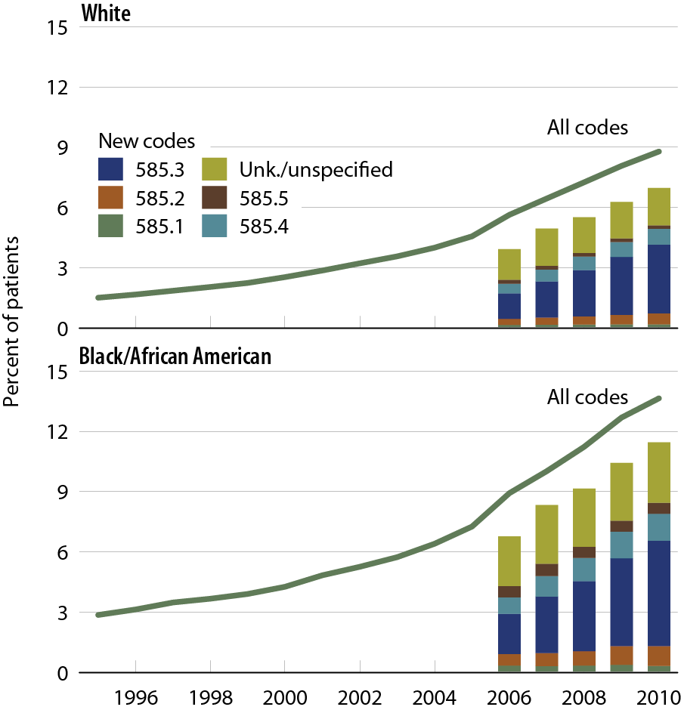
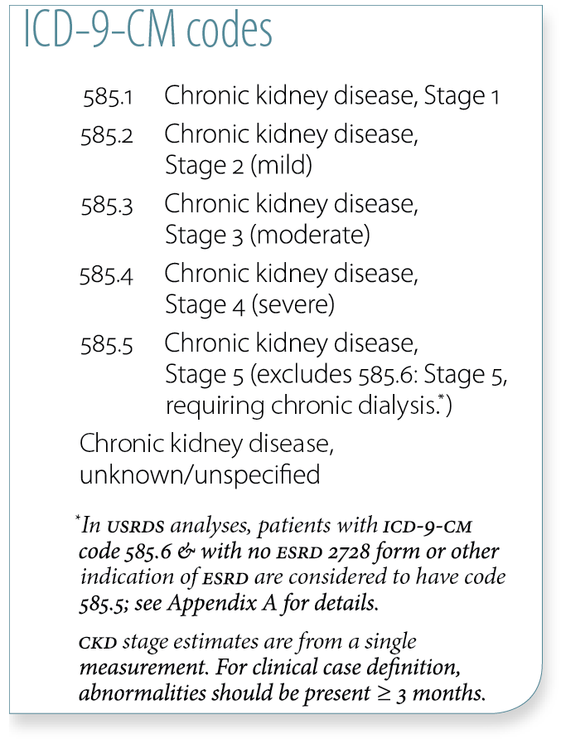
Trends in CKD prevalence:
Medicare patients age 65 & older, by race
Figure 2.2 (volume 1)
Prevalent patients surviving cohort year without ESRD, age 65 & older (Medicare) & 20–64 (MarketScan & Ingenix i3).

Slide 6
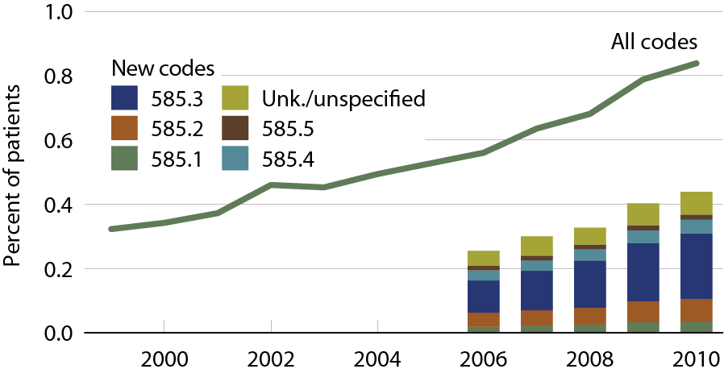
Trends in CKD prevalence:
MarketScan patients age 20–64
Figure 2.3 (volume 1)
Prevalent patients surviving cohort year without ESRD, age 65 & older (Medicare) & 20–64 (MarketScan & Ingenix i3).

Slide 7
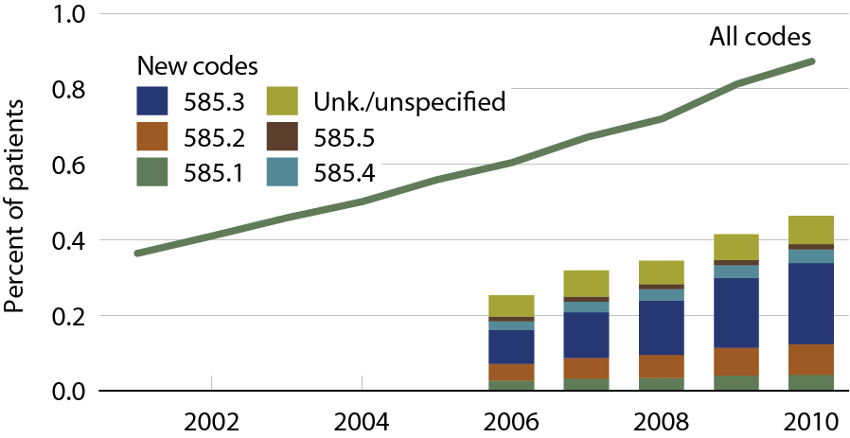
Trends in CKD prevalence:
Ingenix i3 patients age 20–64
Figure 2.4 (volume 1)
Prevalent patients surviving cohort year without ESRD, age 65 & older (Medicare) & 20–64 (MarketScan & Ingenix i3).

Slide 8
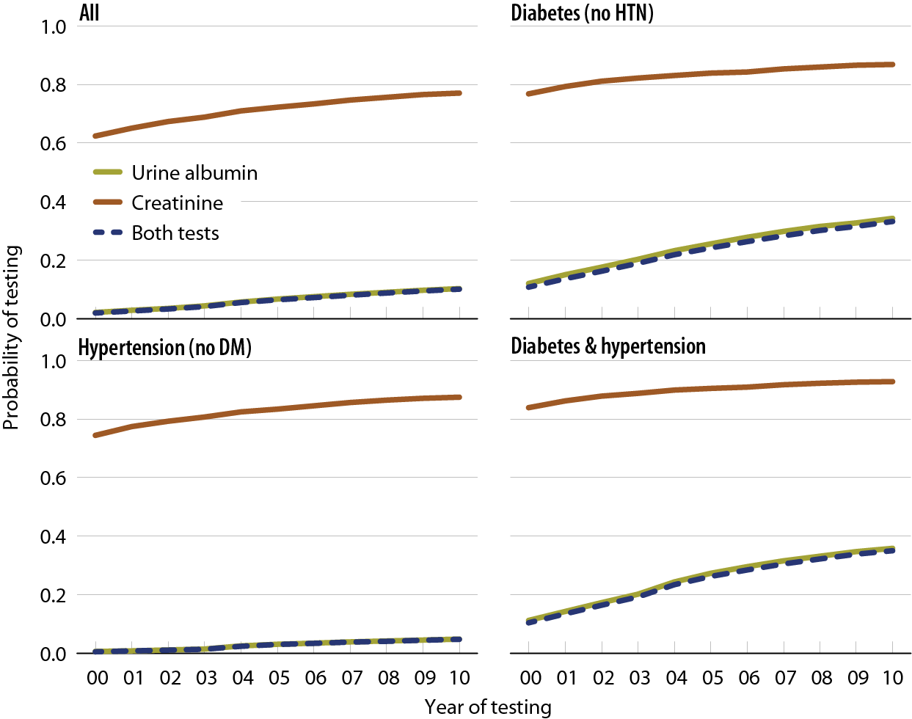
Probability of urine albumin & creatinine testing in Medicare patients at risk for CKD
Figure 2.5 (volume 1)
Prevalent patients surviving cohort year without ESRD, age 65 & older (Medicare) & 20–64 (MarketScan & Ingenix i3).

Slide 9
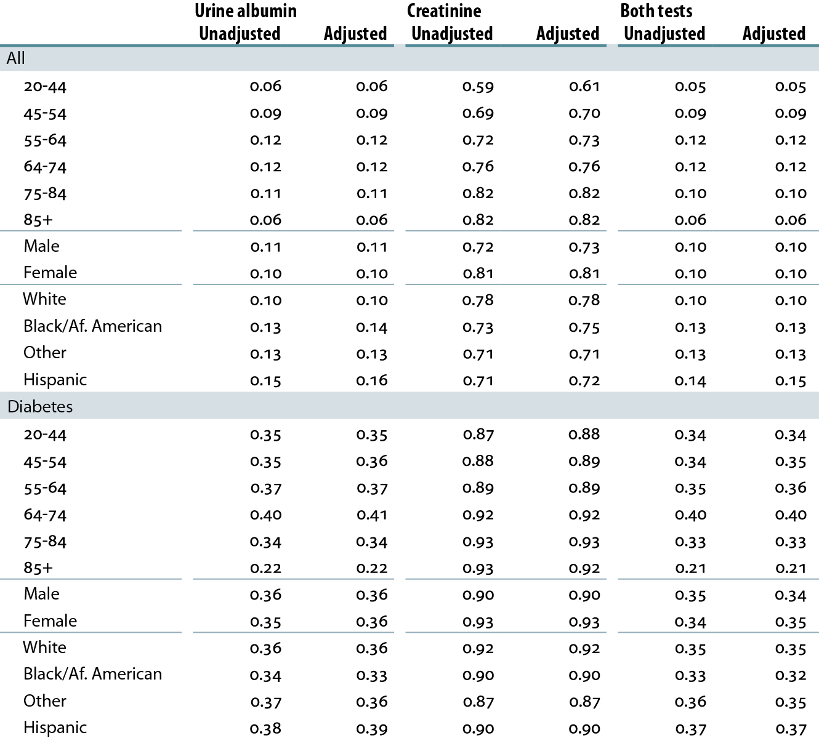
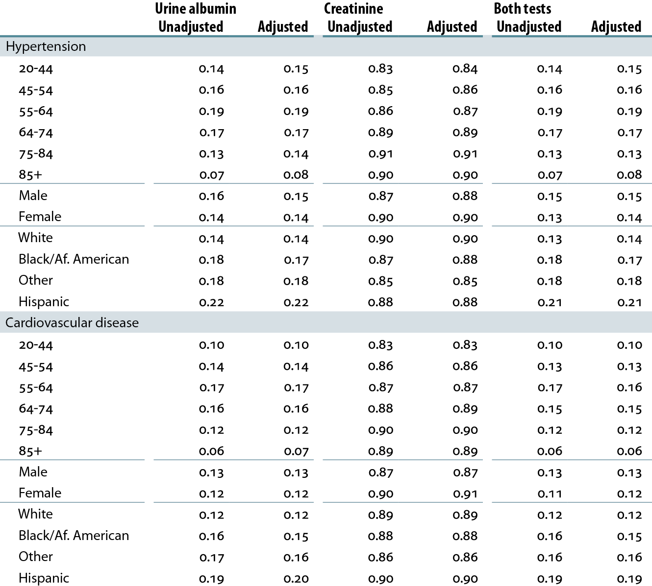
Probability of laboratory testing in patients at risk for CKD, by demographic characteristics, 2010
Table 2.c (volume 1)
Medicare patients from the 5 percent sample, age 20 & older, with Parts A & B coverage in 2009; patients diagnosed with CKD or ESRD during 2009 are excluded.

Slide 10
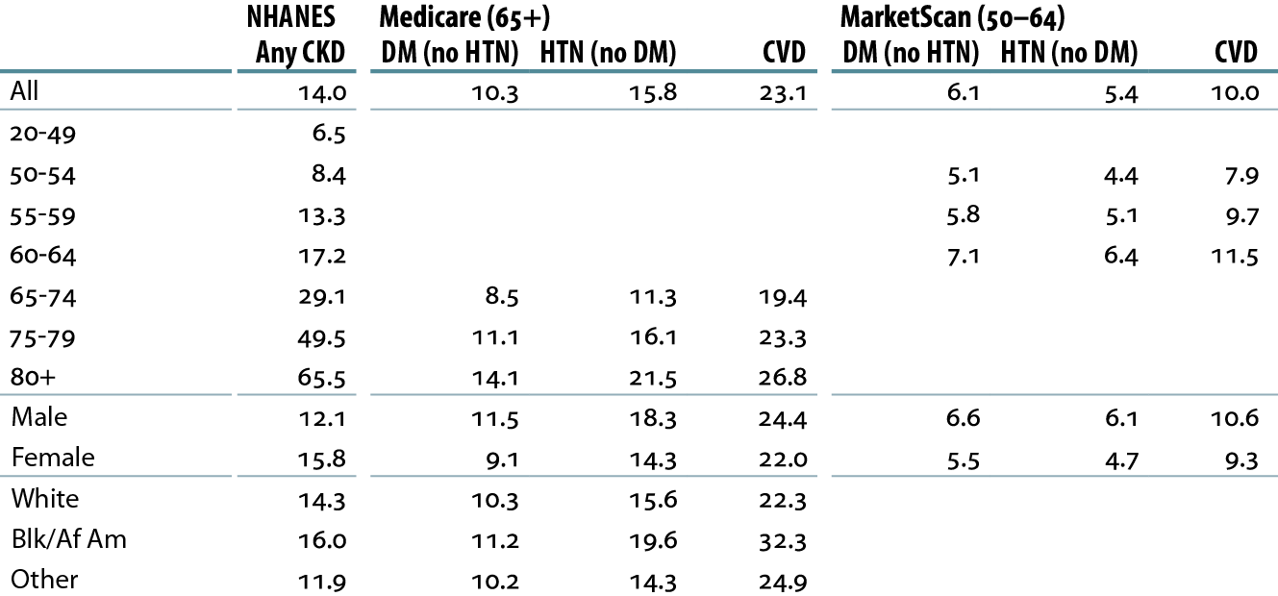
Percent of patients with CKD, by demographic characteristics, comorbidity, & dataset, 2010
Table 2.d (volume 1)
Medicare patients age 65 & older & MarketScan patients age 50–64, alive & eligible for all of 2010. CKD claims as well as other diseases identified in 2010. NHANES 2005–2010 participants, age 20 & older.

Slide 11
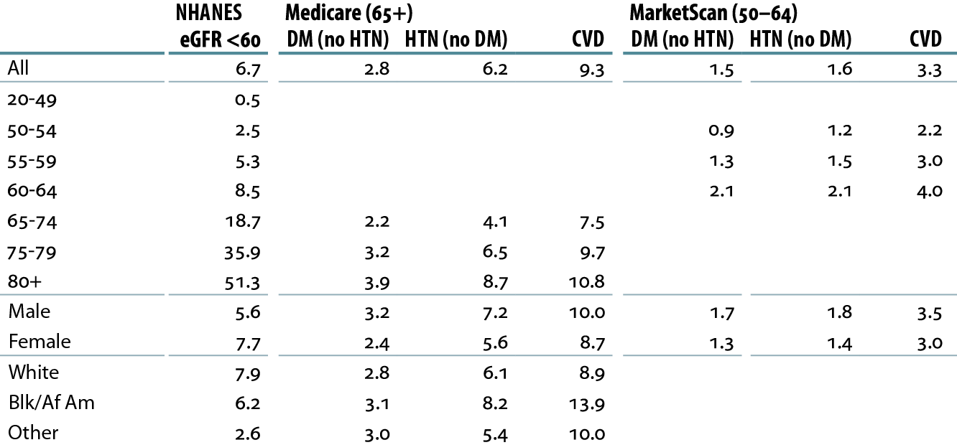
Percent of patients with a CKD diagnosis code of 585.3 or higher, by demographic characteristics, comorbidity, & dataset, 2010
Table 2.e (volume 1)
Medicare patients age 65 & older & MarketScan patients age 50–64, alive & eligible for all of 2010. CKD claims as well as other diseases identified in 2010. NHANES 2005–2010 participants, age 20 & older; eGFR estimated by CKD-EPI equation.

Slide 12
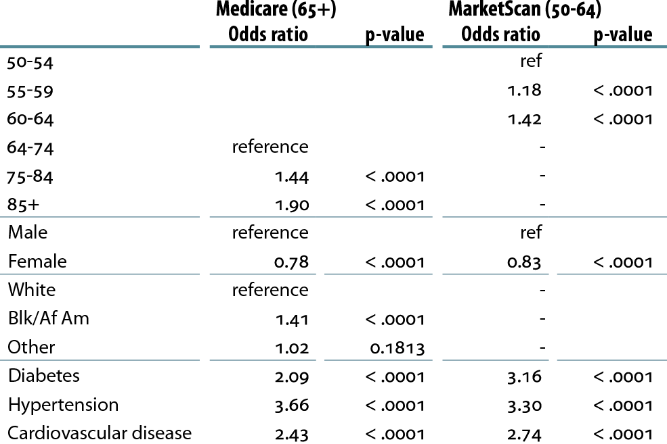
Adjusted odds ratio of a CKD diagnosis code, by demographic, comorbidity, & dataset, 2010
Table 2.f (volume 1)
Medicare patients age 65 & older & MarketScan patients age 50–64, alive & eligible for all of 2010. CKD claims as well as other diseases identified in 2010. NHANES 2005–2010 participants, age 20 & older.

Slide 13
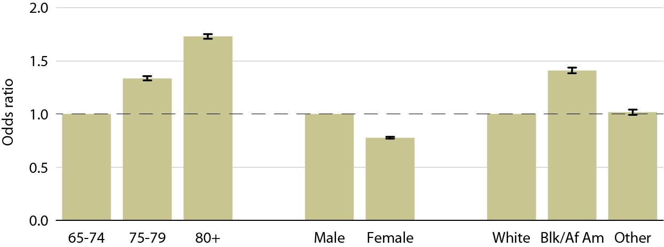
Odds ratio of a CKD diagnosis code in Medicare patients, by age, gender, & race, 2010
Figure 2.6 (volume 1)
Medicare patients age 65 & older & MarketScan patients age 50–64, alive & eligible for all of 2010. CKD claims as well as other diseases identified in 2010.

Slide 14
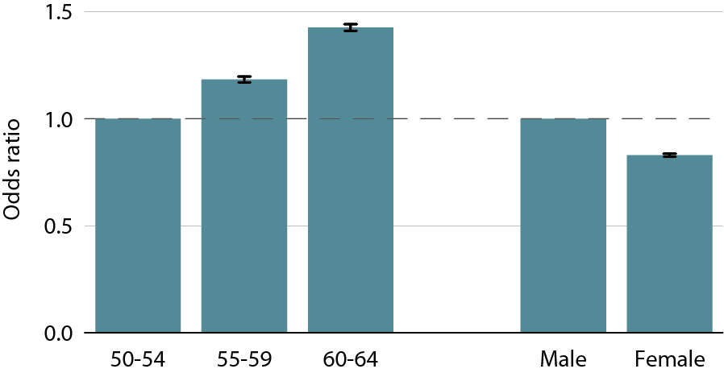
Odds ratio of a CKD diagnosis code in MarketScan patients, by age & gender, 2010
Figure 2.7 (volume 1)
Medicare patients age 65 & older & MarketScan patients age 50–64, alive & eligible for all of 2010. CKD claims as well as other diseases identified in 2010.

Slide 15
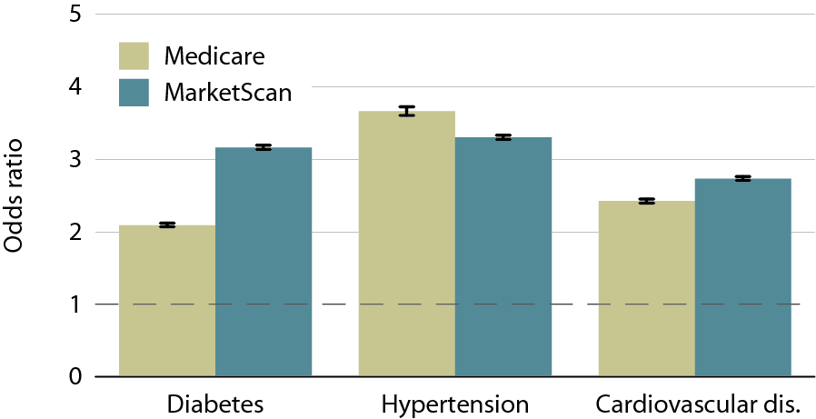
Odds ratio of a CKD diagnosis code, by comorbidity, 2010
Figure 2.8 (volume 1)
Medicare patients age 65 & older & MarketScan patients age 50–64, alive & eligible for all of 2010. CKD claims as well as other diseases identified in 2010.

Slide 16
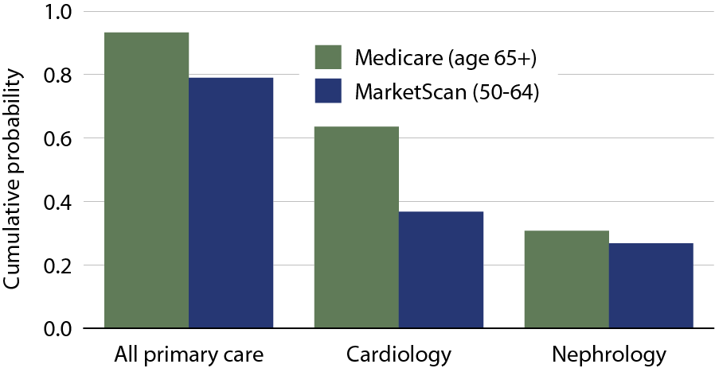
Cumulative probability of a physician visit at month 12 after CKD diagnosis, by dataset & physician specialty, 2010
Table 2.9 (volume 1)
Patients alive & eligible all of 2009. CKD diagnosis represents date of first CKD claim during 2009; physician claims searched during 12 months following that date.

Slide 17
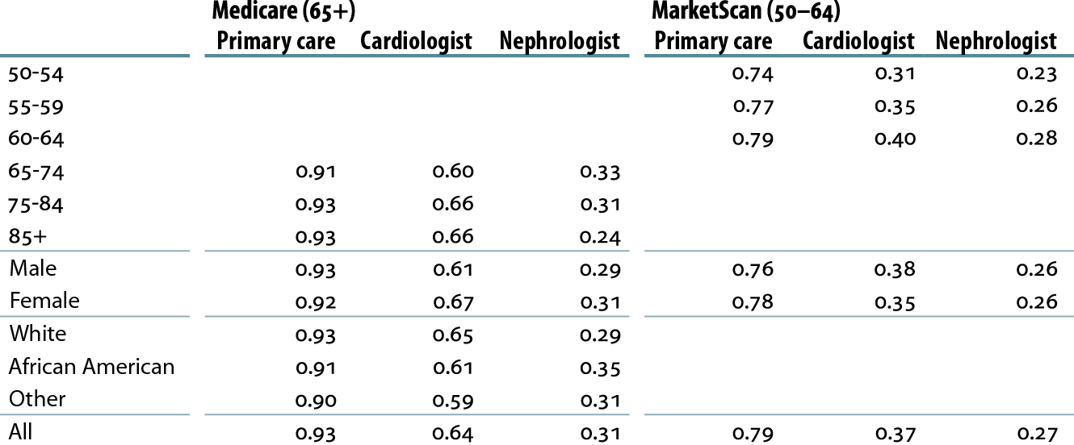
Cumulative probability of a physician visit at month 12 after CKD diagnosis in 2009, by demographic characteristics, physician specialty, & dataset, 2010
Table 2.g (volume 1)
Patients alive & eligible all of 2009. CKD diagnosis represents date of first CKD claim during 2009; physician claims searched during 12 months following that date.

Slide 18
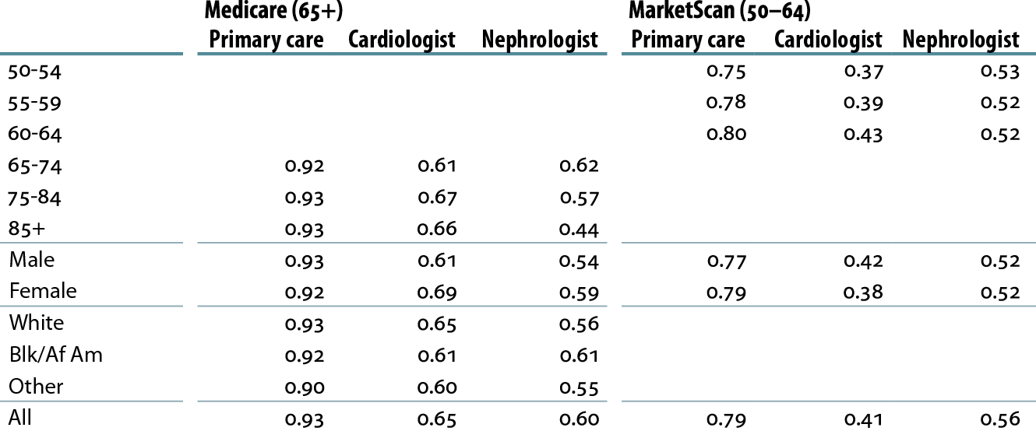
Cumulative probability of a physician visit at month 12 after CKD diagnosis code of 585.3 or higher in 2009, by demographic characteristics, physician specialty, & dataset, 2010
Table 2.h (volume 1)
Patients alive & eligible all of 2009. CKD diagnosis represents date of first CKD claim during 2009; physician claims searched during 12 months following that date.

Slide 19
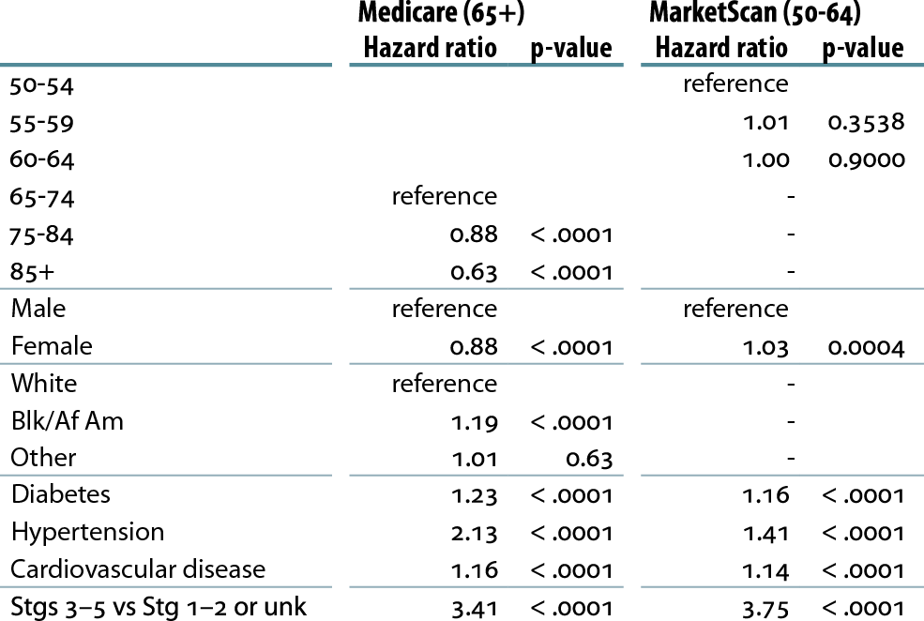
Hazard ratio of seeing a nephrologist 12 months after CKD diagnosis, by demographics, comorbidity, CKD stage, & dataset, 2010
Table 2.i (volume 1)
Patients alive & eligible all of 2009. CKD diagnosis represents date of first CKD claim during 2009; physician claims searched during 12 months following that date.

Slide 20
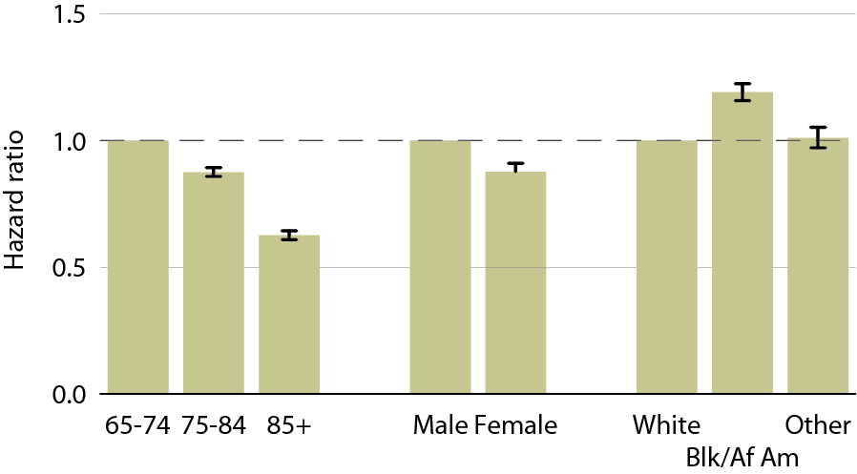
Hazard ratio of Medicare patients seeing a nephrologist 12 months after CKD diagnosis, by age, gender, & race, 2010
Figure 2.10 (volume 1)
Patients alive & eligible all of 2009. CKD diagnosis represents date of first CKD claim during 2009; physician claims searched during 12 months following that date.

Slide 21
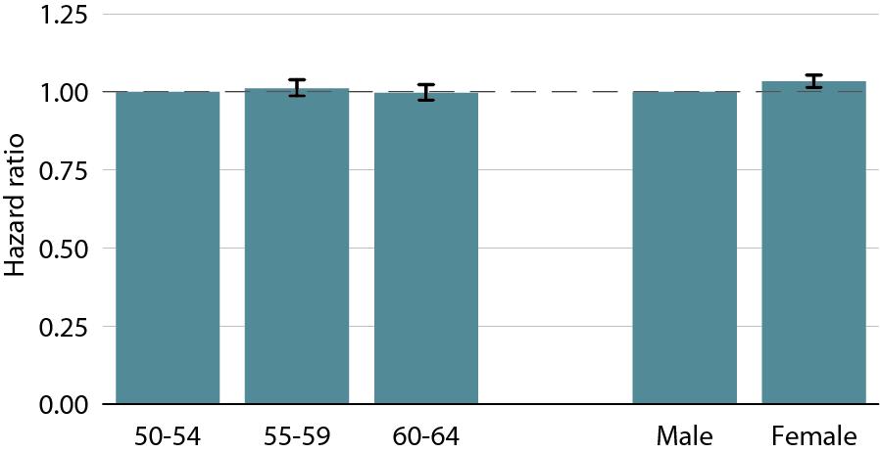
Hazard ratio of MarketScan patients seeing a nephrologist 12 months after CKD diagnosis, by age & gender, 2010
Figure 2.11 (volume 1)
Patients alive & eligible all of 2009. CKD diagnosis represents date of first CKD claim during 2009; physician claims searched during 12 months following that date.

Slide 22
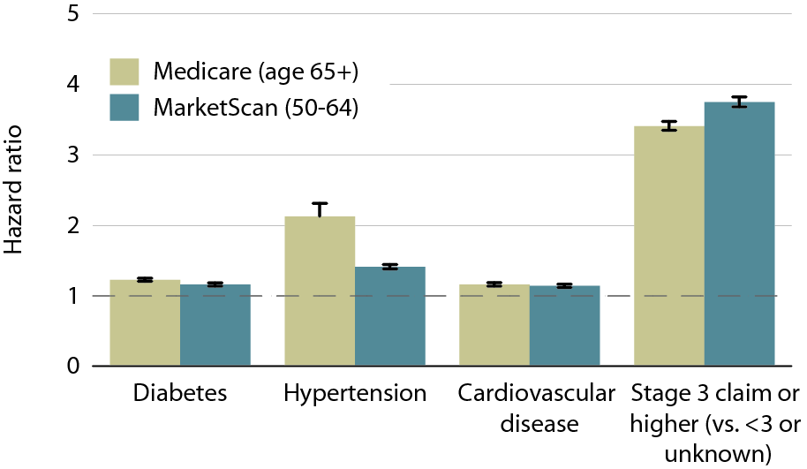
Hazard ratio of patients seeing a nephrologist 12 months after CKD diagnosis, by comorbidity, CKD stage, & dataset, 2010
Figure 2.12 (volume 1)
Patients alive & eligible all of 2009. CKD diagnosis represents date of first CKD claim during 2009; physician claims searched during 12 months following that date.

Slide 23
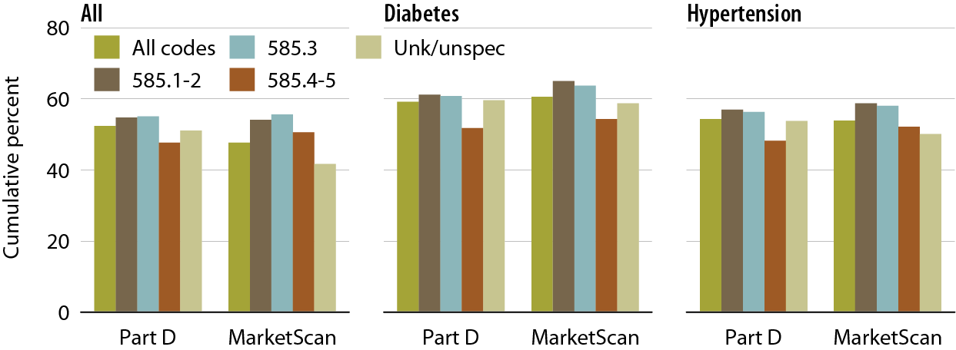
Medicare Part D and MarketScan CKD patients with at least one claim for an ACEI/ARB/renin inhibitor in the 12 months following the disease-defining entry period, by CKD diagnosis code, 2010
Figure 2.13 (volume 1)
Point prevalent Medicare CKD patients age 65 & older, & MarketScan CKD patients age 50–64.

Slide 24
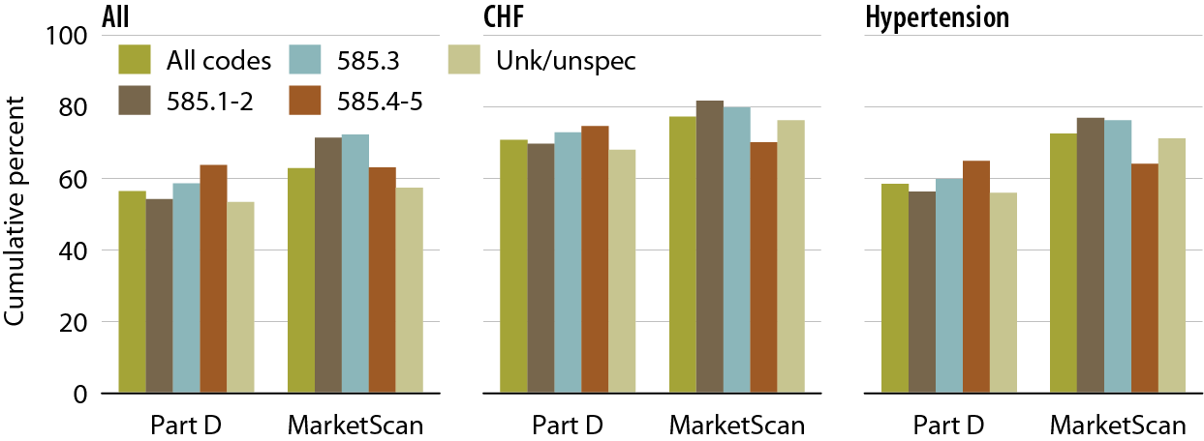
Medicare Part D and MarketScan CKD patients with at least one claim for a beta blocker in the 12 months following the disease- defining entry period, by CKD diagnosis code, 2010
Figure 2.14 (volume 1)
Point prevalent Medicare CKD patients age 65 & older, & MarketScan CKD patients age 50–64.

Slide 25
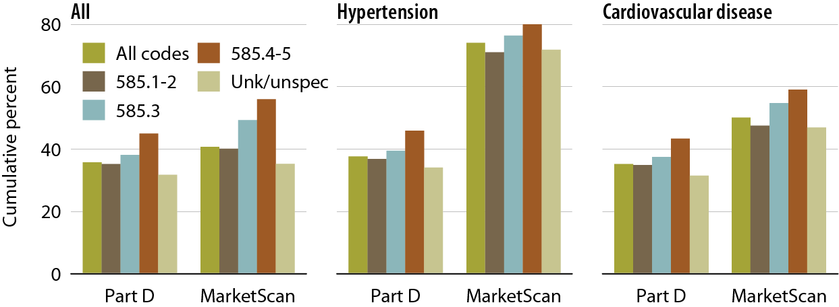
Medicare Part D & MarketScan CKD patients with at least one claim for a DHP calcium channel blocker in the 12 months following the disease-defining entry period, by CKD diagnosis code, 2010
Figure 2.15 (volume 1)
Point prevalent Medicare CKD patients age 65 & older, & MarketScan CKD patients age 50–64.

Slide 26
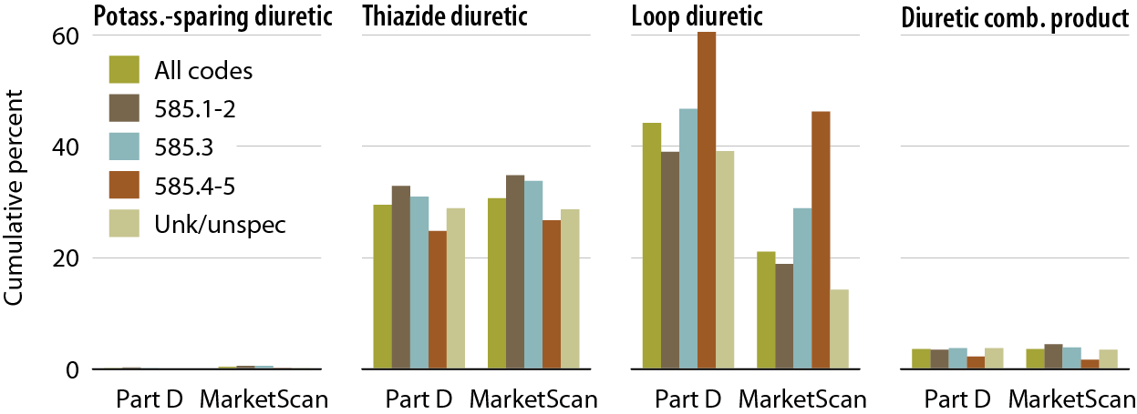
CKD patients with at least one claim for a diuretic in the 12 months following the disease-defining entry period, by dataset & CKD diagnosis code, 2010
Figure 2.16 (volume 1)
Point prevalent Medicare CKD patients age 65 & older, & MarketScan CKD patients age 50–64.

Slide 27
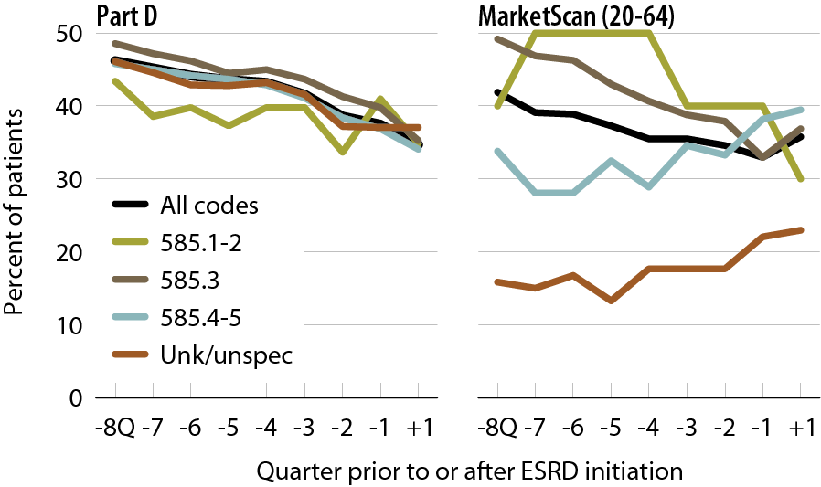
ACEI/ARB/renin inhibitor use during the transition to ESRD, by dataset & CKD stage, 2010
Figure 2.17 (volume 1)
Point prevalent Medicare CKD patients age 67 & older, & MarketScan CKD patients age 20–64.

Slide 28
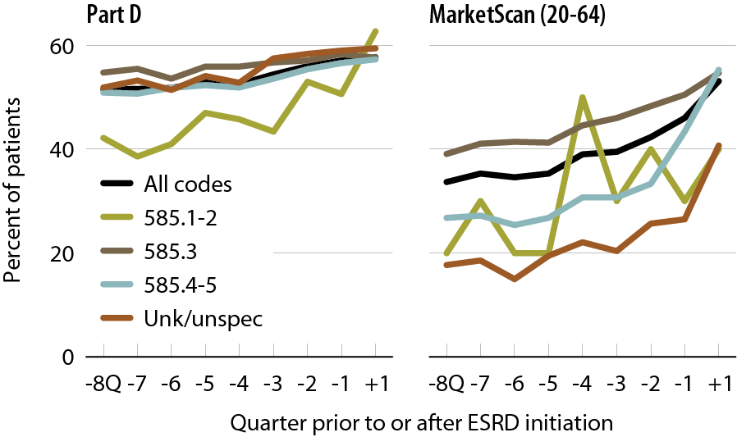
Beta blocker use during the transition to
ESRD, by dataset & CKD stage, 2010
Figure 2.18 (volume 1)
Point prevalent Medicare CKD patients age 67 & older, & MarketScan CKD patients age 20–64.

Slide 29
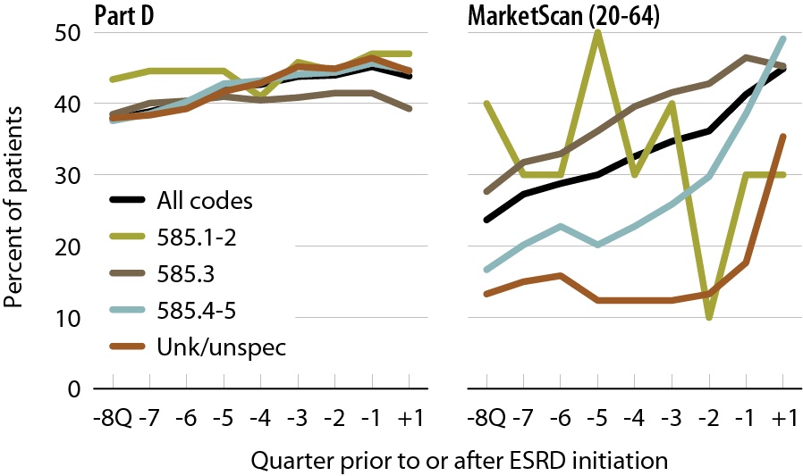
Dihydropyridine calcium channel blocker use during the transition to
ESRD, by dataset & CKD stage, 2010
Figure 2.19 (volume 1)
Point prevalent Medicare CKD patients age 67 & older, & MarketScan CKD patients age 20–64.

Slide 30
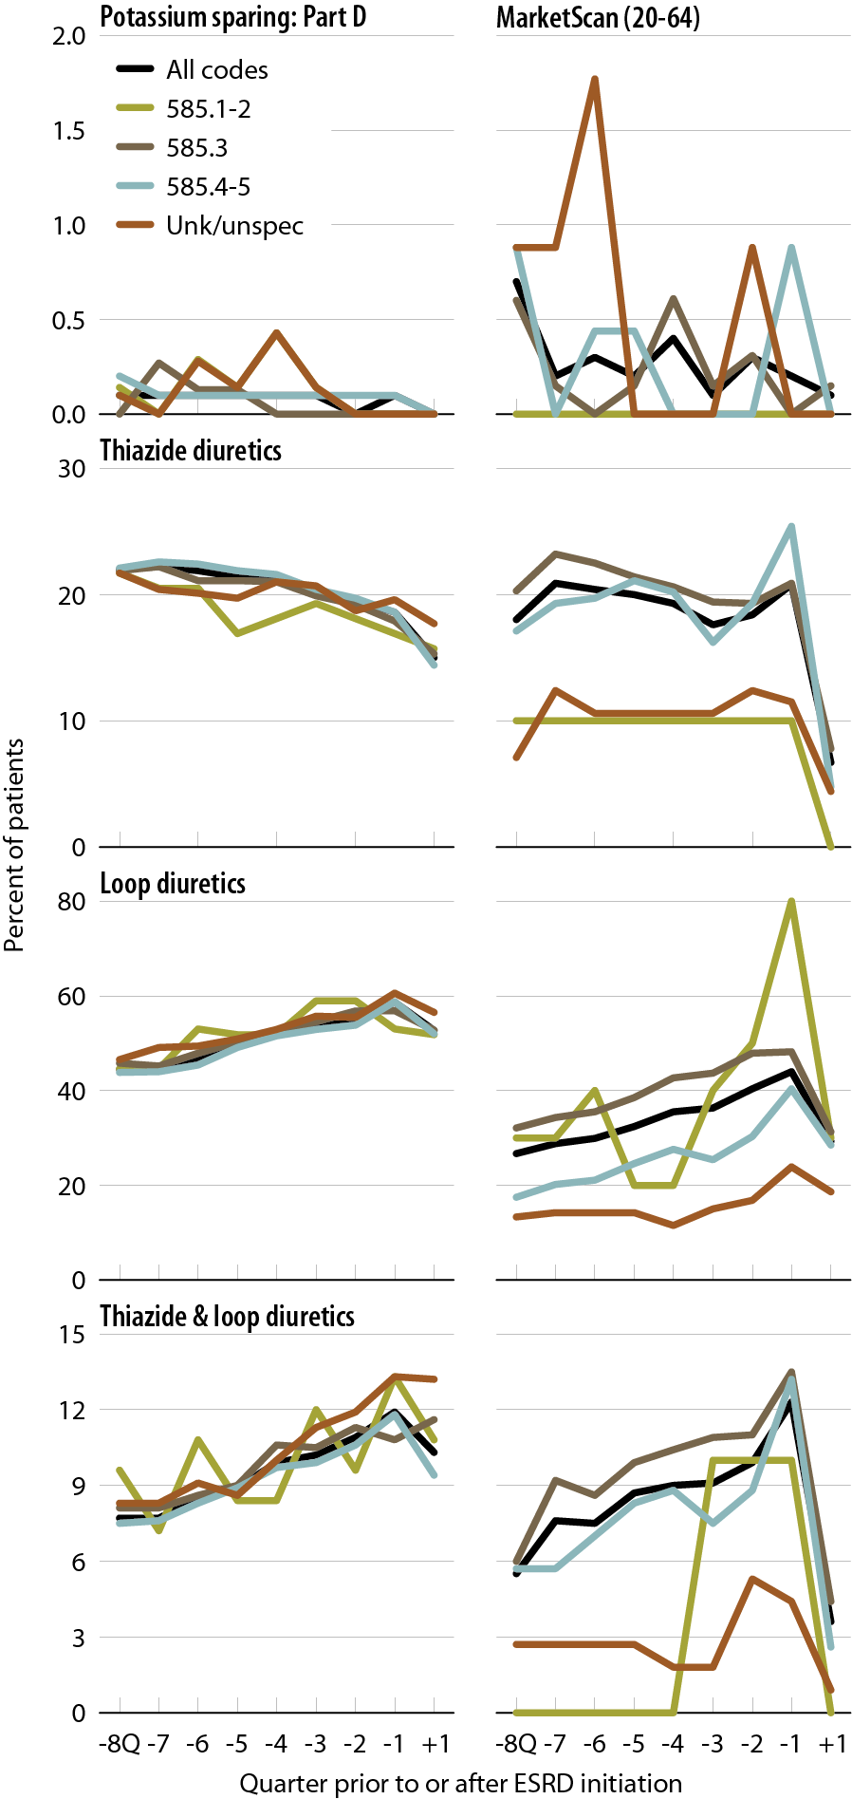
Use of diuretics during the transition to ESRD, by dataset & CKD stage, 2010
Figure 2.20 (volume 1)
Point prevalent Medicare CKD patients age 67 & older, & MarketScan CKD patients age 20–64.

