Slide 1
CKD: Chapter 3 Morbidity & mortality in patients with chronic kidney disease
United States Renal Data System
2012 Annual Data Report

Slide 2
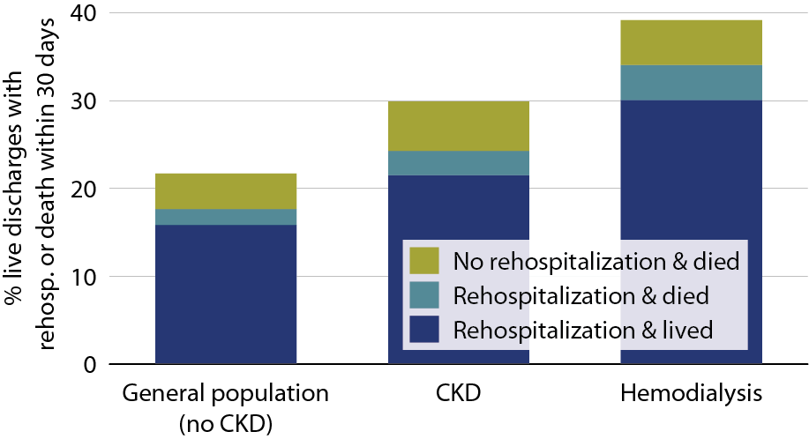
All-cause rehospitalization or death within 30 days after live hospital discharge, in the general Medicare (no CKD), CKD, & hemodialysis populations, age 66+, 2010 Figure 3.1 (volume 1)
January 1, 2010 point prevalent Medicare patients, age 66 & older on December 31, 2009, unadjusted. Includes live hospital discharges from January 1 to December 1, 2010.

Slide 3
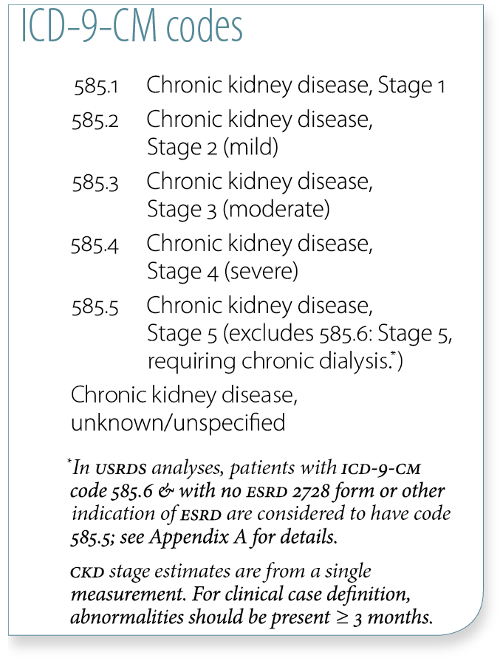
Adjusted hospitalization rates (per 1,000 patient years) in Medicare patients, by CKD diagnosis code, 2010 Table 3.a (volume 1)
January 1, 2010 point prevalent Medicare patients, age 66 & older on December 31, 2009. Adj: age/gender/race/prior hospitalization/comorbidity; rates by one factor are adjusted for the others. Ref: Medicare patients age 66 & older, 2010.

Slide 4
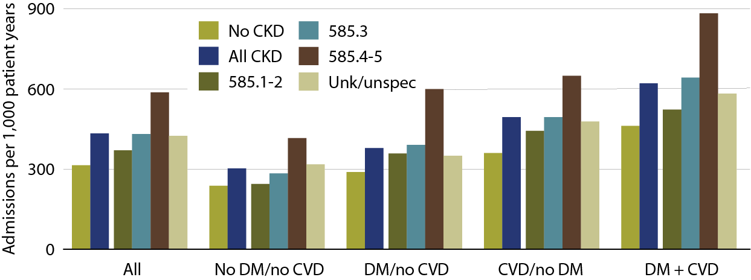
Adjusted hospitalization rates in Medicare patients, by comorbidity & CKD diagnosis code, 2010 Figure 3.2 (volume 1)
January 1, 2010 point prevalent Medicare patients, age 66 & older on December 31, 2009. Adj: age/gender/race/prior hospitalization/comorbidity; rates by one factor are adjusted for the others. Ref: Medicare patients age 66 & older, 2010.

Slide 5
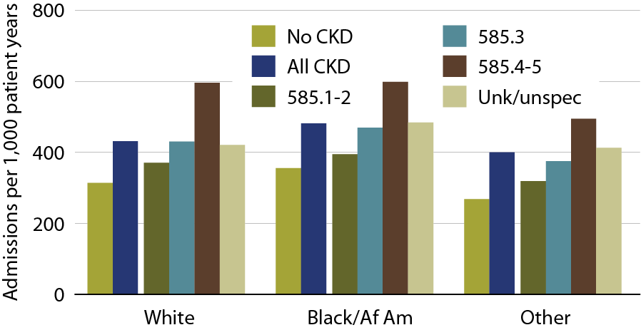
Adjusted hospitalization rates in Medicare patients, by race & CKD diagnosis code, 2010 Figure 3.3 (volume 1)
January 1, 2010 point prevalent Medicare patients, age 66 & older on December 31, 2009. Adj: age/gender/race/prior hospitalization/comorbidity; rates by one factor are adjusted for the others. Ref: Medicare patients age 66 & older, 2010.

Slide 6
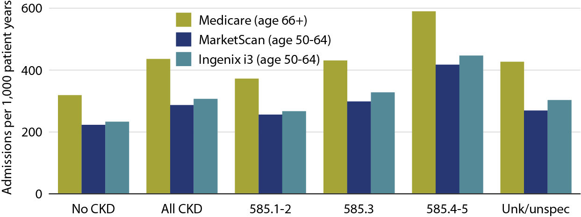
Adjusted all-cause hospitalization rates, by dataset & CKD diagnosis code, 2010 Figure 3.4 (volume 1)
Medicare: point prevalent patients on January 1, 2010, age 66 & older on December 31, 2009. MarketScan & Ingenix i3: point prevalent patients on January 1, 2010, age 50–64 on December 31, 2009. Adj: gender/prior hospitalization/comorbidity; ref: Medicare patients age 66 & older, 2010.

Slide 7
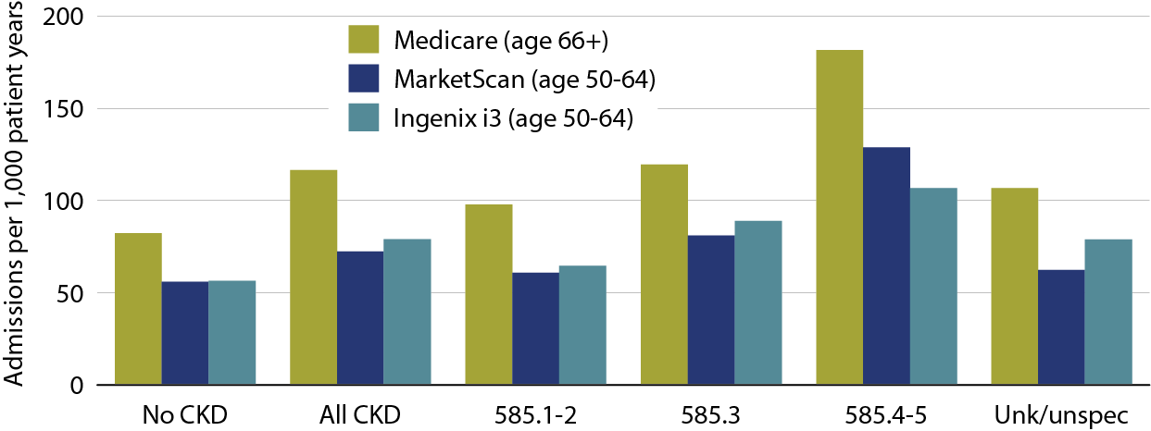
Adjusted rates of hospitalization for cardiovascular disease, by dataset & CKD diagnosis code, 2010 Figure 3.5 (volume 1)
Medicare: point prevalent patients on January 1, 2010, age 66 & older on December 31, 2009. MarketScan & Ingenix i3: point prevalent patients on January 1, 2010, age 50–64 on December 31, 2009. Adj: gender/prior hospitalization/comorbidity; ref: Medicare patients age 66 & older, 2010.

Slide 8
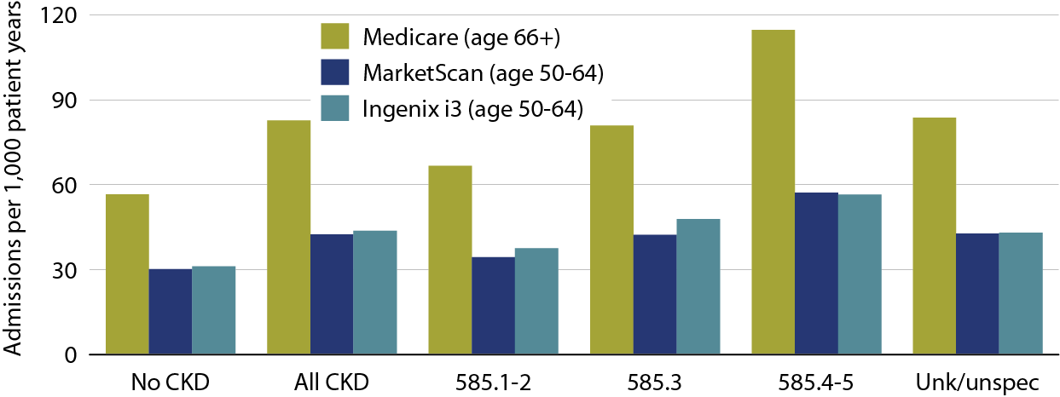
Adjusted rates of hospitalization for infection, by dataset & CKD diagnosis code, 2010 Figure 3.6 (volume 1)
Medicare: point prevalent patients on January 1, 2010, age 66 & older on December 31, 2009. MarketScan & Ingenix i3: point prevalent patients on January 1, 2010, age 50–64 on December 31, 2009. Adj: gender/prior hospitalization/comorbidity; ref: Medicare patients age 66 & older, 2010.

Slide 9
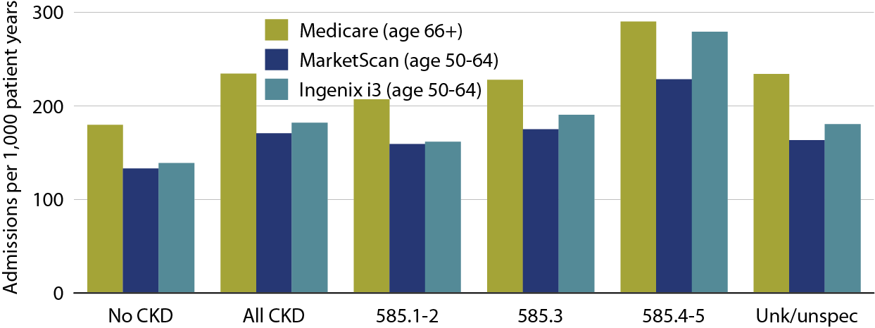
Adjusted rates of hospitalization for other causes, by dataset & CKD diagnosis code, 2010 Figure 3.7 (volume 1)
Medicare: point prevalent patients on January 1, 2010, age 66 & older on December 31, 2009. MarketScan & Ingenix i3: point prevalent patients on January 1, 2010, age 50–64 on December 31, 2009. Adj: gender/prior hospitalization/comorbidity; ref: Medicare patients age 66 & older, 2010.

Slide 10
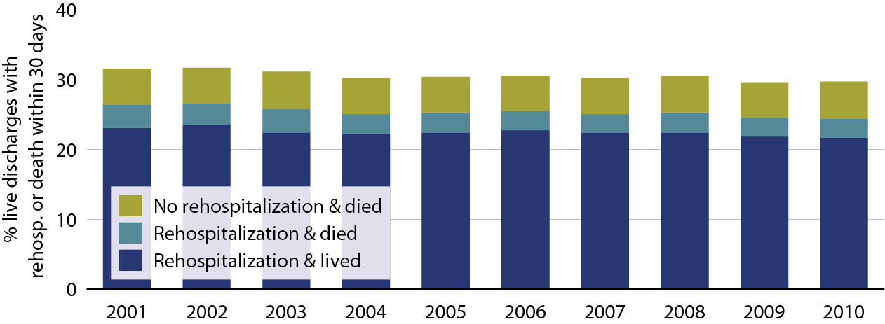
Adjusted all-cause rehospitalization or death 30 days after live hospital discharge in CKD patients Table 3.8 (volume 1)
Point prevalent Medicare CKD patients on January 1 of each year, age 66 & older on December 31 of the prior year. Adj: age/gender/race; ref: discharges in 2005. Includes discharges from January 1 to December 1 of each year

Slide 11
Percent live hospital discharges in patients with all-cause rehospitalization within 30 days, 2010 Table 3.b (volume 1)
January 1, 2010 point prevalent Medicare patients, age 66 & older on December 31, 2009; unadjusted. Includes live hospital discharges from January 1 to December 1, 2010

Slide 12
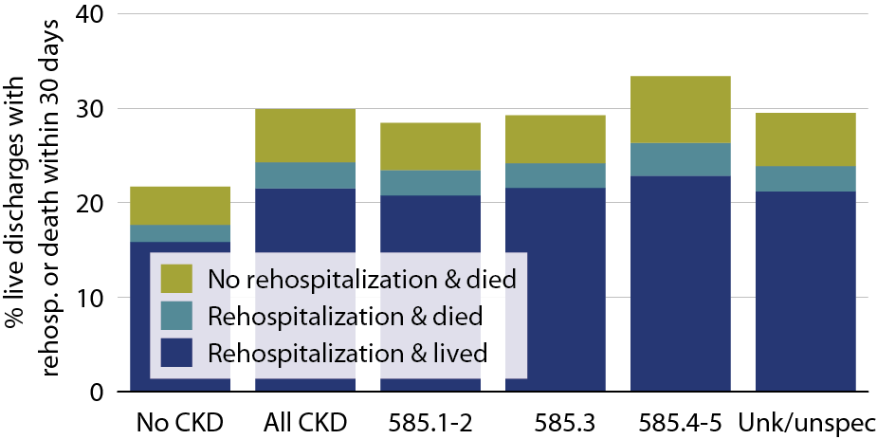
All-cause rehospitalization or death 30 days after live hospital discharge, by CKD stage, 2010 Table 3.9 (volume 1)
January 1, 2010 point prevalent Medicare patients, age 66 & older on December 31, 2009; unadjusted. Includes live hospital discharges from January 1 to December 1, 2010

Slide 13
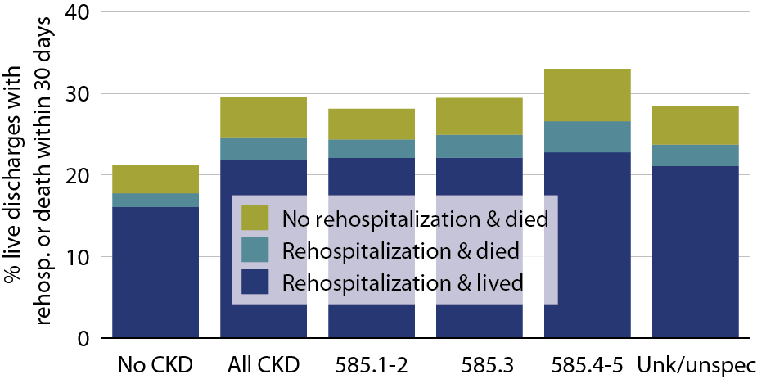
Cardiovascular rehospitalization or death within 30 days, by CKD stage, 2010 Table 3.10 (volume 1)
January 1, 2010 point prevalent Medicare patients, age 66 & older on December 31, 2009; unadjusted. Includes live hospital discharges from January 1 to December 1, 2010

Slide 14
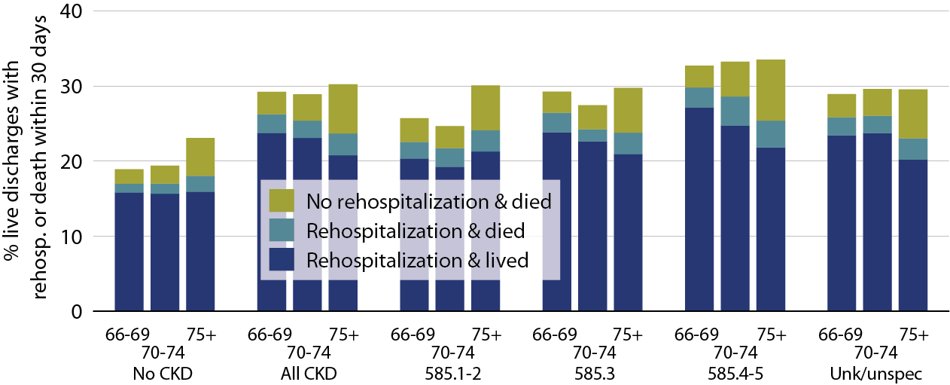
All-cause rehospitalization or death 30 days after live hospital discharge in Medicare patients, by age & CKD diagnosis code, 2010 Table 3.11 (volume 1)
January 1, 2010 point prevalent Medicare patients, age 66 & older on December 31, 2009; unadjusted.

Slide 15
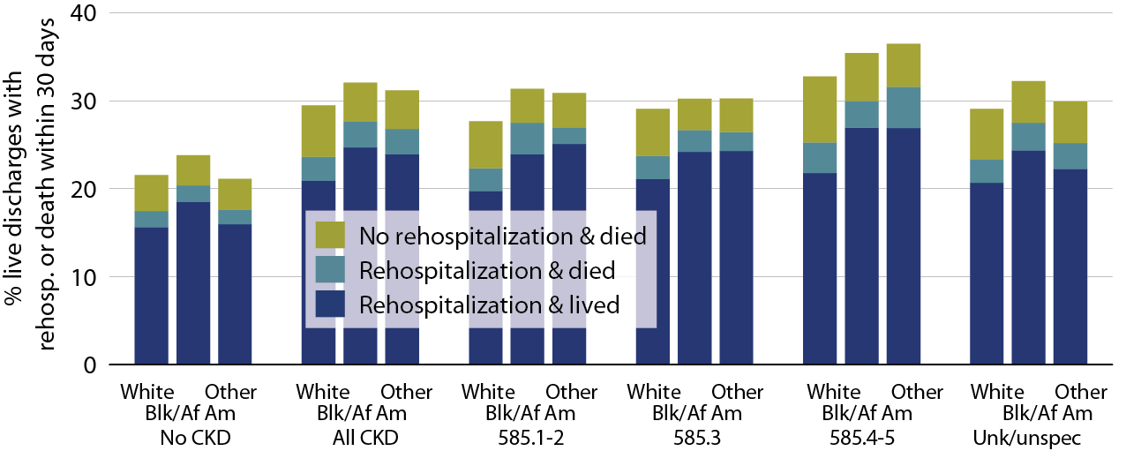
All-cause rehospitalization or death 30 days after live hospital discharge in Medicare patients, by race & CKD diagnosis code, 2010 Table 3.12 (volume 1)
January 1, 2010 point prevalent Medicare patients, age 66 & older on December 31, 2009; unadjusted.

Slide 16
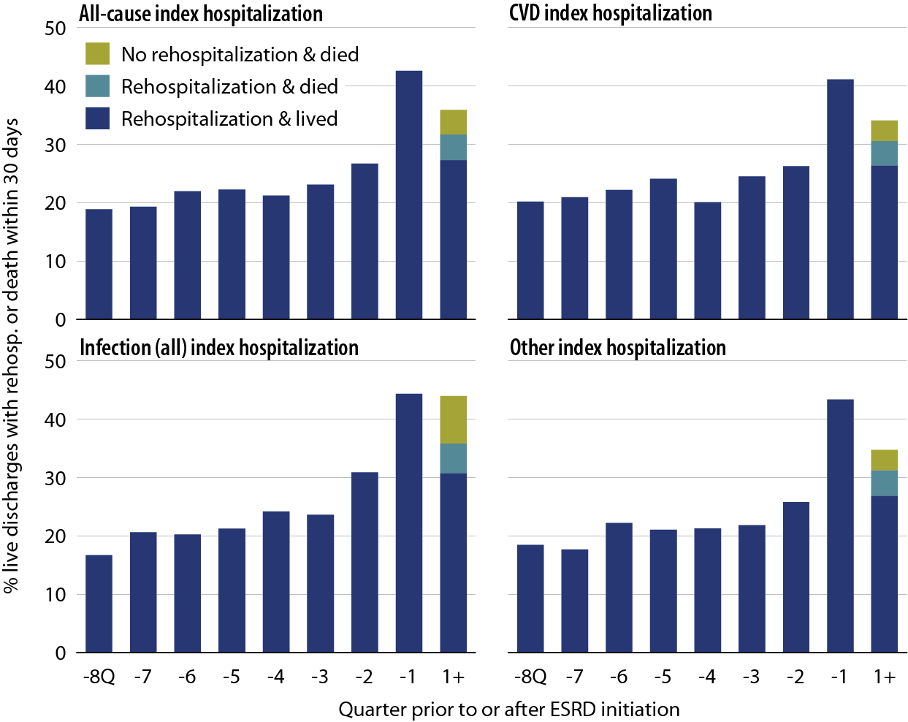
All-cause rehospitalization or death 30 days after live hospital discharge during the transition to ESRD, by cause-specific index hospitalization, 2010 Table 3.13 (volume 1)
Incident ESRD patients, January 1 to October 1, 2010; age 67 or older, unadjusted.

Slide 17
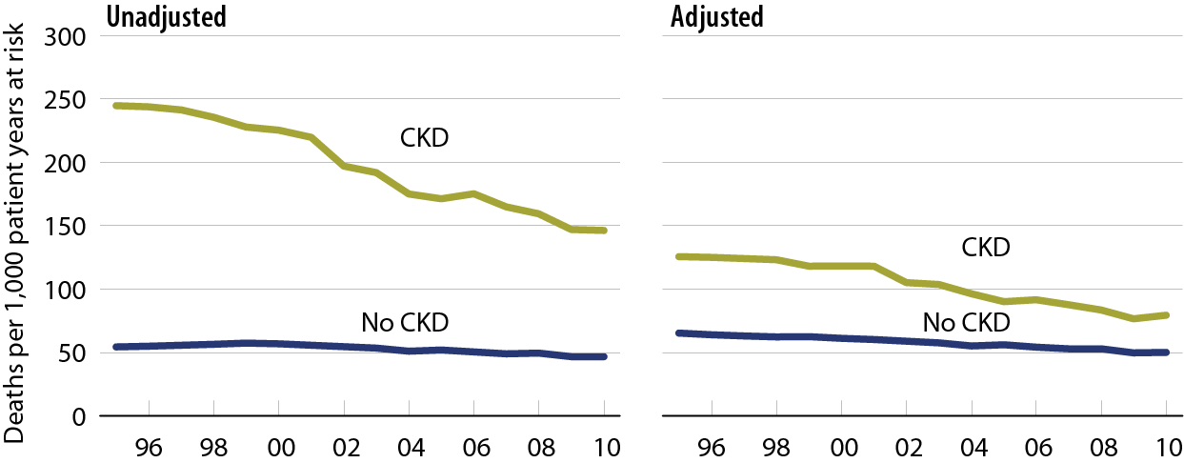
All-cause mortality rates in Medicare CKD & non-CKD patients Table 3.14 (volume 1)
January 1 point prevalent Medicare patients age 66 & older. Adj: age/gender/race/prior hospitalization/comorbidities. Ref: 2005 patients.

Slide 18
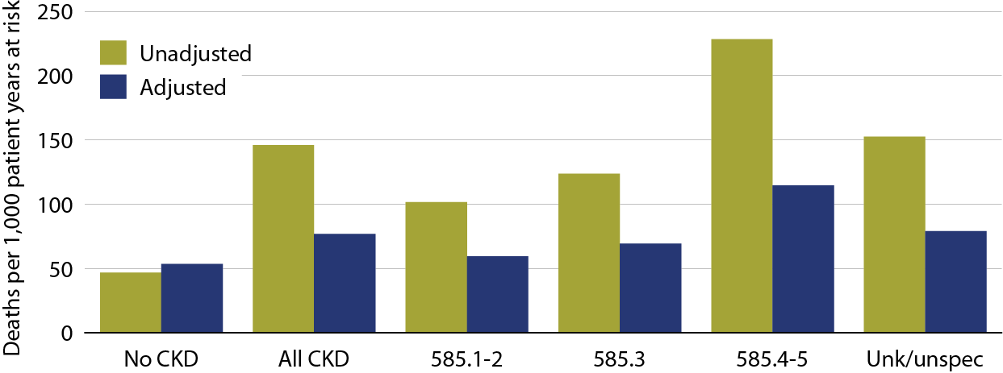
All-cause mortality rates in Medicare CKD & non-CKD patients, by CKD diagnosis code, 2010 Figure 3.15 (volume 1)
January 1, 2010 point prevalent patients age 66 & older. Adj: age/gender/race/prior hospitalization/comorbidities. Ref: 2010 patients.

Slide 19
Adjusted mortality rates (per 1,000 patient years at risk) in Medicare patients, by CKD diagnosis code, 2010 Table 3.c (volume 1)
January 1, 2010 point prevalent patients age 66 & older. Adj: age/gender/race/prior hospitalization/comorbidities. Ref: 2010 all patients.

Slide 20
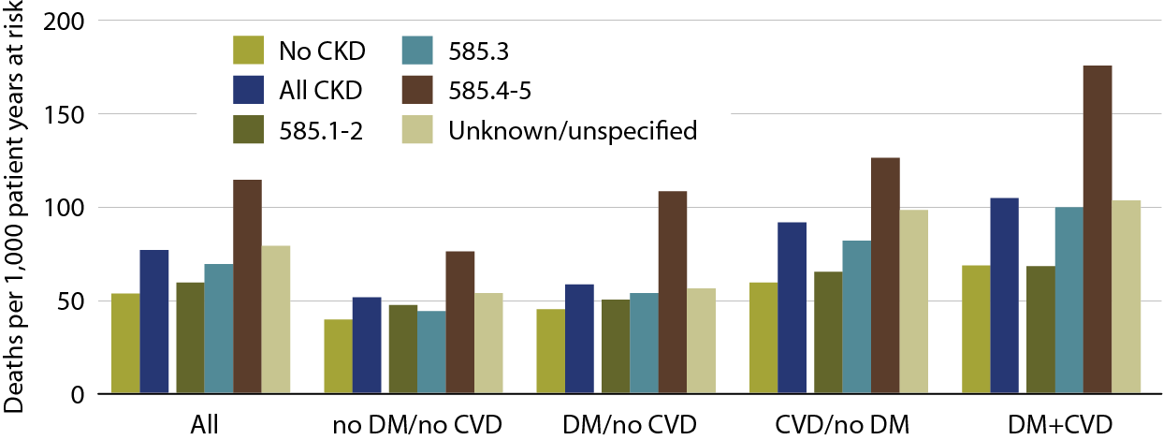
Adjusted mortality rates in Medicare patients, by comorbidity & CKD diagnosis code, 2010 Figure 3.16 (volume 1)
January 1, 2010 point prevalent patients age 66 & older. Adj: age/gender/race/prior hospitalization/comorbidities. Ref: 2010 all patients.

Slide 21
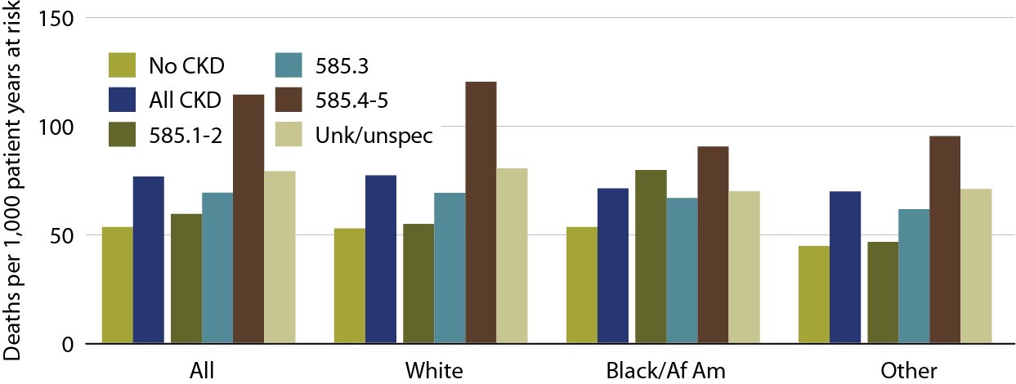
Adjusted mortality rates in Medicare patients, by race & CKD diagnosis code, 2010 Figure 3.17 (volume 1)
January 1, 2010 point prevalent patients age 66 & older. Adj: age/gender/prior hospitalization/comorbidities. Ref: 2010 all patients.

