Slide 1
CKD: Chapter 5
Part D prescription
drug coverage in
patients with CKD
United States Renal Data System
2012 Annual Data Report

Slide 2
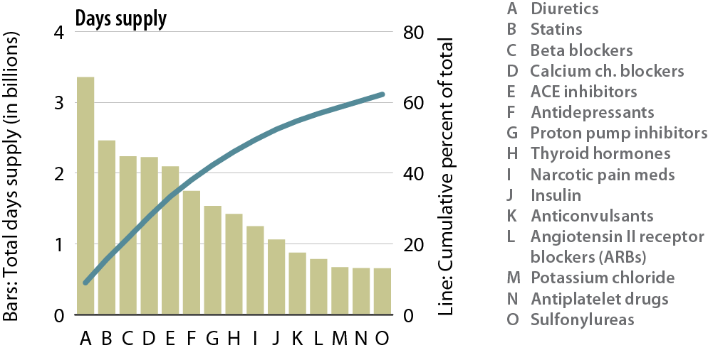
Top 15 drug classes used by general Medicare Part D enrollees with CKD, by days supply, 2010
Figure 5.1 (volume 1)
Part D claims for all patients in the Medicare 5 percent sample; claims & costs scaled up by a factor of 20 to estimate totals. Costs are the sum of Medicare payment & low income subsidy. Therapeutic classifications based on Medi-span’s generic product identifier (GPI) therapeutic classification system.

Slide 3
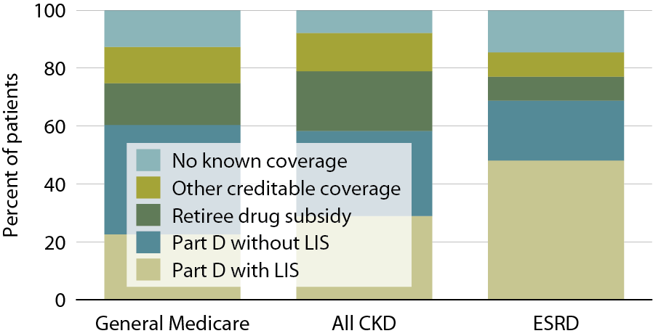
Sources of prescription drug coverage in Medicare enrollees, by population, 2010
Figure 5.2 (volume 1)
Point prevalent Medicare enrollees alive on January 1, 2010.

Slide 4
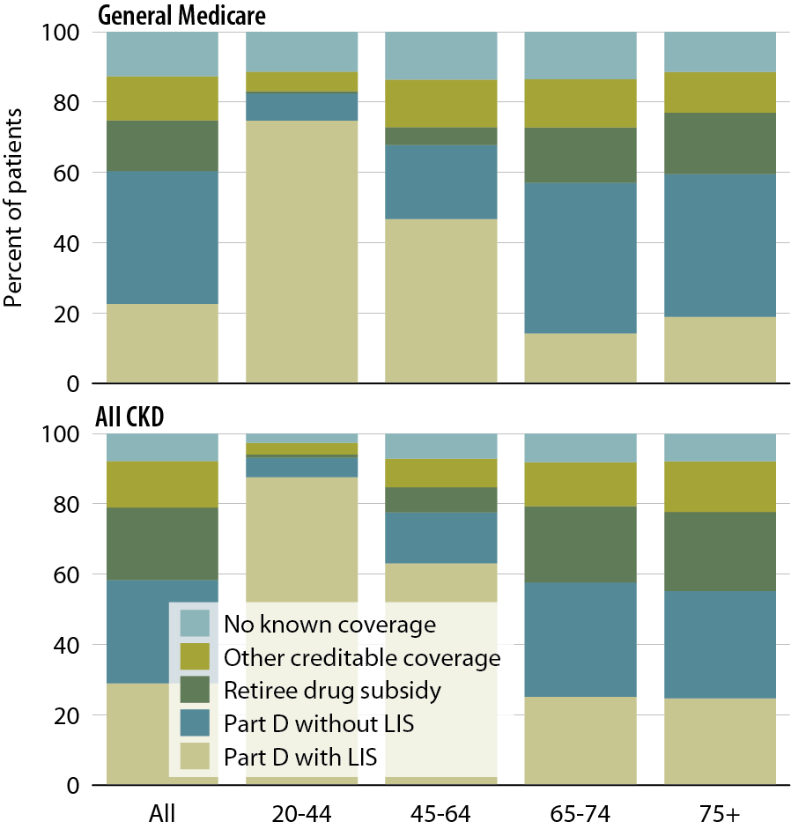
Sources of prescription drug coverage in Medicare enrollees, by age, 2010
Figure 5.3 (volume 1)
Point prevalent Medicare enrollees alive on January 1, 2010.

Slide 5
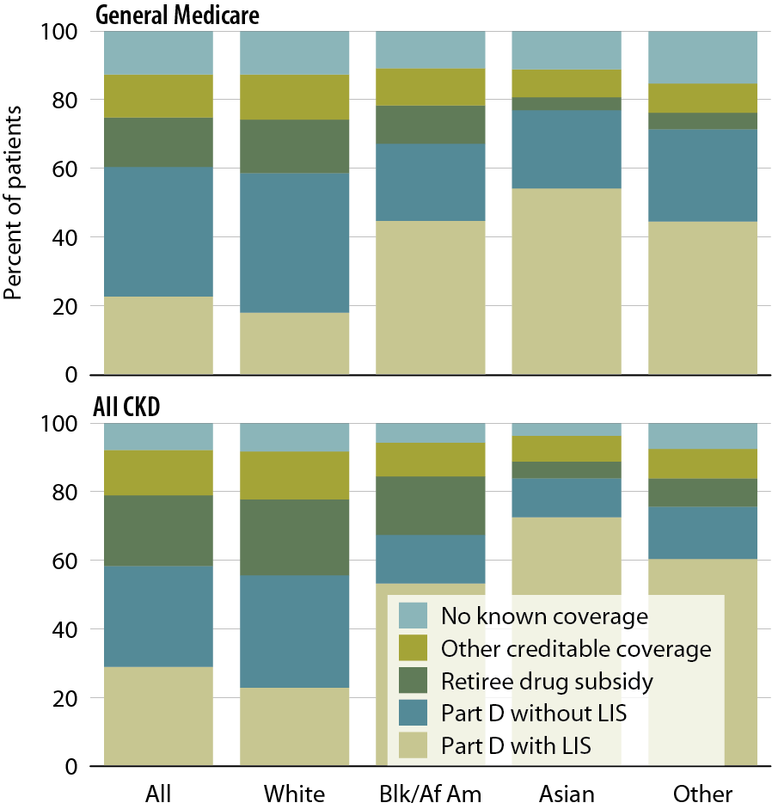
Sources of prescription drug coverage in Medicare enrollees, by race, 2010
Figure 5.4 (volume 1)
Point prevalent Medicare enrollees alive on January 1, 2010.

Slide 6
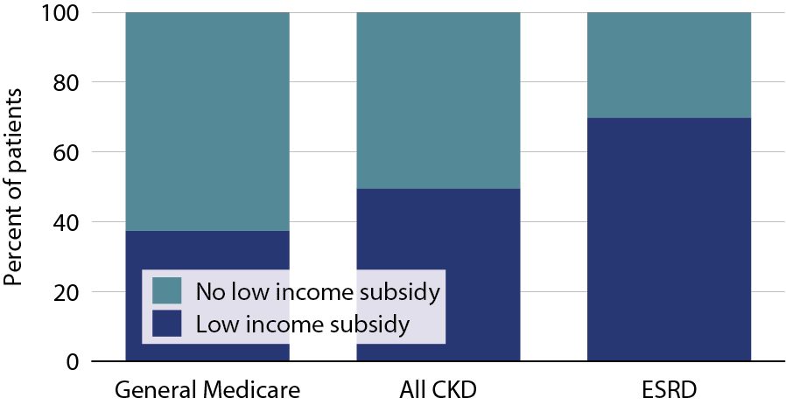
Part D enrollees, by low income subsidy (LIS) status & population, 2010
Figure 5.5 (volume 1)
Point prevalent Medicare enrollees alive on January 1, 2010.

Slide 7
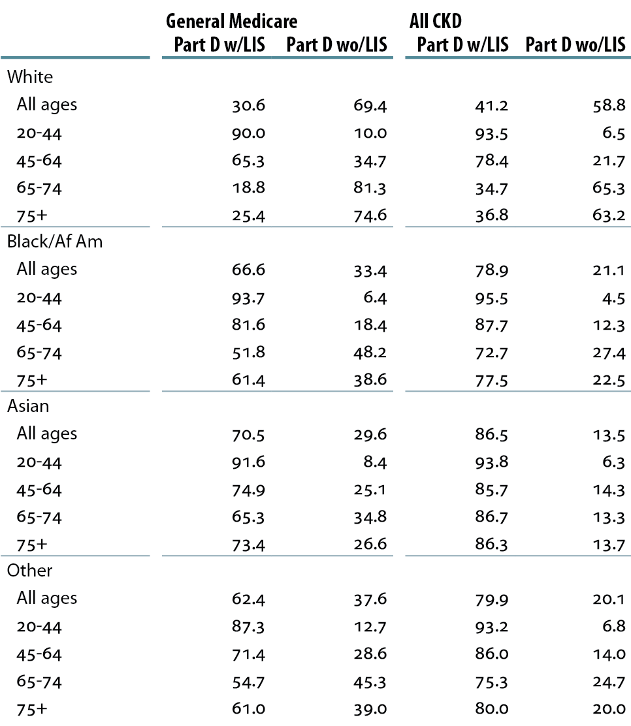
Percent of Part D enrollees with low income subsidy (LIS), by demographic characteristics, 2010
Table 5.a (volume 1)
Point prevalent Medicare enrollees alive on January 1, 2010.

Slide 8
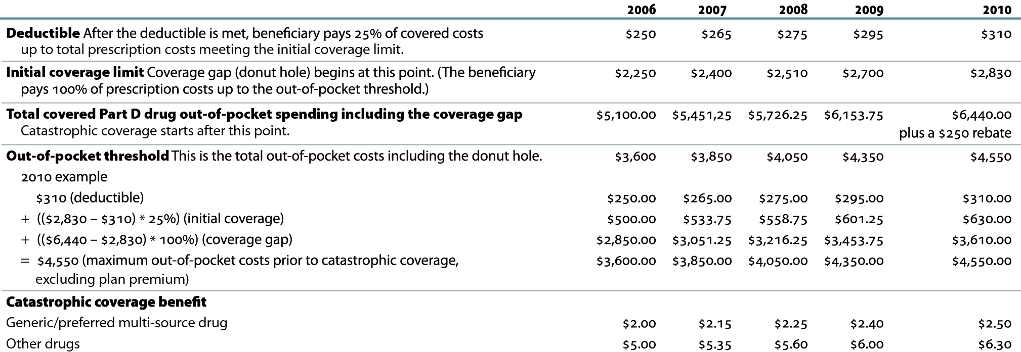
Part D benefit parameters, 2006–2010
Table 5.b (volume 1)
http://www.q1medicare.com/PartD-The-2010-Medicare-Part-D-Outlook.php.

Slide 9
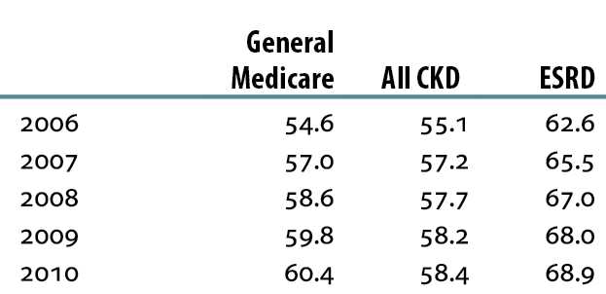
General Medicare, all CKD,
& ESRD patients enrolled in Part D
Table 5.c (volume 1)
Point prevalent Medicare enrollees alive on January 1, excluding those in Medicare Advantage Part D plans.

Slide 10
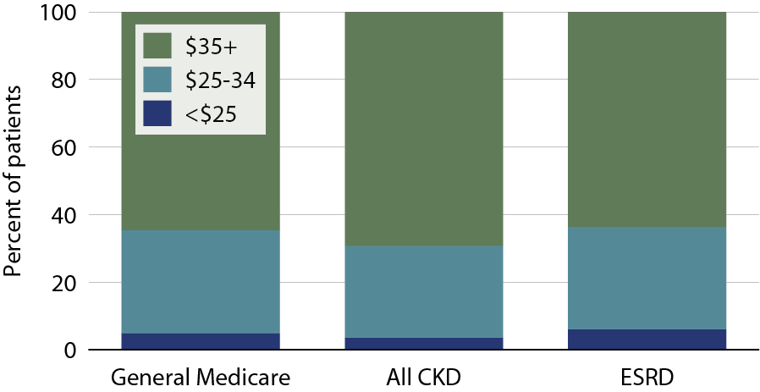
Part D non-LIS enrollees with specified monthly premium, 2010
Figure 5.6 (volume 1)
Point prevalent Medicare enrollees alive on January 1, excluding those in Medicare Advantage Part D plans.

Slide 11
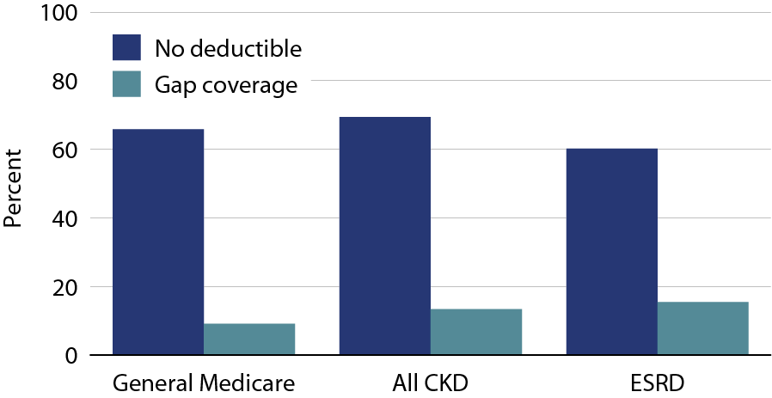
Part D non-LIS enrollees with gap coverage or no deductible, 2010
Figure 5.7 (volume 1)
Point prevalent Medicare enrollees alive on January 1, excluding those in Medicare Advantage Part D plans.

Slide 12
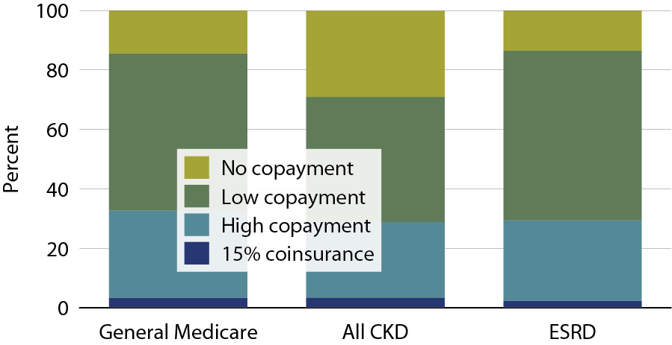
Part D LIS enrollees with specified co-insurance/copayment, 2010
Figure 5.8 (volume 1)
Point prevalent Medicare enrollees alive on January 1, excluding those in Medicare Advantage Part D plans.

Slide 13
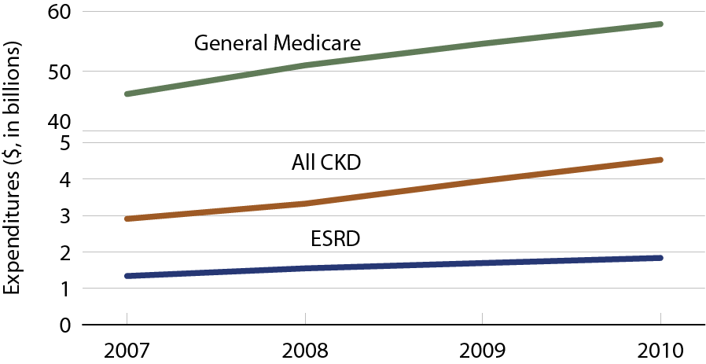
Net Part D payment for Medicare enrollees
Figure 5.9 (volume 1)
General Medicare totals include Part D claims for all patients in the Medicare 5 percent sample enrolled in Part D. CKD total includes Medicare CKD patients, as determined from claims. ESRD totals include all Part D claims for Medicare ESRD patients enrolled in Part D.

Slide 14
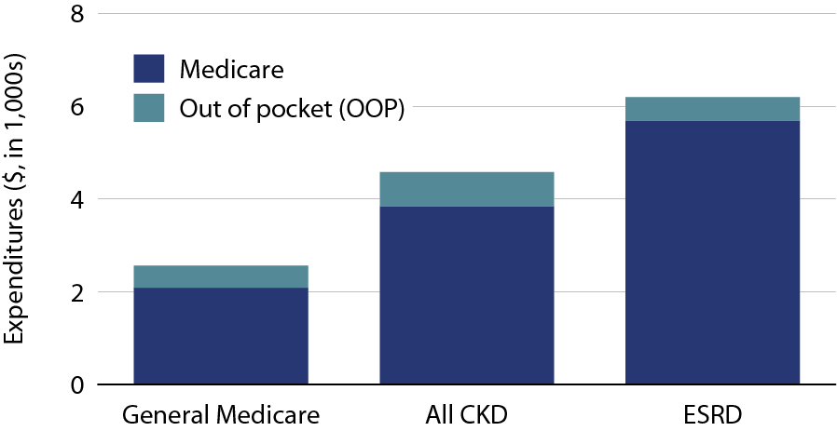
Per person per year Medicare & out-of-pocket Part D costs for enrollees, 2010
Figure 5.10 (volume 1)
General Medicare totals include Part D claims for all patients in the Medicare 5 percent sample enrolled in Part D. CKD totals includes Medicare CKD patients, as determined from claims. ESRD totals include all Part D claims for Medicare ESRD patients enrolled in Part D. Medicare total is the sum of Medicare net payment plus LIS amount.

Slide 15
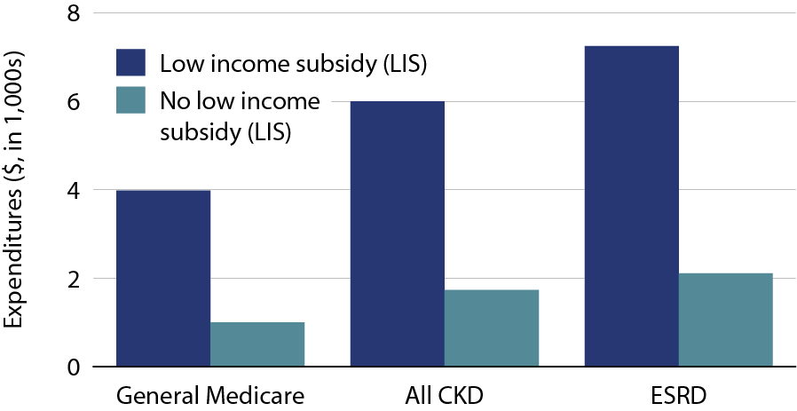
Per person per year Part D costs for enrollees, by low income subsidy (LIS) status, 2010
Figure 5.11 (volume 1)
Medicare patients surviving 2010. General Medicare totals include Part D claims for all patients in the Medicare 5 percent sample enrolled in Part D. CKD total includes Medicare CKD patients, as determined from claims. ESRD totals include all Part D claims for Medicare ESRD patients enrolled in Part D.

Slide 16
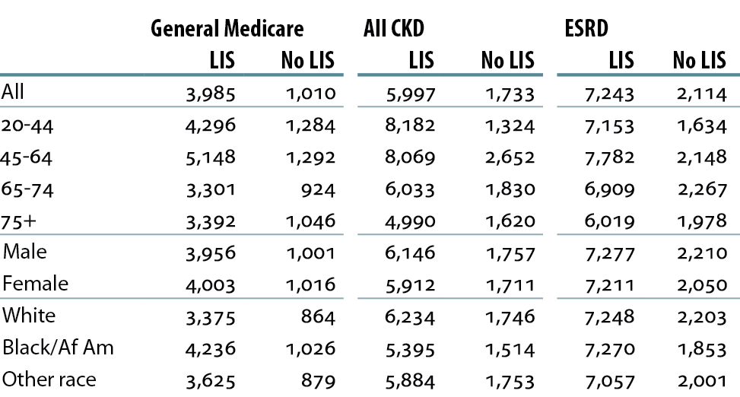
Total per person per year costs ($) for Part D enrollees, by LIS status, 2010
Table 5.d (volume 1)
All Medicare patients enrolled in Part D in 2010. CKD determined from claims. ESRD patients are period prevalent ESRD in 2010.

Slide 17
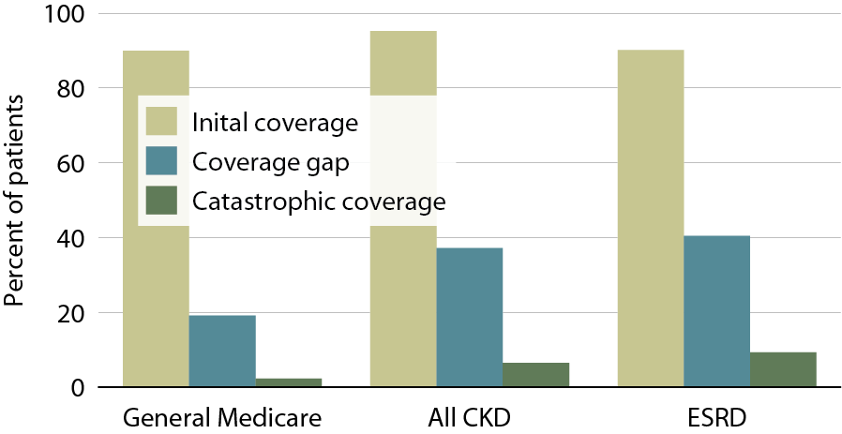
Part D non-LIS enrollees who reach each coverage phase, 2010
Figure 5.12 (volume 1)
Point prevalent Medicare enrollees alive on January 1, excluding those in employer-sponsored & national PACE Part D plans.

Slide 18
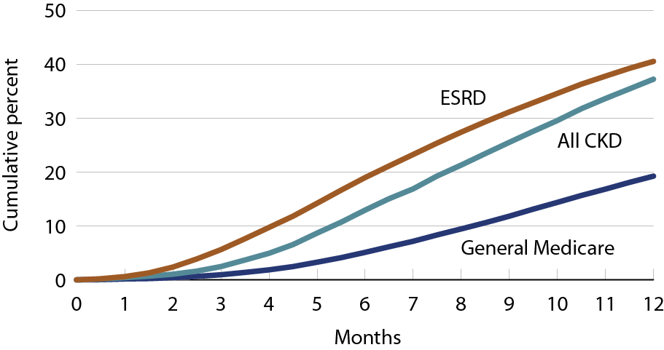
Cumulative percent of Part D non-LIS enrollees who reach the coverage gap, 2010
Figure 5.13 (volume 1)
Point prevalent Medicare enrollees alive on January 1, excluding those in employer-sponsored & national PACE Part D plans.

Slide 19
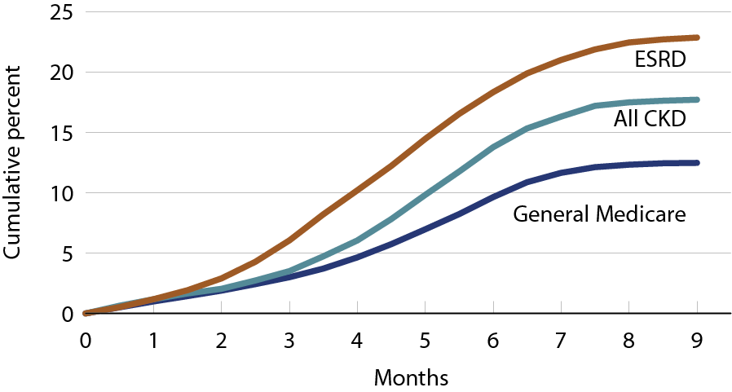
Cumulative percent of Part D non-LIS enrollees who reach catastrophic coverage after reaching the coverage gap, 2010
Figure 5.14 (volume 1)
Point prevalent Medicare enrollees alive on January 1, excluding those in employer-sponsored & national PACE Part D plans.

Slide 20
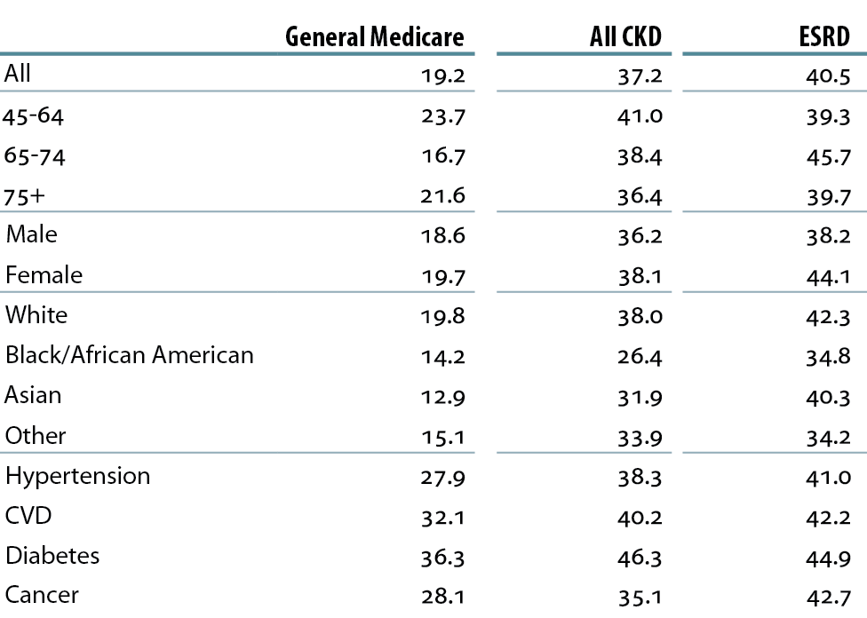
Twelve-month probability of reaching the coverage gap in Part D non-LIS enrollees, 2010
Table 5.e (volume 1)
Point prevalent Medicare enrollees alive on January 1, excluding those in employer-sponsored & national PACE Part D plans.

Slide 21
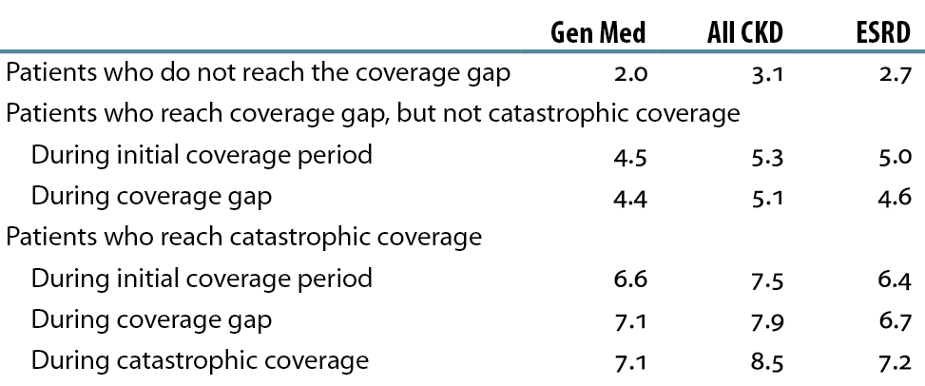
Rate of Part D-covered prescription fills PPPM in Part D non-LIS enrollees, 2010
Table 5.f (volume 1)
Point prevalent Medicare enrollees alive on January 1, excluding those in employer-sponsored & national PACE Part D plans.

Slide 22
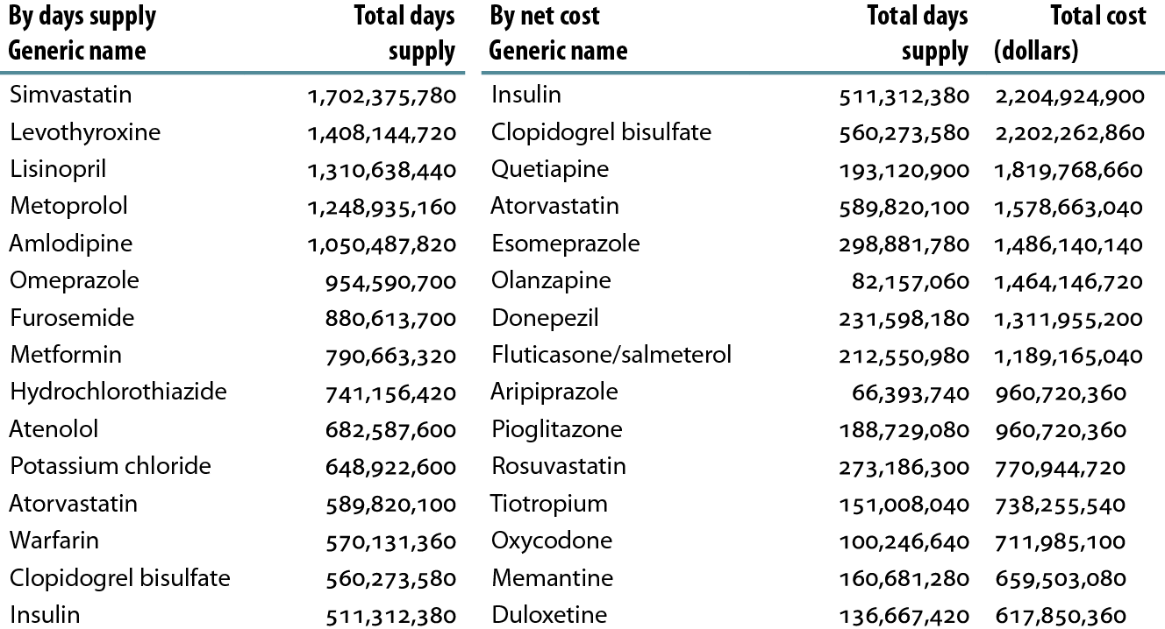
Top 15 drugs used in Part D enrollees, by days supply & net cost, 2010
Table 5.g (volume 1)
Part D claims for all patients in the Medicare 5 percent sample, (claims & costs scaled up by a factor of 20 to estimate totals). Costs are the sum of Medicare payment & low income subsidy

Slide 23
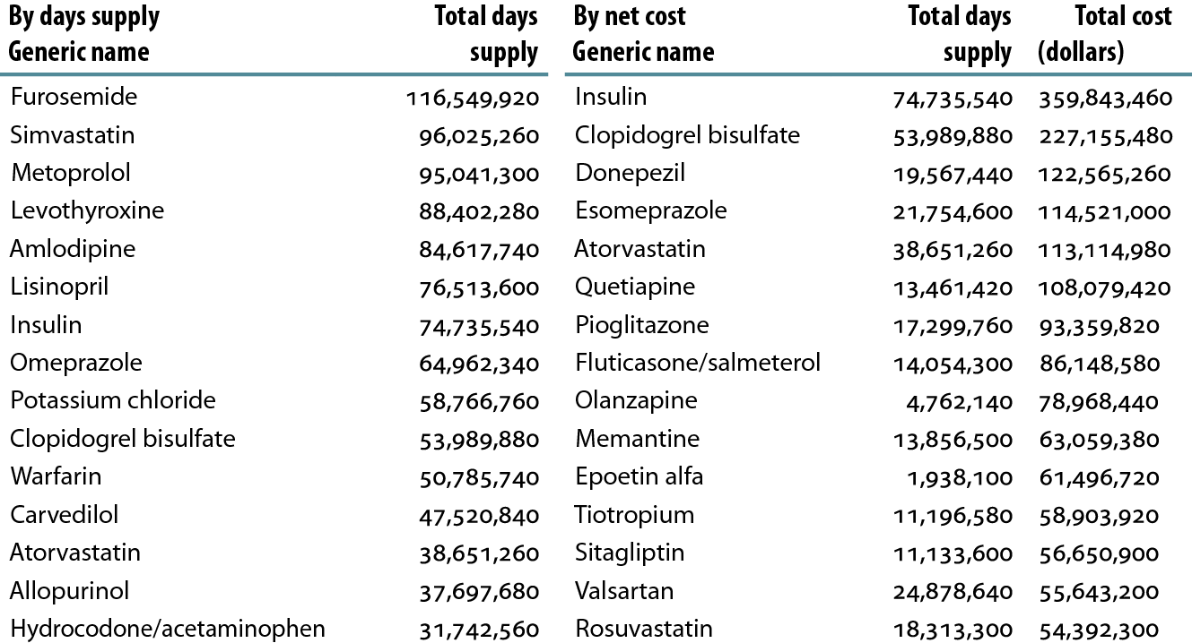
Top 15 drugs used in Part D enrollees with CKD, by days supply & net cost, 2010
Table 5.h (volume 1)
CKD Medicare patients with Medicare as primary payor for calendar year 2009. Part D claims for all patients in the Medicare 5 percent sample; claims & costs scaled up by a factor of 20 to estimate totals. Costs are the sum of Medicare payment & low income subsidy.

Slide 24
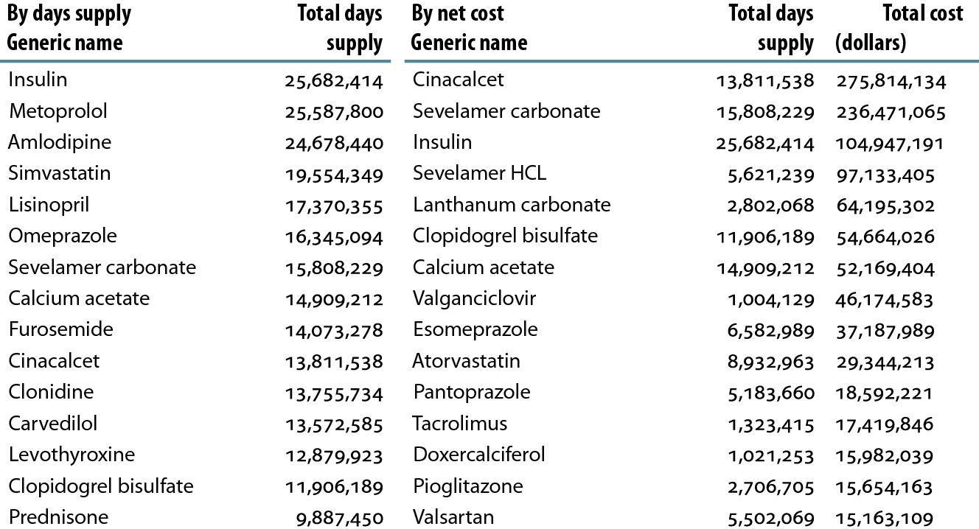
Top 15 drugs used in Part D enrollees with ESRD, by days supply & net cost, 2010
Table 5.i (volume 1)
Part D claims for all ESRD patients in the Medicare 5 percent sample; claims & costs scaled up by a factor of 20 to estimate totals. Costs are the sum of Medicare payment & low income subsidy.

Slide 25
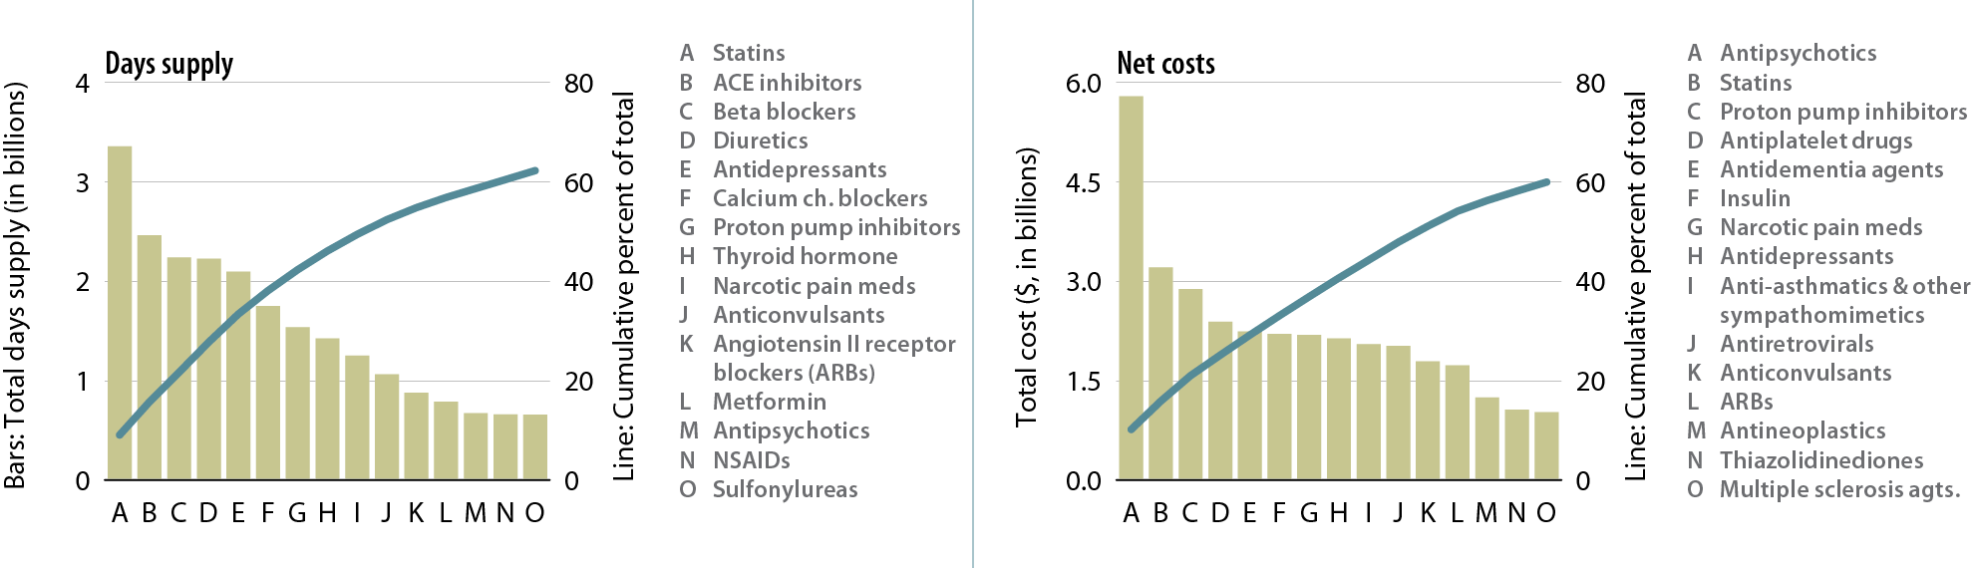
Top 15 drug classes used by Part D enrollees with CKD, by days supply & net costs, 2010
Figure 5.15 (volume 1)
Part D claims for all patients in the Medicare 5 percent sample; claims & costs scaled up by a factor of 20 to estimate totals. Costs are the sum of Medicare payment & low income subsidy. Therapeutic classification based on Medi-Span’s generic product identifier (GPI) therapeutic classification system.

Slide 26
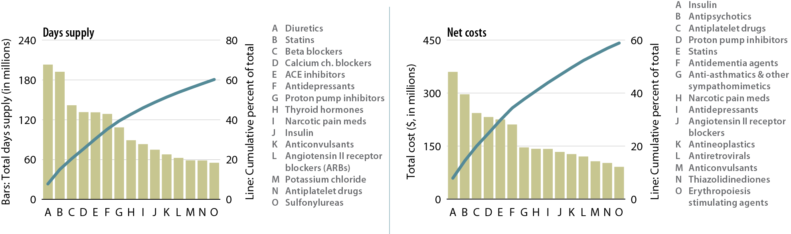
Top 15 drug classes used by Part D enrollees with CKD, by days supply & net costs, 2010
Figure 5.16 (volume 1)
Part D claims for CKD Medicare patients with Medicare as primary payor for calendar year 2009; claims & costs scaled up by a factor of 20 to estimate totals. Costs are the sum of Medicare payment & low income subsidy. Therapeutic classification based on Medi-Span’s generic product identifier (GPI) therapeutic classification system.

Slide 27
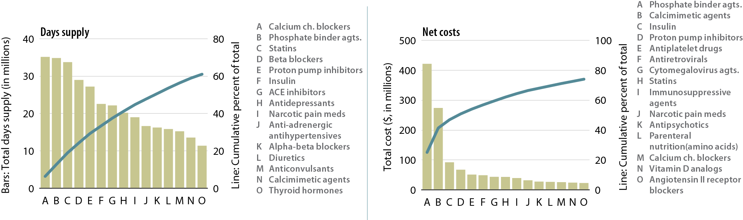
Top 15 drug classes used by Part D enrollees with ESRD, by days supply & net costs, 2010
Figure 5.17 (volume 1)
Part D claims for all ESRD patients in the Medicare 5 percent sample; claims & costs scaled up by a factor of 20 to estimate totals. Costs are the sum of Medicare payment & low income subsidy. Therapeutic classification based on Medi-Span’s generic product identifier (GPI) therapeutic classification system.

