Slide 1
CKD: Chapter Seven
Costs of chronic kidney disease
United States Renal Data System
2012 Annual Data Report

Slide 2
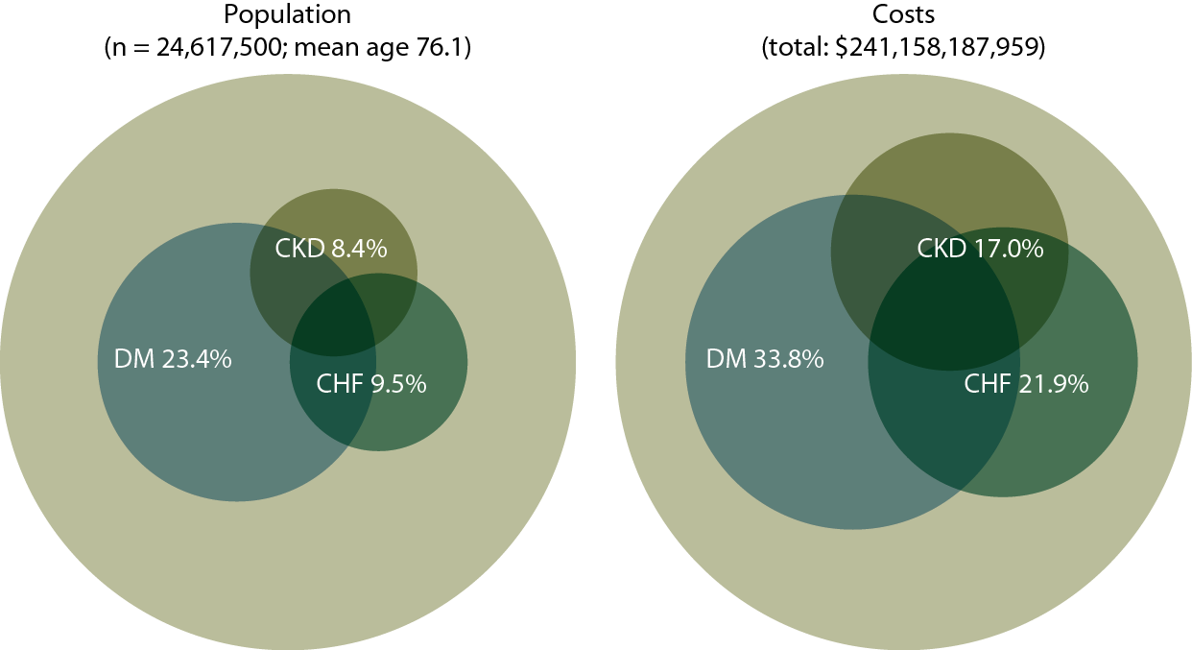
Point prevalent distribution & annual costs of Medicare
(fee-for-service) patients, age 65 & older, with diagnosed diabetes, CHF, & CKD, 2010
Figure 7.1 (volume 1)
Populations estimated from the 5 percent Medicare sample using a point prevalent model (see appendix for details). Population further restricted to patients age 65 & older, without ESRD. Diabetes, CHF, & CKD determined from claims; costs are for calendar year 2010.

Slide 3
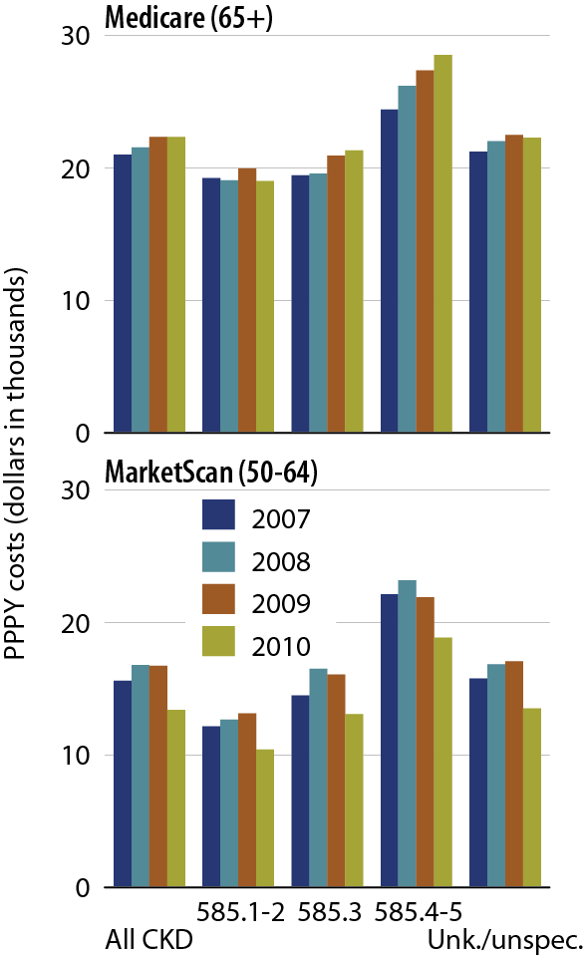
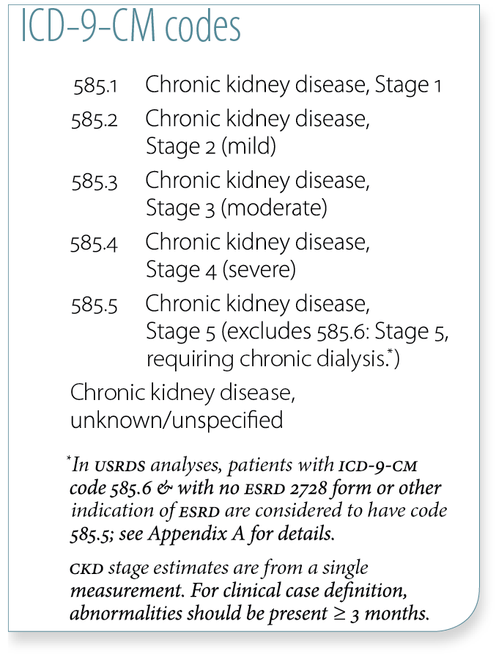
Overall PPPY costs in CKD patients, by CKD diagnosis code, dataset, & year
Figure 7.2 (volume 1)
Point prevalent Medicare patients age 65 & older (5 percent Medicare sample, 7.2–4) & MarketScan patients age 50–64 (7.2). Includes Part D.

Slide 4
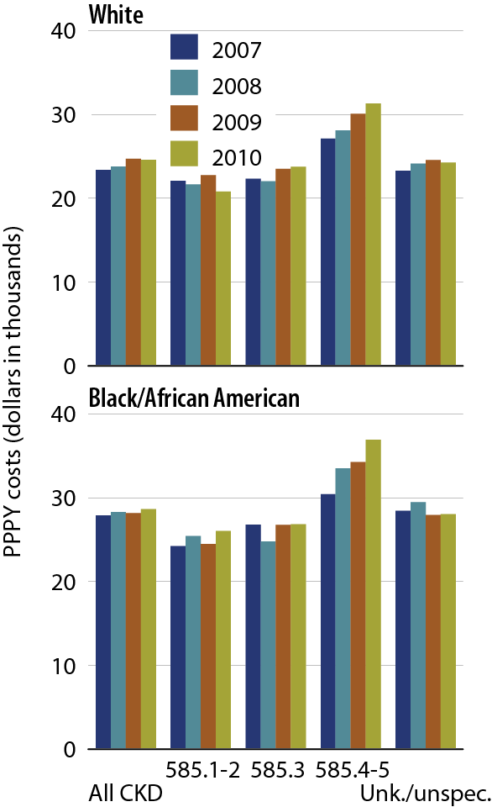
PPPY costs in Medicare CKD patients with diabetes, by CKD diagnosis code, race, & year
Figure 7.3 (volume 1)
Point prevalent Medicare patients age 65 & older (5 percent Medicare sample, 7.2–4) & MarketScan patients age 50–64 (7.2). Includes Part D.

Slide 5
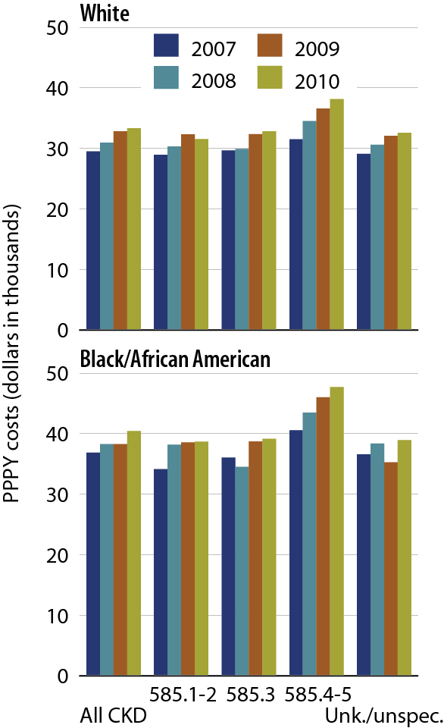
PPPY costs in Medicare CKD patients with CHF, by CKD diagnosis code, race, & year
Figure 7.4 (volume 1)
Point prevalent Medicare patients age 65 & older (5 percent Medicare sample, 7.2–4) & MarketScan patients age 50–64 (7.2). Includes Part D.

Slide 6
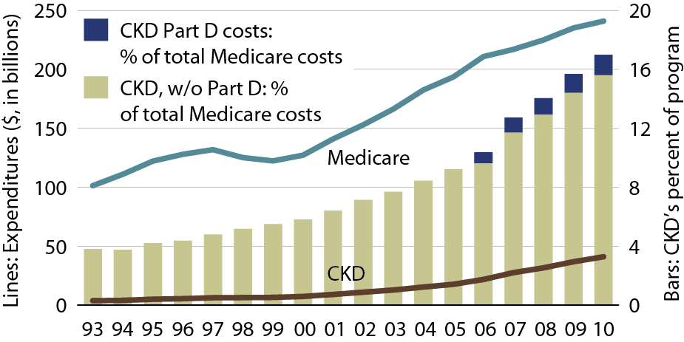
Overall expenditures for CKD in the Medicare population
Figure 7.5 (volume 1)
Point prevalent Medicare CKD patients age 65 & older.

Slide 7
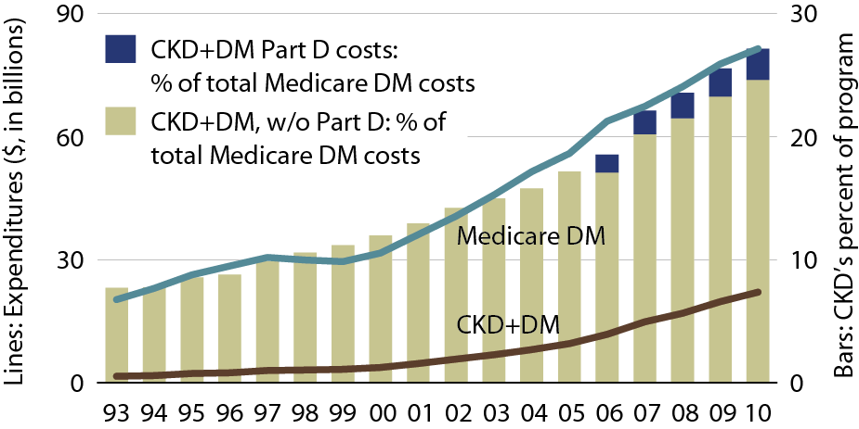
Overall expenditures for CKD
& diabetes in the Medicare population
Figure 7.6 (volume 1)
Point prevalent Medicare CKD patients age 65 & older.

Slide 8
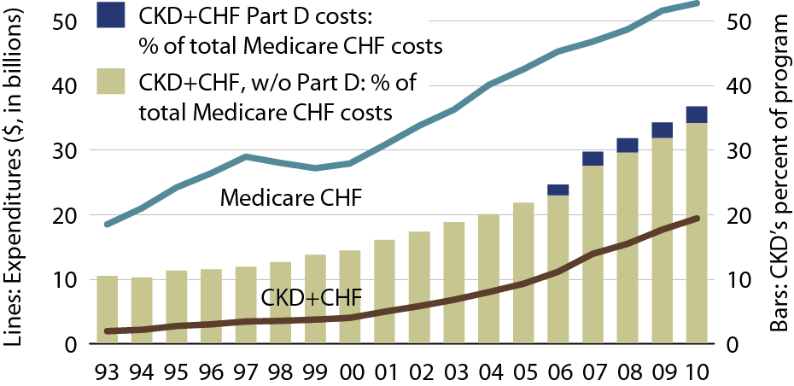
Overall expenditures for CKD & congestive heart failure in the Medicare population
Figure 7.7 (volume 1)
Point prevalent Medicare CKD patients age 65 & older.

Slide 9
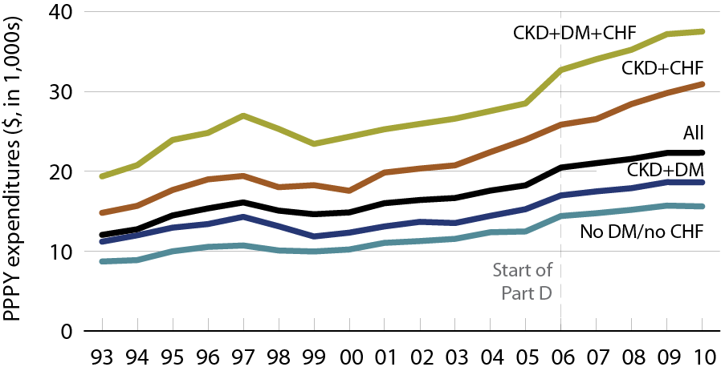
Per person per year expenditures for CKD in the Medicare population, by at-risk group
Figure 7.8 (volume 1)
Point prevalent Medicare CKD patients age 65 & older. Includes Part D.

Slide 10
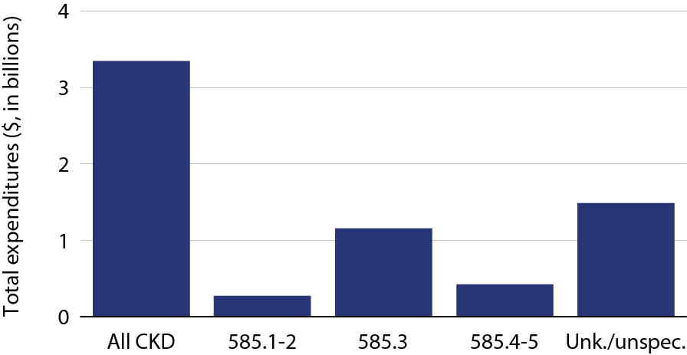
Total Part D costs, by
CKD diagnosis code, 2010
Table 7.9 (volume 1)
Includes Part D claims for all CKD patients, defined from claims on a point prevalent basis, for calendar year 2010. Costs are estimated net pay: sum of plan covered payments & low income subsidy amounts. Counts & costs obtained from 5 percent Medicare sample, & scaled up by a factor of 20 to estimate total Medicare CKD costs.

Slide 11
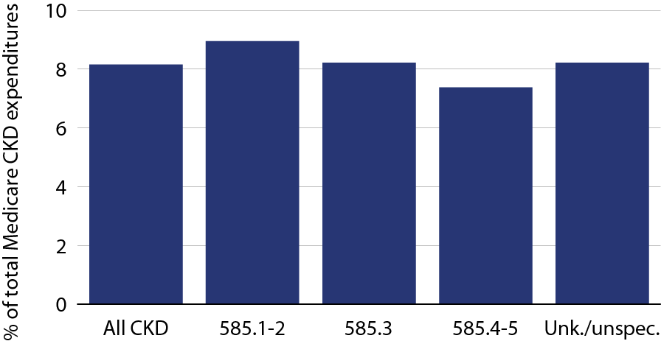
Part D cost in patients with CKD as a proportion of total Medicare CKD expenditures, by CKD diagnosis code, 2010
Figure 7.10 (volume 1)
Includes Part D claims for all CKD patients, defined from claims on a point prevalent basis, for calendar year 2010. Costs are estimated net pay: sum of plan covered payments & low income subsidy amounts. Counts & costs obtained from 5 percent Medicare sample, & scaled up by a factor of 20 to estimate total Medicare CKD costs.

Slide 12
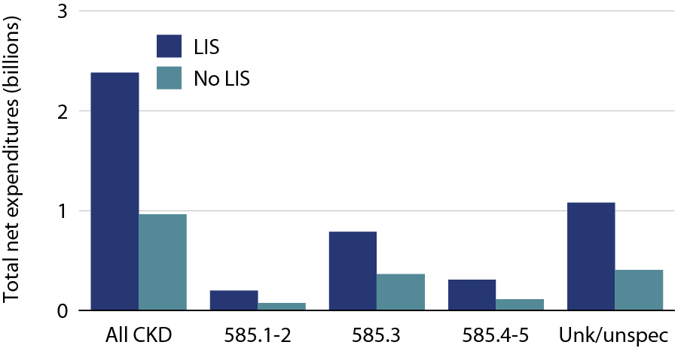
Total Part D CKD net costs in patients with
CKD, by low income subsidy (LIS) status &
CKD diagnosis code, 2010
Figure 7.11 (volume 1)
Includes Part D claims for all CKD patients, defined from claims on a point prevalent basis, for calendar year 2010. Costs are estimated net pay: sum of plan covered payments & low income subsidy amounts. Counts & costs obtained from 5 percent Medicare sample, & scaled up by a factor of 20 to estimate total Medicare CKD costs.

Slide 13
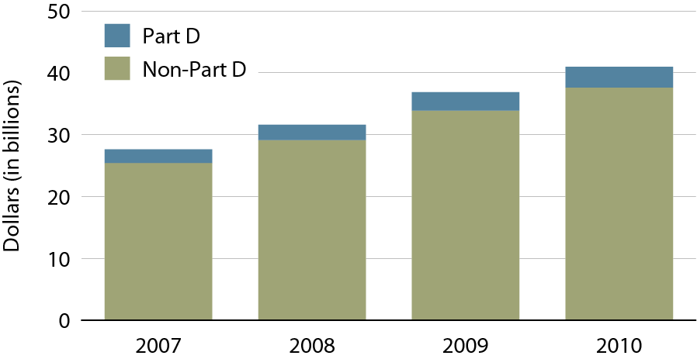
Overall Medicare Part D & non-Part D costs in patients with CKD, by year
Figure 7.12 (volume 1)
Point prevalent Medicare CKD patients age 65 & older.

Slide 14
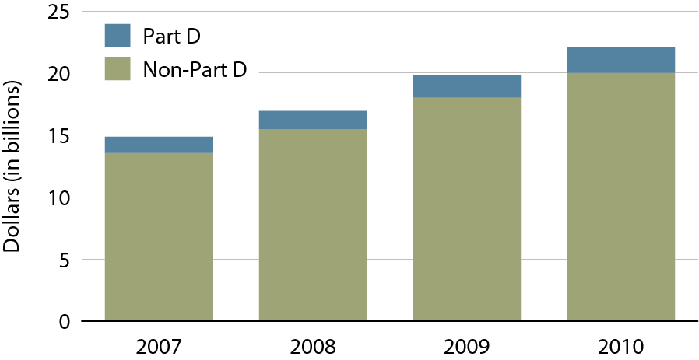
Overall Medicare Part D & non-Part D costs in patients with CKD & diabetes, by year
Figure 7.13 (volume 1)
Point prevalent Medicare CKD patients age 65 & older.

Slide 15
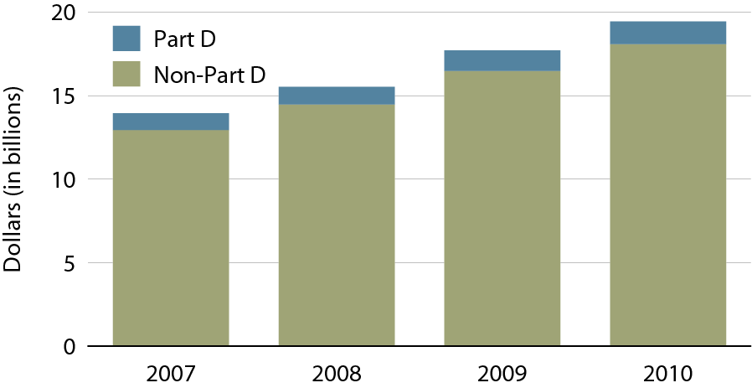
Overall Medicare Part D & non-Part D costs in patients with CKD & CHF, by year
Figure 7.14 (volume 1)
Point prevalent Medicare CKD patients age 65 & older.

Slide 16
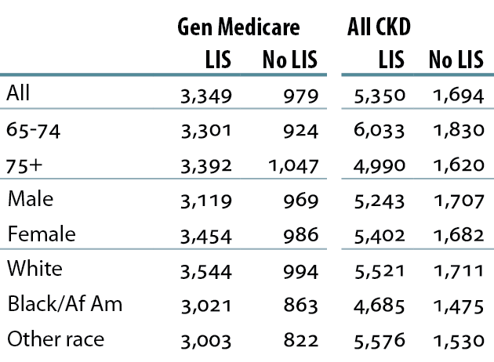
Total per person per year (PPPY) Medicare Part D costs ($) for Medicare Part D enrollees, by LIS subsidy status, 2010
Table 7.a (volume 1)
Point prevalent Medicare CKD patients age 65 & older, 2010.

Slide 17
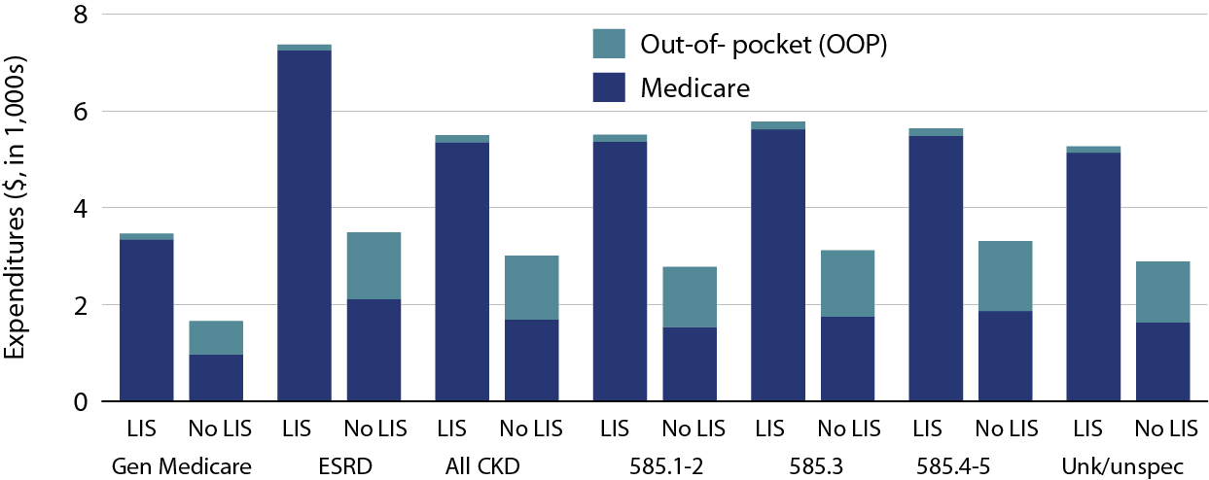
Per person per year (PPPY) Part D costs for Part D enrollees, by low income subsidy (LIS) status, 2010
Figure 7.15 (volume 1)
Point prevalent Medicare CKD patients age 65 & older, 2010.

Slide 18
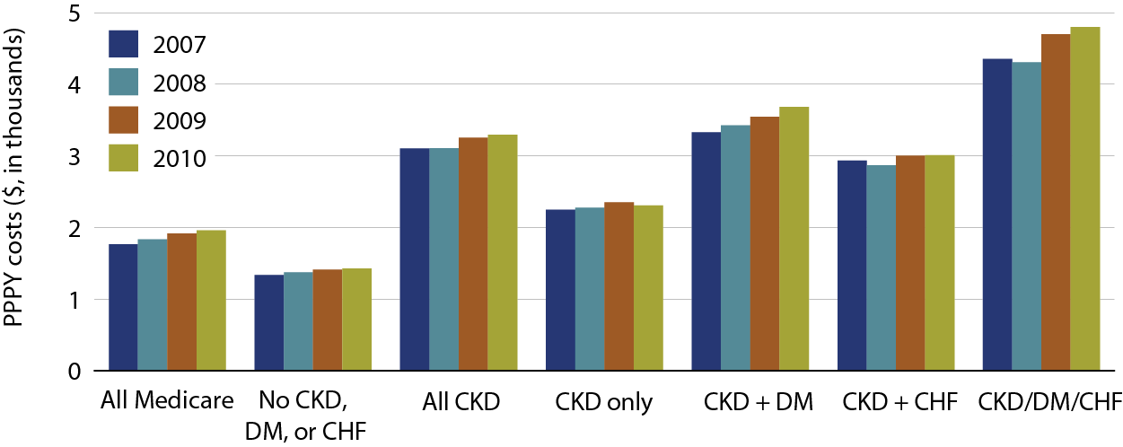
Overall per person per year (PPPY) Part D costs for Part D enrollees, by race & at-risk group, 2010
Figure 7.16 (volume 1)
Point prevalent Medicare CKD patients age 65 & older, 2010.

Slide 19
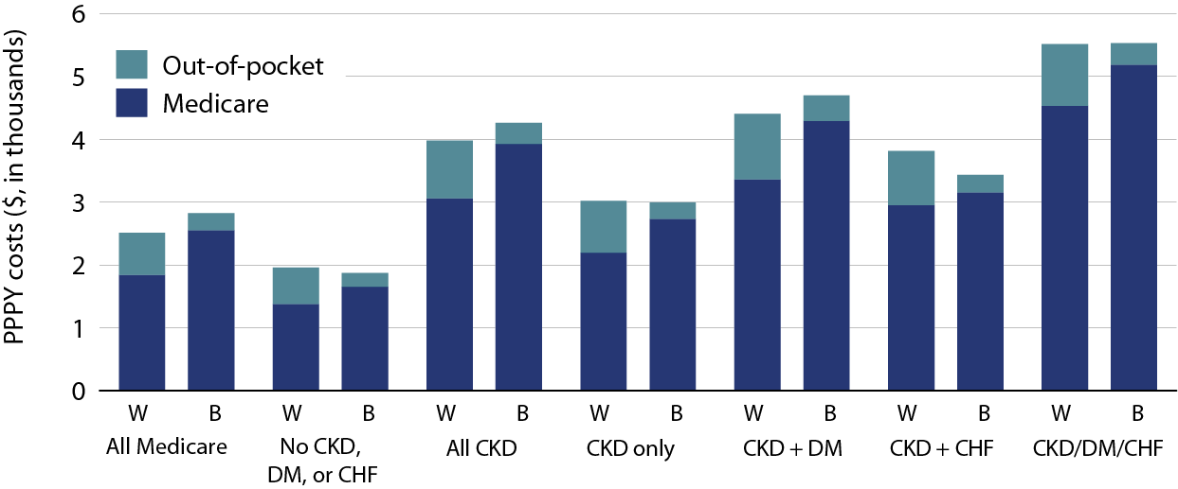
Overall PPPY Medicare Part D costs, by race & at-risk group, 2010
Figure 7.17 (volume 1)
Point prevalent Medicare CKD patients age 65 & older, 2010.

Slide 20
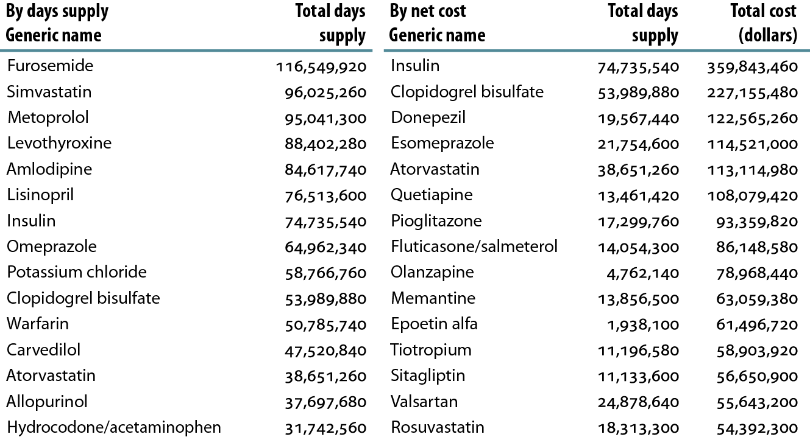
Top 15 drugs used in Part D enrollees with CKD, by days supply & net cost, 2010
Table 7.b (volume 1)
Point prevalent Medicare CKD patients age 65 & older, 2010.

Slide 21
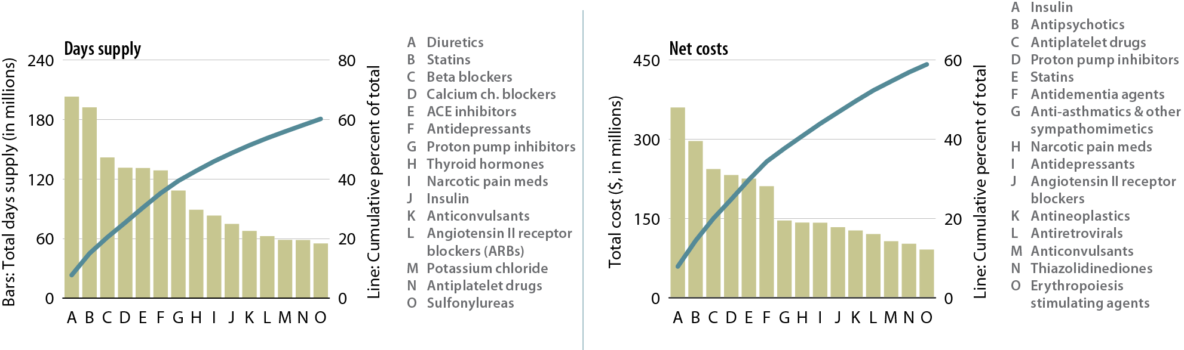
Top 15 drug classes used by Part D-enrollees with CKD, by days supply & drug class, 2010
Figure 7.18 (volume 1)
Point prevalent Medicare CKD patients age 65 & older.

