Slide 1
CKD: Precis An introduction to chronic kidney disease in the U.S.
United States Renal Data System
2012 Annual Data Report

Slide 2
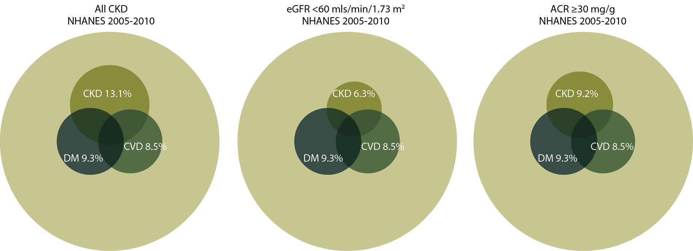
Distribution of NHANES participants with diabetes, congestive heart failure, & markers of CKD, 2005–2010 Figure 1.1 (volume 1)
NHANES participants 2005–2010, age 20 & older; eGFR calculated using CKD-EPI equation; urine albumin creatinine ratio (ACR).

Slide 3
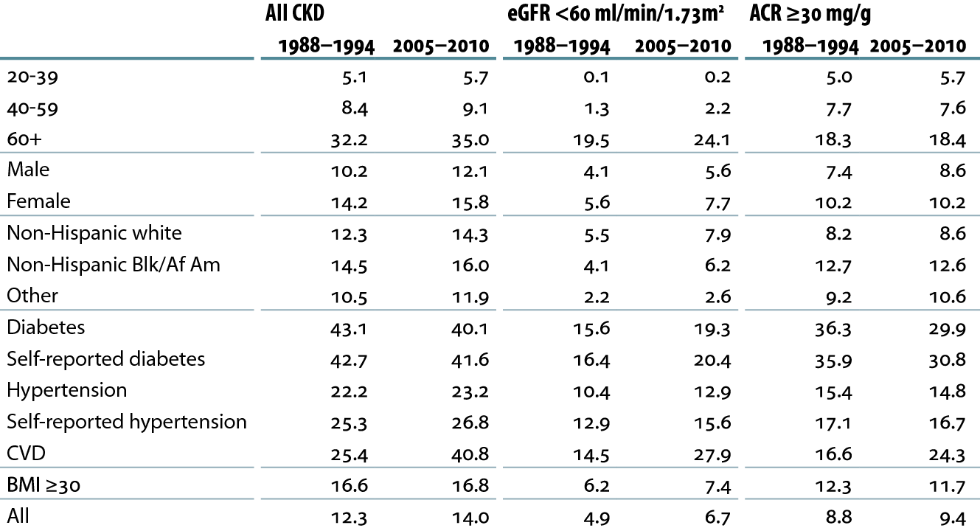
Prevalence (%) of CKD in the NHANES population within age, gender, race/ethnicity, & risk-factor categories Table 1.a (volume 1)
NHANES III (1988–1994) & 2005–2010 participants age 20 & older; eGFR calculated using CKD-EPI equation; urine albumin creatinine ratio (ACR).

Slide 4
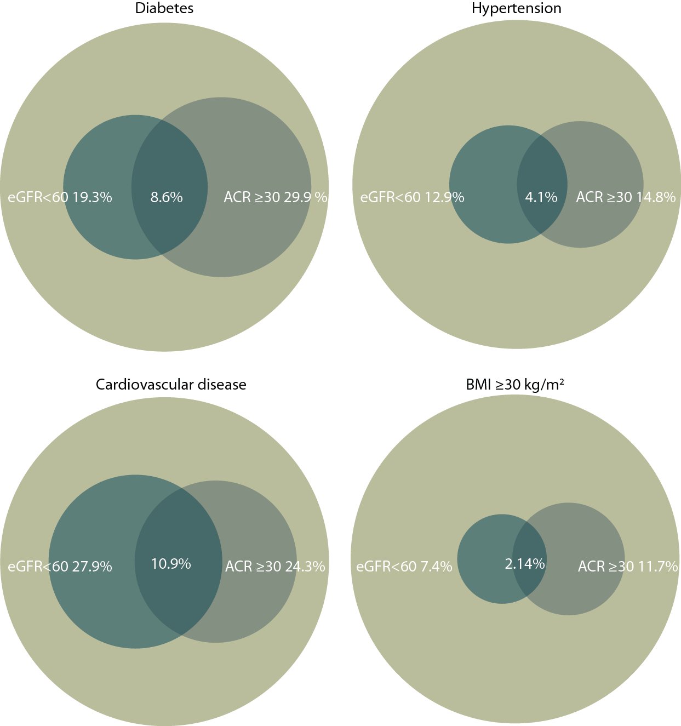
Distribution of markers of CKD in NHANES participants with diabetes & hypertension, 2005–2010 Figure 1.11 (volume 1)
NHANES III (1988–1994) & 2005–2010 participants age 20 & older; eGFR calculated using CKD-EPI equation; urine albumin creatinine ratio (ACR).

Slide 5
Distribution of markers of CKD in NHANES participants with cardiovascular disease & obesity, 2005–2010 Figure 1.11 (continued, volume 1)
NHANES III (1988–1994) & 2005–2010 participants age 20 & older; eGFR calculated using CKD-EPI equation; urine albumin creatinine ratio (ACR).

Slide 6
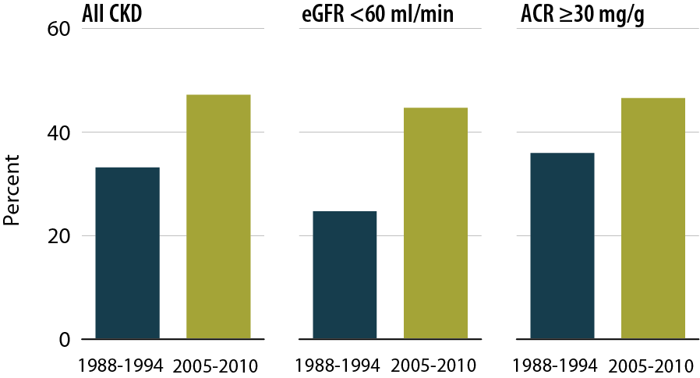
NHANES participants at target blood pressure Figure 1.12 (volume 1)
NHANES III (1988–1994) & 2005–2010 participants age 20 & older; dialysis patients excluded from NHANES 2005–2010; eGFR calculated using CKD-EPI equation; urine albumin creatinine ratio (ACR).

Slide 7
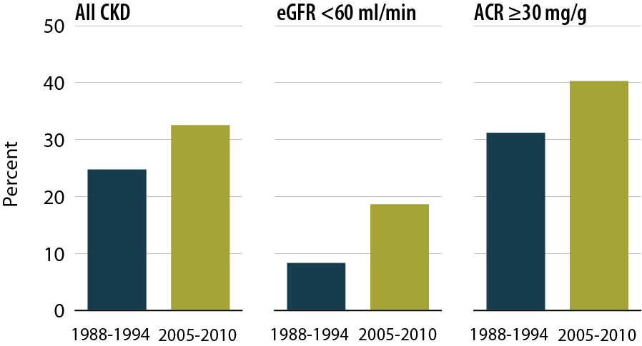
NHANES participants within LDL cholesterol target range Figure 1.13 (volume 1)
NHANES III (1988–1994) & 2005–2010 participants age 20 & older; dialysis patients excluded from NHANES 2005–2010; eGFR calculated using CKD-EPI equation; urine albumin creatinine ratio (ACR).

Slide 8
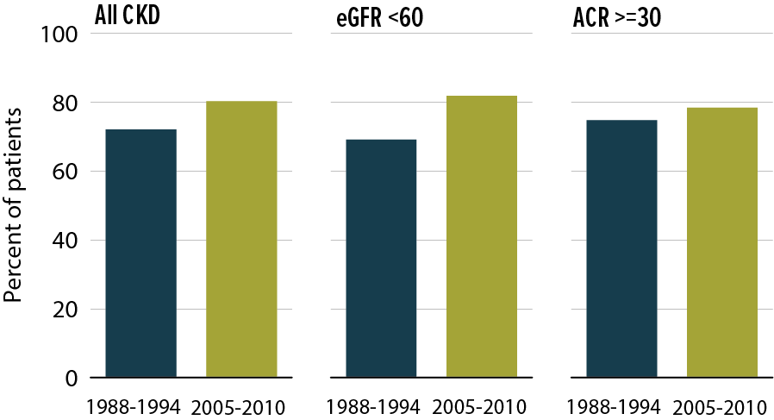
NHANES participants within HDL cholesterol target range Figure 1.14 (volume 1)
NHANES III (1988–1994) & 2005–2010 participants age 20 & older; dialysis patients excluded from NHANES 2005–2010; eGFR calculated using CKD-EPI equation; urine albumin creatinine ratio (ACR).

Slide 9
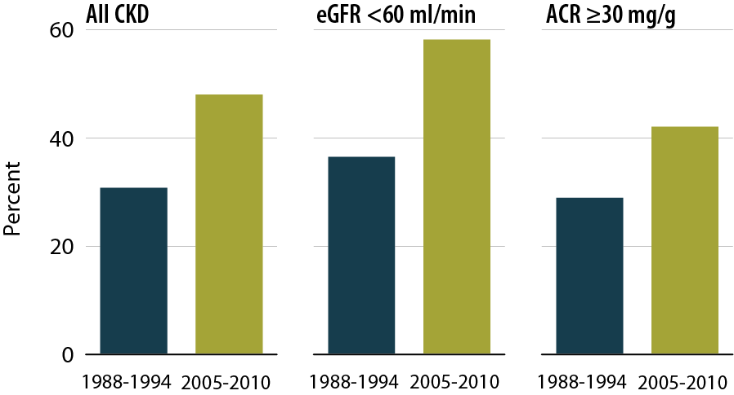
Percent of NHANES participants with glycohemoglobin <7% Figure 1.15 (volume 1)
NHANES III (1988–1994) & 2005–2010 participants age 20 & older; dialysis patients excluded from NHANES 2005–2010; eGFR calculated using CKD-EPI equation; urine albumin creatinine ratio (ACR).

Slide 10
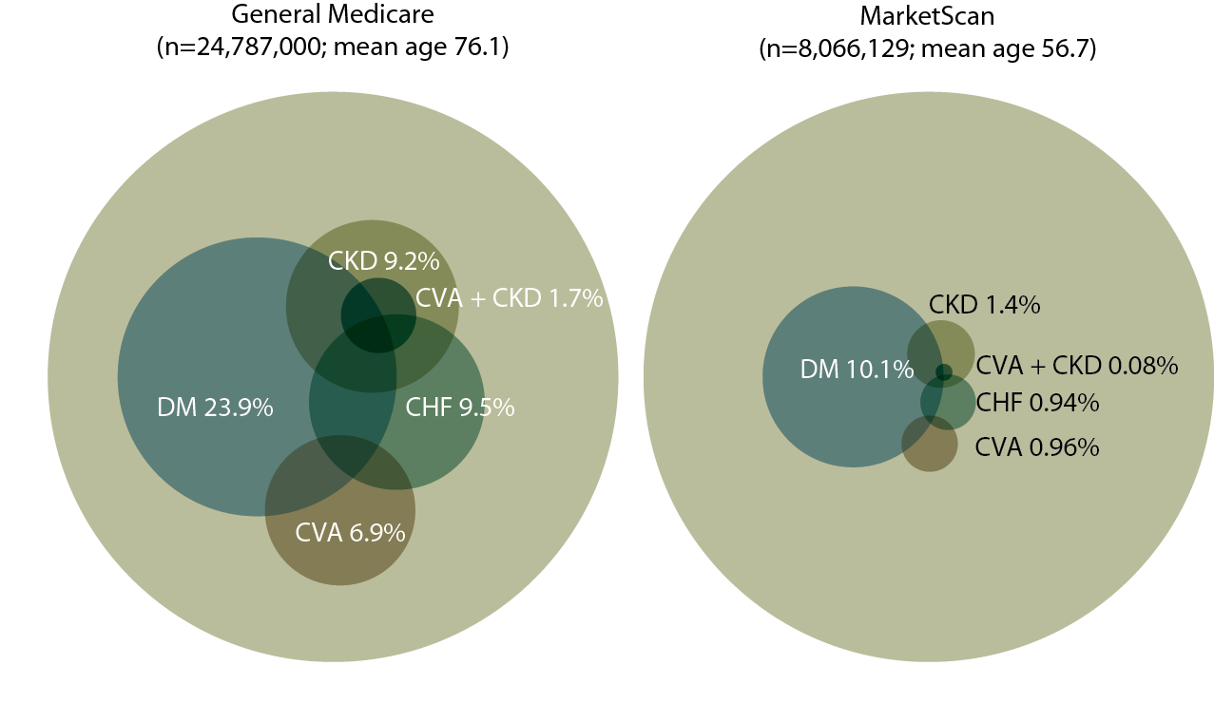
Distribution of point prevalent general Medicare (age 65 & older) & MarketScan (age 50–64) patients with coded diabetes, CKD, CHF, & CVA, 2010 Figure 2.1 (volume 1)
Point prevalent general (fee-for-service) Medicare patients age 65 & older; point prevalent MarketScan patients age 50–64. Diabetes, CKD, CHF, & CVA determined from claims.

Slide 11
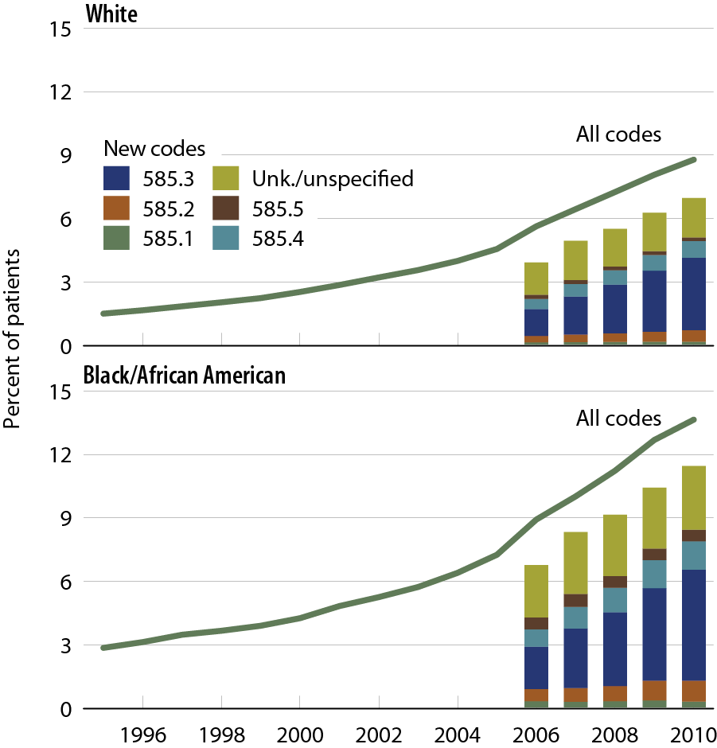
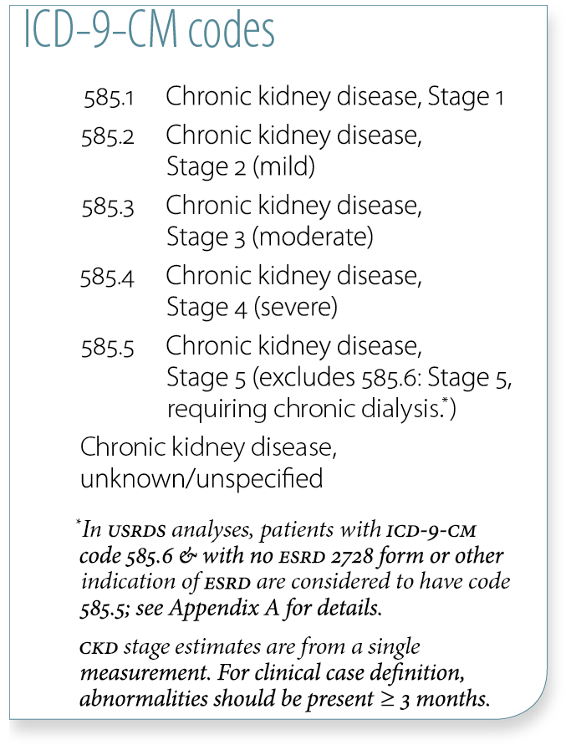
Trends in CKD prevalence: Medicare patients age 65 & older, by race Figure 2.2 (volume 1)
Prevalent patients surviving cohort year without ESRD, age 65 & older (Medicare) & 20–64 (MarketScan & Ingenix i3).

Slide 12
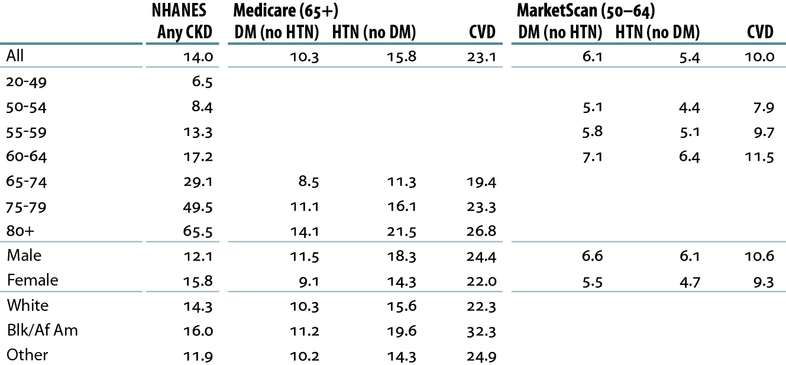
Percent of patients with CKD, by demographic characteristics, comorbidity, & dataset, 2010 Table 2.d (volume 1)
Medicare patients age 65 & older & MarketScan patients age 50–64, alive & eligible for all of 2010. CKD claims as well as other diseases identified in 2010. NHANES 2005–2010 participants, age 20 & older.

Slide 13
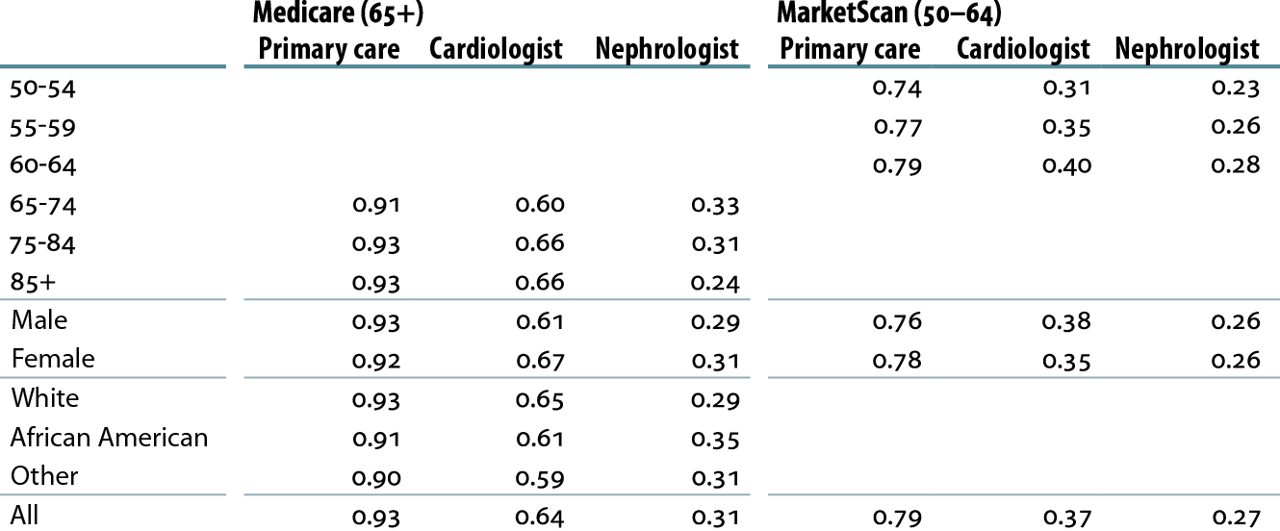
Cumulative probability of a physician visit at month 12 after CKD diagnosis in 2009, by demographic characteristics, physician specialty, & dataset, 2010 Table 2.g (volume 1)
Patients alive & eligible all of 2009. CKD diagnosis represents date of first CKD claim during 2009; physician claims searched during 12 months following that date.

Slide 14
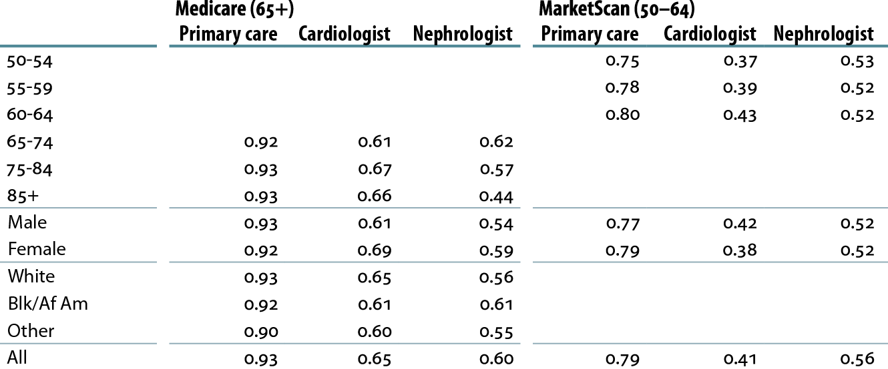
Cumulative probability of a physician visit at month 12 after CKD diagnosis code of 585.3 or higher in 2009, by demographic characteristics, physician specialty, & dataset, 2010 Table 2.h (volume 1)
Patients alive & eligible all of 2009. CKD diagnosis represents date of first CKD claim during 2009; physician claims searched during 12 months following that date.

Slide 15
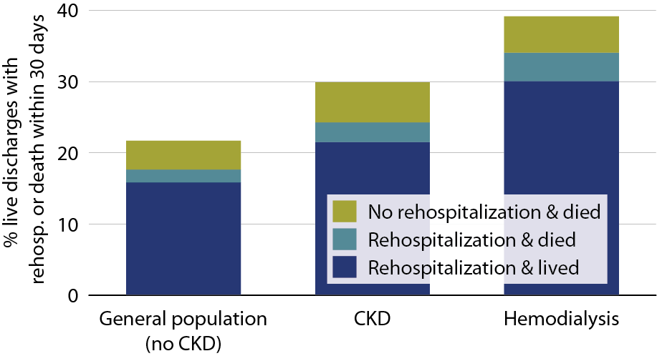
All-cause rehospitalization or death within 30 days after live hospital discharge, in the general Medicare (no CKD), CKD, & hemodialysis populations, age 66+, 2010 Figure 3.1 (volume 1)
January 1, 2010 point prevalent Medicare patients, age 66 & older on December 31, 2009, unadjusted. Includes live hospital discharges from January 1 to December 1, 2010.

Slide 16
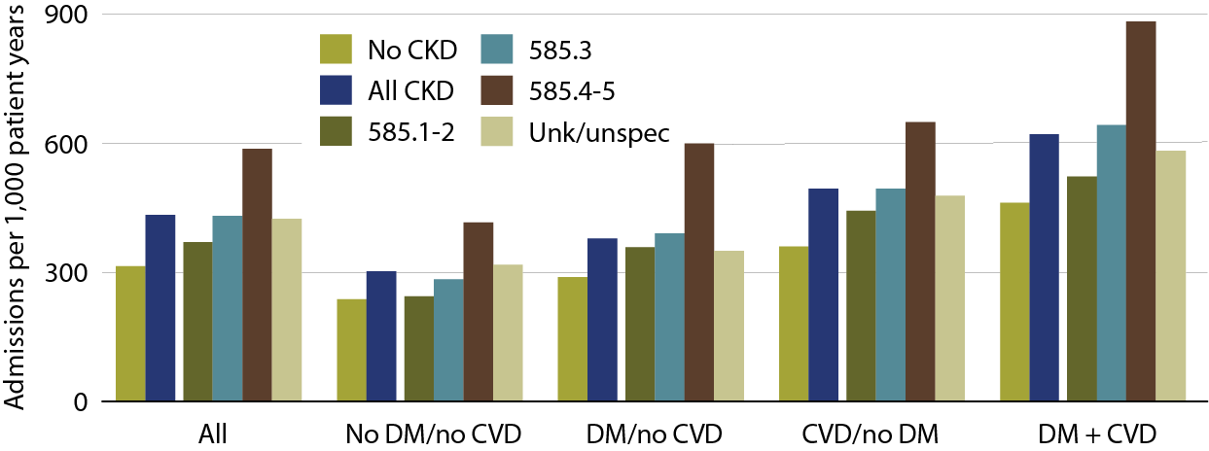
Adjusted hospitalization rates in Medicare patients, by comorbidity & CKD diagnosis code, 2010 Figure 3.2 (volume 1)
January 1, 2010 point prevalent Medicare patients, age 66 & older on December 31, 2009. Adj: age/gender/race/prior hospitalization/comorbidity; rates by one factor are adjusted for the others. Ref: Medicare patients age 66 & older, 2010.

Slide 17
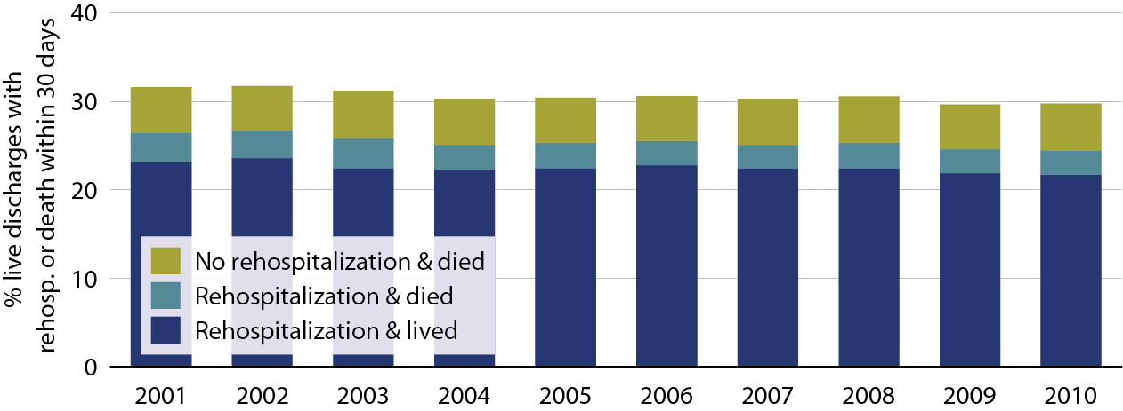
Adjusted all-cause rehospitalization or death 30 days after live hospital discharge in CKD patients Table 3.8 (volume 1)
Point prevalent Medicare CKD patients on January 1 of each year, age 66 & older on December 31 of the prior year. Adj: age/gender/race; ref: discharges in 2005. Includes discharges from January 1 to December 1 of each year

Slide 18
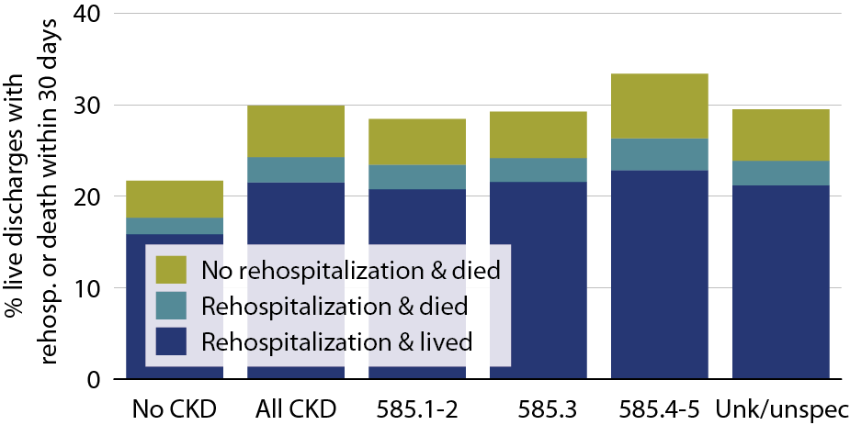
All-cause rehospitalization or death 30 days after live hospital discharge, by CKD stage, 2010 Table 3.9 (volume 1)
January 1, 2010 point prevalent Medicare patients, age 66 & older on December 31, 2009; unadjusted. Includes live hospital discharges from January 1 to December 1, 2010

Slide 19
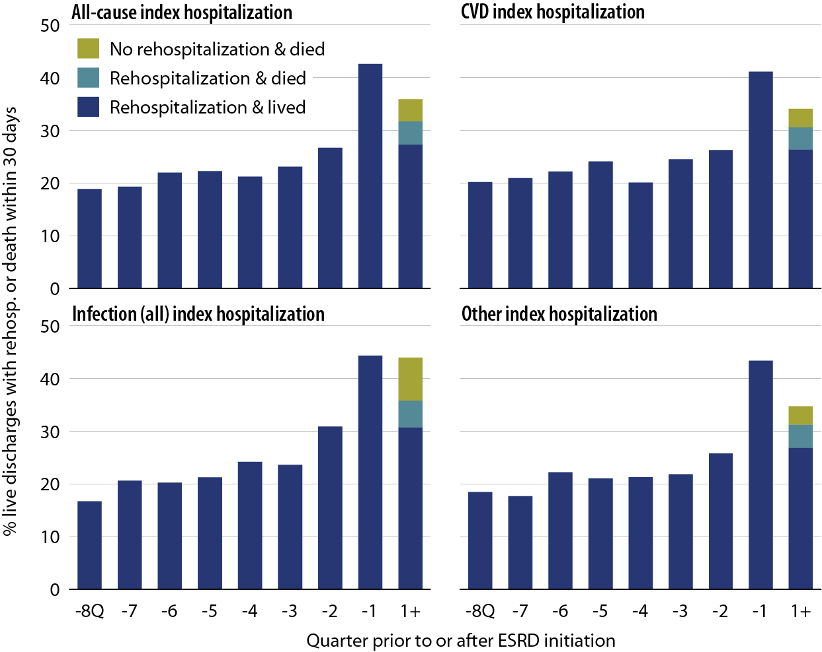
All-cause rehospitalization or death 30 days after live hospital discharge during the transition to ESRD, by cause-specific index hospitalization, 2010 Table 3.13 (volume 1)
Incident ESRD patients, January 1 to October 1, 2010; age 67 or older, unadjusted.

Slide 20
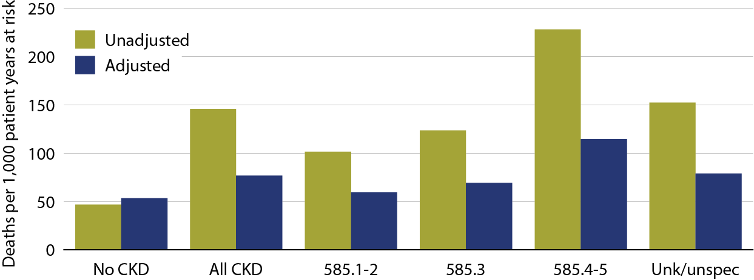
All-cause mortality rates in Medicare CKD & non-CKD patients, by CKD diagnosis code, 2010 Figure 3.15 (volume 1)
January 1, 2010 point prevalent patients age 66 & older. Adj: age/gender/race/prior hospitalization/comorbidities. Ref: 2010 patients.

Slide 21
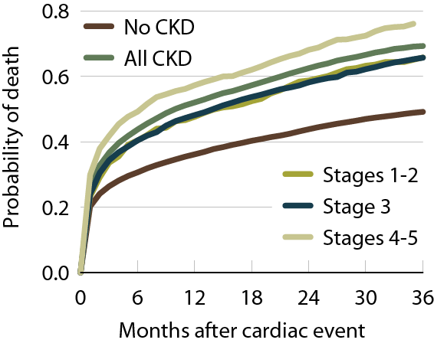
Probability of death following an AMI, by CKD status, 2010 Figure 4.4 (volume 1)
Jan. 1 pt. prev. Medicare pts. age 66 & older; first CVD diag. in 2007–2008.

Slide 22
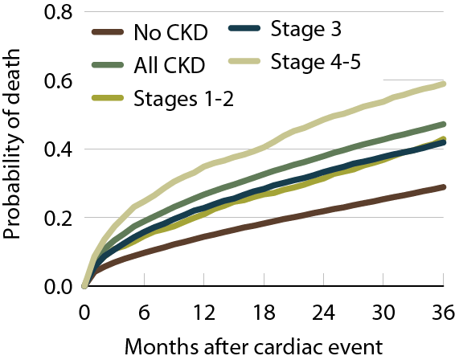
Probability of death following a CVA/TIA, by CKD status Figure 4.5 (volume 1)
Jan. 1 pt. prev. Medicare pts. age 66 & older; first CVD diag. in 2007–2008.

Slide 23
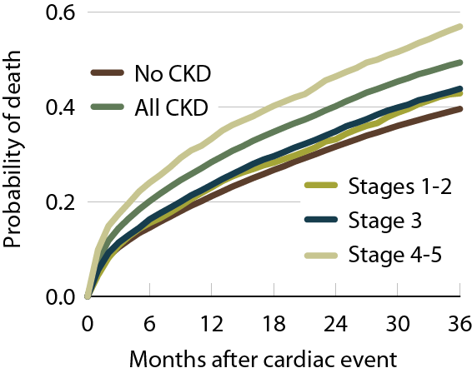
Probability of death following a diagnosis of CHF, by CKD status, 2010 Figure 4.6 (volume 1)
Jan. 1 pt. prev. Medicare pts. age 66 & older; first CVD diag. in 2007–2008.

Slide 24
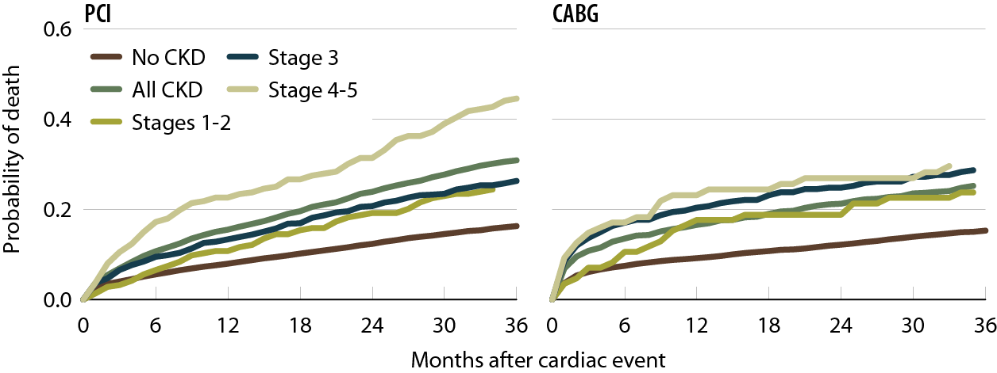
Probability of death following a CV procedure (PCI/CABG), by CKD status, 2010 Figure 4.7 (volume 1)
Jan. 1 pt. prev. Medicare pts. age 66 & older; first CVD diag. in 2007–2008.

Slide 25
Cardiovascular disease & pharmacological interventions (row percent), by diagnosis & CKD stage Table 4.b (volume 1)
January 1 point prevalent Medicare patients with Medicare Parts A, B, & D enrollment.

Slide 26
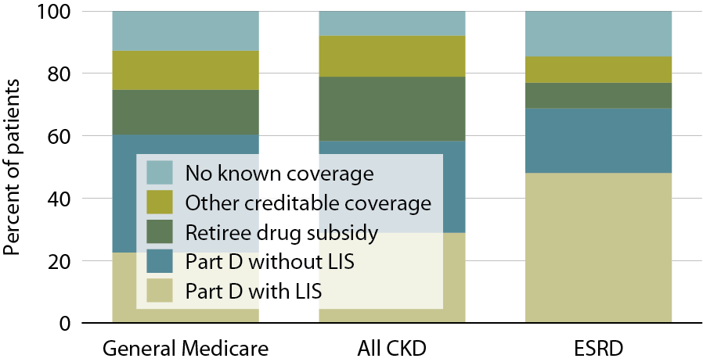
Sources of prescription drug coverage in Medicare enrollees, by population, 2010 Figure 5.2 (volume 1)
Point prevalent Medicare enrollees alive on January 1, 2010.

Slide 27
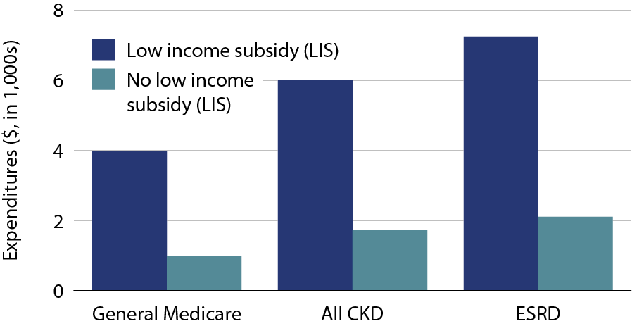
Per person per year Part D costs for enrollees, by low income subsidy (LIS) status, 2010 Figure 5.11 (volume 1)
Medicare patients surviving 2010. General Medicare totals include Part D claims for all patients in the Medicare 5 percent sample enrolled in Part D. CKD total includes Medicare CKD patients, as determined from claims. ESRD totals include all Part D claims for Medicare ESRD patients enrolled in Part D.

Slide 28
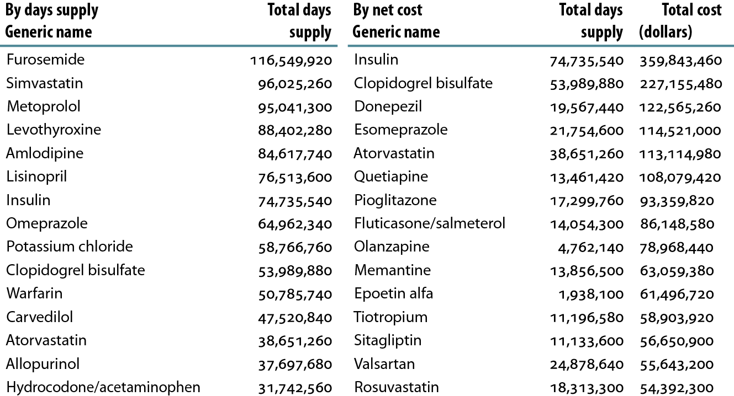
Top 15 drugs used in Part D enrollees with CKD, by days supply & net cost, 2010 Table 5.h (volume 1)
CKD Medicare patients with Medicare as primary payor for calendar year 2009. Part D claims for all patients in the Medicare 5 percent sample; claims & costs scaled up by a factor of 20 to estimate totals. Costs are the sum of Medicare payment & low income subsidy.

Slide 29
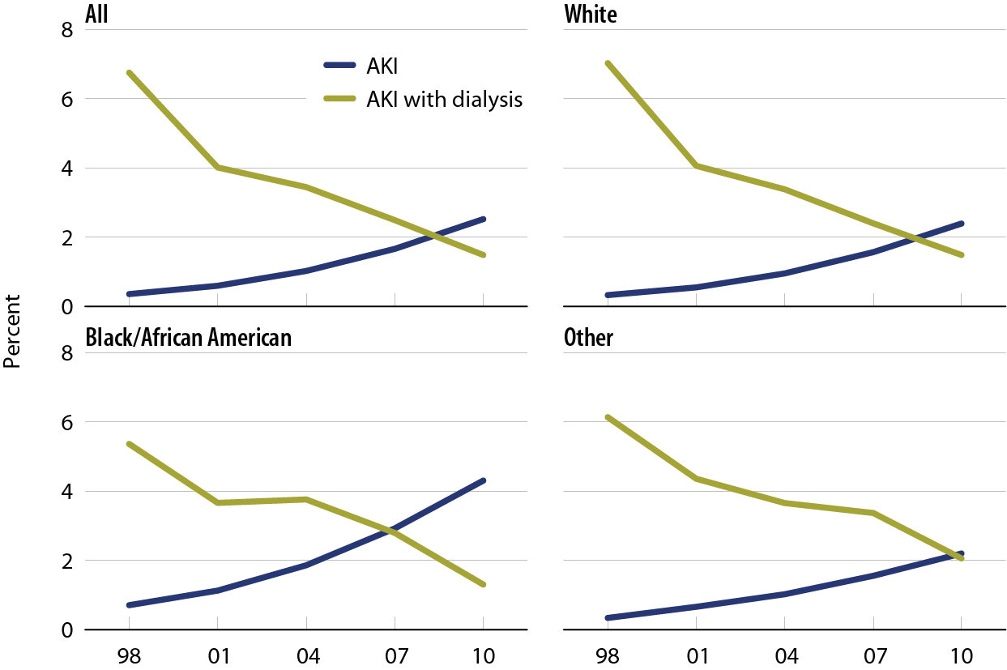
Hospitalizations for acute kidney injury, with or without dialysis, by race Figure 6.1 (volume 1)
Medicare patients age 66 & older.

Slide 30
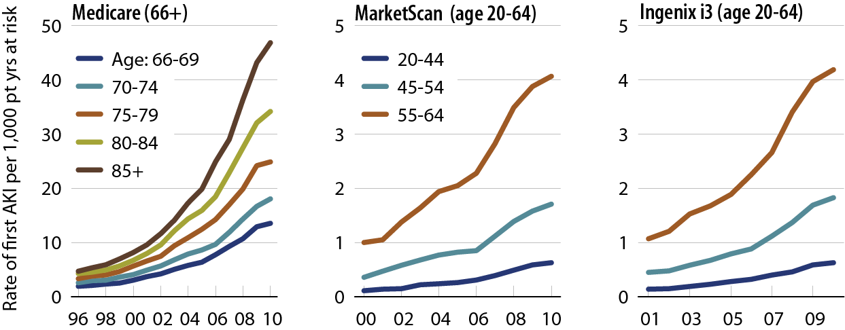
Rates of AKI, by age & dataset Figure 6.3 (volume 1)
Medicare AKI patients age 66 & older, & MarketScan & Ingenix i3 patients AKI age 20–64.

Slide 31
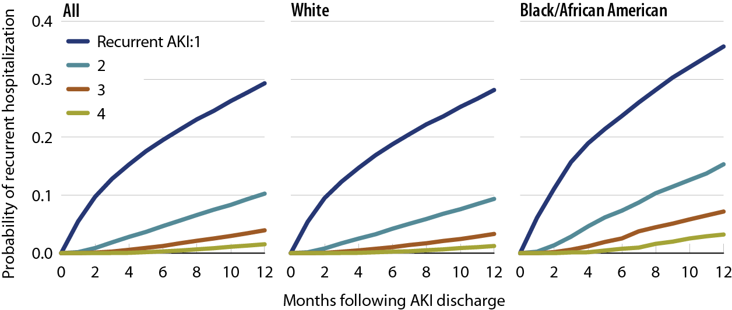
Probability of a recurrent AKI hospitalization in Medicare patients, by number of events & race, 2009–2010 Figure 6.9 (volume 1)
Medicare AKI patients age 66 & older, 2009–2010.

Slide 32
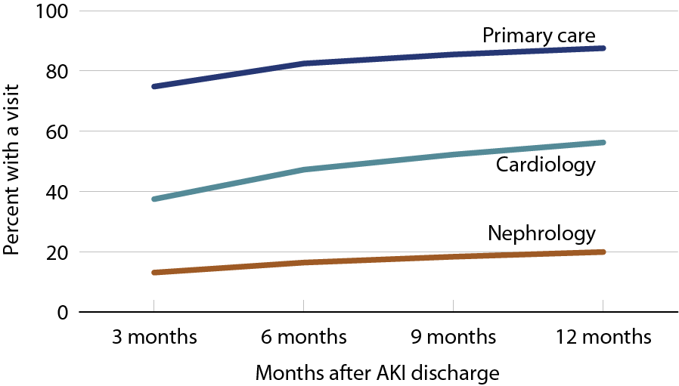
Outpatient physician visits following initial AKI discharge Figure 6.13 (volume 1)
Medicare AKI patients age 66 & older, 2009–2010.

Slide 33
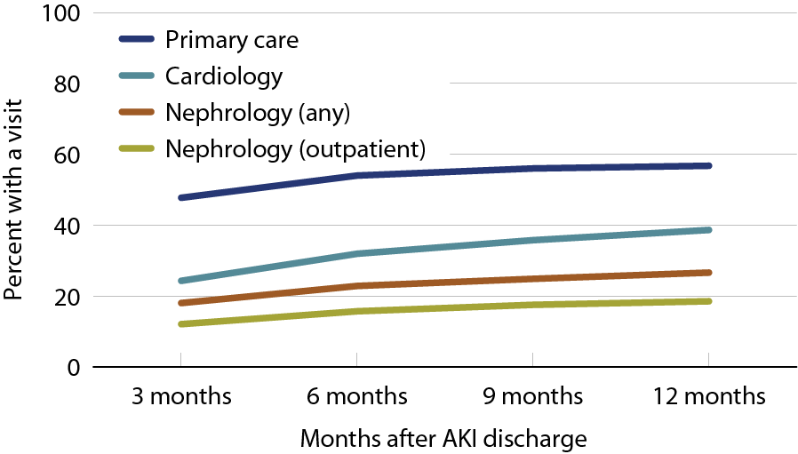
Physician visits in the year following a recurrent AKI discharge Figure 6.14 (volume 1)
Medicare AKI patients age 66 & older, 2009–2010.

Slide 34
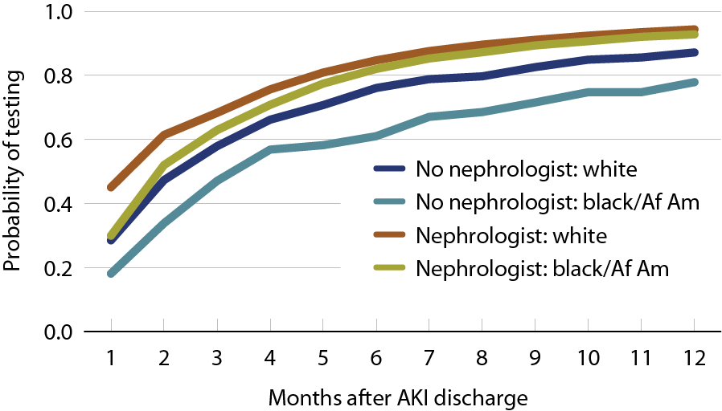
Probability of serum creatinine testing after hospitalization for acute kidney injury, 2010 Figure 6.16 (volume 1)
Medicare AKI patients, age 66 & older, 2009.

Slide 35
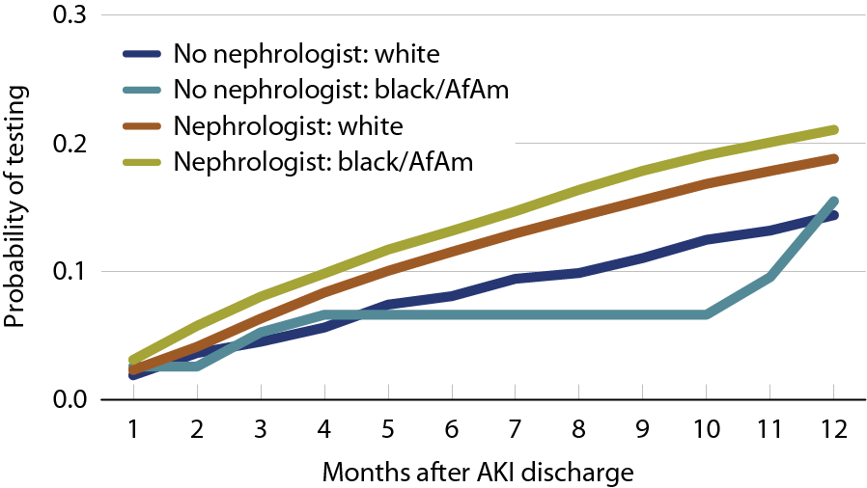
Probability of urine protein testing after hospitalization for acute kidney injury, 2010 Figure 6.17 (volume 1)
Medicare AKI patients, age 66 & older, 2009.

Slide 36
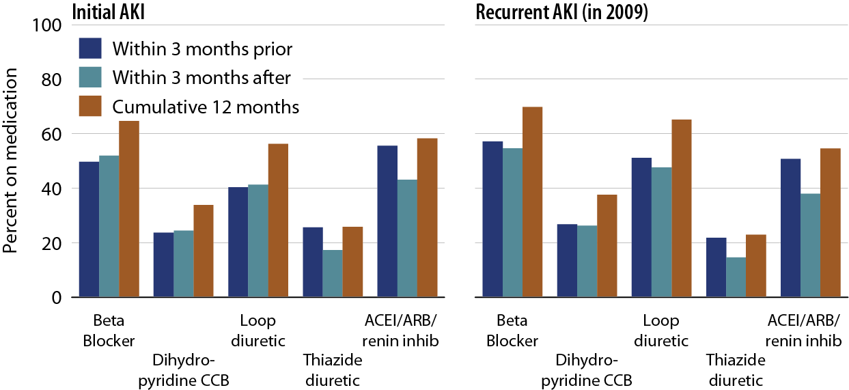
Drug therapy prior to & after hospitalization for AKI in patients with Medicare Part D coverage, for initial & recurrent AKI Figure 6.18 (volume 1)
AKI patients with Part D coverage, 2009.

Slide 37
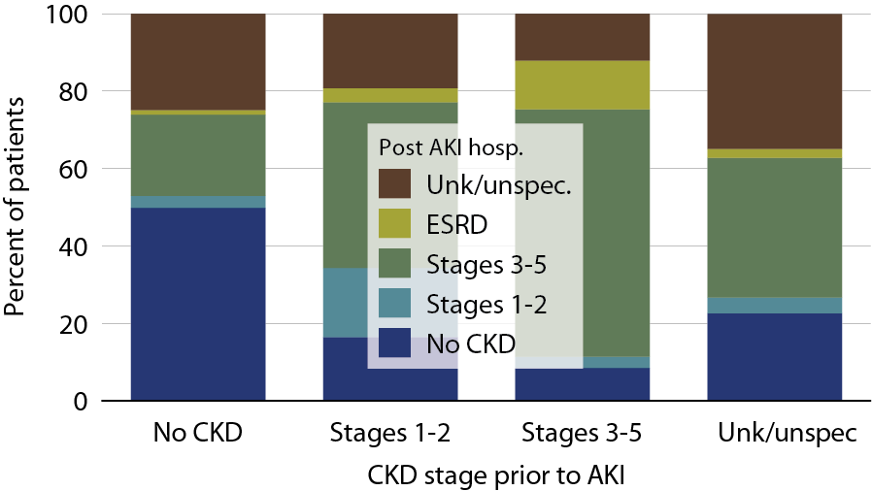
Changes to CKD status following hospitalization for AKI in Medicare patients, 2010 Figure 6.21 (volume 1)
Medicare AKI patients age 66 & older, 2010

Slide 38
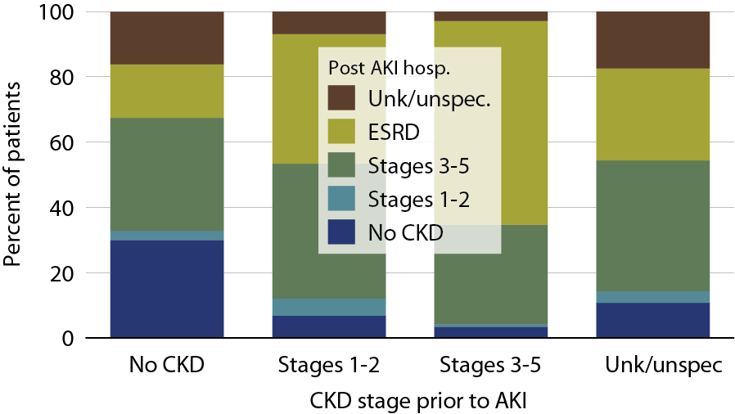
Changes to CKD status following a hospitalization for AKI with dialysis in Medicare patients, 2010 Figure 6.23 (volume 1)
Medicare AKI patients age 66 & older, 2010; data limited to AKI events with dialysis.

Slide 39
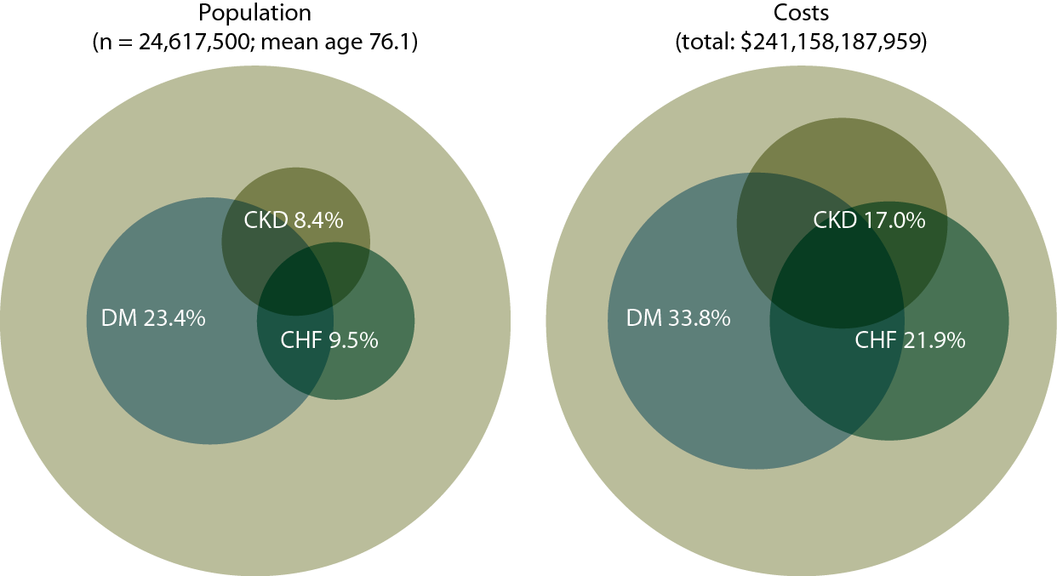
Point prevalent distribution & annual costs of Medicare (fee-for-service) patients, age 65 & older, with diagnosed diabetes, CHF, & CKD, 2010 Figure 7.1 (volume 1)
Populations estimated from the 5 percent Medicare sample using a point prevalent model (see appendix for details). Population further restricted to patients age 65 & older, without ESRD. Diabetes, CHF, & CKD determined from claims; costs are for calendar year 2010.

Slide 40
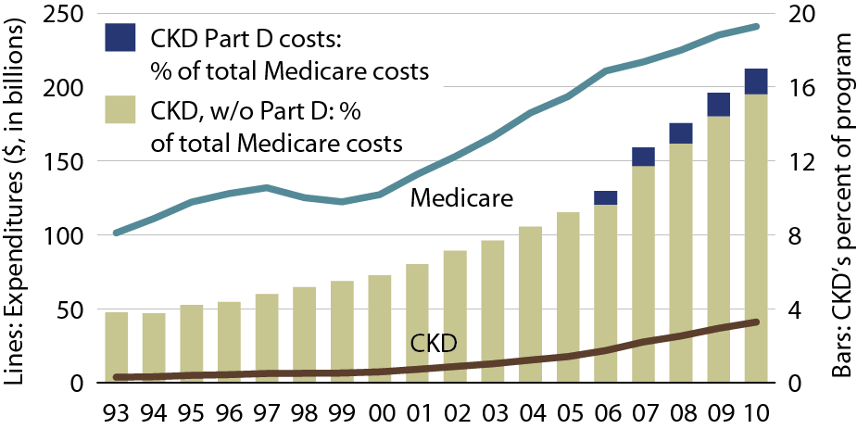
Overall expenditures for CKD in the Medicare population Figure 7.5 (volume 1)
Point prevalent Medicare CKD patients age 65 & older.

Slide 41
Top 15 drugs used in Part D enrollees with CKD, by frequency & net cost, 2010 Table 7.b (volume 1)
Point prevalent Medicare CKD patients age 65 & older, 2010.

