Slide 1
ESRD: Chapter Two Clinical indicators & preventive care
United States Renal Data System
2012 Annual Data Report

Slide 2
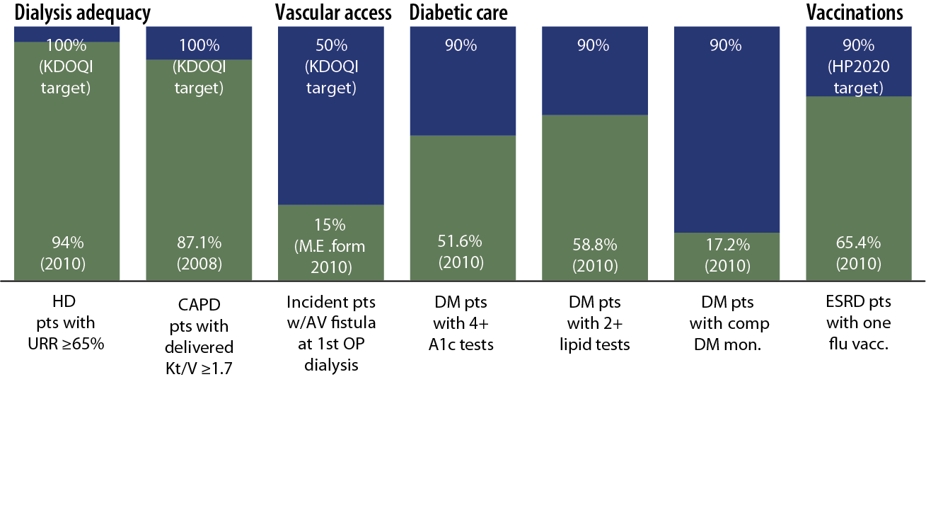
Quality indicators: percentage of patients meeting clinical & preventive care guidelines Figure 2.1 (Volume 2)

Slide 3
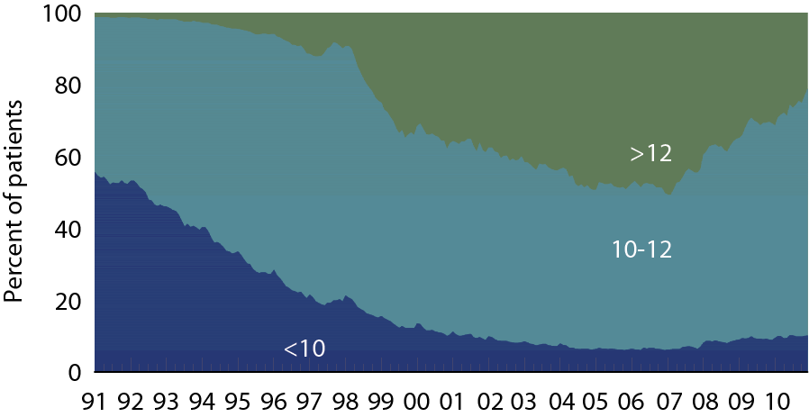
Patient distribution, by mean monthly hemoglobin (g/dl) Figure 2.2 (Volume 2)
Period prevalent dialysis patients.

Slide 4
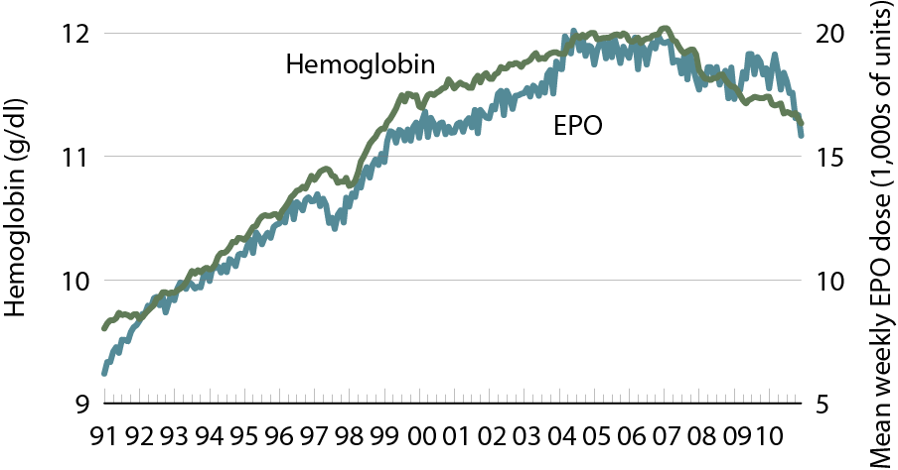
Mean monthly hemoglobin & mean EPO dose per week Figure 2.3 (Volume 2)
Period prevalent dialysis patients.

Slide 5
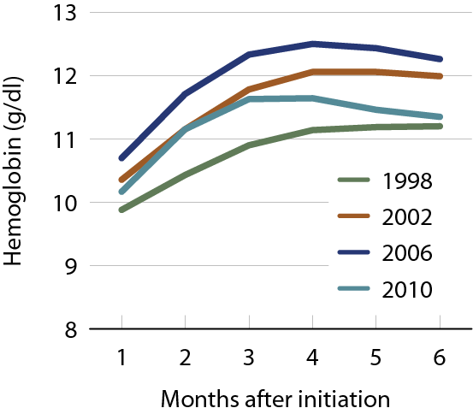
Mean monthly hemoglobin after initiation, by year Figure 2.4 (Volume 2)
Incident dialysis patients.

Slide 6
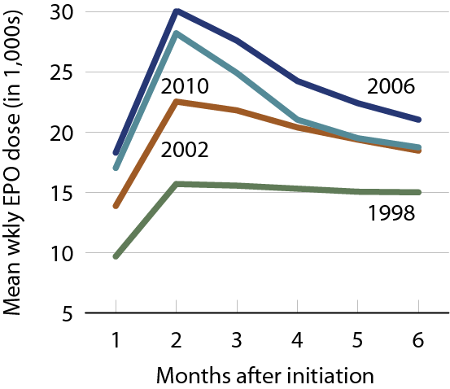
Mean EPO dose per week after initiation, by year Figure 2.5 (Volume 2)
Incident dialysis patients, adjusted for inpatient days.

Slide 7
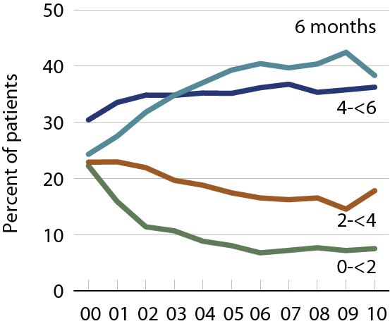
Months with IV iron in the first six months of dialysis (EPO-treated patients) Figure 2.6 (Volume 2)
Incident dialysis patients.

Slide 8
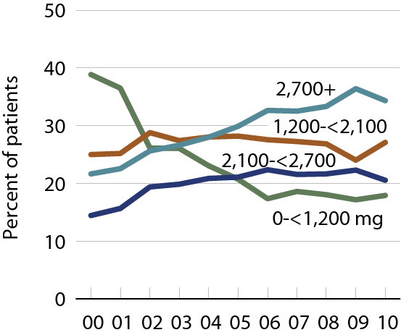
Total IV iron dose in the first six months of dialysis (EPO-treated patients) Figure 2.7 (Volume 2)
Incident dialysis patients.

Slide 9
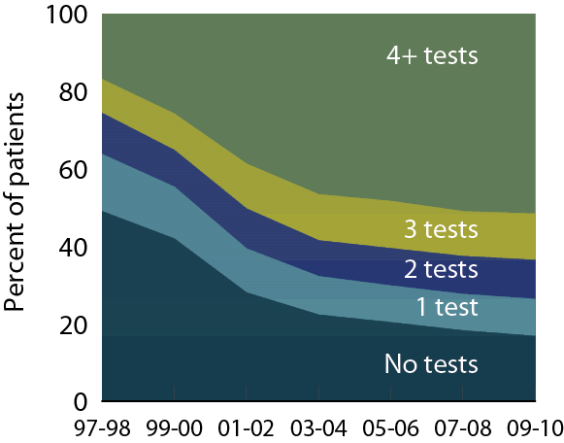
A1c testing in ESRD patients with diabetes, by number of tests Figure 2.8 (Volume 2)
Point prevalent Medicare ESRD patients with diabetes, age 18–75.

Slide 10
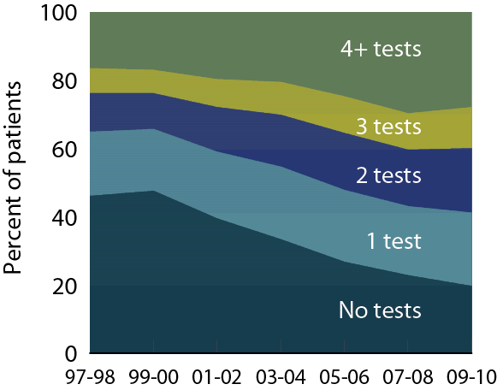
Lipid testing in ESRD patients with diabetes, by number of tests Figure 2.9 (Volume 2)
Point prevalent Medicare ESRD patients with diabetes, age 18–75.

Slide 11
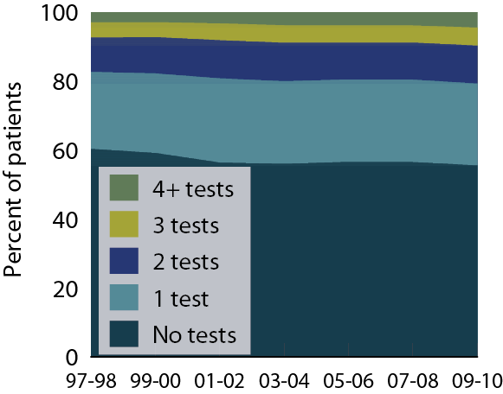
Diabetic eye examinations in patients with diabetes, by number of tests Figure 2.10 (Volume 2)
Point prevalent Medicare ESRD patients with diabetes, age 18–75.

Slide 12
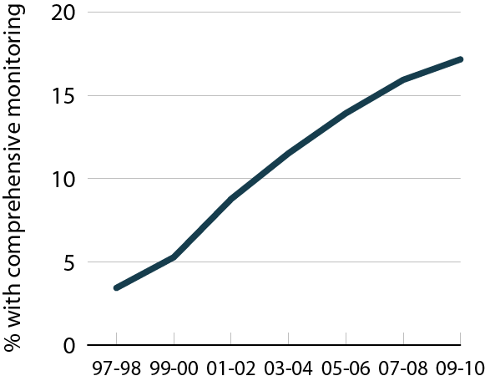
Comprehensive diabetic monitoring in ESRD patients with diabetes Figure 2.11 (Volume 2)
Point prevalent Medicare ESRD patients with diabetes, age 18–75.

Slide 13
Vaccination rates (percent), by age, race/ethnicity, & modality Table 2.a (Volume 2)
ESRD patients initiating treatment at least 90 days before tracking period: September 1–December 31 for influenza, a two-year period for pneumococcal pneumonia, yearly for hepatitis B; patients alive on the period’s last day & vaccinations tracked during the period.

Slide 14
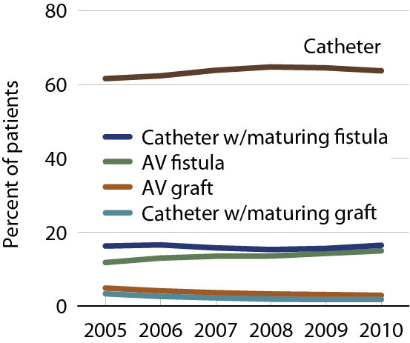
Vascular access at first outpatient dialysis Figure 2.12 (Volume 2)
Incident hemodialysis patients.

Slide 15
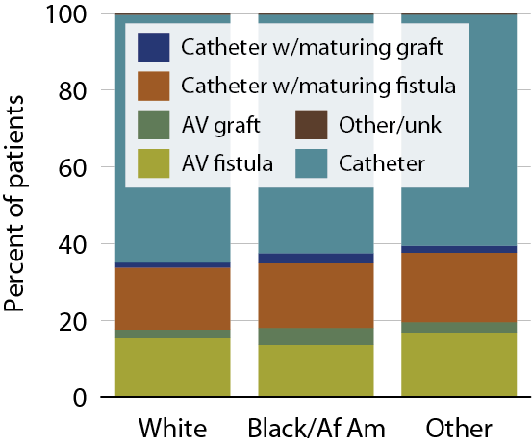
Vascular access use at initiation, by race, 2010 Figure 2.13 (Volume 2)
Incident hemodialysis patients, 2010.

Slide 16
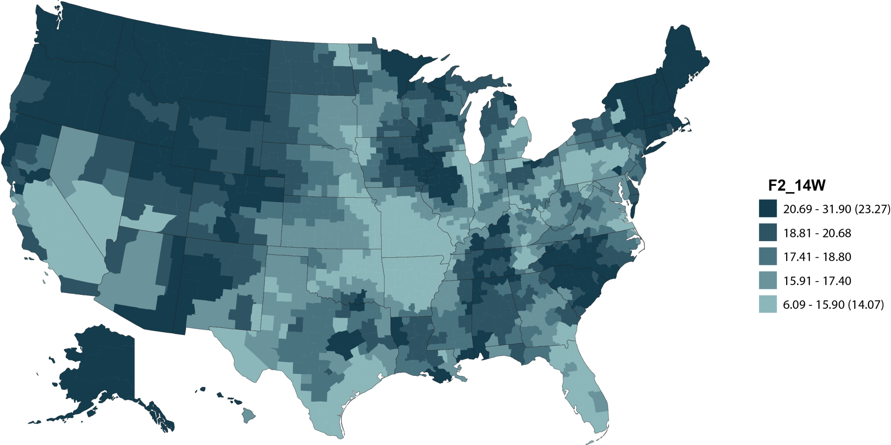
Geographic variations in the percent of hemodialysis patients using an internal access at initiation, by HSA, 2010: whites Figure 2.14 (Volume 2)
Incident hemodialysis patients, 2010.

Slide 17
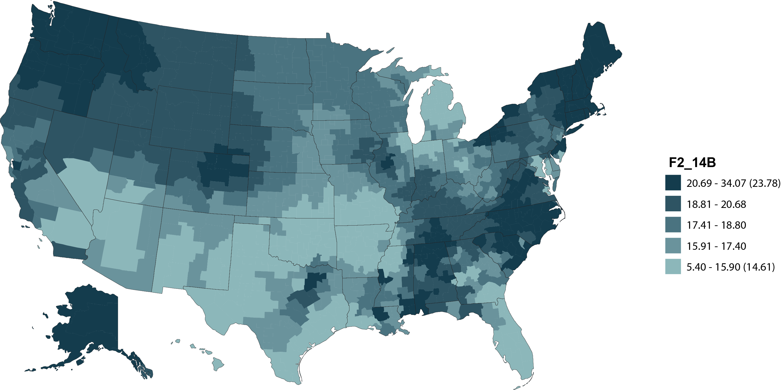
Geographic variations in the percent of hemodialysis pts using an internal access at initiation, by HSA, 2010: Blacks/African Americans Figure 2.14 (continued; Volume 2)
Incident hemodialysis patients, 2010.

Slide 18
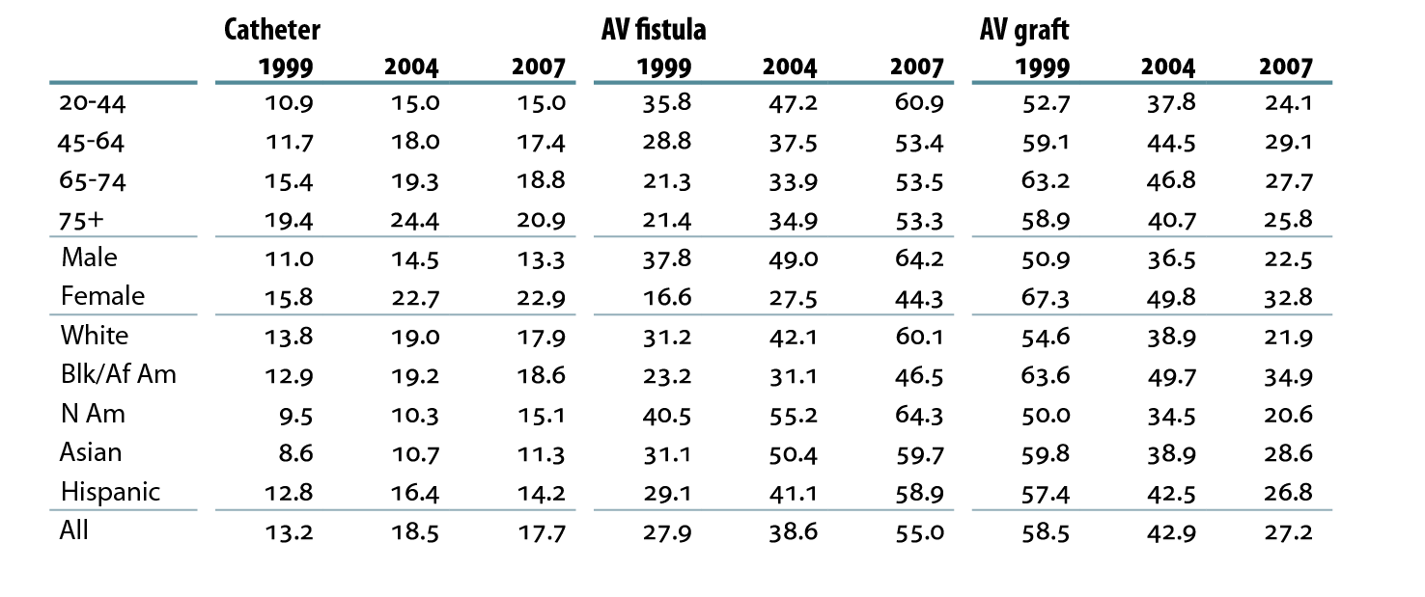
Access use in prevalent hemodialysis patients, by age, gender, & race/ethnicity (ESRD CPM data; %) Table 2.b (Volume 2)
Prevalent hemodialysis patients age 20 & older; ESRD CPM data.

Slide 19
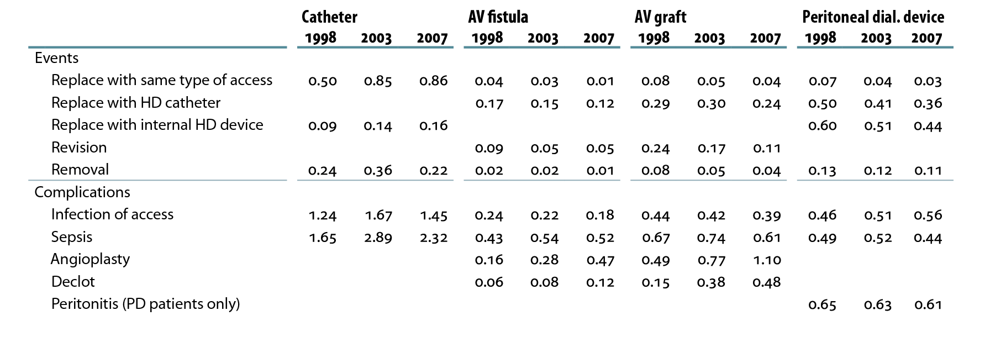
Access events & complications in prevalent dialysis patients (ESRD CPM data; rate per patient year) Table 2.c (Volume 2)
Catheter, fistula, graft: prevalent hemodialysis patients age 20 & older, ESRD CPM & claims data. Peritoneal dialysis device: prevalent peritoneal dialysis patients age 20 & older.

