Slide 1
ESRD: Chapter Three
Hospitalization
United States Renal Data System
2012 Annual Data Report

Slide 2
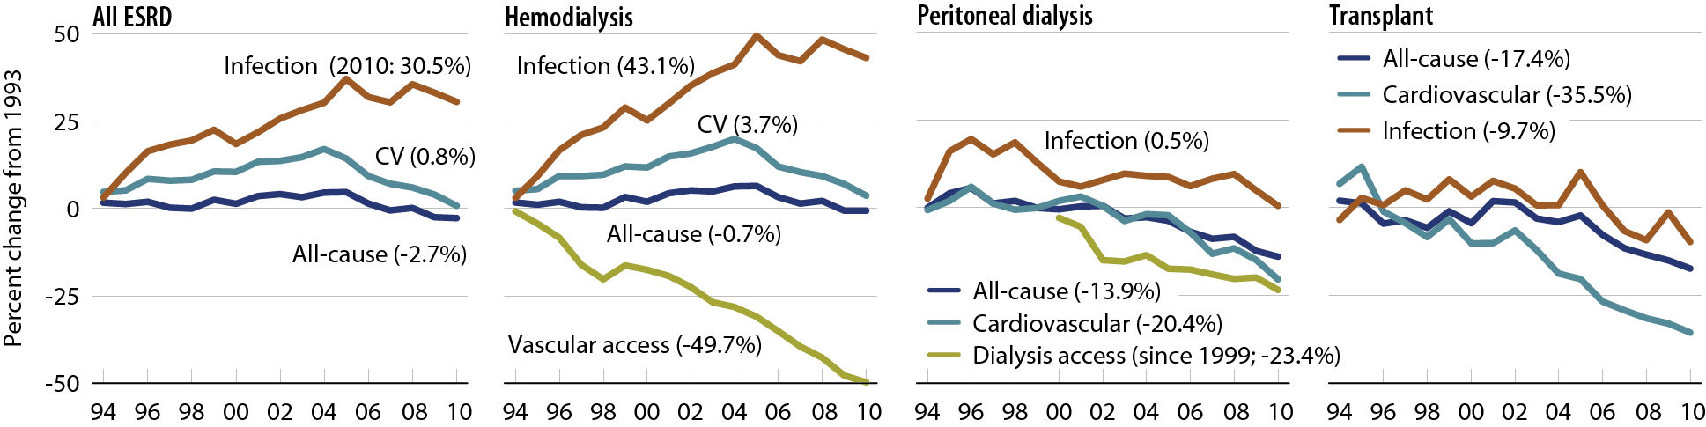
Change in adjusted all-cause & cause- specific hospitalization rates, by modality
Figure 3.1 (Volume 2)
Period prevalent ESRD patients. Adj: age/gender/race/primary diagnosis; ref: ESRD patients, 2005.

Slide 3
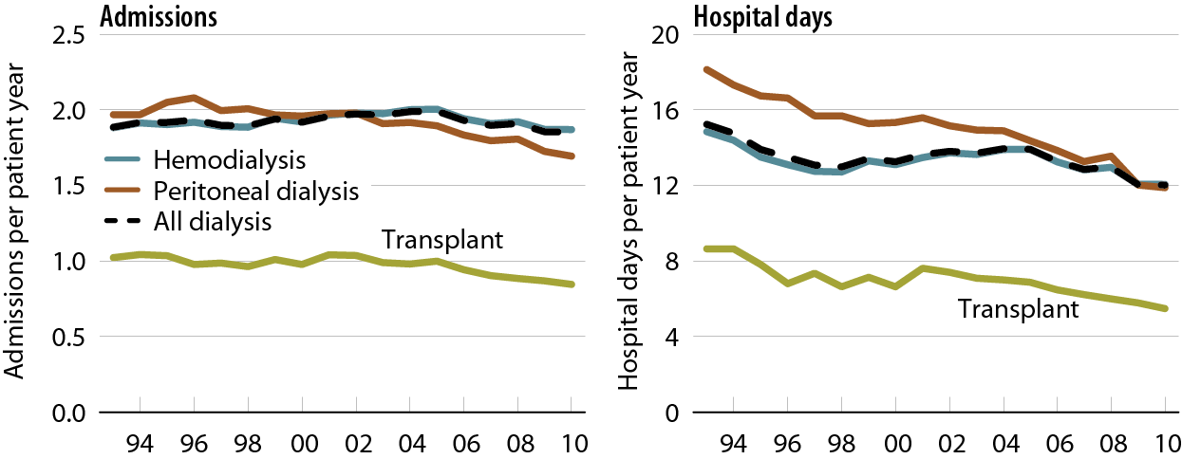
Adjusted hospital admission rates & days, by modality
Figure 3.2 (Volume 2)
Period prevalent ESRD patients. Adj: age/gender/race/primary diagnosis; ref: ESRD patients, 2005.

Slide 4
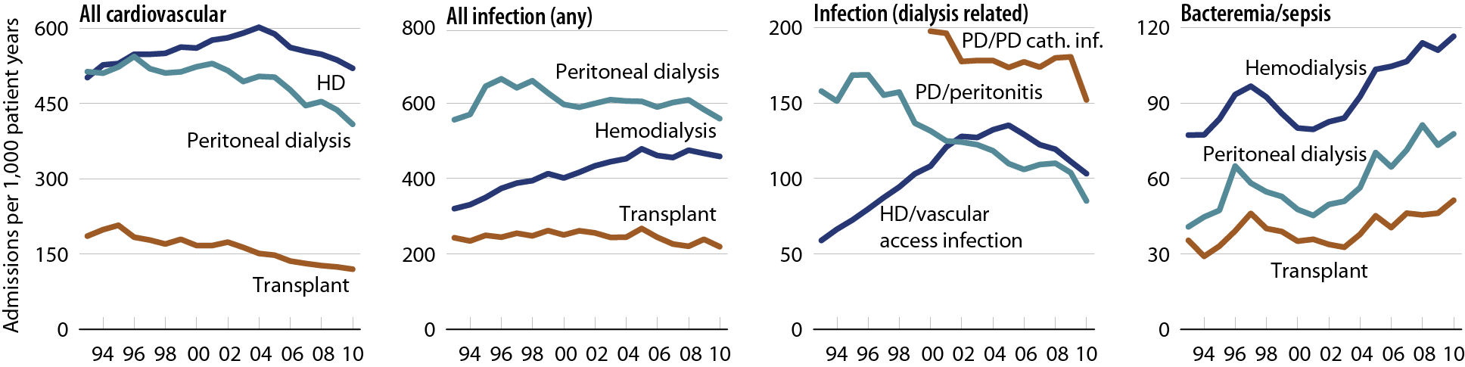
Adjusted hospitalization rates, by principal diagnosis & modality
Figure 3.3 (Volume 2)
Period prevalent ESRD patients. Adj: age/gender/race/primary diagnosis; ref: ESRD patients, 2005.

Slide 5
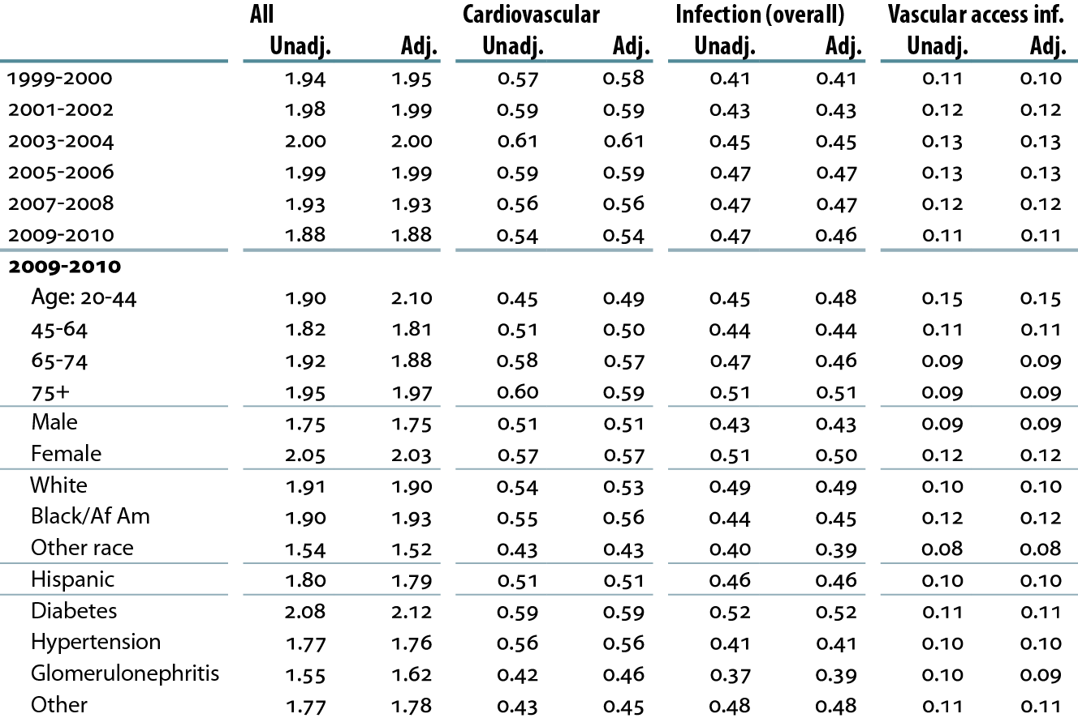
Unadjusted & adjusted all-cause & cause-specific hospitalization rates
(per patient year) in hemodialysis patients
Table 3.a (Volume 2)
Period prevalent hemodialysis patients age 20 & older. Adj: age/gender/ race/primary diagnosis; rates by one factor adjusted for the other three; ref: hemodialysis patients, 2005.

Slide 6
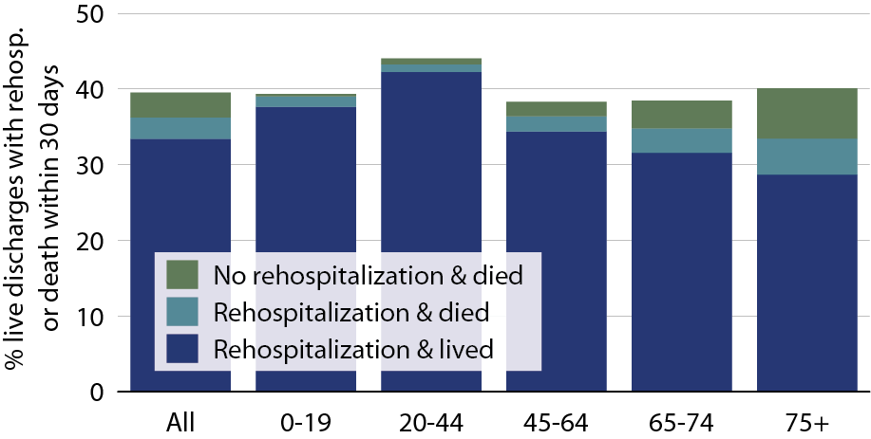
All-cause rehospitalization or death 30 days after live hospital discharge, by age, 2010
Figure 3.4 (Volume 2)
Period prevalent hemodialysis patients, all ages, 2010; unadjusted. Includes live hospital discharges from January 1 to December 1, 2010.

Slide 7
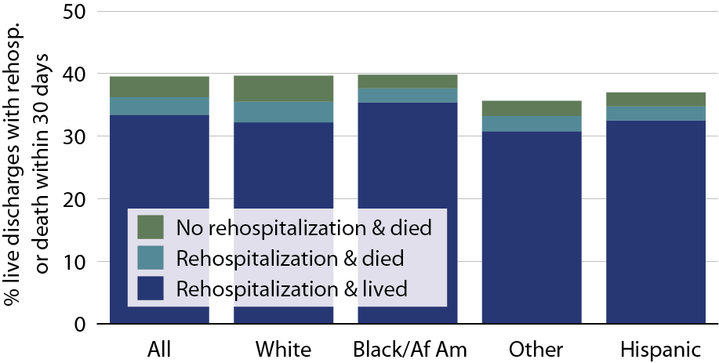
All-cause rehospitalization or death
30 days after live hospital discharge, by race/ethnicity, 2010
Figure 3.5 (Volume 2)
Period prevalent hemodialysis patients, all ages, 2010; unadjusted. Includes live hospital discharges from January 1 to December 1, 2010.

Slide 8
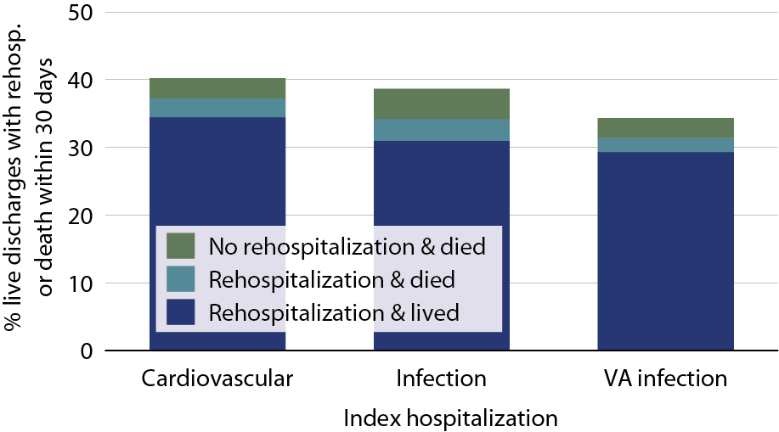
All-cause rehospitalization or death
30 days after live hospital discharge, by cause-specific index hospitalization, 2010
Figure 3.6 (Volume 2)
Period prevalent hemodialysis patients, all ages, 2010; unadjusted. Includes live hospital discharges from January 1 to December 1, 2010.

Slide 9
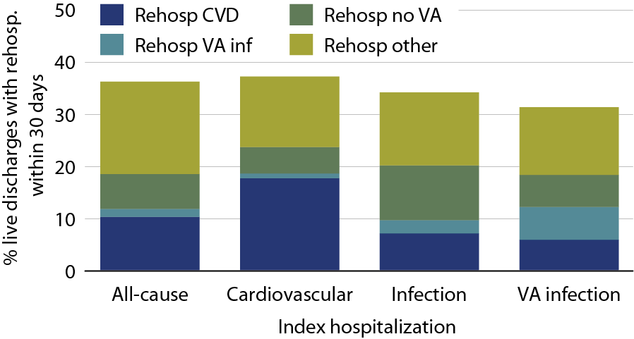
Cause-specific rehospitalization in hemodialysis patients 30 days after live hospital discharge, by cause-specific index hospitalization, 2010
Figure 3.7 (Volume 2)
Period prevalent hemodialysis patients, all ages, 2010; unadjusted. Includes live hospital discharges from January 1 to December 1, 2010.

Slide 10
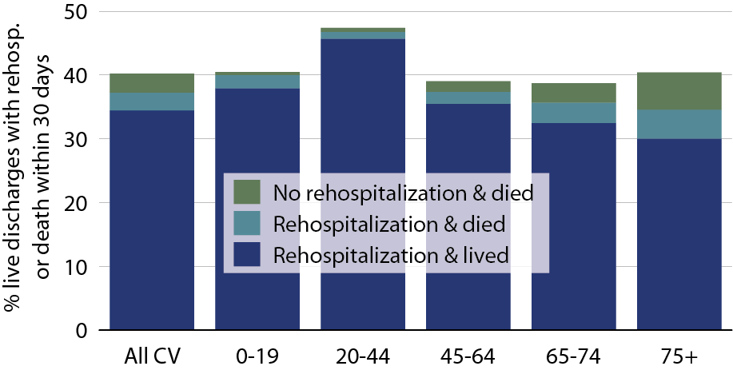
All-cause rehospitalization or death 30 days after live hospital discharge, by age, 2010
Figure 3.8 (Volume 2)
Period prevalent hemodialysis patients, all ages, 2010; unadjusted. Includes live hospital discharges from January 1 to December 1, 2010.

Slide 11
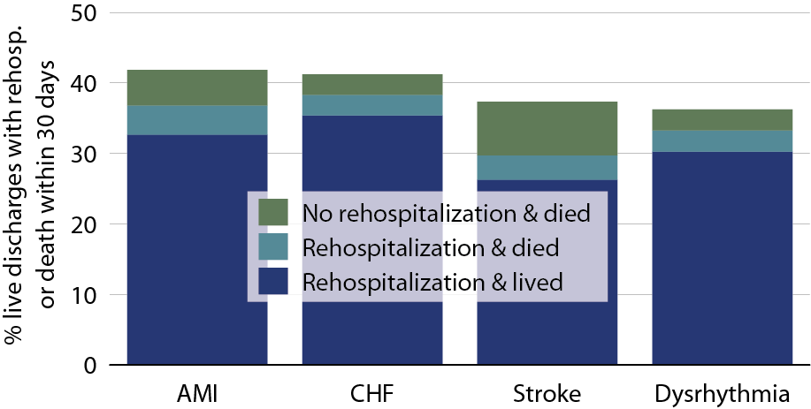
All-cause rehospitalization or death 30 days after live hospital discharge, by cause-specific cardiovascular index hospitalization, 2010
Figure 3.9 (Volume 2)
Period prevalent hemodialysis patients, all ages, 2010; unadjusted. Includes live hospital discharges from January 1 to December 1, 2010.

Slide 12
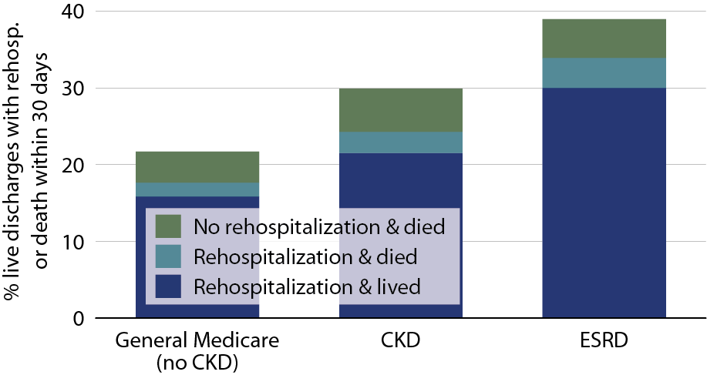
All-cause rehospitalization or death within
30 days after live hospital discharge in patients age 66 & older, by population, 2010
Figure 3.10 (Volume 2)
January 1, 2010 point prevalent Medicare patients age 66 & older on December 31, 2009.

Slide 13
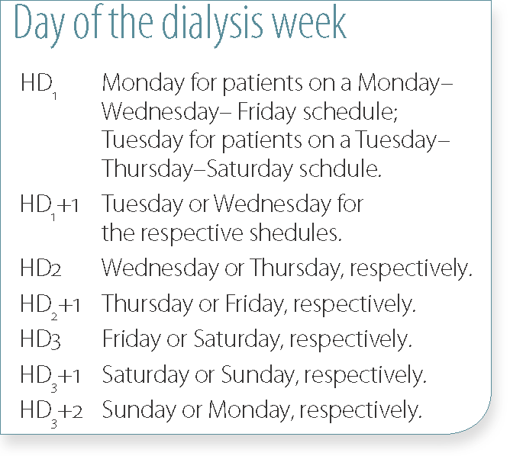
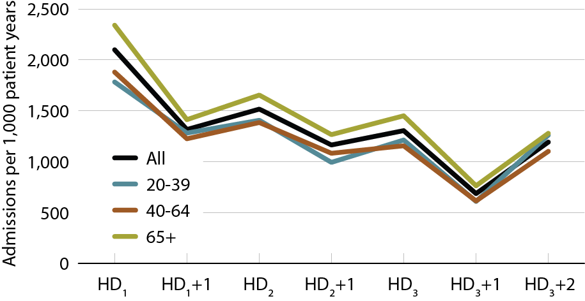
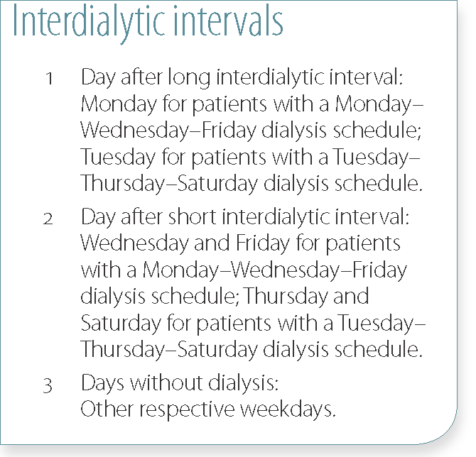
Annualized all-cause admission rates on different days of the dialysis week, by age, 2010
Figure 3.11 (Volume 2)
January 1, 2010 point prevalent Medicare HD patients alive on January 31. Includes patients age 20 & older receiving hemodialysis three times weekly on a Monday–Wednesday–Friday or Tuesday–Thursday–Saturday schedule; HD1, HD2, & HD3, are the first, second, & third hemodialysis sessions. Rates for all patients are adjusted for age, gender, race, Hispanic ethnicity, & primary diagnosis; rates by age are adjusted for the other four factors. Ref: all included HD patients in 2010.

Slide 14
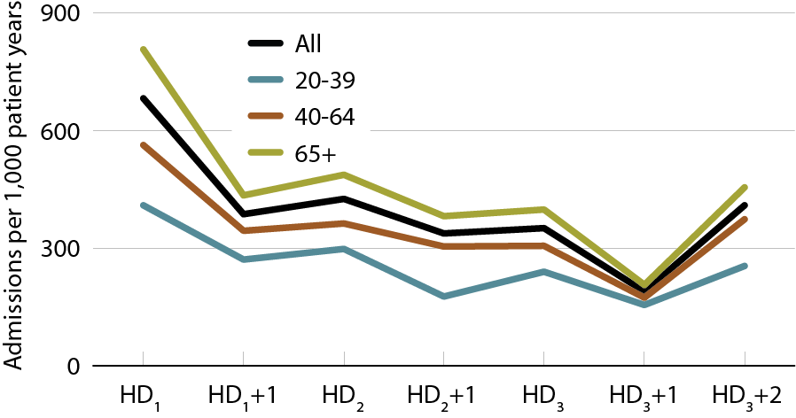
Annualized cardiovascular admission rates on different days of the dialysis week, by age, 2010
Figure 3.12 (Volume 2)
January 1, 2010 point prevalent Medicare HD patients alive on January 31. Includes patients age 20 & older receiving hemodialysis three times weekly on a Monday–Wednesday–Friday or Tuesday–Thursday–Saturday schedule; HD1, HD2, & HD3, are the first, second, & third hemodialysis sessions. Rates for all patients are adjusted for age, gender, race, Hispanic ethnicity, & primary diagnosis; rates by age are adjusted for the other four factors. Ref: all included HD patients in 2010.

Slide 15
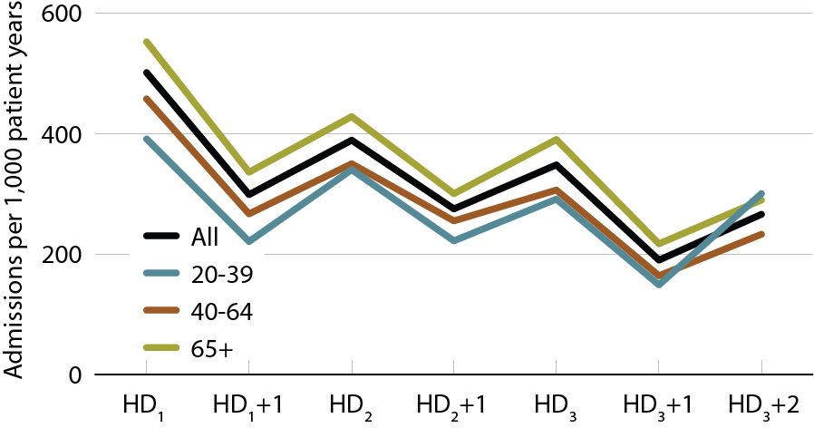
Annualized rates of admission for infection on different days of the dialysis week, by age, 2010
Figure 3.13 (Volume 2)
January 1, 2010 point prevalent Medicare HD patients alive on January 31. Includes patients age 20 & older receiving hemodialysis three times weekly on a Monday–Wednesday–Friday or Tuesday–Thursday–Saturday schedule; HD1, HD2, & HD3, are the first, second, & third hemodialysis sessions. Rates for all patients are adjusted for age, gender, race, Hispanic ethnicity, & primary diagnosis; rates by age are adjusted for the other four factors. Ref: all included HD patients in 2010.

Slide 16
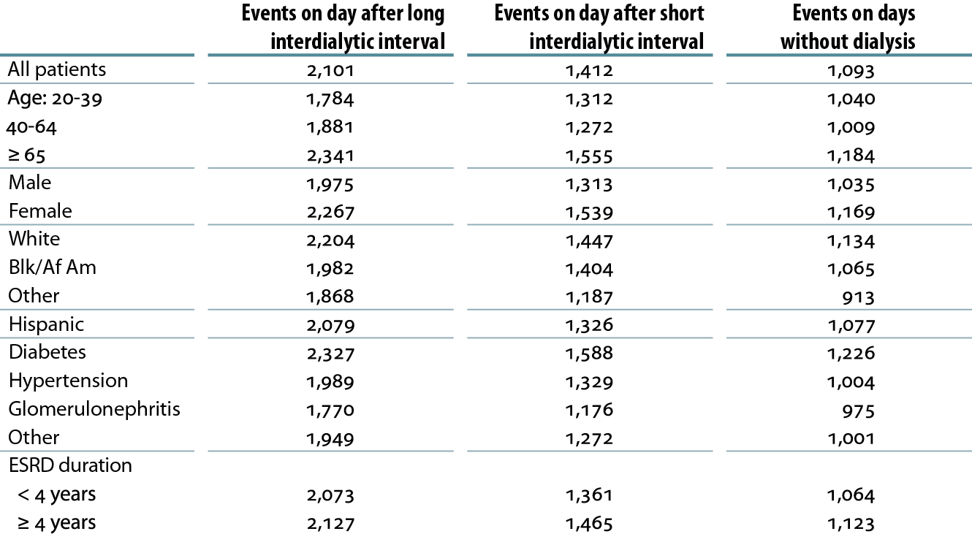
Annualized all-cause admission rates (per 1,000 patient years), on days after the long & short interdialytic intervals & on days without dialysis, 2010
Table 3.b (Volume 2)
January 1, 2010 point prevalent Medicare hemodialysis patients alive on January 31. Includes patients age 20 & older receiving hemodialysis three times weekly on a Monday–Wednesday–Friday or Tuesday–Thursday–Saturday schedule. Rates for all patients & groups by ESRD duration are adjusted for age, gender, race, Hispanic ethnicity, & primary diagnosis; rates by age, gender, & primary diagnosis are adjusted for the other four factors. Rates by race & ethnicity are adjusted for age, gender, & primary diagnosis. Ref: all included hemodialysis patients in 2010.

