Slide 1
ESRD: Chapter Four Cardiovascular disease in patients with ESRD
United States Renal Data System
2012 Annual Data Report

Slide 2
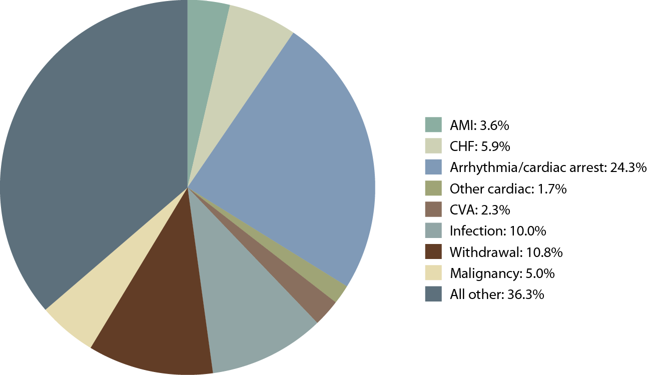
Causes of death in incident dialysis patients, 2008–2010 Figure 4.1 (Volume 2)
Incident & prevalent dialysis patients, 2008–2010.

Slide 3
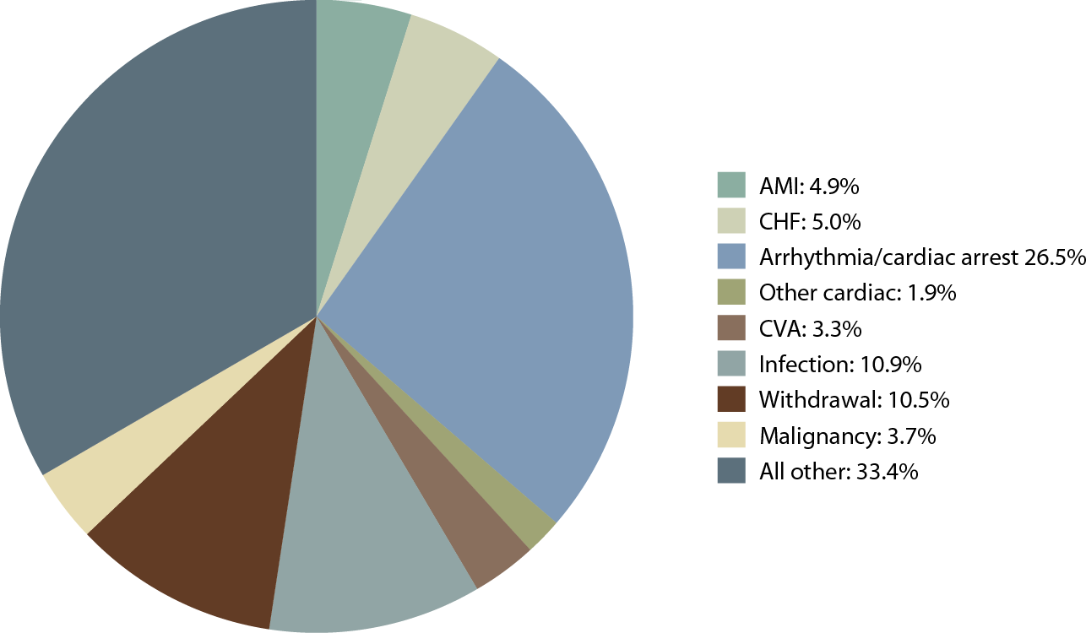
Causes of death in prevalent dialysis patients, 2008–2010 Figure 4.1 (Volume 2)
Incident & prevalent dialysis patients, 2008–2010.

Slide 4
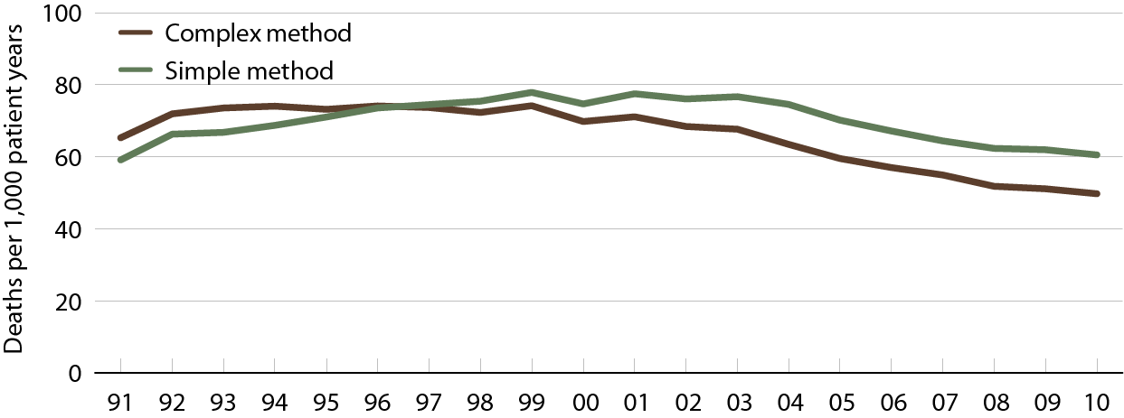
Rates of sudden cardiac death in prevalent dialysis patients, by method of estimation Figure 4.2 (Volume 2)
Period prevalent dialysis patients, age 20 & older, unadjusted, using the complex method.

Slide 5
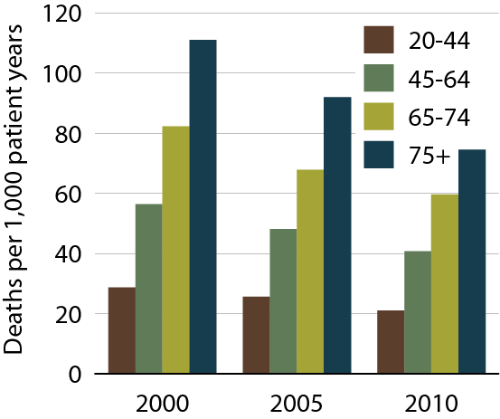
Rates of sudden cardiac death in prevalent dialysis patients, by age Figure 4.3 (Volume 2)
Period prevalent dialysis patients, age 20 & older, unadjusted.

Slide 6
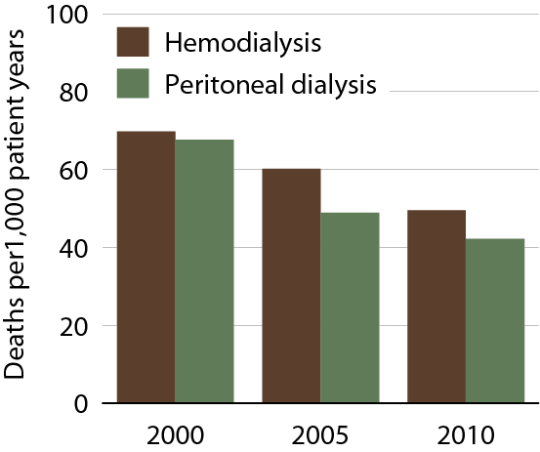
Rates of sudden cardiac death in prevalent dialysis patients, by modality Figure 4.4 (Volume 2)
Period prevalent dialysis patients, age 20 & older, unadjusted.

Slide 7
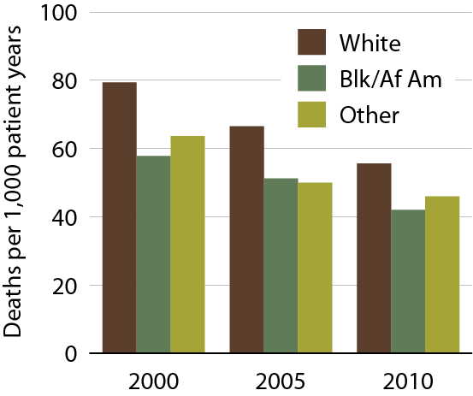
Rates of sudden cardiac death in prevalent dialysis patients, by race Figure 4.5 (Volume 2)
Period prevalent dialysis patients, age 20 & older, unadjusted.

Slide 8
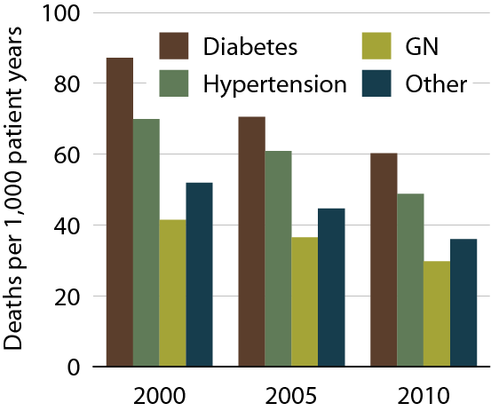
Rates of sudden cardiac death in prevalent dialysis patients, by primary diagnosis Figure 4.6 (Volume 2)
Period prevalent dialysis patients, age 20 & older, unadjusted.

Slide 9
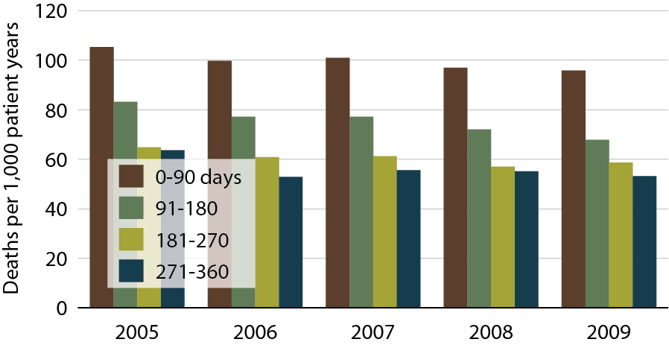
Rates of sudden cardiac death following initiation of treatment in incident dialysis patients Figure 4.7 (Volume 2)
Incident dialysis patients, age 20 & older, unadjusted.

Slide 10
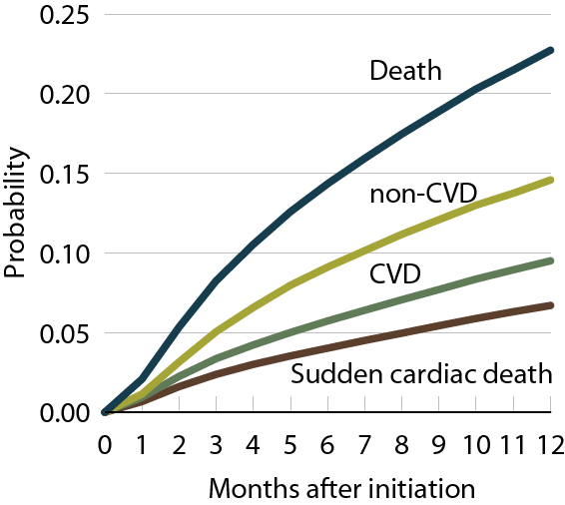
Probability of death in incident dialysis patients, by cause of death, 2009 Figure 4.8 (Volume 2)
Incident dialysis patients, age 20 & older, unadjusted.

Slide 11
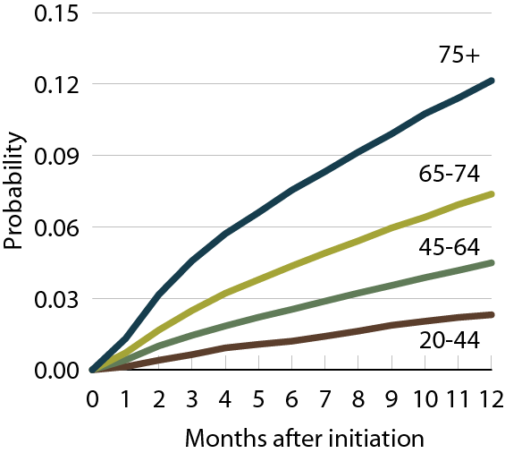
Probability of sudden cardiac death in incident dialysis patients, by age, 2009 Figure 4.9 (Volume 2)
Incident dialysis patients, age 20 & older, unadjusted.

Slide 12
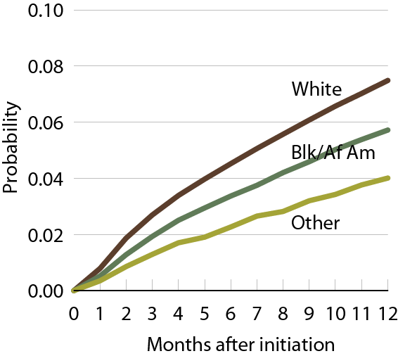
Probability of sudden cardiac death in incident dialysis patients, by race, 2009 Figure 4.10 (Volume 2)
Incident dialysis patients, age 20 & older, unadjusted.

Slide 13
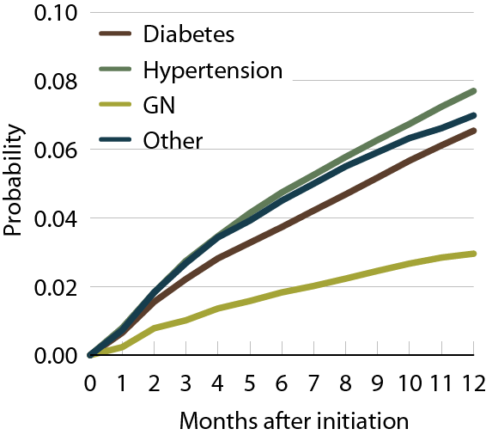
Probability of sudden cardiac death in incident dialysis patients, by primary diagnosis, 2009 Figure 4.11 (Volume 2)
Incident dialysis patients, age 20 & older, unadjusted.

Slide 14
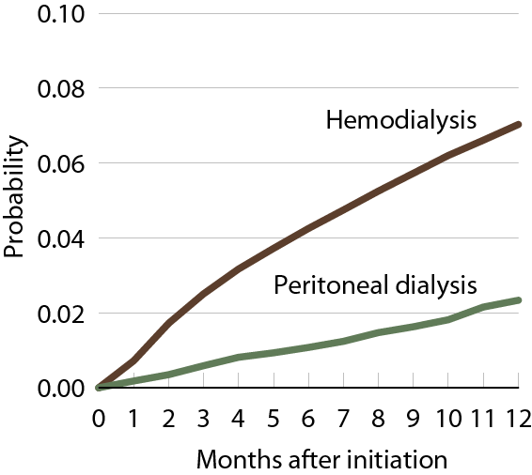
Probability of sudden cardiac death in incident dialysis patients, by modality, 2009 Figure 4.12 (Volume 2)
Incident dialysis patients, age 20 & older, unadjusted.

Slide 15
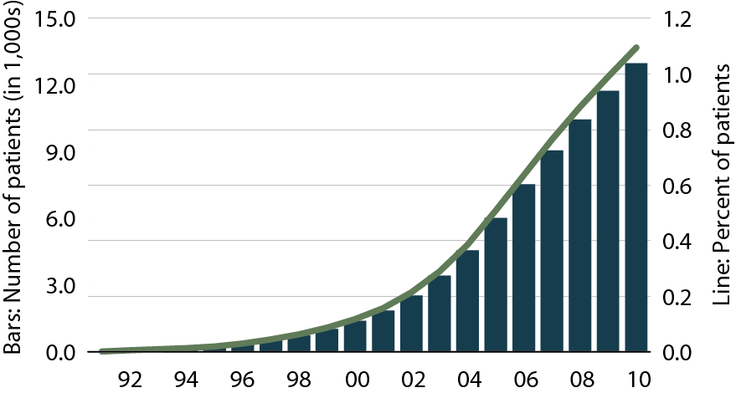
Cumulative number & percent of dialysis patients receiving ICDs/CRT-Ds Figure 4.13 (Volume 2)
Period prevalent patients; dialysis patients 1992–2010.

Slide 16
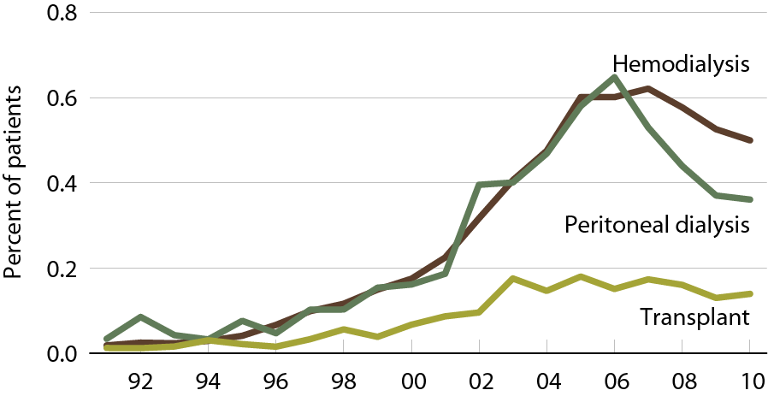
Patients receiving ICDs/CRT-Ds, modality Figure 4.14 (Volume 2)
Dialysis or transplant patients in each year 1992–2010.

Slide 17
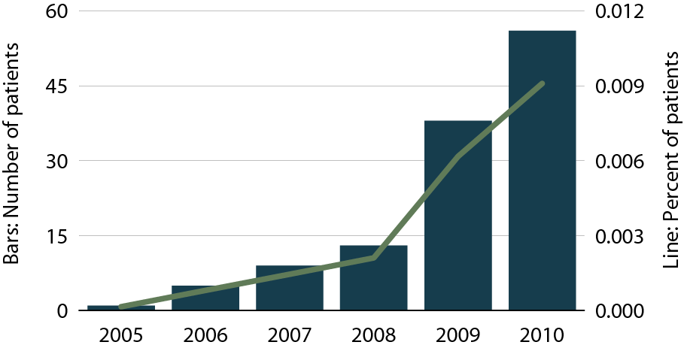
Cumulative number & percent of dialysis patients using a wearable cardioverter defibrillator Figure 4.15 (Volume 2)
Dialysis patients 2005–2010.

Slide 18
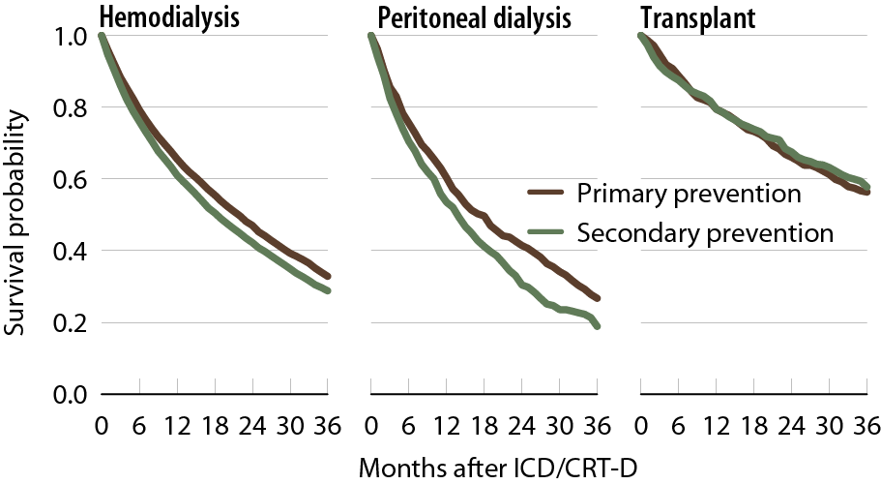
All-cause survival following implantation of first ICD/CRT-D, by modality, 1999–2010 Figure 4.16 (Volume 2)
Dialysis & transplant patients receiving their first ICDs/CRT-Ds in 1999–2010.

Slide 19
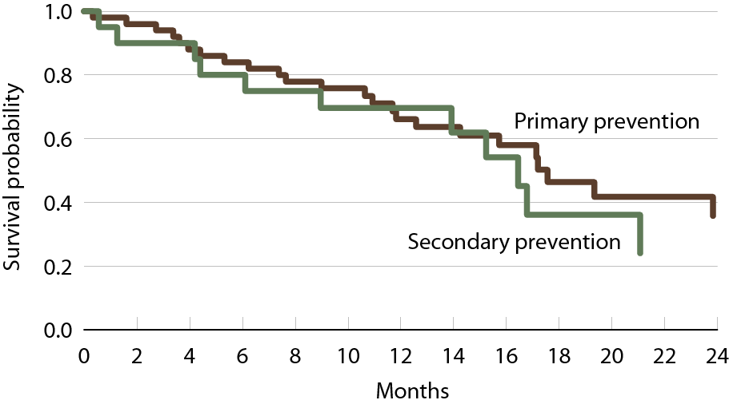
All-cause survival in dialysis patients using first wearable cardioverter defibrillator (WCD), 2005–2010 Figure 4.17 (Volume 2)
Dialysis patients receiving first WCD in 2005–2010.

Slide 20
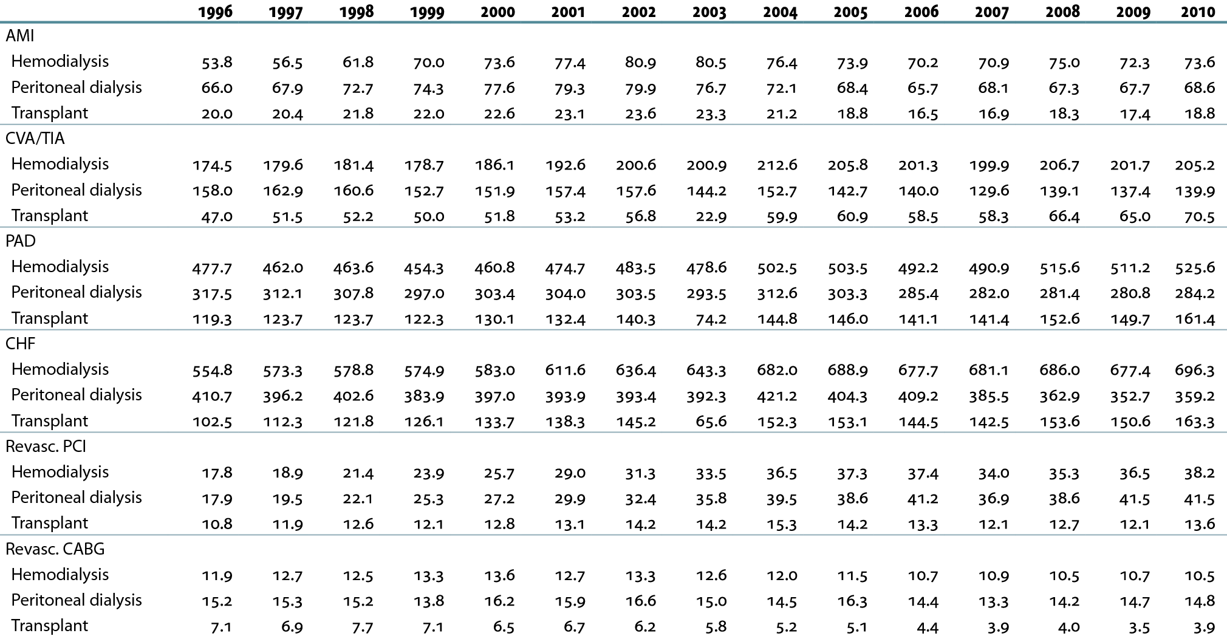
Rates (per 1,000 patient years) of cardiovascular events & procedures Table 4.a (Volume 2)
Point prevalent ESRD patients on January 1 of each year & age 20 or older; unadjusted.

Slide 21
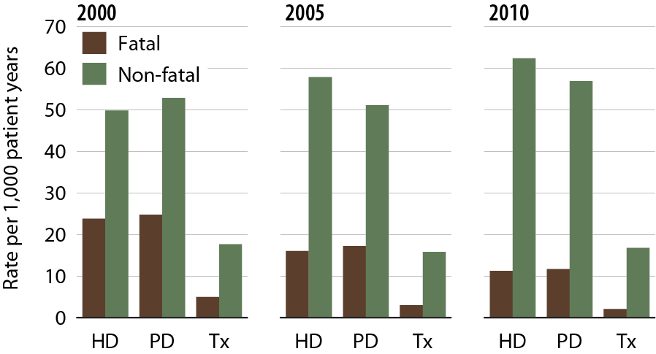
Rates of fatal & non-fatal acute myocardial infarction, by modality Figure 4.18 (Volume 2)
Point prevalent ESRD patients on January 1 of each year & age 20 or older; unadjusted.

Slide 22
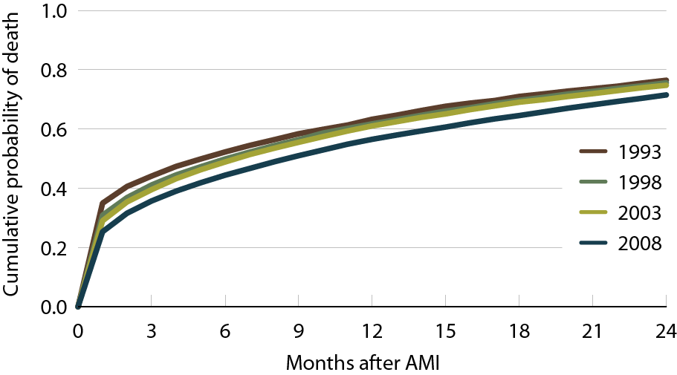
Two-year cumulative probability of death in dialysis patients following an AMI Figure 4.19 (Volume 2)
Period prevalent dialysis patients with first AMI in the year, unadjusted.

Slide 23
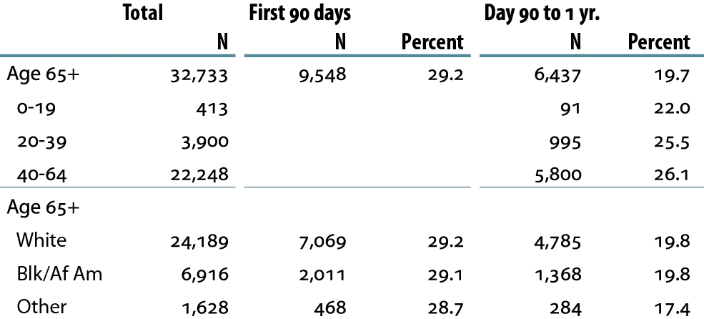
Percent of incident patients receiving first echocardiograms, 2010 Table 4.b (Volume 2)
Incident dialysis patients, 2010.

Slide 24
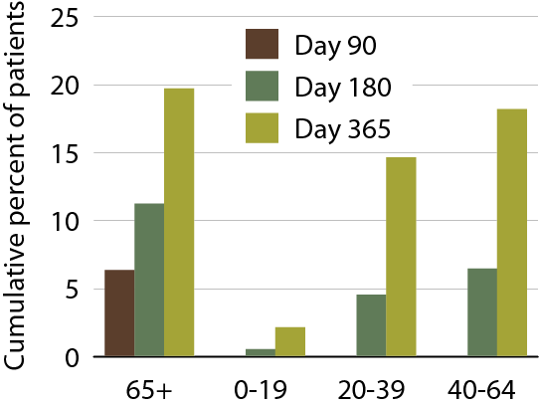
Cumulative percent of patients receiving a stress test, by age Figure 4.20 (Volume 2)
Incident dialysis patients, 2010.

Slide 25
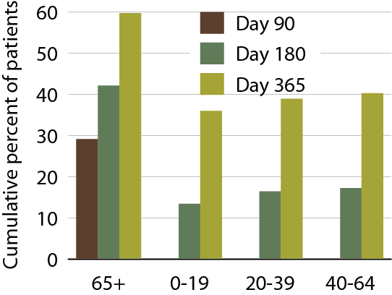
Cumulative percent of patients receiving an echocardiogram, by age Figure 4.21 (Volume 2)
Incident dialysis patients, 2010.

Slide 26
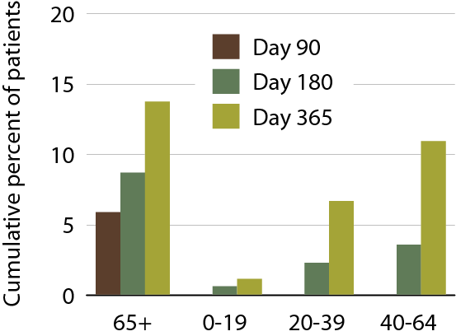
Cumulative percent of patients receiving coronary angiography, by age Figure 4.22 (Volume 2)
Incident dialysis patients, 2010.

Slide 27
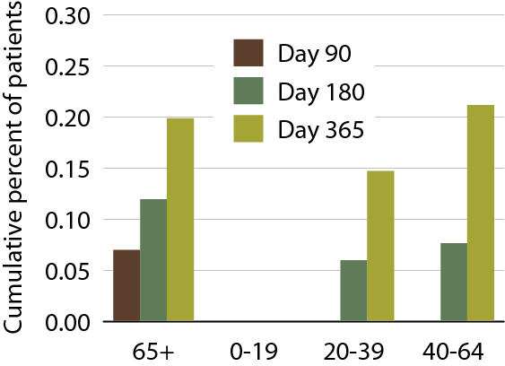
Cumulative percent of patients receiving non-invasive coronary angiography, by age Figure 4.23 (Volume 2)
Incident dialysis patients, 2010.

Slide 28
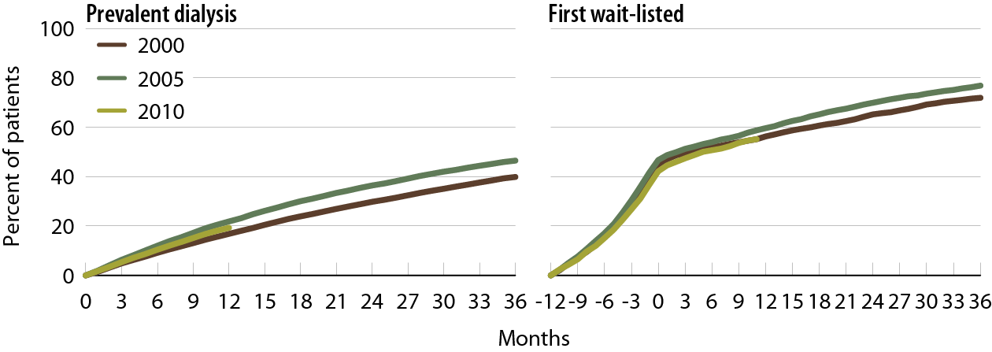
Cumulative percent of prevalent & pre-renal transplant patients receiving a stress test Figure 4.24 (Volume 2)
Point prevalent dialysis patients & Medicare enrollees wait-listed for the first time.

Slide 29
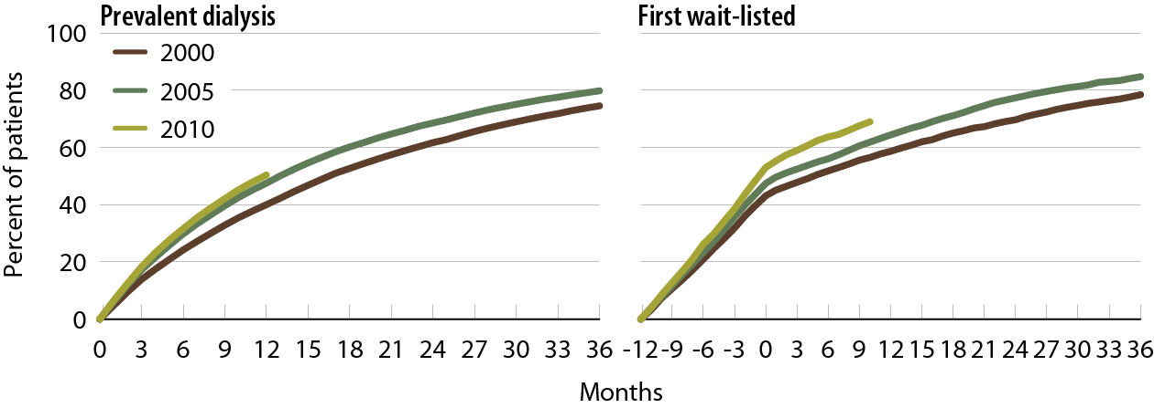
Cumulative percent of prevalent & pre-renal transplant patients receiving an echocardiogram Figure 4.25 (Volume 2)
Point prevalent dialysis patients & Medicare enrollees wait-listed for the first time.

Slide 30
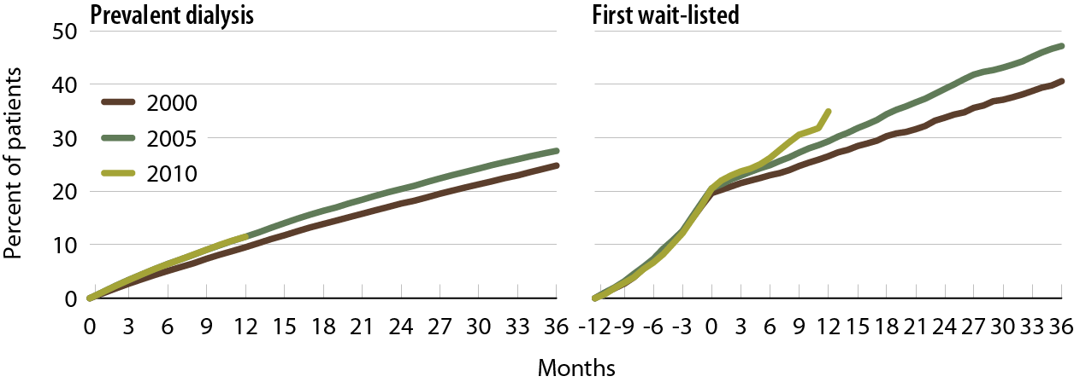
Cumulative percent of prevalent & pre-renal transplant patients receiving coronary angiography Figure 4.26 (Volume 2)
Point prevalent dialysis patients & Medicare enrollees wait-listed for the first time.

Slide 31
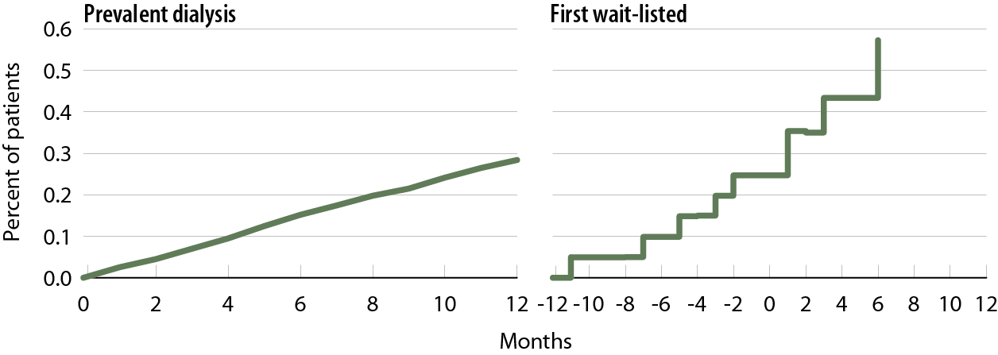
Cumulative percent of prevalent & pre-renal transplant patients receiving non-invasive coronary angiography, 2010 Figure 4.27 (Volume 2)
Point prevalent dialysis patients & Medicare enrollees wait-listed for the first time.

Slide 32
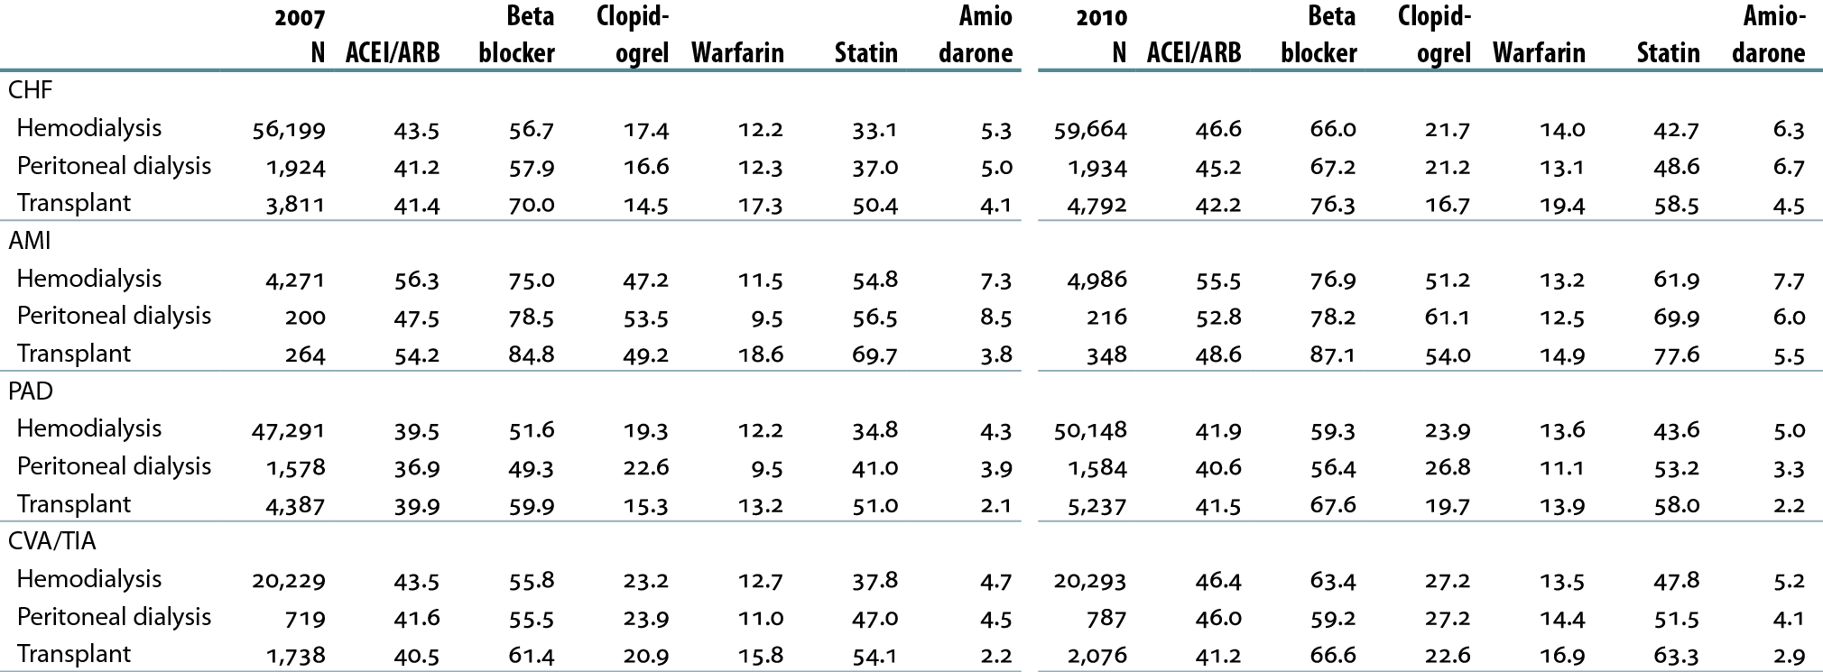
Cardiovascular disease & pharmacological interventions in ESRD patients, by diagnosis & modality (row %) Table 4.c (Volume 2)
January 1 point prevalent ESRD patients with Medicare Parts A, B, & D enrollment, with a first cardiovascular diagnosis or procedure in the year.

Slide 33
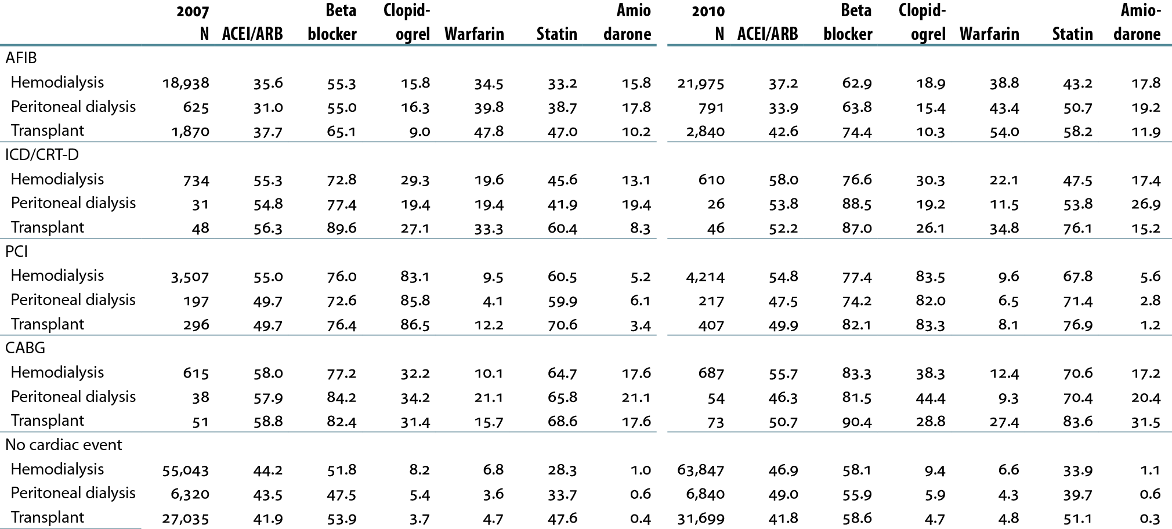
Cardiovascular disease & pharmacological interventions in ESRD patients, by diagnosis & modality (row %) Table 4.c (continued; Volume 2)
January 1 point prevalent patients with Medicare Parts A, B, & D enrollment, with a first cardiovascular diagnosis or procedure in the year.

Slide 34
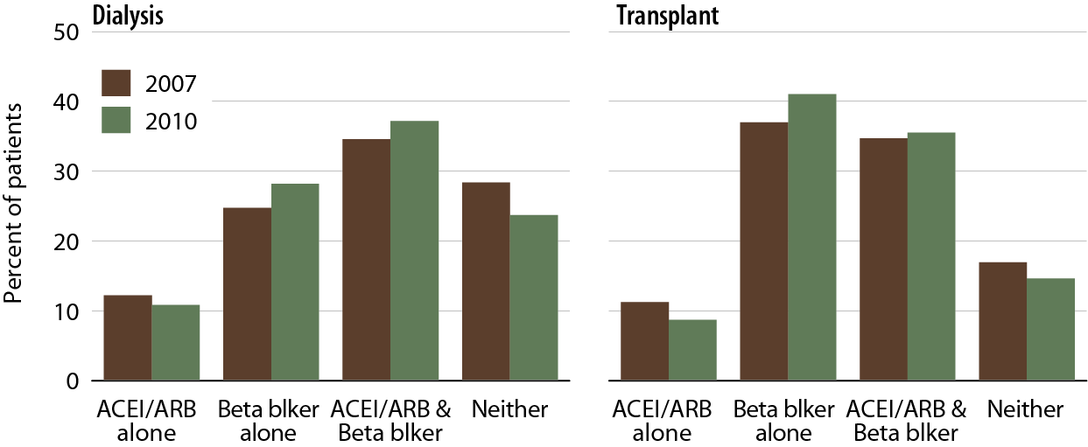
Cardiac drug use in ESRD patients following a diagnosis of CHF or AMI Figure 4.28 (Volume 2)
January 1 point prevalent ESRD patients with Medicare Parts A, B, & D enrollment, with a first diagnosis of CHF or AMI in the year.

Slide 35
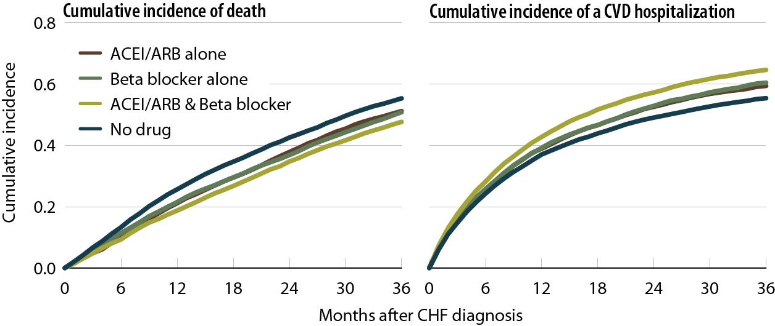
Cumulative incidence of death or CVD hospitalization in ESRD patients following a diagnosis of CHF, 2007–2010 Figure 4.29 (Volume 2)
January 1 point prevalent ESRD patients with Medicare Parts A, B, & D enrollment, with a first diagnosis of CHF in 2007.

Slide 36
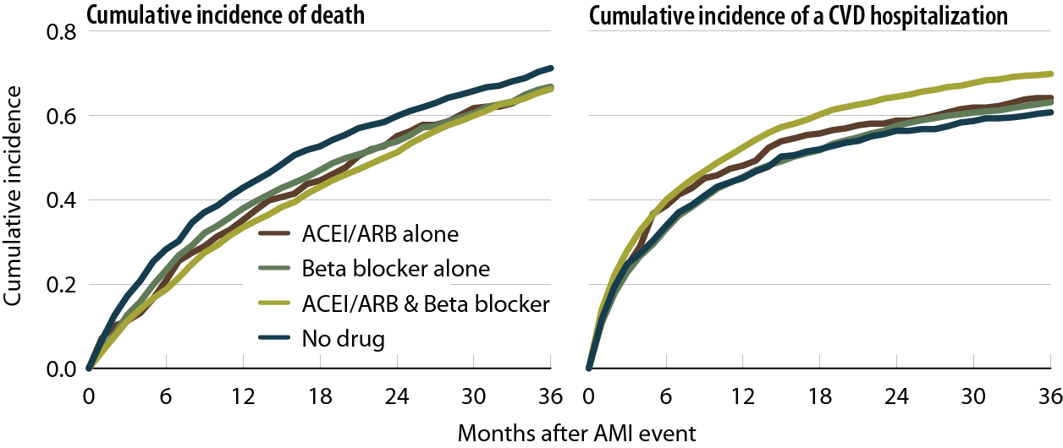
Cumulative incidence of death or CVD hospitalization in ESRD patients following a diagnosis of AMI, 2007–2010 Figure 4.30 (Volume 2)
January 1 point prevalent ESRD patients with Medicare Parts A, B, & D enrollment, with a first diagnosis of AMI in 2007.

