Slide 1
ESRD: Chapter Five
Mortality
United States Renal Data System
2012 Annual Data Report

Slide 2
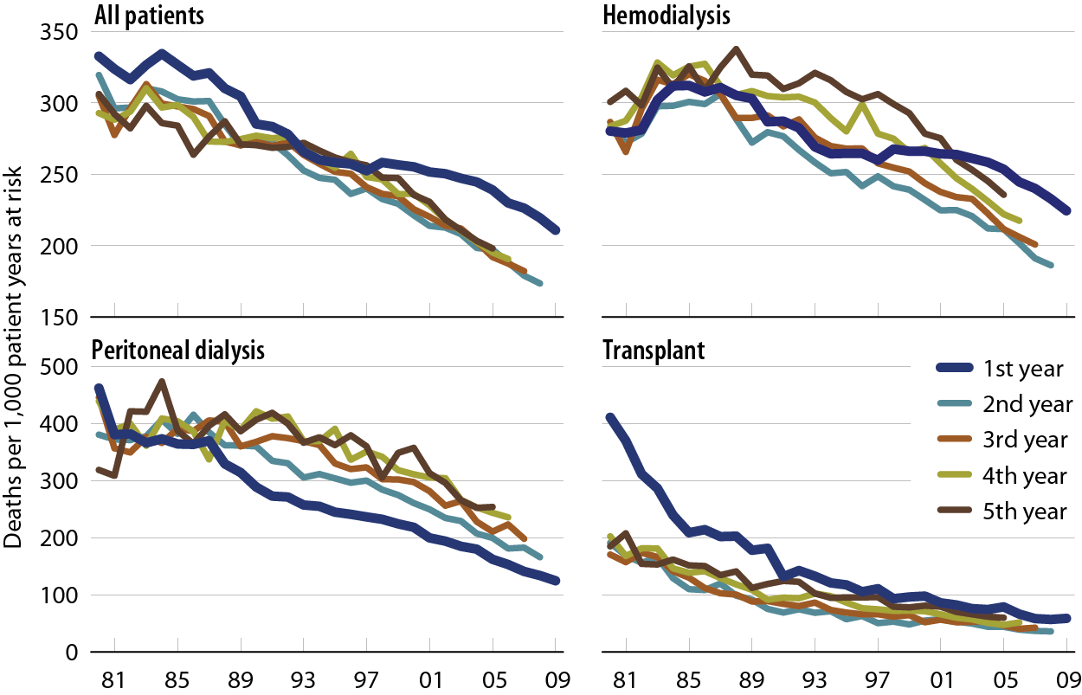
Adjusted all-cause mortality rates (from day 90), by modality & year of treatment Figure 5.1 (Volume 2)
Incident ESRD patients. Adj: age/gender/race /primary diagnosis; ref: incident ESRD patients, 2005.

Slide 3
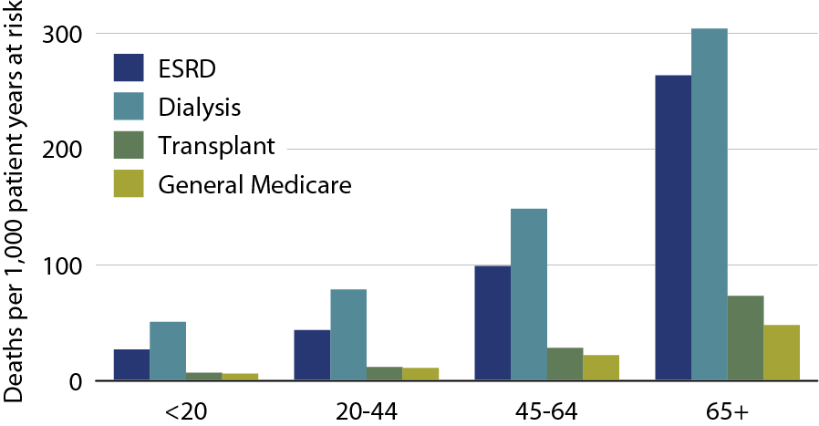
Adjusted all-cause mortality in the ESRD & general populations, by age, 2010 Figure 5.2 (Volume 2)
Prevalent ESRD & general Medicare (non-ESRD) patients. Adj: gender/race; ref: Medicare patients, 2010.

Slide 4
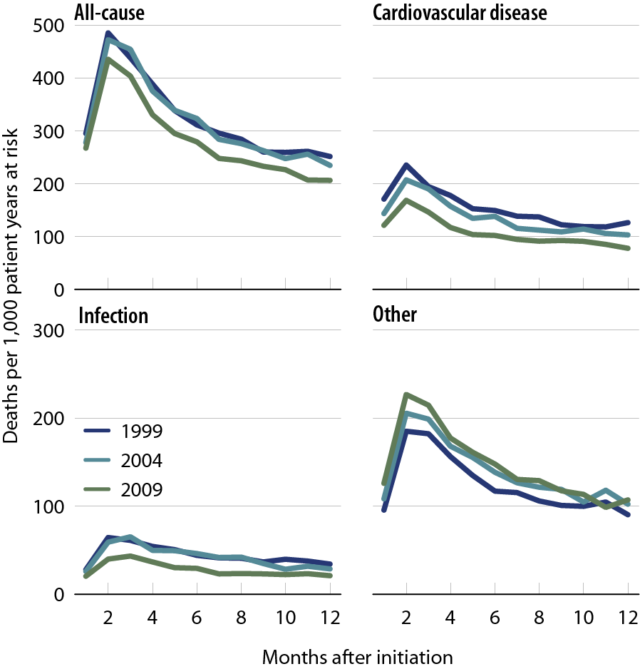
Adjusted all-cause & cause specific mortality (from day one) in the first year of hemodialysis Figure 5.3 (Volume 2)
Incident hemodialysis patients defined on the day of dialysis onset, without the 60-day rule. Adj: age/gender /race/Hispanic ethnicity/ primary diagnosis; ref: incident hemodialysis patients, 2005.

Slide 5
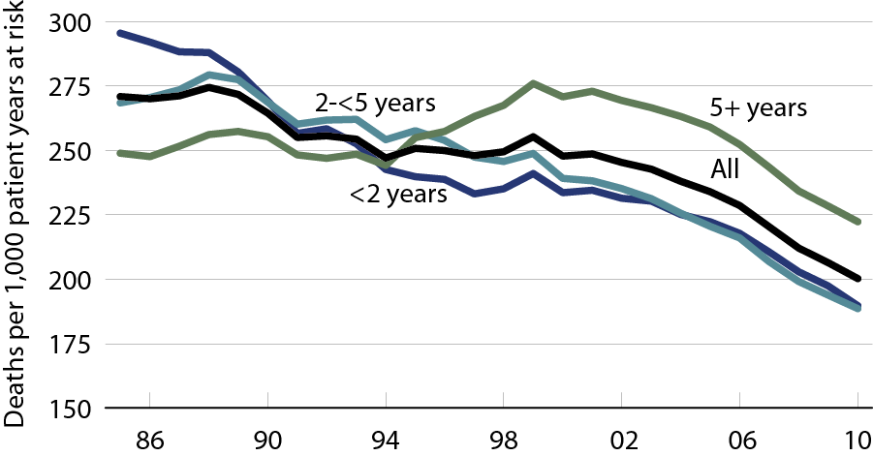
Adjusted all-cause mortality in prevalent hemodialysis patients, by vintage Figure 5.4 (Volume 2)
Incident hemodialysis patients. Adj: age/gender/race/primary diagnosis; ref: incident hemodialysis patients, 2005.

Slide 6
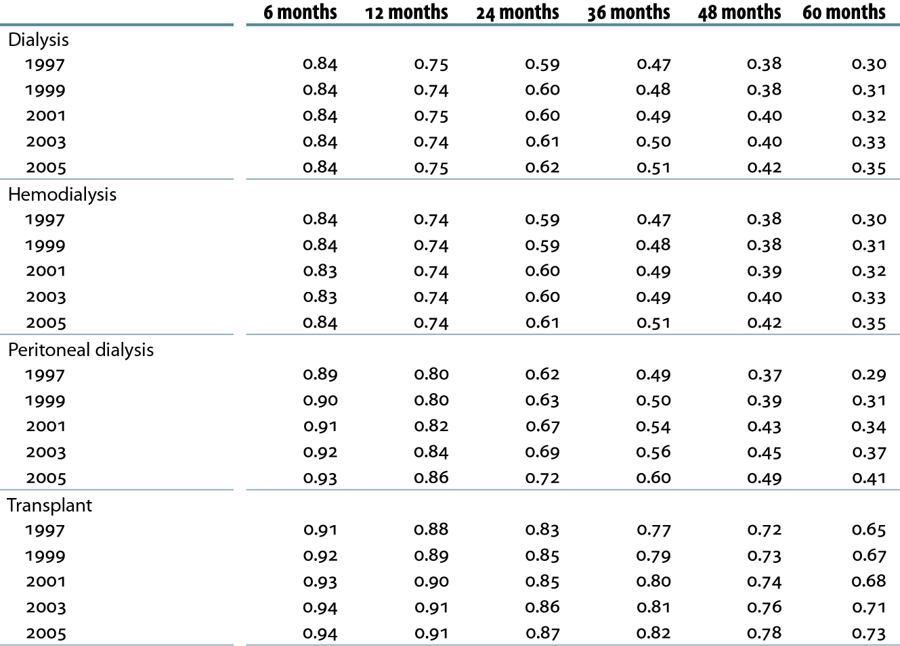
Adjusted survival probabilities, from day one, in the ESRD population Table 5.a (Volume 2)
Incident dialysis patients defined on the day of dialysis onset, without the 60-day rule from day one of dialysis to December 31, 2010; transplant patients receiving a first transplant in the calendar year, followed from day of transplant to December 31, 2010. Adj: age/gender/race/ Hispanic ethnicity/primary diagnosis; ref: incident ESRD patients, 2005.

Slide 7
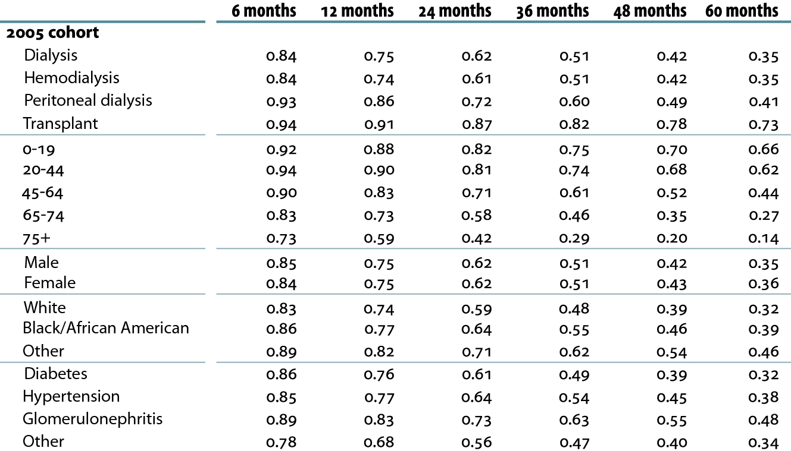
Adjusted survival probabilities, from day one, in the ESRD population Table 5.a (continued; Volume 2)
Incident dialysis patients defined on the day of dialysis onset, without the 60-day rule from day one of dialysis to December 31, 2010; transplant patients receiving a first transplant in the calendar year, followed from day of transplant to December 31, 2010. Adj: age/gender/race/ Hispanic ethnicity/primary diagnosis; ref: incident ESRD patients, 2005.

Slide 8
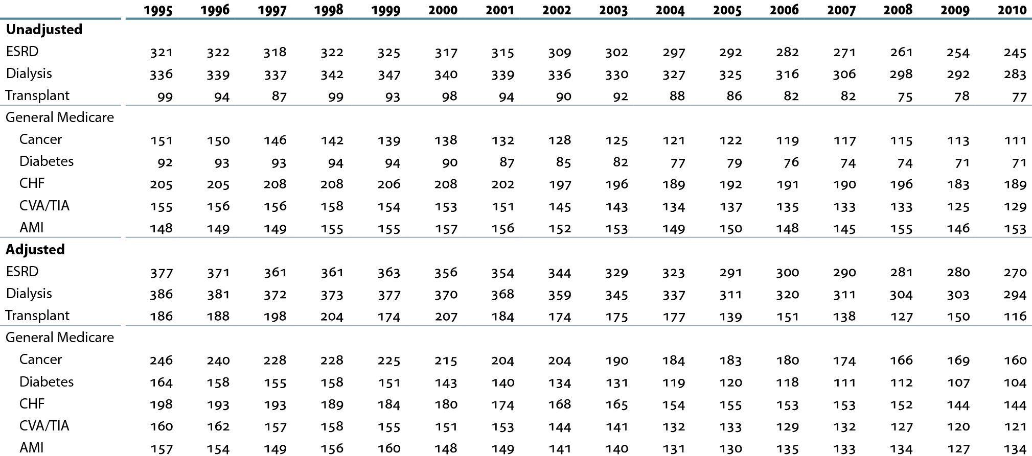
Unadjusted & adjusted mortality rates in the ESRD & general Medicare populations, age 65 & older (per 1,000 patient years at risk) Table 5.b (Volume 2)
January 1 point prevalent ESRD & general Medicare patients age 65 & older. Adj: age/gender/race /comorbidity; ref: ESRD patients, 2005.

Slide 9
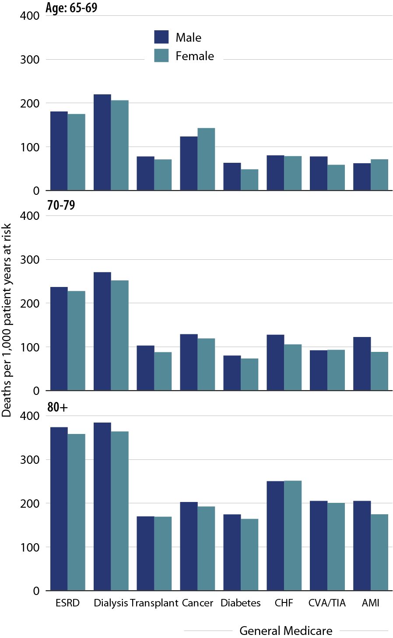
Adjusted all-cause mortality rates in the ESRD & general populations, by age & gender, 2010 Figure 5.5 (Volume 2)
January 1 point prevalent ESRD & general Medicare patients age 65 & older. Adj: age/gender/race/ comorbidity; ref: 2010 ESRD patients.

Slide 10
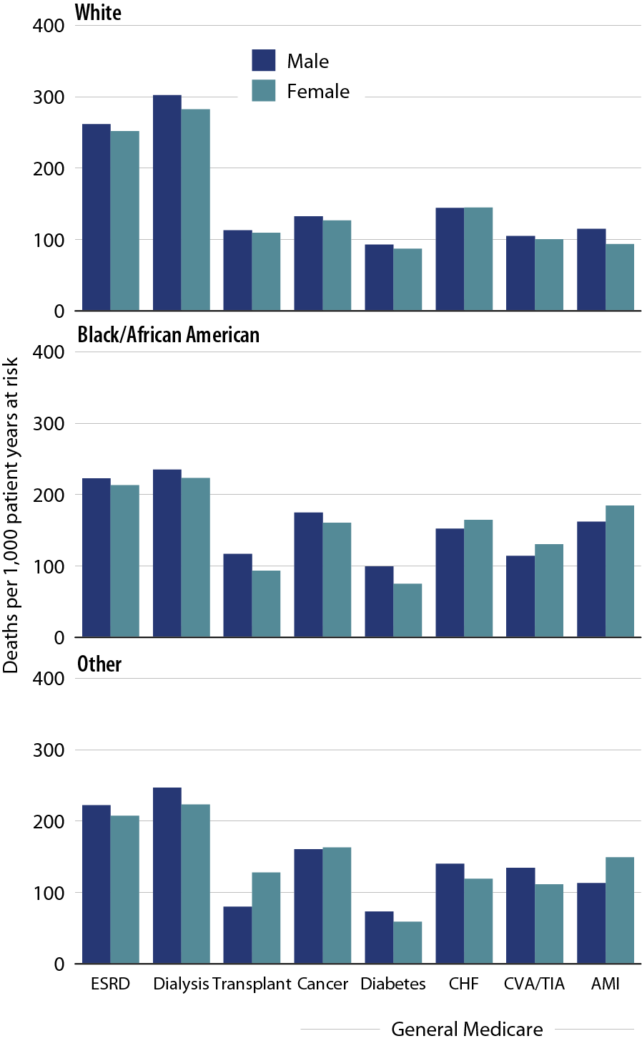
Adjusted all-cause mortality rates in the ESRD & general populations, by race & gender, 2010 Figure 5.6 (Volume 2)
January 1 point prevalent ESRD & general Medicare patients age 65 & older. Adj: age/gender/race/ comorbidity; ref: 2010 ESRD patients.

Slide 11
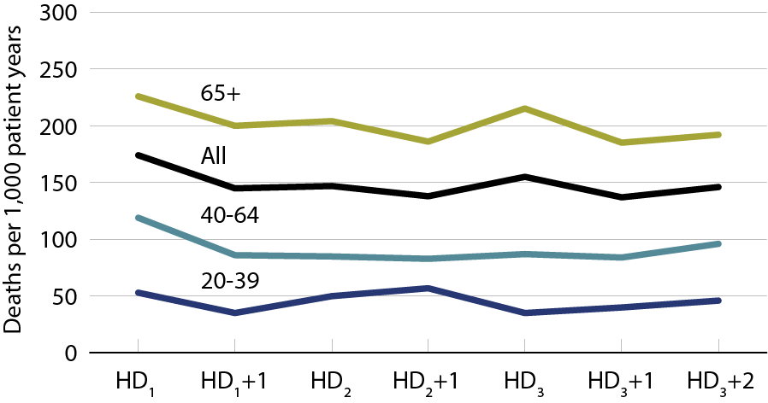
Annualized all-cause mortality rates on different days of the dialysis week, 2010 Figure 5.7 (Volume 2)
January 1, 2010 point prevalent Medicare hemodialysis patients alive on January 31. Includes patient age 20 & older receiving hemodialysis three times weekly on a Monday–Wednesday–Friday or Tuesday–Thursday–Saturday schedule; HD1, HD2, & HD3, are the first, second, & third hemodialysis sessions. Rates for all patients are adjusted for age, gender, race, Hispanic ethnicity, & primary diagnosis; rates by age are adjusted for the other four factors. Ref: all included hemodialysis patients in 2010.

Slide 12
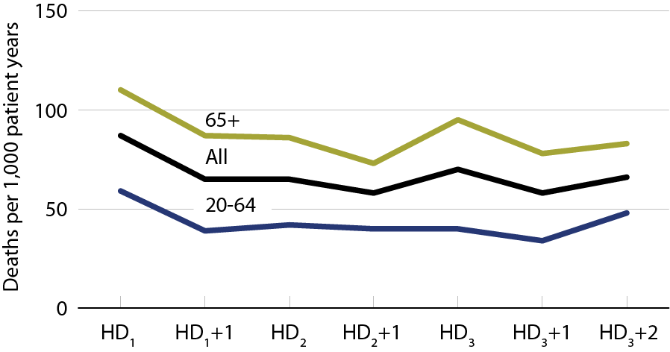
Annualized cardiovascular mortality rates on different days of the dialysis week, 2010 Figure 5.8 (Volume 2)
January 1, 2010 point prevalent Medicare hemodialysis patients alive on January 31. Includes patient age 20 & older receiving hemodialysis three times weekly on a Monday–Wednesday–Friday or Tuesday–Thursday–Saturday schedule; HD1, HD2, & HD3, are the first, second, & third hemodialysis sessions. Rates for all patients are adjusted for age, gender, race, Hispanic ethnicity, & primary diagnosis; rates by age are adjusted for the other four factors. Ref: all included hemodialysis patients in 2010.

Slide 13
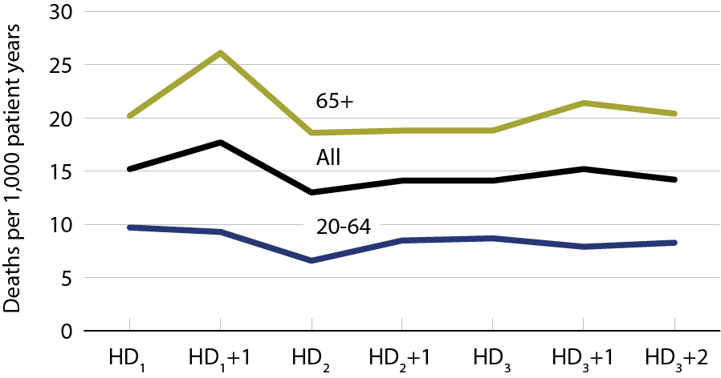
Annualized rates of mortality due to infection on different days of the dialysis week, 2010 Figure 5.9 (Volume 2)
January 1, 2010 point prevalent Medicare hemodialysis patients alive on January 31. Includes patient age 20 & older receiving hemodialysis three times weekly on a Monday–Wednesday–Friday or Tuesday–Thursday–Saturday schedule; HD1, HD2, & HD3, are the first, second, & third hemodialysis sessions. Rates for all patients are adjusted for age, gender, race, Hispanic ethnicity, & primary diagnosis; rates by age are adjusted for the other four factors. Ref: all included hemodialysis patients in 2010.

Slide 14
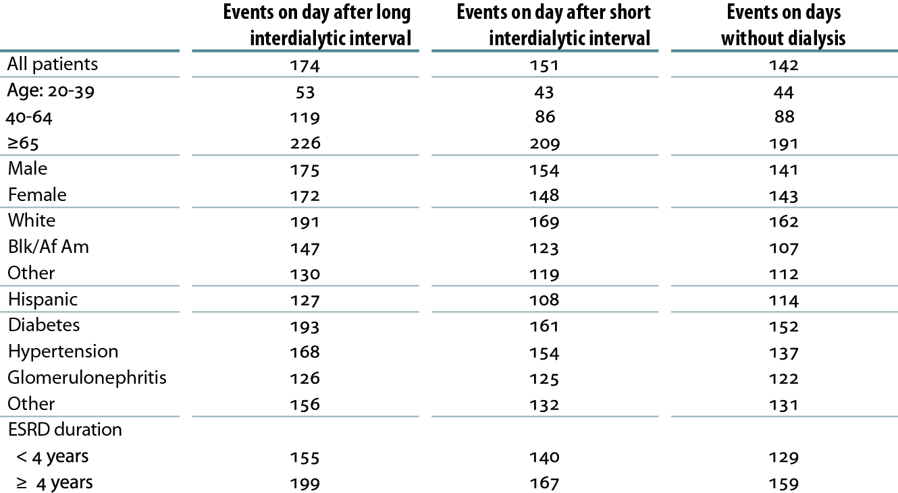
Annualized all-cause mortality rates (per 1,000 patient years) on days after the long & short interdialytic intervals & on days without dialysis, 2010 Table 5.c (Volume 2)
January 1, 2010 point prevalent Medicare hemodialysis patients alive on January 31. Includes patients age 20 & older receiving hemodialysis three times weekly on a Monday–Wednesday–Friday or Tuesday–Thursday–Saturday schedule. Rates for all patients, & groups by ESRD duration, are adjusted for age, gender, race, Hispanic ethnicity, & primary diagnosis; rates by age, gender, & primary diagnosis are adjusted for the other four factors. Rates by race & ethnicity are adjusted for age, gender, & primary diagnosis. Ref; all included hemodialysis patients in 2010.

