Slide 1
ESRD: Chapter Six Prescription drug coverage Medicare Part D & private insurance
United States Renal Data System
2012 Annual Data Report

Slide 2
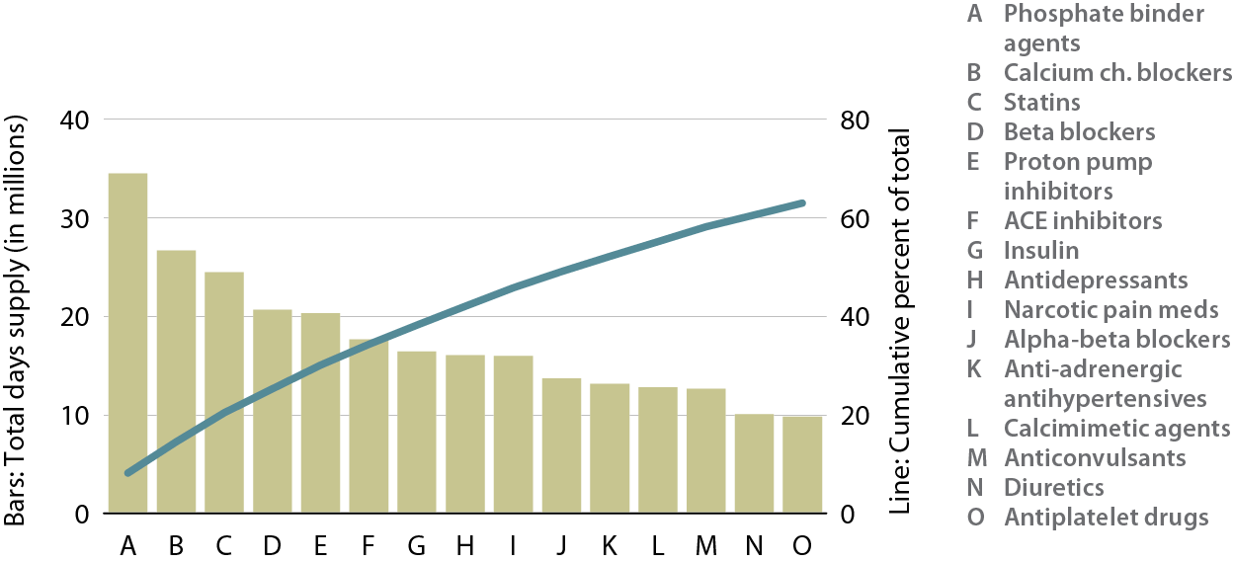
Top 15 drug classes used by Part D-enrolled dialysis patients, by days supply, 2010 Figure 6.1 (Volume 2)
Point prevalent Medicare enrollees alive on January 1, 2010. Therapeutic classification based on the Medi-Span’s generic product identifier (GPI) therapeutic classification system.

Slide 3
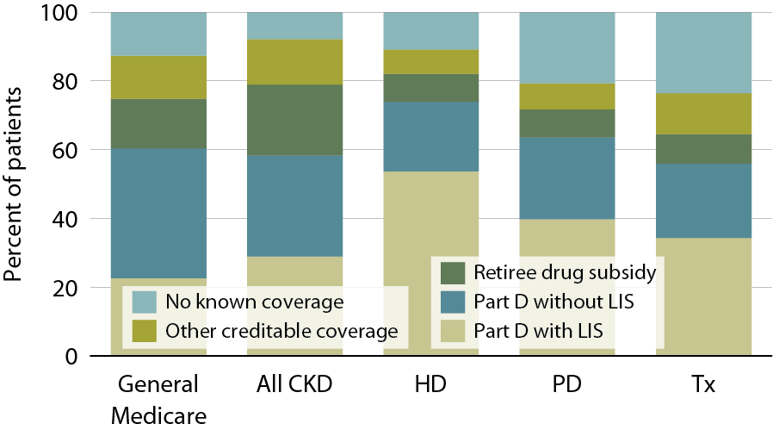
Sources of prescription drug coverage in Medicare ESRD enrollees compared to general Medicare and Medicare-enrolled CKD populations, 2010 Figure 6.2 (Volume 2)
Point prevalent Medicare enrollees alive on January 1, 2010.

Slide 4
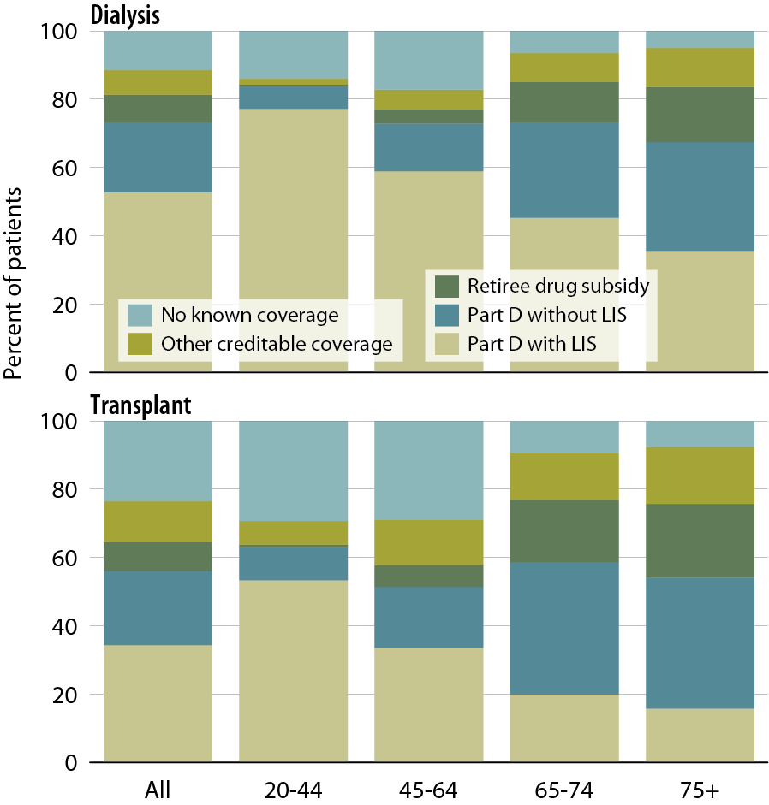
Sources of prescription drug coverage in Medicare ESRD enrollees, by age & modality, 2010 Figure 6.3 (Volume 2)
Point prevalent Medicare enrollees alive on January 1, 2010.

Slide 5
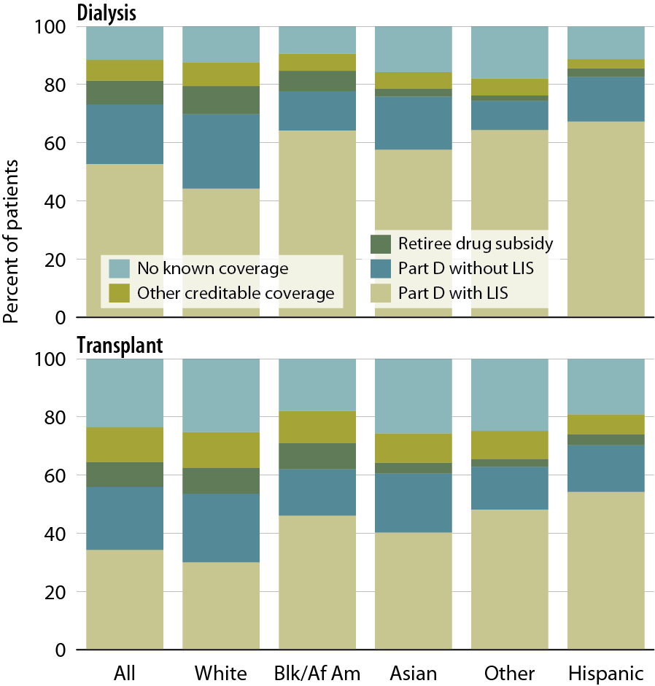
Sources of prescription drug coverage in Medicare ESRD enrollees, by race/ethnicity & modality, 2010 Figure 6.4 (Volume 2)
Point prevalent Medicare enrollees alive on January 1, 2010.

Slide 6
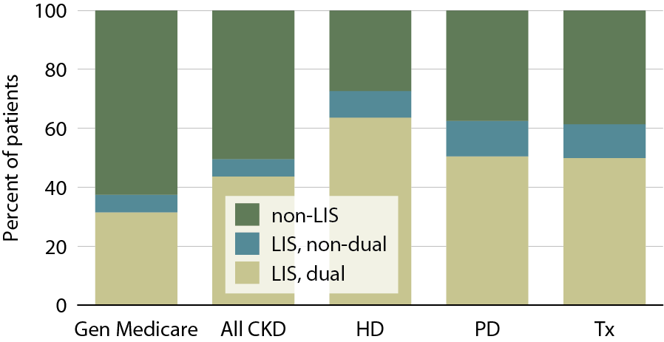
Patients enrolled in Part D, by dual eligibility & low income subsidy (LIS) status, 2010 Figure 6.5 (Volume 2)
Point prevalent Medicare enrollees alive on January 1, 2010.

Slide 7
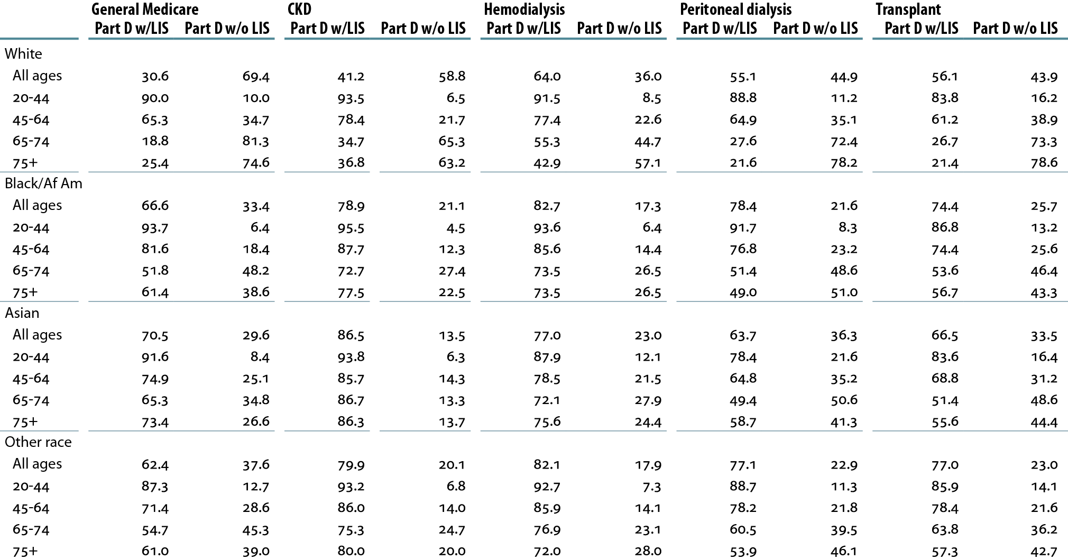
Medicare Part D enrollees with or without the low income subsidy (LIS; percent), by age & race, 2010 Table 6.a (Volume 2)
Point prevalent Medicare enrollees alive on January 1, 2010.

Slide 8
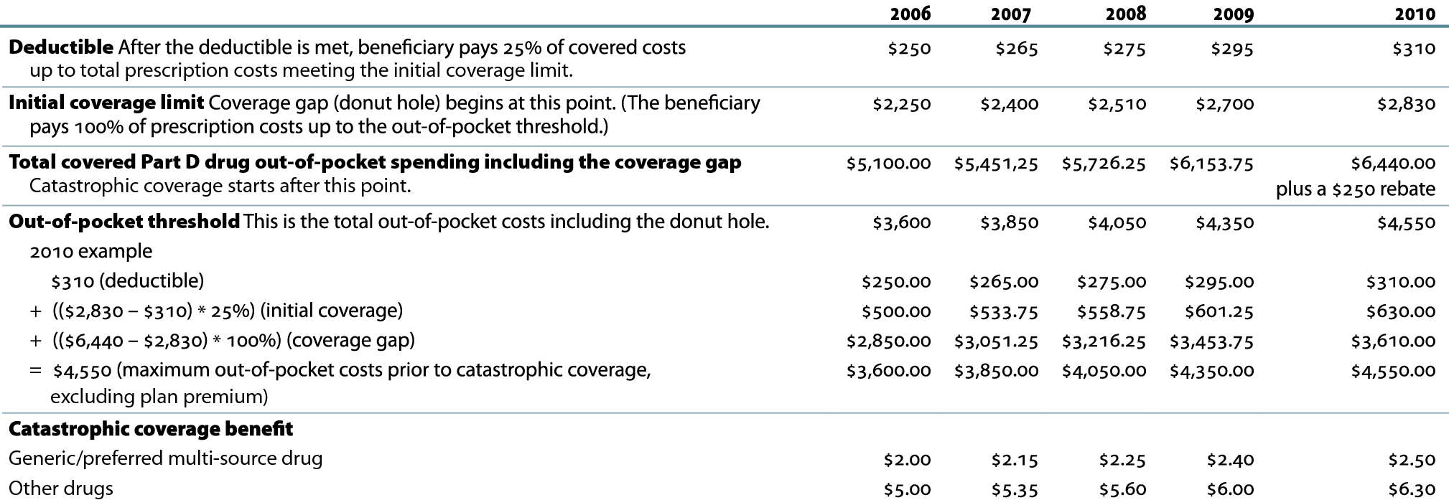
Medicare Part D benefit parameters for defined standard benefit, 2006–2010 Table 6.b (Volume 2)

Slide 9
General Medicare, CKD, & ESRD patients enrolled in Part D (percent) Table 6.c (Volume 2)

Slide 10
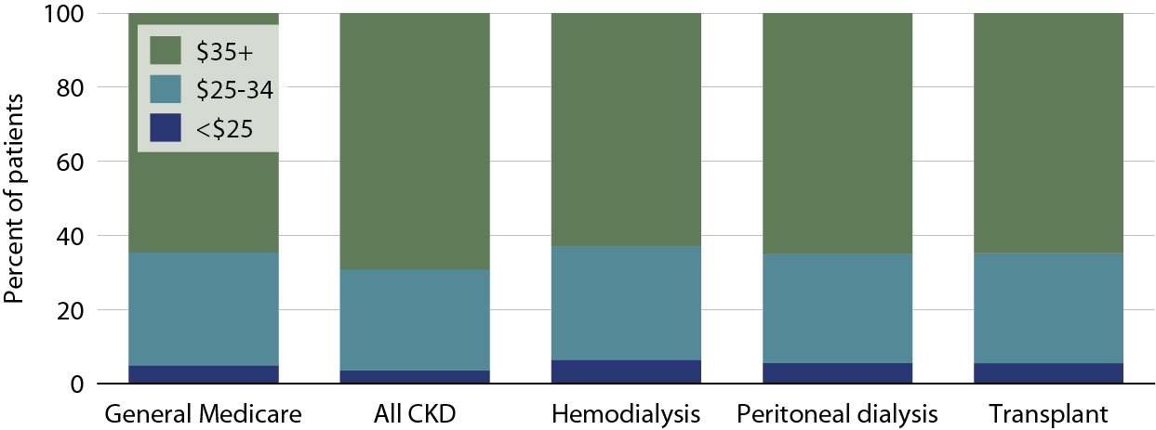
Part D non-LIS enrollees with specified monthly premium, 2010 Figure 6.6 (Volume 2)
Point prevalent Medicare enrollees alive on January 1, excluding those in Medicare Advantage Part D plans.

Slide 11
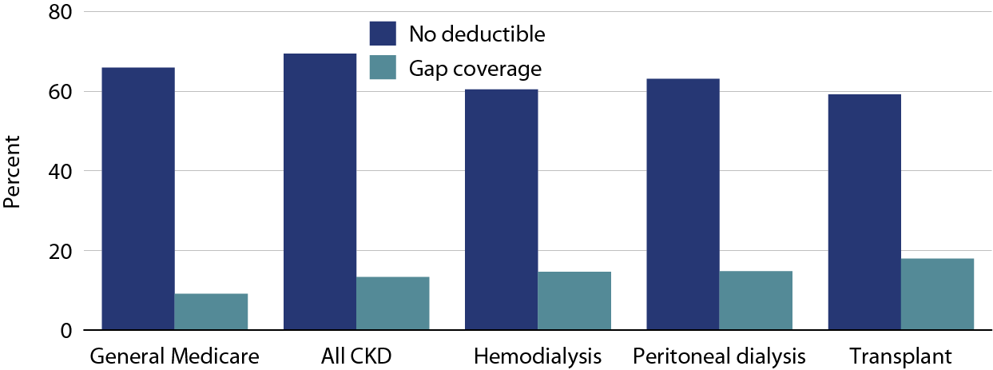
Part D non-LIS enrollees with gap coverage or no deductible, 2010 Figure 6.7 (Volume 2)
Point prevalent Medicare enrollees alive on January 1, excluding those in Medicare Advantage Part D plans.

Slide 12
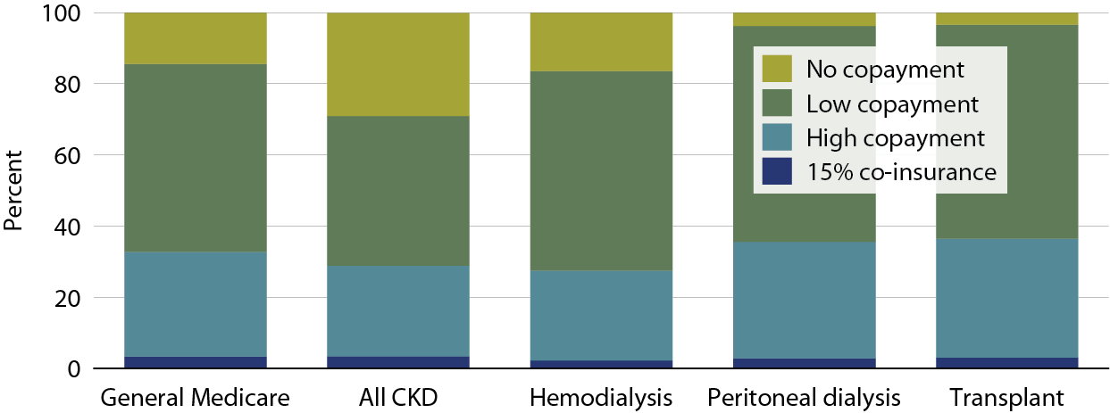
Medicare Part D LIS enrollees with specified coinsurance/copayment, 2010 Figure 6.8 (Volume 2)
Point prevalent Medicare enrollees alive on January 1, excluding those in Medicare Advantage Part D plans.

Slide 13
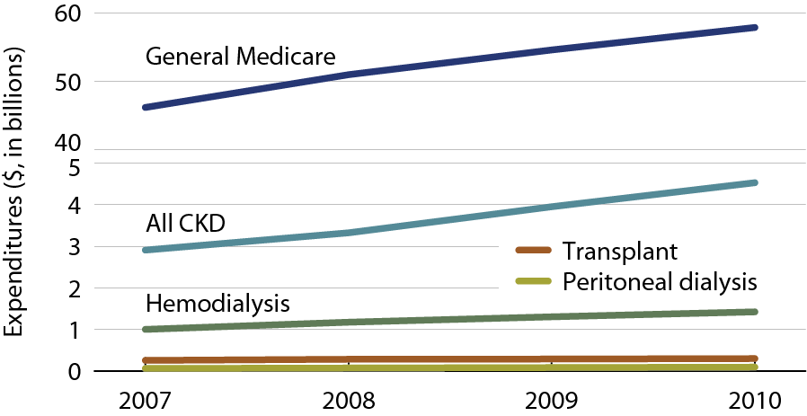
Total estimated net Part D payment for enrollees Figure 6.9 (Volume 2)
All patients enrolled in Part D.

Slide 14
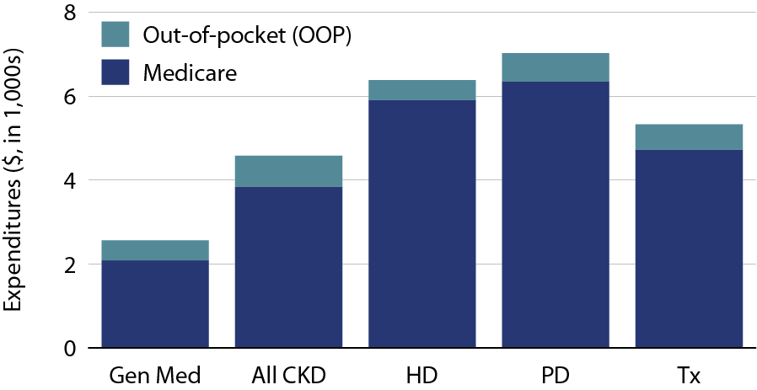
Per person per year Medicare & out- of-pocket Part D costs for enrollees, 2010 Figure 6.10 (Volume 2)
All patients enrolled in Part D.

Slide 15
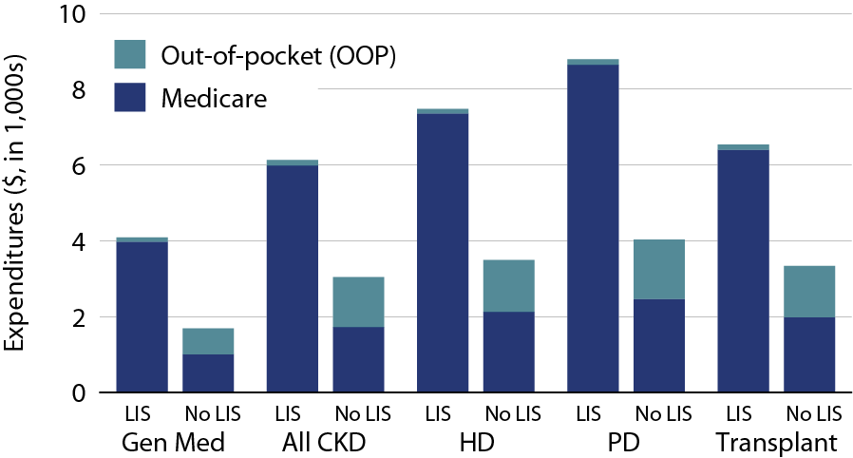
Per person per year Medicare & out-of-pocket Part D costs for enrollees, by low income subsidy (LIS) status, 2010 Figure 6.11 (Volume 2)
All patients enrolled in Part D.

Slide 16
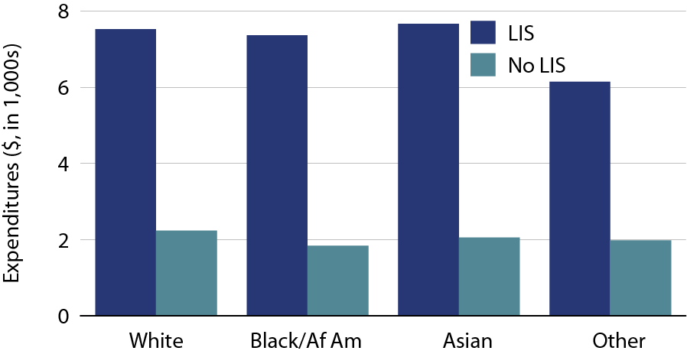
Per person per year Part D costs for enrolled dialysis patients, by low income status (LIS) & race, 2010 Figure 6.12 (Volume 2)
Period prevalent dialysis patients enrolled in Part D.

Slide 17
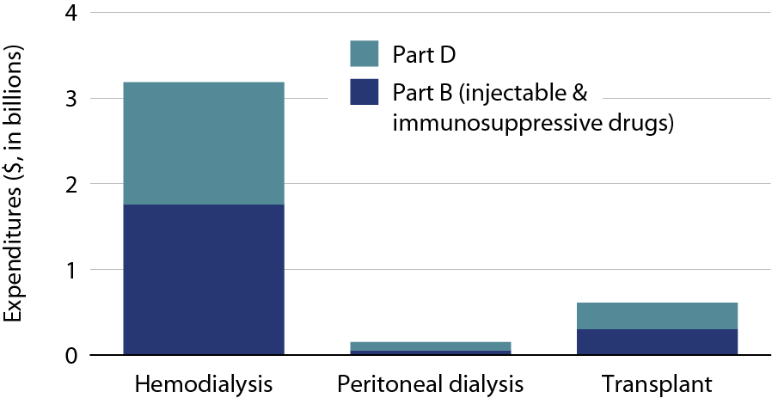
Total Part B & Part D medication costs, by modality, 2010 Figure 6.13 (Volume 2)
Period prevalent ESRD patients.

Slide 18
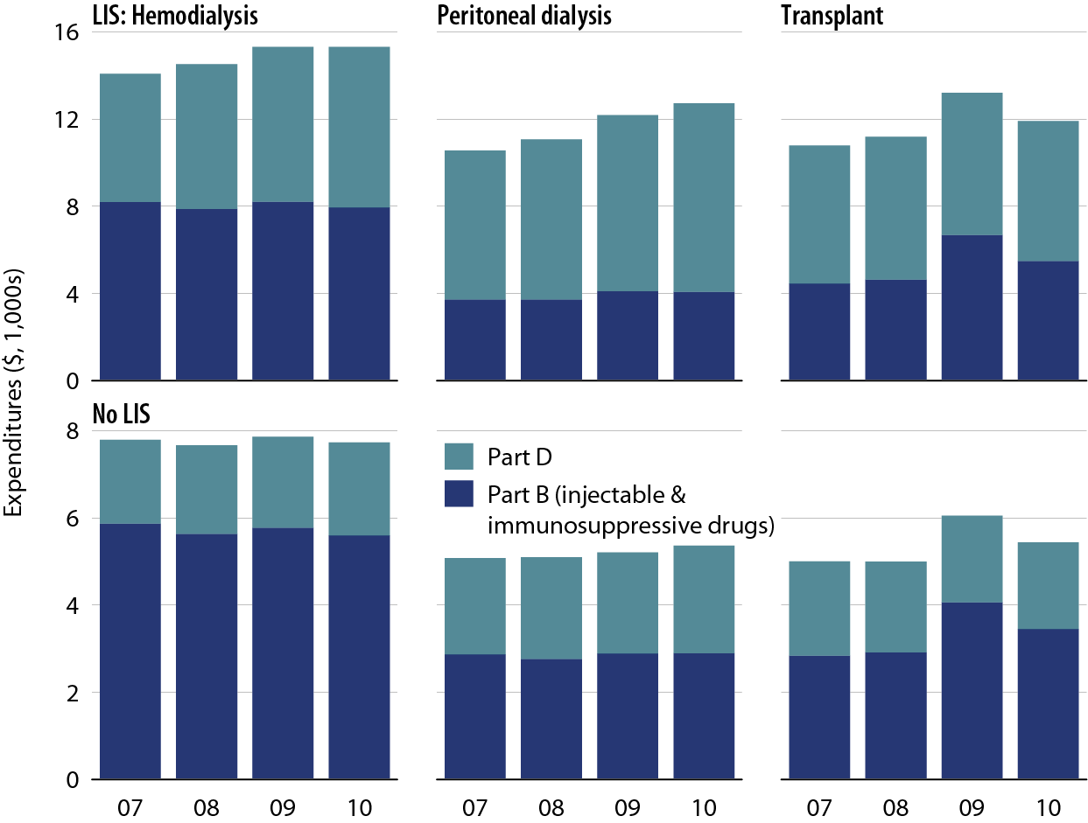
Total per person per year Medicare costs for Part B- & Part D-covered medications, by low income subsidy (LIS) status, modality, & year Figure 6.14 (Volume 2)
Period prevalent ESRD patients.

Slide 19
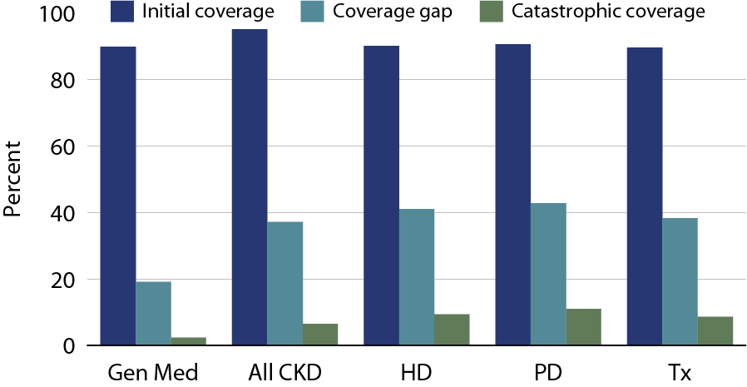
Part D non-LIS enrollees who reach each coverage phase, 2010 Figure 6.15 (Volume 2)
Point-prevalent Medicare enrollees alive on January 1, excluding those in employer-sponsored & national PACE Part D plans.

Slide 20
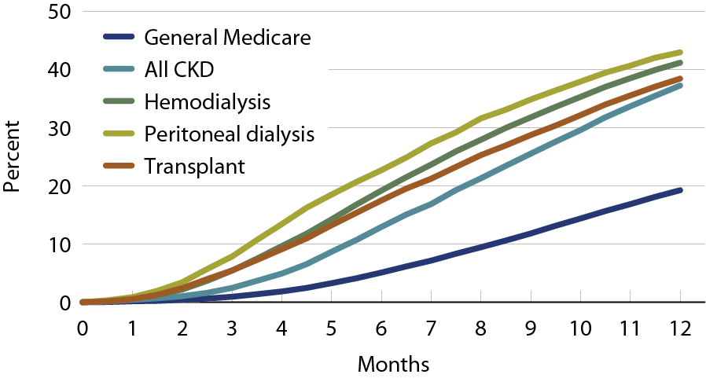
Cumulative percent of Part D non-LIS enrollees who reach the coverage gap, 2010 Figure 6.16 (Volume 2)
Point-prevalent Medicare enrollees alive on January 1, excluding those in employer-sponsored & national PACE Part D plans.

Slide 21
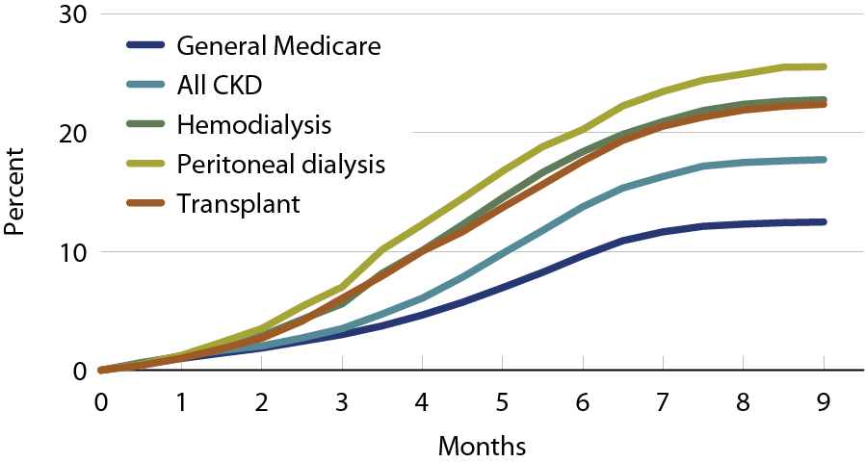
Cumulative percent of Part D non-LIS enrollees who reach catastrophic coverage after reaching the coverage gap, 2010 Figure 6.17 (Volume 2)
Point-prevalent Medicare enrollees alive on January 1, excluding those in employer-sponsored & national PACE Part D plans.

Slide 22
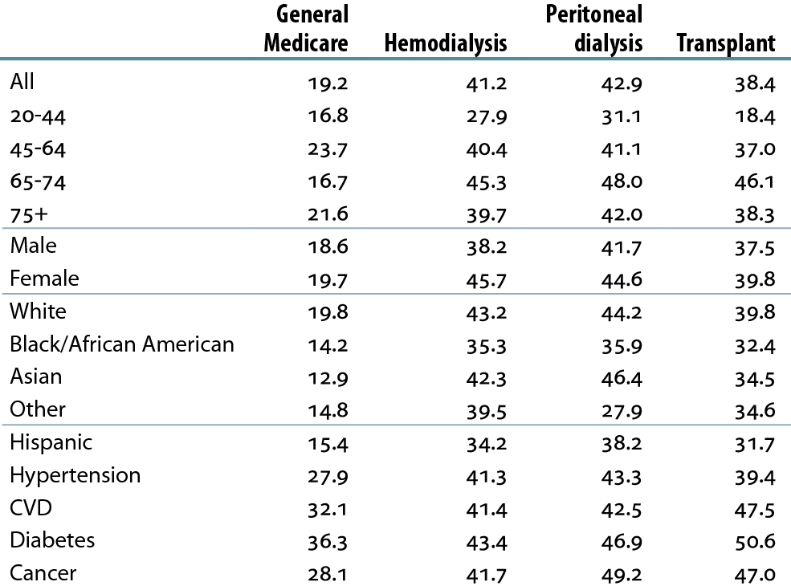
Twelve-month probability (percent) of reaching the coverage gap in Part D non-LIS enrollees, by modality, 2010 Table 6.d (Volume 2)
Point-prevalent Medicare enrollees alive on January 1, excluding those in employer-sponsored & national PACE Part D plans.

Slide 23
Part D-covered prescription fills per person per month in Part D non-LIS enrollees, by modality, 2010 Table 6.e (Volume 2)
Point-prevalent Medicare enrollees alive on January 1, excluding those in employer-sponsored & national PACE Part D plans.

Slide 24
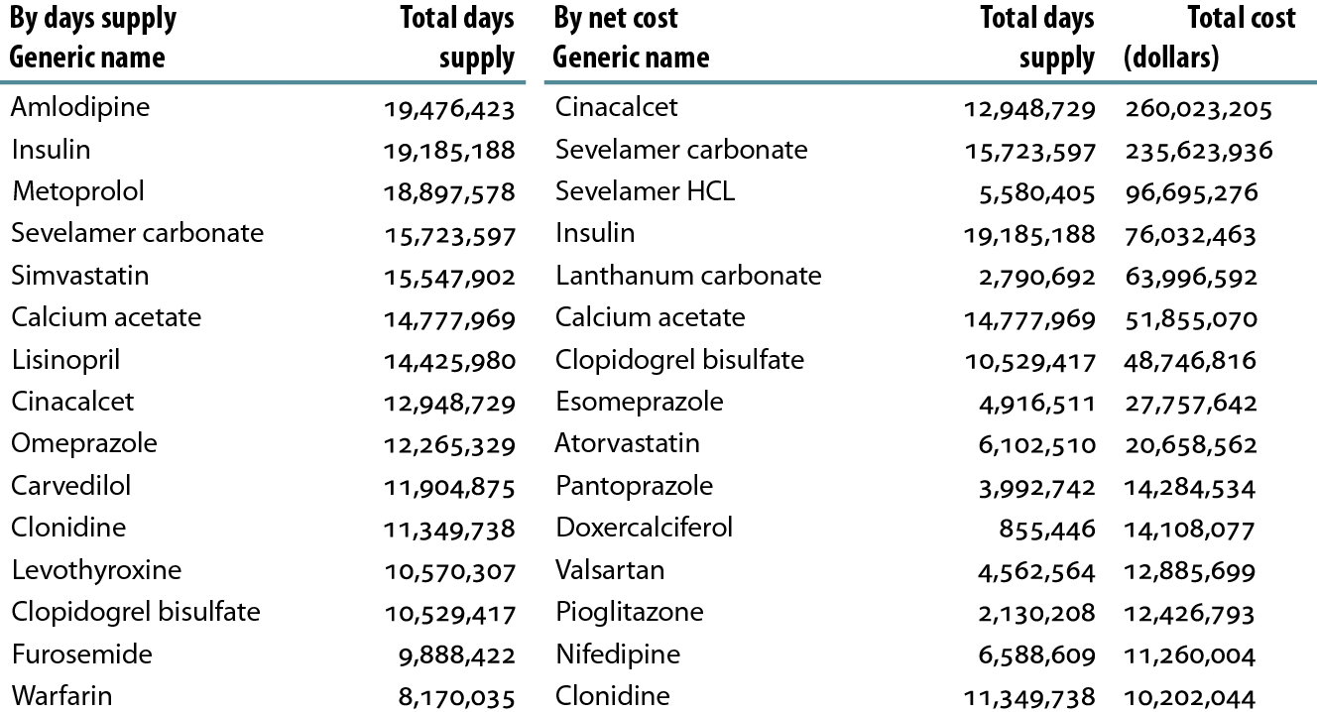
Top 15 drugs used by Part D-enrolled dialysis patients, by days supply & net cost, 2010 Table 6.f (Volume 2)
Part D claims for all dialysis patients, 2010.

Slide 25
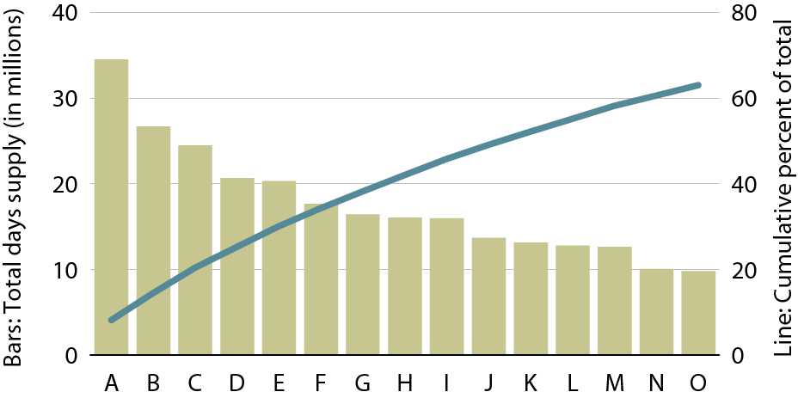
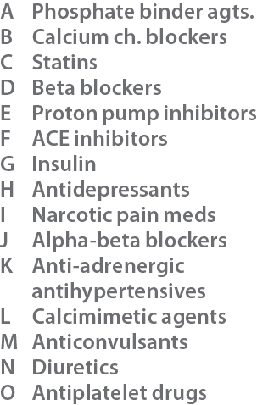
Top 15 drug classes used by Part D-enrolled dialysis patients, by days supply, 2010 Figure 6.18 (Volume 2)
Part D claims for all dialysis patients, 2010. Therapeutic classification based on Medi-Span’s generic product identifier (GPI) therapeutic classification system.

Slide 26
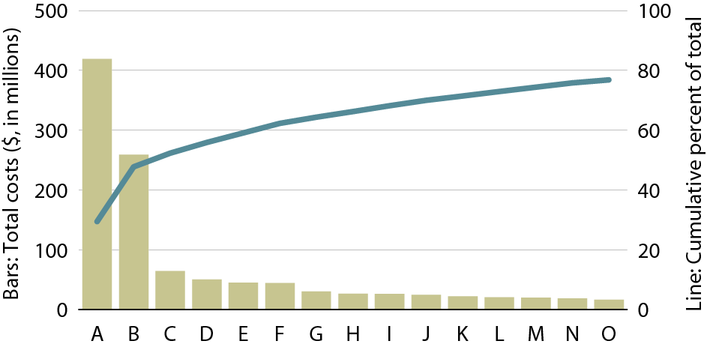
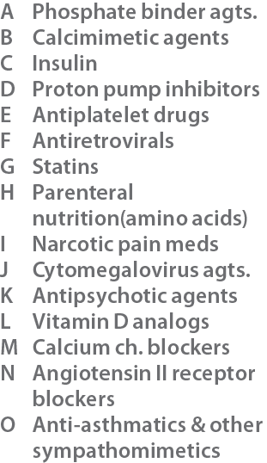
Top 15 drug classes used by Part D-enrolled dialysis patients, by net cost, 2010 Figure 6.19 (Volume 2)
Part D claims for all dialysis patients, 2010. Therapeutic classification based on Medi-Span’s generic product identifier (GPI) therapeutic classification system.

Slide 27
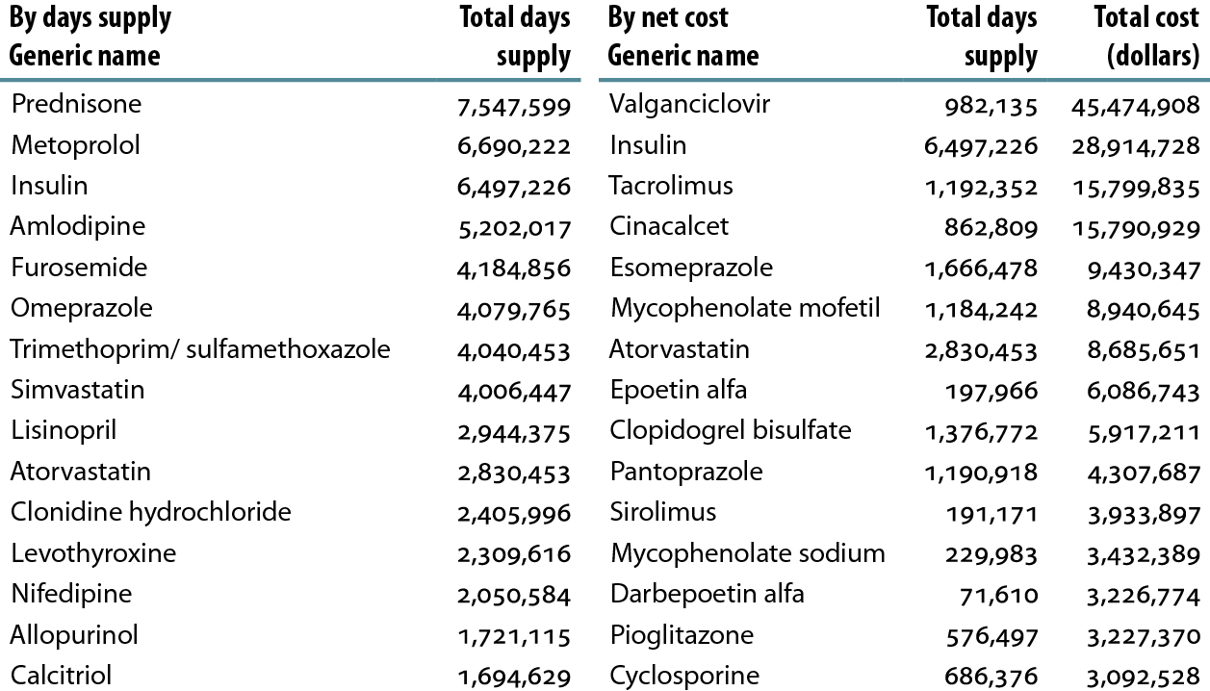
Top 15 drugs used by Part D-enrolled transplant patients, by days supply & net cost, 2010 Table 6.g (Volume 2)
Part D claims for all kidney transplant patients, 2010.

Slide 28
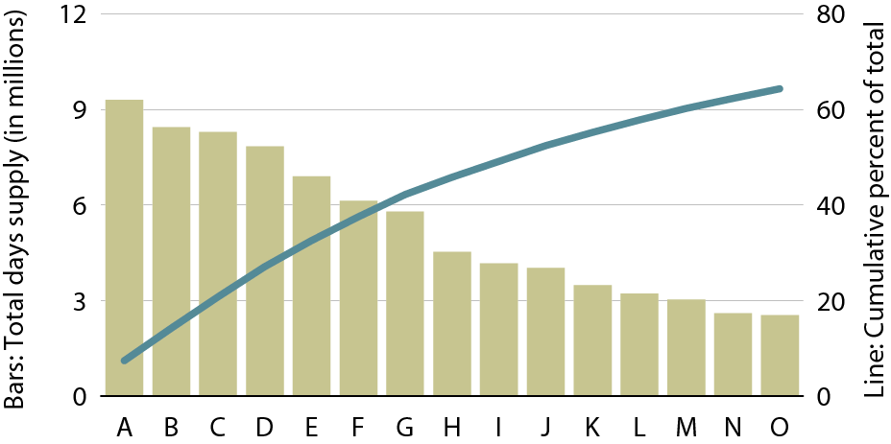
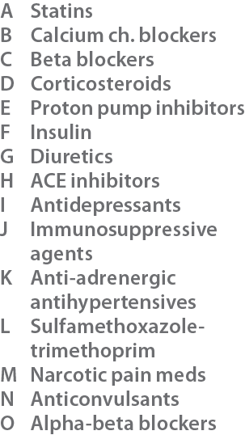
Top 15 drug classes used by Part D-enrolled transplant patients, by days supply, 2010 Figure 6.20 (Volume 2)
Part D claims for all kidney transplant patients, 2010. Therapeutic classification based on Medi-Span’s generic product identifier (GPI) therapeutic classification system.

Slide 29
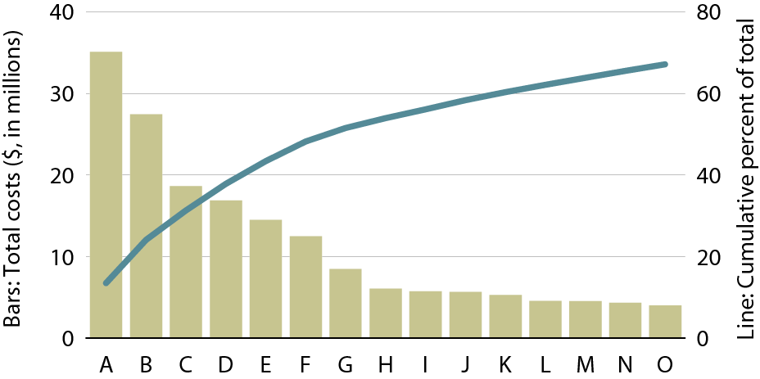
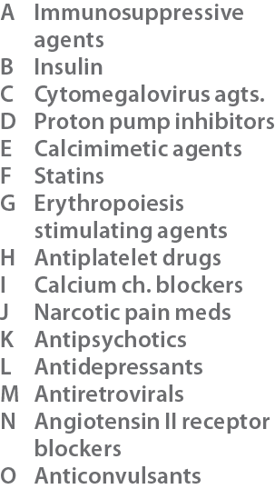
Top 15 drug classes used by Part D-enrolled transplant patients, by net cost, 2010 Figure 6.21 (Volume 2)
Part D claims for all kidney transplant patients, 2010. Therapeutic classification based on Medi-Span’s generic product identifier (GPI) therapeutic classification system.

