Slide 1
ESRD Chapter Seven
Transplant
United States Renal Data System
2012 Annual Data Report

Slide 2
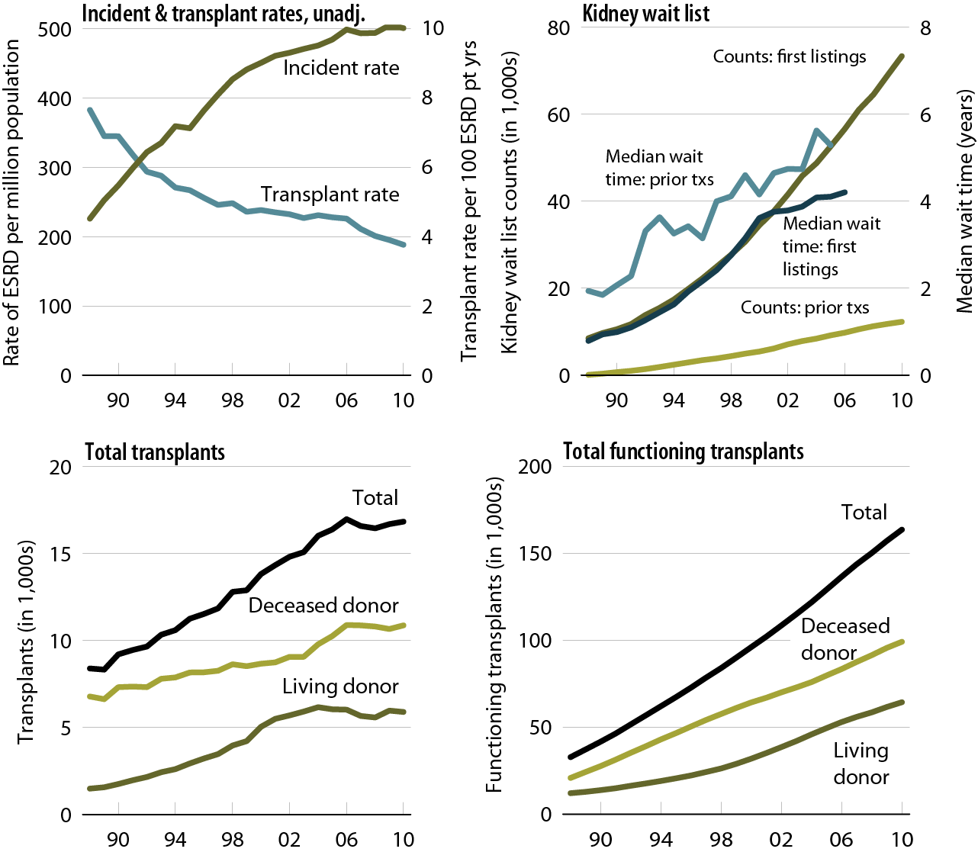
Trends in transplantation: unadjusted rates, wait list, & total & functioning transplants, patients age 20 & older
Figure 7.1 (Volume 2)
Unadjusted incident & transplant rates: limited to ESRD patients age 20 & older, thus yielding a computed incident rate higher than the overall rate presented elsewhere in the ADR. Wait list counts: patients age 20 & older listed for a kidney or kidney-pancreas transplant on December 31 of each year. Wait time: patients age 20 & older entering wait list in the given year. Transplant counts: patients age 20 & older as known to the USRDS.

Slide 3
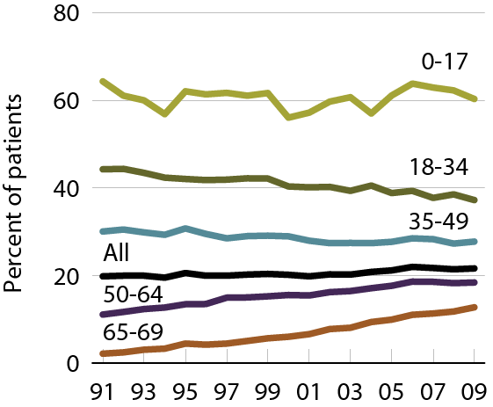
Patients wait-listed or receiving a deceased donor transplant within one year of initiation, by age
Figure 7.2 (Volume 2)
Incident ESRD patients younger than 70.

Slide 4
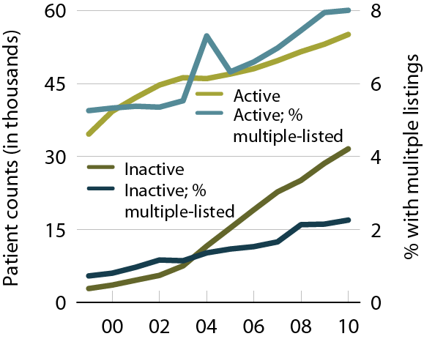
Wait list counts & multiple listings
Figure 7.3 (Volume 2)
Patients age 18 & older listed for a kidney or kidney-pancreas transplant on December 31 of each year.

Slide 5
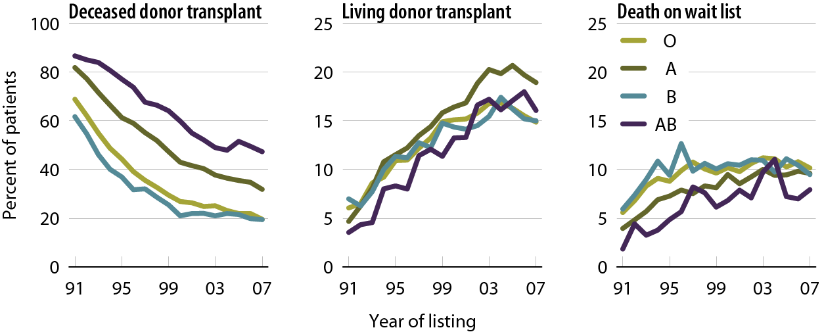
Outcomes for wait-listed adult patients within three years of listing, by blood type
Figure 7.4 (Volume 2)
Patients ate 18 & older listed for a first-time kidney or kidney-pancreas transplant.

Slide 6
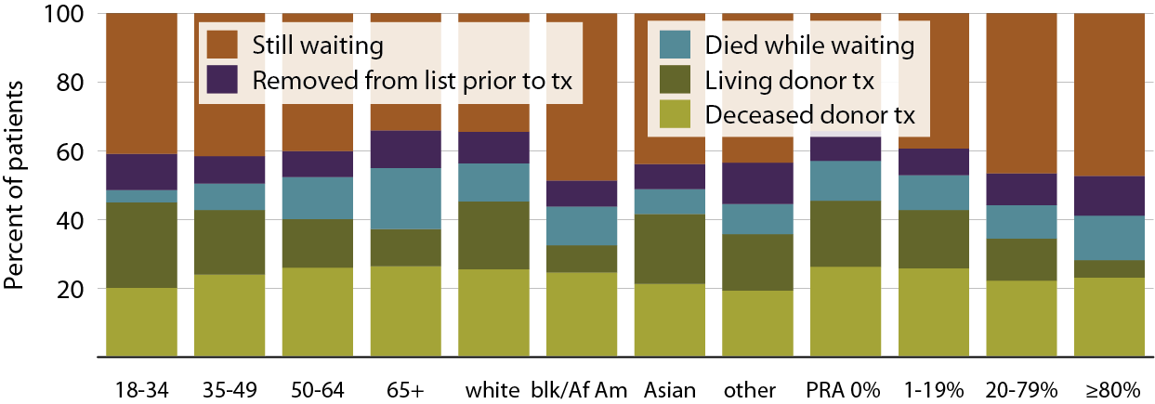
Outcomes for first-time wait-listed patients three years after listing in 2007, by age, race, & PRA
Figure 7.5 (Volume 2)
Patients age 18 & older listed for a first-time, kidney-only transplant in 2006; transplanted patients may have subsequent outcomes in the three-year follow-up period.

Slide 7
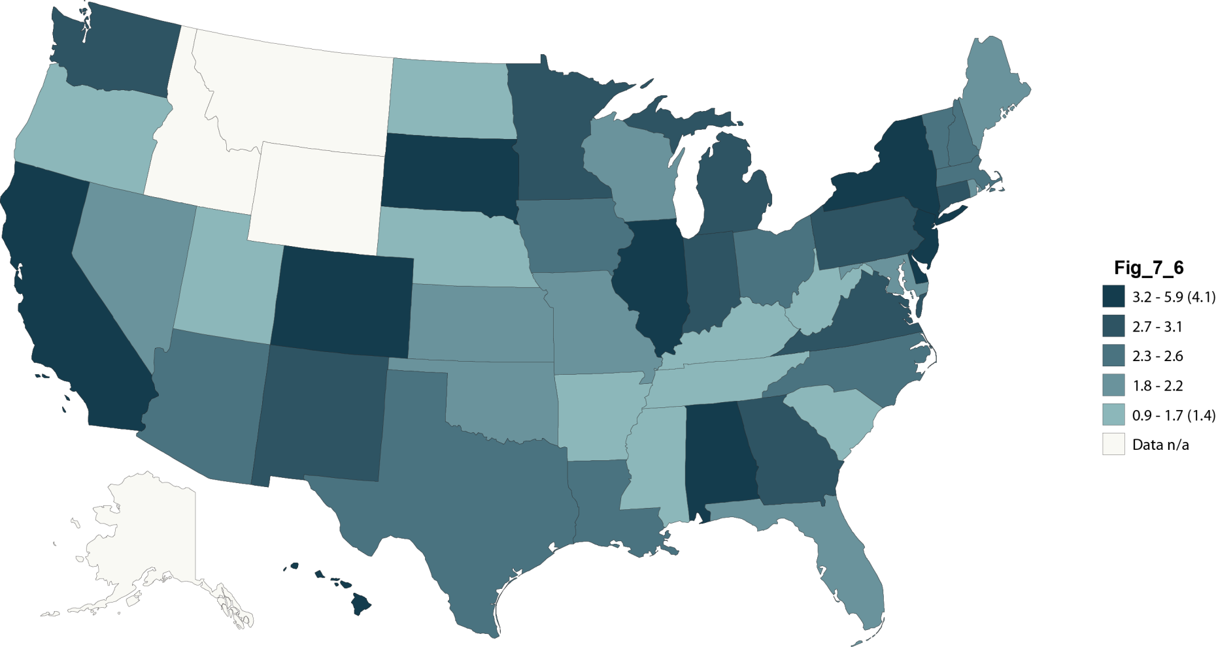
Unadjusted median wait times (years) for adults transplanted in 2010, by state of transplant center
Figure 7.6 (Volume 2)
Patients age 18 & older receiving a first-time, deceased-donor, kidney-only transplant in 2010.

Slide 8
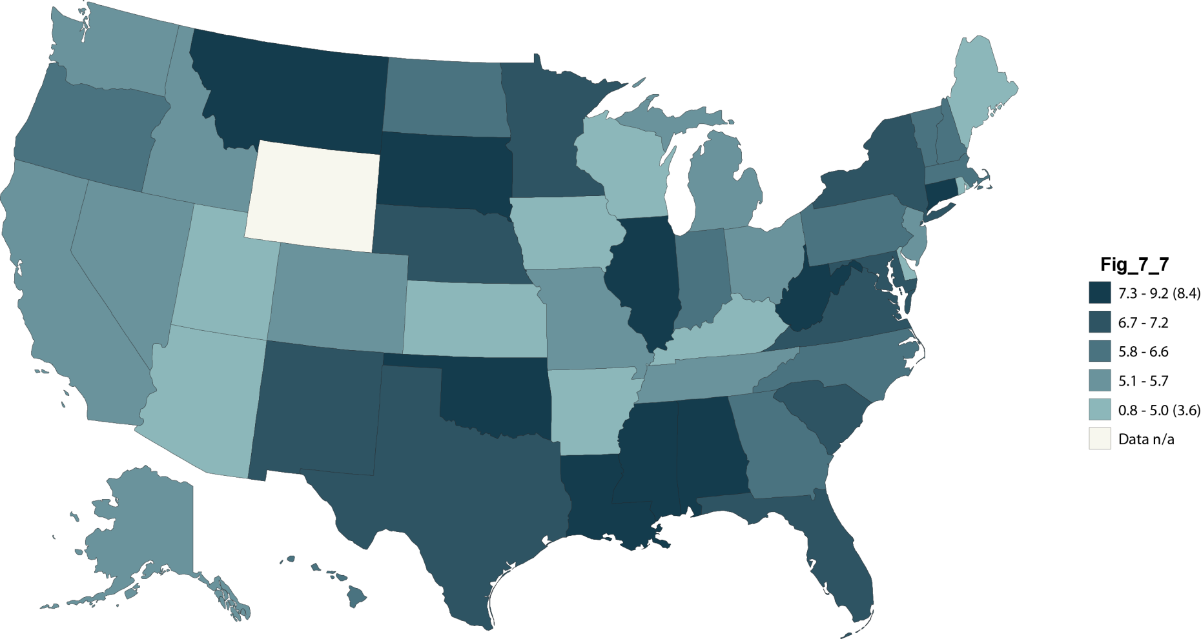
Adjusted mortality rates
(per 100 person years of waiting) for wait-listed patients, by state, 2010
Figure 7.7 (Volume 2)
Pts age 18 & older, listed for a kidney or kidney-pancreas transplant as of January 1, 2010.

Slide 9
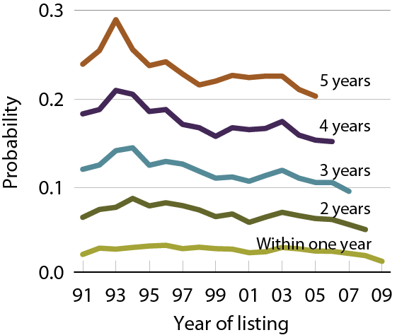
Likelihood of dying while awaiting transplant
Figure 7.8 (Volume 2)
Patients age 18 & older, listed for a first-time kidney or kidney-pancreas transplant.

Slide 10
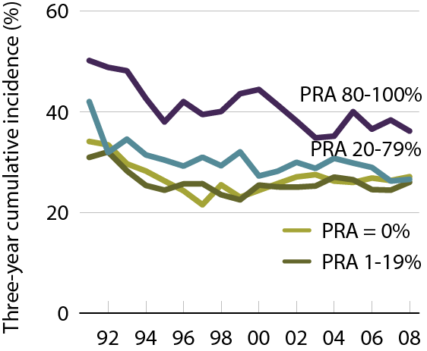
Three-year cumulative incidence of transfusion in wait-listed patients, by PRA
Figure 7.9 (Volume 2)
Patients age 18 & older with Medicare primary coverage & first listed for a kidney transplant in the given year.

Slide 11
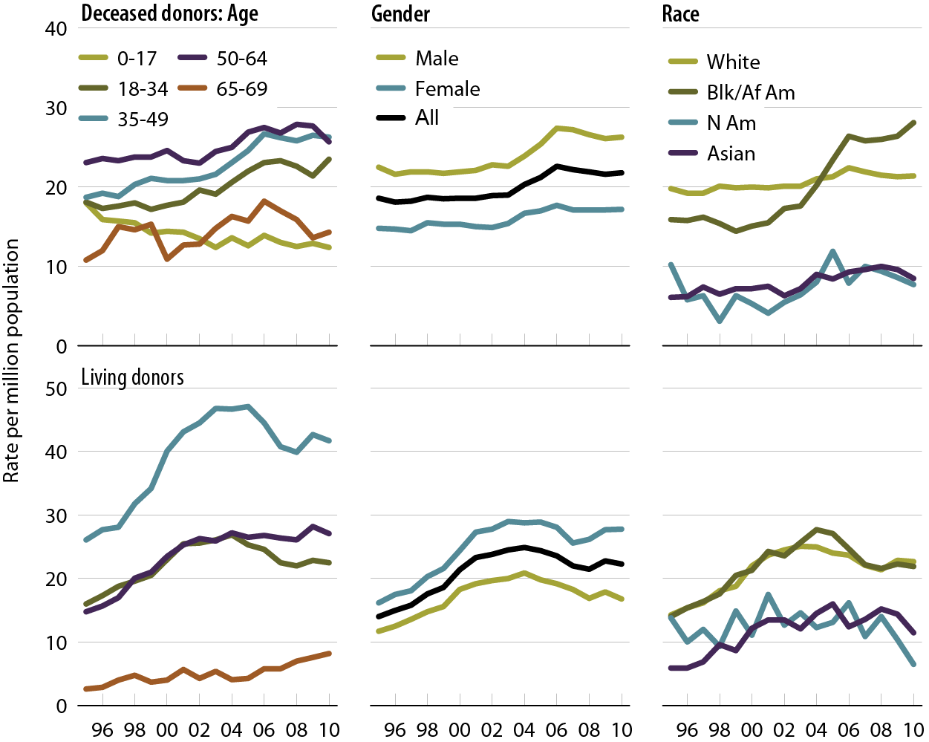
Donation rates, by age, gender, & race
Figure 7.10 (Volume 2)
Donors younger than 70 whose organs are eventually transplanted.

Slide 12
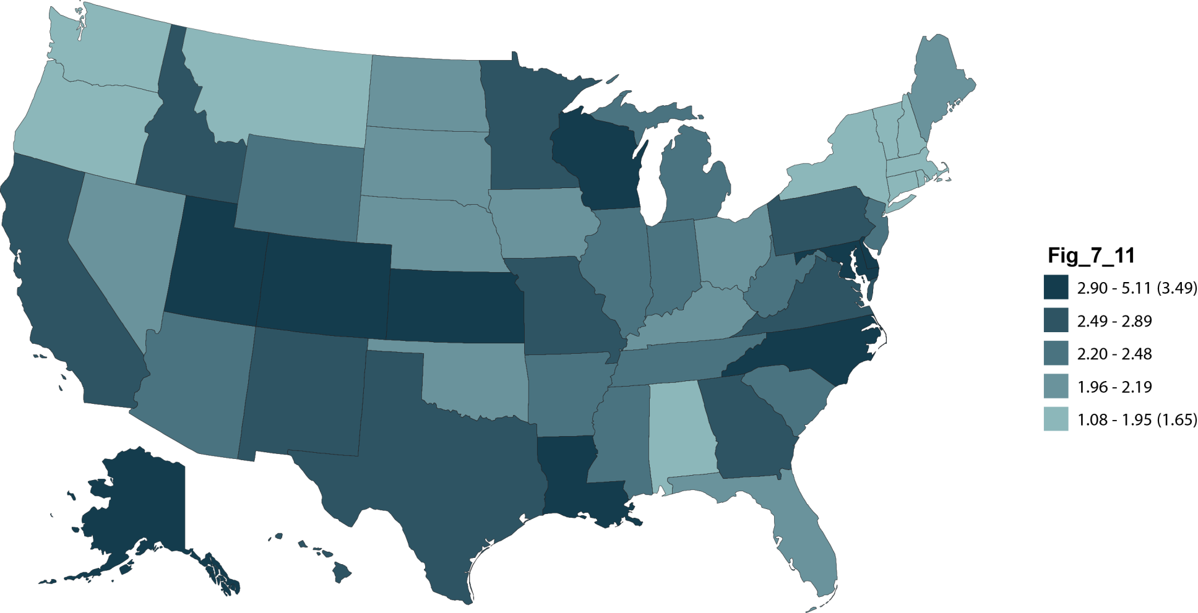
Deceased donor donations
(per 1,000 deaths), by state, 2009–2010
Figure 7.11 (Volume 2)
Deaths from July 1, 2009 to July 1, 2010.

Slide 13
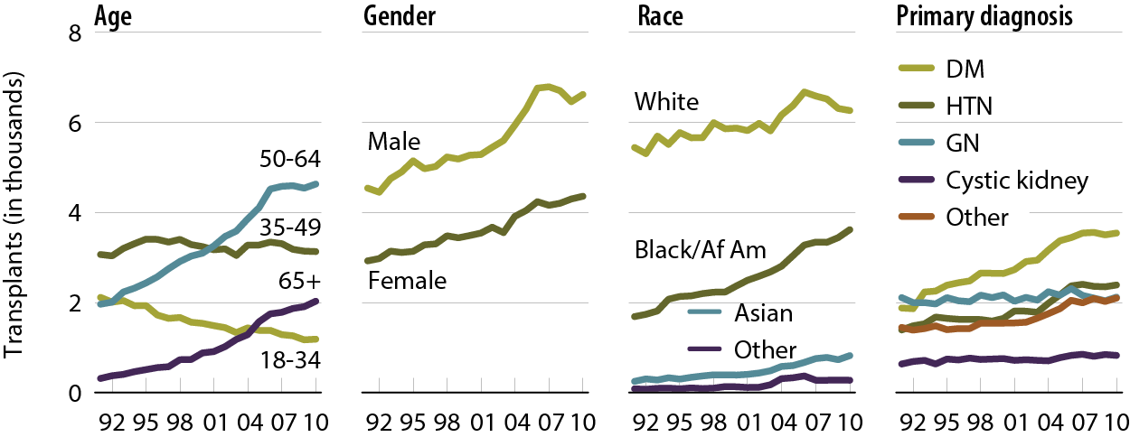
Deceased donor transplants, by age, gender, race, & primary diagnosis
Figure 7.12 (Volume 2)
Patients age 18 & older. Includes kidney-alone & kidney-pancreas transplants.

Slide 14
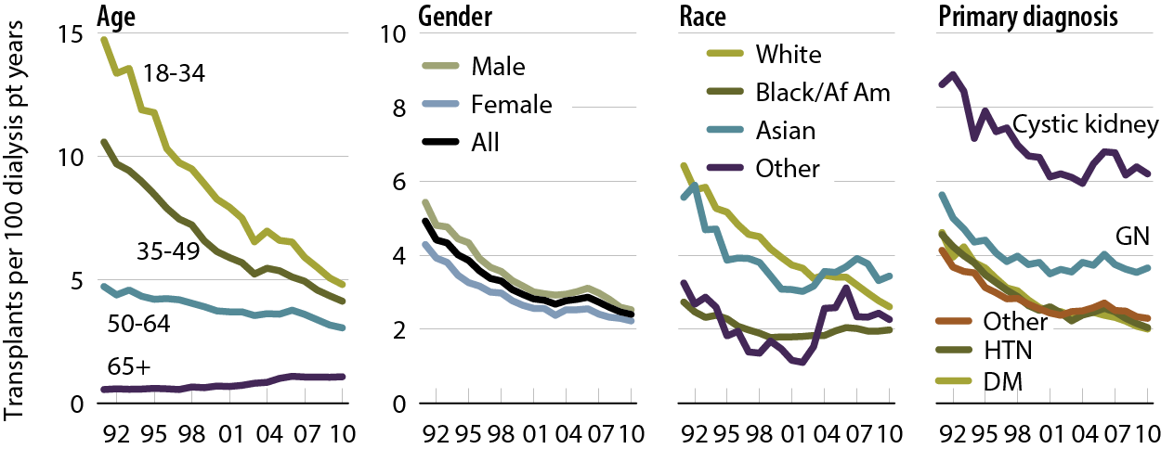
Adjusted transplant rates, by age, gender, race, & primary diagnosis: deceased donors
Figure 7.13 (Volume 2)
Patients age 18 & older. Adj: age/gender/race/ethnicity/primary diagnosis (rates by one factor adjusted for remaining four).

Slide 15
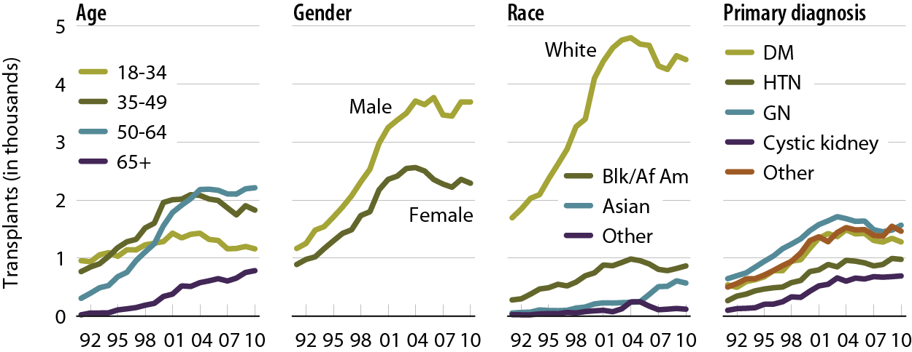
Living donor transplants, by age, gender, race, & primary diagnosis
Figure 7.14 (Volume 2)
Patients age 18 & older. Includes kidney-alone & kidney-pancreas transplants.

Slide 16
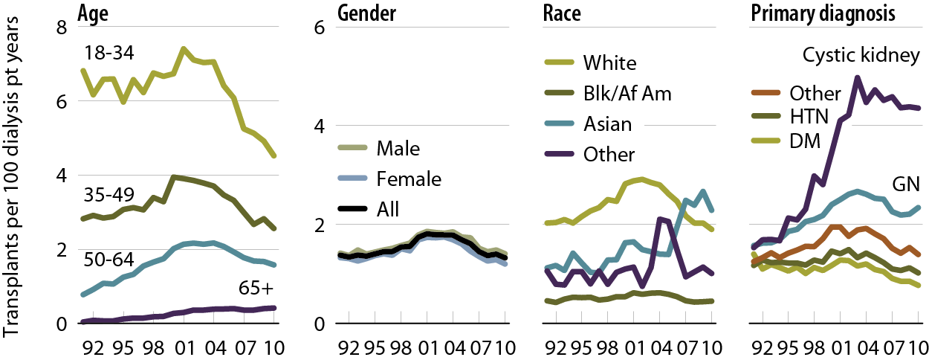
Adjusted transplant rates, by age, gender, race, & primary diagnosis: living donors
Figure 7.15 (Volume 2)
Patients age 18 & older. Adj: age/gender/race/ethnicity/primary diagnosis (rates by one factor adjusted for remaining four).

Slide 17
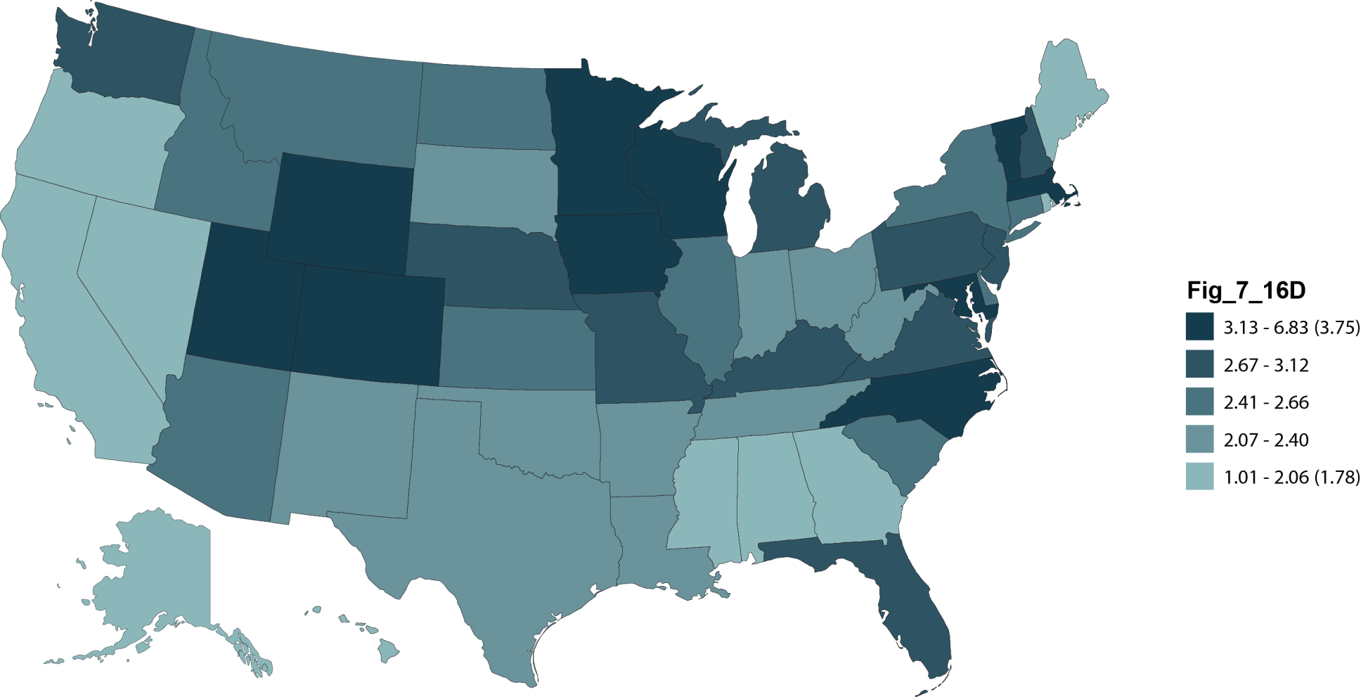
Adjusted transplant rates (per 100 dialysis patient years) by state of patient residence & donor type, 2010: deceased donor
Figure 7.16 (Volume 2)
Patients age 18 & older. Adj: age/gender/race/ primary diagnosis; ref: prevalent dialysis patients, 2010.

Slide 18
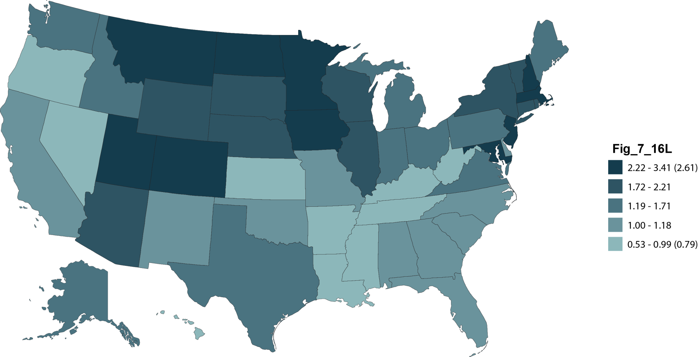
Adjusted transplant rates (per 100 dialysis patient years) by state of patient residence & donor type, 2010: living donor
Figure 7.16 (cont.; Volume 2)
Patients age 18 & older. Adj: age/gender/race/ primary diagnosis; ref: prevalent dialysis patients, 2010.

Slide 19
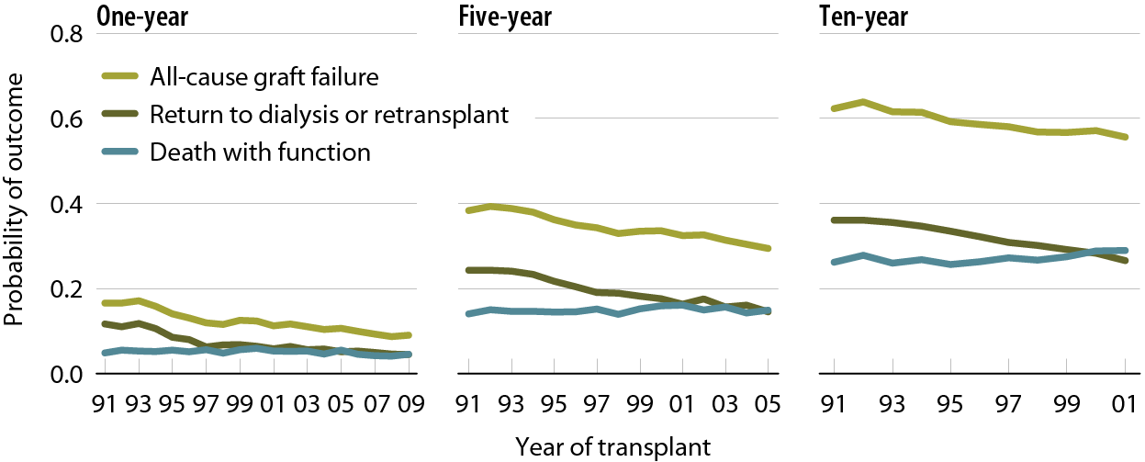
Outcomes: deceased donor transplants
Figure 7.17 (Volume 2)
Patients age 18 & older receiving a first-time, kidney-only transplant; unadjusted.

Slide 20
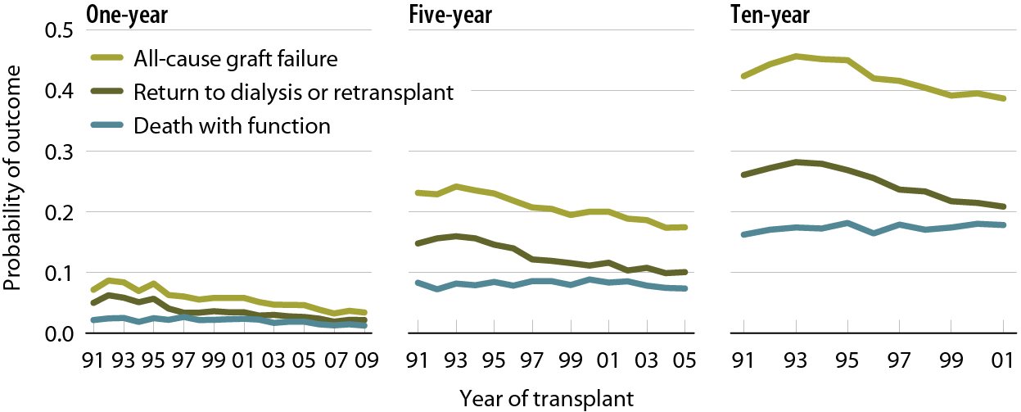
Outcomes: living donor transplants
Figure 7.18 (Volume 2)
Patients age 18 & older receiving a first-time, kidney-only transplant; unadjusted.

Slide 21
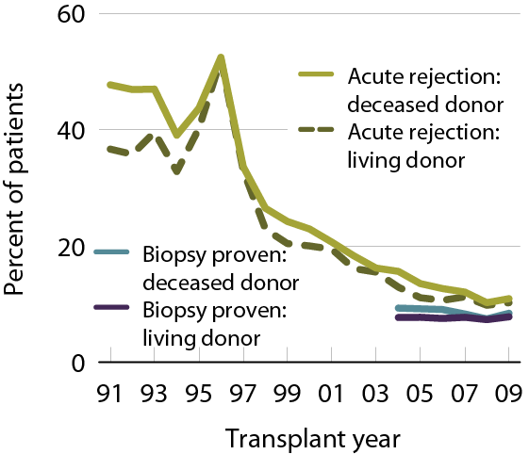
Acute rejection within the first year post-transplant
Figure 7.19 (Volume 2)
Patients age 18 & older with a functioning graft at discharge.

Slide 22
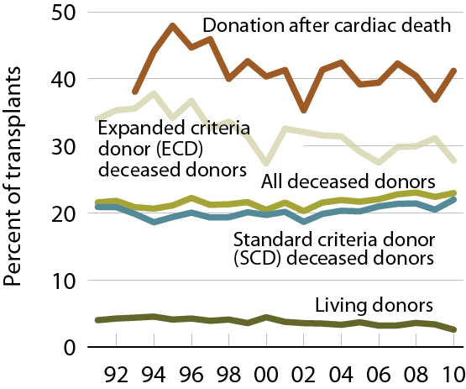
Transplants with delayed graft function (DGF), by donor type
Figure 7.20 (Volume 2)
Patients age 18 & older with functioning graft at discharge.

Slide 23
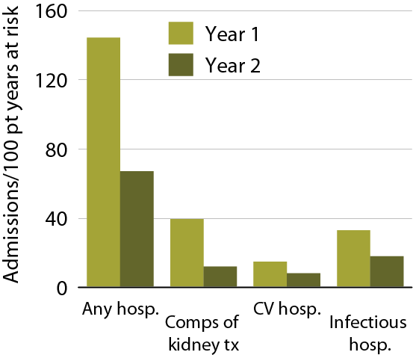
Hospitalization rates in the first
& second years post-transplant, 2008
Figure 7.21 (Volume 2)
First-time, kidney-only transplant recipients, age 18 & older, transplanted in 2008; ref: transplant patients, 2005.

Slide 24
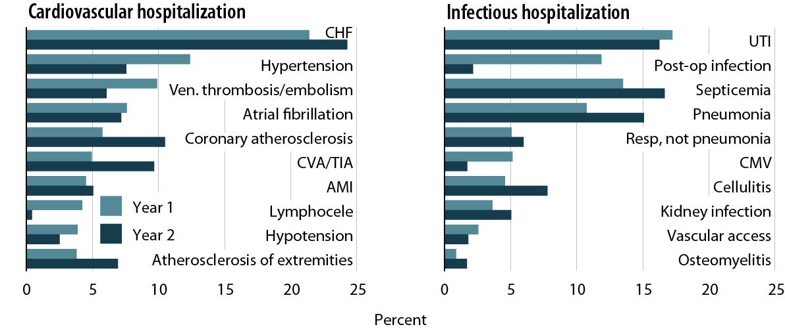
Primary diagnoses of cardiac
& infectious hospitalizations in the first & second years post-transplant
Figure 7.22 (Volume 2)
First-time, kidney-only transplant recipients, age 18 & older, with Medicare primary coverage, transplanted in 2006–2008.

Slide 25
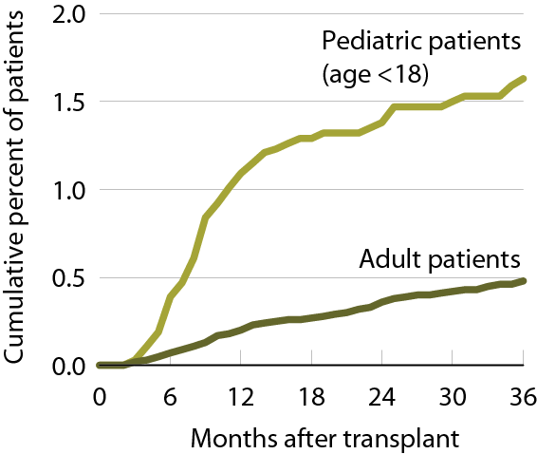
Cumulative incidence of post-transplant lymphoproliferative disorder (PTLD)
Figure 7.23 (Volume 2)
Patients receiving a first-time, kidney-only transplant, 2003–2007 combined.

Slide 26
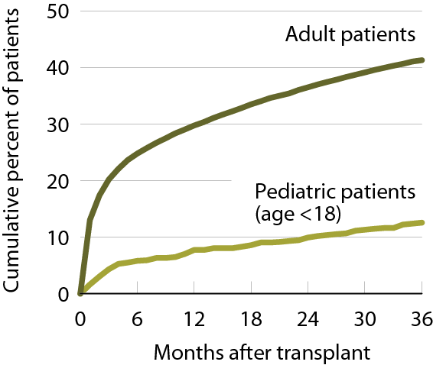
Cumulative incidence of post-transplant diabetes
Figure 7.24 (Volume 2)
Patients receiving a first-time, kidney-only transplant, 2003–2007 combined.

Slide 27
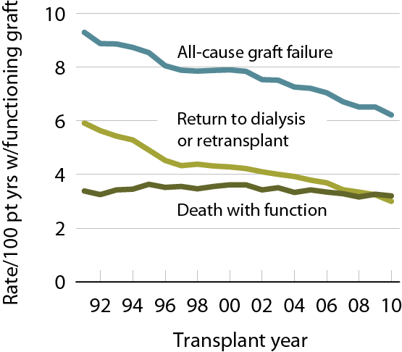
Adjusted rate of outcomes after transplant
Figure 7.25 (Volume 2)
Patients age 18 & older at transplant; adj: age/gender/race; ref: 2009 prevalent dialysis patients.

Slide 28
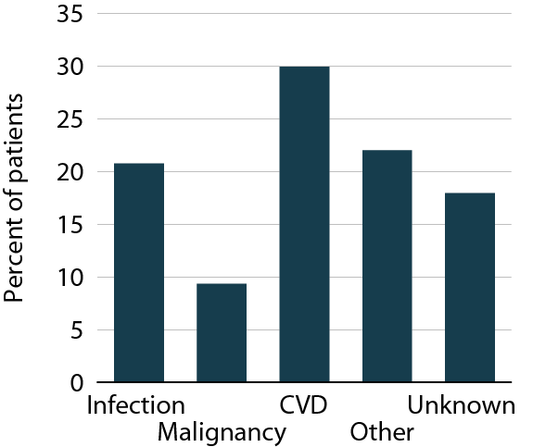
Causes of death with function, 2006–2010
Figure 7.26 (Volume 2)
First-time, kidney-only transplant recipients, age 18 & older, 2006–2010, who died with functioning graft.

Slide 29
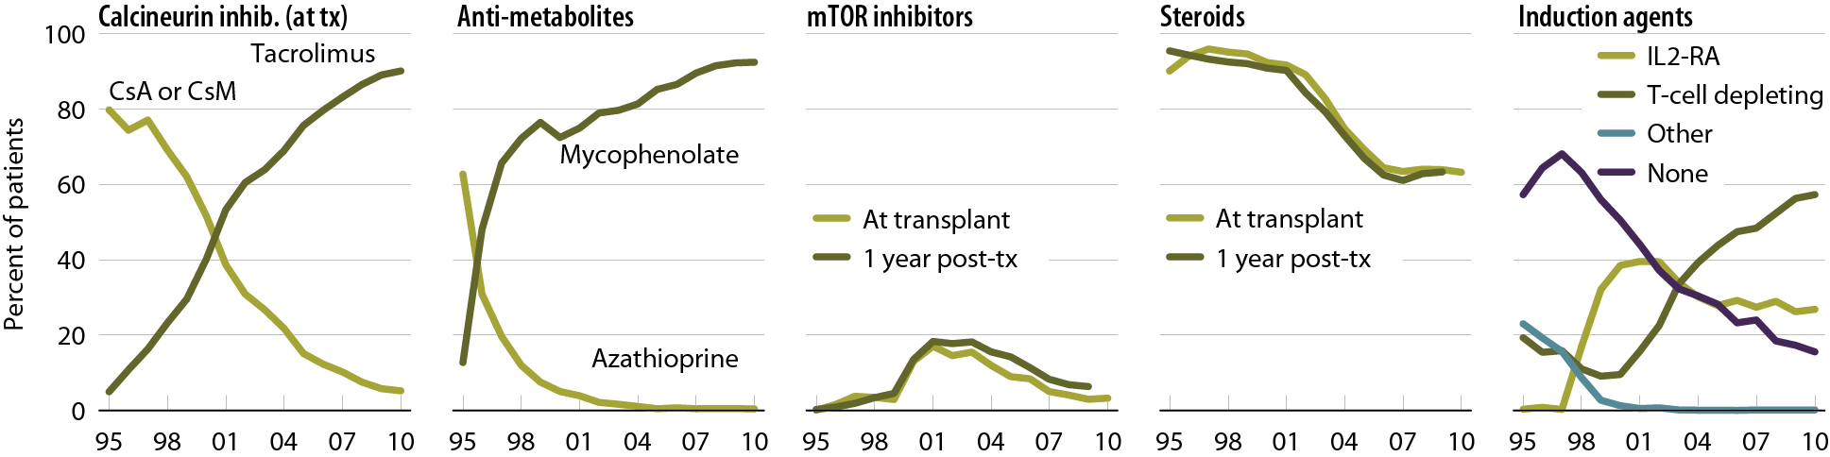
Immunosuppression use
Figure 7.27 (Volume 2)
Patients age 18 & older receiving a first-time, kidney-only transplant. CsA: cyclosporine A; CsM: cyclosporine microemulsion.

Slide 30
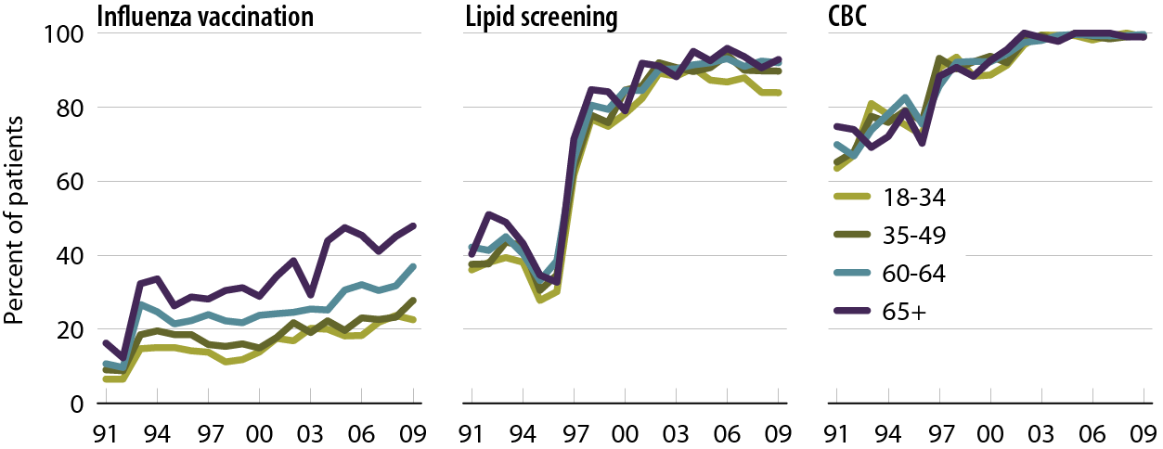
Follow-up care & screening in the first 12 months post-transplant, by age
Figure 7.28 (Volume 2)
Patients age 18 & older, with Medicare primary payor coverage, receiving a first-time, kidney-only transplant.

Slide 31
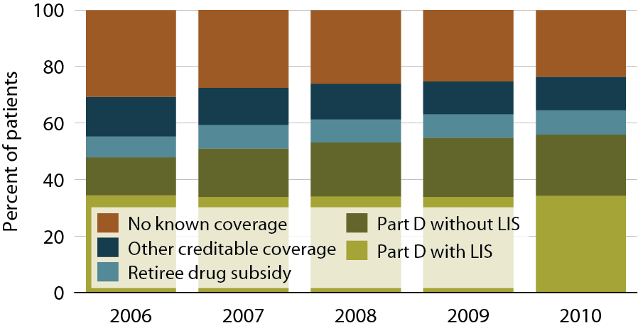
Sources of prescription drug coverage in kidney transplant recipients
Figure 7.29 (Volume 2)
Point prevalent Medicare-enrolled transplant recipients alive on January 1.

Slide 32
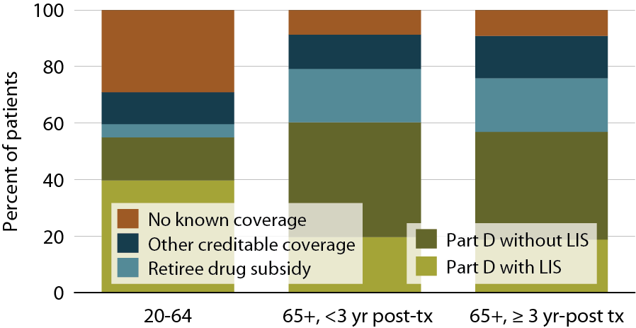
Sources of prescription drug coverage in kidney transplant recipients, by age
& years post-transplant (age 65 & older)
Figure 7.30 (Volume 2)
Point prevalent Medicare-enrolled transplant recipients alive on January 1.

Slide 33
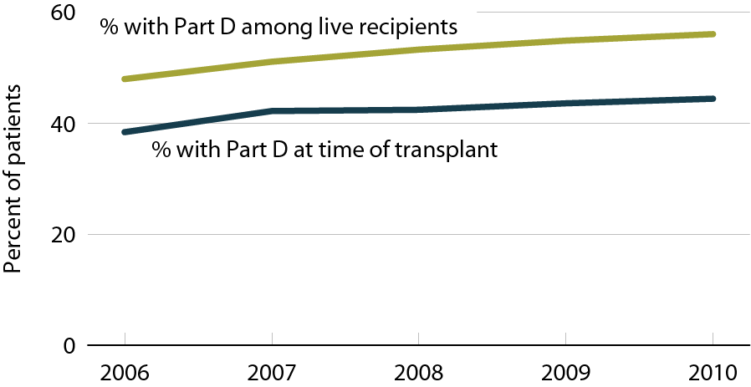
Transplant recipients enrolled in Part D
Figure 7.31 (Volume 2)
Medicare-enrolled transplant recipients.

Slide 34
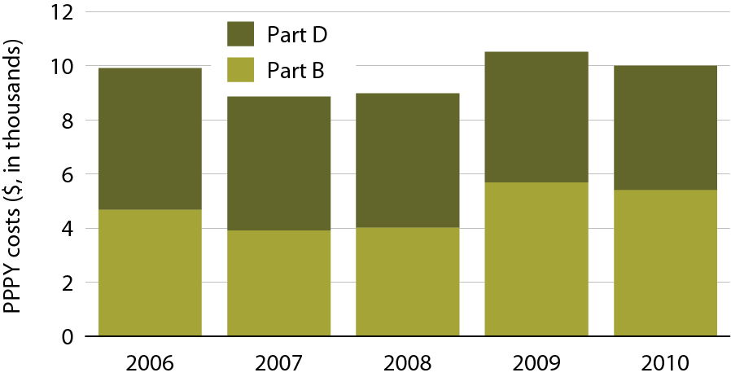
Total Part B & Part D medication costs in kidney transplant recipients
Figure 7.32 (Volume 2)
Period prevalent transplant patients; includes all Part B & Part D costs for injectable and immunosuppressive drugs for calendar years 2006–2010.

Slide 35
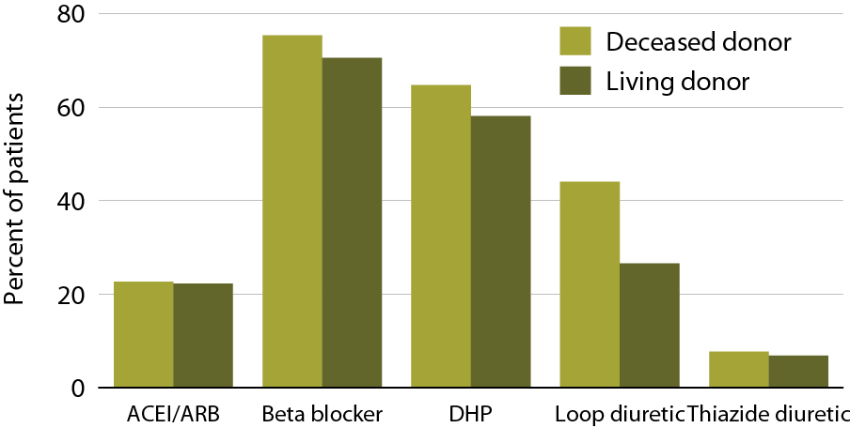
Cardiovascular medication use in the first six months post-transplant, 2008-2010 (Part D data)
Figure 7.33 (Volume 2)
Patients age 18 & older receiving a first-time, kidney-only transplant between January 1, 2008 & June 30, 2010, who remain alive with function, & who have Medicare Part D coverage for six months post-transplant.

Slide 36
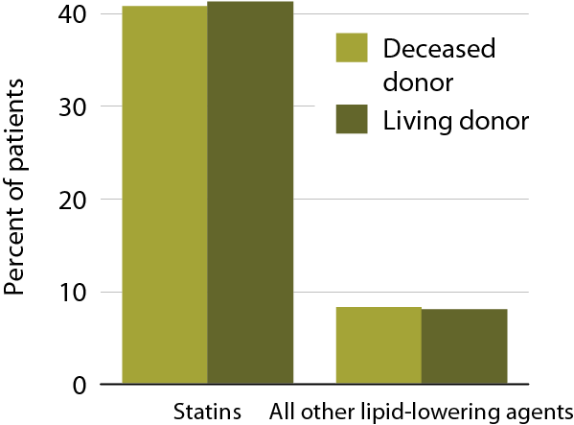
Medications for lipid control in the first 6 months post-transplant, 2008–2010 (Part D data)
Figure 7.34 (Volume 2)
Patients age 18 & older receiving a first-time, kidney-only transplant between January 1, 2008 & June 30, 2010, who remain alive with function, & who have Medicare Part D coverage for six months post-transplant.

Slide 37
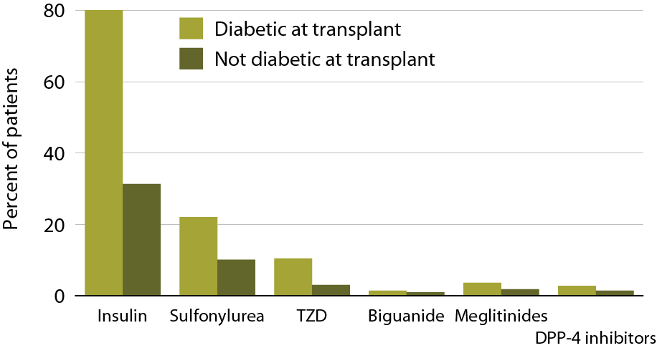
Medications for diabetes control in the first 6 months post-transplant, 2008–2010 (Part D data)
Figure 7.35 (Volume 2)
Patients age 18 & older receiving a first-time, kidney-only transplant between January 1, 2008 & June 30, 2010, who remain alive with function, & who have Medicare Part D coverage for six months post-transplant.

Slide 38
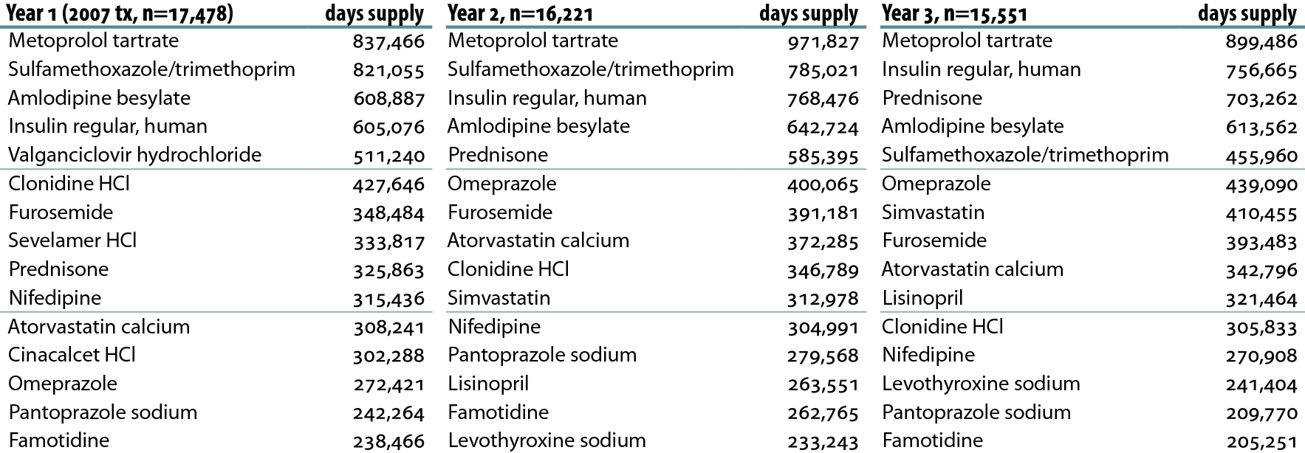
Top 15 medications used by
Part D-enrolled kidney recipients transplanted in 2007, by days supply
Table 7.a (Volume 2)
Patients enrolled in Medicare Part D & transplanted in 2007. Costs are estimated Medicare payment, defined as the sum of plan covered payment amount & low income subsidy amount. “Year 1” is the period from transplant to one year later. Years 2 & 3 are similarly defined.

Slide 39
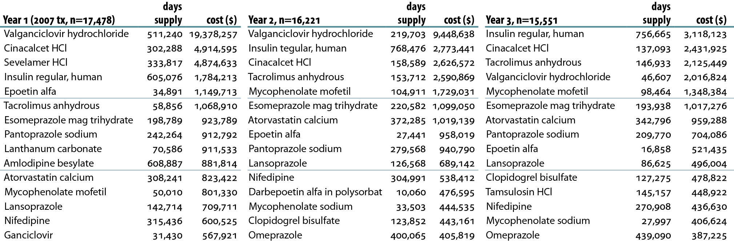
Top 15 medications used by Part D-enrolled kidney recipients transplanted in 2007, by days supply & cost
Table 7.b (Volume 2)
Patients enrolled in Medicare Part D & transplanted in 2007. Costs are estimated Medicare payment, defined as the sum of plan covered payment amount & low income subsidy amount. “Year 1” is the period from transplant to one year later. Years 2 & 3 are similarly defined.

