Slide 1
ESRD: Chapter Eight
Pediatric ESRD
United States Renal Data System
2012 Annual Data Report

Slide 2
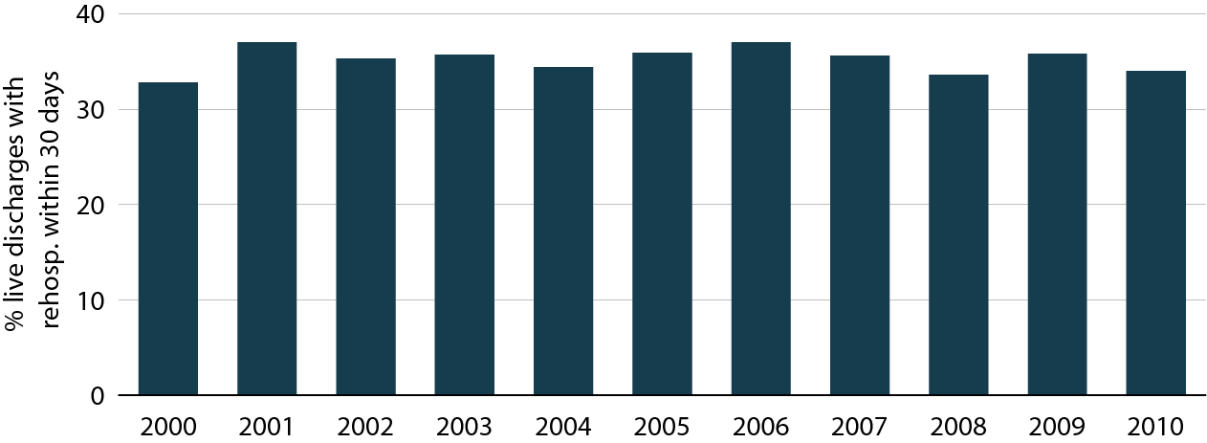
Adjusted all-cause rehospitalization rates in pediatric patients 30 days after live hospital discharge Figure 8.1 (Volume 2)
ESRD patients age 0–19. Adj: gender/race/primary diagnosis; ref: discharges in 2005.

Slide 3
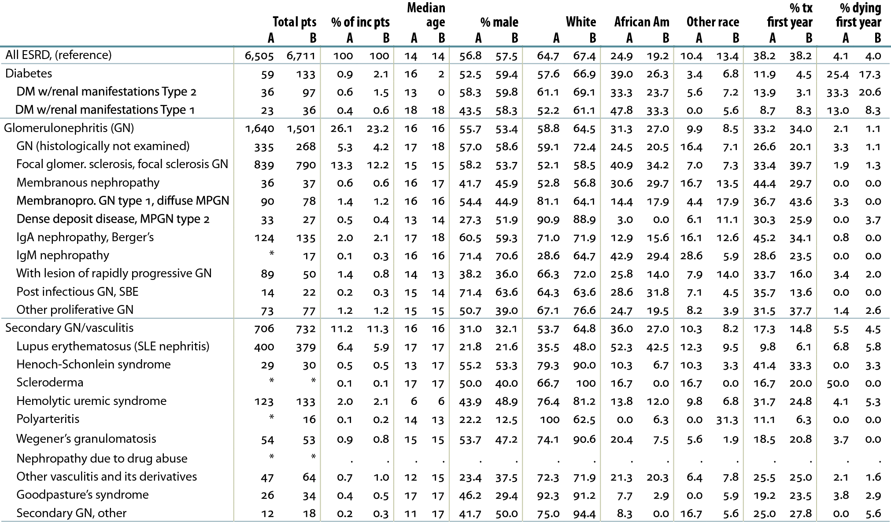
Distribution of reported incident ESRD pediatric patients, by primary diagnosis, 2001–2005 (period A) & 2006–2010 (period B) Table 8.a (Volume 2)
Incident ESRD patients age 0–19. *Values for cells with ten or fewer patients are suppressed.
“.” Zero values in this cell.

Slide 4
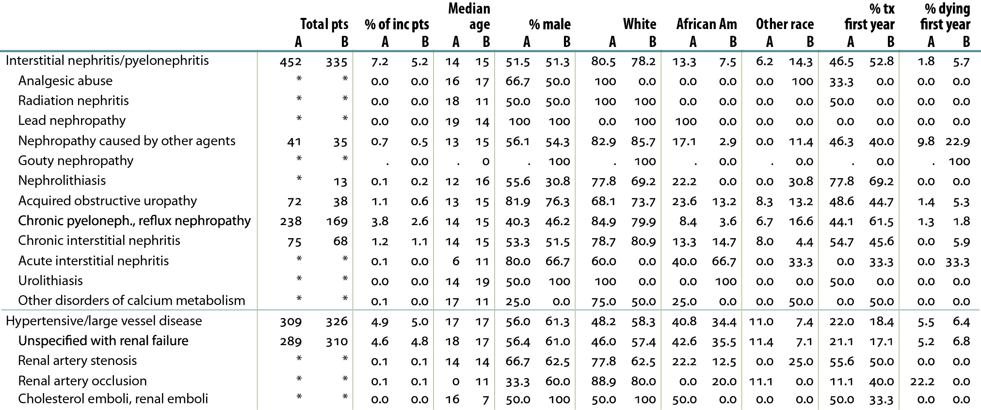
Distribution of reported incident ESRD pediatric patients, by primary diagnosis, 2001–2005 (period A) & 2006–2010 (period B) Table 8.a, continued (Volume 2)
Incident ESRD patients age 0–19. *Values for cells with ten or fewer patients are suppressed.
“.” Zero values in this cell.

Slide 5
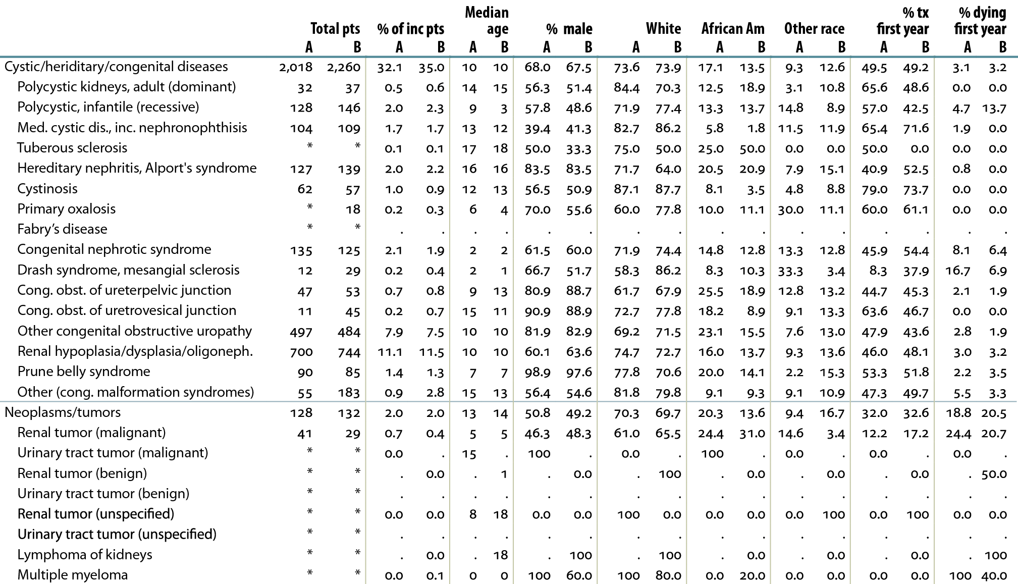
Distribution of reported incident ESRD pediatric patients, by primary diagnosis, 2001–2005 (period A) & 2006–2010 (period B) Table 8.a, continued (Volume 2)
Incident ESRD patients age 0–19. *Values for cells with ten or fewer patients are suppressed.
“.” Zero values in this cell.

Slide 6
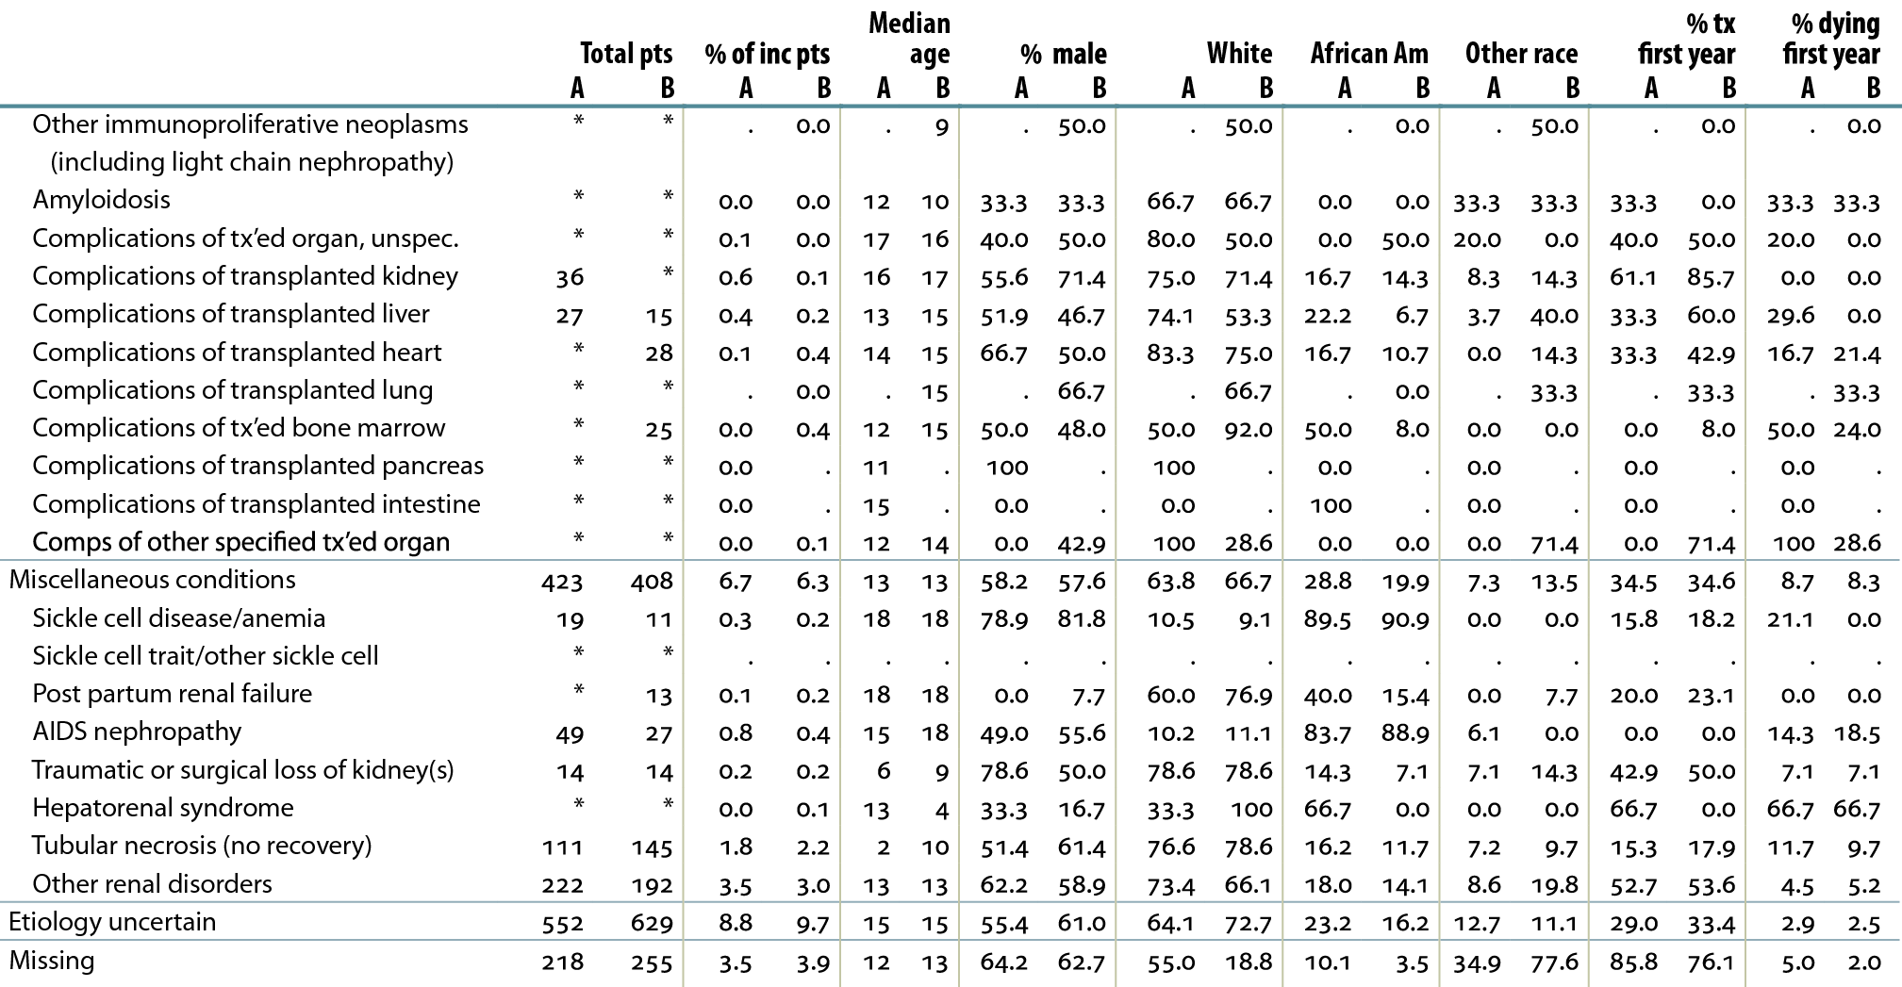
Distribution of reported incident ESRD pediatric patients, by primary diagnosis, 2001–2005 (period A) & 2006–2010 (period B) Table 8.a, continued (Volume 2)
Incident ESRD patients age 0–19. *Values for cells with ten or fewer patients are suppressed.
“.” Zero values in this cell.

Slide 7
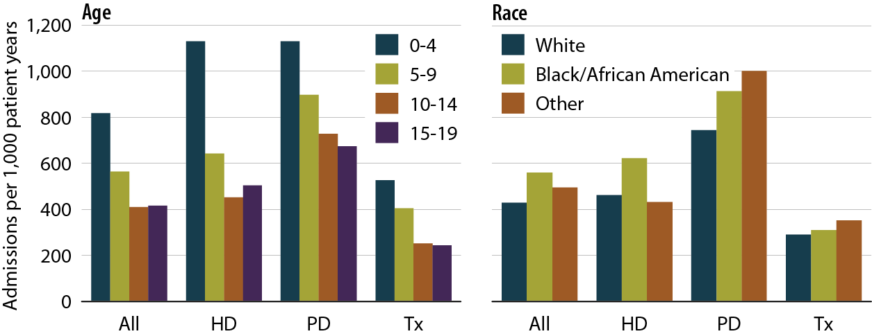
Unadjusted rates of hospitalization for any infection, by modality, age, & race, 2007–2010 Figure 8.2 (Volume 2)
Period prevalent ESRD patients age 0–19, 2007-2010; unadjusted.

Slide 8
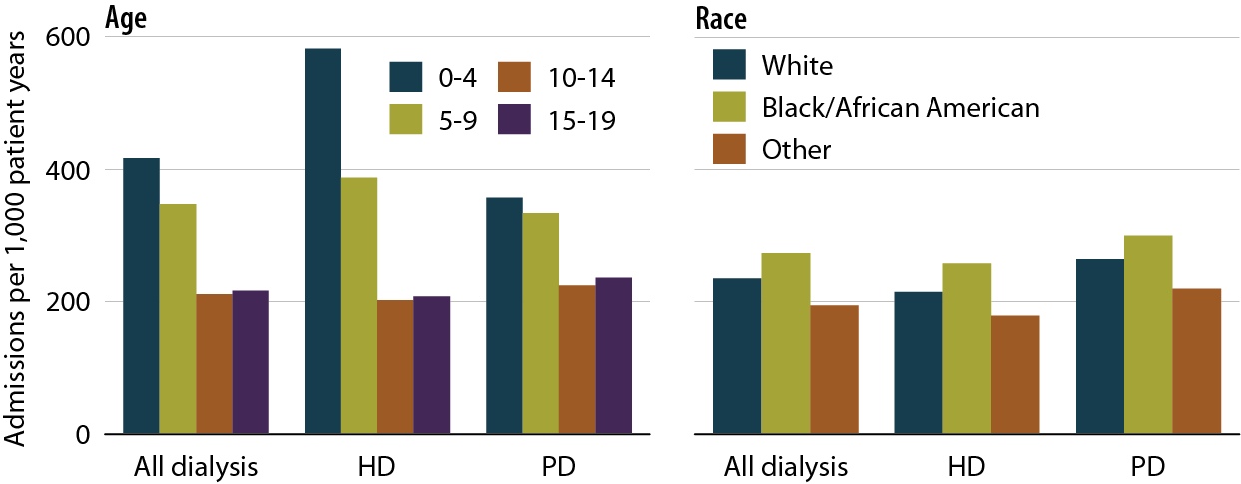
Unadjusted rates of hospitalization for infection due to internal device, by modality, age, & race, 2007–2010 Figure 8.3 (Volume 2)
Period prevalent dialysis patients age 0–19, 2007–2010; unadjusted. “Infection due to internal device” includes those related to a vascular access device or peritoneal dialysis catheter.

Slide 9
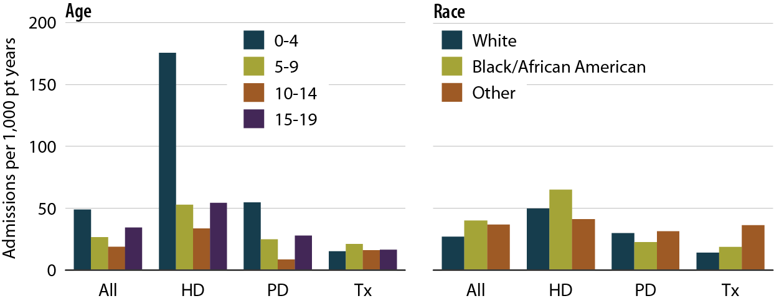
Unadjusted rates of hospitalization for bacteremia/septicemia, by modality, age, & race, 2007–2010 Figure 8.4 (Volume 2)
Period prevalent ESRD patients age 0–19, 2007–2010; unadjusted.

Slide 10
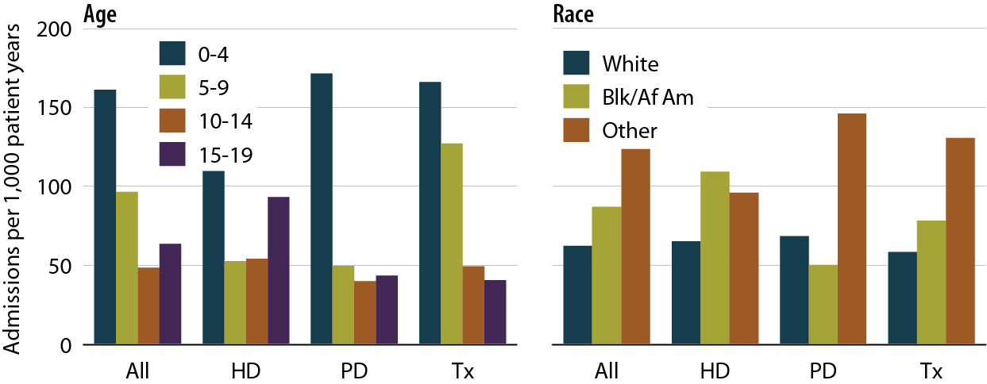
Unadjusted rates of hospitalization for respiratory infection (including pneumonia,) by modality, age, & race, 2007–2010 Figure 8.5 (Volume 2)
Period prevalent ESRD patients age 0–19, 2007–2010; unadjusted.

Slide 11
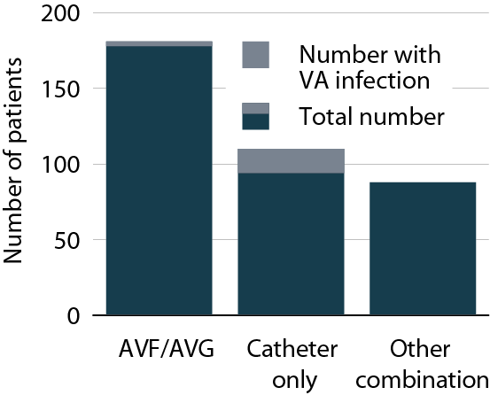
Infections in pediatric patients by vascular access use, July–December, 2010 Figure 8.6 (Volume 2)
Point prevalent hemodialysis patients age 0–19.

Slide 12
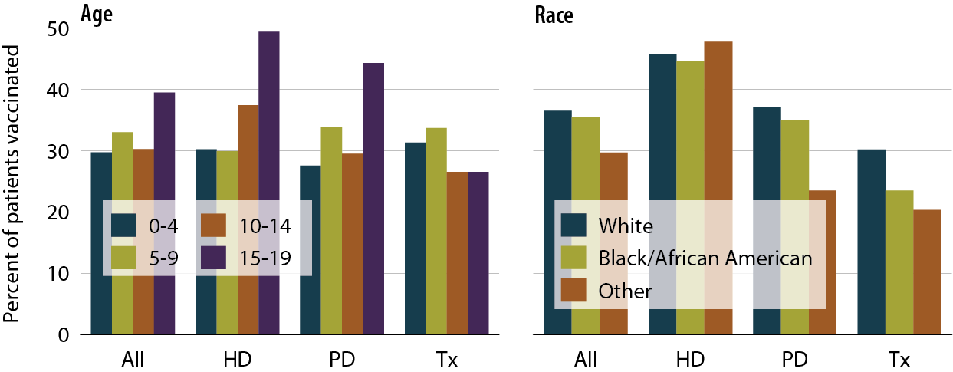
Influenza vaccination rates in pediatric patients, by modality, age, & race, 2007–2010 Figure 8.7 (Volume 2)
Point prevalent ESRD patients age 0–19 prior to January 1 of the two year study period & alive through December 31 of the second year, 2007–2008 & 2009–2010.

Slide 13
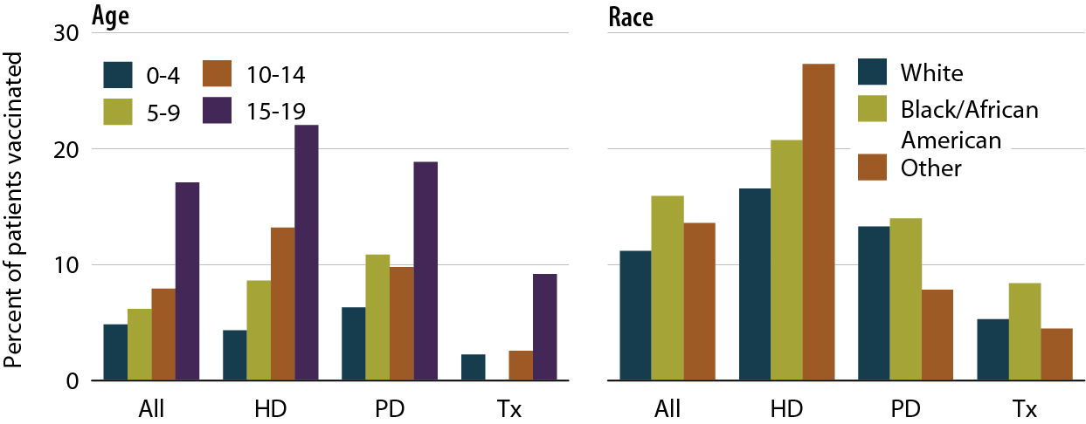
Pneumovax vaccination rates in pediatric patients, by modality, age, & race, 2007–2010 Figure 8.8 (Volume 2)
Point prevalent ESRD patients age 0–19 prior to January 1 of the two year study period & alive through December 31 of the second year, 2007–2008 & 2009–2010.

Slide 14
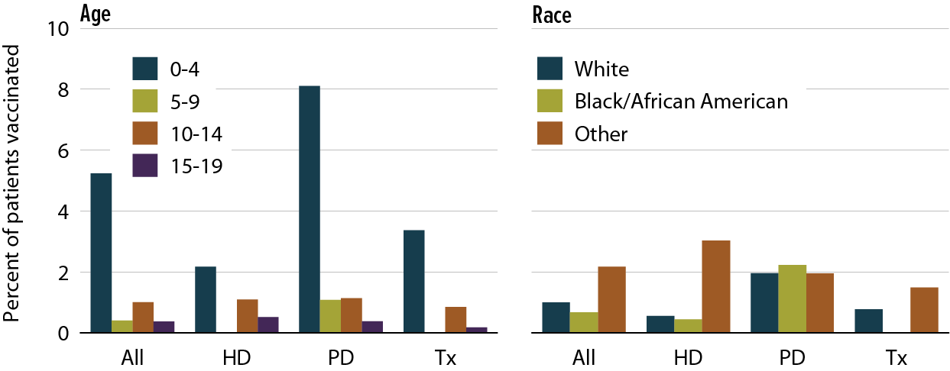
Prevnar vaccination rates in pediatric patients, by modality, age, & race, 2007–2010 Figure 8.9 (Volume 2)
Point prevalent ESRD patients age 0–19 prior to January 1 of the two year study period & alive through December 31 of the second year, 2007–2008 & 2009–2010.

Slide 15
One-year adjusted all-cause hospitalization rates in pediatric patients (from day 90), by age & modality Figure 8.10 (Volume 2)
Incident ESRD patients age 0–19, 2000–2009. Adjusted for gender, race, and primary diagnosis. Ref: incident ESRD patients age 0–19, 2004–2005. Included patients survived the first 90 days after ESRD initiation and are followed from day 90.

Slide 16
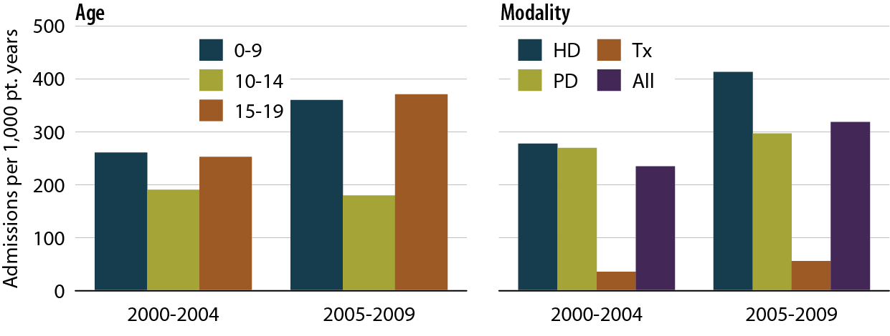
One-year adjusted cardiovascular hospitalization rates in pediatric patients (from day 90), by age, & modality Figure 8.11 (Volume 2)
Incident ESRD patients age 0–19, 2000–2009. Adjusted for gender, race, and primary diagnosis. Ref: incident ESRD patients age 0–19, 2004–2005. Included patients survived the first 90 days after ESRD initiation and are followed from day 90.

Slide 17
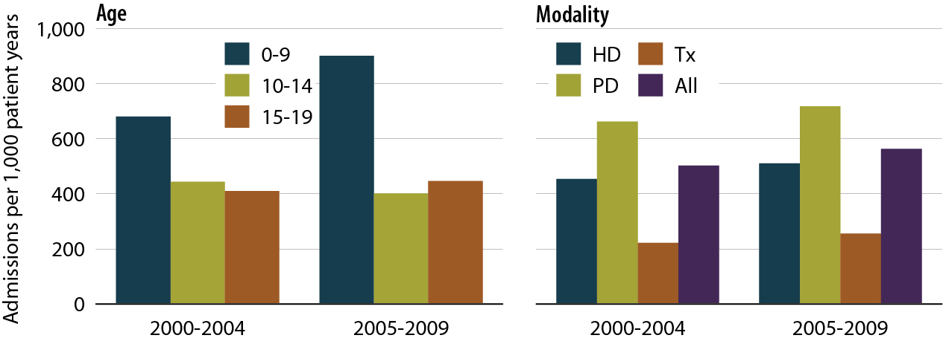
One-year adjusted rates of hospitalization for infection in pediatric patients (from day 90), by age & modality Figure 8.12 (Volume 2)
Incident ESRD patients age 0–19, 2000–2009. Adjusted for gender, race, and primary diagnosis. Ref: incident ESRD patients age 0–19, 2004–2005. Included patients survived the first 90 days after ESRD initiation and are followed from day 90.

Slide 18
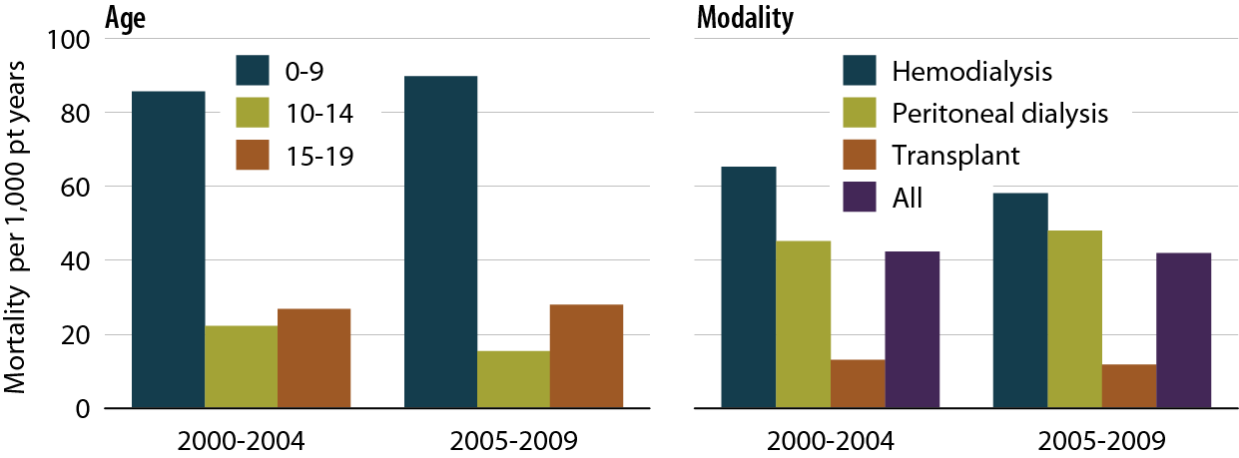
One-year adjusted all-cause mortality rates in pediatric patients (from day one), by age & modality Figure 8.13 (Volume 2)
Incident dialysis & transplant pts defined on the onset of dialysis or transplant day without the 60-day rule; followed to December 31, 2010. Adjusted for age, gender, race, Hispanic ethnicity, & primary diagnosis. Ref: incident ESRD patients age 0–19, 2004–2005.

Slide 19
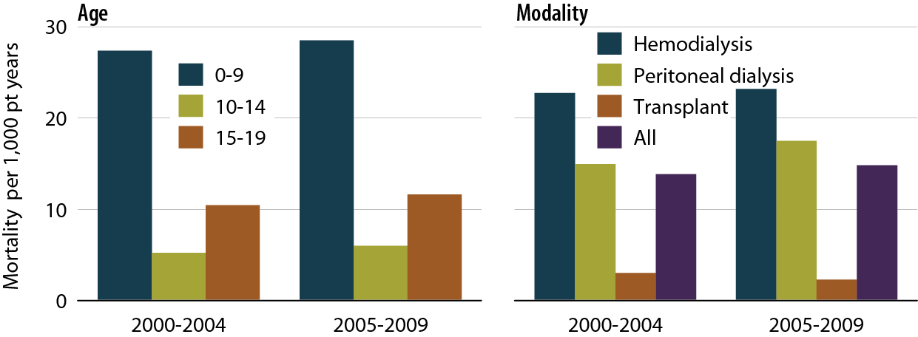
One-year adjusted cardiovascular mortality rates in pediatric patients (from day one), by age & modality Figure 8.14 (Volume 2)
Incident dialysis & transplant pts defined on the onset of dialysis or transplant day without the 60-day rule; followed to December 31, 2010. Adjusted for age, gender, race, Hispanic ethnicity, & primary diagnosis. Ref: incident ESRD patients age 0–19, 2004–2005.

Slide 20
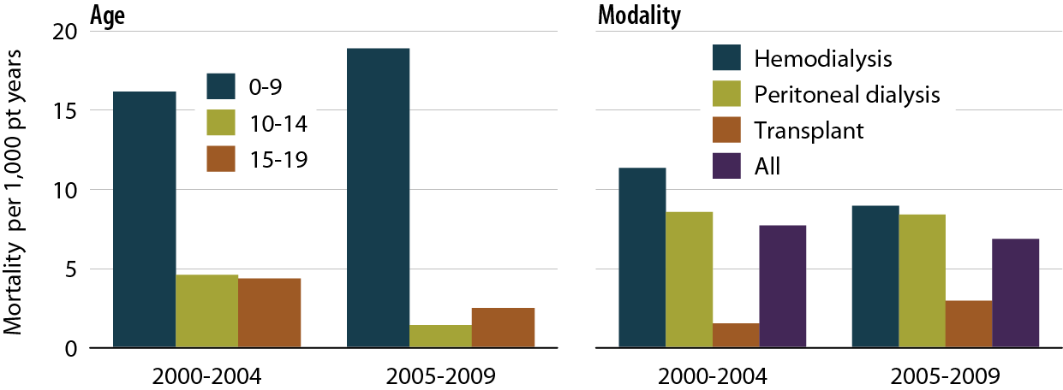
One-year adjusted rates of mortality due to infection in pediatric patients (from day one), by age & modality Figure 8.15 (Volume 2)
Incident dialysis & transplant pts defined on the onset of dialysis or transplant day without the 60-day rule; followed to December 31, 2010. Adjusted for age, gender, race, Hispanic ethnicity, & primary diagnosis. Ref: incident ESRD patients age 0–19, 2004–2005.

Slide 21
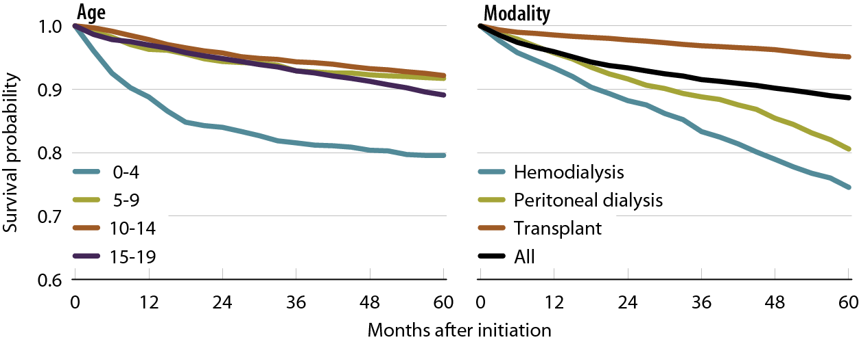
Adjusted five-year survival in pediatric patients (from day one), by age & modality, 2001–2005 Figure 8.16 (Volume 2)
Incident dialysis & transplant pts defined on the onset of dialysis or transplant day without the 60-day rule; followed to December 31, 2010. Adjusted for age, gender, race, Hispanic ethnicity, & primary diagnosis. Ref: incident ESRD patients age 0–19, 2004–2005.

Slide 22
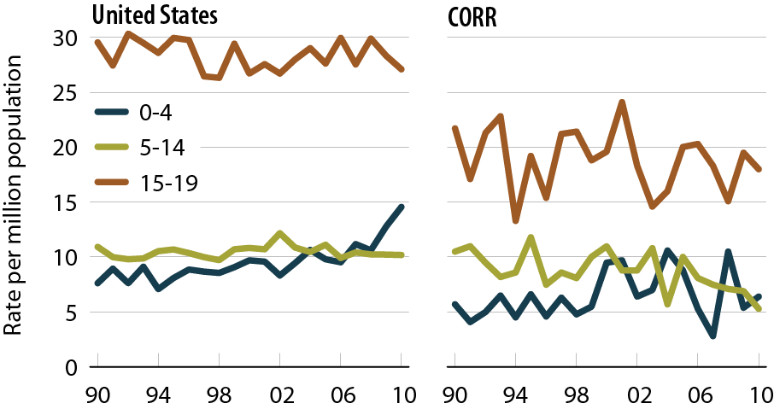
Incident rates of ESRD in the United States & Canada, by age Figure 8.17 (Volume 2)
Incident ESRD patients age 0–19; unadjusted.

Slide 23
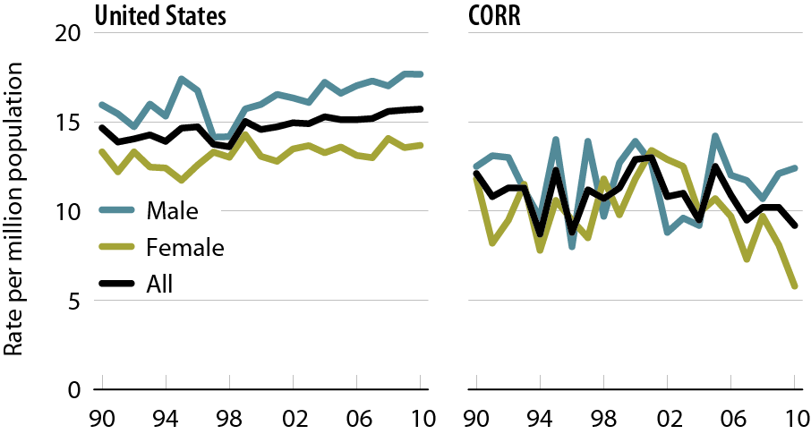
Incident rates of ESRD in the United States & Canada, by gender Figure 8.18 (Volume 2)
Incident ESRD patients age 0–19; unadjusted.

Slide 24
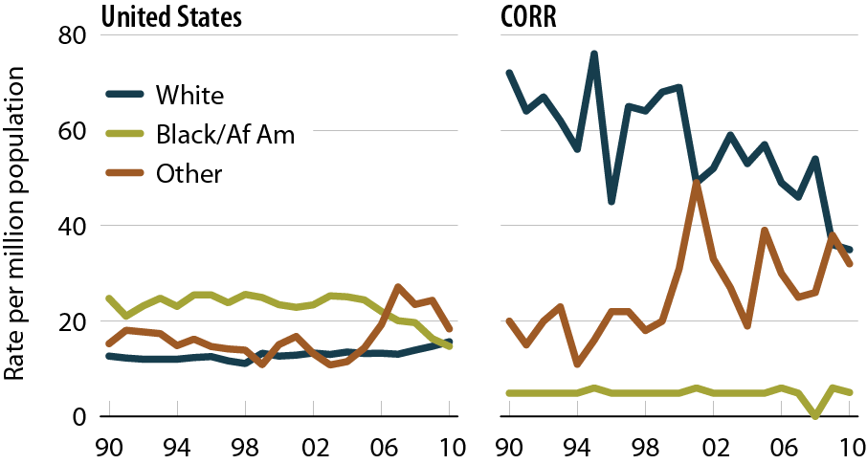
Incident rates of ESRD in the United States & Canada, by race Figure 8.19 (Volume 2)
Incident ESRD patients age 0–19; unadjusted.

Slide 25
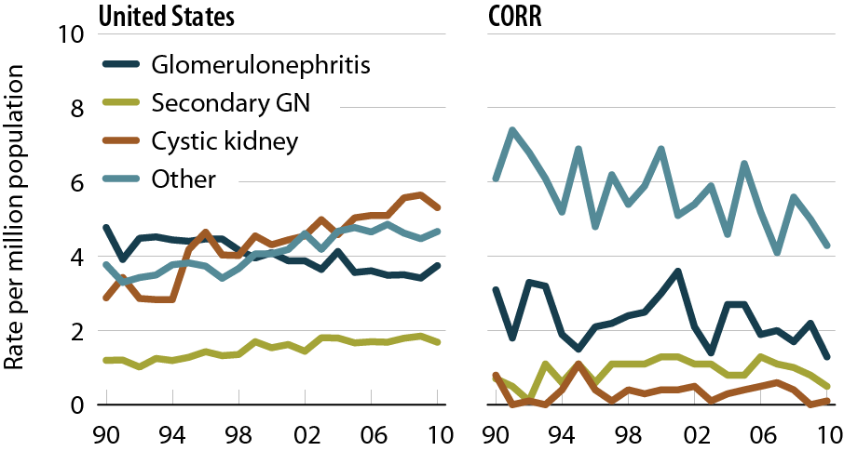
Incident rates of ESRD in the United States & Canada, by primary cause of renal failure Figure 8.20 (Volume 2)
Incident ESRD patients age 0–19; unadjusted.

Slide 26
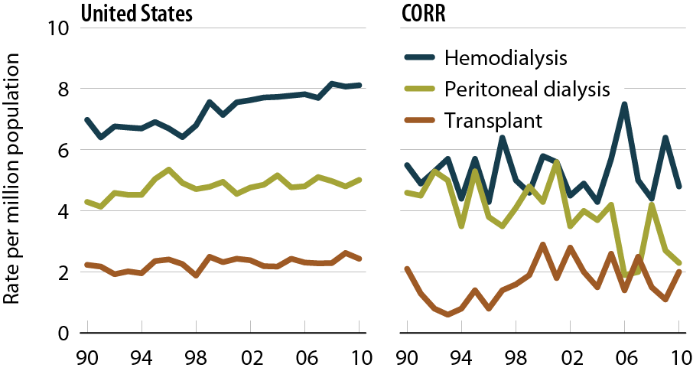
Incident rates of ESRD in the United States & Canada, by modality Figure 8.21 (Volume 2)
Incident ESRD patients age 0–19; unadjusted.

Slide 27
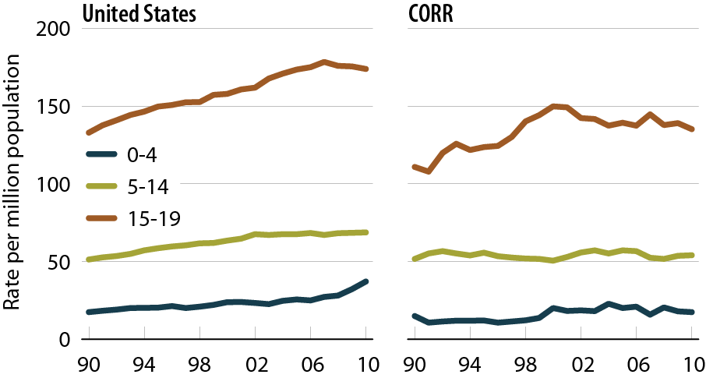
Prevalent rates of ESRD in the United States & Canada, by age Figure 8.22 (Volume 2)
Incident ESRD patients age 0–19; unadjusted.

Slide 28
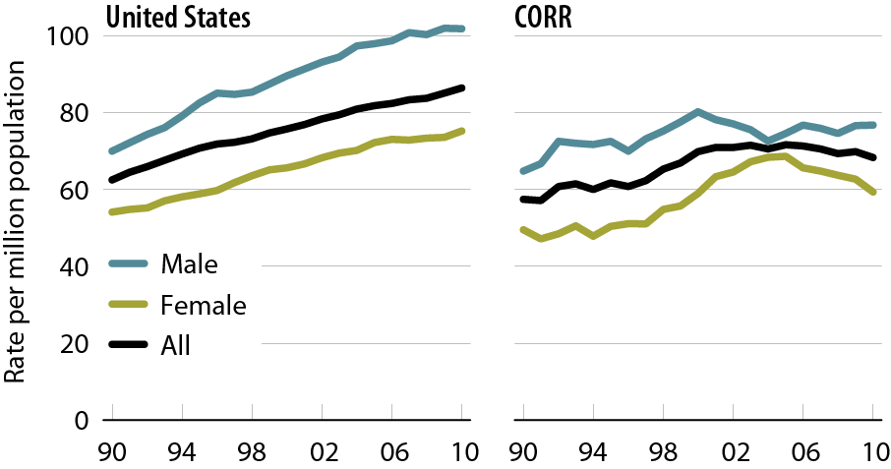
Prevalent rates of ESRD in the United States & Canada, by gender Figure 8.23 (Volume 2)
Incident ESRD patients age 0–19; unadjusted.

Slide 29
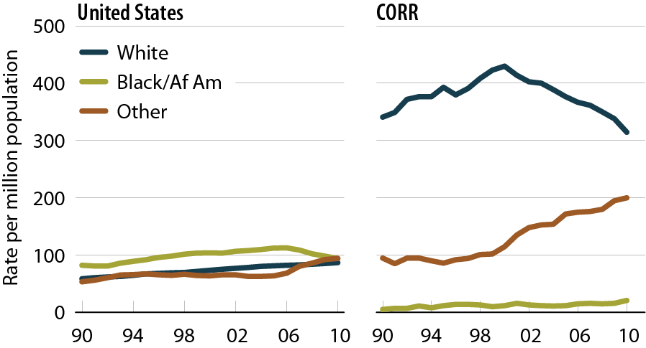
Prevalent rates of ESRD in the United States & Canada, by race Figure 8.24 (Volume 2)
Incident ESRD patients age 0–19; unadjusted.

Slide 30
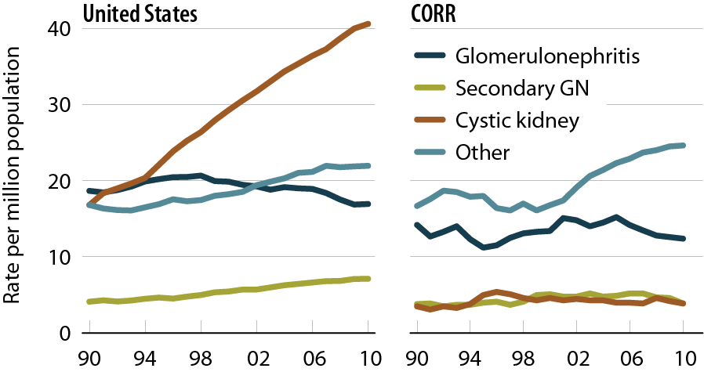
Prevalent rates of ESRD in the United States & Canada, by primary cause of renal failure Figure 8.25 (Volume 2)
Incident ESRD patients age 0–19; unadjusted.

Slide 31
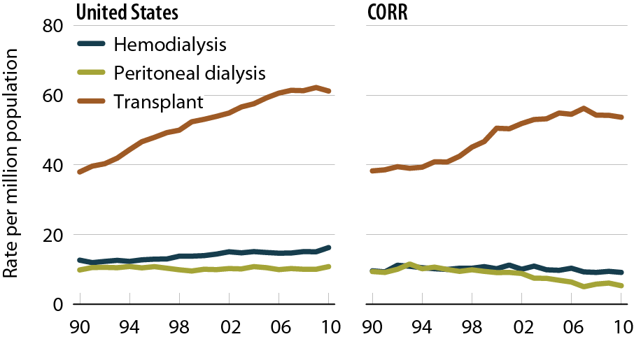
Prevalent rates of ESRD in the United States & Canada, by modality Figure 8.26 (Volume 2)
Incident ESRD patients age 0–19; unadjusted.

Slide 32
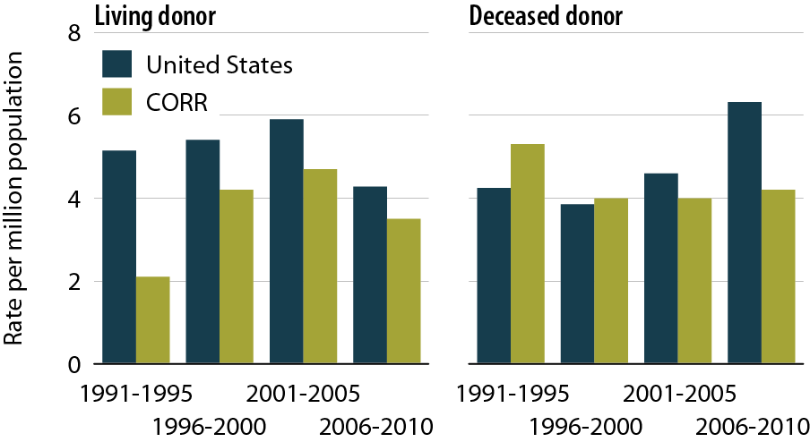
First transplant rates in incident ESRD patients in the United States & Canada, by donor type Figure 8.27 (Volume 2)
Incident ESRD patients age 0–19; unadjusted.

Slide 33
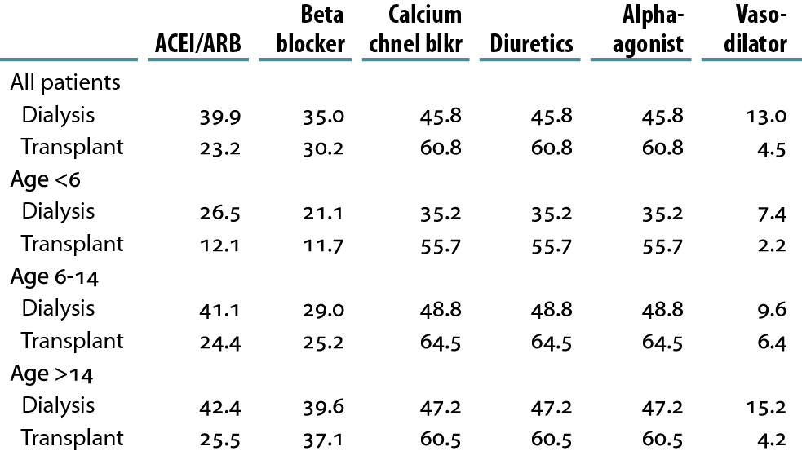
Antihypertensive medication use in pediatric patients with ESRD, by age & modality (column %) Table 8.b (Volume 2)
Period prevalent ESRD patients with Medicare Part D, 2009–2010.

Slide 34
Average dose per week of injectable medications in pediatric dialysis patients, by age Table 8.c (Volume 2)
Period prevalent ESRD patients with Medicare Part D, 2009–2010. IV vitamin D dose in paricalcitol-equivalent units.

Slide 35
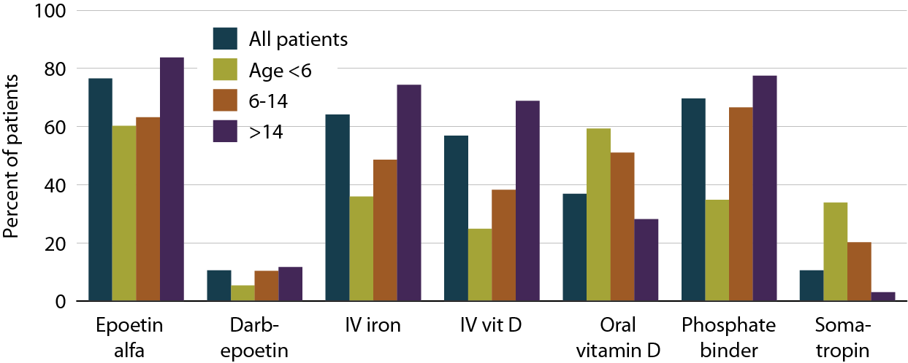
Use of injectables & oral medications in pediatric dialysis patients, by age Figure 8.28 (Volume 2)
Period prevalent ESRD patients with Medicare Part D, 2009–2010. IV vitamin D dose in paricalcitol-equivalent units.

Slide 36
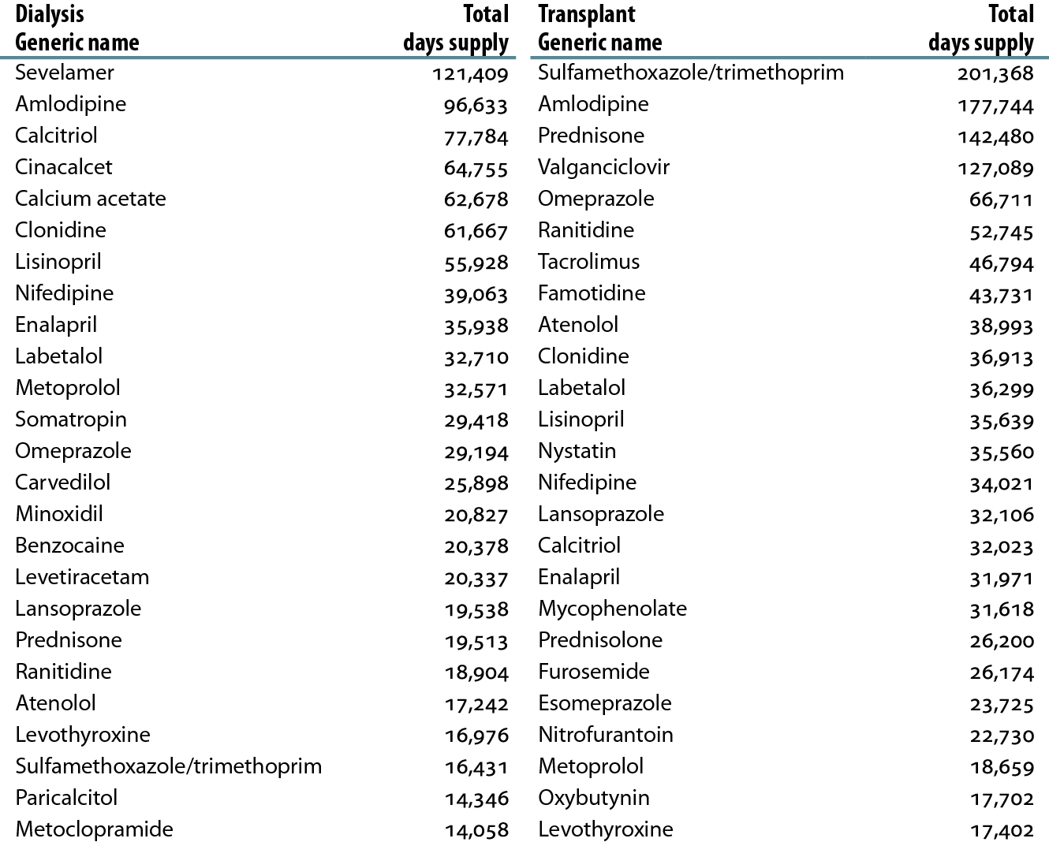
Top 25 drugs used in pediatric ESRD patients, sorted by total days supply, 2009–2010 Table 8.d (Volume 2)
Period prevalent ESRD patients with Medicare Part D, 2009–2010; each prescription drug is disbursed with sufficient quantity to administer for a set number of days, so long as instructions are followed (i.e., so long as adherence is perfect). Total days supplied equals the cumulative number of days supplied through all fills of a particular medication in a population

Slide 37
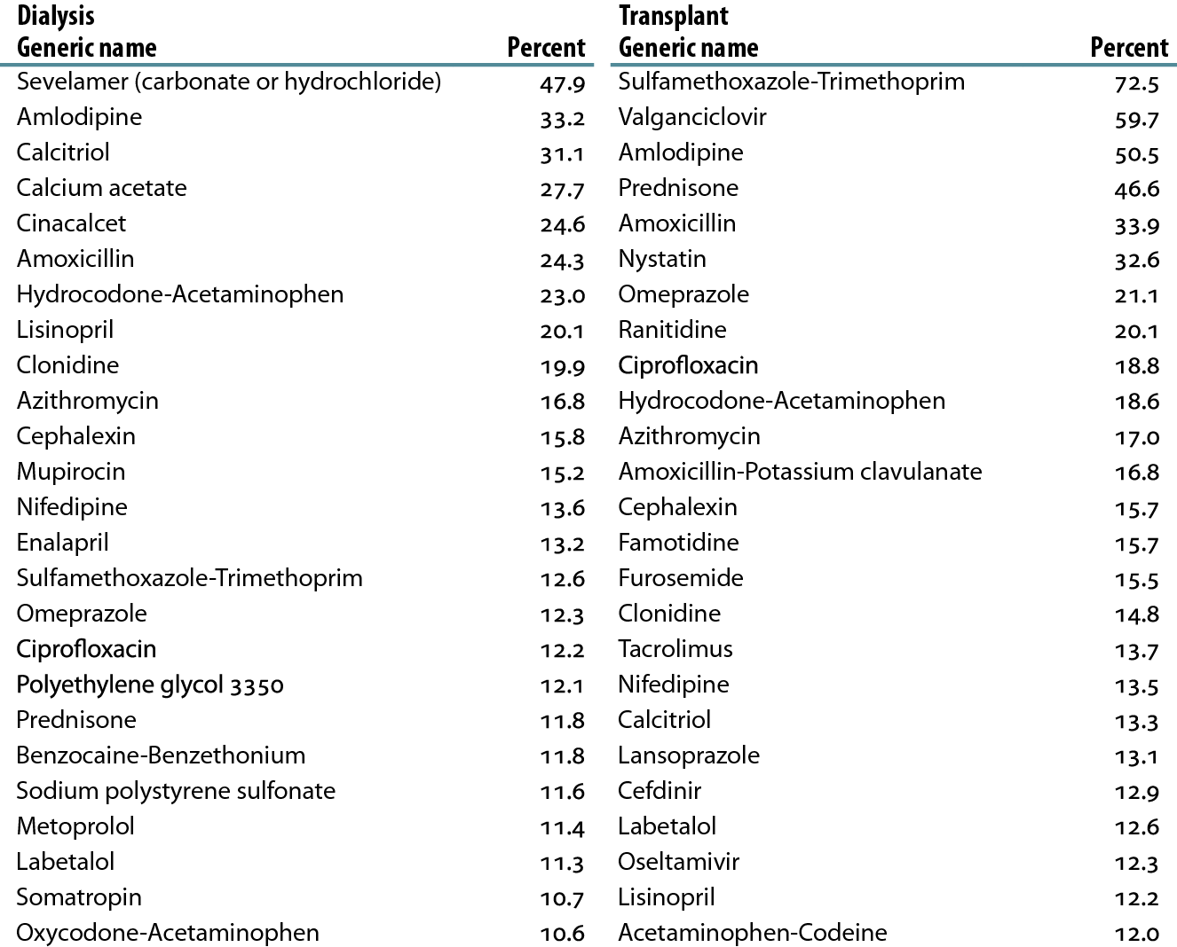
Top 25 drugs used in pediatric ESRD patients, sorted by percentage of patients with at least one fill, 2009–2010 Table 8.e (Volume 2)
Period prevalent ESRD patients with Medicare Part D, 2009–2010

