Slide 1
ESRD: Chapter Nine
Rehabilitation/Quality of Life
& Nutrition Special Studies
United States Renal Data System
2012 Annual Data Report

Slide 2
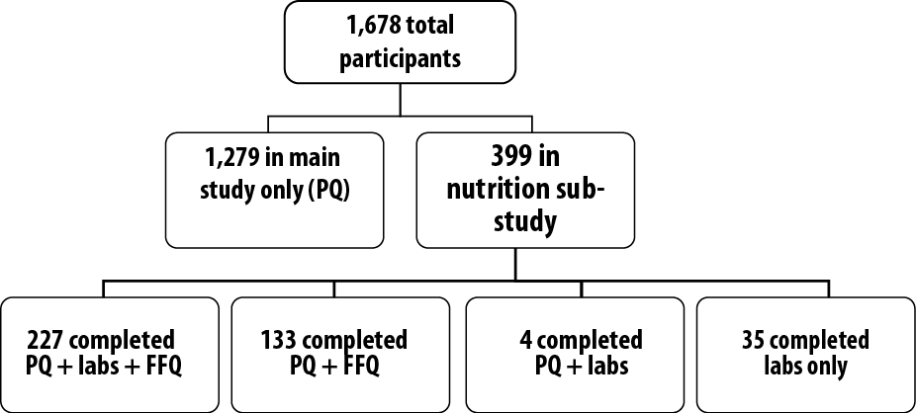
Distribution of CDS participants
Figure 9.1 (Volume 2)
CDS participants who started treatment between June 1, 2005, & June 1, 2007.

Slide 3
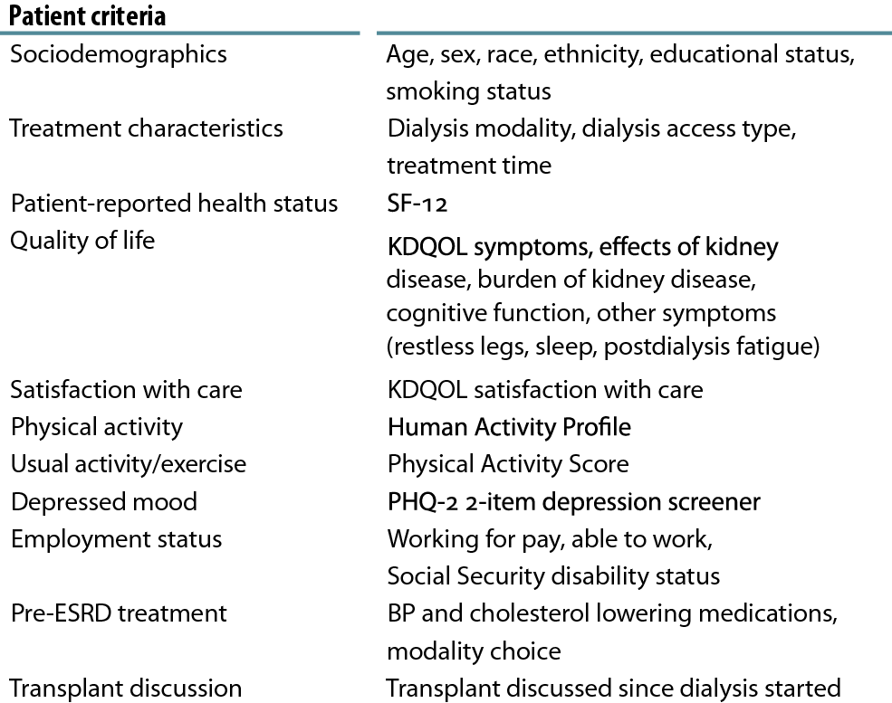
Patient activity & quality of life questionnaire
Table 9.a (Volume 2)
CDS participants who started treatment between June 1, 2005, & June 1, 2007.

Slide 4
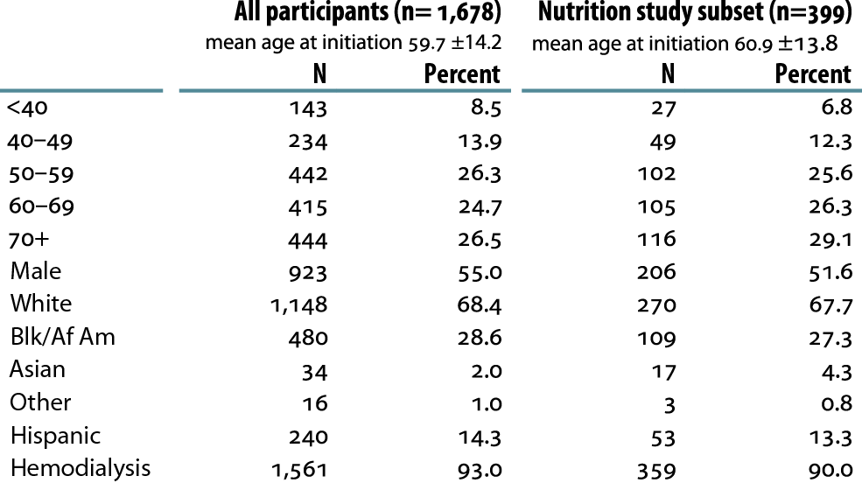
Sociodemographic characteristics of Comprehensive Dialysis Study participants
Table 9.b (Volume 2)
CDS participants who started treatment between June 1, 2005, & June 1, 2007.

Slide 5
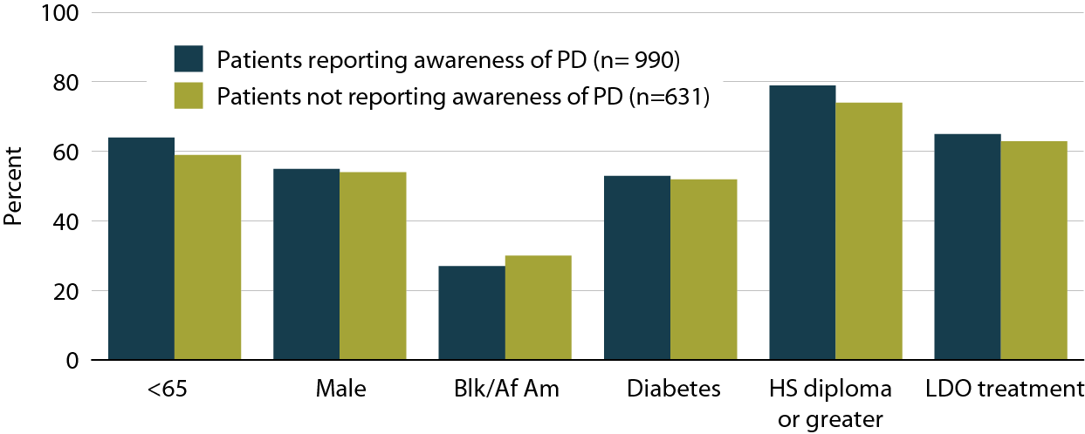
Patients reporting or not reporting early awareness (pre-dialysis) of peritoneal dialysis, by age, gender, race, diabetes, education, and treatment site.
Figure 9.2 (Volume 2)
CDS participants who started treatment between June 1, 2005, & June 1, 2007.

Slide 6
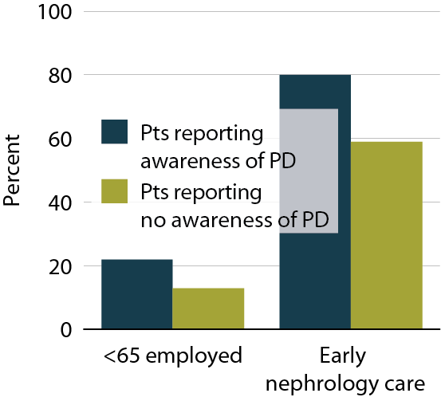
Patients reporting or not reporting awareness of peritoneal dialysis, by employment, & nephrology care
Figure 9.3 (Volume 2)
CDS participants who started treatment between June 1, 2005, & June 1, 2007.

Slide 7
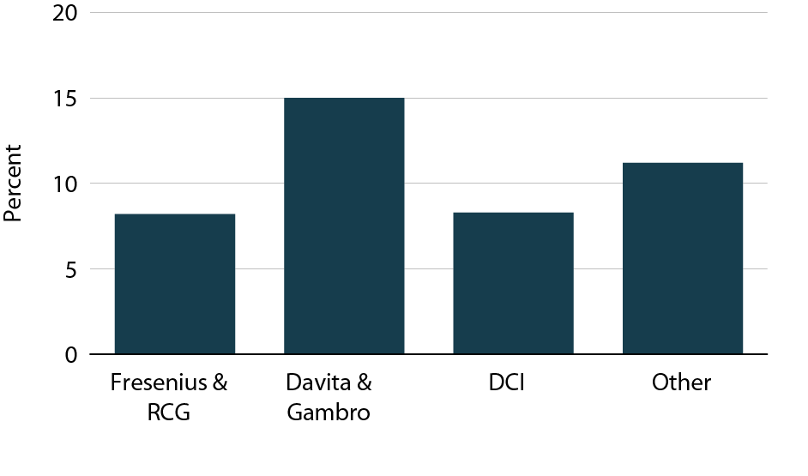
Peritoneal dialysis selection among CDS participants, by dialysis unit ownership
Figure 9.4 (Volume 2)
CDS participants who started treatment between June 1, 2005, & June 1, 2007.

Slide 8
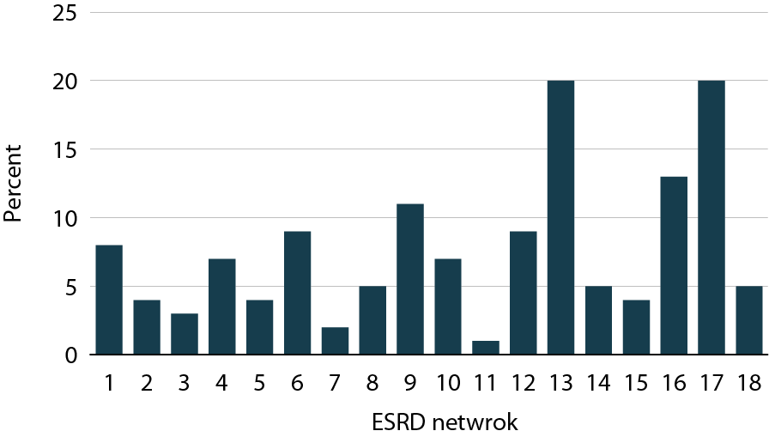
Peritoneal dialysis selection among
CDS participants, by ESRD network
Figure 9.5 (Volume 2)
CDS participants who started treatment between June 1, 2005, & June 1, 2007.

Slide 9
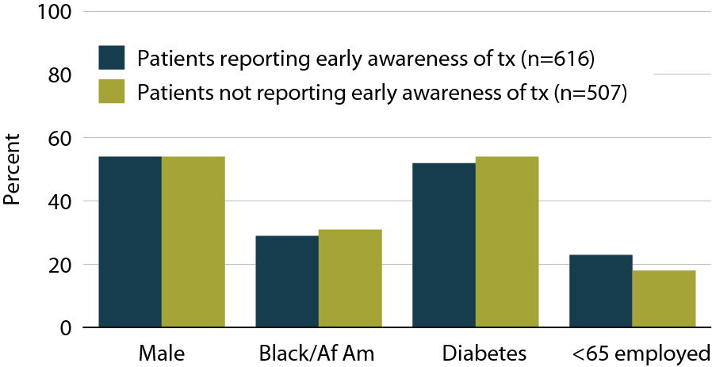
Patients reporting or not reporting early awareness of kidney transplantation, by patient characteristics, & employment status
Figure 9.6 (Volume 2)
Incident dialysis patients who started treatment June 1, 2005 to June 1, 2007.

Slide 10
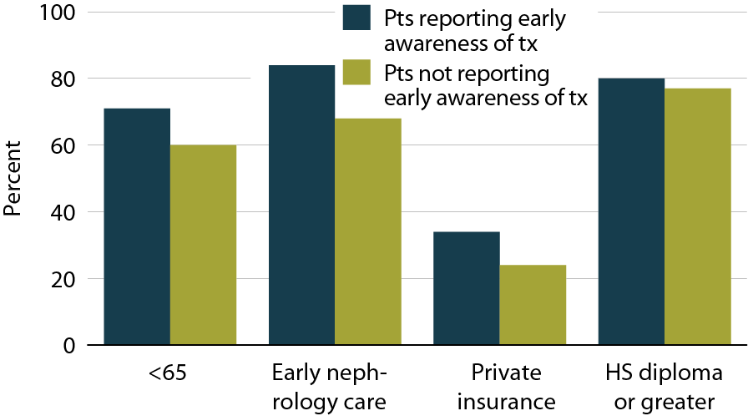
Patients reporting or not reporting early awareness of kidney transplantation, by age, care, insurance status & education
Figure 9.7 (Volume 2)
Incident dialysis patients who started treatment June 1, 2005 to June 1, 2007.

Slide 11
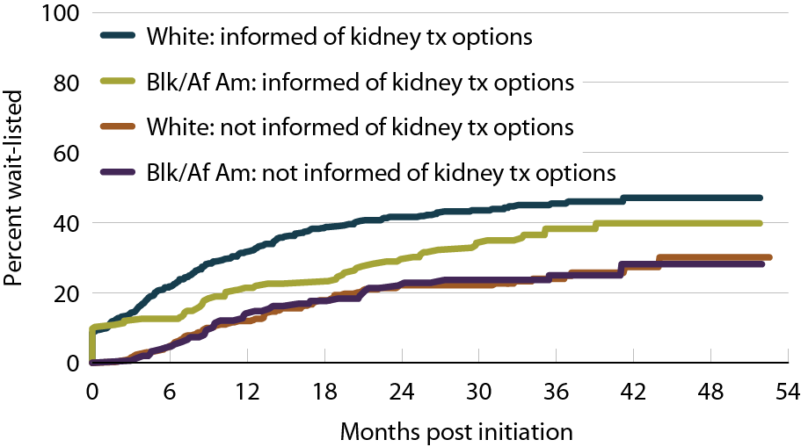
Time to wait listing in patients with early awareness of kidney transplant options
Figure 9.8 (Volume 2)
Incident dialysis patients who started treatment June 1, 2005 to June 1, 2007.

Slide 12
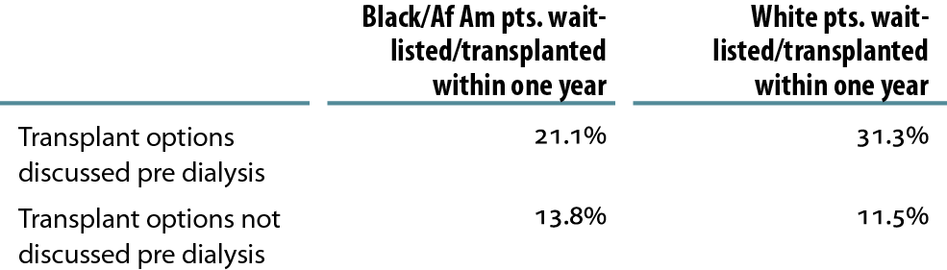
Patients wait-listed or who received a deceased donor kidney transplant within one year of ESRD initiation
Table 9.c (Volume 2)
Incident dialysis patients who started treatment June 1, 2005 to June 1, 2007.

Slide 13
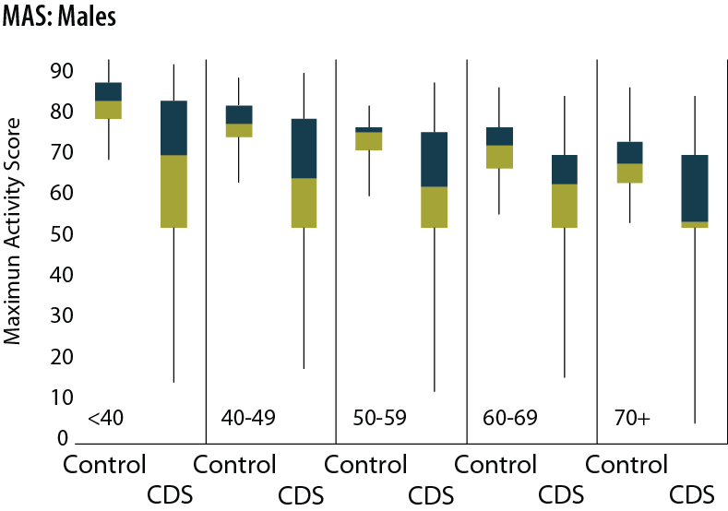
Maximum activity scores (MAS) in CDS participants: males
Figure 9.9 (Volume 2)
Incident dialysis patients who started treatment June 1, 2005 to June 1, 2007. The boxes represent the 25th to 75th percentiles with the line in the center indicating the 50th percentile. Lines above and below extend to the 99th and 1st percentile, respectively. In each figure, scores are shown by age group, beginning with age <40 and progressing by decade to age 70+ years. Within each age group, normative data are represented on the left and CDS participants’ data are plotted on the right.

Slide 14
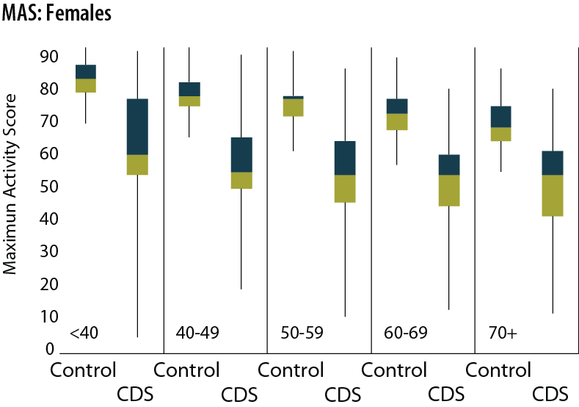
Maximum activity scores (MAS) in CDS participants: females
Figure 9.9 (continued Volume 2)
Incident dialysis patients who started treatment June 1, 2005 to June 1, 2007. The boxes represent the 25th to 75th percentiles with the line in the center indicating the 50th percentile. Lines above and below extend to the 99th and 1st percentile, respectively. In each figure, scores are shown by age group, beginning with age <40 and progressing by decade to age 70+ years. Within each age group, normative data are represented on the left and CDS participants’ data are plotted on the right.

Slide 15
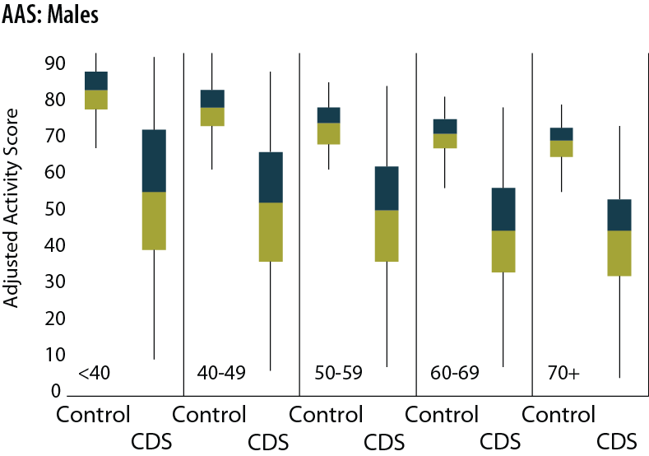
Adjusted activity scores (AAS) in CDS participants: males
Figure 9.9 (continued Volume 2)
Incident dialysis patients who started treatment June 1, 2005 to June 1, 2007. The boxes represent the 25th to 75th percentiles with the line in the center indicating the 50th percentile. Lines above and below extend to the 99th and 1st percentile, respectively. In each figure, scores are shown by age group, beginning with age <40 and progressing by decade to age 70+ years. Within each age group, normative data are represented on the left and CDS participants’ data are plotted on the right.

Slide 16
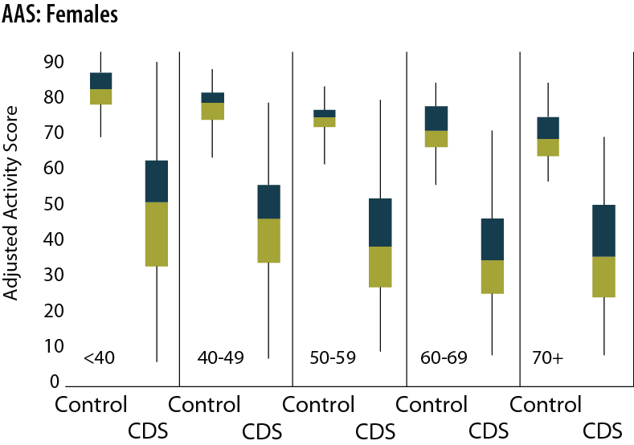
Adjusted activity scores (AAS) in CDS participants: females
Figure 9.9 (continued Volume 2)
Incident dialysis patients who started treatment June 1, 2005 to June 1, 2007. The boxes represent the 25th to 75th percentiles with the line in the center indicating the 50th percentile. Lines above and below extend to the 99th and 1st percentile, respectively. In each figure, scores are shown by age group, beginning with age <40 and progressing by decade to age 70+ years. Within each age group, normative data are represented on the left and CDS participants’ data are plotted on the right.

Slide 17
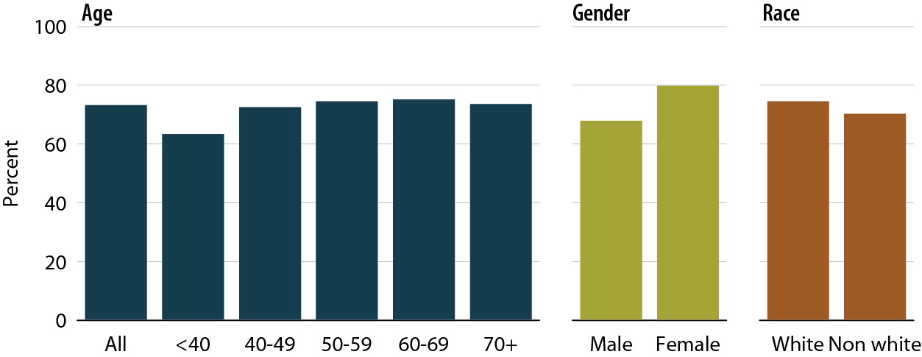
CDS participants classified as frail, by age, gender, & race
Figure 9.10 (Volume 2)
Incident dialysis patients who started treatment June 1, 2005 to June 1, 2007.

Slide 18
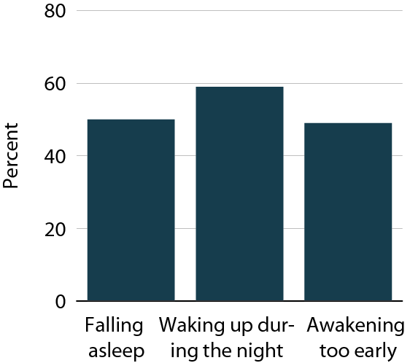
Frequency & severity of individual insomnia symptoms in CDS participants
Figure 9.11 (Volume 2)
Incident dialysis patients who started treatment June 1, 2005 to June 1, 2007.

Slide 19
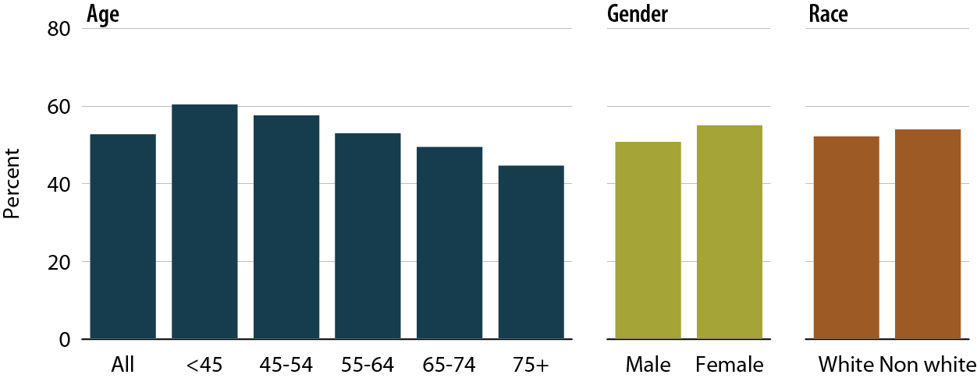
CDS participants with at least one severe symptom of insomnia, by age, gender, & race
Figure 9.12 (Volume 2)
Incident dialysis patients who started treatment June 1, 2005 to June 1, 2007.

Slide 20
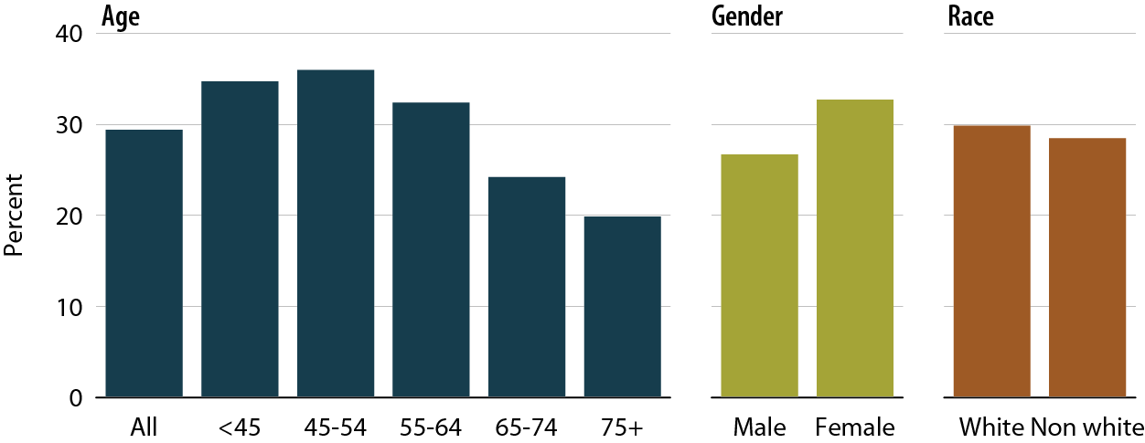
CDS participants meeting criteria for restless legs syndrome, by age, gender, & race
Figure 9.13 (Volume 2)
Incident dialysis patients who started treatment June 1, 2005 to June 1, 2007.

Slide 21
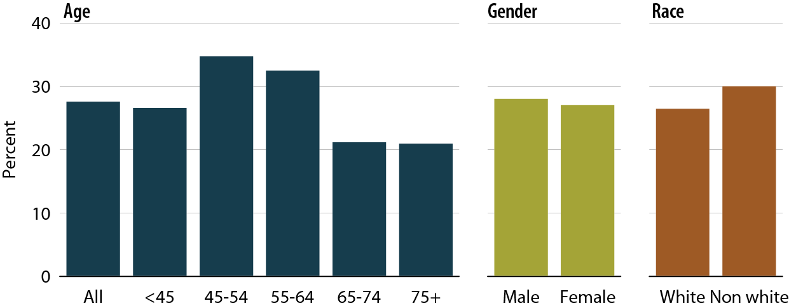
CDS participants meeting criteria for depression, by age, gender, & race
Figure 9.14 (Volume 2)
Incident dialysis patients who started treatment June 1, 2005 to June 1, 2007.

Slide 22
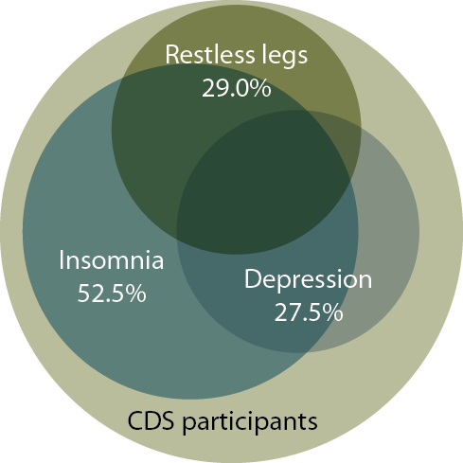
Frequency of symptom complexes in CDS participants
Figure 9.15 (Volume 2)
Incident dialysis patients who started treatment June 1, 2005 to June 1, 2007.

Slide 23
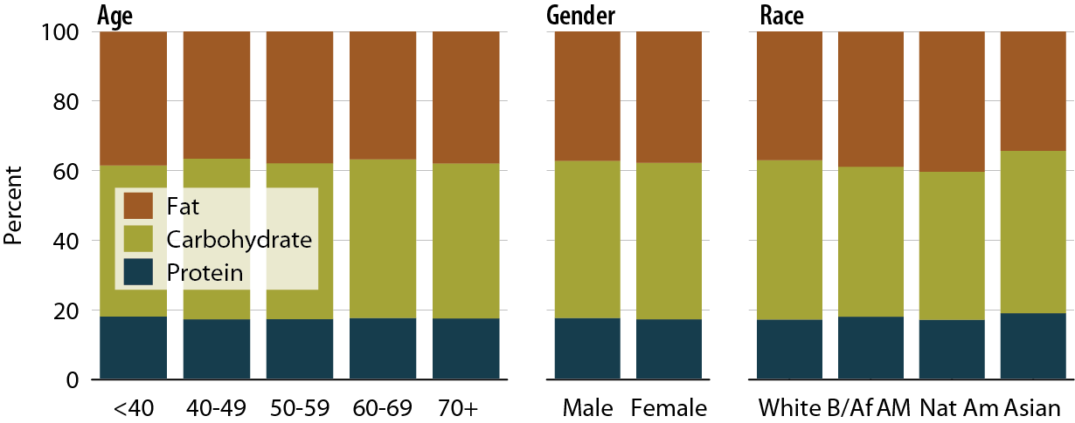
Among CDS participants, percentage of dietary intake from protein, carbohydrate, or fat sources, by age, gender, & race
Figure 9.16 (Volume 2)
Incident dialysis patients who started treatment June 1, 2005 to June 1, 2007.

Slide 24
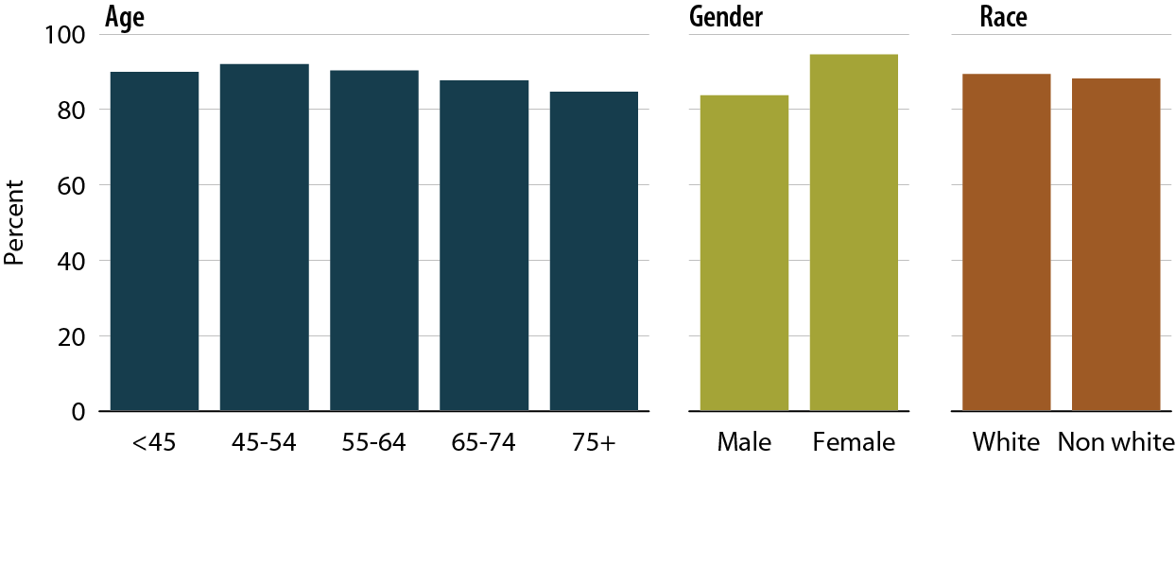
CDS participants who were 25-OH vitamin D deficient, by age, gender, & race
Figure 9.17 (Volume 2)
Incident dialysis patients who started treatment June 1, 2005 to June 1, 2007.

