Slide 1
ESRD: Chapter Eleven
Costs of ESRD
United States Renal Data System
2012 Annual Data Report

Slide 2
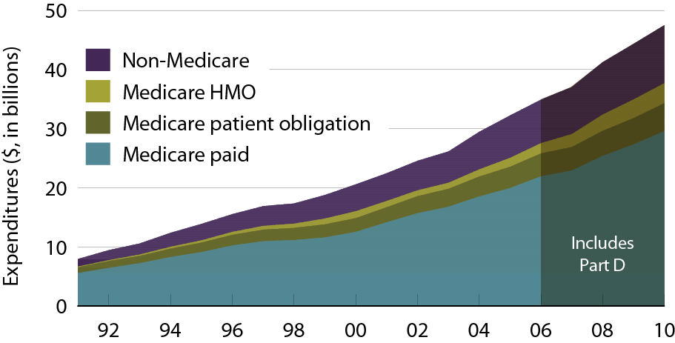
ESRD expenditures, by payor Figure 11.1 (Volume 2)
Period prevalent ESRD patients; includes Part D.

Slide 3
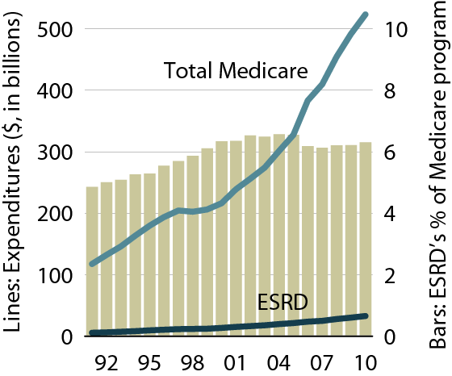
Costs of the Medicare & ESRD programs Figure 11.2 (Volume 2)
Includes Part D

Slide 4
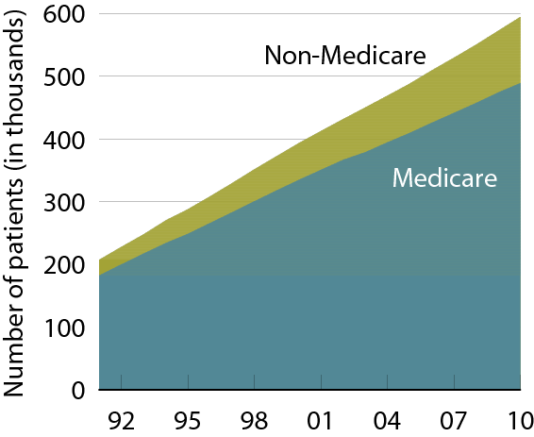
Estimated numbers of point prevalent ESRD patients Figure 11.3 (Volume 2)
December 31 point prevalent ESRD patients.

Slide 5
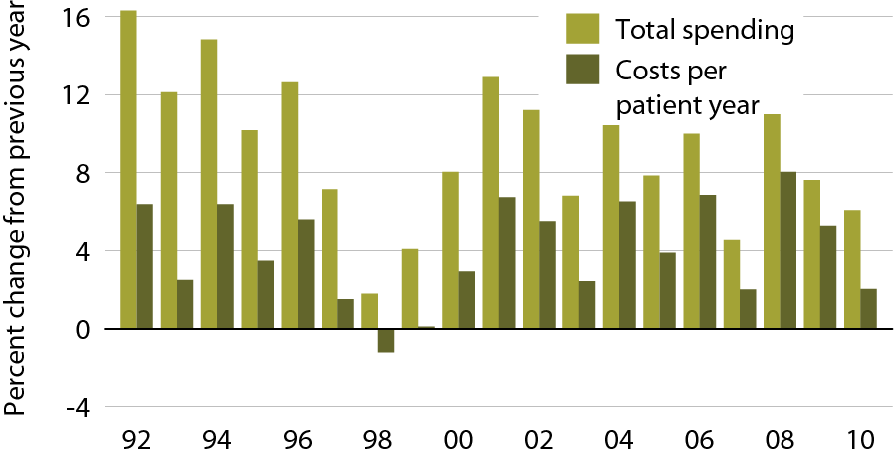
Annual percent change in Medicare ESRD spending Figure 11.4 (Volume 2)
Total Medicare ESRD costs from claims data; includes all Medicare as primary payor claims as well as amounts paid by Medicare as secondary payor.

Slide 6
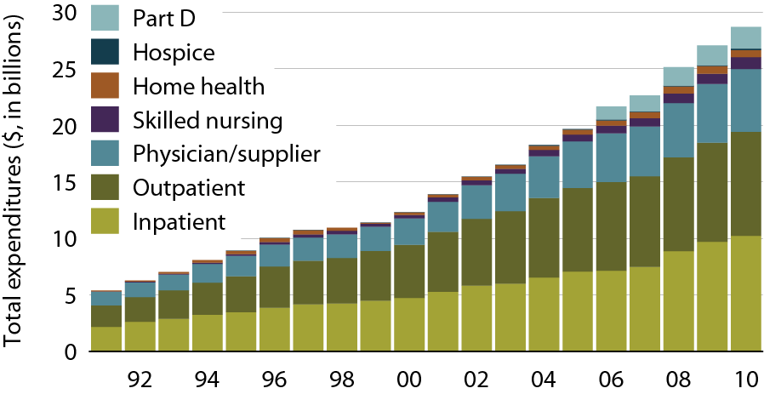
Total Medicare dollars spent on ESRD, by type of service Figure 11.5 (Volume 2)
Total Medicare costs from claims data; include all Medicare as primary payor claims as well as amounts paid by Medicare as secondary payor

Slide 7
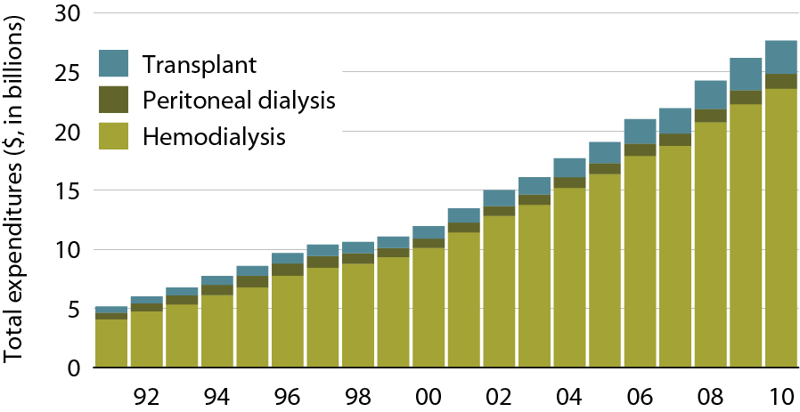
Total Medicare ESRD expenditures, by modality Figure 11.6 (Volume 2)
Period prevalent ESRD patients, patients with Medicare as secondary payor are excluded.

Slide 8
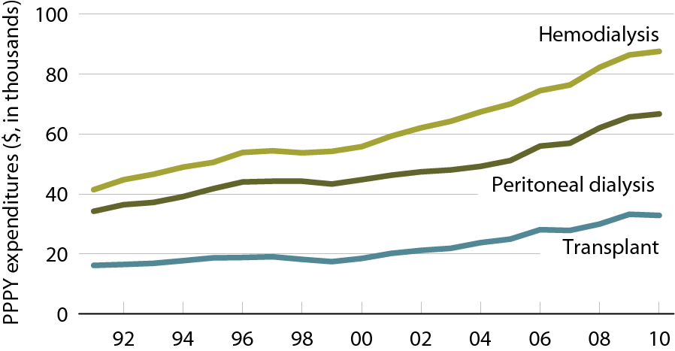
Total Medicare ESRD expenditures per person per year, by modality Figure 11.7 (Volume 2)
Period prevalent ESRD patients, patients with Medicare as secondary payor are excluded.

Slide 9
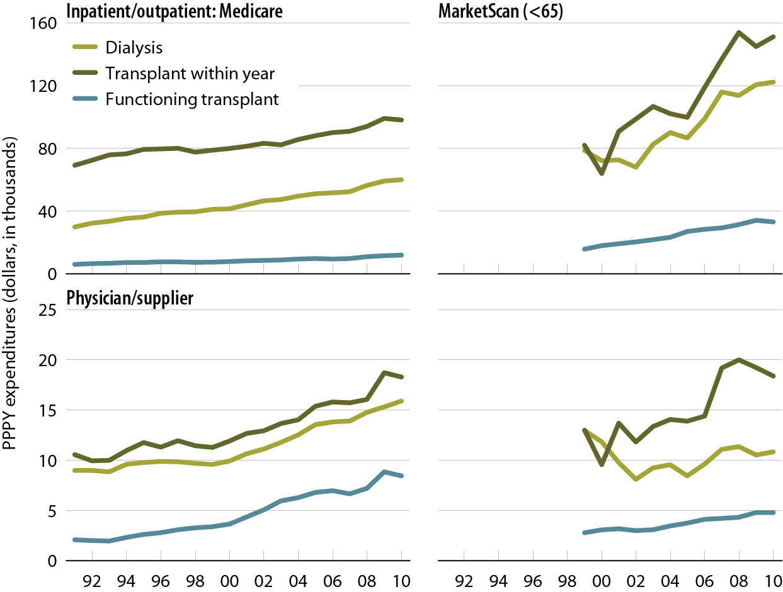
Per person per year inpatient/outpatient & physician/supplier net costs for Medicare & MarketScan (EGHP) patients with ESRD Figure 11.8 (Volume 2)
Medicare: period prevalent ESRD patients; MarketScan: period prevalent ESRD patients age 64 & younger.

Slide 10
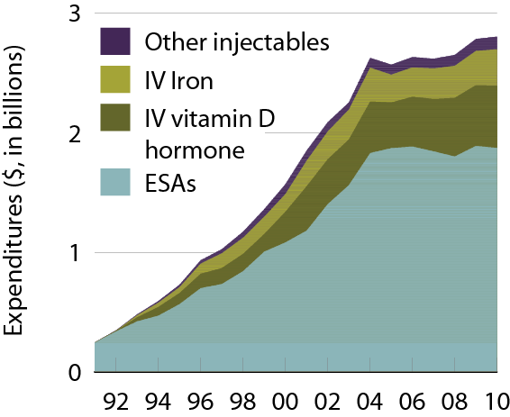
Total Medicare spending for injectables Figure 11.9 (Volume 2)
Period prevalent dialysis patients.

Slide 11
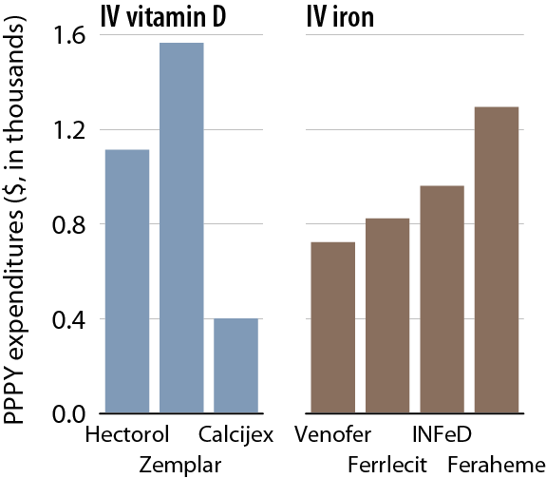
Per person per year costs for injectables, 2010 Figure 11.10 (Volume 2)
Period prevalent dialysis patients.

Slide 12
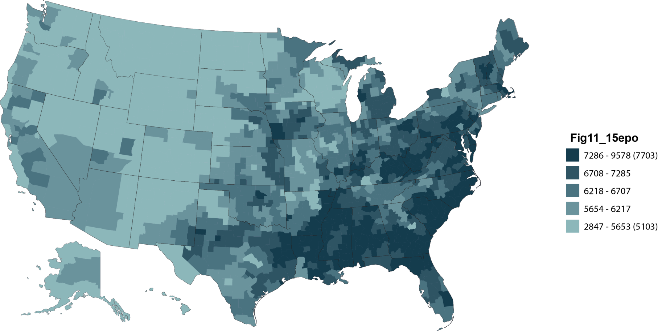
Unadjusted per person per year costs (dollars) for injectables, by HSA, 2010: ESAs/IV iron Figure 11.11 (Volume 2)
Period prevalent dialysis patients, 2010; unadjusted.

Slide 13
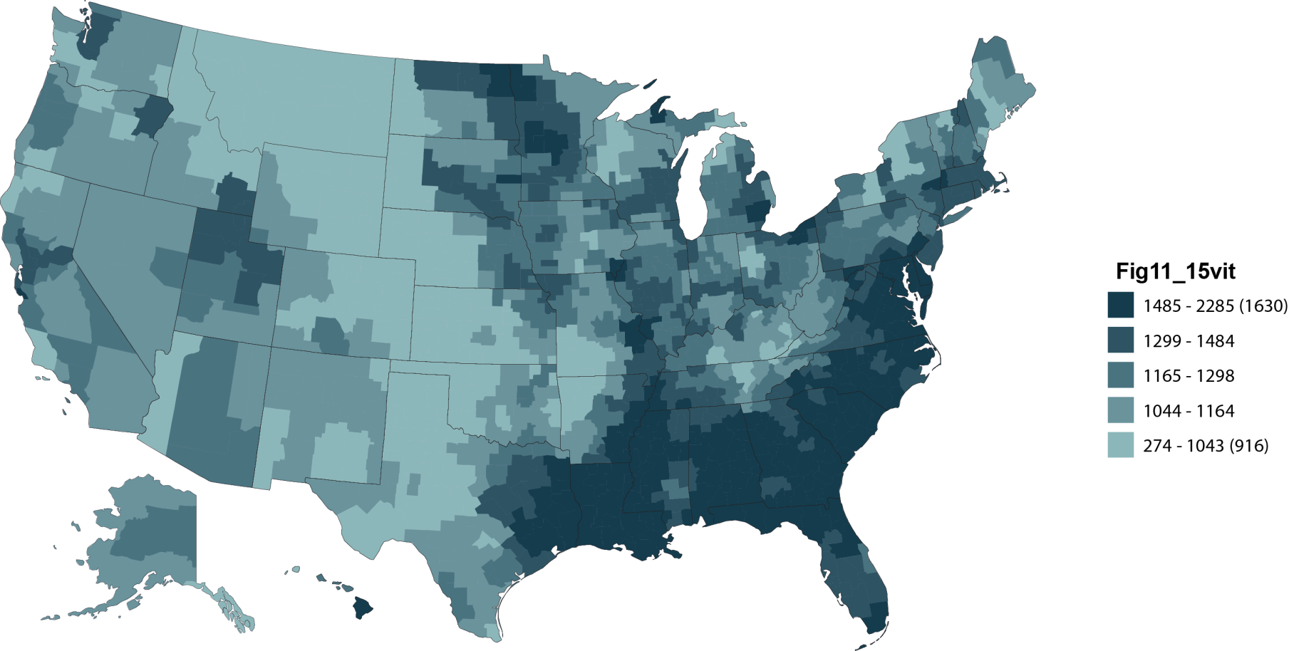
Unadjusted per person per year costs (dollars) for injectables, by HSA, 2010: IV vitamin D Figure 11.11, (continued, Volume 2)
Period prevalent dialysis patients, 2010; unadjusted.

Slide 14
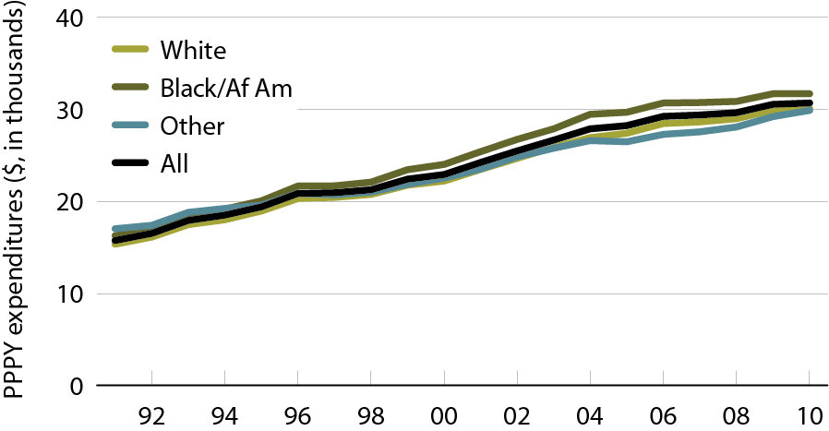
Total per person per year outpatient expenditures, by race Figure 11.12 (Volume 2)
Period prevalent dialysis patients.

Slide 15
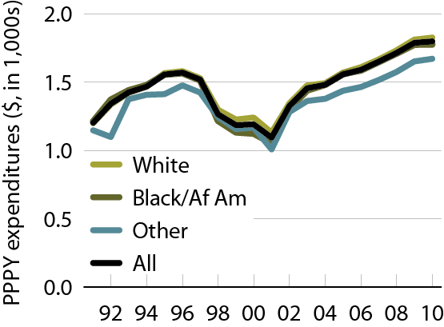
Per person per year expenditures for laboratory tests, by race Figure 11.13 (Volume 2)
Period prevalent dialysis patients.

Slide 16
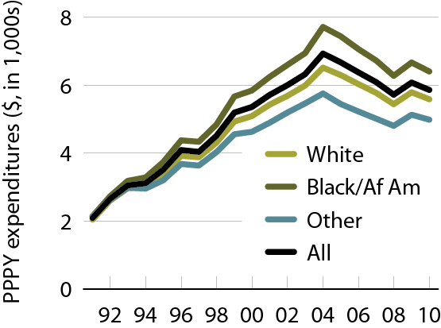
Per person per year expenditures for ESAs, by race Figure 11.14 (Volume 2)
Period prevalent dialysis patients.

Slide 17
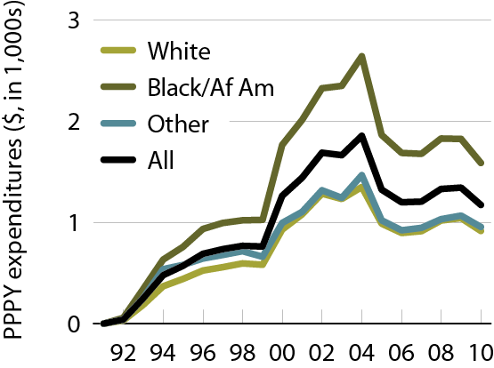
Per person per year expenditures for IV vitamin D, by race Figure 11.15 (Volume 2)
Period prevalent dialysis patients.

Slide 18
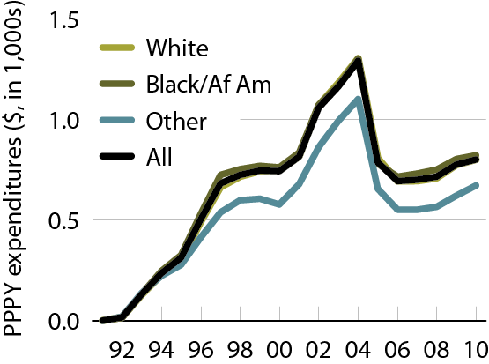
Per person per year expenditures for IV iron, by race Figure 11.16 (Volume 2)
Period prevalent dialysis patients.

Slide 19
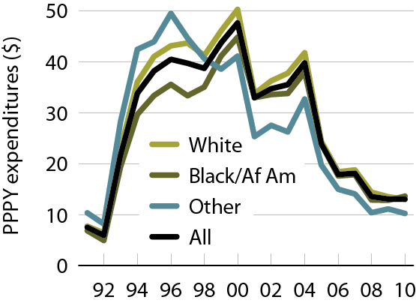
Per person per year expenditures for IV antibiotics, by race Figure 11.17 (Volume 2)
Period prevalent dialysis patients.

Slide 20
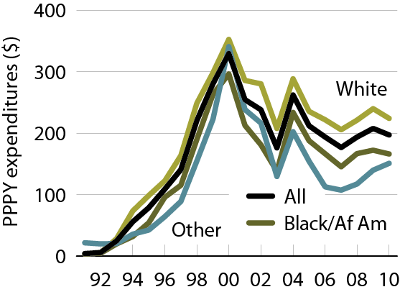
Per person per year expenditures for other injectables, by race Figure 11.18 (Volume 2)
Period prevalent dialysis patients.

Slide 21
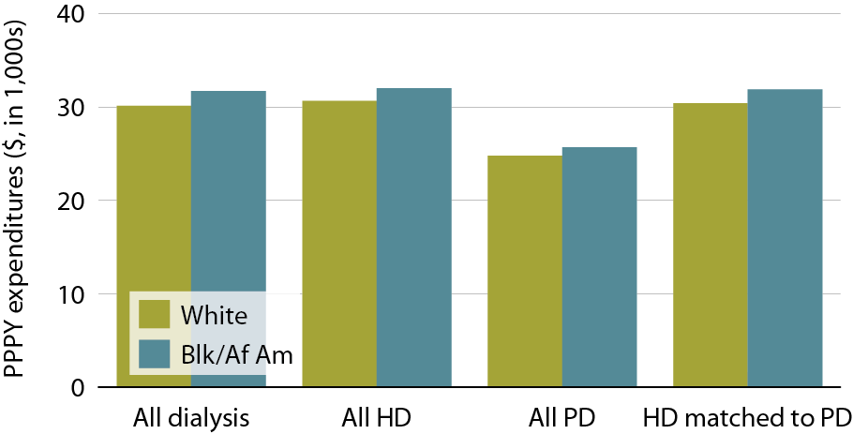
Total per person per year outpatient expenditures, by dialysis modality & race, 2010 Figure 11.19 (Volume 2)
Period prevalent dialysis patients, 2010.

Slide 22
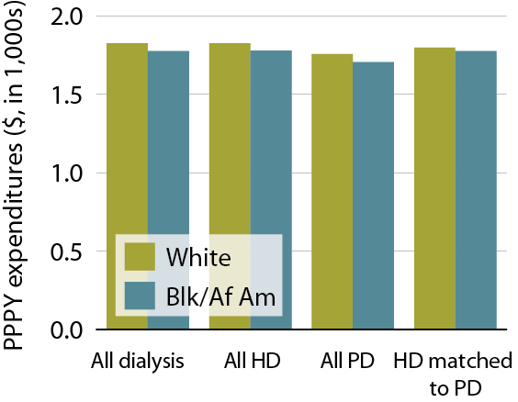
Per person per year expenditures for laboratory tests, by dialysis modality & race, 2010 Figure 11.20 (Volume 2)
Period prevalent dialysis patients, 2010.

Slide 23
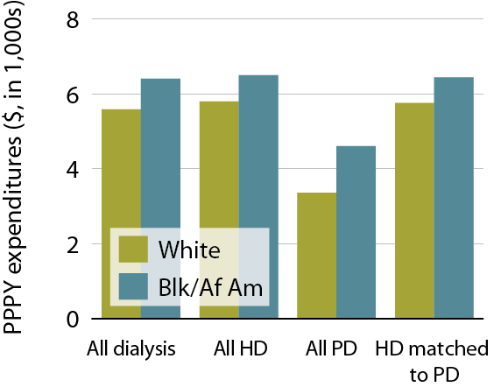
Per person per year expenditures for ESAs, by dialysis modality & race, 2010 Figure 11.21 (Volume 2)
Period prevalent dialysis patients, 2010.

Slide 24
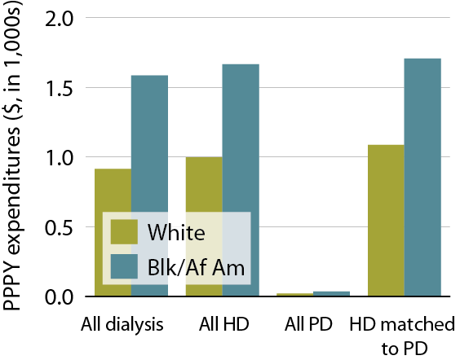
Per person per year expenditures for IV vitamin D, by dialysis modality & race, 2010 Figure 11.22 (Volume 2)
Period prevalent dialysis patients, 2010.

Slide 25
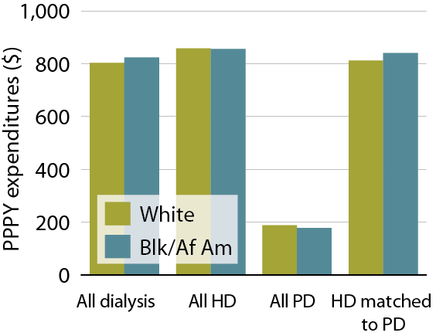
Per person per year expenditures for IV iron, by dialysis modality & race, 2010 Figure 11.23 (Volume 2)
Period prevalent dialysis patients, 2010.

Slide 26
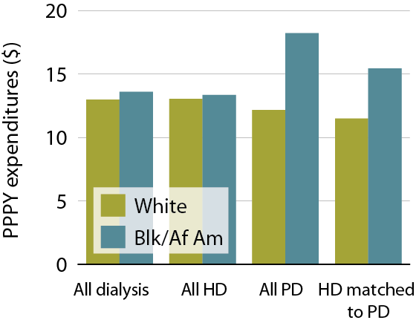
Per person per year expenditures for IV antibiotics, by dialysis modality & race, 2010 Figure 11.24 (Volume 2)
Period prevalent dialysis patients, 2010.

Slide 27
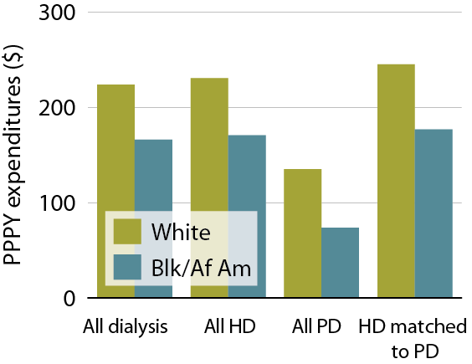
Per person per year expenditures for other injectables, by dialysis modality & race, 2010 Figure 11.25 (Volume 2)
Period prevalent dialysis patients, 2010.

Slide 28
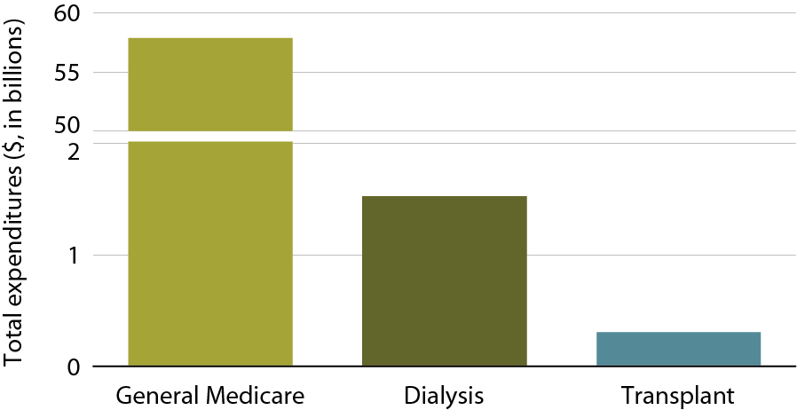
Total Part D net costs in the general Medicare & ESRD populations, 2010 Figure 11.26 (Volume 2)
Part D-enrolled general Medicare patients from the 5 percent sample & period prevalent dialysis & transplant patients, 2010.

Slide 29
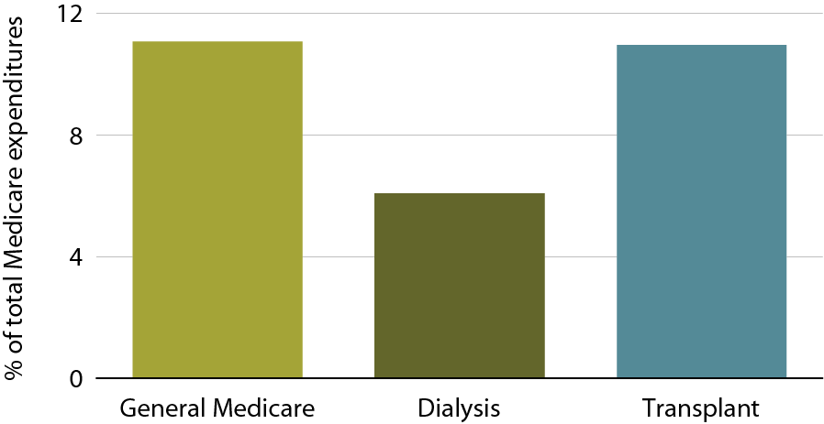
Part D costs as a part of total Medicare expenses in the general Medicare & ESRD populations, 2010 Figure 11.27 (Volume 2)
Part D-enrolled general Medicare patients from the 5 percent sample & period prevalent dialysis & transplant patients, 2010. Values are Part D costs as percent of total Medicare costs.

Slide 30
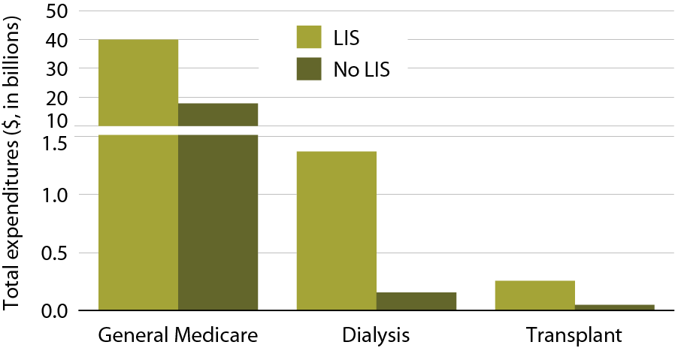
Total Part D net costs, by low income subsidy (LIS) status & modality, 2010 Figure 11.28 (Volume 2)
Part D-enrolled general Medicare patients from the 5 percent sample & period prevalent dialysis & transplant patients, 2010.

Slide 31
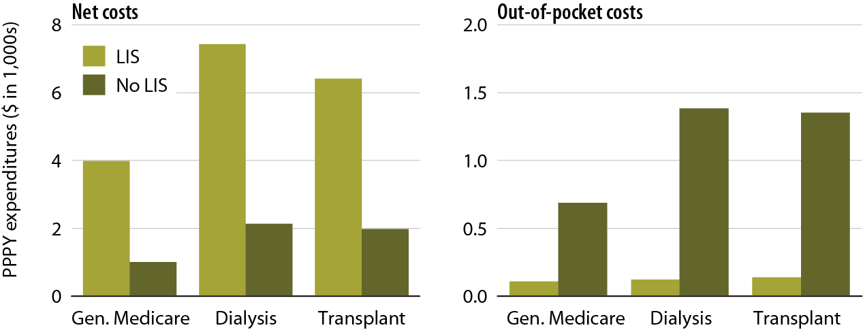
Total per person per year Part D net & out-of-pocket costs, 2010 Figure 11.29 (Volume 2)
Part D-enrolled general Medicare patients from the 5 percent sample & period prevalent dialysis & transplant patients, 2010. Net pay is estimated as the sum of Medicare covered amount & LIS amount.

Slide 32
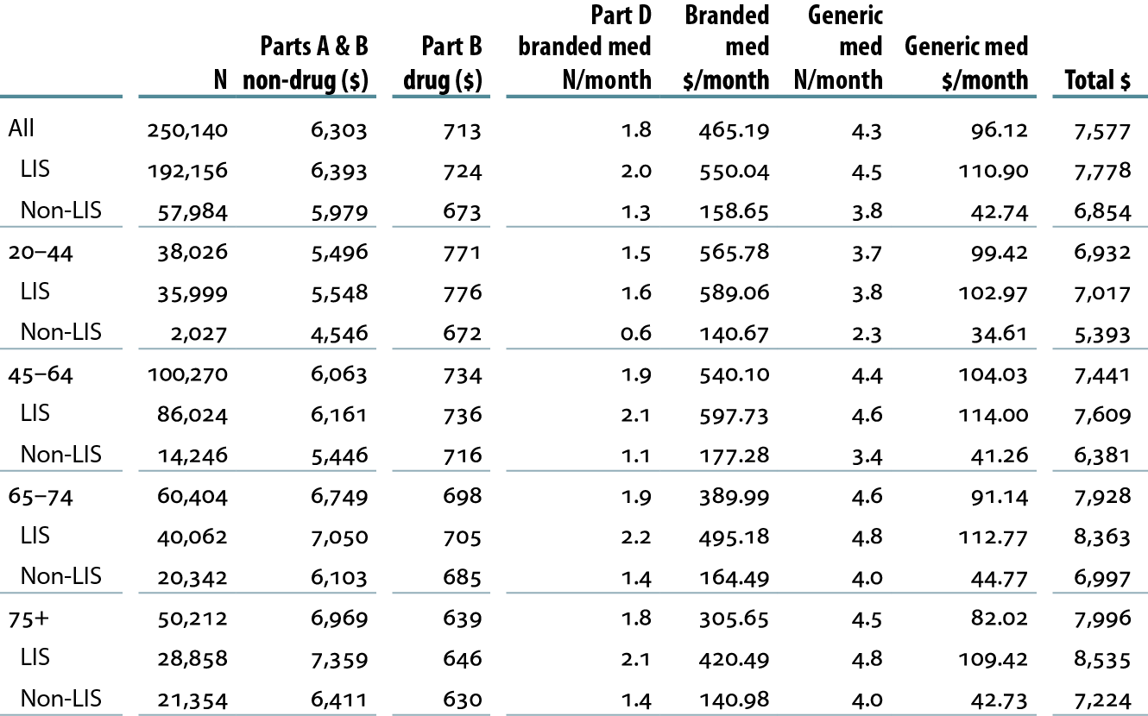
Variation in total Medicare per person per month (PPPM) spending & number of monthly Part D prescriptions, by age, gender, race, ethnicity, & LIS status, 2010 Table 11.a (Volume 2)
Medicare Part D-enrolled period prevalent dialysis patients with Medicare as primary payor.

Slide 33
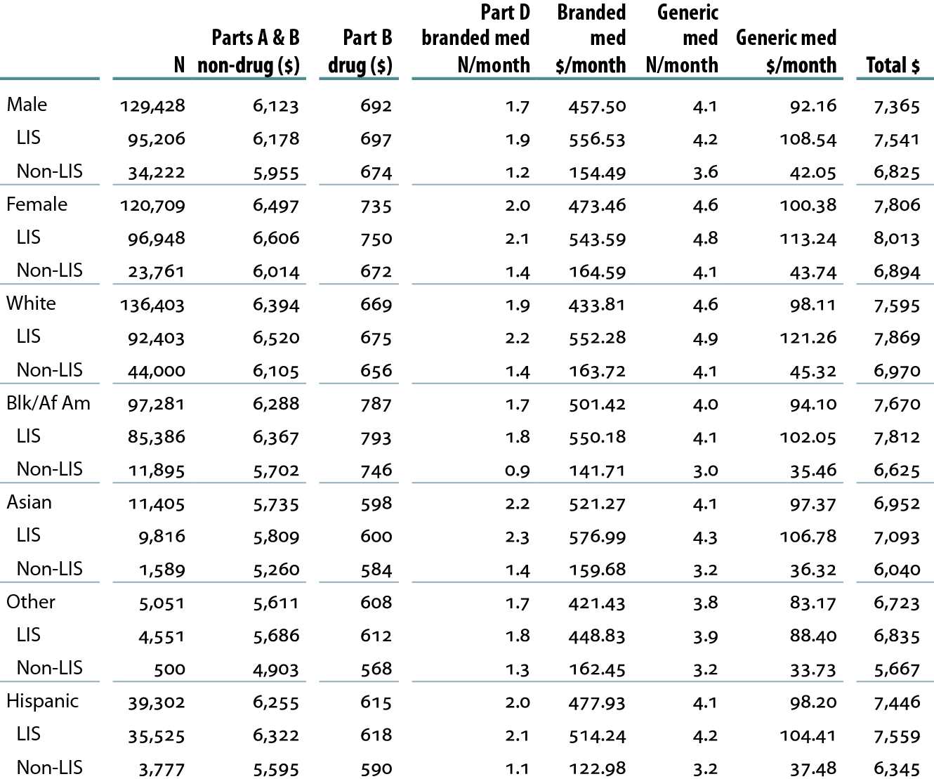
Variation in total Medicare per person per month (PPPM) spending & number of monthly Part D prescriptions, by age, gender, race, ethnicity, & LIS status, 2010 Table 11.a (continued; Volume 2)
Medicare Part D-enrolled period prevalent dialysis patients with Medicare as primary payor.

Slide 34
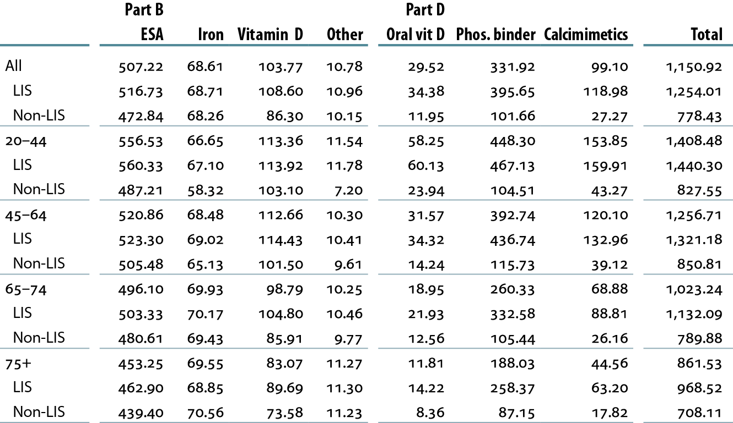
Medicare Parts B & D per person per month costs ($) for ESRD-related medications, by age, gender, race, ethnicity, & LIS status, 2010 Table 11.b (Volume 2)
Medicare Part D-enrolled period prevalent dialysis patients with Medicare as primary payor.

Slide 35
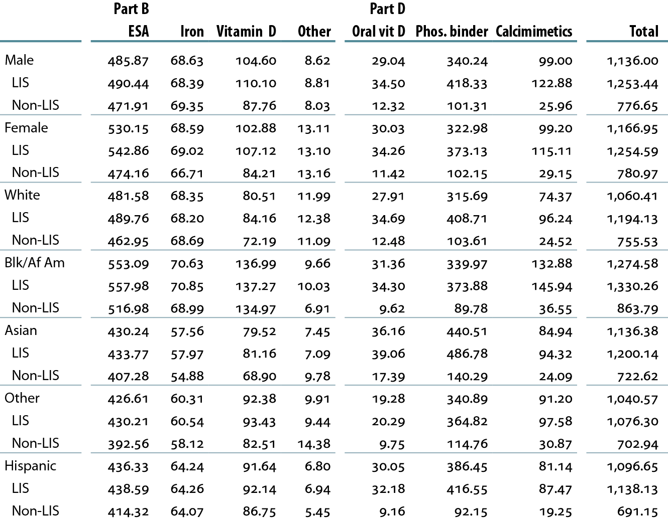
Medicare Parts B & D per person per month costs ($) for ESRD-related medications, by age, gender, race, ethnicity, & LIS status, 2010 Table 11.b (continued; Volume 2)
Medicare Part D-enrolled period prevalent dialysis patients with Medicare as primary payor.

