Slide 1
ESRD: Chapter Twelve
International comparisons
United States Renal Data System
2012 Annual Data Report

Slide 2
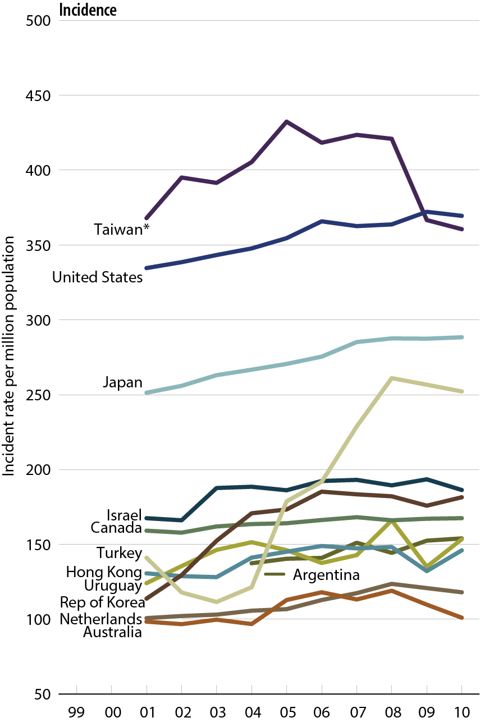
Comparison of unadjusted ESRD incidence worldwide
Figure 12.1 (Volume 2)
All rates are unadjusted. Data from Argentina (2005–2007), Japan, & Taiwan are dialysis only. *Downturn in incident rates is due to changes in criteria for incidence and in the payment system.

Slide 3
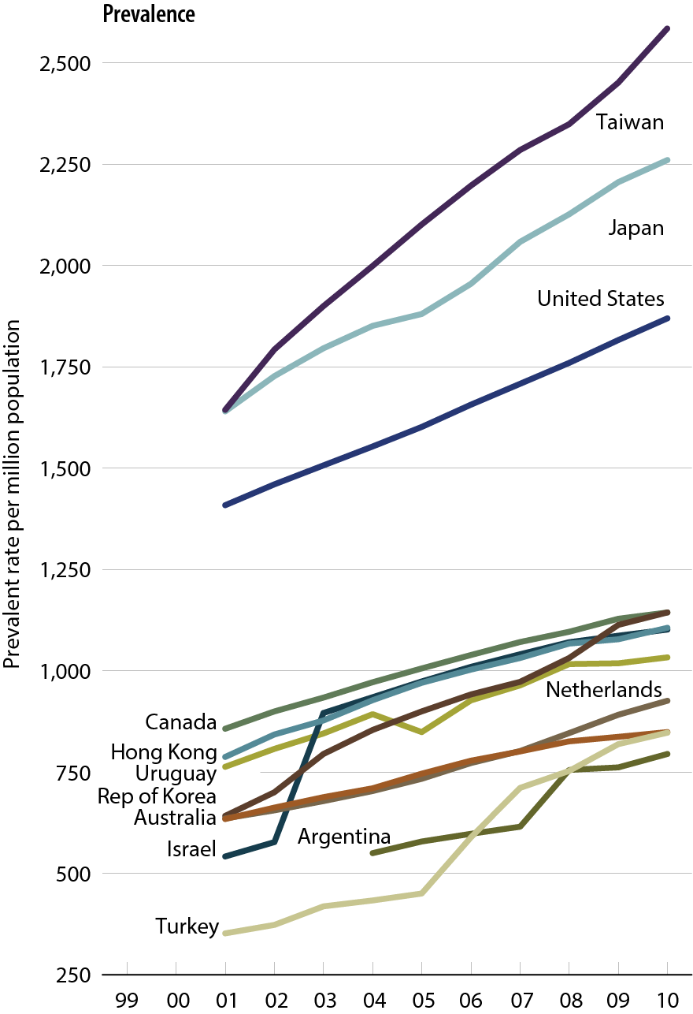
Comparison of unadjusted
ESRD prevalence worldwide
Figure 12.1, continued (Volume 2)
All rates are unadjusted. Data from Argentina (2005–2007), Japan, & Taiwan are dialysis only.

Slide 4
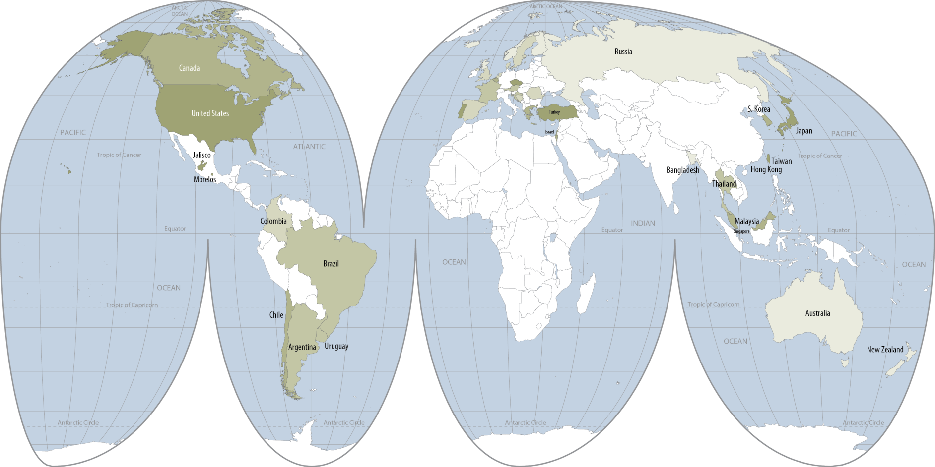

Geographic variations in the incidence of ESRD, 2010
Figure 12.2 (Volume 2)
Data presented only for countries from which relevant information was available. All rates unadjusted. Latest data for Singapore & Morelos (Mexico) are for 2009 . Data for France include 23 regions. Data for Belgium & for England/Wales/Northern Ireland do not include patients younger than 18.

Slide 5
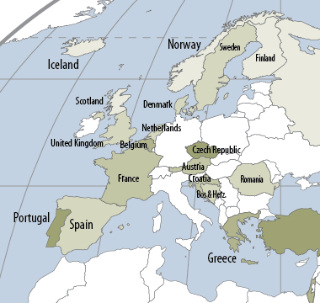
Geographic variations in the incidence of ESRD, 2010
Figure 12.2, continued (Volume 2)
Data presented only for countries from which relevant information was available. All rates unadjusted. Latest data for Singapore & Morelos (Mexico) are for 2009 . Data for France include 23 regions. Data for Belgium & for England/Wales/Northern Ireland do not include patients younger than 18.

Slide 6
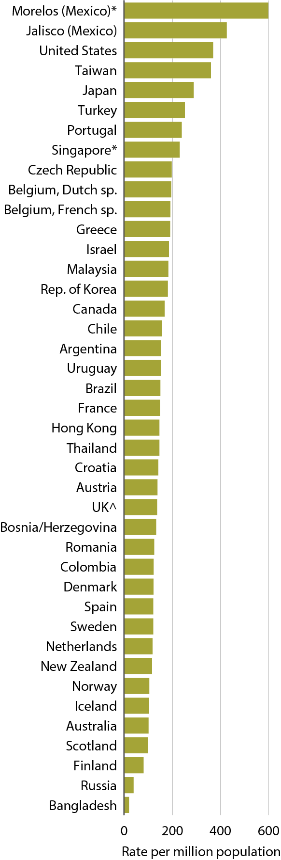
Incidence of ESRD, 2010
Figure 12.3 (Volume 2)
Data presented only for countries from which relevant information was available; All rates unadjusted. ^UK: England, Wales, & Northern Ireland (Scotland data reported separately). Data for Belgium & England/Wales/Northern Ireland do not include patients younger than 18. *Latest data for Singapore & Morelos (Mexico) are for 2009. Data for France include 23 regions in 2010.

Slide 7
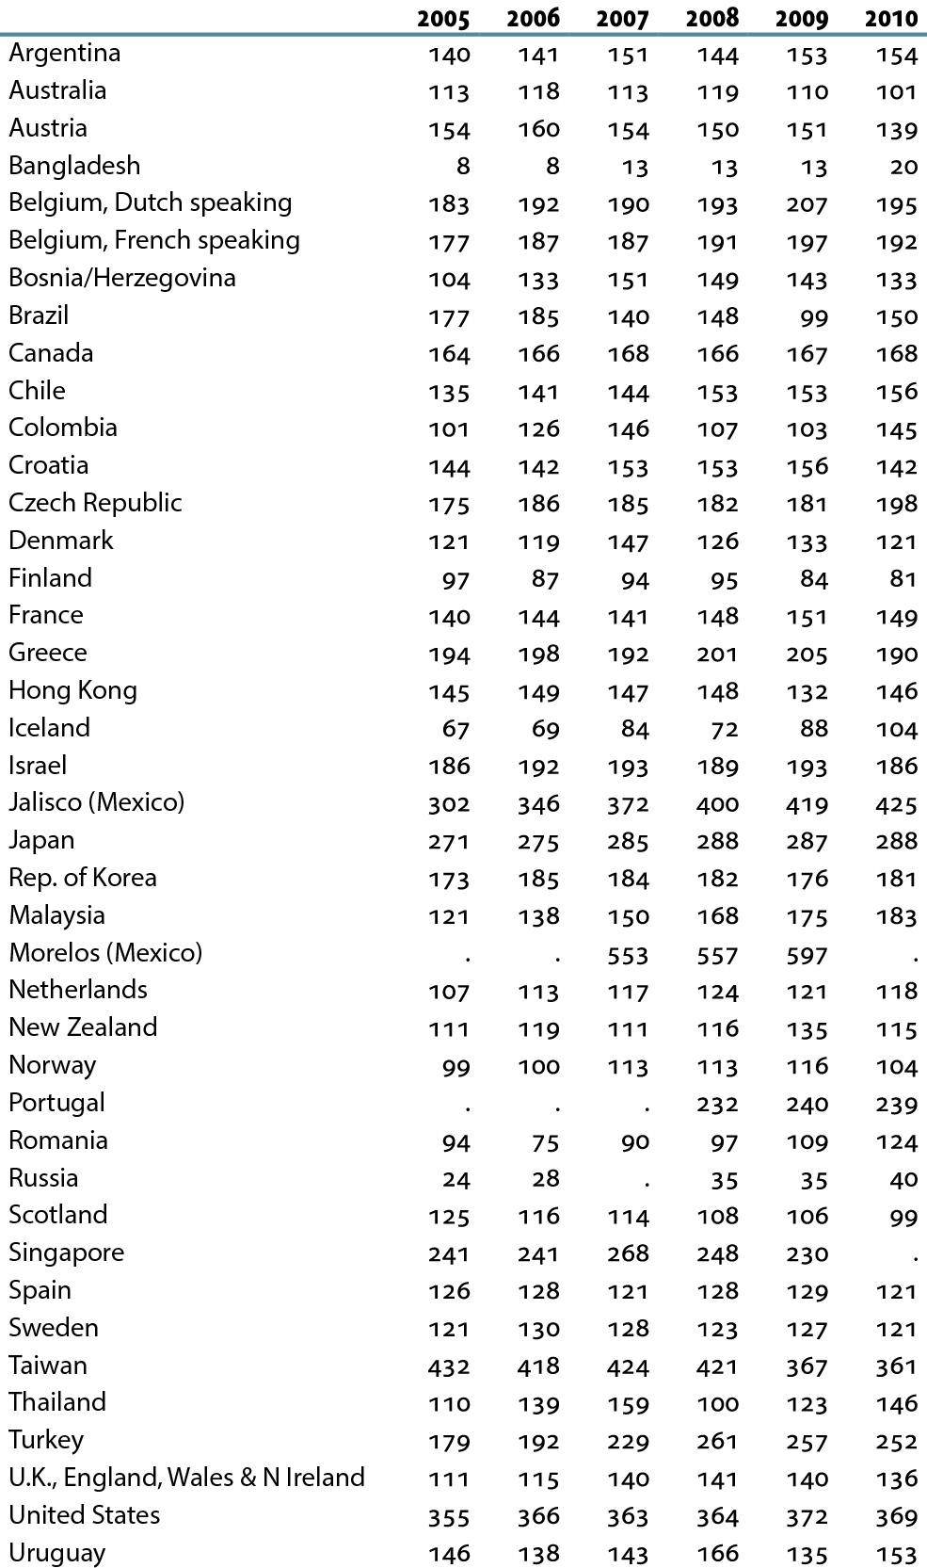
Incidence of ESRD, by year (per million population)
Table 12.a (Volume 2)
Data presented only for countries from which relevant information was available; “.” signifies data not reported. All rates unadjusted. ^UK: England, Wales, & Northern Ireland (Scotland data reported separately). Data for Belgium & England/Wales/Northern Ireland do not include patients younger than 18. *Latest data for Singapore & Morelos (Mexico) are for 2010. Data for France include 23 regions.

Slide 8
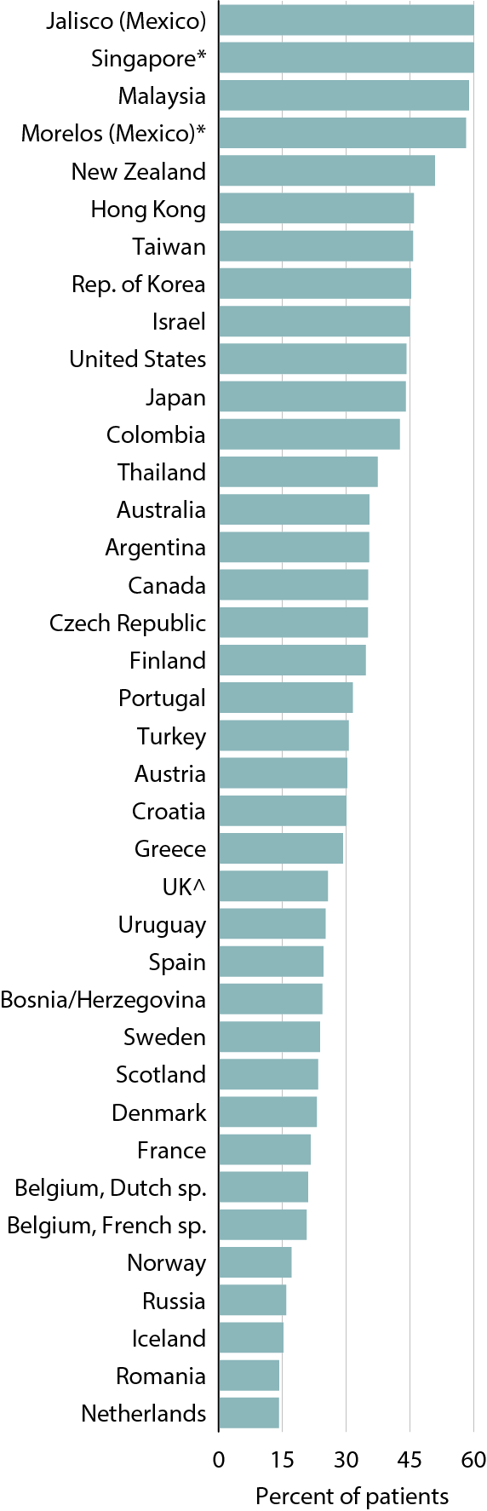
Percentage of incident patients with ESRD due to diabetes, 2010
Figure 12.4 (Volume 2)
Data presented only for countries from which relevant information was available. All rates unadjusted. ^UK: England, Wales, & Northern Ireland (Scotland data reported separately). Data for Belgium & England/Wales/Northern Ireland do not include patients younger than 18. *Latest data for Singapore & Morelos (Mexico) are for 2009. Data for France include 23 regions in 2010.

Slide 9
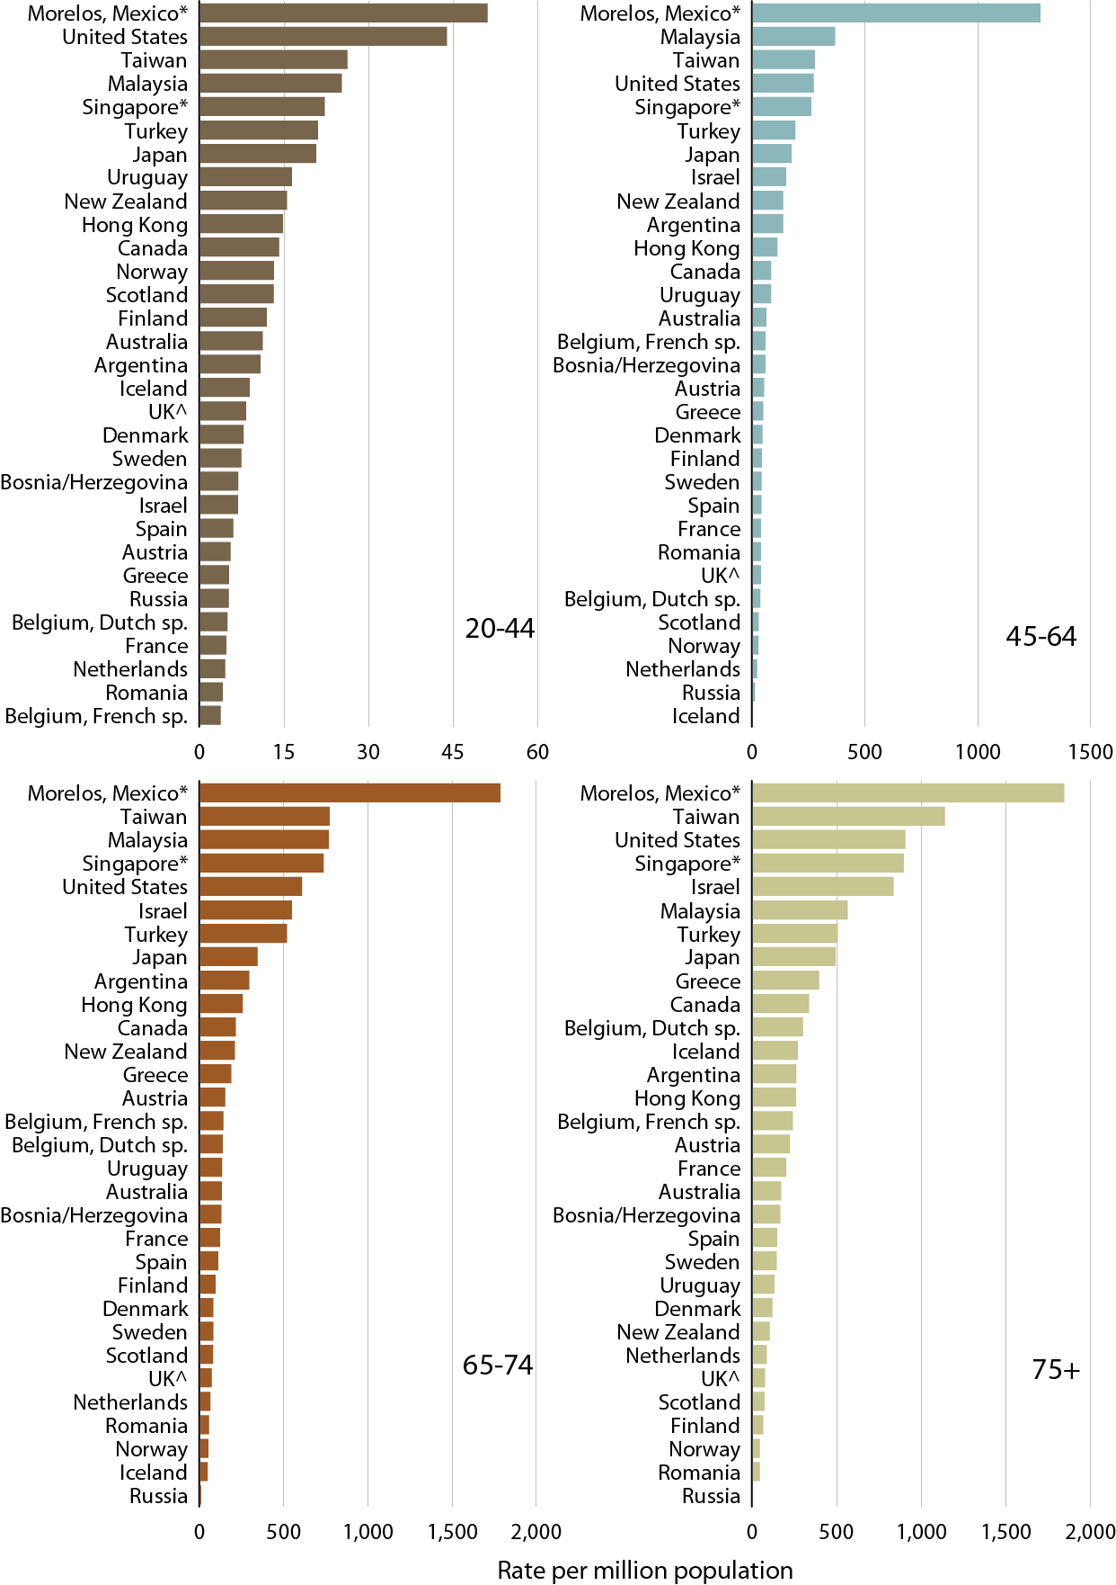
Percentage of incident patients with ESRD due to diabetes, by age, 2010
Figure 12.5 (Volume 2)
Data presented only for countries from which relevant information was available. All rates unadjusted. ^UK: England, Wales, & Northern Ireland (Scotland data reported separately). Data for Belgium & England/Wales/Northern Ireland do not include patients younger than 18. *Latest data for Singapore & Morelos (Mexico) are for 2009. Data for France include 23 regions in 2010.

Slide 10
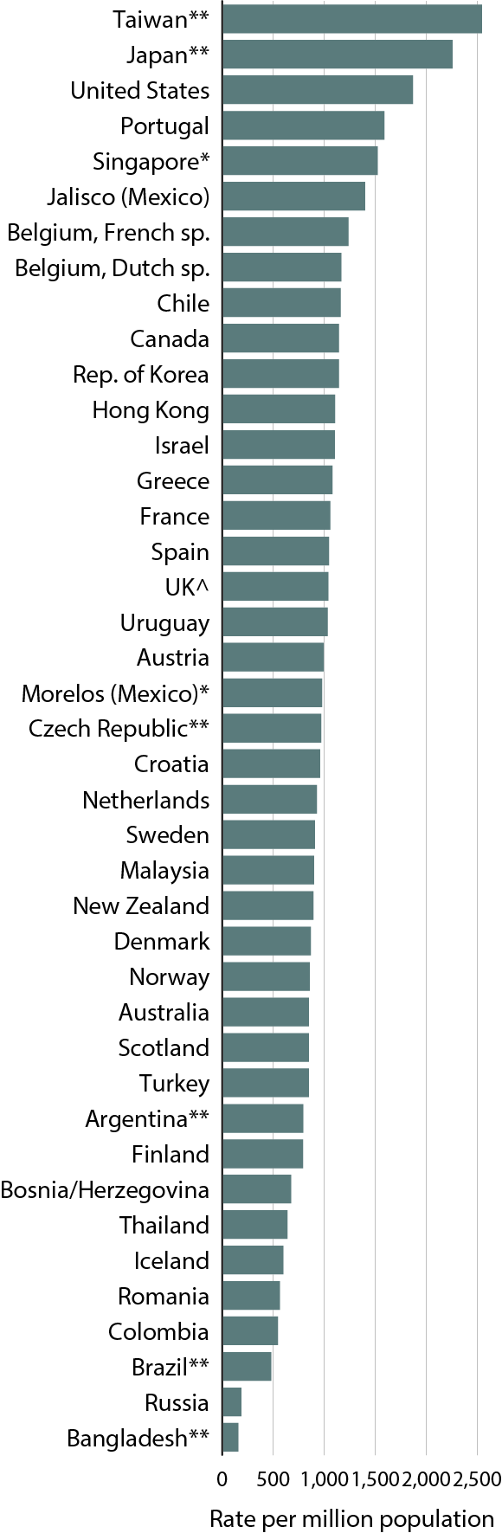
Prevalence of ESRD, 2010
Figure 12.6 (Volume 2)
Data presented only for countries from which relevant information was available; All rates unadjusted. ^UK: England, Wales, & Northern Ireland (Scotland data reported separately). Data for Belgium & England/Wales/Northern Ireland do not include patients younger than 18. **Argentina (2005–2007), Bangladesh, Brazil, Czech Republic (2005–2008), Japan, & Taiwan are dialysis only. *Latest data for Singapore & Morelos (Mexico) are for 2009. Data for France include 23 regions in 2010.

Slide 11
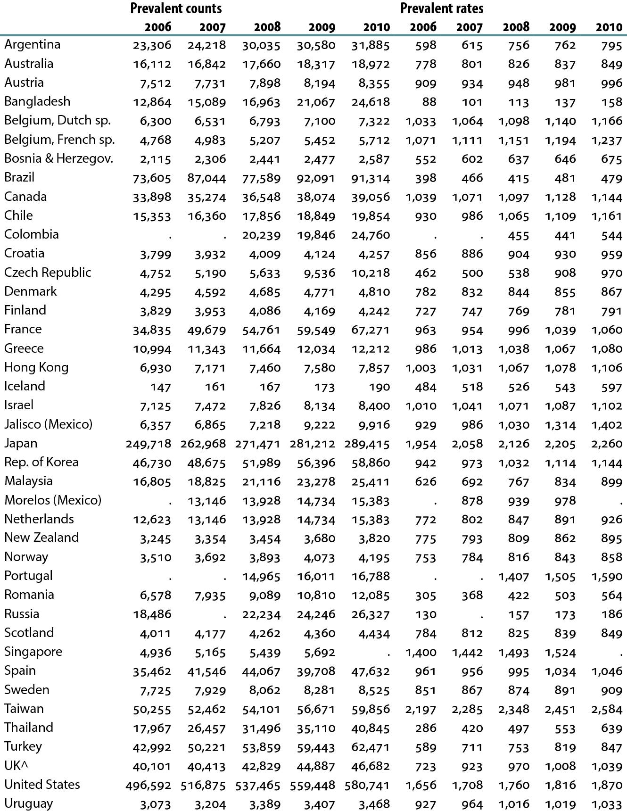
Prevalence of ESRD, by year (per million population)
Table 12.b (Volume 2)
Data presented only for countries from which relevant information was available; “.” signifies data not reported. All rates unadjusted. ^UK: England, Wales, & Northern Ireland (Scotland data reported separately). Data for Belgium & England/Wales/Northern Ireland do not include patients younger than 18. Argentina (2005–2007), Bangladesh, Brazil, Czech Republic (2005–2008), Japan, & Taiwan are dialysis only. *Latest data for Singapore & Morelos (Mexico) are for 2009. Data for France include 15 regions in 2006, 18 regions in 2007, 20 regions in 2008 & 2009, & 23 regions in 2010.

Slide 12
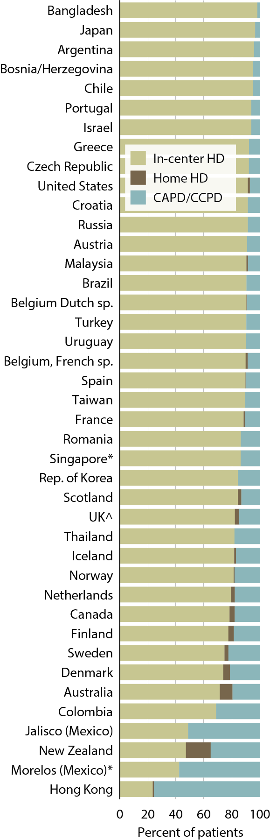
Percent distribution of prevalent dialysis patients, by modality, 2010
Figure 12.7 (Volume 2)
Data presented only for countries from which relevant information was available; All rates unadjusted. ^UK: England, Wales, & Northern Ireland (Scotland data reported separately). Data for Belgium & England/Wales/Northern Ireland do not include patients younger 18, respectively. *Latest data for Singapore & Morelos (Mexico) are for 2009. Data for France include 23 regions in 2010.

Slide 13
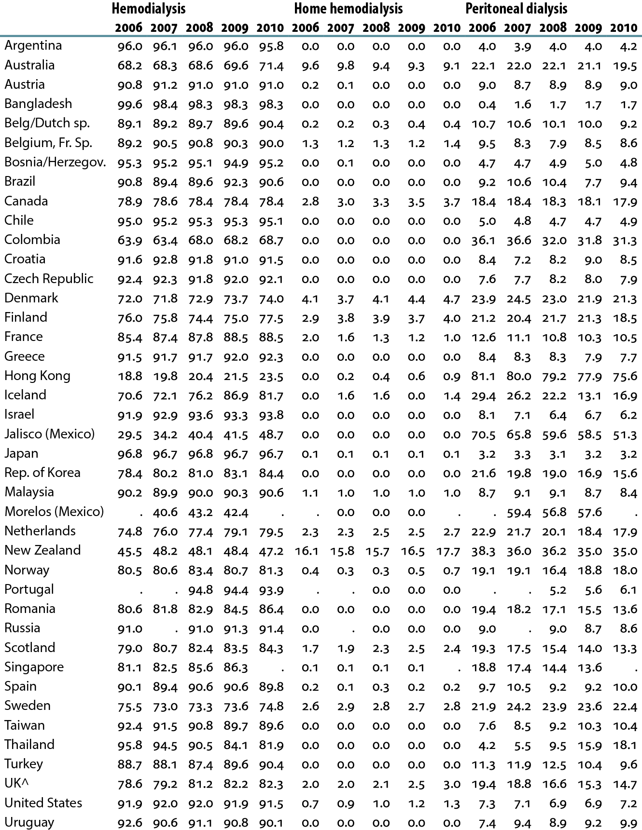
Percent distribution of prevalent dialysis patients, by modality & year
Table 12.c (Volume 2)
Data presented only for countries from which relevant information was available; “.” signifies data not reported. All rates unadjusted. ^UK: England, Wales, & Northern Ireland (Scotland data reported separately). Data for Belgium & England/Wales/Northern Ireland do not include patients younger 18, respectively. *Latest data for Singapore & Morelos (Mexico) are for 2009. Data for France include 13 regions in 2005, 15 regions in 2006, 18 regions in 2007, 20 regions in 2008 & 2009, & 23 regions in 2010.

Slide 14
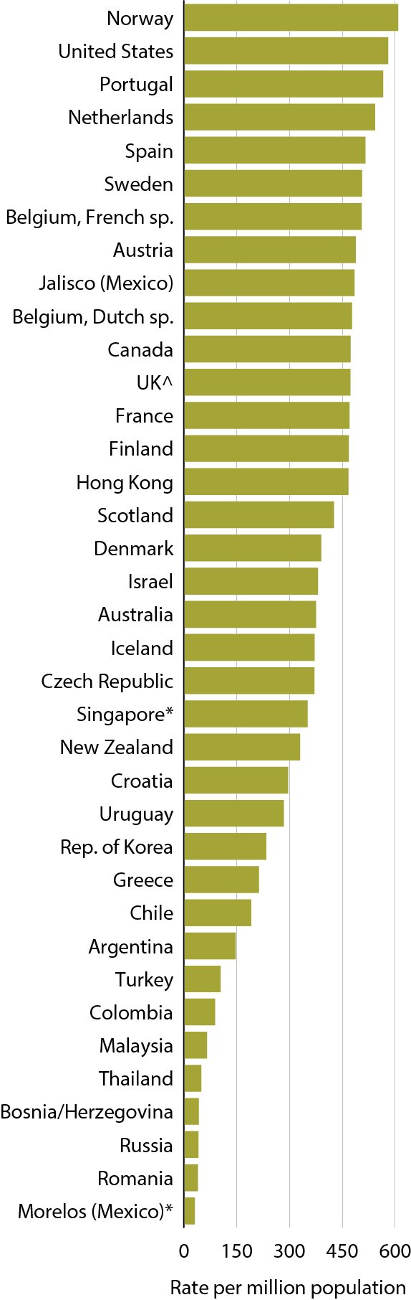
Prevalent rates of functioning grafts, 2010
Figure 12.8 (Volume 2)
Data presented only for countries from which relevant information was available; All rates unadjusted. ^UK: England, Wales, & Northern Ireland (Scotland data reported separately). Data for Belgium & England/Wales/Northern Ireland do not include patients younger than 18. *Latest data for Singapore & Morelos (Mexico) are for 2009. Data for France include 23 regions in 2010.

Slide 15
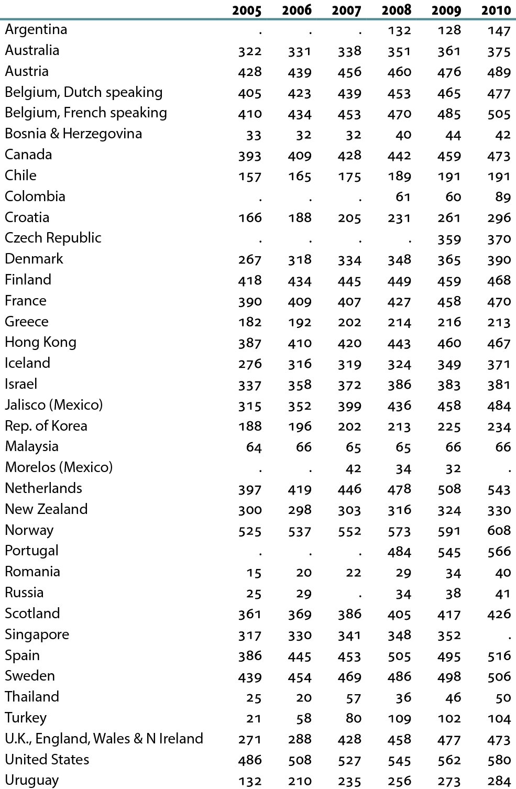
Prevalent rates of functioning grafts, by year (per million population)
Table 12.d (Volume 2)
Data presented only for countries from which relevant information was available; “.” signifies data not reported. All rates unadjusted. ^UK: England, Wales, & Northern Ireland (Scotland data reported separately). Data for Belgium & England/Wales/Northern Ireland do not include patients younger than 18. *Latest data for Singapore & Morelos (Mexico) are for 2009. Data for France include 13 regions in 2005, 15 regions in 2006, 18 regions in 2007, 20 regions in 2008 & 2009, & 23 regions in 2010.

Slide 16
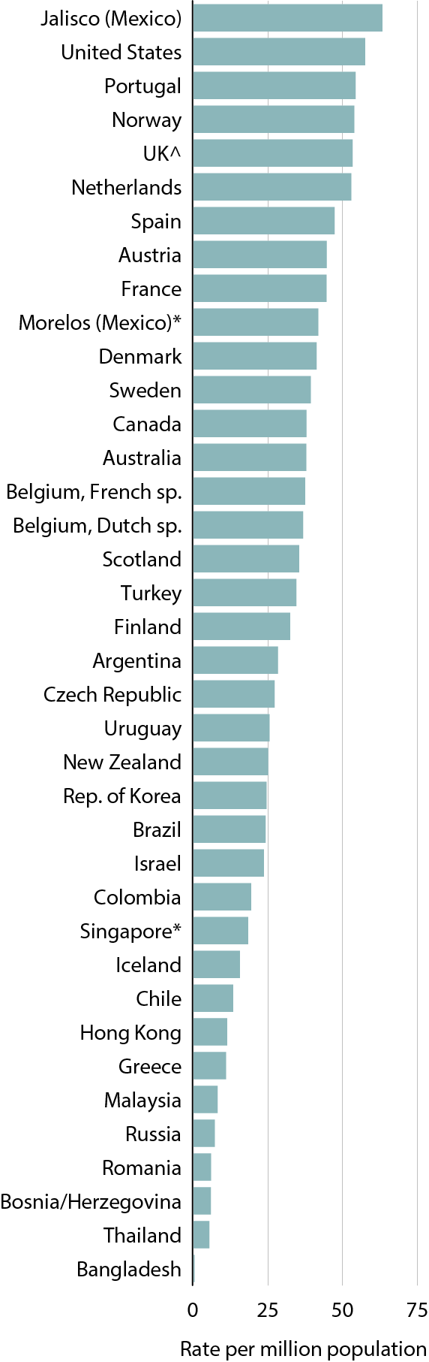
Transplant rates, 2010
Figure 12.9 (Volume 2)
Data presented only for countries from which relevant information was available; All rates unadjusted. ^UK: England, Wales, & Northern Ireland (Scotland data reported separately). Data for Belgium & England/Wales/Northern Ireland do not include patients younger than 18. *Latest data for the Singapore & Morelos (Mexico) are for 2009. Data for France include 23 regions in 2010.

Slide 17
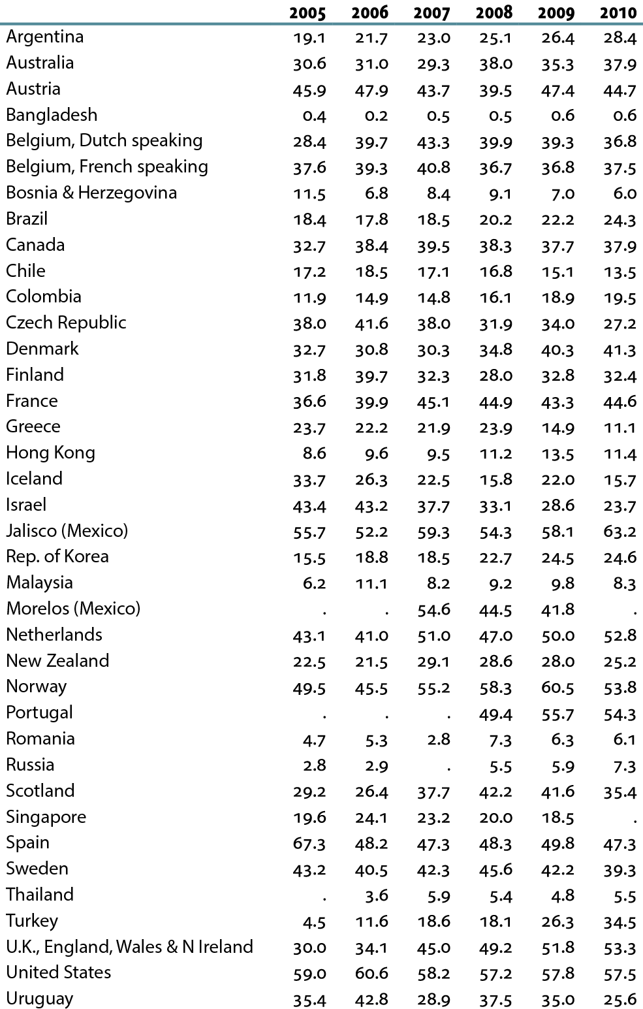
Transplant rates, by year (per million population)
Table 12.e (Volume 2)
Data presented only for countries from which relevant information was available; “.” signifies data not reported. All rates unadjusted. ^UK: England, Wales, & Northern Ireland (Scotland data reported separately). Data for Belgium & England/Wales/Northern Ireland do not include patients younger than 18. *Latest data for the Singapore & Morelos (Mexico) are for 2009. Data for France include 13 regions in 2005, 15 regions in 2006, 18 regions in 2007, 20 regions in 2008 & 2009, & 23 regions in 2010.

