Slide 1
ESRD: Precis An introduction to end-stage renal disease in the U.S.
United States Renal Data System
2012 Annual Data Report

Slide 2
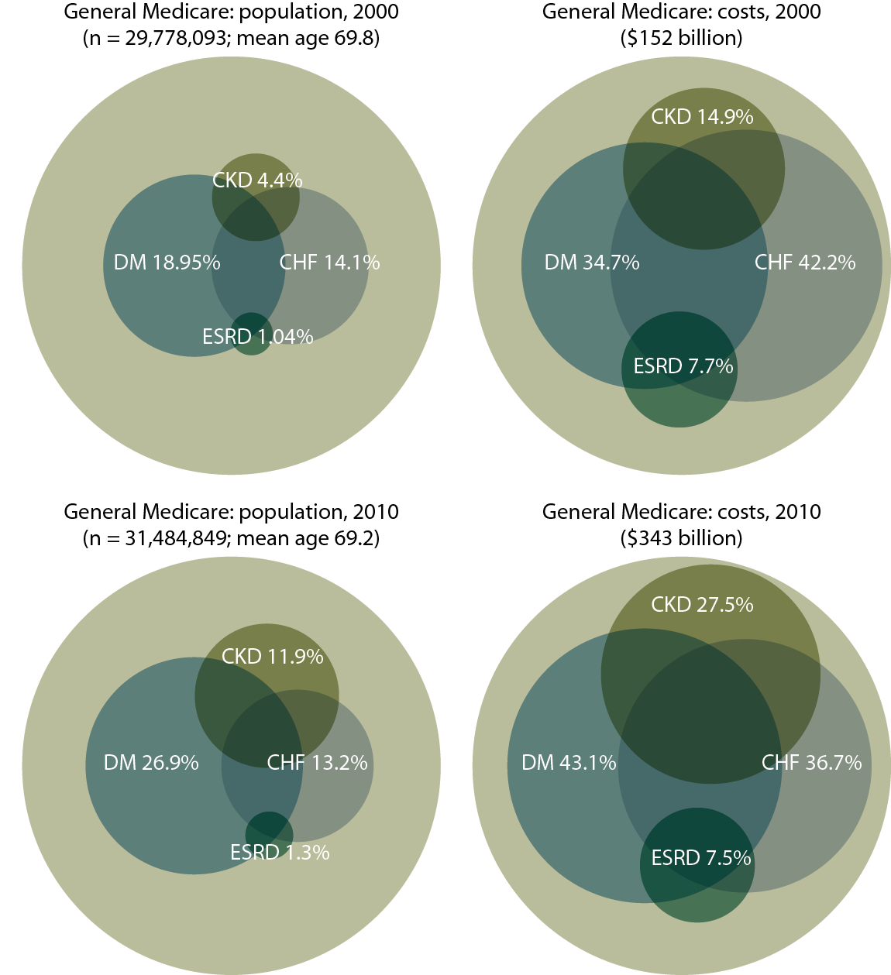
Distribution of general (fee-for-service) Medicare patients & costs for CKD, CHF, diabetes, & ESRD, 2000 & 2010 Figure p.1 (Volume 2)
Period prevalent general (fee-for-service) Medicare patients. Diabetes, CKD, & congestive heart failure determined from claims, 1999–2000 & 2009–2010; costs are for calendar years 2000 & 2010.

Slide 3
Distribution of general (fee-for-service) Medicare patients & costs for CKD, CHF, diabetes, & ESRD, 2000 & 2010 Figure p.1 continued (Volume 2)
Period prevalent general (fee-for-service) Medicare patients. Diabetes, CKD, & congestive heart failure determined from claims, 1999–2000 & 2009–2010; costs are for calendar years 2000 & 2010.

Slide 4
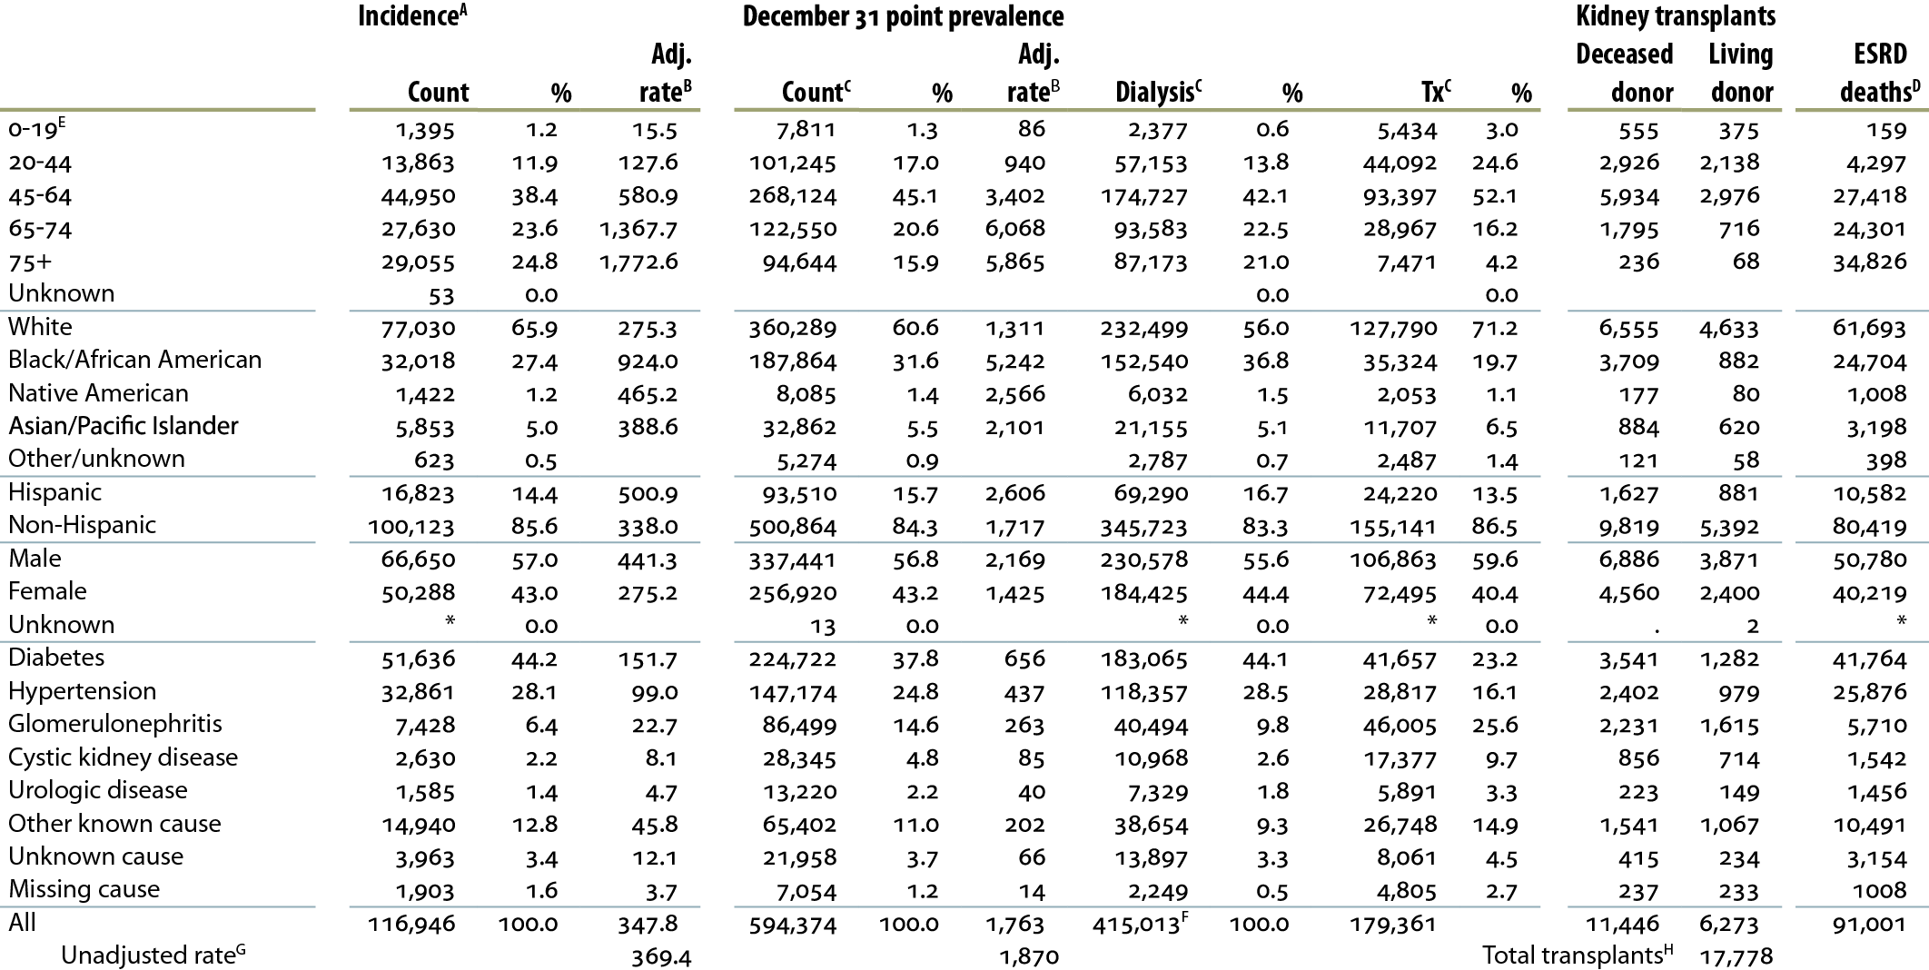
Summary statistics on reported ESRD therapy in the United States, by age, race, ethnicity, gender, & primary diagnosis, 2010 Table p.a (Volume 2)
Dialysis & transplant patients, 2010.

Slide 5
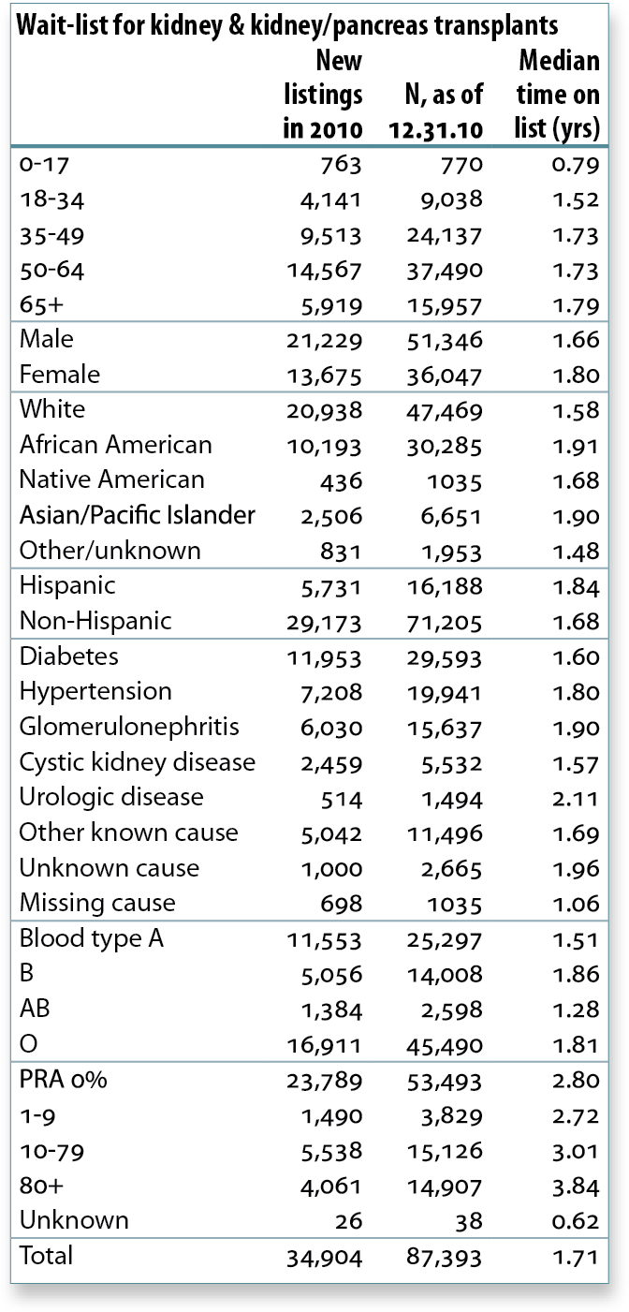
Wait-list for kidney & kidney/pancreas transplants, 2010 Table p.a (continued; Volume 2)
Dialysis & transplant patients, 2010.

Slide 6
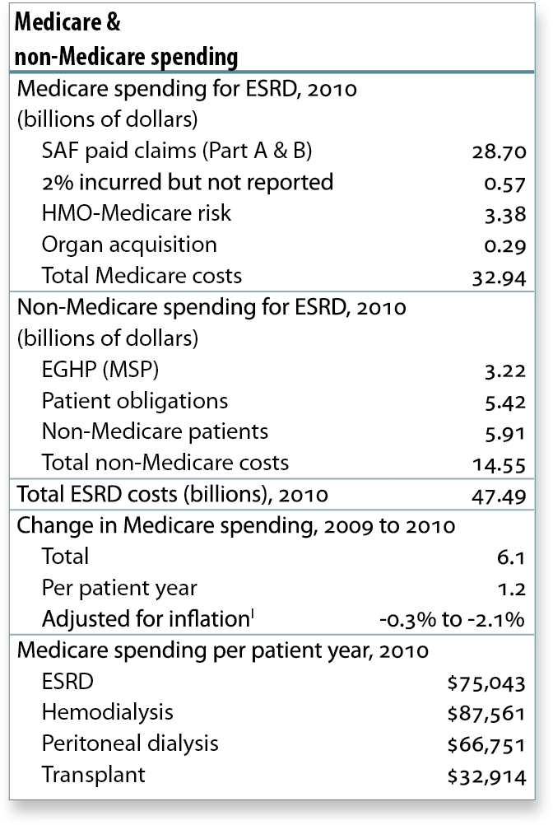
Medicare & non-Medicare spending, 2010 Table p.a (continued; Volume 2)
Dialysis & transplant patients, 2010.

Slide 7
Counts of new & returning dialysis patients Figure p.2 (Volume 2)
CMS Annual Facility Survey.

Slide 8
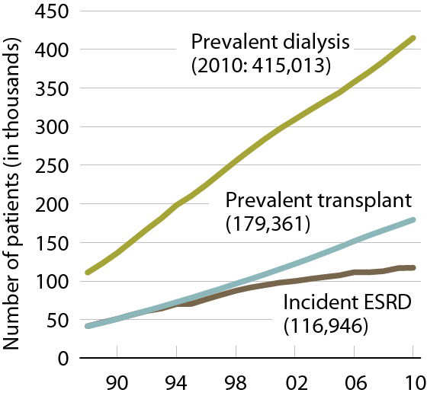
Patient counts, by modality Figure p.3 (Volume 2)
Incident & December 31 point prevalent ESRD patients.

Slide 9
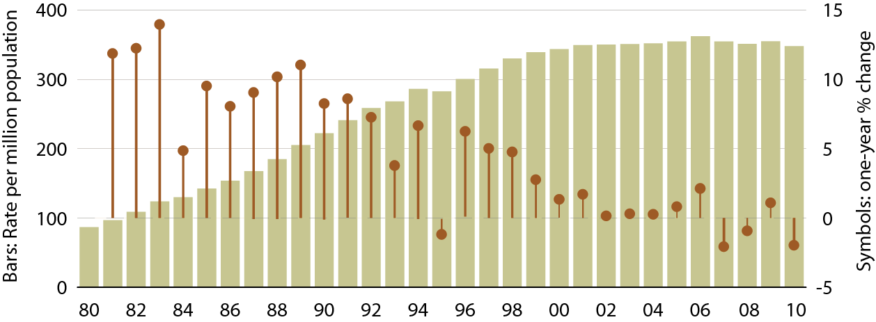
Adjusted incident rates of ESRD & annual percent change Figure 1.2 (Volume 2)
Incident ESRD patients. Adj: age/gender/race; ref: 2005 ESRD patients.

Slide 10
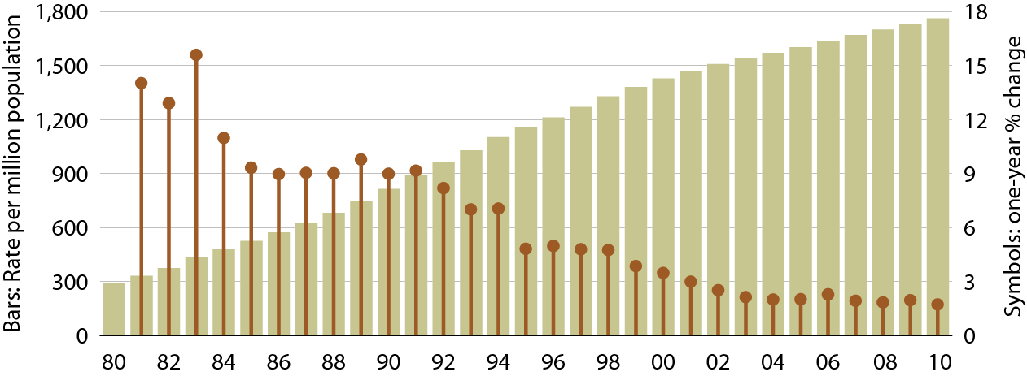
Adjusted prevalent rates of ESRD & annual percent change Figure 1.10 (Volume 2)
December 31 point prevalent ESRD patients. Adj: age/gender/race; ref: 2005 ESRD patients.

Slide 11
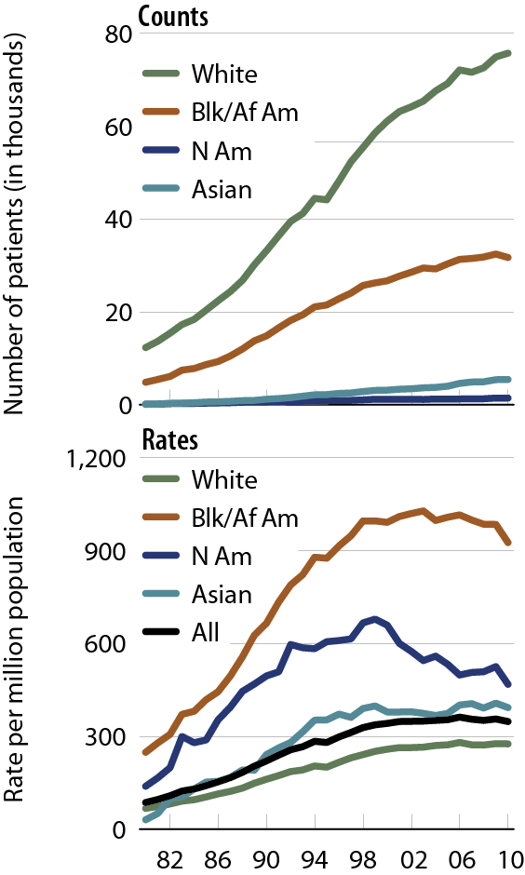
Incident counts & adjusted rates of ESRD, by race Figure 1.5 (Volume 2)
Incident ESRD patients. Adj: age/gender; ref: 2005 ESRD patients.

Slide 12
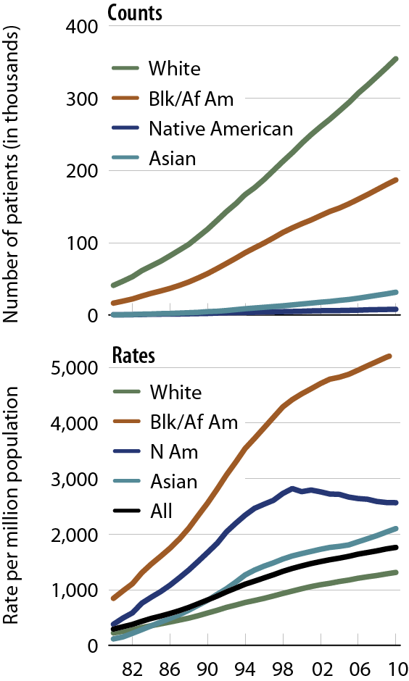
Prevalent counts & adjusted rates of ESRD, by race Figure 1.13 (Volume 2)
December 31 point prevalent ESRD patients. Adj: age/gender; ref: 2005 ESRD patients.

Slide 13
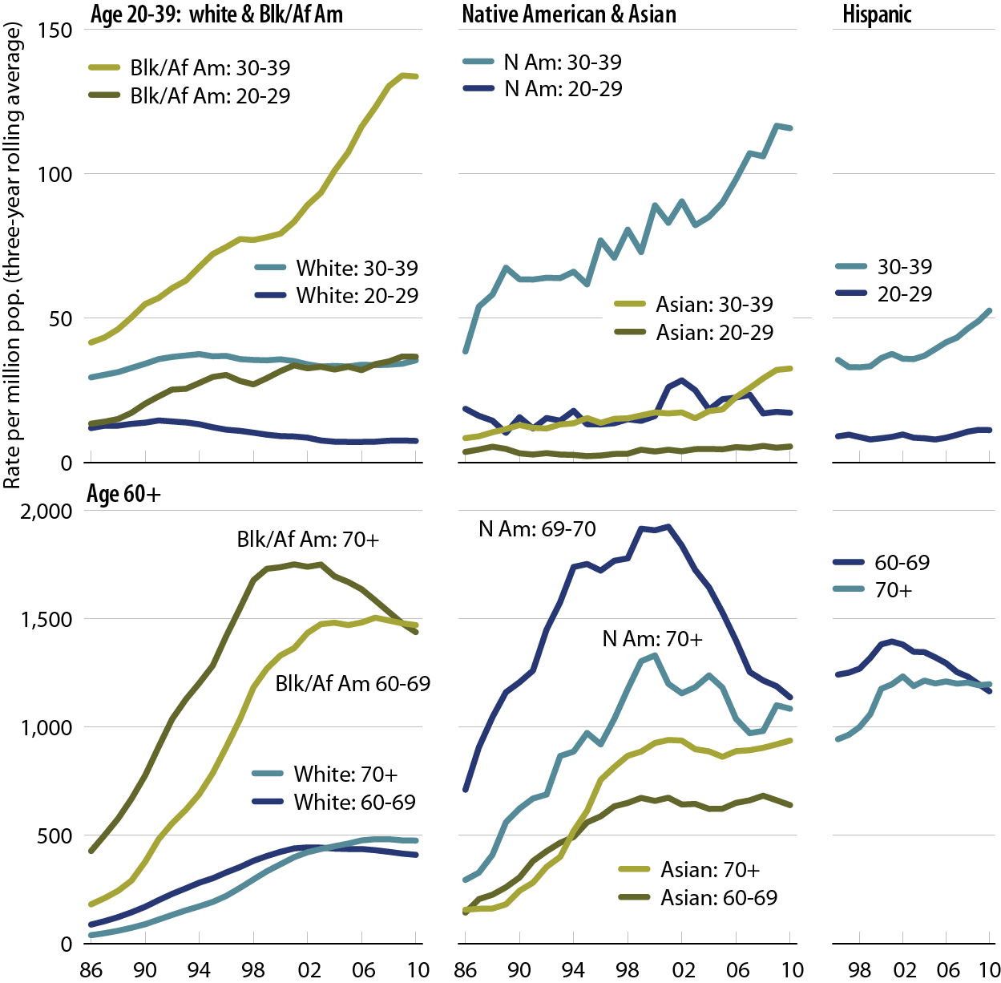
Adjusted incident rates of ESRD due to diabetes, by age, race, & ethnicity Figure 1.8 (Volume 2)
Incident ESRD patients; rates are three-year rolling averages. Adj: gender; ref: 2005 ESRD patients.

Slide 14
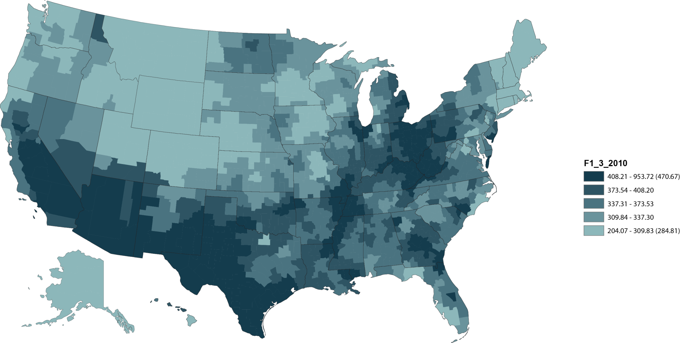
Geographic variations in adjusted incident rates of ESRD per million population, 2010, by HSA Figure 1.3 (Volume 2)
Adj: age/gender/race; ref: 2005 ESRD patients.

Slide 15
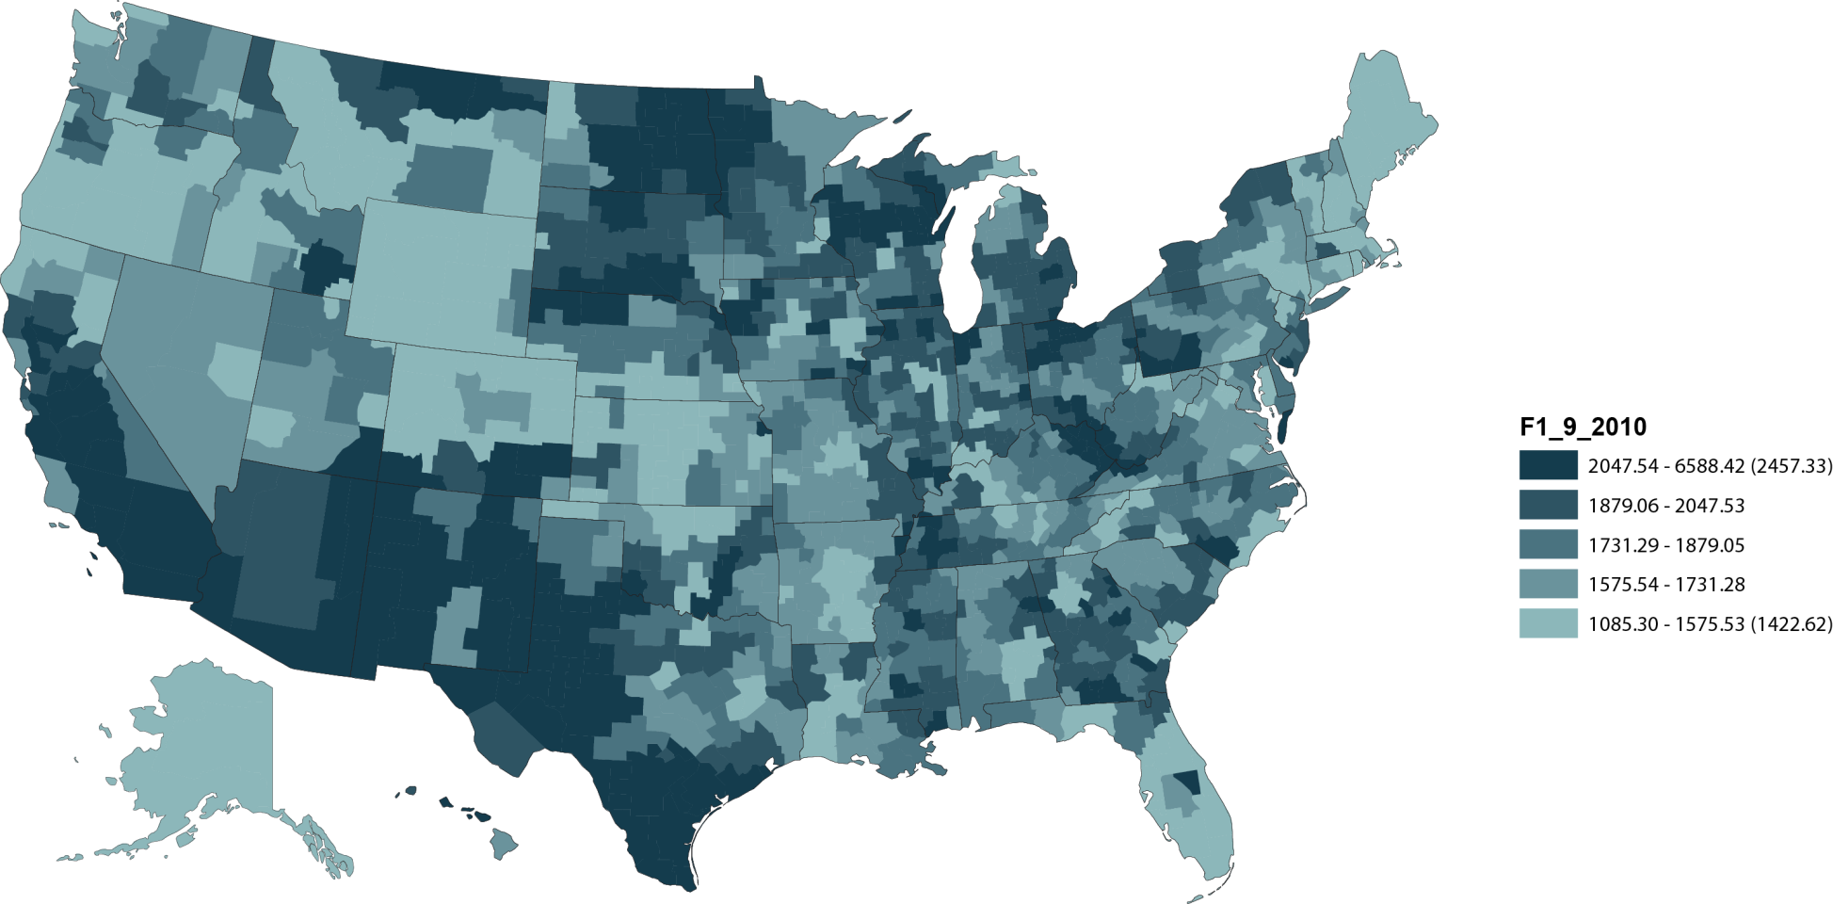
Geographic variations in adjusted prevalent rates of ESRD per million population, 2010, by HSA Figure 1.11 (Volume 2)
December 31 point prevalent patients. Adj: age/gender/race; ref: 2005 ESRD patients.

Slide 16
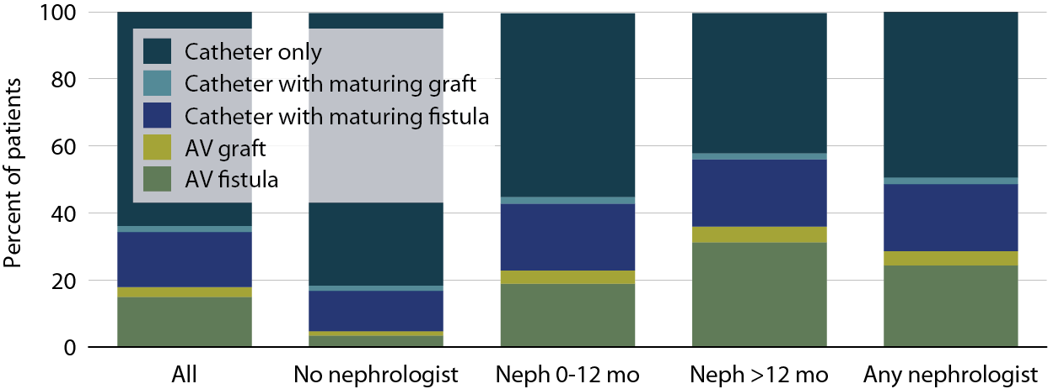
Access use at first outpatient hemodialysis, by pre-ESRD nephrology care, 2010 Figure 1.19 (Volume 2)
Incident ESRD patients, 2010.

Slide 17
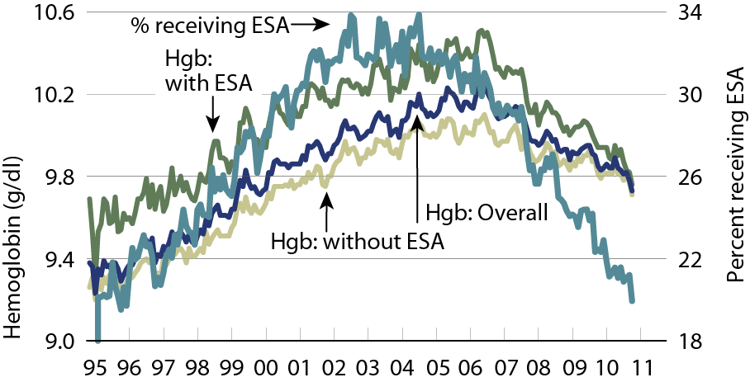
Mean hemoglobin at initiation, by pre-ESRD ESA treatment Figure 1.20 (Volume 2)
Incident ESRD patients.

Slide 18
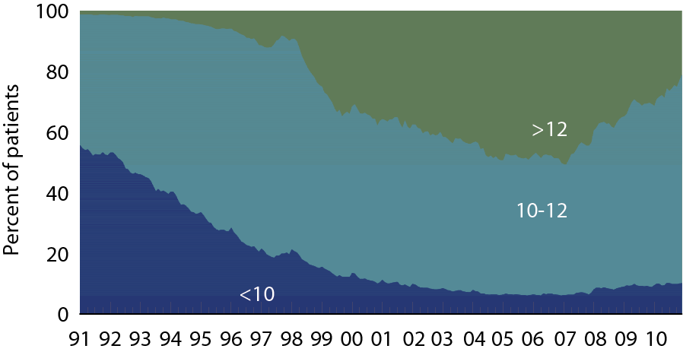
Patient distribution, by mean monthly hemoglobin (g/dl) Figure 2.2 (Volume 2)
Period prevalent dialysis patients.

Slide 19
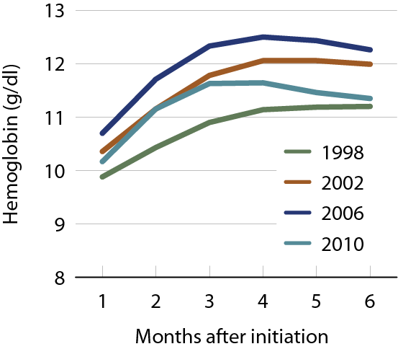
Mean monthly hemoglobin after initiation, by year Figure 2.4 (Volume 2)
Incident dialysis patients.

Slide 20
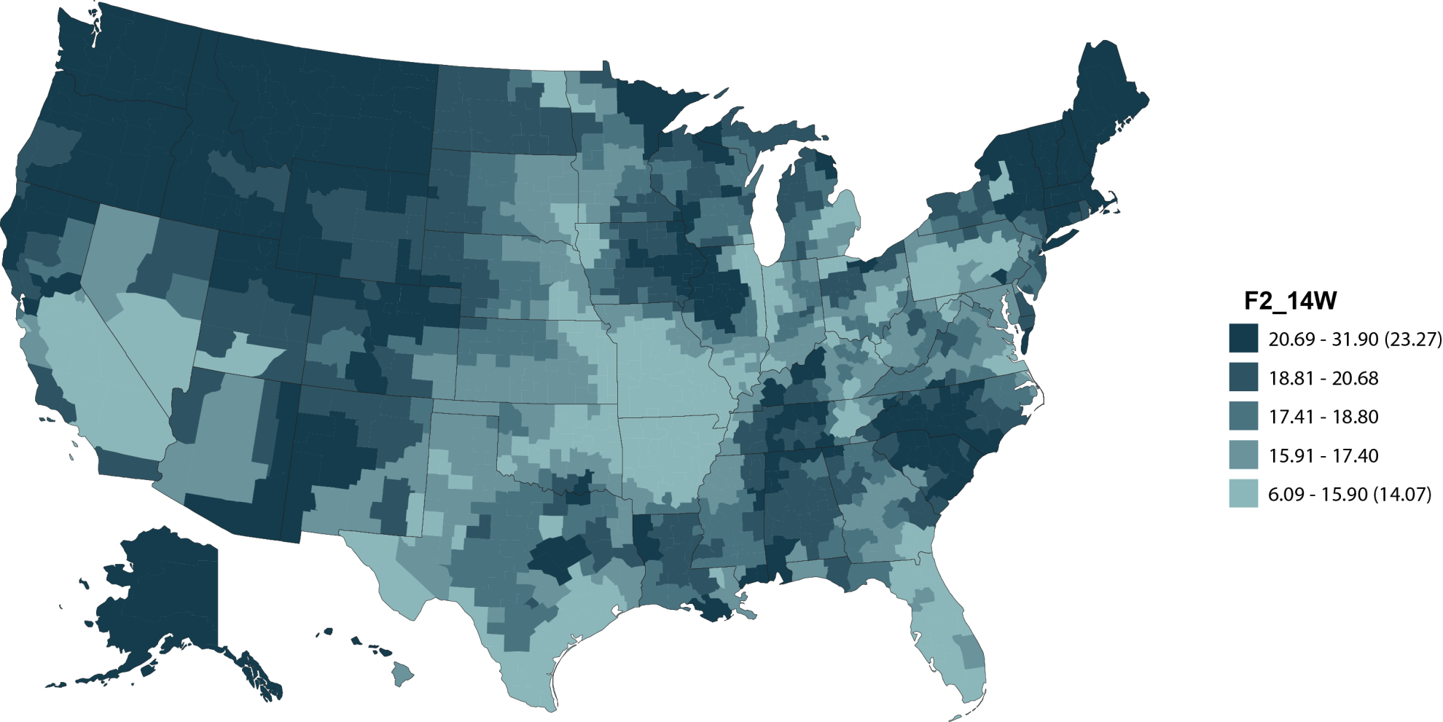
Geographic variations in the percent of hemodialysis patients using an internal access at initiation, by HSA, 2010: whites Figure 2.14 (Volume 2)
Incident hemodialysis patients, 2010.

Slide 21
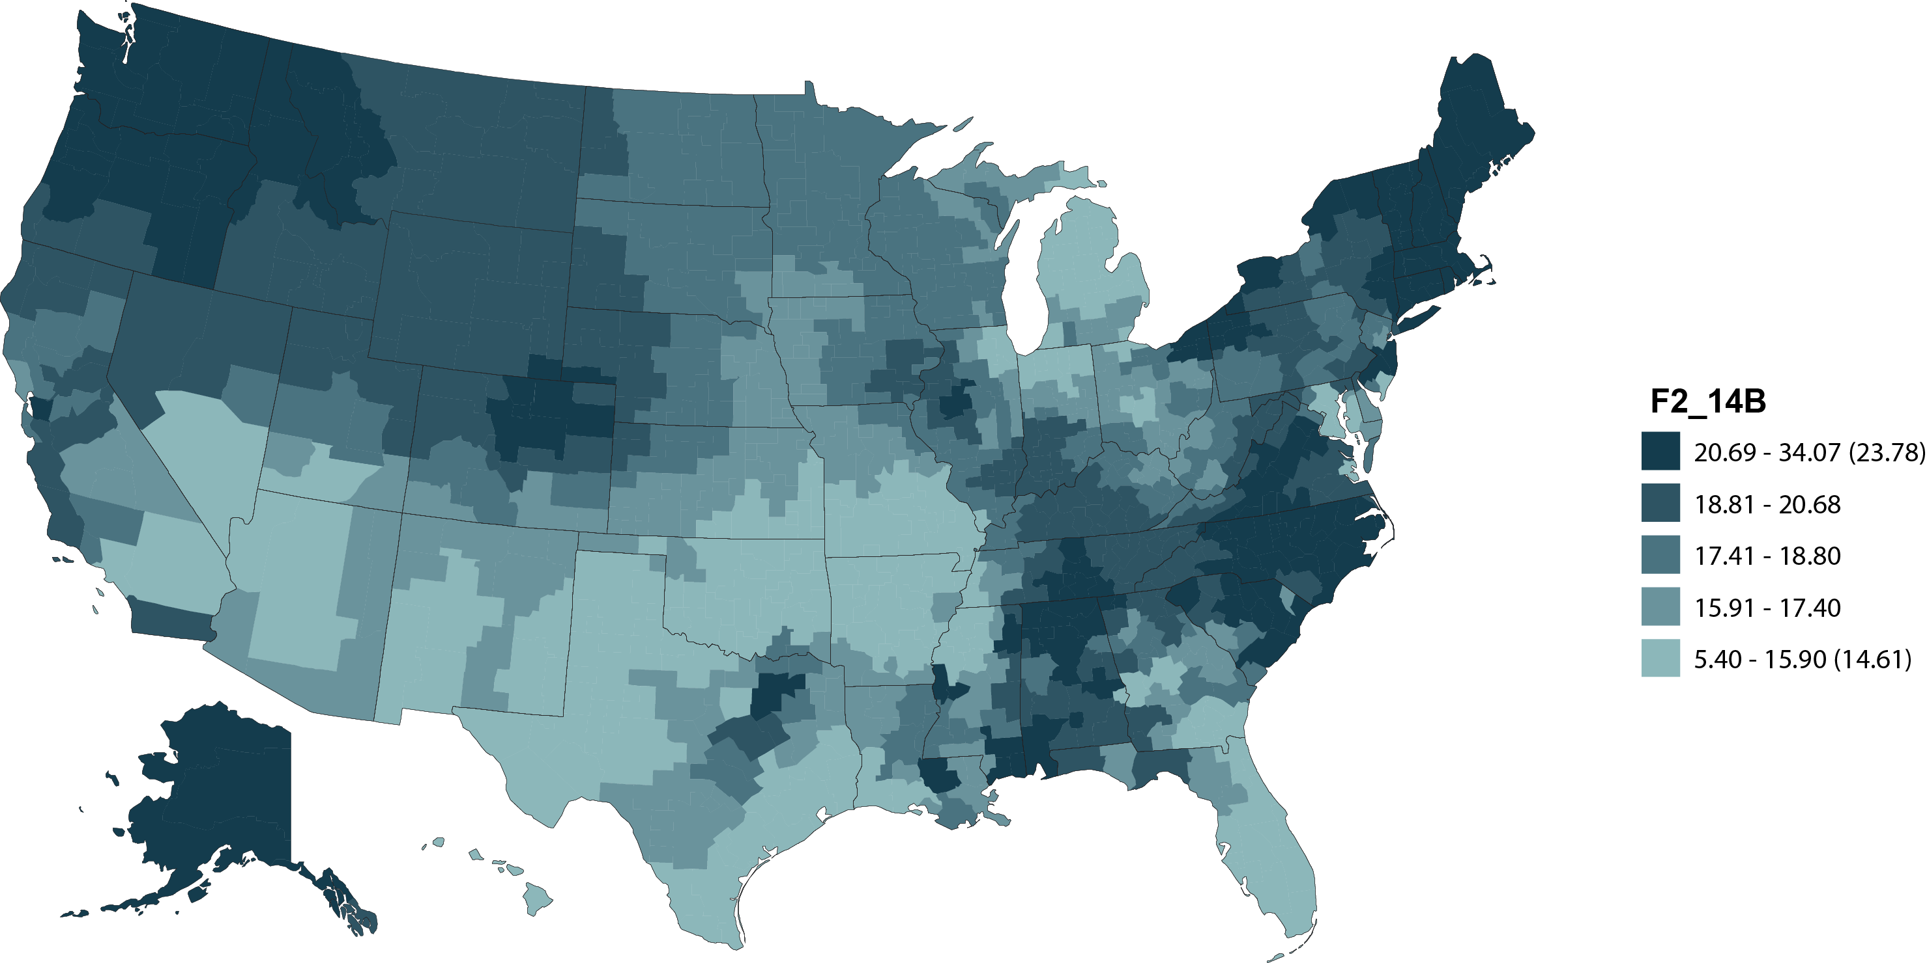
Geographic variations in the percent of hemodialysis pts using an internal access at initiation, by HSA, 2010: Blacks/African Americans Figure 2.14 (continued; Volume 2)
Incident hemodialysis patients, 2010.

Slide 22
Change in adjusted all-cause & cause- specific hospitalization rates, by modality Figure 3.1 (Volume 2)
Period prevalent ESRD patients. Adj: age/gender/race/primary diagnosis; ref: ESRD patients, 2005.

Slide 23
Adjusted hospitalization rates, by principal diagnosis & modality Figure 3.3 (Volume 2)
Period prevalent ESRD patients. Adj: age/gender/race/primary diagnosis; ref: ESRD patients, 2005.

Slide 24
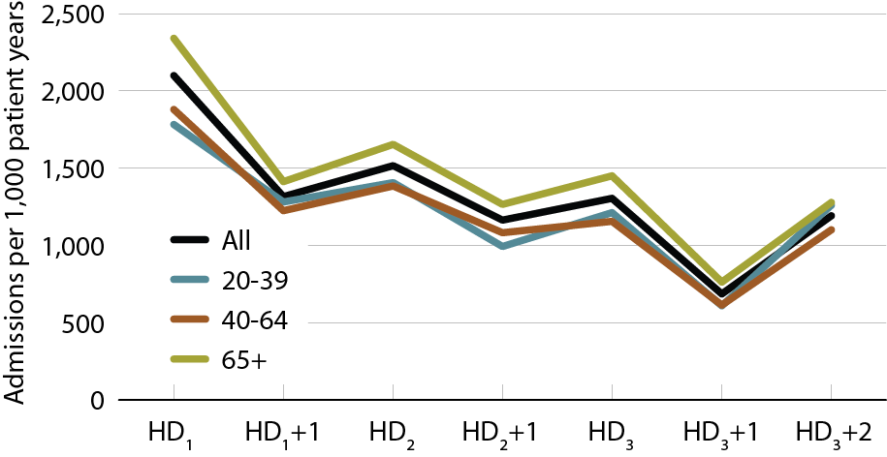
Annualized all-cause admission rates on different days of the dialysis week, by age Figure 3.11 (Volume 2)
January 1, 2010 point prevalent Medicare HD patients alive on January 31. Includes patients age 20 & older receiving hemodialysis three times weekly on a Monday–Wednesday–Friday or Tuesday–Thursday–Saturday schedule; HD1, HD2, & HD3, are the first, second, & third hemodialysis sessions. Rates for all patients are adjusted for age, gender, race, Hispanic ethnicity, & primary diagnosis; rates by age are adjusted for the other four factors. Ref: all included HD patients in 2010.

Slide 25
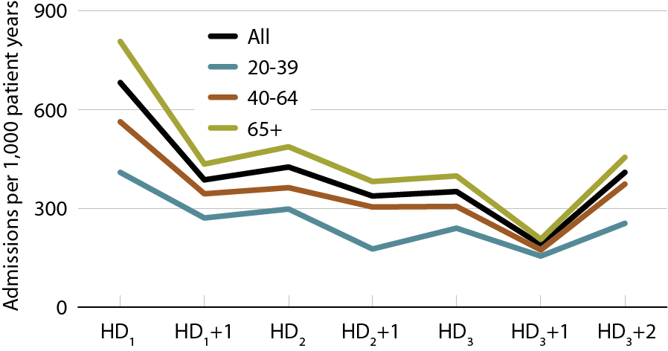
Annualized cardiovascular admission rates on different days of the dialysis week, by age Figure 3.12 (Volume 2)
January 1, 2010 point prevalent Medicare HD patients alive on January 31. Includes patients age 20 & older receiving hemodialysis three times weekly on a Monday–Wednesday–Friday or Tuesday–Thursday–Saturday schedule; HD1, HD2, & HD3, are the first, second, & third hemodialysis sessions. Rates for all patients are adjusted for age, gender, race, Hispanic ethnicity, & primary diagnosis; rates by age are adjusted for the other four factors. Ref: all included HD patients in 2010.

Slide 26
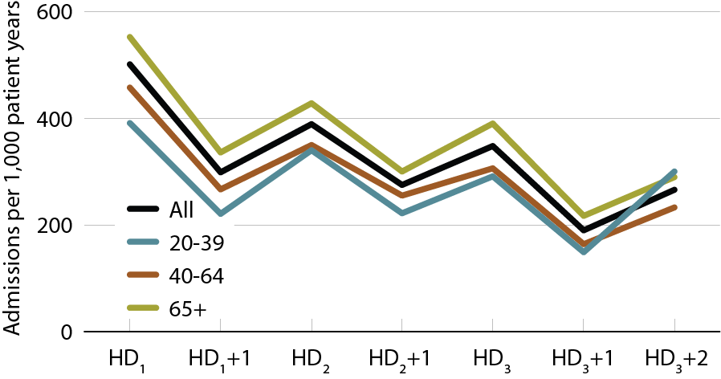
Annualized rates of admission for infection on different days of the dialysis week, by age Figure 3.13 (Volume 2)
January 1, 2010 point prevalent Medicare HD patients alive on January 31. Includes patients age 20 & older receiving hemodialysis three times weekly on a Monday–Wednesday–Friday or Tuesday–Thursday–Saturday schedule; HD1, HD2, & HD3, are the first, second, & third hemodialysis sessions. Rates for all patients are adjusted for age, gender, race, Hispanic ethnicity, & primary diagnosis; rates by age are adjusted for the other four factors. Ref: all included HD patients in 2010.

Slide 27
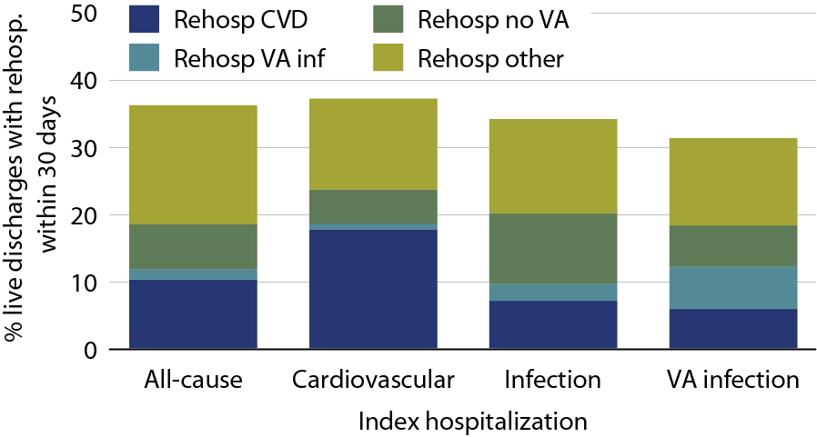
Cause-specific rehospitalization in hemodialysis patients 30 days after live hospital discharge, by cause-specific index hospitalization, 2010 Figure 3.7 (Volume 2)
Period prevalent hemodialysis patients, all ages, 2010; unadjusted. Includes live hospital discharges from January 1 to December 1, 2010.

Slide 28
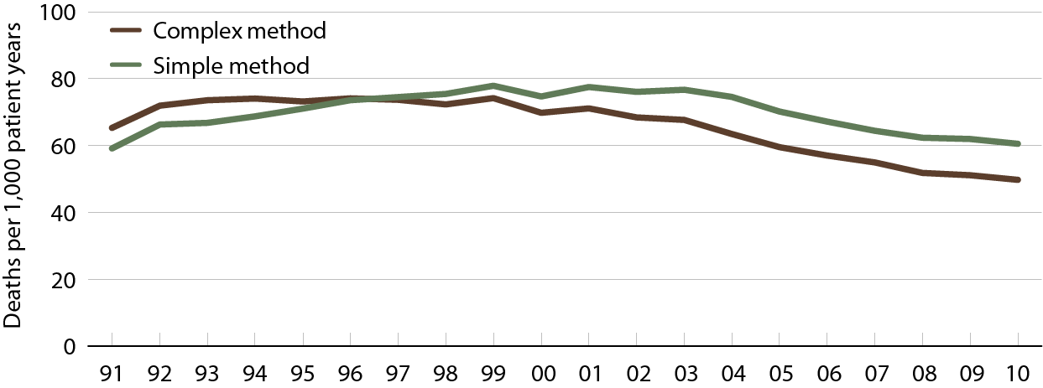
Rates of sudden cardiac death in prevalent dialysis patients Figure 4.2 (Volume 2)
Period prevalent dialysis patients, age 20 & older, unadjusted, using the complex method.

Slide 29
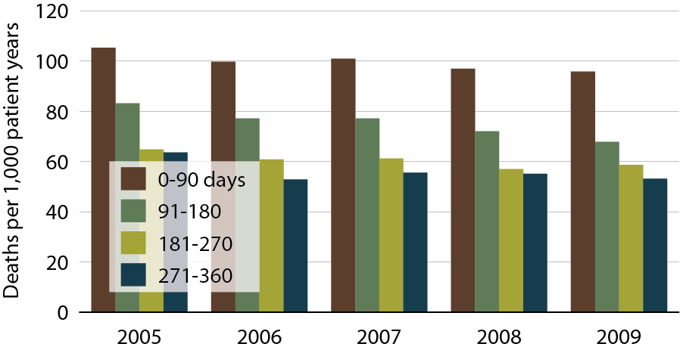
Rates of sudden cardiac death following initiation of treatment in incident dialysis patients Figure 4.7 (Volume 2)
Incident dialysis patients, age 20 & older, unadjusted.

Slide 30
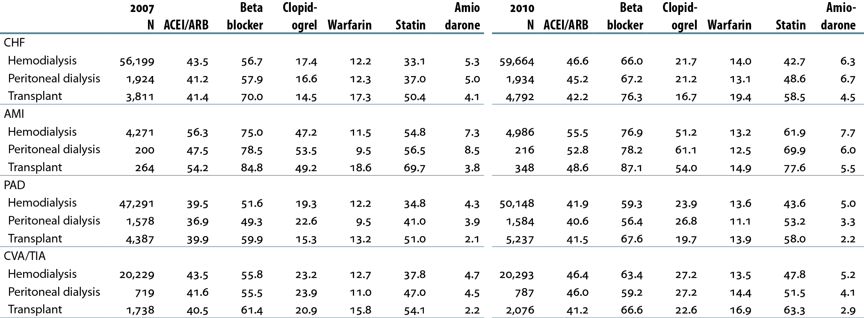
Cardiovascular disease & pharmacological interventions in ESRD patients, by diagnosis & modality (row %) Table 4.c (Volume 2)
January 1 point prevalent ESRD patients with Medicare Parts A, B, & D enrollment, with a first cardiovascular diagnosis or procedure in the year.

Slide 31
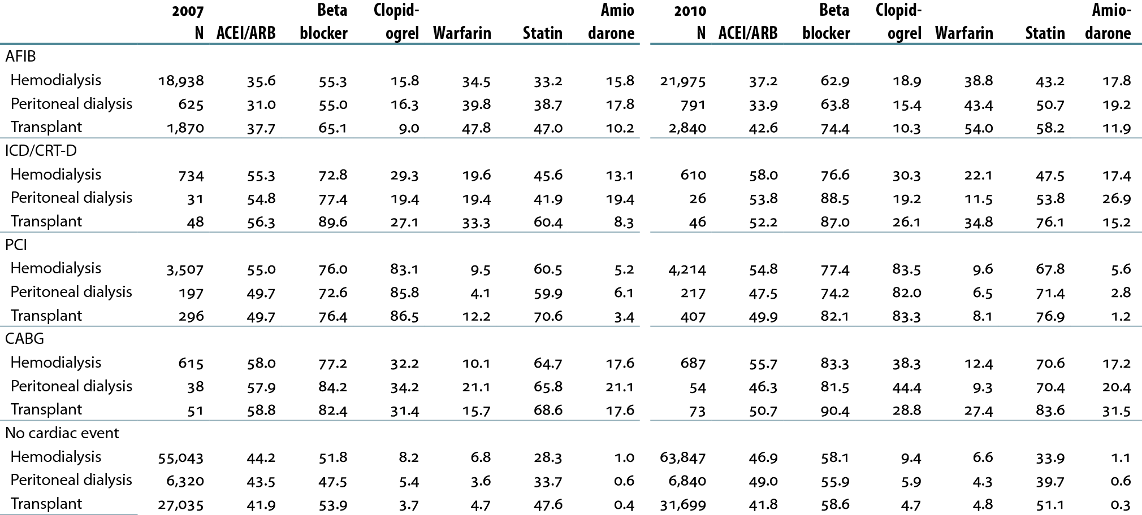
Cardiovascular disease & pharmacological interventions in ESRD patients, by diagnosis & modality (row %) Table 4.c (continued; Volume 2)
January 1 point prevalent patients with Medicare Parts A, B, & D enrollment, with a first cardiovascular diagnosis or procedure in the year.

Slide 32
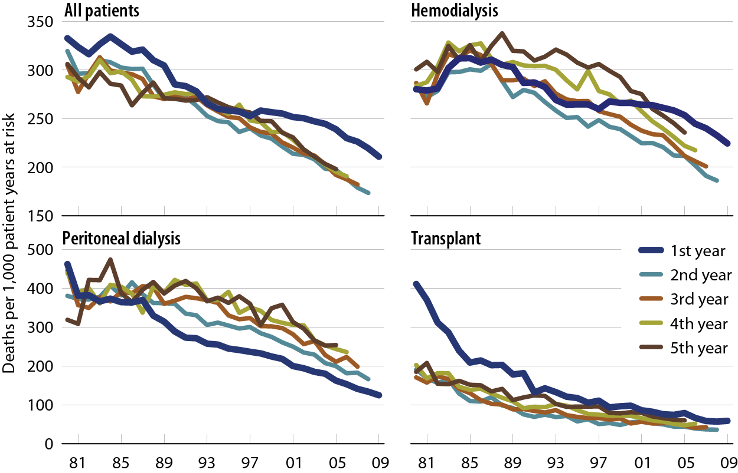
Adjusted all-cause mortality rates (from day 90), by modality & year of treatment Figure 5.1 (Volume 2)
Incident ESRD patients. Adj: age/gender/race /primary diagnosis; ref: incident ESRD patients, 2005.

Slide 33
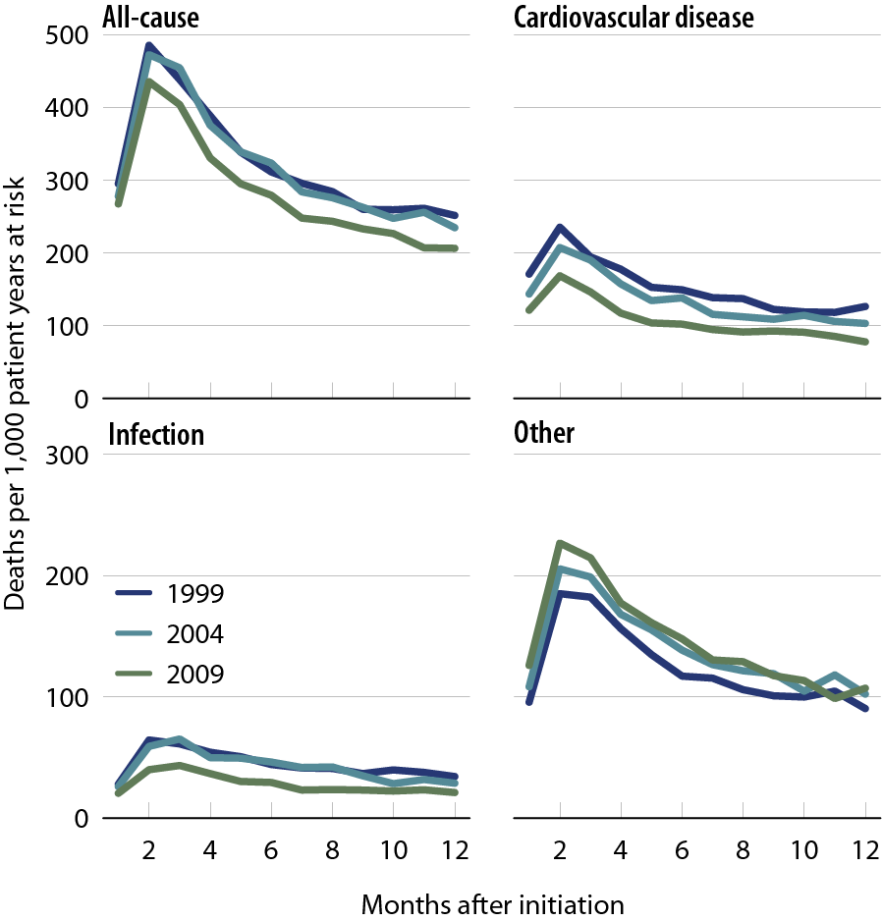
Adjusted all-cause & cause specific mortality (from day one) in the first year of hemodialysis Figure 5.3 (Volume 2)
Incident hemodialysis patients defined on the day of dialysis onset, without the 60-day rule. Adj: age/gender /race/Hispanic ethnicity/ primary diagnosis; ref: incident hemodialysis patients, 2005.

Slide 34
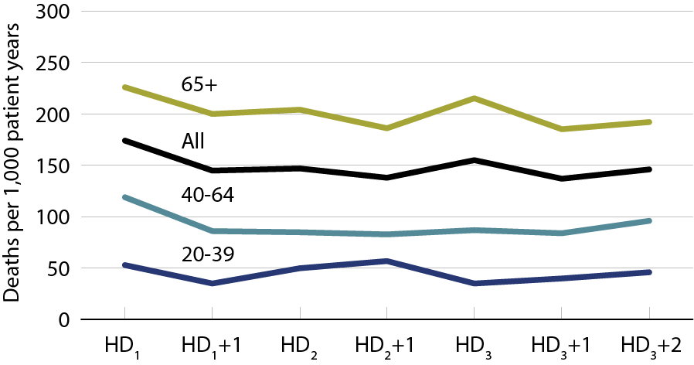
Annualized all-cause mortality rates on different days of the dialysis week Figure 5.7 (Volume 2)
January 1, 2010 point prevalent Medicare hemodialysis patients alive on January 31. Includes patient age 20 & older receiving hemodialysis three times weekly on a Monday–Wednesday–Friday or Tuesday–Thursday–Saturday schedule; HD1, HD2, & HD3, are the first, second, & third hemodialysis sessions. Rates for all patients are adjusted for age, gender, race, Hispanic ethnicity, & primary diagnosis; rates by age are adjusted for the other four factors. Ref: all included hemodialysis patients in 2010.

Slide 35
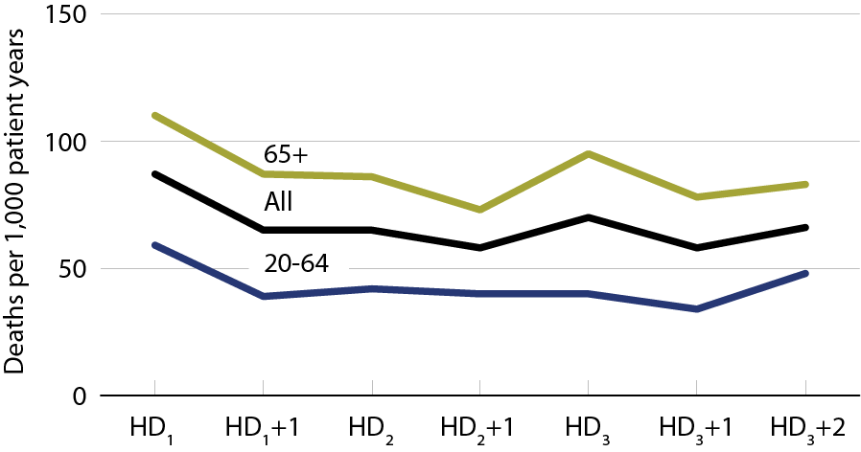
Annualized cardiovascular mortality rates on different days of the dialysis week Figure 5.8 (Volume 2)
January 1, 2010 point prevalent Medicare hemodialysis patients alive on January 31. Includes patient age 20 & older receiving hemodialysis three times weekly on a Monday–Wednesday–Friday or Tuesday–Thursday–Saturday schedule; HD1, HD2, & HD3, are the first, second, & third hemodialysis sessions. Rates for all patients are adjusted for age, gender, race, Hispanic ethnicity, & primary diagnosis; rates by age are adjusted for the other four factors. Ref: all included hemodialysis patients in 2010.

Slide 36
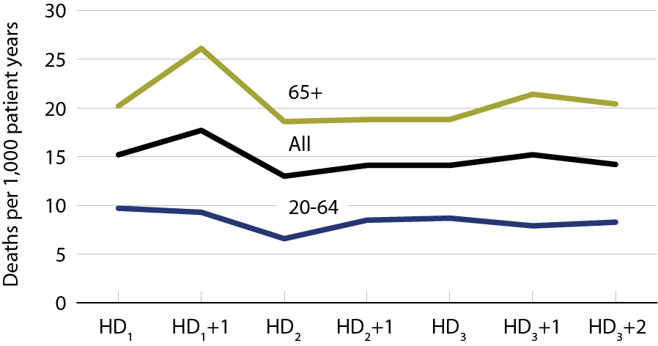
Annualized rates of mortality due to infection on different days of the dialysis week Figure 5.9 (Volume 2)
January 1, 2010 point prevalent Medicare hemodialysis patients alive on January 31. Includes patient age 20 & older receiving hemodialysis three times weekly on a Monday–Wednesday–Friday or Tuesday–Thursday–Saturday schedule; HD1, HD2, & HD3, are the first, second, & third hemodialysis sessions. Rates for all patients are adjusted for age, gender, race, Hispanic ethnicity, & primary diagnosis; rates by age are adjusted for the other four factors. Ref: all included hemodialysis patients in 2010.

Slide 37
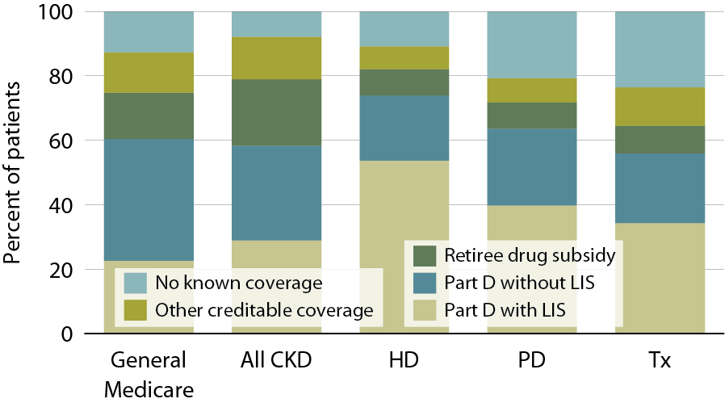
Sources of prescription drug coverage in Medicare ESRD enrollees, 2010 Figure 6.2 (Volume 2)
Point prevalent Medicare enrollees alive on January 1, 2010.

Slide 38
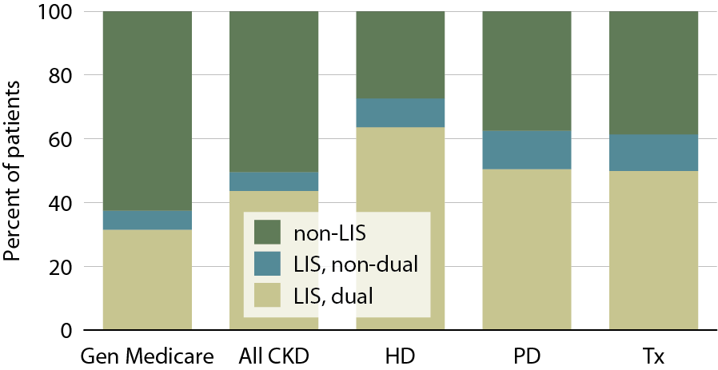
Patients enrolled in Part D, by dual eligibility & low income subsidy (LIS) status, 2010 Figure 6.5 (Volume 2)
Point prevalent Medicare enrollees alive on January 1, 2010.

Slide 39
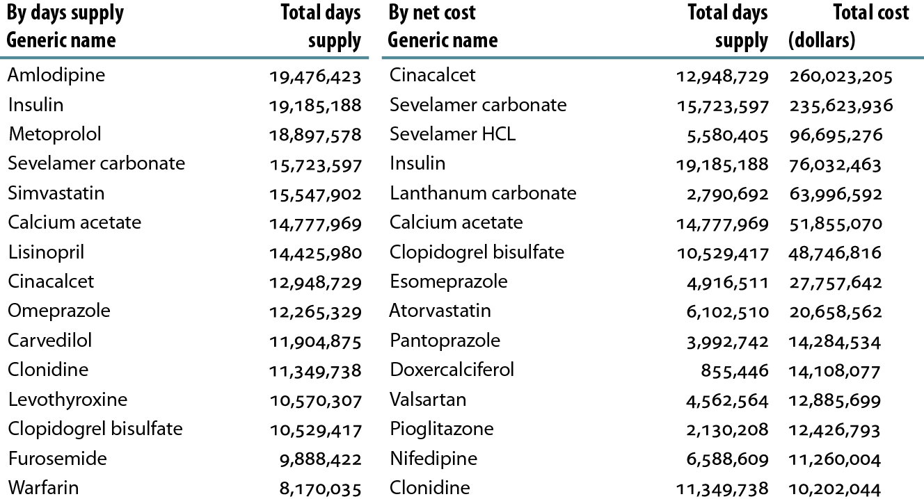
Top 15 drugs used by Part D-enrolled dialysis patients, by days supply & net cost, 2010 Table 6.f (Volume 2)
Part D claims for all dialysis patients, 2010.

Slide 40
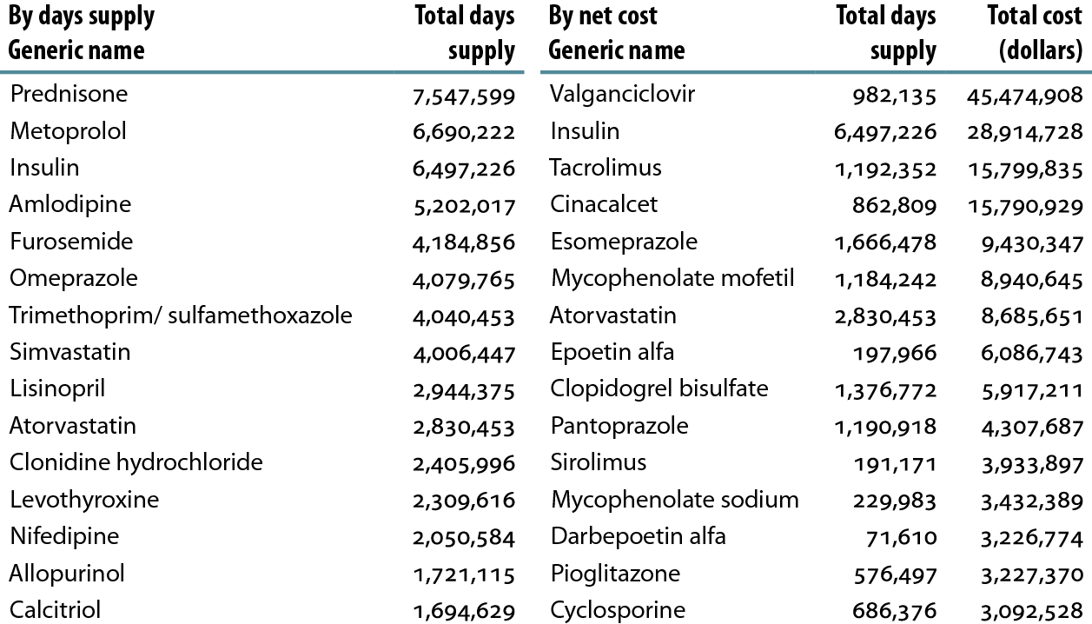
Top 15 drugs used by Part D-enrolled transplant patients, by days supply & net cost, 2010 Table 6.g (Volume 2)
Part D claims for all kidney transplant patients, 2010.

Slide 41
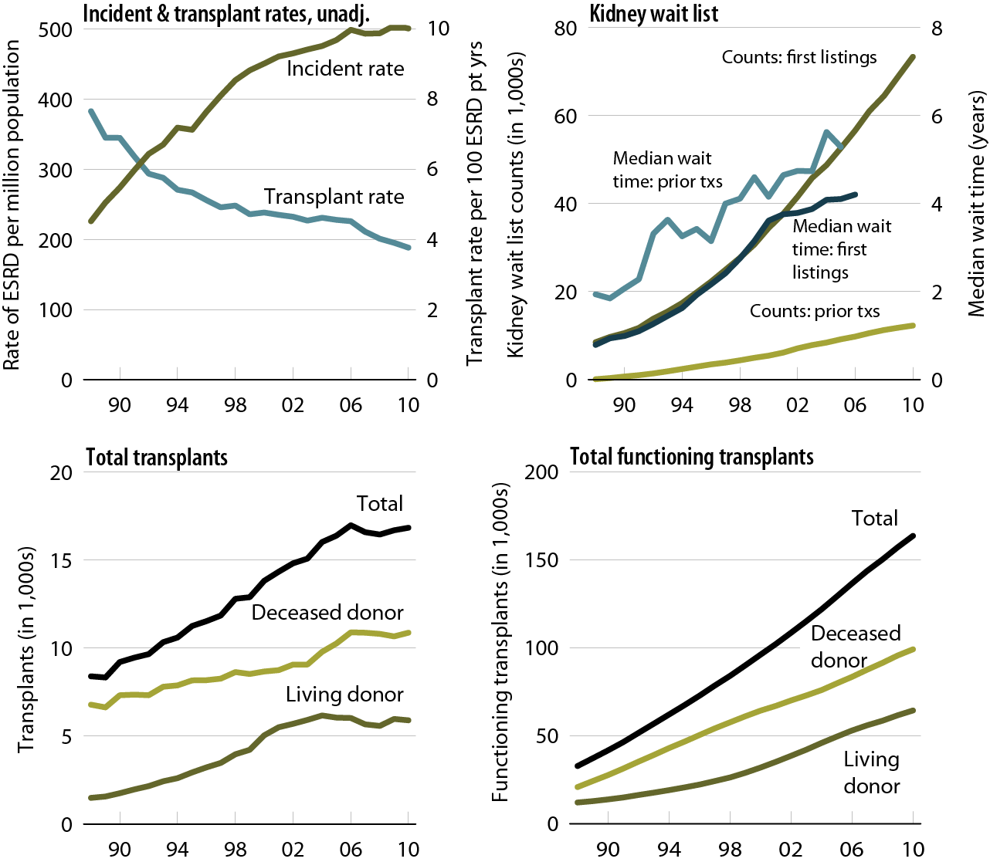
Trends in transplantation: unadjusted rates, wait list, & total & functioning transplants, patients age 20 & older Figure 7.1 (Volume 2)
Unadjusted incident & transplant rates: limited to ESRD patients age 20 & older, thus yielding a computed incident rate higher than the overall rate presented elsewhere in the ADR. Wait list counts: patients age 20 & older listed for a kidney or kidney-pancreas transplant on December 31 of each year. Wait time: patients age 20 & older entering wait list in the given year. Transplant counts: patients age 20 & older as known to the USRDS.

Slide 42
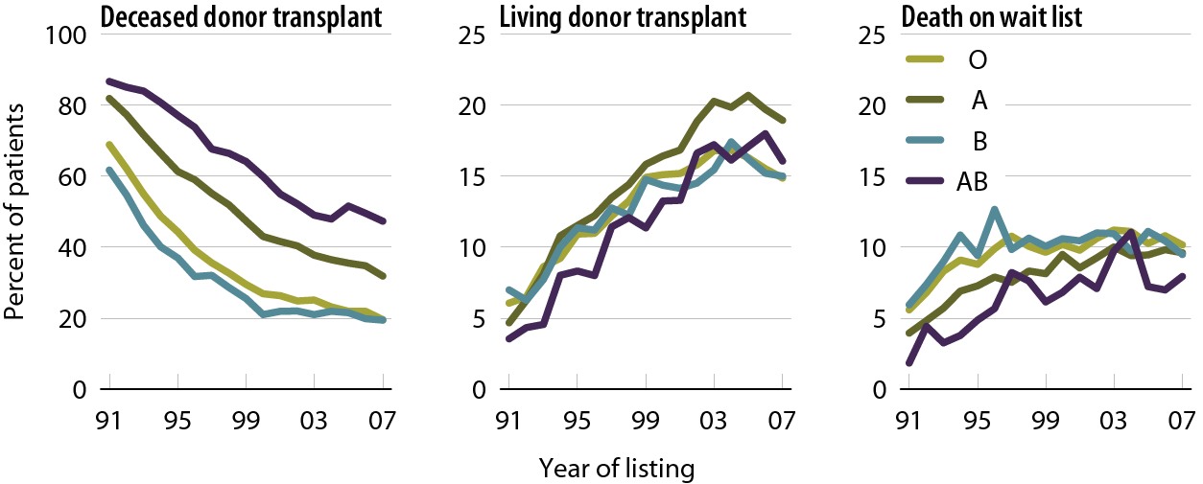
Outcomes for wait-listed adult patients within three years of listing, by blood type Figure 7.4 (Volume 2)
Patients ate 18 & older listed for a first-time kidney or kidney-pancreas transplant.

Slide 43
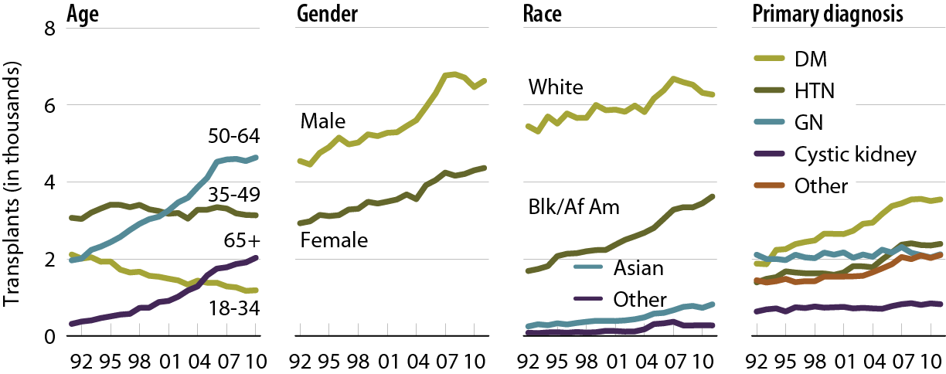
Deceased donor transplants, by age, gender, race, & primary diagnosis Figure 7.12 (Volume 2)
Patients age 18 & older. Includes kidney-alone & kidney-pancreas transplants.

Slide 44
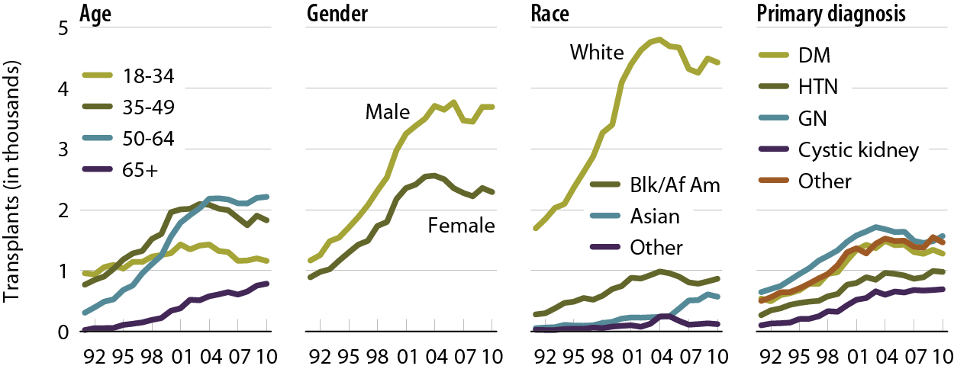
Living donor transplants, by age, gender, race, & primary diagnosis Figure 7.14 (Volume 2)
Patients age 18 & older. Includes kidney-alone & kidney-pancreas transplants.

Slide 45
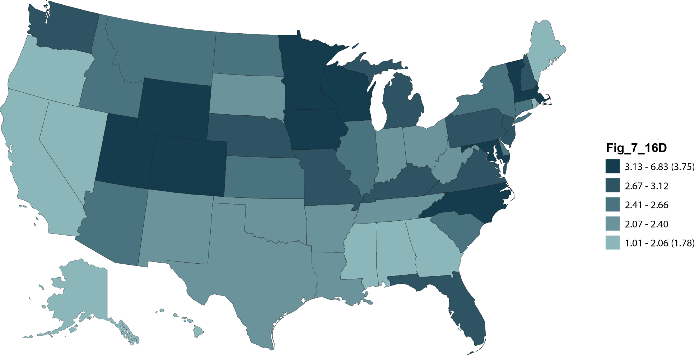
Adjusted transplant rates (per 100 dialysis patient years) by state of patient residence & donor type, 2010: deceased donor Figure 7.16 (Volume 2)
Patients age 18 & older. Adj: age/gender/race/ primary diagnosis; ref: prevalent dialysis patients, 2010.

Slide 46
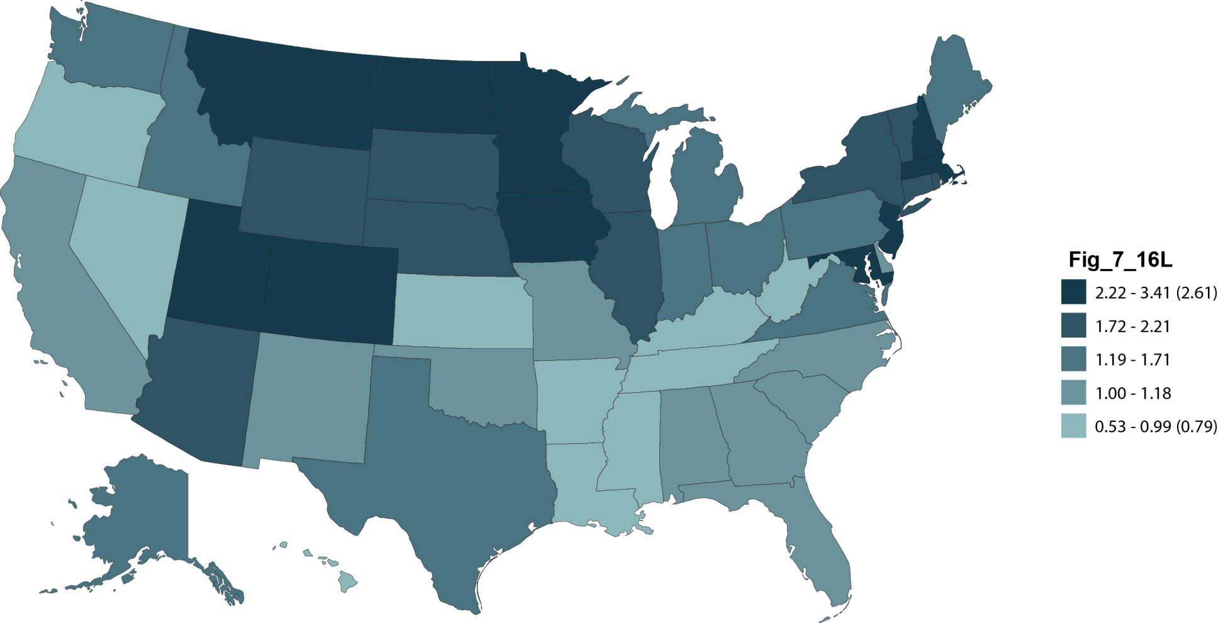
Adjusted transplant rates (per 100 dialysis patient years) by state of patient residence & donor type, 2010: living donor Figure 7.16 (cont.; Volume 2)
Patients age 18 & older. Adj: age/gender/race/ primary diagnosis; ref: prevalent dialysis patients, 2010.

Slide 47
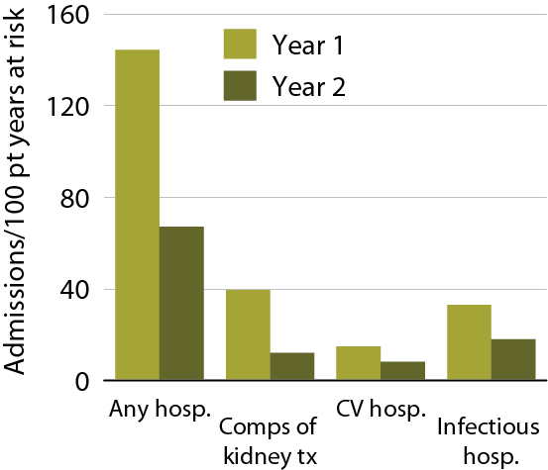
Hospitalization rates in the first & second years post-transplant, 2008 Figure 7.21 (Volume 2)
First-time, kidney-only transplant recipients, age 18 & older, transplanted in 2008; ref: transplant patients, 2005.

Slide 48
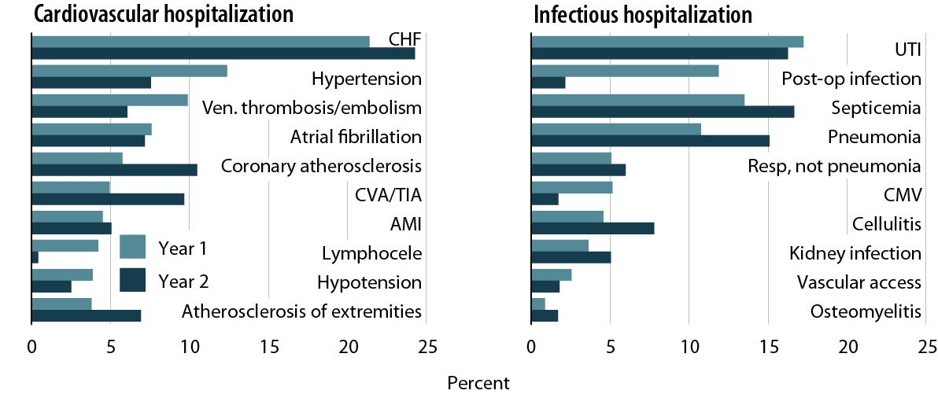
Primary diagnoses of cardiac & infectious hospitalizations in the first & second years post-transplant Figure 7.22 (Volume 2)
First-time, kidney-only transplant recipients, age 18 & older, with Medicare primary coverage, transplanted in 2006–2008.

Slide 49
Primary diagnoses of cardiac & infectious hospitalizations in the first & second years post-transplant Figure 7.22 (Volume 2)
First-time, kidney-only transplant recipients, age 18 & older, with Medicare primary coverage, transplanted in 2006–2008.

Slide 50
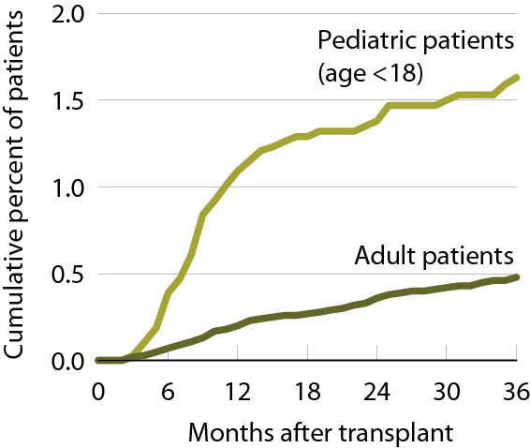
Cumulative incidence of post-transplant lymphoproliferative disorder (PTLD) Figure 7.23 (Volume 2)
Patients receiving a first-time, kidney-only transplant, 2003–2007 combined.

Slide 51
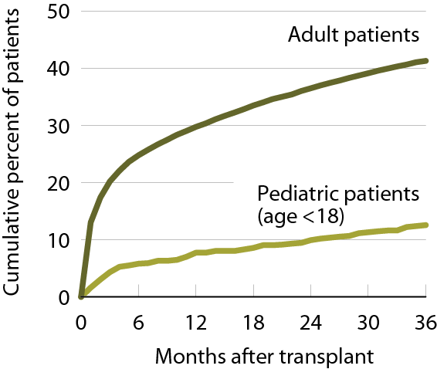
Cumulative incidence of post-transplant diabetes Figure 7.24 (Volume 2)
Patients receiving a first-time, kidney-only transplant, 2003–2007 combined.

Slide 52
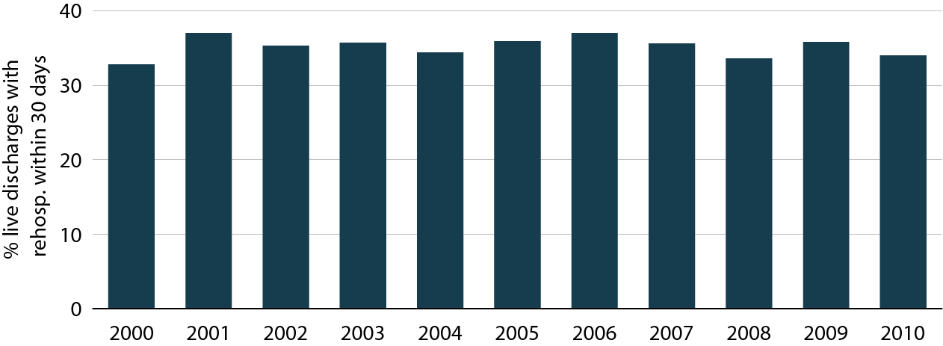
Adjusted all-cause rehospitalization rates in pediatric patients 30 days after live hospital discharge Figure 8.1 (Volume 2)
ESRD patients age 0–19. Adj: gender/race/primary diagnosis; ref: discharges in 2005.

Slide 53
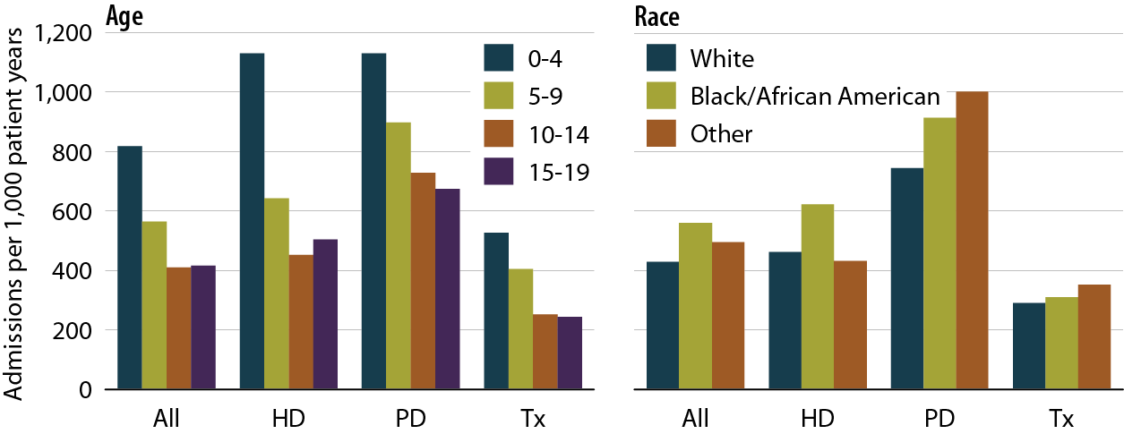
Unadjusted rates of hospitalization for any infection, by modality, age, & race, 2007–2010 Figure 8.2 (Volume 2)
Period prevalent ESRD patients age 0–19, 2007-2010; unadjusted.

Slide 54
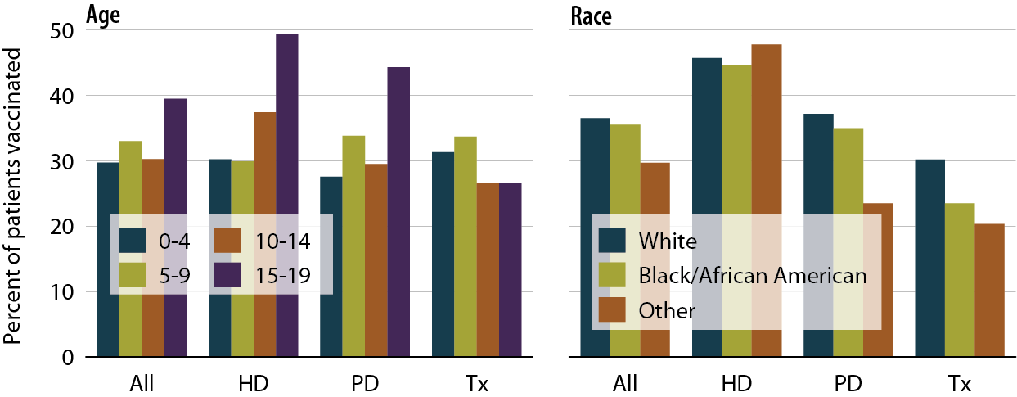
Influenza vaccination rates in pediatric patients, by modality, age, & race, 2007–2010 Figure 8.7 (Volume 2)
Point prevalent ESRD patients age 0–19 prior to January 1 of the two year study period & alive through December 31 of the second year, 2007–2008 & 2009–2010.

Slide 55
One-year adjusted all-cause hospitalization rates in pediatric patients (from day 90), by age & modality Figure 8.10 (Volume 2)
Incident ESRD patients age 0–19, 2000–2009. Adjusted for gender, race, and primary diagnosis. Ref: incident ESRD patients age 0–19, 2004–2005. Included patients survived the first 90 days after ESRD initiation and are followed from day 90.

Slide 56
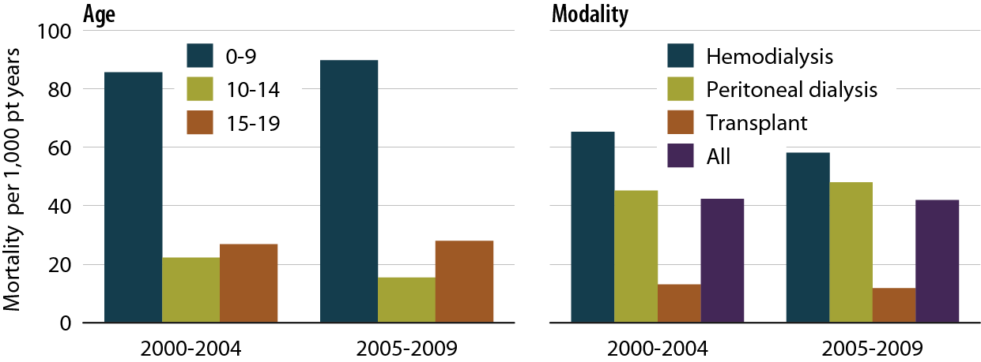
One-year adjusted all-cause mortality rates in pediatric patients (from day one), by age & modality Figure 8.13 (Volume 2)
Incident dialysis & transplant pts defined on the onset of dialysis or transplant day without the 60-day rule; followed to December 31, 2010. Adjusted for age, gender, race, Hispanic ethnicity, & primary diagnosis. Ref: incident ESRD patients age 0–19, 2004–2005.

Slide 57
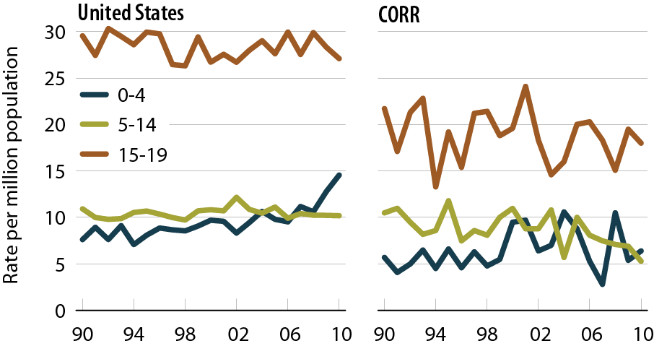
Incident rates of ESRD in the United States & Canada, by age Figure 8.17 (Volume 2)
Incident ESRD patients age 0–19; unadjusted.

Slide 58
Prevalent rates of ESRD in the United States & Canada, by age Figure 8.22 (Volume 2)
Incident ESRD patients age 0–19; unadjusted.

Slide 59
Prevalent rates of ESRD in the United States & Canada, by primary cause of renal failure Figure 8.25 (Volume 2)
Incident ESRD patients age 0–19; unadjusted.

Slide 60
Distribution of CDS participants Figure 9.1 (Volume 2)
CDS participants who started treatment between June 1, 2005, & June 1, 2007.

Slide 61
Sociodemographic characteristics of Comprehensive Dialysis Study participants Table 9.b (Volume 2)
CDS participants who started treatment between June 1, 2005, & June 1, 2007.

Slide 62
Time to wait listing in patients with early awareness of kidney transplant options Figure 9.8 (Volume 2)
Incident dialysis patients who started treatment June 1, 2005 to June 1, 2007.

Slide 63
CDS participants classified as frail, by age, gender, & race Figure 9.10 (Volume 2)
Incident dialysis patients who started treatment June 1, 2005 to June 1, 2007.

Slide 64
Frequency of symptom complexes in CDS participants Figure 9.15 (Volume 2)
Incident dialysis patients who started treatment June 1, 2005 to June 1, 2007.

Slide 65
Distribution of patients, by unit affiliation, 2010 Figure 10.1 (Volume 2)

Slide 66
Distribution of providers opting into the new dialysis composite rate Table 10.a (Volume 2)
Point prevalent dialysis patients 2010–2011; only facilities defined as opting in the new bundle are included.

Slide 67
Total Medicare dollars spent on ESRD, by type of service Figure 11.5 (Volume 2)
Total Medicare costs from claims data; include all Medicare as primary payor claims as well as amounts paid by Medicare as secondary payor

Slide 68
Total Medicare ESRD expenditures per person per year, by modality Figure 11.7 (Volume 2)
Period prevalent ESRD patients, patients with Medicare as secondary payor are excluded.

Slide 69
Total Medicare spending for injectables Figure 11.9 (Volume 2)
Period prevalent dialysis patients.

Slide 70
Total per person per year outpatient expenditures, by dialysis modality & race, 2010 Figure 11.19 (Volume 2)
Period prevalent dialysis patients, 2010.

Slide 71
Total per person per year Part D net & out-of-pocket costs, 2010 Figure 11.29 (Volume 2)
Part D-enrolled general Medicare patients from the 5 percent sample & period prevalent dialysis & transplant patients, 2010. Net pay is estimated as the sum of Medicare covered amount & LIS amount.

