Slide 1
CKD: Précis An introduction to chronic kidney disease in the U.S.
United States Renal Data System
2013 Annual Data Report

Slide 2
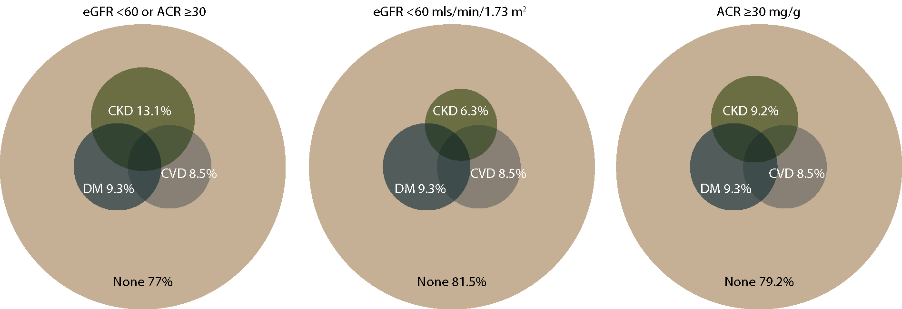
Distribution of NHANES 2005–2010 participants with diabetes, cardiovascular disease, & single-sample markers of CKD Figure 1.1 (Volume 1)
NHANES participants 2005–2010, age 20 & older; single-sample estimates of eGFR & ACR.

Slide 3
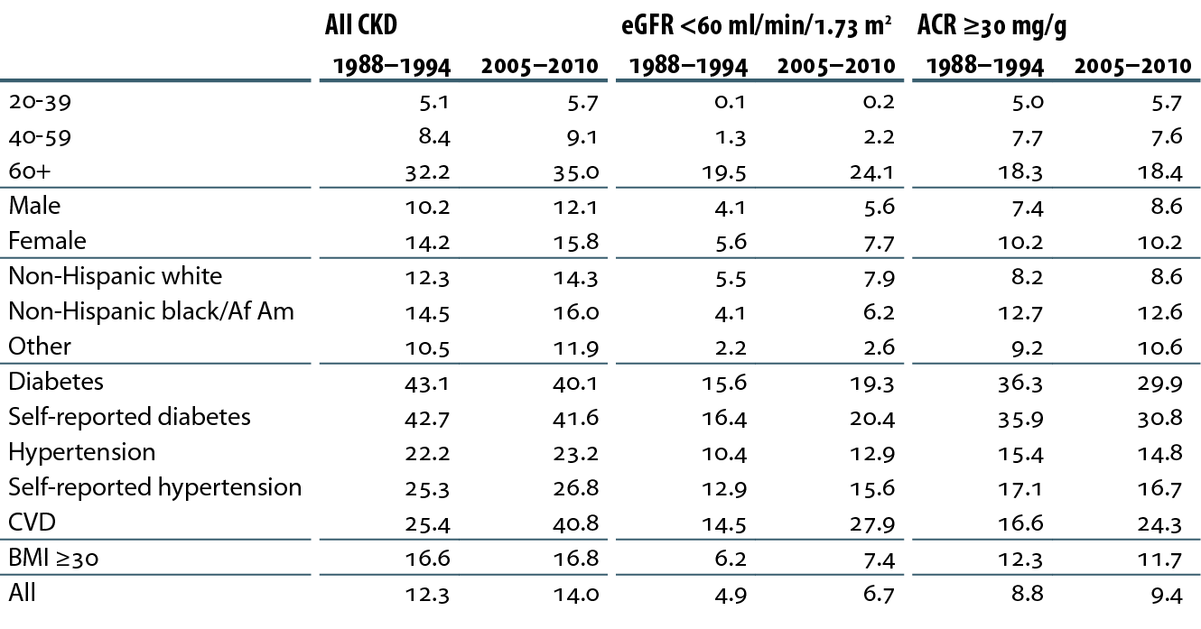
Prevalence (%) of CKD in the NHANES population within age, gender, race/ethnicity, & risk factor categories Table 1.a (Volume 1)
NHANES 1988–1994 & 2005–2010 participants age 20 & older; single-sample estimates of eGFR & ACR. eGFR calculated using the CKD-EPI equation. eGFR calculated using the CKD-EPI equation.

Slide 4
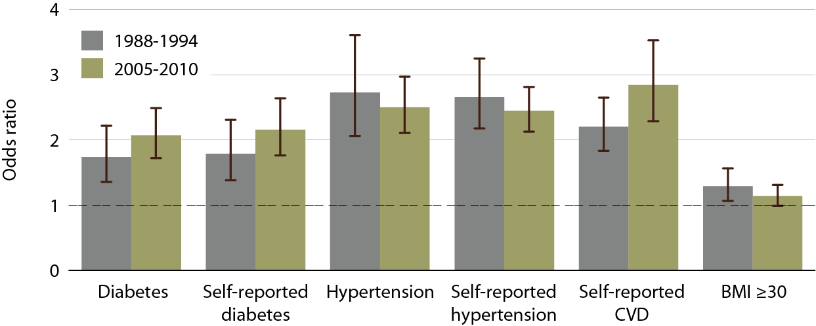
Adjusted odds ratios of spot eGFR <60 ml/min/1.73 m² in NHANES participants, by risk factor Figure 1.5 (Volume 1)
NHANES 1988-1994 & 2005-2010 participants age 20& older; single sample estimates of eGFR and ACR. Adjusted: age, gender, race; eGFR calculated using CKD-EPI equation.

Slide 5
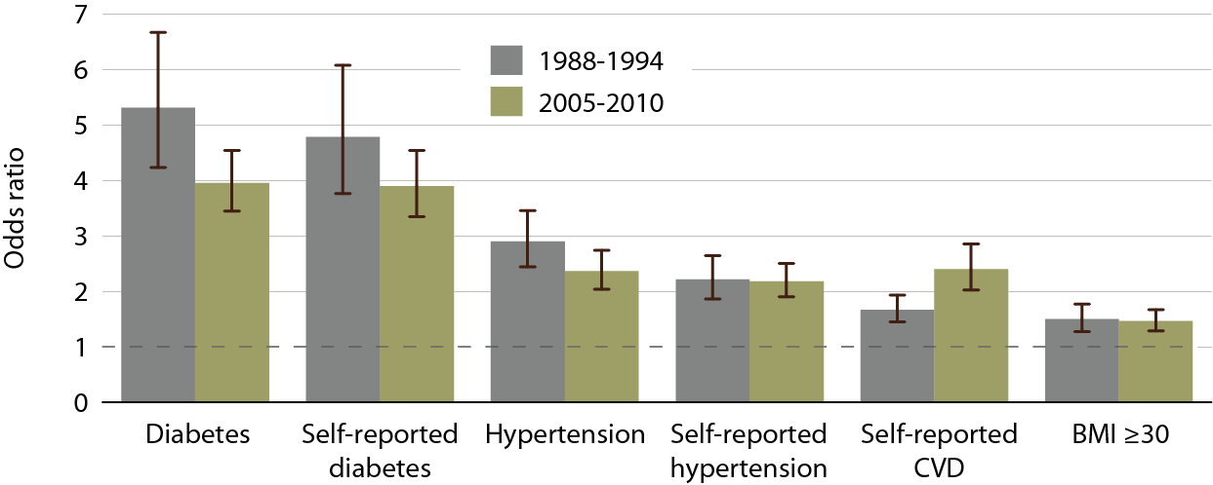
Adjusted odds ratios of spot urine albumin/ creatinine ratio (ACR) ≥30 mg/g in NHANES participants, by risk factor Figure 1.6 (Volume 1)
NHANES 1988-1994 & 2005-2010 participants age 20& older; single sample estimates of eGFR and ACR. Adjusted: age, gender, race; eGFR calculated using CKD-EPI equation.

Slide 6
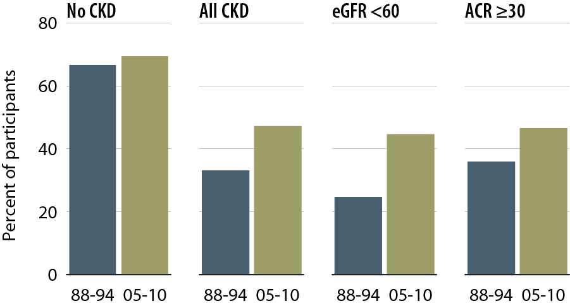
NHANES participants at target blood pressure Figure 1.12 (Volume 1)
NHANES 1988–1994 & 2005–2010 participants age 20 & older; single sample estimates of eGFR & ACR; dialysis patients excluded from NHANES 2005–2010. eGFR calculated using the CKD-EPI equation. This figure cannot be directly compared to values in Table 1.b. The table represents NHANES participants who are classified as hypertensive (measured/treated) but some of those are at target blood pressure. Represents all hypertensives plus those hypertensives who are at target blood pressure probably due to medication.

Slide 7
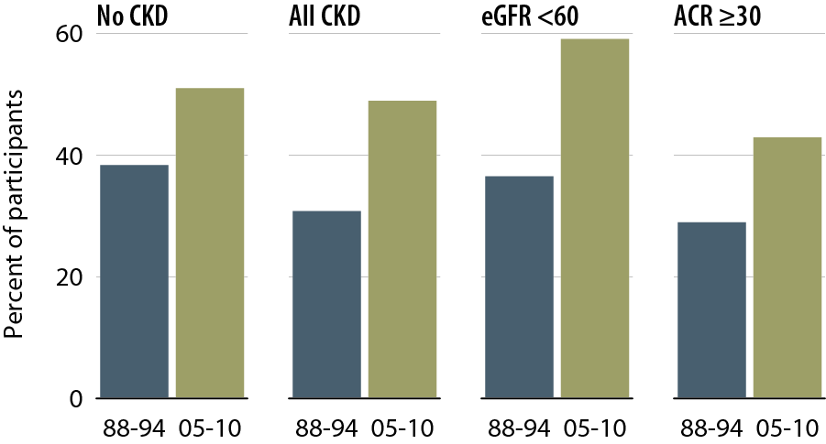
NHANES participants with glycohemoglobin <7% Figure 1.15 (Volume 1)
NHANES 1988–1994 & 2005–2010 participants age 20 & older; single sample estimates of eGFR & ACR; dialysis patients excluded from NHANES 2005–2010. eGFR calculated using the CKD-EPI equation.

Slide 8
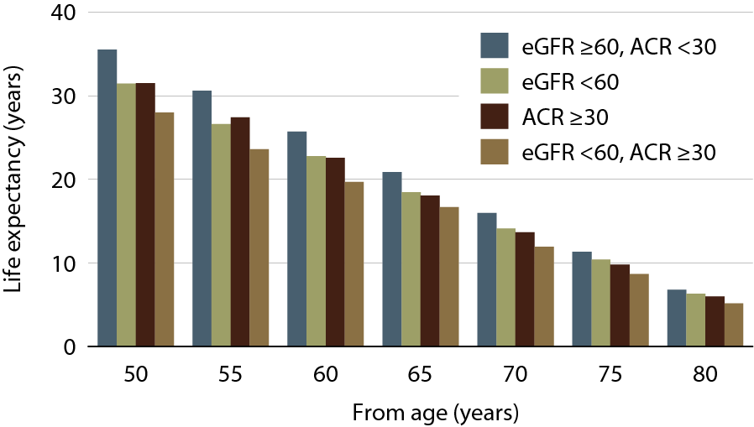
Life expectancy of NHANES participants with or without CKD, 1999–2004 Figure 1.16 (Volume 1)
NHANES 1999–2004 participants age 20 & older; single sample estimates of eGFR & ACR. eGFR calculated using the CKD-EPI equation.

Slide 9
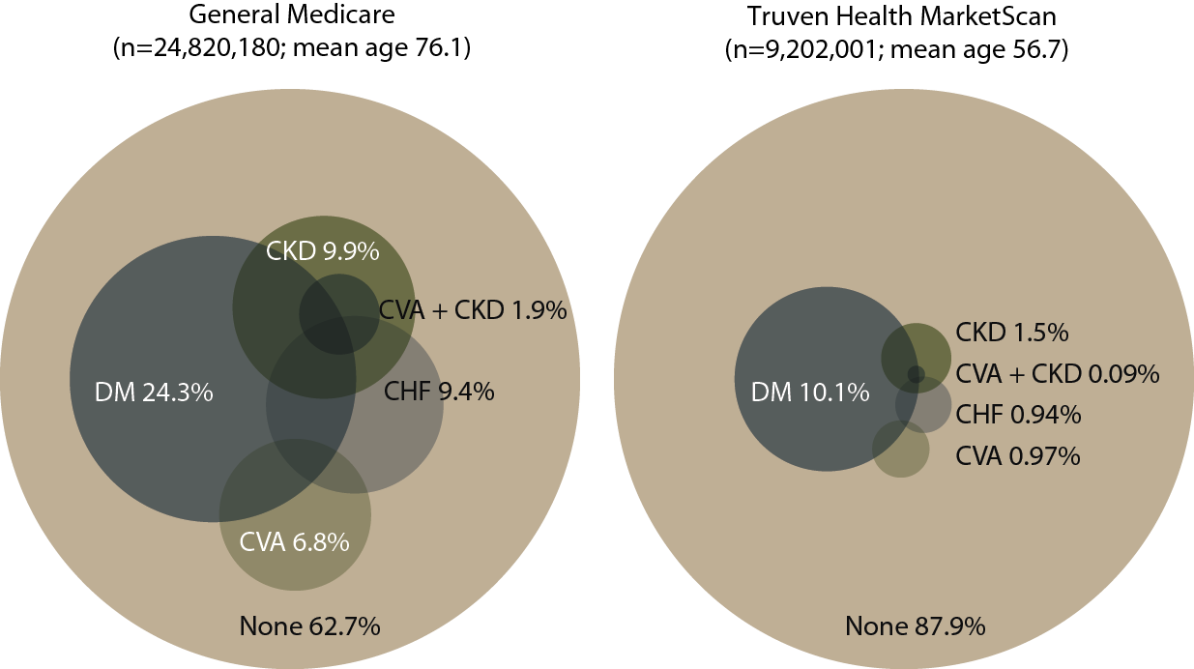
Distribution of point prevalent general Medicare (age 65 & older) & Truven Health MarketScan (age 50–64) patients with coded diabetes, CKD, CHF, & CVA, 2011 Figure 2.1 (Volume 1)
Point prevalent general (fee-for-service) Medicare patients age 65 & older; point prevalent Truven Health MarketScan patients age 50–64. Diabetes, CKD, CHF, & CVA determined from claims.

Slide 10
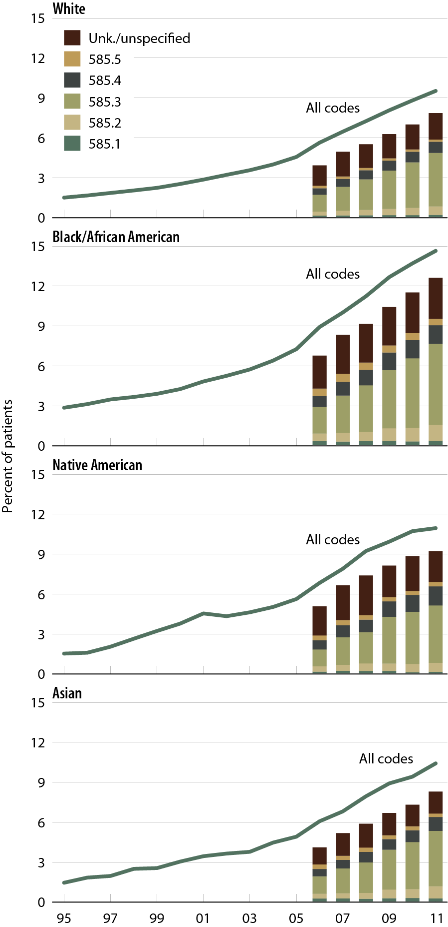
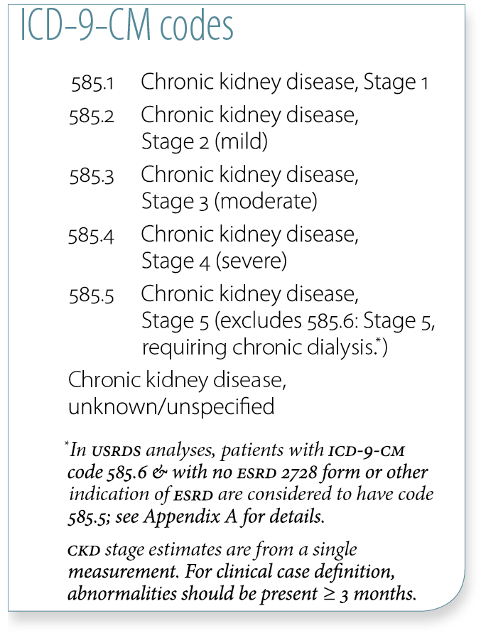
Trends in CKD prevalence: Medicare patients age 65 & older, by race Figure 2.2 (Volume 1)
Prevalent patients surviving cohort year, without ESRD, age 65 & older .

Slide 11
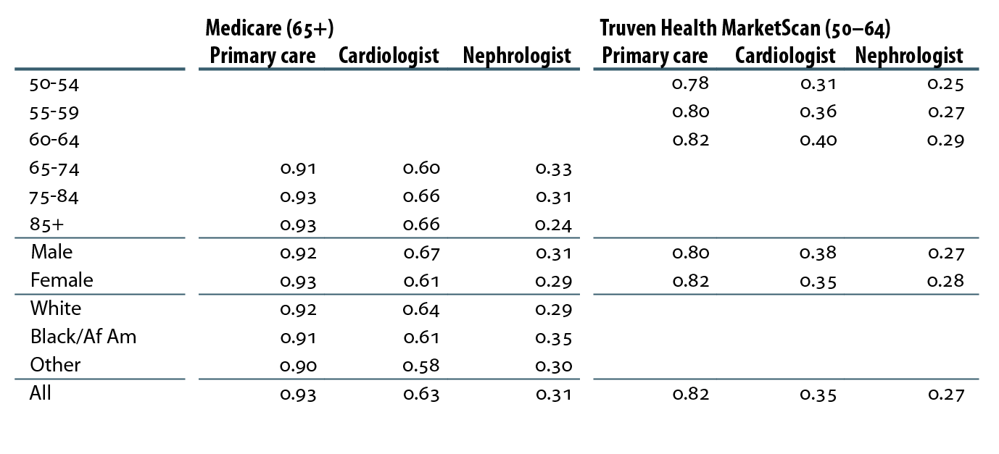
Cumulative probability of a physician visit by month 12 after CKD diagnosis in 2010, by demographic characteristics, physician specialty, & dataset Table 2.g (Volume 1)
Patients alive & eligible all of 2010. CKD diagnosis represents date of first CKD claim during 2010; physician claims searched during 12 months following that date.

Slide 12
Cumulative probability of a physician visit by month 12 after a CKD diagnosis code of 585.3 or higher in 2010, by demographic characteristics, physician specialty, & dataset Table 2.h (Volume 1)
Patients alive & eligible all of 2010. CKD diagnosis represents date of first CKD claim during 2010; physician claims searched during 12 months following that date.

Slide 13
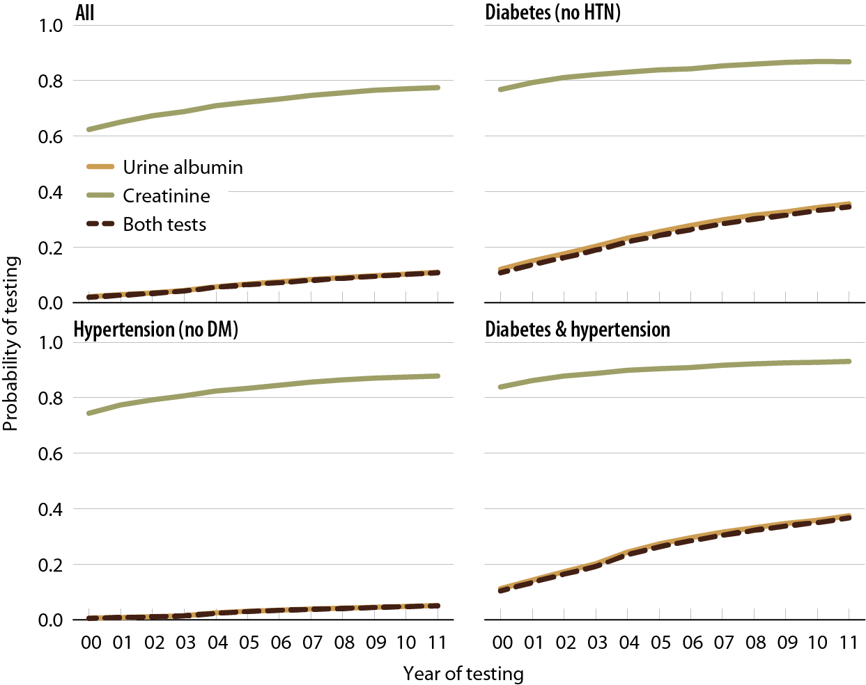
Probability of urine albumin & creatinine testing in Medicare patients at risk for CKD Figure 2.5 (Volume 1)
Medicare patients from the 5 percent sample, age 20 & older, with Parts A & B coverage in the prior year; patients diagnosed with CKD or ESRD during prior year are excluded. Tests tracked during each year.

Slide 14
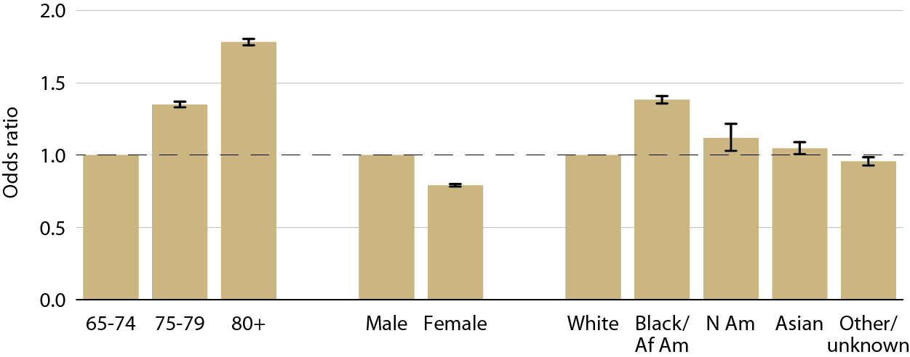
Adjusted odds ratio of a CKD diagnosis code in Medicare patients, by age, gender, & race, 2011 Figure 2.6 (Volume 1)
Medicare patients age 65 & older, alive & eligible for all of 2011. CKD claims as well as other diseases identified in 2011.

Slide 15
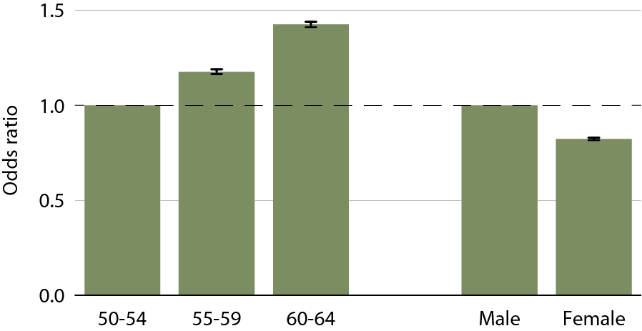
Adjusted odds ratio of a CKD diagnosis code in Truven Health MarketScan patients, by age & gender, 2011 Figure 2.7 (Volume 1)
Medicare patients age 65 & older & Truven Health MarketScan patients age 50–64, alive & eligible for all of 2011. CKD claims as well as other diseases identified in 2011.

Slide 16
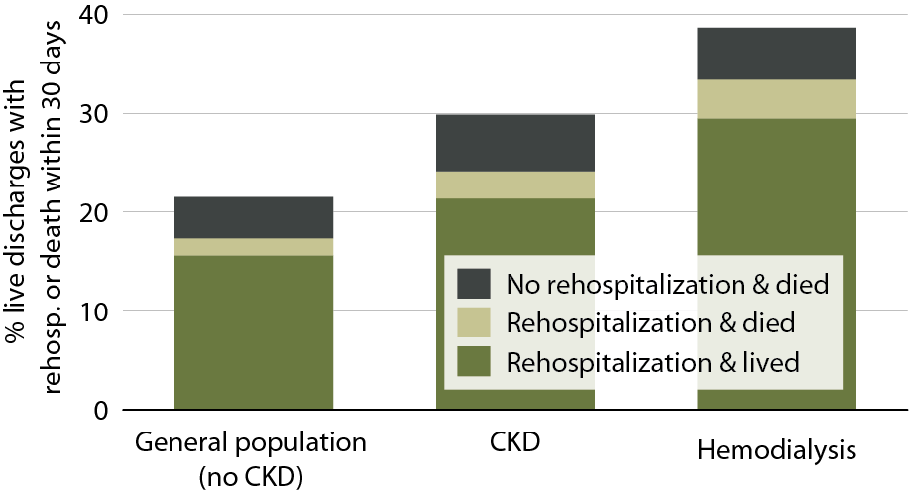
All-cause rehospitalization or death within 30 days after live hospital discharge, in the general Medicare (no CKD), CKD, & hemodialysis populations, age 66+, 2011 Figure 3.1 (Volume 1)
January 1, 2011 point prevalent Medicare patients, age 66 & older on December 31, 2010, unadjusted. Includes live hospital discharges from January 1 to December 1, 2011.

Slide 17
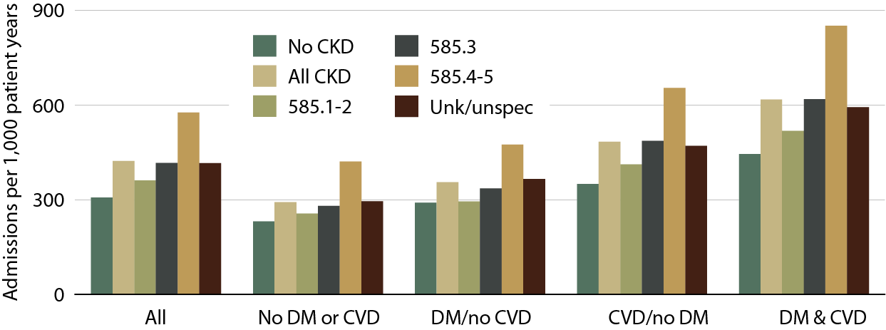
Adjusted hospitalization rates in Medicare patients, by comorbidity & CKD diagnosis code, 2011 Figure 3.2 (Volume 1)
January 1, 2011 point prevalent Medicare patients, age 66 & older on December 31, 2010. Adj: age/gender/race/prior hospitalization/comorbidity; rates by one factor are adjusted for the others. Ref: Medicare patients age 66 & older, 2011.

Slide 18
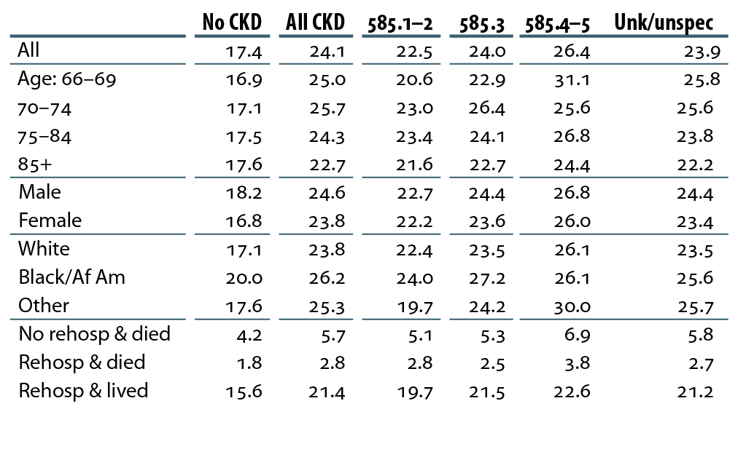
Percent live hospital discharges in CKD patients with an all-cause rehospitalization within 30 days, 2011 Table 3.b (Volume 1)
January 1, 2011 point prevalent Medicare patients, age 66 & older on December 31, 2010; unadjusted. Includes live hospital discharges from January 1 to December 1, 2011.

Slide 19
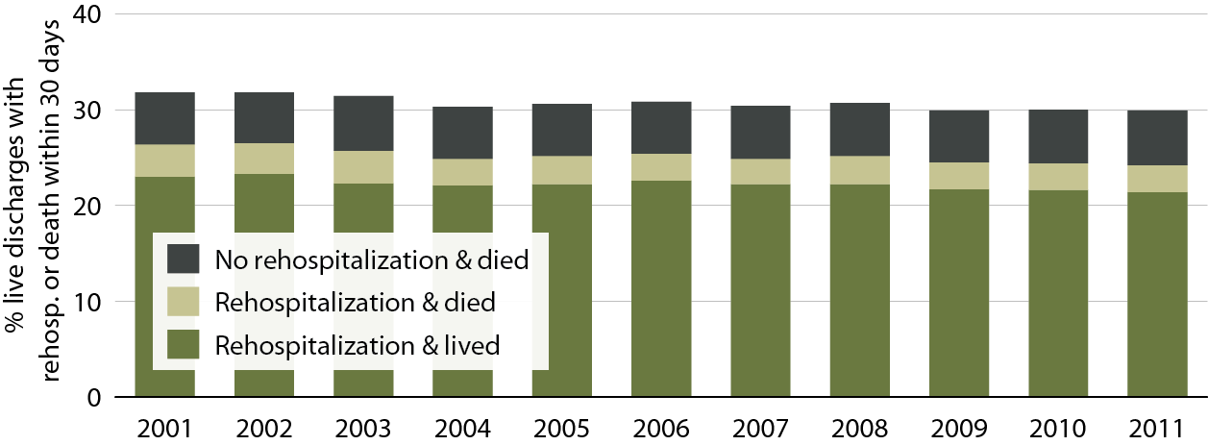
Adjusted all-cause rehospitalization or death 30 days after live hospital discharge in CKD patients Figure 3.8 (Volume 1)
Point prevalent Medicare CKD patients on January 1 of each year, age 66 & older on December 31 of the prior year. Adj: age/gender/race; ref: discharges in 2010. Includes discharges from January 1 to December 1 of each year.

Slide 20
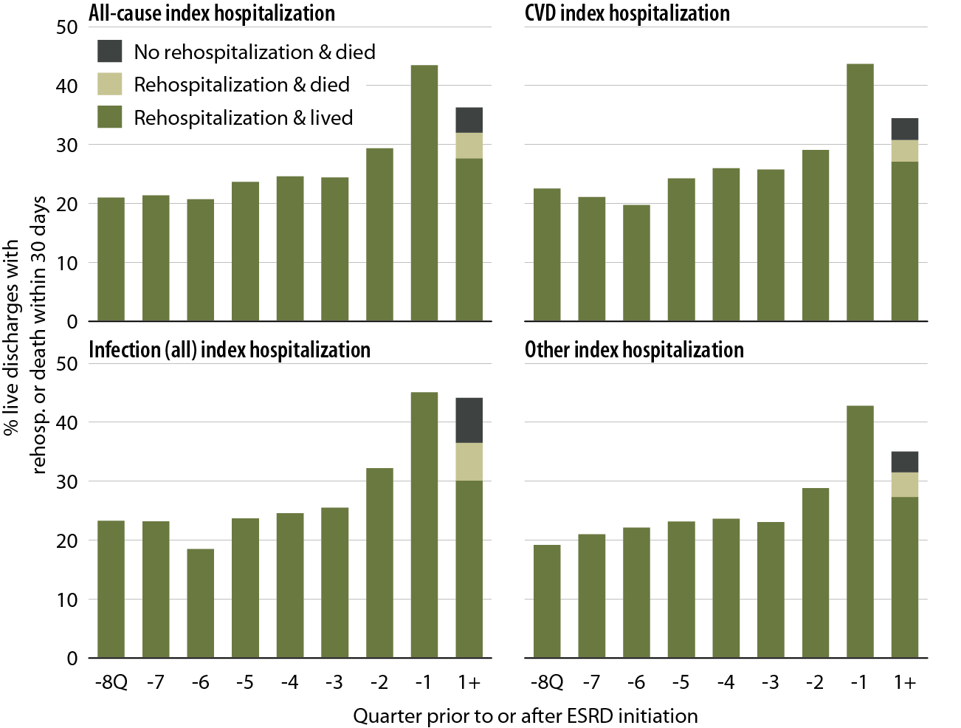
All-cause rehospitalization or death 30 days after live hospital discharge during the transition to ESRD, by cause-specific index hospitalization, 2011 Table 3.13 (Volume 1)
Incident ESRD patients, January 1 to October 1, 2011; age 67 or older, unadjusted.

Slide 21
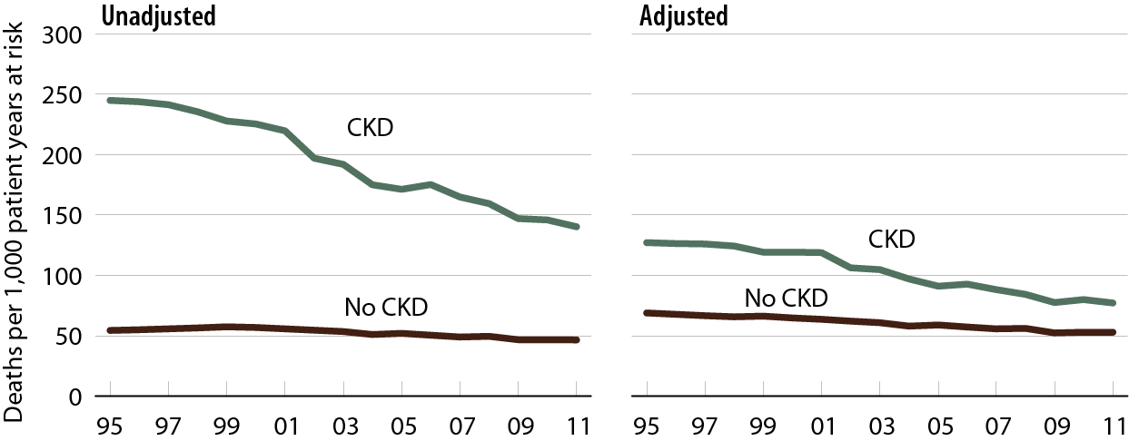
All-cause mortality rates in Medicare CKD & non-CKD patients Table 3.14 (Volume 1)
January 1 point prevalent Medicare patients age 66 & older. Adj: age/gender/race/prior hospitalization/comorbidities. Ref: 2010 patients.

Slide 22
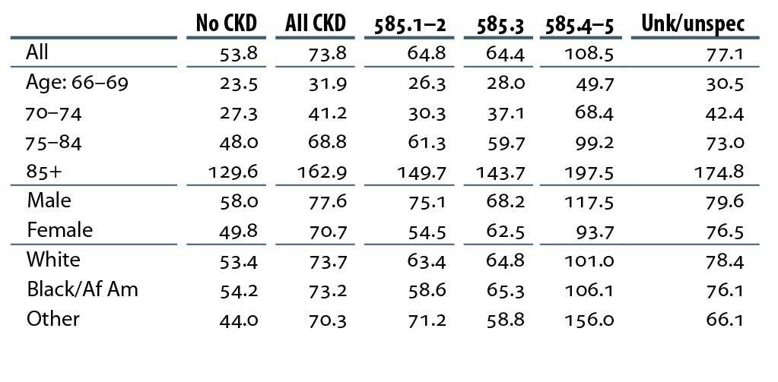
Adjusted mortality rates (per 1,000 patient years at risk) in Medicare patients, by CKD diagnosis code, 2011 Table 3.c (Volume 1)
January 1, 2011 point prevalent patients age 66 & older. Adj: age/gender/race/prior hospitalization/comorbidities. Ref: all patients, 2011.

Slide 23
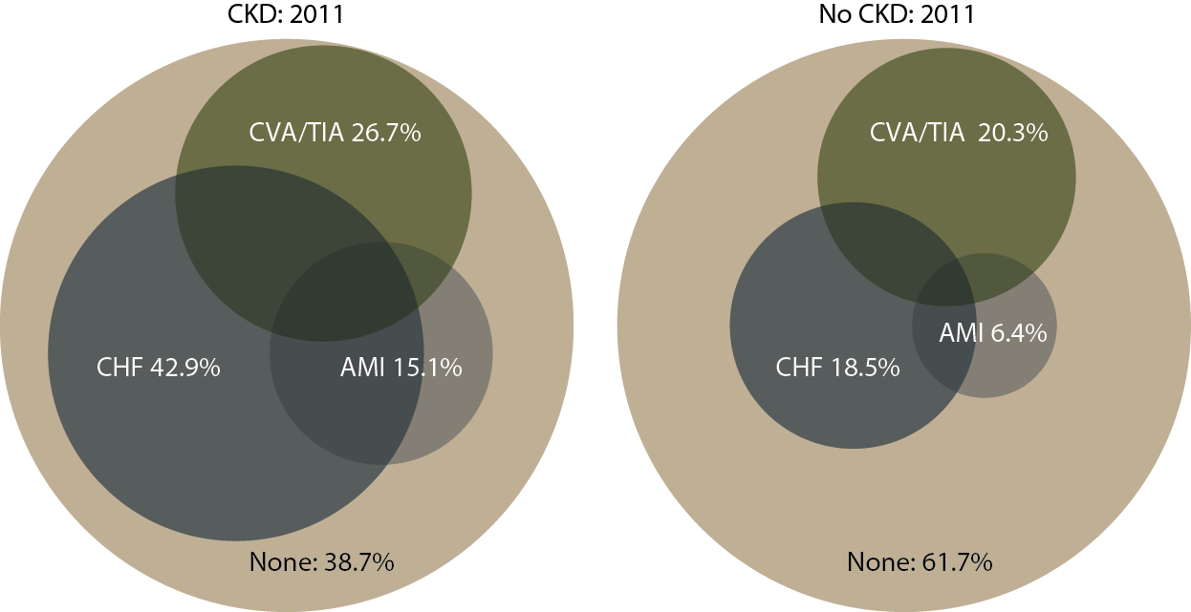
Cardiovascular disease in patients with or without CKD, 2011 Figure 4.1 (Volume 1)
December 31, 2011 point prevalent Medicare enrollees, age 66 & older, with fee-for-service coverage for the entire calendar year.

Slide 24
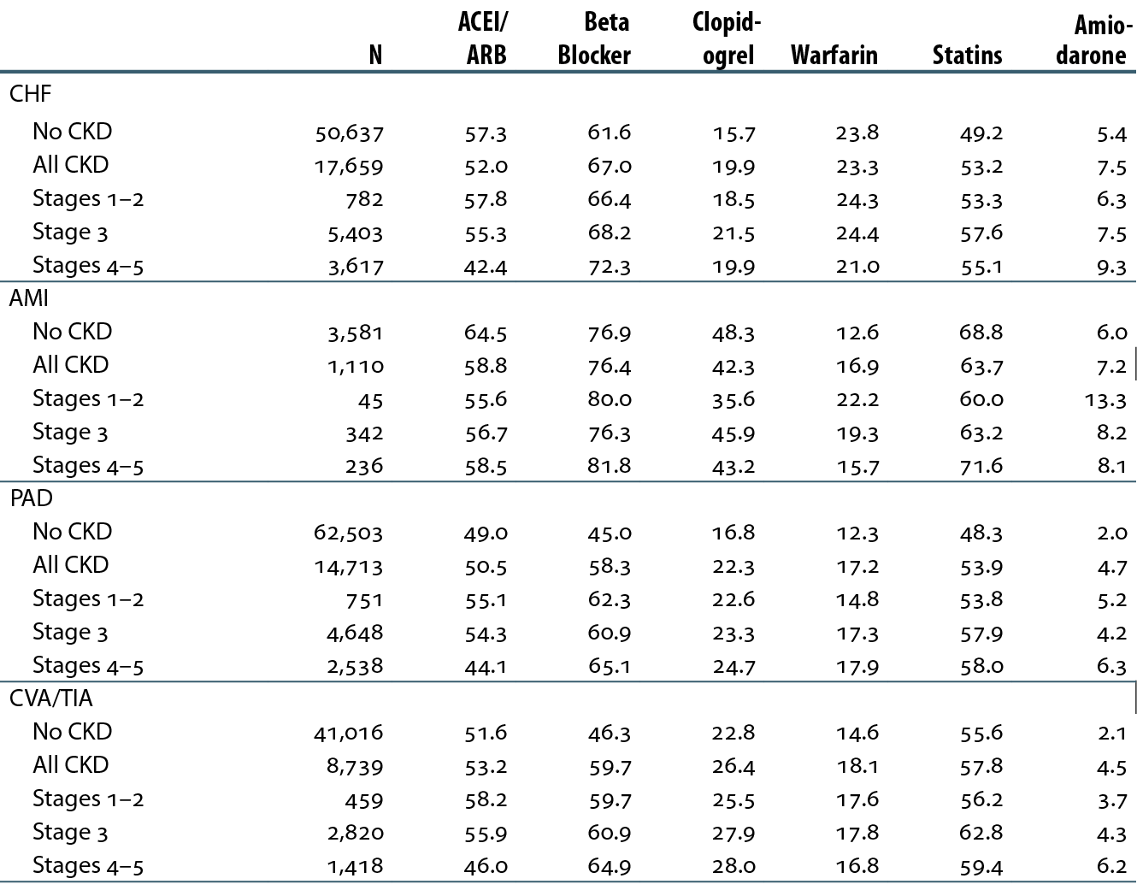
Cardiovascular disease & pharmacological interventions (row percent), by CKD status, 2011 Table 4.b (Volume 1)
January 1 point prevalent patients with Medicare Parts A, B, & D enrollment with a first cardiovascular diagnosis or procedure in 2011.

Slide 25
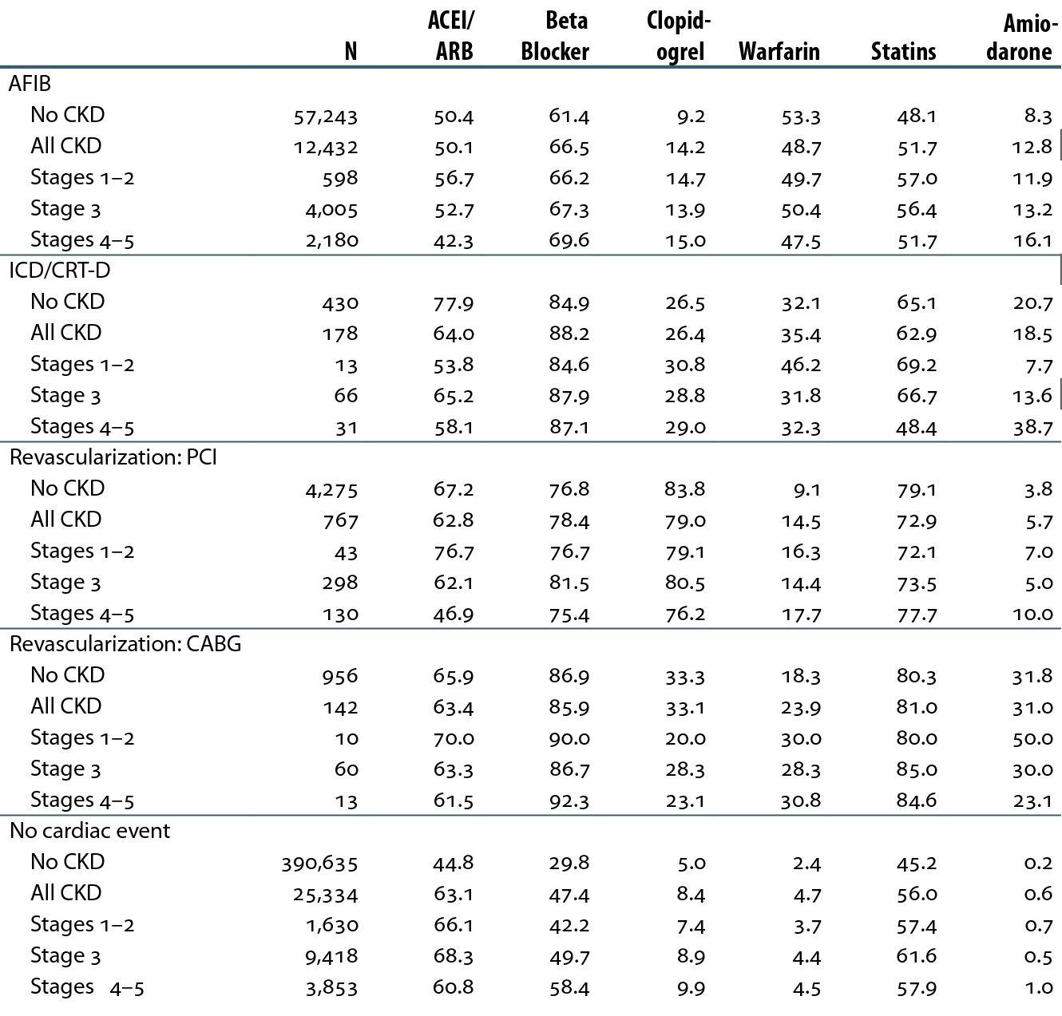
Cardiovascular disease & pharmacological interventions (row percent), by CKD status, 2011 Table 4.b (continued; Volume 1)
January 1 point prevalent patients with Medicare Parts A, B, & D enrollment with a first cardiovascular diagnosis or procedure in 2011.

Slide 26
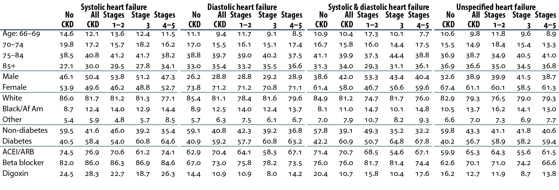
Characteristics of patients with heart failure, by CKD status, 2011 Table 4.c (Volume 1)
December 31 point prevalent patients with Medicare Parts A, B, & D enrollment, 2011.

Slide 27
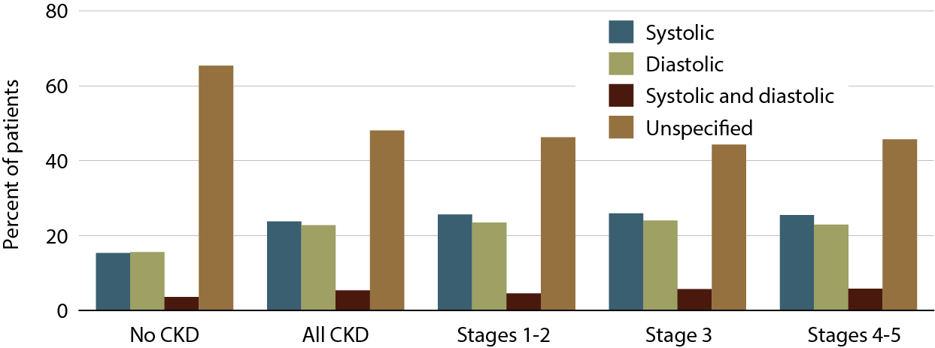
Heart failure in patients with or without CKD, 2011 Figure 4.6 (Volume 1)
December 31 point prevalent patients with Medicare Parts A, B, & D enrollment, 2011.

Slide 28
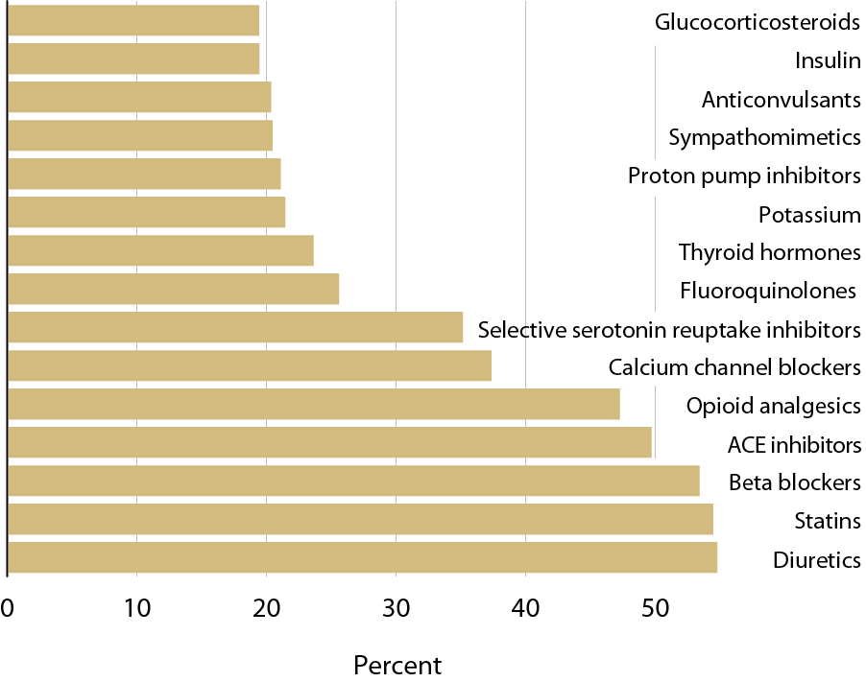
Top 15 drug classes used by Part D enrollees with CKD, by percent of patients & drug class, 2011 Figure 5.1 (Volume 1)
CKD patients in the Medicare 5 percent sample.

Slide 29
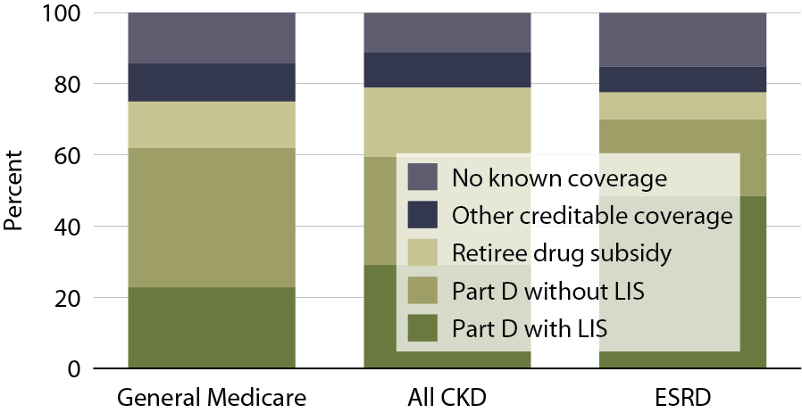
Sources of prescription drug coverage in Medicare enrollees, by population, 2011 Figure 5.2 (Volume 1)
Point prevalent Medicare enrollees alive on January 1, 2011.

Slide 30
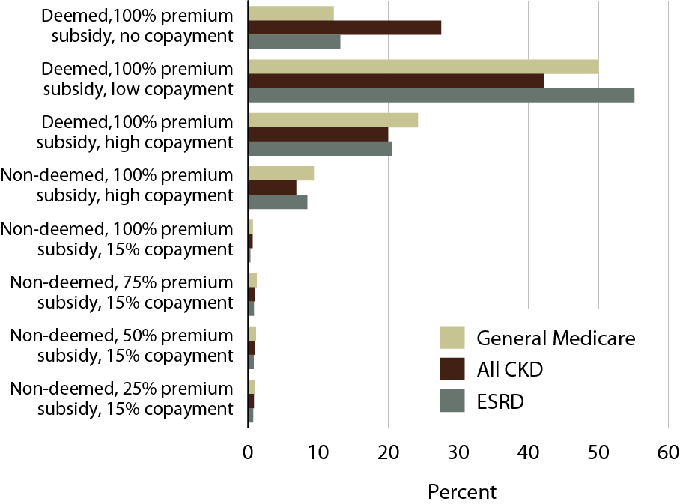
Distribution of low income subsidy (LIS) categories in Part D general Medicare, CKD, & ESRD patients, 2011 Figure 5.5 (Volume 1)
Point prevalent Medicare enrollees alive on January 1, 2011.

Slide 31
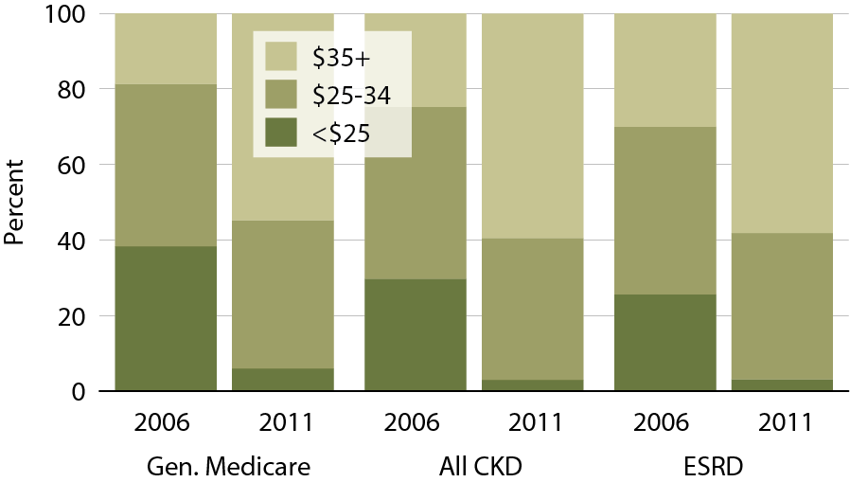
Part D non-LIS enrollees with specified monthly premium, 2006 & 2011 Figure 5.6 (Volume 1)
Point prevalent Medicare enrollees alive on January 1, excluding those in Medicare Advantage Part D plans.

Slide 32
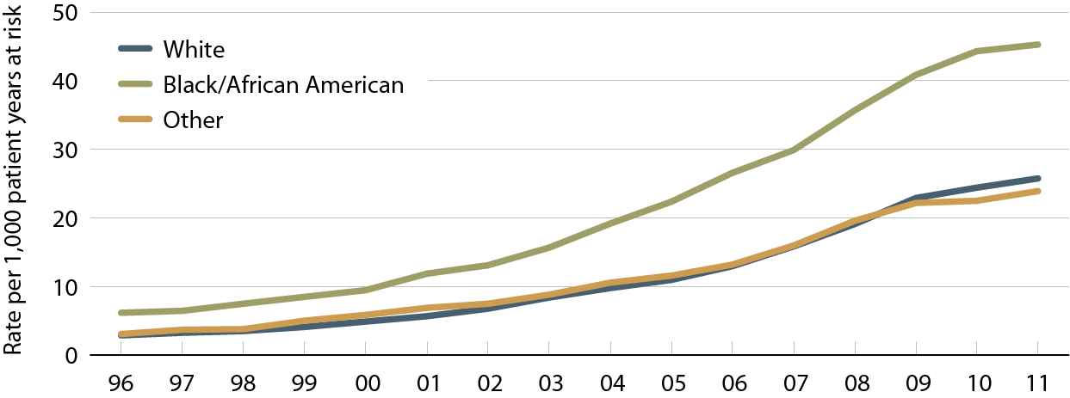
Unadjusted rates of first AKI within the cohort year among Medicare patients age 66 & older, by race Figure 6.4 (Volume 1)
Medicare patients age 66 & older.

Slide 33
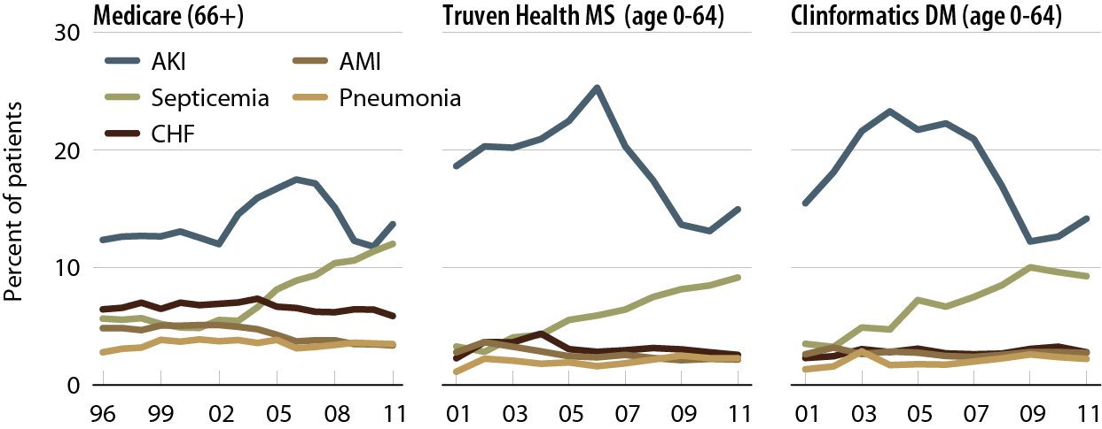
Principal diagnosis code on AKI claim, by dataset Figure 6.6 (Volume 1)
Medicare AKI patients age 66 & older, & Truven Health MarketScan & Clinformatics DataMart AKI patients age 0–64.

Slide 34
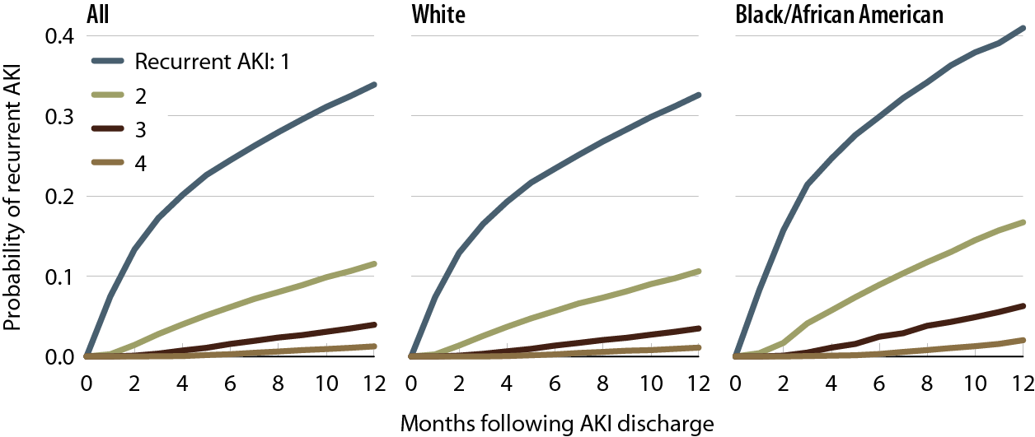
Probability of a recurrent AKI hospitalization in Medicare patients, by number of events & race, 2010–2011 Figure 6.9 (Volume 1)
Medicare AKI patients age 66 & older, 2010–2011.

Slide 35
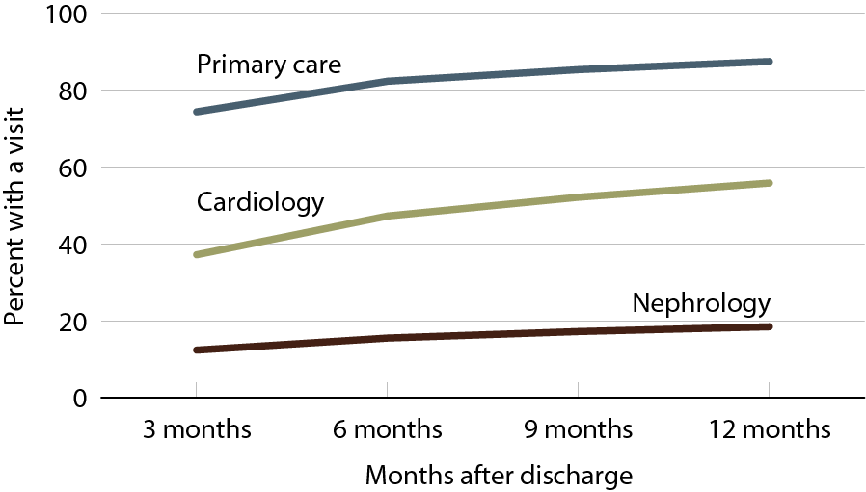
Outpatient physician visits following initial AKI discharge, 2010–2011 Figure 6.13 (Volume 1)
Medicare AKI patients age 66 & older, 2010-2011.

Slide 36
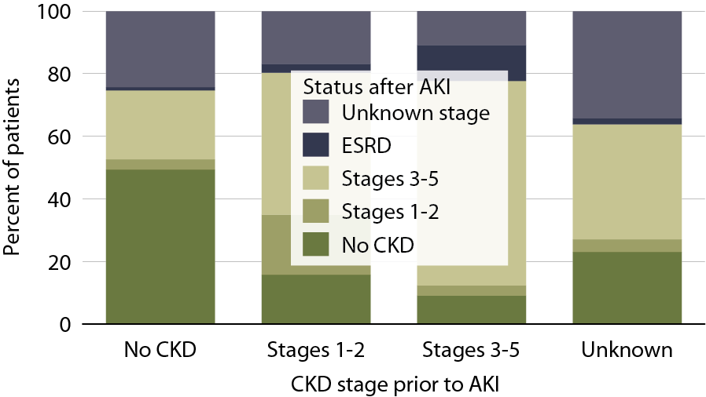
Changes to CKD status following an AKI in Medicare patients, 2010-2011 Figure 6.21 (Volume 1)
Medicare AKI patients age 66 & older, 2010–2011.

Slide 37
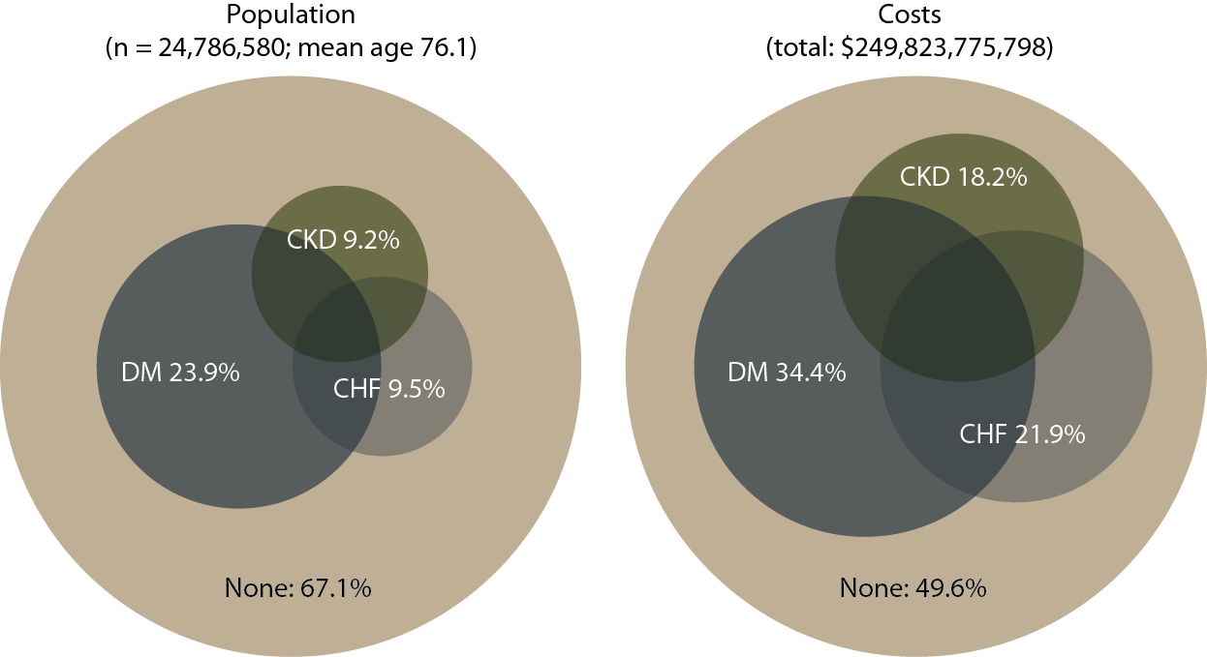
Point prevalent distribution & annual costs of Medicare (fee-for-service) patients, age 65 & older, with diagnosed diabetes, CHF, & CKD, 2011 Figure 7.1 (Volume 1)
Populations estimated from the 5 percent Medicare sample using a point prevalent model. Population further restricted to patients age 65 & older, without ESRD. Diabetes, CHF, & CKD determined from claims; costs are for calendar year 2011.

Slide 38
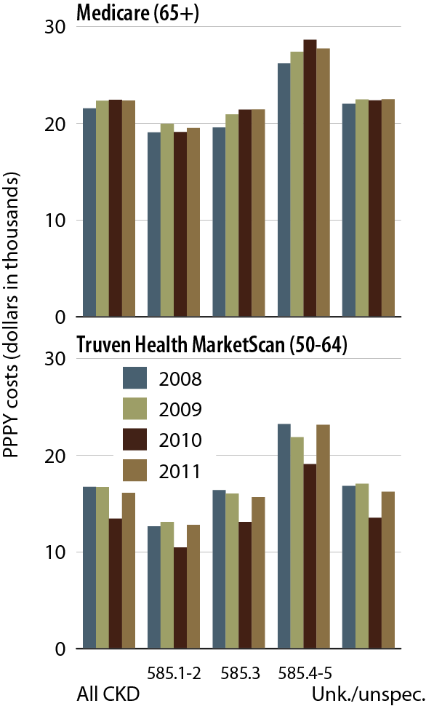
Overall PPPY costs in CKD patients, by CKD diagnosis code, dataset, & year Figure 7.2 (Volume 1)
Point prevalent Medicare patients age 65 & older (5 percent Medicare sample, 7.2–4) & Truven Health MarketScan patients age 50–64 (7.2). Includes Part D.

Slide 39
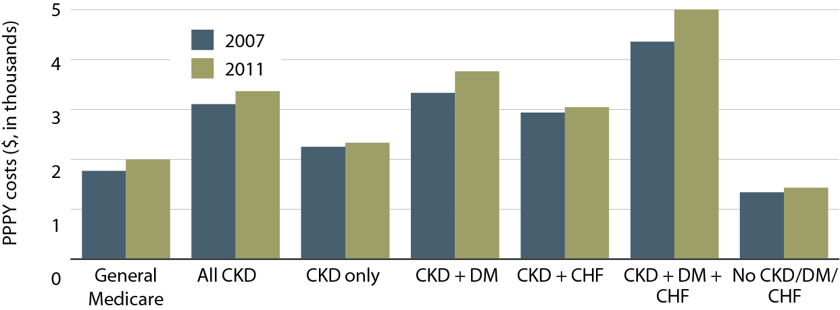
Total per person per year (PPPY) Part D costs, by at-risk group, 2007 & 2011 Figure 7.13 (Volume 1)
Point prevalent Medicare CKD patients age 65 & older, 2011

Slide 40
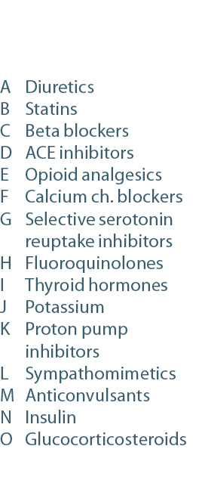
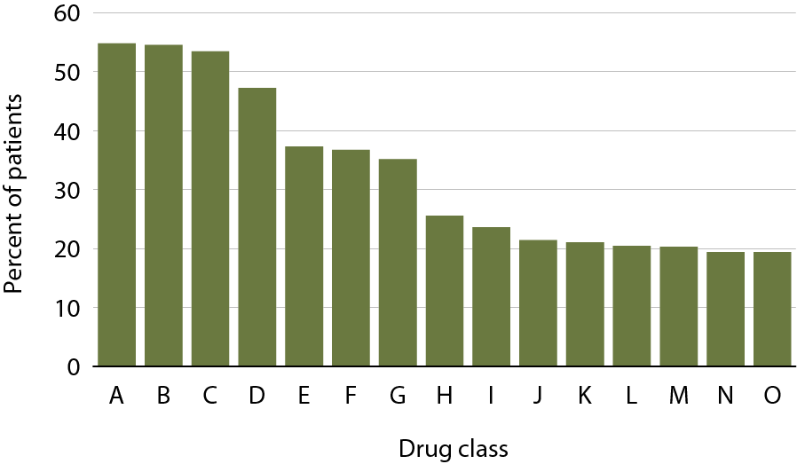
Top 15 drug classes used by Part D enrollees with CKD, by percent of patients & drug class, 2011 Figure 7.17 (Volume 1)
Medicare patients with CKD; costs scaled up by a factor of 20 to estimate totals.

Slide 41
Top 15 drugs used by Part D enrollees with CKD, by percent of patients & net cost, 2011 Figure 7.b (Volume 1)
Medicare patients with CKD; costs scaled up by a factor of 20 to estimate totals.

Slide 42
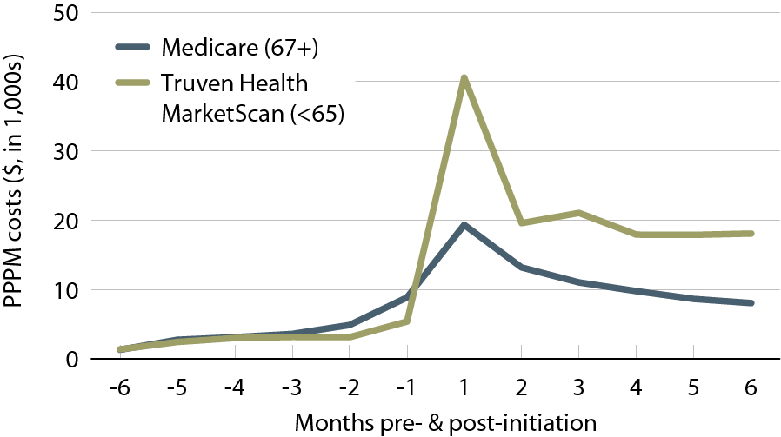
Per person per month (PPPM) expenditures during the transition to ESRD, by dataset, 2011 Figure 7.19 (Volume 1)
Incident Medicare (age 67 & older) & Truven Health MarketScan (younger than 65) ESRD patients, initiating in 2008.

