Slide 1
CKD: Chapter One
CKD in the
general population
United States Renal Data System
2013 Annual Data Report

Slide 2
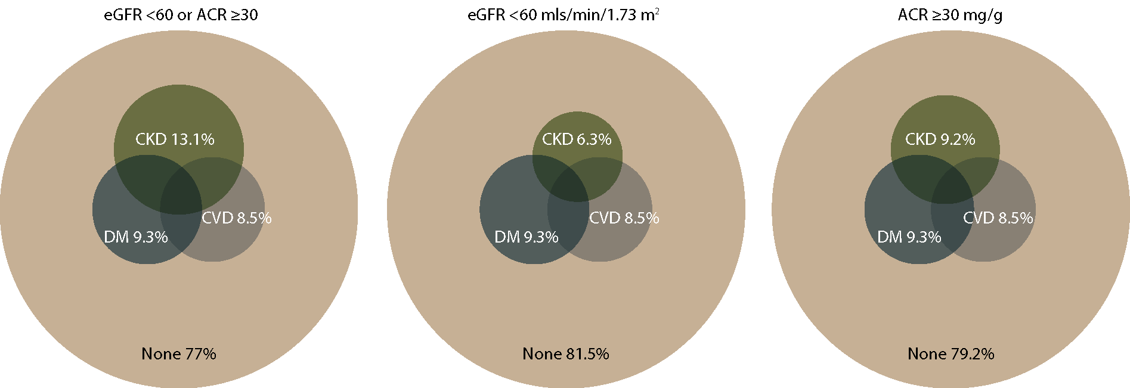
Distribution of NHANES 2005–2010 participants with diabetes, cardiovascular disease,
& single-sample markers of CKD
Figure 1.1 (Volume 1)
NHANES participants 2005–2010, age 20 & older; single-sample estimates of eGFR & ACR.

Slide 3
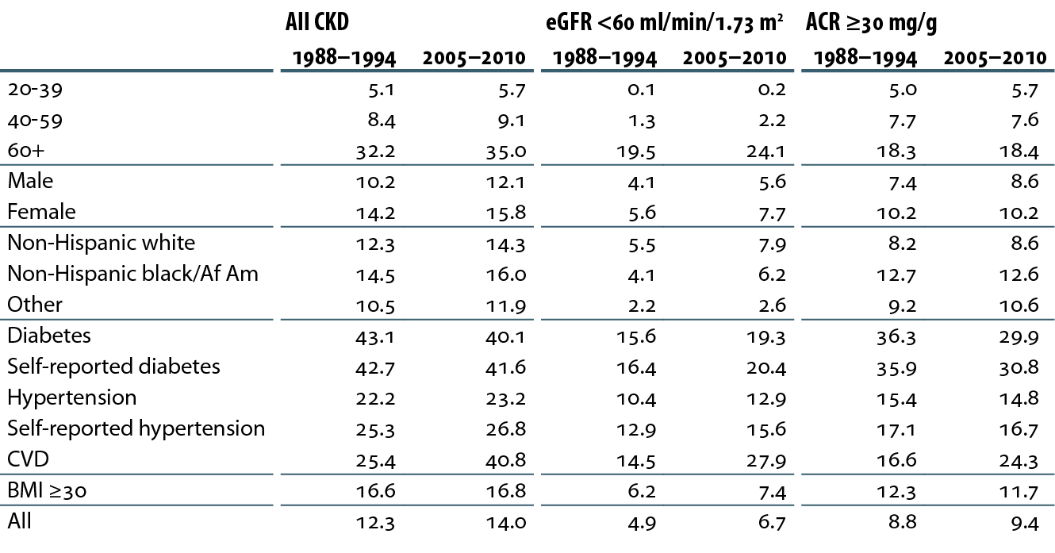
Prevalence (%) of CKD in the NHANES population within age, gender, race/ethnicity, & risk factor categories
Table 1.a (Volume 1)
NHANES 1988–1994 & 2005–2010 participants age 20 & older; single-sample estimates of eGFR & ACR. eGFR calculated using the CKD-EPI equation. eGFR calculated using the CKD-EPI equation.

Slide 4
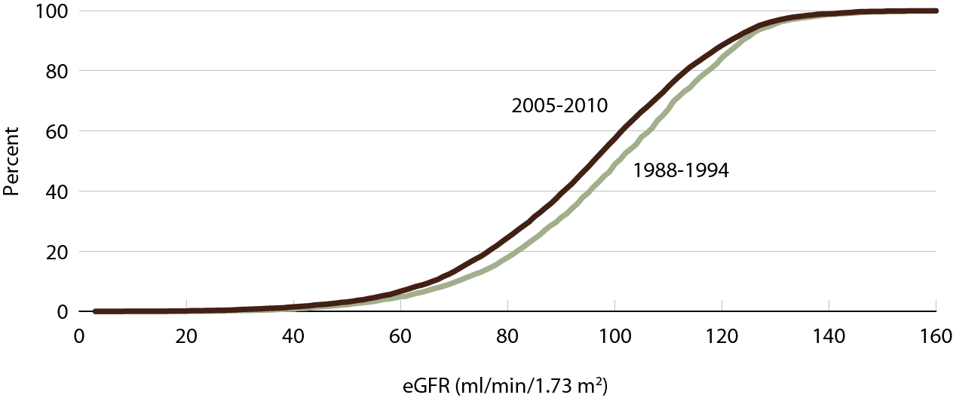
Cumulative eGFR distribution curves of NHANES participants
Figure 1.2 (Volume 1)
NHANES 1988–1994 & 2005–2010 participants age 20 & older; single-sample estimates of eGFR. eGFR calculated using the CKD-EPI equation. eGFR calculated using the CKD-EPI equation.

Slide 5
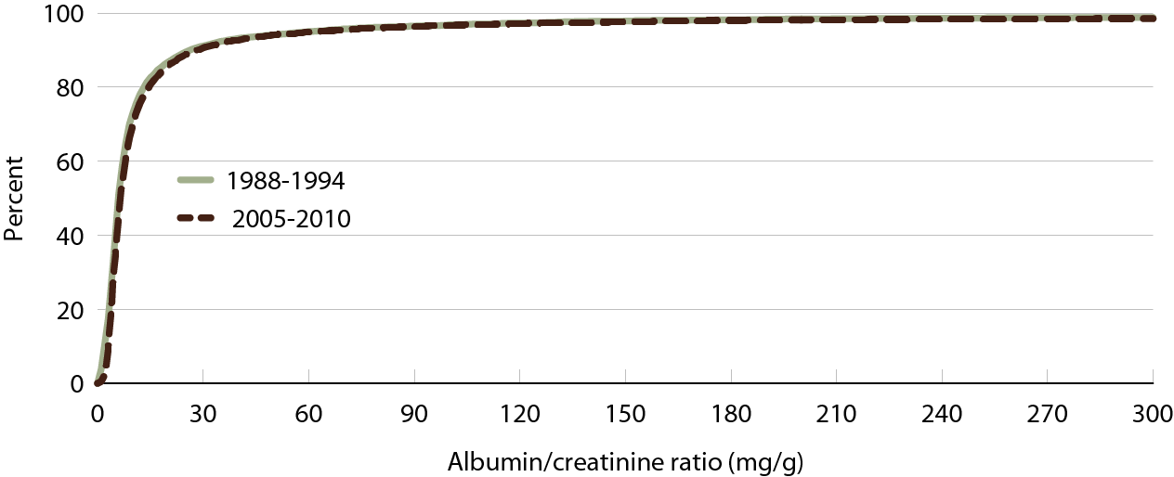
Cumulative urine albumin/creatinine ratio (ACR) distribution curves of
NHANES participants
Figure 1.3 (Volume 1)
NHANES 1988–1994 & 2005–2010 participants age 20 & older; single-sample estimates of ACR.

Slide 6
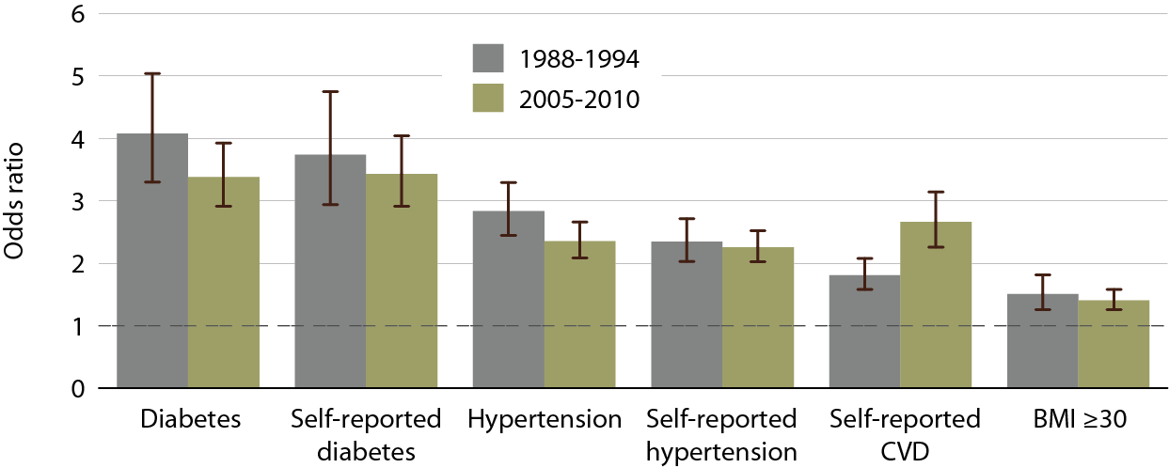
Adjusted odds ratios of CKD in
NHANES participants, by risk factor
Figure 1.4 (Volume 1)
NHANES 1988-1994 & 2005-2010 participants age 20& older; single sample estimates of eGFR and ACR. Adjusted: age, gender, race; eGFR calculated using CKD-EPI equation.

Slide 7
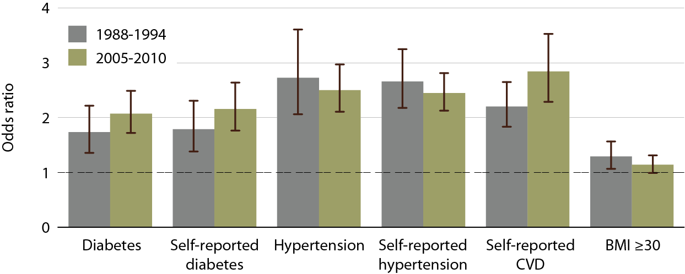
Adjusted odds ratios of spot eGFR
<60 ml/min/1.73 m² in NHANES participants, by risk factor
Figure 1.5 (Volume 1)
NHANES 1988-1994 & 2005-2010 participants age 20& older; single sample estimates of eGFR and ACR. Adjusted: age, gender, race; eGFR calculated using CKD-EPI equation.

Slide 8
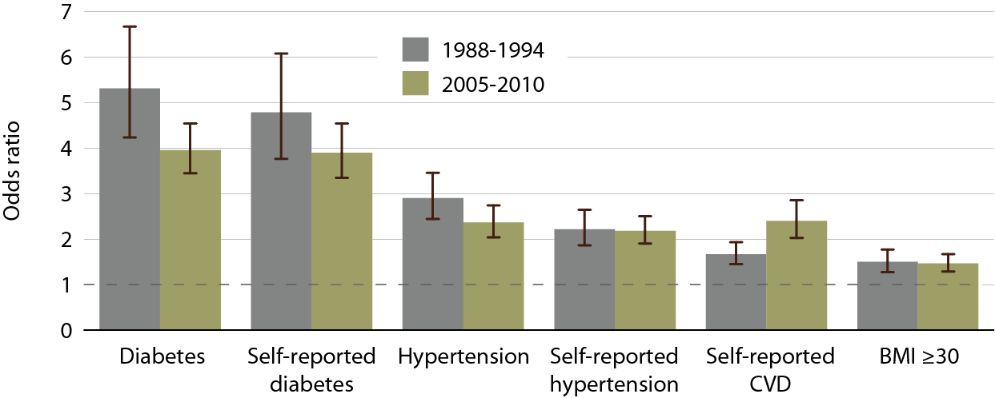
Adjusted odds ratios of spot urine albumin/ creatinine ratio (ACR) ≥30 mg/g in
NHANES participants, by risk factor
Figure 1.6 (Volume 1)
NHANES 1988-1994 & 2005-2010 participants age 20& older; single sample estimates of eGFR and ACR. Adjusted: age, gender, race; eGFR calculated using CKD-EPI equation.

Slide 9
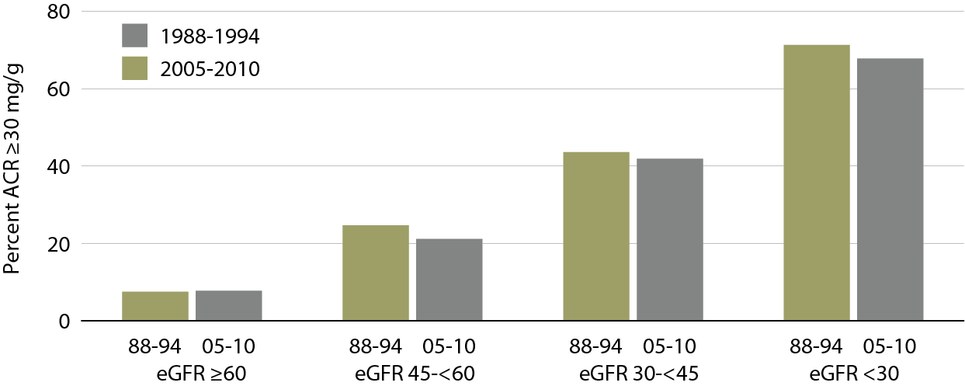
NHANES participants with spot urine albumin/creatinine ratio (ACR)
≥ 30 mg/g, by spot eGFR range
Figure 1.7 (Volume 1)
NHANES 1988–1994 & 2005–2010 participants age 20 & older; single sample estimates of eGFR & ACR.

Slide 10
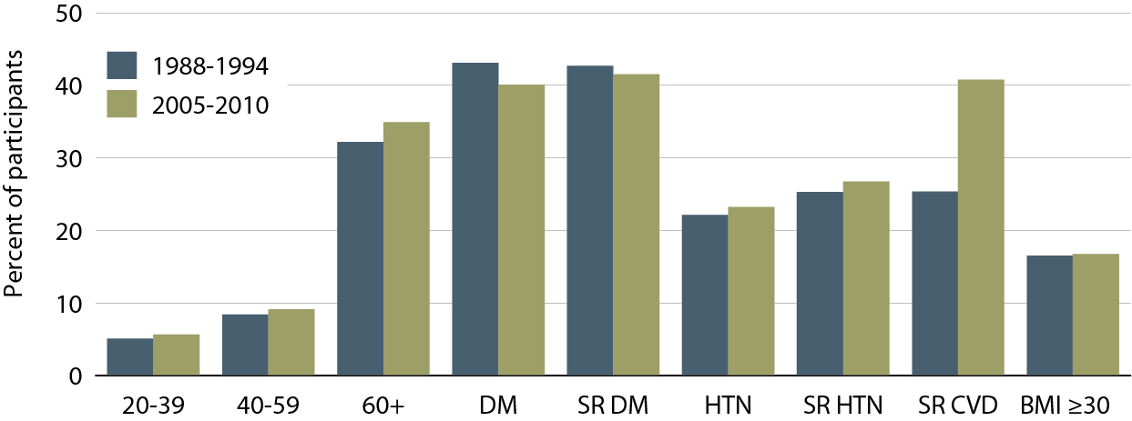
NHANES participants with
CKD, by age & risk factor
Figure 1.8 (Volume 1)
NHANES 1988–1994 & 2005–2010 participants age 20 & older; single sample estimates of eGFR & ACR. Diabetes defined as A1c <7 percent, self-reported (SR), or currently taking glucose-lowering medications. Hypertension defined as BP ≥130/≥80 for those with diabetes or CKD, otherwise BP ≥140/≥90, or taking medication for hypertension. eGFR calculated using the CKD-EPI equation.

Slide 11
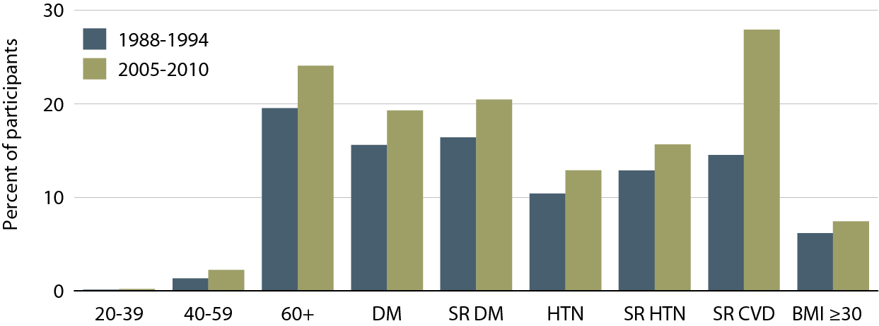
NHANES participants with spot eGFR < 60 ml/min/1.73 m², by age & risk factor
Figure 1.9 (Volume 1)
NHANES 1988–1994 & 2005–2010 participants age 20 & older; single sample estimates of eGFR & ACR. Diabetes defined as A1c <7 percent, self-reported (SR), or currently taking glucose-lowering medications. Hypertension defined as BP ≥130/≥80 for those with diabetes or CKD, otherwise BP ≥140/≥90, or taking medication for hypertension. eGFR calculated using the CKD-EPI equation.

Slide 12
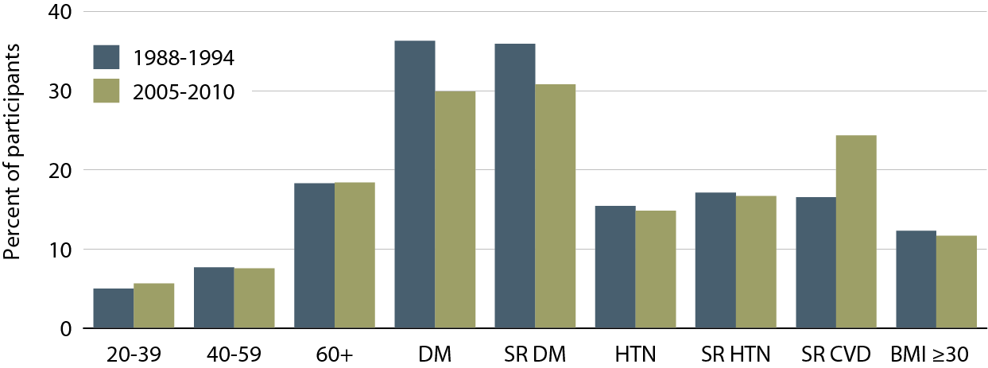
NHANES participants with spot urine albumin/creatinine ratio (ACR)
≥30 mg/g, by age & risk factor
Figure 1.10 (Volume 1)
NHANES 1988–1994 & 2005–2010 participants age 20 & older; single sample estimates of eGFR & ACR. Diabetes defined as A1c <7 percent, self-reported (SR), or currently taking glucose-lowering medications. Hypertension defined as BP ≥130/≥80 for those with diabetes or CKD, otherwise BP ≥140/≥90, or taking medication for hypertension. eGFR calculated using the CKD-EPI equation.

Slide 13
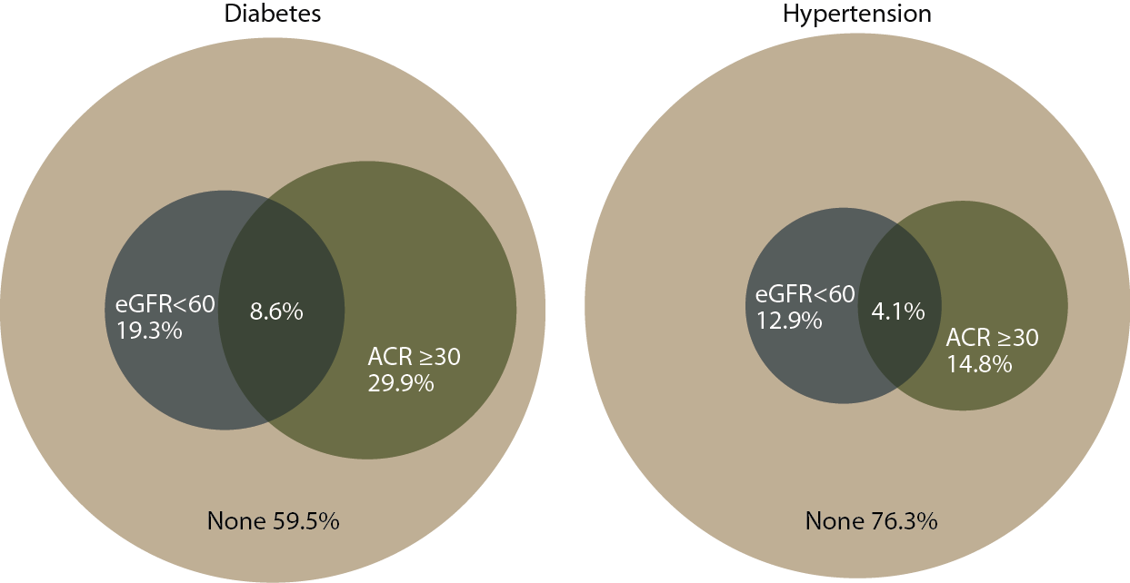
Distribution of markers of CKD in
NHANES participants with diabetes
& hypertension, 2005–2010
Figure 1.11 (Volume 1)
NHANES 1988–1994 & 2005–2010 participants age 20 & older; single sample estimates of eGFR & ACR. eGFR calculated using the CKD-EPI equation.

Slide 14
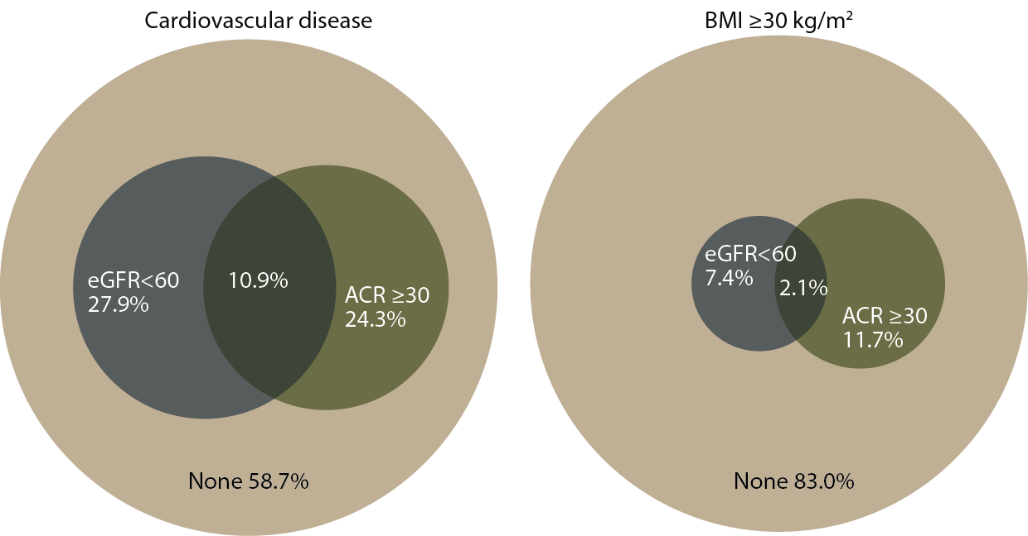
Distribution of markers of CKD in
NHANES participants with cardiovascular disease & obesity, 2005–2010
Figure 1.11 (continued, Volume 1)
NHANES 1988–1994 & 2005–2010 participants age 20 & older; single sample estimates of eGFR & ACR. eGFR calculated using the CKD-EPI equation.

Slide 15
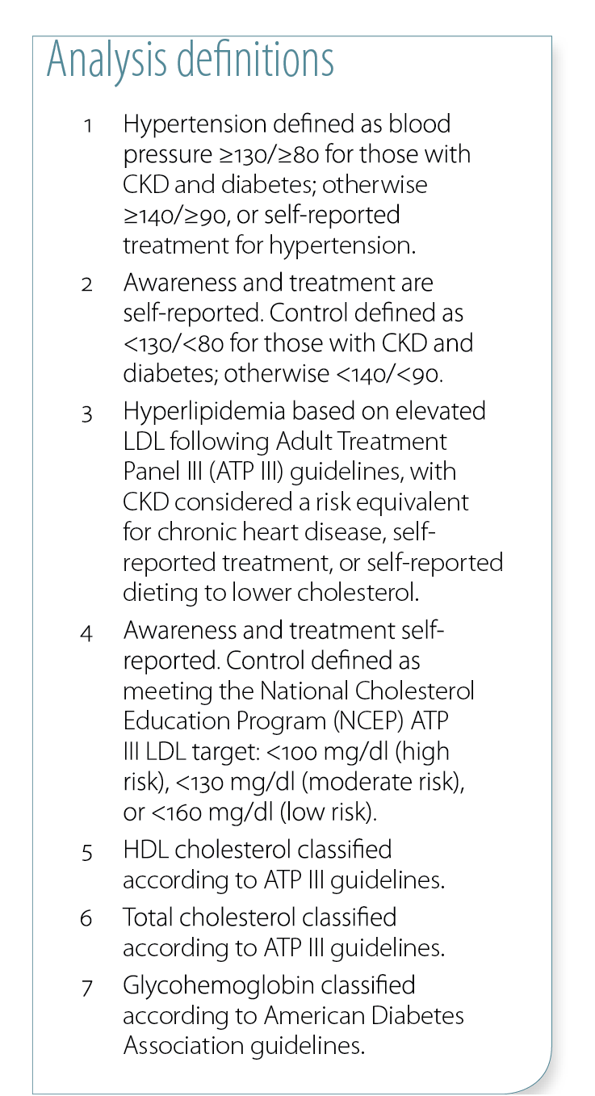
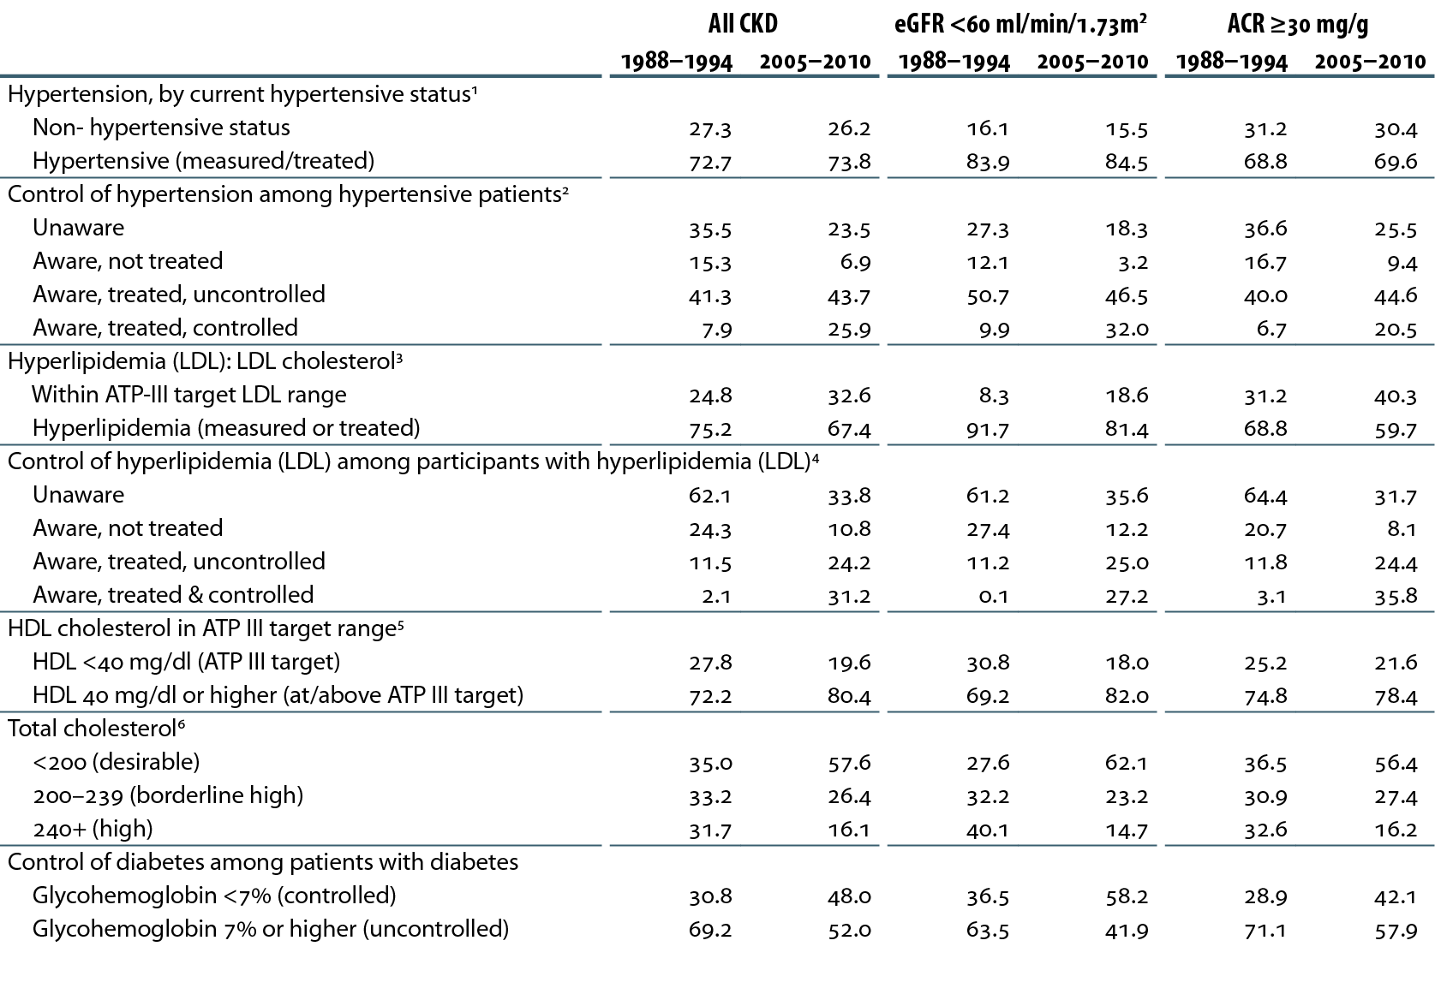
Awareness, treatment, & control of hypertension, hyperlipidemia,
HDL, total cholesterol, & diabetes
Table 1.b (Volume 1)
NHANES 1988–1994 & 2005–2010 participants age 20 & older; single sample estimates of eGFR & ACR. eGFR calculated using the CKD-EPI equation.

Slide 16
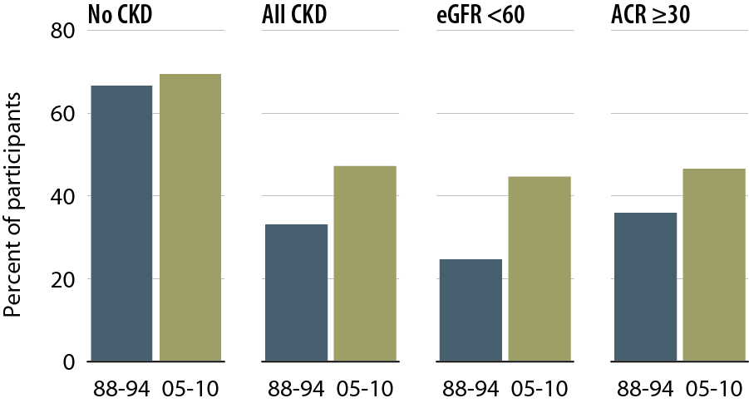
NHANES participants at target blood pressure
Figure 1.12 (Volume 1)
NHANES 1988–1994 & 2005–2010 participants age 20 & older; single sample estimates of eGFR & ACR; dialysis patients excluded from NHANES 2005–2010. eGFR calculated using the CKD-EPI equation. This figure cannot be directly compared to values in Table 1.b. The table represents NHANES participants who are classified as hypertensive (measured/treated) but some of those are at target blood pressure. Represents all hypertensives plus those hypertensives who are at target blood pressure probably due to medication.

Slide 17
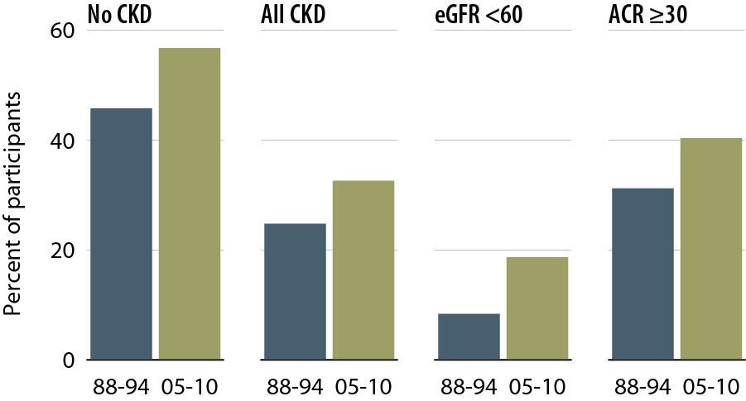
NHANES participants within
LDL cholesterol target range
Figure 1.13 (Volume 1)
NHANES 1988–1994 & 2005–2010 participants age 20 & older; single sample estimates of eGFR & ACR; dialysis patients excluded from NHANES 2005–2010. eGFR calculated using the CKD-EPI equation.

Slide 18
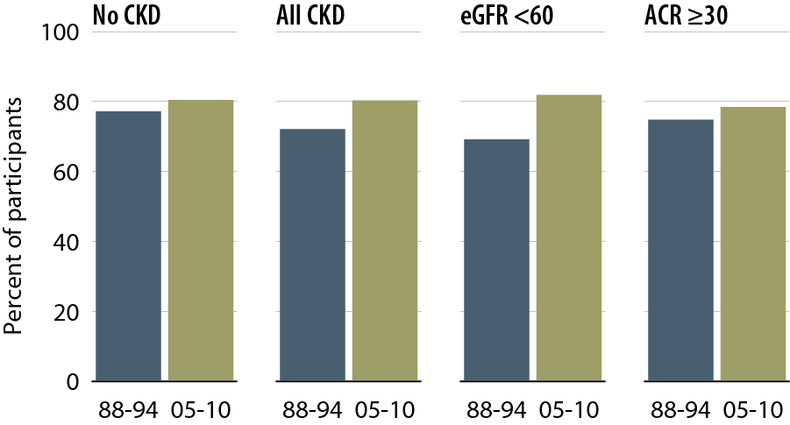
NHANES participants within
HDL cholesterol target range
Figure 1.14 (Volume 1)
NHANES 1988–1994 & 2005–2010 participants age 20 & older; single sample estimates of eGFR & ACR; dialysis patients excluded from NHANES 2005–2010. eGFR calculated using the CKD-EPI equation.

Slide 19
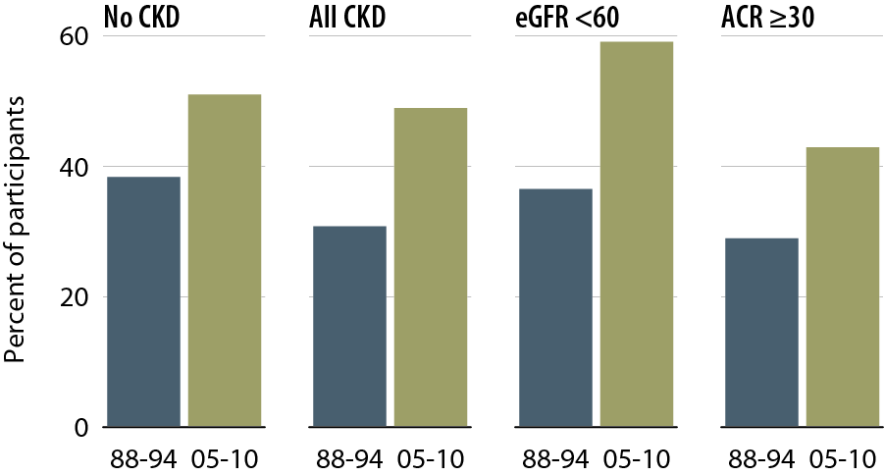
NHANES participants with glycohemoglobin <7%
Figure 1.15 (Volume 1)
NHANES 1988–1994 & 2005–2010 participants age 20 & older; single sample estimates of eGFR & ACR; dialysis patients excluded from NHANES 2005–2010. eGFR calculated using the CKD-EPI equation.

Slide 20
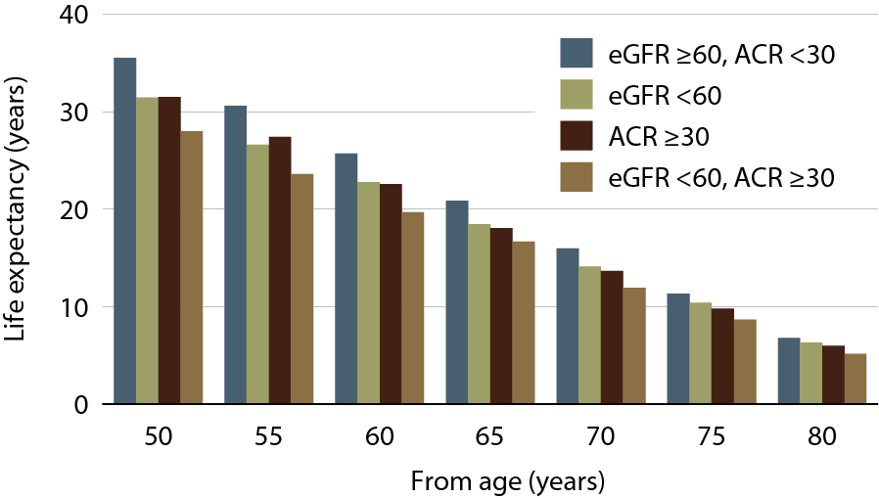
Life expectancy of NHANES participants with or without CKD, 1999–2004
Figure 1.16 (Volume 1)
NHANES 1999–2004 participants age 20 & older; single sample estimates of eGFR & ACR. eGFR calculated using the CKD-EPI equation.

