Slide 1
CKD: Chapter Two Identification & care of patients with CKD
United States Renal Data System
2013 Annual Data Report

Slide 2
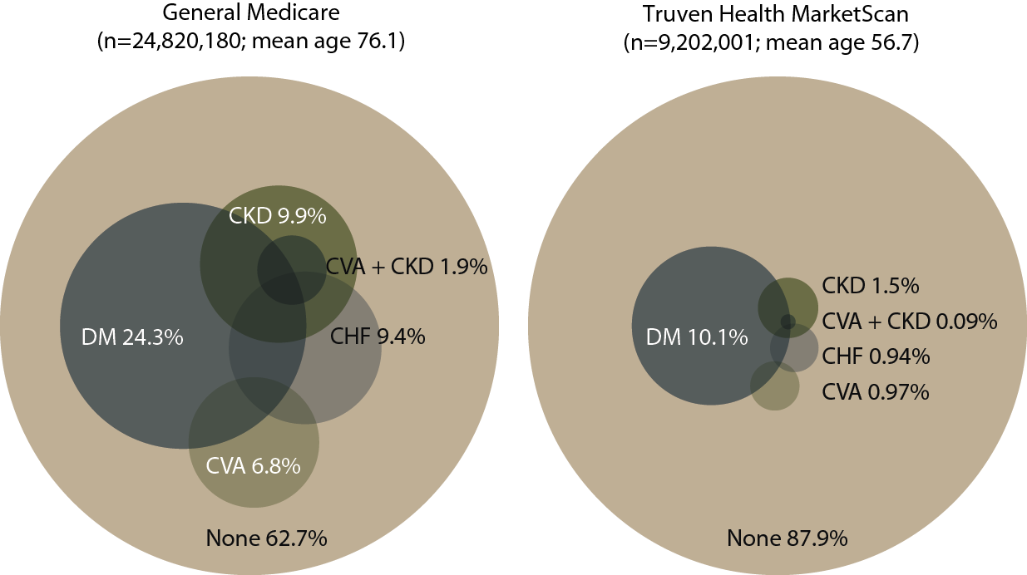
Distribution of point prevalent general Medicare (age 65 & older) & Truven Health MarketScan (age 50–64) patients with coded diabetes, CKD, CHF, & CVA, 2011 Figure 2.1 (Volume 1)
Point prevalent general (fee-for-service) Medicare patients age 65 & older; point prevalent Truven Health MarketScan patients age 50–64. Diabetes, CKD, CHF, & CVA determined from claims.

Slide 3
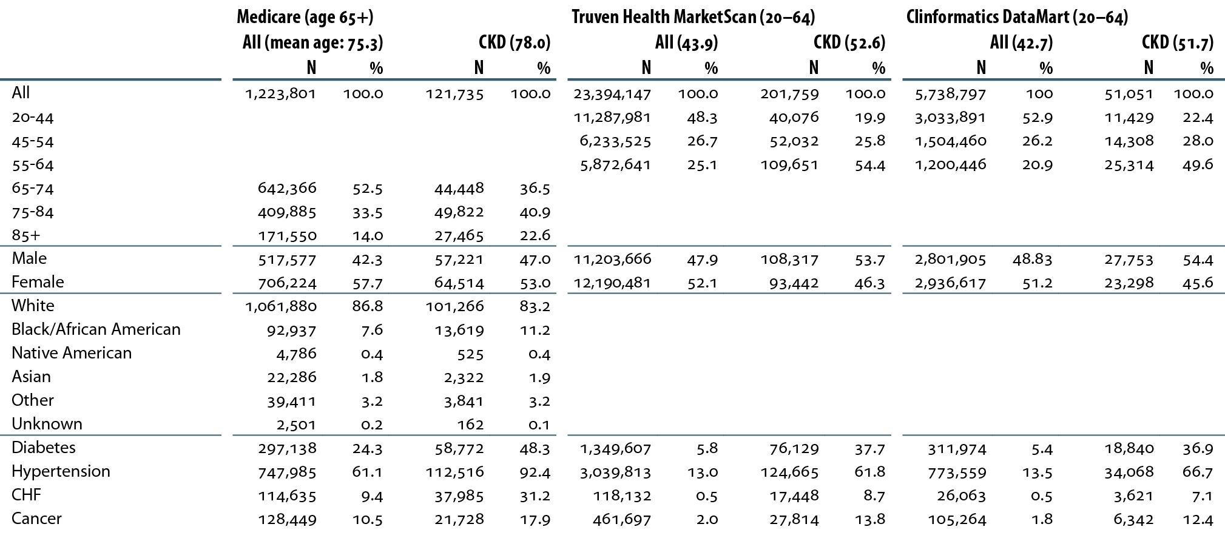
Descriptive parameters of CKD datasets, by age, gender, race, & coded comorbidity, 2011 Table 2.a (Volume 1)
Period prevalent patients, 2011, without ESRD, age 65 & older (Medicare) & <65 (Truven Health MarketScan & Clinformatics DataMart).

Slide 4
Prevalence (%) of recognized CKD, by dataset & age Table 2.b (Volume 1)
Prevalent patients surviving cohort year without ESRD, age 65 & older (Medicare) & age <65 (Truven Health MarketScan & Clinformatics DataMart).

Slide 5
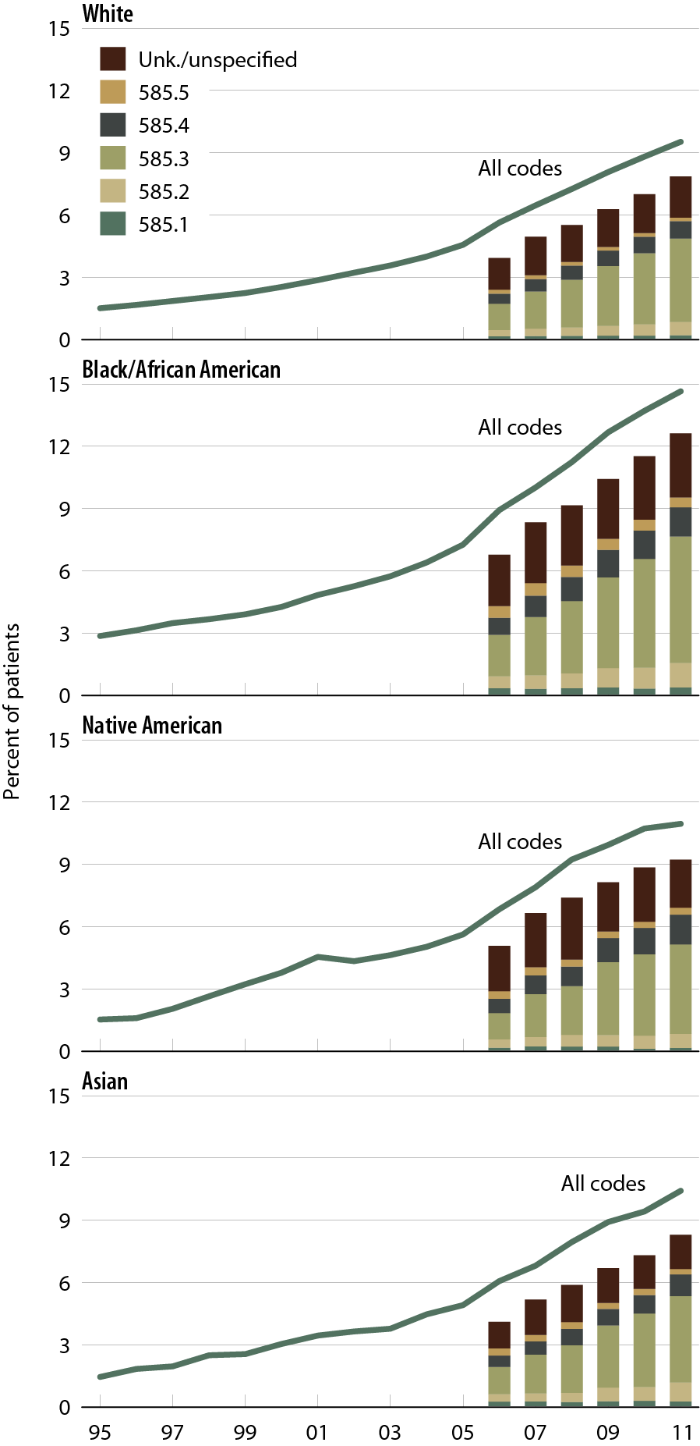
Trends in CKD prevalence: Medicare patients age 65 & older, by race Figure 2.2 (Volume 1)
Prevalent patients surviving cohort year, without ESRD, age 65 & older .

Slide 6
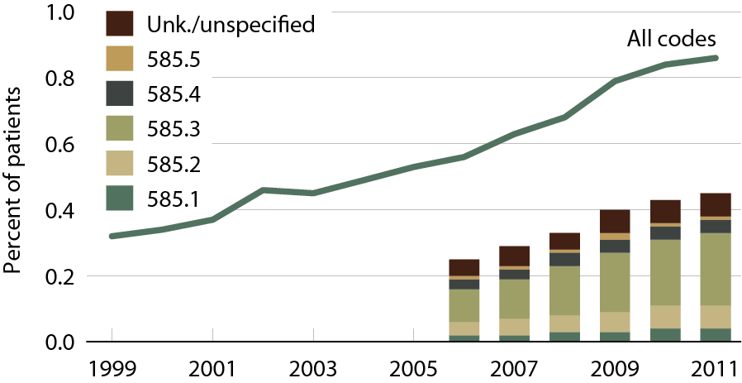
Trends in CKD prevalence: Truven Health MarketScan patients age 20–64 Figure 2.3 (Volume 1)
Prevalent patients surviving cohort year, without ESRD, age 20–64.

Slide 7
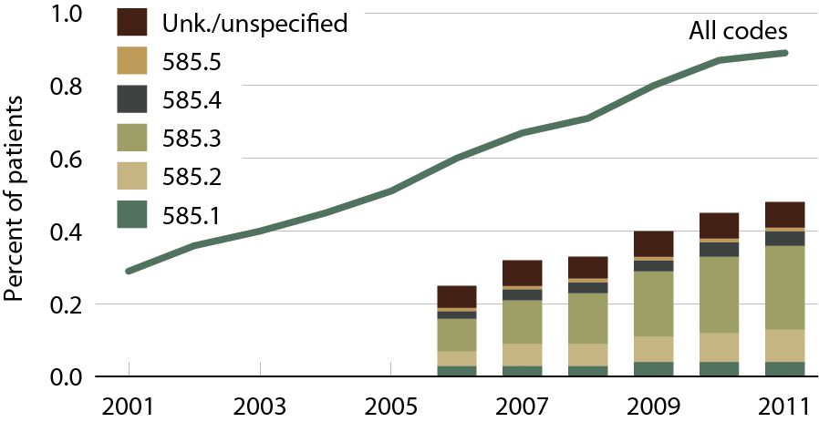
Trends in CKD prevalence: Clinformatics DataMart patients age 20–64 Figure 2.4 (Volume 1)
Prevalent patients surviving cohort year, without ESRD, age 20–64.

Slide 8
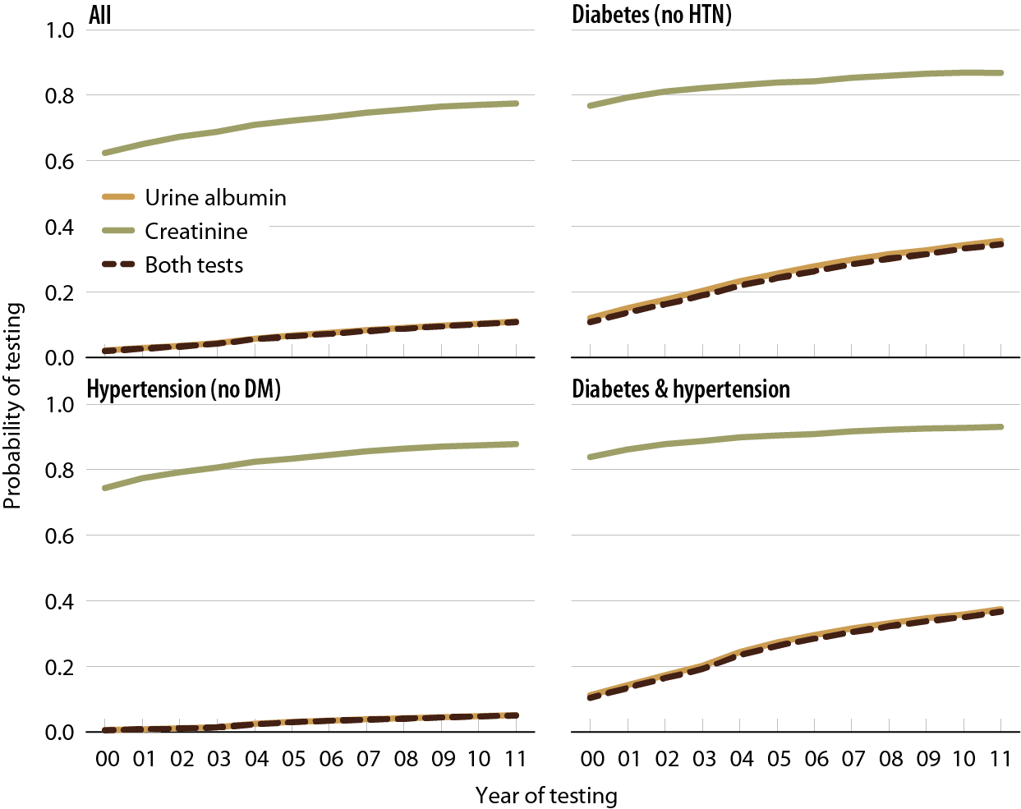
Probability of urine albumin & creatinine testing in Medicare patients at risk for CKD Figure 2.5 (Volume 1)
Medicare patients from the 5 percent sample, age 20 & older, with Parts A & B coverage in the prior year; patients diagnosed with CKD or ESRD during prior year are excluded. Tests tracked during each year.

Slide 9
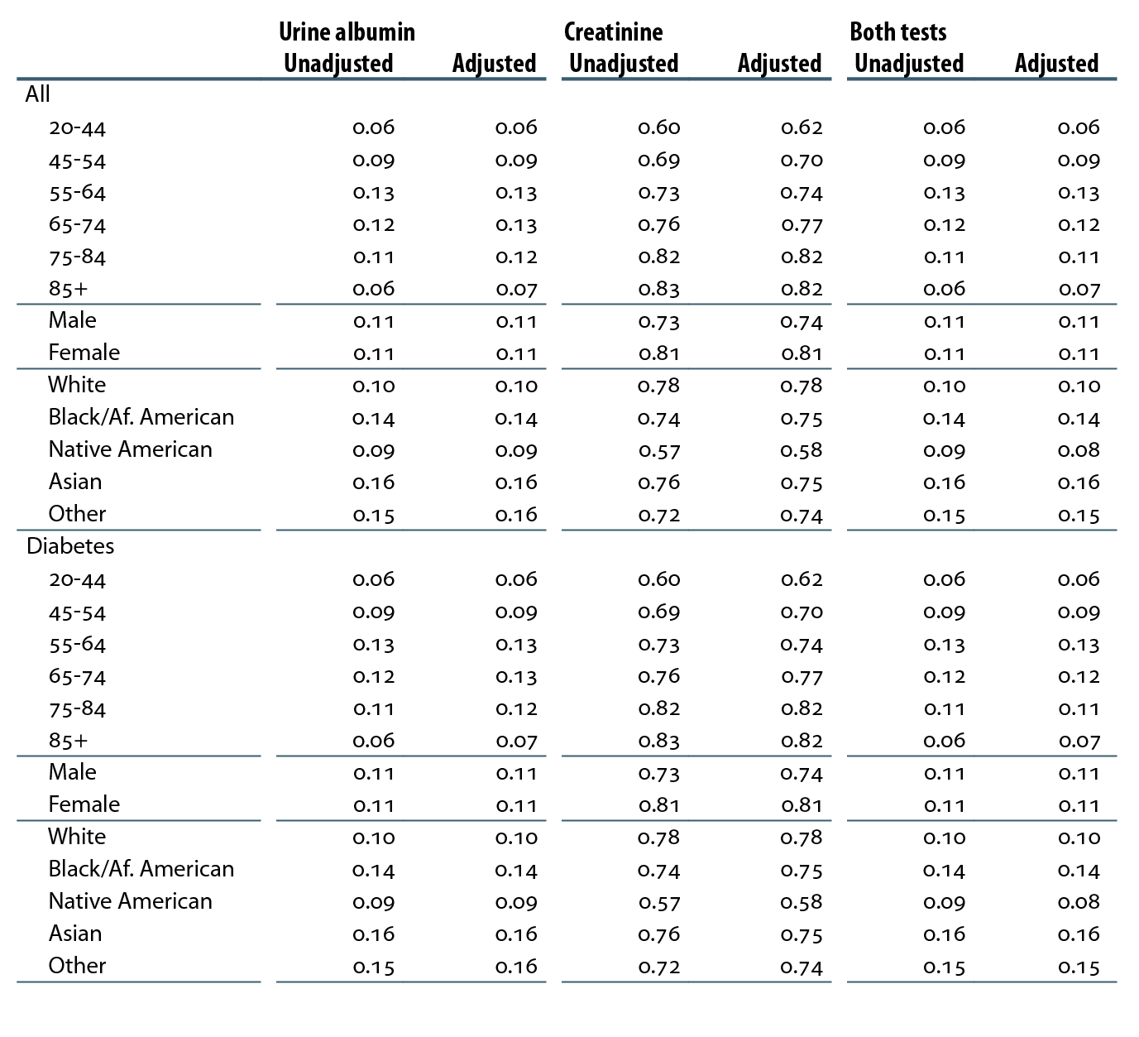
Probability of laboratory testing in patients at risk for CKD, by demographic characteristics, 2011 Table 2.c (Volume 1)
Medicare patients from the 5 percent sample, age 20 & older, with Parts A & B coverage in 2010; patients diagnosed with CKD or ESRD during 2010 are excluded; category “Other” includes Hispanics.

Slide 10
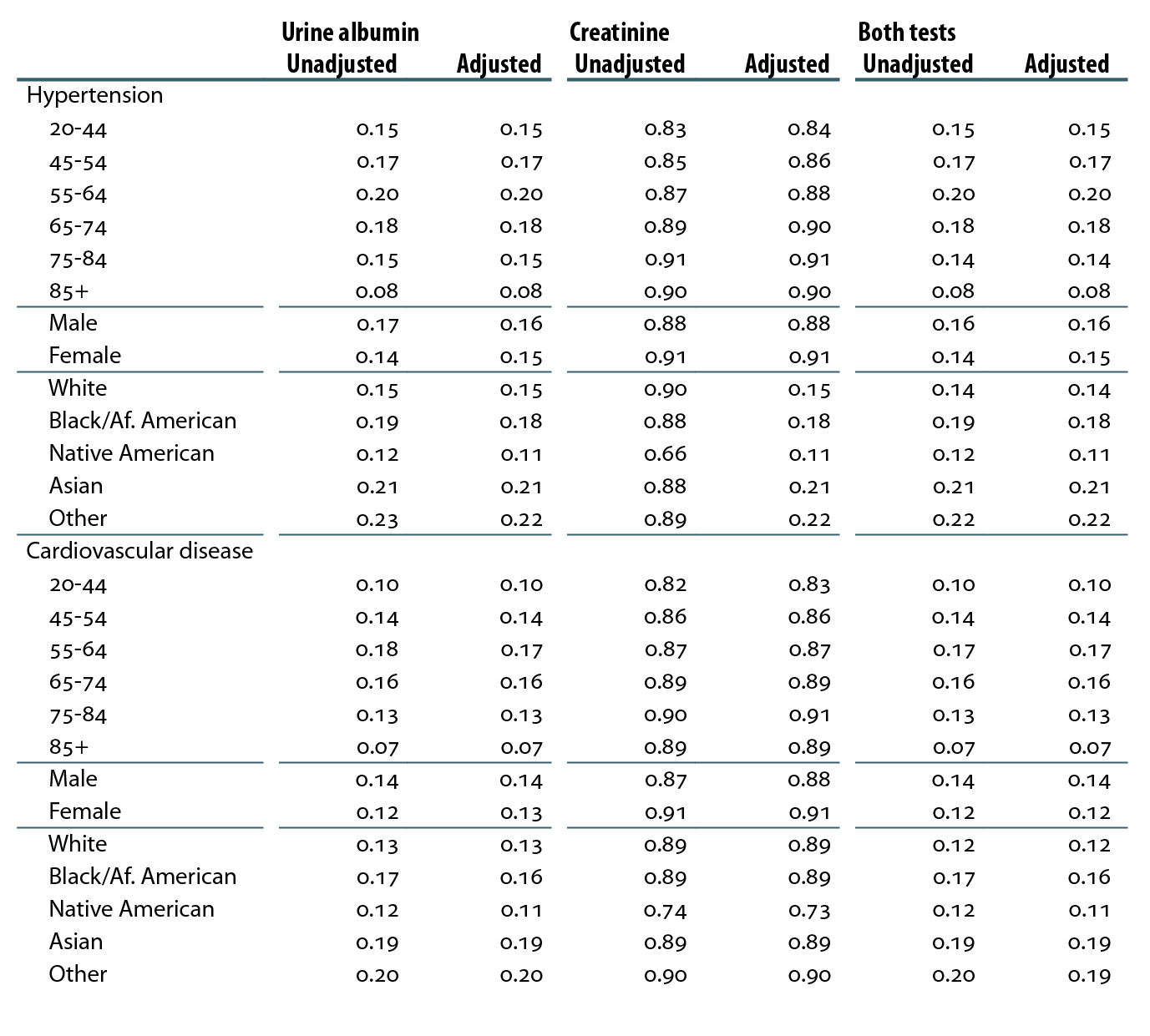
Probability of laboratory testing in patients at risk for CKD, by demographic characteristics, 2011 Table 2.c (continued; Volume 1)
Medicare patients from the 5 percent sample, age 20 & older, with Parts A & B coverage in 2010; patients diagnosed with CKD or ESRD during 2010 are excluded; category “Other” includes Hispanics.

Slide 11
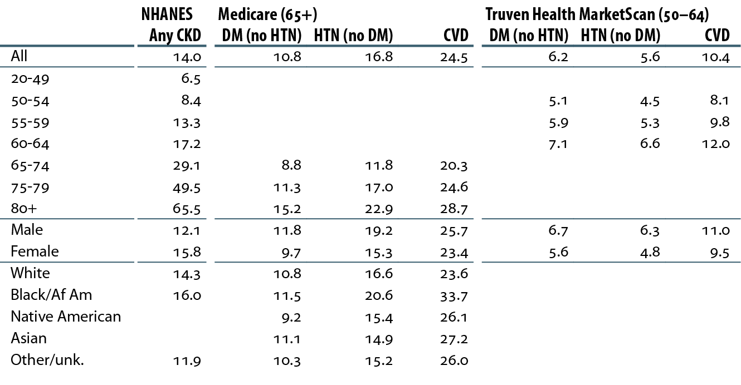
Percent of patients with CKD, by demographic characteristics, comorbidity, & dataset, 2011 Table 2.d (Volume 1)
Medicare patients age 65 & older & Truven Health MarketScan patients age 50–64, alive & eligible for all of 2011. CKD claims as well as other diseases identified in 2011. NHANES 2005–2010 participants, age 20 & older; eGFR estimated by CKD-EPI equation.

Slide 12
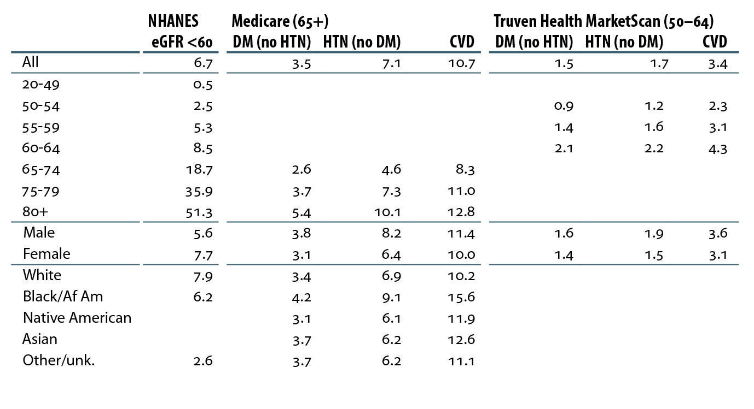
Percent of patients with a CKD diagnosis code of 585.3 or higher, by demographic characteristics, comorbidity, & dataset, 2011 Table 2.e (Volume 1)
Medicare patients age 65 & older & Truven Health MarketScan patients age 50–64, alive & eligible for all of 2011. CKD claims as well as other diseases identified in 2011. NHANES 2005–2010 participants, age 20 & older; eGFR estimated by CKD-EPI equation.

Slide 13
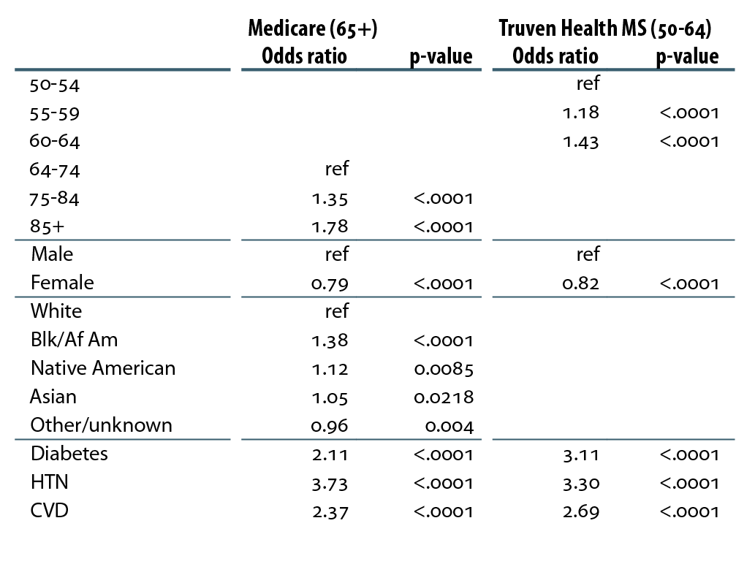
Adjusted odds ratio of a CKD diagnosis code, by demographic, comorbidity, & dataset, 2011 Table 2.f (Volume 1)
Medicare patients age 65 & older & Truven Health MarketScan patients age 50–64, alive & eligible for all of 2011. CKD claims as well as other diseases identified in 2011.

Slide 14
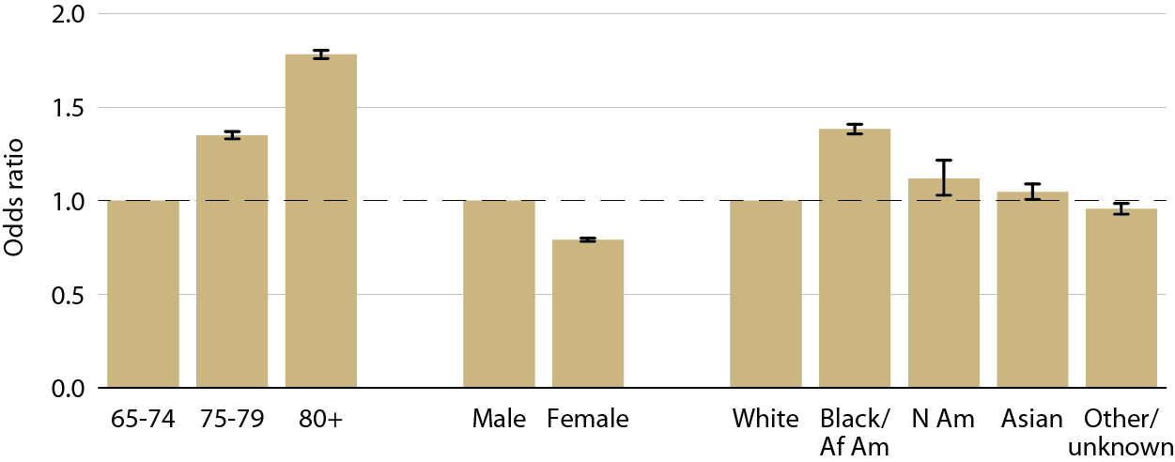
Adjusted odds ratio of a CKD diagnosis code in Medicare patients, by age, gender, & race, 2011 Figure 2.6 (Volume 1)
Medicare patients age 65 & older, alive & eligible for all of 2011. CKD claims as well as other diseases identified in 2011.

Slide 15
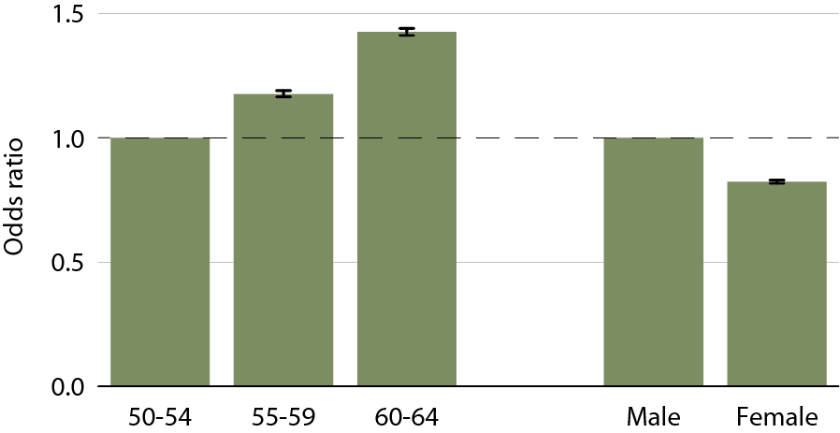
Adjusted odds ratio of a CKD diagnosis code in Truven Health MarketScan patients, by age & gender, 2011 Figure 2.7 (Volume 1)
Medicare patients age 65 & older & Truven Health MarketScan patients age 50–64, alive & eligible for all of 2011. CKD claims as well as other diseases identified in 2011.

Slide 16
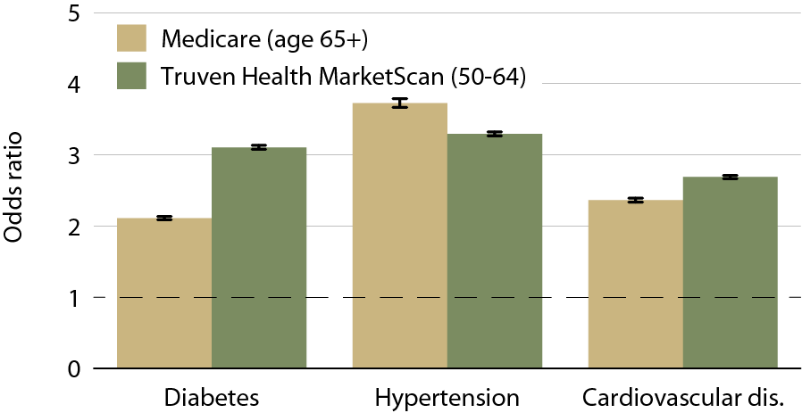
Adjusted odds ratio of a CKD diagnosis code, by dataset & comorbidity, 2011 Figure 2.8 (Volume 1)
Medicare patients age 65 & older & Truven Health MarketScan patients age 50–64, alive & eligible for all of 2011. CKD claims as well as other diseases identified in 2011.

Slide 17
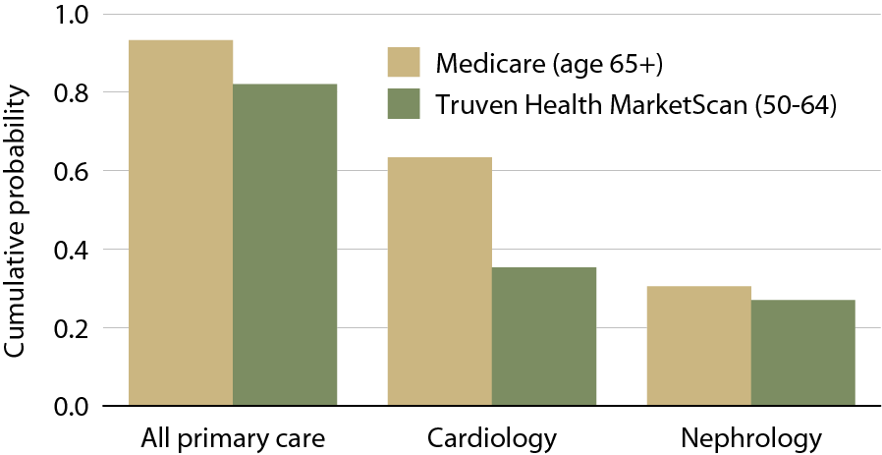
Cumulative probability of a physician visit by month 12 after CKD diagnosis in 2010, by dataset & physician specialty Table 2.9 (Volume 1)
Patients alive & eligible all of 2010. CKD diagnosis represents date of first CKD claim during 2010; physician claims searched during the 12 months following that date.

Slide 18
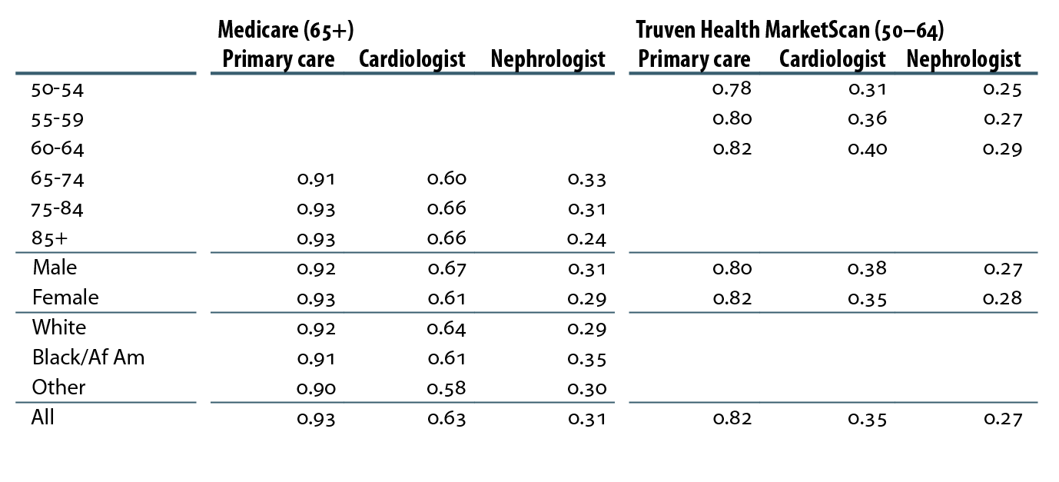
Cumulative probability of a physician visit by month 12 after CKD diagnosis in 2010, by demographic characteristics, physician specialty, & dataset Table 2.g (Volume 1)
Patients alive & eligible all of 2010. CKD diagnosis represents date of first CKD claim during 2010; physician claims searched during 12 months following that date.

Slide 19
Cumulative probability of a physician visit by month 12 after a CKD diagnosis code of 585.3 or higher in 2010, by demographic characteristics, physician specialty, & dataset Table 2.h (Volume 1)
Patients alive & eligible all of 2010. CKD diagnosis represents date of first CKD claim during 2010; physician claims searched during 12 months following that date.

Slide 20
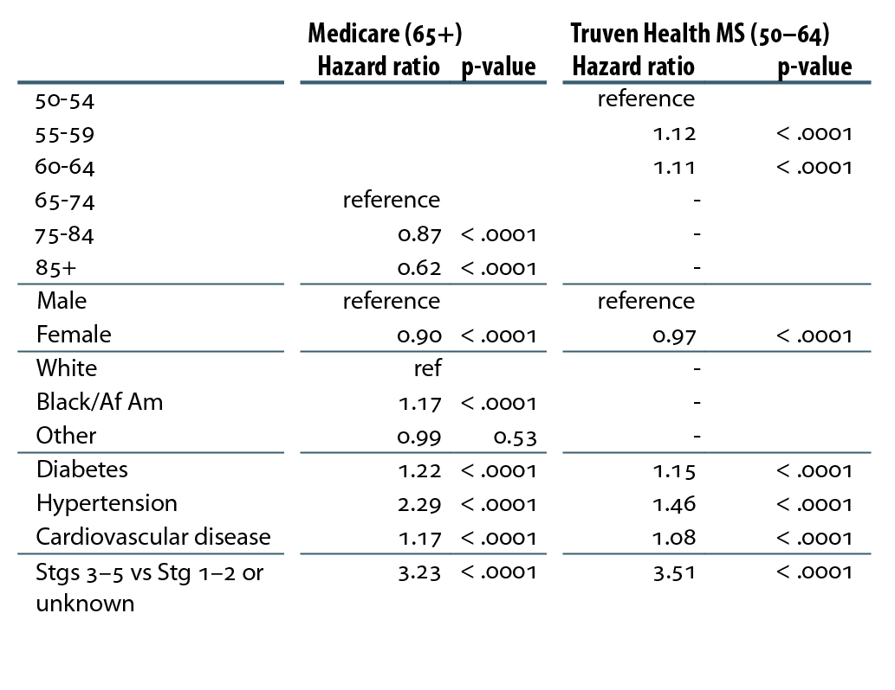
Likelihood of seeing a nephrologist 12 months after CKD diagnosis in 2010, by demographics, comorbidity, CKD stage, & dataset Table 2.i (Volume 1)
Patients alive & eligible all of 2010. CKD diagnosis represents date of first CKD claim during 2010; physician claims searched during the 12 months following that date.

Slide 21
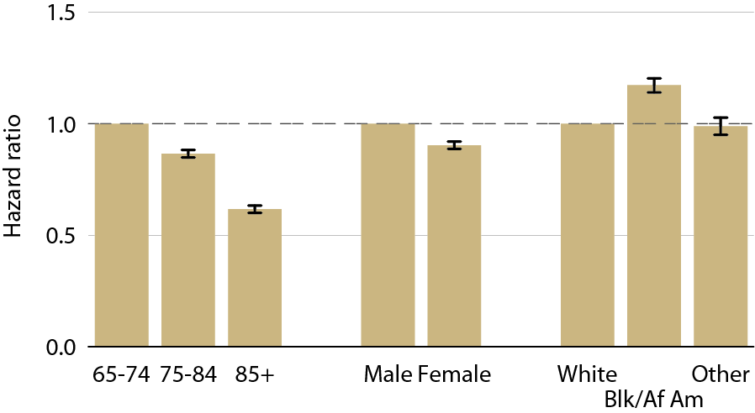
Likelihood of Medicare patients (age 65+) seeing a nephrologist 12 months after CKD diagnosis in 2010, by age, gender, & race Figure 2.10 (Volume 1)
Patients alive & eligible all of 2010. CKD diagnosis represents date of first CKD claim during 2010; physician claims searched during the 12 months following that date.

Slide 22
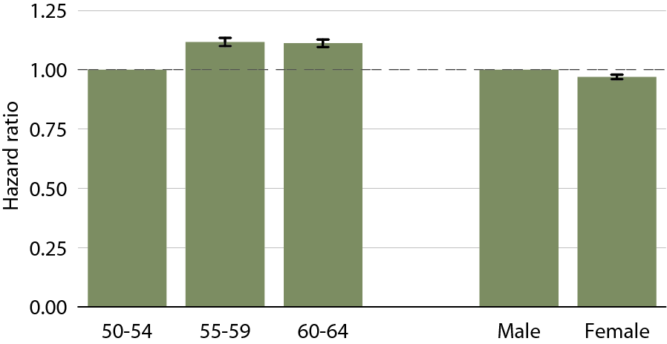
Likelihood of Truven Health MarketScan patients (age 50–64) seeing a nephrologist 12 months after CKD diagnosis, by age & gender Figure 2.11 (Volume 1)
Patients alive & eligible all of 2010. CKD diagnosis represents date of first CKD claim during 2010; physician claims searched during the 12 months following that date.

Slide 23
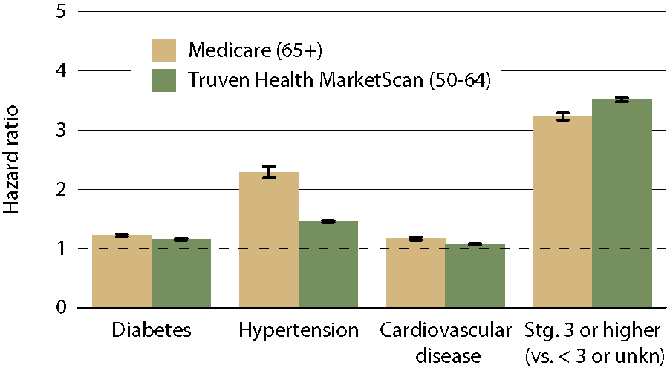
Likelihood of patients seeing a nephrologist 12 months after CKD diagnosis in 2010, by comorbidity, CKD stage, & dataset Figure 2.12 (Volume 1)
Patients alive & eligible all of 2010. CKD diagnosis represents date of first CKD claim during 2010; physician claims searched during the 12 months following that date.

