Slide 1
CKD: Chapter Three
Morbidity & mortality in patients with CKD
United States Renal Data System
2013 Annual Data Report

Slide 2
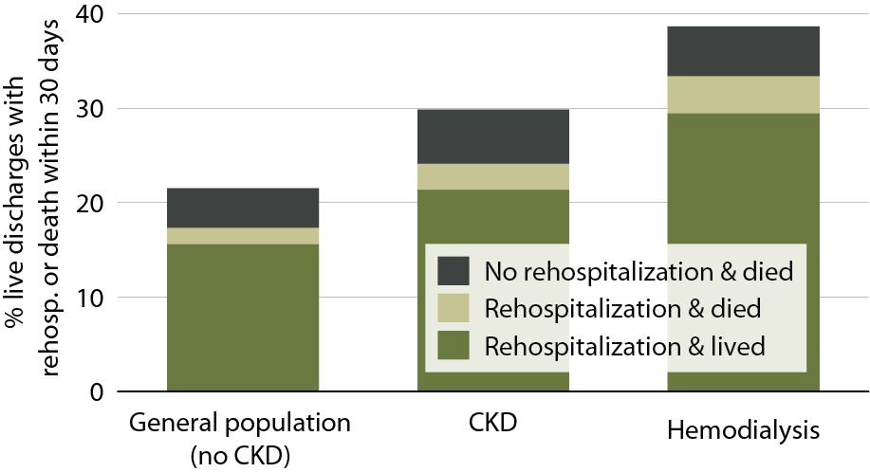
All-cause rehospitalization or death within 30 days after live hospital discharge, in the general Medicare (no CKD), CKD, & hemodialysis populations, age 66+, 2011
Figure 3.1 (Volume 1)
January 1, 2011 point prevalent Medicare patients, age 66 & older on December 31, 2010, unadjusted. Includes live hospital discharges from January 1 to December 1, 2011.

Slide 3
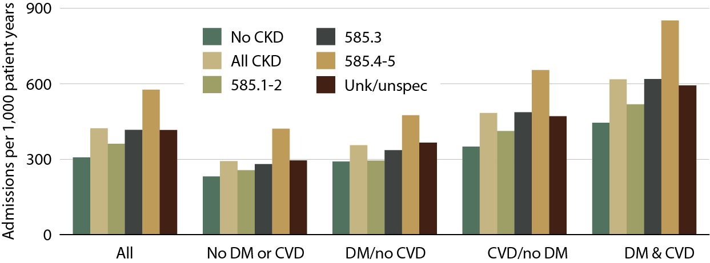
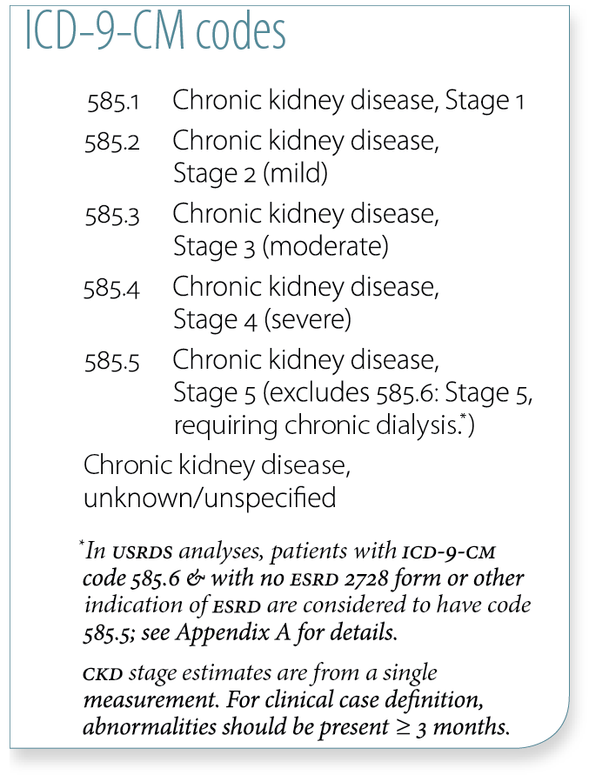
Adjusted hospitalization rates in
Medicare patients, by comorbidity
& CKD diagnosis code, 2011
Figure 3.2 (Volume 1)
January 1, 2011 point prevalent Medicare patients, age 66 & older on December 31, 2010. Adj: age/gender/race/prior hospitalization/comorbidity; rates by one factor are adjusted for the others. Ref: Medicare patients age 66 & older, 2011.

Slide 4
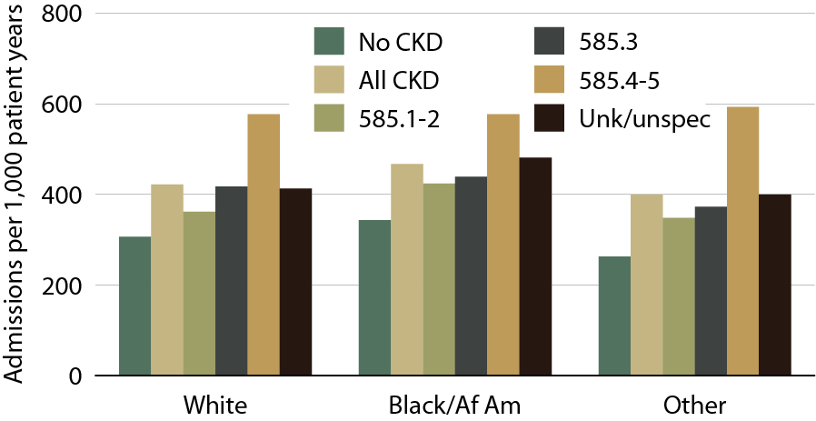
Adjusted hospitalization rates in Medicare patients, by race & CKD diagnosis code, 2011
Figure 3.3 (Volume 1)
January 1, 2011 point prevalent Medicare patients, age 66 & older on December 31, 2010. Adj: age/gender/race/prior hospitalization/comorbidity; rates by one factor are adjusted for the others. Ref: Medicare patients age 66 & older, 2011.

Slide 5
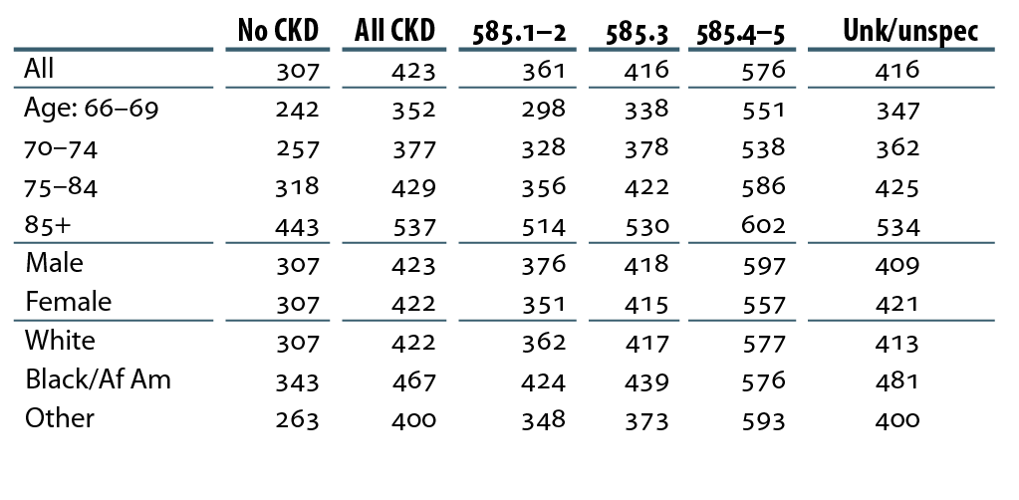
Adjusted hospitalization rates
(per 1,000 patient years) in Medicare patients, by CKD diagnosis code, 2011
Table 3.a (Volume 1)
January 1, 2011 point prevalent Medicare patients, age 66 & older on December 31, 2010. Adj: age/gender/race/prior hospitalization/comorbidity; rates by one factor are adjusted for the others. Ref: Medicare patients age 66 & older, 2011.

Slide 6
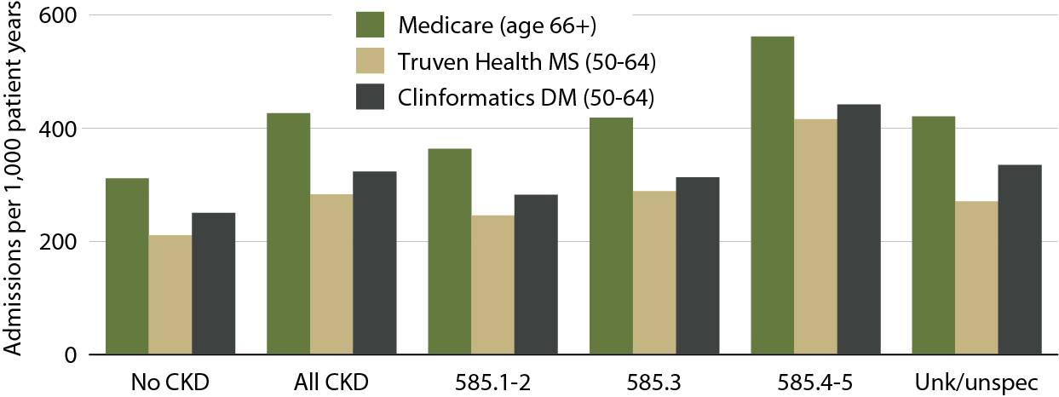
Adjusted all-cause hospitalization rates, by dataset & CKD diagnosis code, 2011
Figure 3.4 (Volume 1)
Medicare: point prevalent patients on January 1, 2011, age 66 & older on December 31, 2010. Truven Health MarketScan & Clinformatics DataMart: point prevalent patients on January 1, 2011, age 50–64 on December 31, 2010. Adj: gender/prior hospitalization/comorbidity; ref: Medicare patients age 66 & older, 2011.

Slide 7
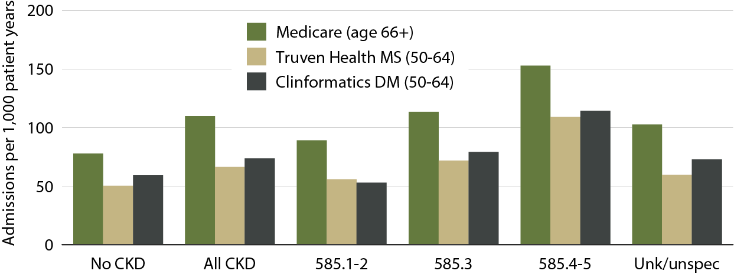
Adjusted rates of hospitalization for cardiovascular disease, by dataset
& CKD diagnosis code, 2011
Figure 3.5 (Volume 1)
Medicare: point prevalent patients on January 1, 2011, age 66 & older on December 31, 2010. Truven Health MarketScan & Clinformatics DataMart: point prevalent patients on January 1, 2011, age 50–64 on December 31, 2010. Adj: gender/prior hospitalization/comorbidity; ref: Medicare patients age 66 & older, 2011.

Slide 8
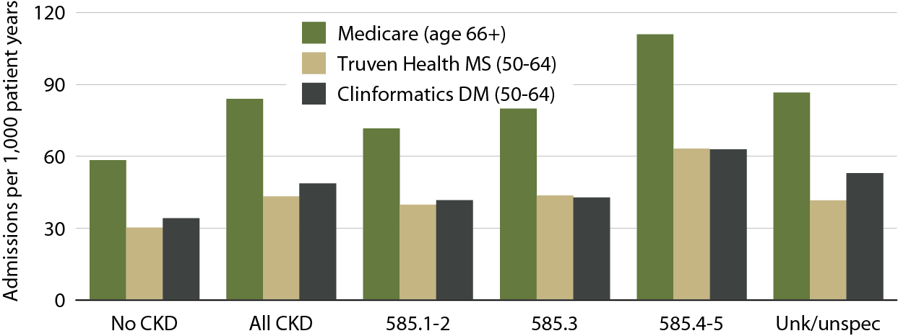
Adjusted rates of hospitalization for infection, by dataset & CKD diagnosis code, 2011
Figure 3.6 (Volume 1)
Medicare: point prevalent patients on January 1, 2011, age 66 & older on December 31, 2010. Truven Health MarketScan & Clinformatics DataMart: point prevalent patients on January 1, 2011, age 50–64 on December 31, 2010. Adj: gender/prior hospitalization/comorbidity; ref: Medicare patients age 66 & older, 2011.

Slide 9
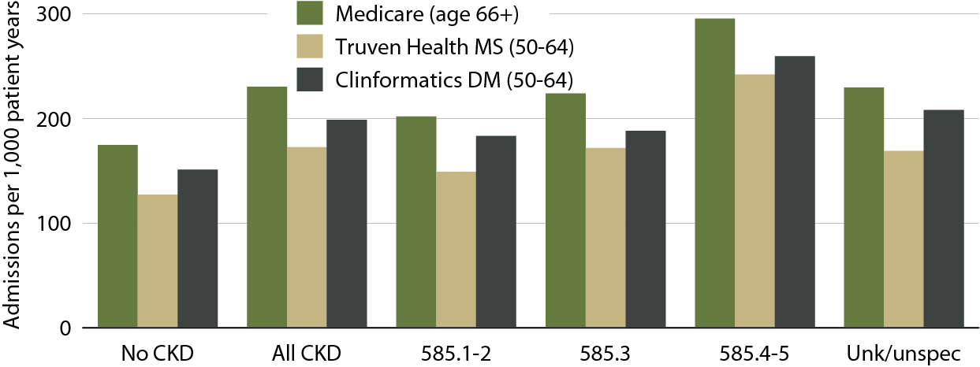
Adjusted rates of hospitalization for other causes, by dataset & CKD diagnosis code, 2011
Figure 3.7 (Volume 1)
Medicare: point prevalent patients on January 1, 2011, age 66 & older on December 31, 2010. Truven Health MarketScan & Clinformatics DataMart: point prevalent patients on January 1, 2011, age 50–64 on December 31, 2010. Adj: gender/prior hospitalization/comorbidity; ref: Medicare patients age 66 & older, 2011.

Slide 10
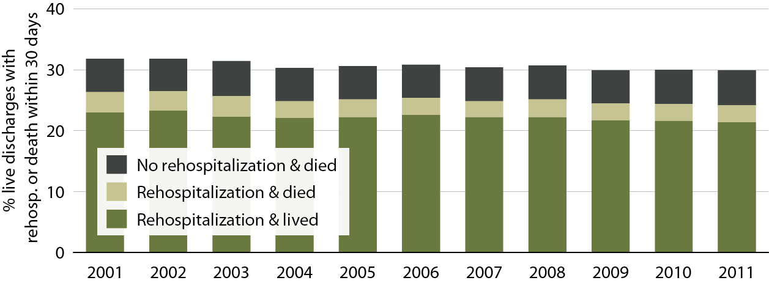
Adjusted all-cause rehospitalization or death 30 days after live hospital discharge in CKD patients
Figure 3.8 (Volume 1)
Point prevalent Medicare CKD patients on January 1 of each year, age 66 & older on December 31 of the prior year. Adj: age/gender/race; ref: discharges in 2010. Includes discharges from January 1 to December 1 of each year.

Slide 11
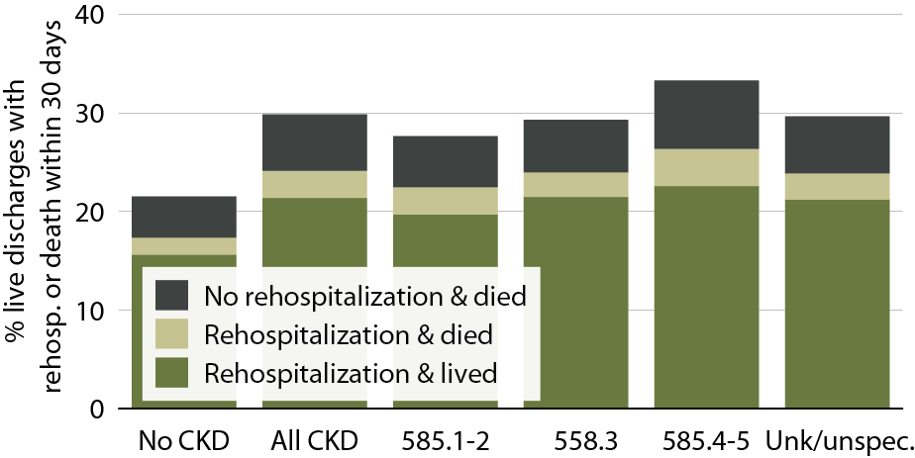
All-cause rehospitalization or death within 30 days after discharge from all-cause index hospitalization, by CKD stage, 2011
Figure 3.9 (Volume 1)
January 1, 2011 point prevalent Medicare patients, age 66 & older on December 31, 2010; unadjusted. Includes live hospital discharges from January 1 to December 1, 2011.

Slide 12
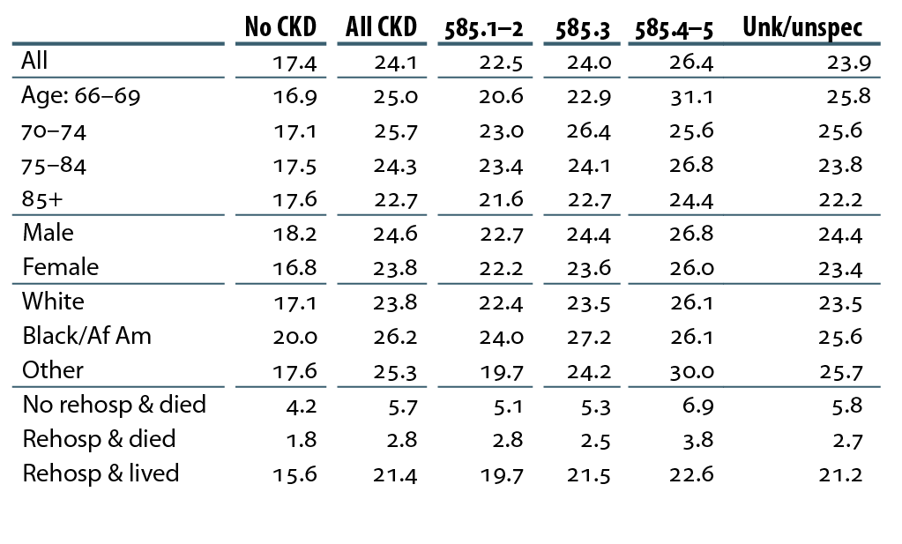
Percent live hospital discharges in CKD patients with an all-cause rehospitalization within 30 days, 2011
Table 3.b (Volume 1)
January 1, 2011 point prevalent Medicare patients, age 66 & older on December 31, 2010; unadjusted. Includes live hospital discharges from January 1 to December 1, 2011.

Slide 13

All-cause rehospitalization or death within 30 days after discharge from cardiovascular index hospitalization, by CKD stage, 2011
Figure 3.10 (Volume 1)
January 1, 2011 point prevalent Medicare patients, age 66 & older on December 31, 2010; unadjusted. Includes live hospital discharges from January 1 to December 1, 2011.

Slide 14
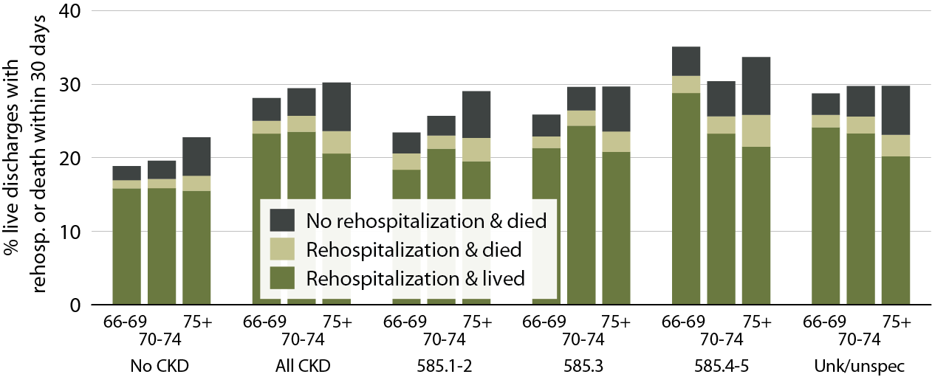
All-cause rehospitalization or death 30 days after live hospital discharge in Medicare patients, by age & CKD diagnosis code, 2011
Figure 3.11 (Volume 1)
January 1, 2011 point prevalent Medicare patients, age 66 & older on December 31, 2010; unadjusted.

Slide 15
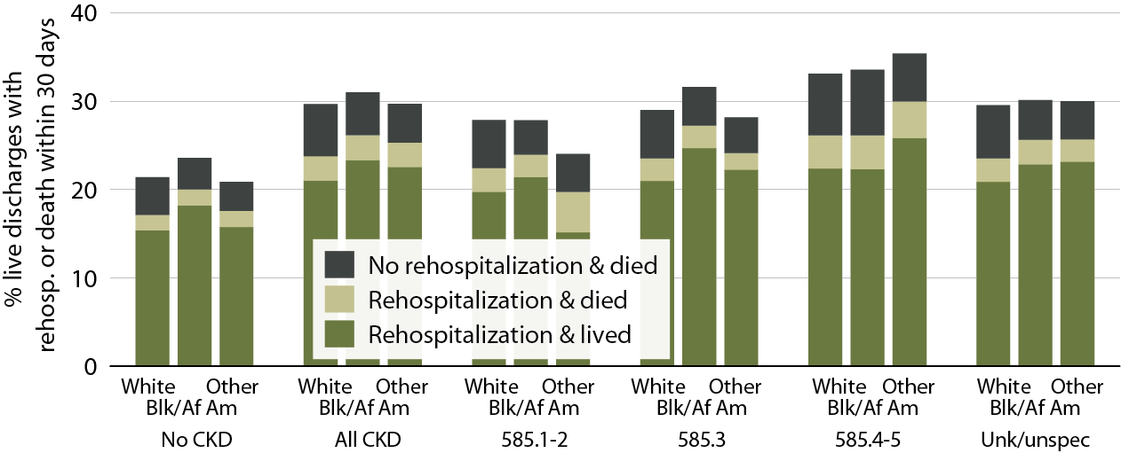
All-cause rehospitalization or death 30 days after live hospital discharge in Medicare patients, by race & CKD diagnosis code, 2011
Figure 3.12 (Volume 1)
January 1, 2011 point prevalent Medicare patients, age 66 & older on December 31, 2010; unadjusted.

Slide 16
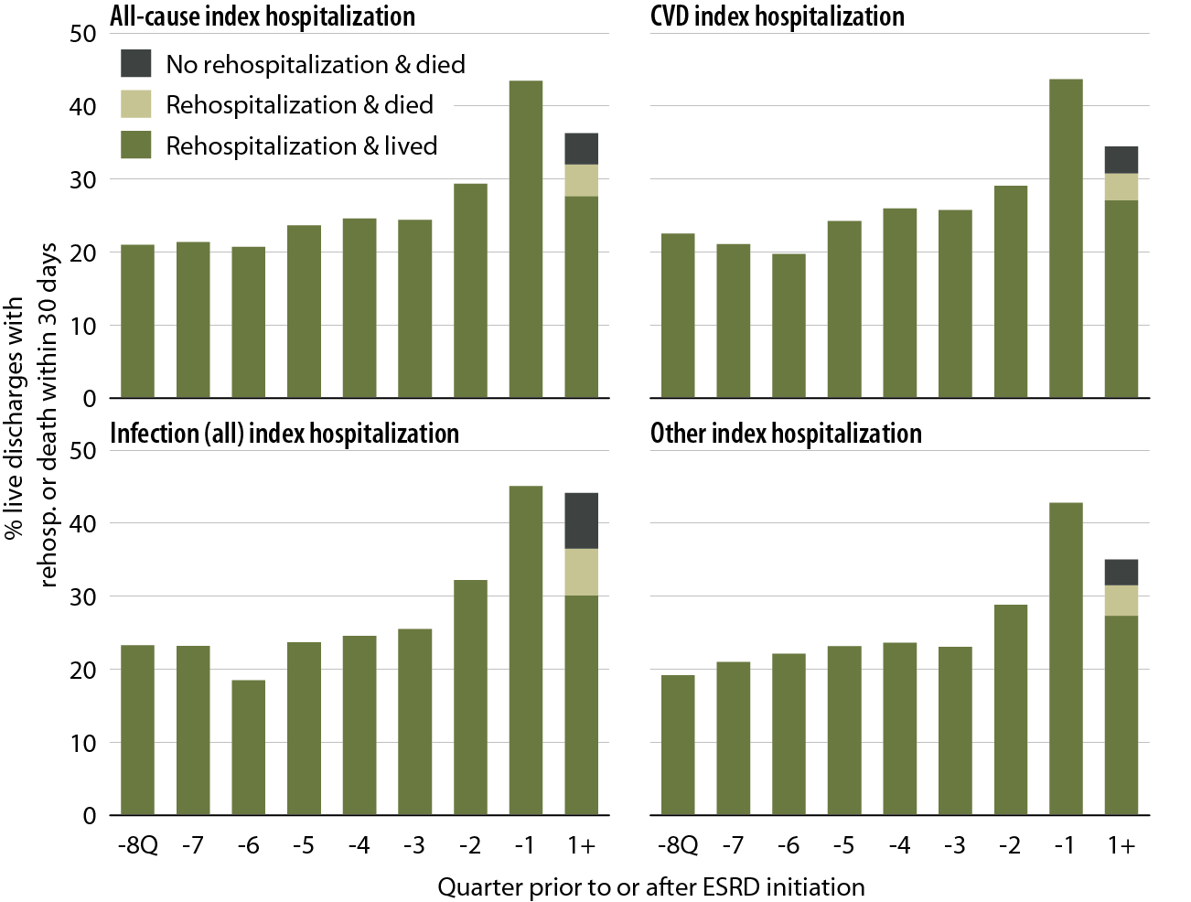
All-cause rehospitalization or death 30 days after live hospital discharge during the transition to ESRD, by cause-specific index hospitalization, 2011
Table 3.13 (Volume 1)
Incident ESRD patients, January 1 to October 1, 2011; age 67 or older, unadjusted.

Slide 17
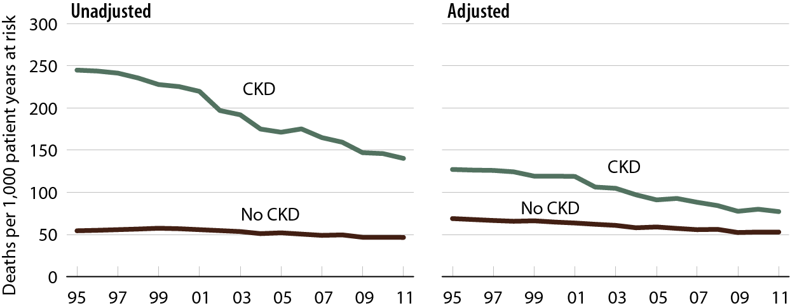
All-cause mortality rates in
Medicare CKD & non-CKD patients
Table 3.14 (Volume 1)
January 1 point prevalent Medicare patients age 66 & older. Adj: age/gender/race/prior hospitalization/comorbidities. Ref: 2010 patients.

Slide 18
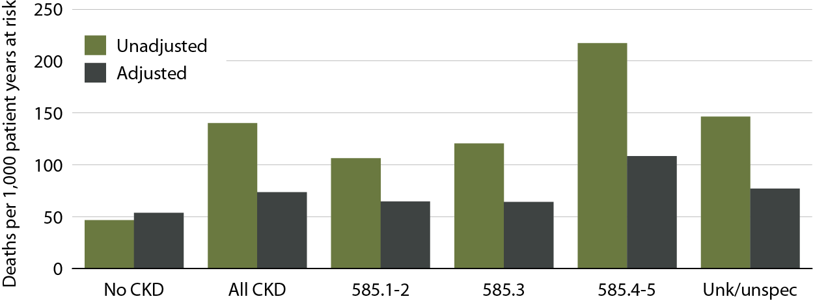
All-cause mortality rates in Medicare
CKD & non-CKD patients, by CKD diagnosis code, 2011
Figure 3.15 (Volume 1)
January 1, 2011 point prevalent patients age 66 & older. Adj: age/gender/race/prior hospitalization/comorbidities. Ref: 2011, all patients.

Slide 19
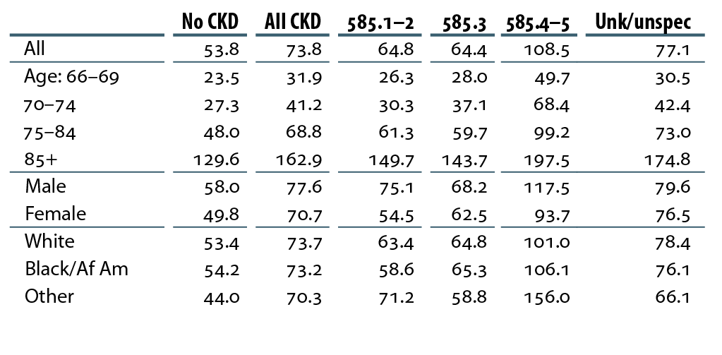
Adjusted mortality rates (per 1,000 patient years at risk) in Medicare patients, by CKD diagnosis code, 2011
Table 3.c (Volume 1)
January 1, 2011 point prevalent patients age 66 & older. Adj: age/gender/race/prior hospitalization/comorbidities. Ref: all patients, 2011.

Slide 20
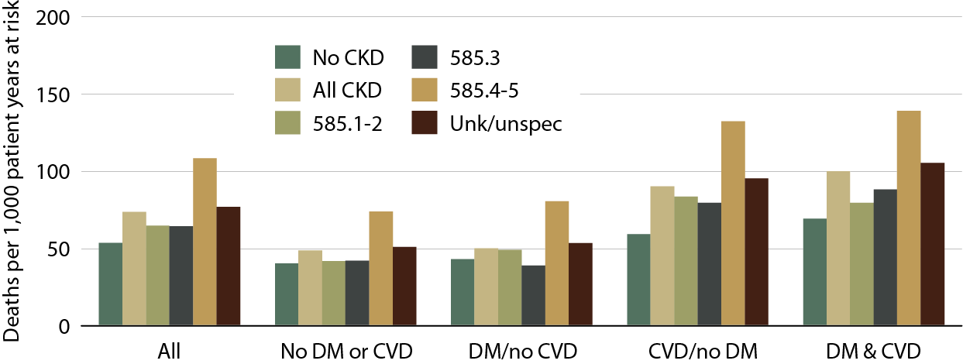
Adjusted mortality rates in Medicare patients, by comorbidity & CKD diagnosis code, 2011
Figure 3.16 (Volume 1)
January 1, 2011 point prevalent patients age 66 & older. Adj: age/gender/race/prior hospitalization/comorbidities. Ref: all patients, 2011.

Slide 21
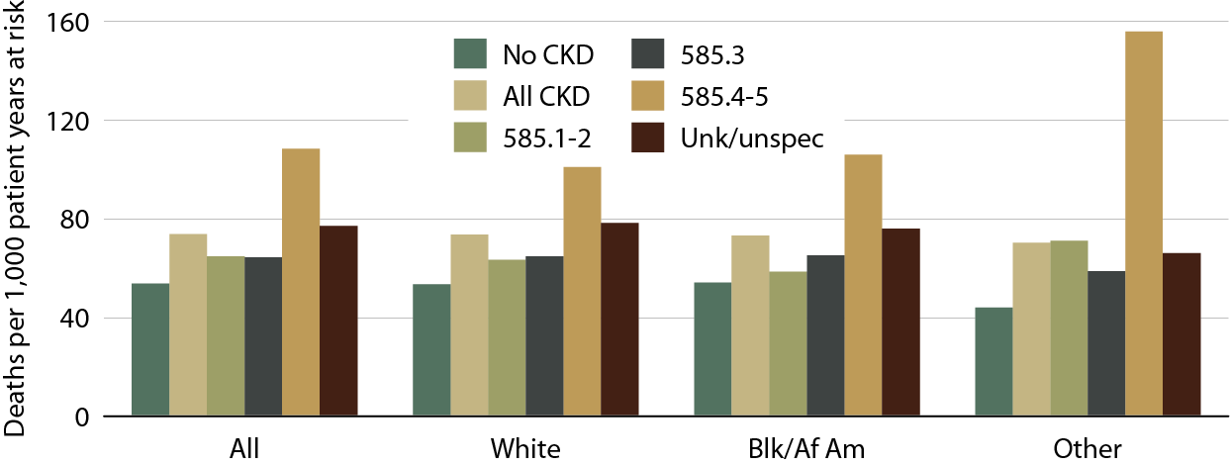
Adjusted mortality rates in Medicare patients, by race & CKD diagnosis code, 2011
Figure 3.17 (Volume 1)
January 1, 2011 point prevalent patients age 66 & older. Adj: age/gender/prior hospitalization/comorbidities. Ref: all patients, 2011.

