Slide 1
CKD: Chapter Four Cardiovascular disease patients with CKD
United States Renal Data System
2013 Annual Data Report

Slide 2
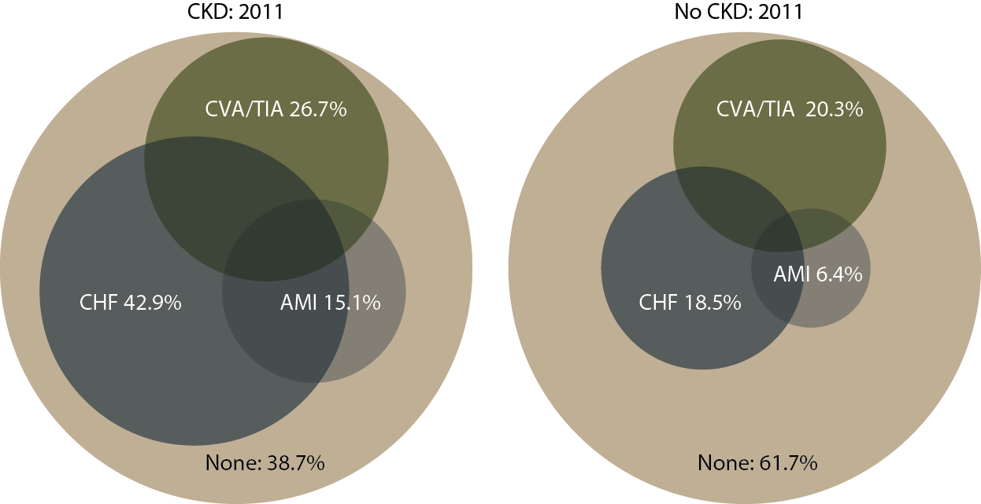
Cardiovascular disease in patients with or without CKD, 2011 Figure 4.1 (Volume 1)
December 31, 2011 point prevalent Medicare enrollees with CVD, age 66 & older, with fee-for-service coverage for the entire calendar year.

Slide 3
Cardiovascular disease & intervention (cell percent), by CKD status, age, & race, 2011 Table 4.a (Volume 1)
December 31, 2011 point prevalent Medicare enrollees, age 66 & older.

Slide 4
Cardiovascular disease & intervention (cell percent), by CKD status, age, & race, 2011 Table 4.a (continued; Volume 1)
December 31, 2011 point prevalent Medicare enrollees, age 66 & older.

Slide 5
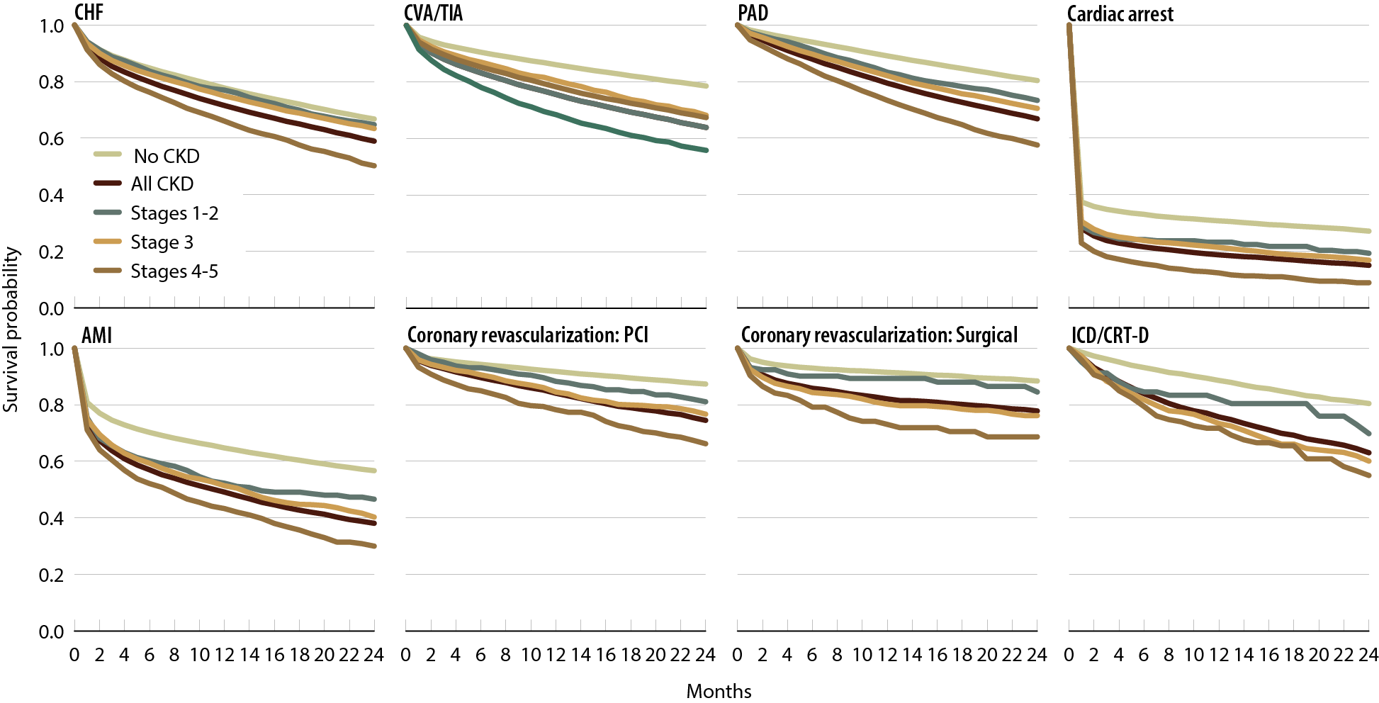
Survival of patients with a cardiovascular diagnosis or procedure, by CKD status, 2009-2011 Figure 4.2 (Volume 1)
Medicare enrollees age 66 & older with a first cardiovascular event or procedure in 2009–2011 (index date).

Slide 6
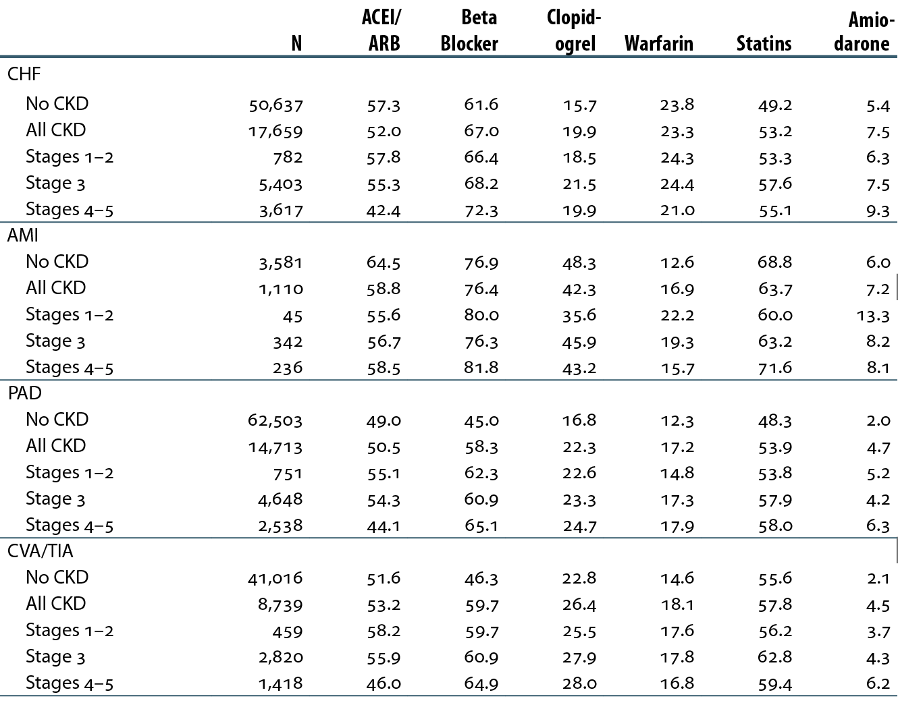
Cardiovascular disease & pharmacological interventions (row percent), by CKD status, 2011 Table 4.b (Volume 1)
January 1 point prevalent patients with Medicare Parts A, B, & D enrollment with a first cardiovascular diagnosis or procedure in 2011.

Slide 7
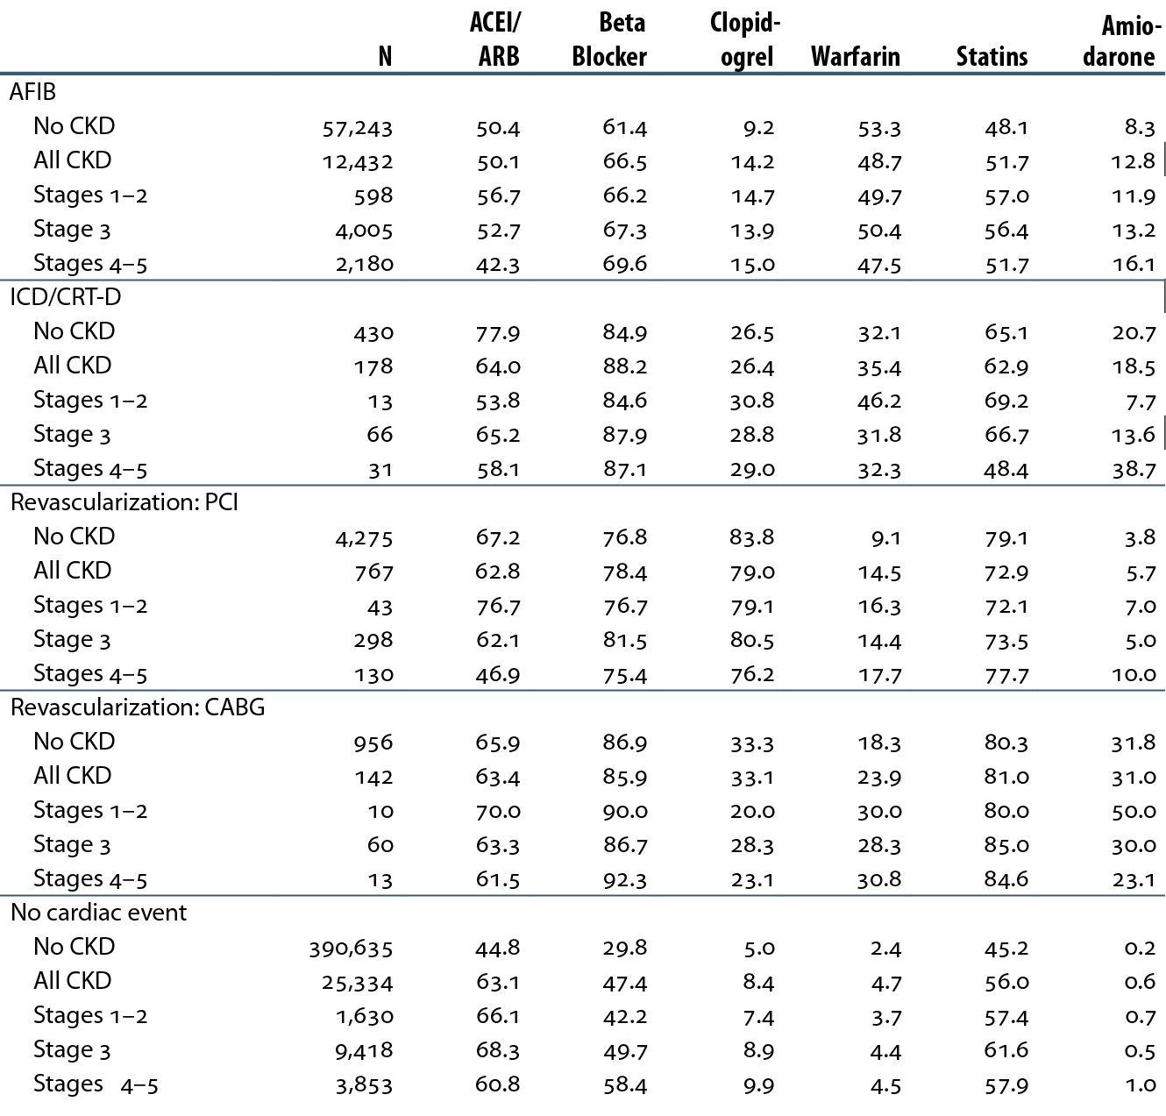
Cardiovascular disease & pharmacological interventions (row percent), by CKD status, 2011 Table 4.b (continued; Volume 1)
January 1 point prevalent patients with Medicare Parts A, B, & D enrollment with a first cardiovascular diagnosis or procedure in 2011.

Slide 8
Prescription drug therapy in patients with CHF, by CKD status, 2011 Figure 4.3 (Volume 1)
January 1 point prevalent patients with Medicare Parts A, B, & D enrollment with a first cardiovascular diagnosis or procedure in 2011.

Slide 9
Prescription drug therapy in patients with an AMI, by CKD status, 2011 Figure 4.4 (Volume 1)
January 1 point prevalent patients with Medicare Parts A, B, & D enrollment with a first cardiovascular diagnosis or procedure in 2011.

Slide 10
Prescription drug therapy in patients with atrial fibrillation, by CKD status, 2011 Figure 4.5 (Volume 1)
January 1 point prevalent patients with Medicare Parts A, B, & D enrollment with a first cardiovascular diagnosis or procedure in 2011.

Slide 11
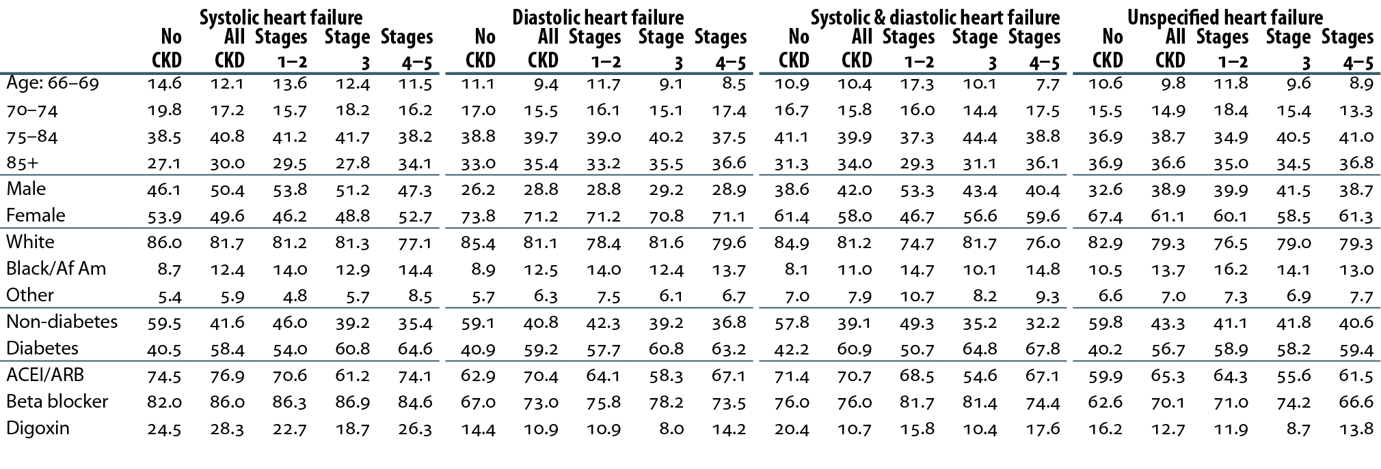
Characteristics of patients with heart failure, by CKD status, 2011 Table 4.c (Volume 1)
December 31 point prevalent patients with Medicare Parts A, B, & D enrollment, 2011.

Slide 12
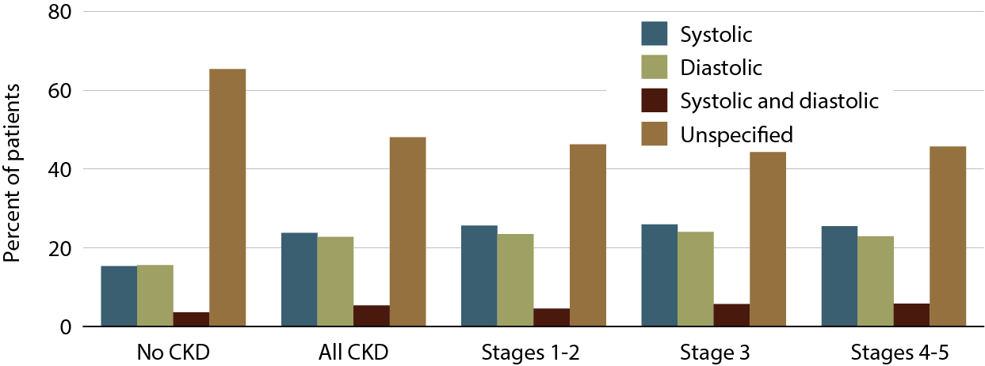
Heart failure in patients with or without CKD, 2011 Figure 4.6 (Volume 1)
December 31 point prevalent patients with Medicare Parts A, B, & D enrollment, 2011.

Slide 13
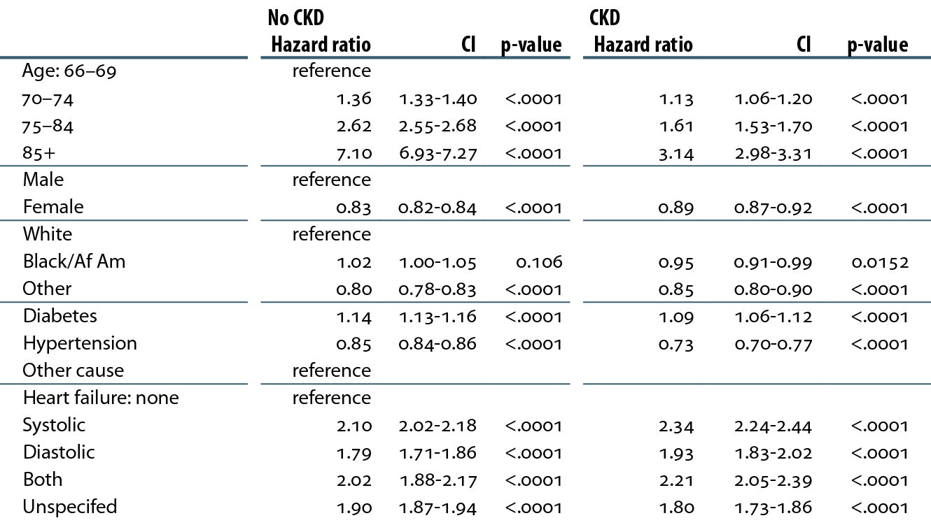
Adjusted hazard ratios of all-cause death in patients with heart failure, by CKD status, 2010–2011 Table 4.d (Volume 1)
December 31 point prevalent patients with Medicare Parts A, B, and D, enrolled in 2009.

Slide 14
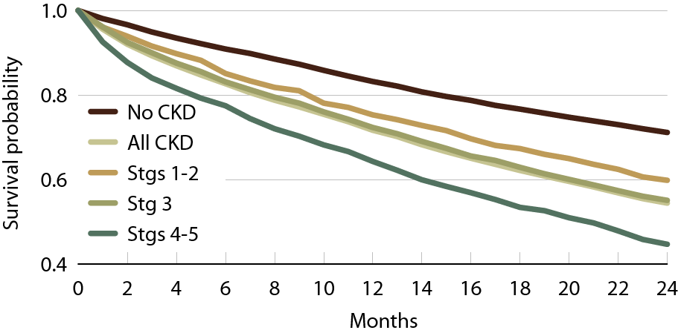
Unadjusted survival in patients with systolic heart failure, by CKD status, 2010–2011 Figure 4.7 (Volume 1)
Point prevalent Medicare patients identified with a heart failure diagnosis in 2009.

Slide 15
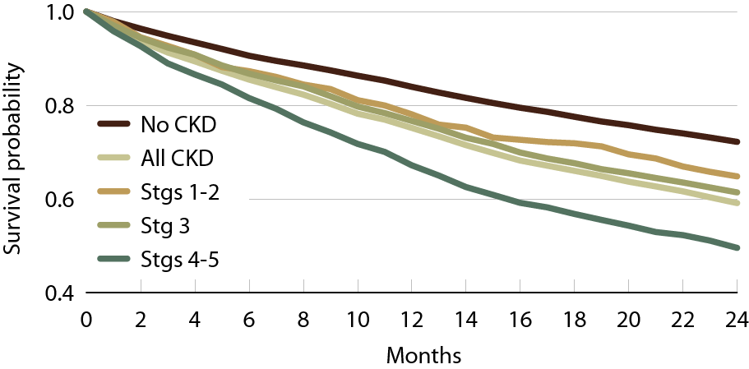
Unadjusted survival in patients with diastolic heart failure, by CKD status, 2010–2011 Figure 4.8 (Volume 1)
Point prevalent Medicare patients identified with a heart failure diagnosis in 2009.

Slide 16
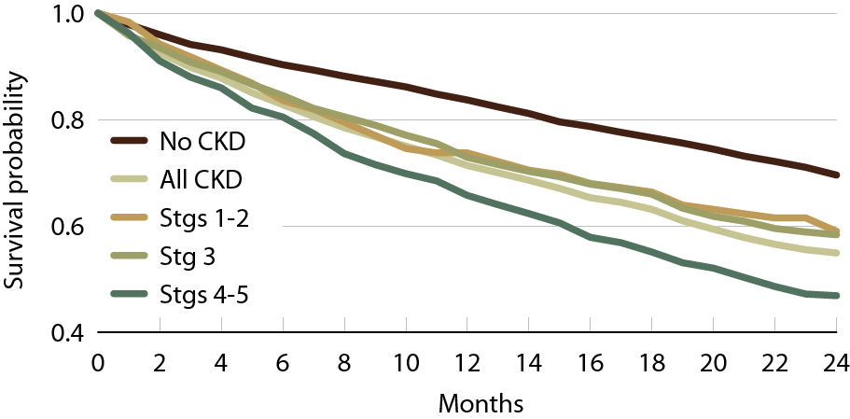
Unadjusted survival in patients with systolic & diastolic heart failure, by CKD status, 2010–2011 Figure 4.9 (Volume 1)
Point prevalent Medicare patients identified with a heart failure diagnosis in 2009.

Slide 17
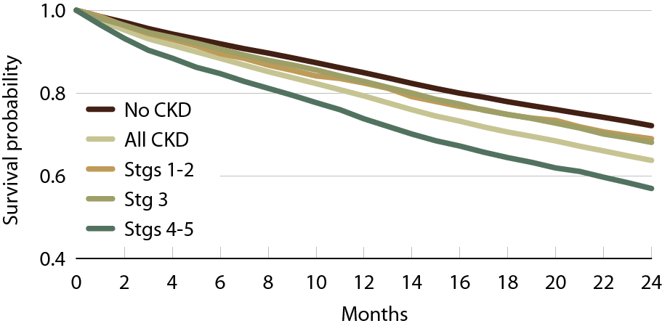
Unadjusted survival in patients with unspecified heart failure, by CKD status, 2010–2011 Figure 4.10 (Volume 1)
Point prevalent Medicare patients identified with a heart failure diagnosis in 2009.

