Slide 1
CKD: Chapter Five
Part D prescription
drug coverage in
patients with CKD
United States Renal Data System
2013 Annual Data Report

Slide 2
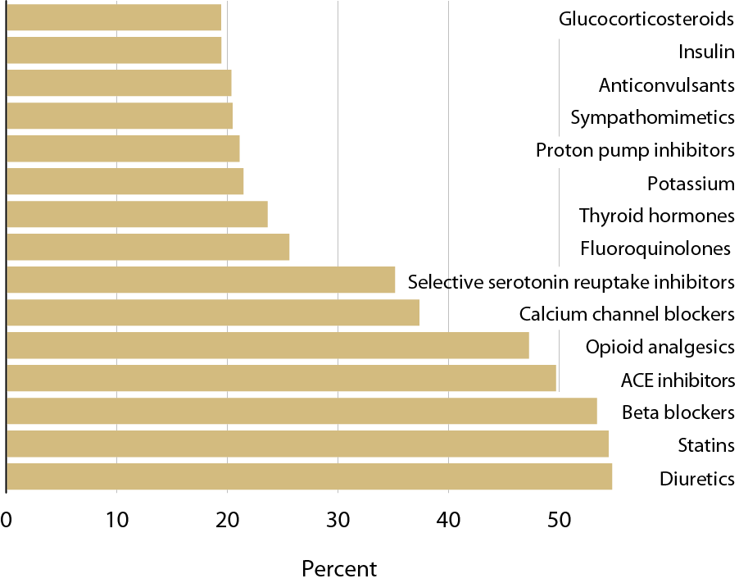
Top 15 drug classes used by Part D enrollees with CKD, by percent of patients & drug class, 2011
Figure 5.1 (Volume 1)
CKD patients in the Medicare 5 percent sample.

Slide 3
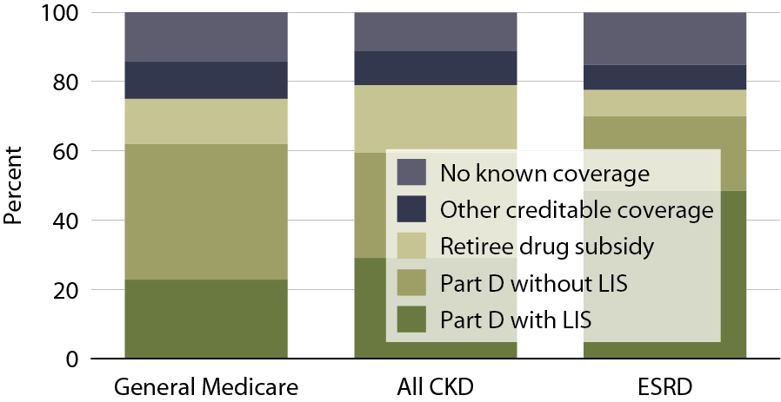
Sources of prescription drug coverage in Medicare enrollees, by population, 2011
Figure 5.2 (Volume 1)
Point prevalent Medicare enrollees alive on January 1, 2011.

Slide 4
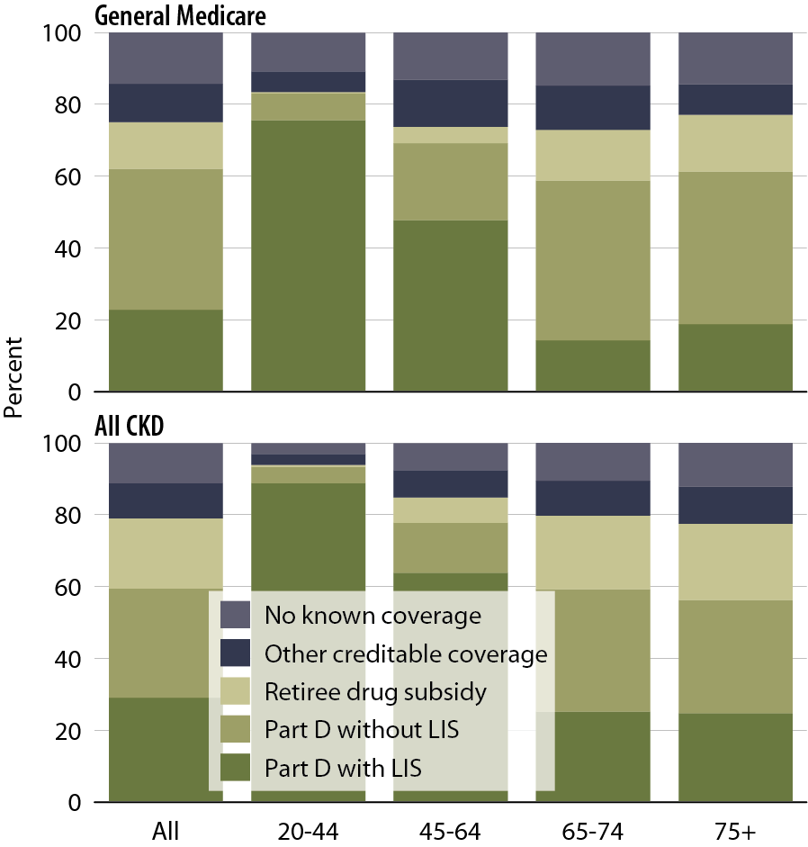
Sources of prescription drug coverage in Medicare enrollees, by age, 2011
Figure 5.3 (Volume 1)
Point prevalent Medicare enrollees alive on January 1, 2011.

Slide 5
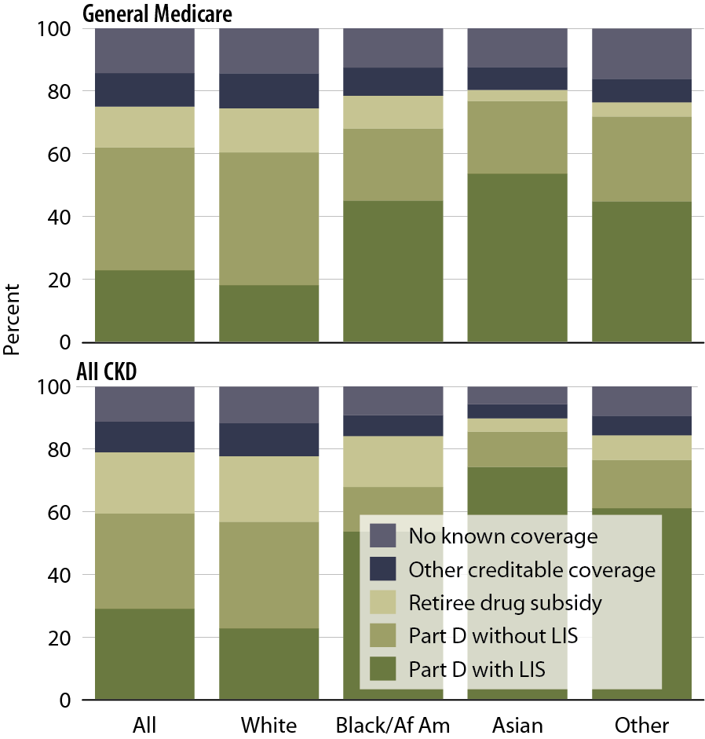
Sources of prescription drug coverage in Medicare enrollees, by race, 2011
Figure 5.4 (Volume 1)
Point prevalent Medicare enrollees alive on January 1, 2011.

Slide 6
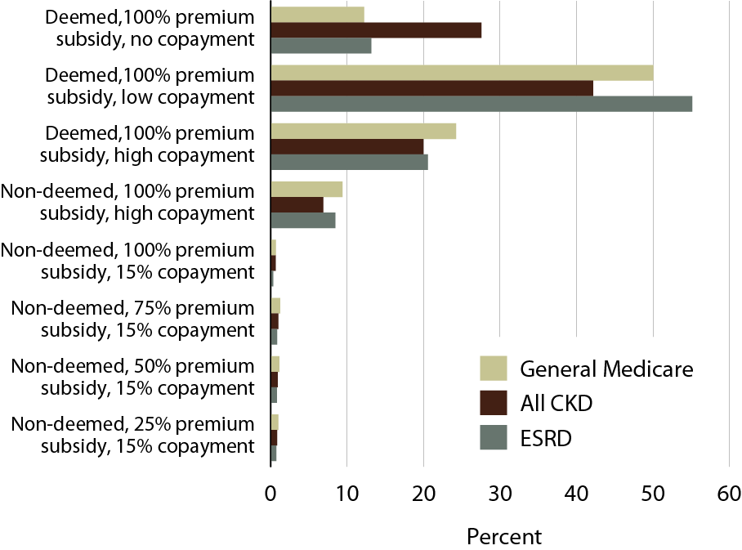
Distribution of low income subsidy (LIS) categories in Part D general Medicare, CKD,
& ESRD patients, 2011
Figure 5.5 (Volume 1)
Point prevalent Medicare enrollees alive on January 1, 2011.

Slide 7
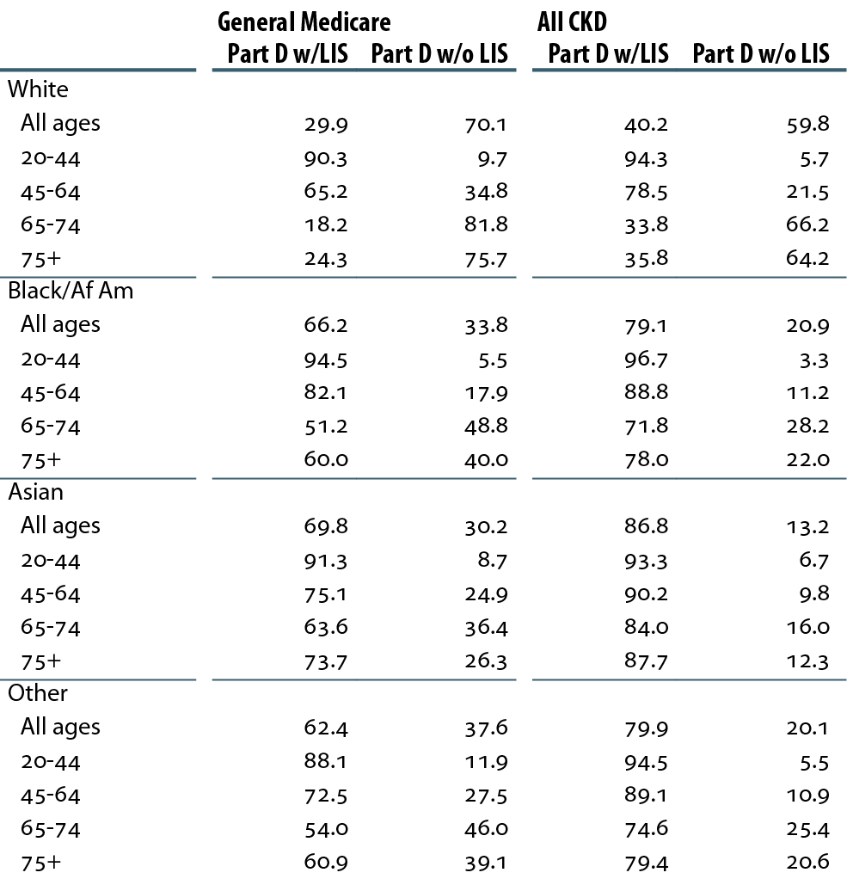
Percent of Medicare Part D enrollees with/without low income subsidy (LIS), by age & race, 2011
Table 5.a (Volume 1)
Point prevalent Medicare enrollees alive on January 1, 2011.

Slide 8
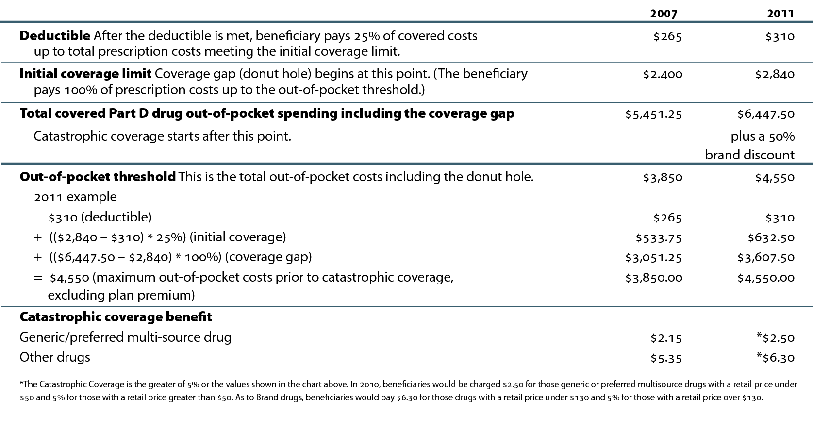
Medicare Part D benefit parameters for defined standard benefit, 2007 & 2011
Table 5.b (Volume 1)
http://www.q1medicare.com/PartD-The-2011-Medicare-Part-D-Outlook.php.

Slide 9
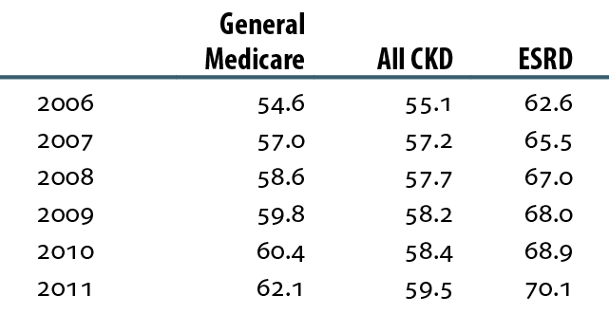
General Medicare, CKD, & ESRD patients enrolled in Part D (%)
Table 5.c (Volume 1)
Point prevalent Medicare enrollees alive on January 1, excluding those in Medicare Advantage Part D plans.

Slide 10
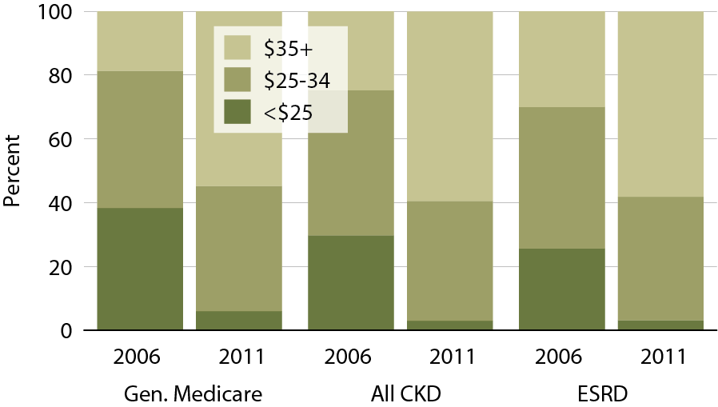
Part D non-LIS enrollees with specified monthly premium, 2006 & 2011
Figure 5.6 (Volume 1)
Point prevalent Medicare enrollees alive on January 1, excluding those in Medicare Advantage Part D plans.

Slide 11
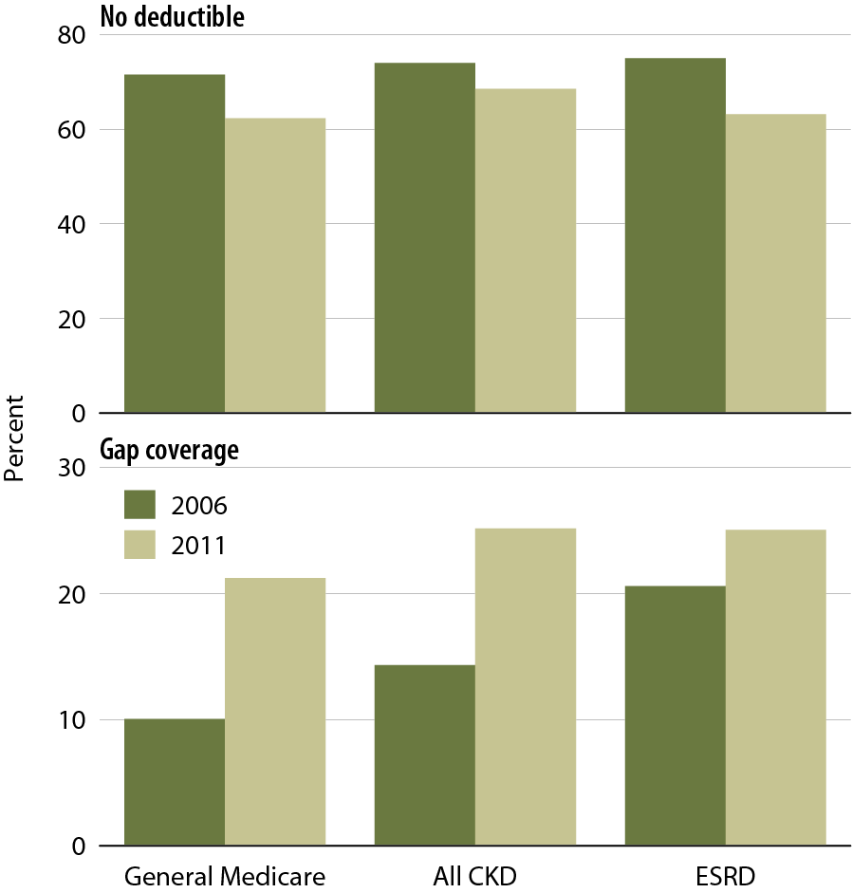
Part D non-LIS enrollees with no deductible or with gap coverage, 2006 & 2011
Figure 5.7 (Volume 1)
Point prevalent Medicare enrollees alive on January 1, excluding those in Medicare Advantage Part D plans.

Slide 12
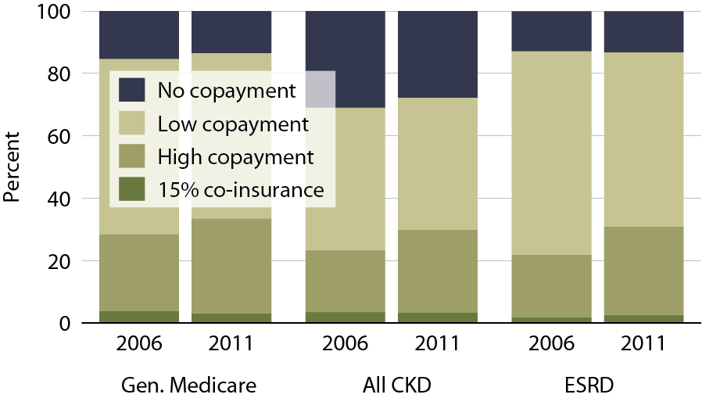
Part D LIS enrollees with specified co-insurance/copayment, 2006 & 2011
Figure 5.8 (Volume 1)
Point prevalent Medicare enrollees alive on January 1, excluding those in Medicare Advantage Part D plans.

Slide 13
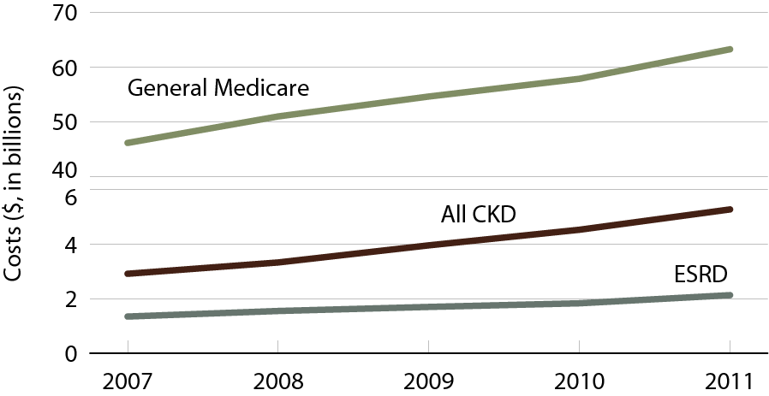
Total estimated net Part D costs for enrollees
Figure 5.9 (Volume 1)
General Medicare totals include Part D claims for all patients in the Medicare 5 percent sample enrolled in Part D. CKD total includes Medicare CKD patients, as determined from claims. ESRD totals include all Part D claims for Medicare ESRD patients enrolled in Part D.

Slide 14
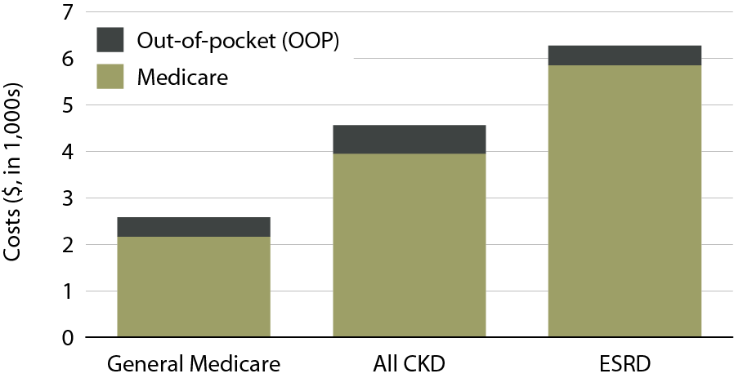
Per person per year Medicare & out-of-pocket Part D costs for enrollees, 2011
Figure 5.10 (Volume 1)
General Medicare totals include Part D claims for all patients in the Medicare 5 percent sample enrolled in Part D. CKD totals includes Medicare CKD patients, as determined from claims. ESRD totals include all Part D claims for Medicare ESRD patients enrolled in Part D. Costs are per person per year for calendar year 2011. Medicare total is the sum of Medicare net payment plus LIS amount.

Slide 15
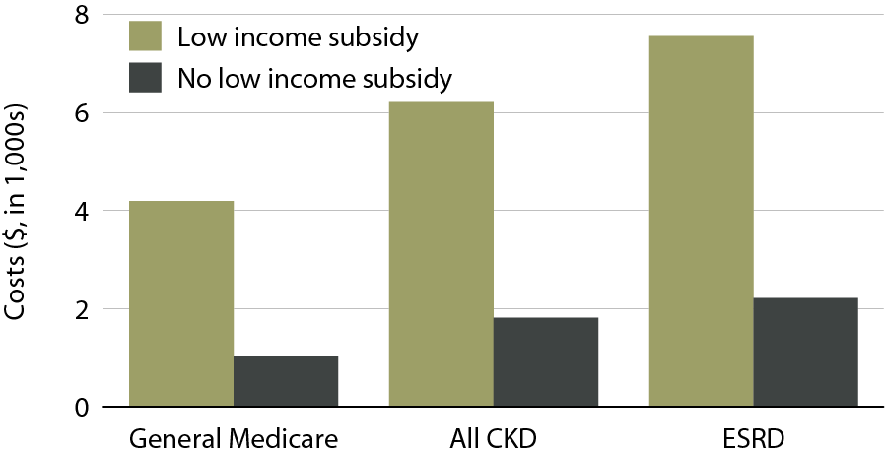
Per person per year Part D costs for enrollees, by low income subsidy (LIS) status, 2011
Figure 5.11 (Volume 1)
General Medicare totals include Part D claims for all patients in the Medicare 5 percent sample enrolled in Part D. CKD totals includes Medicare CKD patients, as determined from claims. ESRD totals include all Part D claims for Medicare ESRD patients enrolled in Part D. Costs are PPPY for calendar year 2011. Low income subsidy (LIS) status is determined from the Part D enrollment. A person is classified as LIS if they are eligible for the LIS for at least one month during 2011.

Slide 16
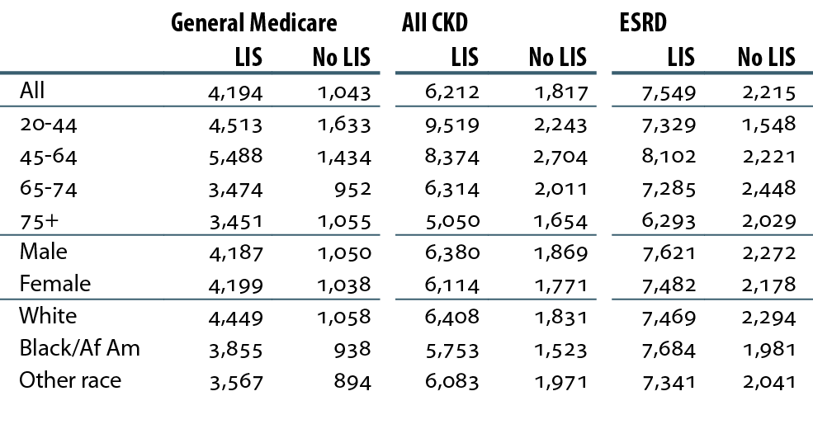
Total per person per year Part D costs ($) for enrollees, by LIS status, 2011
Table 5.d (Volume 1)
All Medicare patients enrolled in Part D, 2011. CKD determined from claims. ESRD: period prevalent ESRD patients, 2011. Costs are per person per year for calendar year 2011. Medicare PPPY is the sum of Medicare payment amount & low income subsidy amount. Low income subsidy (LIS) status is determined from the Part D enrollment. A person is classified as LIS if they are eligible for the low income subsidy for at least one month during 2011.

Slide 17
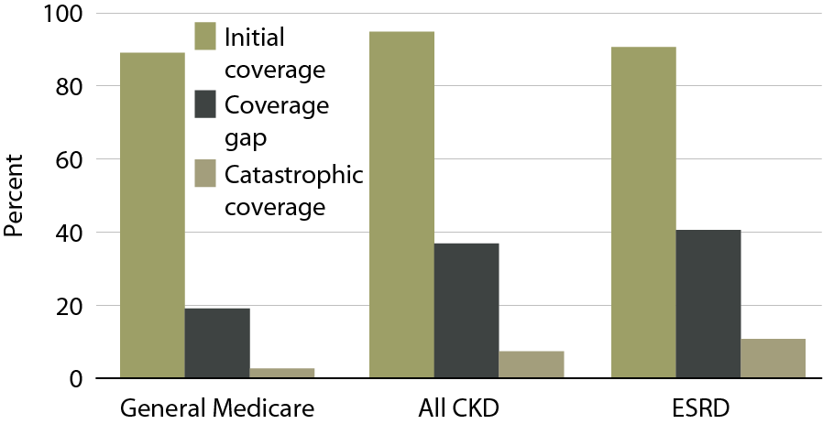
Part D enrollees not receiving the low income subsidy (LIS) who reach each coverage phase, 2011
Figure 5.12 (Volume 1)
Point-prevalent Medicare enrollees alive on January 1, excluding those in employer-sponsored & national PACE Part D plans.

Slide 18
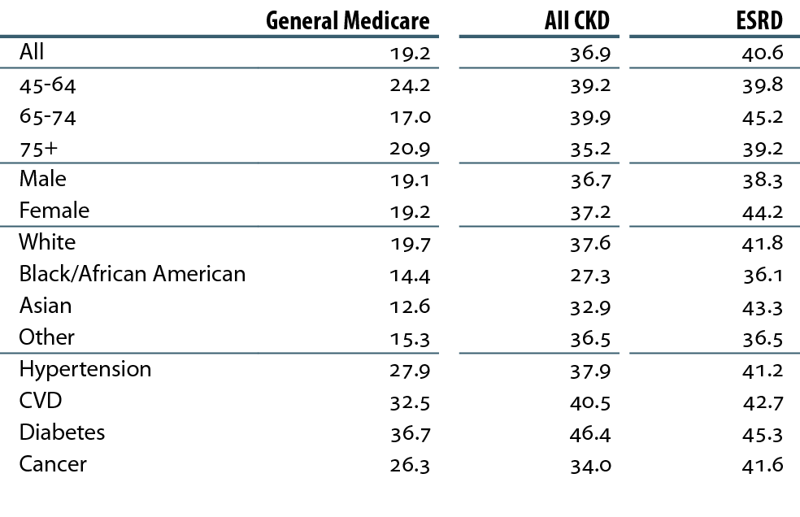
Twelve-month probability (%) of reaching the coverage gap in Part D enrollees not receiving the low income subsidy (LIS), 2011
Table 5.e (Volume 1)
Point prevalent Medicare enrollees alive on January 1, excluding those in employer-sponsored & national PACE Part D plans.

Slide 19
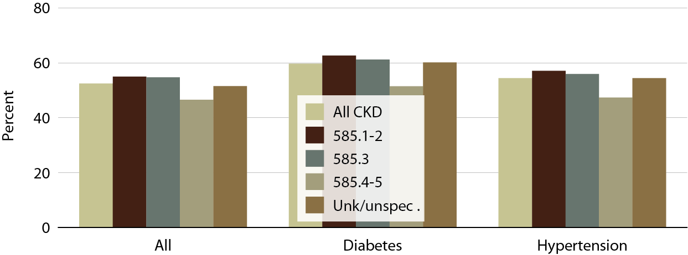
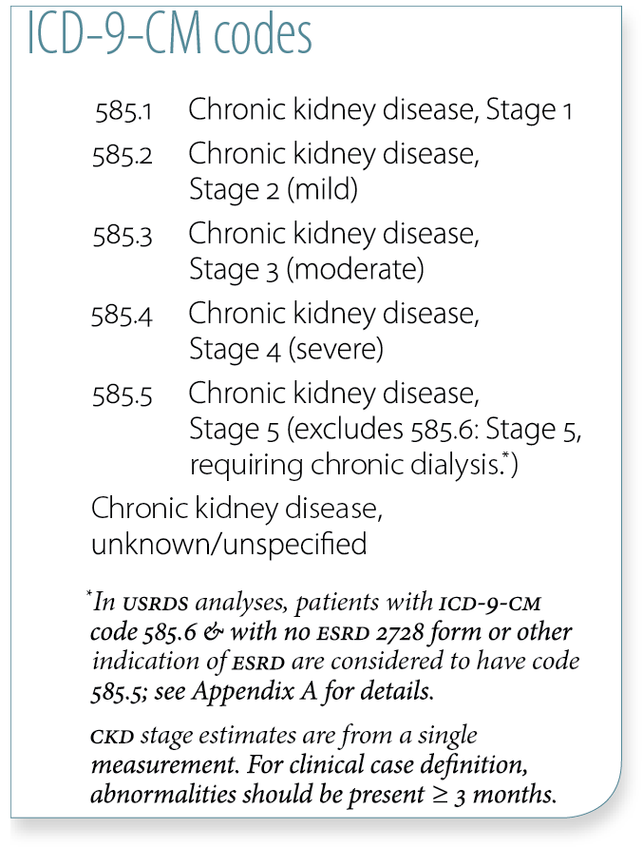
Medicare Part D CKD patients with at least one claim for an ACEI/ARB/renin inhibitor in the 12 months following the disease defining entry period, by CKD diagnosis code, 2011
Figure 5.13 (Volume 1)
Point prevalent Medicare CKD patients age 65 & older.

Slide 20
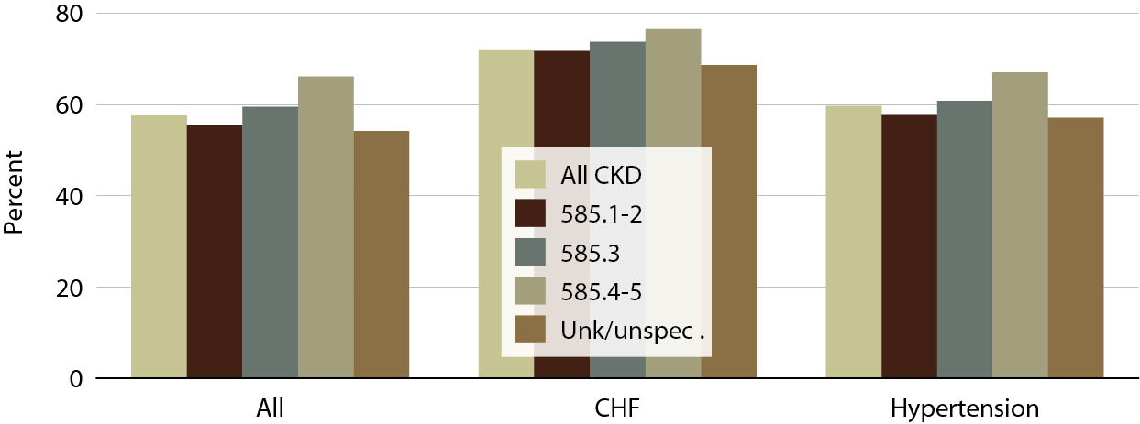
Medicare Part D CKD patients with at least one claim for a beta blocker in the 12 months following the disease defining entry period, by CKD diagnosis code, 2011
Figure 5.14 (Volume 1)
Point prevalent Medicare CKD patients age 65 & older.

Slide 21
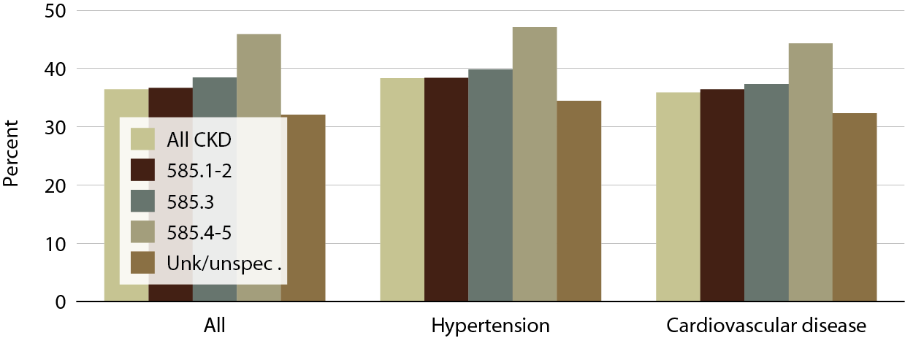
Medicare Part D CKD patients with at least one claim for a DHP calcium channel blocker in the 12 months following the disease-defining entry period, by CKD diagnosis code, 2011
Figure 5.15 (Volume 1)
Point prevalent Medicare CKD patients age 65 & older.

Slide 22
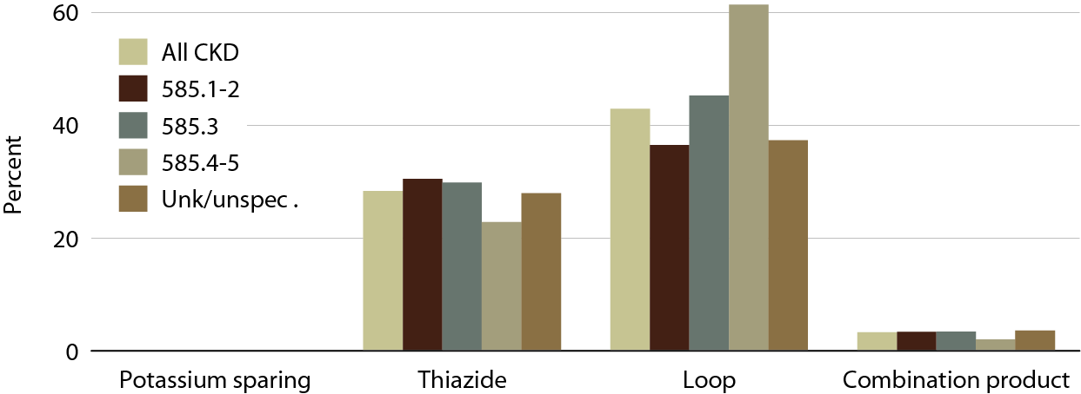
CKD patients with at least one claim for a diuretic in the 12 months following the disease-defining entry period, by CKD diagnosis code, 2011
Figure 5.16 (Volume 1)
Point prevalent Medicare CKD patients age 65 & older.

Slide 23
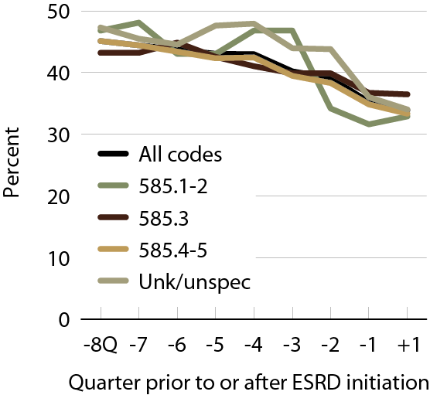
ACEI/ARB/renin inhibitor use in Part D enrollees in the transition to ESRD, 2011
Figure 5.17 (Volume 1)
Point prevalent Medicare CKD patients age 67 & older.

Slide 24
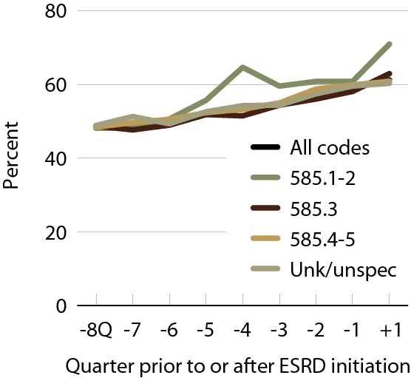
Beta blocker use in Part D enrollees in the transition to ESRD, 2011
Figure 5.18 (Volume 1)
Point prevalent Medicare CKD patients age 67 & older.

Slide 25
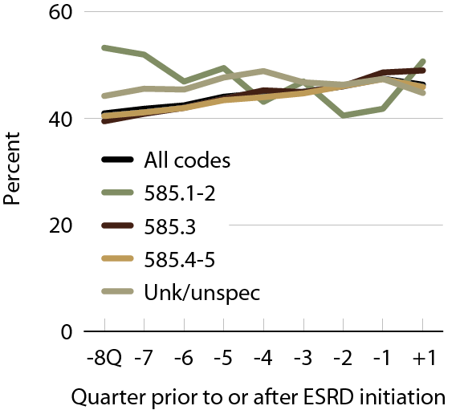
DHP calcium channel blocker use in
Part D enrollees in the transition to ESRD, 2011
Figure 5.19 (Volume 1)
Point prevalent Medicare CKD patients age 67 & older.

Slide 26
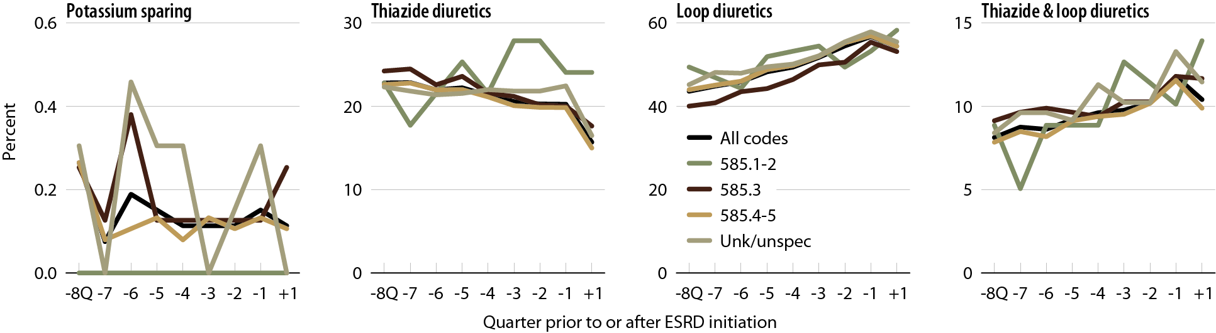
Diuretic use in Part D enrollees during the transition to ESRD, by CKD diagnosis code, 2011
Figure 5.20 (Volume 1)
Point prevalent Medicare CKD patients age 67 & older.

Slide 27
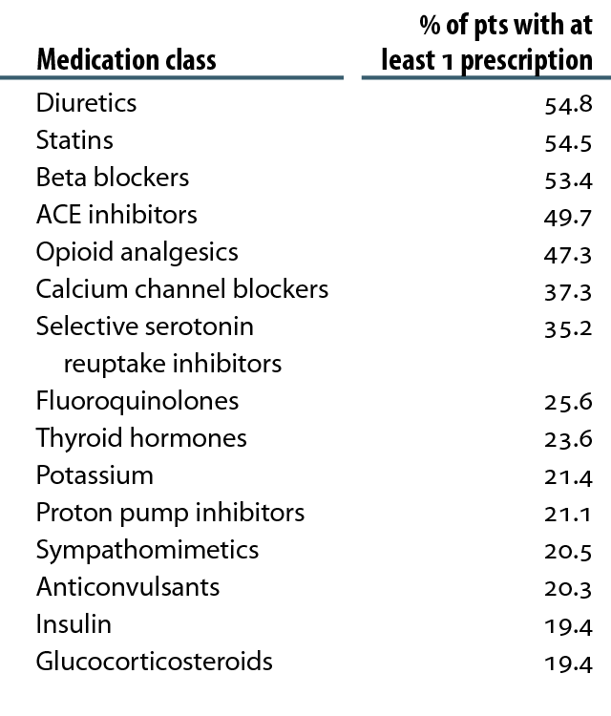
Top 15 drug classes in by Part D enrollees with CKD, by % of patients & drug class, 2011
Table 5.f (Volume One)
CKD patients in the Medicare 5 percent sample.

