Slide 1
CKD: Chapter Six Acute kidney injury
United States Renal Data System
2013 Annual Data Report

Slide 2
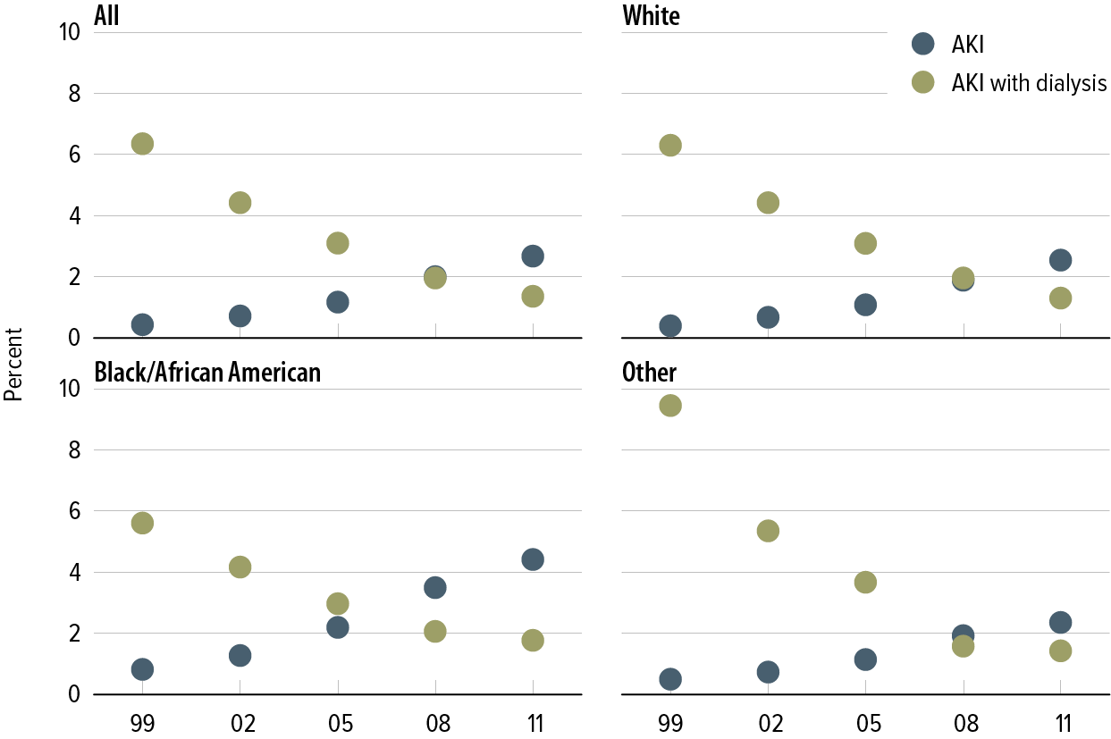
Percent of patients with at least one recognized AKI event, with or without dialysis, by race Figure 6.1 (Volume 1)
Medicare patients age 66 & older.

Slide 3
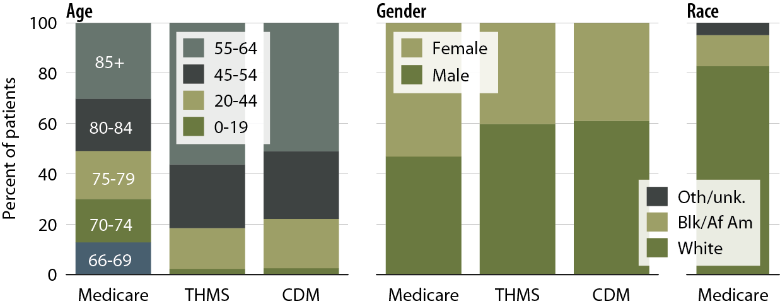
Characteristics of patients with acute kidney injury, by age, gender, race, & dataset, 2011 Figure 6.2 (Volume 1)
Medicare patients age 66 & older, & Truven Health MarketScan & Clinformatics DataMart patients age 20–64.

Slide 4
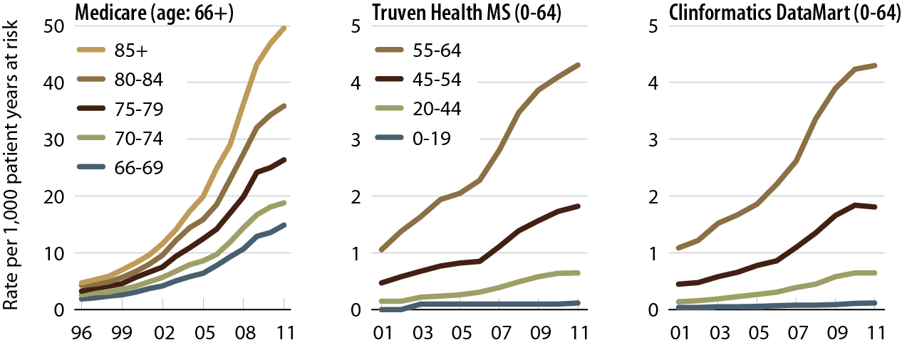
Unadjusted rates of first AKI within the cohort year, by age & dataset Figure 6.3 (Volume 1)
Medicare AKI patients age 66 & older, & Truven Health MarketScan & Clinformatics DataMart patients AKI age 20–64.

Slide 5
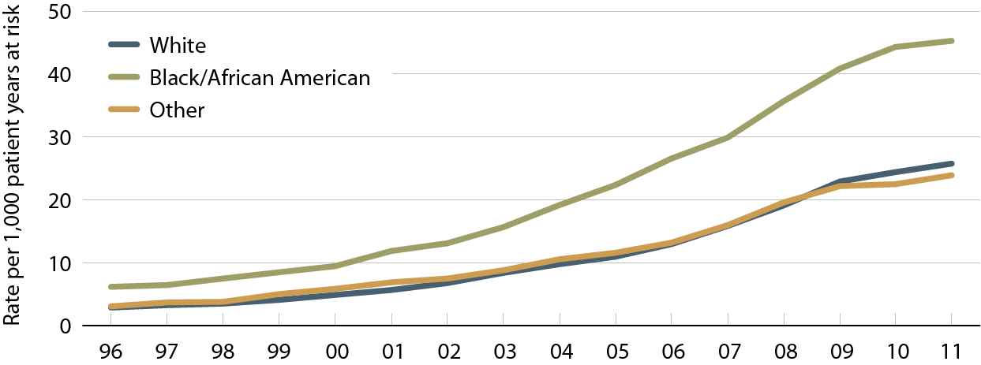
Unadjusted rates of first AKI within the cohort year among Medicare patients age 66 & older, by race Figure 6.4 (Volume 1)
Medicare patients age 66 & older.

Slide 6
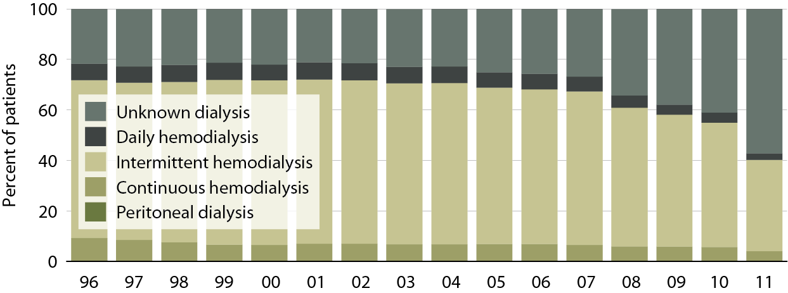
Type of dialysis in Medicare patients age 66 & older, hospitalized for AKI & requiring dialysis Figure 6.5 (Volume 1)
Medicare patients age 66 & older with at least one AKI hospitalization/event.

Slide 7
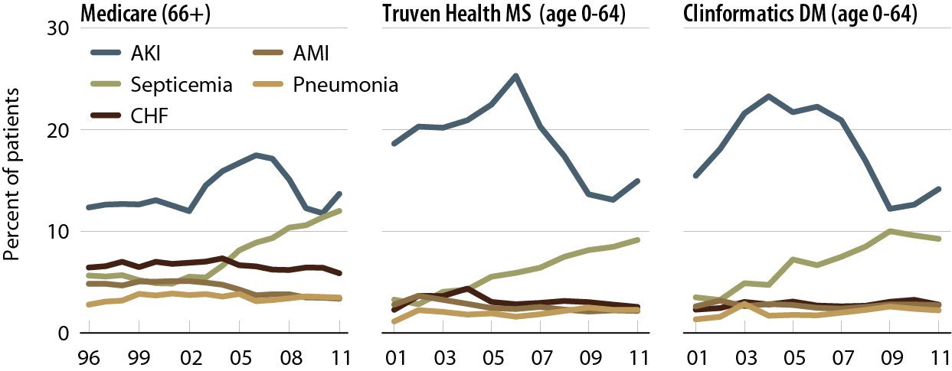
Principal diagnosis code on AKI claim, by dataset Figure 6.6 (Volume 1)
Medicare AKI patients age 66 & older, & Truven Health MarketScan & Clinformatics DataMart AKI patients age 0–64.

Slide 8
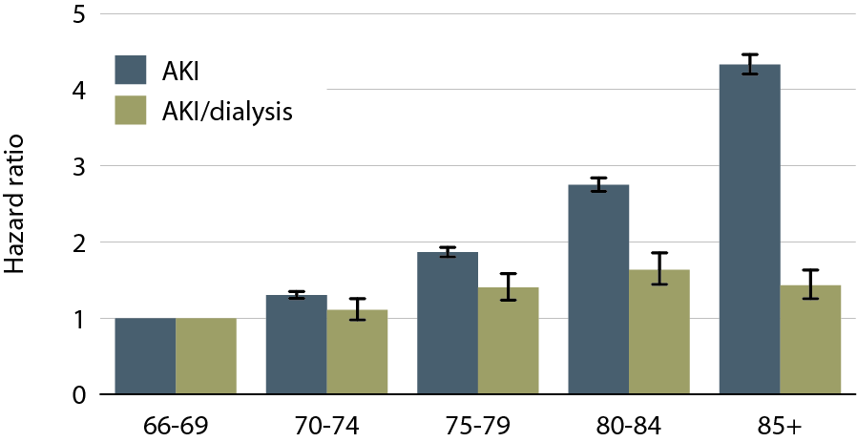
Adjusted hazard of an AKI hospitalization in Medicare patients, by age, 2011 Figure 6.7 (Volume 1)
Medicare patients age 66 & older; adj: gender/race; ref: patients age 66–69, 2011.

Slide 9
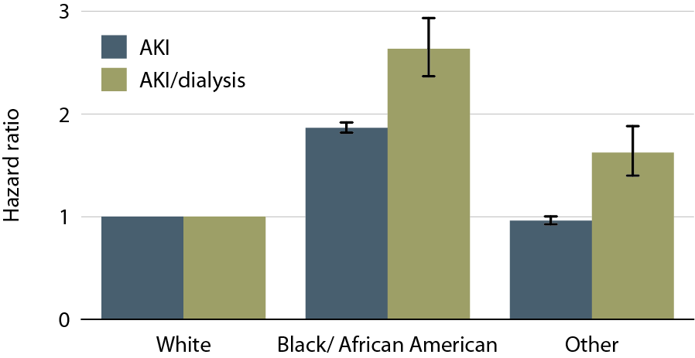
Adjusted hazard of an AKI hospitalization in Medicare patients, by race, 2011 Figure 6.8 (Volume 1)
Medicare patients age 66 & older; adj: age, & gender; ref: whites, 2011.

Slide 10
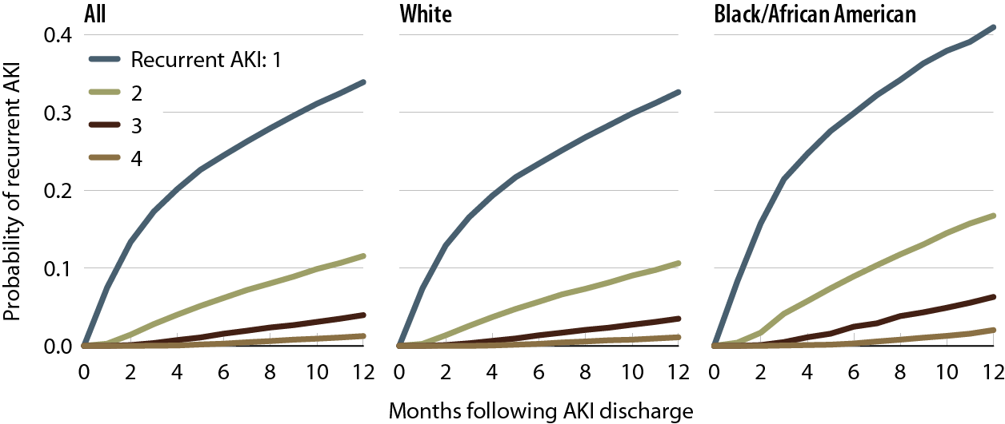
Probability of a recurrent AKI hospitalization in Medicare patients, by number of events & race, 2010–2011 Figure 6.9 (Volume 1)
Medicare AKI patients age 66 & older, 2010–2011.

Slide 11
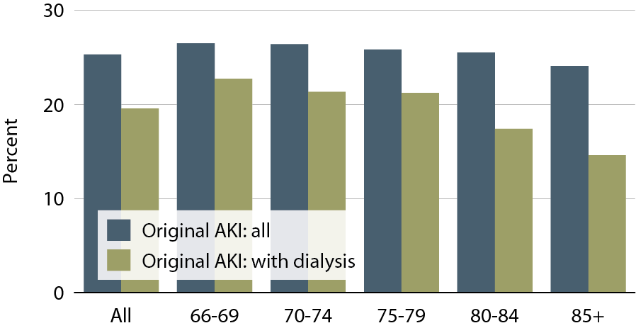
Patients with a recurrent AKI, by age, 2010–2011 Figure 6.10 (Volume 1)
Medicare patients age 66 & older; original AKI in 2010, recurrent AKI within one year.

Slide 12
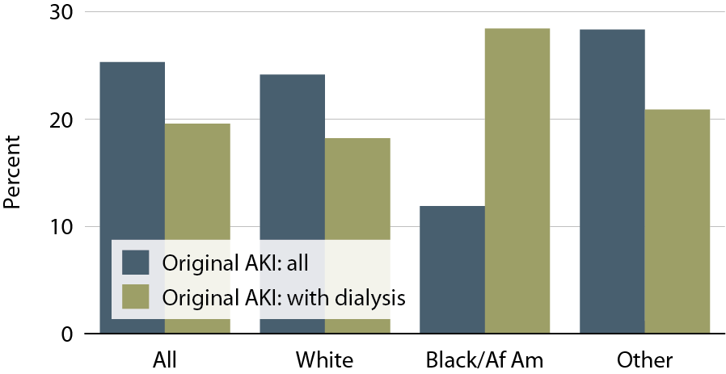
Patients with a recurrent AKI, by race, 2010–2011 Figure 6.11 (Volume 1)
Medicare patients age 66 & older; original AKI in 2010, recurrent AKI within one year.

Slide 13
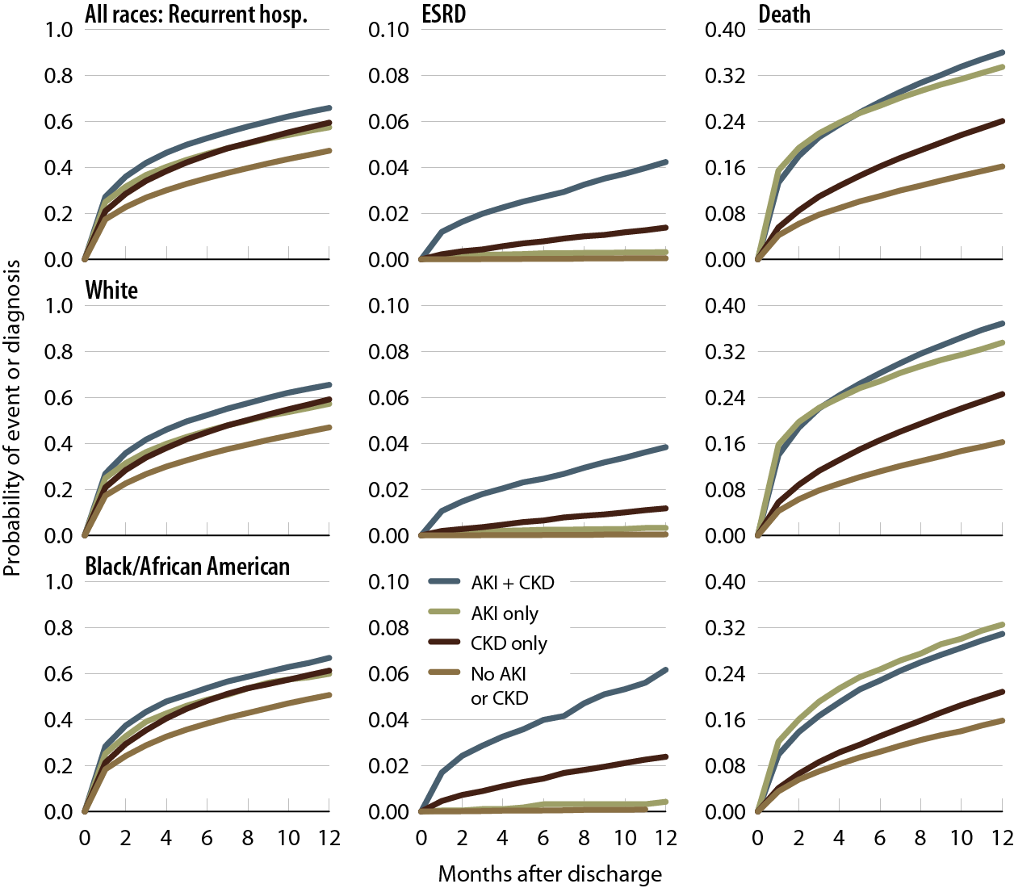
Probability of a recurrent hospitalization, ESRD, or death in the year following discharge, by race and renal status at initial hospitalization, 2010–2011 Figure 6.12 (Volume 1)
Medicare patients age 66 & older, 2010–2011.

Slide 14
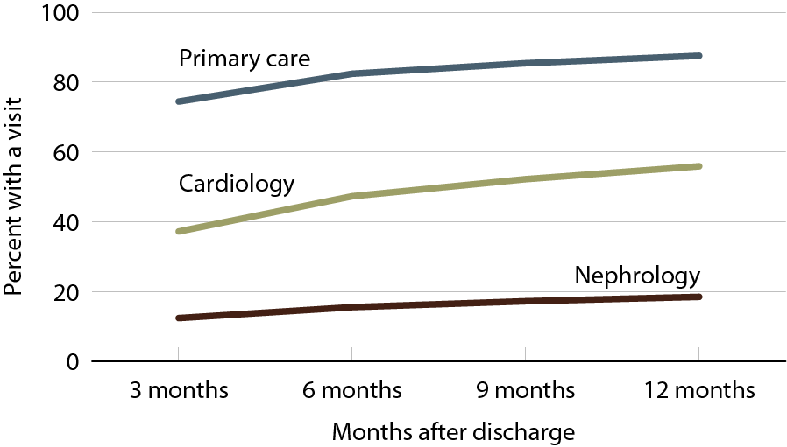
Outpatient physician visits following initial AKI discharge, 2010–2011 Figure 6.13 (Volume 1)
Medicare AKI patients age 66 & older, 2010-2011.

Slide 15
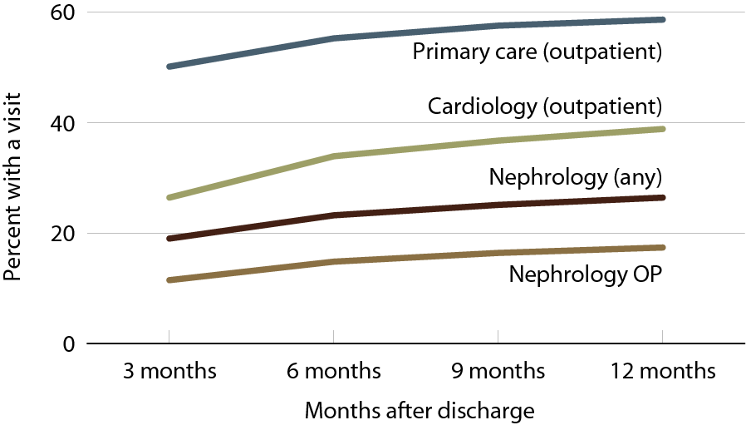
Physician visits in the year following a recurrent AKI discharge, 2010–2011 Figure 6.14 (Volume 1)
Medicare AKI patients age 66 & older, 2010–2011.

Slide 16
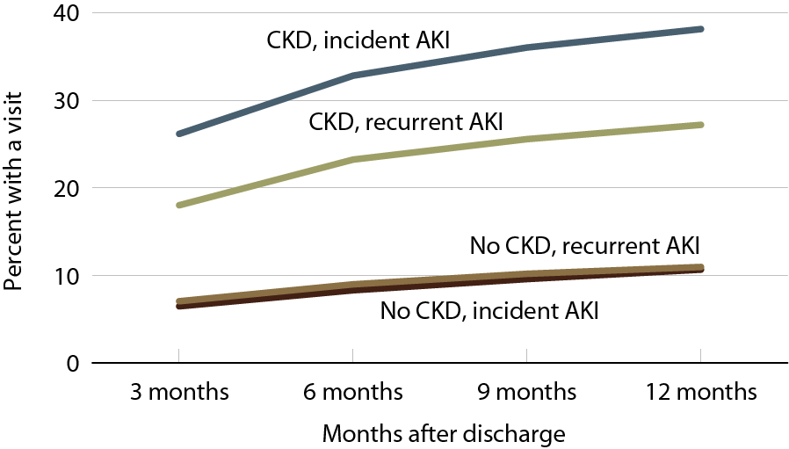
Outpatient nephrology visits in the year following a recurrent AKI discharge, by CKD status, 2010–2011 Figure 6.15 (Volume 1)
Medicare AKI patients age 66 & older, 2010–2011.

Slide 17
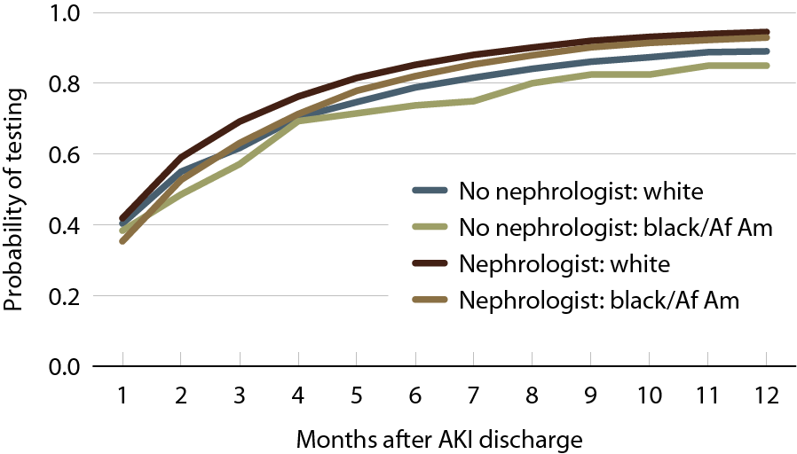
Probability of serum creatinine testing after hospitalization for AKI, by nephrologist care & race, 2010–2011 Figure 6.16 (Volume 1)
Medicare AKI patients age 66 & older, 2010–2011.

Slide 18
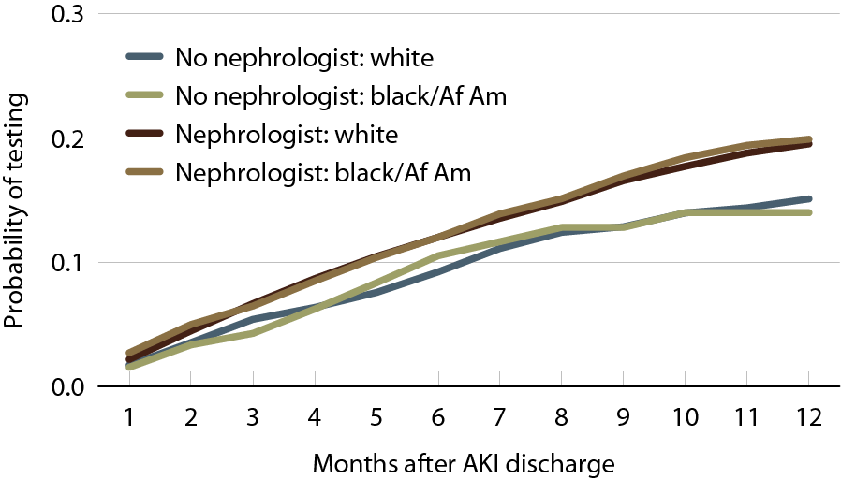
Probability of urine albumin testing after hospitalization for AKI, by nephrologist care & race, 2010–2011 Figure 6.17 (Volume 1)
Medicare AKI patients age 66 & older, 2010–2011.

Slide 19
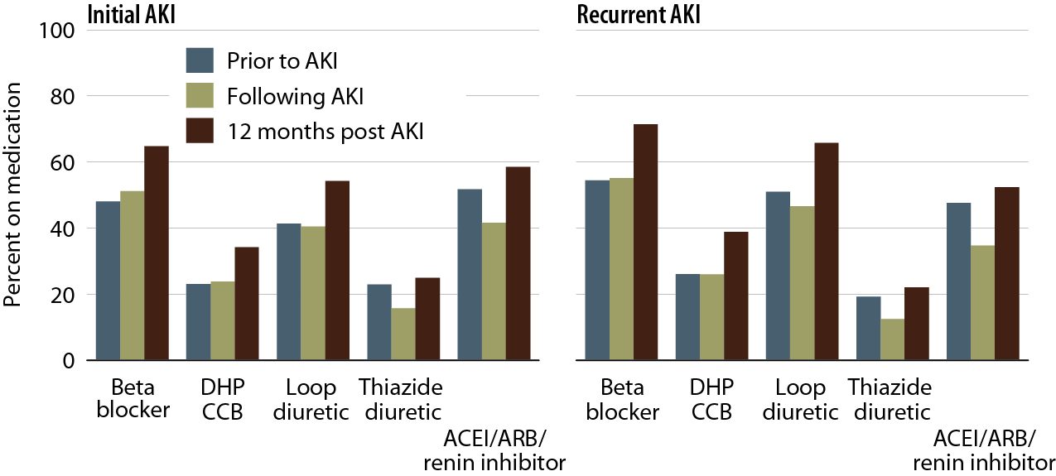
Drug therapy prior to & after hospitalization for AKI in patients with Medicare Part D coverage, for initial & recurrent AKI Figure 6.18 (Volume 1)
AKI patients with Part D coverage, 2010.

Slide 20
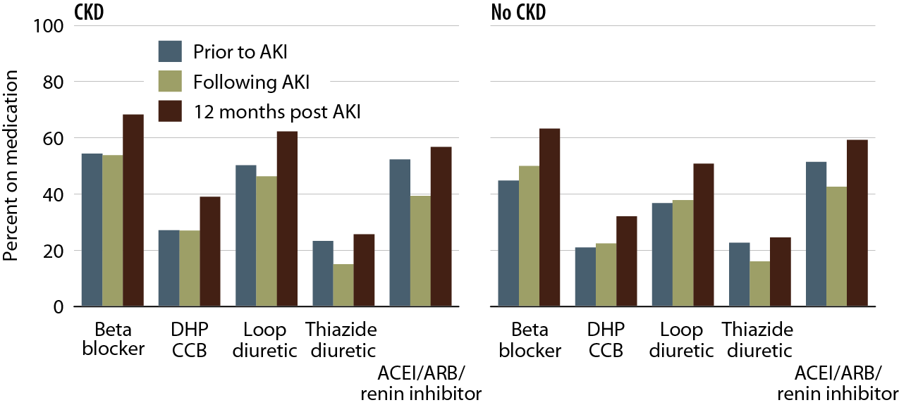
Drug therapy prior to & after hospitalization for AKI in patients with Medicare Part D coverage, by CKD status Figure 6.19 (Volume 1)
AKI patients with Part D coverage, 2010; CKD identified as any CKD claim during the three months prior to AKI.

Slide 21
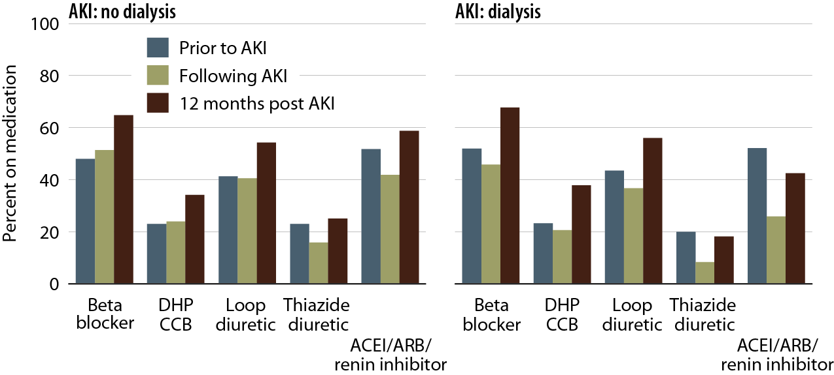
Drug therapy prior to & after AKI hospitalization in patients with Medicare Part D coverage, by AKI type Figure 6.20 (Volume 1)
AKI patients with Part D coverage, 2010.

Slide 22
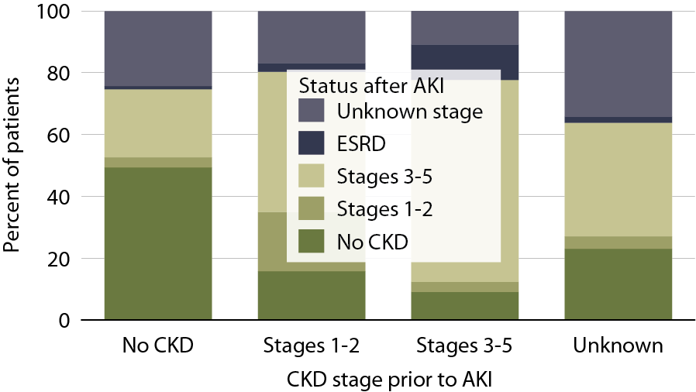
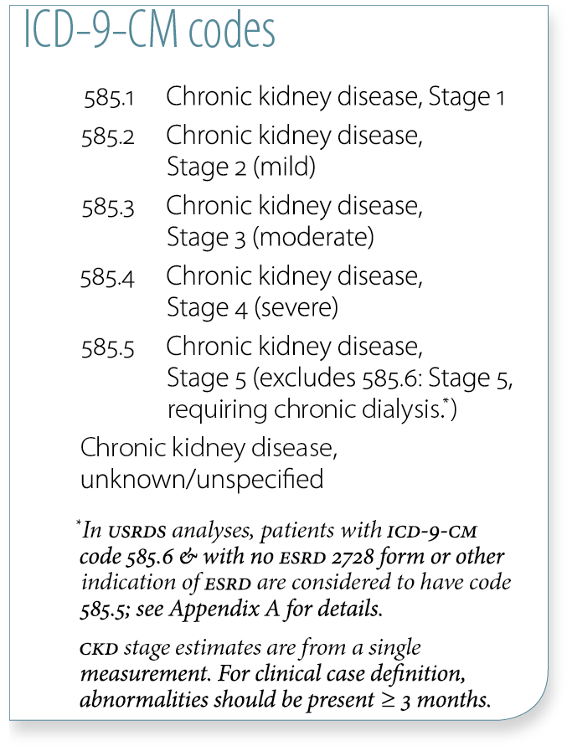
Changes to CKD status in the year following an AKI in Medicare patients, 2010-2011 Figure 6.21 (Volume 1)
Medicare AKI patients age 66 & older, 2010–2011.

Slide 23
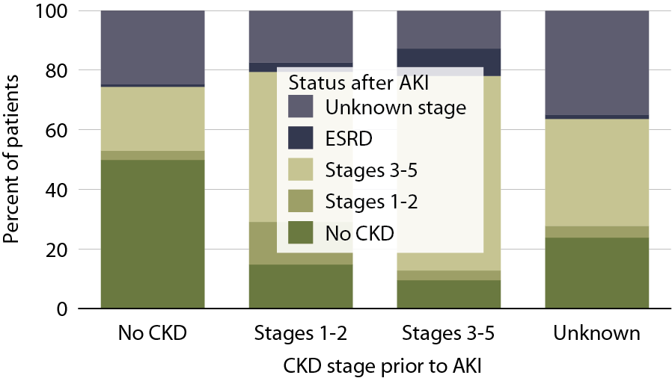
Changes to CKD status in the year following a recurrent AKI in Medicare patients, 2010-2011 Figure 6.22 (Volume 1)
Medicare AKI patients age 66 & older, 2010-2011; first hospitalization occurred in 2010.

Slide 24
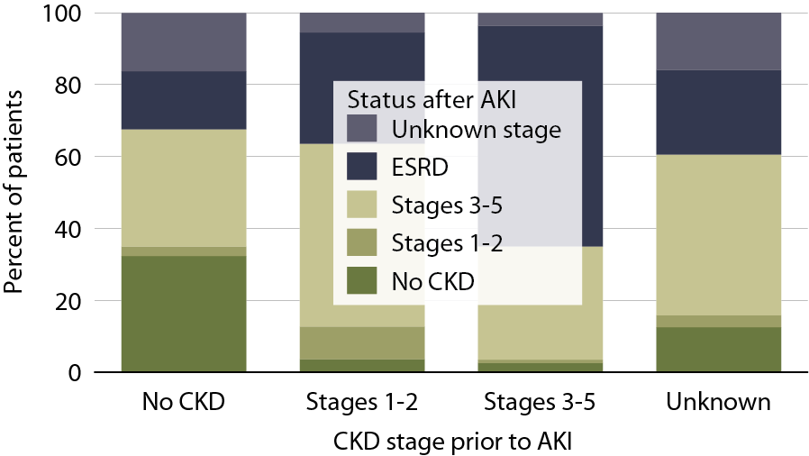
Changes to CKD status in the year following an AKI with dialysis in Medicare patients, 2010-2011 Figure 6.23 (Volume 1)
Medicare AKI patients age 66 & older, 2010-2011; data limited to AKI events with dialysis.

Slide 25
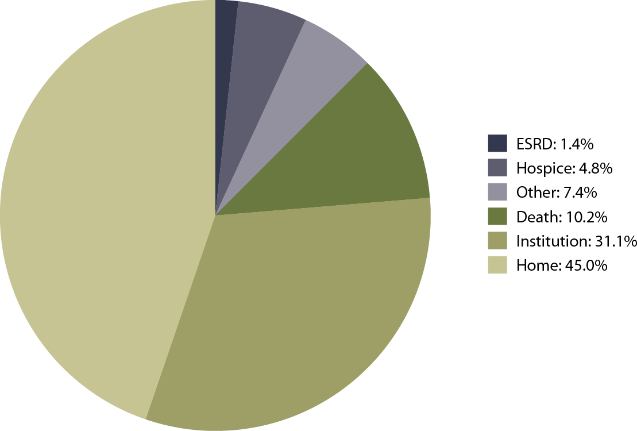
Discharge status following an AKI, 2011 Figure 6.24 (Volume 1)
Medicare AKI patients age 66 & older, 2011.

