Slide 1
CKD: Chapter Seven
Costs of CKD
United States Renal Data System
2013 Annual Data Report

Slide 2
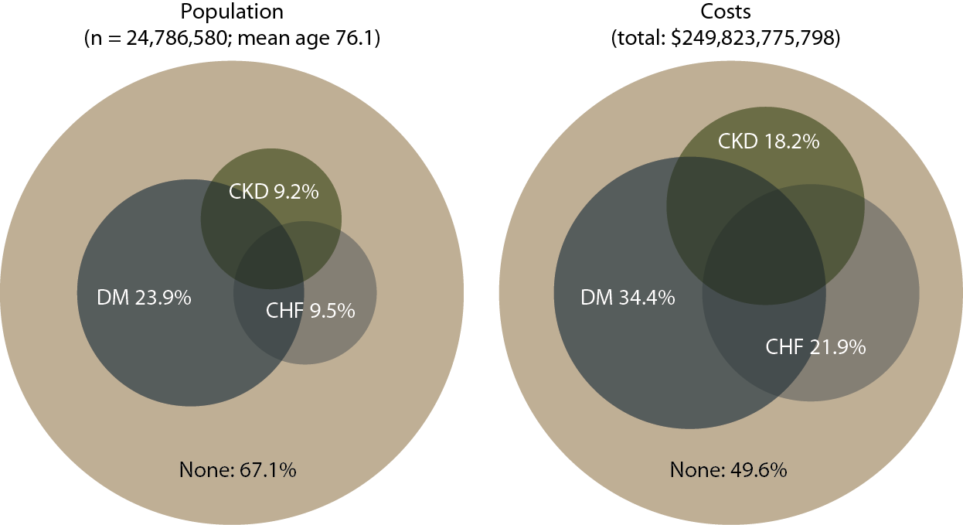
Point prevalent distribution & annual costs of Medicare
(fee-for-service) patients, age 65 & older, with diagnosed diabetes, CHF, & CKD, 2011
Figure 7.1 (Volume 1)
Populations estimated from the 5 percent Medicare sample using a point prevalent model. Population further restricted to patients age 65 & older, without ESRD. Diabetes, CHF, & CKD determined from claims; costs are for calendar year 2011.

Slide 3
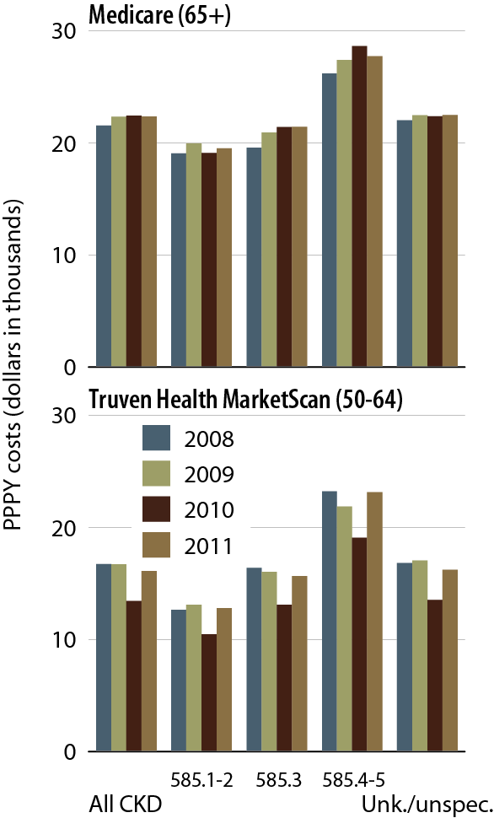

Overall PPPY costs in CKD patients, by CKD diagnosis code, dataset, & year
Figure 7.2 (Volume 1)
Point prevalent Medicare patients age 65 & older (5 percent Medicare sample, 7.2–4) & Truven Health MarketScan patients age 50–64 (7.2). Includes Part D.

Slide 4
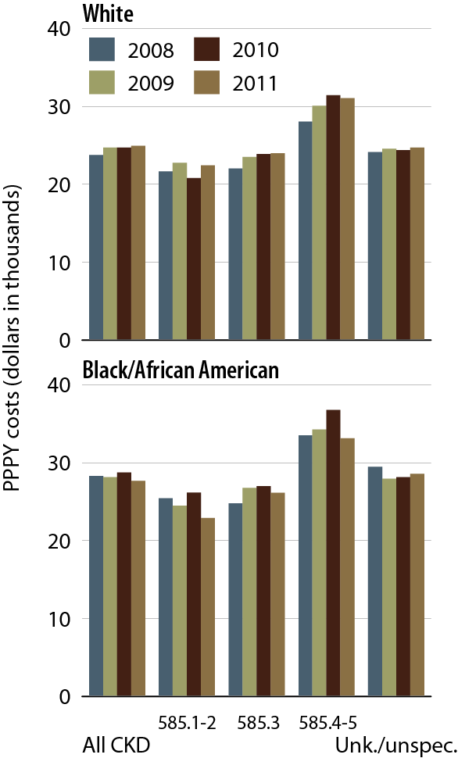
PPPY costs in Medicare CKD patients with diabetes, by CKD diagnosis code, race, & year
Figure 7.3 (Volume 1)
Point prevalent Medicare patients age 65 & older (5 percent Medicare sample, 7.2–4) & Truven Health MarketScan patients age 50–64 (7.2). Includes Part D.

Slide 5
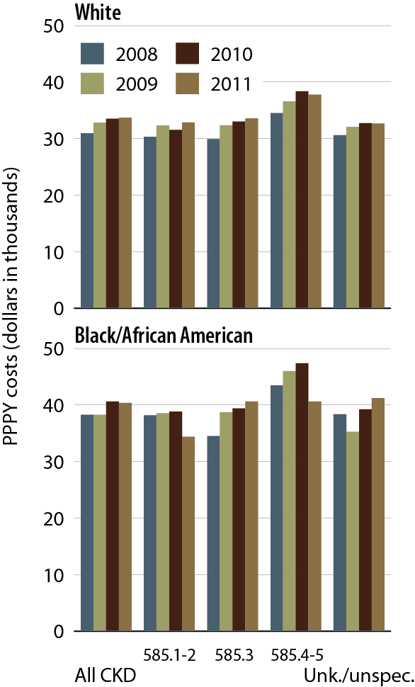
PPPY costs in Medicare CKD patients with CHF, by CKD diagnosis code, race, & year
Figure 7.4 (Volume 1)
Point prevalent Medicare patients age 65 & older (5 percent Medicare sample, 7.2–4) & Truven Health MarketScan patients age 50–64 (7.2). Includes Part D.

Slide 6
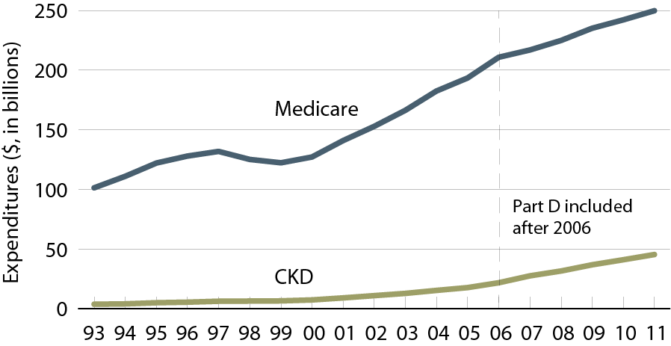
Overall expenditures for CKD in the
Medicare population age 65 & older
Figure 7.5 (Volume 1)
Point prevalent Medicare CKD patients age 65 & older; costs are total expenditures per calendar year.

Slide 7
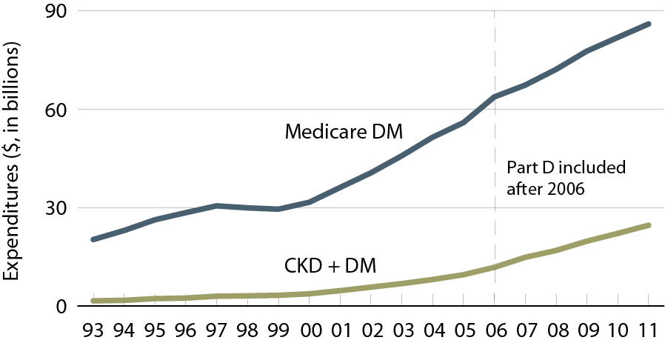
Overall expenditures for CKD & diabetes in the Medicare population age 65 & older
Figure 7.6 (Volume 1)
Point prevalent Medicare CKD patients age 65 & older; costs are total expenditures per calendar year.

Slide 8
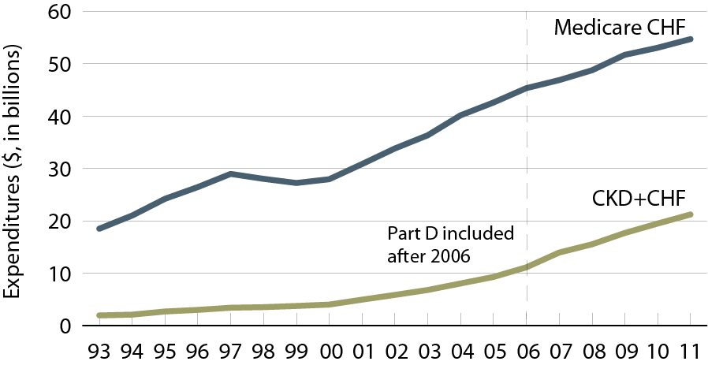
Overall expenditures for CKD & congestive heart failure in the Medicare population age 65 & older
Figure 7.7 (Volume 1)
Point prevalent Medicare CKD patients age 65 & older; costs are total expenditures per calendar year.

Slide 9
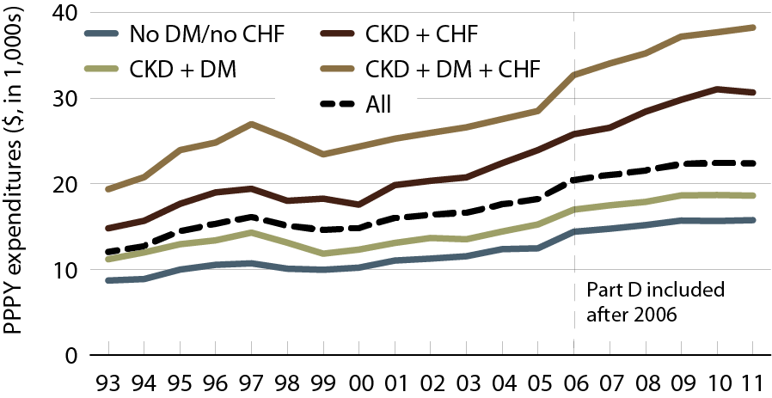
Per person per year expenditures for CKD in the Medicare population age 65 & older, by at-risk group
Figure 7.8 (Volume 1)
Point prevalent Medicare CKD patients age 65 & older. Includes Part D.

Slide 10
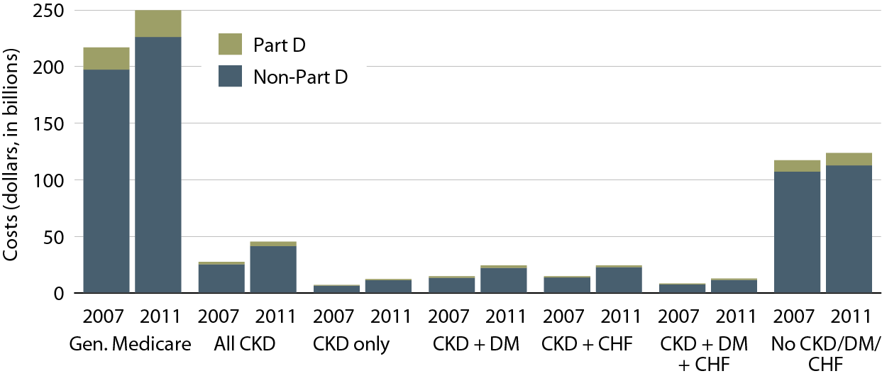
Overall Medicare Part D & non-Part D costs, by at-risk group & year
Figure 7.9 (Volume 1)
Point prevalent Medicare CKD patients age 65 & older, 2011; 5 percent Medicare sample.

Slide 11
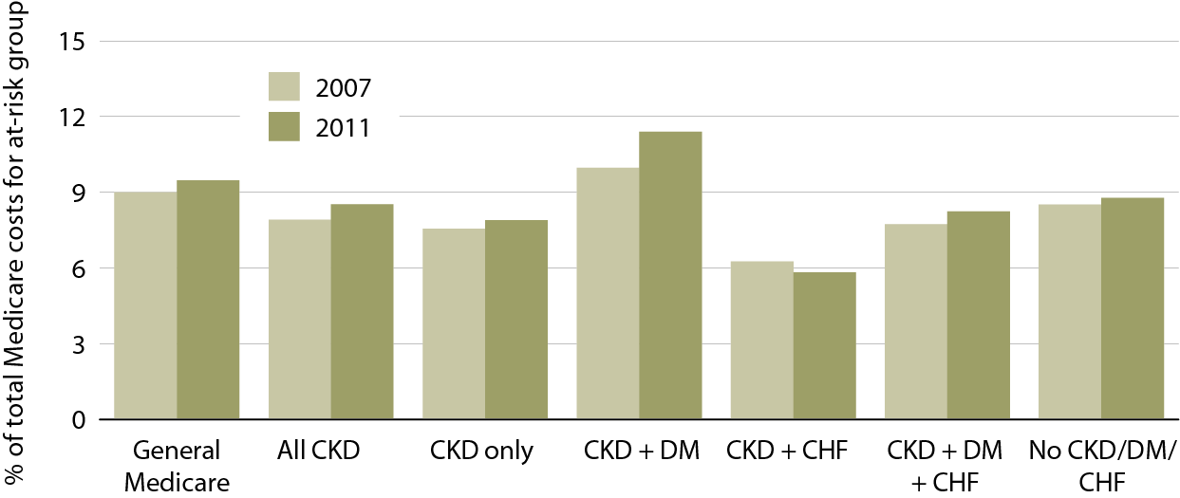
Part D costs as a proportion of total Medicare costs for each at-risk group, 2007 & 2011
Figure 7.10 (Volume 1)
Point prevalent Medicare CKD patients age 65 & older, 2011; 5 percent Medicare sample.

Slide 12
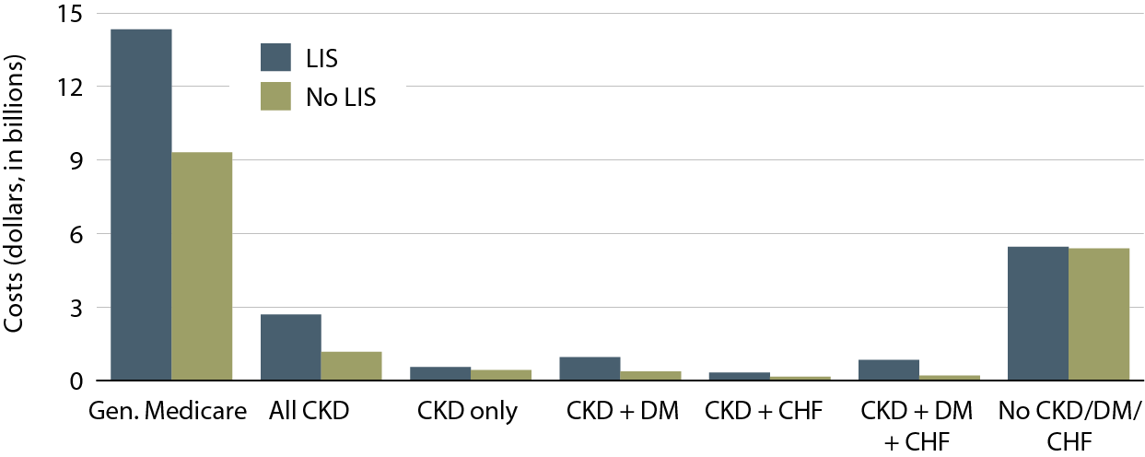
Total Part D, by at-risk group & low income subsidy (LIS) status, 2011
Figure 7.11 (Volume 1)
Point prevalent Medicare CKD patients age 65 & older, 2011; 5 percent Medicare sample.

Slide 13
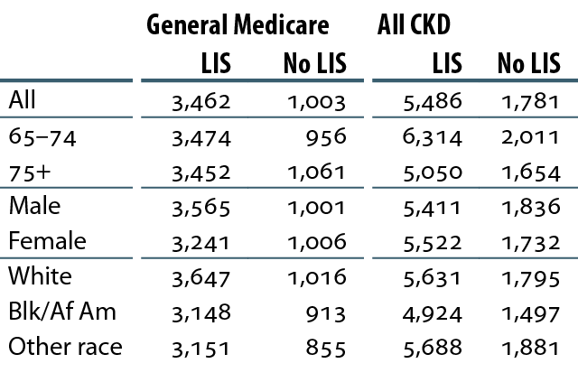
Total PPPY Part D costs ($) for
Part D enrollees, by LIS status, 2011
Table 7.a (Volume 1)
Point prevalent Medicare CKD patients age 65 & older; claims &
costs are scaled up by a factor of 20 to estimate totals.

Slide 14
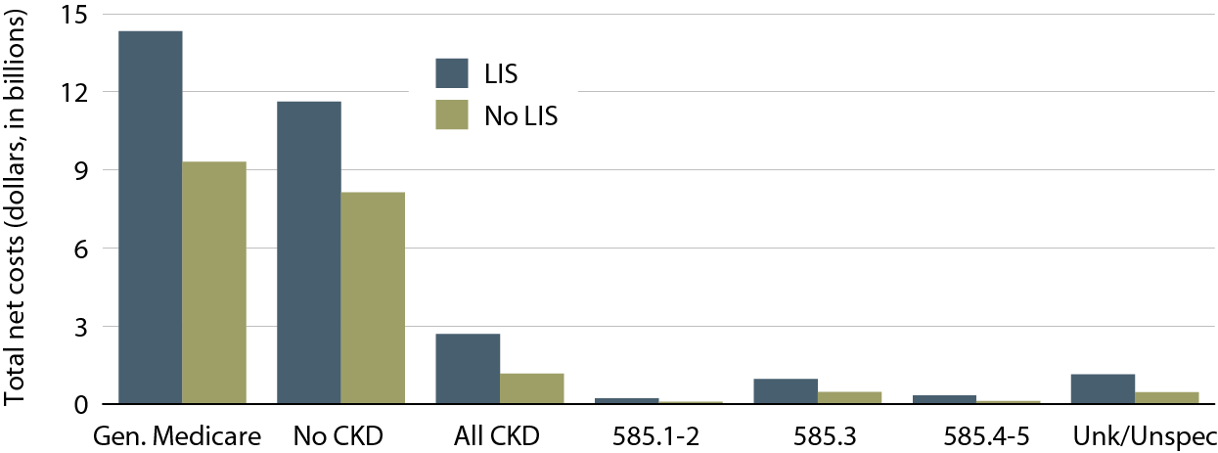
Total estimated Part D costs, by low income subsidy (LIS) status & CKD diagnosis code, 2011
Figure 7.12 (Volume 1)
Point prevalent Medicare CKD patients age 65 & older, 2011; For figure 7.12, includes Part D claims for all CKD patients, defined from claim. Costs are estimated net pay: sum of plan covered payments & low income subsidy amounts. Counts & counts obtained from 5 percent Medicare sample, & scaled up by factor of 20 to estimate total Medicare CKD costs.

Slide 15
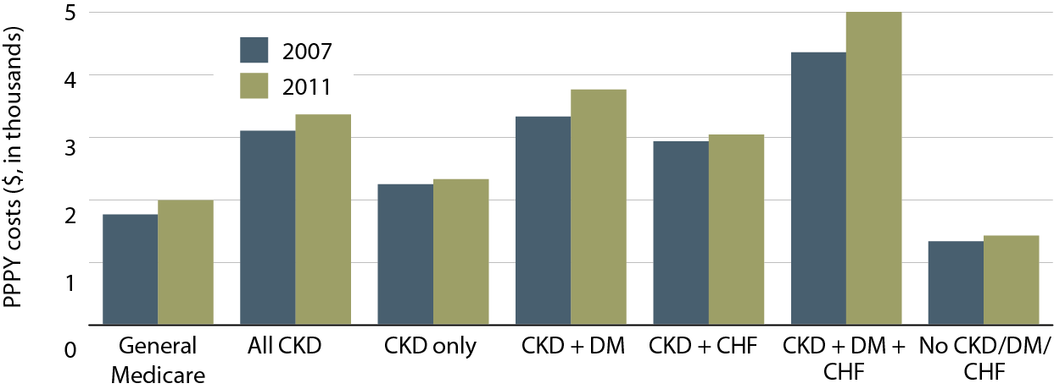
Total per person per year (PPPY) Part D costs, by at-risk group, 2007 & 2011
Figure 7.13 (Volume 1)
Point prevalent Medicare CKD patients age 65 & older, 2011

Slide 16
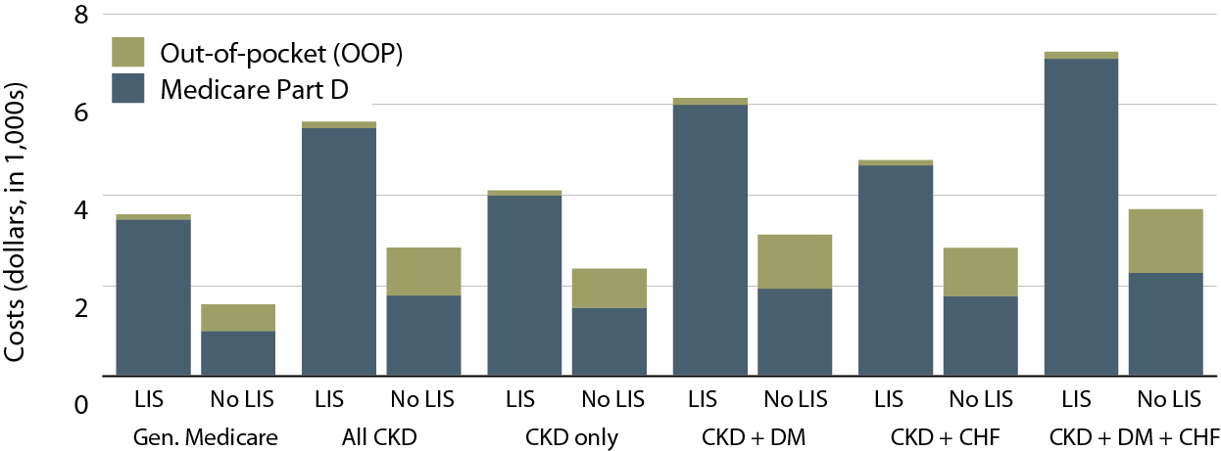
Per person per year (PPPY) Medicare Part D
& out-of-pocket costs, by low income subsidy (LIS) status & at-risk group, 2011
Figure 7.14 (Volume 1)
Point prevalent Medicare CKD patients age 65 & older, 2011; costs are estimated from the Medicare 5 percent sample.

Slide 17
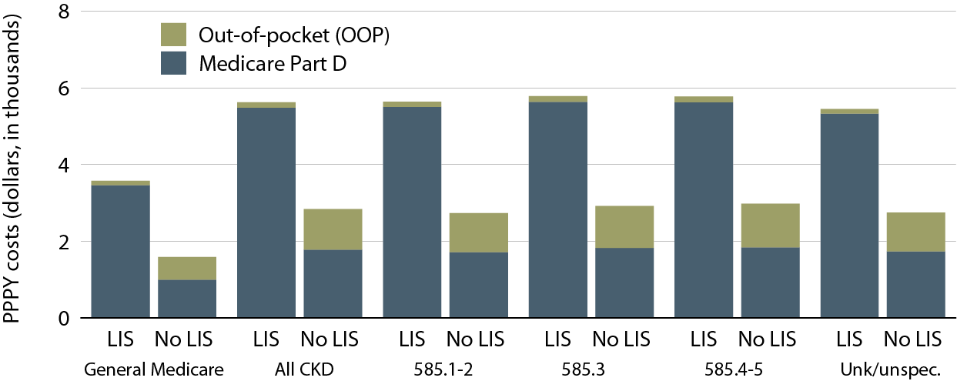
Per person per year (PPPY) Medicare Part D & out-of- pocket costs, by low income subsidy (LIS) status & CKD diagnosis code, 2011
Figure 7.15 (Volume 1)
Point prevalent Medicare CKD patients age 65 & older, 2011.

Slide 18
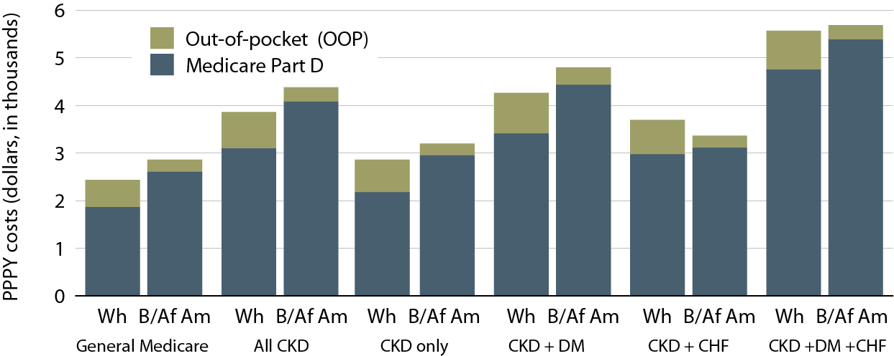
Overall per person per year (PPPY) Medicare Part D & out-of-pocket costs, by race & at-risk group, 2011
Figure 7.16 (Volume 1)
Point prevalent Medicare CKD patients age 65 & older, 2011.

Slide 19
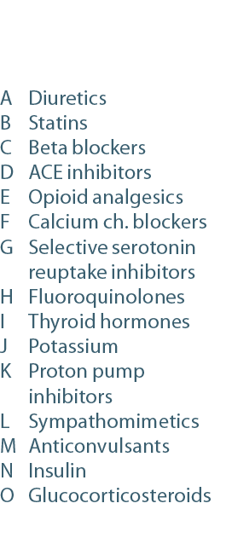
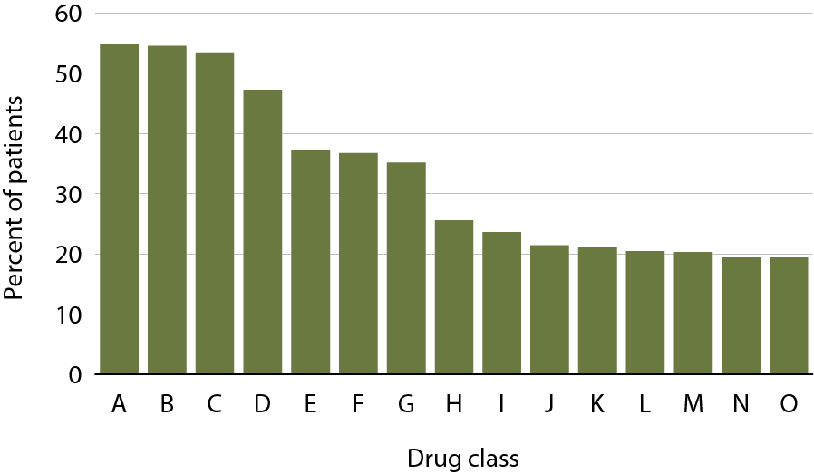
Top 15 drug classes used by Part D enrollees with CKD, by percent of patients & drug class, 2011
Figure 7.17 (Volume 1)
Medicare patients with CKD; costs scaled up by a factor of 20 to estimate totals.

Slide 20
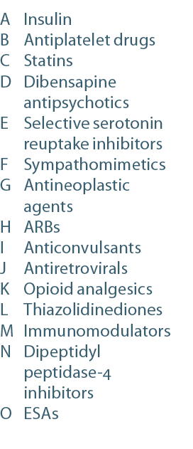
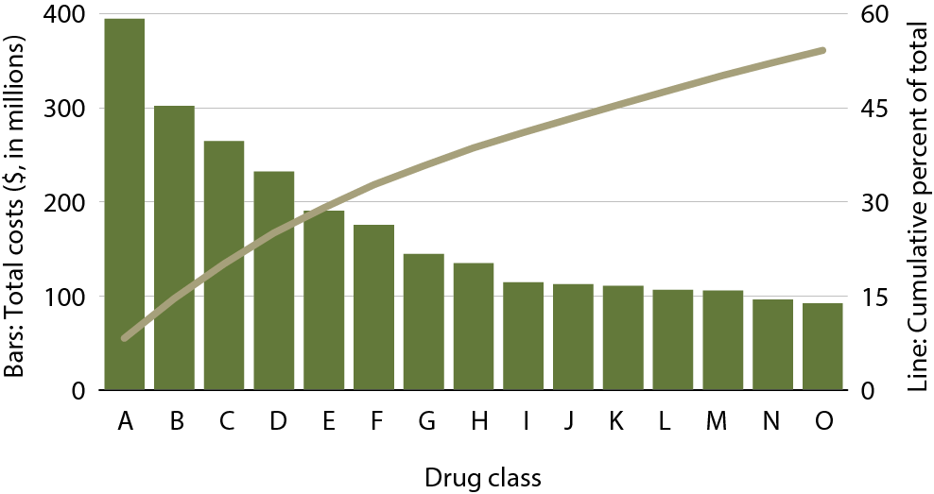
Top 15 drug classes used by Part D enrollees with CKD, by net costs & drug class, 2011
Figure 7.18 (Volume 1)
Medicare patients with CKD; costs scaled up by a factor of 20 to estimate totals.

Slide 21
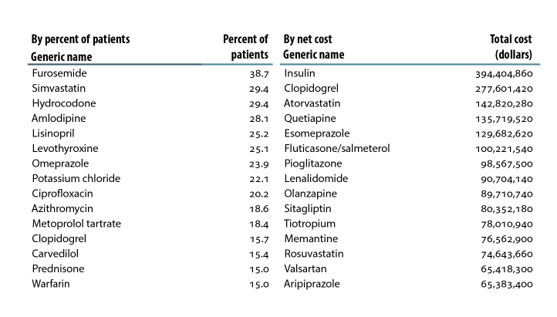
Top 15 drugs used by Part D enrollees with CKD, by percent of patients & net cost, 2011
Figure 7.b (Volume 1)
Medicare patients with CKD; costs scaled up by a factor of 20 to estimate totals.

Slide 22
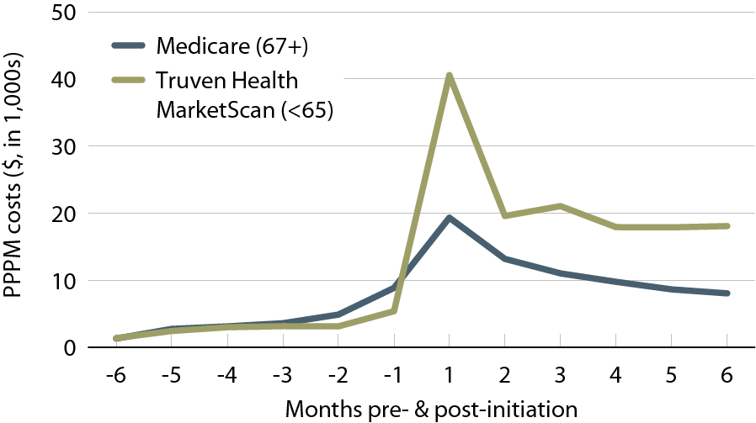
Per person per month (PPPM) expenditures during the transition to ESRD, by dataset, 2011
Figure 7.19 (Volume 1)
Incident Medicare (age 67 & older) & Truven Health MarketScan (younger than 65) ESRD patients, initiating in 2008.

Slide 23
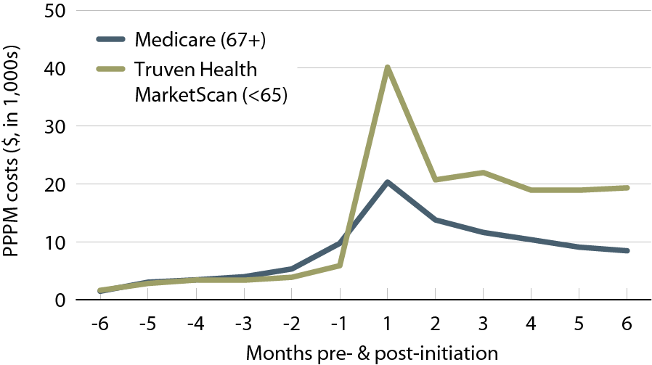
Per person per month (PPPM) expenditures during the transition to ESRD for patients with diabetes, by dataset, 2011
Figure 7.20 (Volume 1)
Incident Medicare (age 67 & older) & Truven Health MarketScan (younger than 65) ESRD patients, initiating in 2008.

Slide 24
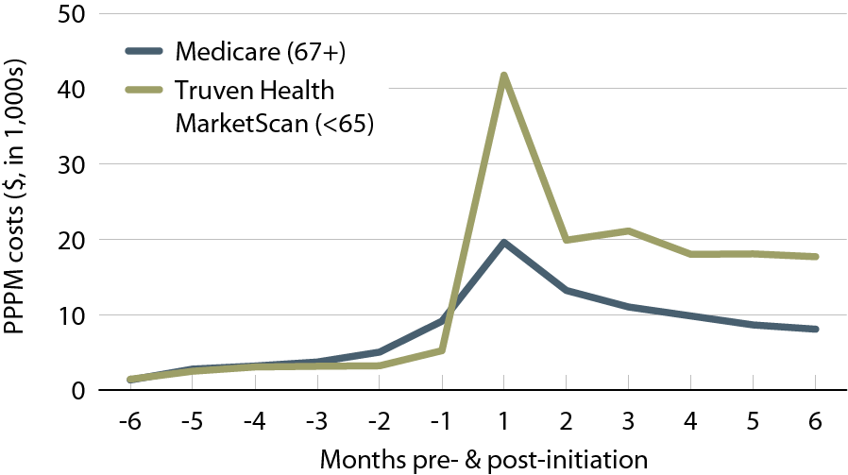
Per person per month (PPPM) expenditures during the transition to ESRD for patients with hypertension, by dataset, 2011
Figure 7.21 (Volume 1)
Incident Medicare (age 67 & older) & Truven Health MarketScan (younger than 65) ESRD patients, initiating in 2008.

Slide 25
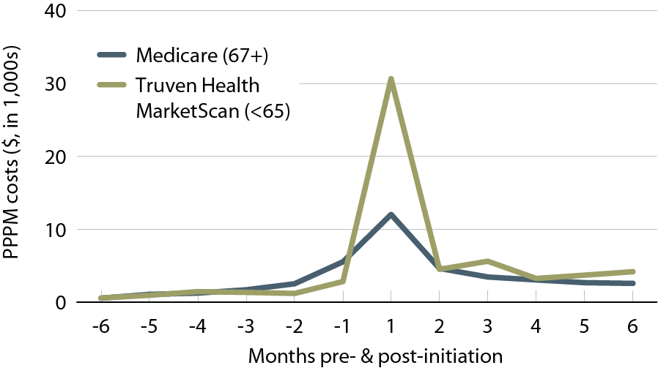
Per person per month (PPPM) expenditures for inpatient services during the transition to ESRD, by dataset, 2011
Figure 7.22 (Volume 1)
General Medicare patients with CKD age 65 & older, & Pre-ESRD patients age 67 or older at initiation of ESRD.

Slide 26
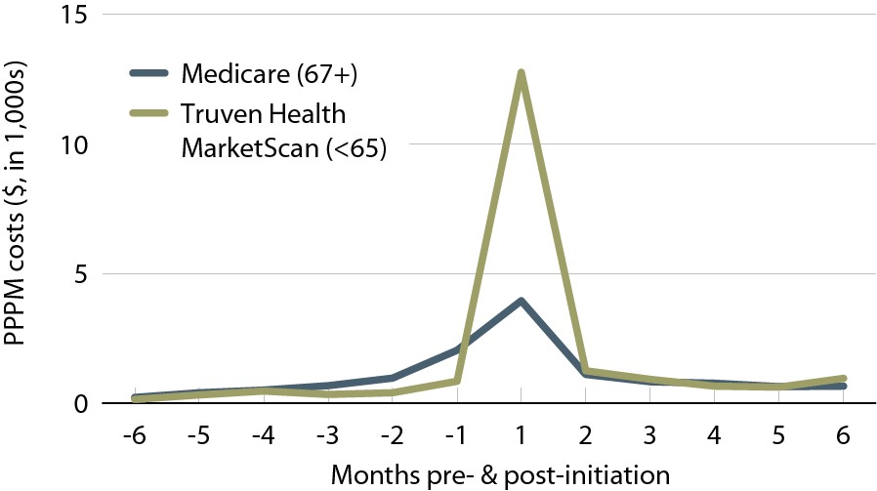
Per person per month (PPPM) expenditures for cardiovascular hospitalizations during the transition to ESRD, by dataset, 2011
Figure 7.23 (Volume 1)
General Medicare patients with CKD age 65 & older, & Pre-ESRD patients age 67 or older at initiation of ESRD.

Slide 27
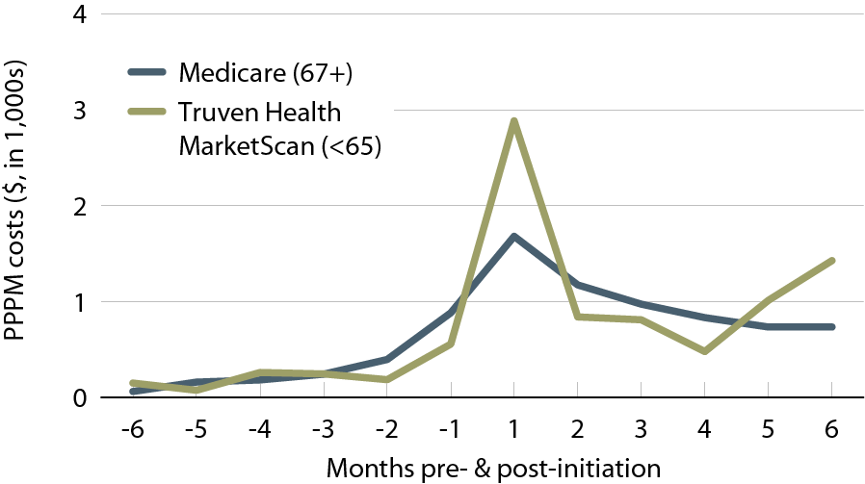
Per person per month (PPPM) expenditures for hospitalization due to infection during the transition to ESRD, by dataset, 2011
Figure 7.24 (Volume 1)
General Medicare patients with CKD age 65 & older, & Pre-ESRD patients age 67 or older at initiation of ESRD.

Slide 28
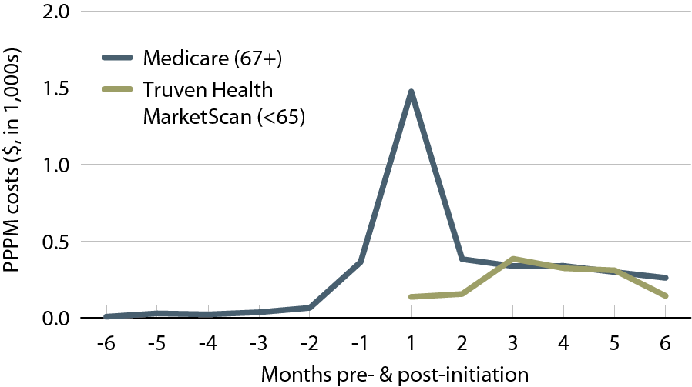
Per person per month (PPPM) expenditures for vascular access during the transition to ESRD, by dataset, 2011
Figure 7.25 (Volume 1)
General Medicare patients with CKD age 65 & older, & Pre-ESRD patients age 67 or older at initiation of ESRD.

Slide 29
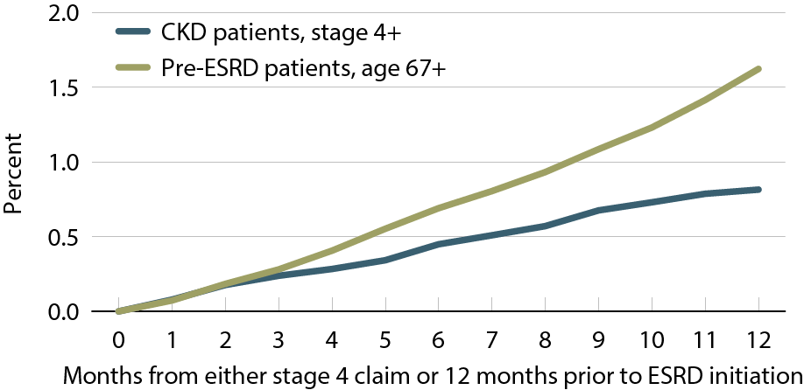
Cumulative percent of patients receiving the CMS Kidney Disease
Education System benefit, 2010–2011
Figure 7.26 (Volume 1)
General Medicare patients with CKD age 65 & older, & Pre-ESRD patients age 67 or older at initiation of ESRD.

