Slide 1
Healthy People 2020
United States Renal Data System
2013 Annual Data Report

Slide 2
HP2020 CKD-3 Increase the proportion of hospital patients who incurred acute kidney injury who have follow-up renal evaluation in six months post discharge TARGET: 12.4%
Medicare patients age 65 & older (5 percent Medicare sample) with a hospitalized AKI event in given year.

Slide 3
HP2020 DIABETES-12 Increase the proportion of persons with diagnosed diabetes who obtain an annual urinary microalbumin measurement TARGET: 37.0%
Medicare patients with diabetes, age 65 & older.

Slide 4
HP2020 CKD-4.1 Increase the proportion of persons with chronic kidney disease who receive medical evaluation with serum creatinine, lipids, & urine albumin TARGET: 28.4%
Medicare patients age 65 & older with CKD.

Slide 5
HP2020 CKD-4.2 Increase the proportion of persons with type 1 or type 2 diabetes & CKD who receive medical evaluation with serum creatinine, urine albumin, HBA1c, lipids, & eye examinations TARGET: 25.4%
Medicare patients age 65 & older with CKD & diabetes.

Slide 6
HP2020 CKD-5 Increase the proportion of persons with diabetes & CKD who receive recommended medical treatment with ACE inhibitors or ARBS TARGET: 81.0%
Fee-for-service beneficiaries enrolled in Medicare Part D, age 65 & older.

Slide 7
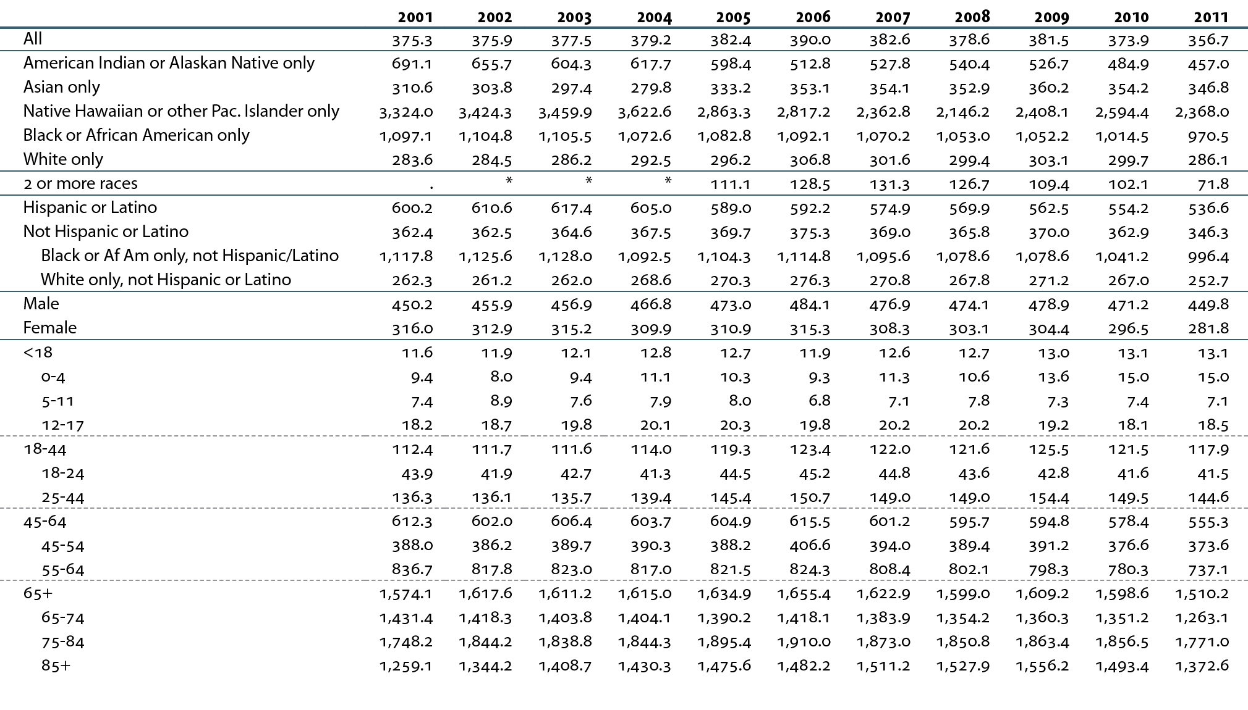
HP2020 CKD-8 Reduce the rate of new cases of end-stage renal disease TARGET: 318.5 new cases per million population
Incident ESRD patients. Adj: overall, age/gender/race; rates by age adjusted for gender/race; rates by gender adjusted for age/race; rates by race/ethnicity adjusted for age/gender. Ref: 2010 patients. “.” Zero values in this cell. *Values for cells with ten or fewer patients are suppressed.

Slide 8
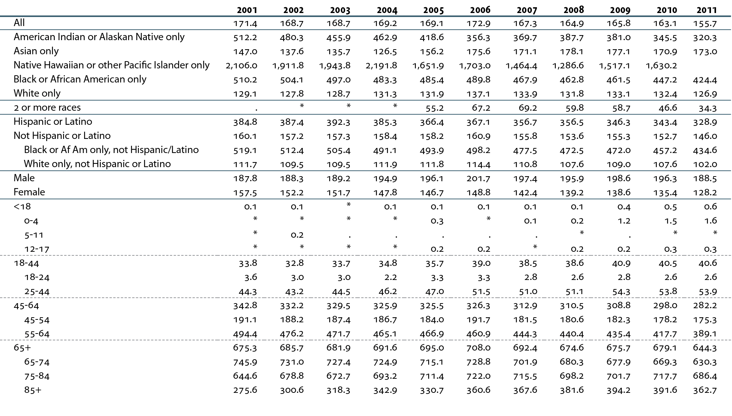
HP2020 CKD-9.1 Reduce kidney failure due to diabetes TARGET: 139.2 per million population
Incident ESRD patients. Adjusted for age/gender/race; Ref: 2010. “.” Zero values in this cell. *Values for cells with ten or fewer patients are suppressed.

Slide 9
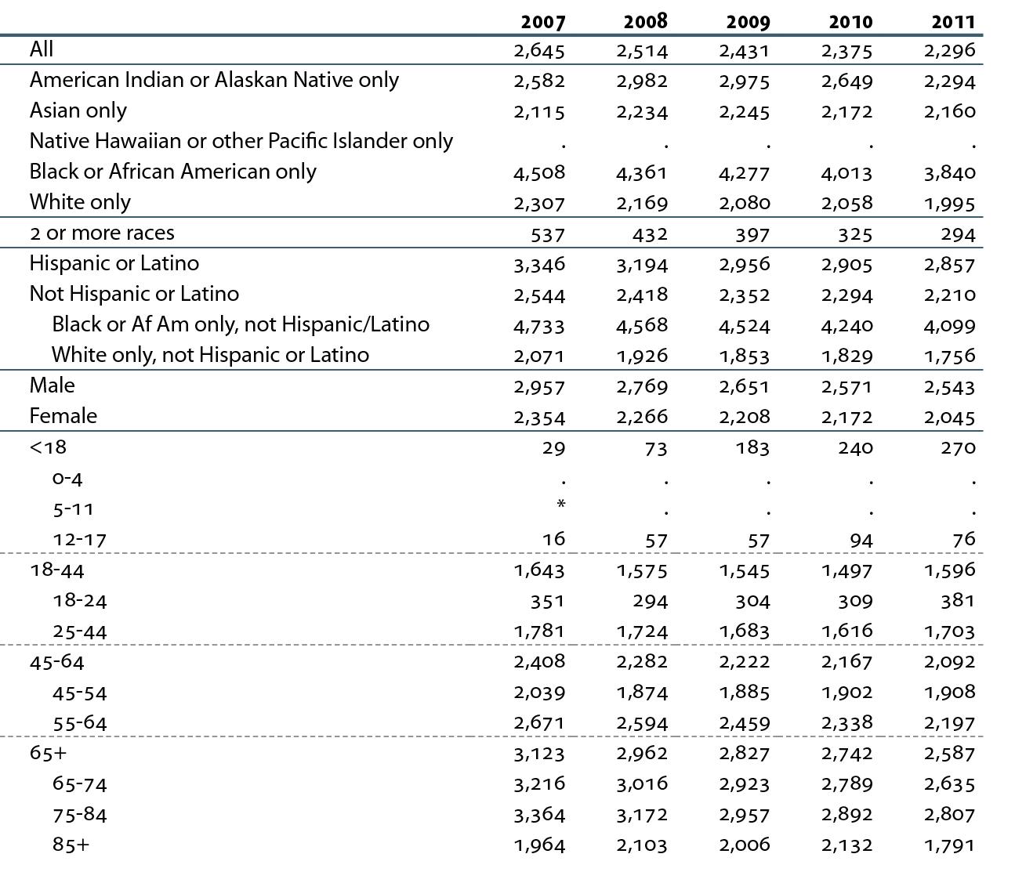
HP2020 CKD-9.2 Reduce kidney failure due to diabetes among persons with diabetes TARGET: 2,374.1 per million population
Incident ESRD patients. Adj: age/gender/race; ref: 2010. NHIS 2006–2011 used to estimate diabetes prevalence; SUDDAN used for national estimates (9.2). “.” Zero values in this cell. *Values for cells with ten or fewer patients are suppressed.

Slide 10
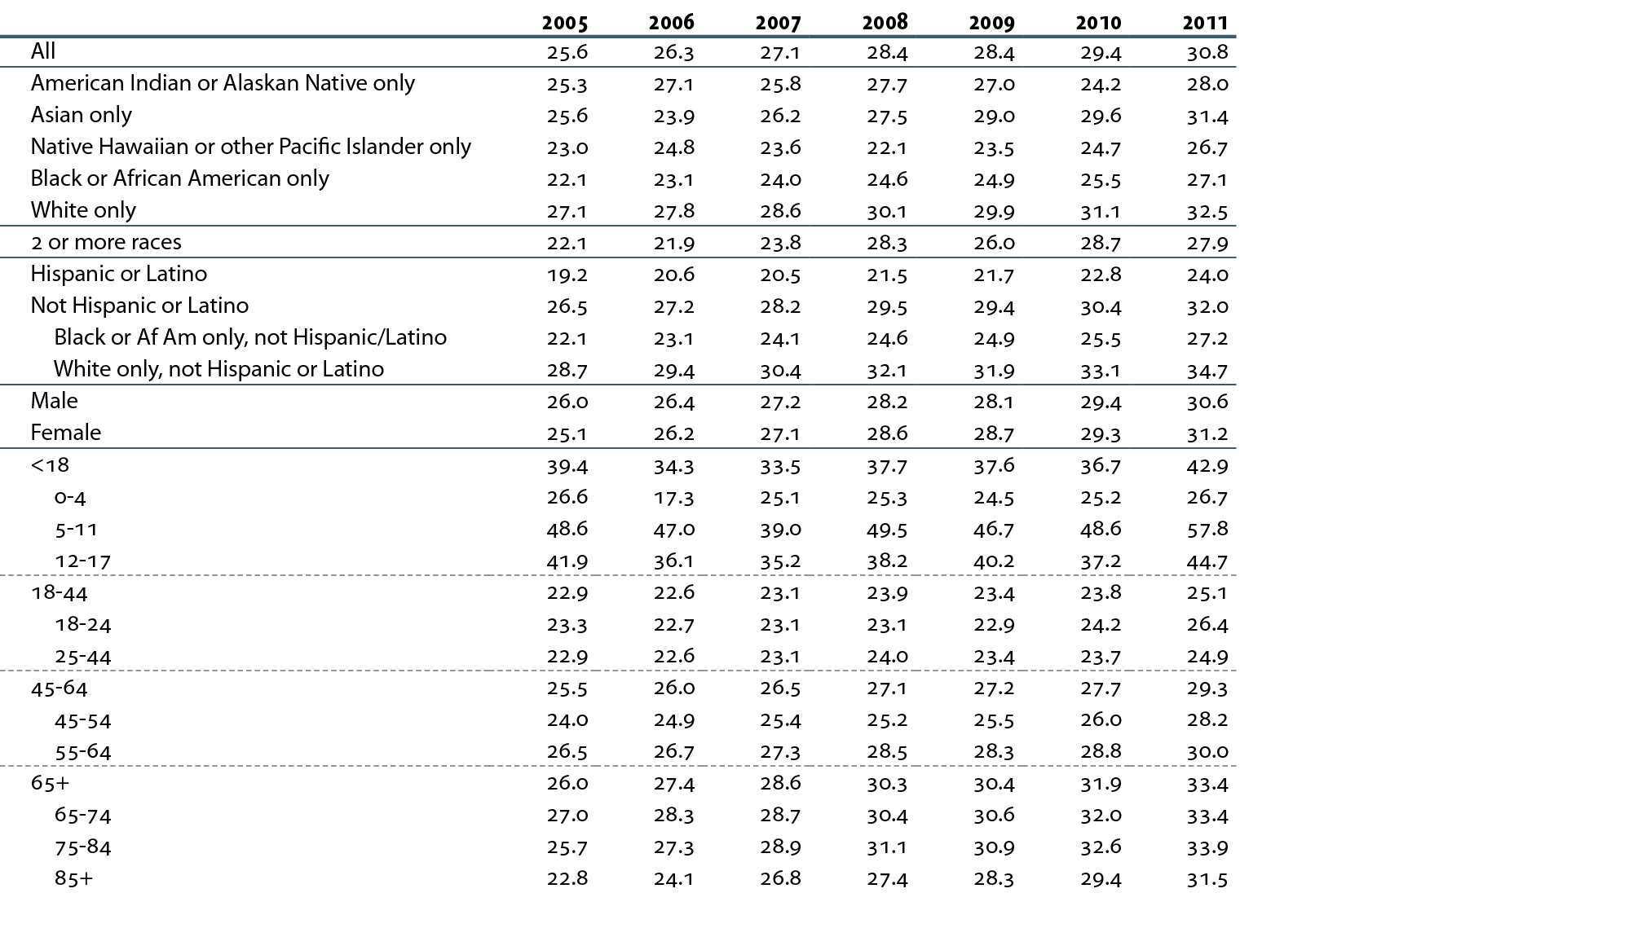
HP2020 CKD-10 Increase the proportion of CKD patients receiving care from a nephrologist at least 12 months before the start of renal replacement therapy TARGET: 29.8 percent
Incident hemodialysis patients with a valid Medical Evidence form; nephrologist care determined from Medical Evidence form.

Slide 11
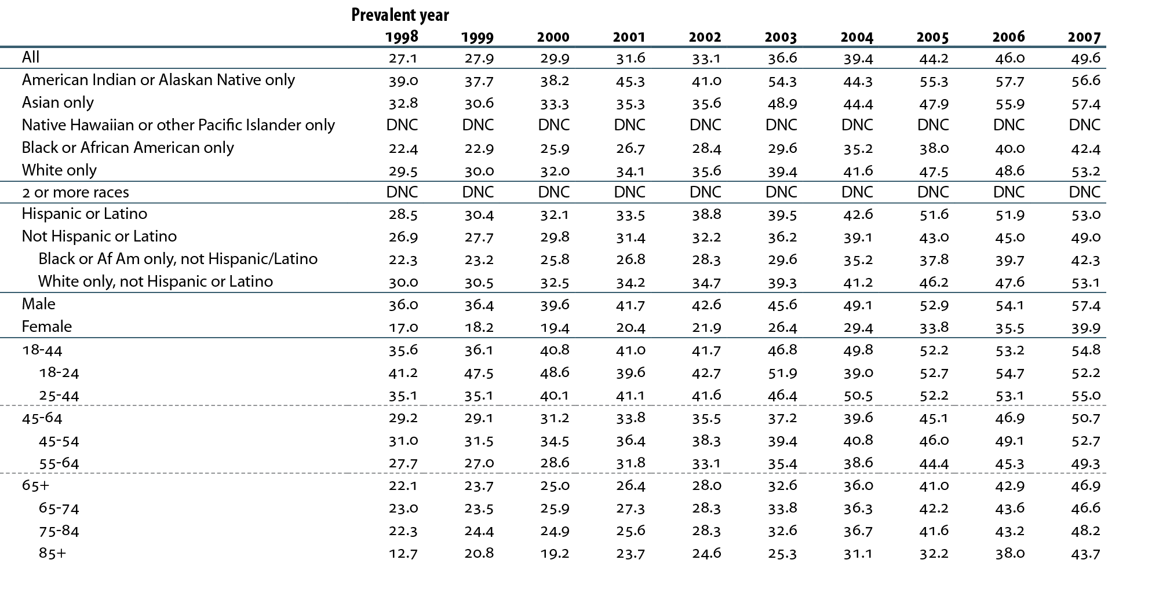
HP2020 CKD-11.1 Increase the proportion of adult hemodialysis patients who use an arteriovenous fistulas as the primary mode of vascular access TARGET: 50.6 percent
Prevalent hemodialysis patients; ESRD CPM data. Vascular access determined from “current access” within CPM data. Prevalent year represents year of data collection. DNC: data not collected.

Slide 12
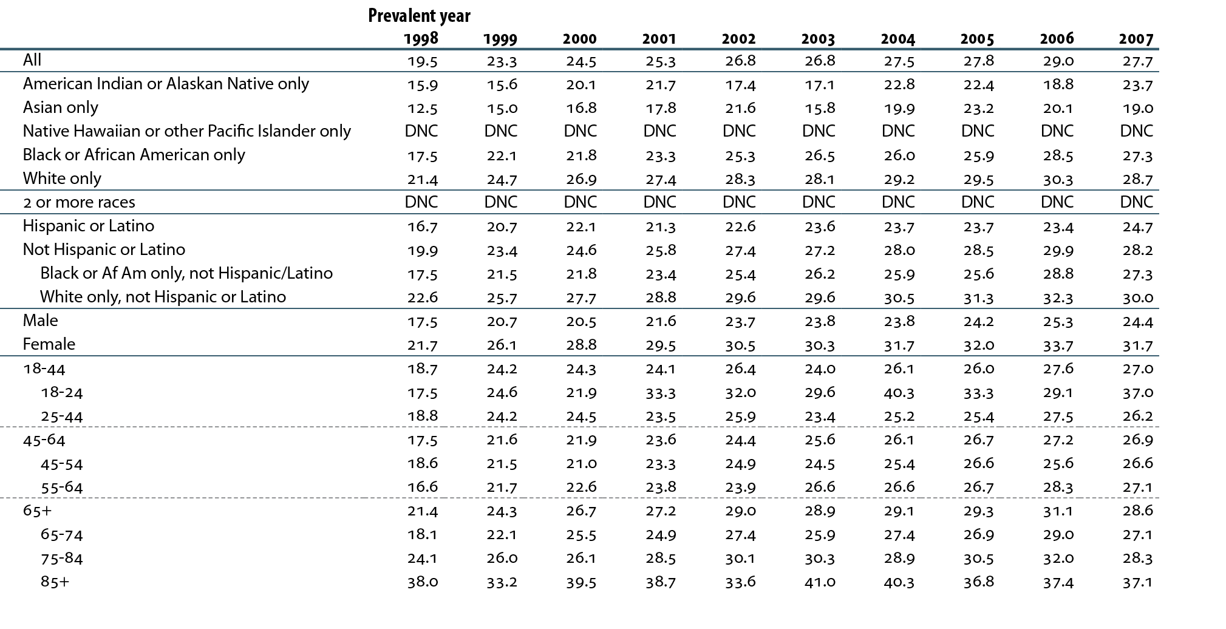
HP2020 CKD-11.2 Decrease the proportion of adult hemodialysis patients who use catheters as the only mode of vascular access TARGET: 26.1 percent
Prevalent hemodialysis patients; ESRD CPM data. Vascular access determined from “current access” within CPM data. Prevalent year represents year of data collection. DNC: data not collected.

Slide 13
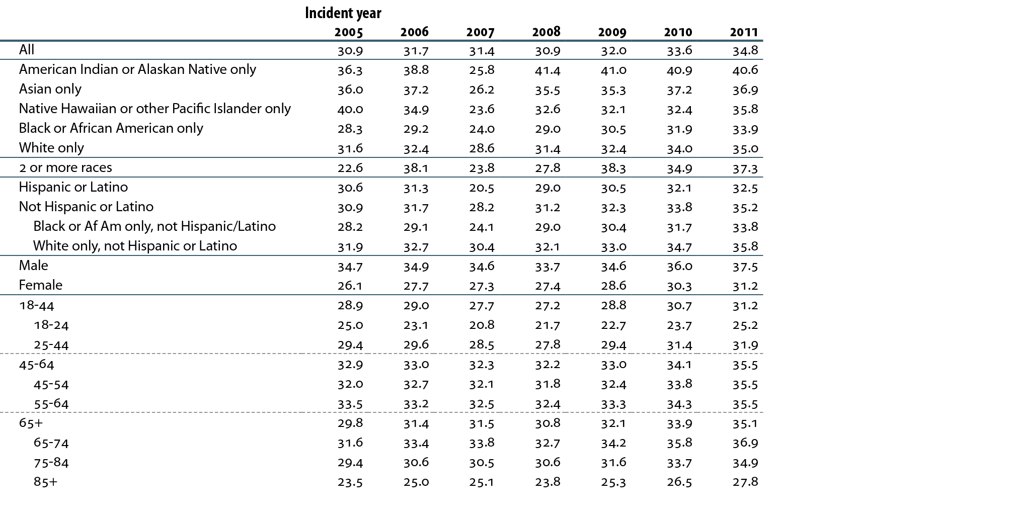
HP2020 CKD-11.3 Increase the proportion of adult hemodialysis patients who use AV fistulas or have a maturing fistula as the primary mode of vascular access at the start of renal replacement therapy TARGET: 34.5 percent
Incident hemodialysis patients age 18 & older.

Slide 14
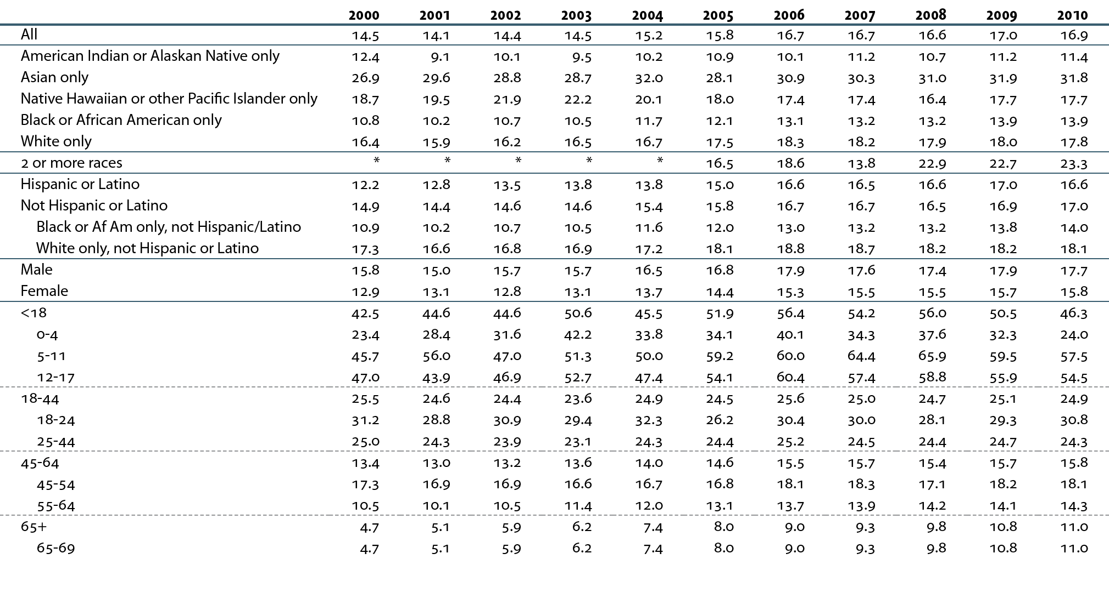
HP2020 CKD-12 Increase the proportion of dialysis patients wait-listed and/or receiving a deceased donor kidney transplant within one year of ESRD start (patients <70) TARGET: 18.8 percent of dialysis patients
Incident ESRD patients younger than 70. *Values for cells with ten or fewer patients are suppressed.

Slide 15
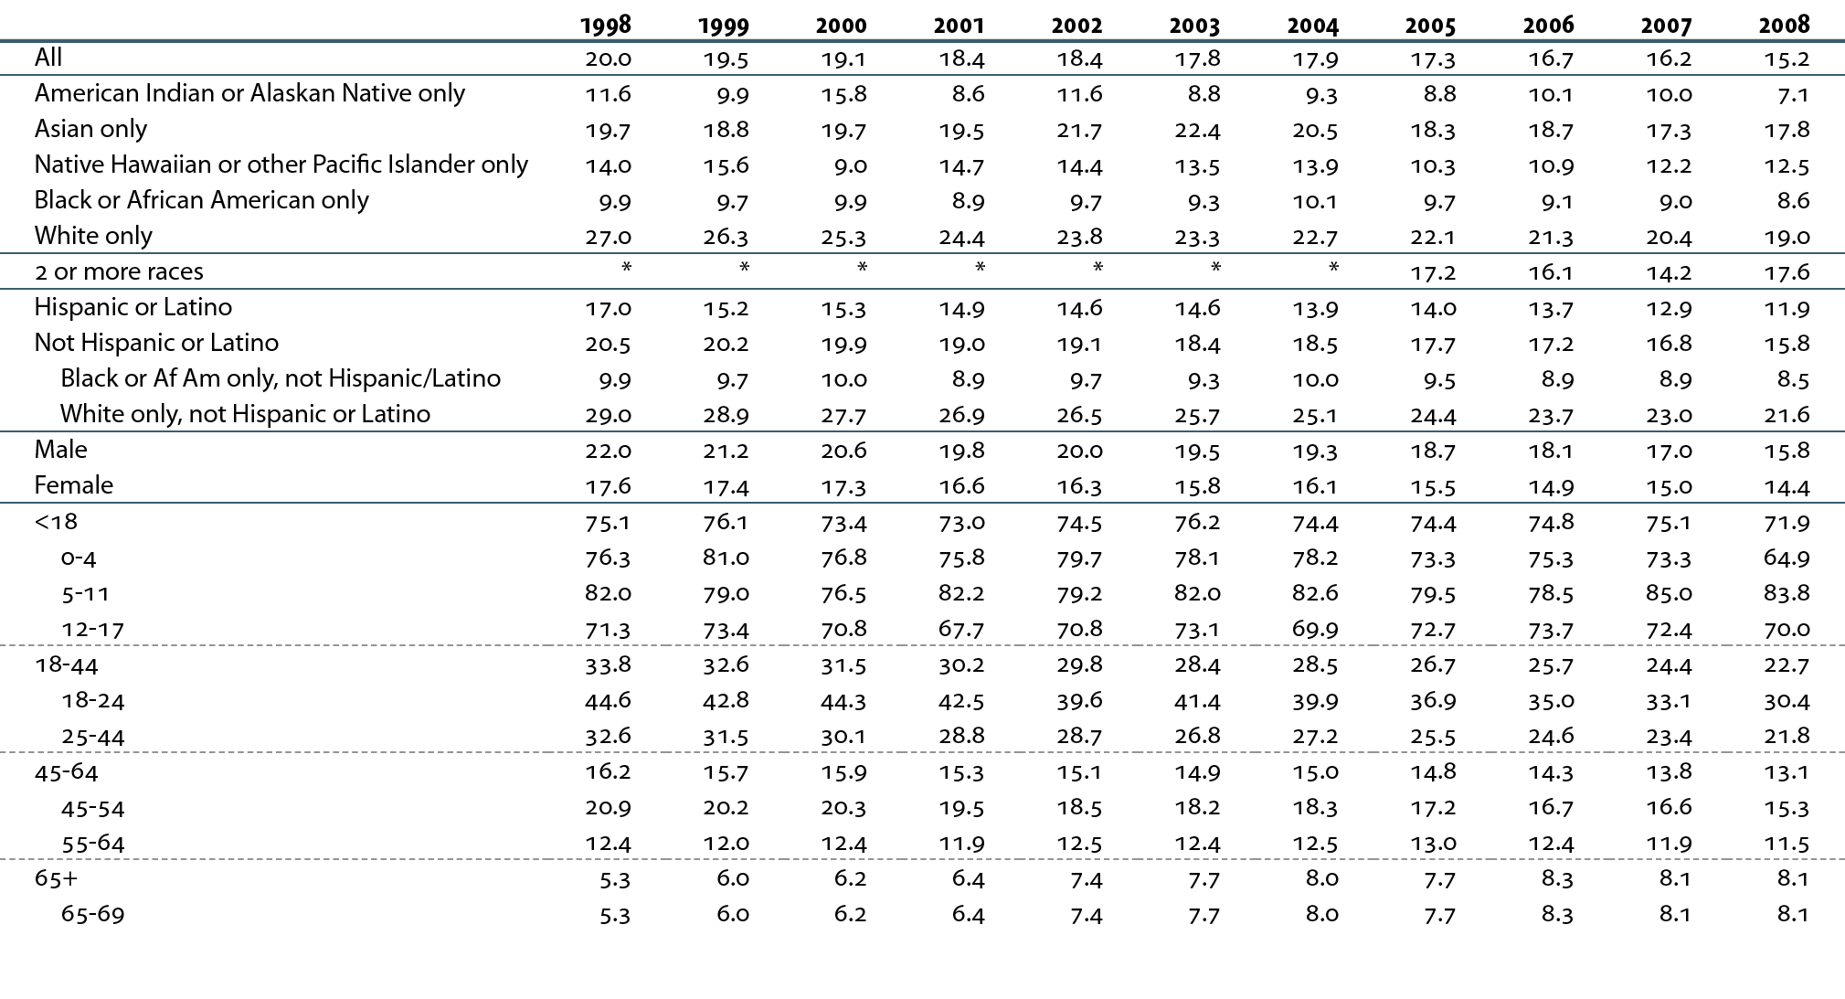
HP2020 CKD-13.1 Increase the proportion of patients receiving a kidney transplant within three years of ESRD TARGET: 19.7 percent
Incident ESRD patients younger than 70.

Slide 16
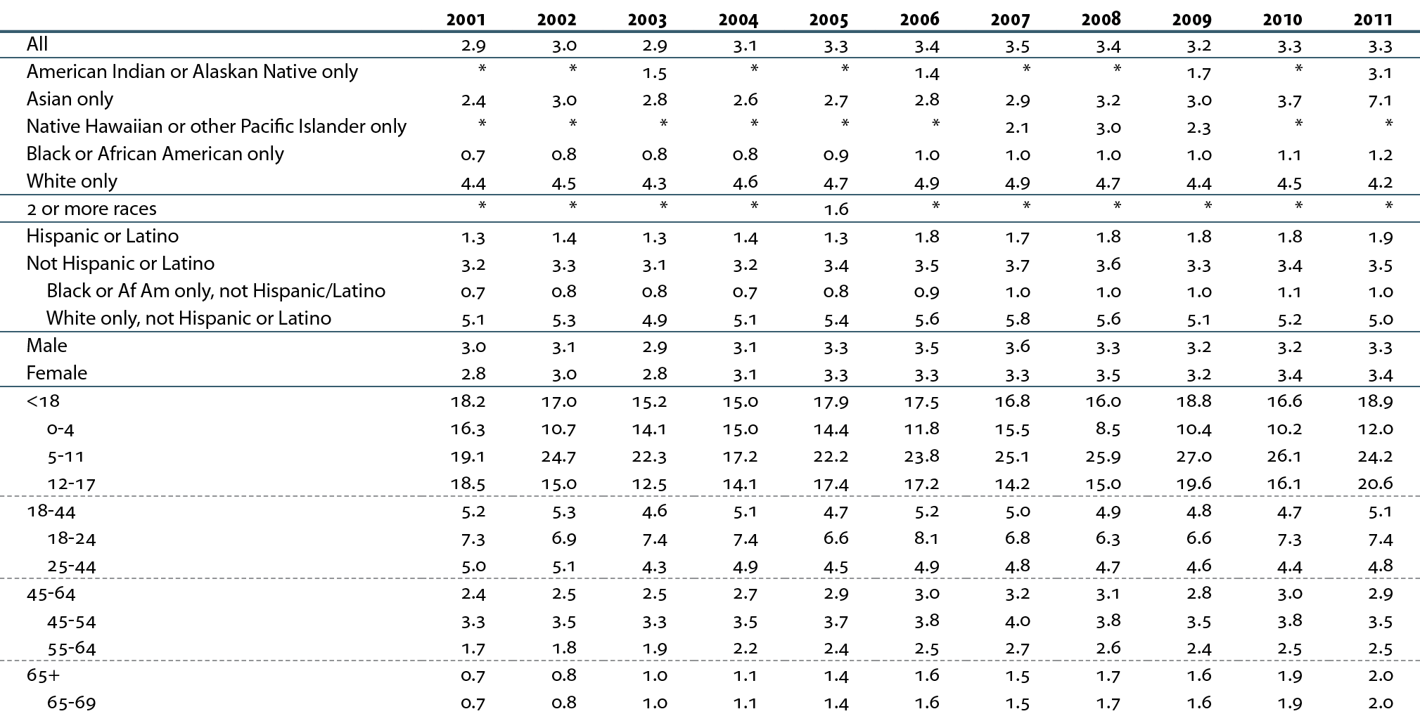
HP2020 CKD-13.2 Increase the proportion of patients who receive a preemptive transplant at the start of ESRD
Incident ESRD patients younger than 70.

Slide 17
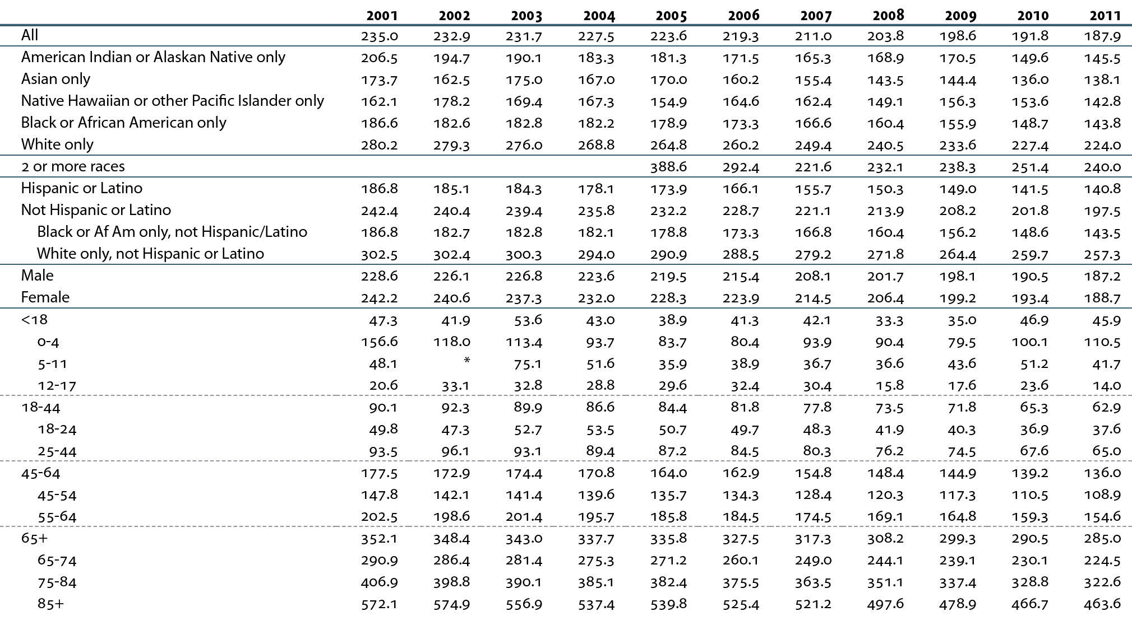
HP2020 CKD-14.1 Reduce the total death rate for persons on dialysis TARGET: 190.8 deaths per 1,000 patient years
Period prevalent dialysis patients; unadjusted. *Values for cells with ten or fewer patients are suppressed.

Slide 18
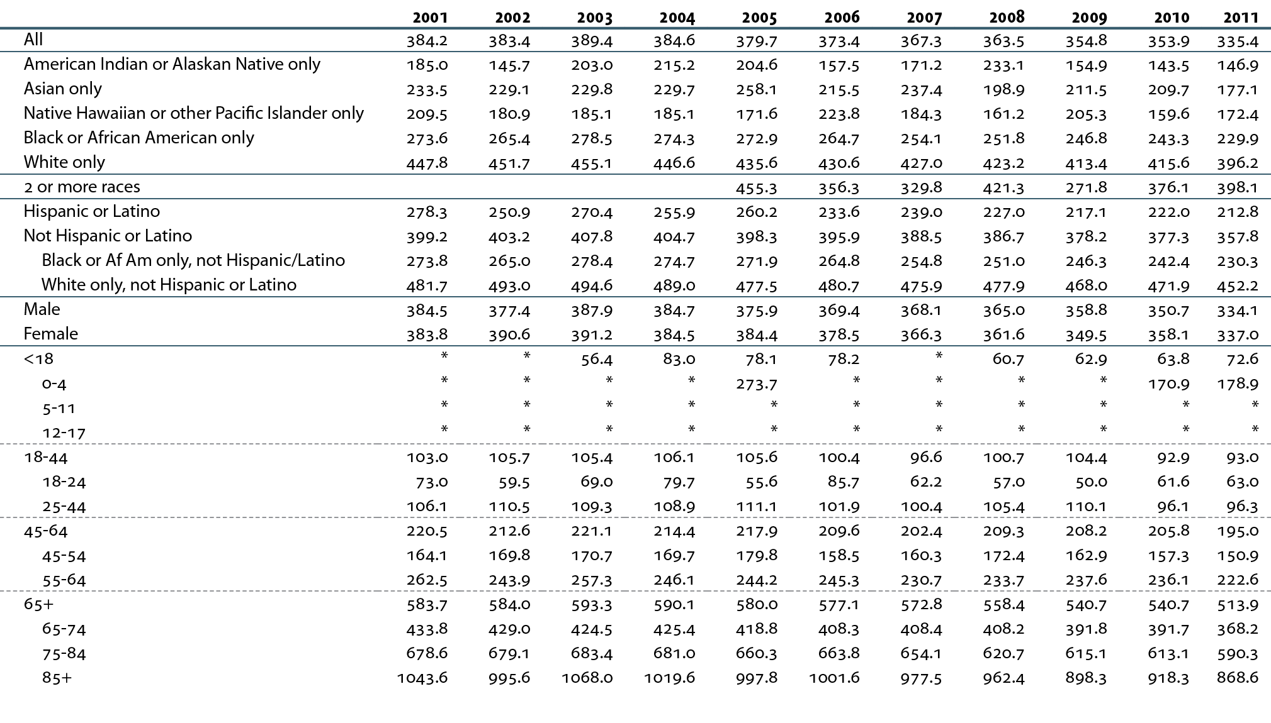
HP2020 CKD-14.2 Reduce the death rate in dialysis patients within the first three months of initiation of renal replacement therapy TARGET: 319.9 deaths per 1,000 patient years at risk
Incident dialysis patients; unadjusted. *Values for cells with ten or fewer patients are suppressed.

Slide 19
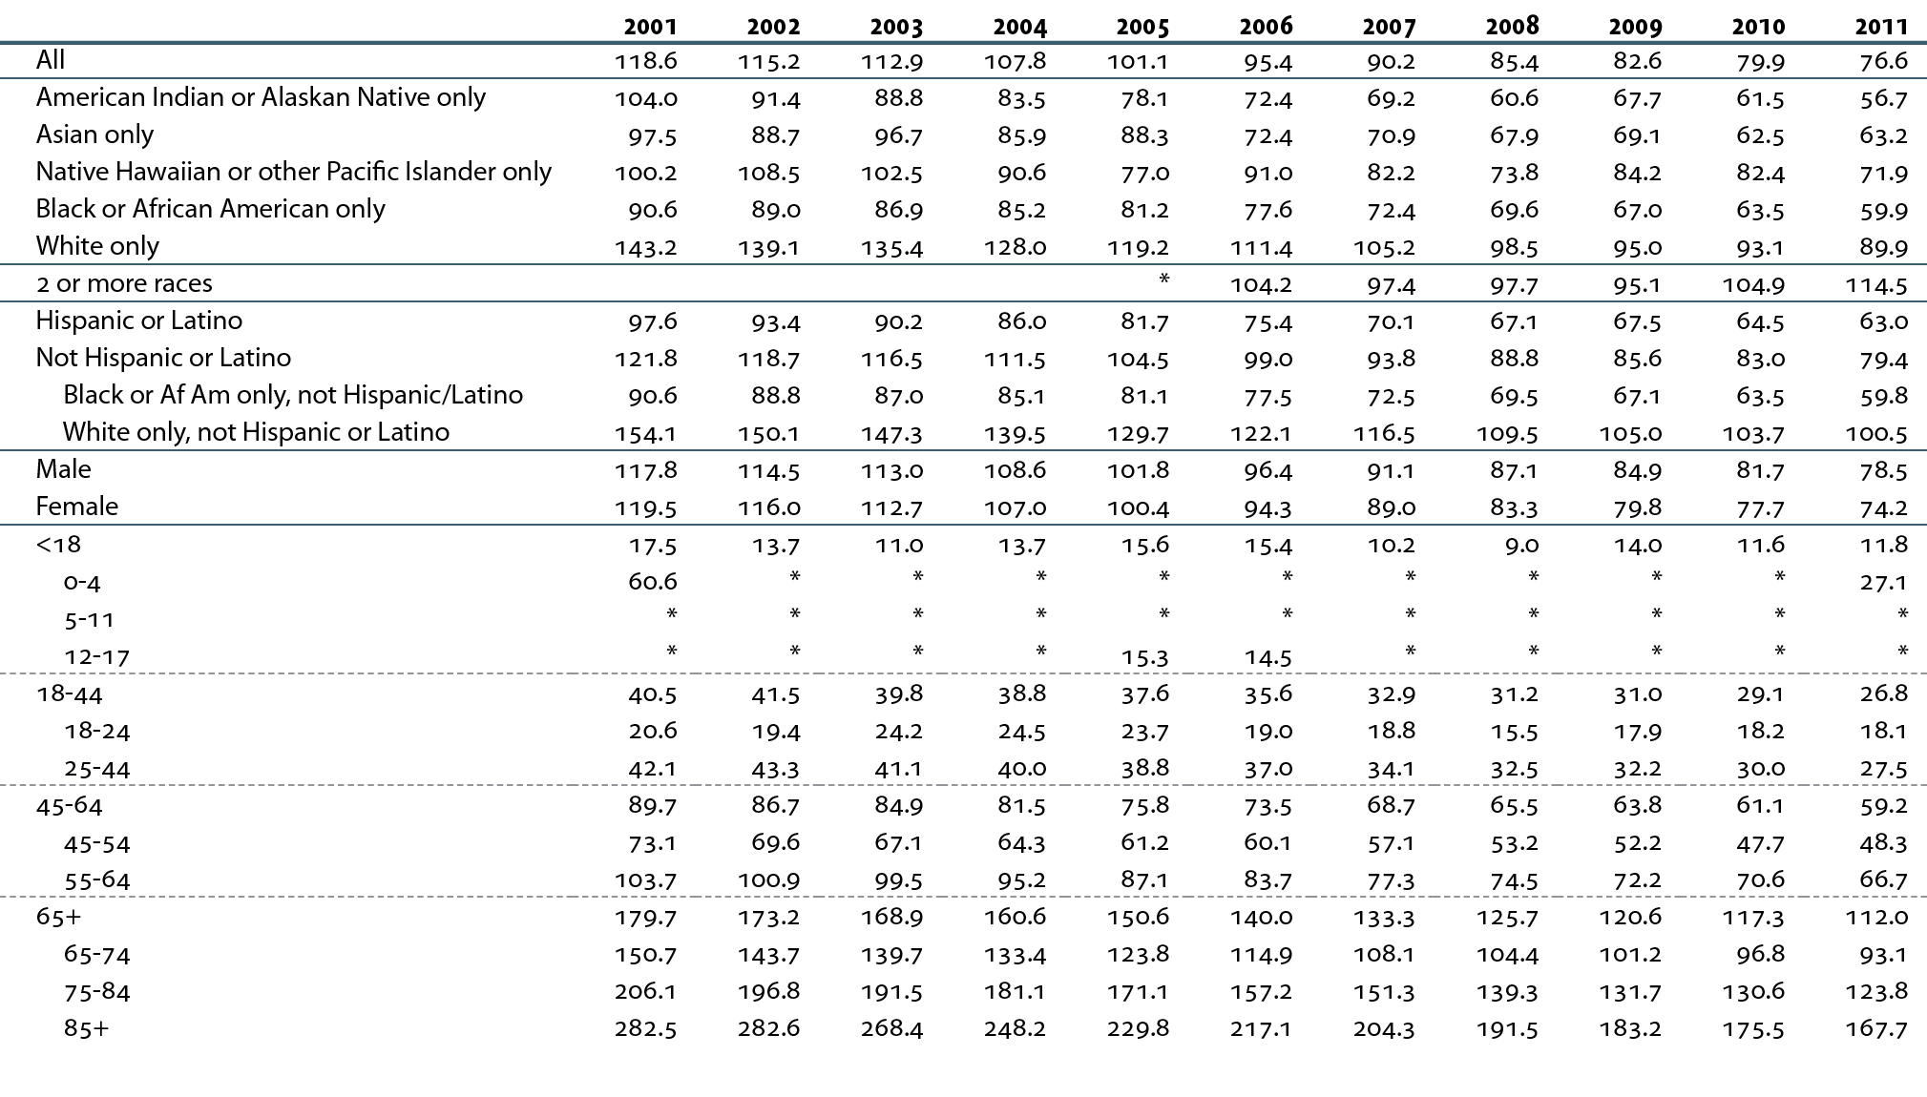
HP2020 CKD-14.3 Reduce the cardiovascular death rate for persons on dialysis TARGET: 81.3 deaths per 1,000 patient years at risk
Period prevalent dialysis patients; unadjusted. *Values for cells with ten or fewer patients are suppressed.

Slide 20
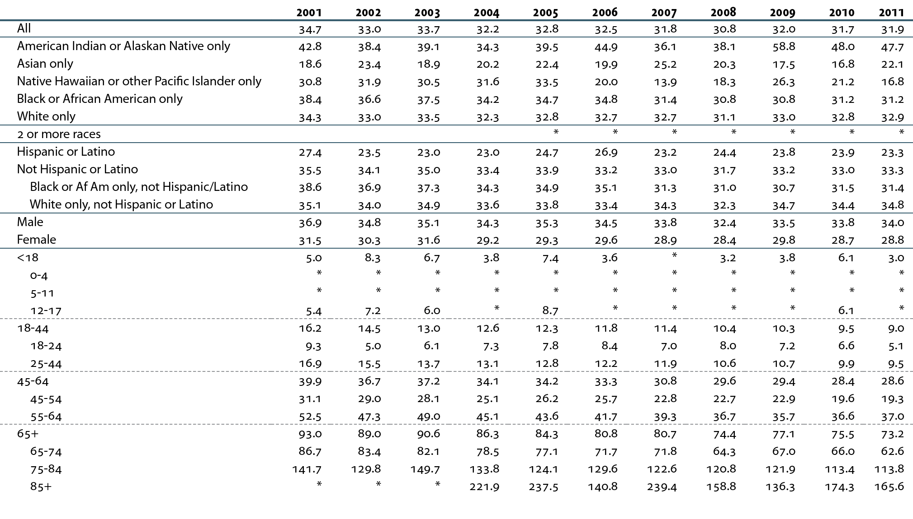
HP2020 CKD-14.4 Reduce the total death rate for persons with a functioning kidney transplant TARGET: 29.4 deaths per 1,000 patient years at risk
Period prevalent transplant patients; unadjusted. *Values for cells with ten or fewer patients are suppressed.

Slide 21
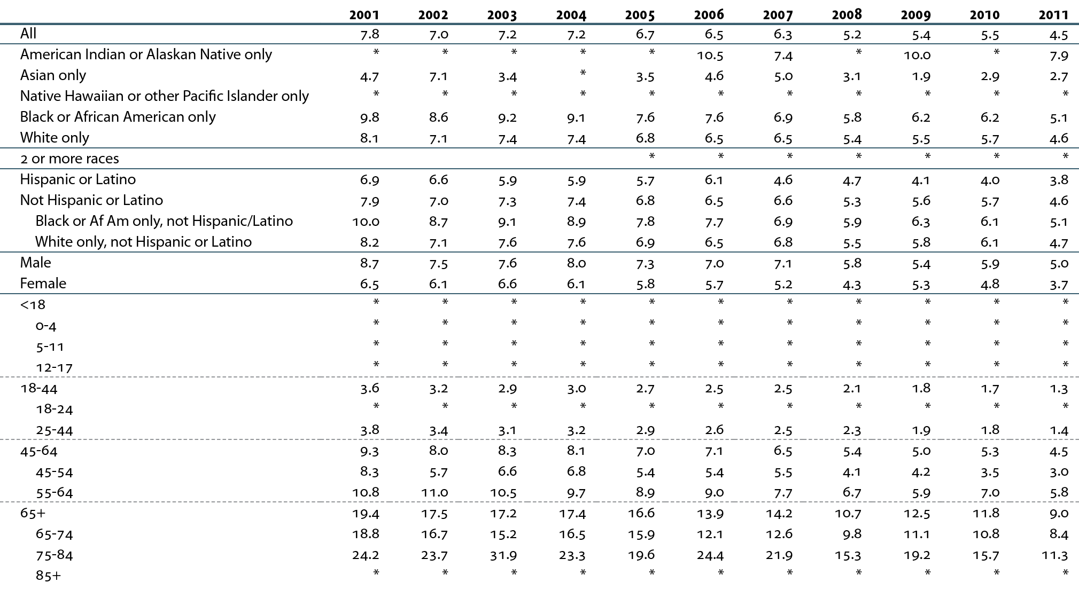
HP2020 CKD-14.5 Reduce the cardiovascular death rate in persons with a functioning transplant TARGET: 4.5 cardiovascular deaths per 1,000 patient years at risk
Period prevalent transplant patients; unadjusted. *Values for cells with ten or fewer patients are suppressed.

