Slide 1
ESRD: Chapter One
Incidence, prevalence,
patient characteristics,
& treatment modalities
United States Renal Data System
2013 Annual Data Report

Slide 2
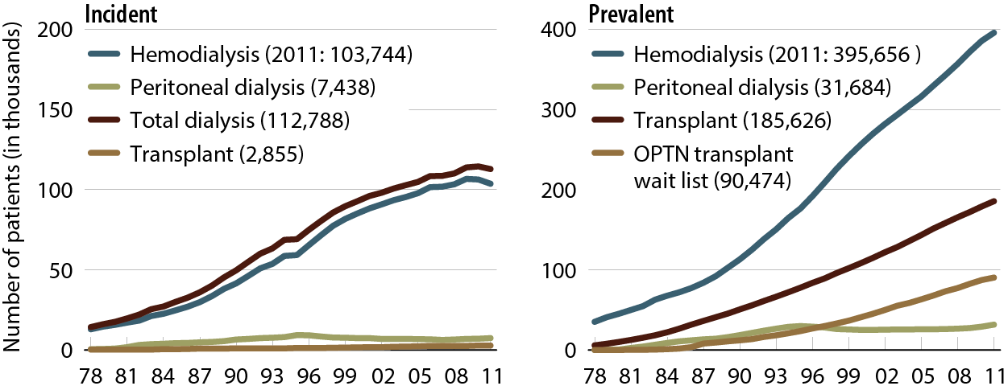
Incident & prevalent patient counts (USRDS), by modality
Figure 1.1 (Volume 2)
Incident & December 31 point prevalent ESRD patients; peritoneal dialysis consists of CAPD & CCPD.

Slide 3
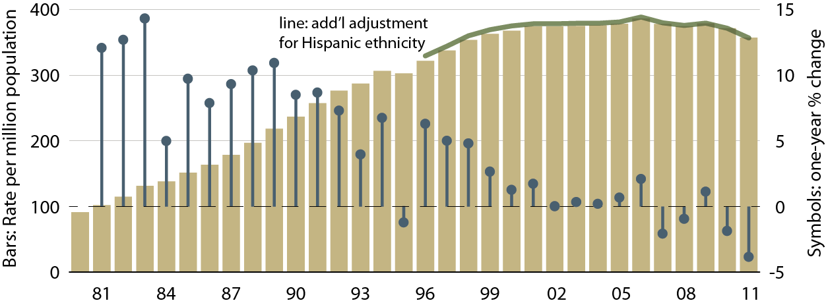
Adjusted incident rates of ESRD
& annual percent change
Figure 1.2 (Volume 2)
Incident ESRD patients. Adj: age/gender/race; ref: 2010 ESRD patients.

Slide 4
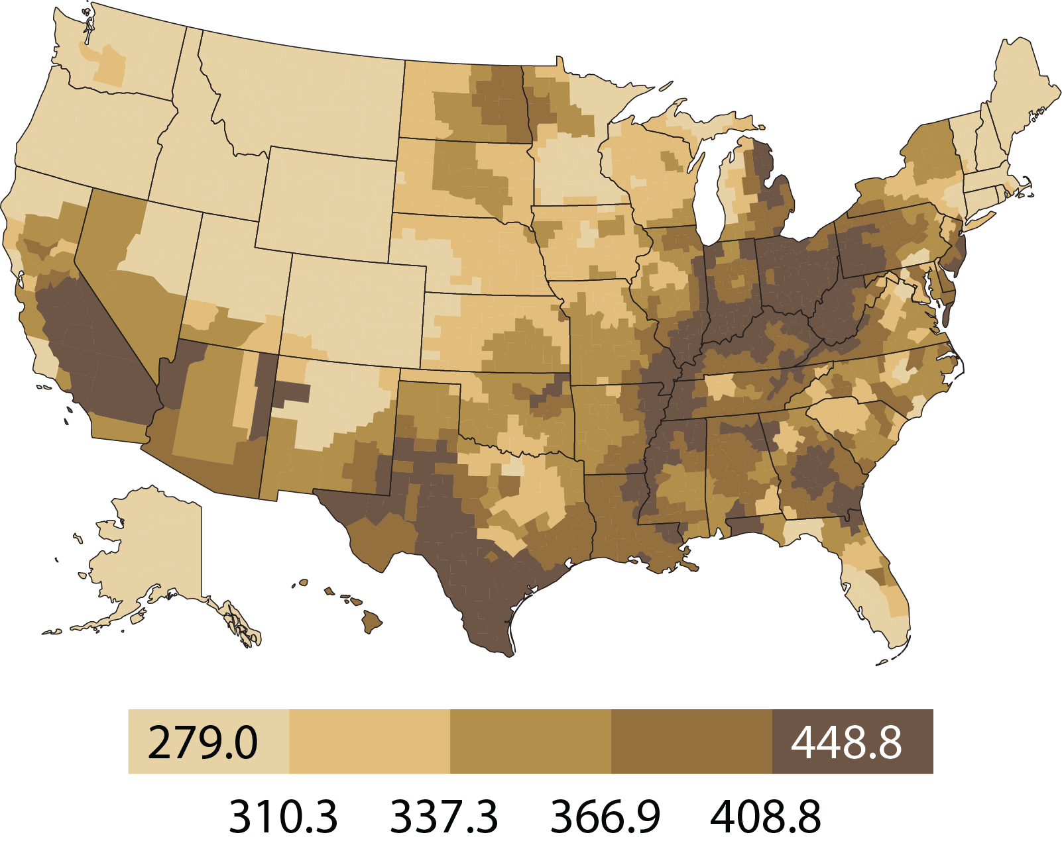
Geographic variations in adjusted incident rates of ESRD per million population, 2011, by HSA
Figure 1.3 (Volume 2)
Incident ESRD patients. Adj: age/gender/race/ethnicity; ref: 2010 ESRD patients.

Slide 5
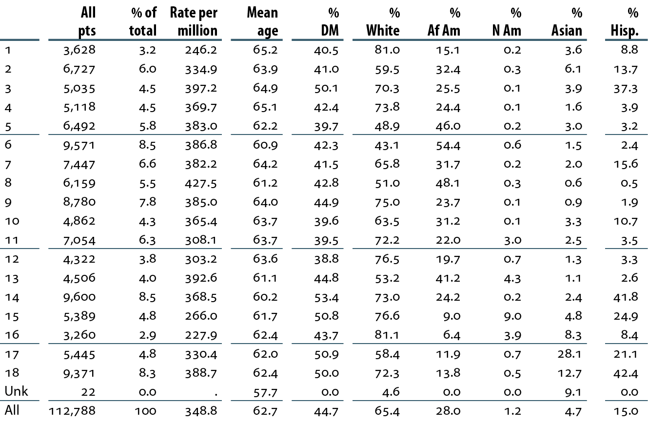
Patient demographics & adjusted rates, by ESRD network: incident dialysis patients, 2011
Table 1.a (Volume 2)
Incident dialysis patients, 2011. Adj: age/gender/race; ref: 2010 patients.
“.” Zero values in this cell.

Slide 6
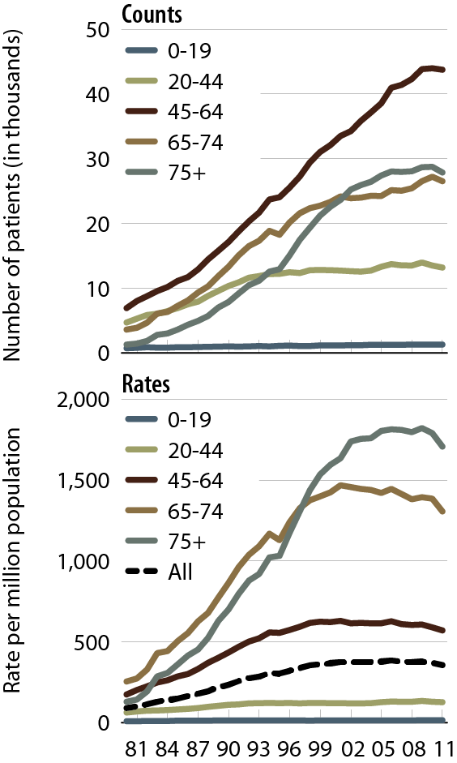
Incident counts & adjusted rates of ESRD, by age
Figure 1.4 (Volume 2)
Incident ESRD patients.
Adj: gender/race; ref: 2010 ESRD patients.

Slide 7
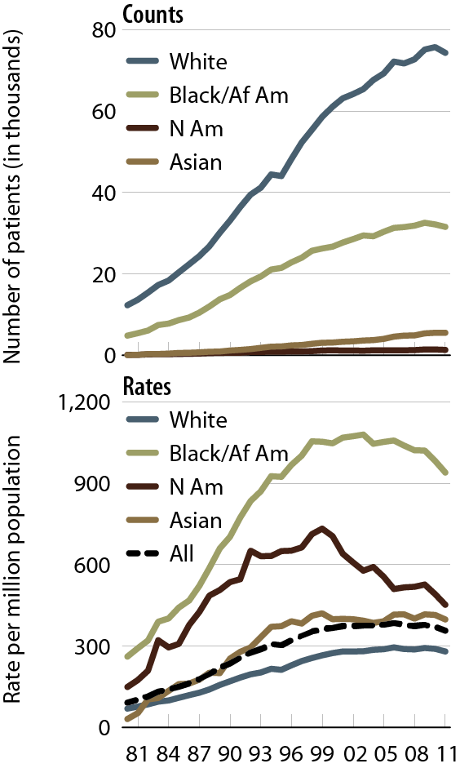
Incident counts & adjusted rates of ESRD, by race
Figure 1.5 (Volume 2)
Incident ESRD patients.
Adj: age/gender; ref: 2010 ESRD patients.

Slide 8
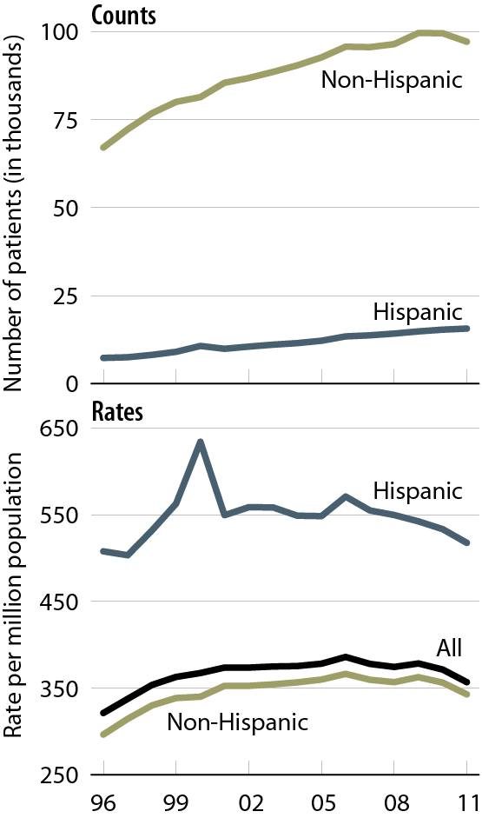
Incident counts & adjusted rates of ESRD, by Hispanic ethnicity
Figure 1.6 (Volume 2)
Incident ESRD patients.
Adj: age/gender; ref: 2010 ESRD patients.

Slide 9
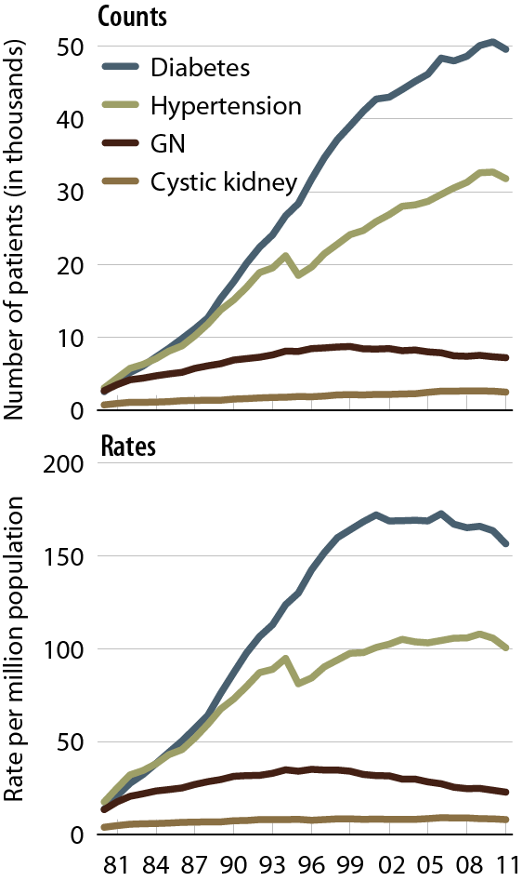
Incident counts & adjusted rates of ESRD, by primary diagnosis
Figure 1.7 (Volume 2)
Incident ESRD patients.
Adj: age/gender/race; ref: 2010 ESRD patients.

Slide 10
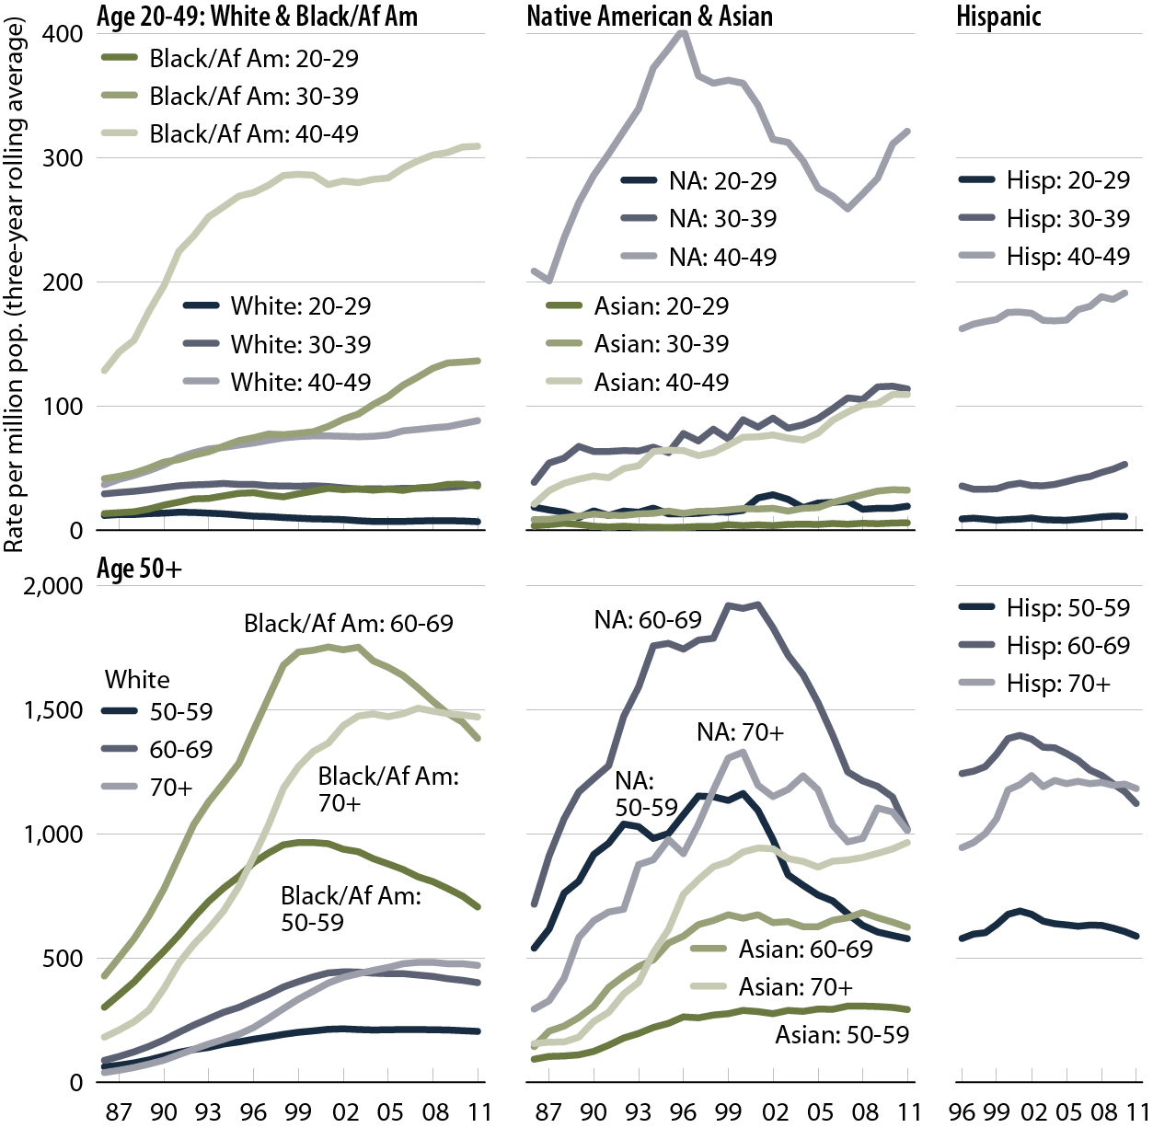
Adjusted incident rates of ESRD due to diabetes, by age, race, & ethnicity
Figure 1.8 (Volume 2)
Incident ESRD patients; rates are three-year rolling averages. Adj: gender; ref: 2010 ESRD patients.

Slide 11
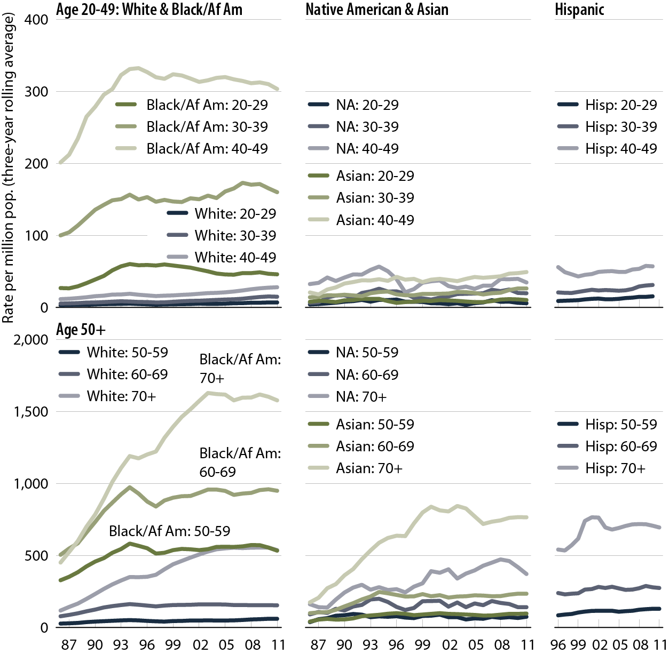
Adjusted incident rates of ESRD due to hypertension, by age, race, & ethnicity
Figure 1.9 (Volume 2)
Incident ESRD patients; rates are three-year rolling averages. Adj: gender; ref: 2010 ESRD patients.

Slide 12
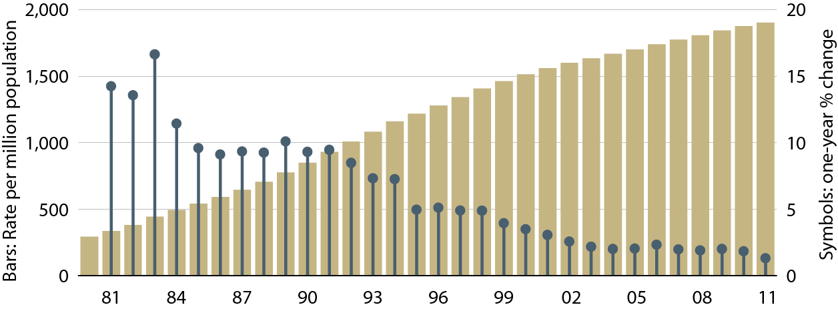
Adjusted prevalent rates of
ESRD & annual percent change
Figure 1.10 (Volume 2)
December 31 point prevalent ESRD patients. Adj: age/gender/race; ref: 2010 ESRD patients.

Slide 13
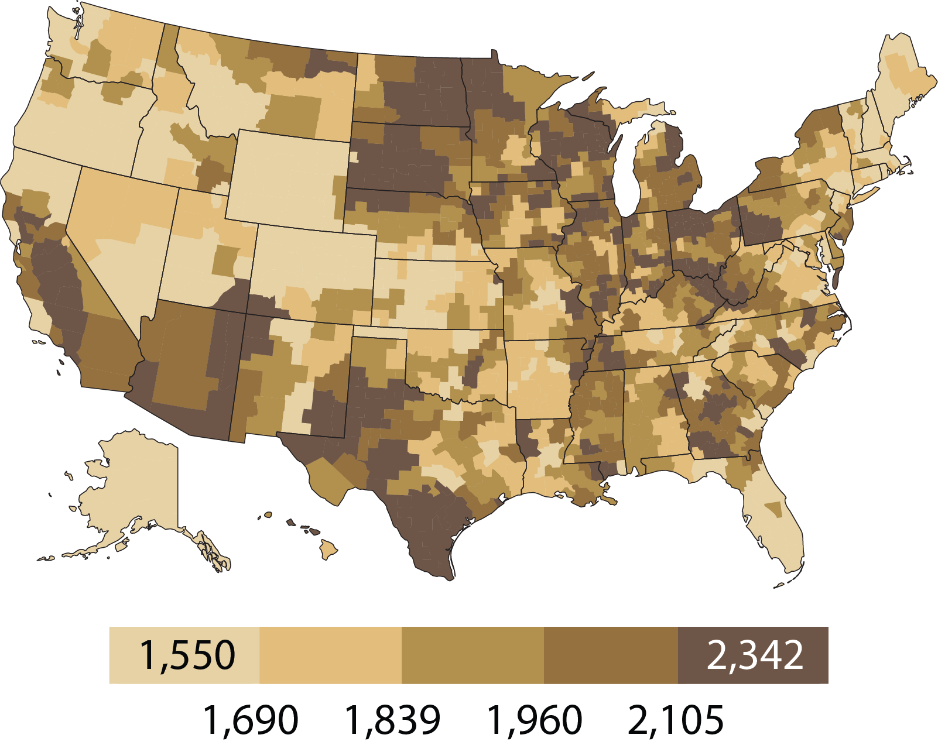
Geographic variations in adjusted prevalent rates of ESRD per million population, 2011, by HSA
Figure 1.11 (Volume 2)
December 31 point prevalent patients. Adj: age/gender/race/ethnicity; ref: 2010 ESRD patients.

Slide 14
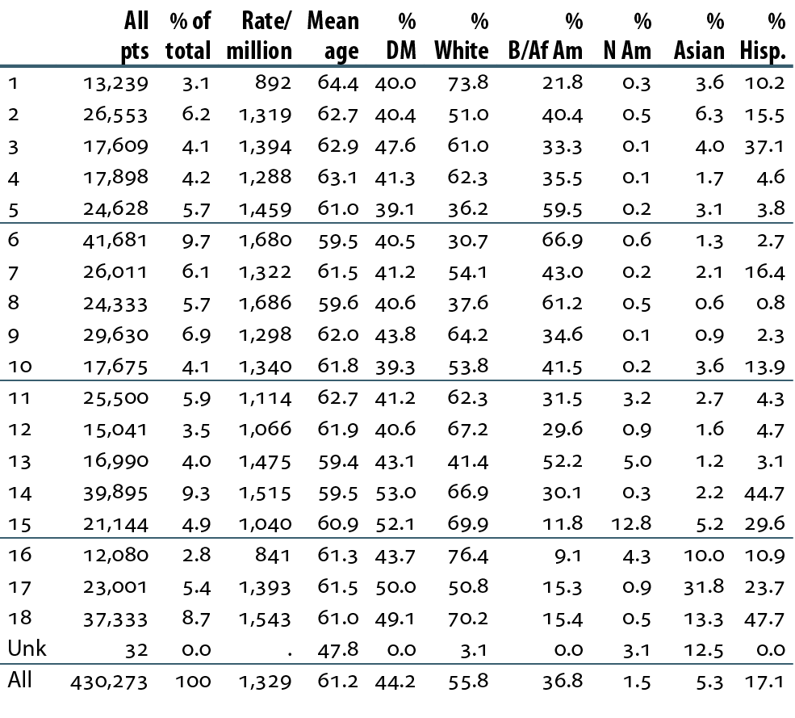
Patient demographics & adjusted rates, by ESRD network: December 31 point prevalent dialysis patients, 2011
Table 1.b (Volume 2)
December 31 point prevalent dialysis patients. Adj: age/gender/race; ref: 2010 patients. “.” Zero values in this cell.

Slide 15
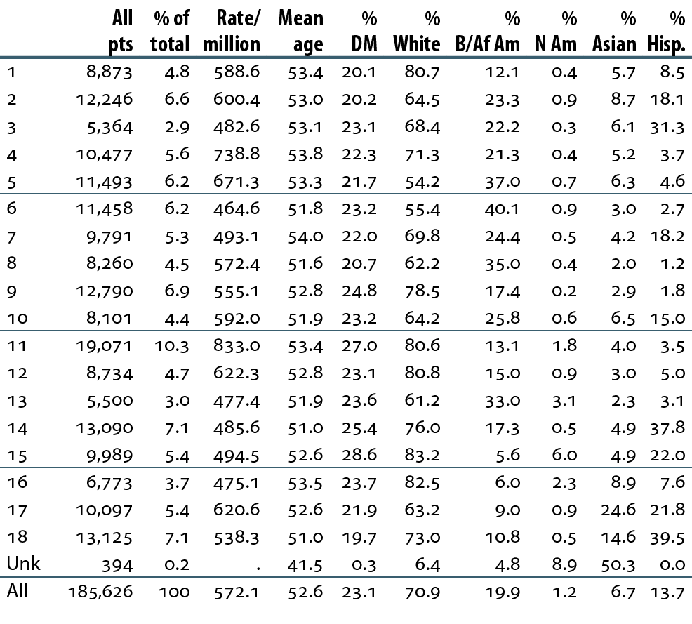
Patient demographics & adjusted rates, by ESRD network: December 31 point prevalent transplant patients, 2011
Table 1.c (Volume 2)
December 31 point prevalent transplant patients. Adj: age/gender/race; ref: 2010 patients. “.” Zero values in this cell.

Slide 16
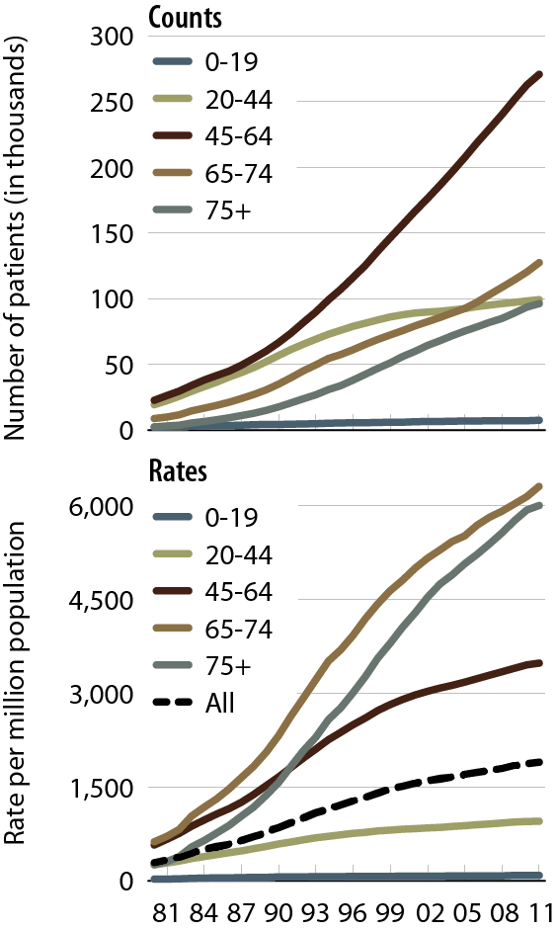
Prevalent counts & adjusted rates of ESRD, by age
Figure 1.12 (Volume 2)
December 31 point prevalent ESRD patients.
Adj: gender/race; ref: 2010 ESRD patients.

Slide 17
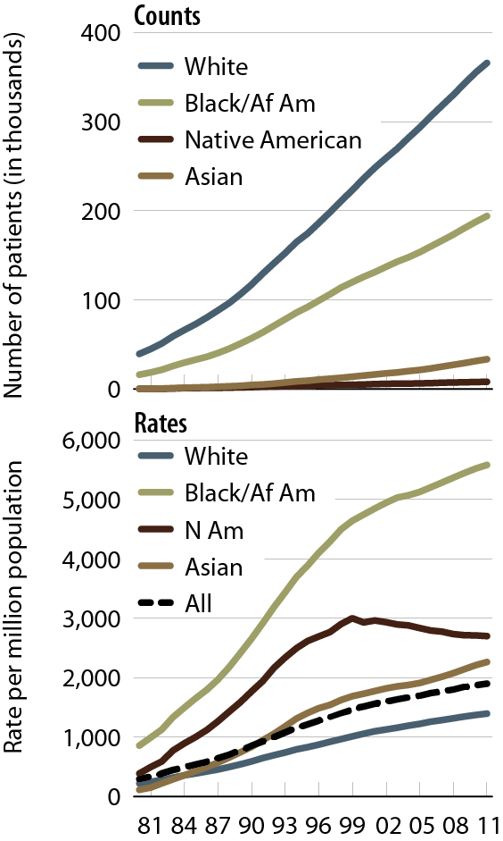
Prevalent counts & adjusted rates of ESRD, by race
Figure 1.13 (Volume 2)
December 31 point prevalent ESRD patients.
Adj: age/gender; ref: 2010 ESRD patients.

Slide 18
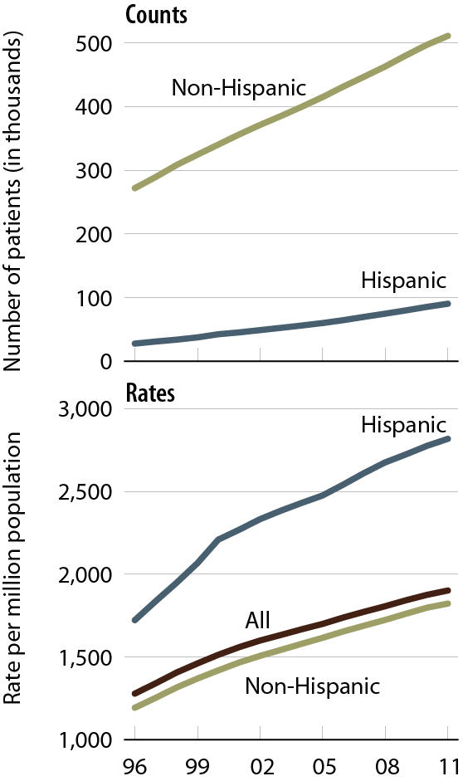
Prevalent counts & adjusted rates of ESRD, by Hispanic ethnicity
Figure 1.14 (Volume 2)
December 31 point prevalent ESRD patients.
Adj: age/gender; ref: 2010 ESRD patients.

Slide 19
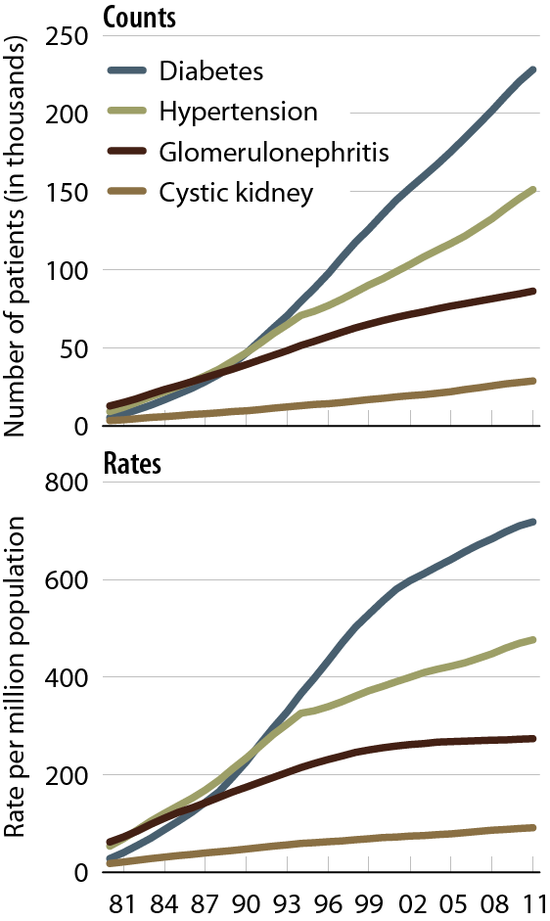
Prevalent counts & adjusted rates of ESRD, by primary diagnosis
Figure 1.15 (Volume 2)
December 31 point prevalent ESRD patients.
Adj: age/gender/race; ref: 2010 ESRD patients.

Slide 20
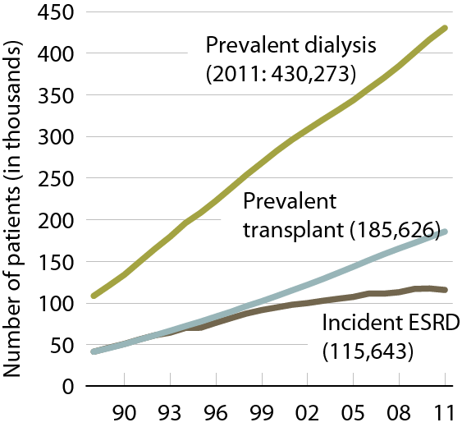
Patient counts, by modality
Figure 1.16 (Volume 2)
Incident & December point prevalent ESRD patients. CMS Annual Facility Survey.

Slide 21
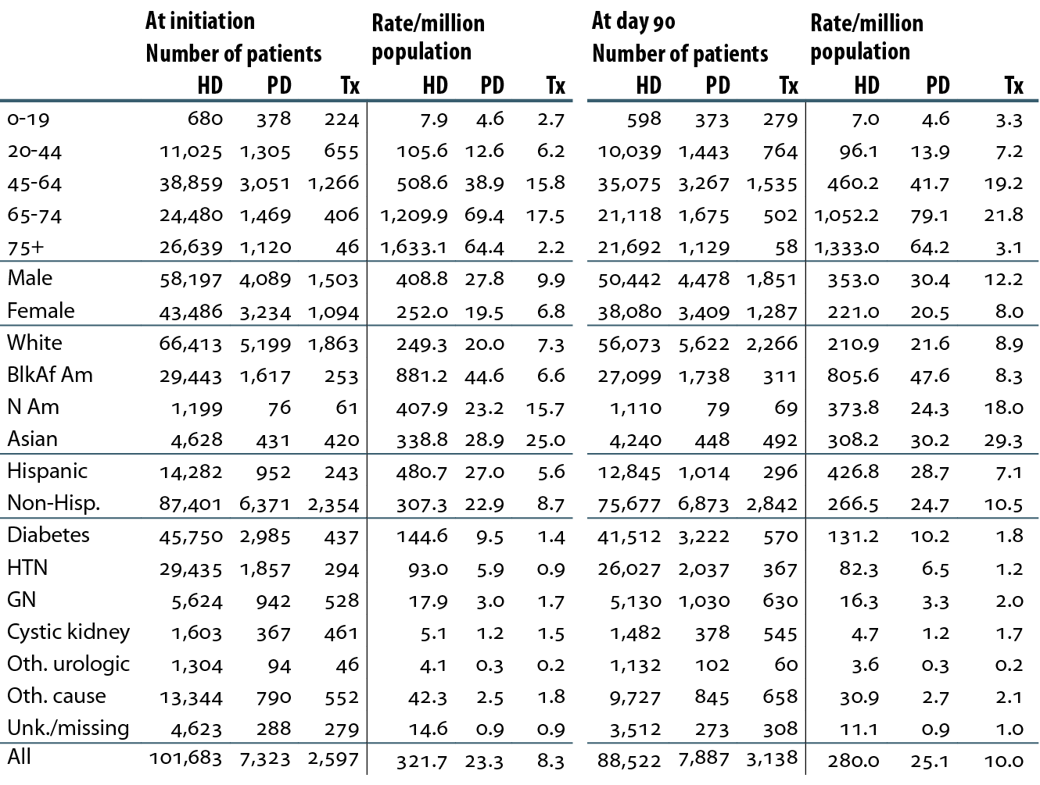
Incident counts & adjusted rates of ESRD at initiation & day 90, by modality, age, gender, race, ethnicity, & primary diagnosis, 2011
Table 1.d (Volume 2)
Incident ESRD patients, 2011; unknowns dropped. Adj: age/gender/race; ref: 2010 patients.

Slide 22
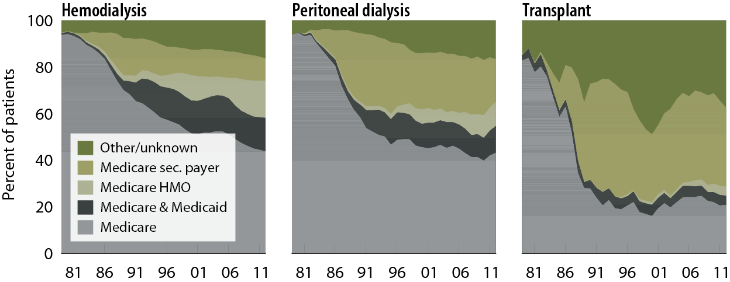
Incident patient distribution, by first modality & payor
Figure 1.17 (Volume 2)
Incident ESRD patients; peritoneal dialysis consists of CAPD & CCPD only.

Slide 23
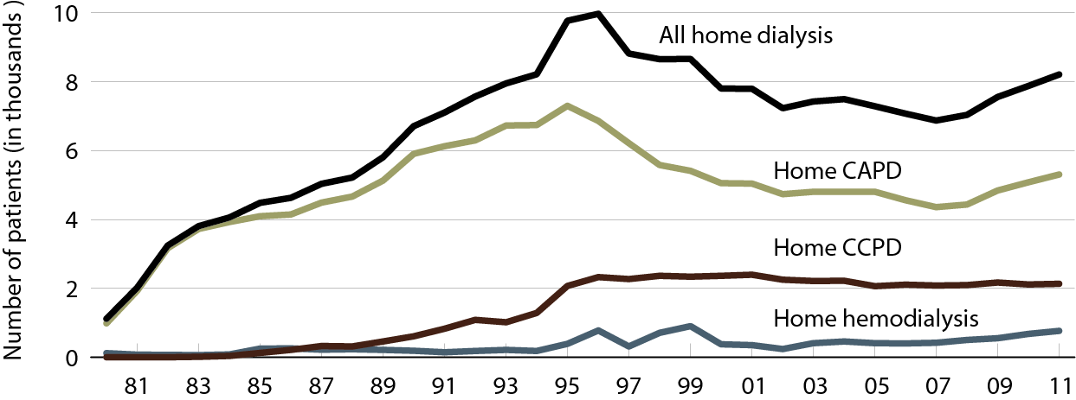
Incident patients using home dialysis, by therapy type
Figure 1.18 (Volume 2)
Incident dialysis patients.

Slide 24
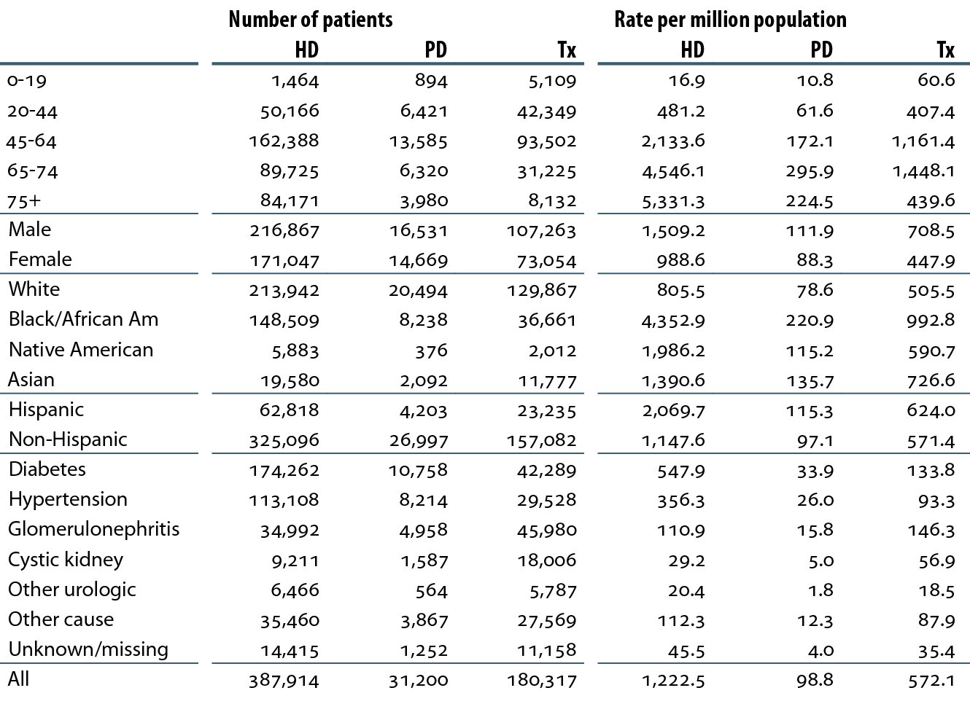
Prevalent counts & adjusted rates of ESRD, by modality, age, gender, race, ethnicity,
& primary diagnosis, 2011
Table 1.e (Volume 2)
December 31 point prevalent ESRD patients, 2011; unknowns dropped. Adj: age/gender/race; ref: 2010 ESRD patients.

Slide 25
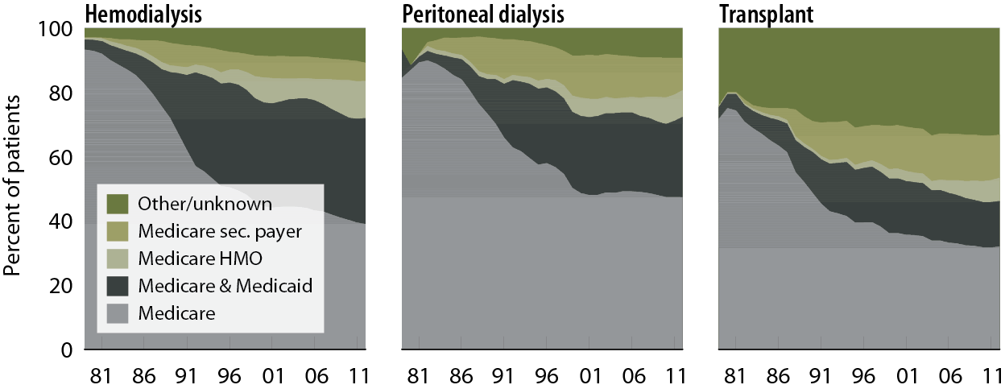
Prevalent patient distribution, by modality & payor
Figure 1.19 (Volume 2)
December 31 prevalent ESRD patients; peritoneal dialysis consists of CAPD & CCPD only.

Slide 26
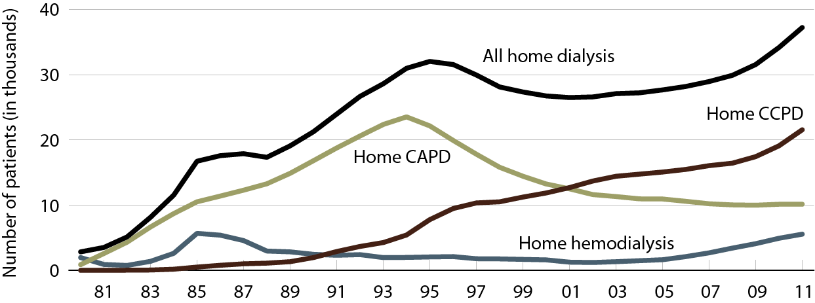
Prevalent patients using home dialysis, by therapy type
Figure 1.20 (Volume 2)
Prevalent dialysis patients.

Slide 27
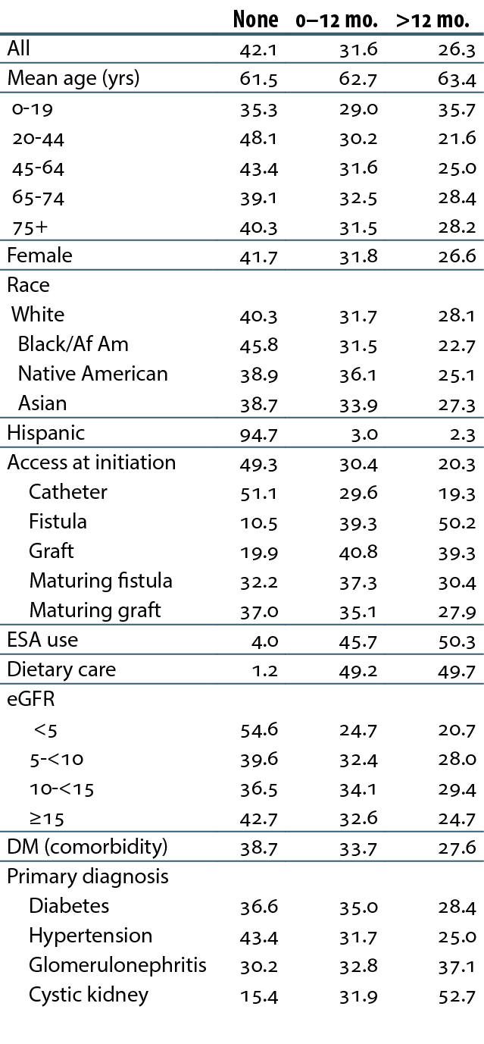
Pre-ESRD nephrologist care (row %), 2011
Table 1.f (Volume 2)
Incident ESRD patients, 2011. eGFR calculated using the CKD–EPI equation.

Slide 28
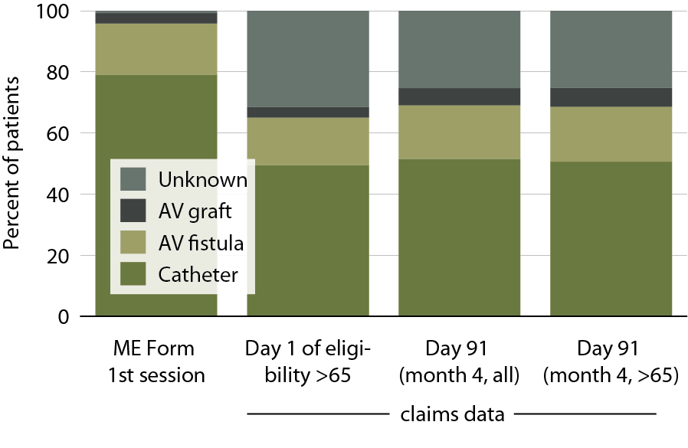
Vascular access use at initiation and on day of eligibility, 2011
Figure 1.21 (Volume 2)
Incident hemodialysis patients, 2011.

Slide 29
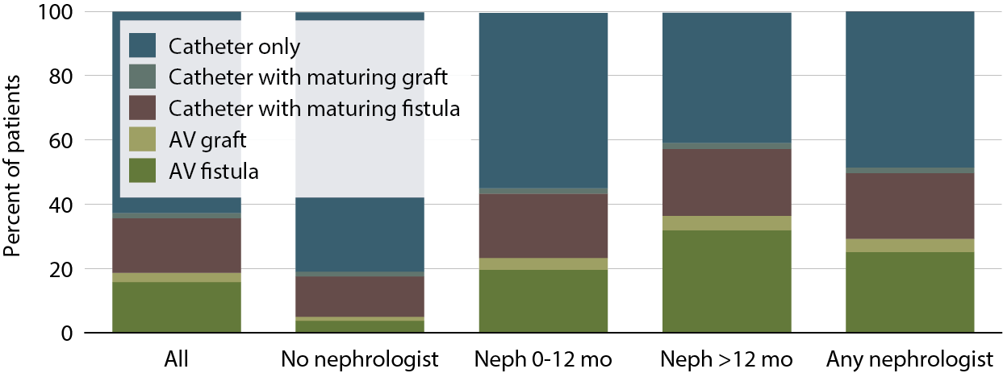
Access use at first outpatient hemodialysis, by pre-ESRD nephrology care, 2011
Figure 1.22 (Volume 2)
Incident hemodialysis patients, 2011.

Slide 30
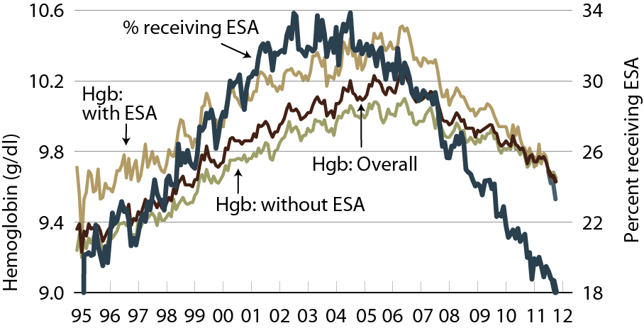
Mean hemoglobin at initiation, by pre-ESRD ESA treatment
Figure 1.23 (Volume 2)
Incident ESRD patients.

Slide 31
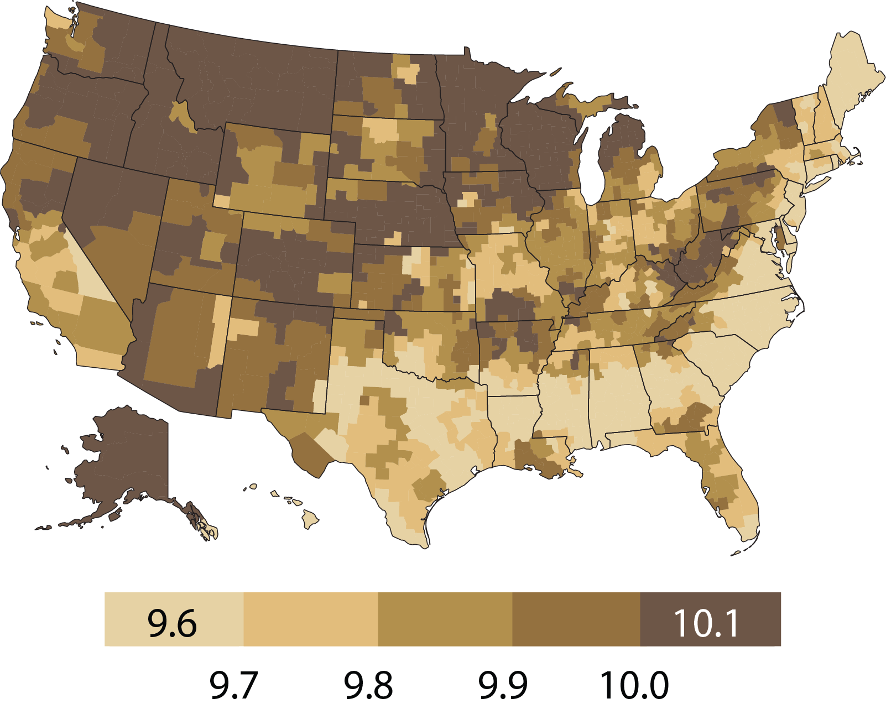
Variations in mean hemoglobin (g/dl) at initiation, by HSA, 2011
Figure 1.24 (Volume 2)
Incident ESRD patients, 2011.

Slide 32
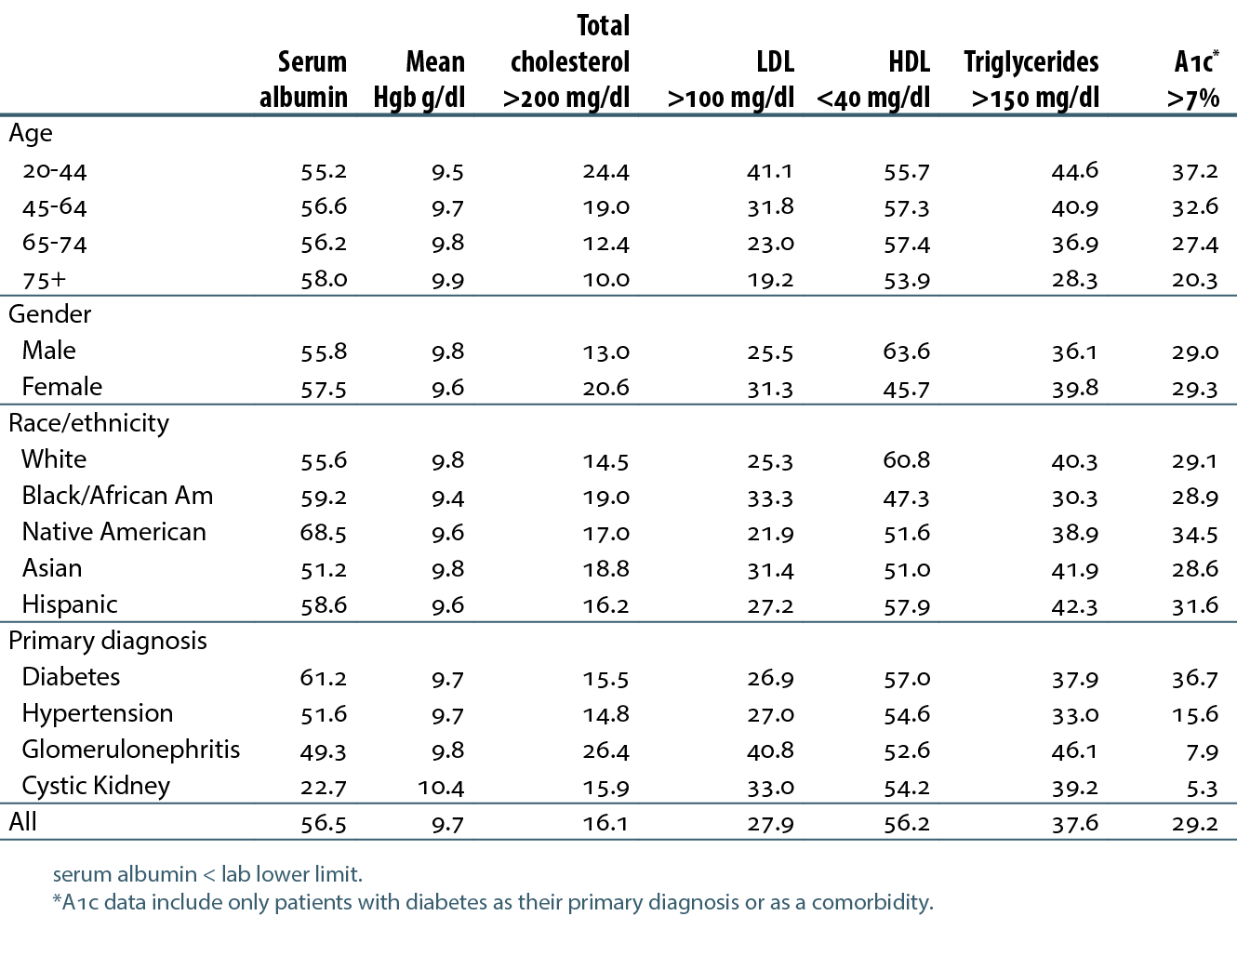
Patients initiating ESRD therapy, by laboratory values, by age, gender, race, ethnicity, & primary diagnosis, 2011
Table 1.g (Volume 2)
Incident ESRD patients, 2011.

Slide 33
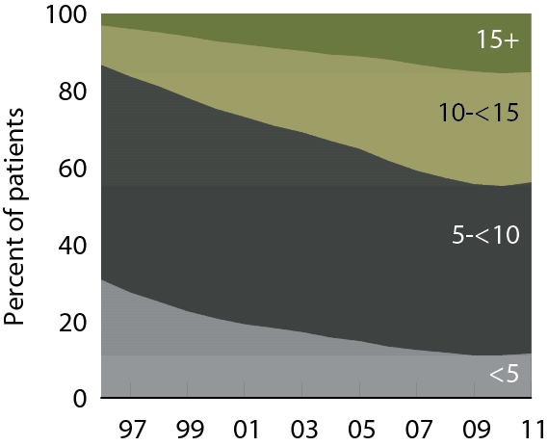
Patient distribution at initiation, by eGFR (ml/min/1.73 m²)
Figure 1.25 (Volume 2)
Incident ESRD patients. eGFR calculated using the CKD-EPI equation.

