Slide 1
ESRD: Chapter Four
Cardiovascular disease
United States Renal Data System
2013 Annual Data Report

Slide 2
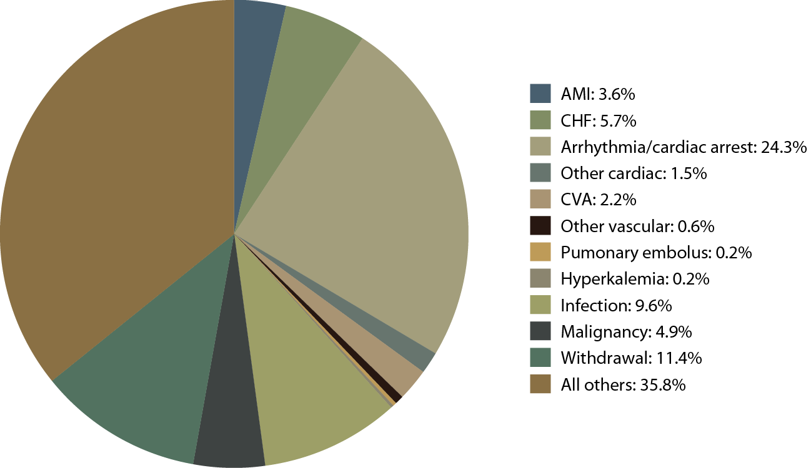
Causes of death in incident dialysis patients, 2009-2011, first 180 days
Figure 4.1 (Volume 2)
Incident & prevalent dialysis patients, 2009–2011.

Slide 3
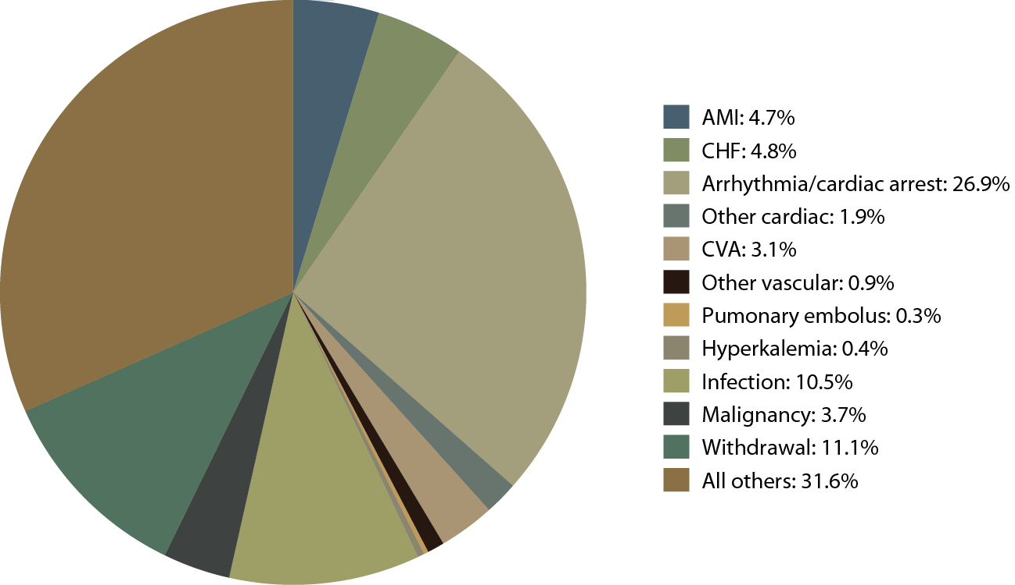
Causes of death in prevalent dialysis patients, 2009-2011
Figure 4.1 (continued; Volume 2)
Incident & prevalent dialysis patients, 2009–2011.

Slide 4
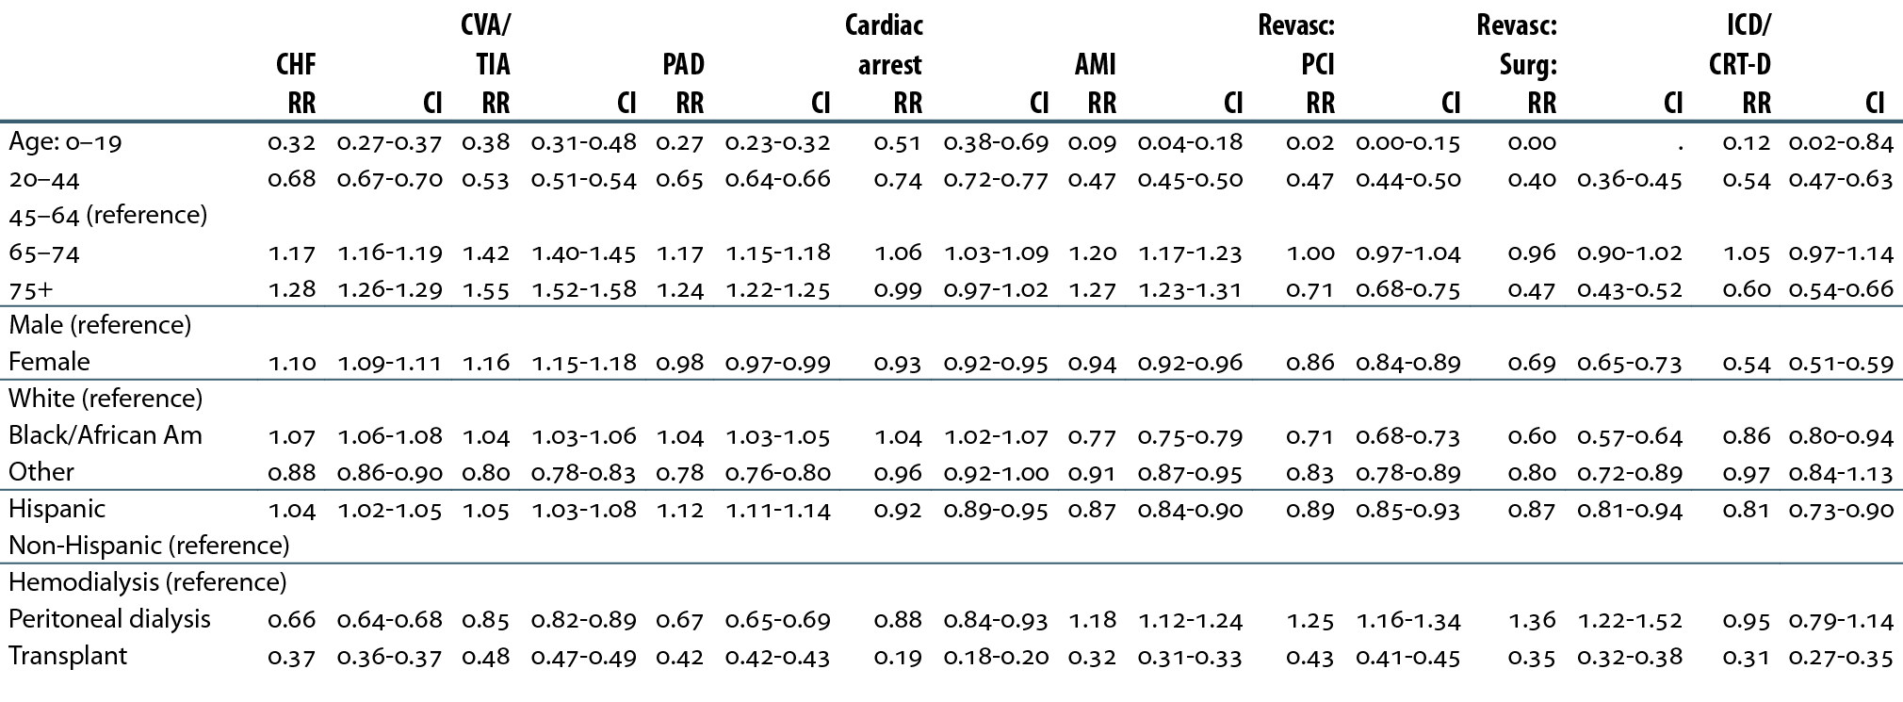
Relative risk of a cardiovascular diagnosis or procedure, by age, gender, race, ethnicity, & modality, 2009–2011
Table 4.a (Volume 2)
January 1, 2009 point prevalent ESRD patients with Medicare as primary payer; January 1, 2009 point prevalent ESRD patients with Medicare as primary payer; follow can occur up to three years.

Slide 5
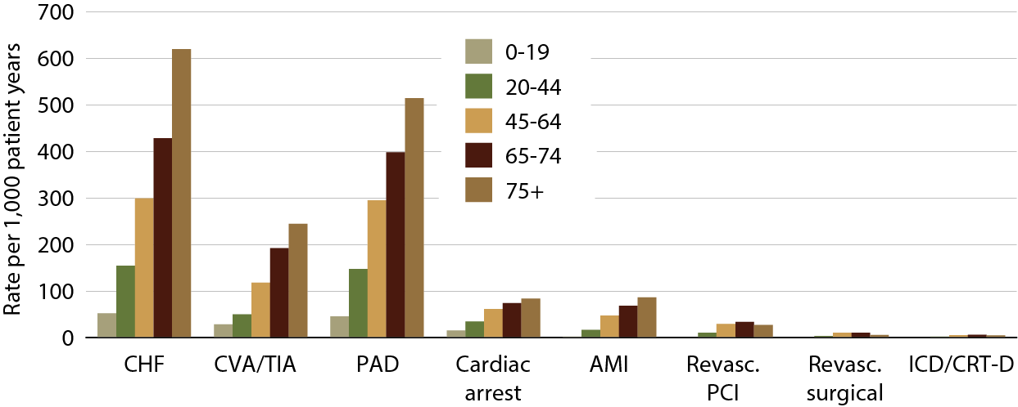
Rates of cardiovascular diagnoses
& procedures, by age, 2009–2011
Figure 4.2 (Volume 2)
January 1, 2009 point prevalent ESRD patients with Medicare as primary payer; January 1, 2009 point prevalent ESRD patients with Medicare as primary payer; follow can occur up to three years.

Slide 6
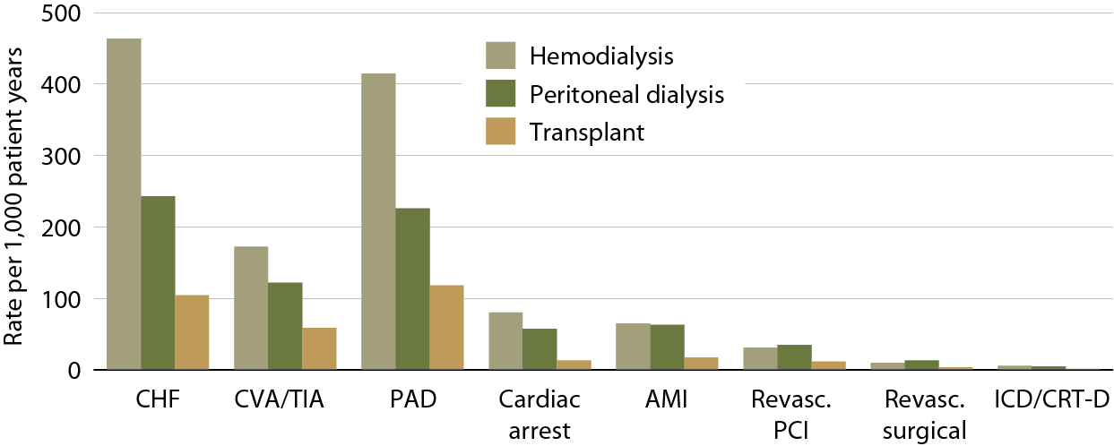
Event rates of cardiovascular diagnoses
& procedures, by modality, 2009–2011
Figure 4.3 (Volume 2)
January 1, 2009 point prevalent ESRD patients with Medicare as primary payer; January 1, 2009 point prevalent ESRD patients with Medicare as primary payer; follow can occur up to three years.

Slide 7
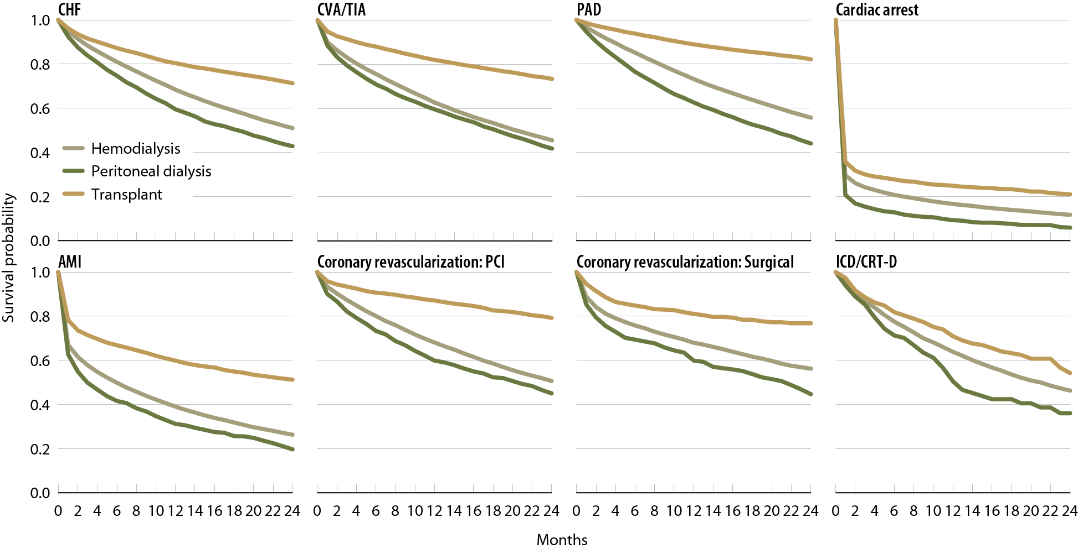
Survival of patients with cardiovascular diagnoses & procedures, by modality, 2009–2011
Figure 4.4 (Volume 2)
January 1 point prevalent ESRD patients, 2009, with a
first cardiovascular diagnosis or procedure in 2009–2011.

Slide 8
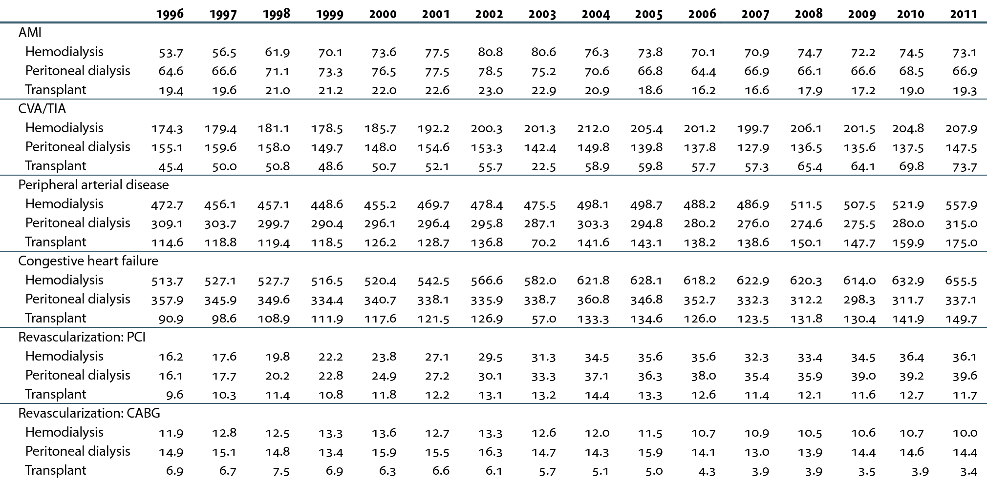
Rates (per 1,000 patient years) of cardiovascular diagnoses & procedures, by modality
Table 4.b (Volume 2)
Point prevalent ESRD patients on January 1 of each year: unadjusted; follow-up can occur up to one year

Slide 9
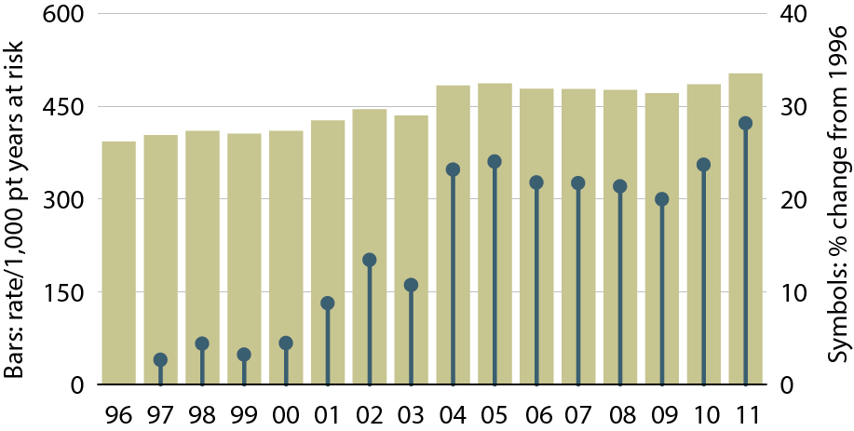
Rates of a CHF diagnosis in ESRD patients
Figure 4.5 (Volume 2)
Point prevalent ESRD patients on January 1 of each year: unadjusted.

Slide 10
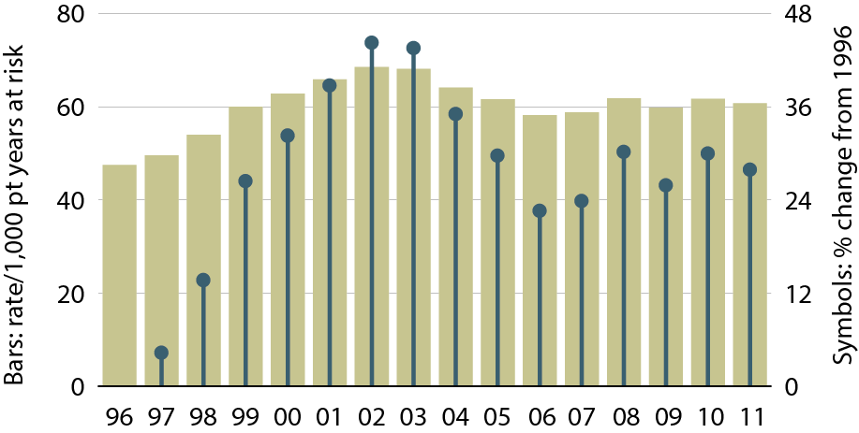
Rates of an AMI event in ESRD patients
Figure 4.6 (Volume 2)
Point prevalent ESRD patients on January 1 of each year: unadjusted.

Slide 11
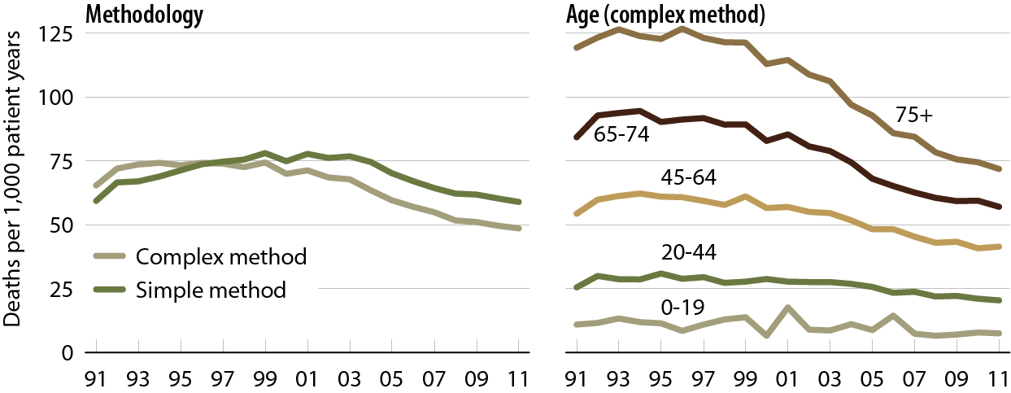
Rates of sudden cardiac death in prevalent dialysis patients, by method of estimation
Figure 4.7 (Volume 2)
Period prevalent dialysis patients.

Slide 12
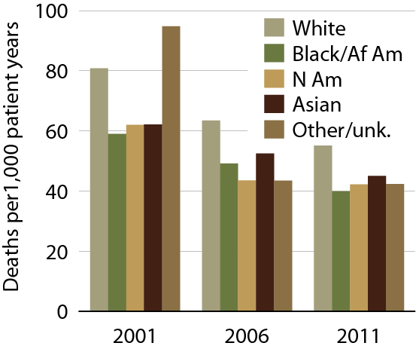
Rates of sudden cardiac death in prevalent dialysis patients, by race
Figure 4.8 (Volume 2)
Period prevalent dialysis patients: unadjusted & using the complex method.

Slide 13
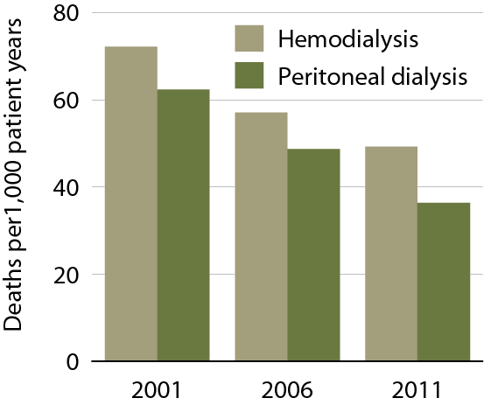
Rates of sudden cardiac death in prevalent dialysis patients, by modality
Figure 4.9 (Volume 2)
Period prevalent dialysis patients: unadjusted & using the complex method.

Slide 14
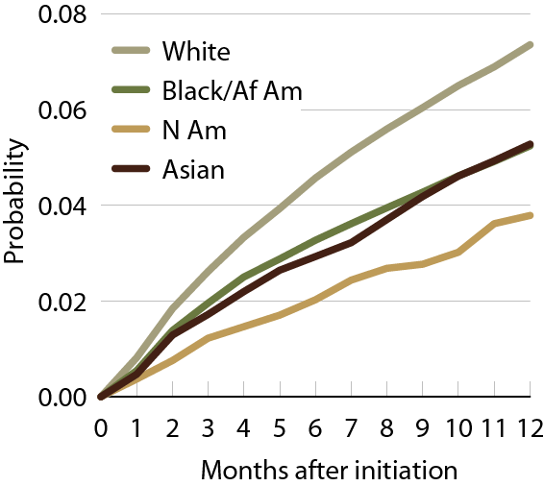
Probability of sudden cardiac death in
2010 incident dialysis patients, by race
Figure 4.10 (Volume 2)
Incident dialysis patients; simple method.

Slide 15
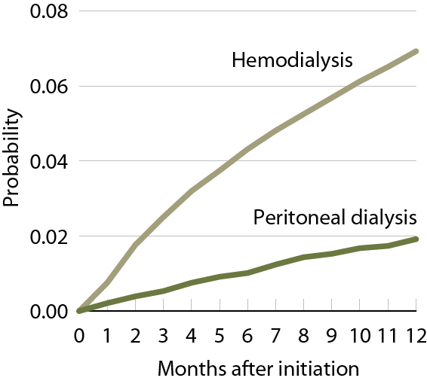
Probability of sudden cardiac death in
2010 incident dialysis patients, by modality
Figure 4.11 (Volume 2)
Incident dialysis patients; simple method.

Slide 16
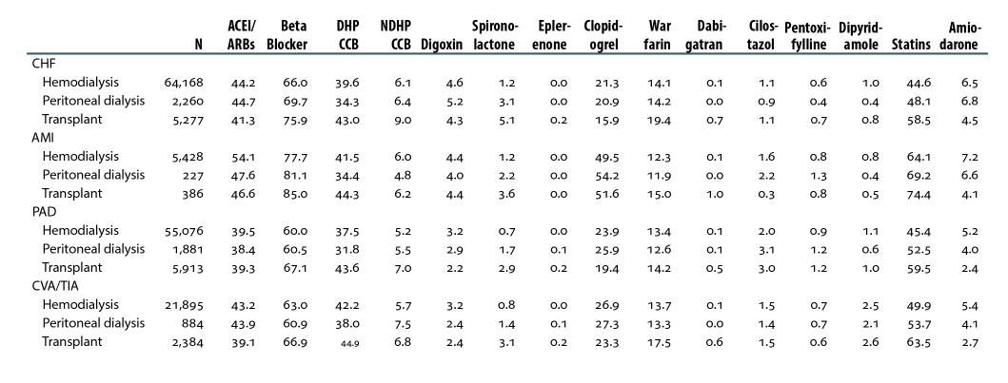
Cardiovascular disease & pharmacological interventions (row percent), by diagnosis & modality, 2011
Table 4.c (Volume 2)
January 1 point prevalent patients with Medicare Parts A, B, & D enrollment with a first cardiovascular diagnosis or procedure in 2011.

Slide 17
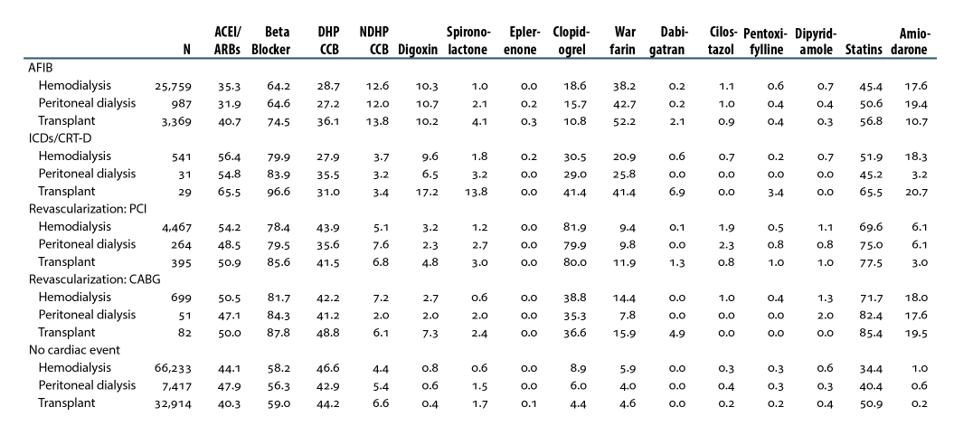
Cardiovascular disease & pharmacological interventions (row percent), by diagnosis & modality, 2011
Table 4.c (continued; Volume 2)
January 1 point prevalent patients with Medicare Parts A, B, & D enrollment with a first cardiovascular diagnosis or procedure in 2011.

Slide 18
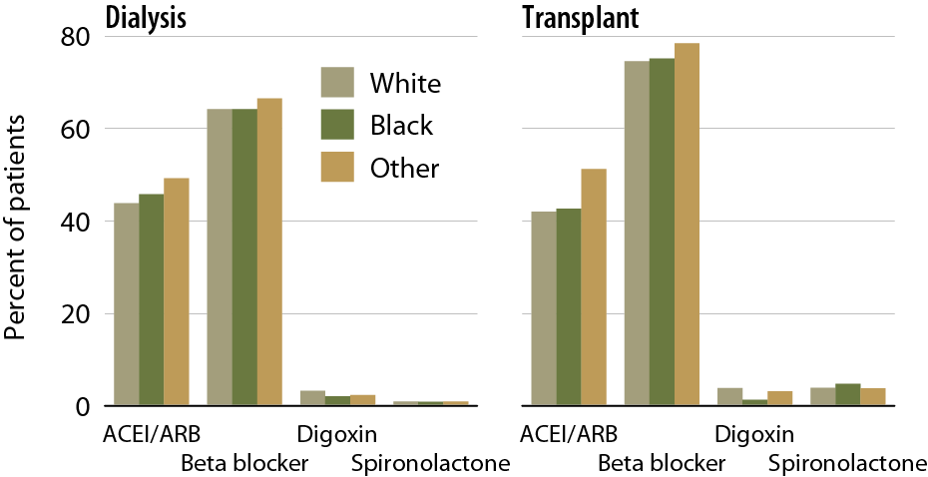
Prescription drug therapy in prevalent ESRD patients with CHF, by modality & race, 2011
Figure 4.12 (Volume 2)
January 1 point prevalent ESRD patients with Medicare Parts A, B, & D enrollment & with a first CHF diagnosis in 2011.

Slide 19
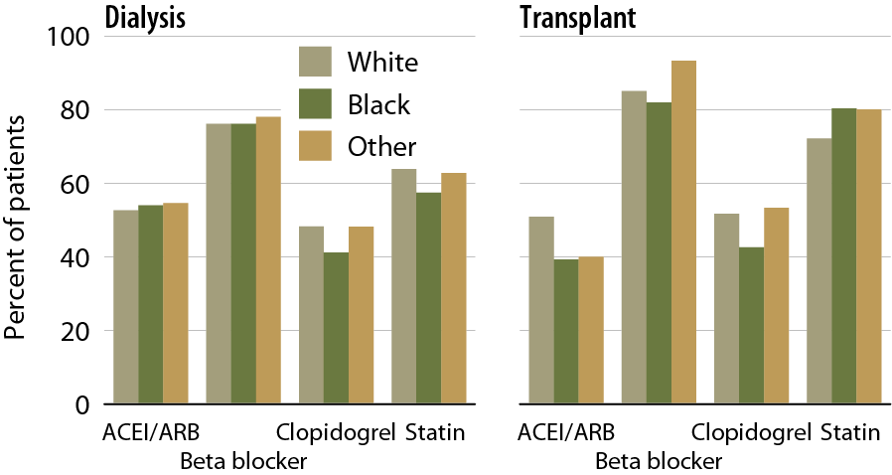
Prescription drug therapy in prevalent ESRD patients with AMI, by modality & race, 2011
Figure 4.13 (Volume 2)
January 1 point prevalent ESRD patients with Medicare Parts A, B, & D enrollment & with a first AMI diagnosis in 2011.

Slide 20
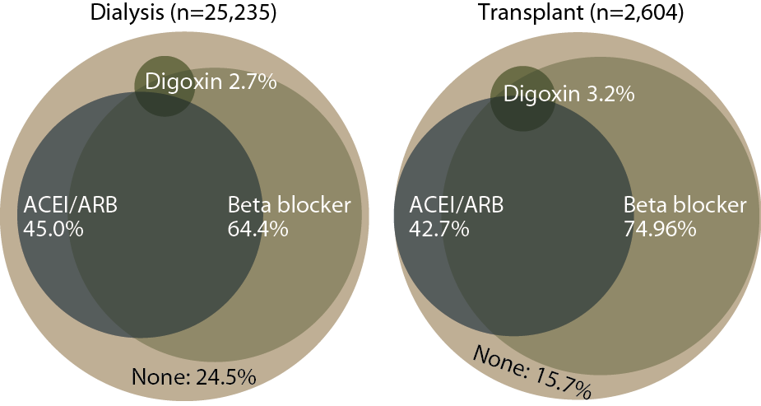
Patients treated for CHF, by type of medication & modality, 2011
Figure 4.14 (Volume 2)
January 1 point prevalent ESRD patients with Medicare Parts A, B, & D enrollment & with a cardiovascular diagnosis or procedure between January 1 & November 30, 2011.

Slide 21
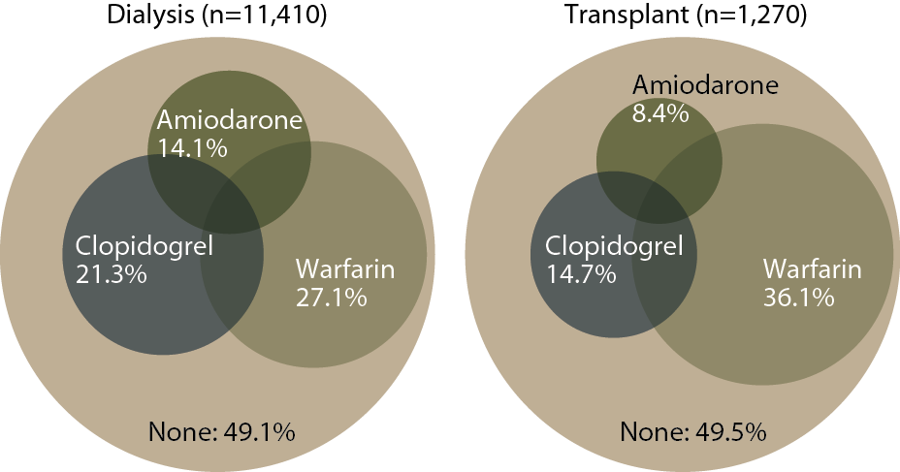
Patients treated for atrial fibrillation, by type of medication & modality, 2011
Figure 4.15 (Volume 2)
January 1 point prevalent ESRD patients with Medicare Parts A, B, & D enrollment & with a cardiovascular diagnosis or procedure between January 1 & November 30, 2011.

Slide 22
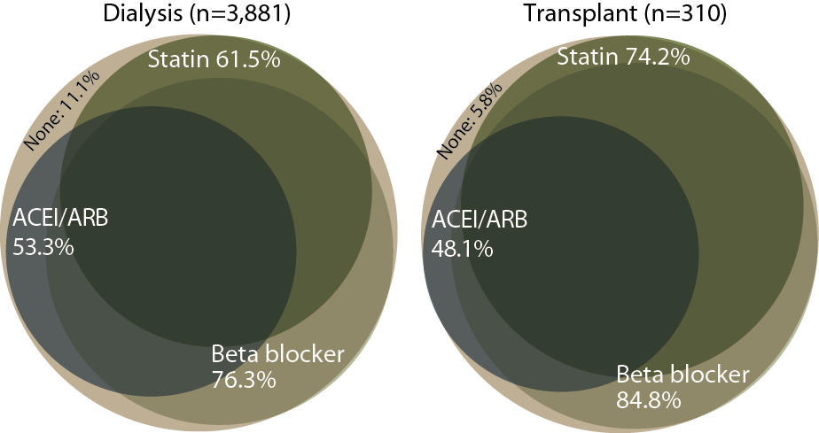
Patients treated for AMI, by type of medication & modality, 2011
Figure 4.16 (Volume 2)
January 1 point prevalent ESRD patients with Medicare Parts A, B, & D enrollment & with a cardiovascular diagnosis or procedure between January 1 & November 30, 2011.

Slide 23
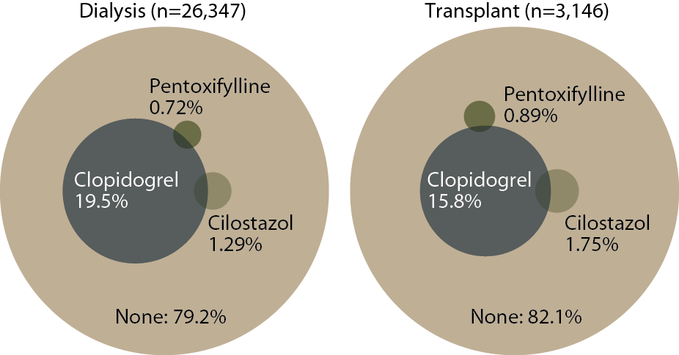
Patients treated for PAD, by type of medication & modality, 2011
Figure 4.17 (Volume 2)
January 1 point prevalent ESRD patients with Medicare Parts A, B, & D enrollment & with a cardiovascular diagnosis or procedure between January 1 & November 30, 2011.

Slide 24
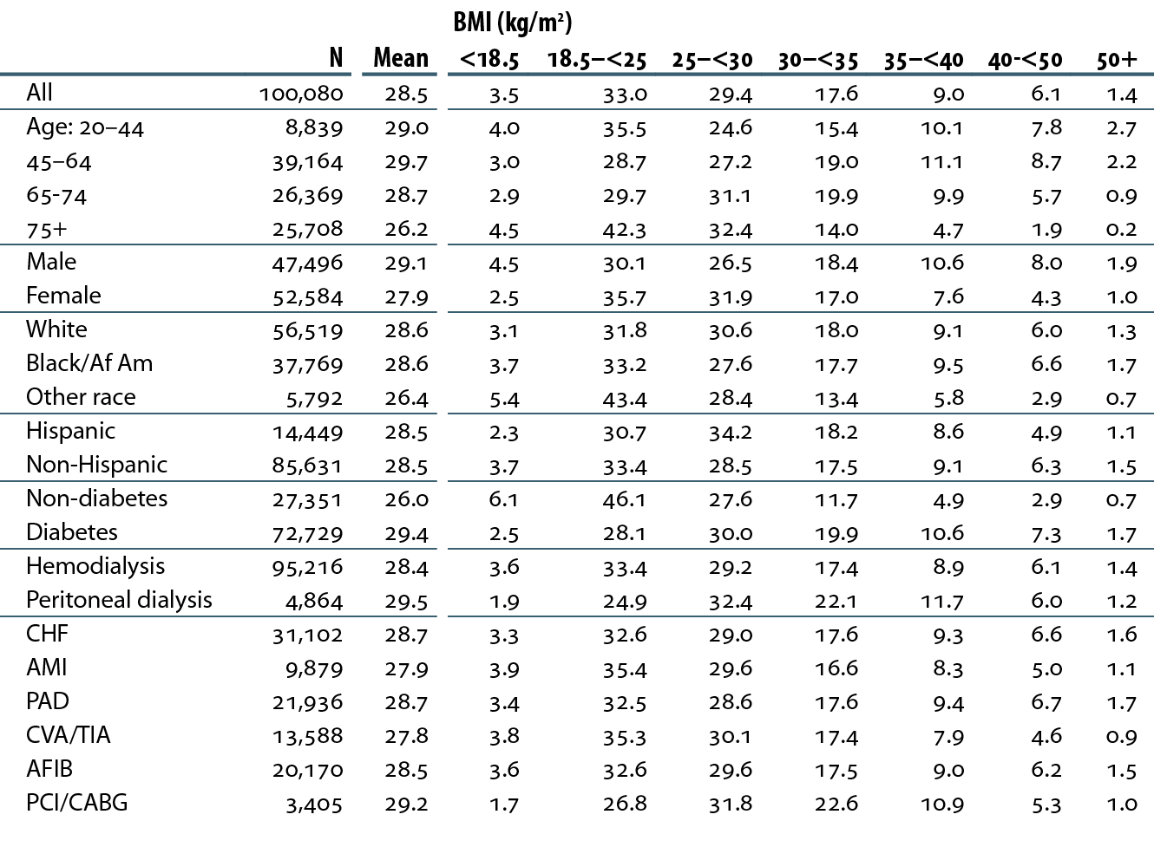
Distribution of patients with cardiovascular disease (row percent), by body mass index (BMI), 2011
Table 4.d (Volume 2)
January 1 point prevalent dialysis patients age 20 & older with a first cardiovascular diagnosis or procedure in 2011.

Slide 25
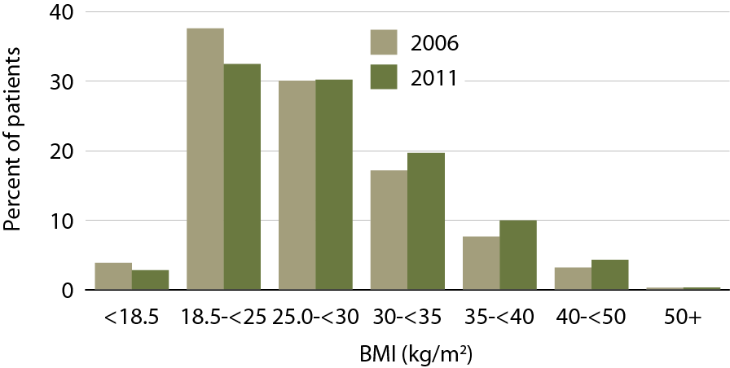
Distribution of dialysis patients on the transplant wait list, by body mass index (BMI)
Figure 4.18 (Volume 2)
January 1 point prevalent hemodialysis & peritoneal dialysis patients on the transplant waiting list.

Slide 26
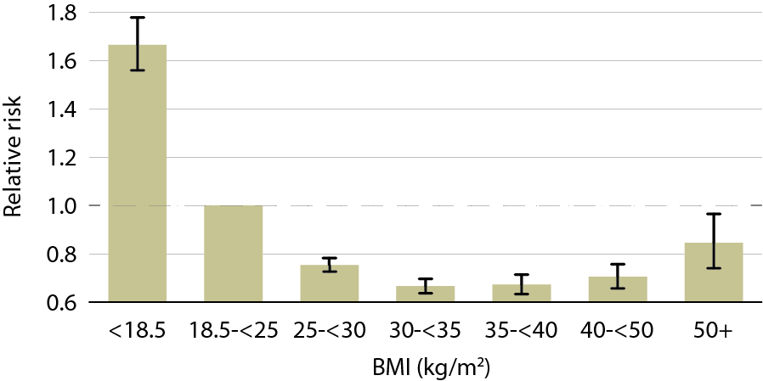
Adjusted relative risk of a cardiovascular death, by body mass index (BMI), 2011
Figure 4.19 (Volume 2)
January 1 point prevalent dialysis patients age 20 & older.

Slide 27
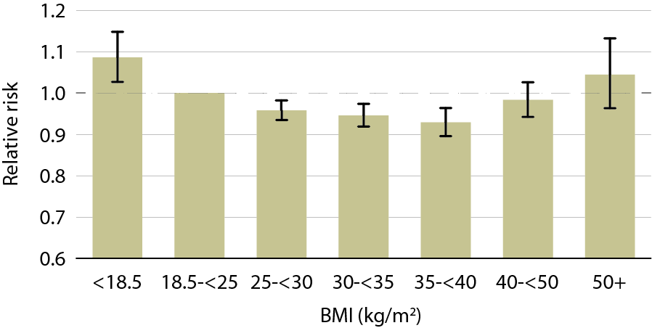
Adjusted relative risk of incident CHF, by body mass index (BMI), 2011
Figure 4.20 (Volume 2)
January 1 point prevalent dialysis patients age 20 & older.

Slide 28
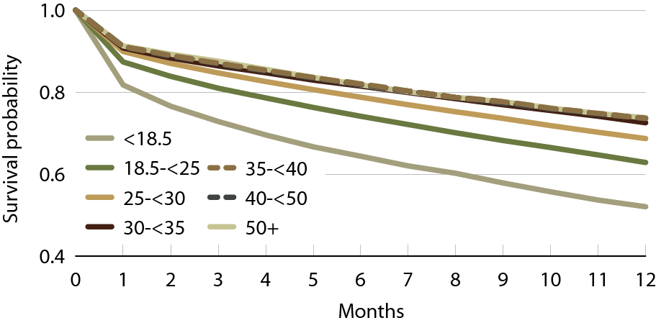
Unadjusted survival in patients with cardiovascular disease, by BMI, 2011
Figure 4.21 (Volume 2)
January 1 point prevalent dialysis patients age 20 & older with a first cardiovascular diagnosis or procedure in 2010.

Slide 29
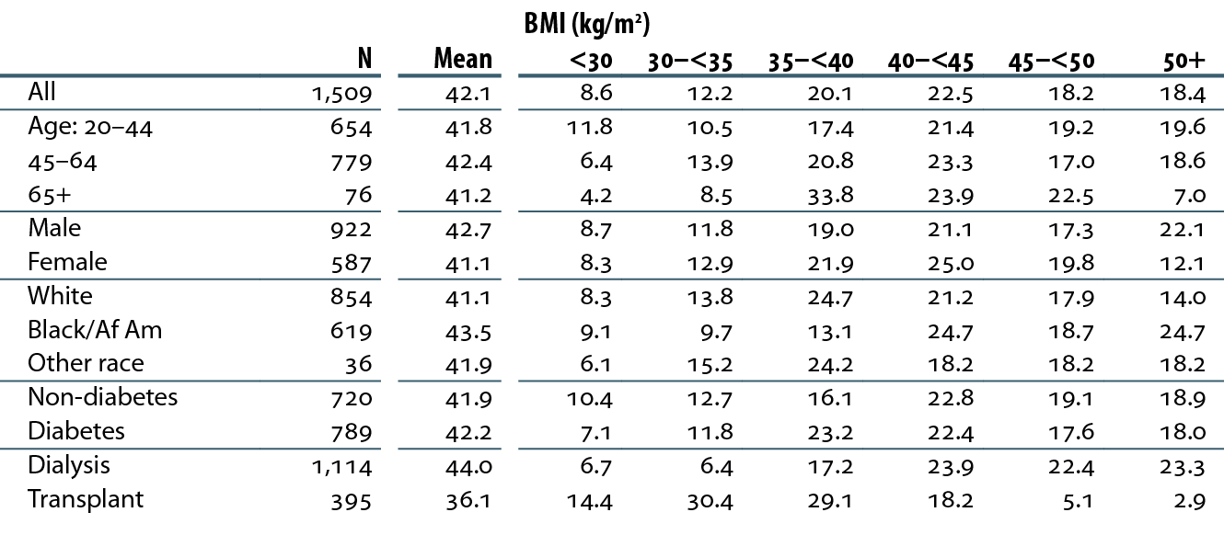
BMI at ESRD incidence in patients who undergo bariatric surgery, 2002–2011
Table 4.e (Volume 2)
ESRD patients age 20 & older with Medicare coverage at time of surgery.

Slide 30
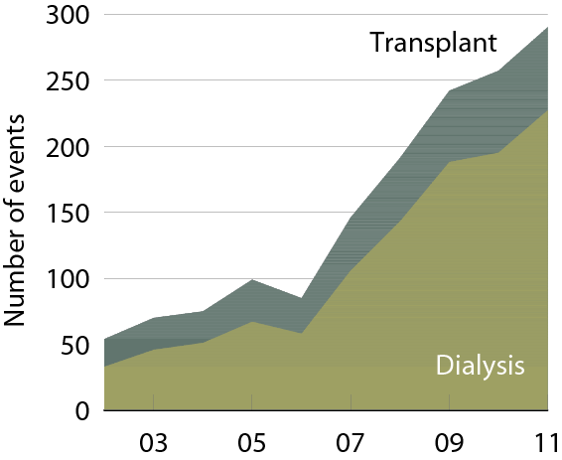
Number of bariatric surgery events, by modality
Figure 4.22 (Volume 2)
ESRD patients age 20 & older with Medicare coverage at time of surgery.

Slide 31
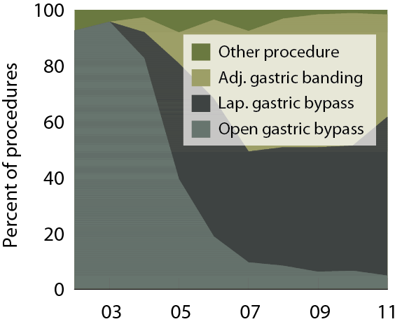
Distribution of bariatric surgical procedures
Figure 4.23 (Volume 2)
ESRD patients age 20 & older with Medicare coverage at time of surgery.

Slide 32
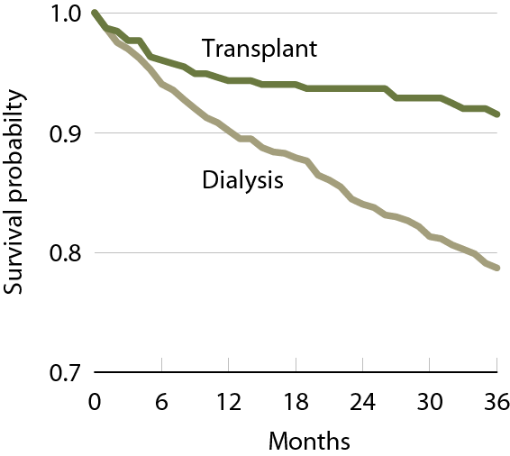
Survival following bariatric surgery, by modality, 2002–2011
Figure 4.24 (Volume 2)
ESRD patients age 20 & older with Medicare coverage at time of surgery.

Slide 33
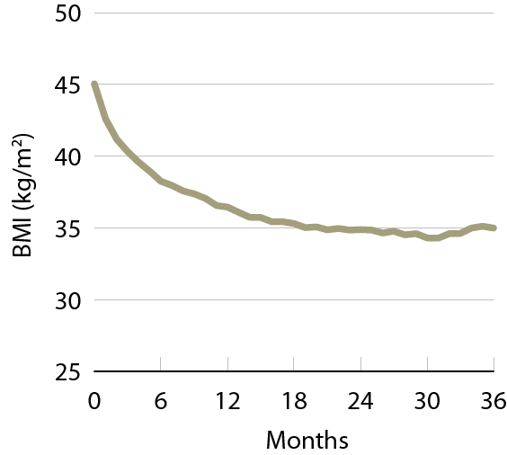
BMI following bariatric surgery in dialysis patients, 2005–2011
Figure 4.25 (Volume 2)
Dialysis patients age 20 & older with Medicare as primary payor at time of surgery.

Slide 34
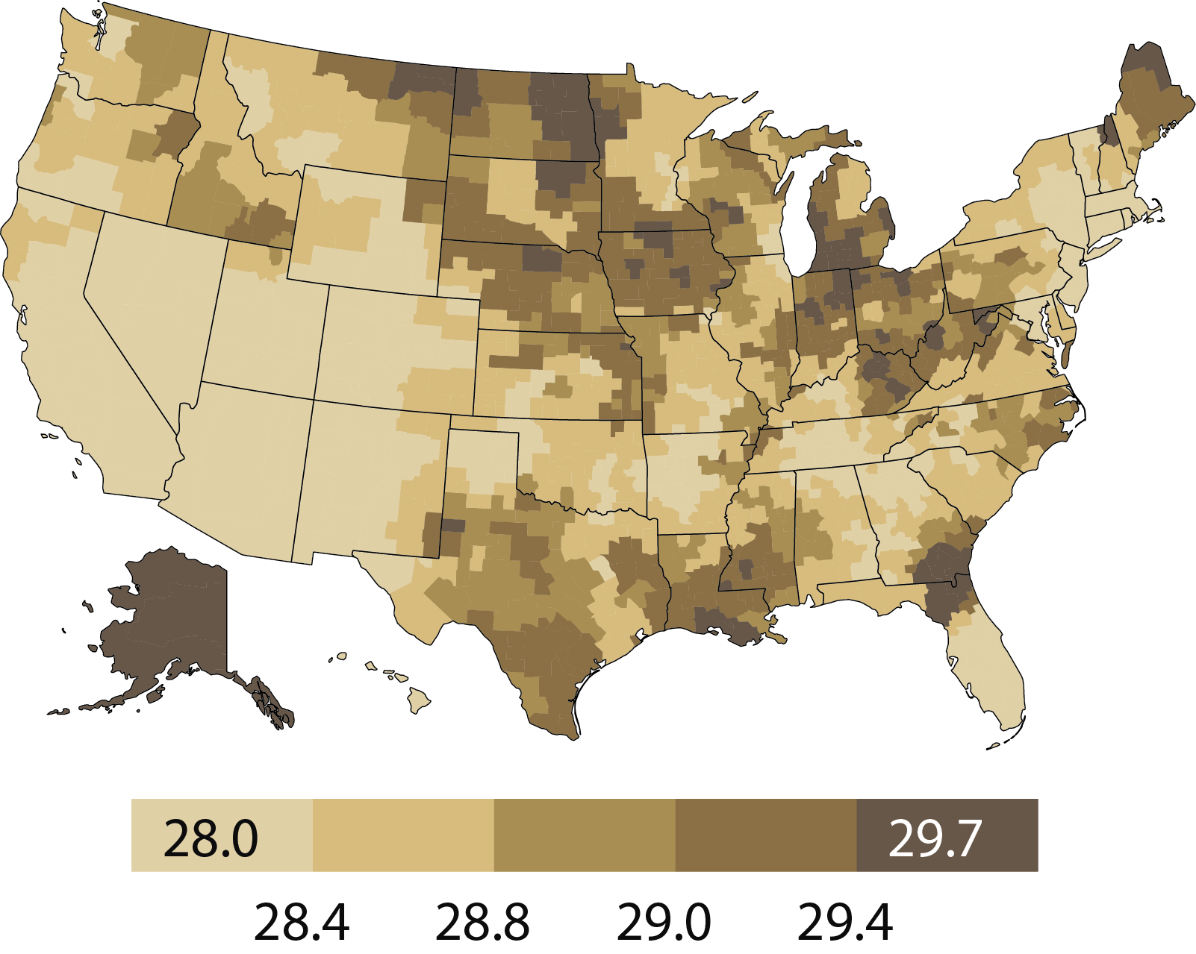
Geographic variations in BMI (kg/m²), by HSA, 2008
Figure 4.26 (Volume 2)
January 1 point prevalent dialysis patients who received dialysis for the entire year.

Slide 35
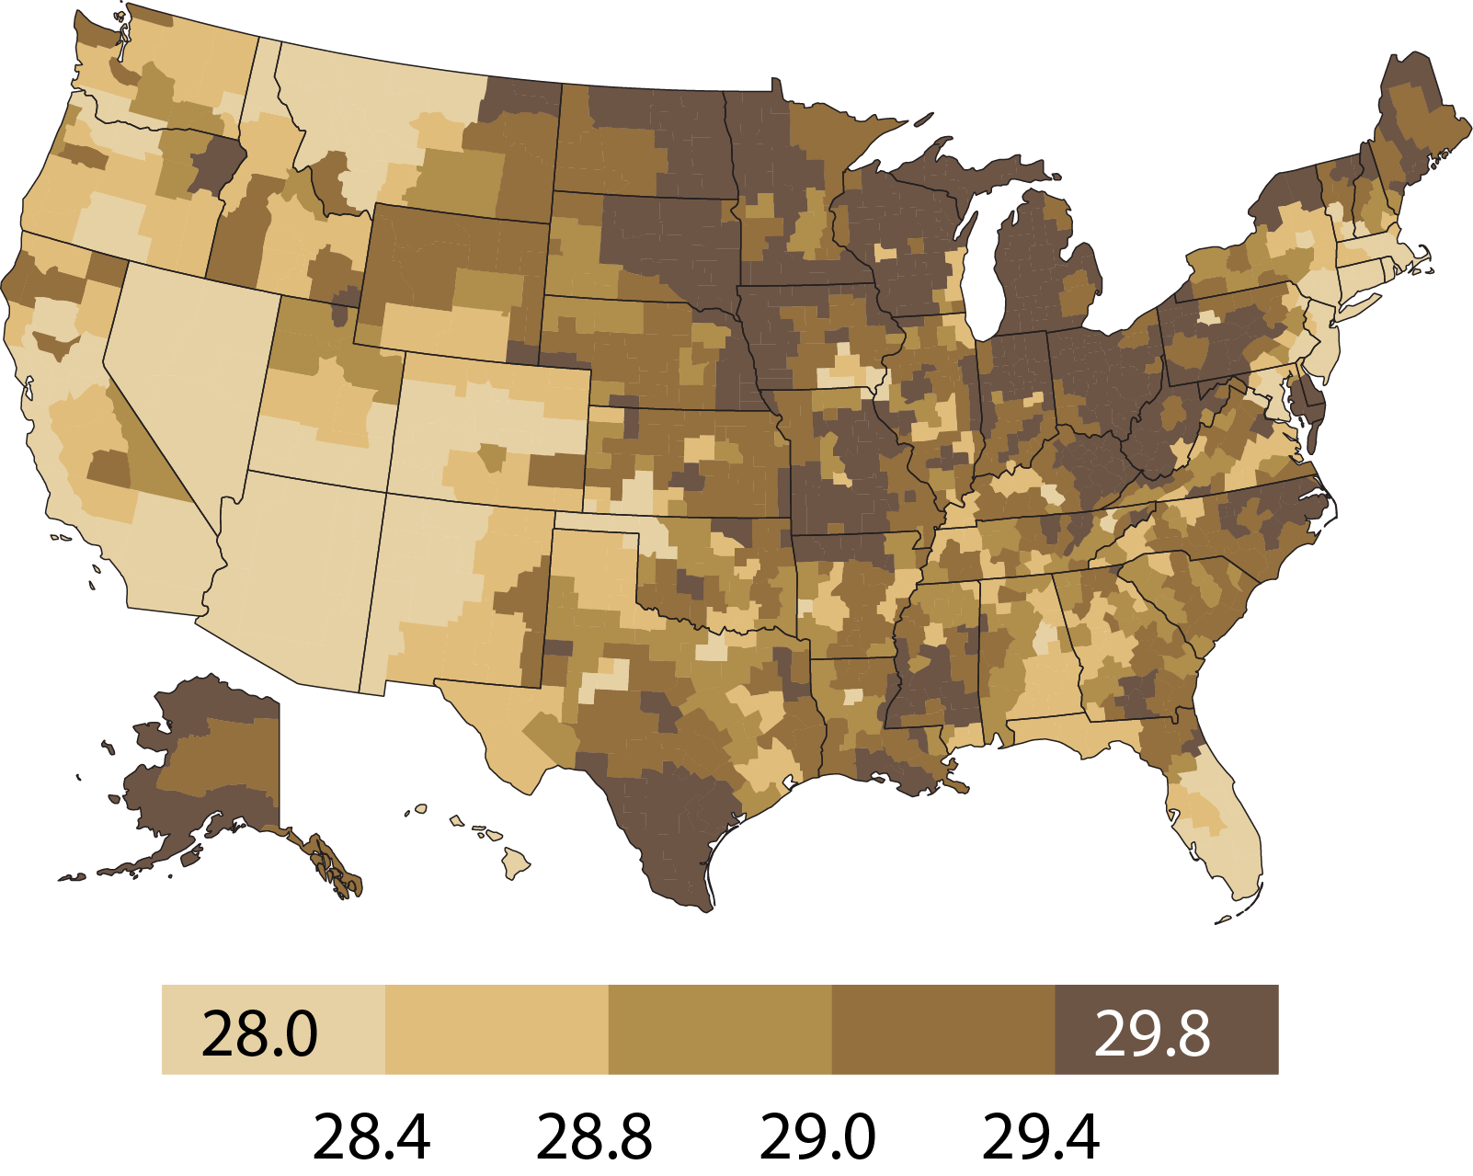
Geographic variations in BMI (kg/m²), by HSA, 2011
Figure 4.26 (continued; Volume 2)
January 1 point prevalent dialysis patients who received dialysis for the entire year.

Slide 36
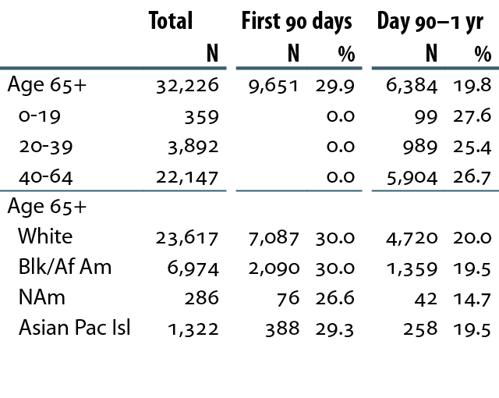
Percent of incident dialysis patients receiving first echocardiograms, 2011
Table 4.f (Volume 2)
Incident dialysis patients, 2011.

Slide 37
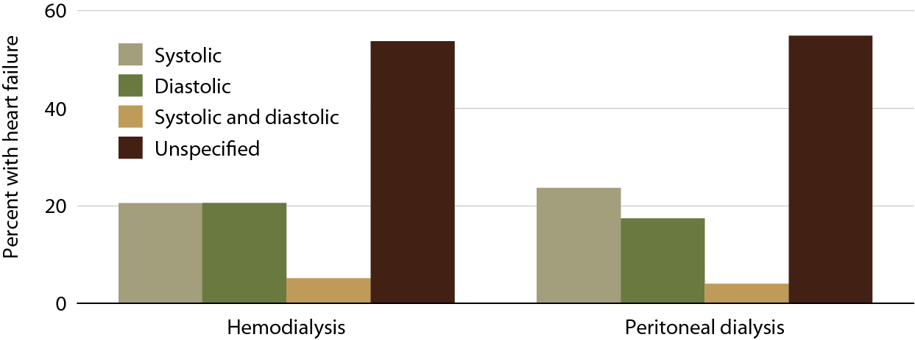
Heart failure in prevalent dialysis patients, by modality, 2011
Figure 4.27 (Volume 2)
January 1, 2011 point prevalent ESRD dialysis patients with Medicare Parts A, B,& D coverage, diagnosed with heart failure in 2011, & surviving & staying on the same modality for all of 2011.

Slide 38
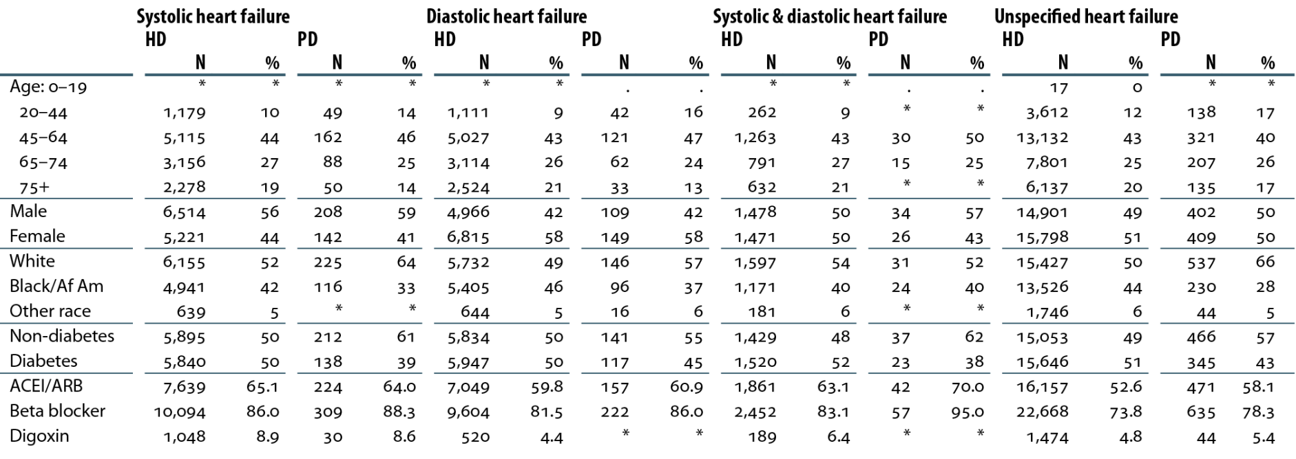
Characteristics of dialysis patients with heart failure
Table 4.g (Volume 2)
January 1, 2011 point prevalent ESRD dialysis patients with Medicare Parts A, B,& D coverage, diagnosed with heart failure in 2011, & surviving & staying on the same modality for all of 2011.
“.” Zero patients in this cell. *Values for cells with ten or fewer patients are suppressed.

Slide 39
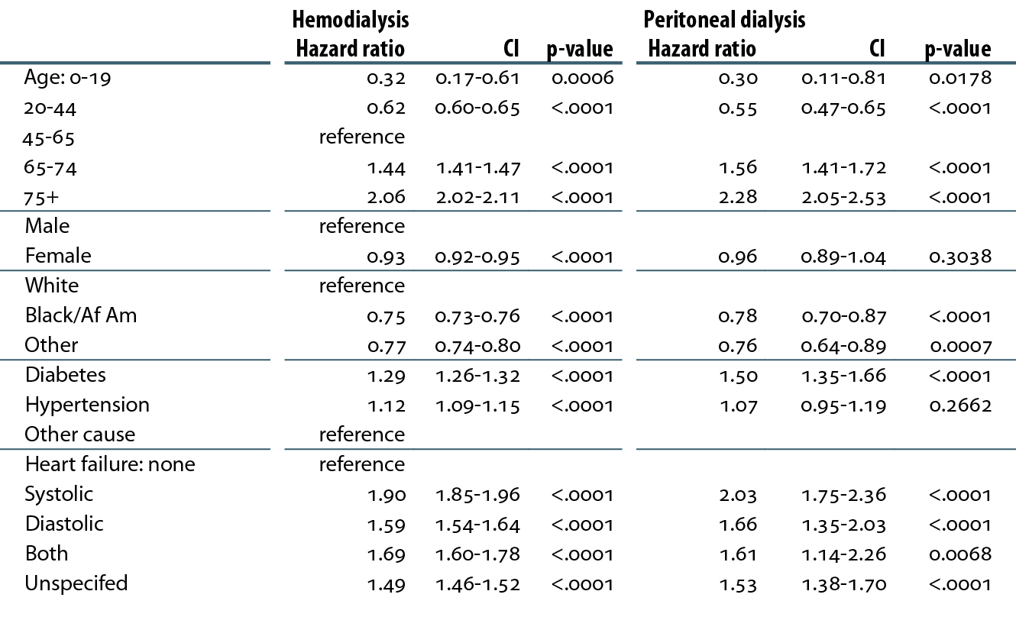
Adjusted hazard ratios of all-cause death in patients with heart failure, by modality, 2010-2011
Table 4.h (Volume 2)
January 1, 2009 point prevalent dialysis patients, diagnosed with heart failure in 2009, & surviving & staying on the same modality for all of 2009.

Slide 40
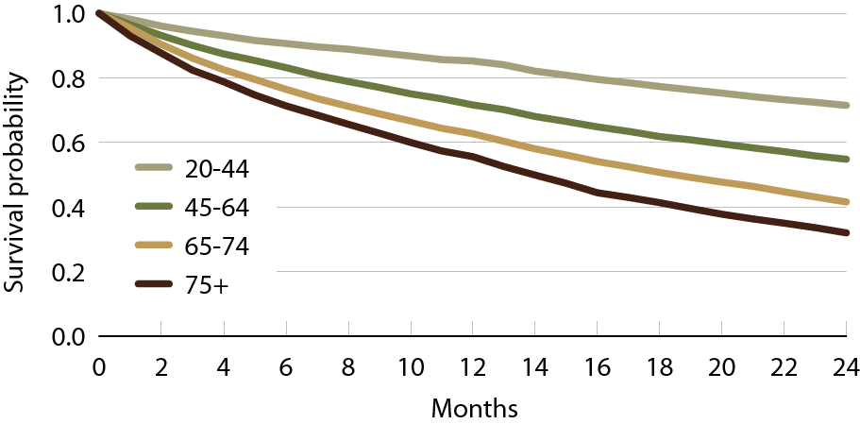
Unadjusted survival in patients with systolic heart failure, by age, 2010–2011
Figure 4.28 (Volume 2)
January 1, 2009 point prevalent dialysis patients, diagnosed with heart failure in 2009, & surviving & staying on the same modality for all of 2009.

Slide 41
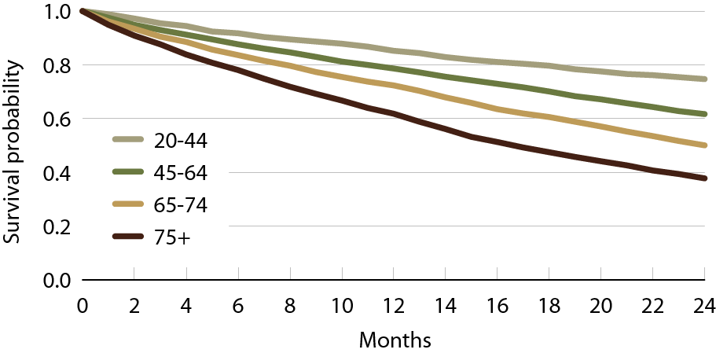
Unadjusted survival in patients with diastolic heart failure, by age, 2010–2011
Figure 4.29 (Volume 2)
January 1, 2009 point prevalent dialysis patients, diagnosed with heart failure in 2009, & surviving & staying on the same modality for all of 2009.

Slide 42
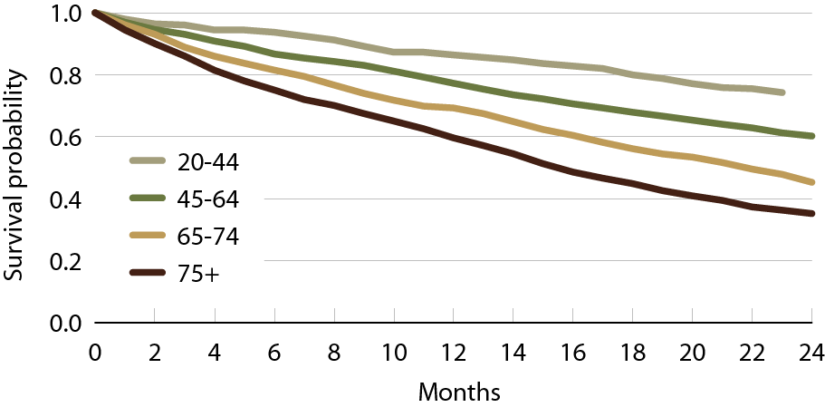
Unadjusted survival in patients with systolic
& diastolic heart failure, by age, 2010–2011
Figure 4.30 (Volume 2)
January 1, 2009 point prevalent dialysis patients, diagnosed with heart failure in 2009, & surviving & staying on the same modality for all of 2009.

Slide 43
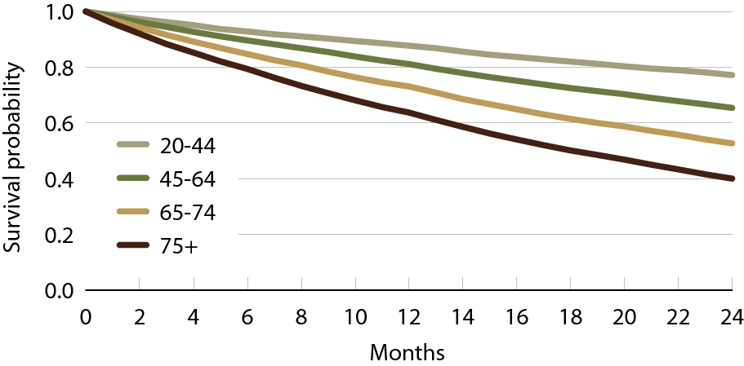
Unadjusted survival in patients with unspecified heart failure, by age, 2010–2011
Figure 4.31 (Volume 2)
January 1, 2009 point prevalent dialysis patients, diagnosed with heart failure in 2009, & surviving & staying on the same modality for all of 2009.

