Slide 1
ESRD: Chapter Five
Mortality
United States Renal Data System
2013 Annual Data Report

Slide 2
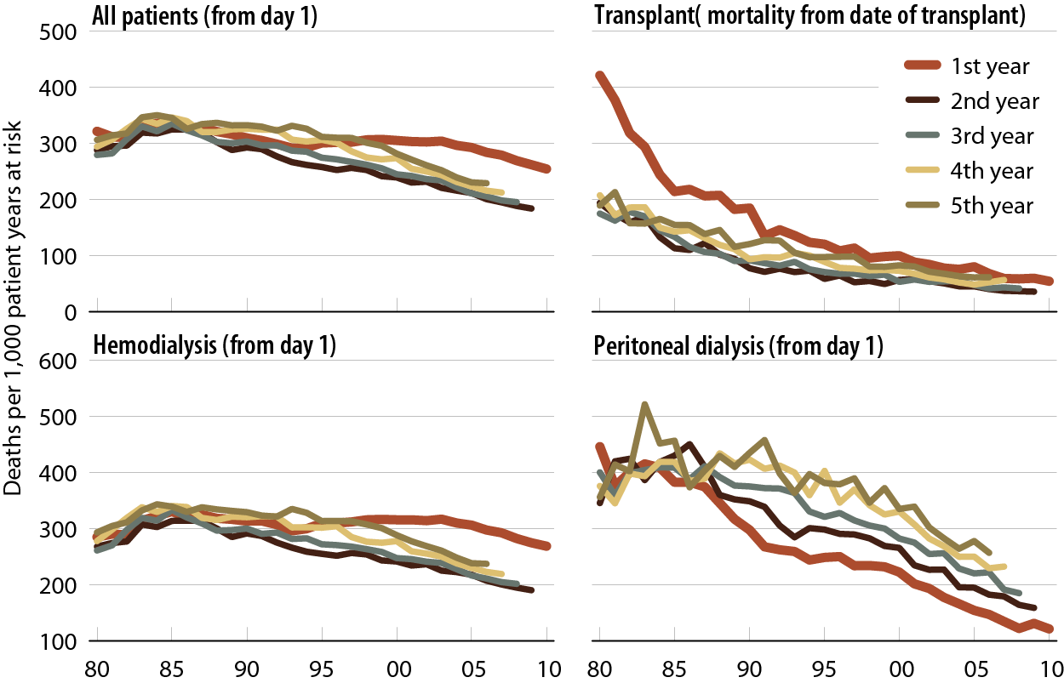
Adjusted all-cause mortality rates (from day 1 and day 90), by modality & year of treatment
Figure 5.1 (Volume 2)
Incident ESRD patients. Adj: age/gender/race /primary diagnosis; ref: incident ESRD patients, 2010.

Slide 3
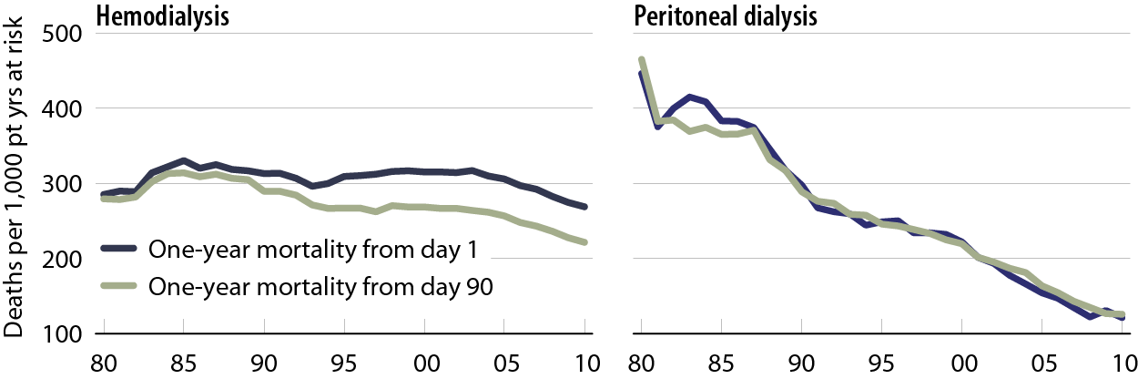
Adjusted all-cause mortality rates (from day 1 and day 90), by modality & year of treatment
Figure 5.1 (continued; Volume 2)
Incident ESRD patients. Adj: age/gender/race/primary diagnosis; ref: incident ESRD patients, 2010.

Slide 4
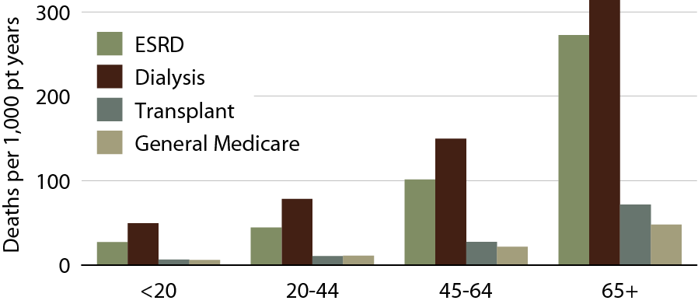
Adjusted all-cause mortality in the ESRD
& general populations, by age, 2011
Figure 5.2 (Volume 2)
Prevalent ESRD patients from day one, 2011, & general Medicare (non-ESRD) patients with at least one month of Medicare eligibility in 2011. Adj: gender/race; ref: Medicare patients, 2011.

Slide 5
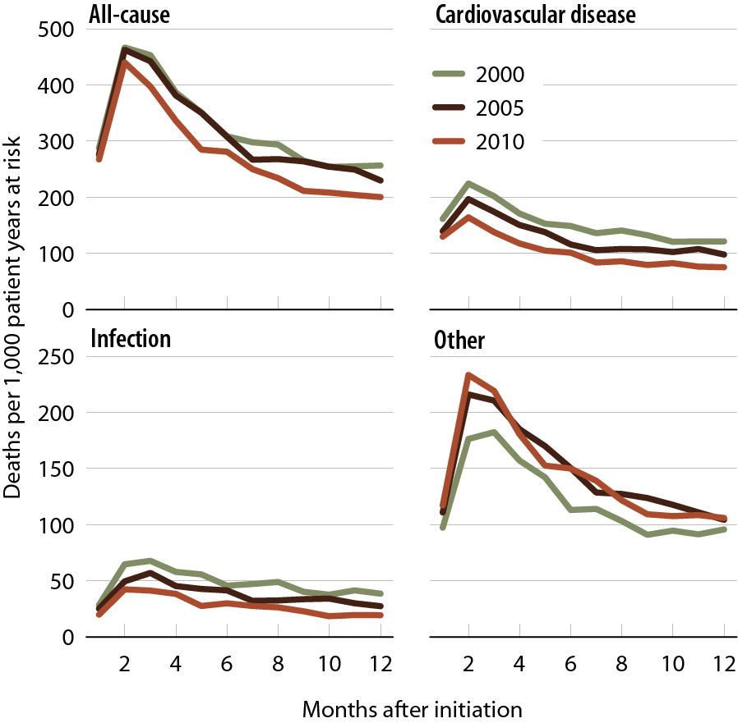
Adjusted all-cause & cause specific mortality (from day one) in the first year of hemodialysis
Figure 5.3 (Volume 2)
Incident hemodialysis patients defined on the day of dialysis onset, without the 60-day rule. Adj: age/gender /race/Hispanic ethnicity/ primary diagnosis; ref: incident hemodialysis patients, 2010.

Slide 6
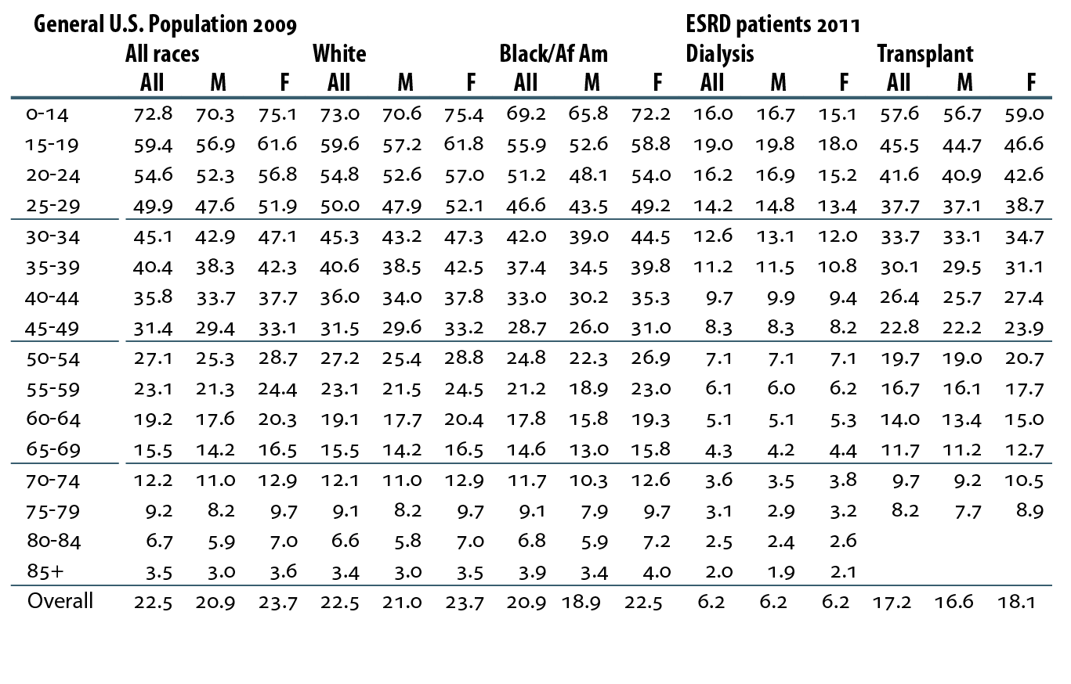
Expected remaining lifetimes (years) of the general U.S. population, & of prevalent dialysis & transplant patients
Table 5.a (Volume 2)
U.S. data: calculated from Table 7 in the U.S. life tables (Arias E). ESRD data: prevalent dialysis & transplant patients, 2011. Expected remaining lifetimes by race & gender can be found in Reference Table H.13. Prevalent ESRD population 2011, used as weight to calculate overall combined-age remaining lifetimes.

Slide 7
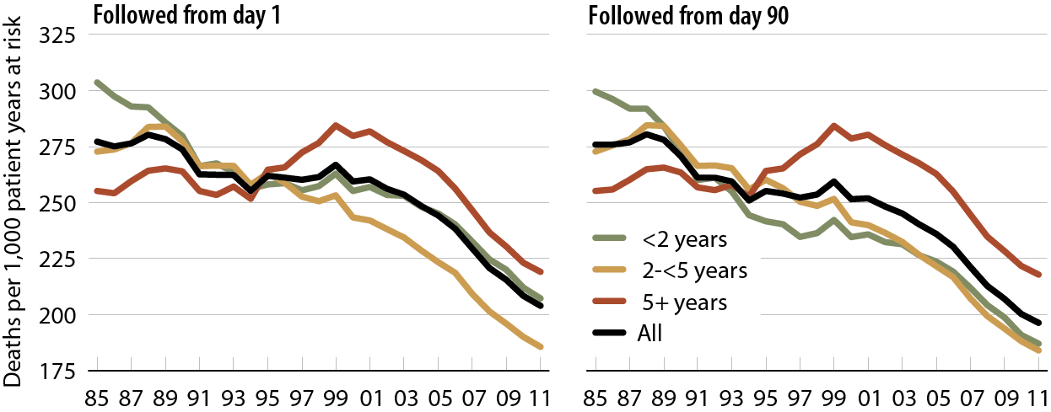
Adjusted all-cause mortality in prevalent hemodialysis patients, by vintage
Figure 5.4 (Volume 2)
Period prevalent dialysis patients defined on day one or day 90 of dialysis. Adj: age/gender/race/primary diagnosis. Ref: incident hemodialysis patients, 2010.

Slide 8
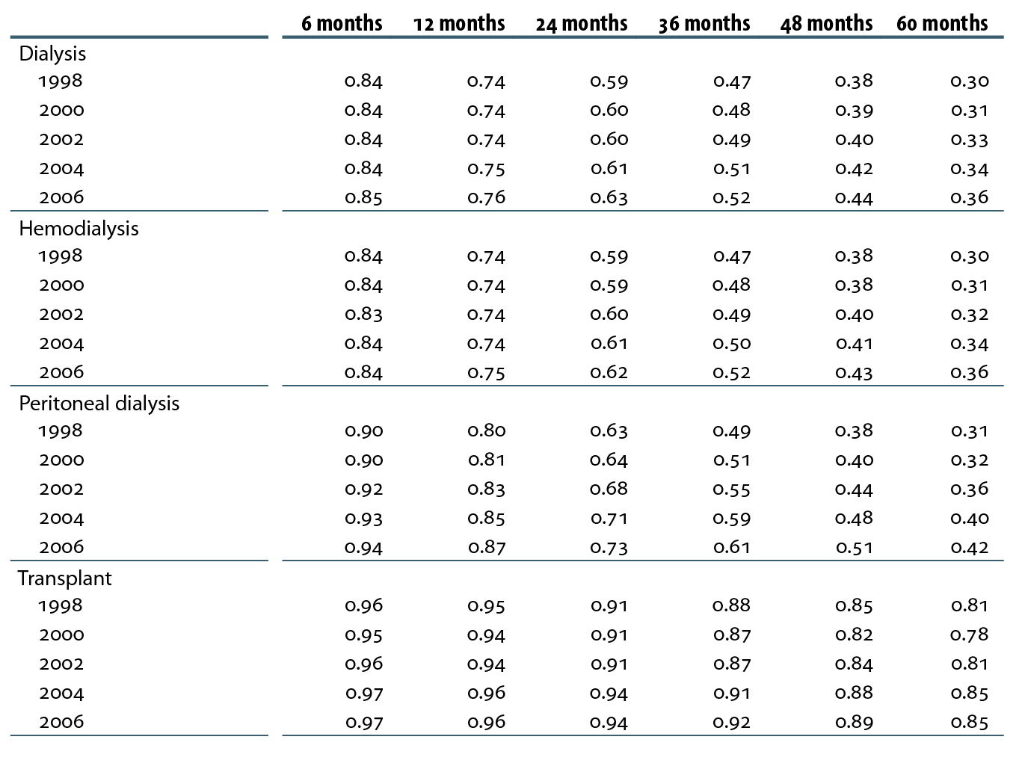
Adjusted survival probabilities, from day one, in the ESRD population
Table 5.b (Volume 2)
Incident ESRD patients defined at the onset of ESRD without the 60-day rule, followed from day one to December 31, 2011; Adj: age/gender/race/Hispanic ethnicity/primary diagnosis. Ref: incident ESRD patients, 2010.

Slide 9
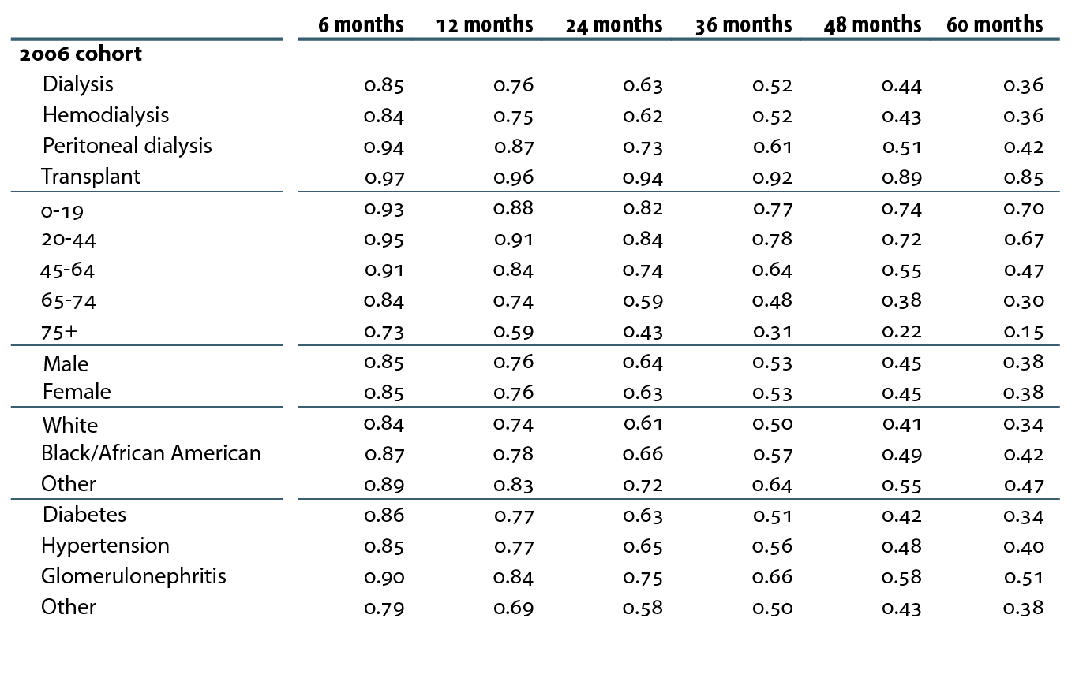
Adjusted survival probabilities, from day one, in the ESRD population
Table 5.b (continued; Volume 2)
Incident ESRD patients defined at the onset of ESRD without the 60-day rule, followed from day one to December 31, 2011; Adj: age/gender/race/Hispanic ethnicity/primary diagnosis. Ref: incident ESRD patients, 2010.

Slide 10
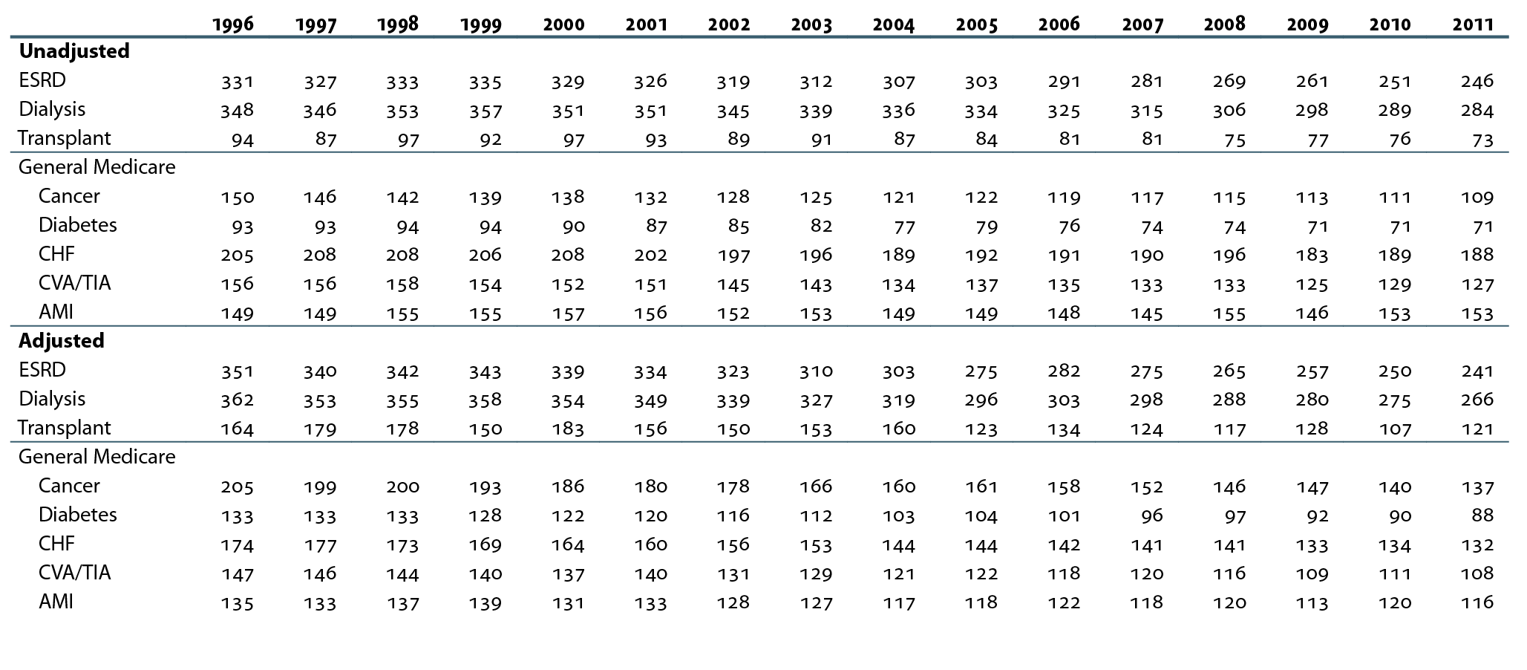
Unadjusted & adjusted mortality rates in the
ESRD & general Medicare populations, age
65 & older (per 1,000 patient years at risk)
Table 5.c (Volume 2)
January 1 point prevalent ESRD & general Medicare patients age 65 & older.
Adj: age/gender/race /comorbidity; ref: ESRD patients, 2010.

Slide 11
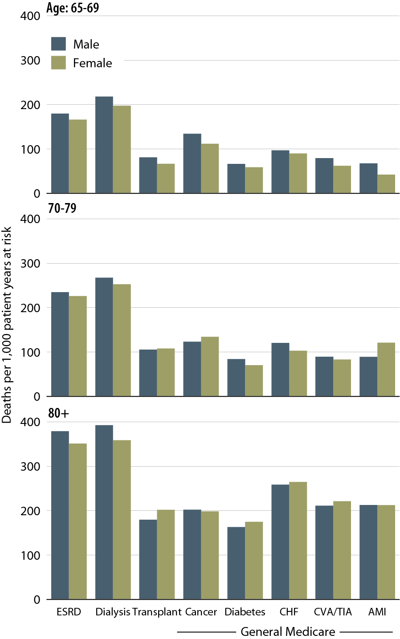
Adjusted all-cause mortality rates in the ESRD & general populations, by age & gender, 2011
Figure 5.5 (Volume 2)
January 1, 2011 point prevalent ESRD & general Medicare patients age 65 & older. Adj: age/gender/race/ comorbidity; ref: ESRD patients, 2011.

Slide 12
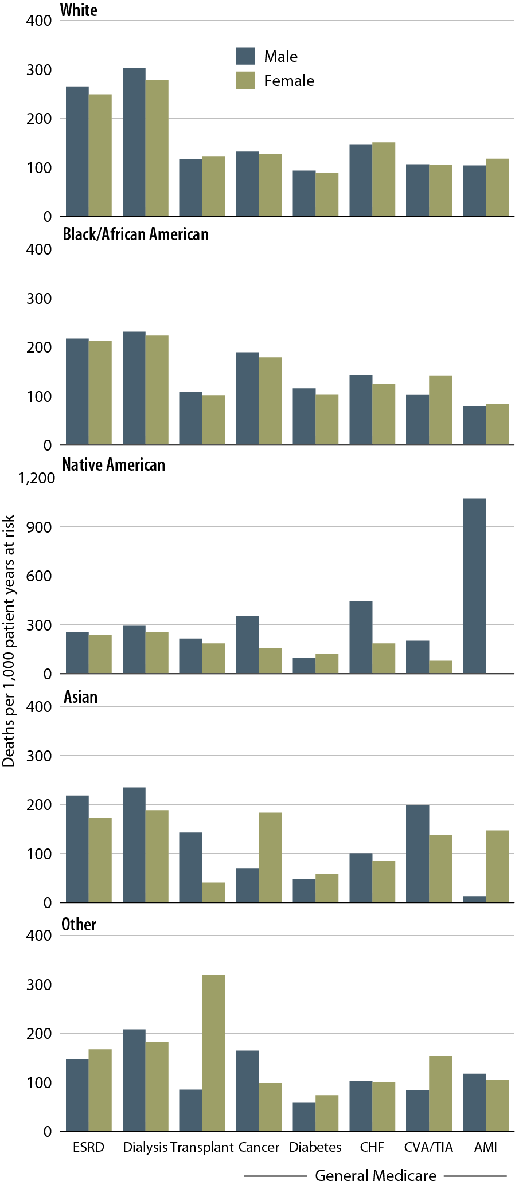
Adjusted all-cause mortality rates in the ESRD & general populations, by race & gender, 2011
Figure 5.6 (Volume 2)
January 1, 2011 point prevalent ESRD & general Medicare patients age 65 & older. Adj: age/gender/race/ comorbidity; ref: ESRD patients, 2011.

