Slide 1
ESRD: Chapter Seven
Transplantation
United States Renal Data System
2013 Annual Data Report

Slide 2
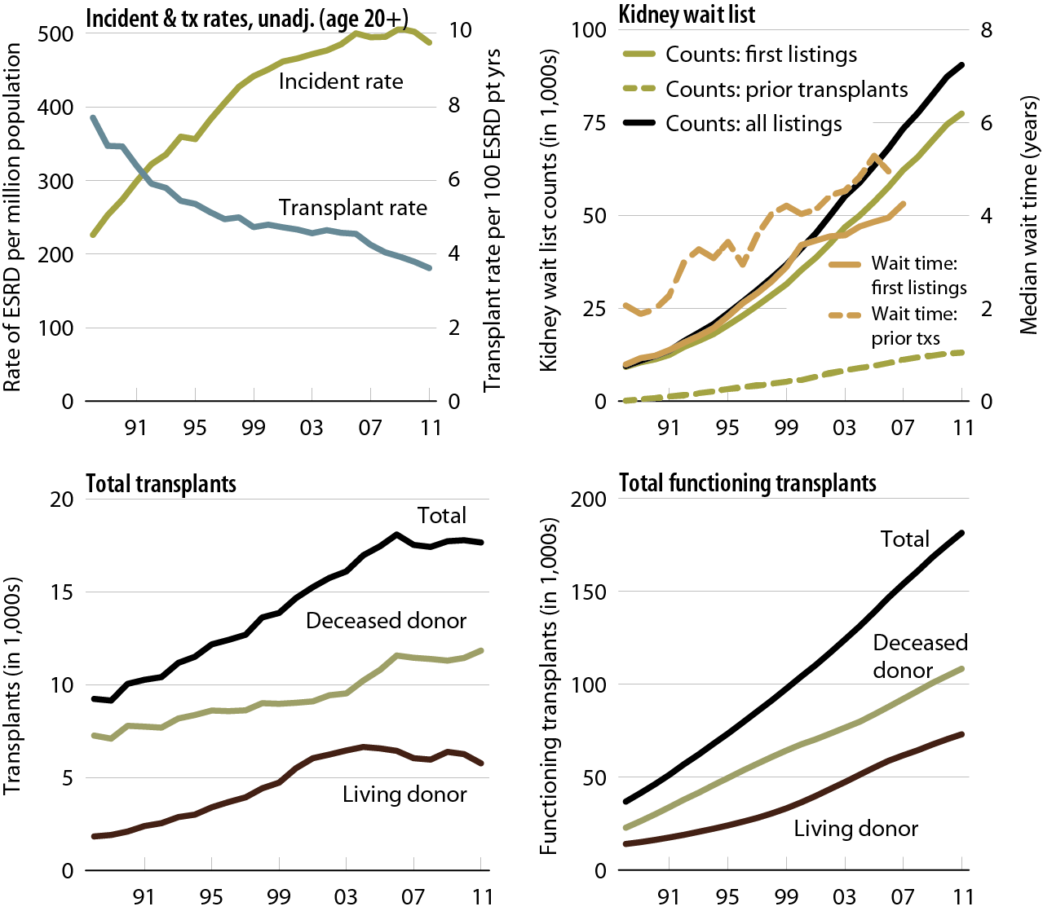
Trends in transplantation: unadjusted rates, wait list, & total & functioning transplants Figure 7.1 (Volume 2)
Unadjusted incident & transplant rates: limited to ESRD patients age 20 & older, thus yielding a computed incident rate higher than the overall rate presented elsewhere in the Annual Data Report. Wait list counts: all patients listed for a kidney or kidney-pancreas transplant on December 31 of each year. Wait time: all patients entering wait list in the given year. Transplant counts: all patients known to the USRDS. Functioning transplant: annual status of all patients who received a kidney or kidney-pancreas transplant, regardless of transplant date.

Slide 3
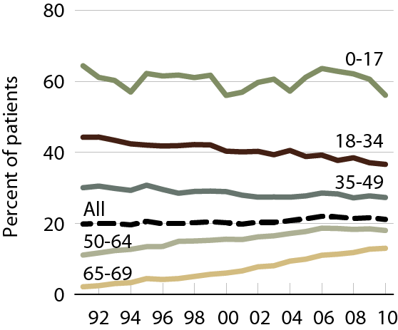
Patients wait-listed or receiving any transplant within one year of initiation, by age Figure 7.2 (Volume 2)
Incident ESRD patients younger than 70.

Slide 4
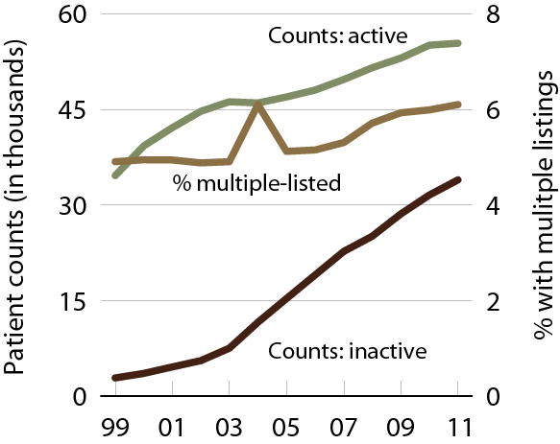
Wait list counts & multiple listings Figure 7.3 (Volume 2)
Patients age 18 & older listed for a kidney or kidney-pancreas transplant on December 31 of each year.

Slide 5
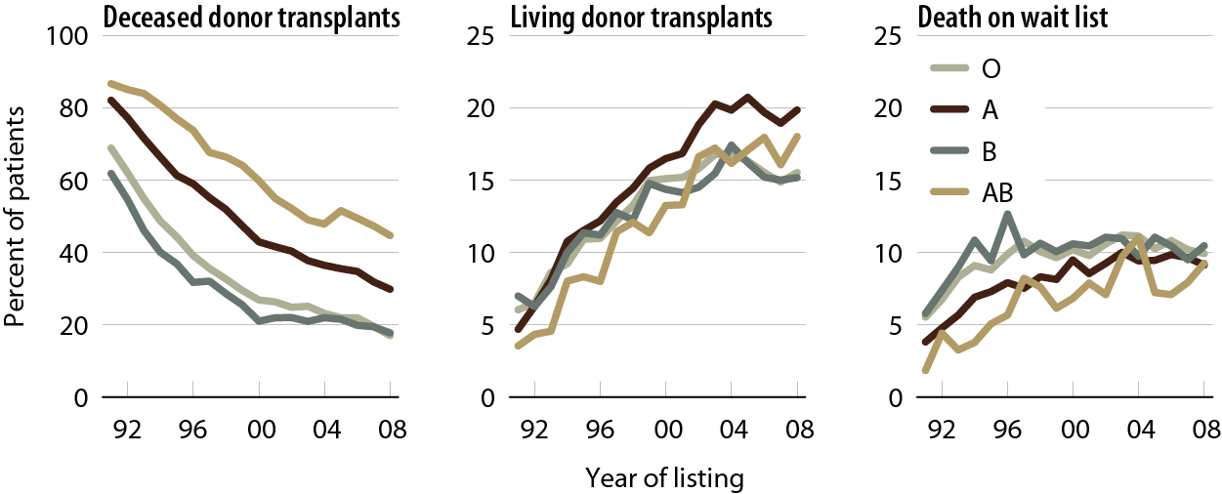
Outcomes for wait-listed adult patients within three years of listing, by blood type Figure 7.4 (Volume 2)
Patients age 18 & older listed for a first-time kidney or kidney-pancreas transplant.

Slide 6
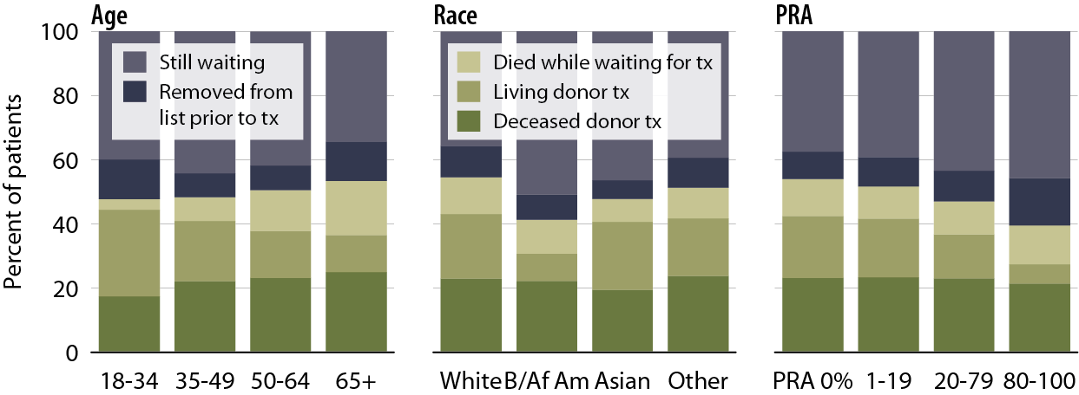
Outcomes for first-time wait-listed patients three years after listing in 2008, by age, race, & PRA Figure 7.5 (Volume 2)
Patients age 18 & older listed for a first-time, kidney-only transplant in 2008; transplanted patients may have subsequent outcomes in the three-year follow-up period.

Slide 7
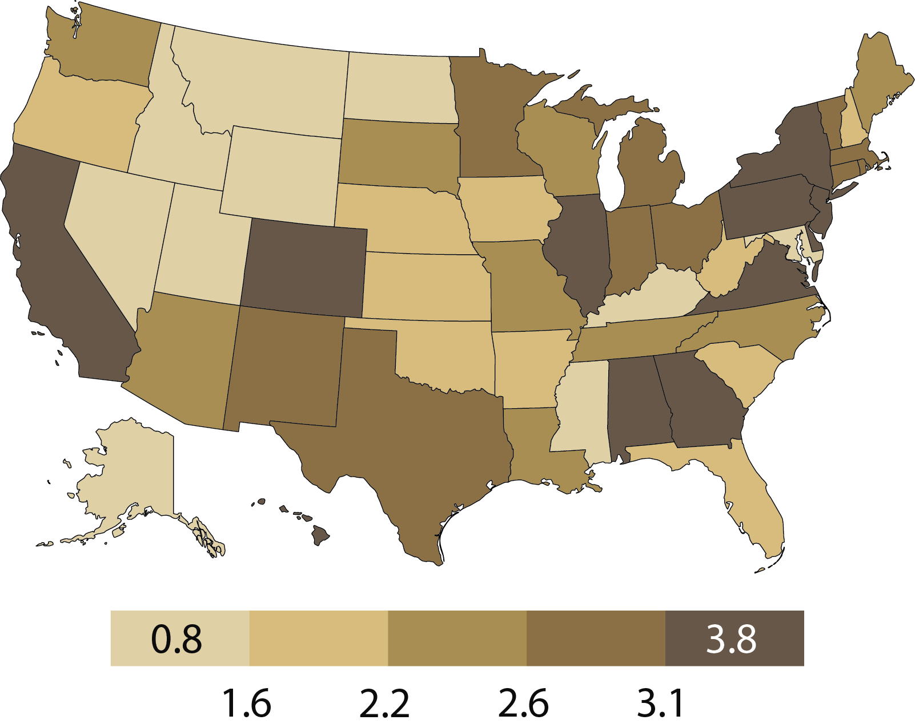
Unadjusted median wait times (years) for adults transplanted in 2011, by state of transplant center Figure 7.6 (Volume 2)
Patients age 18 & older receiving a first-time, deceased-donor, kidney-only transplant in 2011.

Slide 8
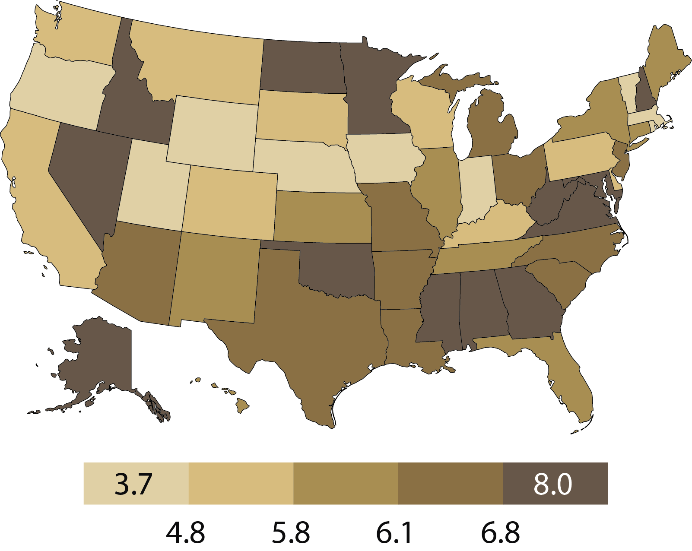
Adjusted mortality rates (per 100 person years of waiting) for wait-listed patients, by state, 2011 Figure 7.7 (Volume 2)
Patients age 18 & older, listed for a kidney or kidney-pancreas transplant as of January 1, 2011.

Slide 9
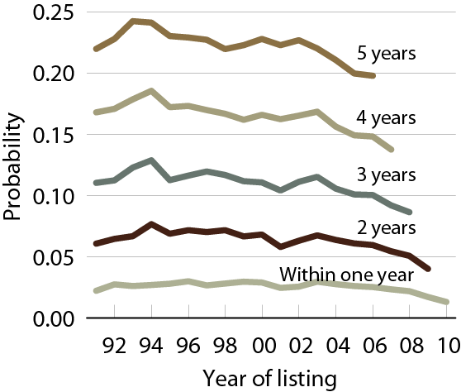
Likelihood of dying while awaiting transplant Figure 7.8 (Volume 2)
Patients age 18 & older, listed for a first-time kidney or kidney-pancreas transplant.

Slide 10
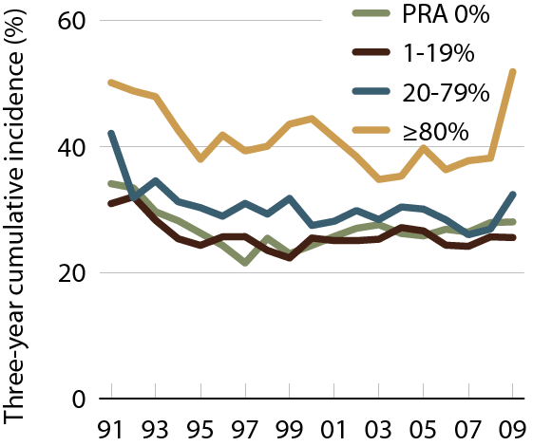
Three-year cumulative incidence of transfusion in wait-listed patients, by PRA Figure 7.9 (Volume 2)
Patients age 18 & older with Medicare primary coverage & first listed for a kidney transplant in the given year.

Slide 11
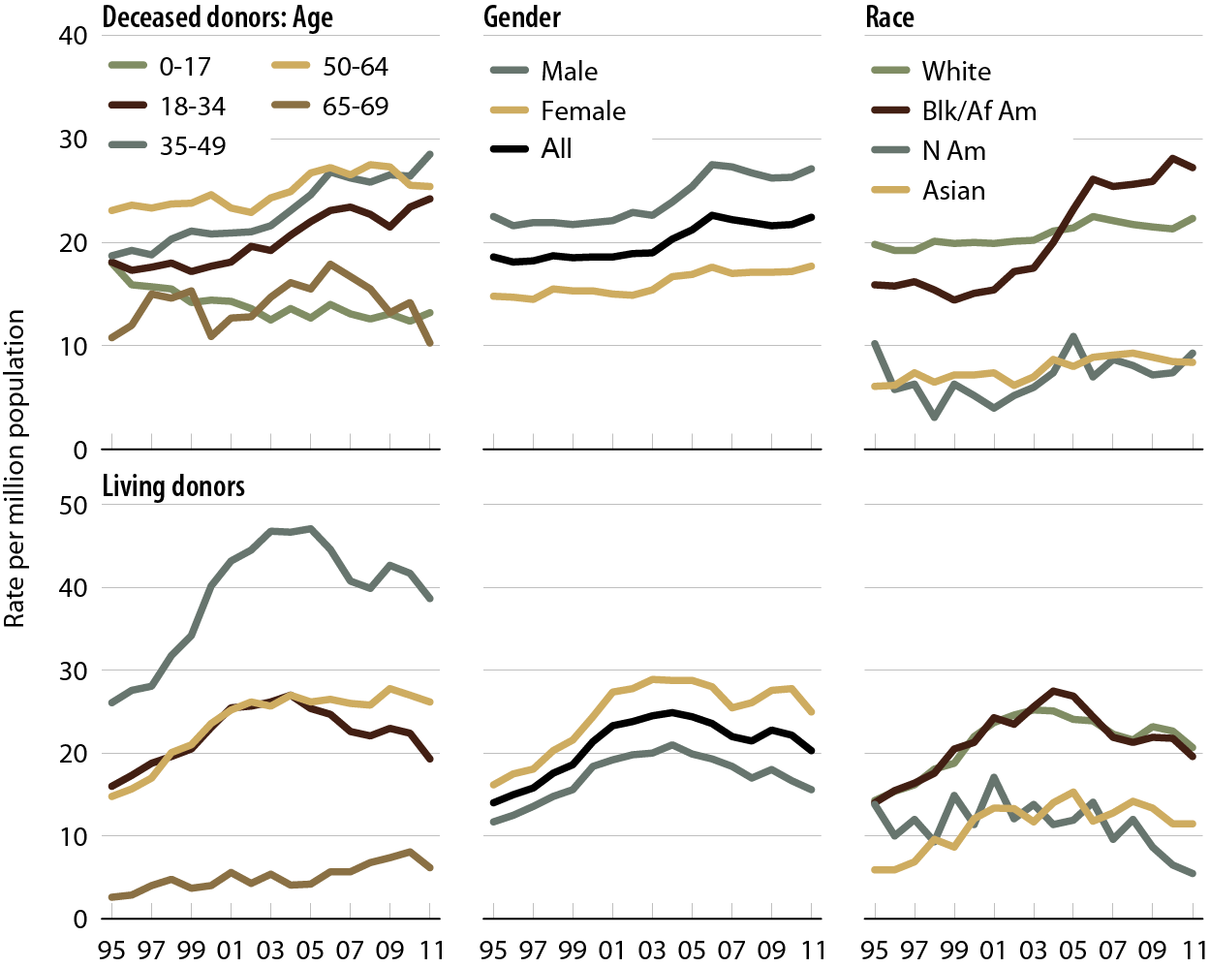
Donation rates, by age, gender, & race Figure 7.10 (Volume 2)
Donors younger than 70 whose organs are eventually transplanted.

Slide 12
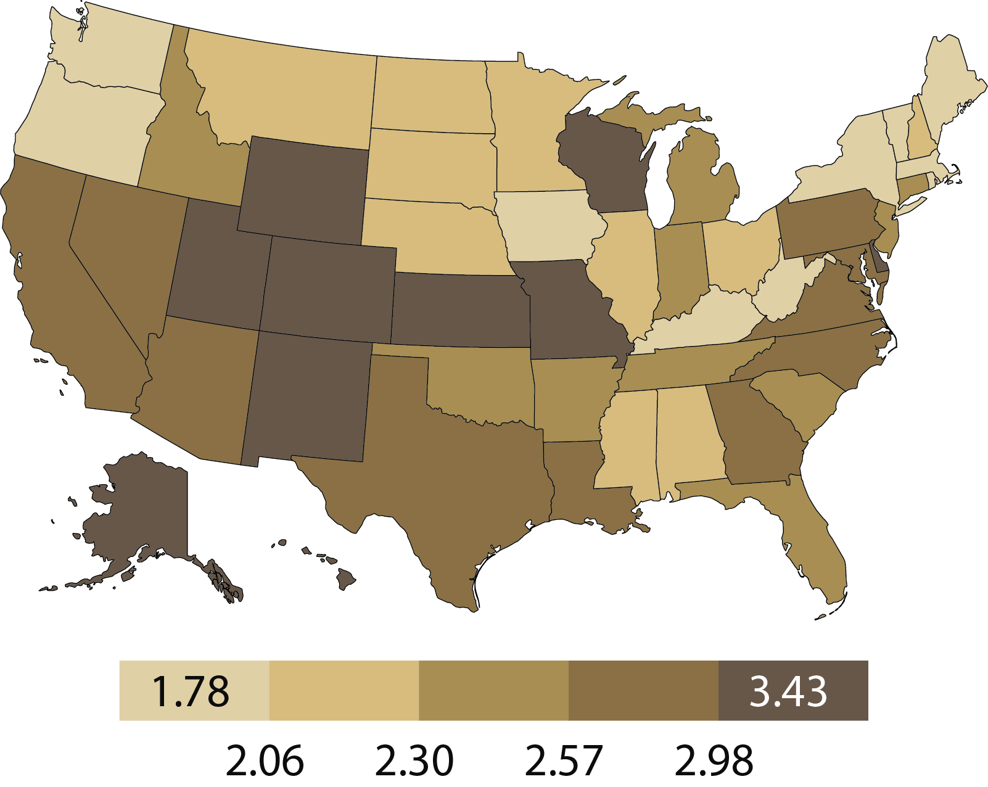
Deceased donor donations (per 1,000 deaths), by state, 2010–2011 Figure 7.11 (Volume 2)
Donations per 1,000 deaths, from July 1, 2010 to July 1, 2011.

Slide 13
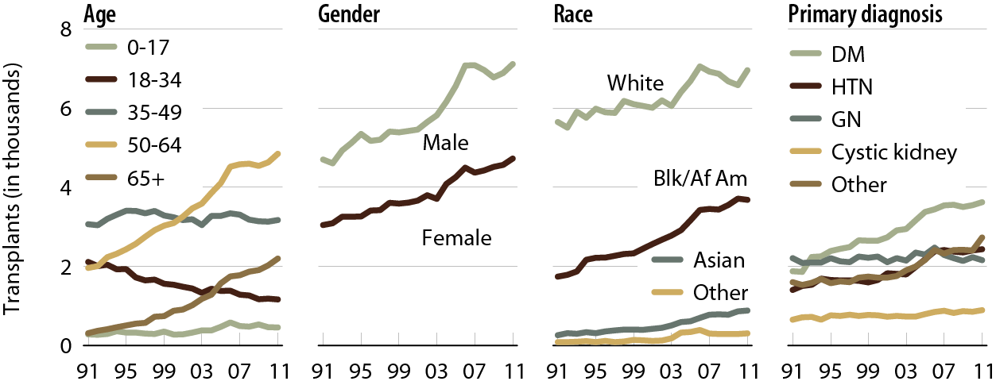
Deceased donor transplants, by age, gender, race, & primary diagnosis Figure 7.12 (Volume 2)
Includes kidney-alone & kidney-pancreas transplants.

Slide 14
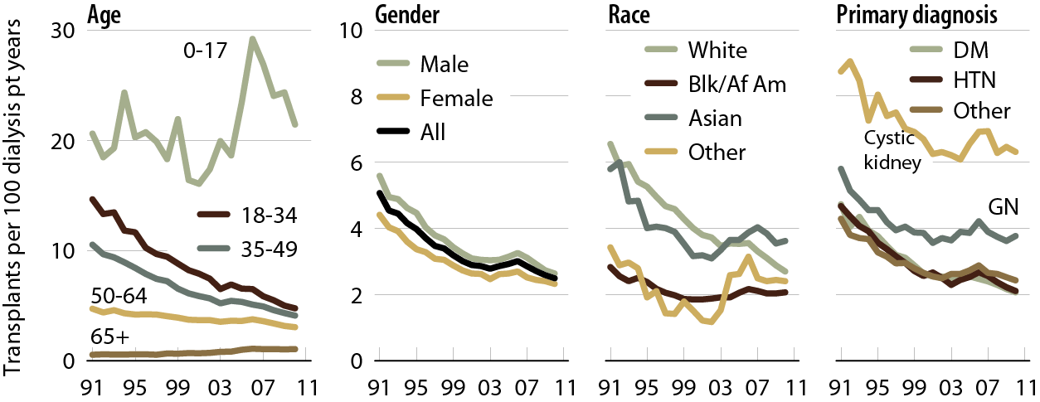
Adjusted transplant rates, by age, gender, race, & primary diagnosis: deceased donors Figure 7.13 (Volume 2)
Adj: age/gender/race/ethnicity/primary diagnosis (rates by one factor adjusted for remaining four).

Slide 15
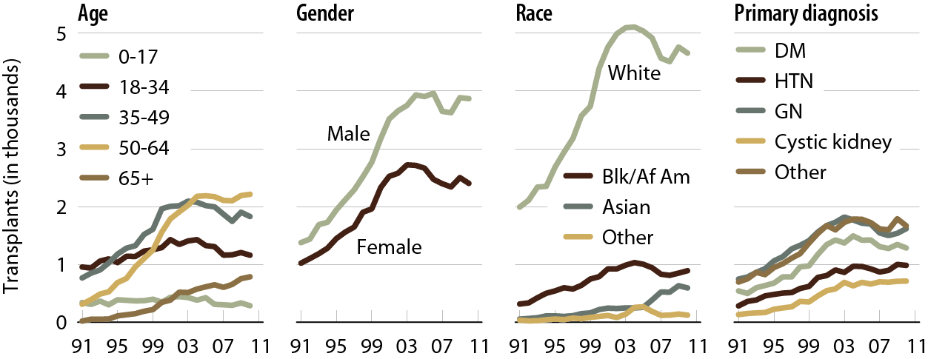
Living donor transplants, by age, gender, race, & primary diagnosis Figure 7.14 (Volume 2)
Includes kidney-alone & kidney-pancreas transplants.

Slide 16
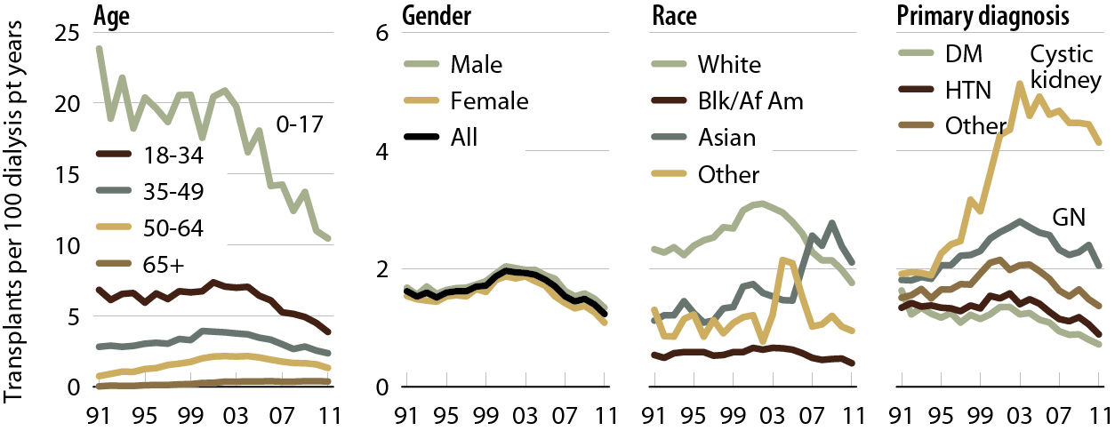
Adjusted transplant rates, by age, gender, race, & primary diagnosis: living donors Figure 7.15 (Volume 2)
Patients age 18 & older. Adj: age/gender/race/ethnicity/primary diagnosis (rates by one factor adjusted for remaining four).

Slide 17
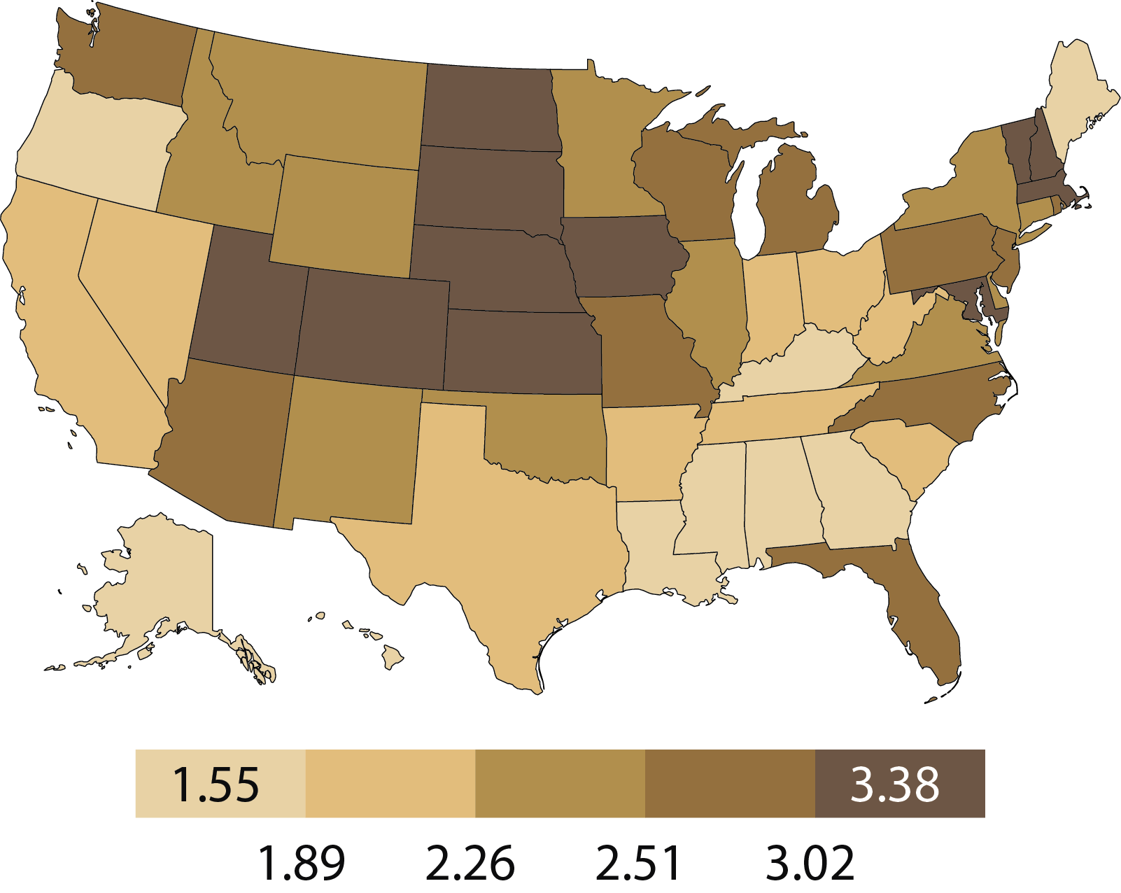
Adjusted transplant rates (per 100 dialysis patient years) by state of patient residence & donor type, 2011: deceased donor Figure 7.16 (Volume 2)
Patients age 18 & older. Adj: age/gender/race/ primary diagnosis; ref: prevalent dialysis patients, 2011.

Slide 18
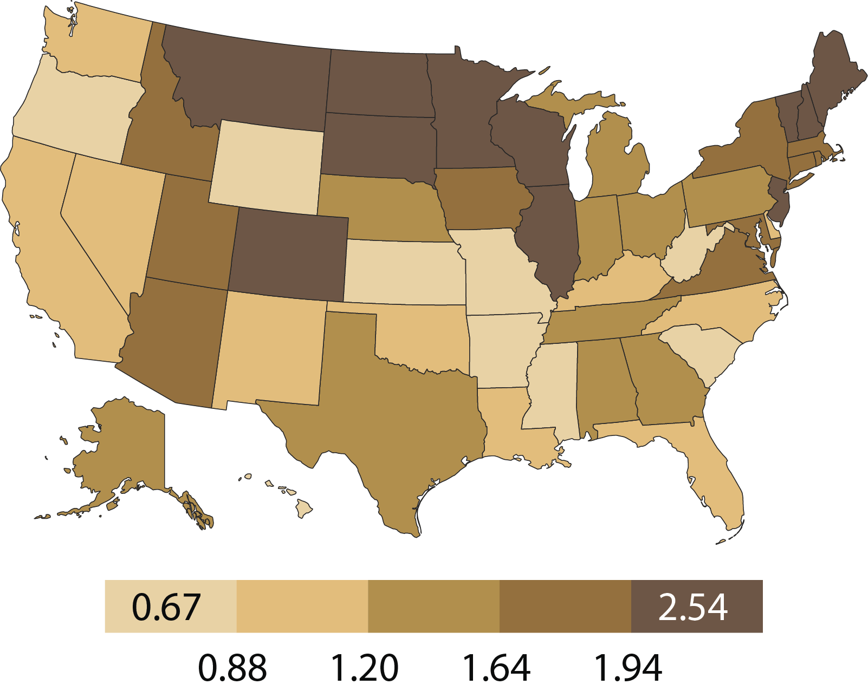
Adjusted transplant rates (per 100 dialysis patient years) by state of patient residence & donor type, 2011: living donor Figure 7.16 (continued; Volume 2)
Patients age 18 & older. Adj: age/gender/race/ primary diagnosis; ref: prevalent dialysis patients, 2011.

Slide 19
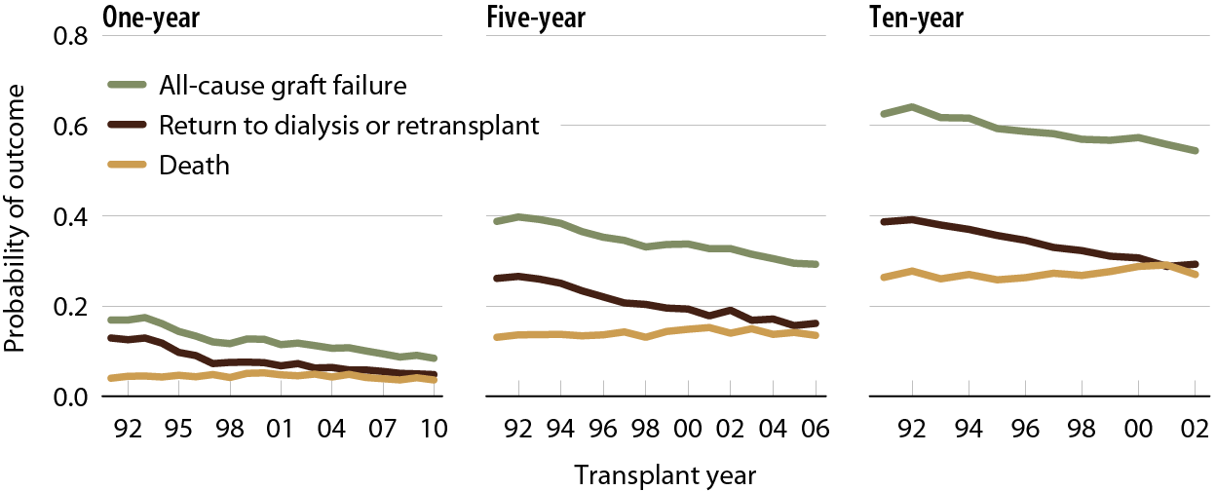
Outcomes: deceased donor transplants Figure 7.17 (Volume 2)
Patients age 18 & older receiving a first-time, kidney-only transplant; unadjusted.

Slide 20
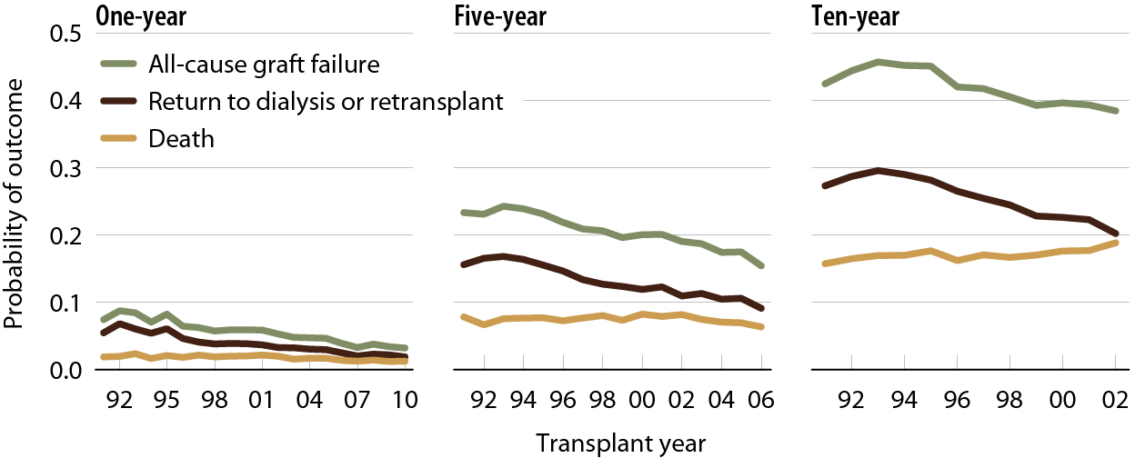
Outcomes: living donor transplants Figure 7.18 (Volume 2)
Patients age 18 & older receiving a first-time, kidney-only transplant; unadjusted.

Slide 21
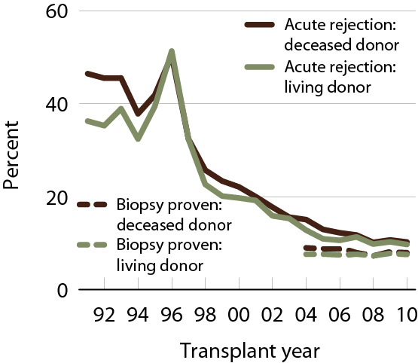
Acute rejection within the first year post-transplant Figure 7.19 (Volume 2)
Patients age 18 & older with a functioning graft at discharge.

Slide 22
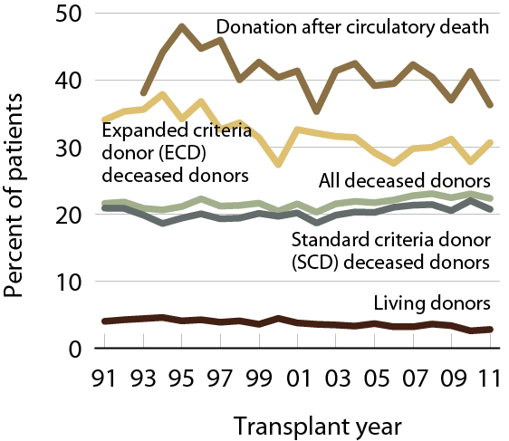
Transplants with delayed graft function (DGF), by donor type Figure 7.20 (Volume 2)
Patients age 18 & older with functioning graft at discharge.

Slide 23
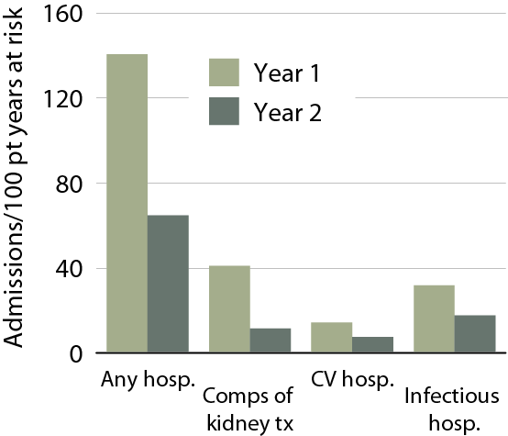
Hospitalization rates in the first & second years post-transplant, 2009 Figure 7.21 (Volume 2)
First-time, kidney-only transplant recipients, age 18 & older, transplanted in 2009; ref: transplant patients, 2009.

Slide 24
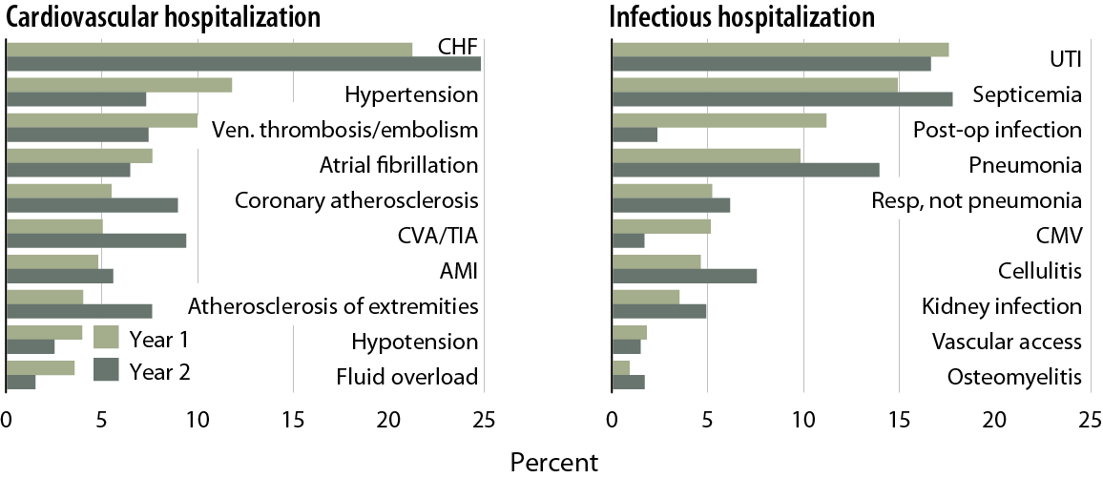
Primary diagnoses of cardiac & infectious hospitalizations in the first & second years post-transplant Figure 7.22 (Volume 2)
First-time, kidney-only transplant recipients, age 18 & older, with Medicare primary coverage, transplanted in 2007–2009.

Slide 25
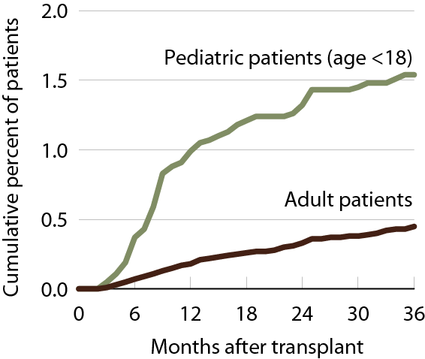
Cumulative incidence of post-transplant lymphoproliferative disorder (PTLD) Figure 7.23 (Volume 2)
Patients receiving a first-time, kidney-only transplant, 2004–2008 combined.

Slide 26
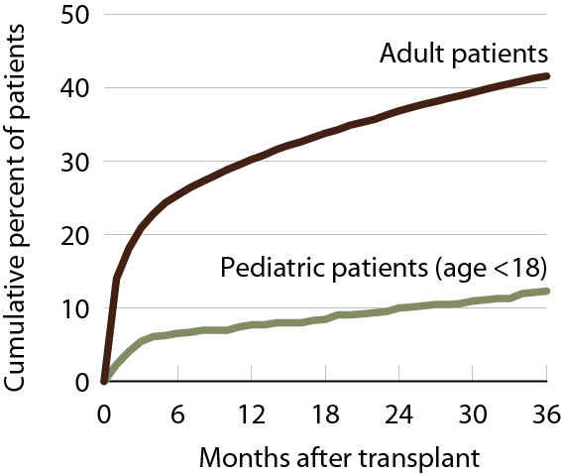
Cumulative incidence of post-transplant diabetes Figure 7.24 (Volume 2)
Patients receiving a first-time, kidney-only transplant, 2004–2008 combined.

Slide 27
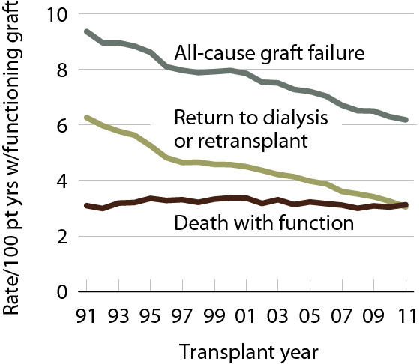
Adjusted rate of outcomes after transplant Figure 7.25 (Volume 2)
Patients age 18 & older at transplant; adj: age/gender/race.

Slide 28
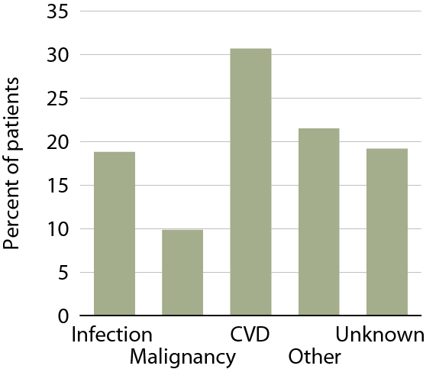
Causes of death with function, 2007–2011 Figure 7.26 (Volume 2)
First-time, kidney-only transplant recipients, age 18 & older, 2007–2011, who died with functioning graft.

Slide 29
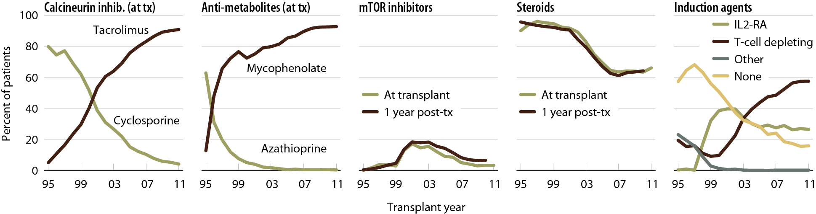
Immunosuppression use Figure 7.27 (Volume 2)
Patients age 18 & older receiving a first-time, kidney-only transplant. IL2-RA: interleukin-2 receptor antagonist.

Slide 30
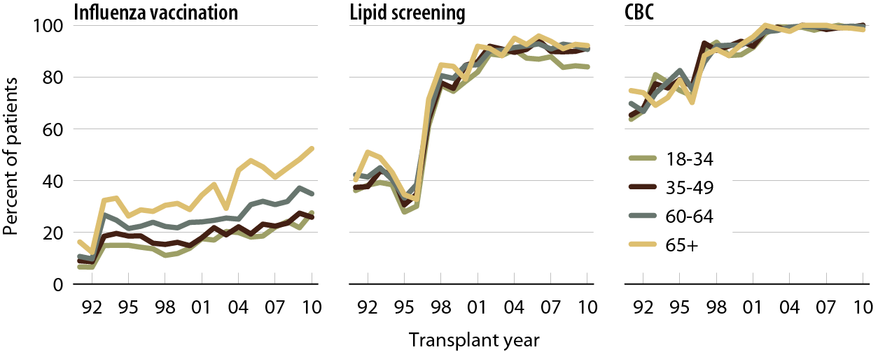
Follow-up care & screening in the first 12 months post-transplant, by age Figure 7.28 (Volume 2)
Patients age 18 & older, with Medicare primary payor coverage, receiving a first-time, kidney-only transplant.

Slide 31
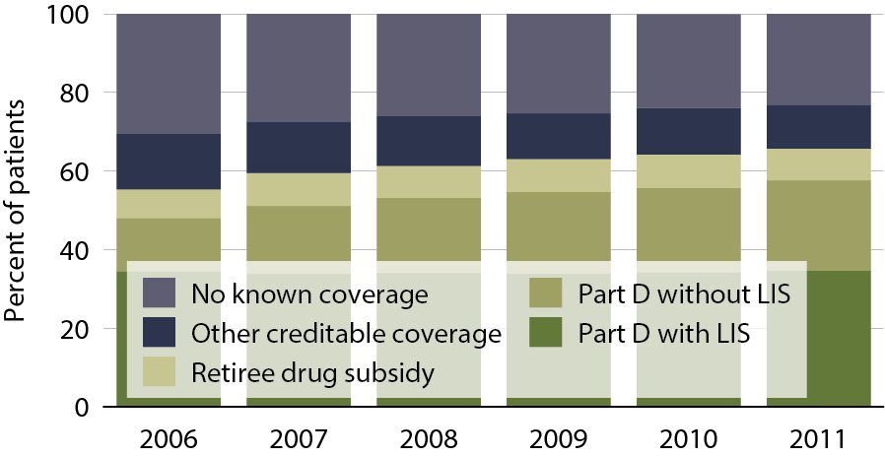
Sources of prescription drug coverage in kidney transplant recipients Figure 7.29 (Volume 2)
Point prevalent Medicare-enrolled transplant recipients alive on January 1.

Slide 32
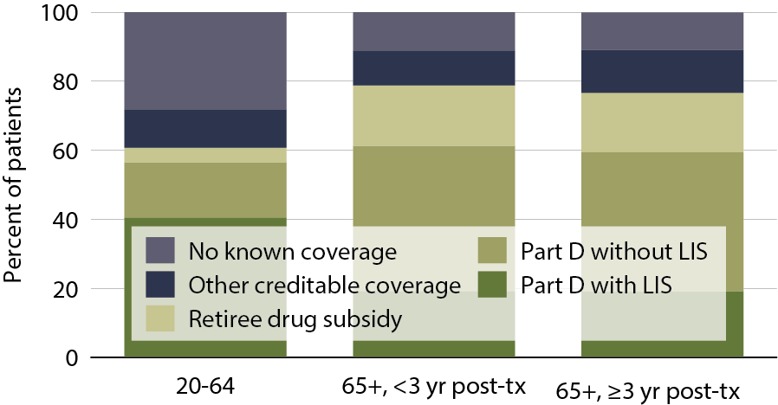
Sources of prescription drug coverage in kidney transplant recipients, by age & years post-transplant (age 65 & older) Figure 7.30 (Volume 2)
Point prevalent Medicare-enrolled transplant recipients alive on January 1.

Slide 33
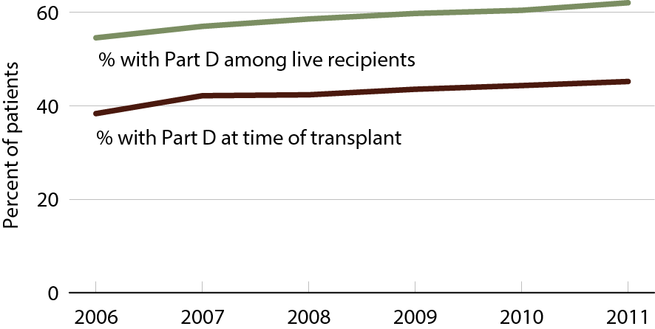
Transplant recipients enrolled in Part D Figure 7.31 (Volume 2)
Medicare-enrolled transplant recipients.

Slide 34
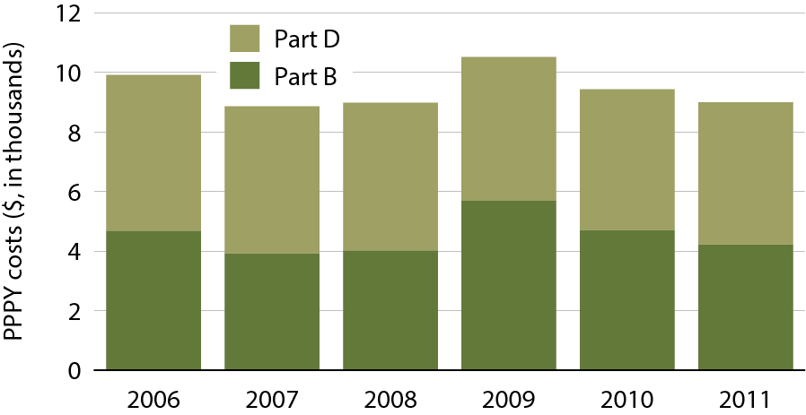
Total Part B & Part D medication costs per person per year (PPPY) in kidney transplant recipients Figure 7.32 (Volume 2)
Period prevalent transplant patients; includes all Part B & Part D costs for injectable & immunosuppressive drugs for calendar years 2006–2011.

Slide 35
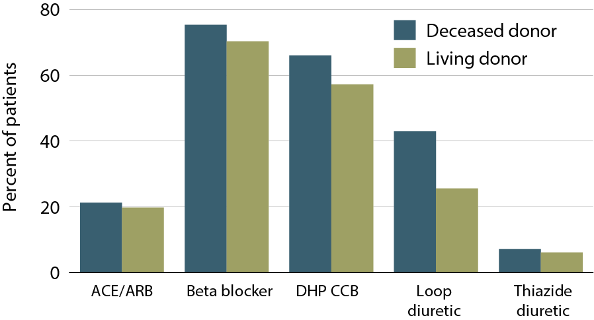
Cardiovascular medication use in the first six months post-transplant, 2009-2011 (Part D data) Figure 7.33 (Volume 2)
Patients age 18 & older receiving a first-time, kidney-only transplant between January 1, 2009& June 30, 2011, who remain alive with function, & who have Medicare Part D coverage for six months post-transplant.

Slide 36
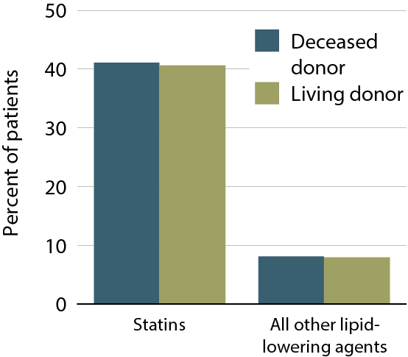
Lipid control medications in the first 6 months post-tx, 2009–2011 (Part D data) Figure 7.34 (Volume 2)
Patients age 18 & older receiving a first-time, kidney-only transplant between January 1, 2009& June 30, 2011, who remain alive with function, & who have Medicare Part D coverage for six months post-transplant.

Slide 37
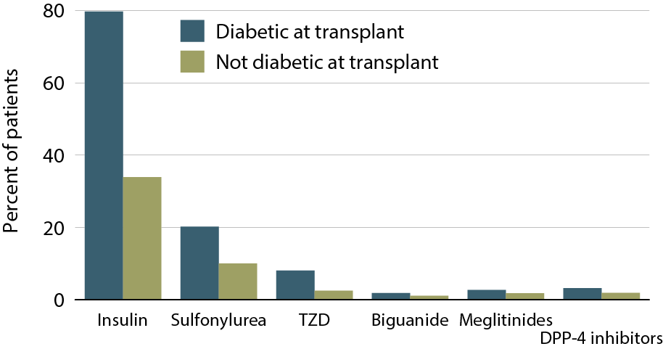
Medications for diabetes control in the first 6 months post-transplant, 2009–2011 (Part D data) Figure 7.35 (Volume 2)
Patients age 18 & older receiving a first-time, kidney-only transplant between January 1, 2009& June 30, 2011, who remain alive with function, & who have Medicare Part D coverage for six months post-transplant.

Slide 38
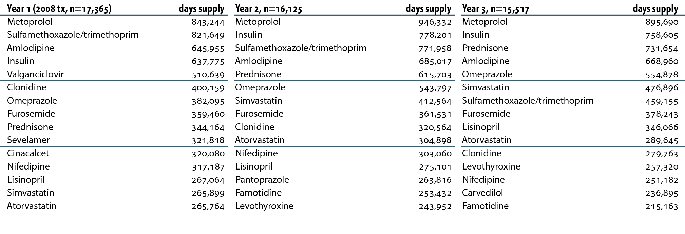
Top 15 medications used by Part D-enrolled kidney recipients transplanted in 2008, by days supply Table 7.a (Volume 2)
Patients enrolled in Medicare Part D & transplanted in 2008. Costs are estimated Medicare payment, defined as the sum of plan covered payment amount & low income subsidy amount. “Year 1” is the period from transplant to one year later. Years 2 & 3 are similarly defined.

Slide 39
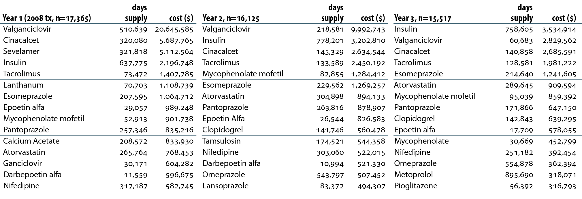
Top 15 medications used by Part D-enrolled kidney recipients transplanted in 2008, by days supply & cost Table 7.b (Volume 2)
Patients enrolled in Medicare Part D & transplanted in 2008. Costs are estimated Medicare payment, defined as the sum of plan covered payment amount & low income subsidy amount. “Year 1” is the period from transplant to one year later. Years 2 & 3 are similarly defined.

