Slide 1
ESRD: Chapter Eight
Pediatric ESRD
United States Renal Data System
2013 Annual Data Report

Slide 2
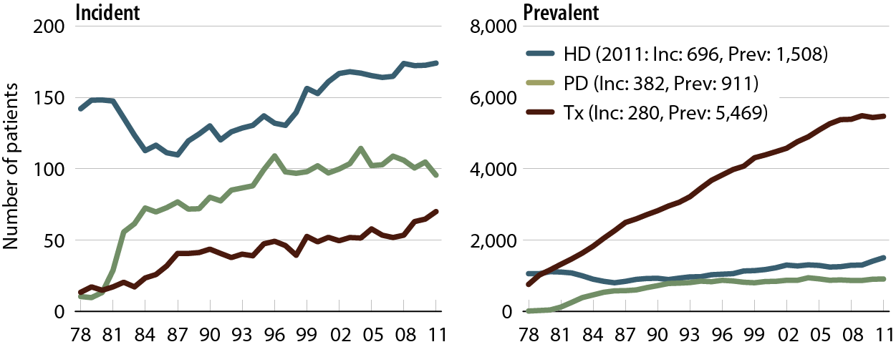
Incident & prevalent counts for pediatric ESRD patients
Figure 8.1 (Volume 2)
Incident & prevalent ESRD patients age 0–19, 2011.

Slide 3
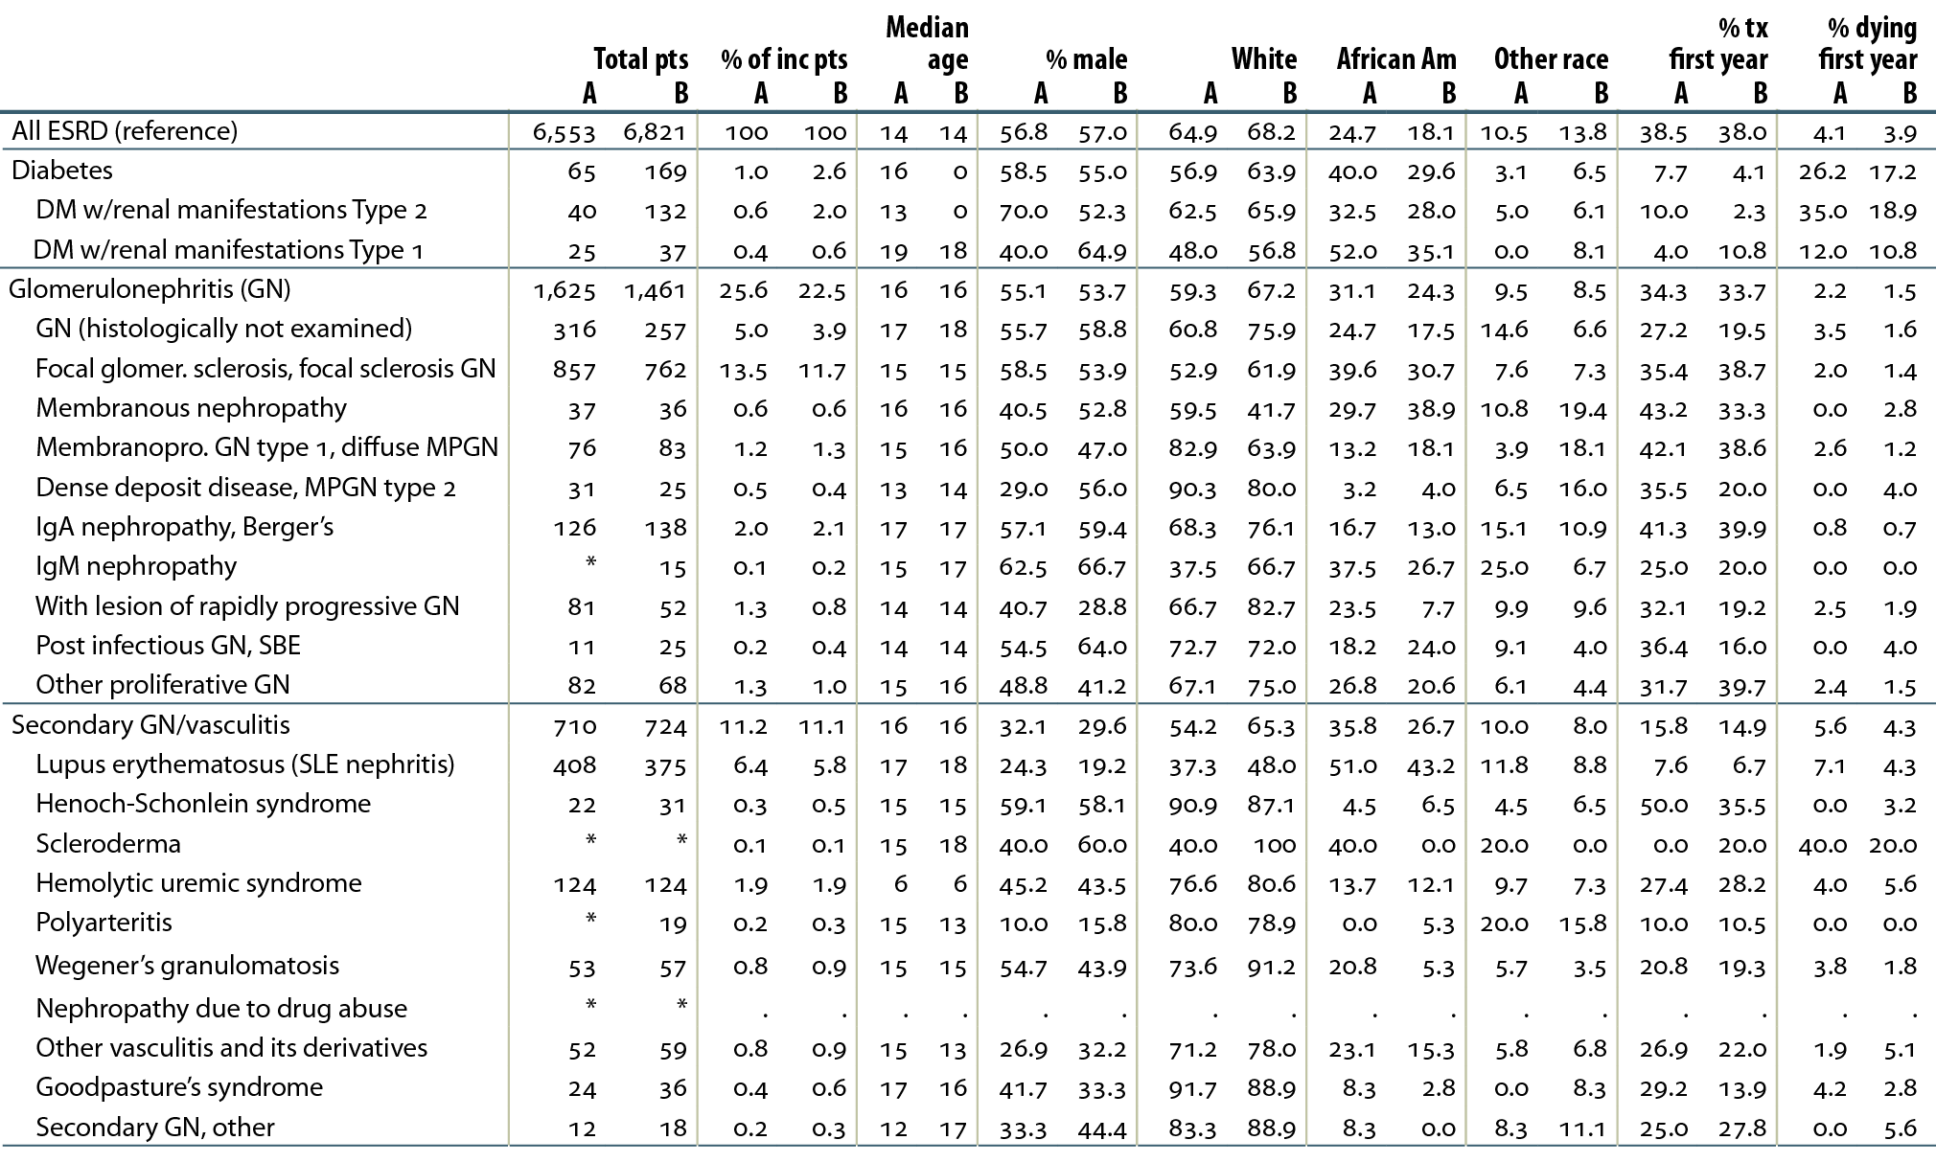
Distribution of reported incident ESRD pediatric patients, by primary diagnosis,
2002–2006 (period A) & 2007–2011 (period B)
Table 8.a (Volume 2)
Incident ESRD patients age 0–19. *Values for cells with ten or fewer patients are suppressed.
“.” Zero values in this cell.

Slide 4
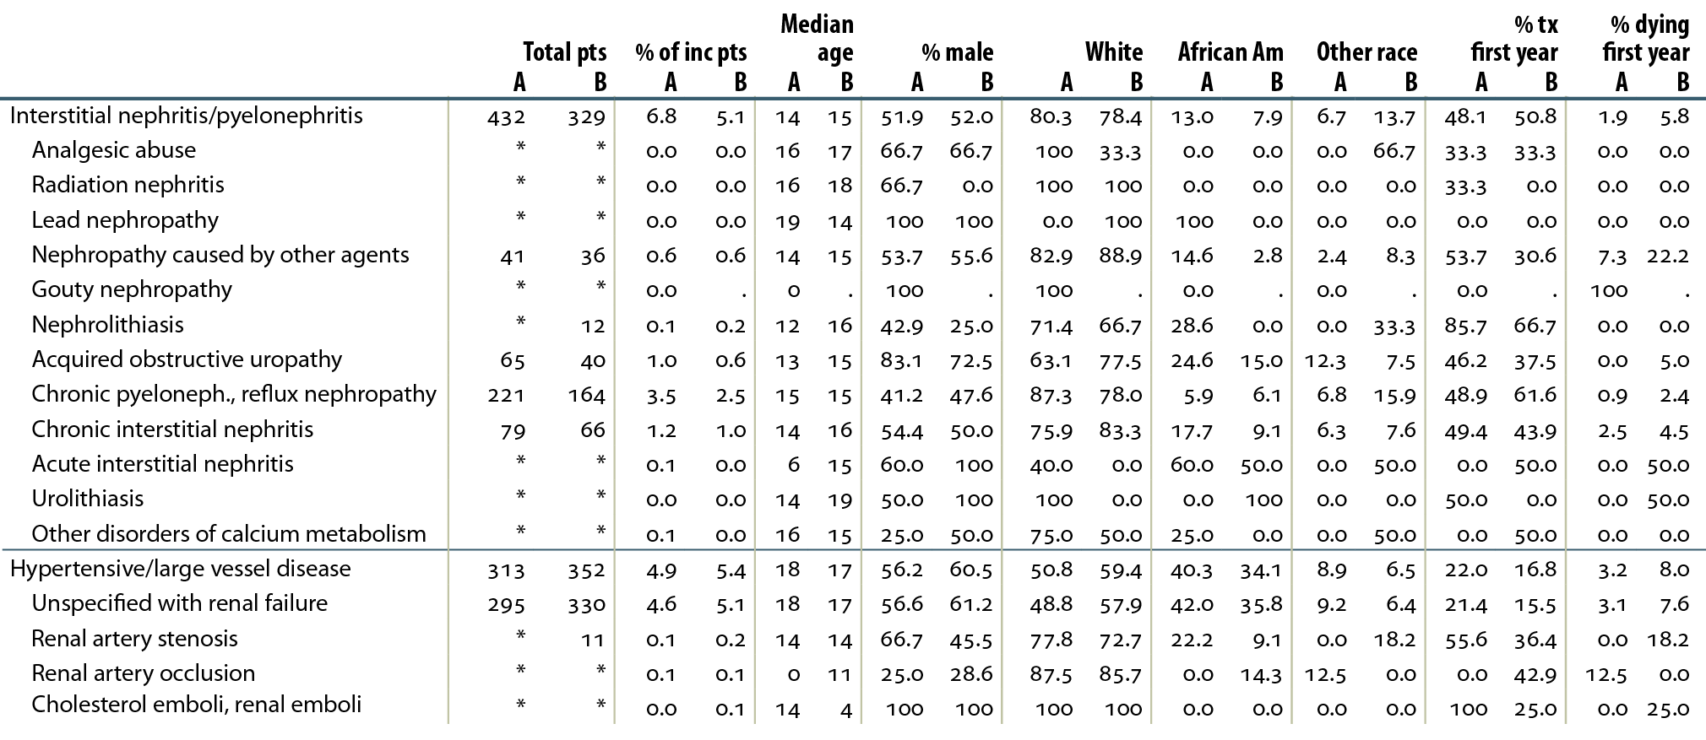
Distribution of reported incident ESRD pediatric patients, by primary diagnosis,
2002–2006 (period A) & 2007–2011 (period B)
Table 8.a (continued, Volume 2)
Incident ESRD patients age 0–19. *Values for cells with ten or fewer patients are suppressed.
“.” Zero values in this cell.

Slide 5
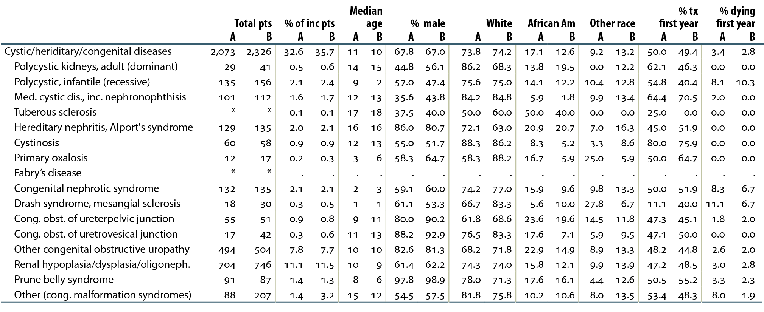
Distribution of reported incident ESRD pediatric patients, by primary diagnosis,
2002–2006 (period A) & 2007–2011 (period B)
Table 8.a (continued, Volume 2)
Incident ESRD patients age 0–19. *Values for cells with ten or fewer patients are suppressed.
“.” Zero values in this cell.

Slide 6
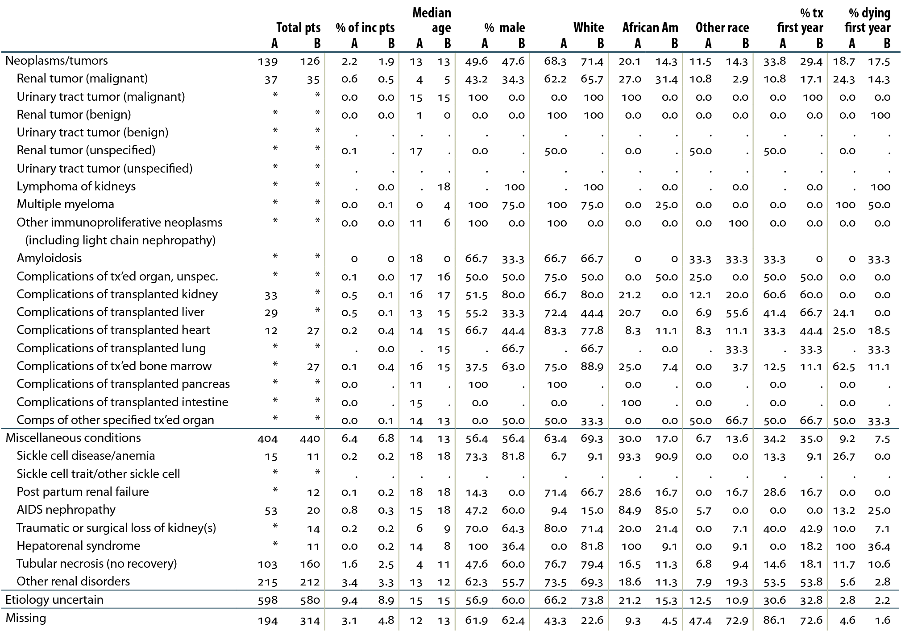
Distribution of reported incident ESRD pediatric patients, by primary diagnosis,
2002–2006 (period A) & 2007–2011 (period B)
Table 8.a (continued, Volume 2)

Slide 7
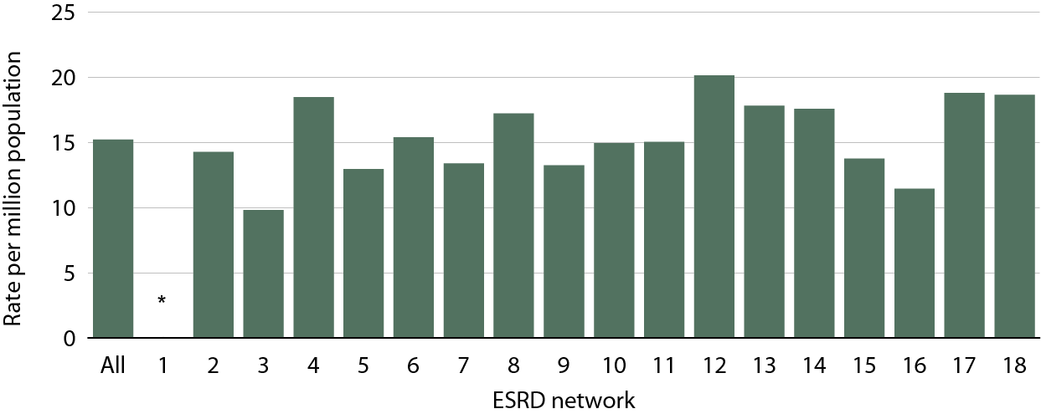
Overall incident rates for pediatric ESRD patients, by renal network, 2007–2011
Figure 8.2 (Volume 2)
Incident ESRD patients age 0–19, 2007–2011; Adj: age/gender/race; ref: 2010 ESRD patients.
*Primary diagnosis values with ten or fewer patients are suppressed.

Slide 8
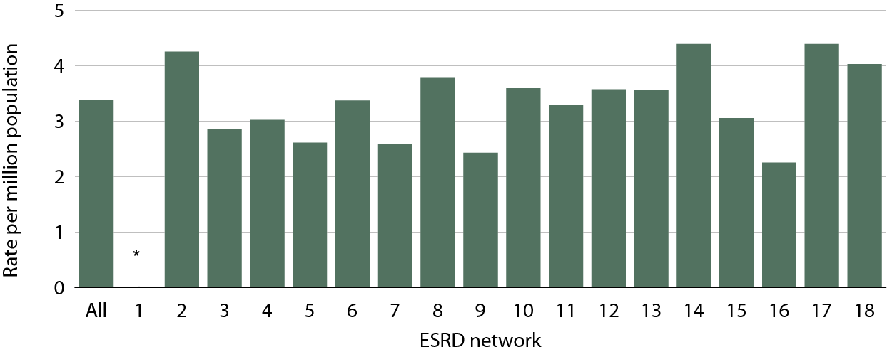
Overall incident rates for pediatric ESRD patients with glomerulonephritis as a primary diagnosis, by renal network, 2007–2011
Figure 8.3 (Volume 2)
Incident ESRD patients age 0–19, 2007–2011; Adj: age/gender/race; ref: 2010 ESRD patients.
*Primary diagnosis values with ten or fewer patients are suppressed.

Slide 9
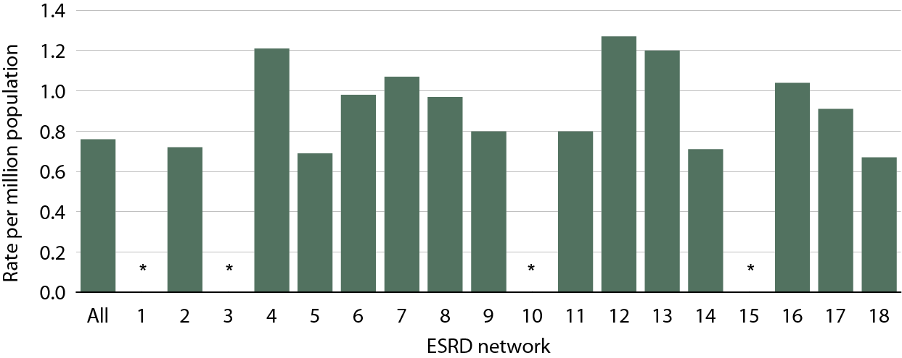
Overall incident rates for pediatric ESRD patients with cystic kidney/hereditary disease as a primary diagnosis, by renal network, 2007–2011
Figure 8.4 (Volume 2)
Incident ESRD patients age 0–19, 2007–2011; Adj: age/gender/race; ref: 2010 ESRD patients.
*Primary diagnosis values with ten or fewer patients are suppressed.

Slide 10
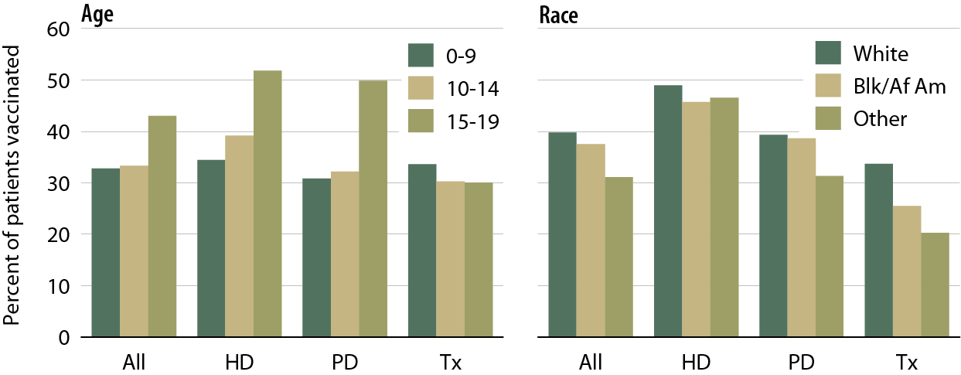
Influenza vaccination rates in pediatric patients, by modality, age, & race, 2008–2011
Figure 8.5 (Volume 2)
Point prevalent ESRD patients age 0–19 prior to January 1 of the two year study period & alive through December 31 of the second year, 2008–2009 & 2010–2011.

Slide 11
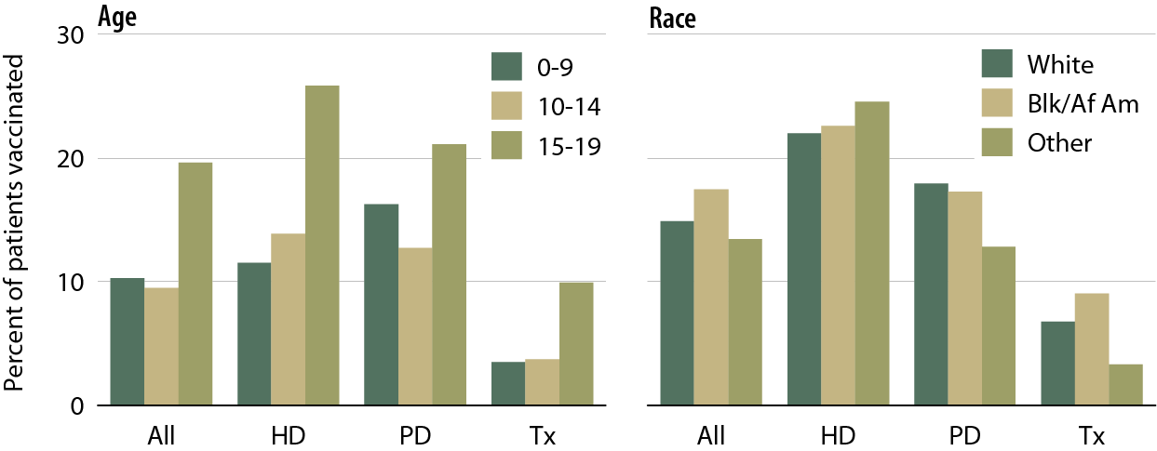
Pneumococcal vaccination rates in pediatric patients, by modality, age, & race, 2008–2011
Figure 8.6 (Volume 2)
Point prevalent ESRD patients age 0–19 prior to January 1 of the two year study period & alive through December 31 of the second year, 2008–2009 & 2010–2011.

Slide 12
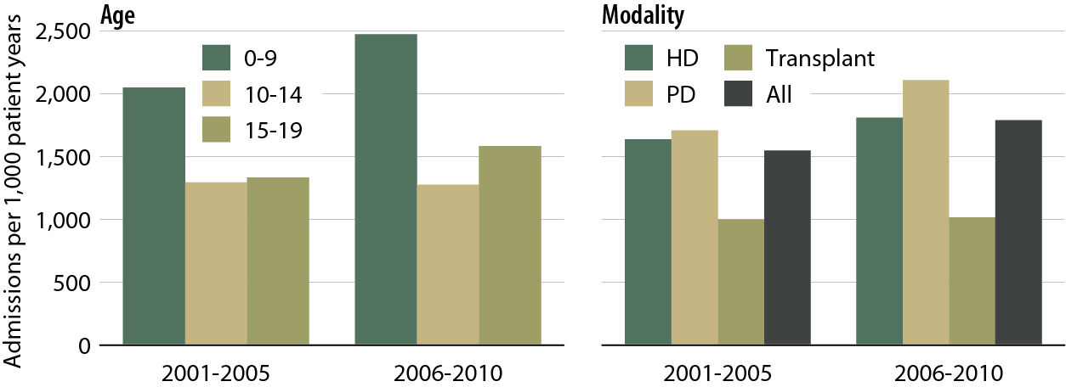
One-year adjusted all-cause hospitalization rates in pediatric patients
(from day 90), by age & modality
Figure 8.7 (Volume 2)
Incident ESRD patients age 0–19, 2001–2010. Adj: gender/race/Hispanic ethnicity/primary diagnosis. Ref: incident ESRD patients age 0–19, 2009–2010. Included patients survived the first 90 days after ESRD initiation & are followed from day 90.

Slide 13
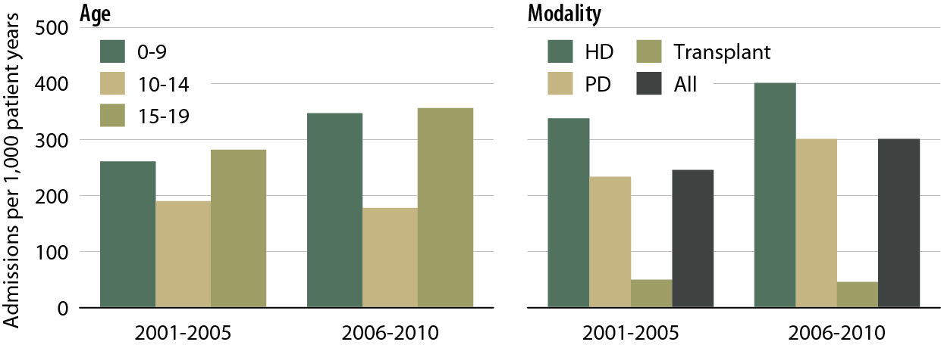
One-year adjusted cardiovascular hospitalization rates in pediatric patients
(from day 90), by age, & modality
Figure 8.8 (Volume 2)
Incident ESRD patients age 0–19, 2001–2010. Adj: gender/race/Hispanic ethnicity/primary diagnosis. Ref: incident ESRD patients age 0–19, 2009–2010. Included patients survived the first 90 days after ESRD initiation & are followed from day 90.

Slide 14
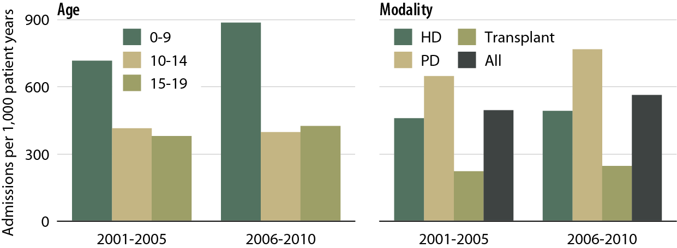
One-year adjusted rates of hospitalization for infection in pediatric patients (from day 90), by age & modality
Figure 8.9 (Volume 2)
Incident ESRD patients age 0–19, 2001–2010. Adj: gender/race/Hispanic ethnicity/primary diagnosis. Ref: incident ESRD patients age 0–19, 2009–2010. Included patients survived the first 90 days after ESRD initiation & are followed from day 90.

Slide 15
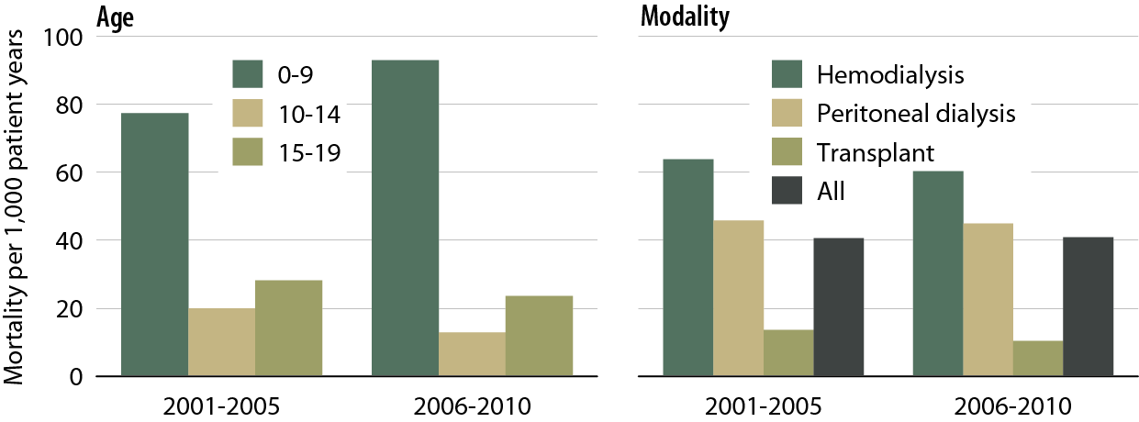
One-year adjusted all-cause mortality rates in pediatric patients
(from day one), by age & modality
Figure 8.10 (Volume 2)
Incident dialysis & transplant patients defined at the onset of dialysis or the day of transplant without the 60-day rule; followed to December 31, 2011. Adj: age/gender/race/Hispanic ethnicity/primary diagnosis. Ref: incident ESRD patients age 0–19, 2009–2010.

Slide 16
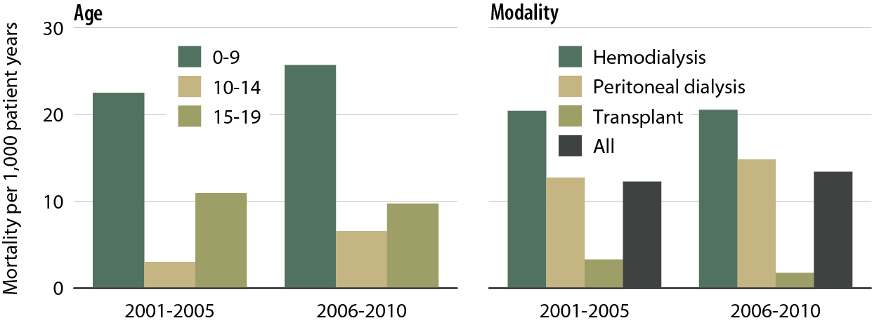
One-year adjusted cardiovascular mortality rates in pediatric patients
(from day one), by age & modality
Figure 8.11 (Volume 2)
Incident dialysis & transplant patients defined at the onset of dialysis or the day of transplant without the 60-day rule; followed to December 31, 2011. Adj: age/gender/race/Hispanic ethnicity/primary diagnosis. Ref: incident ESRD patients age 0–19, 2009–2010.

Slide 17
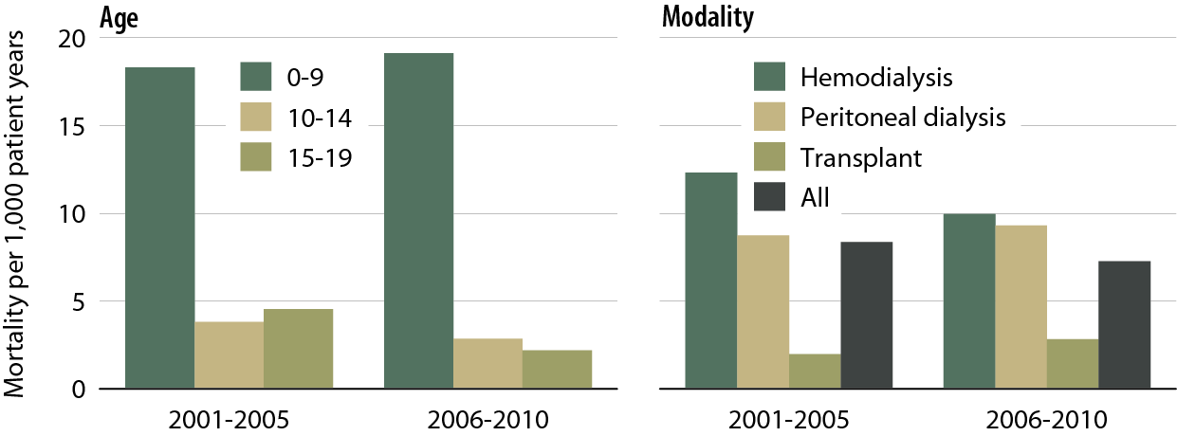
One-year adjusted rates of mortality due to infection in pediatric patients
(from day one), by age & modality
Figure 8.12 (Volume 2)
Incident dialysis & transplant patients defined at the onset of dialysis or the day of transplant without the 60-day rule; followed to December 31, 2011. Adj: age/gender/race/Hispanic ethnicity/primary diagnosis. Ref: incident ESRD patients age 0–19, 2009–2010.

Slide 18
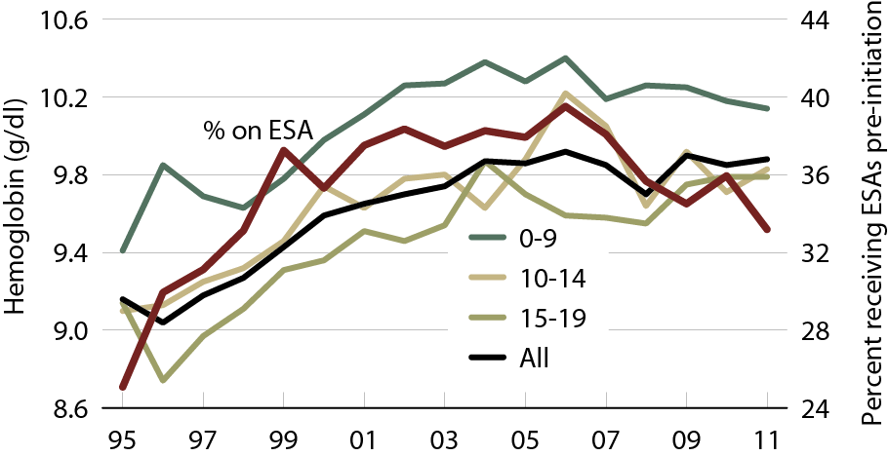
Adjusted five-year survival in pediatric patients (from day one), by age & modality, 2002–2006
Figure 8.13 (Volume 2)
Incident dialysis & transplant patients defined at the onset of dialysis or the day of transplant without the 60-day rule; followed to December 31, 2011. Adj: age/gender/race/Hispanic ethnicity/primary diagnosis. Ref: incident ESRD patients age 0–19, 2009–2010.

Slide 19
Mean hemoglobin at initiation & pre-initiation
ESA treatment in pediatric ESRD patients, by age
Figure 8.14 (Volume 2)
Incident ESRD patients age 0–19.

Slide 20
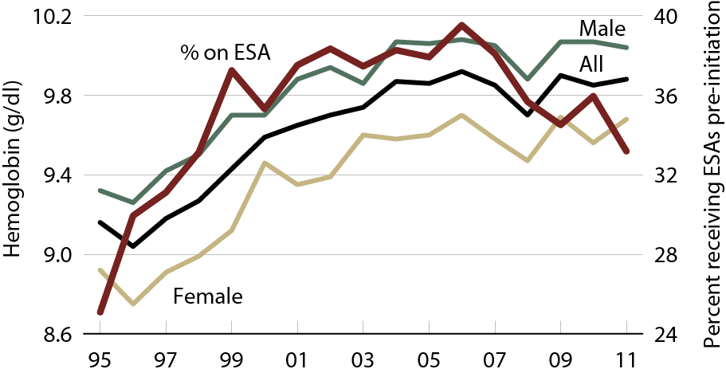
Mean hemoglobin at initiation & pre-initiation ESA treatment in pediatric ESRD patients, by gender
Figure 8.15 (Volume 2)
Incident ESRD patients age 0–19.

Slide 21
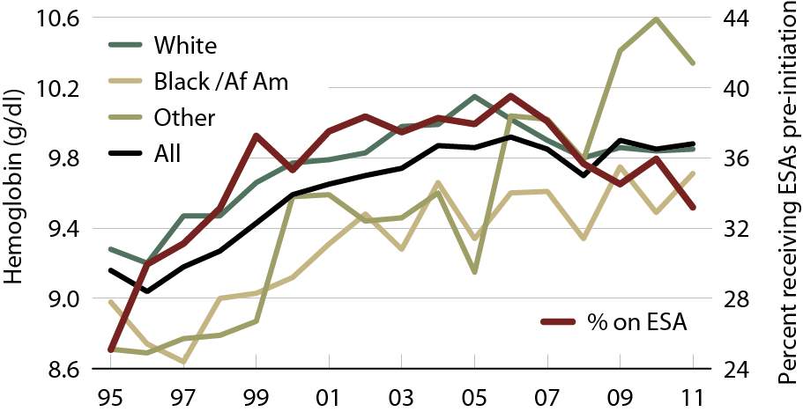
Mean hemoglobin at initiation & pre-initiation ESA treatment in pediatric ESRD patients, by race
Figure 8.16 (Volume 2)
Incident ESRD patients age 0–19.

Slide 22
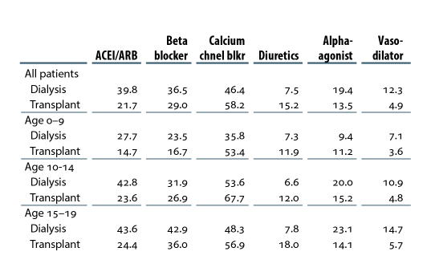
Antihypertensive medication use in pediatric patients with ESRD, by age & modality (column %)
Table 8.b (Volume 2)
Period prevalent ESRD patients with Medicare Part D, 2010-2011

Slide 23
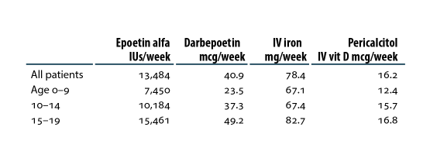
Average dose per week of injectable medications in pediatric dialysis patients, by age
Table 8.c (Volume 2)
Period prevalent ESRD patients with Medicare Parts A & B, 2010-2011.

Slide 24
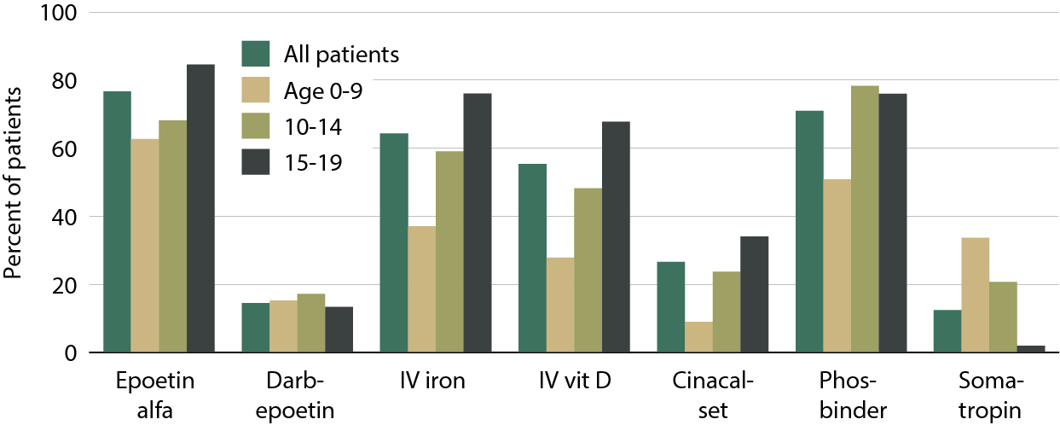
Use of injectables & oral medications in pediatric dialysis patients, by age
Figure 8.17 (Volume 2)
Period prevalent ESRD patients with Medicare Parts A, B, & D, 2010-2011

