Slide 1
ESRD: Chapter Ten
ESRD providers
United States Renal Data System
2013 Annual Data Report

Slide 2
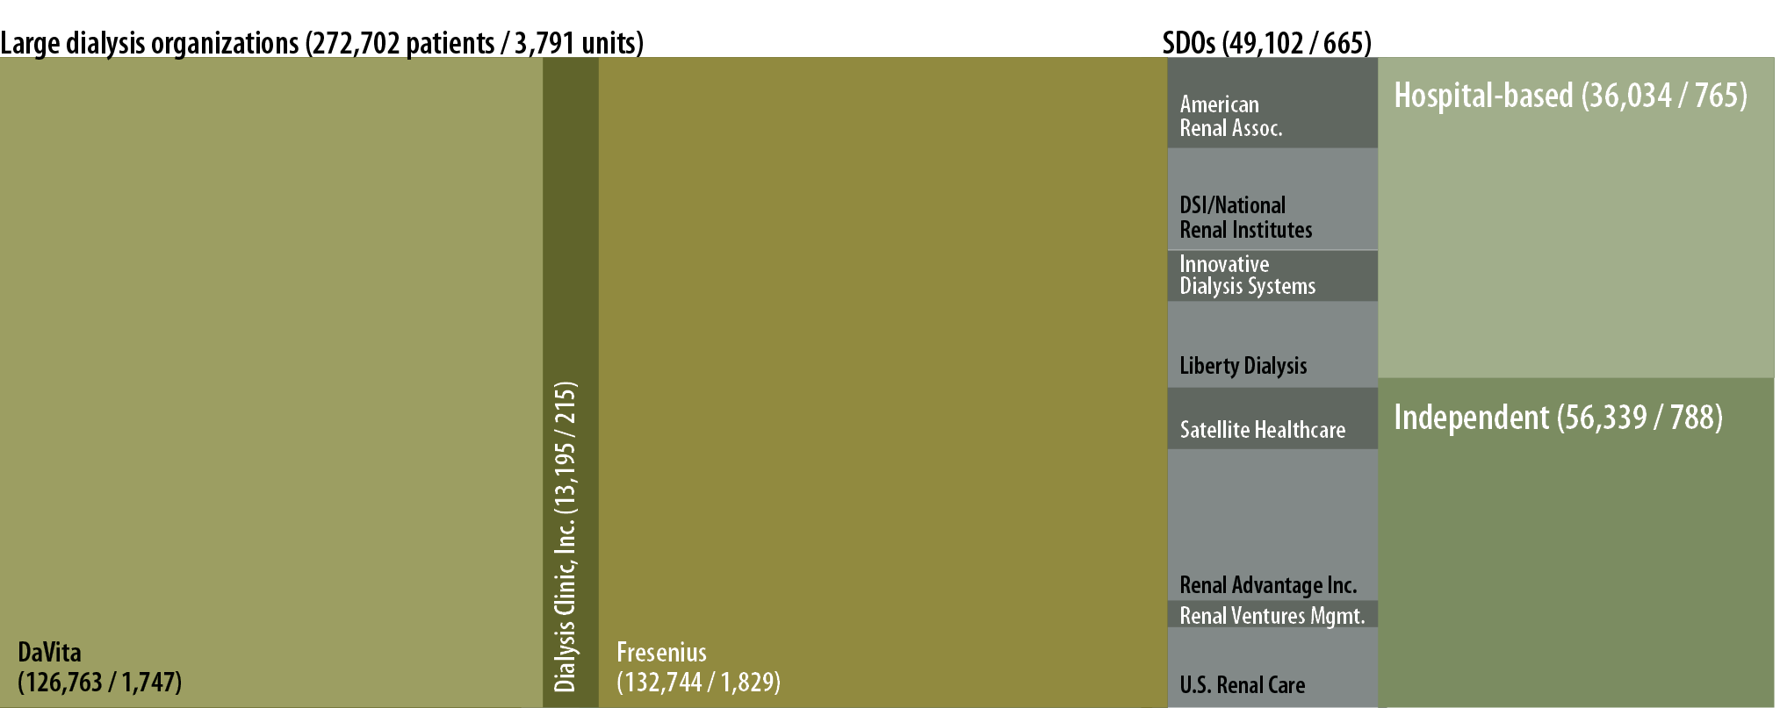
Distribution of patients, by unit affiliation, 2011
Figure 10.1 (Volume 2)
CMS Annual Facility Survey, 2011.

Slide 3
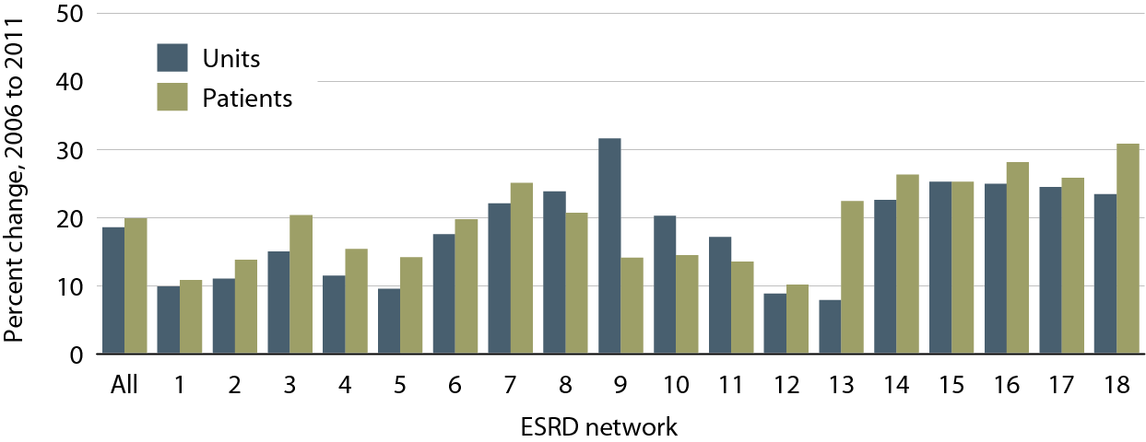
Percent change in the number of dialysis units & patients,
2006 to 2011, by ESRD network
Figure 10.2 (Volume 2)
CMS Annual Facility Survey.

Slide 4
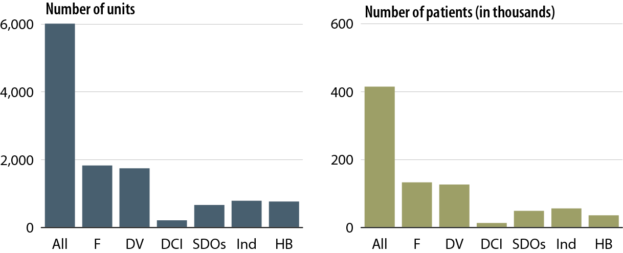
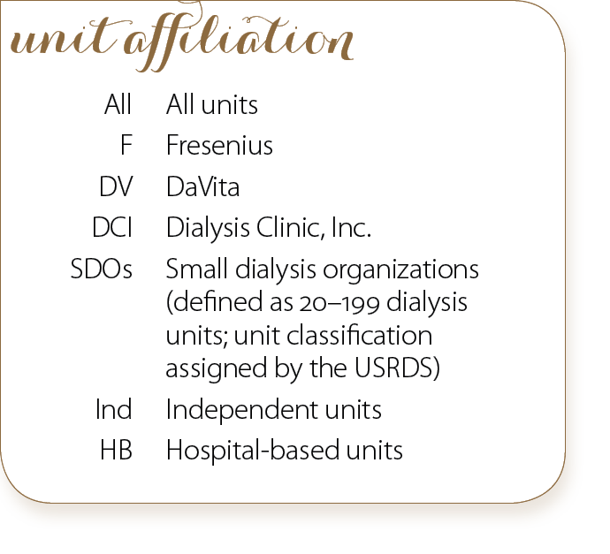
Dialysis unit & patient counts, by unit affiliation, 2011
Figure 10.3 (Volume 2)
CMS Annual Facility Survey.

Slide 5
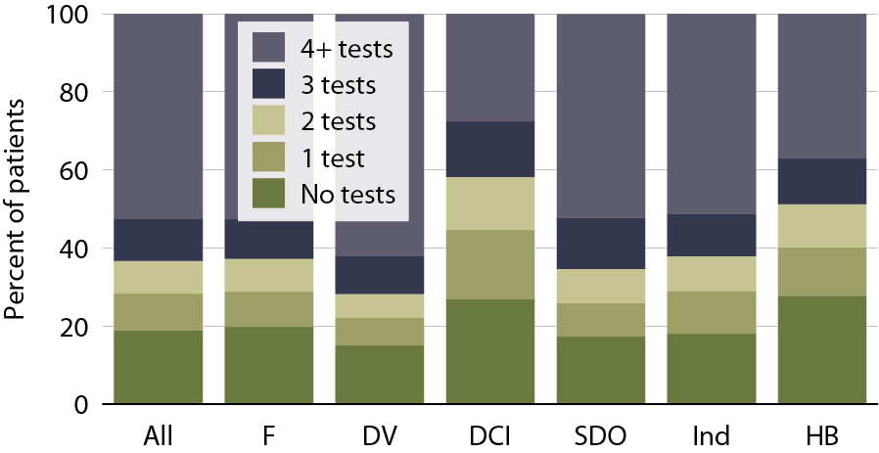
Glycosylated hemoglobin (A1c) testing in dialysis patients with diabetes, by unit affiliation & number of tests, 2010–2011
Figure 10.4 (Volume 2)
Point prevalent dialysis patients with diabetes as the primary cause of ESRD or as a comorbidity listed on the Medical Evidence form, age 18–75, 2010–2011.

Slide 6
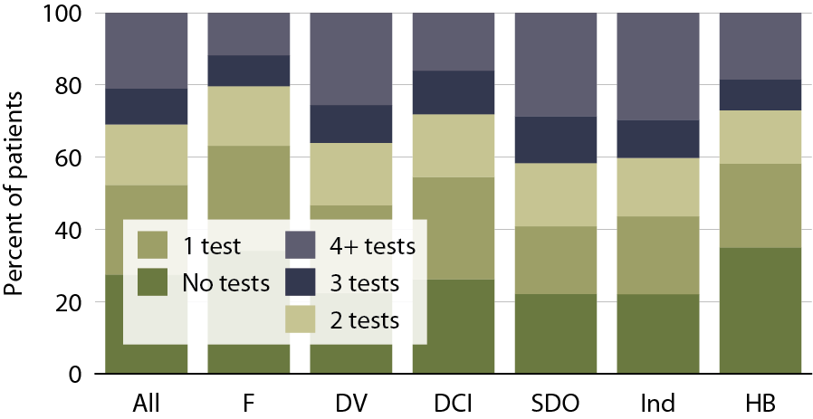
Lipid testing in dialysis patients, by unit affiliation & number of tests, 2010–2011
Figure 10.5 (Volume 2)
Point prevalent dialysis patients with diabetes as the primary cause of ESRD or as a comorbidity listed on the Medical Evidence form, age 18–75, 2010–2011.

Slide 7
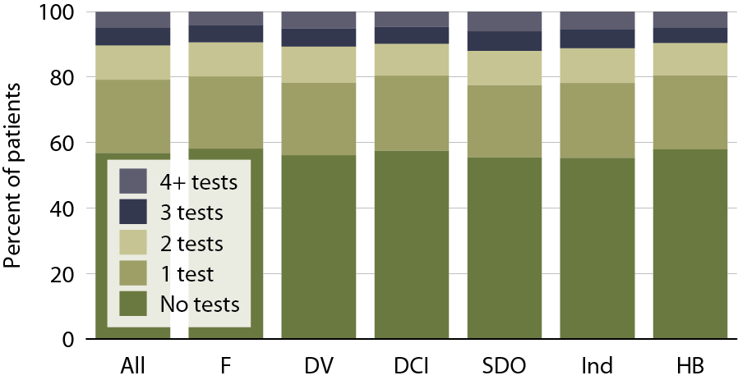
Eye examinations in dialysis patients with diabetes, by unit affiliation
& number of tests, 2010–2011
Figure 10.6 (Volume 2)
Point prevalent dialysis patients with diabetes as the primary cause of ESRD or as a comorbidity listed on the Medical Evidence form, age 18–75, 2010–2011.

Slide 8
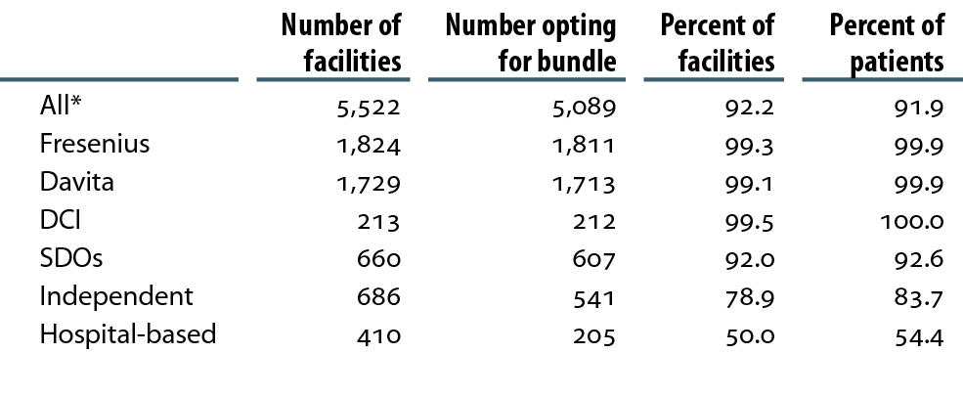
Distribution of providers opting into the new dialysis composite rate, 2012
Table 10.a (Volume 2)

Slide 9
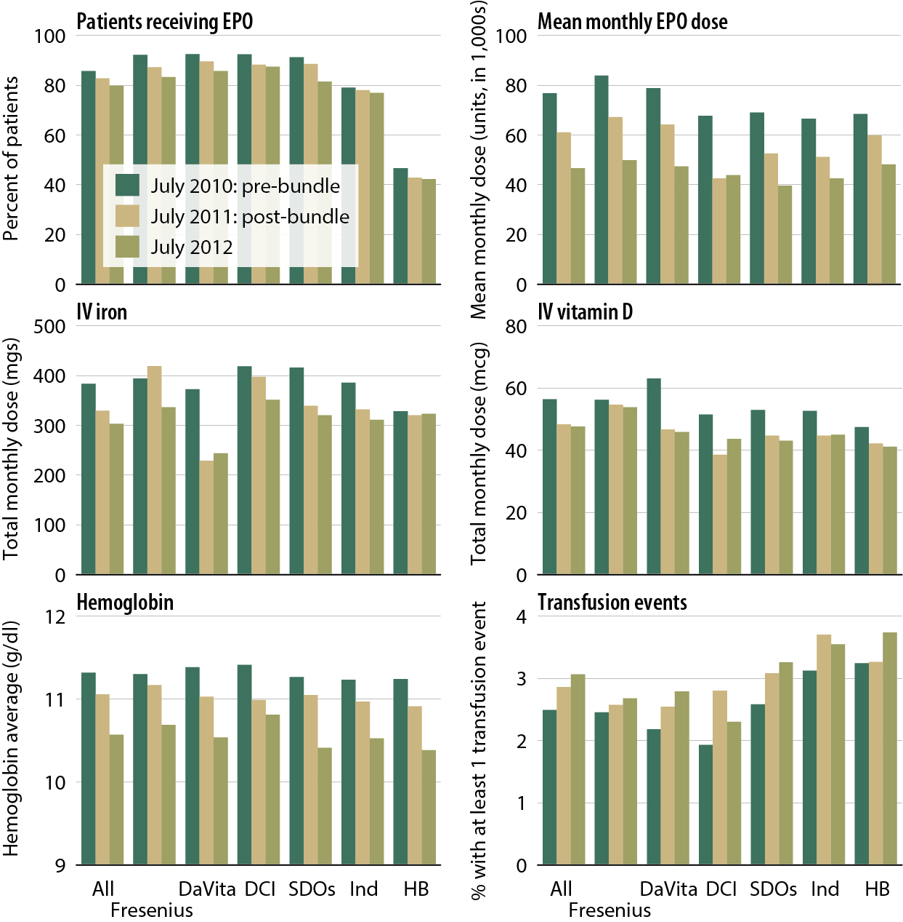
Total monthly dose of anemia treatment therapeutics, hemoglobin levels, & transfusion events, pre- & post- dialysis bundle, by unit affiliation
Figure 10.7 (Volume 2)
Point prevalent dialysis patients.

Slide 10
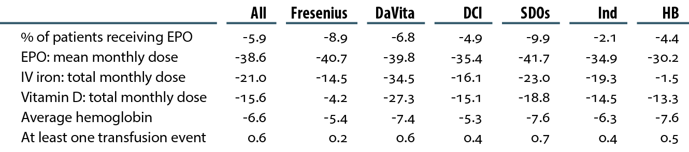
Changes (%) in the use of injectable medications, average hemoglobin, & transfusion events pre- & post- dialysis bundle (July 2010 to July 2012), by unit affiliation
Table 10.b (Volume 2)
Point prevalent dialysis patients.

Slide 11
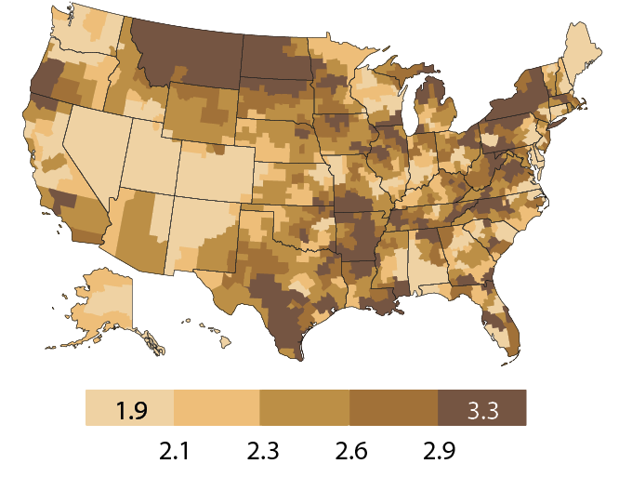
Geographic variations in the percentage of patients with at least one transfusion, by HSA: July, 2010
Figure 10.8 (Volume 2)
Period prevalent dialysis patients.

Slide 12
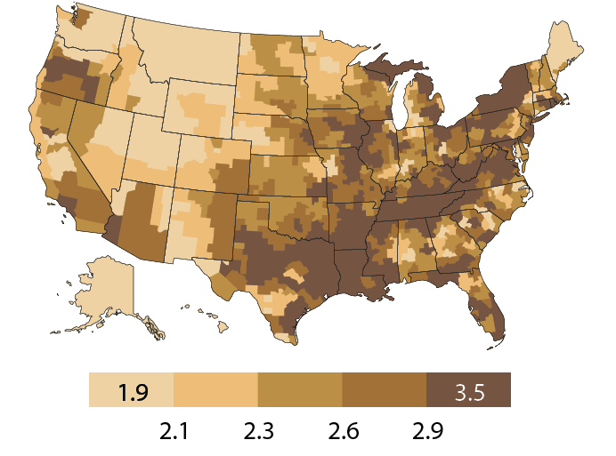
Geographic variations in the percentage of patients with at least one transfusion, by HSA: July, 2011
Figure 10.8 (Volume 2, continued)
Period prevalent dialysis patients.

Slide 13
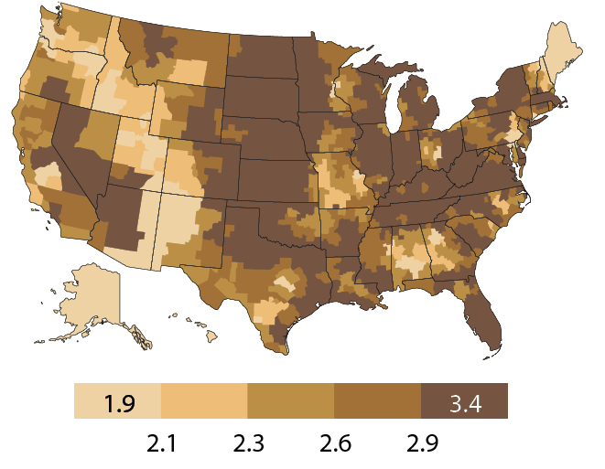
Geographic variations in the percentage of patients with at least one transfusion, by HSA: July, 2012
Figure 10.8 (Volume 2, continued)
Period prevalent dialysis patients.

Slide 14
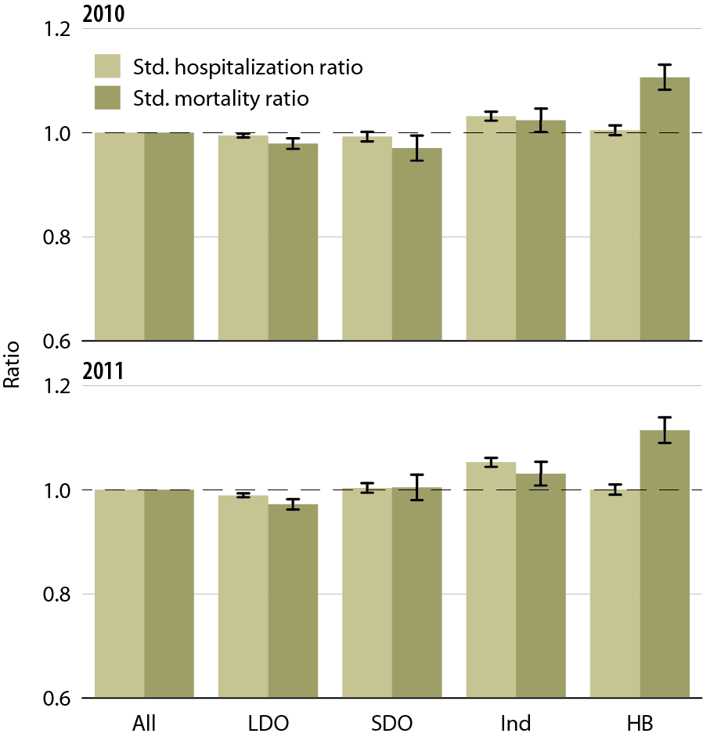
All-cause standardized hospitalization
& mortality ratios, by unit affiliation, 2010 & 2011
Figure 10.9 (Volume 2)
January 1 point prevalent hemodialysis patients with Medicare as primary payor (SHRs); January 1 point prevalent hemodialysis patients (SMRS). SHRS & SMRS are calculated based on national hospitalization & death rates; adjusted for age, gender, race, & dialysis vintage.

Slide 15
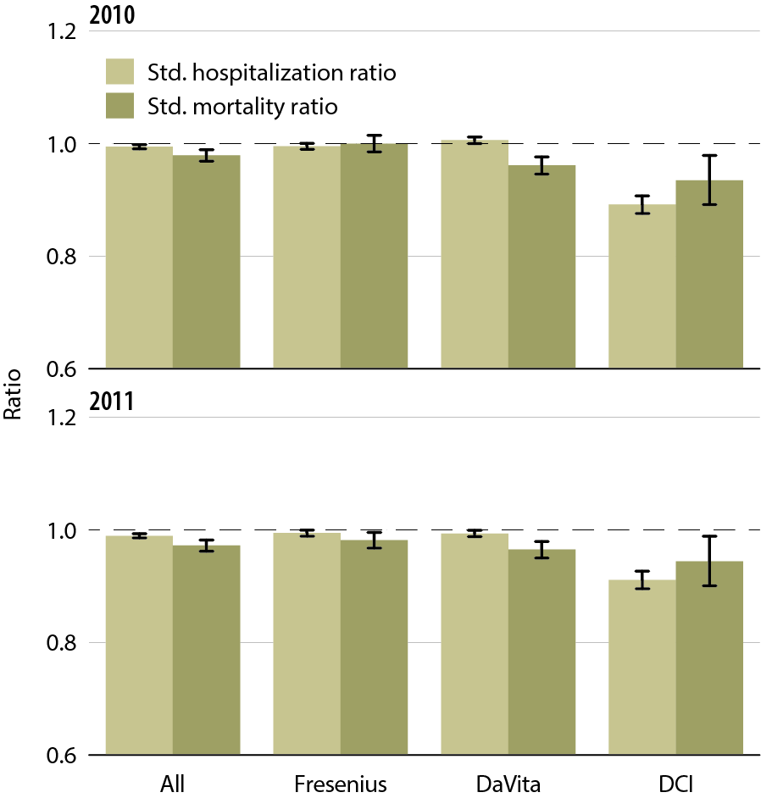
All-cause standardized hospitalization
& mortality ratios in large dialysis organizations, 2010 & 2011
Figure 10.10 (Volume 2)
January 1 point prevalent hemodialysis patients with Medicare as primary payor (SHRs); January 1 point prevalent hemodialysis patients (SMRS). SHRS & SMRS are calculated based on national hospitalization & death rates; adjusted for age, gender, race, & dialysis vintage.

Slide 16
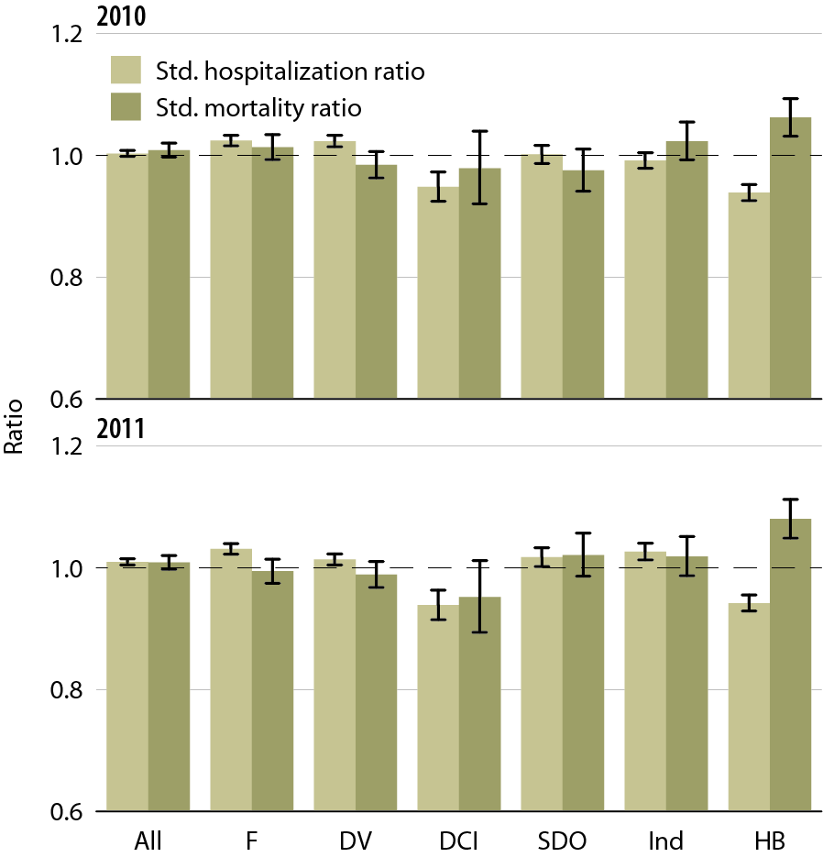
All-cause standardized hospitalization
& mortality ratios, by unit affiliation,
2010 & 2011: whites
Figure 10.11 (Volume 2)
January 1 point prevalent hemodialysis patients with Medicare as primary payor (SHRs); January 1 point prevalent hemodialysis patients (SMRS). SHRS & SMRS are calculated based on national hospitalization & death rates; adjusted for age, gender, race, & dialysis vintage.

Slide 17
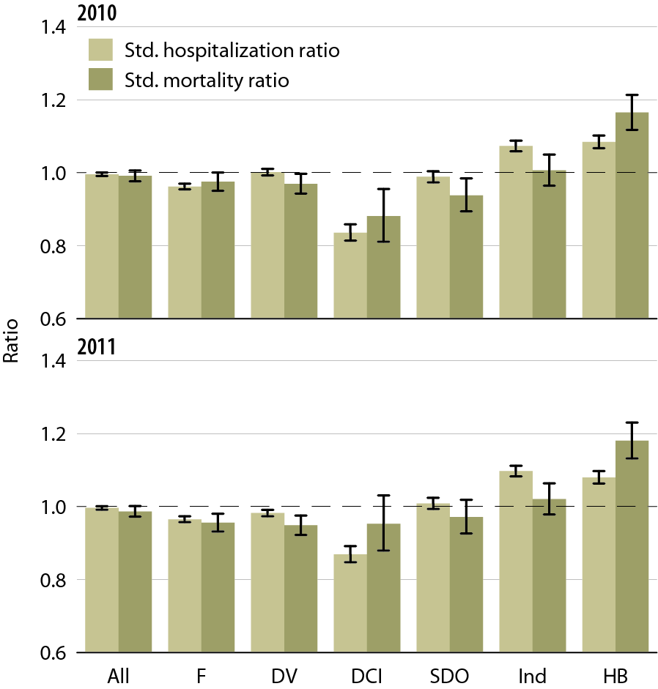
All-cause standardized hospitalization
& mortality ratios, by unit affiliation,
2010 & 2011: blacks/African Americans
Figure 10.12 (Volume 2)
January 1 point prevalent hemodialysis patients with Medicare as primary payor (SHRs); January 1 point prevalent hemodialysis patients (SMRS). SHRS & SMRS are calculated based on national hospitalization & death rates; adjusted for age, gender, race, & dialysis vintage.

