Slide 1
ESRD: Chapter Eleven
Costs of ESRD
United States Renal Data System
2013 Annual Data Report

Slide 2
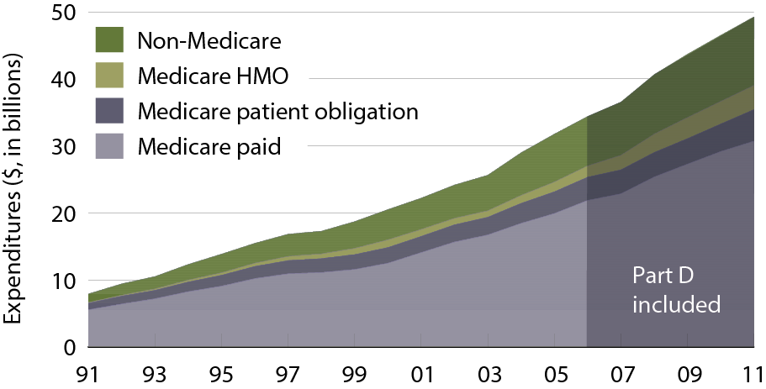
ESRD expenditures, by payor
Figure 11.1 (Volume 2)
Period prevalent ESRD patients; includes Part D.

Slide 3
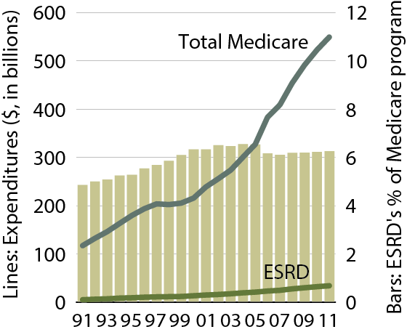
Costs of the Medicare & ESRD programs
Figure 11.2 (Volume 2)
Costs (inflated by 2 percent) include estimated costs for HMO & organ acquisition; includes Part D

Slide 4
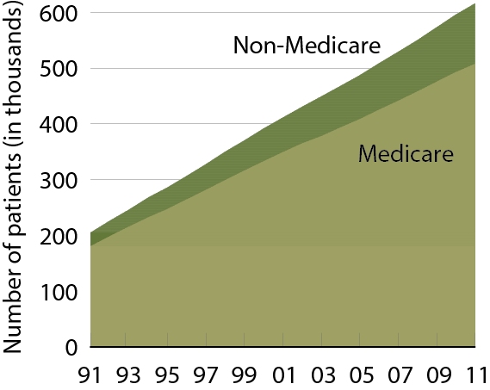
Estimated numbers of point prevalent ESRD patients
Figure 11.3 (Volume 2)
December 31 point prevalent ESRD patients.

Slide 5
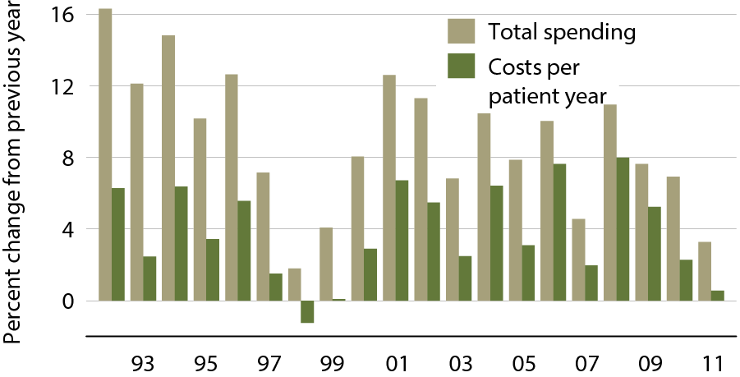
Annual percent change in Medicare ESRD spending
Figure 11.4 (Volume 2)
Total Medicare ESRD costs from claims data; includes all Medicare as primary payor claims as well as amounts paid by Medicare as secondary payor.

Slide 6
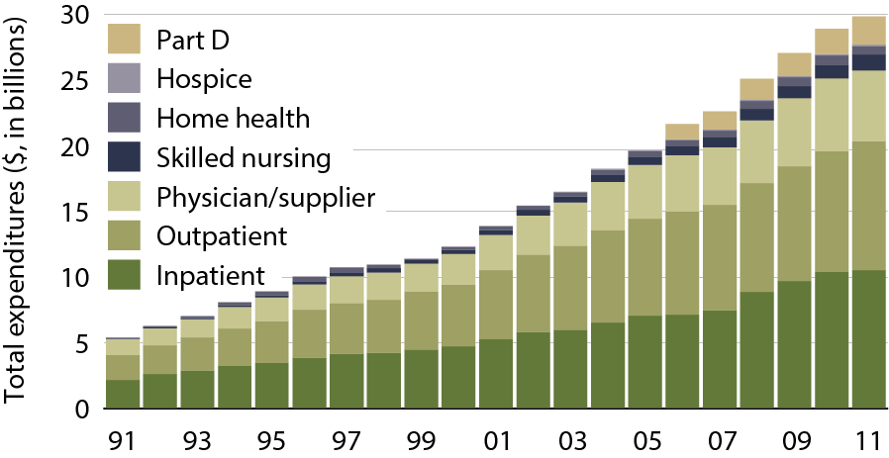
Total Medicare dollars spent on ESRD, by type of service
Figure 11.5 (Volume 2)
Total Medicare costs from claims data; include all Medicare as primary payor
claims as well as amounts paid by Medicare as secondary payor.

Slide 7
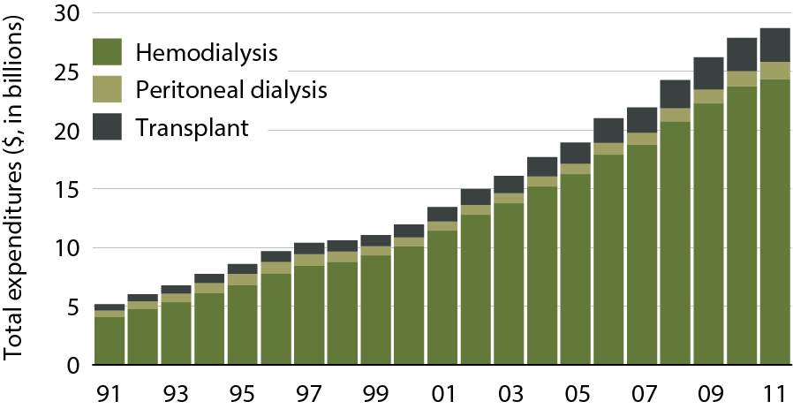
Total Medicare ESRD expenditures, by modality
Figure 11.6 (Volume 2)
Period prevalent ESRD patients.

Slide 8
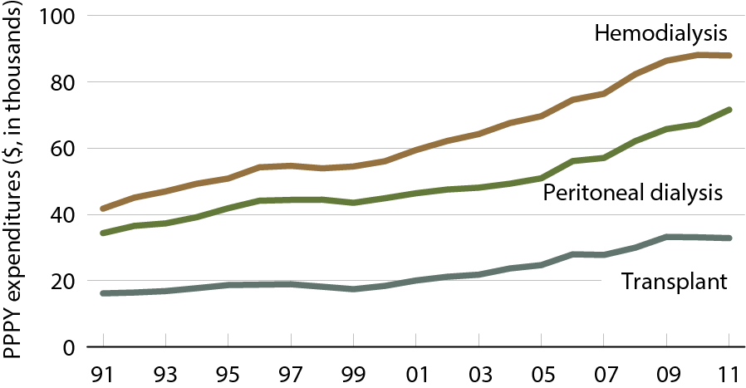
Total Medicare ESRD expenditures per person per year, by modality
Figure 11.7 (Volume 2)
Period prevalent ESRD patients; patients with Medicare as secondary payor are excluded.

Slide 9
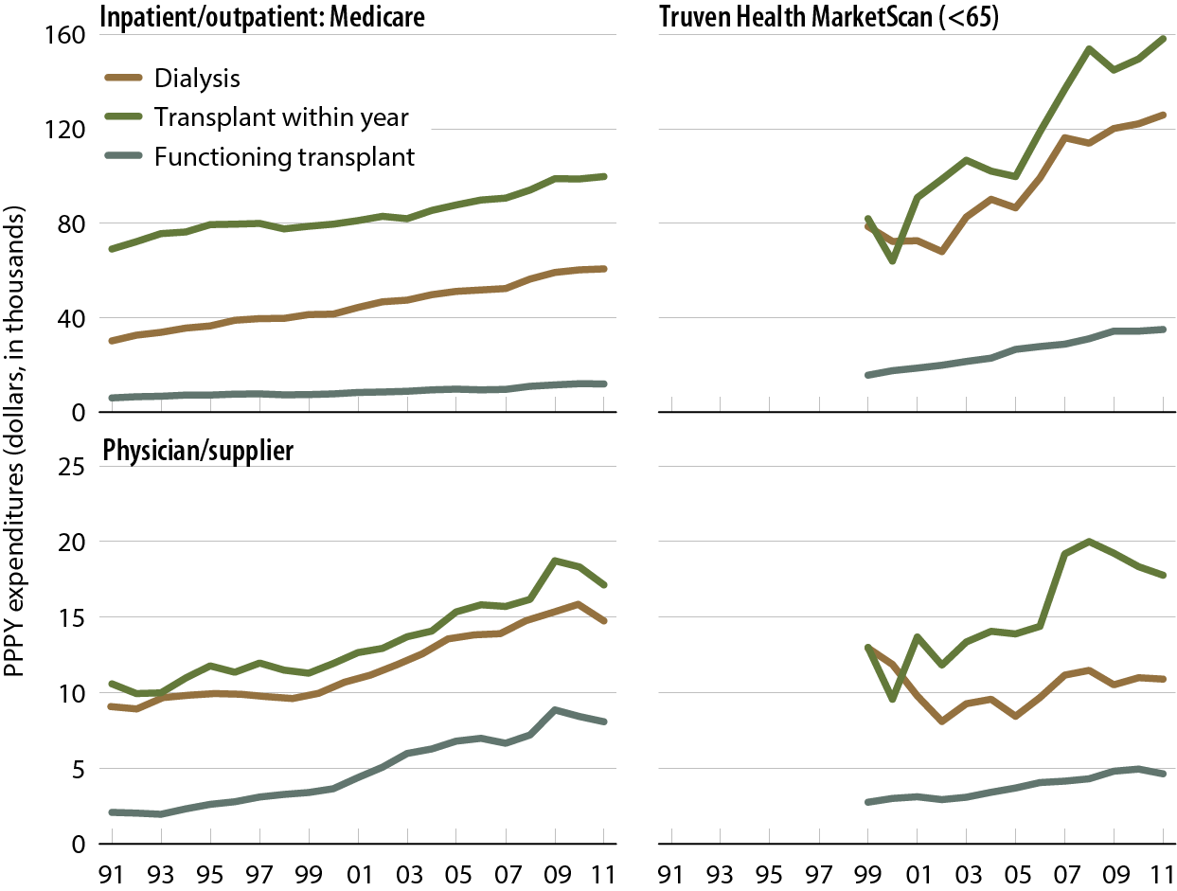
Per person per year inpatient/outpatient
& physician/supplier net costs for Medicare & Truven Health MarketScan (EGHP) patients with ESRD
Figure 11.8 (Volume 2)
Medicare: period prevalent ESRD patients; Truven Health MarketScan: period prevalent ESRD patients age 64 & younger.

Slide 10
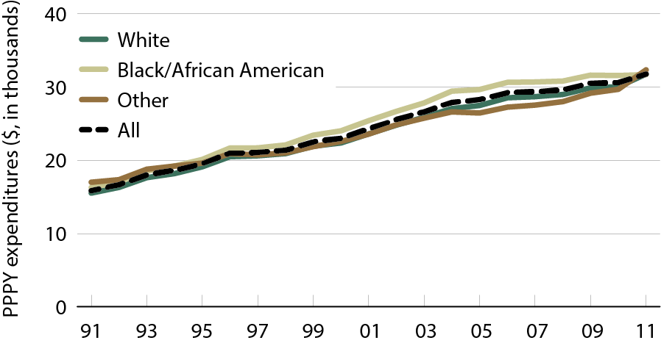
Total per person per year outpatient expenditures, by race
Figure 11.9 (Volume 2)
Period prevalent dialysis patients.

Slide 11
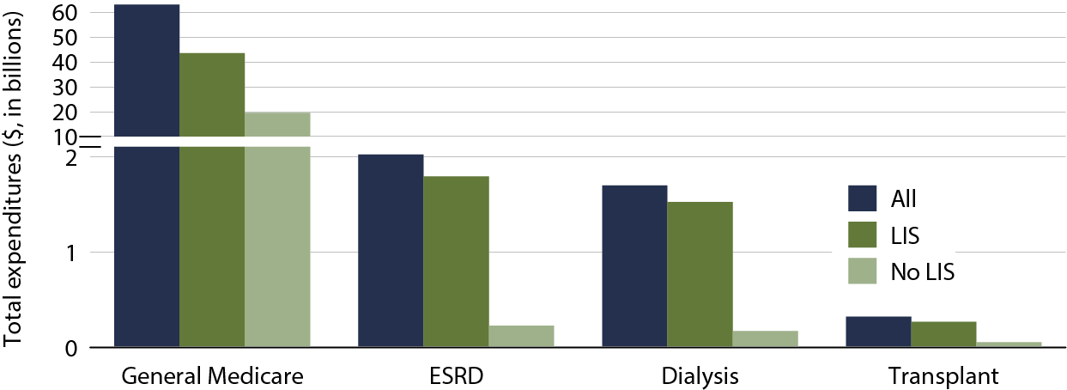
Total Part D net costs, by low income subsidy (LIS) status & modality, 2011
Figure 11.10 (Volume 2)
Part D-enrolled general Medicare patients from the 5 percent sample & period prevalent dialysis & transplant patients, 2011.

Slide 12
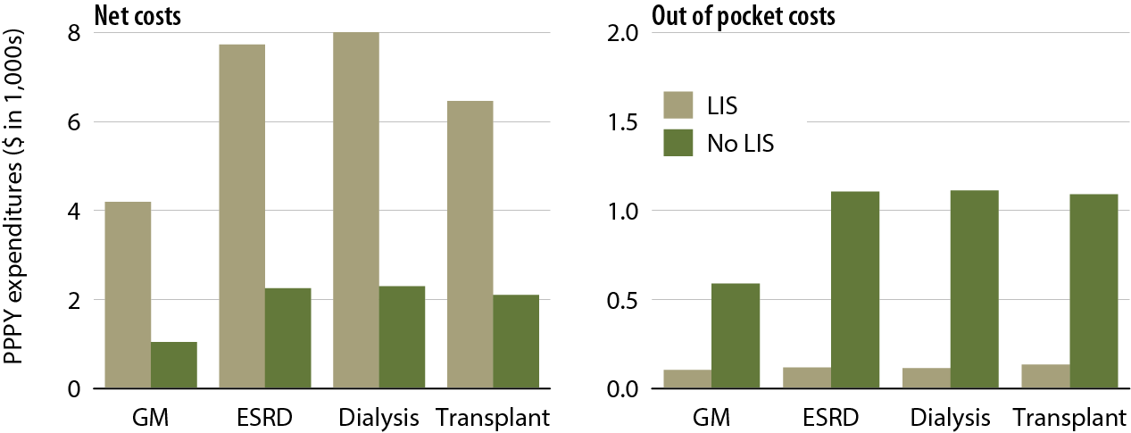
Total per person per year Part D net & out-of pocket costs, by low income subsidy (LIS) status, 2011
Figure 11.11 (Volume 2)
Part D-enrolled general Medicare patients from the 5 percent sample & period prevalent dialysis & transplant patients, 2011.

Slide 13
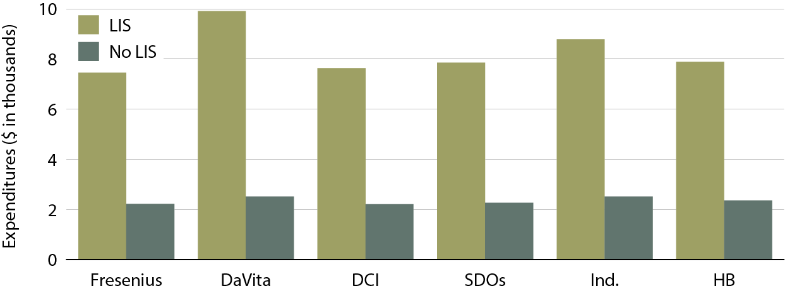
Total per person per year (PPPY) Part D costs, by low income subsidy (LIS) status, & provider, 2011
Figure 11.12 (Volume 2)
Part D-enrolled dialysis patients, 2011.

Slide 14
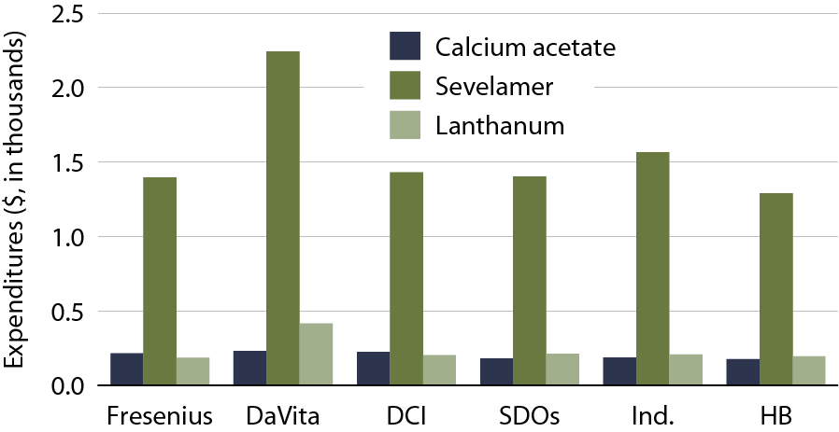
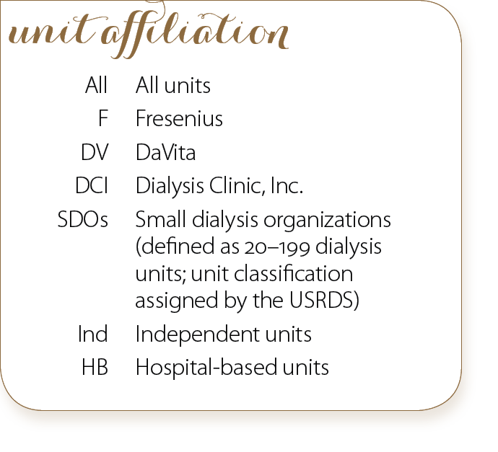
Total per person per year (PPPY) Part D costs for phosphate binders, by provider, 2011
Figure 11.13 (Volume 2)
Part D-enrolled dialysis patients, 2011.

Slide 15
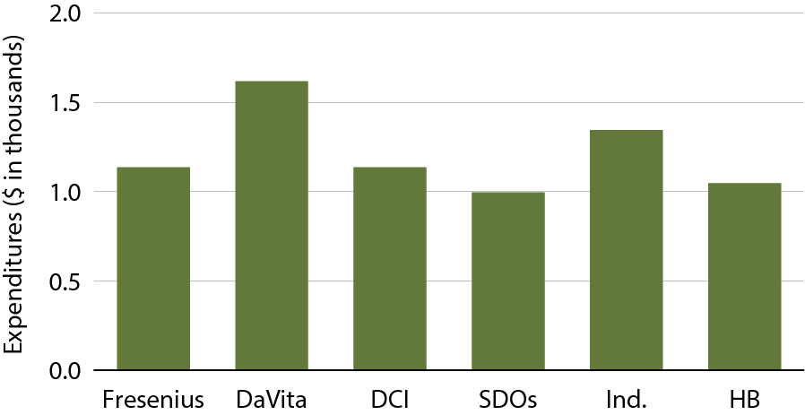
Total per person per year (PPPY) Part D costs for cinacalcet, by provider, 2011
Figure 11.14 (Volume 2)
Part D-enrolled dialysis patients, 2011.

Slide 16
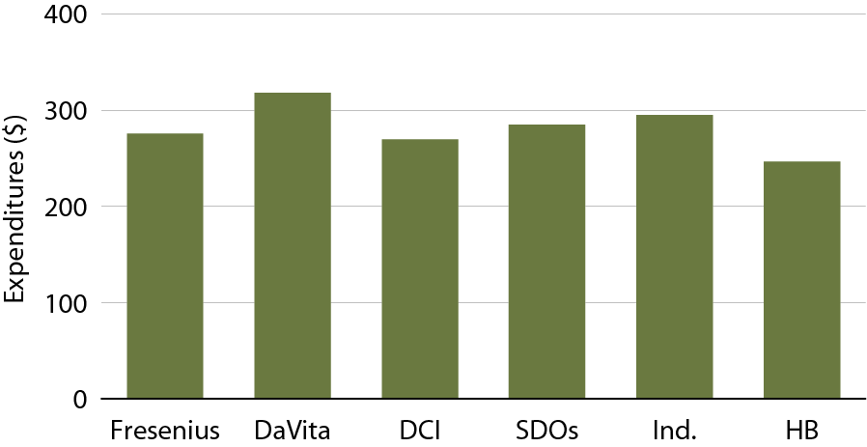
Total per person per year (PPPY) Part D costs for antihypertensives, by provider, 2011
Figure 11.15 (Volume 2)
Part D-enrolled dialysis patients, 2011.

Slide 17
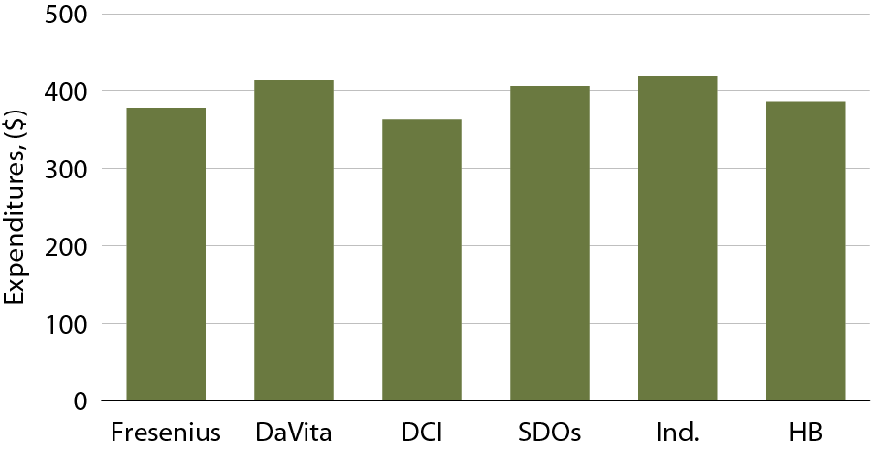
Total per person per year (PPPY) Part D costs for diabetes agents, by provider, 2011
Figure 11.16 (Volume 2)
Part D-enrolled dialysis patients, 2011.

