Slide 1
ESRD: Chapter Twelve
International comparisons
United States Renal Data System
2013 Annual Data Report

Slide 2
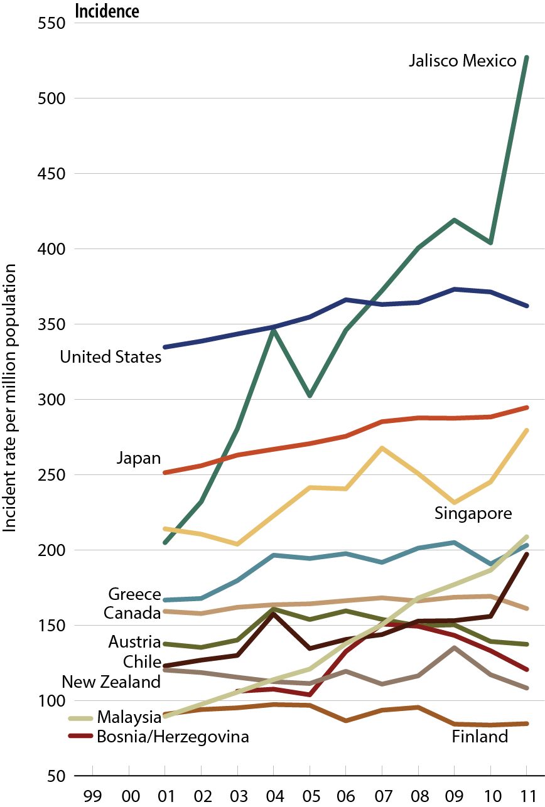
Comparison of unadjusted ESRD incidence worldwide
Figure 12.1 (Volume 2)
All rates are unadjusted. Data from Japan are dialysis only.

Slide 3
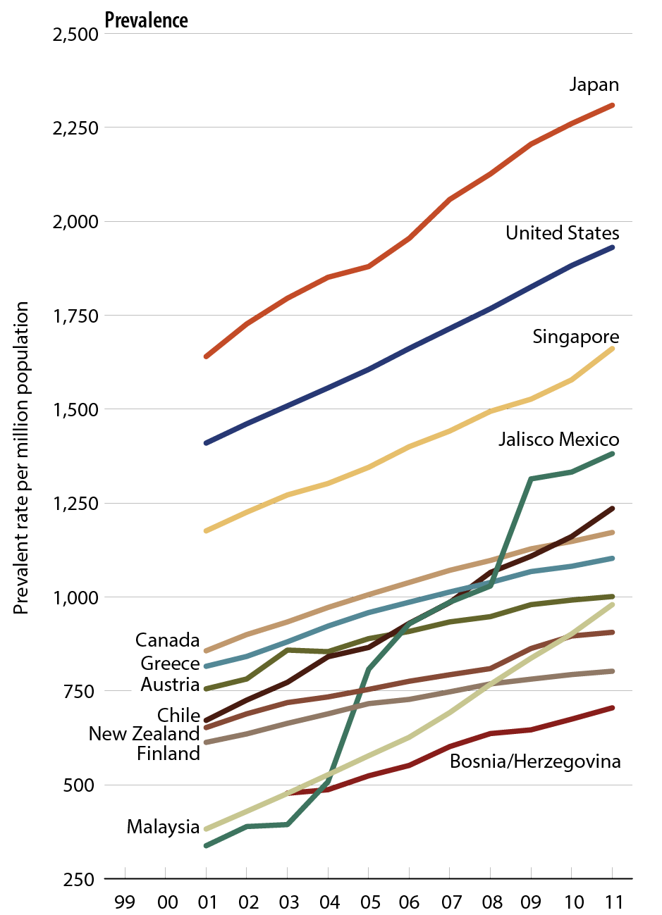
Comparison of unadjusted
ESRD prevalence worldwide
Figure 12.1, continued (Volume 2)
All rates are unadjusted. Data from Japan are dialysis only.

Slide 4
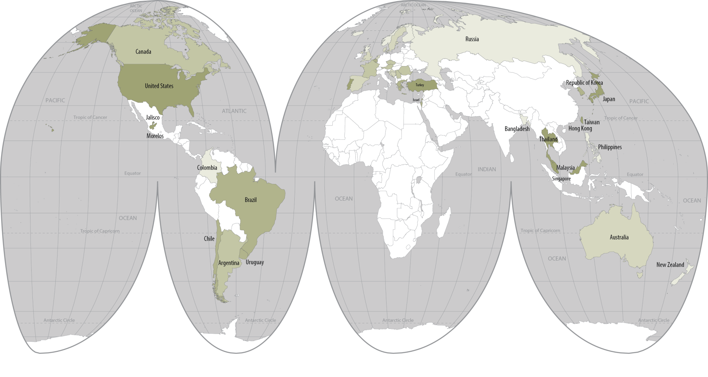

Geographic variations in the incidence of ESRD (per million population), 2011
Figure 12.2 (Volume 2)
Data presented only for countries from which relevant information was available. All rates unadjusted. Latest data for Taiwan are for 2010. Data for France include 25 regions. Data for Belgium do not include patients younger than 20.

Slide 5
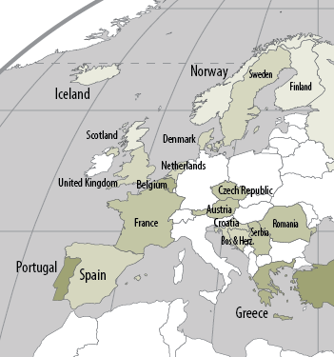
Geographic variations in the incidence of ESRD (per million population), 2011
Figure 12.2, continued (Volume 2)
Data presented only for countries from which relevant information was available. All rates unadjusted. Latest data for Taiwan are for 2010. Data for France include 25 regions. Data for Belgium do not include patients younger than 20.

Slide 6
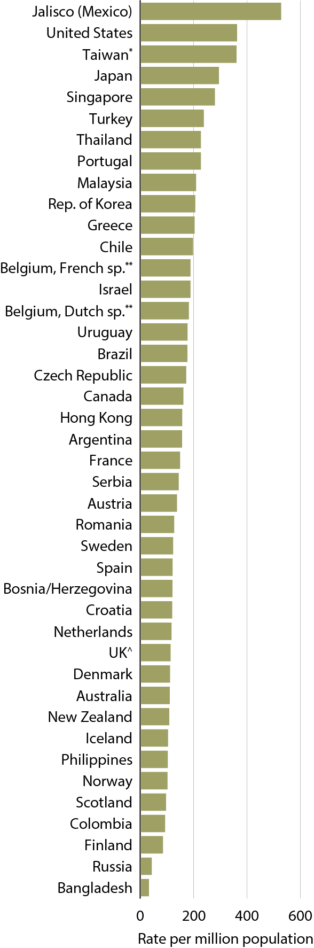
Incidence of
ESRD, 2011
Figure 12.3 (Volume 2)
Data presented only for countries from which relevant information was available; “.” signifies data not reported. All rates unadjusted. ^UK: England, Wales, & Northern Ireland (Scotland data reported separately). Data for Belgium do not include patients younger than 20. *Latest data for Taiwan are from 2010. Incident data for Croatia start at day 91, 2011. Data for France include 25 regions in 2011. All rates are unadjusted.

Slide 7
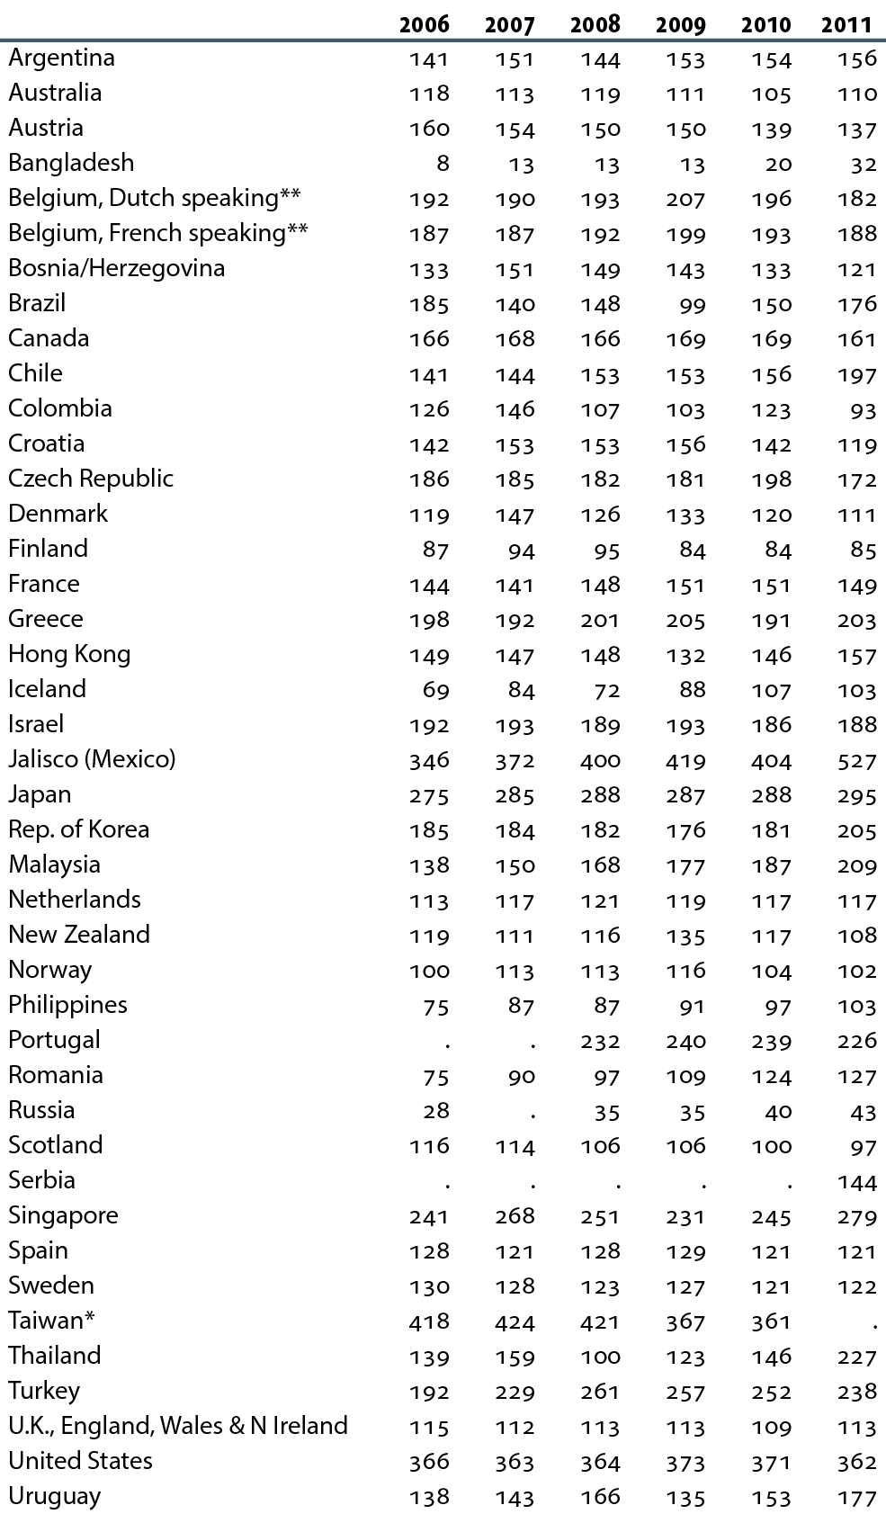
Incidence of ESRD, by year (per million population)
Table 12.a (Volume 2)
Data presented only for countries from which relevant information was available; “.” signifies data not reported. All rates unadjusted. ^UK: England, Wales, & Northern Ireland (Scotland data reported separately). Data for Belgium do not include patients younger than 20. *Latest data for Taiwan are from 2010. Incident data for Croatia start at day 91, 2011. Data for France include 15 regions in 2006, 18 regions in 2007, 20 regions in 2008 & 2009, 23 regions in 2010, & 25 regions in 2011. All rates are unadjusted.

Slide 8
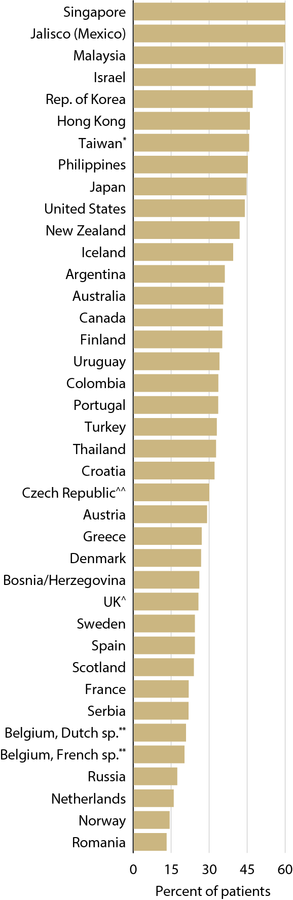
Percentage of incident patients with ESRD due to diabetes, 2011
Figure 12.4 (Volume 2)
Data presented only for countries from which relevant information was available. All rates unadjusted. ^UK: England, Wales, & Northern Ireland (Scotland data reported separately). *Latest data for Taiwan are from 2010. ^^ Czech Republic: Data on incident ESRD due to diabetes is an estimate. Data for France include 25 regions in 2011. .

Slide 9
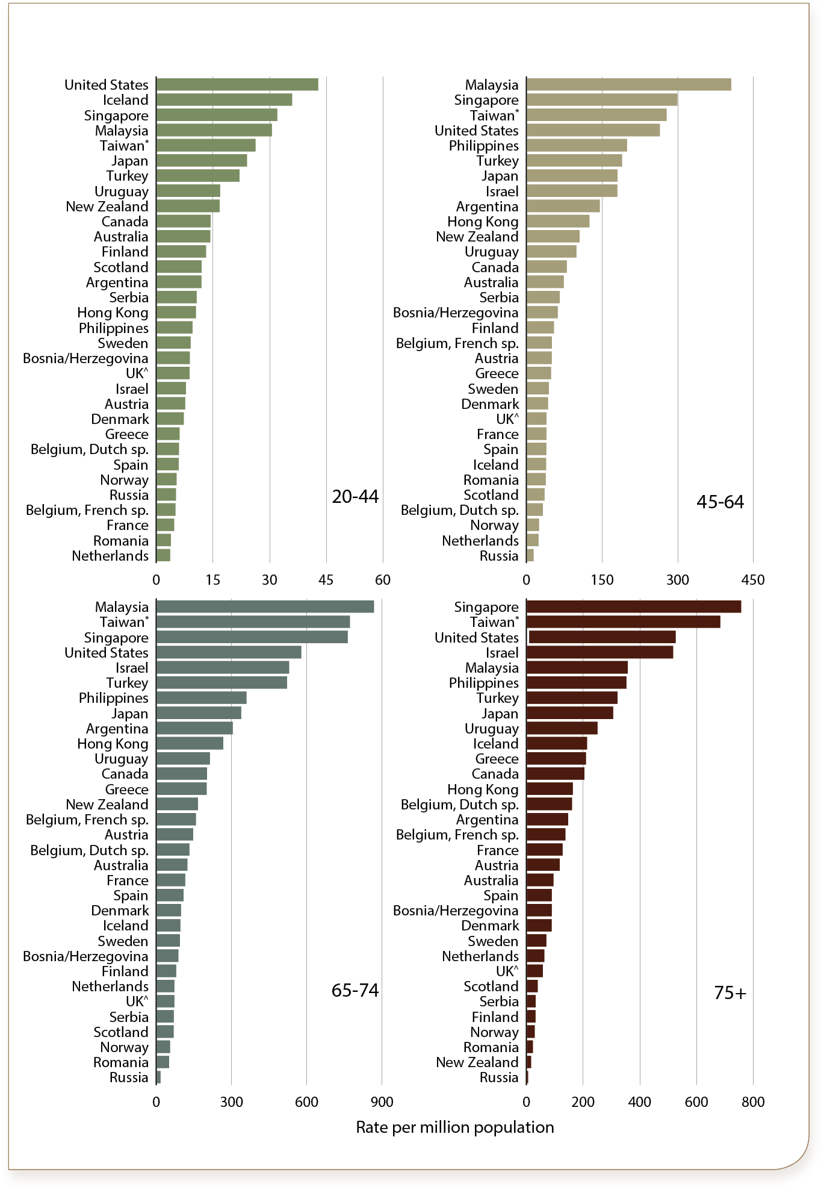
Percentage of incident patients with ESRD due to diabetes, by age, 2011
Figure 12.5 (Volume 2)
Data presented only for countries from which relevant information was available. All rates unadjusted. ^UK: England, Wales, & Northern Ireland (Scotland data reported separately). *Latest data for Taiwan are from 2010. Data for France include 25 regions in 2011.

Slide 10
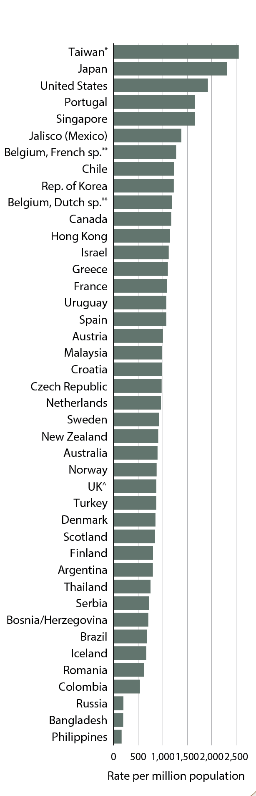
Prevalence of
ESRD, 2011
Figure 12.6 (Volume 2)
Data presented only for countries from which relevant information was available; “.” signifies data not reported. All rates unadjusted. ^UK: England, Wales, & Northern Ireland (Scotland data reported separately). **Data for Belgium do not include patients younger than 20. Japan, Philippines, & Taiwan are dialysis only. *Latest data for Taiwan are from 2010. Data for France include 18 regions in 2007, 20 regions in 2008 & 2009, 23 regions in 2010, & 25 regions in 2011. All rates are unadjusted.

Slide 11
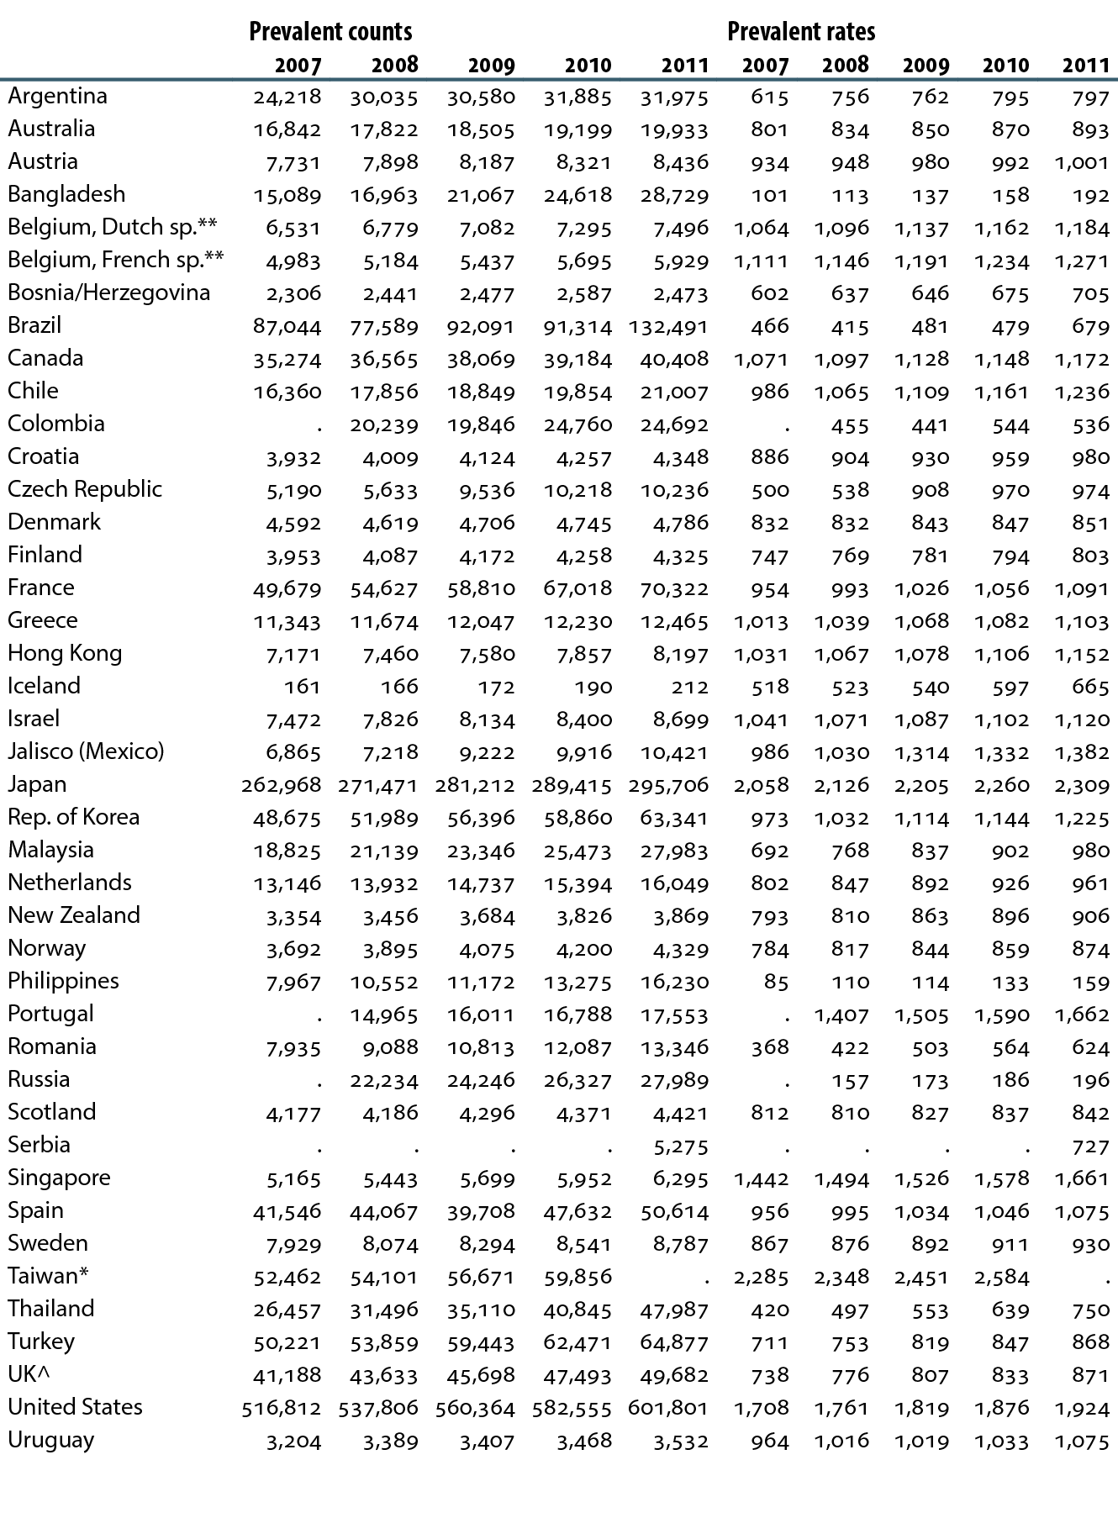
Prevalence of ESRD, by year (per million population)
Table 12.b (Volume 2)
Data presented only for countries from which relevant information was available; “.” signifies data not reported. All rates unadjusted. ^UK: England, Wales, & Northern Ireland (Scotland data reported separately). **Data for Belgium do not include patients younger than 20. Argentina (2007), Bangladesh, Brazil (2007–2010), Czech Republic (2007–2008), Japan, Philippines, & Taiwan are dialysis only. *Latest data for Taiwan are from 2010. Data for France include 18 regions in 2007, 20 regions in 2008 & 2009, 23 regions in 2010, & 25 regions in 2011. All rates are unadjusted.

Slide 12
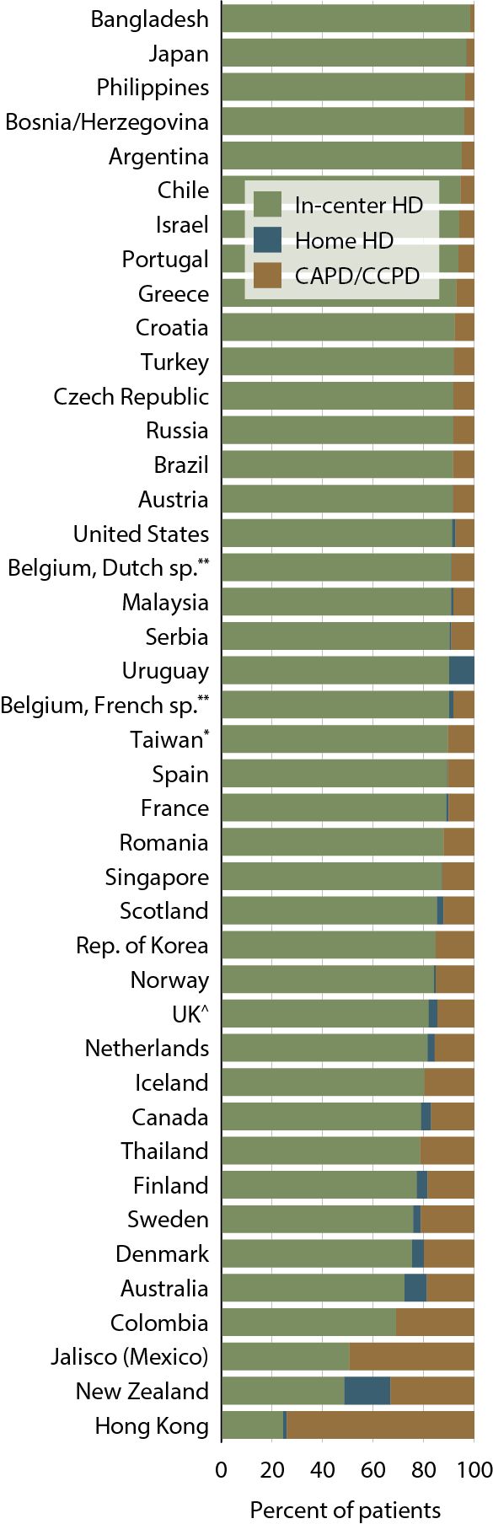
Percent distribution of prevalent dialysis patients, by modality, 2011
Figure 12.7 (Volume 2)
Data presented only for countries from which relevant information was available; “.” signifies data not reported. All rates unadjusted. ^UK: England, Wales, & Northern Ireland (Scotland data reported separately). **Data for Belgium do not include patients younger than 20. *Latest data for Taiwan are from 2010. Data for France include 25 regions in 2011.

Slide 13
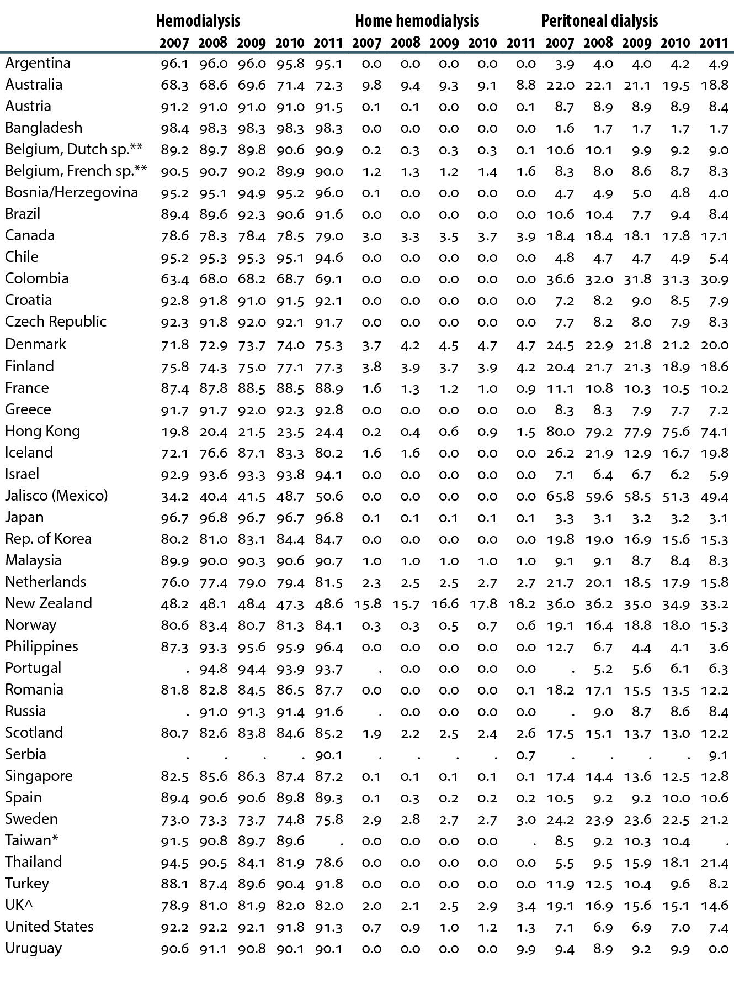
Percent distribution of prevalent dialysis patients, by modality & year
Table 12.c (Volume 2)
Data presented only for countries from which relevant information was available; “.” signifies data not reported. All rates unadjusted. ^UK: England, Wales, & Northern Ireland (Scotland data reported separately). **Data for Belgium do not include patients younger than 20. *Latest data for Taiwan are from 2010. Data for France include 18 regions in 2007, 20 regions in 2008 & 2009, 23 regions in 2010, & 25 regions in 2011.

Slide 14
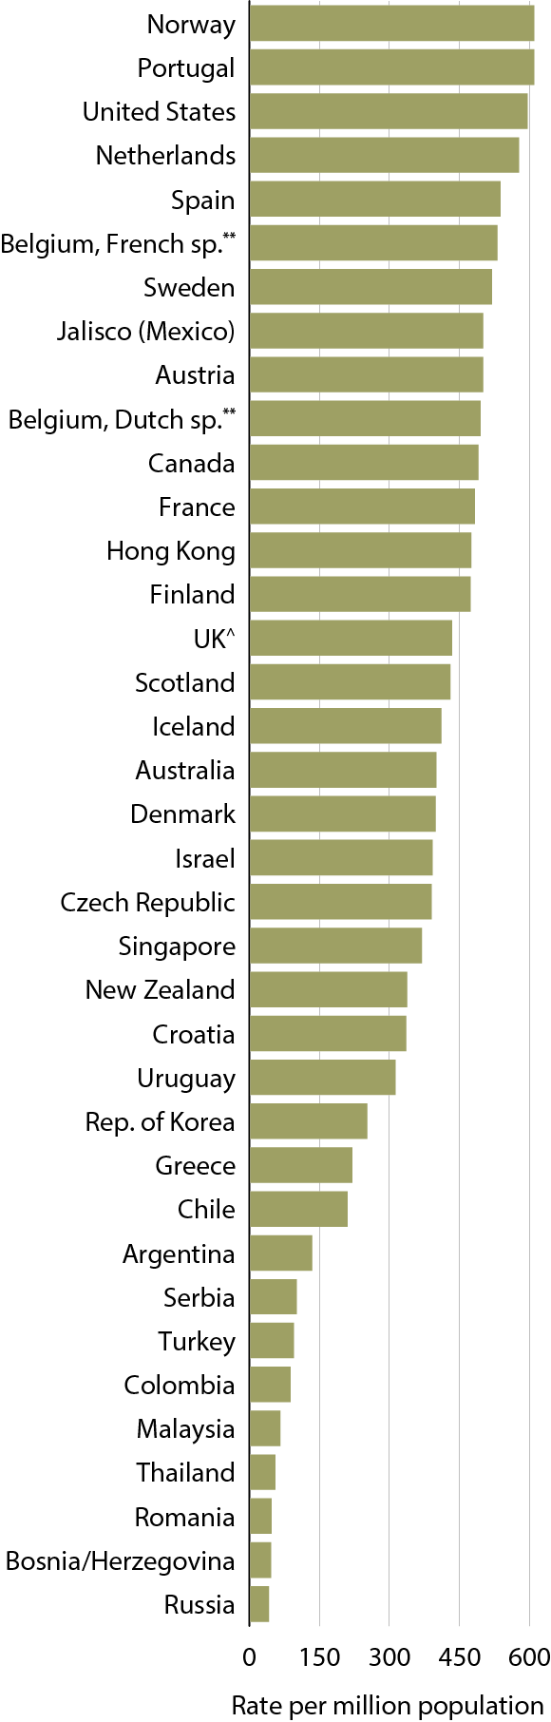
Prevalent rates of functioning grafts, 2011
Figure 12.8 (Volume 2)
Data presented only for countries from which relevant information was available; “.” signifies data not reported. All rates unadjusted. ^UK: England, Wales, & Northern Ireland (Scotland data reported separately). **Data for Belgium do not include patients younger than 20. Data for France include 25 regions in 2011. All rates are unadjusted.

Slide 15
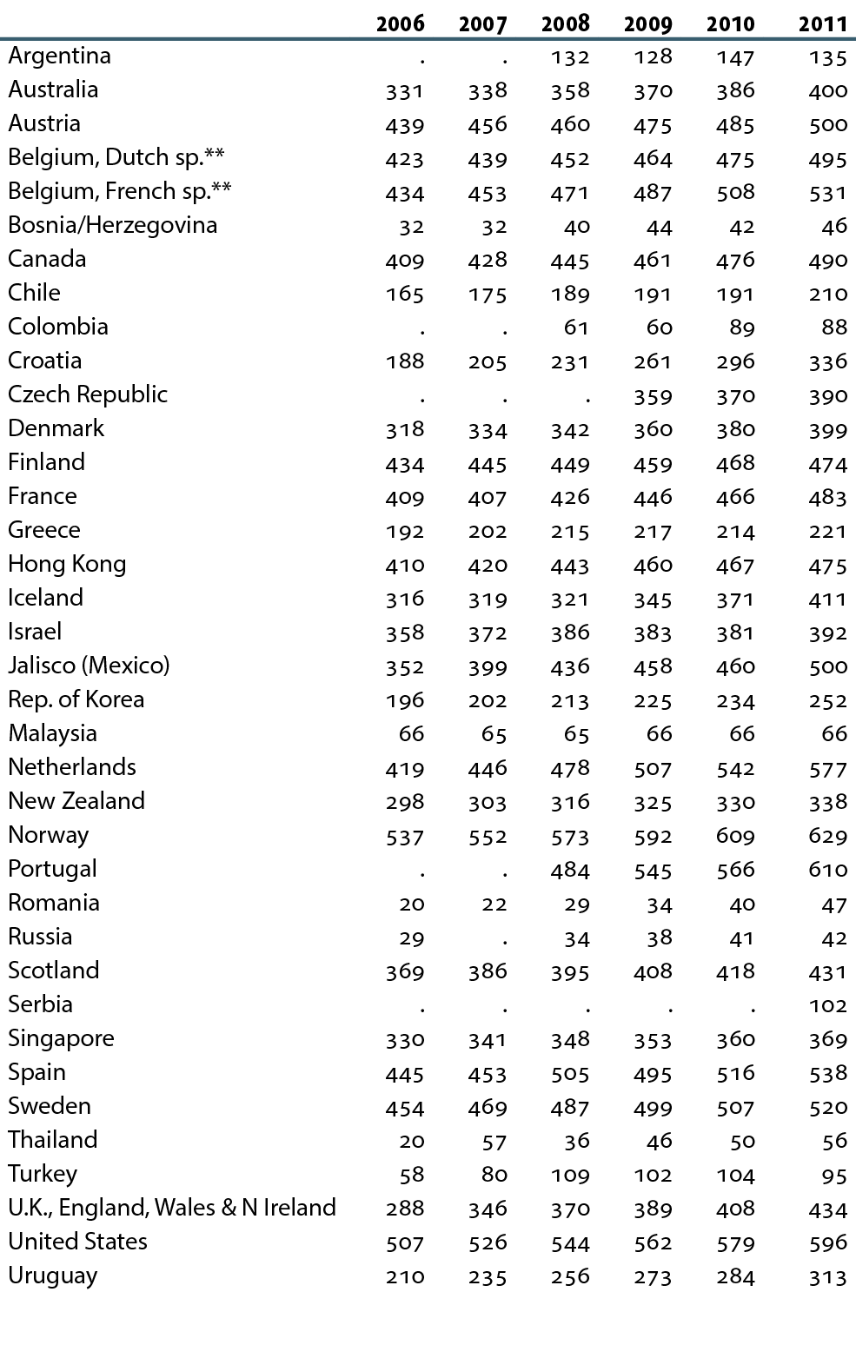
Prevalent rates of functioning grafts, by year (per million population)
Table 12.d (Volume 2)
Data presented only for countries from which relevant information was available; “.” signifies data not reported. All rates unadjusted. ^UK: England, Wales, & Northern Ireland (Scotland data reported separately). **Data for Belgium do not include patients younger than 20. Data for France include 15 regions in 2006, 18 regions in 2007, 20 regions in 2008 & 2009, 23 regions in 2010, & 25 regions in 2011. All rates are unadjusted.

Slide 16
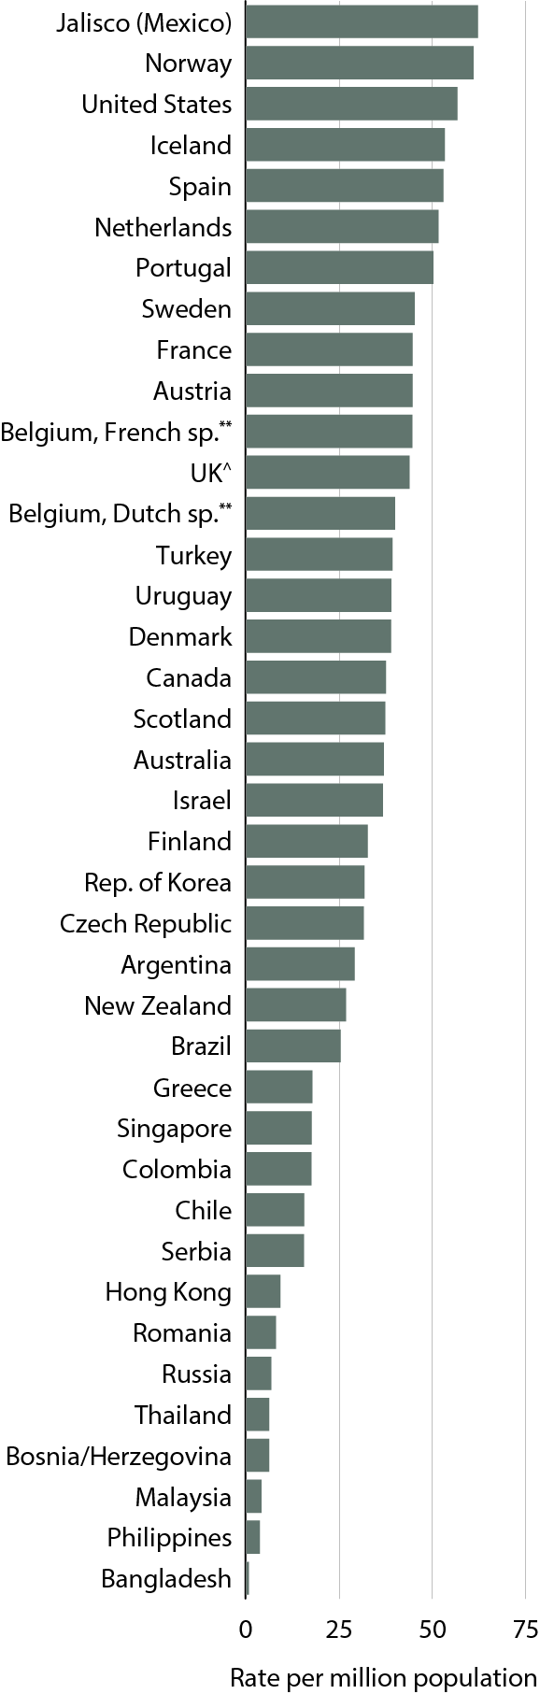
Transplant rates, 2011
Figure 12.9 (Volume 2)
Data presented only for countries from which relevant information was available; “.” signifies data not reported. All rates unadjusted. ^UK: England, Wales, & Northern Ireland (Scotland data reported separately). **Data for Belgium do not include patients younger than 20. Data for France include 25 regions in 2011. All rates are unadjusted.

Slide 17
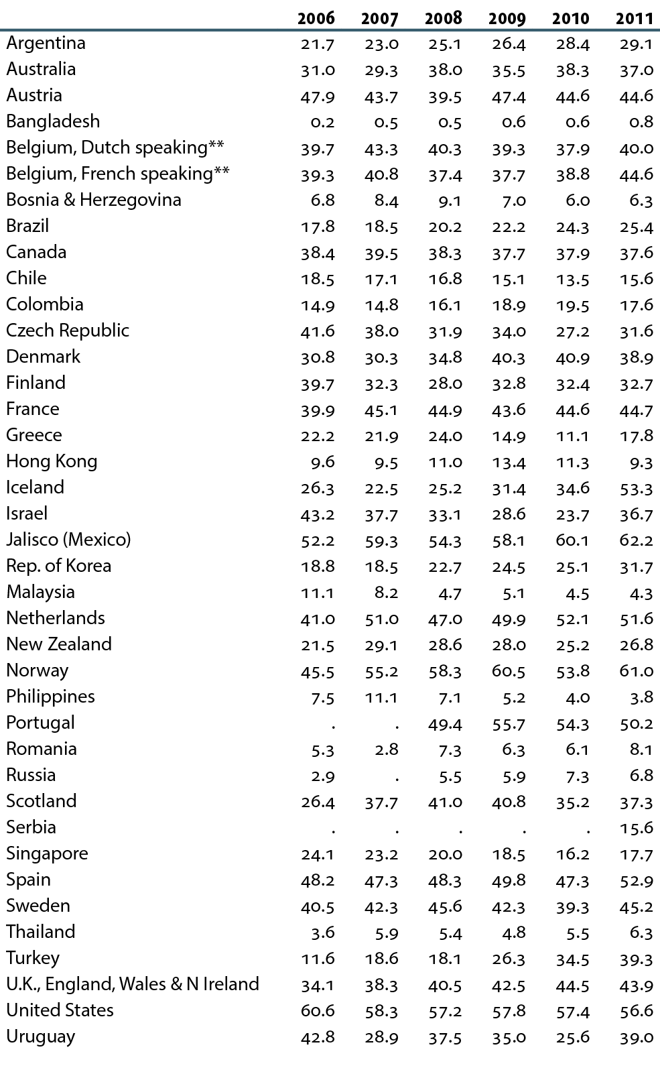
Transplant rates, by year (per million population)
Table 12.e (Volume 2)
Data presented only for countries from which relevant information was available; “.” signifies data not reported. All rates unadjusted. ^UK: England, Wales, & Northern Ireland (Scotland data reported separately). **Data for Belgium do not include patients younger than 20. Data for France include 15 regions in 2006, 18 regions in 2007, 20 regions in 2008 & 2009, 23 regions in 2010, & 25 regions in 2011. All rates are unadjusted.

