Slide 2
vol 1 Table 1.1 Distribution of NHANES participants with diabetes, self-reported cardiovascular disease, & single sample markers of CKD, 2007-2012
 | Percent of NHANES population
No DM, SR CVD, or CKD | 76.5 | .
DM only | 5.0 | .
SR CVD only | 3.9 | .
DM & SR CVD | 1.0 | .
All CKD | 13.6 | .
CKD only | . | 8.0
DM & CKD | . | 2.4
SR CVD & CKD | . | 1.7
DM & SR CVD & CKD | . | 1.5
Total | 100.00 | 13.6
Data Source: National Health and Nutrition Examination Survey (NHANES), 1988–1994, 1999-2004 & 2005–2012 participants age 20 & older. Note: Cardiovascular disease designation is based on self-report of any CVD condition (see CKD Analytical Methods chapter for detail); CKD is defined as eGFR <60 or ACR ≥30. Abbreviations: ACR, urine albumin/creatinine ratio; CKD, chronic kidney disease; SR CVD, self-reported cardiovascular disease; DM, diabetes mellitus; eGFR, estimated glomerular filtration rate; . not applicable.

Slide 3
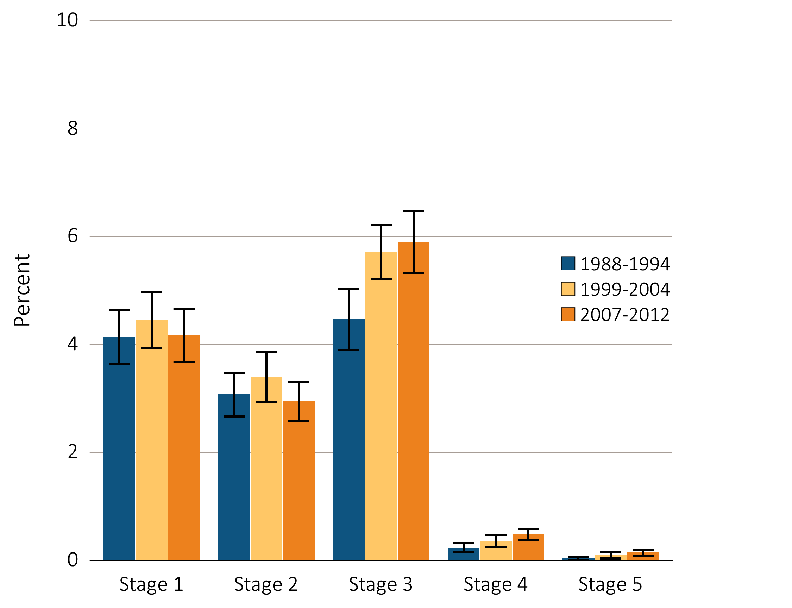
vol 1 Figure 1.1 Prevalence of CKD by stage among NHANES participants, 1988-2012
Stages of CKD – KDOQI 2002 Definitions
Stage 1: eGFR ≥ 90 ml/min/1.73m² and ACR ≥ 30 mg/g
Stage 2: eGFR 60-89 ml/min/1.73m² and ACR ≥ 30 mg/g
Stage 3: eGFR 30-59 ml/min/1.73m²
Stage 4: eGFR 15-29 ml/min/1.73m²
Stage 5: eGFR < 15 ml/min/1.73m²
Data Source: National Health and Nutrition Examination Survey (NHANES), 1988–1994, 1999-2004 & 2005–2012 participants age 20 & older. Whisker lines indicate 95% confidence intervals. Abbreviations: CKD, chronic kidney disease.

Slide 4
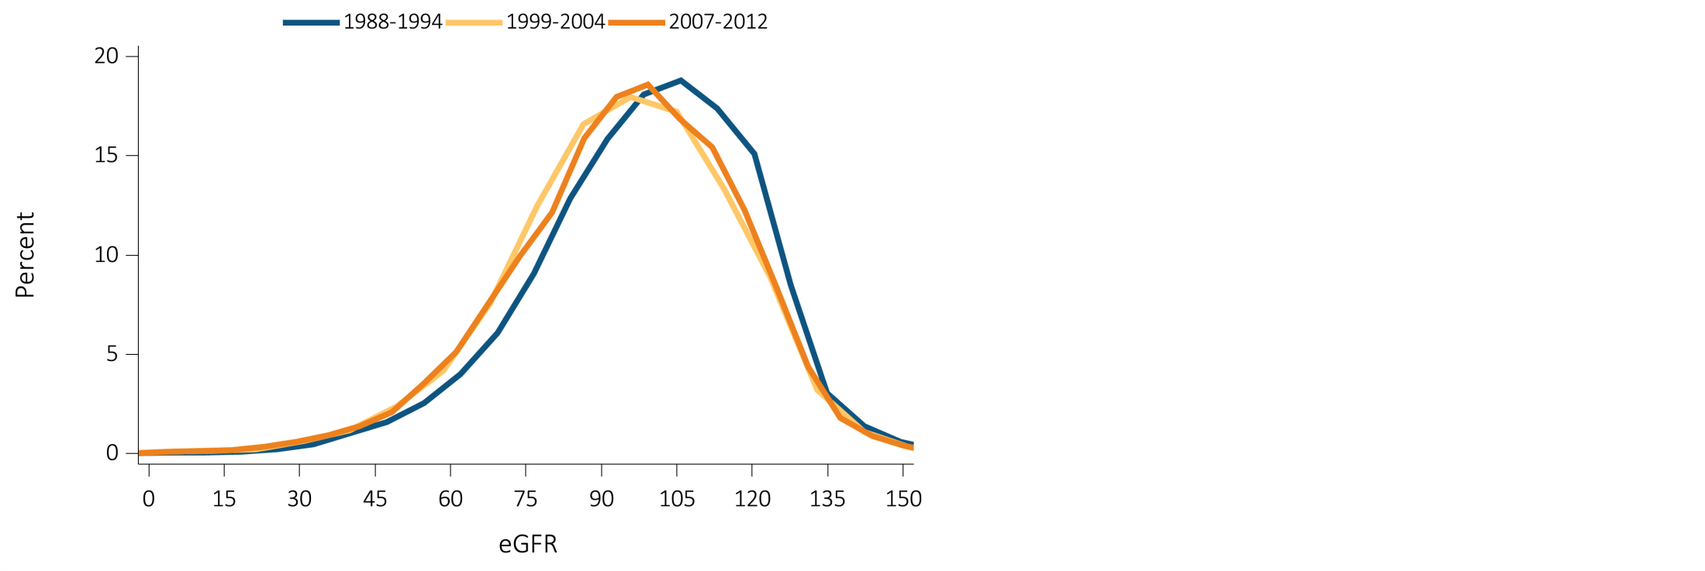
vol 1 Figure 1.2 eGFR distribution curves among NHANES participants, 1988-2012
Data Source: National Health and Nutrition Examination Survey (NHANES), 1988–1994, 1999-2004 & 2005–2012 participants age 20 & older. Single-sample estimates of eGFR & ACR; eGFR calculated using the CKD-EPI equation. Abbreviations: ACR, urine albumin/creatinine ratio; eGFR, estimated glomerular filtration rate.

Slide 5
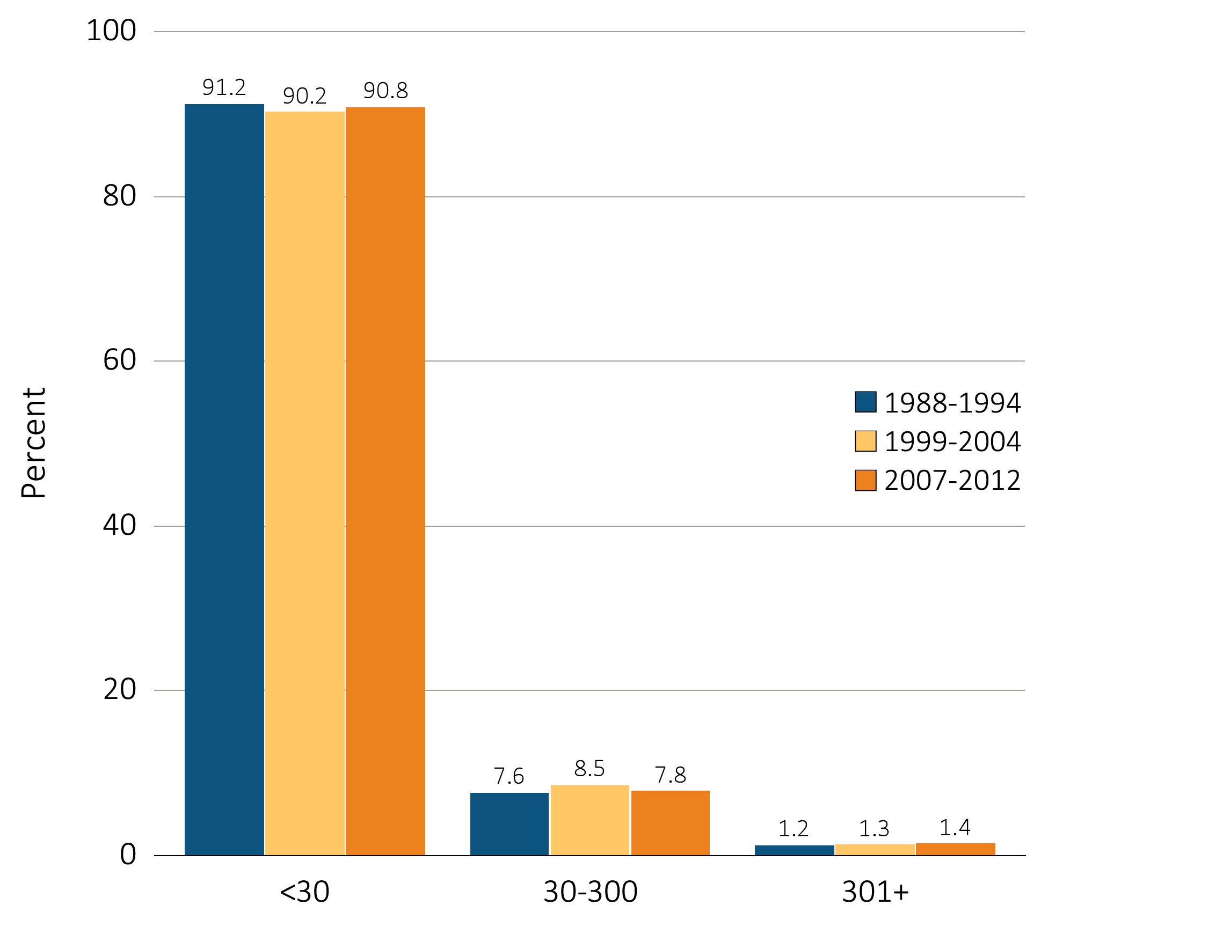
vol 1 Figure 1.3 Urine albumin/creatinine ratio distribution of NHANES participants, 1988-2012
Data Source: National Health and Nutrition Examination Survey (NHANES), 1988–1994, 1999-2004 & 2005–2012 participants age 20 & older. Single-sample estimates of eGFR & ACR; eGFR calculated using the CKD-EPI equation. Abbreviations: ACR, urine albumin/creatinine ratio; eGFR, estimated glomerular filtration rate.

Slide 6
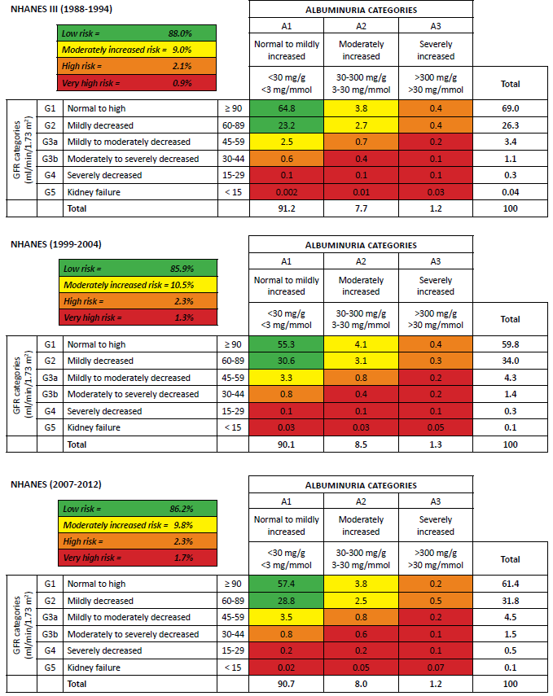
vol 1 Table 1.2 Percentage of NHANES participants within the KDIGO 2012 prognosis of CKD by GFR and albuminuria categories, 1998-2012
Data source: National Health and Nutrition Examination Survey (NHANES), 1988-1994, 1999-2004 & 2007-2012 participants age 20 and older. Single-sample estimates of eGFR and ACR; eGFR calculated using the CKD-EPI equation. Abbreviations: ACR, urine albumin/creatinine ratio; CKD, chronic kidney disease; eGFR, estimated glomerular filtration rate; GFR, glomerular filtration rate; KDIGO, Kidney Disease: Improving Global Outcomes CKD Work Group.

Slide 7
vol 1 Table 1.3 Prevalence (%) of CKD in NHANES population within age, sex, race/ethnicity, & risk-factor categories, 1998-2012
 | All CKD |  |  | eGFR <60 ml/min/1.73m² |  |  | ACR ≥30 mg/g
 | 1988-1994 | 1999-2004 | 2007-2012 | 1988-1994 | 1999-2004 | 2007-2012 | 1988-1994 | 1999-2004 | 2007-2012
20-39 | 5.1 | 5.9 | 5.7 | 0.1 | 0.3 | 0.2 | 5.0 | 5.8 | 5.5
40-59 | 8.4 | 9.8 | 8.9 | 1.3 | 2.0 | 2.3 | 7.5 | 8.4 | 7.2
60+ | 32.2 | 37.5 | 33.2 | 19.1 | 25.1 | 22.7 | 18.0 | 20.1 | 17.7
Male | 10.2 | 12.3 | 12.1 | 4.1 | 5.0 | 5.4 | 7.4 | 9.2 | 8.7
Female | 14.2 | 15.7 | 15.1 | 5.6 | 7.2 | 7.6 | 10.2 | 10.3 | 9.6
Non-Hispanic White | 12.3 | 14.0 | 13.9 | 5.5 | 7.0 | 7.6 | 8.2 | 8.9 | 8.4
Non-Hispanic Black/Af Am | 14.5 | 14.9 | 15.9 | 4.1 | 5.0 | 6.2 | 12.7 | 12.4 | 12.3
Other | 10.5 | 13.5 | 11.7 | 2.2 | 3.4 | 3.1 | 9.2 | 11.7 | 10.1
Diabetes | 43.1 | 42.0 | 39.2 | 15.6 | 17.0 | 19.6 | 36.3 | 33.3 | 28.6
Self-reported diabetes | 42.7 | 42.2 | 40.4 | 16.4 | 18.5 | 21.1 | 35.9 | 32.6 | 29.3
Hypertension | 33.3 | 32.7 | 31.0 | 15.3 | 17.1 | 17.1 | 23.4 | 21.3 | 19.8
Self-reported hypertension | 25.3 | 27.2 | 26.0 | 12.9 | 15.8 | 15.2 | 17.1 | 16.4 | 16.2
Self-reported cardiovascular disease | 25.4 | 40.0 | 39.5 | 14.5 | 27.3 | 26.8 | 16.6 | 23.0 | 23.8
Obesity (BMI 30+) | 16.6 | 16.8 | 16.6 | 6.2 | 6.4 | 7.3 | 12.3 | 12.6 | 11.5
All | 12.0 | 14.0 | 13.6 | 4.9 | 6.2 | 6.5 | 8.8 | 9.8 | 9.2
Data source: National Health and Nutrition Examination Survey (NHANES), 1988-1994, 1999-2004 & 2007-2012 participants age 20 & older. Single-sample estimates of eGFR & ACR; eGFR calculated using the CKD-EPI equation. Diabetes defined as HbA1c >7 percent, self-reported (SR), or currently taking glucose-lowering medications. Hypertension defined as BP ≥130/≥80 for those with diabetes or CKD, otherwise BP ≥140/≥90, or taking medication for hypertension. Values in Figure 1.12 cannot be directly compared to those in Table 1.3 due to different Survey cohorts. The table represents NHANES participants who are classified as hypertensive (measured/treated) but some of those are at target blood pressure. Abbreviations: ACR, urine albumin/creatinine ratio; BMI, body mass index; BP, blood pressure, CKD, chronic kidney disease; eGFR, estimated glomerular filtration rate.

Slide 8
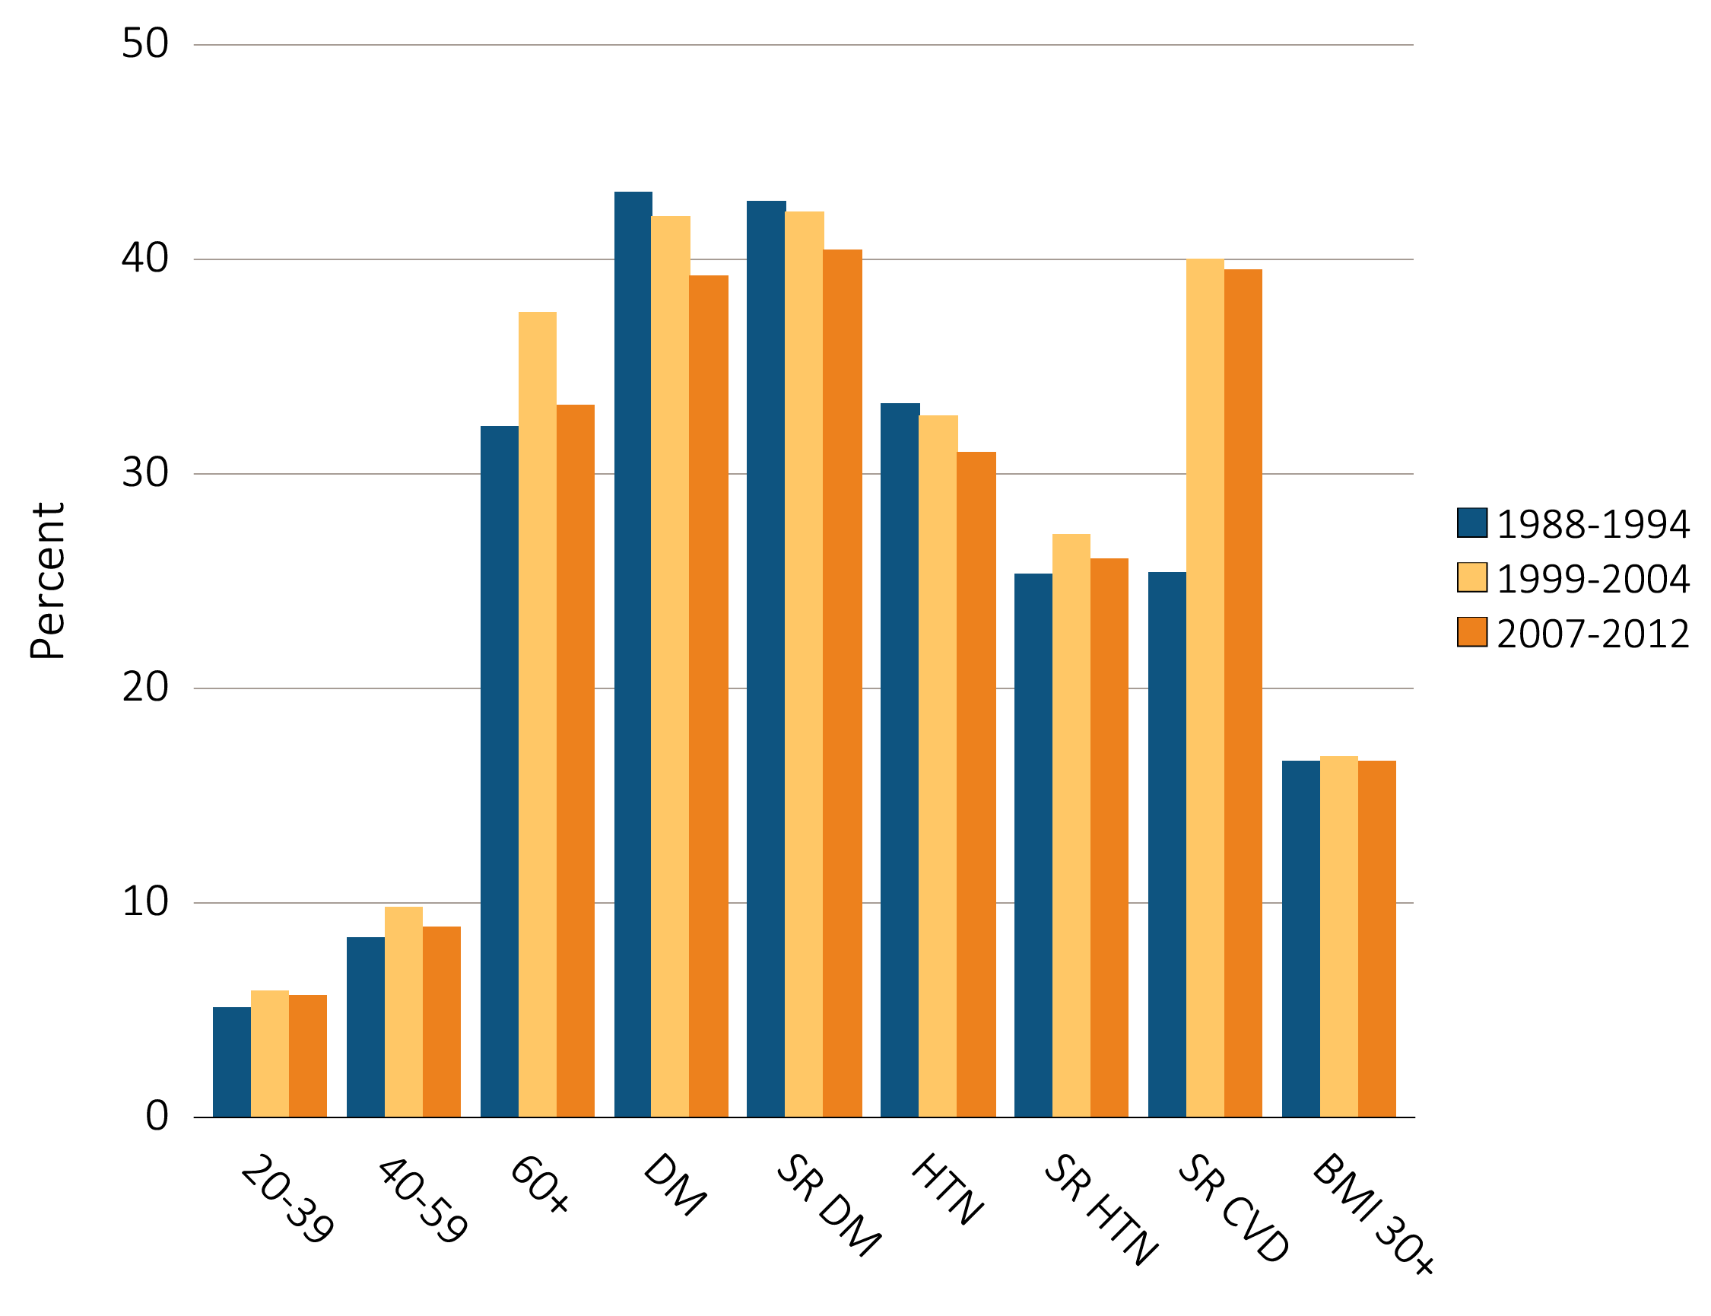
vol 1 Figure 1.4 NHANES participants with CKD, by age & risk factor, 1998-2012
Data Source: National Health and Nutrition Examination Survey (NHANES), 1988–1994, 1999-2004 & 2007–2012 participants age 20 & older. Single-sample estimates of eGFR & ACR; eGFR calculated using the CKD-EPI equation. Diabetes defined as HbA1c >7 percent, self-reported, or currently taking glucose-lowering medications. Hypertension defined as BP ≥130/≥80 for those with diabetes or CKD, otherwise BP ≥140/≥90, or taking medication for hypertension. Abbreviations: ACR, urine albumin/creatinine ratio; BMI, body mass index; CKD, chronic kidney disease; CVD, cardiovascular disease; DM, diabetes mellitus; eGFR, estimated glomerular filtration rate; HTN, hypertension; SR, self-reported.

Slide 9
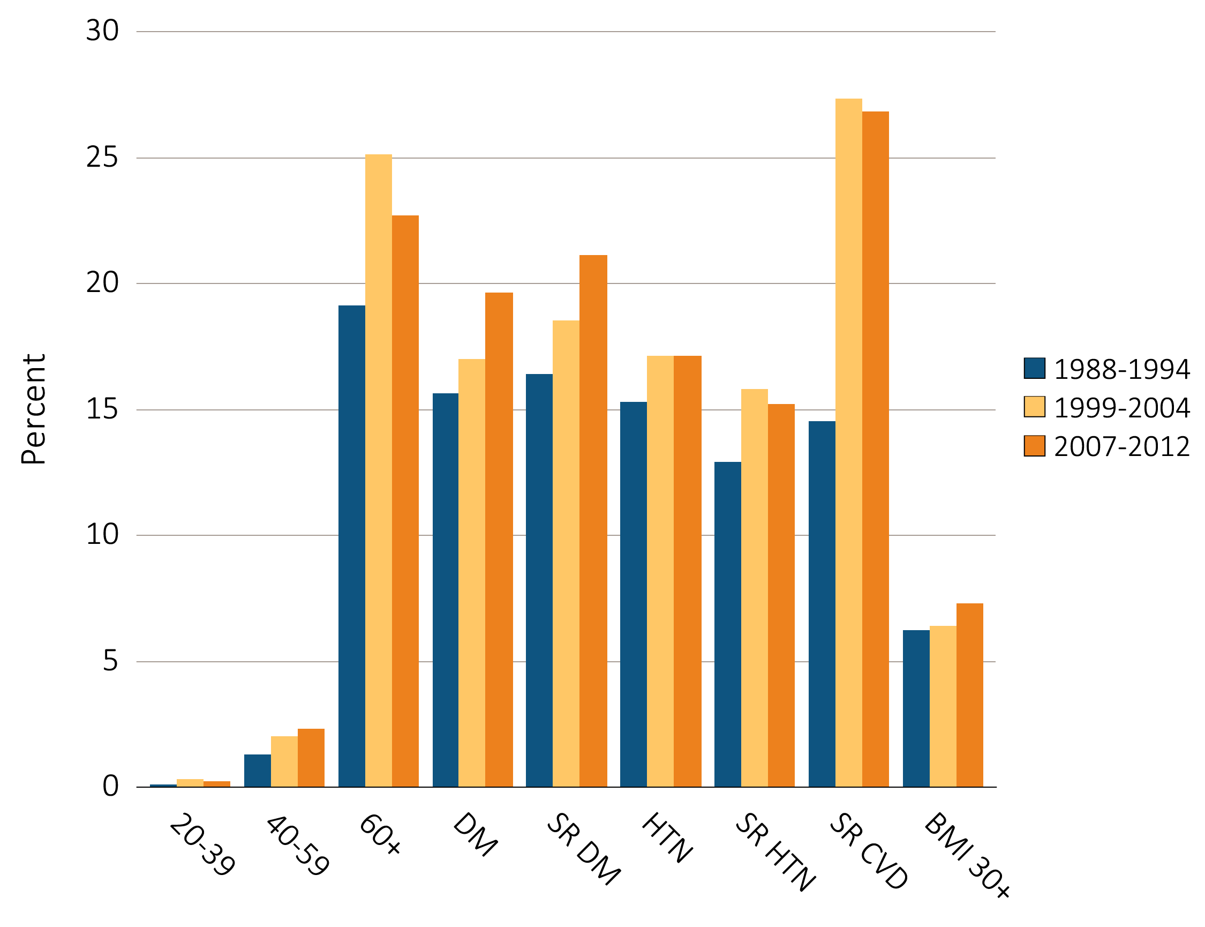
vol 1 Figure 1.5 NHANES participants with eGFR <60 ml/min/1.73 m², by age & risk factor, 1998-2012
Data Source: National Health and Nutrition Examination Survey (NHANES), 1988–1994, 1999-2004 & 2007–2012 participants age 20 & older. Single-sample estimates of eGFR & ACR; eGFR calculated using the CKD-EPI equation. Diabetes defined as HbA1c >7 percent, self-reported (SR), or currently taking glucose-lowering medications. Hypertension defined as BP ≥130/≥80 for those with diabetes or CKD, otherwise BP ≥140/≥90, or taking medication for hypertension. Abbreviations: ACR, urine albumin/creatinine ratio; BMI, body mass index; CVD, cardiovascular disease; DM, diabetes mellitus; eGFR, estimated glomerular filtration rate; HTN, hypertension; SR, self-reported.

Slide 10
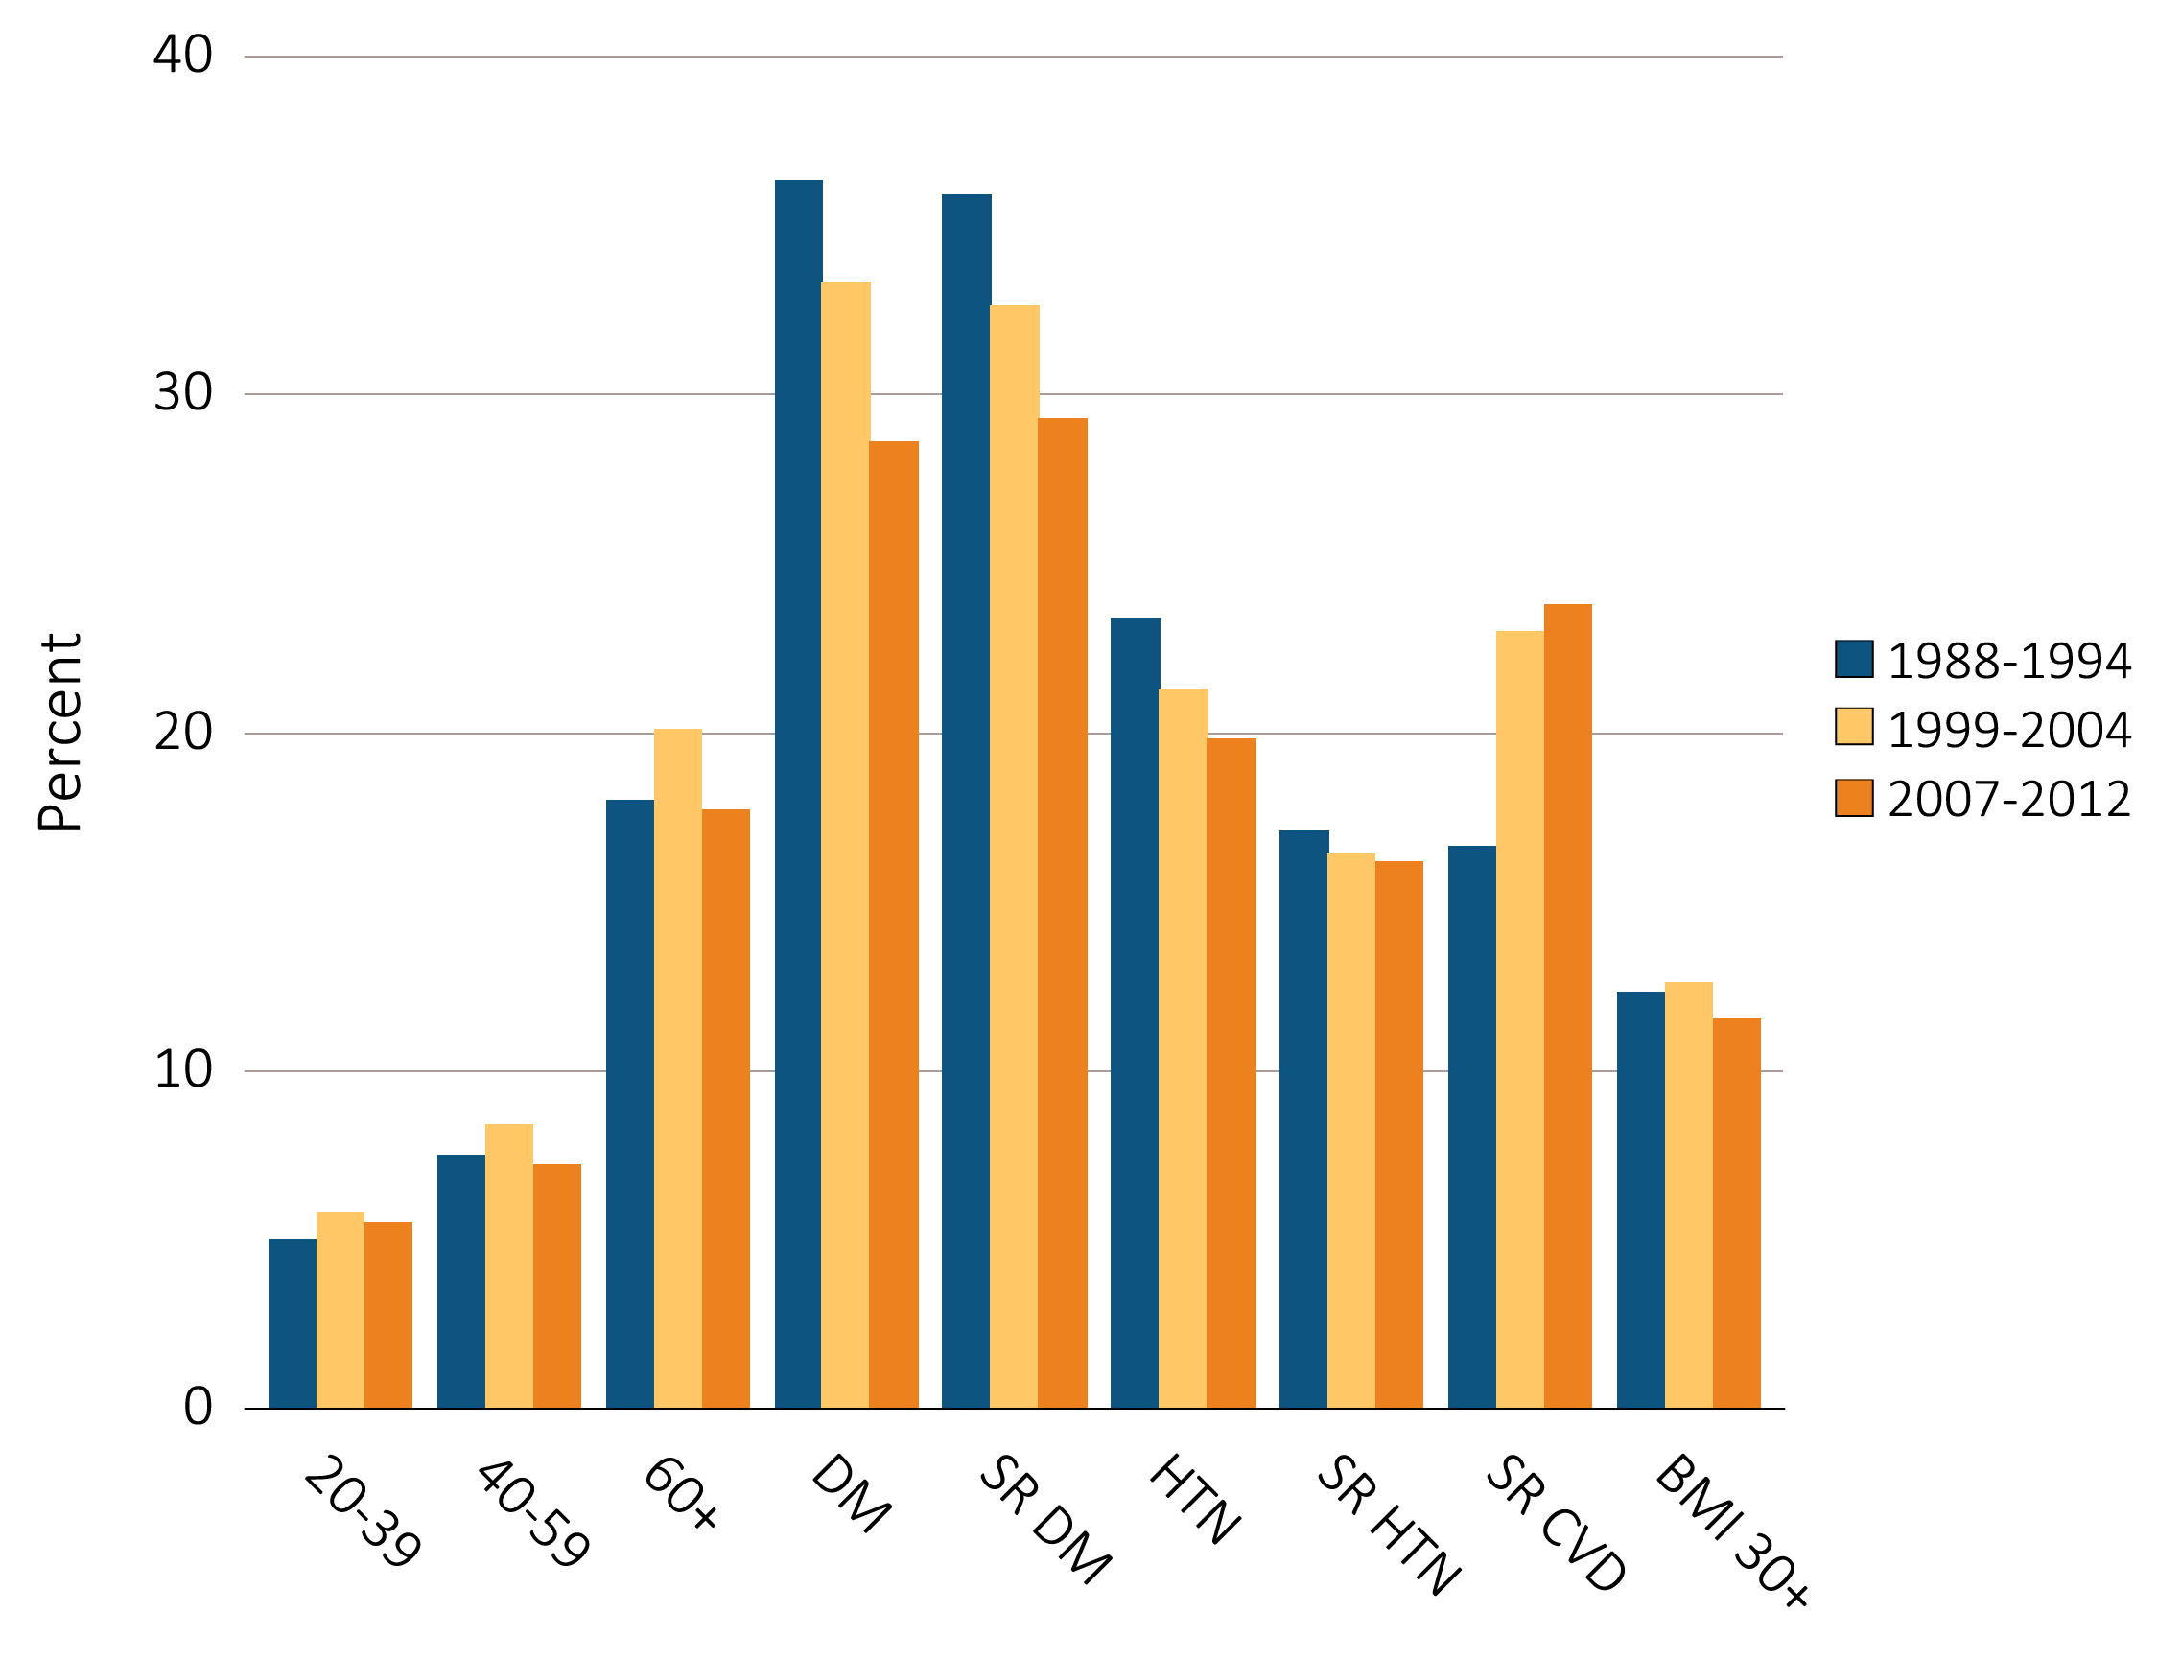
vol 1 Figure 1.6 NHANES participants with urine albumin/creatinine ratio ≥30 mg/g, by age & risk factor, 1998-2012
Data Source: National Health and Nutrition Examination Survey (NHANES), 1988–1994, 1999-2004 & 2007–2012 participants age 20 & older. Single-sample estimates of eGFR & ACR; eGFR calculated using the CKD-EPI equation. Diabetes defined as HbA1c >7 percent, self-reported (SR), or currently taking glucose-lowering medications. Hypertension defined as BP ≥130/≥80 for those with diabetes or CKD, otherwise BP ≥140/≥90, or taking medication for hypertension. Abbreviations: ACR, urine albumin/creatinine ratio; BMI, body mass index; CVD, cardiovascular disease; DM, diabetes mellitus; eGFR, estimated glomerular filtration rate; HTN, hypertension; SR, self-reported.

Slide 11
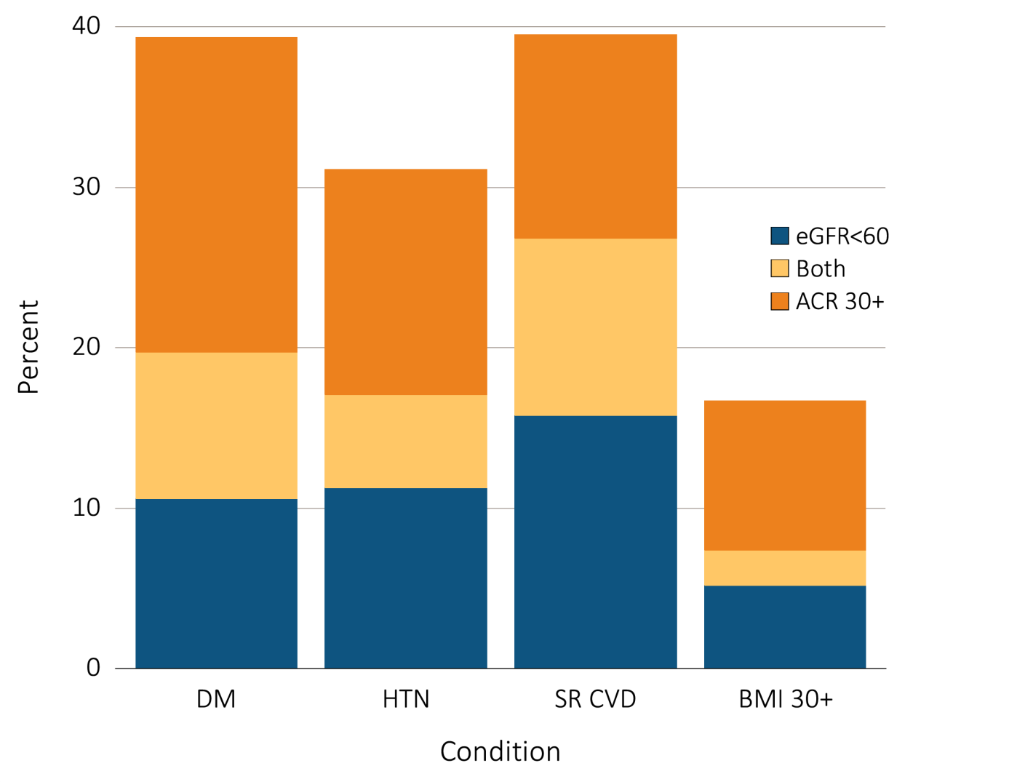
vol 1 Figure 1.7 Distribution of markers of CKD in NHANES participants with diabetes, hypertension, self-reported cardiovascular disease, & obesity, 2007–2012
Data Source: National Health and Nutrition Examination Survey (NHANES), 2007–2012 participants age 20 & older. Single-sample estimates of eGFR & ACR; eGFR calculated using the CKD-EPI equation. Abbreviations: ACR, urine albumin/creatinine ratio; BMI, body mass index; CKD, chronic kidney disease; SR CVD, self-reported cardiovascular disease; eGFR, estimated glomerular filtration rate; HTN, hypertension.

Slide 12
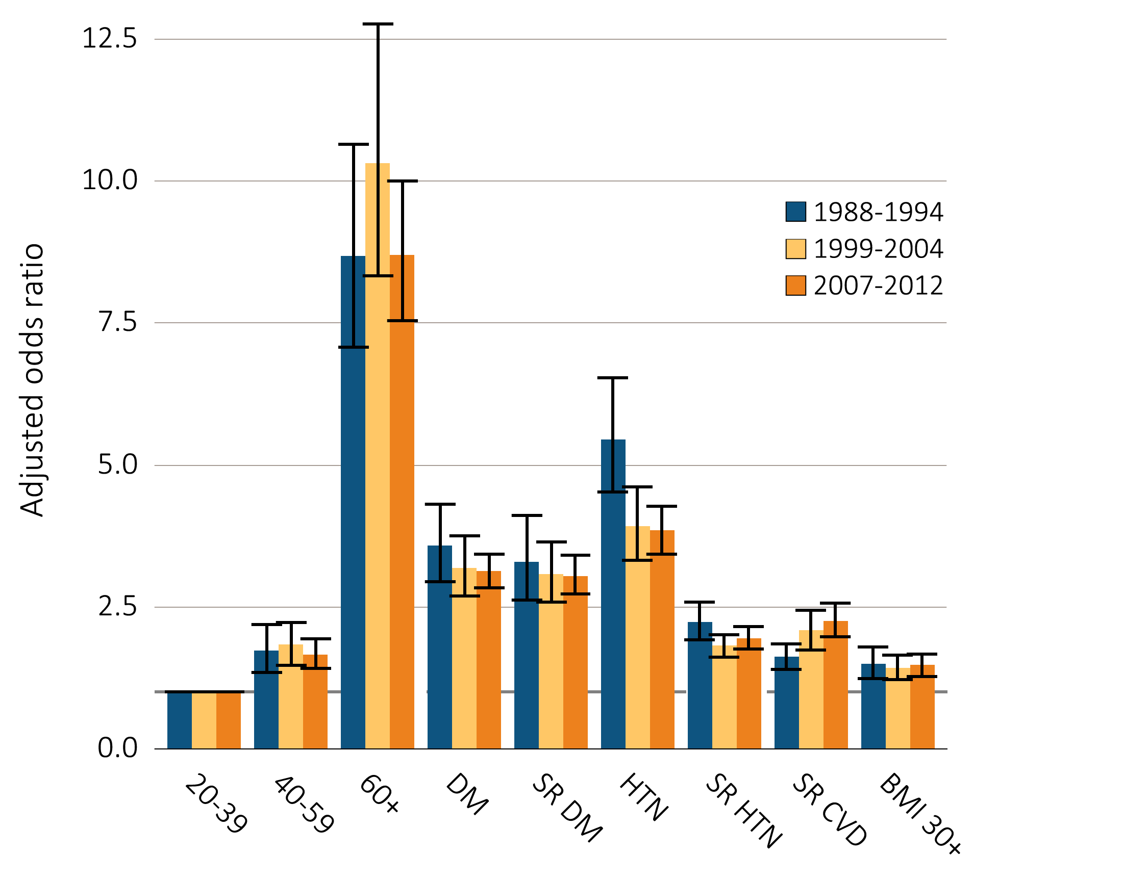
vol 1 Figure 1.8 Adjusted odds ratios of CKD in NHANES participants by risk factor, 1998-2012
Data Source: National Health and Nutrition Examination Survey (NHANES), 1988–1994, 1999-2004 & 2007–2012 participants age 20 & older; single-sample estimates of eGFR & ACR. Adj: age, sex, & race; eGFR calculated using the CKD-EPI equation. Whisker lines indicate 95% confidence intervals. Abbreviations: ACR, urine albumin/creatinine ratio; BMI, body mass index; CKD, chronic kidney disease; CVD, cardiovascular disease; DM, diabetes mellitus; eGFR, estimated glomerular filtration rate; HTN, hypertension; SR, self-report.

Slide 13
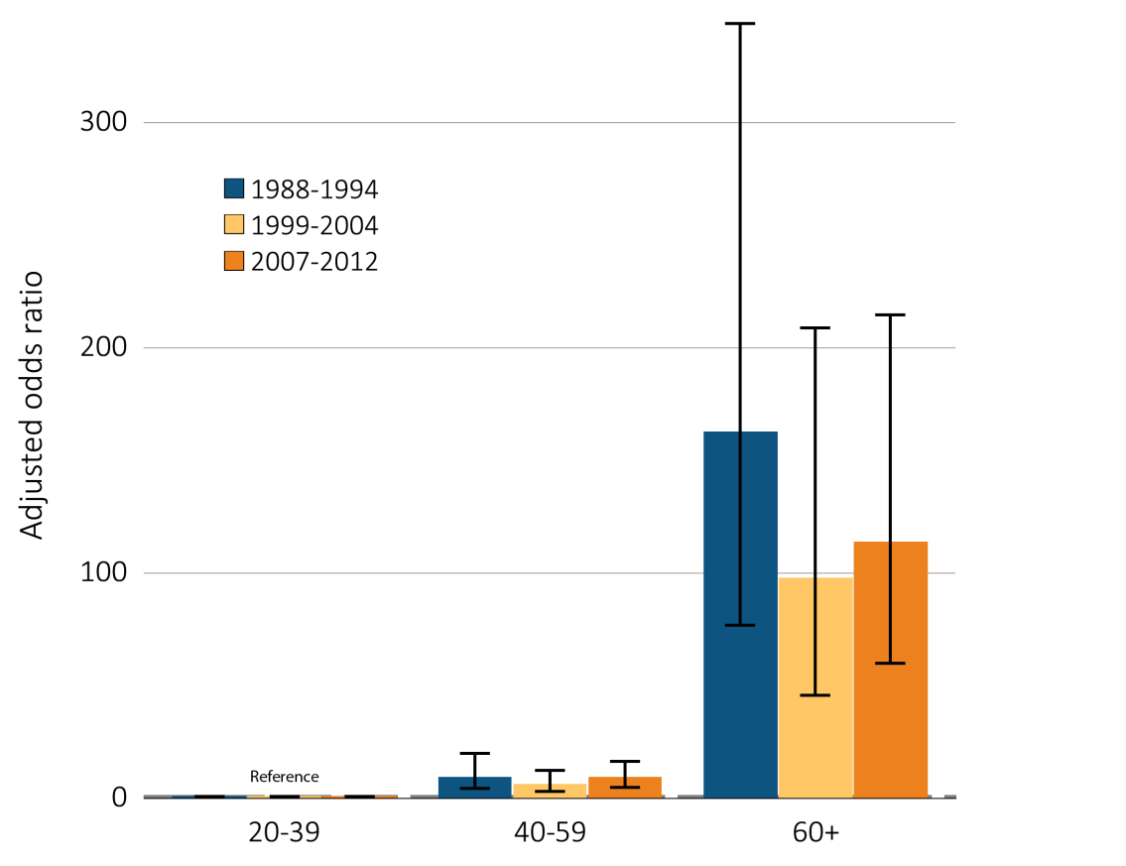
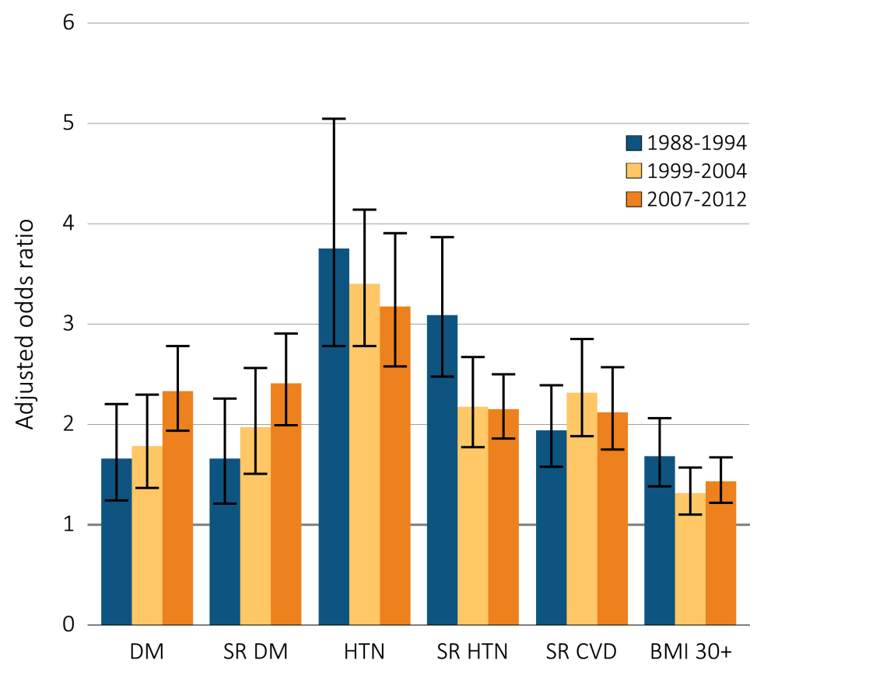
vol 1 Figure 1.9 Adjusted odds ratios of eGFR <60 ml/min/1.73m² in NHANES participants by age & risk factor, 1998-2012
(a) Age category
(b) CKD risk factor
Data Source: National Health and Nutrition Examination Survey (NHANES), 1988–1994, 1999-2004 & 2007–2012 participants age 20 & older; single-sample estimates of eGFR & ACR. Adj: age, sex, & race; eGFR calculated using the CKD-EPI equation. Whisker lines indicate 95% confidence intervals. Abbreviations: ACR, urine albumin/creatinine ratio; BMI, body mass index; CKD, chronic kidney disease; CVD, cardiovascular disease; DM, diabetes mellitus; eGFR, estimated glomerular filtration rate; HTN, hypertension; SR, self-report.

Slide 14
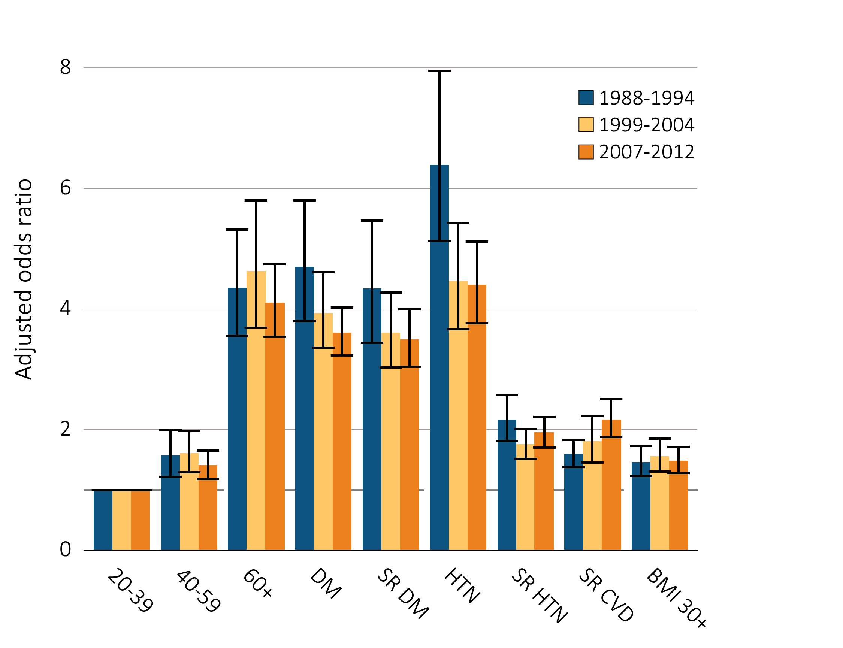
vol 1 Figure 1.10 Adjusted odds ratios of urine albumin/creatinine ratio ≥30 mg/g in NHANES participants by age & risk factor, 1998-2012
Data Source: National Health and Nutrition Examination Survey (NHANES), 1988–1994, 1999-2004 & 2007–2012 participants age 20 & older; single-sample estimates of eGFR & ACR. Adjusted: age, sex, & race; eGFR calculated using the CKD-EPI equation. Whisker lines indicate 95% confidence intervals. Abbreviations: ACR, urine albumin/creatinine ratio; BMI, body mass index; CKD, chronic kidney disease; CVD, cardiovascular disease; DM, diabetes mellitus; eGFR, estimated glomerular filtration rate; HTN, hypertension; SR, self-report.

Slide 15
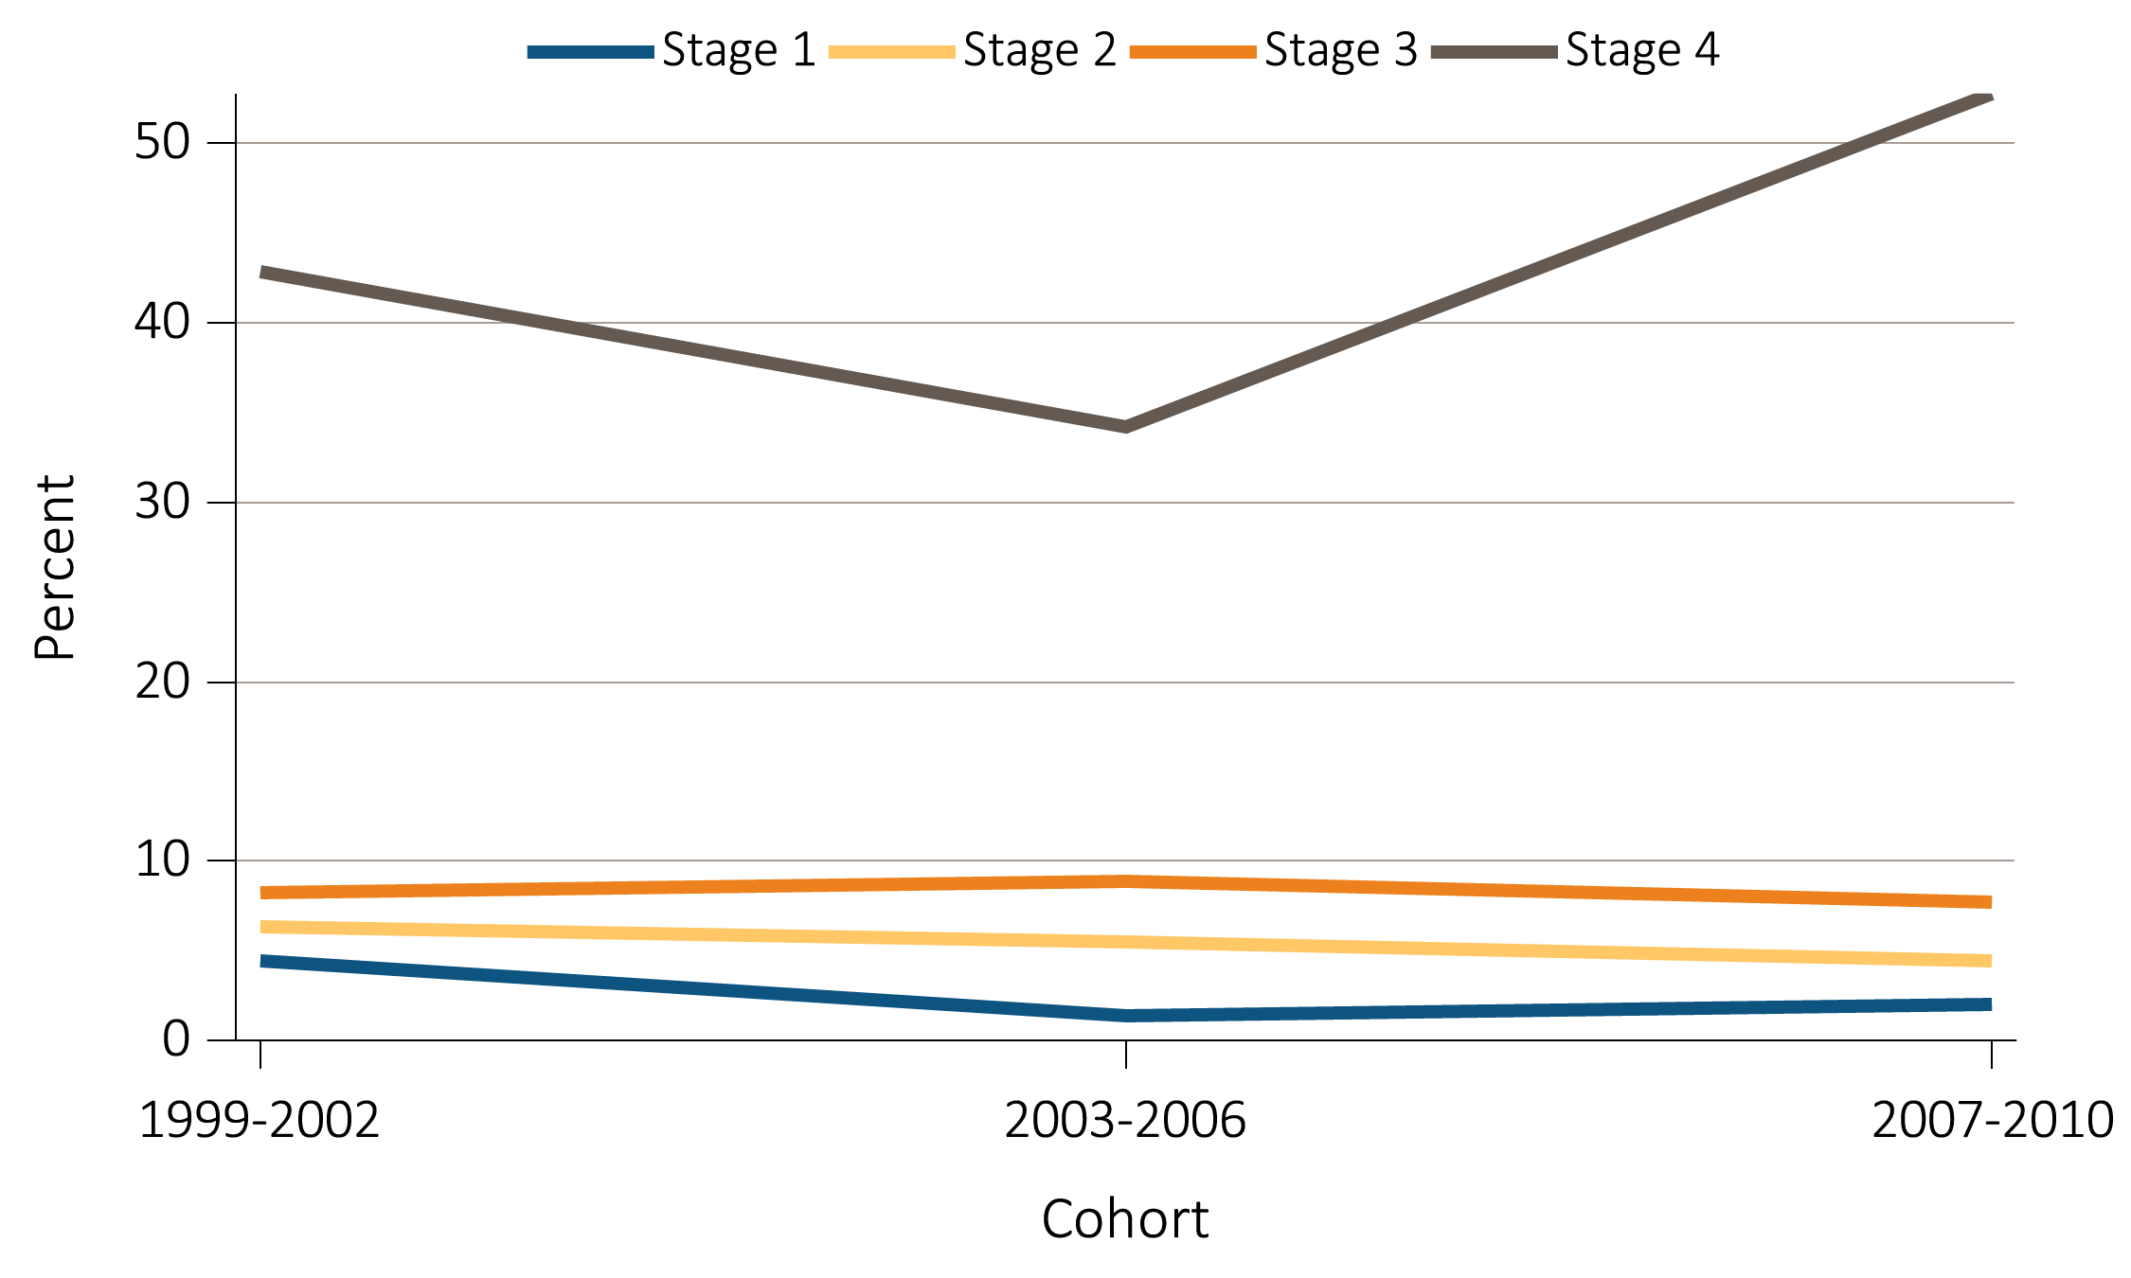
vol 1 Figure 1.11 NHANES participants with CKD aware of their kidney disease, 1999-2010
Data Source: National Health and Nutrition Examination Survey (NHANES), 1988–1994, 1999-2004 & 2007–2012 participants age 20 & older. Abbreviations: CKD, chronic kidney disease.

Slide 16
vol 1 Table 1.4 Awareness, treatment, & measures of control of risk factors (% of NHANES participants), 1998-2012
 |  | All CKD |  |  | eGFR <60 ml/min/1.73m² |  |  | ACR ≥30
 |  | 1988-1994 | 1999-2004 | 2007-2012 | 1988-1994 | 1999-2004 | 2007-2012 | 1988-1994 | 1999-2004 | 2007-2012
Hypertension, by current hypertensive statusª
Non-hypertensive status | 30.7 |  | 26.5 | 26.0 | 18.4 | 14.3 | 15.9 | 32.0 | 30.4 | 29.1
Hypertensive (measured/treated) | 69.3 |  | 73.5 | 74.0 | 81.6 | 85.7 | 84.1 | 68.0 | 69.6 | 70.9
Control of hypertension among hypertensive patients^{b}
Unaware |  | 33.4 | 50.6 | 22.5 | 22.8 | 44.2 | 16.4 | 36.0 | 54.7 | 25.1
Aware, not treated |  | 14.7 | 6.3 | 6.5 | 12.1 | 4.2 | 2.8 | 15.7 | 7.1 | 8.7
Aware, treated, uncontrolled |  | 39.2 | 31.5 | 43.9 | 47.8 | 36.4 | 46.6 | 38.4 | 30.2 | 44.8
Aware, treated, controlled |  | 12.7 | 11.5 | 27.2 | 17.3 | 15.2 | 34.2 | 9.9 | 8.0 | 21.4
Total cholesterol^{c}
<200 (desirable) |  | 35.1 | 46.6 | 58.7 | 27.2 | 45.6 | 62.1 | 38.2 | 47.5 | 58.2
200–239 (borderline high) |  | 33.5 | 32.6 | 26.4 | 32.7 | 33.7 | 23.5 | 32.8 | 31.9 | 27.3
240+ (high) |  | 31.4 | 20.8 | 14.9 | 40.0 | 20.7 | 13.4 | 29.0 | 20.6 | 14.5
Uric Acid
Normal |  | 69.6 | 69.2 | 69.2 | 54.4 | 55.2 | 55.1 | 73.9 | 74.0 | 75.4
High |  | 30.4 | 30.8 | 30.8 | 45.6 | 44.8 | 44.9 | 26.1 | 26.0 | 24.6
Smoking
Current |  | 22.2 | 16.9 | 14.6 | 11.9 | 7.8 | 8.2 | 27.0 | 21.3 | 17.6
Former |  | 35.2 | 32.3 | 32.6 | 43.2 | 39.4 | 40.1 | 31.5 | 29.1 | 29.7
Never |  | 42.6 | 50.7 | 52.8 | 44.9 | 52.8 | 51.6 | 41.5 | 49.6 | 52.6
Control of diabetes among patients with diabetes^{d}
Glycohemoglobin <7% (controlled) |  | 31.5 | 39.2 | 45.3 | 37.1 | 50.9 | 55.0 | 29.6 | 33.6 | 37.9
Glycohemoglobin 7% or higher (uncontrolled) |  | 68.5 | 60.8 | 55.7 | 62.9 | 49.1 | 45.0 | 70.4 | 66.4 | 62.1
Data Source: National Health and Nutrition Examination Survey (NHANES), 1988–1994, 1999-2004 & 2007–2012 participants age 20 & older. Single-sample estimates of eGFR & ACR; eGFR calculated using the CKD-EPI equation. Abbreviations: ACR, urine albumin/creatinine ratio; CKD, chronic kidney disease; eGFR, estimated glomerular filtration rate. ª. Hypertension defined as blood pressure ≥130/≥80 for those with CKD and diabetes; otherwise ≥140/≥90, or self- reported treatment for hypertension. ^{b}. Awareness and treatment are self-reported. Control defined as <130/<80 for those with CKD and diabetes; otherwise <140/<90. ^{c}. Total cholesterol classified according to Adult Treatment Panel III blood cholesterol guidelines (ATP III). ^{d}. Glycohemoglobin classified according to American Diabetes Association guidelines.

Slide 17
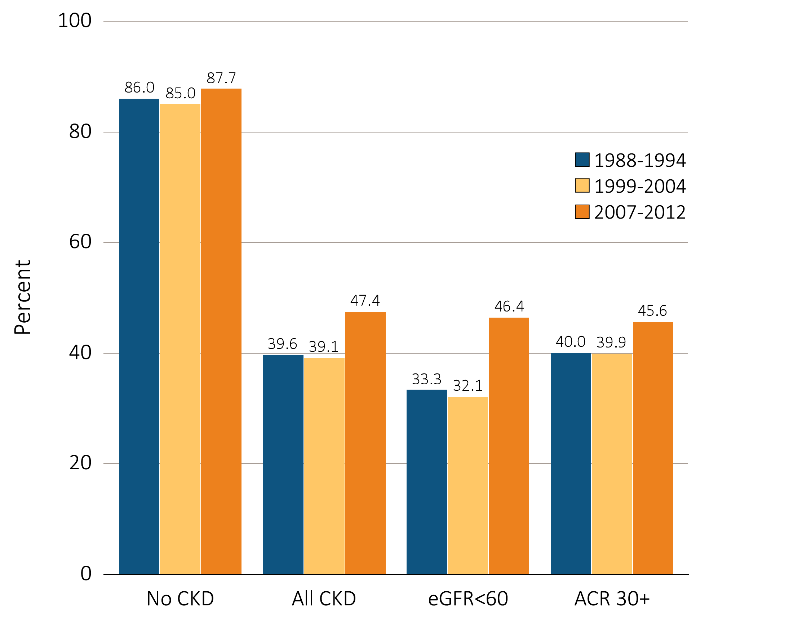
vol 1 Figure 1.12 NHANES participants at target blood pressure, 1998-2012
Data Source: National Health and Nutrition Examination Survey (NHANES), 1988–1994, 1999-2004 & 2007–2012 participants age 20 & older. Single-sample estimates of eGFR & ACR; eGFR calculated using the CKD-EPI equation. Figure represents all hypertensives plus those hypertensive participants that are at target blood pressure, probably due to medication. Abbreviations: ACR, urine albumin/creatinine ratio; CKD, chronic kidney disease; eGFR, estimated glomerular filtration rate.

Slide 18
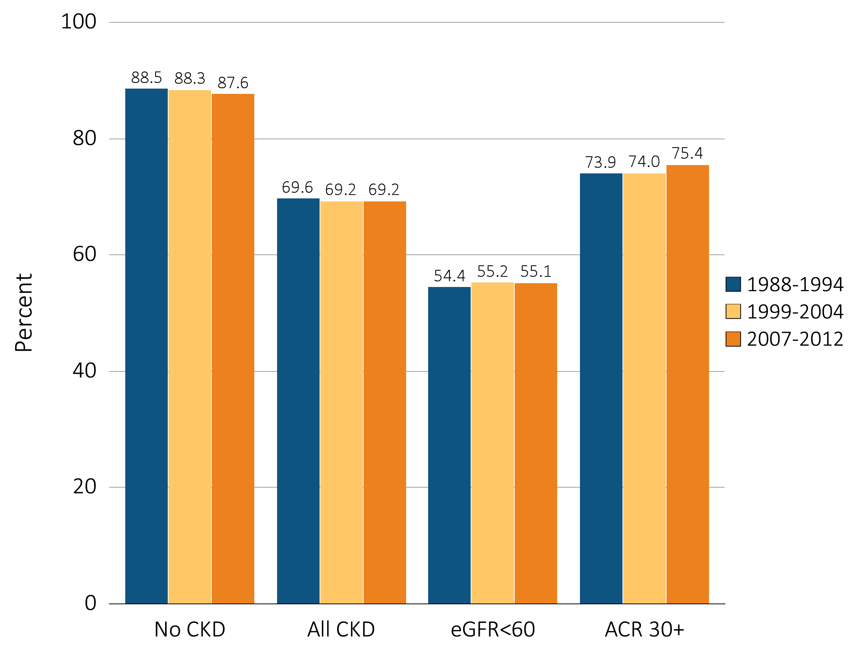
vol 1 Figure 1.13 NHANES participants within uric acid normal range, 1998-2012
Data Source: National Health and Nutrition Examination Survey (NHANES), 1988–1994, 1999-2004 & 2007–2012 participants age 20 & older. Single-sample estimates of eGFR & ACR; eGFR calculated using the CKD-EPI equation. Figure represents all hypertensives plus those hypertensive participants that are at target blood pressure, probably due to medication. Abbreviations: ACR, urine albumin/creatinine ratio; CKD, chronic kidney disease; eGFR, estimated glomerular filtration rate.

Slide 19
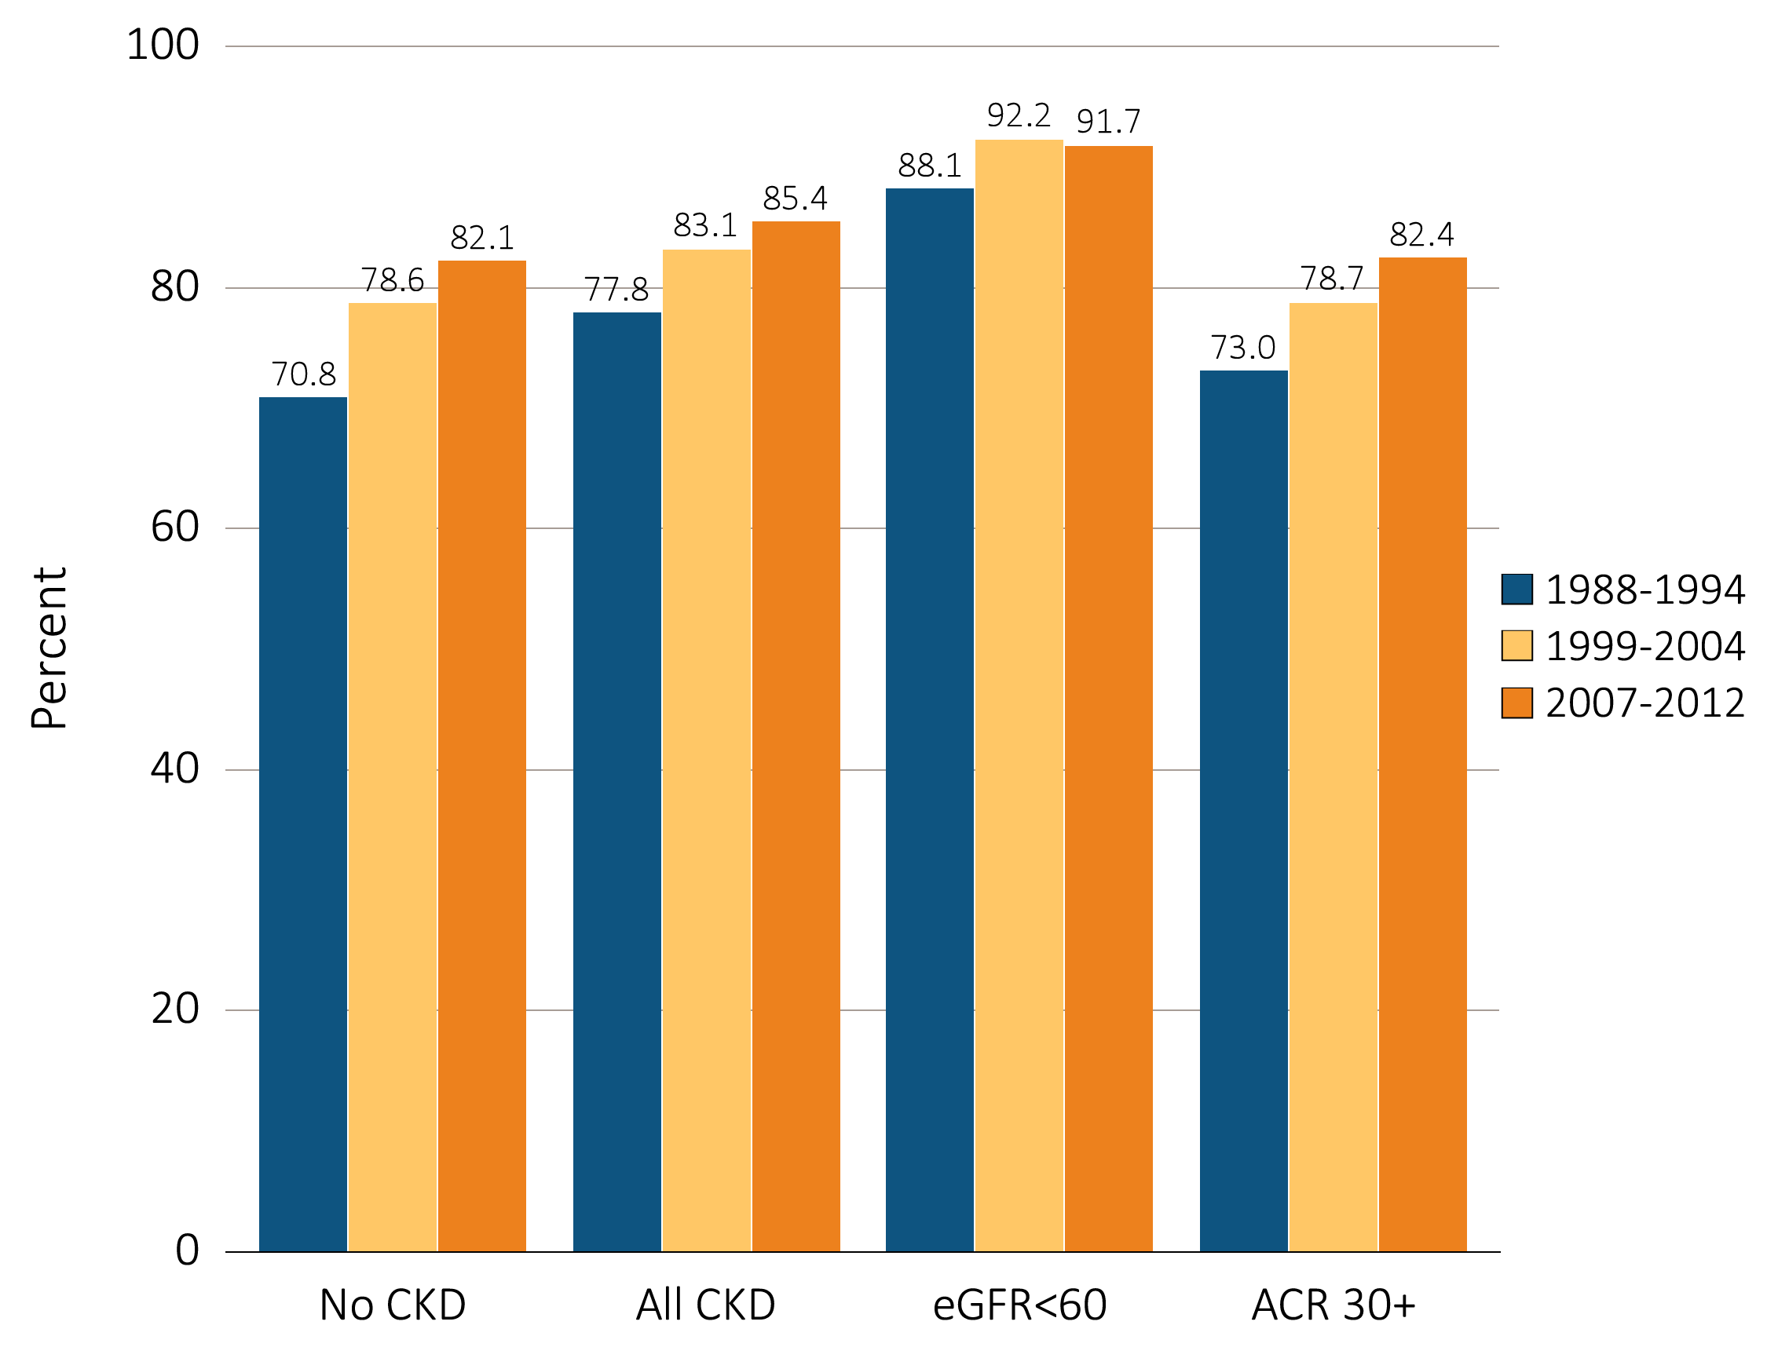
vol 1 Figure 1.14 NHANES participants not currently smoking, 1998-2012
Data Source: National Health and Nutrition Examination Survey (NHANES), 1988–1994, 1999-2004 & 2007–2012 participants age 20 & older. Single-sample estimates of eGFR & ACR; eGFR calculated using the CKD-EPI equation. Figure represents all hypertensives plus those hypertensive participants that are at target blood pressure, probably due to medication. Abbreviations: ACR, urine albumin/creatinine ratio; CKD, chronic kidney disease; eGFR, estimated glomerular filtration rate.

Slide 20
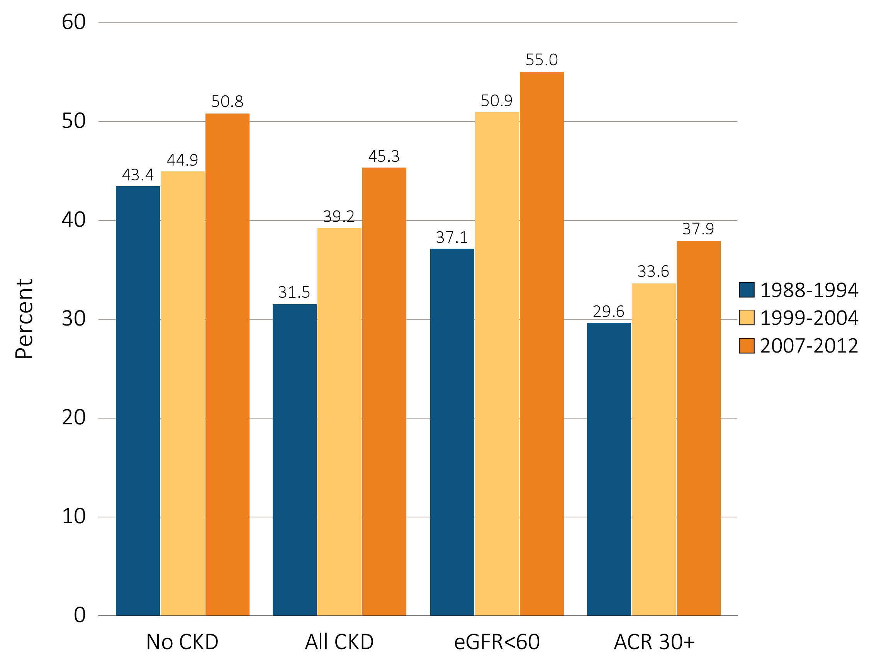
vol 1 Figure 1.15 Diabetic NHANES participants with glycohemoglobin <7%, 1998-2012
Data Source: National Health and Nutrition Examination Survey (NHANES), 1988–1994, 1999-2004 & 2007–2012 participants age 20 & older. Single-sample estimates of eGFR & ACR; eGFR calculated using the CKD-EPI equation. Figure represents all hypertensives plus those hypertensive participants that are at target blood pressure, probably due to medication. Abbreviations: ACR, urine albumin/creatinine ratio; CKD, chronic kidney disease; eGFR, estimated glomerular filtration rate.

