Slide 2
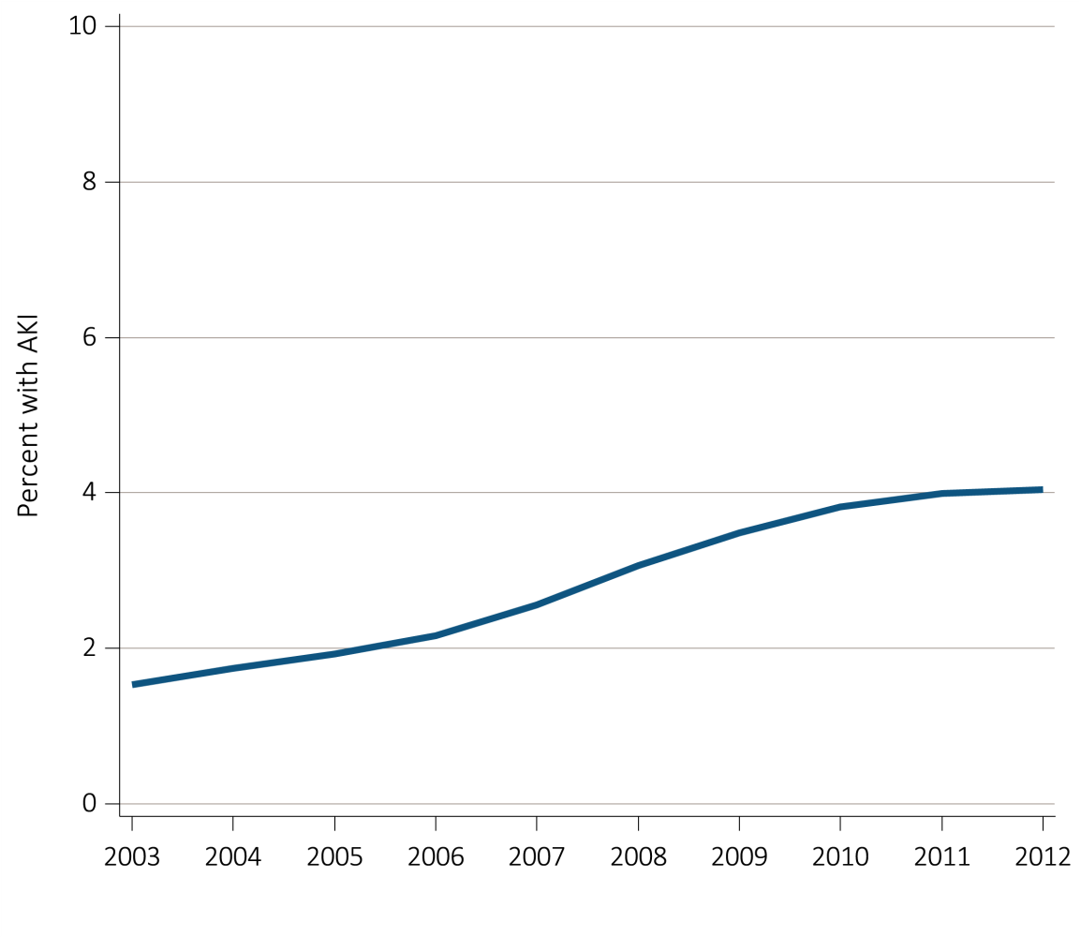
vol 1 Figure 1.1 Percent of Medicare patients aged 66+, (a) with at least one AKI hospitalization, and (b) with an AKI hospitalization that had dialysis by year, 2003-2012
(a)
Data Source: Medicare 5 percent sample. 5.1a: Percent with an AKI hospitalization among all Medicare patients aged 66 and older who had both Medicare Parts A & B, no Medicare Advantage plan (Part C/HMO), no ESRD by first service date from Medical Evidence form, and were alive on January 1 of year shown. 5.1b: Percent of patients receiving dialysis during their first AKI hospitalization among patients with a first AKI hospitalization. Dialysis is identified by a diagnosis or charge for dialysis on the AKI hospitalization inpatient claim or a physician/supplier (Part B) claim for dialysis during the time period of the AKI inpatient claim. Abbreviation: AKI, acute kidney injury.

Slide 3
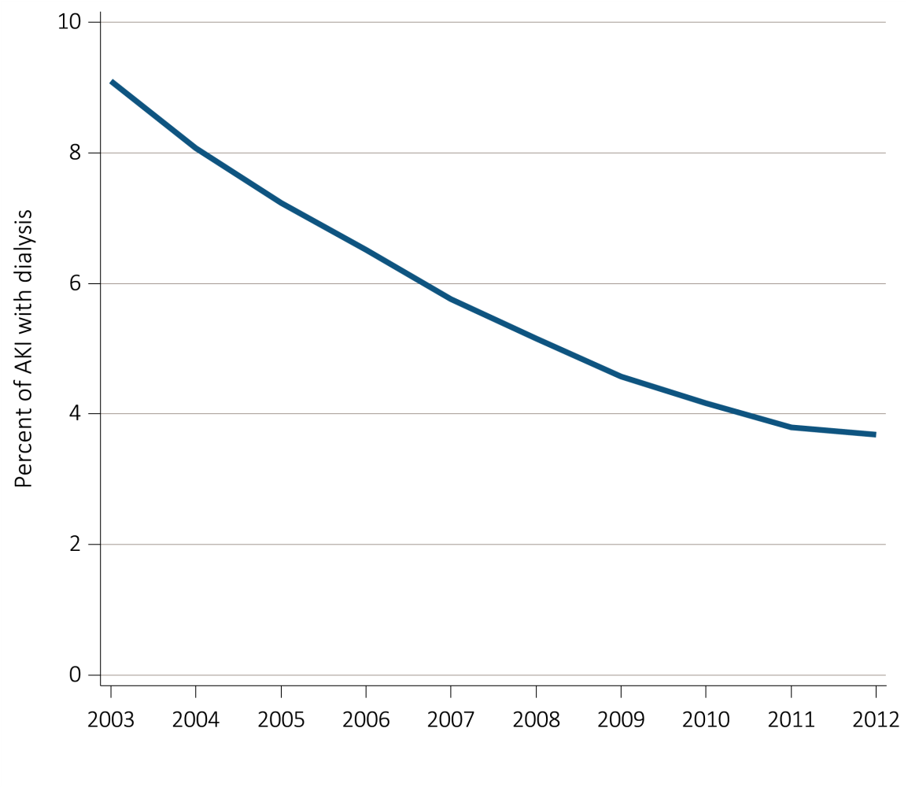
vol 1 Figure 1.1 Percent of Medicare patients aged 66+, (a) with at least one AKI hospitalization, and (b) with an AKI hospitalization that had dialysis by year, 2003-2012
(b)
Data Source: Medicare 5 percent sample. 5.1a: Percent with an AKI hospitalization among all Medicare patients aged 66 and older who had both Medicare Parts A & B, no Medicare Advantage plan (Part C/HMO), no ESRD by first service date from Medical Evidence form, and were alive on January 1 of year shown. 5.1b: Percent of patients receiving dialysis during their first AKI hospitalization among patients with a first AKI hospitalization. Dialysis is identified by a diagnosis or charge for dialysis on the AKI hospitalization inpatient claim or a physician/supplier (Part B) claim for dialysis during the time period of the AKI inpatient claim. Abbreviation: AKI, acute kidney injury.

Slide 4
vol 1 Table 5.1 Characteristics of Medicare patients aged 66+ with at least one AKI hospitalization: age, sex, race, CKD, DM by year, 2003-2012
 | 2003 | 2004 | 2005 | 2006 | 2007 | 2008 | 2009 | 2010 | 2011 | 2012
Age
66-69 | 10.6 | 10.5 | 10.3 | 10.6 | 10.6 | 10.3 | 10.9 | 10.8 | 11.3 | 11.3
70-74 | 16.5 | 16.3 | 16.0 | 15.3 | 15.4 | 15.5 | 15.4 | 15.6 | 15.6 | 15.8
75-79 | 21.8 | 21.3 | 21.0 | 20.2 | 19.4 | 18.5 | 18.6 | 18.0 | 17.7 | 18.0
80-84 | 22.5 | 22.9 | 22.9 | 22.3 | 22.4 | 22.4 | 21.5 | 21.3 | 20.7 | 19.9
85+ | 28.6 | 29.0 | 29.9 | 31.6 | 32.1 | 33.4 | 33.7 | 34.3 | 34.7 | 34.9
Sex
Female | 47.9 | 48.0 | 47.7 | 48.1 | 47.8 | 47.8 | 47.8 | 47.5 | 47.7 | 48.2
Male | 52.1 | 52.0 | 52.3 | 51.9 | 52.2 | 52.2 | 52.2 | 52.5 | 52.3 | 51.9
Race
White | 82.9 | 82.6 | 81.7 | 82.0 | 82.8 | 83.2 | 83.2 | 83.1 | 83.1 | 82.7
Black/African American | 12.7 | 13.0 | 13.7 | 13.5 | 12.5 | 12.0 | 12.0 | 12.1 | 12.0 | 12.2
Native Am | 0.4 | 0.3 | 0.4 | 0.4 | 0.4 | 0.4 | 0.4 | 0.5 | 0.5 | 0.5
Asian | 1.0 | 1.3 | 1.2 | 1.2 | 1.2 | 1.4 | 1.4 | 1.4 | 1.5 | 1.5
Other | 3.0 | 2.9 | 3.1 | 2.9 | 3.0 | 3.0 | 3.0 | 3.0 | 2.9 | 3.1
Pre-existing comorbidities
No DM or CKD prior year | 55.0 | 53.3 | 52.2 | 51.2 | 49.4 | 48.2 | 47.2 | 46.0 | 44.5 | 43.4
DM no CKD prior year | 24.6 | 25.2 | 25.1 | 25.1 | 23.1 | 23.0 | 22.5 | 22.5 | 22.0 | 21.1
CKD no DM prior year | 8.8 | 9.5 | 9.5 | 10.0 | 12.1 | 12.8 | 13.5 | 13.9 | 14.8 | 15.3
Both CKD & DM prior year | 11.7 | 12.0 | 13.2 | 13.7 | 15.4 | 16.0 | 16.8 | 17.7 | 18.7 | 20.2
Data Source: Medicare 5 percent sample. Medicare patients aged 66 and older who had both Medicare Parts A & B, no Medicare Advantage plan (Part C/HMO), no ESRD by first service date from Medical Evidence form, and were alive on January 1 of year shown. Abbreviations: AKI, acute kidney injury; CKD, chronic kidney disease; DM, diabetes mellitus.

Slide 5
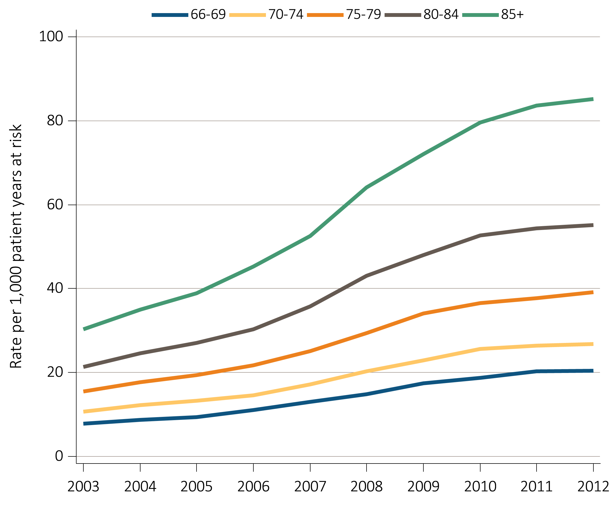
vol 1 Figure 5.2 Unadjusted rates of first hospitalization with AKI for Medicare patients aged 66+ by age and year, 2003-2012
Data Source: Medicare 5 percent sample. Age as of January 1 of specified year. All patient-years at risk for Medicare patients aged 66 and older who had both Medicare Parts A & B, no Medicare Advantage plan (Part C/HMO), no ESRD by first service date from Medical Evidence form, and were alive on January 1 of year shown. Censored at death, ESRD, end of Medicare Parts A & B participation, or switch to Medicare Advantage program. Abbreviation: AKI, acute kidney injury.

Slide 6
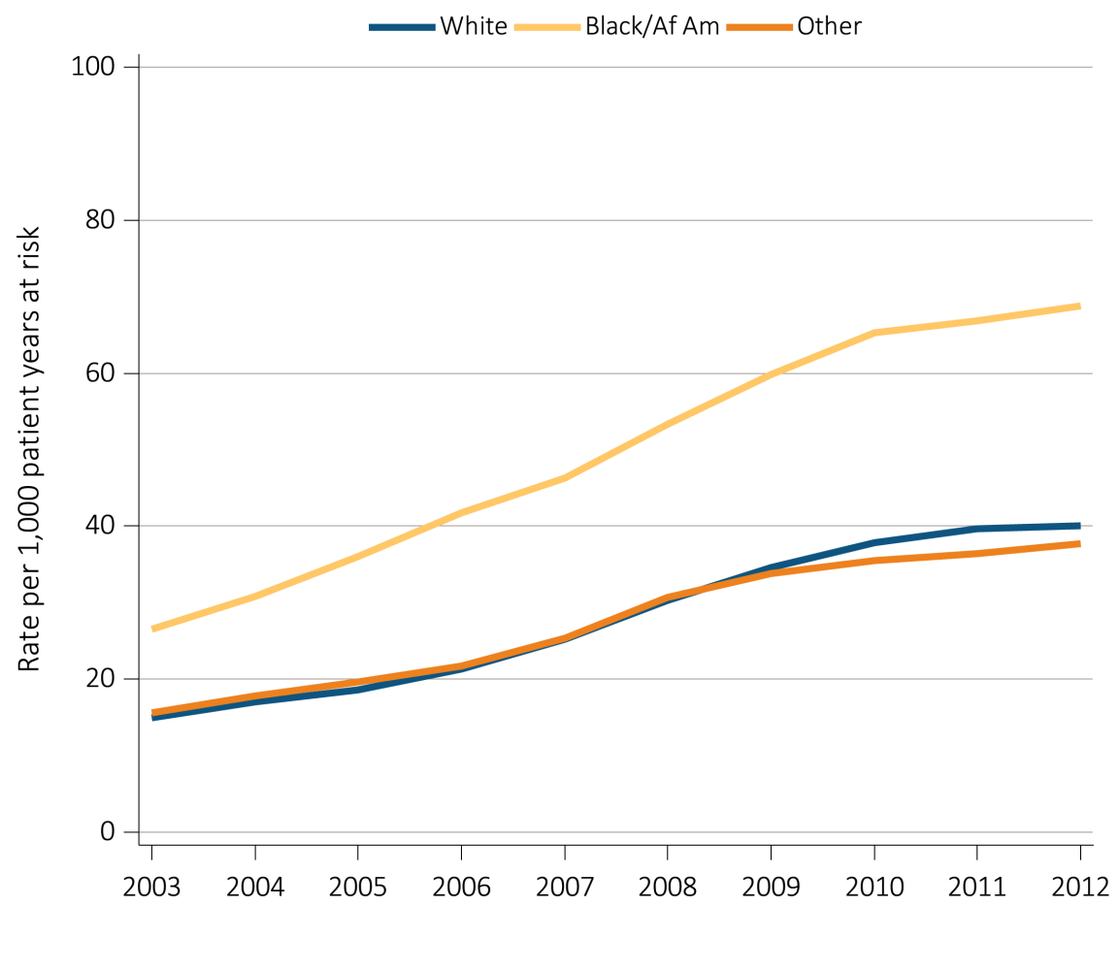
vol 1 Figure 5.3 Unadjusted rates of first hospitalization with AKI for Medicare patients aged 66+ by race and year, 2003-2012
Data Source: Medicare 5 percent sample. All patient-years at risk for Medicare patients aged 66 or older who had both Medicare Parts A & B, no Medicare Advantage plan (Part C/HMO), no ESRD by first service date from Medical Evidence form, and were alive on January 1 of year shown. Censored at death, ESRD, end of Medicare Parts A & B participation, or switch to Medicare Advantage program. Abbreviations: Af Am, African American; AKI, acute kidney injury.

Slide 7
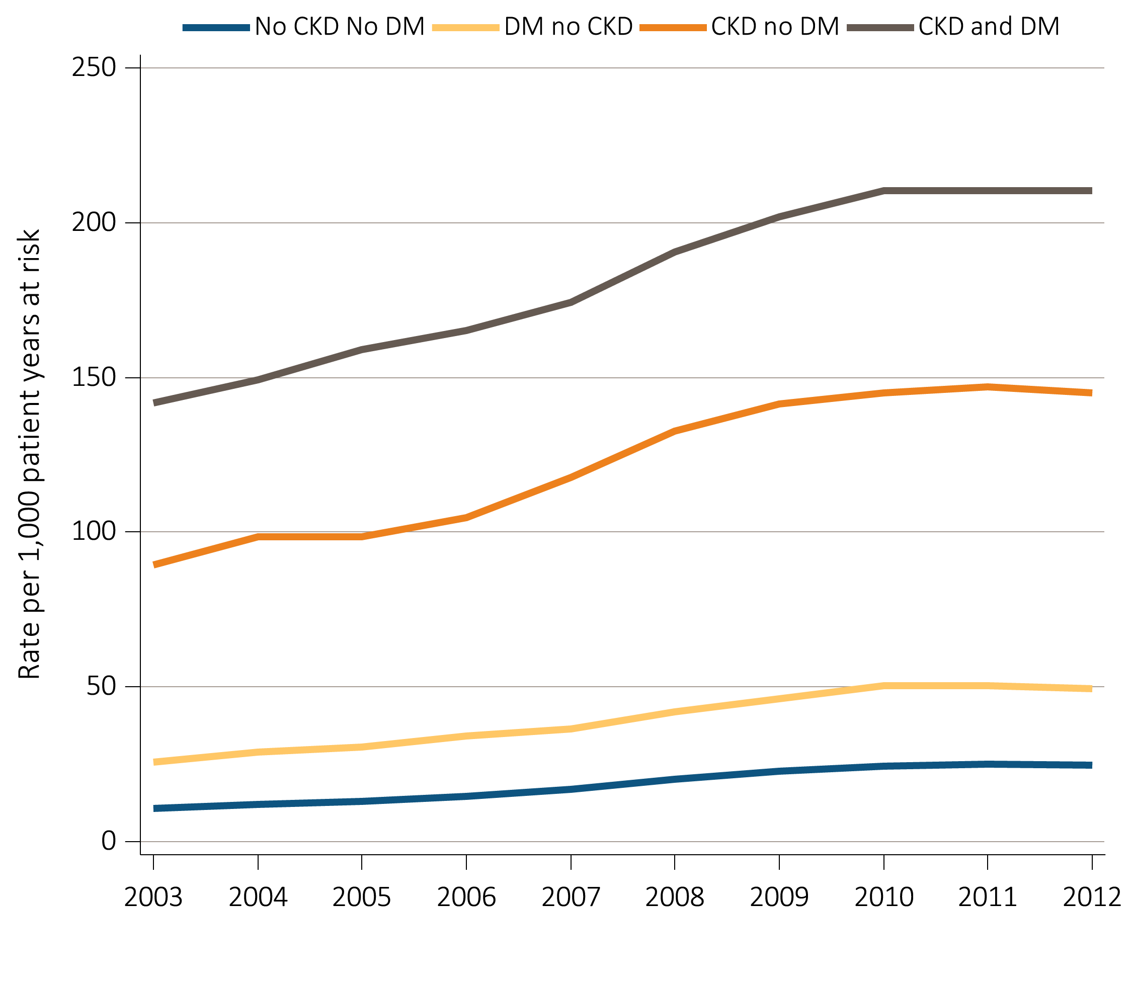
vol 1 Figure 5.4 Unadjusted rates of first hospitalization with AKI for Medicare patients aged 66+ by CKD, DM and year, 2003-2012
Data Source: Medicare 5 percent sample. All patient-years at risk for Medicare patients aged 66 and older who had both Medicare Parts A & B, no Medicare Advantage plan (Part C/HMO), no ESRD by first service date from Medical Evidence form, and were alive on January 1 of year shown. Censored at death, ESRD, end of Medicare Parts A & B participation, or switch to Medicare Advantage program. Abbreviations: AKI, acute kidney injury; CKD, chronic kidney disease; DM, diabetes mellitus.

Slide 8
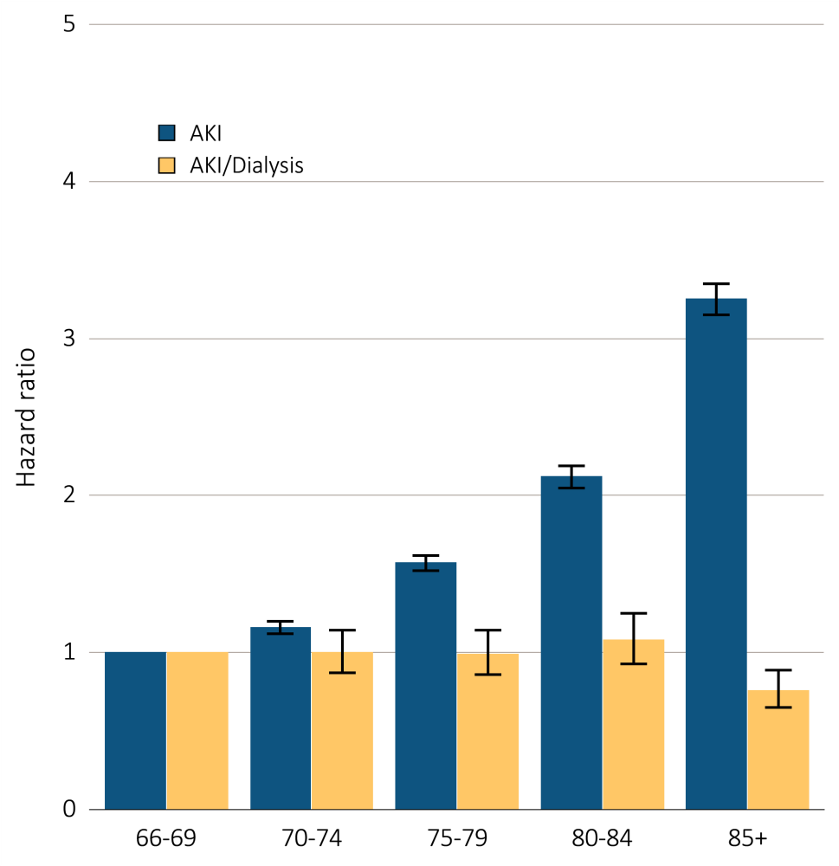
vol 1 Figure 5.5 Adjusted hazard of a first AKI hospitalization in Medicare patients aged 66+, overall and dialysis-requiring, by age, 2012
Data Source: Medicare 5 percent sample. Medicare patients aged 66 or older who had both Medicare Parts A & B, no Medicare Advantage plan (Part C/HMO), no ESRD by first service date from Medical Evidence form, and were alive on 1/1/2012. Dialysis is identified by a diagnosis or charge for dialysis on the AKI inpatient claim or a physician/supplier (Part B) claim for dialysis during the time period of the AKI inpatient claim. Models each include age, race, sex, DM, and CKD status in prior year. Censored at death, ESRD, end of Medicare Parts A & B participation, or switch to Medicare Advantage program. Error bars represent 95% confidence interval of estimates. Abbreviation: AKI, acute kidney injury.

Slide 9
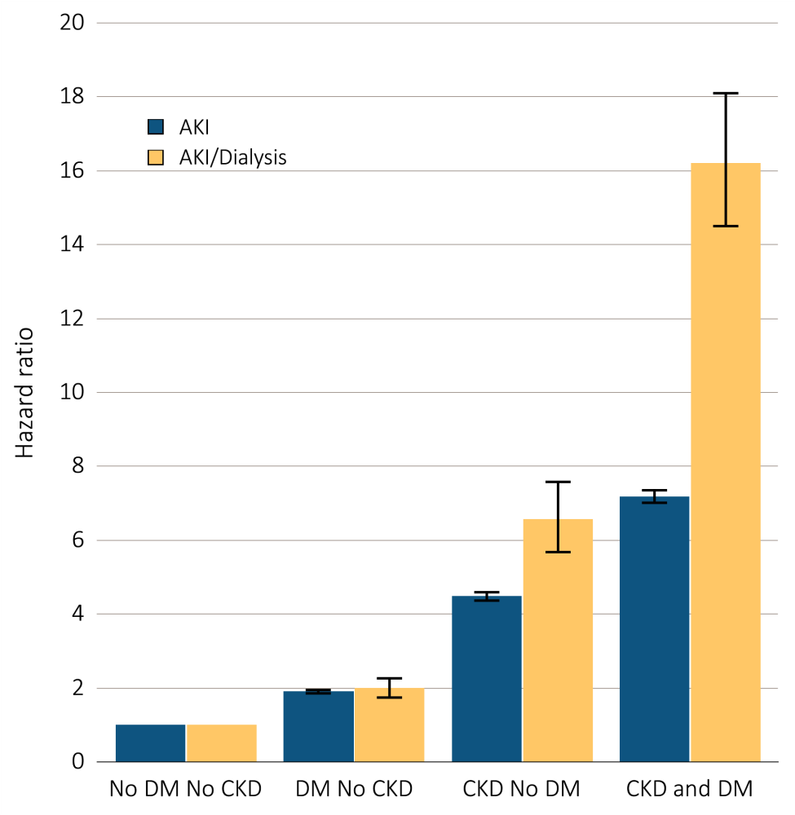
vol 1 Figure 5.6 Adjusted hazard of an AKI hospitalization in Medicare patients by DM & CKD status, 2012
Data Source: Medicare 5 percent sample. Medicare patients aged 66 and older who had both Medicare Parts A & B, no Medicare Advantage plan (Part C/HMO), no ESRD by first service date from Medical Evidence form, and were alive on 1/1/2012. Dialysis is identified by a diagnosis or charge for dialysis on the AKI inpatient claim or a physician/supplier (Part B) claim for dialysis during the time period of the AKI inpatient claim. Models each include age, race, sex, DM, and CKD status in prior year. Censored at death, ESRD, end of Medicare Parts A & B participation, or switch to Medicare Advantage program. Error bars represent 95% confidence interval of estimates. Abbreviations: AKI, acute kidney injury; CKD, chronic kidney disease; DM, diabetes mellitus.

Slide 10
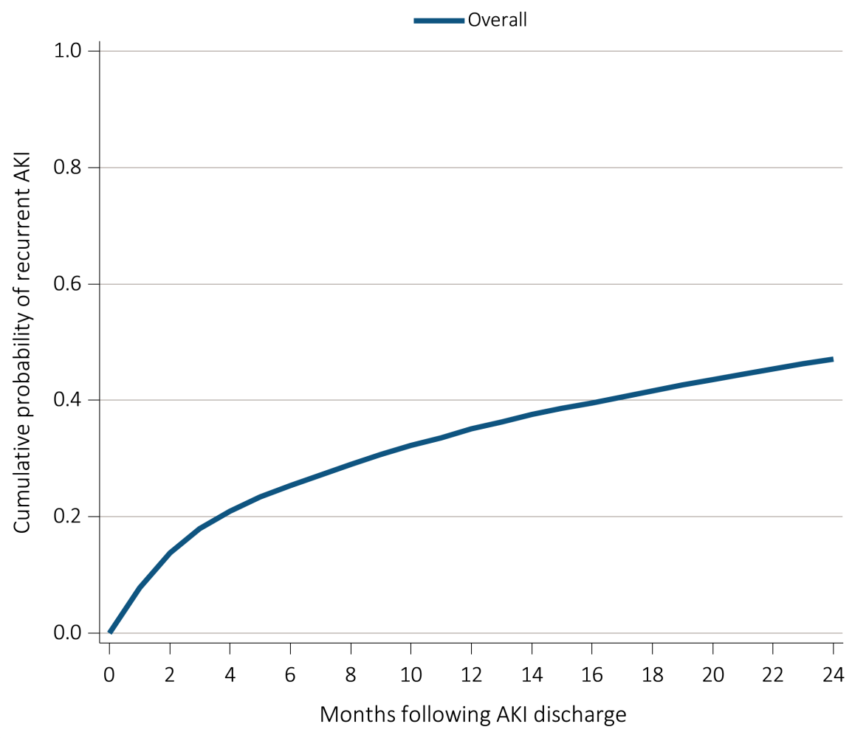
vol 1 Figure 5.7 Cumulative probability of a recurrent AKI hospitalization within two years of live discharge from first AKI hospitalization in 2010 for Medicare patients aged 66+, (a) overall, (b) by age, (c) by race, and (d) by CKD and DM
(a)
Data Source: Medicare 5 percent sample. Age on January 1, 2010. Medicare patients aged 66 and older who had both Medicare Parts A & B, no Medicare Advantage plan (Part C/HMO), no ESRD by first service date from Medical Evidence form on 1/1/2010 and were discharged alive from an AKI hospitalization in 2010. Censored at death, ESRD, end of Medicare Parts A & B participation, or switch to Medicare Advantage program. Abbreviations: AKI, acute kidney injury; CKD, chronic kidney disease; DM, diabetes mellitus.

Slide 11
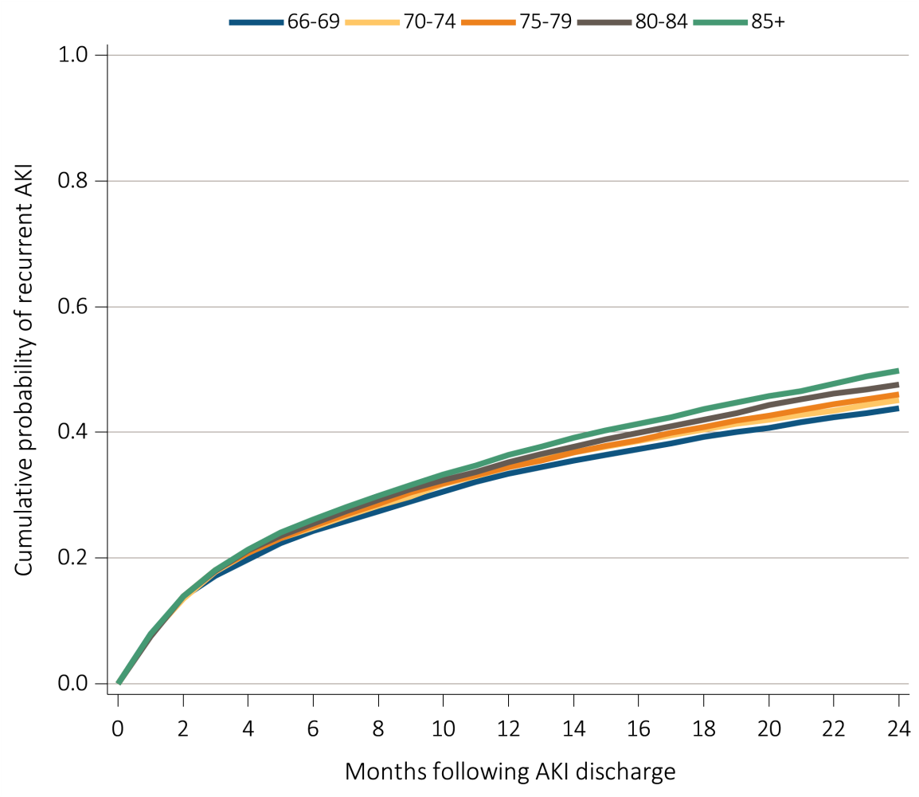
vol 1 Figure 5.7 Cumulative probability of a recurrent AKI hospitalization within two years of live discharge from first AKI hospitalization in 2010 for Medicare patients aged 66+, (a) overall, (b) by age, (c) by race, and (d) by CKD and DM
(b)
Data Source: Medicare 5 percent sample. Age on January 1, 2010. Medicare patients aged 66 and older who had both Medicare Parts A & B, no Medicare Advantage plan (Part C/HMO), no ESRD by first service date from Medical Evidence form on 1/1/2010 and were discharged alive from an AKI hospitalization in 2010. Censored at death, ESRD, end of Medicare Parts A & B participation, or switch to Medicare Advantage program. Abbreviations: AKI, acute kidney injury; CKD, chronic kidney disease; DM, diabetes mellitus.

Slide 12
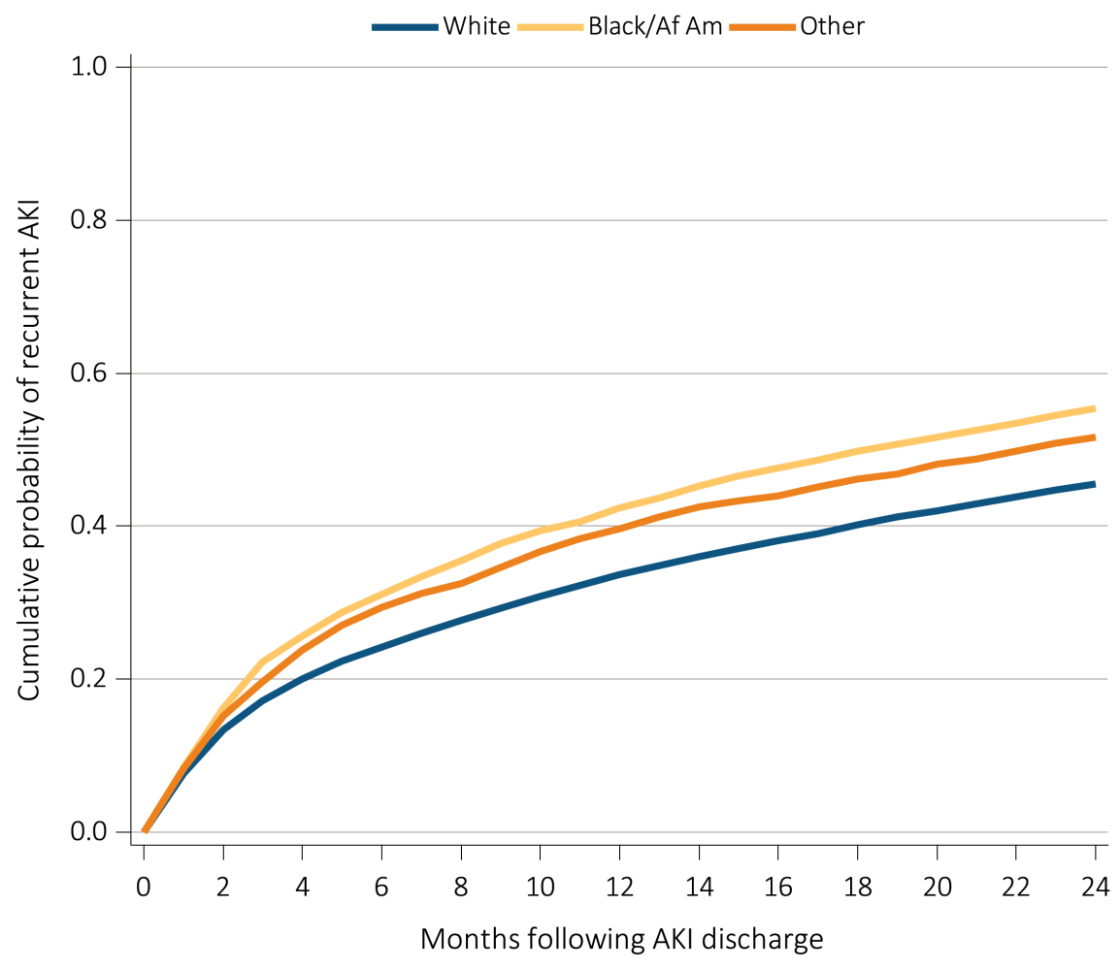
vol 1 Figure 5.7 Cumulative probability of a recurrent AKI hospitalization within two years of live discharge from first AKI hospitalization in 2010 for Medicare patients aged 66+, (a) overall, (b) by age, (c) by race, and (d) by CKD and DM
(c)
Data Source: Medicare 5 percent sample. Age on January 1, 2010. Medicare patients aged 66 and older who had both Medicare Parts A & B, no Medicare Advantage plan (Part C/HMO), no ESRD by first service date from Medical Evidence form on 1/1/2010 and were discharged alive from an AKI hospitalization in 2010. Censored at death, ESRD, end of Medicare Parts A & B participation, or switch to Medicare Advantage program. Abbreviations: AKI, acute kidney injury; CKD, chronic kidney disease; DM, diabetes mellitus.

Slide 13
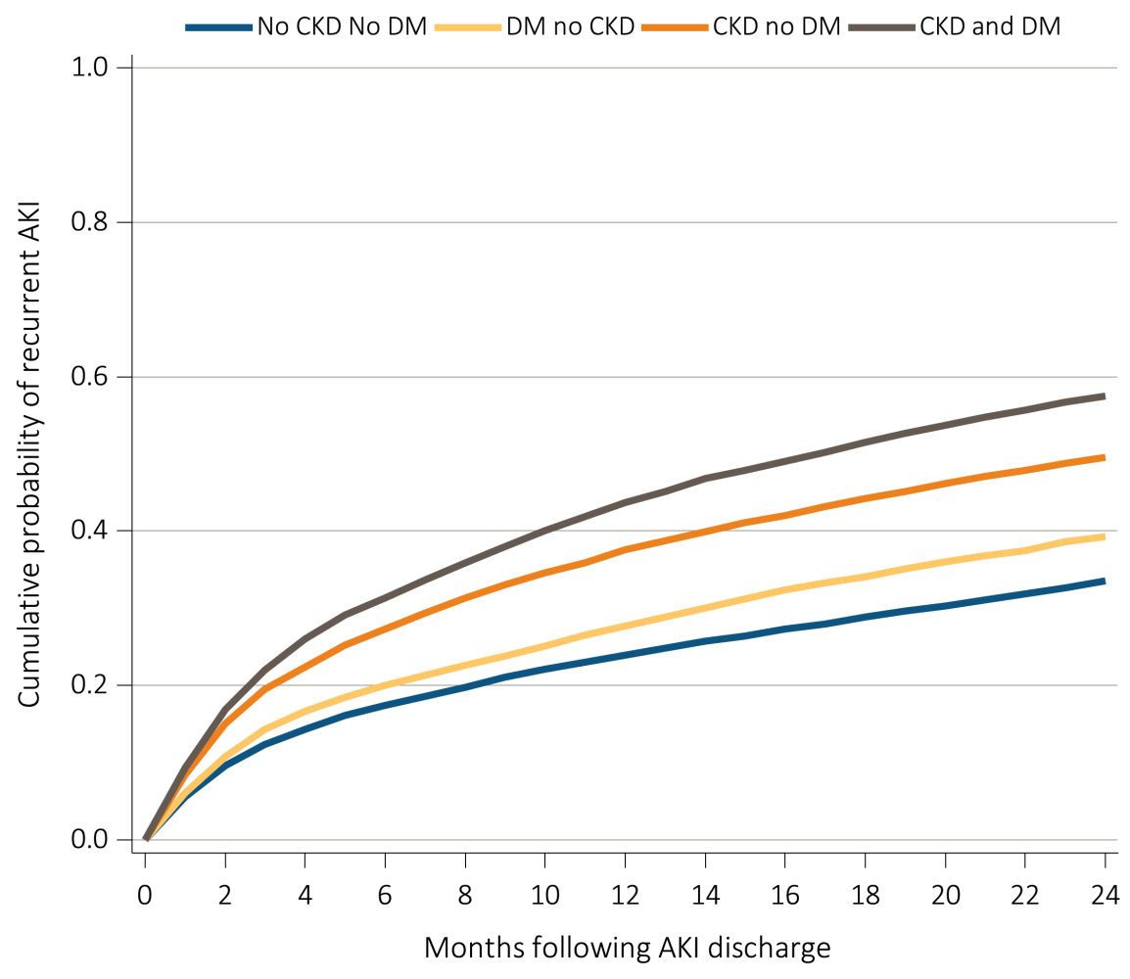
vol 1 Figure 5.7 Cumulative probability of a recurrent AKI hospitalization within two years of live discharge from first AKI hospitalization in 2010 for Medicare patients aged 66+, (a) overall, (b) by age, (c) by race, and (d) by CKD and DM
(d)
Data Source: Medicare 5 percent sample. Age on January 1, 2010. Medicare patients aged 66 and older who had both Medicare Parts A & B, no Medicare Advantage plan (Part C/HMO), no ESRD by first service date from Medical Evidence form on 1/1/2010 and were discharged alive from an AKI hospitalization in 2010. Censored at death, ESRD, end of Medicare Parts A & B participation, or switch to Medicare Advantage program. Abbreviations: AKI, acute kidney injury; CKD, chronic kidney disease; DM, diabetes mellitus.

Slide 14
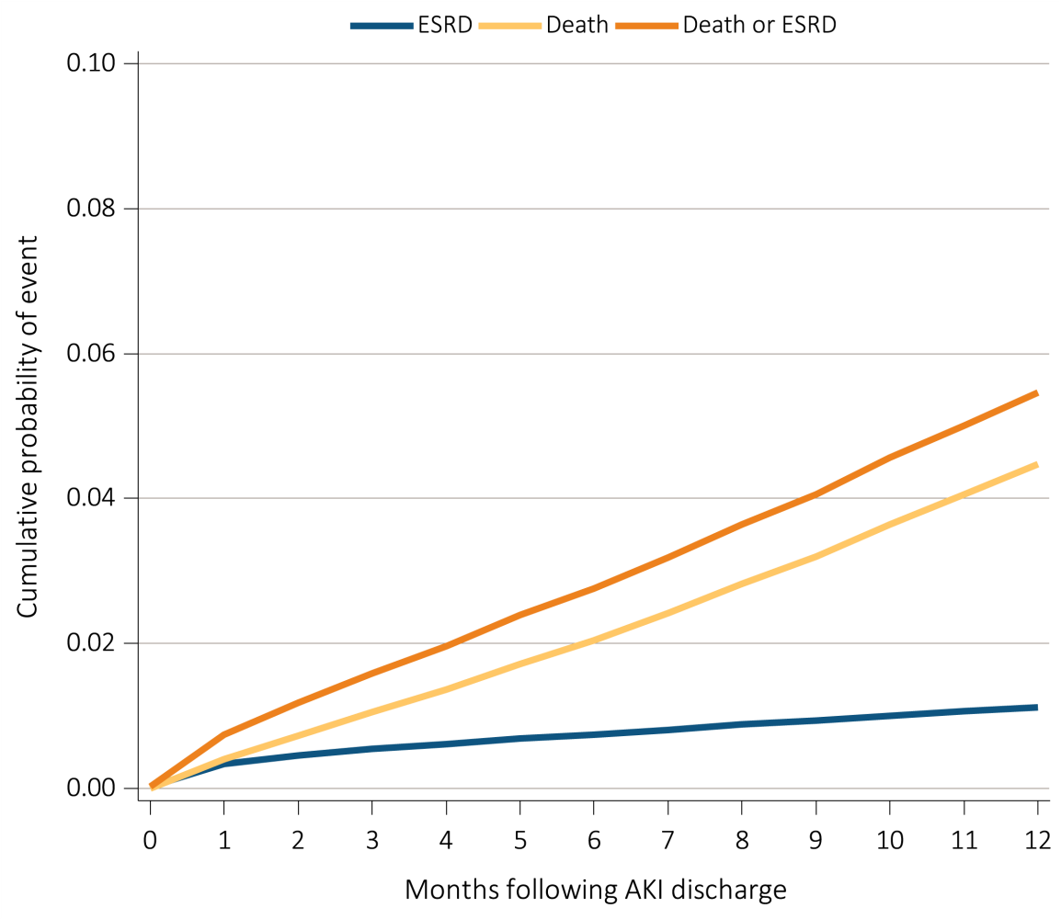
vol 1 Figure 5.8 Cumulative probability of death-censored ESRD, death, and the composite of death or ESRD within one year of live discharge from first AKI hospitalization occurring in 2010-2011 for Medicare patients aged 66+
Data Source: Medicare 5 percent sample. Medicare patients aged 66 or older who had both Medicare Parts A & B, no Medicare Advantage plan (Part C/HMO), no ESRD by first service date from Medical Evidence form, and were discharged alive from a first AKI hospitalization in 2010 or 2011. All models censored at the end of Medicare Parts A & B participation, switch to Medicare Advantage program, or 365 days after AKI discharge. Model for ESRD also is censored at death. Model for death is not censored at the start of ESRD. Abbreviations: AKI, acute kidney injury by diagnosis code; ESRD, end-stage renal disease.

Slide 15
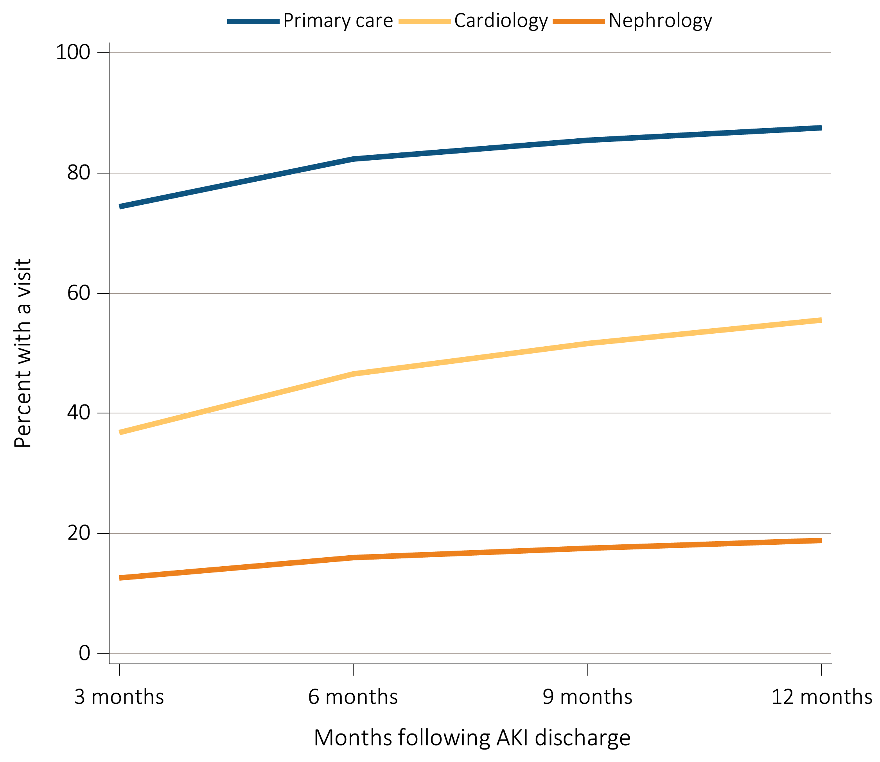
vol 1 Figure 5.9 Outpatient physician visits within one year of live discharge from first AKI hospitalization in 2011 for Medicare patients aged 66+ by physician specialty and time
Data Source: Medicare 5 percent sample. Medicare patients aged 66 and older who had both Medicare Parts A & B, no Medicare Advantage plan (Part C/HMO), no ESRD by first service date from Medical Evidence form on 1/1/2011, and were discharged alive from a first AKI hospitalization in 2011. For each time point, the denominator is all patients alive, without ESRD, not in a Medicare Advantage plan and with Medicare Parts A & B. Physician visits are from physician/supplier claims with provider specialty codes for primary care (01, 08-family practice, 11-internal medicine), cardiology (06), and nephrology (39) and claim source indicating an outpatient setting. Abbreviation: AKI, acute kidney injury.

Slide 16
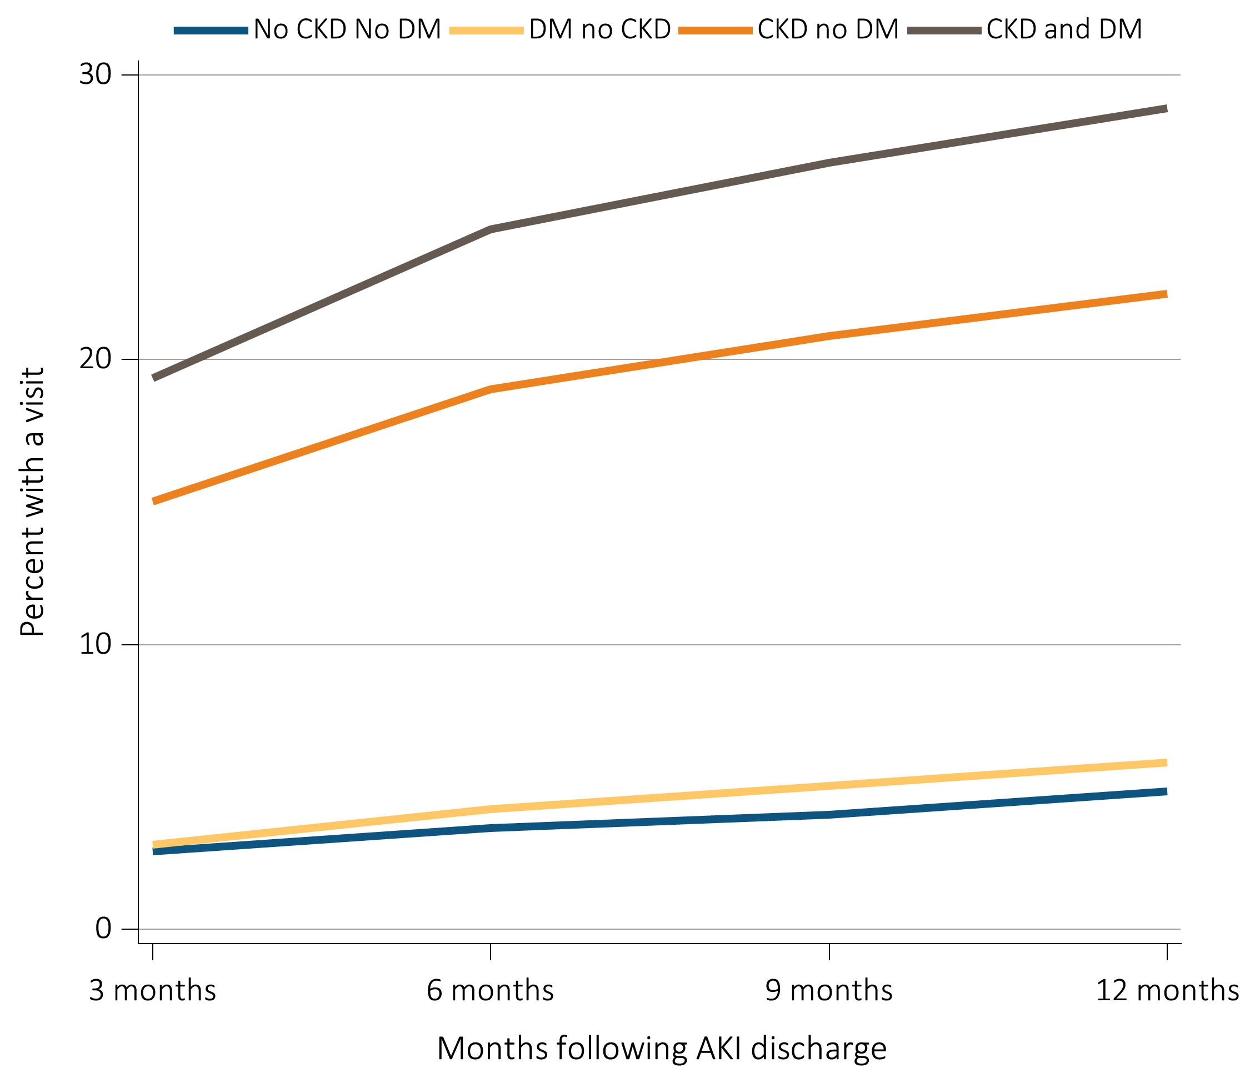
vol 1 Figure 5.10 Outpatient nephrology visits within one year of live discharge from first AKI hospitalization in 2011 for Medicare patients aged 66+ by CKD, DM, and time
Data Source: Medicare 5 percent sample. Medicare patients aged 66 and older who had both Medicare Parts A & B, no Medicare Advantage plan (Part C/HMO), no ESRD by first service date from Medical Evidence form on 1/1/2011, and were discharged alive from a first AKI hospitalization in 2011. For each time point, the denominator is all patients alive, without ESRD, not in a Medicare Advantage plan and with Medicare Parts A & B. Physician visits are from physician/supplier claims with provider specialty codes for nephrology (39) and claim source indicating an outpatient setting. Abbreviations: AKI, acute kidney injury; CKD, chronic kidney disease; DM, diabetes mellitus.

Slide 17
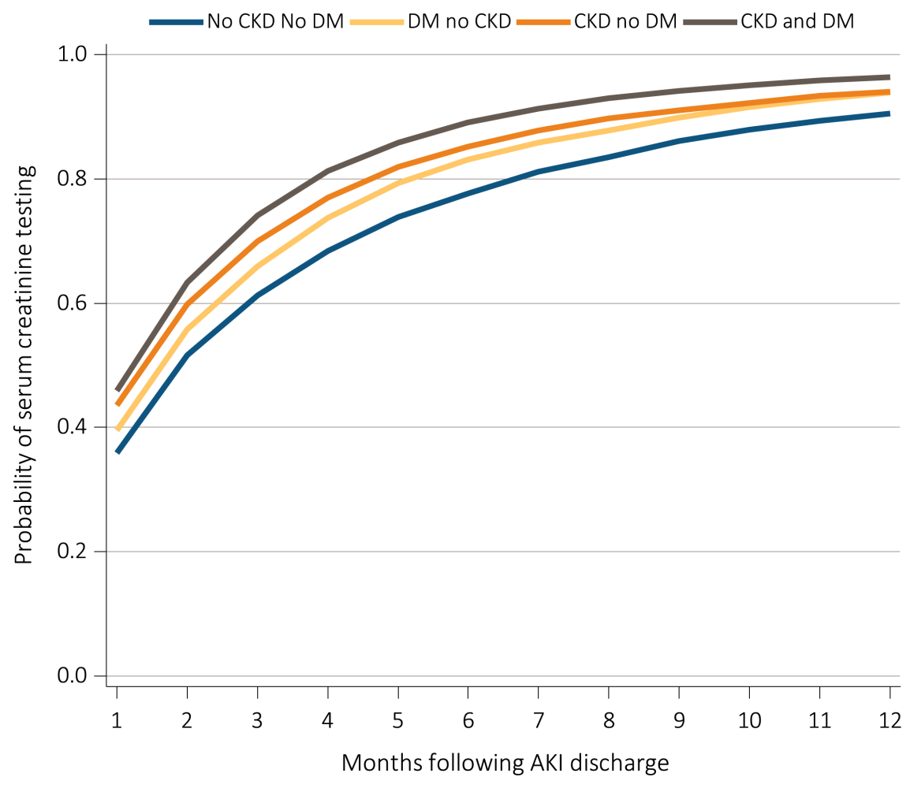
vol 1 Figure 5.11 Cumulative probability of a claim for a serum creatinine test within one year of live discharge from first AKI hospitalization in 2011 for Medicare patients aged 66+ by CKD, DM and time
Data Source: Medicare 5 percent sample. Medicare patients aged 66 and older who had both Medicare Parts A & B, no Medicare Advantage plan (Part C/HMO), no ESRD by first service date from Medical Evidence form on 1/1/2011, and were discharged alive from a first AKI hospitalization in 2011. Date of first serum creatinine test following AKI discharge is from inpatient and outpatient claims with healthcare common procedure coding system (HCPCS) codes of 80048, 80050, 80053, 80069, or 82565. Censored at death, ESRD, end of Medicare Parts A & B participation, or switch to Medicare Advantage program. Abbreviations: AKI, acute kidney injury; CKD, chronic kidney disease; DM, diabetes mellitus.

Slide 18
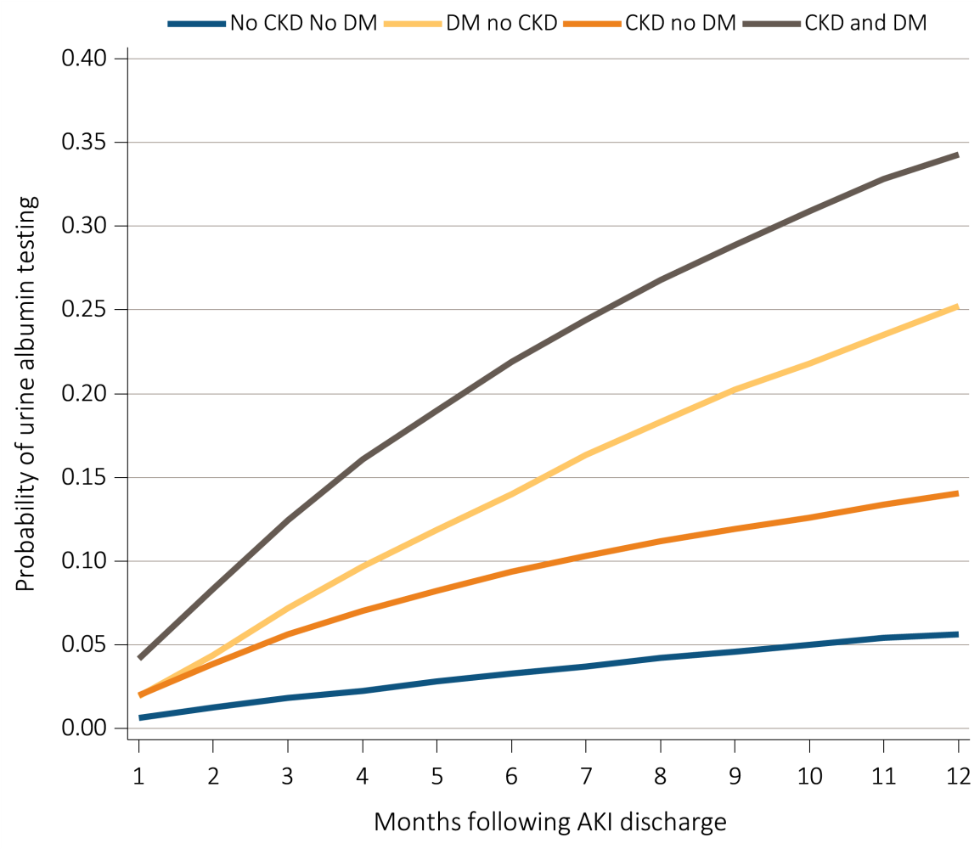
vol 1 Figure 5.12 Cumulative probability of a claim for an urine albumin test within one year of live discharge from first AKI hospitalization in 2011 for Medicare patients aged 66+ by CKD, DM and time
Data Source: Medicare 5 percent sample. Medicare patients aged 66 and older who had both Medicare Parts A and B, no Medicare Advantage plan (Part C/HMO), no ESRD by first service date from Medical Evidence form on 1/1/2011, and were discharged alive from a first AKI hospitalization in 2011. Date of first urine albumin test following AKI discharge is from inpatient and outpatient claims with healthcare common procedure coding system (HCPCS) codes of 82042, 82043, 82044, or 84156. Censored at death, ESRD, end of Medicare Parts A & B participation, or switch to Medicare Advantage program. Abbreviations: AKI, acute kidney injury; CKD, chronic kidney disease; DM, diabetes mellitus.

Slide 19
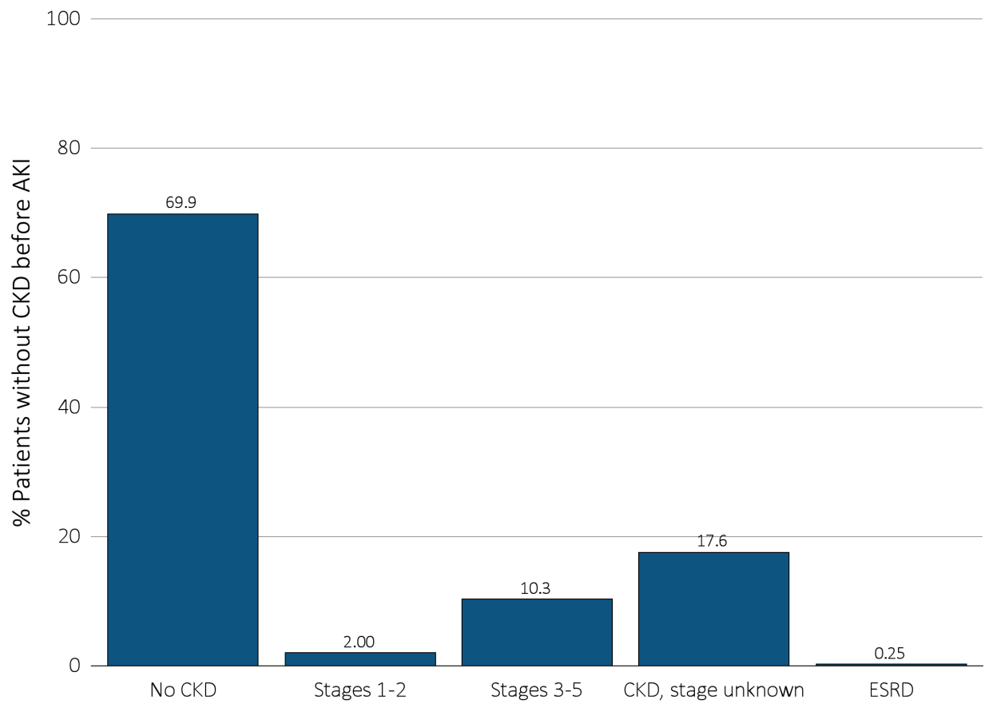
vol 1 Figure 5.13 Renal status one year following discharge from AKI hospitalization in 2010-2011, among surviving Medicare patients aged 66+ without kidney disease prior to AKI hospitalization, by CKD stage and ESRD status
Data Source: Medicare 5 percent sample. Medicare patients aged 66 and older who had both Medicare Parts A & B, no Medicare Advantage plan (Part C/HMO), did not have ESRD, were discharged alive from a first AKI hospitalization in 2010 or 2011, and did not have any claims with a diagnosis of CKD in the 365 days prior to the AKI. Renal status after AKI determined from claims between discharge from AKI hospitalization and 365 days after discharge. Stage determined by 585.x claim closest to 365 days after discharge; ESRD by first service date on Medical Evidence form. Abbreviations: AKI, acute kidney injury; CKD, chronic kidney disease.

Slide 20
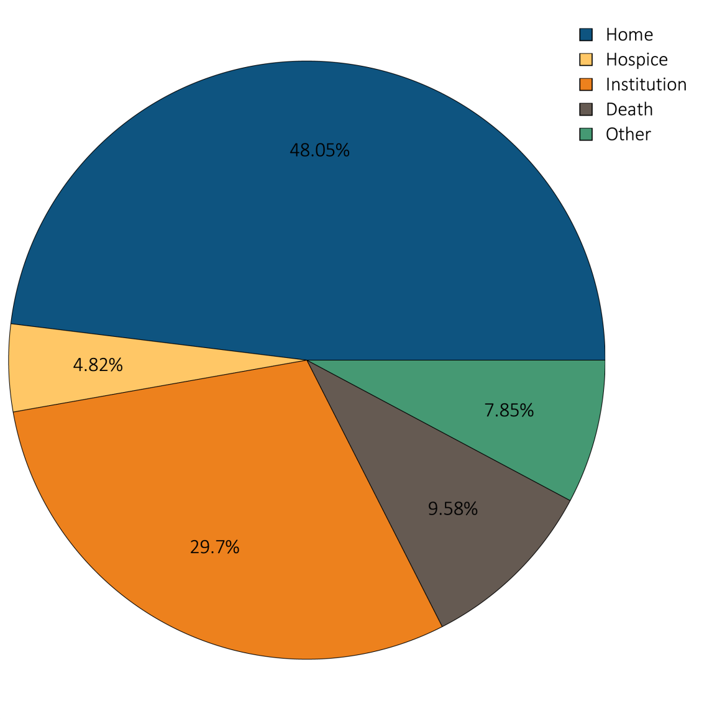
vol 1 Figure 5.14 Hospital discharge status of first AKI hospitalization for Medicare patients aged 66+, 2012
Data Source: Medicare 5 percent sample. Medicare patients aged 66 or older who had both Medicare Parts A & B, no Medicare Advantage plan (Part C/HMO), did not have ESRD on 1/1/2012 and had a first AKI hospitalization in 2012. Institution includes short-term skilled nursing facilities, rehabilitation hospitals, and long-term care facilities. Home also includes patients receiving home health care services. Excludes patients admitted to the acute care hospital from a skilled nursing facility. Abbreviation: AKI, acute kidney injury.

