Slide 2
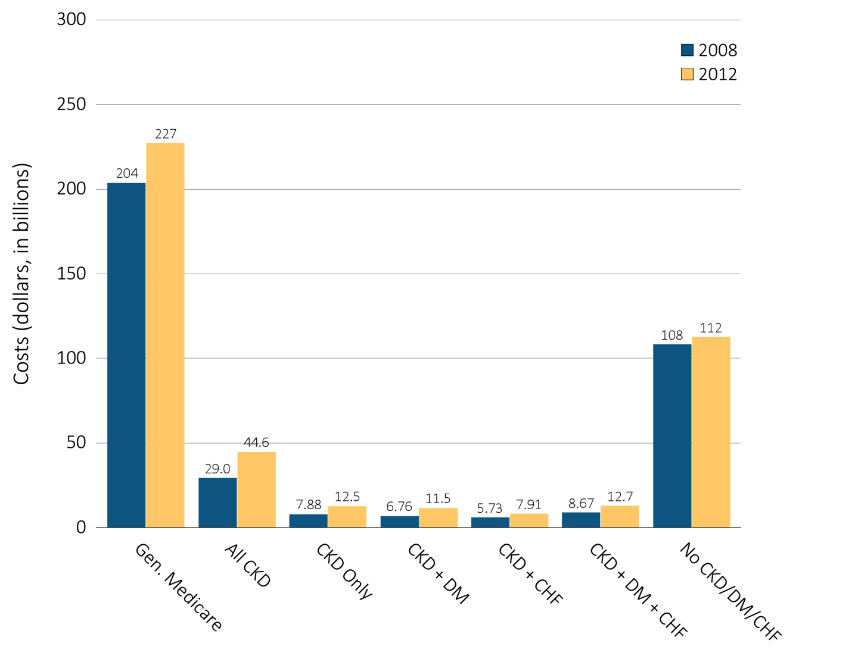
vol 1 Figure 6.1 Overall Medicare Parts A and B costs for fee-for-service patients aged 65 and older, by CKD, DM, CHF, and year, 2008 and 2012
Data source: Medicare 5 percent sample. Abbreviations: CKD, chronic kidney disease; CHF, congestive heart failure, DM, diabetes mellitus.

Slide 3
vol 1 Table 6.1 Point prevalent distribution of Medicare fee-for-service patients aged 65+ and total annual costs of Medicare Parts A and B services, by DM, CHF, and/or CKD, 2012
 | U.S. Medicare population | Costs (millions, U.S. $) | PPPY (U.S. $) | Population (%) | Costs (%)
All | 24,818,540 | $227,107 | $9,806 | 100.0 | 100.0
With CHF or CKD or DM | 8,295,460 | $114,649 | $15,048 | 33.4 | 50.5
CKD only (- DM & CHF) | 931,880 | $12,463 | $14,469 | 3.8 | 5.5
DM only (- CHF & CKD) | 4,265,980 | $40,811 | $10,182 | 17.2 | 18.0
CHF only (- DM & CKD) | 977,660 | $16,924 | $19,215 | 3.9 | 7.5
CKD & DM only (- CHF) | 762,740 | $11,535 | $16,492 | 3.1 | 5.1
CKD & CHF only (- DM) | 340,140 | $7,910 | $27,810 | 1.4 | 3.5
DM & CHF only (- CKD) | 580,740 | $12,332 | $23,768 | 2.3 | 5.4
CKD & CHF & DM | 436,320 | $12,674 | $34,631 | 1.8 | 5.6
No CKD or DM or CHF | 16,523,080 | $112,459 | $7,236 | 66.6 | 49.5
All CKD (+/- DM & CHF) | 2,471,080 | $44,581 | $20,162 | 10.0 | 19.6
All DM (+/- CKD & CHF) | 6,045,780 | $77,352 | $13,832 | 24.4 | 34.1
All CHF (+/- DM & CKD) | 2,334,860 | $49,840 | $24,312 | 9.4 | 21.9
CKD & DM (+/- CHF) | 1,199,060 | $24,209 | $22,723 | 4.8 | 10.7
CKD & CHF (+/- DM) | 776,460 | $20,584 | $31,648 | 3.1 | 9.1
DM & CHF (+/- CKD) | 1,017,060 | $25,006 | $28,261 | 4.1 | 11.0
Data Source: Medicare 5 percent sample. Abbreviations: CKD, chronic kidney disease; CHF, congestive heart failure; DM, diabetes mellitus; PPPY, per patient per year costs.

Slide 4
vol 1 Table 6.2 Overall per person per year costs for Medicare Parts A and B services for CKD patients, by CKD stage, age, sex, race, and year, 2009 and 2012
 | 2009 |  |  |  |  | 2012
 | Any CKD | Stages 1-2 | Stage 3 | Stages 4-5 | Unk/unspc | Any CKD | Stages 1-2 | Stage 3 | Stages 4-5 | Unk/unspc
All | $20,555 | $18,290 | $19,262 | $25,456 | $20,657 | $20,162 | $17,969 | $19,392 | $25,623 | $20,100
Population | 1,653,828 | 140,329 | 531,543 | 188,477 | 793,479 | 2,211,129 | 209,487 | 936,011 | 225,867 | 839,765
Age:
66-69 | $18,623 | $16,002 | $17,101 | $26,268 | $18,700 | $18,364 | $16,876 | $16,955 | $26,641 | $18,482
70-74 | $18,545 | $15,441 | $17,643 | $24,903 | $18,489 | $18,023 | $15,682 | $17,155 | $24,502 | $18,186
75-80 | $19,730 | $17,341 | $18,448 | $24,220 | $20,063 | $19,509 | $16,643 | $18,907 | $24,496 | $19,698
70-84 | $21,791 | $21,277 | $20,589 | $24,719 | $21,939 | $20,851 | $18,594 | $20,258 | $25,564 | $20,668
85+ | $23,100 | $21,901 | $21,864 | $27,023 | $22,925 | $22,836 | $22,222 | $22,238 | $26,614 | $22,387
Male | $20,317 | $17,741 | $19,222 | $26,272 | $20,198 | $20,346 | $18,072 | $19,837 | $26,020 | $20,055
Female | $20,774 | $18,839 | $19,302 | $24,770 | $21,068 | $20,000 | $17,873 | $18,993 | $25,304 | $20,138
White | $20,172 | $18,052 | $19,005 | $24,737 | $20,281 | $19,935 | $18,016 | $19,260 | $24,914 | $19,855
Black/Af Am | $22,664 | $20,360 | $20,590 | $29,155 | $22,600 | $22,322 | $18,631 | $20,803 | $29,014 | $23,015
Other race | $22,455 | $17,385 | $20,921 | $27,122 | $23,123 | $19,320 | $16,195 | $18,551 | $27,813 | $18,477
Data source: Medicare 5 percent sample. Abbreviations: Af Am, African American; CKD, chronic kidney disease; Unk/unspc, CKD stage unknown.

Slide 5
vol 1 Table 6.3 Per person per year costs for Parts A and B services for Medicare CKD patients with DM, by CKD stage, age, sex, race, and year, 2009 and 2012
 | 2009 |  |  |  |  | 2012
 | Any CKD | Stages 1-2 | Stage 3 | Stages 4-5 | Unk/unspc | Any CKD | Stages 1-2 | Stage 3 | Stages 4-5 | Unk/unspc
All | $23,240 | $20,692 | $22,130 | $28,694 | $23,037 | $22,723 | $20,247 | $22,007 | $29,378 | $22,190
Population | 778,557 | 68,088 | 257,455 | 97,343 | 355,671 | 778,557 | 68,088 | 257,455 | 97,343 | 355,671
Age:
66-69 | $21,615 | $18,199 | $20,202 | $29,882 | $21,505 | $21,330 | $19,670 | $19,918 | $30,064 | $21,075
70-74 | $21,689 | $17,995 | $21,122 | $28,108 | $21,292 | $20,629 | $17,337 | $19,719 | $28,304 | $20,599
75-80 | $22,841 | $20,565 | $21,834 | $27,836 | $22,677 | $22,095 | $18,874 | $21,680 | $28,408 | $21,538
70-84 | $24,551 | $24,737 | $23,191 | $27,883 | $24,532 | $23,451 | $21,540 | $22,707 | $29,456 | $22,775
85+ | $25,960 | $24,981 | $24,977 | $30,265 | $25,365 | $26,408 | $26,439 | $26,249 | $30,779 | $25,094
Male | $22,680 | $19,541 | $21,626 | $29,512 | $22,381 | $22,587 | $20,117 | $22,101 | $29,830 | $21,799
Female | $23,788 | $21,948 | $22,658 | $28,011 | $23,666 | $22,853 | $20,383 | $21,913 | $29,007 | $22,558
White | $22,719 | $20,794 | $21,668 | $27,958 | $22,472 | $22,494 | $20,279 | $21,976 | $28,472 | $21,913
Black/Af Am | $25,518 | $22,019 | $24,211 | $31,968 | $25,058 | $24,696 | $21,198 | $22,838 | $32,817 | $25,132
Other race | $25,028 | $17,418 | $24,063 | $29,545 | $25,989 | $21,541 | $18,305 | $20,724 | $31,379 | $20,042
Data source: Medicare 5 percent sample. Abbreviations: Af Am, African American; CKD, chronic kidney disease; DM, diabetes mellitus; Unk/unspc, CKD stage unknown.

Slide 6
vol 1 Table 6.4 Per person per year costs for Parts A and B services for Medicare CKD patients with CHF, by CKD stage, age, sex, race, and year, 2009 and 2012
 | 2009 |  |  |  |  | 2012
 | Any CKD | Stages 1-2 | Stage 3 | Stages 4-5 | Unk/unspc | Any CKD | Stages 1-2 | Stage 3 | Stages 4-5 | Unk/unspc
All | $31,537 | $31,444 | $31,242 | $36,013 | $30,403 | $31,648 | $30,850 | $31,301 | $37,295 | $30,159
Population | 650,385 | 53,480 | 273,146 | 86,839 | 236,920 | 650,385 | 53,480 | 273,146 | 86,839 | 236,920
Age:
66-69 | $32,896 | $34,075 | $32,129 | $37,935 | $31,711 | $34,610 | $36,698 | $32,620 | $45,419 | $32,814
70-74 | $32,640 | $29,107 | $33,077 | $38,163 | $31,353 | $31,720 | $28,523 | $30,698 | $38,903 | $31,258
75-80 | $31,678 | $30,702 | $31,486 | $36,504 | $30,471 | $31,498 | $30,081 | $31,783 | $36,879 | $29,529
70-84 | $31,808 | $33,222 | $31,143 | $34,649 | $31,138 | $32,036 | $30,058 | $31,753 | $37,563 | $30,660
85+ | $30,172 | $30,698 | $29,548 | $35,097 | $28,986 | $30,460 | $30,818 | $30,518 | $34,409 | $28,855
Male | $31,068 | $31,196 | $30,762 | $36,597 | $29,621 | $31,656 | $31,668 | $31,587 | $37,552 | $29,571
Female | $31,970 | $31,683 | $31,748 | $35,511 | $31,080 | $31,641 | $30,086 | $31,026 | $37,080 | $30,646
White | $30,703 | $30,258 | $30,424 | $34,479 | $29,861 | $30,943 | $30,250 | $30,802 | $35,605 | $29,598
Black/Af Am | $35,688 | $37,547 | $35,865 | $44,088 | $32,290 | $35,990 | $34,245 | $34,398 | $44,559 | $34,873
Other race | $36,464 | $34,734 | $35,946 | $40,037 | $35,713 | $33,551 | $31,441 | $32,551 | $45,961 | $29,712
Data source: Medicare 5 percent sample. Abbreviations: Af Am, African American; CHF, congestive heart failure; CKD, chronic kidney disease; Unk/unspc, CKD stage unknown.

Slide 7
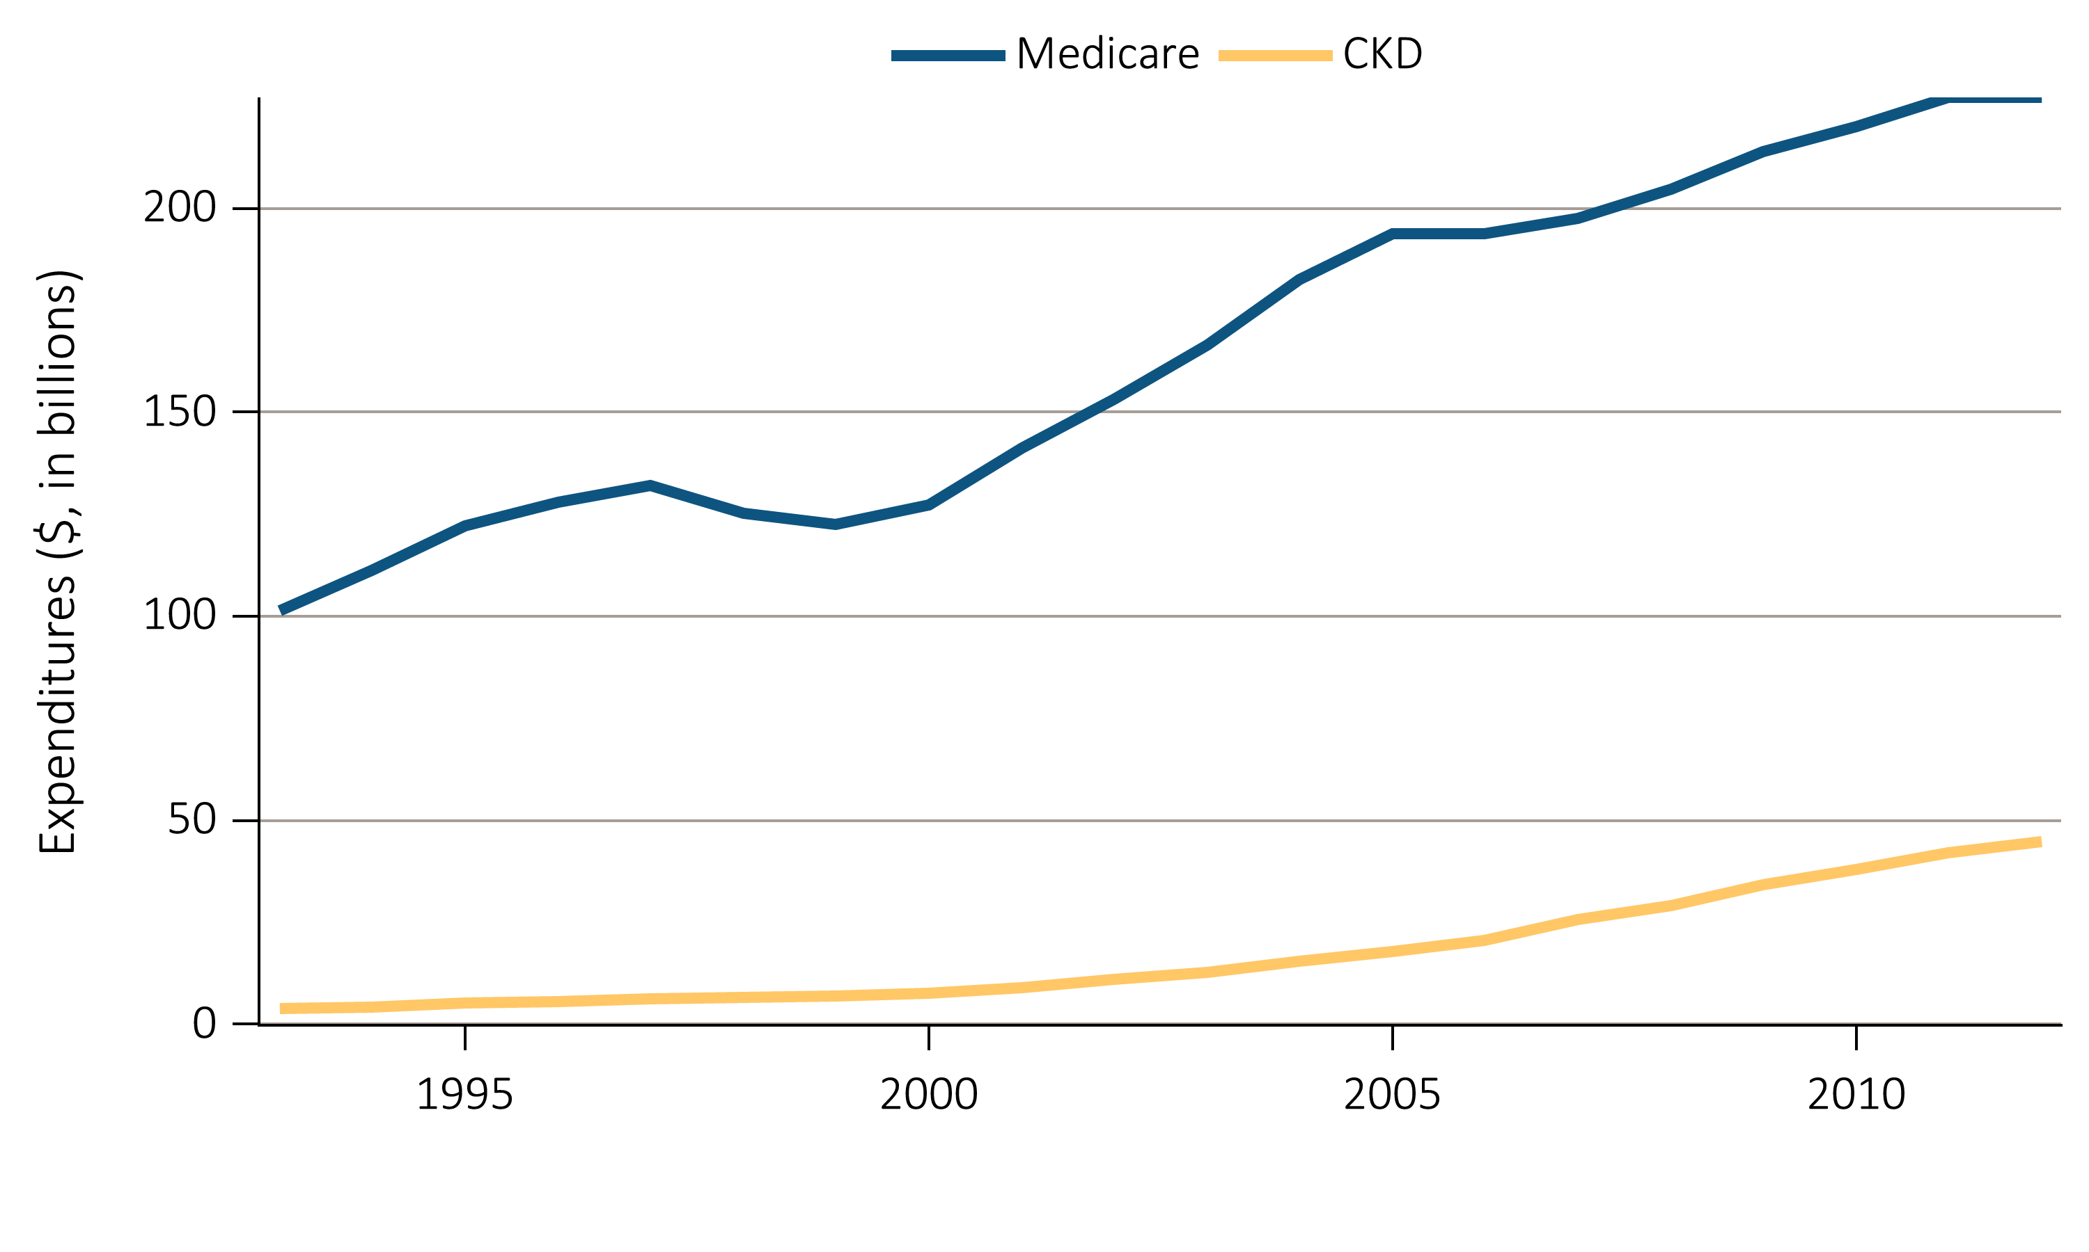
vol 1 Figure 6.2 Overall expenditures on Parts A and B services for the Medicare population age 65+ and for those with CKD, by year, 1993-2012
Data source: Medicare 5 percent sample. Abbreviations: CKD, chronic kidney disease.

Slide 8
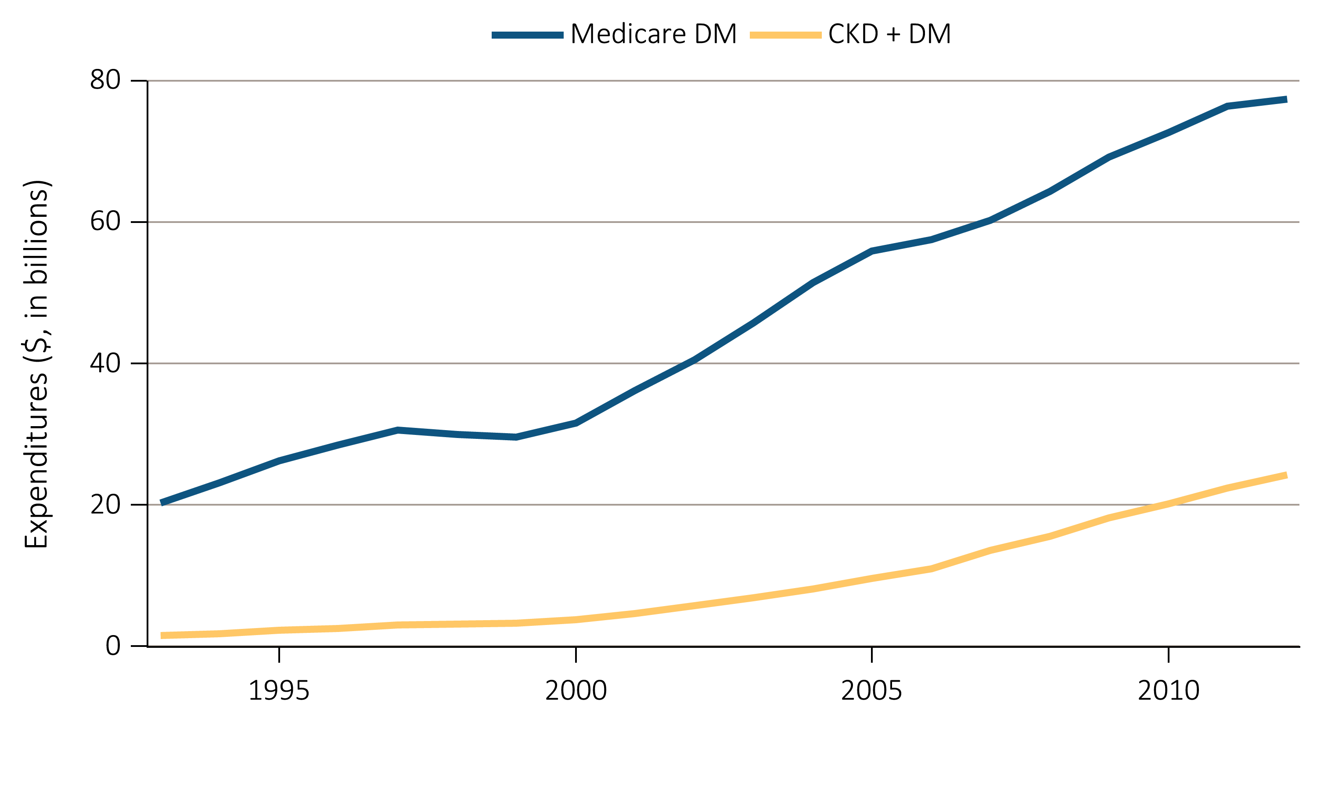
vol 1 Figure 6.3 Overall expenditures on Parts A and B services for the Medicare DM population age 65+ and for those with CKD and DM, by year, 1993-2012
Data Source: Medicare 5 percent sample. Abbreviations: CKD, chronic kidney disease; DM, diabetes mellitus; Unk/unspc, CKD stage unknown.

Slide 9
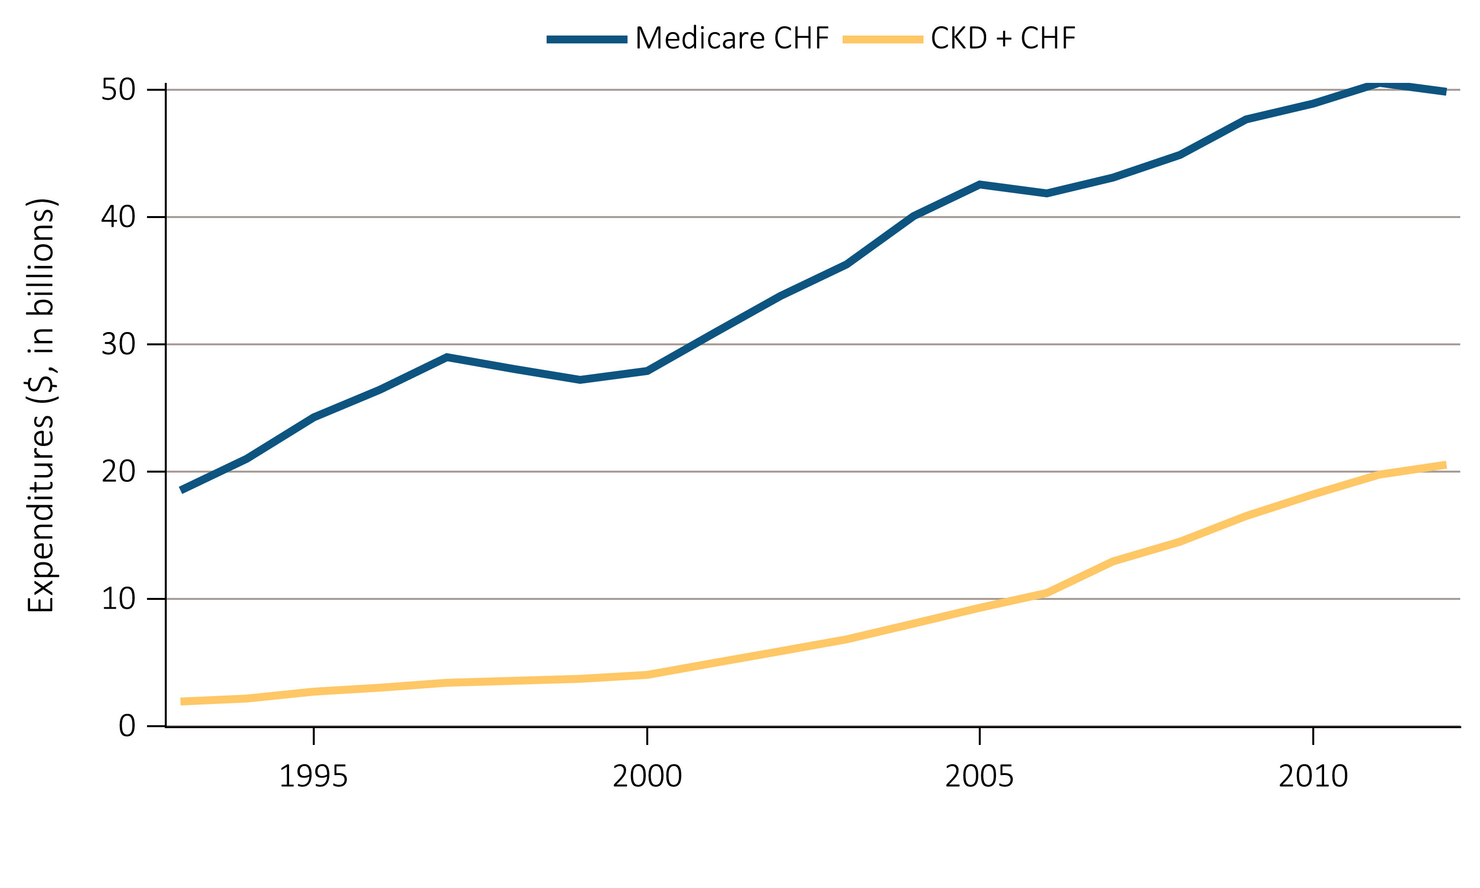
vol 1 Figure 6.4 Overall expenditures on Parts A and B services for the Medicare CHF population age 65+ and for those with CKD and CHF, by year, 1993-2012
Data Source: Medicare 5 percent sample. Abbreviations: CKD, chronic kidney disease; CHF, congestive heart failure.

Slide 10
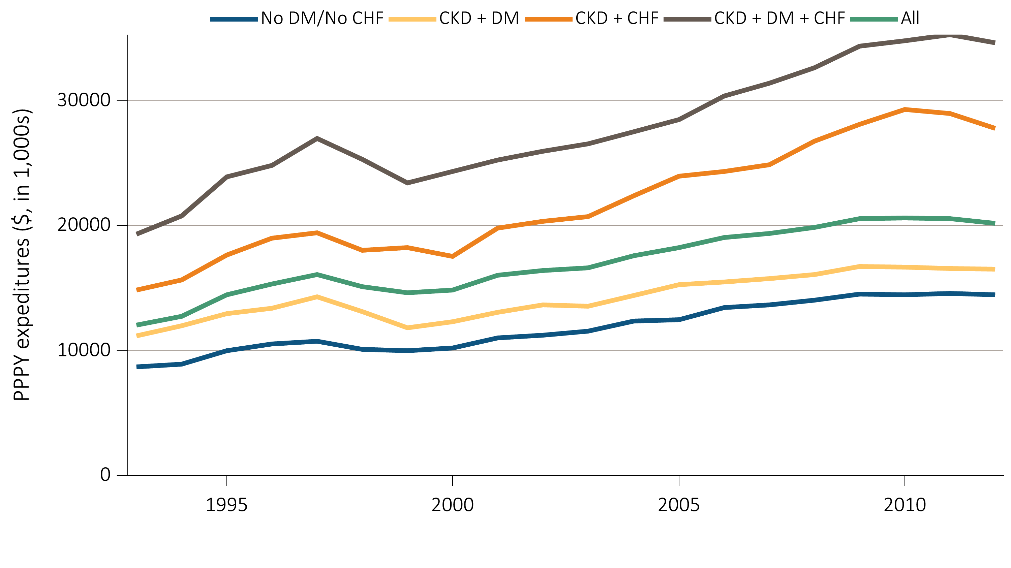
vol 1 Figure 6.5 Per person per year expenditures on Parts A and B services for the CKD Medicare population age 65+, by DM, CHF, and year, 1993-2012
Data Source: Medicare 5 percent sample. Abbreviations: CKD, chronic kidney disease; CHF, congestive heart failure, DM, diabetes mellitus; PPPY, per person per year.

