Slide 2
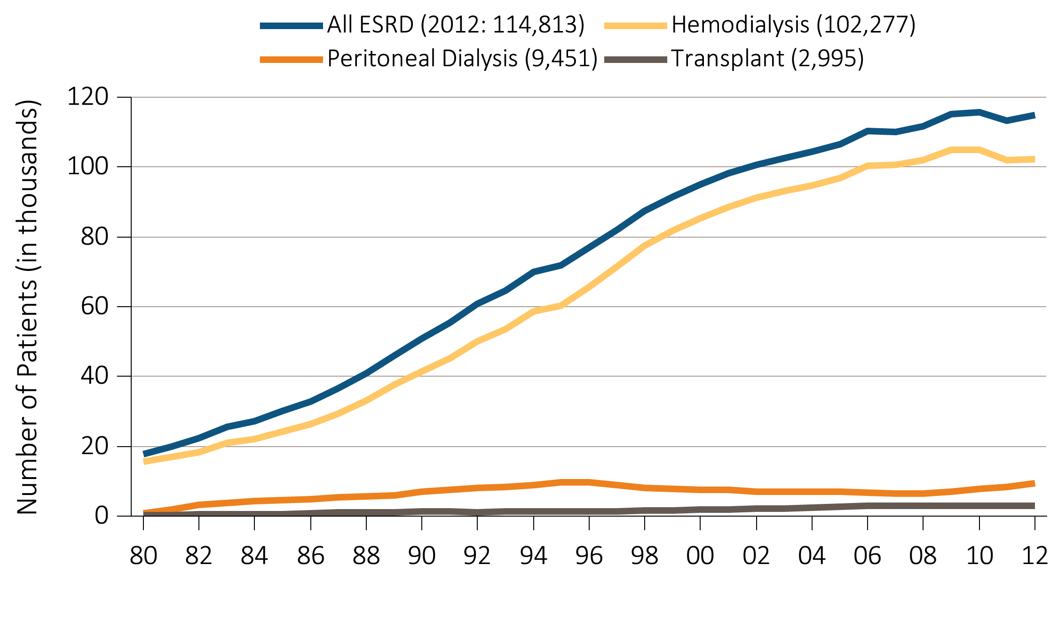
vol 2 Figure 1.1 Trends in the number of incident cases of ESRD, in thousands, by modality, in the U.S. population, 1980-2012
Data Source: Reference table D1. Abbreviation: ESRD, end-stage renal disease.

Slide 3
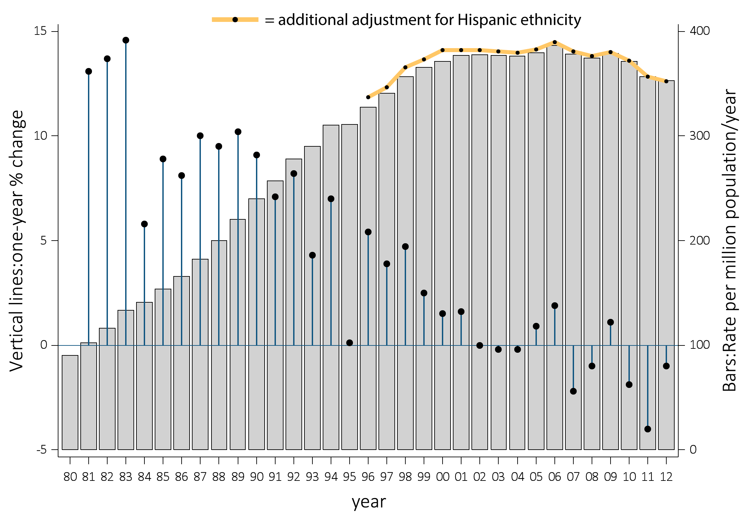
vol 2 Figure 1.2 Trends in the adjusted* incidence rate of ESRD, per million/year (bars; scale on right), and annual percent change in the adjusted* incidence rate of ESRD (lines; scale on left) in the U.S. population, 1980-2012
Data Source: Reference tables A.2(2) and A.2(3). *Adjusted for age, sex, and race. The standard population was the U.S. population in 2011. Abbreviation: ESRD, end-stage renal disease.

Slide 4
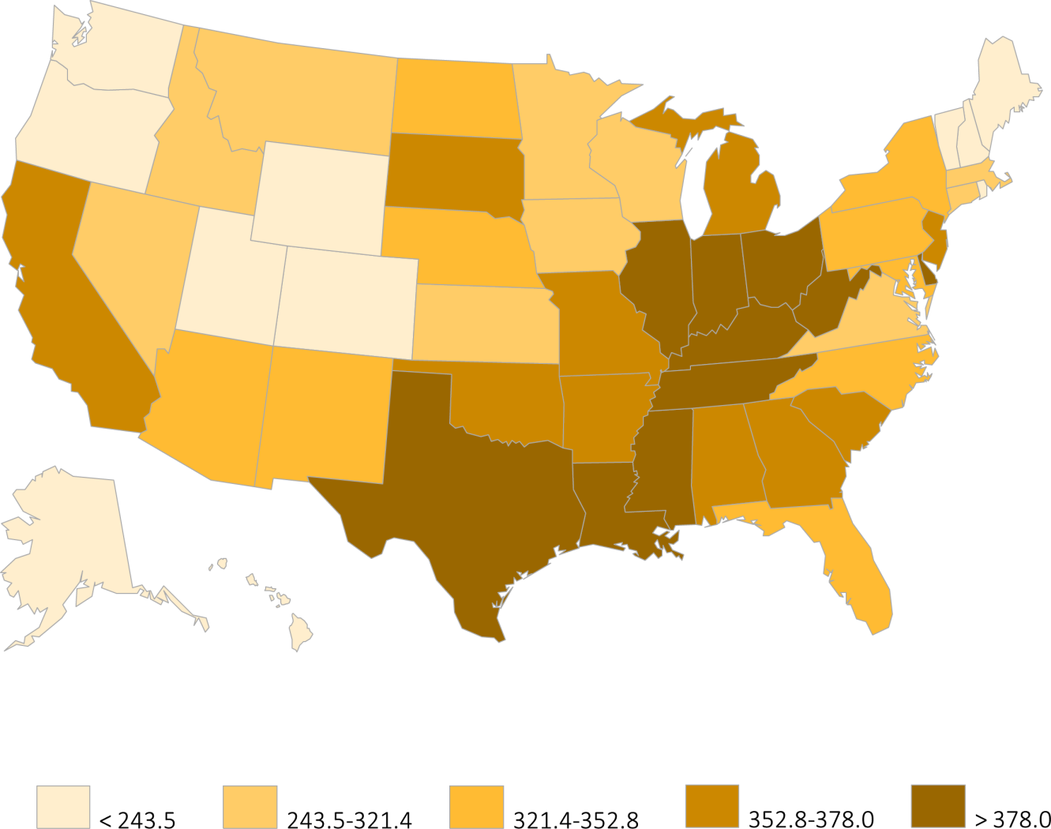
vol 2 Figure 1.3 Map of the adjusted* incidence rate of ESRD, per million/year, by state, in the U.S. population, 2012
Data Source: Reference table A.9, and special analyses, USRDS ESRD Database. *Adjusted for age, sex, and race. The standard population was the U.S. population in 2011. Abbreviation: ESRD, end-stage renal disease.

Slide 5
vol 2 Table 1.1 Adjusted* incidence rate of ESRD, per million/year, and percentage distribution of diabetes, race and ethnicity among incident ESRD patients, by ESRD network, 2012
Net-work | States in Network | Total patients | % of total | Rate per million/year | Mean age | % Diabetic | Race |  |  |  | Ethnicity
 |  |  |  |  |  |  | % White | % Af Am | % N Am | % Asian | % Hisp
1 | CT, MA, ME, NH, RI VT | 3,654 | 3.2 | 256.4 | 64.1 | 39.2 | 82.4 | 14.5 | 0.2 | 2.8 | 9.6
16 | AK, ID, MT, OR, WA | 3,380 | 2.9 | 269.3 | 61.7 | 43.2 | 82.4 | 6.1 | 3.4 | 8.0 | 7.8
15 | AZ, CO, NV, NM, UT, WY | 5,337 | 4.6 | 301.5 | 61.1 | 47.6 | 78.1 | 8.3 | 8.8 | 4.5 | 24.3
7 | FL | 7,444 | 6.5 | 319.5 | 64.2 | 39.6 | 67.8 | 30.0 | 0.2 | 2.0 | 15.4
2 | NY | 6,964 | 6.1 | 325.7 | 64.1 | 43.2 | 63.0 | 30.5 | 0.3 | 6.1 | 14.3
6 | NC, SC, GA | 9,918 | 8.6 | 328.0 | 60.6 | 40.4 | 44.0 | 53.7 | 0.7 | 1.5 | 2.3
5 | MD, DC, VA, WV | 6,596 | 5.7 | 334.7 | 62.5 | 39.3 | 50.6 | 45.9 | 0.1 | 3.2 | 2.7
12 | IA, KS, MO, NE | 4,229 | 3.7 | 336.9 | 63.3 | 40.4 | 76.6 | 21.0 | 0.8 | 1.5 | 4.5
11 | MI, MN, ND, SD, WI | 7,151 | 6.2 | 337.5 | 63.2 | 39.9 | 71.8 | 22.7 | 2.8 | 2.5 | 3.7
4 | DE, PA | 5,130 | 4.5 | 341.0 | 65.0 | 41.5 | 74.7 | 23.7 | 0.1 | 1.5 | 3.8
17 | N. CA, HI, GUAM, AS | 5,792 | 5.0 | 358.5 | 62.4 | 49.0 | 56.3 | 11.6 | 0.6 | 31.3 | 20.2
8 | AL, MS, TN | 6,310 | 5.5 | 364.4 | 61.2 | 43.0 | 51.0 | 47.6 | 0.4 | 0.9 | 1.4
3 | NJ, PR | 5,092 | 4.4 | 366.7 | 63.9 | 49.5 | 71.5 | 24.7 | 0.0 | 3.6 | 38.7
13 | AR, LA, OK | 4,651 | 4.1 | 372.4 | 61.3 | 44.1 | 56.1 | 38.8 | 3.9 | 1.1 | 3.3
10 | IL | 5,210 | 4.5 | 395.5 | 63.6 | 38.4 | 64.7 | 30.9 | 0.3 | 3.9 | 12.3
9 | IN, KY, OH | 9,152 | 8.0 | 404.0 | 63.3 | 44.5 | 76.6 | 22.2 | 0.1 | 1.1 | 2.4
18 | S. CA | 8,816 | 7.7 | 420.4 | 62.8 | 48.8 | 72.9 | 12.3 | 0.5 | 13.9 | 41.3
14 | TX | 9,800 | 8.5 | 426.4 | 60.3 | 54.7 | 73.6 | 23.5 | 0.2 | 2.6 | 40.9
All |  | 114,813 | 100.0 | 353.2 | 62.5 | 44.0 | 66.3 | 27.4 | 1.1 | 5.1 | 14.8
Data Source: Reference table: A.10, A.11, and Special Analyses, USRDS ESRD Database. *Adjusted for age, sex, and race. The standard population was the U.S. population in 2011. Listed from lowest to highest rate per million/year. Abbreviations: Af Am, African American; ESRD, end-stage renal disease; Hisp, Hispanic; N Am, Native American.

Slide 6
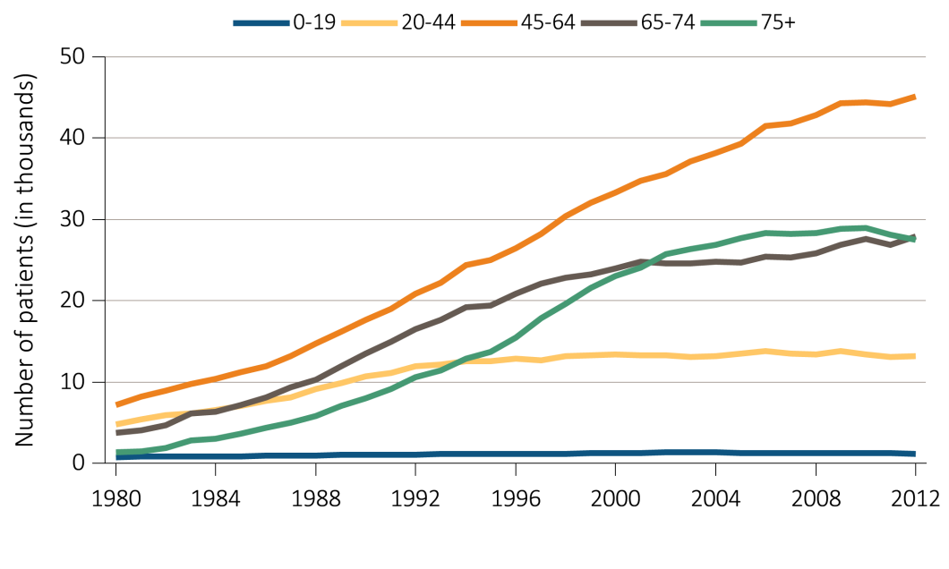
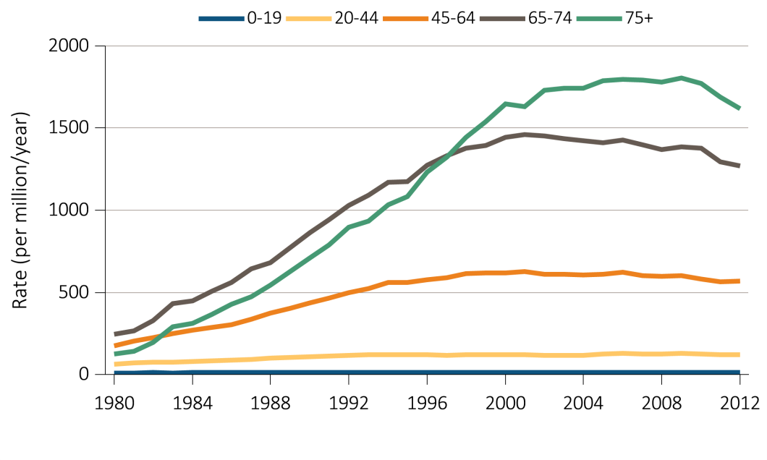
vol 2 Figure 1.4 Trends in (a) ESRD incident cases, in thousands, and (b) adjusted* ESRD incidence rate, per million/year, by age group, in the U.S. population, 1980-2012
(a) Incident Cases
(b) Incidence Rates
Data Source: Reference tables A.1, A.2(2). *Adjusted for sex and race. The standard population is the U.S. population in 2011. Abbreviation: ESRD, end-stage renal disease.

Slide 7
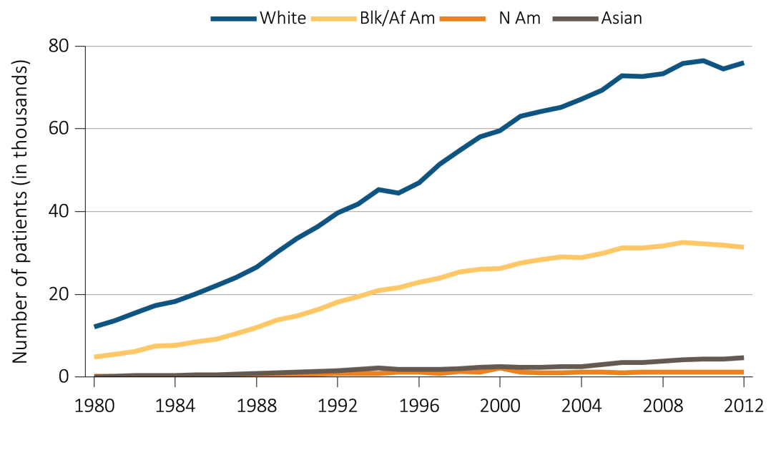
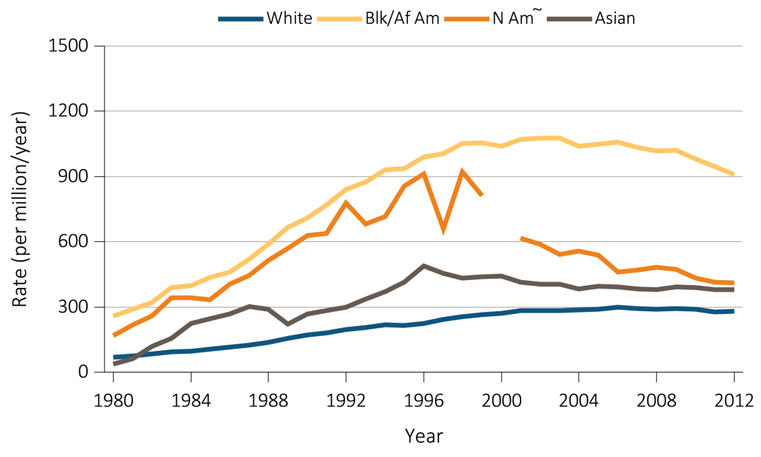
vol 2 Figure 1.5 Trends in (a) ESRD incident cases, in thousands, and (b) adjusted* ESRD incidence rate, per million/year, by race, in the U.S. population, 1980-2012
(a) Incident Cases
(b) Incidence Rates
Data Source: Reference tables A.1, A.2(2). *Adjusted for age and sex; the standard population was the U.S. population in 2011. Panel b: ~Estimate shown is imprecise due to small sample size and may be unstable over time. The line for Native Americans has a discontinuity because of unreliable data for that year. Abbreviations: Af Am, African American; ESRD, end-stage renal disease; N Am, Native American.

Slide 8
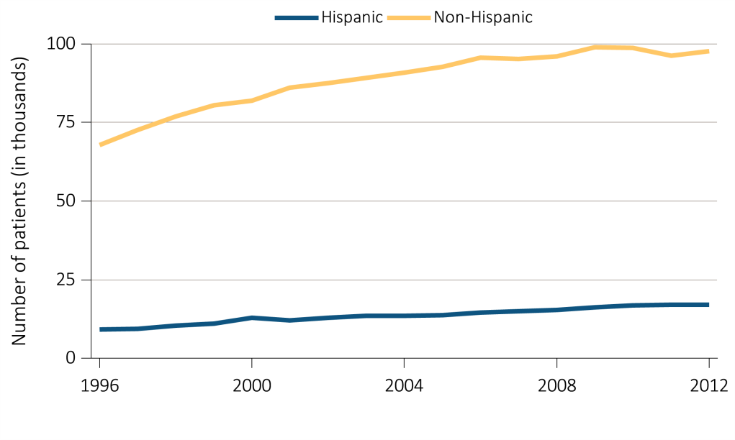
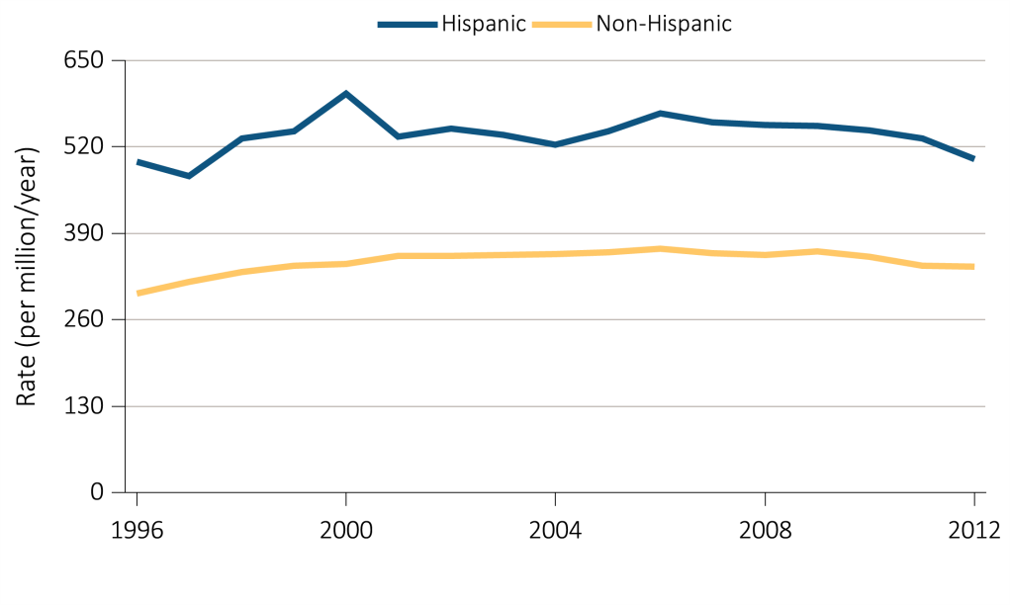
vol 2 Figure 1.6 Trends in (a) ESRD incident cases, in thousands, and (b) adjusted* ESRD incidence rate, per million/year, by Hispanic ethnicity, in the U.S. population, 1996-2012
(a) Incident Cases
(b) Incidence Rates
Data Source: Reference tables A.1, A.2(3). *Adjusted for age, sex, and race. The standard population was the U.S. population in 2011. Abbreviation: ESRD, end-stage renal disease.

Slide 9
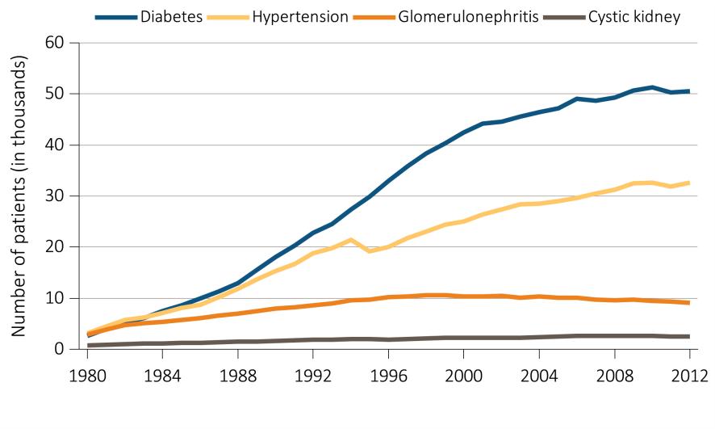
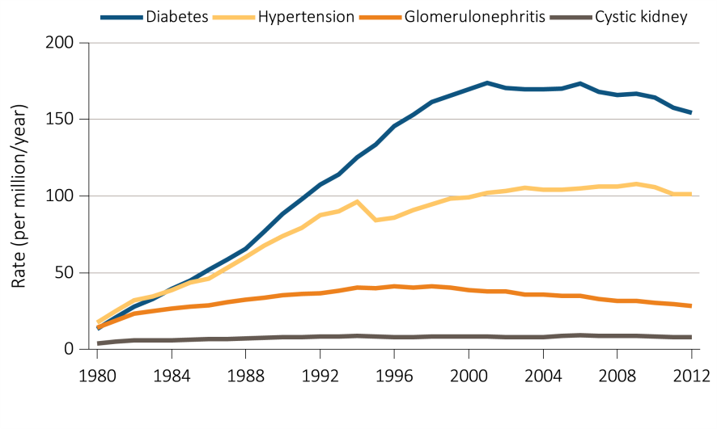
vol 2 Figure 1.7 Trends in (a) ESRD incident cases, in thousands, and (b) adjusted* ESRD incidence rate, per million/year, by primary cause of ESRD, in the U.S. population, 1980-2012
(a) Incident Cases
(b) Incidence Rates
Data Source: Reference tables A.1, A.2(2). *Adjusted for age, sex, and race. The standard population was the U.S. population in 2011. Abbreviation: ESRD, end-stage renal disease.

Slide 10
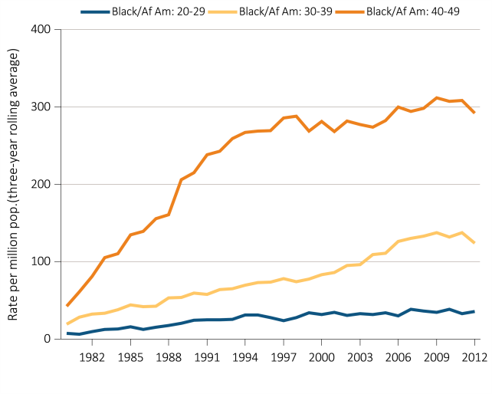
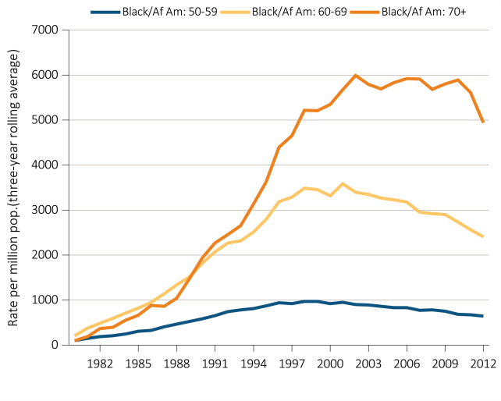
vol 2 Figure 1.8 Trends in the sex-adjusted incidence rate* of ESRD due to diabetes as the primary cause, per million/year, by age, race, and ethnicity, for black/African Americans, in the U.S. population, 1980-2012
Data Source: Special analyses, USRDS ESRD Database. *Rates are based on three-year rolling averages, and they are adjusted for sex. The standard population is the U.S. population in 2011. Abbreviations: Af Am, African American; ESRD, end-stage renal disease.

Slide 11
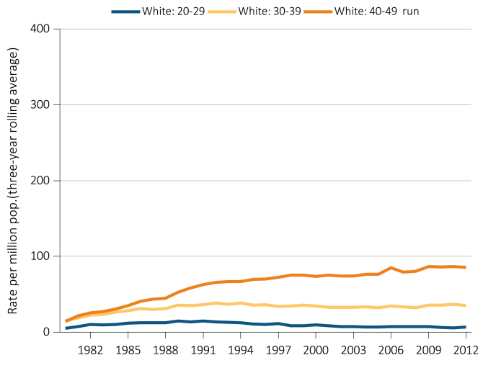
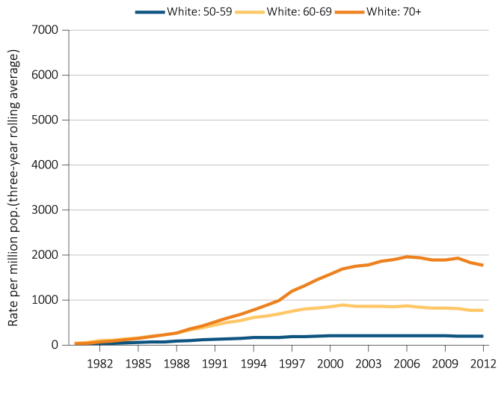
vol 2 Figure 1.8 Trends in the sex-adjusted incidence rate* of ESRD due to diabetes as the primary cause, per million/year, by age, race, and ethnicity, for whites, in the U.S. population, 1980-2012
Data Source: Special analyses, USRDS ESRD Database. *Rates are based on three-year rolling averages, and they are adjusted for sex. The standard population is the U.S. population in 2011. Abbreviations: ESRD, end-stage renal disease.

Slide 12
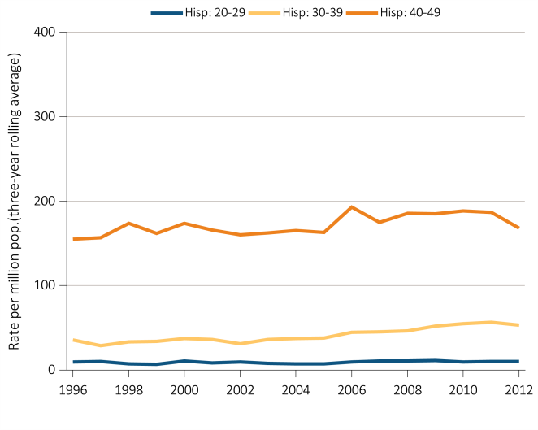
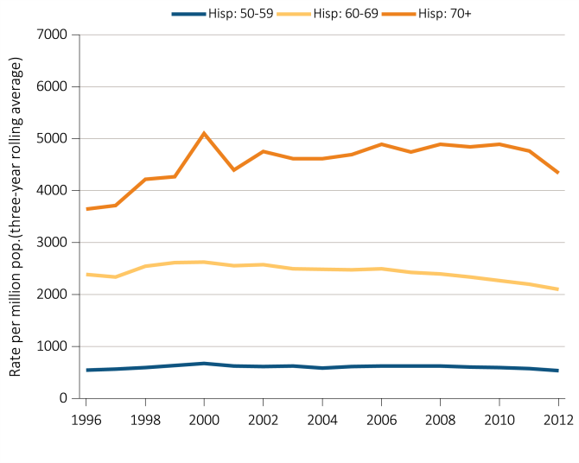
vol 2 Figure 1.8 Trends in the sex-adjusted incidence rate* of ESRD due to diabetes as the primary cause, per million/year, by age, race, and ethnicity, for Hispanics, in the U.S. population, 1980-2012
Data Source: Special analyses, USRDS ESRD Database. *Rates are based on three-year rolling averages, and they are adjusted for sex. The standard population is the U.S. population in 2011. Abbreviations: Hisp, Hispanic; ESRD, end-stage renal disease.

Slide 13
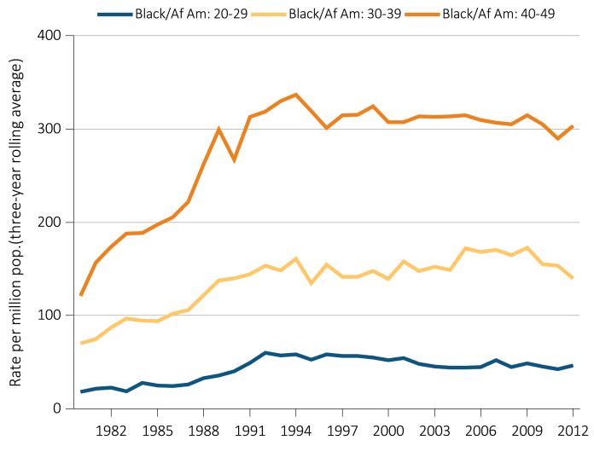
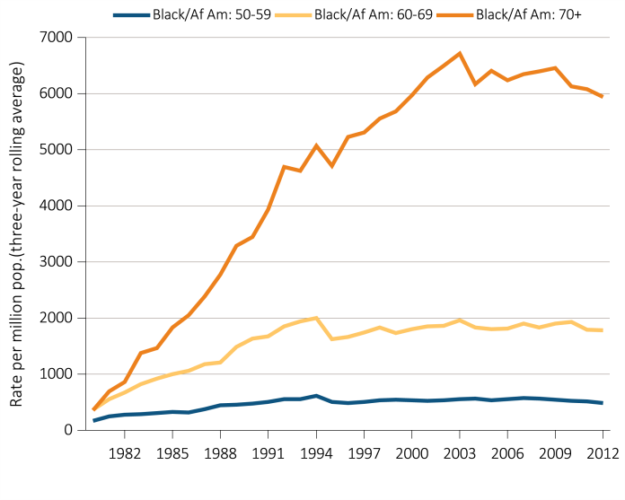
vol 2 Figure 1.9 Trends in the sex-adjusted incidence rate* of ESRD due to hypertension as the primary cause, per million/year, by age, race, and ethnicity, for blacks/African Americans, in the U.S. population, 1980-2012
Data Source: Special analyses, USRDS ESRD Database. *Rates are based on three-year rolling averages, and they are adjusted for sex. The standard population is the U.S. population in 2011. Abbreviations: Af Am, African American; ESRD, end-stage renal disease.

Slide 14
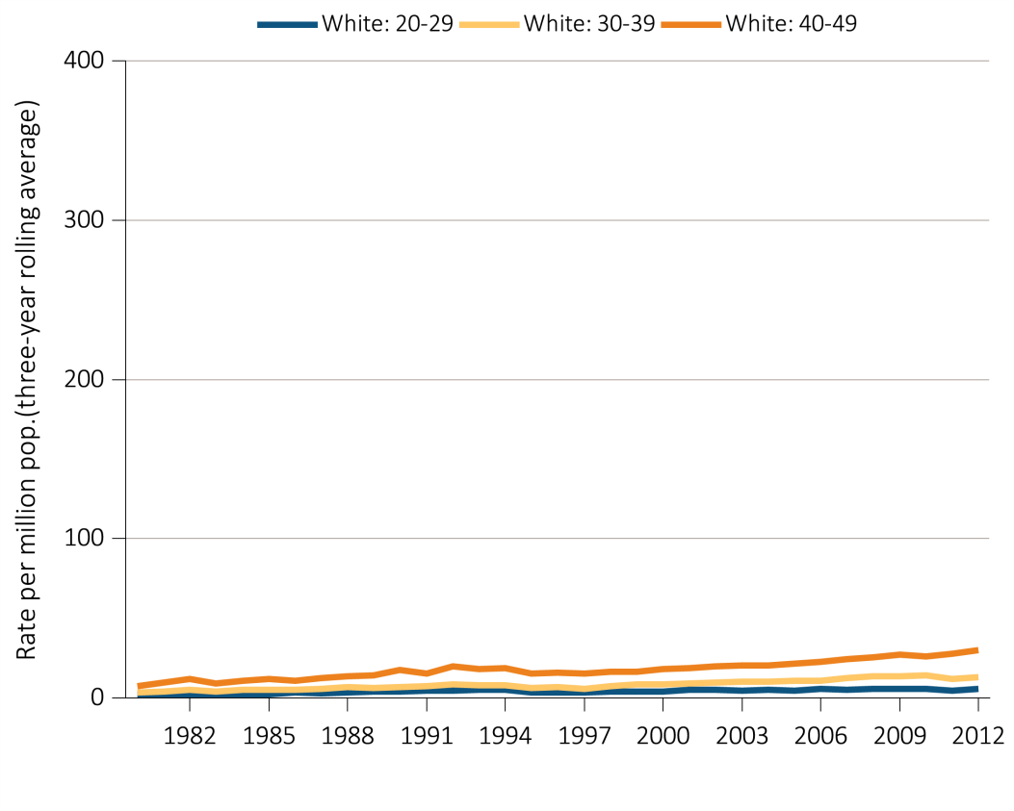
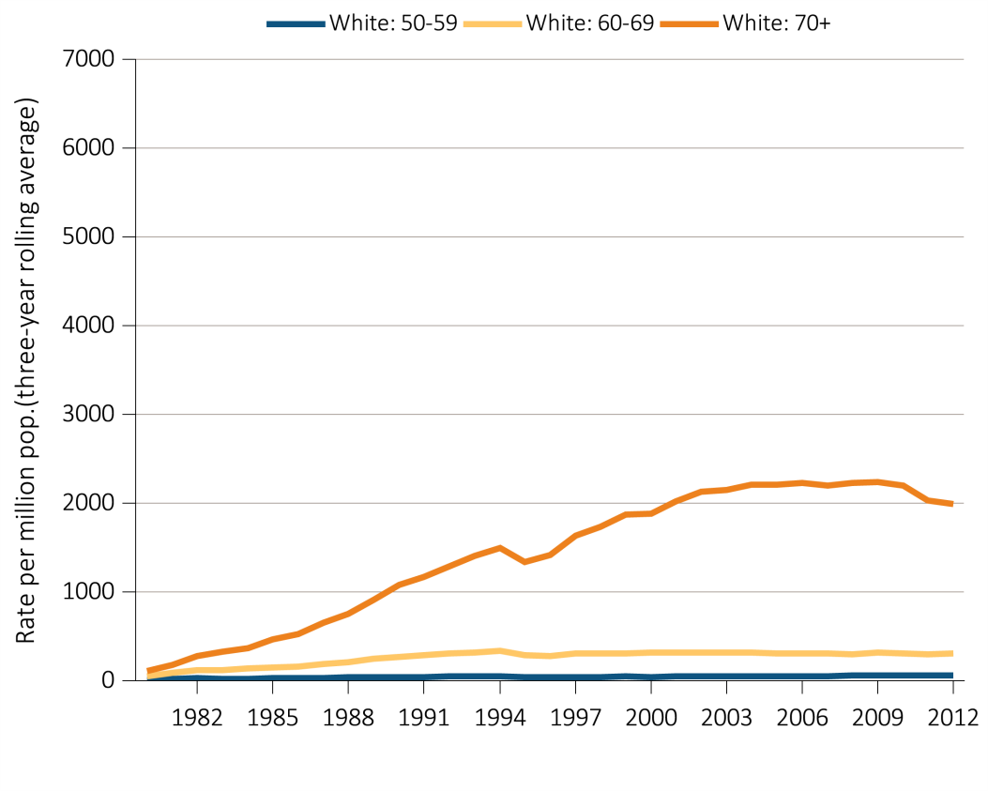
vol 2 Figure 1.9 Trends in the sex-adjusted incidence rate* of ESRD due to hypertension as the primary cause, per million/year, by age, race, and ethnicity, for whites, in the U.S. population, 1980-2012
Data Source: Special analyses, USRDS ESRD Database. *Rates are based on three-year rolling averages, and they are adjusted for sex. The standard population is the U.S. population in 2011. Abbreviations: ESRD, end-stage renal disease.

Slide 15
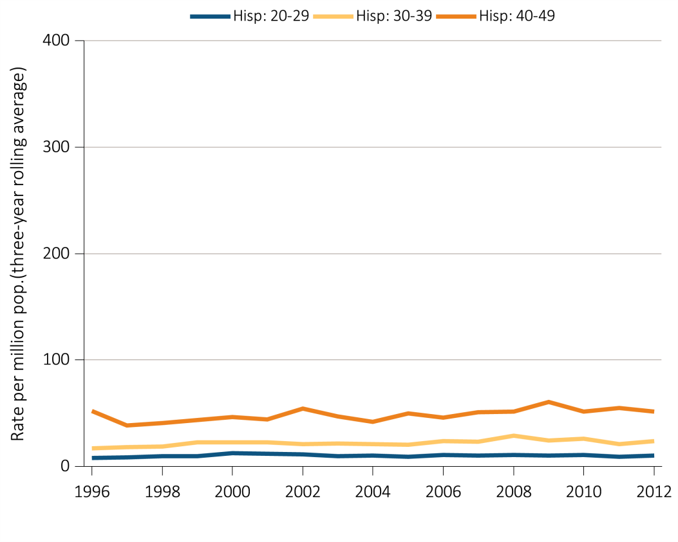
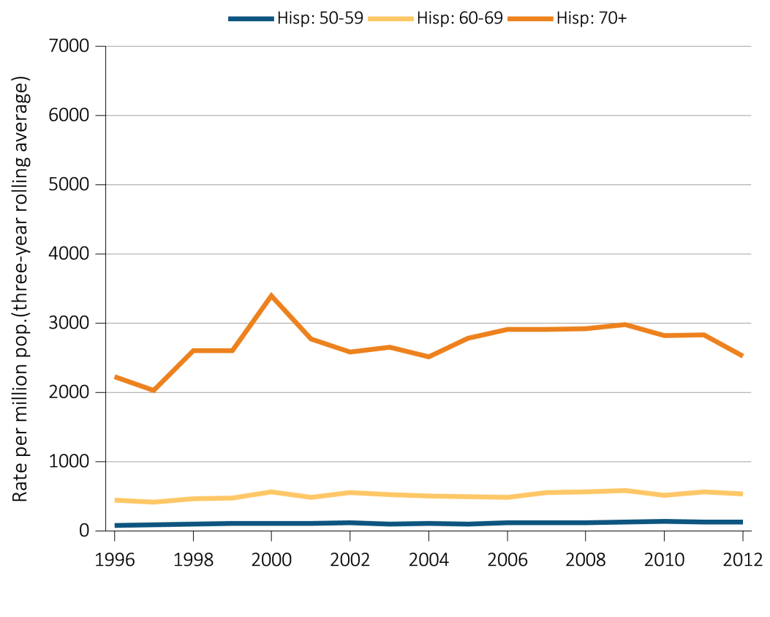
vol 2 Figure 1.9 Trends in the sex-adjusted incidence rate* of ESRD due to hypertension as the primary cause, per million/year, by age, race, and ethnicity, for Hispanics, in the U.S. population, 1980-2012
Data Source: Special analyses, USRDS ESRD Database. *Rates are based on three-year rolling averages, and they are adjusted for sex. The standard population is the U.S. population in 2011. Abbreviations: Hisp, Hispanic; ESRD, end-stage renal disease.

Slide 16
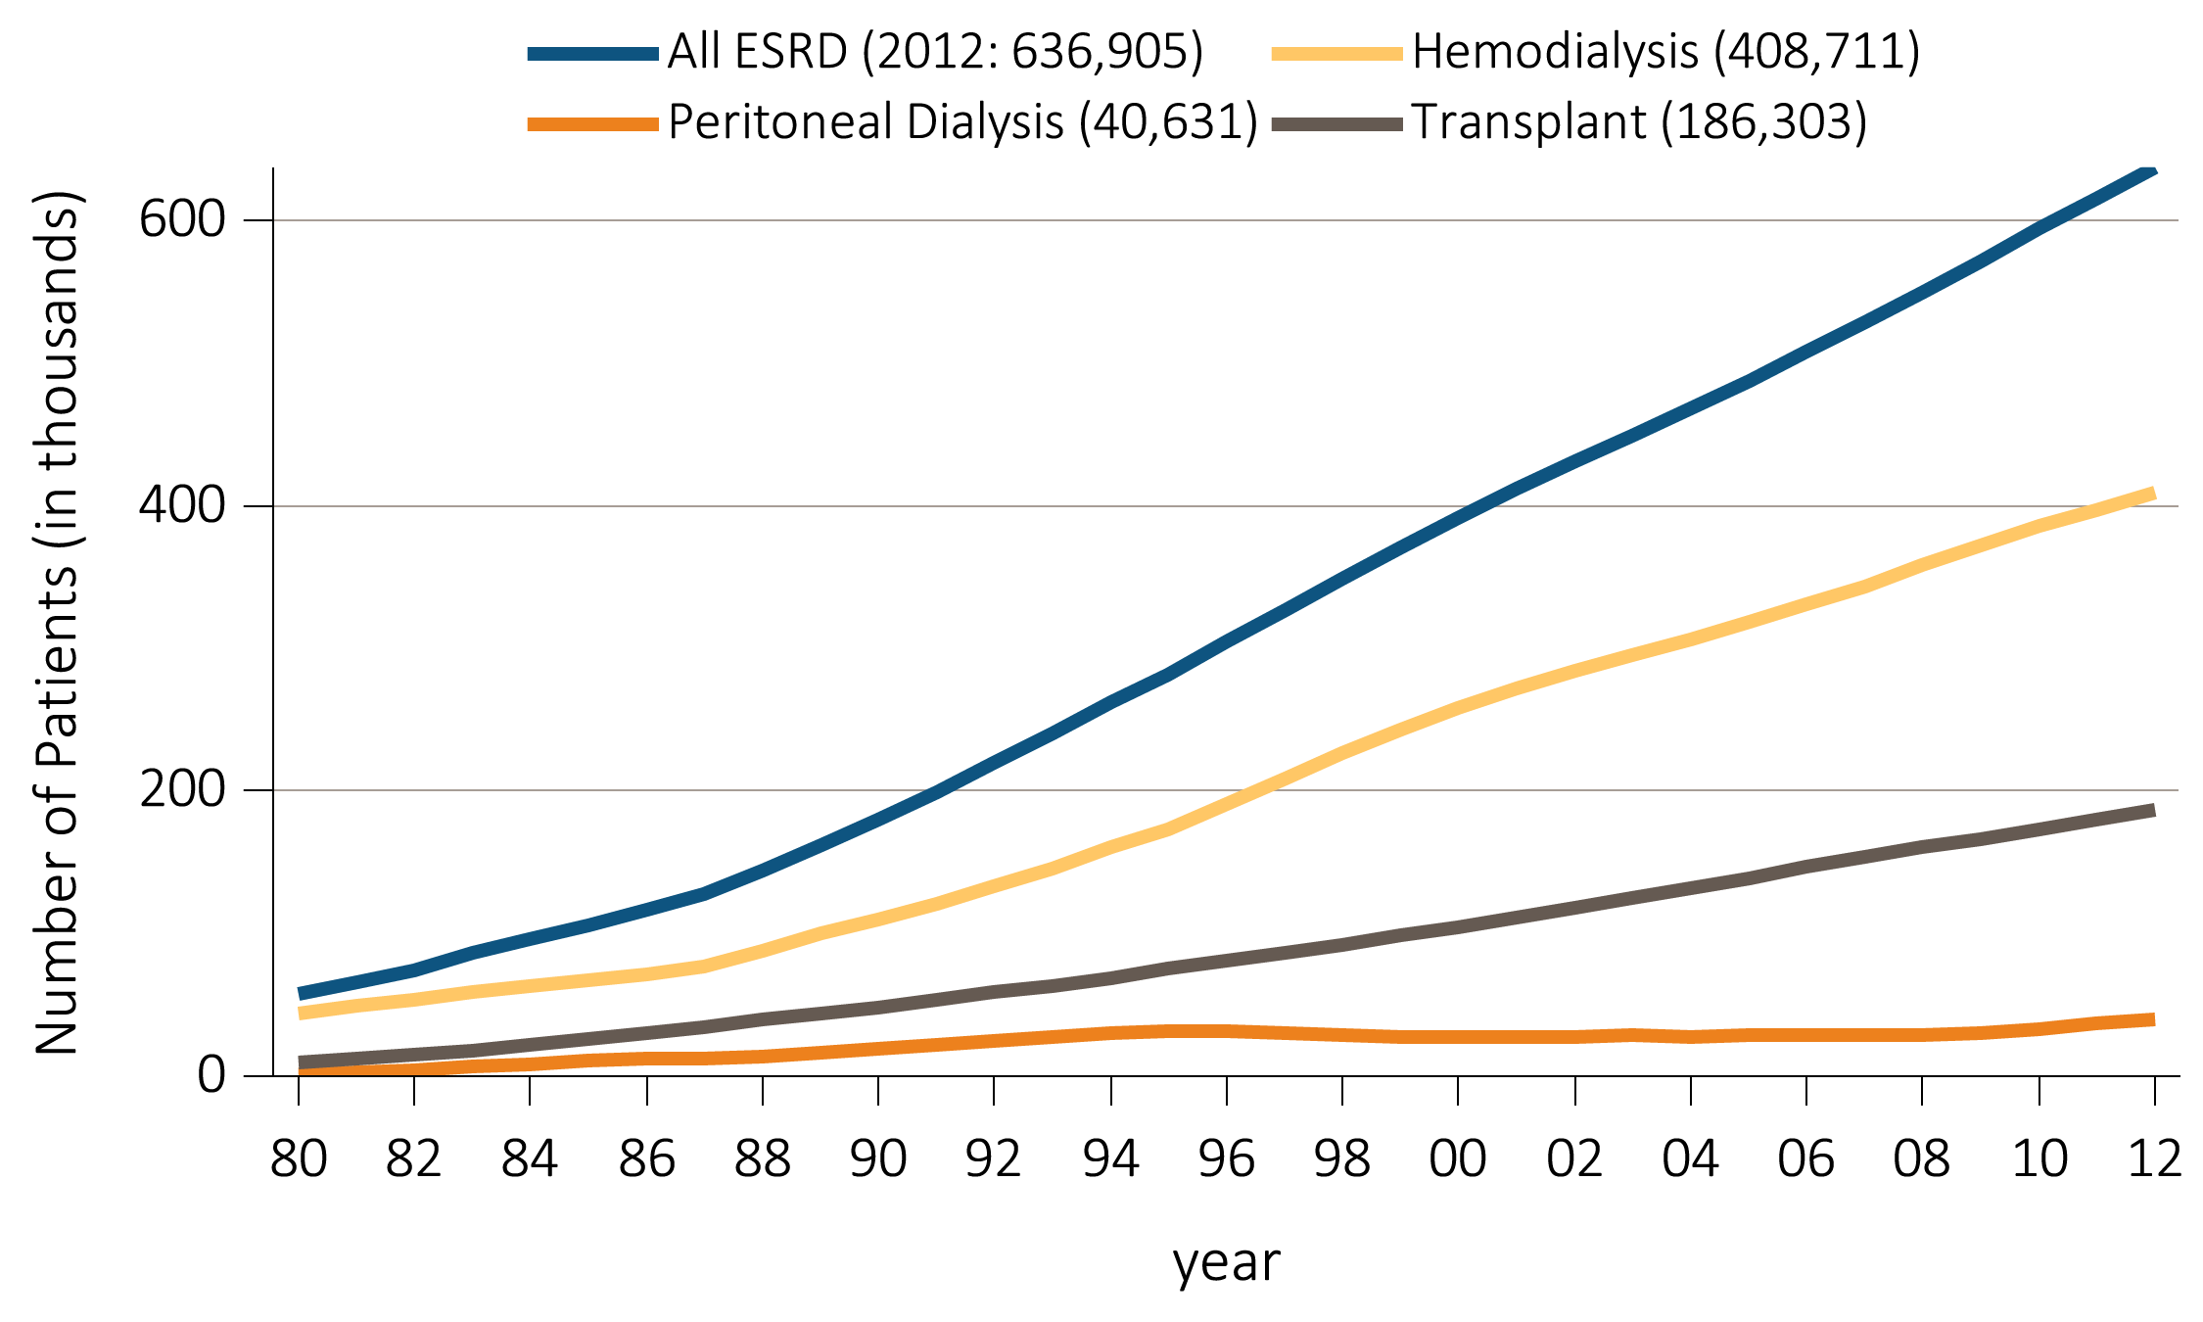
vol 2 Figure 1.10 Trends in the number of prevalent cases of ESRD, in thousands, by modality, in the U.S. population, 1980-2012
Data Source: Reference table D.1. Abbreviation: ESRD, end-stage renal disease.

Slide 17
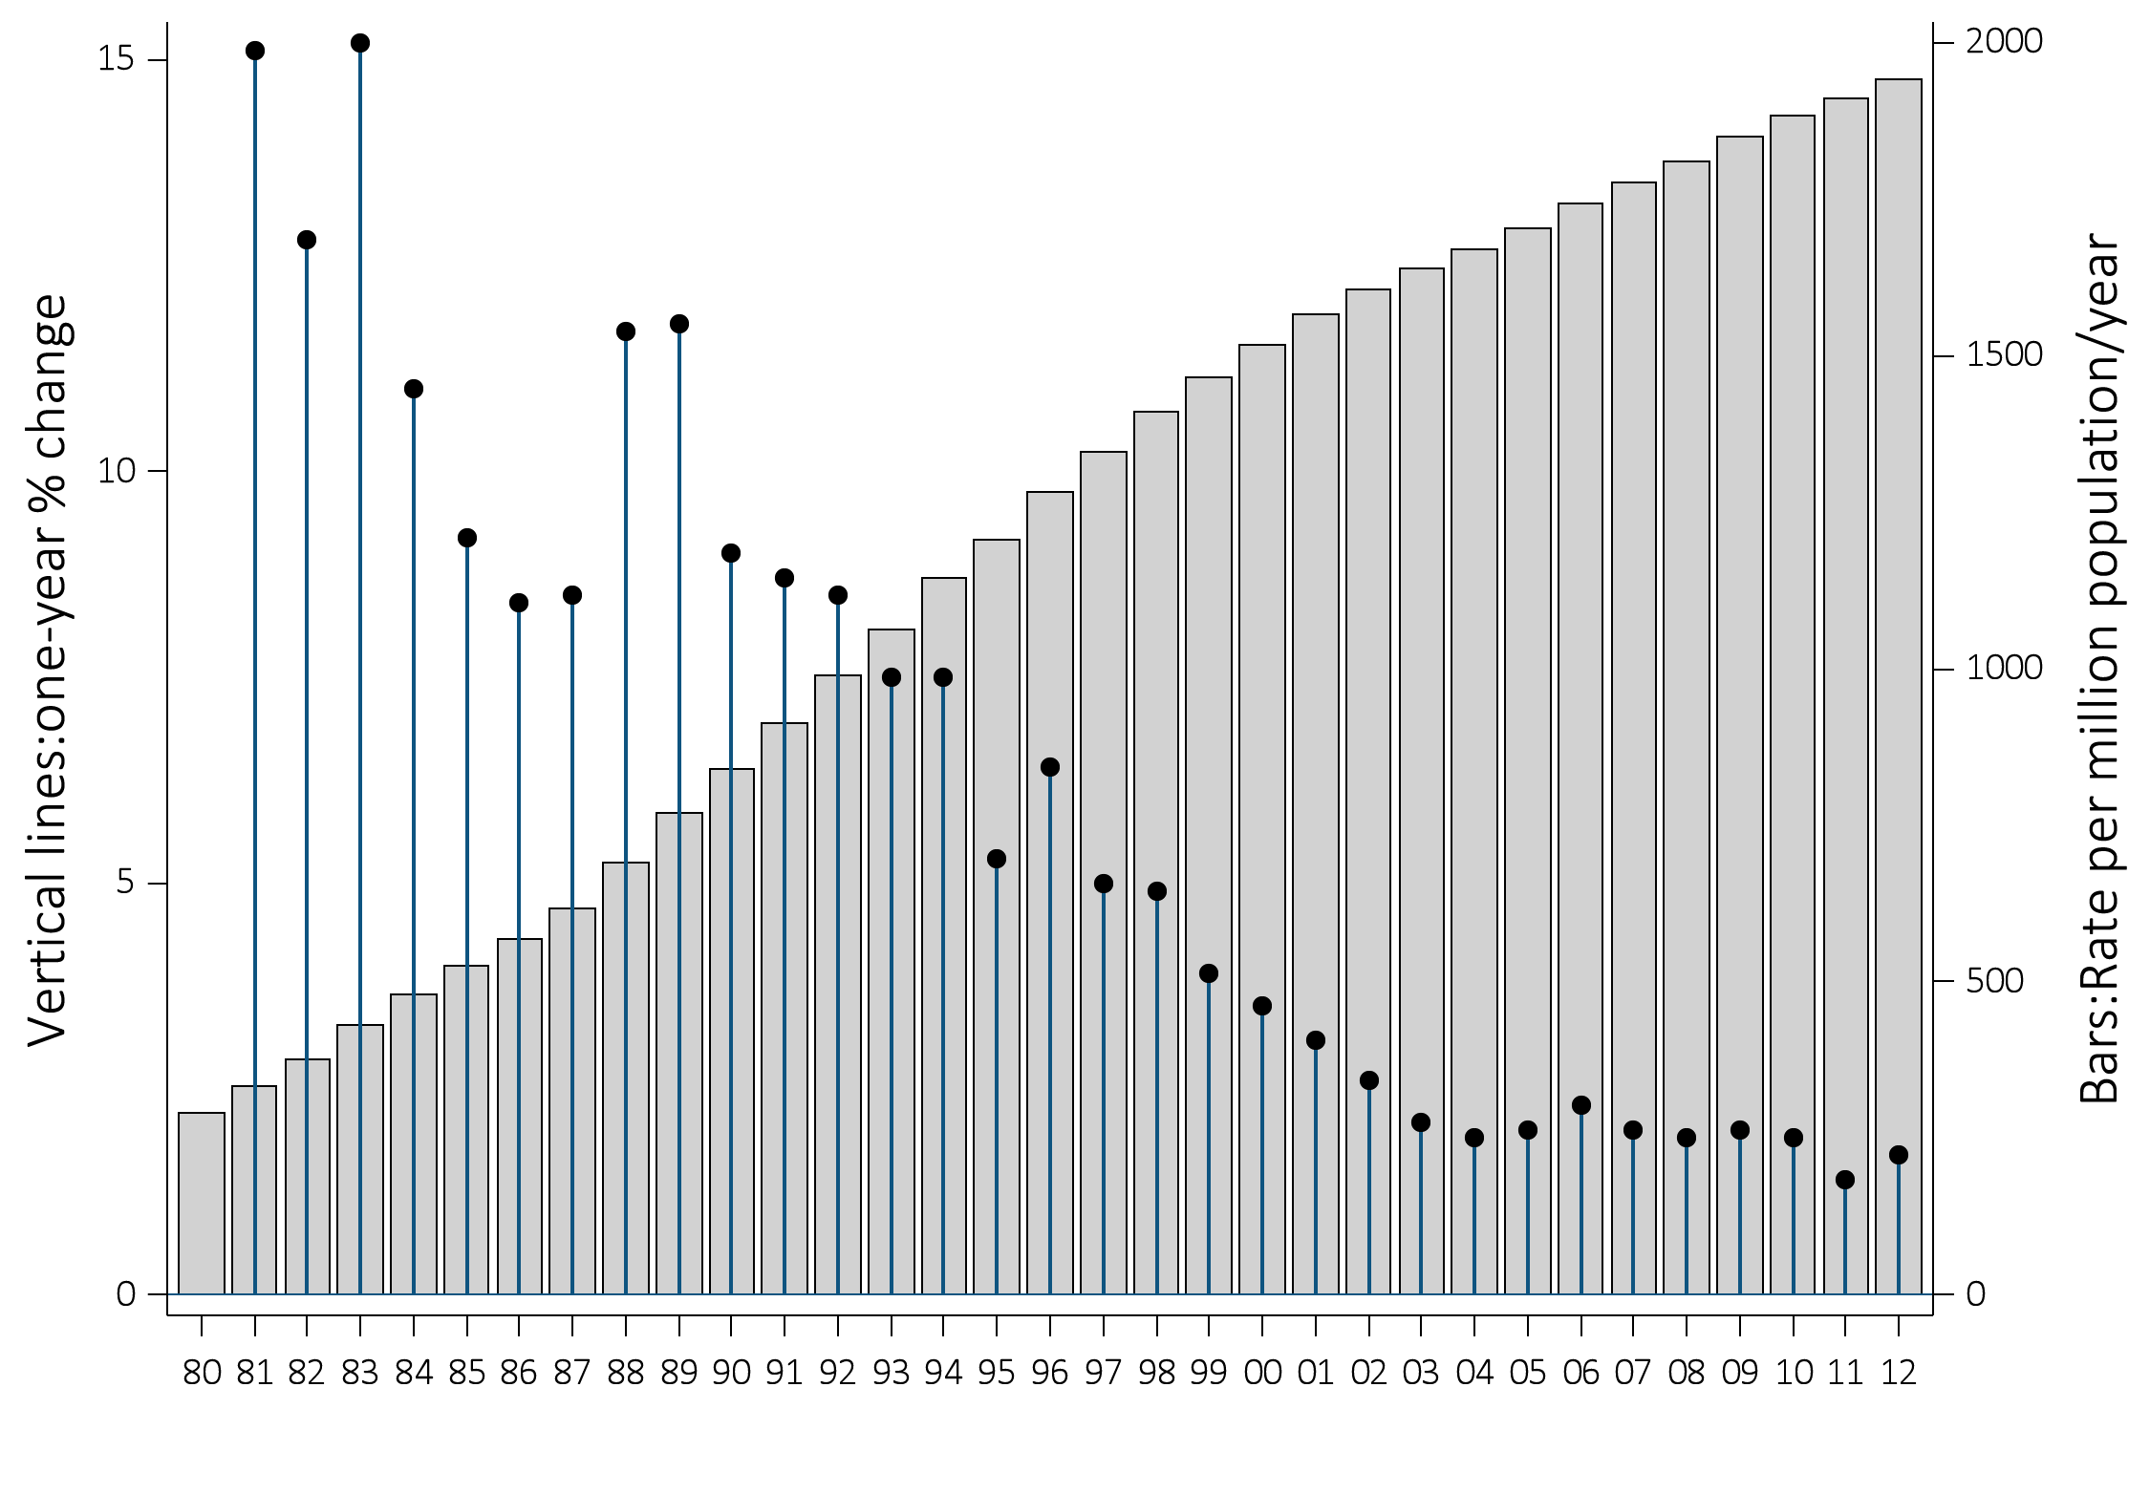
vol 2 Figure 1.11 Trends in the adjusted* ESRD prevalence per million (bars; scale on left), and annual percent change in adjusted* prevalence of ESRD (lines; scale on right), in the U.S. population, 1980-2012
Data Source: Reference table: B.2(2), and B.2(3). *Adjusted for age, sex, and race. The standard population was the U.S. population in 2011. Abbreviation: ESRD, end-stage renal disease.

Slide 18
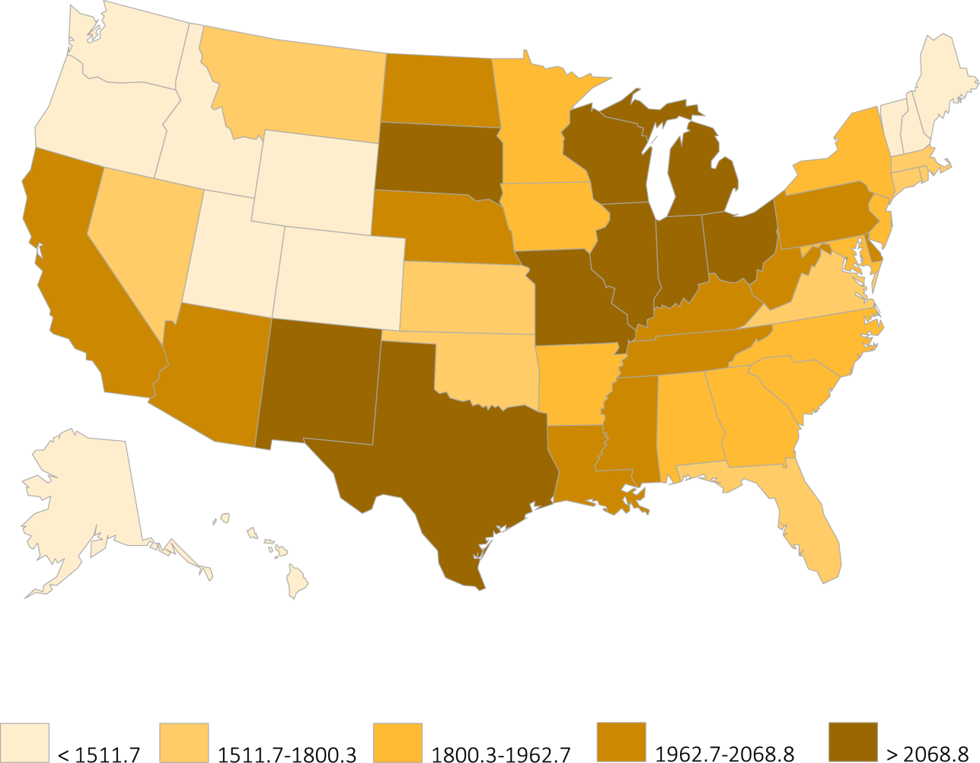
vol 2 Figure 1.12 Map of the adjusted* prevalence of ESRD per million, by state, in the U.S. population, 2012
Data Source: Reference table B.9, and special analyses, USRDS ESRD Database. *Adjusted for age, sex, and race. The standard population was the U.S. population in 2011. Abbreviation: ESRD, end-stage renal disease.

Slide 19
vol 2 Table 1.2 Adjusted* prevalence of dialysis, per million, and percentage distribution of diabetes, race, and ethnicity among prevalent dialysis patients, by ESRD network, 2012
 |  |  |  |  |  |  | Race |  |  |  | Ethnicity
Network | States in Network | Total patients | % of total | Prevalence per million | Mean age | % Diabetic | % White | % Af Am | % N Am | % Asian | % Hisp
16 | AK, ID, MT, OR, WA | 11,187 | 2.7 | 772 | 61.9 | 44.7 | 75.9 | 9.5 | 4.0 | 10.3 | 11.0
1 | CT, MA, ME, NH, RI VT | 12,422 | 3.0 | 831 | 64.9 | 40.2 | 74.2 | 21.4 | 0.3 | 3.4 | 11.7
15 | AZ, CO, NV, NM, UT, WY | 19,135 | 4.7 | 929 | 61.7 | 52.6 | 70.2 | 11.2 | 13.2 | 5.0 | 31.6
12 | IA, KS, MO, NE | 13,531 | 3.3 | 961 | 62.9 | 41.5 | 66.1 | 30.9 | 1.1 | 1.7 | 5.8
11 | MI, MN, ND, SD, WI | 24,138 | 5.9 | 1,048 | 63.1 | 41.7 | 61.0 | 32.7 | 3.2 | 2.9 | 4.7
9 | IN, KY, OH | 27,997 | 6.9 | 1,224 | 62.5 | 44.3 | 63.5 | 35.2 | 0.1 | 1.0 | 2.8
4 | DE, PA | 17,264 | 4.2 | 1,237 | 63.5 | 41.4 | 61.0 | 36.6 | 0.1 | 1.9 | 5.2
7 | FL | 24,661 | 6.0 | 1,241 | 62.9 | 40.7 | 54.1 | 43.0 | 0.3 | 2.1 | 17.9
17 | N. CA, HI, GUAM, AS | 21,696 | 5.3 | 1,295 | 62.8 | 51.1 | 49.0 | 15.4 | 0.8 | 33.7 | 23.6
2 | NY | 26,616 | 6.5 | 1,320 | 63.5 | 41.2 | 49.9 | 41.4 | 0.4 | 6.8 | 16.6
10 | IL | 17,616 | 4.3 | 1,342 | 62.7 | 39.6 | 53.4 | 42.3 | 0.2 | 3.8 | 14.8
3 | NJ, PR | 17,436 | 4.3 | 1,350 | 63.5 | 47.3 | 59.5 | 33.4 | 0.1 | 3.9 | 37.7
13 | AR, LA, OK | 16,041 | 3.9 | 1,387 | 60.1 | 43.5 | 40.1 | 54.0 | 4.4 | 1.3 | 3.7
5 | MD, DC, VA, WV | 23,770 | 5.8 | 1,401 | 61.9 | 39.4 | 35.6 | 60.4 | 0.3 | 3.1 | 4.0
18 | S. CA | 34,850 | 8.5 | 1,429 | 62.6 | 49.9 | 70.0 | 15.6 | 0.4 | 13.5 | 48.6
14 | TX | 38,712 | 9.5 | 1,444 | 60.3 | 54.0 | 66.5 | 30.2 | 0.3 | 2.3 | 45.8
6 | NC, SC, GA | 38,706 | 9.5 | 1,544 | 60.3 | 40.6 | 28.9 | 68.7 | 0.7 | 1.3 | 2.9
8 | AL, MS, TN | 22,665 | 5.6 | 1,559 | 60.2 | 41.5 | 35.5 | 63.2 | 0.5 | 0.6 | 1.2
All |  | 408,711 | 100.0 | 1,251 | 62.1 | 44.6 | 54.9 | 37.6 | 1.4 | 5.4 | 17.9
Data Source: Special analyses, USRDS ESRD Database. *Adjusted for age, sex, and race. The standard population was the U.S. population in 2011. Listed from lowest to highest prevalence per million. Abbreviations: Af Am, African American; ESRD, end-stage renal disease; Hisp, Hispanic; N Am, Native American.

Slide 20
vol 2 Table 1.3 Adjusted* prevalence of kidney transplant patients, per million, and percentage distribution of diabetes, race, and ethnicity among prevalent transplant patients, by ESRD network, 2012
 |  |  |  |  |  |  | Race |  |  |  | Ethnicity
Network | States in Network | Total patients | % of total | Prevalence per million | Mean age | % Diabetic | % White | % Af Am | % N Am | % Asian | % Hisp
13 | AR, LA, OK | 5,554 | 3.0 | 482.1 | 52.2 | 24.0 | 64.0 | 30.9 | 2.6 | 2.0 | 3.5
7 | FL | 9,649 | 5.2 | 482.3 | 54.9 | 22.3 | 71.1 | 23.0 | 0.5 | 3.4 | 19.5
14 | TX | 13,089 | 7.0 | 482.3 | 51.4 | 25.3 | 75.3 | 17.7 | 0.4 | 4.0 | 37.5
16 | AK, ID, MT, OR, WA | 7,205 | 3.9 | 498.3 | 53.3 | 22.9 | 83.4 | 5.2 | 1.8 | 8.6 | 7.5
6 | NC, SC, GA | 12,554 | 6.7 | 501.8 | 52.5 | 22.8 | 55.0 | 40.8 | 0.8 | 2.3 | 3.4
15 | AZ, CO, NV, NM, UT, WY | 10,436 | 5.6 | 506.2 | 52.9 | 28.3 | 83.0 | 5.8 | 5.4 | 4.4 | 23.4
18 | S. CA | 12,985 | 7.0 | 525.6 | 51.7 | 19.8 | 73.9 | 9.9 | 0.4 | 13.3 | 41.5
8 | AL, MS, TN | 7,804 | 4.2 | 540.2 | 51.9 | 21.4 | 60.6 | 37.6 | 0.2 | 1.3 | 1.5
9 | IN, KY, OH | 12,937 | 6.9 | 565.7 | 53.0 | 24.8 | 79.7 | 17.6 | 0.1 | 1.6 | 2.4
1 | CT, MA, ME, NH, RI VT | 8,538 | 4.6 | 568.1 | 53.9 | 20.2 | 82.5 | 11.4 | 0.3 | 3.8 | 8.6
2 | NY | 12,153 | 6.5 | 587.4 | 53.4 | 21.3 | 64.8 | 23.2 | 0.5 | 6.9 | 18.2
17 | N. CA, HI, GUAM, AS | 9,764 | 5.2 | 589.8 | 53.3 | 22.1 | 61.8 | 8.9 | 0.7 | 24.6 | 24.4
12 | IA, KS, MO, NE | 8,328 | 4.5 | 593.7 | 53.3 | 23.8 | 82.0 | 13.9 | 1.4 | 2.2 | 5.2
4 | DE, PA | 8,808 | 4.7 | 626.0 | 54.6 | 23.0 | 74.8 | 20.5 | 0.2 | 2.6 | 4.2
3 | NJ, PR | 7,255 | 3.9 | 629.7 | 53.6 | 23.3 | 64.0 | 20.3 | 0.2 | 5.7 | 29.1
5 | MD, DC, VA, WV | 11,046 | 5.9 | 647.2 | 53.6 | 22.0 | 55.1 | 38.0 | 0.3 | 4.8 | 4.6
10 | IL | 9,191 | 4.9 | 687.7 | 52.8 | 23.3 | 69.4 | 22.6 | 0.4 | 4.9 | 14.7
11 | MI, MN, ND, SD, WI | 16,256 | 8.7 | 707.7 | 53.9 | 26.3 | 79.9 | 14.0 | 1.9 | 3.5 | 3.5
All |  | 186,303 | 100.0 | 562.4 | 53.0 | 23.0 | 70.6 | 19.6 | 1.0 | 5.7 | 14.5
Data Source: Special analyses, USRDS ESRD Database. *Adjusted for age, sex, and race. The standard population was the U.S. population in 2011. Listed from lowest to highest prevalence per million. Abbreviations: Af Am, African American; ESRD, end-stage renal disease; Hisp, Hispanic; N Am, Native American.

Slide 21
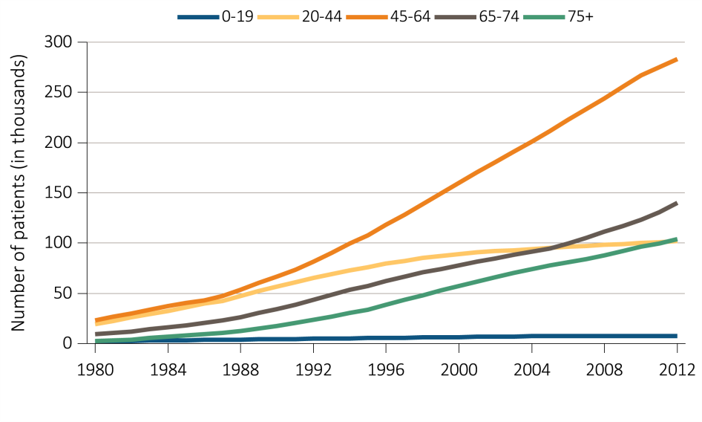
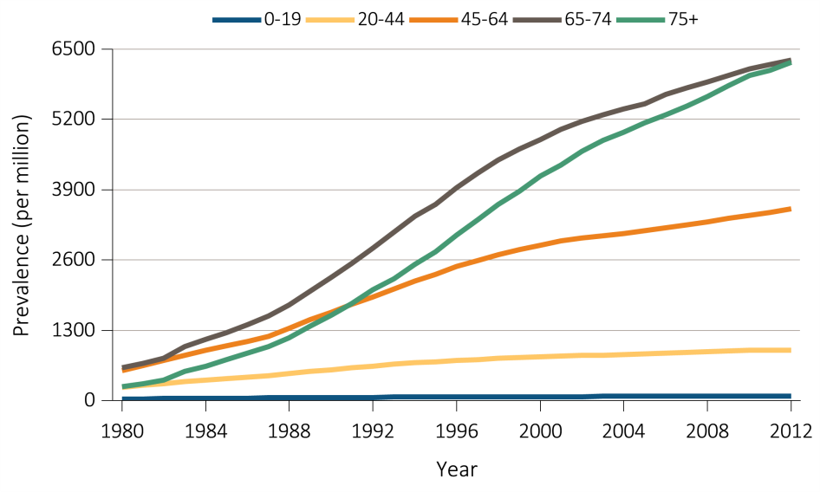
vol 2 Figure 1.13 Trends in (a) prevalent ESRD cases and (b) the adjusted* prevalence of ESRD, per million, by age group, in the U.S. population, 1980-2012
(a) Prevalent Cases
(b) Prevalence per million
Data Source: Reference tables B.1, B.1(2). *Point prevalence on December 31 of each year; Adjusted for sex and race; The standard population was the U.S. population in 2011 ESRD patients. Abbreviation: ESRD, end-stage renal disease.

Slide 22
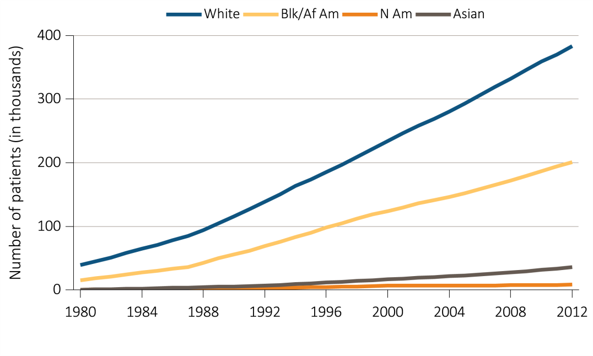
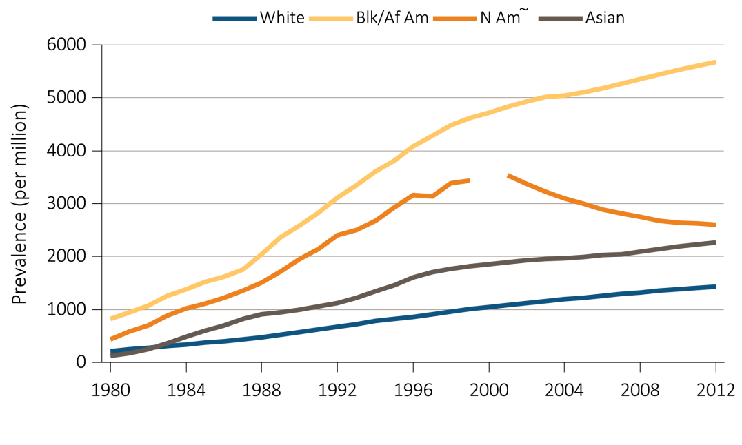
vol 2 Figure 1.14 Trends in (a) prevalent ESRD cases and (b) the adjusted* prevalence of ESRD, per million, by race, in the U.S. population, 1980-2012
(a) Prevalent Cases
(b) Prevalence per million
Data Source: Reference tables B.1, B.1(2). *Point prevalence on December 31 of each year; Adjusted for age and sex; The standard population was the U.S. population in 2011 ESRD patients. Panel b: ~Estimate shown is imprecise due to small sample size and may be unstable over time. The line for Native Americans has a discontinuity because of unreliable data for that year. Abbreviations: Af Am, African American; ESRD, end-stage renal disease; N Am, Native American.

Slide 23
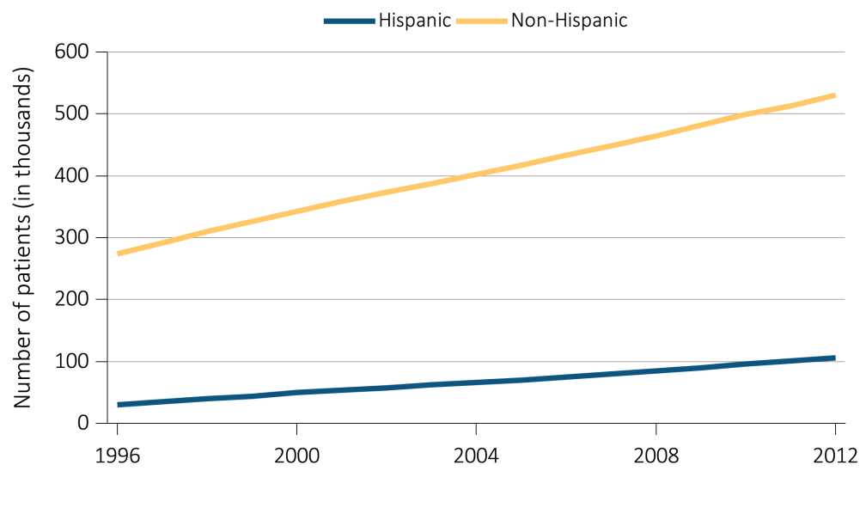
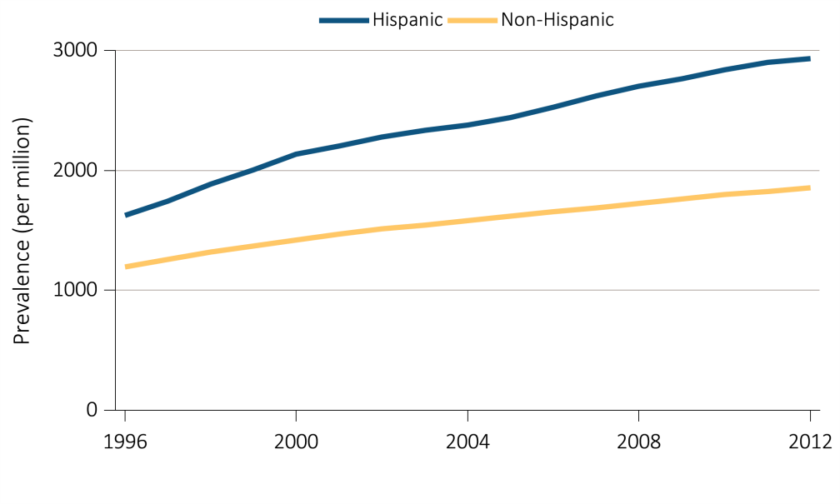
vol 2 Figure 1.15 Trends in (a) prevalent ESRD cases and (b) the adjusted* prevalence of ESRD, per million, by ethnicity, in the U.S. population, 1980-2012
(a) Prevalent Cases
(b) Prevalence per million
Data Source: Reference tables B.1, B.1(3). *Point prevalence on December 31 of each year; Adjusted for age, sex, and race; The standard population was the U.S. population in 2011 ESRD patients. Abbreviation: ESRD, end-stage renal disease.

Slide 24
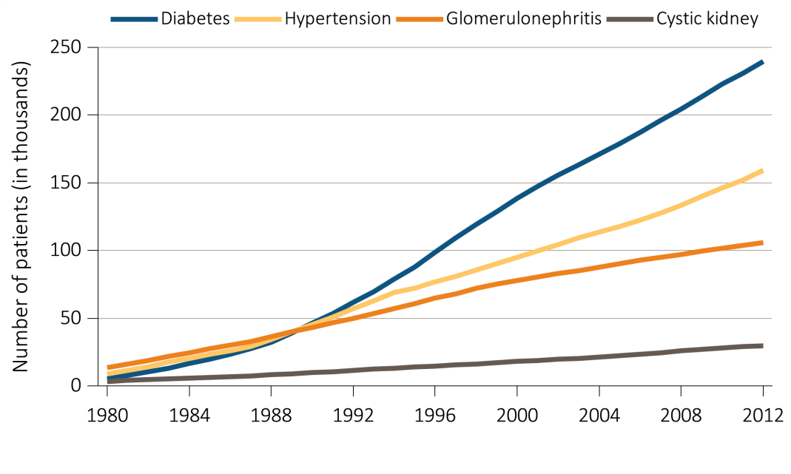
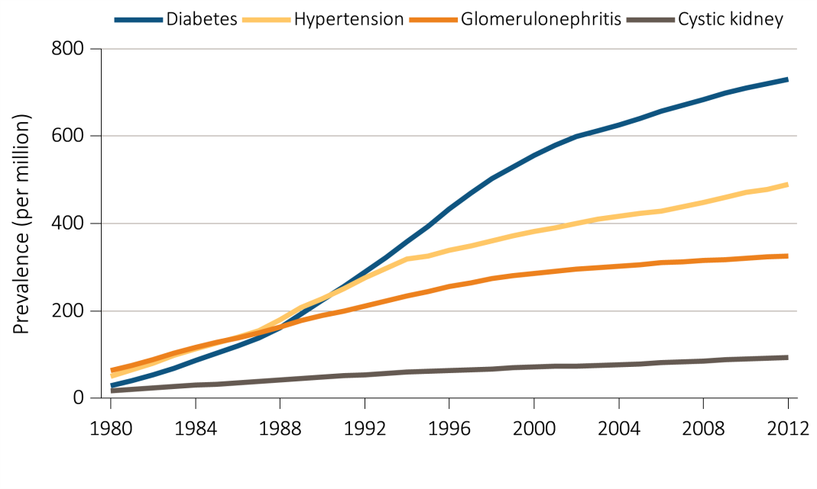
vol 2 Figure 1.16 Trends in (a) prevalent ESRD cases and (b) adjusted* prevalence of ESRD, per million, by primary cause of ESRD, in the U.S. population, 1980-2012
(a) Prevalent Cases
(b) Prevalence per million
Data Source: Reference tables B.1, B.1(2). *Point prevalence on December 31 of each year; Adjusted for age, sex, and race, The standard population was the U.S. population in 2011 ESRD patients. Abbreviation: ESRD, end-stage renal disease.

Slide 25
vol 2 Table 1.4 Number and percentage of incident cases of hemodialysis (HD), peritoneal dialysis (PD), and transplantation (Tx) by age, sex, race, ethnicity, and primary ESRD diagnosis, in the U.S. population, 2012
 | HD |  | PD |  | Tx
 | N | % | N | % | N | %
Age
0-19 | 506 | 0.5 | 349 | 3.8 | 245 | 8.7
20-44 | 10,375 | 10.5 | 1,650 | 18.0 | 661 | 23.6
45-64 | 38,268 | 38.7 | 3,952 | 43.1 | 1,355 | 48.3
65-74 | 24,528 | 24.8 | 1,900 | 20.7 | 485 | 17.3
75+ | 25,277 | 25.5 | 1,324 | 14.4 | 57 | 2.0
Sex
Male | 56,847 | 57.4 | 5,197 | 56.6 | 1,612 | 57.5
Female | 42,107 | 42.6 | 3,978 | 43.4 | 1,191 | 42.5
Race
White | 65,430 | 66.1 | 6,415 | 69.9 | 2,288 | 81.6
Black/African Am | 28,659 | 29.0 | 2,137 | 23.3 | 292 | 10.4
Native American | 1,139 | 1.2 | 87 | 0.9 | 29 | 1.0
Asian | 3,726 | 3.8 | 536 | 5.8 | 194 | 6.9
Ethnicity
Hispanic | 13,702 | 13.8 | 1,251 | 13.6 | 420 | 15.0
Non-Hispanic | 85,252 | 86.2 | 7,924 | 86.4 | 2,383 | 85.0
Primary cause of ESRD
Diabetes | 43,922 | 44.4 | 3,783 | 41.2 | 441 | 15.7
Hypertension | 29,111 | 29.4 | 2,373 | 25.9 | 257 | 9.2
Glomerulonephritis | 6,889 | 7.0 | 1,387 | 15.1 | 553 | 19.7
Cystic kidney | 1,551 | 1.6 | 476 | 5.2 | 429 | 15.3
Other urologic | 410 | 0.4 | 61 | 0.7 | 54 | 1.9
Other Cause | 10,762 | 10.9 | 682 | 7.4 | 501 | 17.9
Unknown/missing | 6,309 | 6.4 | 413 | 4.5 | 568 | 20.3
All | 98,954 | 100.0 | 9,175 | 100.0 | 2,803 | 100.0
Data Source: Special analyses, USRDS ESRD Database. Abbreviation: African Am, African American; ESRD, end-stage renal disease.

Slide 26
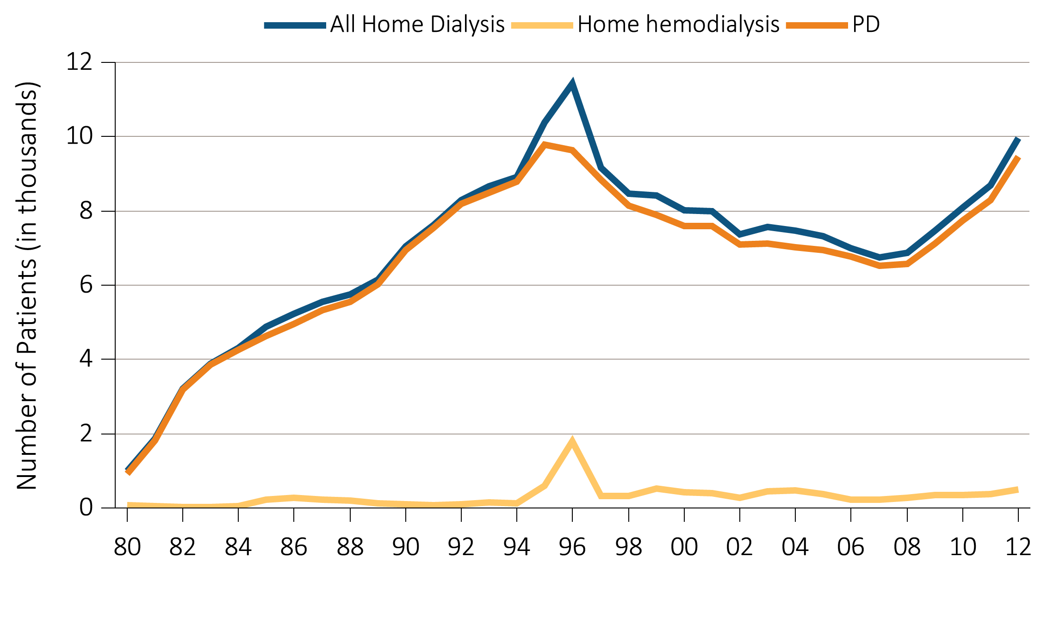
vol 2 Figure 1.17 Trend in the number of incident ESRD patients using home hemodialysis, in thousands, by type of therapy, in the U.S. population, 1980-2012
Data Source: Reference table: D.1.

Slide 27
vol 2 Table 1.5 Number and percentage of prevalent cases of hemodialysis (HD), peritoneal dialysis (PD), and transplantation (Tx) by age, sex, race, ethnicity, and primary ESRD diagnosis, in the U.S. population, 2012
 | HD |  | PD |  | Tx
 | N | % | N | % | N | %
Age
0-19 | 1,134 | 0.3 | 898 | 2.2 | 4,957 | 2.8
20-44 | 49,843 | 12.4 | 8,187 | 20.2 | 39,965 | 22.7
45-64 | 167,499 | 41.6 | 18,137 | 44.7 | 89,876 | 51.1
65-74 | 95,889 | 23.8 | 8,284 | 20.4 | 32,475 | 18.5
75+ | 88,149 | 21.9 | 5,099 | 12.6 | 8,705 | 4.9
Sex
Male | 226,205 | 56.2 | 21,968 | 54.1 | 104,654 | 59.5
Female | 176,309 | 43.8 | 18,637 | 45.9 | 71,324 | 40.5
Race
White | 221,887 | 55.1 | 26,690 | 65.7 | 128,468 | 73.0
Black/African Am | 153,264 | 38.1 | 10,534 | 25.9 | 35,628 | 20.2
Native American | 5,839 | 1.5 | 476 | 1.2 | 1,755 | 1.0
Asian | 21,524 | 5.3 | 2,905 | 7.2 | 10,127 | 5.8
Ethnicity
Hispanic | 68,710 | 17.1 | 5,915 | 14.6 | 35,467 | 20.2
Non-Hispanic | 333,804 | 82.9 | 34,690 | 85.4 | 140,511 | 79.8
Primary cause of ESRD
Diabetes | 178,012 | 44.2 | 14,120 | 34.8 | 40,688 | 23.1
Hypertension | 116,260 | 28.9 | 10,528 | 25.9 | 27,785 | 15.8
Glomerulonephritis | 43,521 | 10.8 | 7,931 | 19.5 | 48,980 | 27.8
Cystic kidney | 9,543 | 2.4 | 1,895 | 4.7 | 17,463 | 9.9
Other urologic | 3,052 | 0.8 | 369 | 0.9 | 3,515 | 2.0
Other Cause | 32,513 | 8.1 | 3,660 | 9.0 | 20,306 | 11.5
Unknown/missing | 19,613 | 4.9 | 2,102 | 5.2 | 17,241 | 9.8
All | 402,514 | 100.0 | 40,605 | 100.0 | 175,978 | 100.0
Data Source: Special analyses, USRDS ESRD Database. Abbreviation: African Am, African American; ESRD, end-stage renal disease.

Slide 28
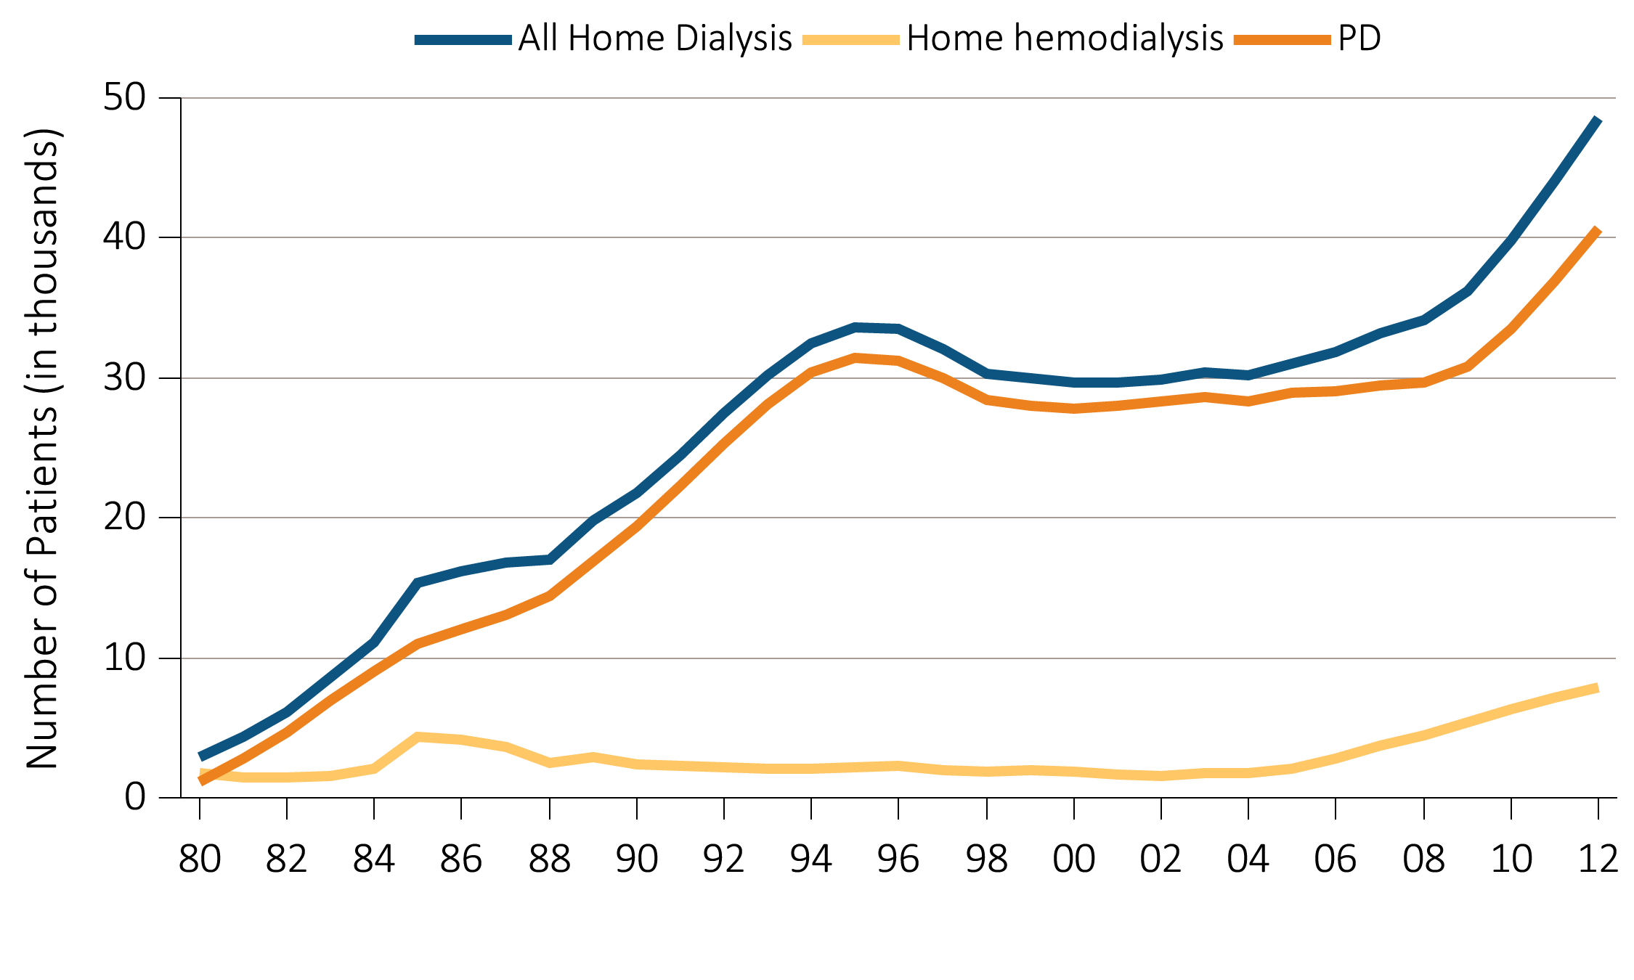
vol 2 Figure 1.18 Trend in the number of prevalent ESRD patients using home dialysis, in thousands, by type of therapy, in the U.S. population, 1980-2012
Data Source: Reference table: D.1. December 31 prevalent ESRD patients; peritoneal dialysis consists of CAPD and CCPD only. Abbreviations: CAPD, continuous ambulatory peritoneal dialysis; CCPD, continuous cycler peritoneal dialysis; ESRD, end-stage renal disease.

Slide 29
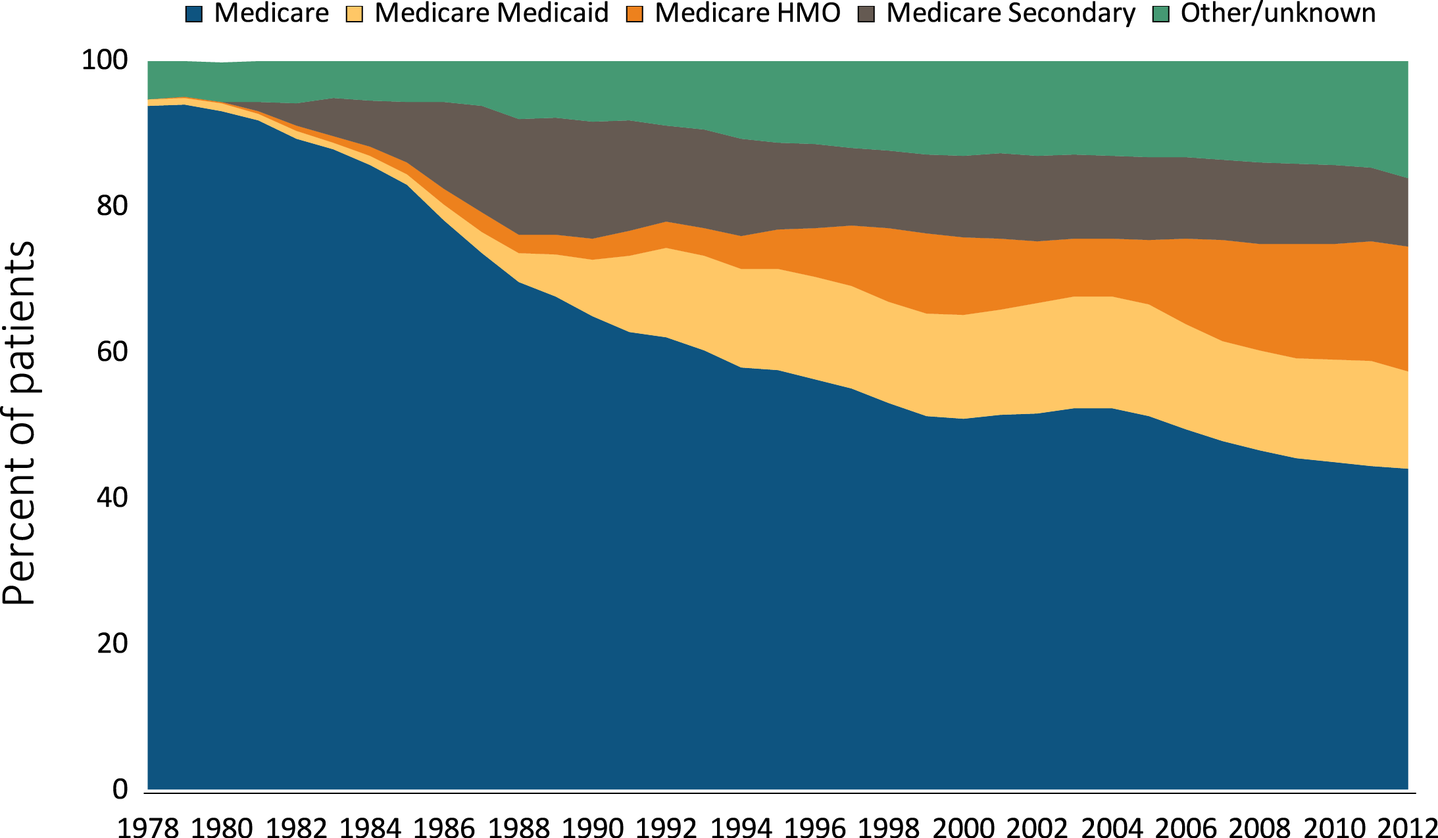
vol 2 Figure 1.19 Trend in the distribution of payer type among incident ESRD patients using hemodialysis, 1978-2012
(a) Hemodialysis
Data Source: Special analyses, USRDS ESRD Database. Abbreviations: ESRD, end-stage renal disease.

Slide 30
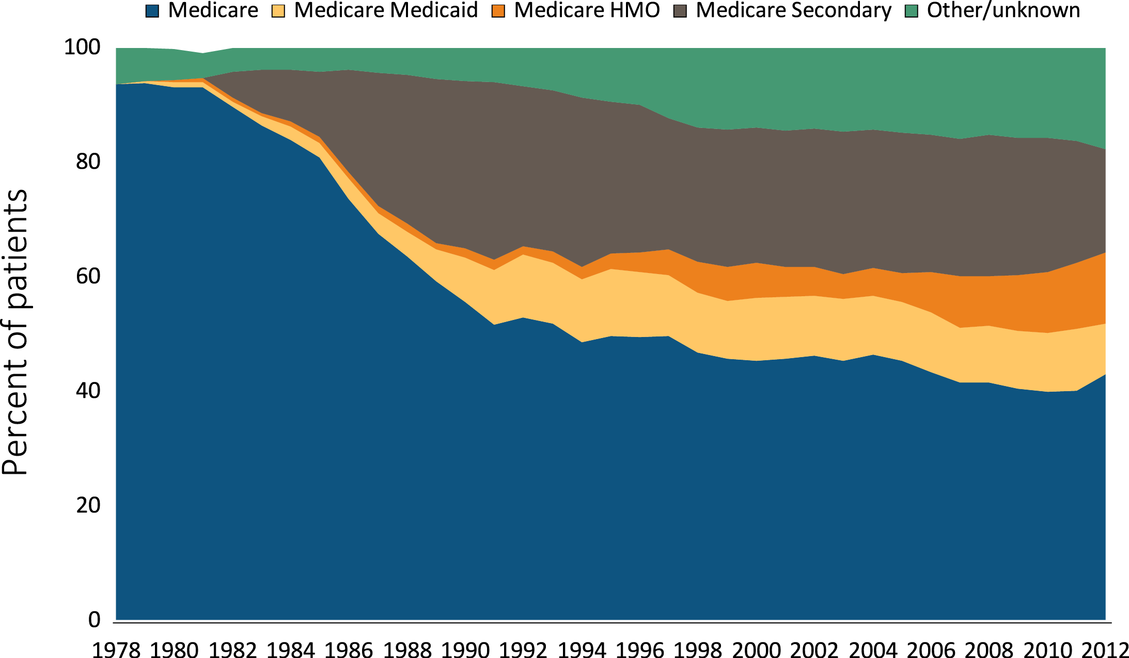
vol 2 Figure 1.19 Trend in the distribution of payer type among incident ESRD patients using peritoneal dialysis, 1978-2012
(b) Peritoneal Dialysis
Data Source: Special analyses, USRDS ESRD Database. Peritoneal dialysis consists of CAPD and CCPD only. Abbreviations: CAPD, continuous ambulatory peritoneal dialysis; CCPD, continuous cycler peritoneal dialysis; ESRD, end-stage renal disease.

Slide 31
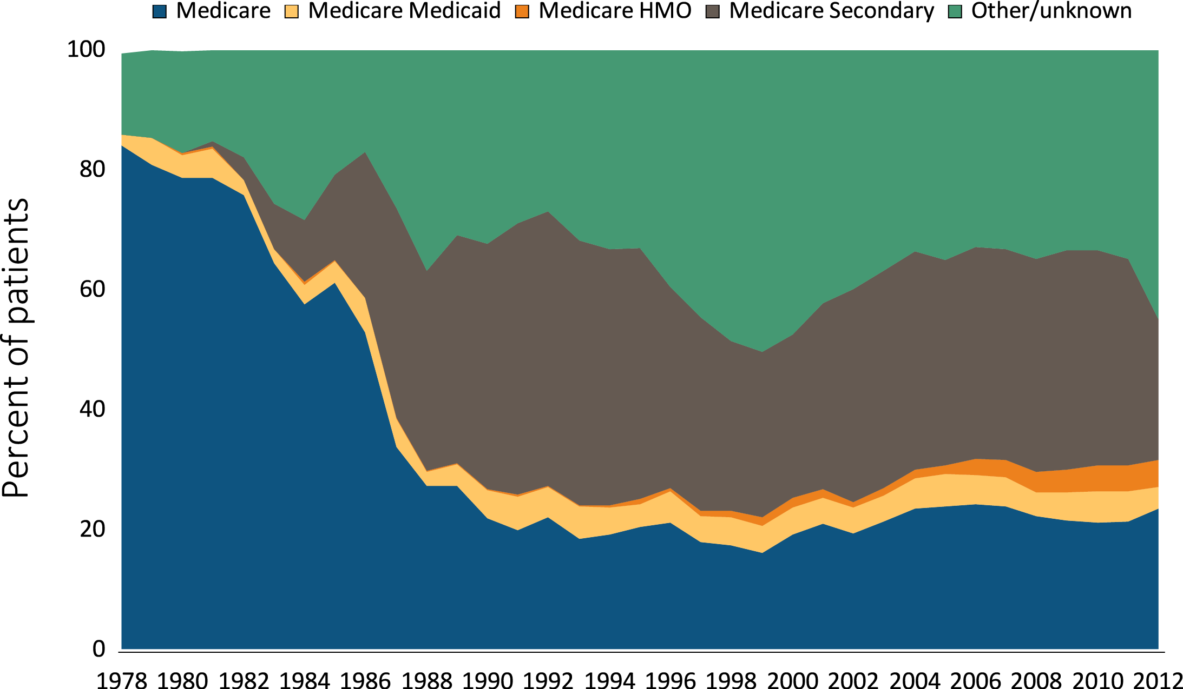
vol 2 Figure 1.19 Trend in the distribution of payer type among incident ESRD patients with transplants, 1978-2012
(c) Transplant
Data Source: Special analyses, USRDS ESRD Database. Abbreviations: ESRD, end-stage renal disease.

Slide 32
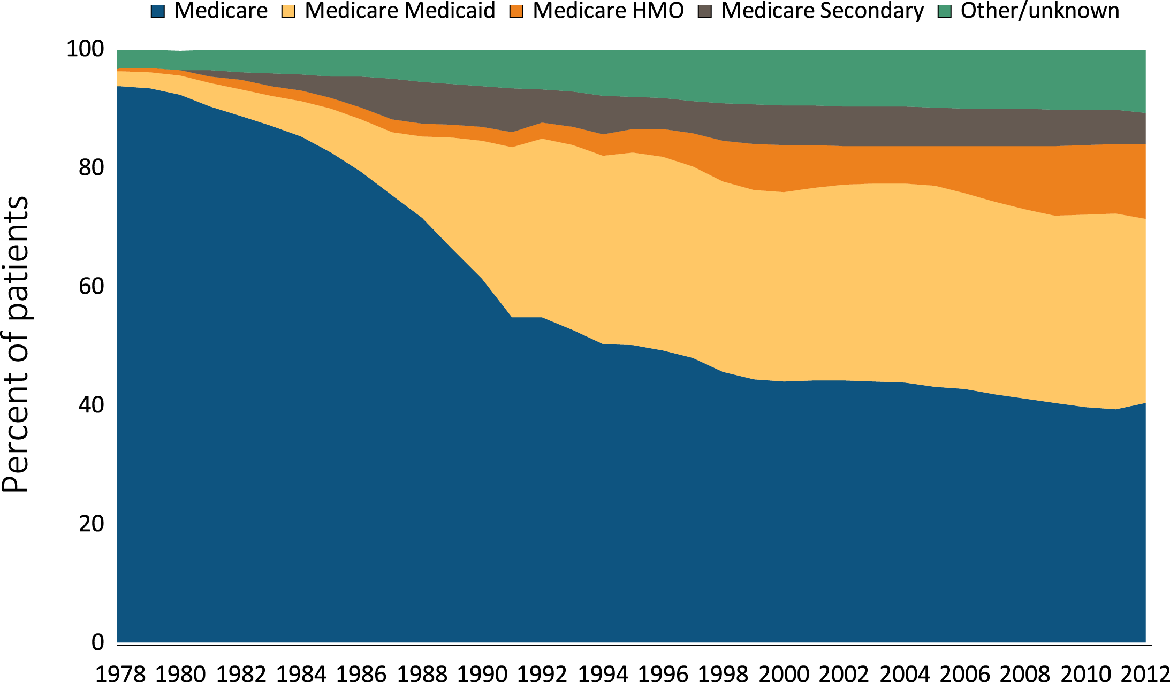
vol 2 Figure 1.20 Trend in the distribution of payer type among prevalent ESRD patients using hemodialysis, 1978-2012
(a) Hemodialysis
Data Source: Special analyses, USRDS ESRD Database. Point prevalence on December 31 of each year. Abbreviations: ESRD, end-stage renal disease.

Slide 33
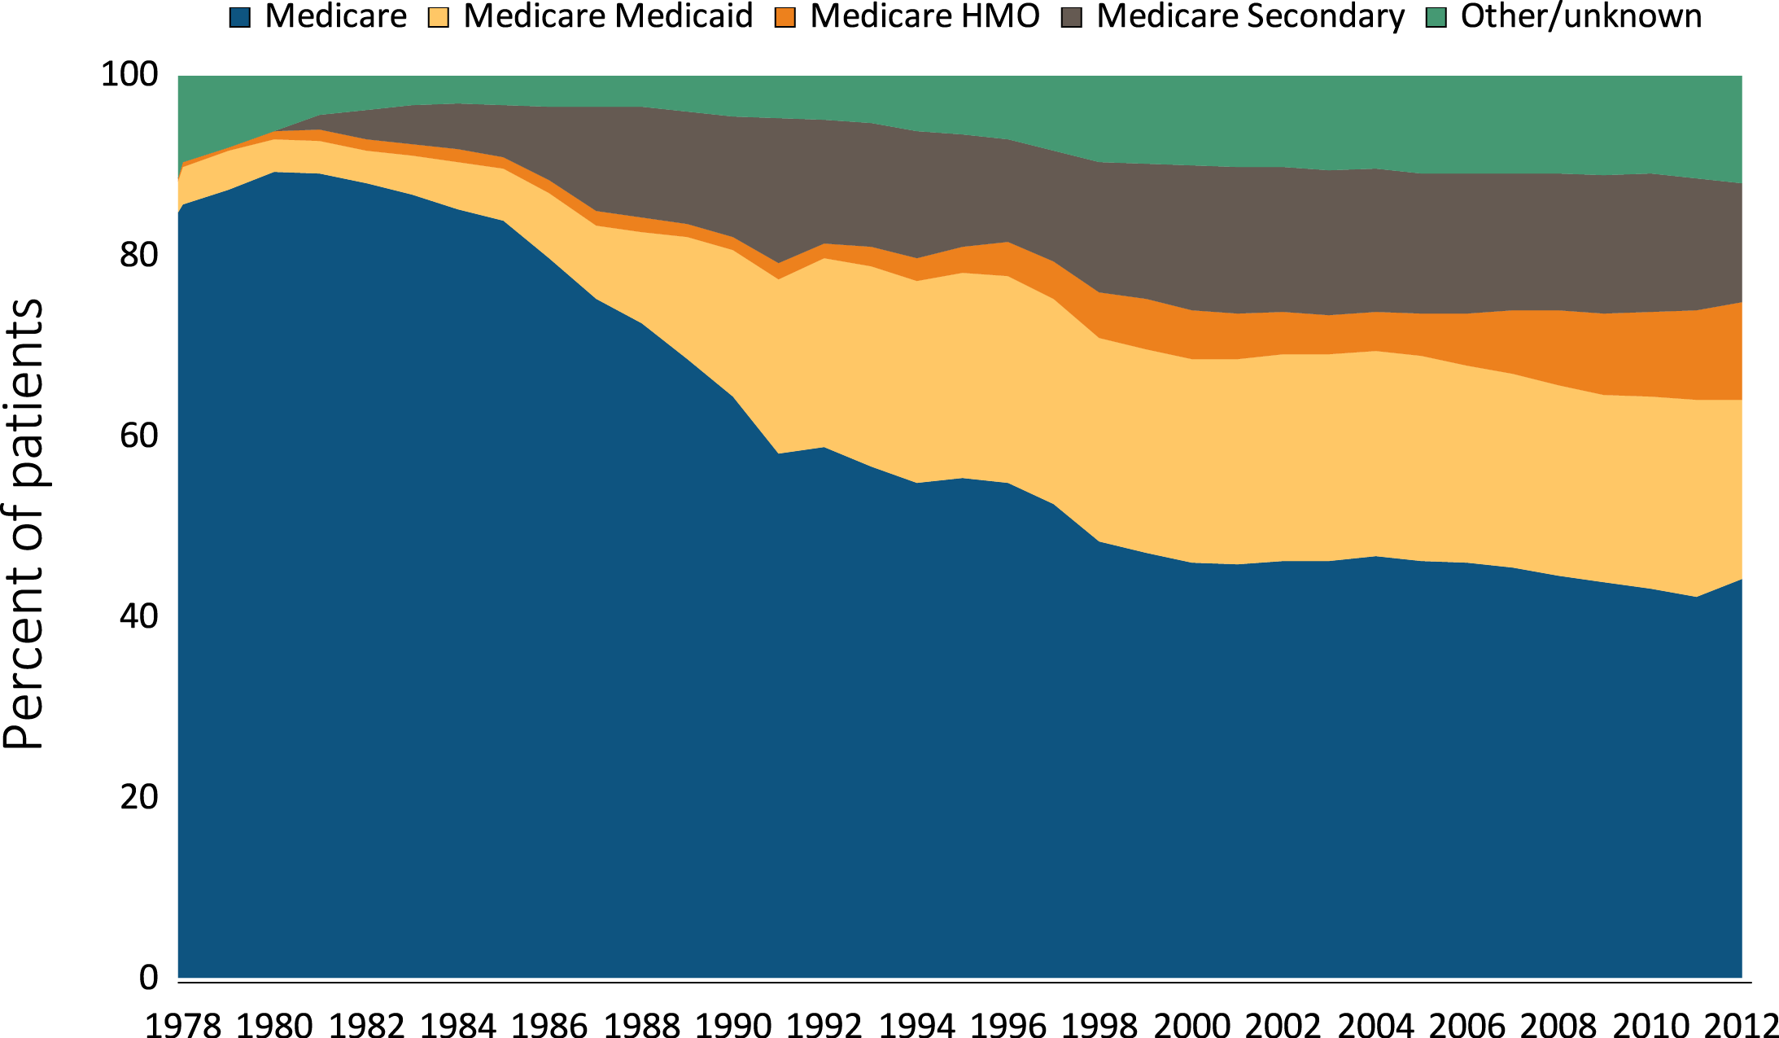
vol 2 Figure 1.20 Trend in the distribution of payer type among prevalent ESRD patients using peritoneal dialysis, 1978-2012
(b) Peritoneal Dialysis
Data Source: Special analyses, USRDS ESRD Database. Point prevalence on December 31 of each year; Peritoneal dialysis consists of CAPD and CCPD only. Abbreviations: CAPD, continuous ambulatory peritoneal dialysis; CCPD, continuous cycler peritoneal dialysis; ESRD, end-stage renal disease.

Slide 34
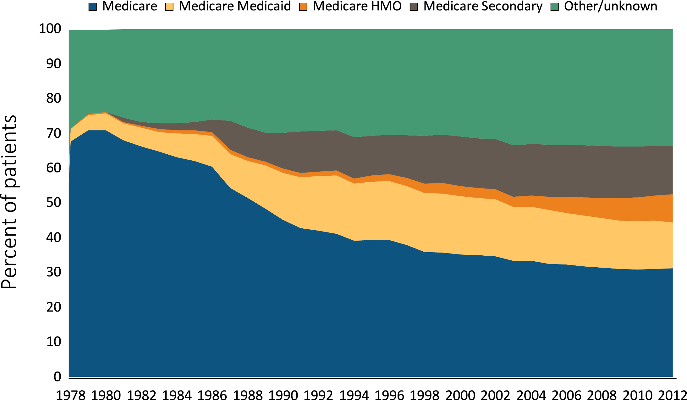
vol 2 Figure 1.20 Trend in the distribution of payer type among prevalent ESRD patients with transplants, 1978-2012
(c) Transplant
Data Source: Special analyses, USRDS ESRD Database. Point prevalence on December 31 of each year. Abbreviations: ESRD, end-stage renal disease.

Slide 35
vol 2 Table 1.6 Distribution of the reported duration of pre-ESRD nephrology care, by demographic and clinical characteristics, among incident ESRD patients in the U.S., 2012
 | None | 0-12 mo. | >12 mo.*
% of patients | 41.3 | 30.8 | 27.9
Mean Age | 61.6 | 62.7 | 63.7
Age
0-19 | 34.3 | 31.2 | 34.4
20-24 | 47.6 | 29.0 | 23.3
45-64 | 42.7 | 30.9 | 26.4
65-74 | 38.7 | 31.3 | 30.0
75+ | 38.9 | 30.7 | 30.3
Sex
Male | 39.1 | 31.8 | 29.1
Female | 38.8 | 32.3 | 28.9
Race
White | 37.2 | 36.5 | 26.4
Black | 42.1 | 32.2 | 25.7
Native Amer. | 45.0 | 30.2 | 24.7
Asian | 39.6 | 30.8 | 29.6
Hispanic ethnicity
Yes | 47.7 | 30.9 | 21.4
No | 39.7 | 31.0 | 29.3
 | None | 0-12 mo. | >12 mo.*
Vascular Access
Fistula | 10.5 | 36.0 | 53.5
Catheter | 49.3 | 30.1 | 20.6
Graft | 19.9 | 36.8 | 43.3
ESA use | 3.8 | 42.5 | 53.7
Dietary care | 0.7 | 45.7 | 53.5
eGFR at RRT start*
<5 | 53.0 | 24.8 | 22.2
5-<10 | 37.8 | 31.7 | 30.5
10-<15 | 34.6 | 34.1 | 31.3
≥15 | 42.8 | 32.0 | 25.1
Primary diagnosis
Diabetes | 35.3 | 34.6 | 30.1
Hypertension | 41.9 | 31.2 | 26.8
Glomerulonephritis | 31.8 | 31.4 | 36.8
Cystic kidney | 17.3 | 27.3 | 55.3
Data Source: Reference tables C.8, C.10, and special analyses, USRDS ESRD Database. eGFR calculated using the CKD-EPI equation (CKD-EPI eGFR (ml/min/1.73 m²). Abbreviations: CKD-EPI; chronic kidney disease epidemiology calculation; DM, diabetes mellitus; eGFR, estimated glomerular filtration rate; ESA, erythropoiesis-stimulating agents; RRT, renal replacement therapy. *All these numbers are percent within row, except mean age.

Slide 36
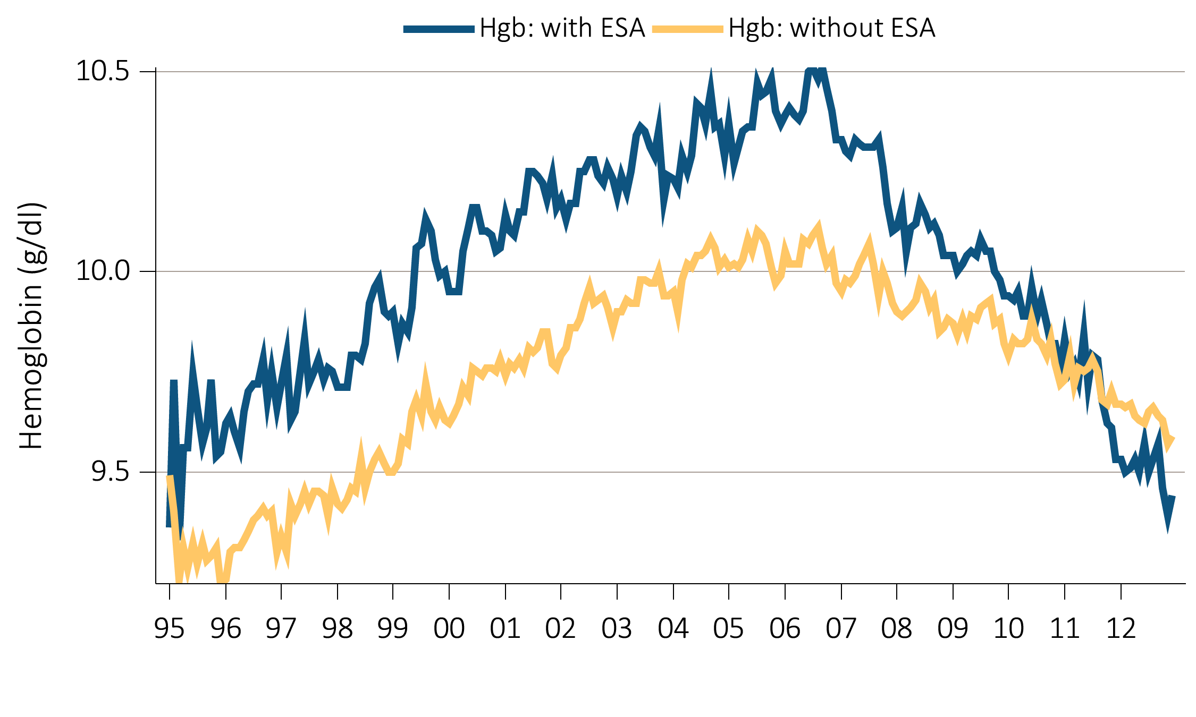
vol 2 Figure 1.21 (a) Trend in Hgb levels, among incident ESRD patients, 1995-2012
Data Source: Special analyses, USRDS ESRD Database. Abbreviations: ESA, erythropoiesis-stimulating agents; ESRD, end-stage renal disease.

Slide 37
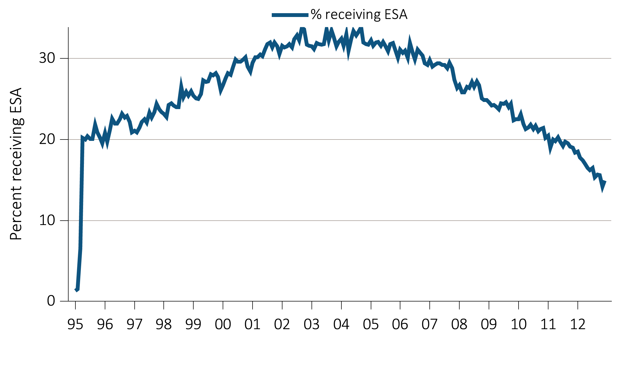
vol 2 Figure 1.21 (b) Trend in the percentage of patients who received pre-ESRD erythropoiesis-stimulating agent (ESA) treatment, among incident ESRD patients, 1995-2012
Data Source: Special analyses, USRDS ESRD Database. Abbreviations: ESA, erythropoiesis-stimulating agents; ESRD, end-stage renal disease.

Slide 38
vol 2 Table 1.7 Mean laboratory values, by age, sex, race/ethnicity, and primary ESRD diagnosis, among incident ESRD patients, 2012
 | Serum albumin | Hgb (g/dl) | Total cholesterol (mg/dl) | LDL (mg/dl) | HDL (mg/dl) | Triglycer (mg/dl) | HbA1c | eGFR at RRT start
Age
20-44 | 3.3 | 9.4 | 169.6 | 100.6 | 40.6 | 162.5 | 7.0 | 9.6
45-64 | 3.2 | 9.5 | 159.7 | 91.2 | 40.0 | 156.6 | 6.9 | 10.2
65-74 | 3.3 | 9.6 | 149.1 | 82.8 | 39.7 | 146.2 | 6.6 | 10.6
75+ | 3.2 | 9.7 | 140.4 | 76.1 | 40.6 | 127.8 | 6.4 | 10.6
Sex
Male | 3.3 | 9.7 | 147.5 | 83.7 | 37.8 | 144.8 | 6.7 | 10.7
Female | 3.2 | 9.5 | 164.1 | 91.7 | 43.5 | 154.9 | 6.8 | 10.0
Race/ethnicity
White | 3.3 | 9.7 | 150.4 | 83.6 | 38.8 | 152.9 | 6.7 | 10.7
Black/Af Am | 3.2 | 9.3 | 162.0 | 94.5 | 43.0 | 137.5 | 6.7 | 9.9
Native American | 2.9 | 9.5 | 153.9 | 84.3 | 41.2 | 152.4 | 6.7 | 9.7
Asian | 3.3 | 9.5 | 158.9 | 89.2 | 41.4 | 155.1 | 6.7 | 9.0
Hispanic | 3.3 | 9.5 | 156.5 | 88.6 | 39.7 | 159.8 | 6.8 | 9.9
Primary diagnosis
Diabetes | 3.2 | 9.5 | 153.2 | 86.2 | 40.1 | 151.1 | 7.0 | 10.6
Hypertension | 3.3 | 9.6 | 151.5 | 86.2 | 40.6 | 136.5 | 6.2 | 10.0
Glomerulonephritis | 3.3 | 9.6 | 172.0 | 99.1 | 41.9 | 166.2 | 6.0 | 9.5
Cystic kidney | 3.8 | 10.3 | 160.1 | 87.7 | 40.9 | 153.9 | 5.7 | 9.5
All | 3.3 | 9.6 | 154.2 | 87.0 | 40.1 | 148.9 | 6.7 | 10.4
Data Source: Special analyses, USRDS ESRD Database. eGFR calculated using the CKD-EPI equation (CKD-EPI eGFR (ml/min/1.73 m²). Abbreviations: Af Am, African American; CKD-EPI; chronic kidney disease epidemiology calculation; eGFR, estimated glomerular filtration rate; ESRD, end-stage renal disease; HbA1c, glycosylated hemoglobin; HDL, high-density lipoprotein; Hgb; hemoglobin; LDL, low-density lipoprotein; RRT, renal replacement therapy; Triglycer, triglycerides.

Slide 39
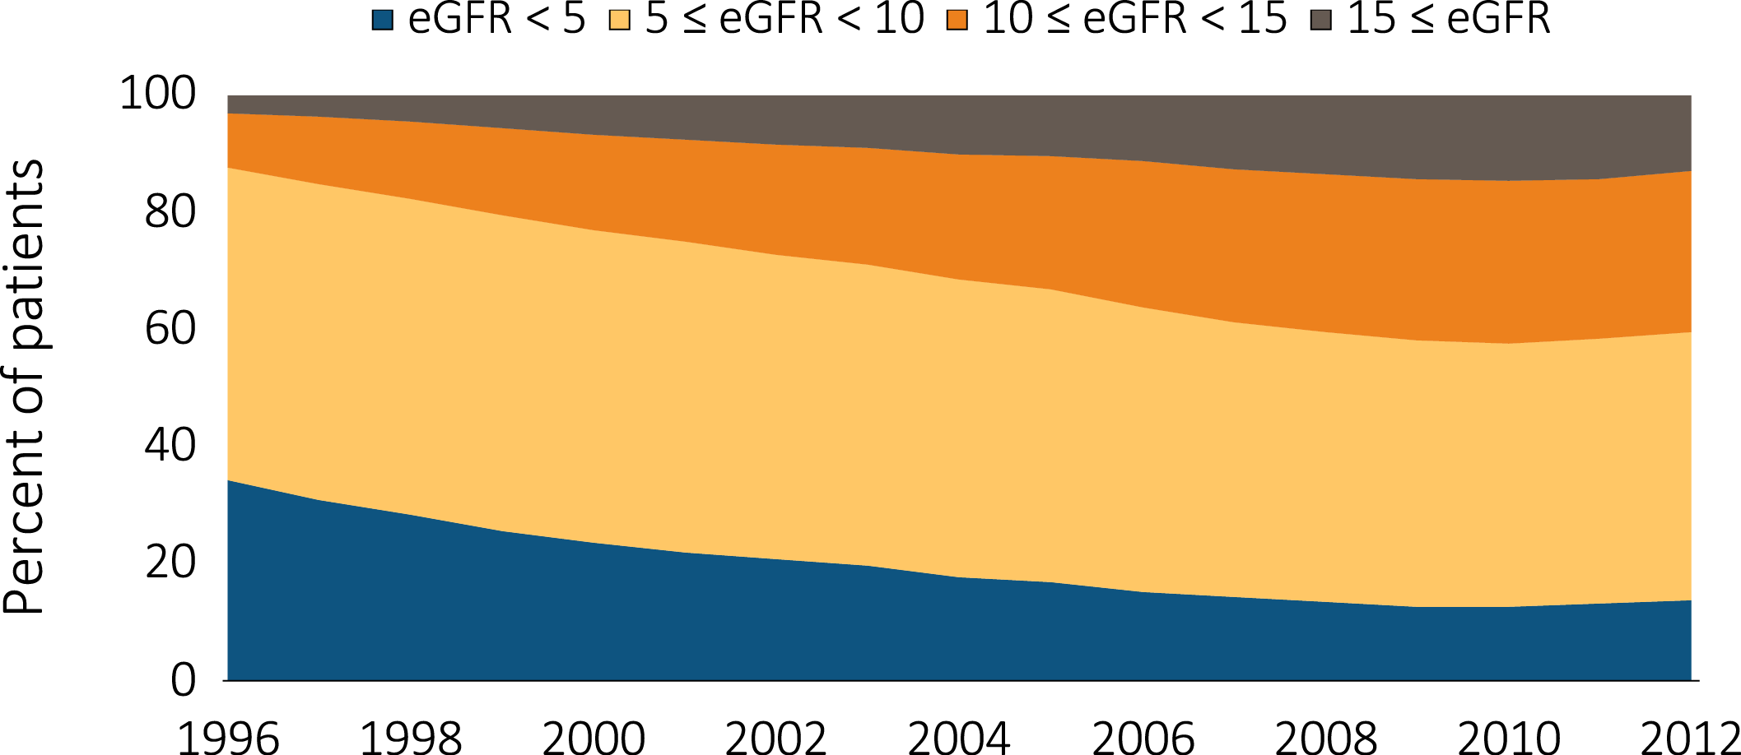
vol 2 Figure 1.22 Trend in the distribution of eGFR (ml/min/1.73 m²) among incident ESRD patients, 1996-2012
Data Source: Special analyses, USRDS ESRD Database. eGFR calculated using the CKD-EPI equation (CKD-EPI eGFR (ml/min/1.73 m²). Abbreviations: CKD-EPI; chronic kidney disease epidemiology calculation; eGFR, estimated glomerular filtration rate; ESRD, end-stage renal disease.

