Slide 2
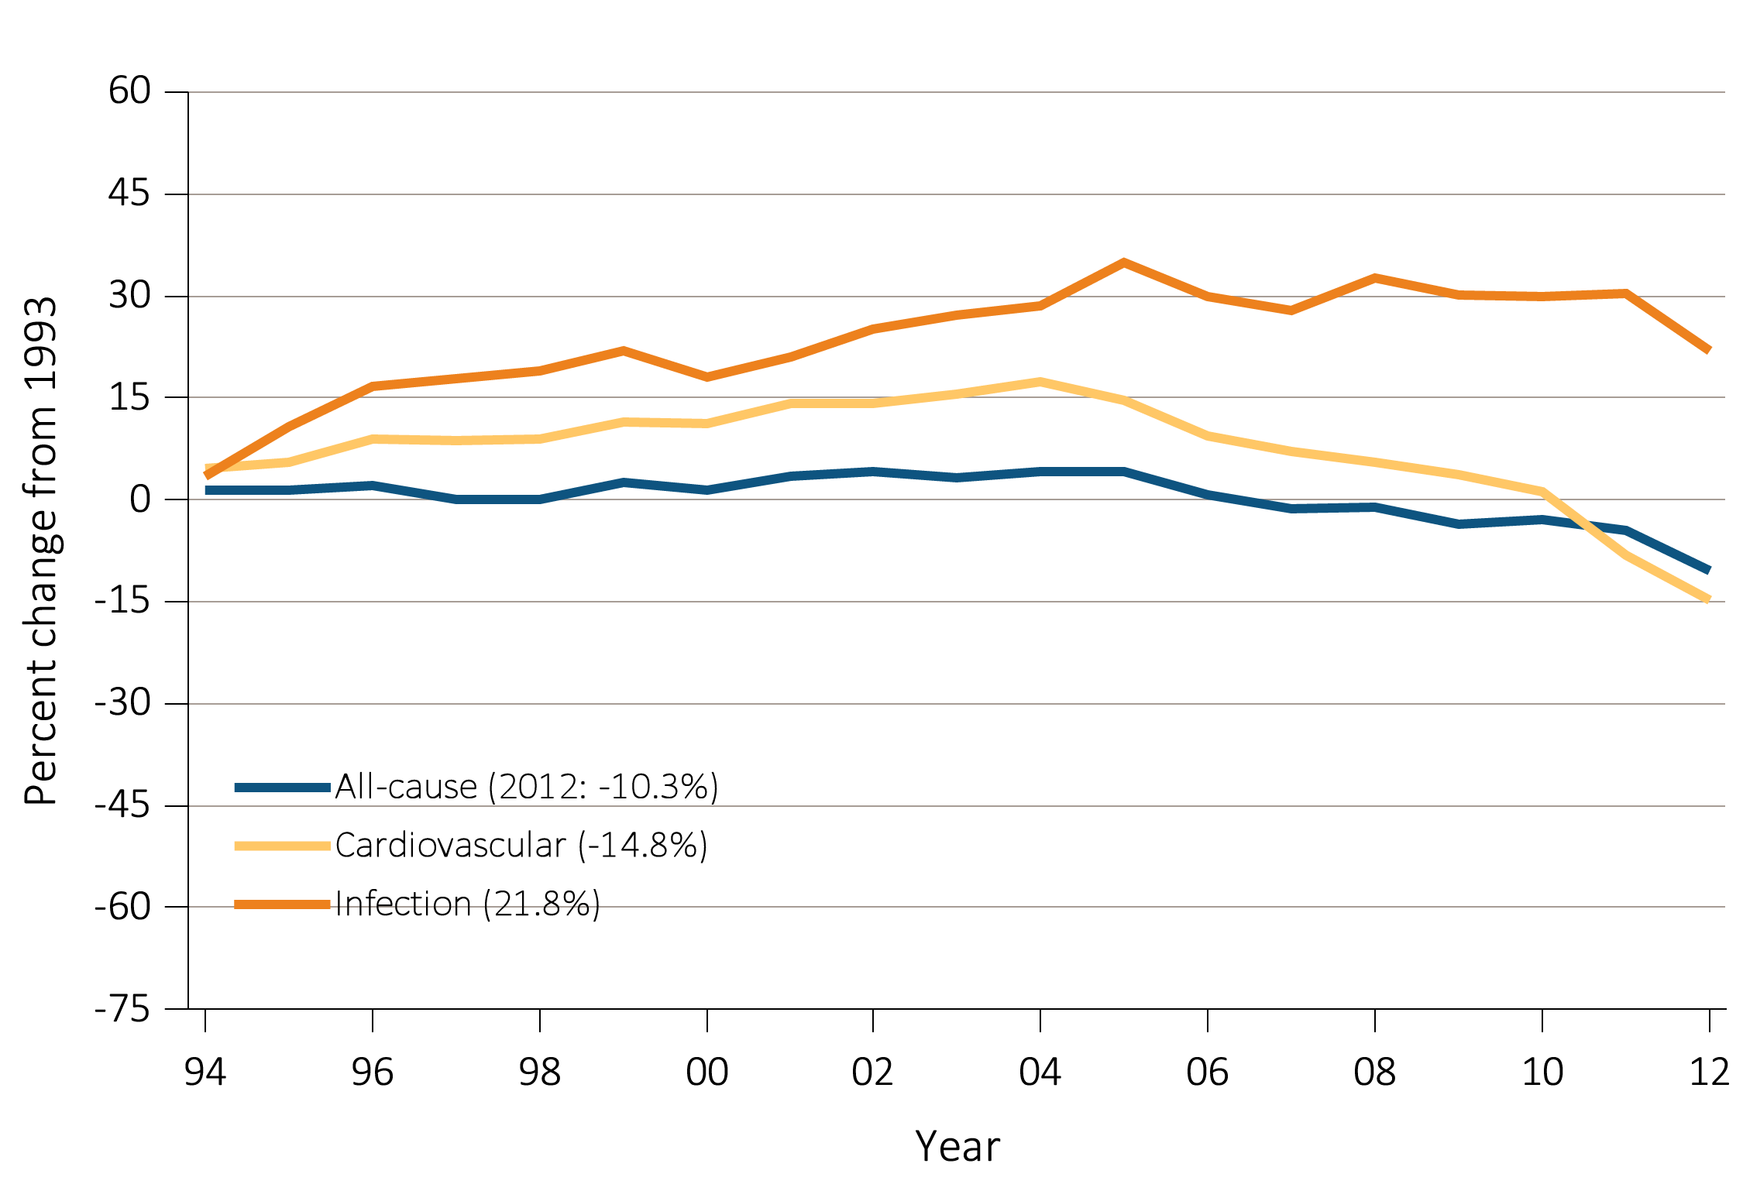
vol 2 Figure 4.1 Trends in adjusted all-cause, cause specific hospitalization rates, all ESRD
Data Source: Reference tables: G.1 and special analyses, USRDS ESRD Database. Period prevalent ESRD patients; adjusted for age, sex, race, & primary diagnosis; ref: ESRD patients, 2010. Percent changes from 1993 for the year 2012 are shown in parentheses. Abbreviations: ESRD, end-stage renal disease.

Slide 3
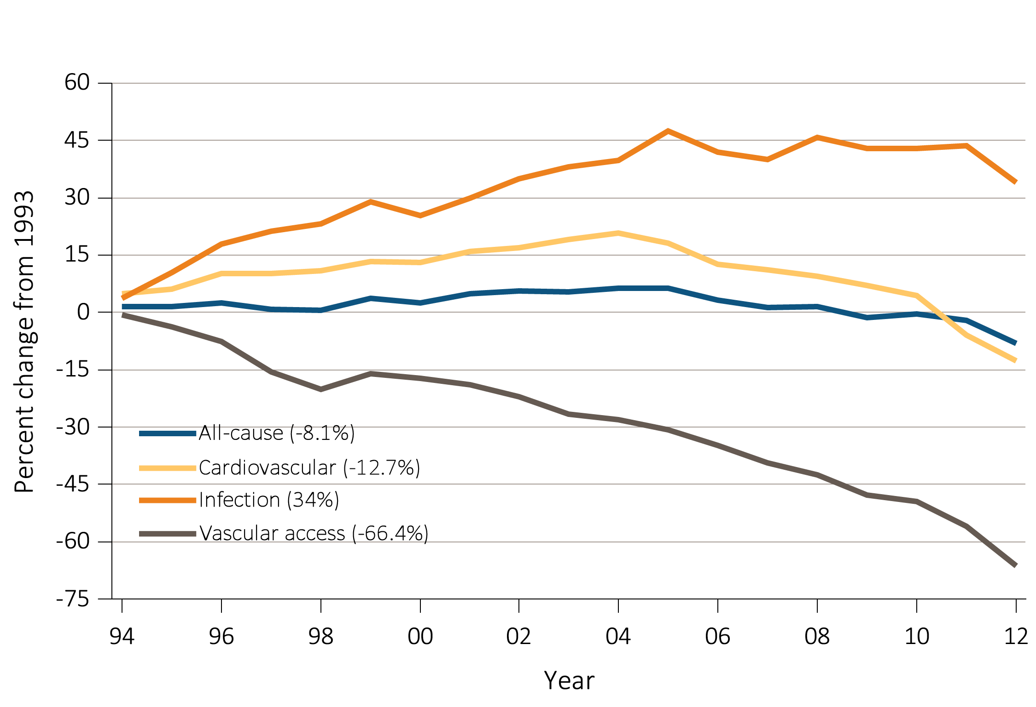
vol 2 Figure 4.1 Trends in adjusted all-cause, cause specific hospitalization rates, hemodialysis
Data Source: Reference tables: G.3 and special analyses, USRDS ESRD Database. Period prevalent ESRD patients; adjusted for age, sex, race, & primary diagnosis; ref: ESRD patients, 2010. Percent changes from 1993 for the year 2012 are shown in parentheses. Abbreviations: ESRD, end-stage renal disease.

Slide 4
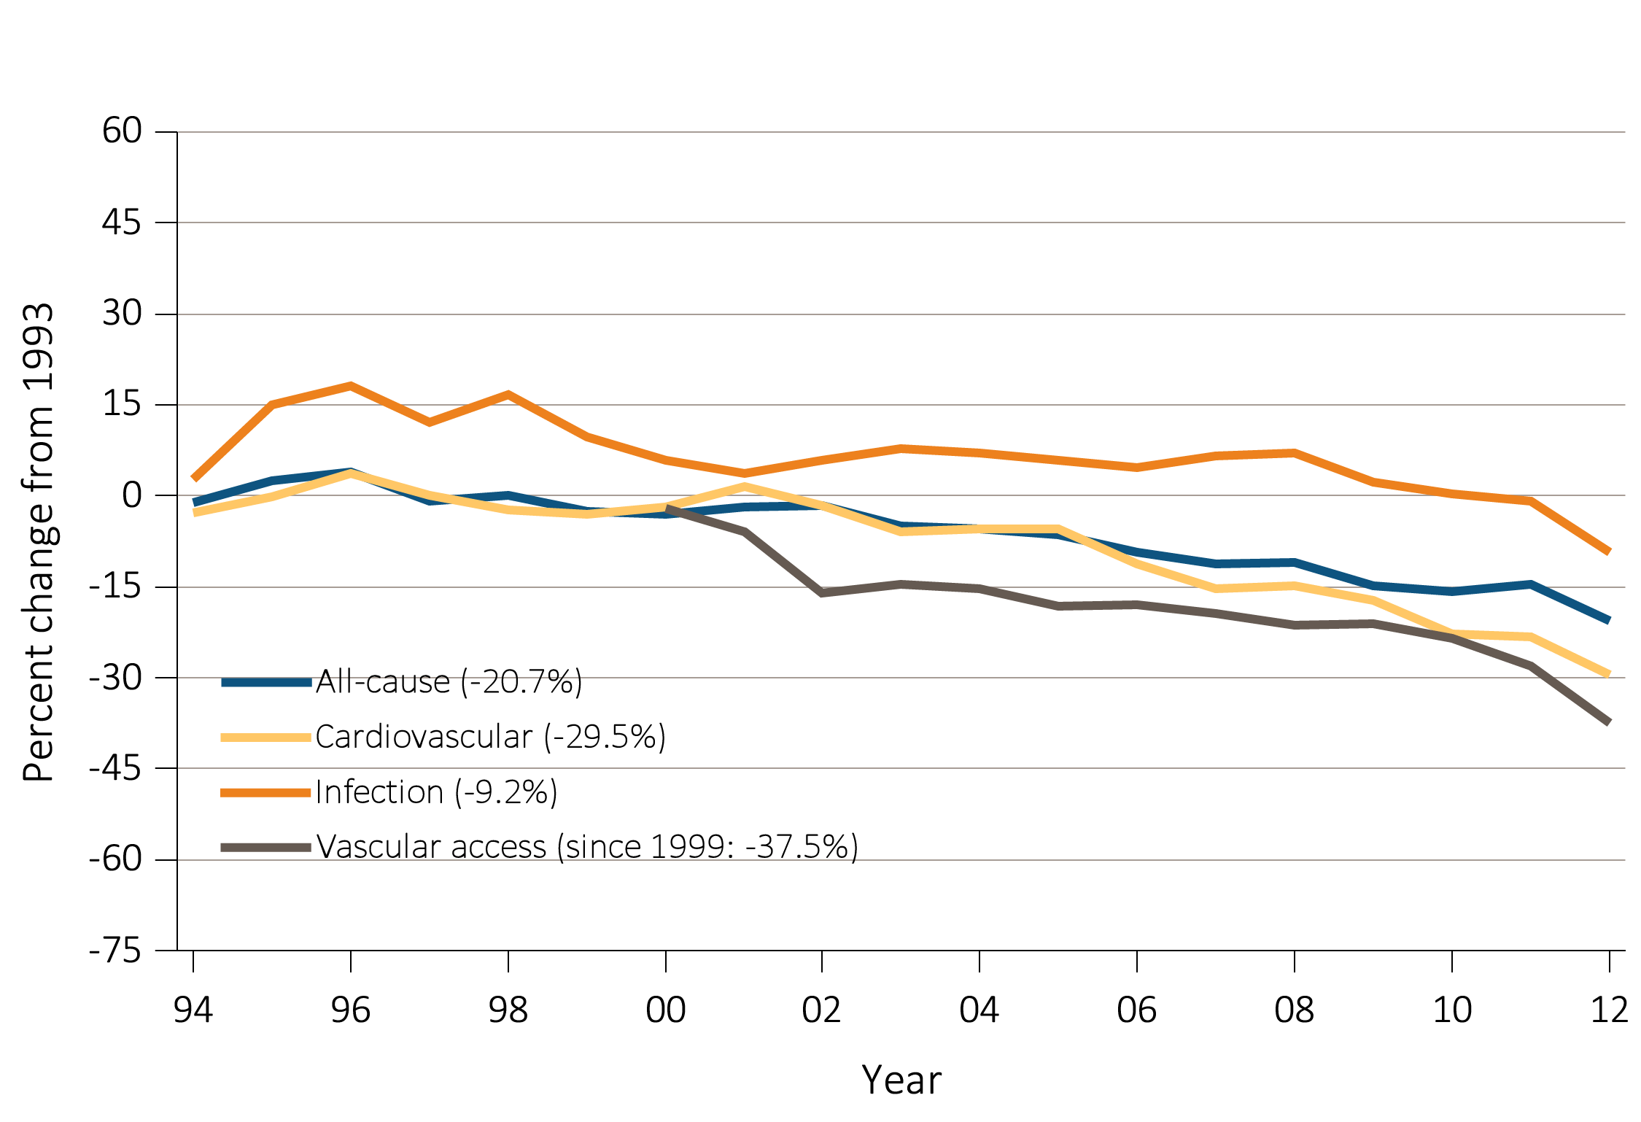
vol 2 Figure 4.1 Trends in adjusted all-cause, cause specific hospitalization rates, peritoneal dialysis
Data Source: Reference tables: G.4 and special analyses, USRDS ESRD Database. Period prevalent ESRD patients; adjusted for age, sex, race, & primary diagnosis; ref: ESRD patients, 2010. Percent changes from 1993 for the year 2012 are shown in parentheses. Abbreviations: ESRD, end-stage renal disease.

Slide 5
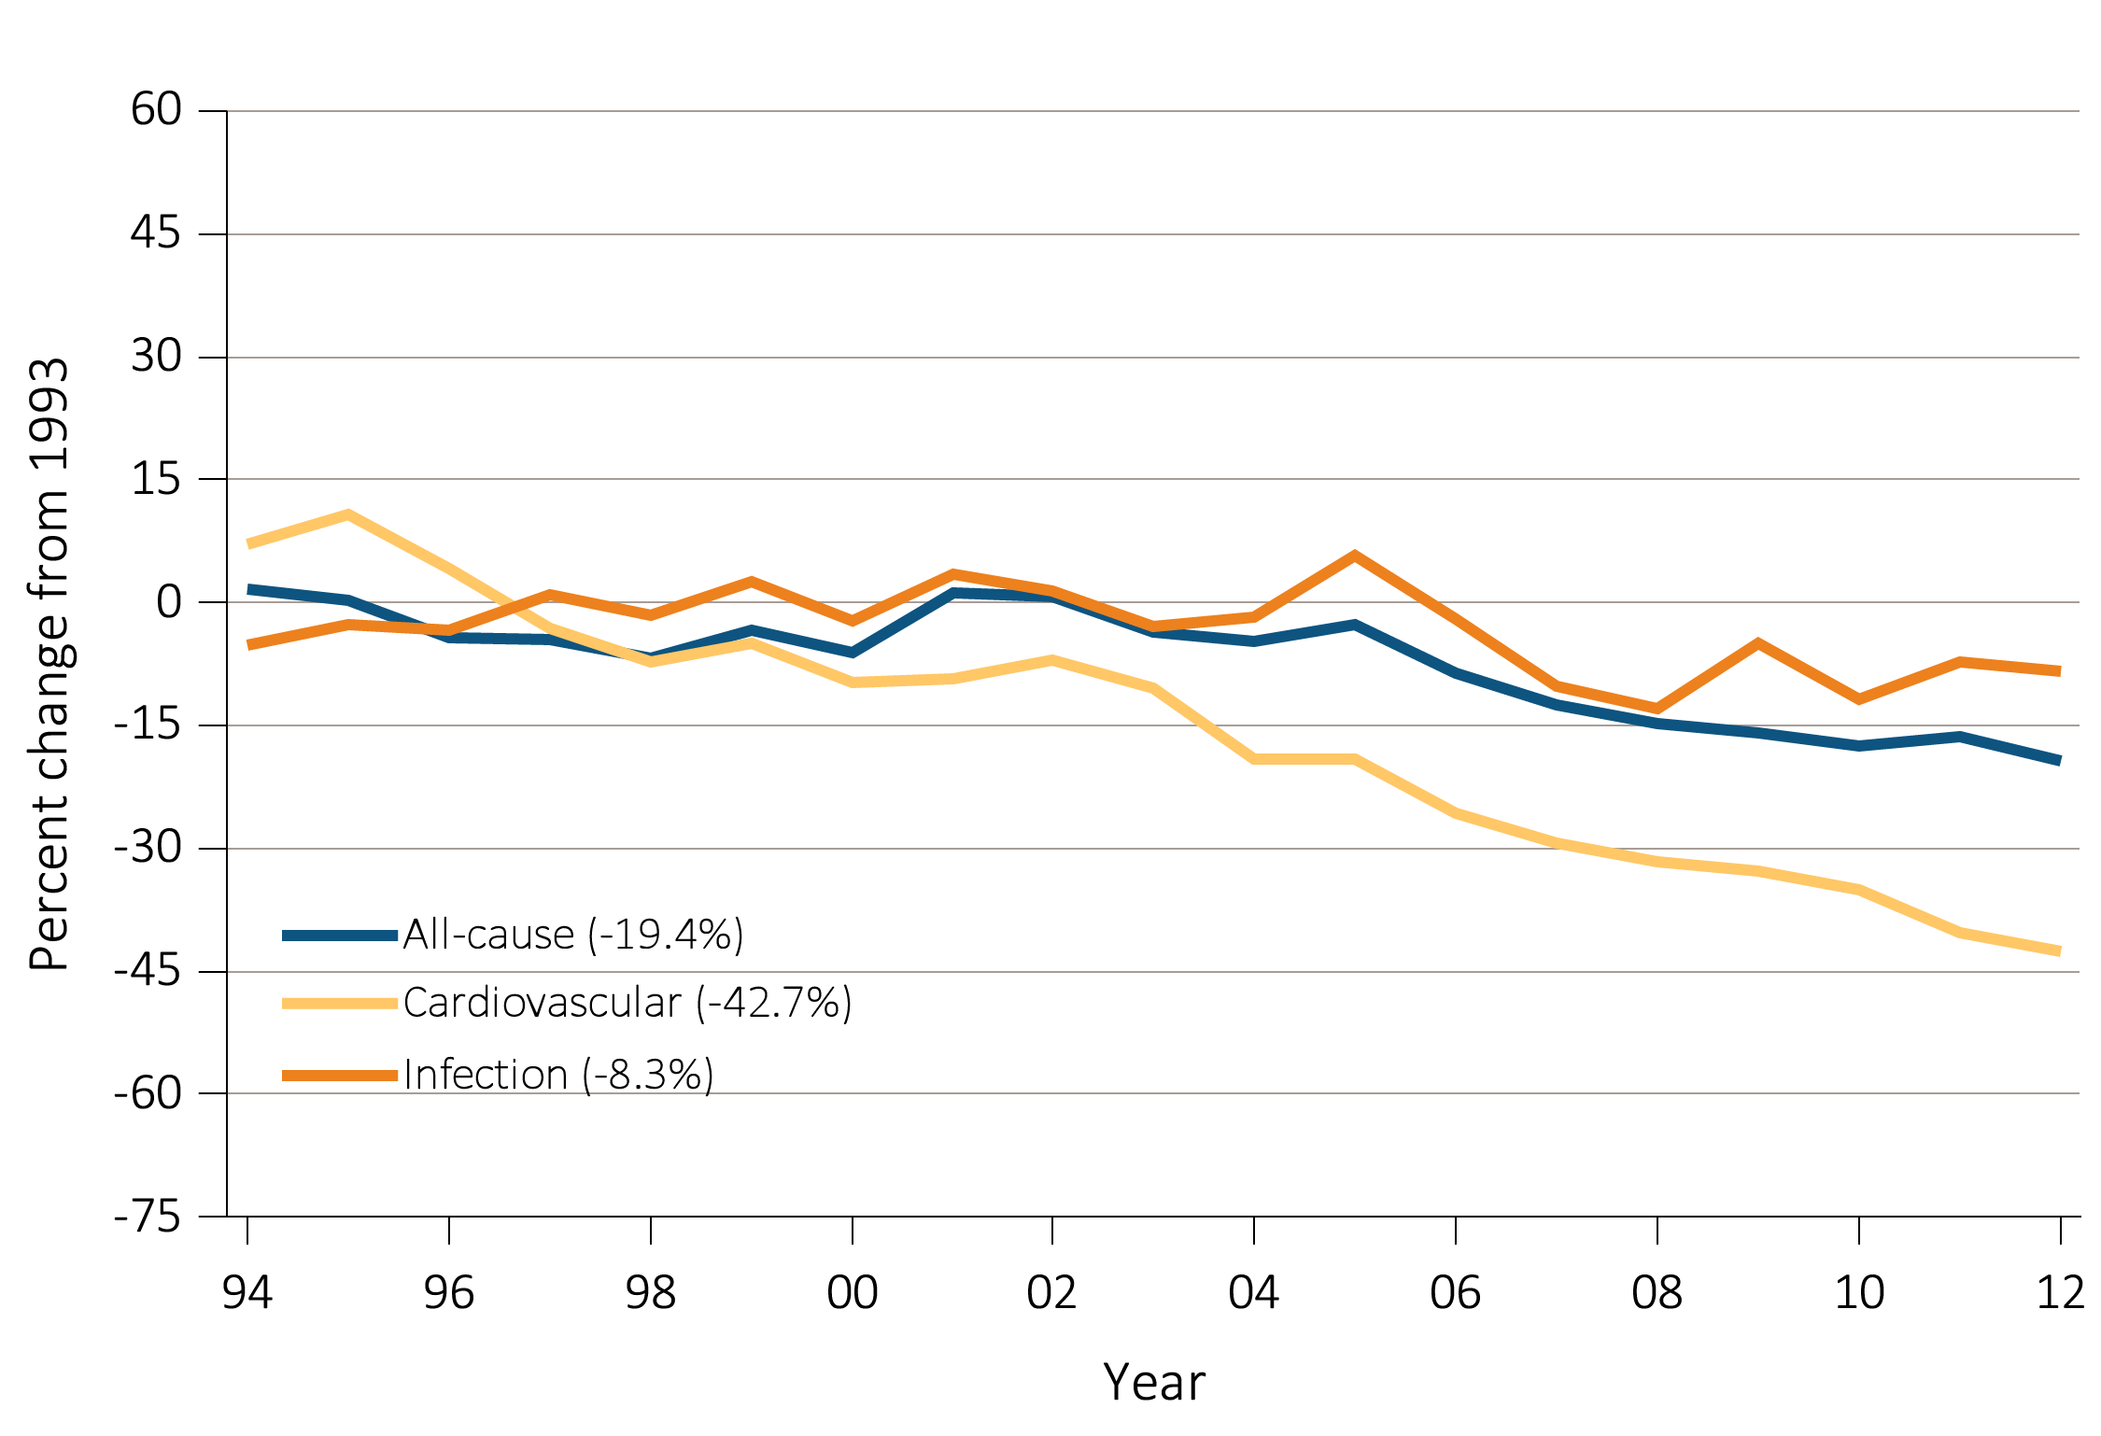
vol 2 Figure 4.1 Trends in adjusted all-cause, cause specific hospitalization rates, transplant
Data Source: Reference tables: G.5 and special analyses, USRDS ESRD Database. Period prevalent ESRD patients; adjusted for age, sex, race, & primary diagnosis; ref: ESRD patients, 2010. Percent changes from 1993 for the year 2012 are shown in parentheses. Abbreviations: ESRD, end-stage renal disease.

Slide 6
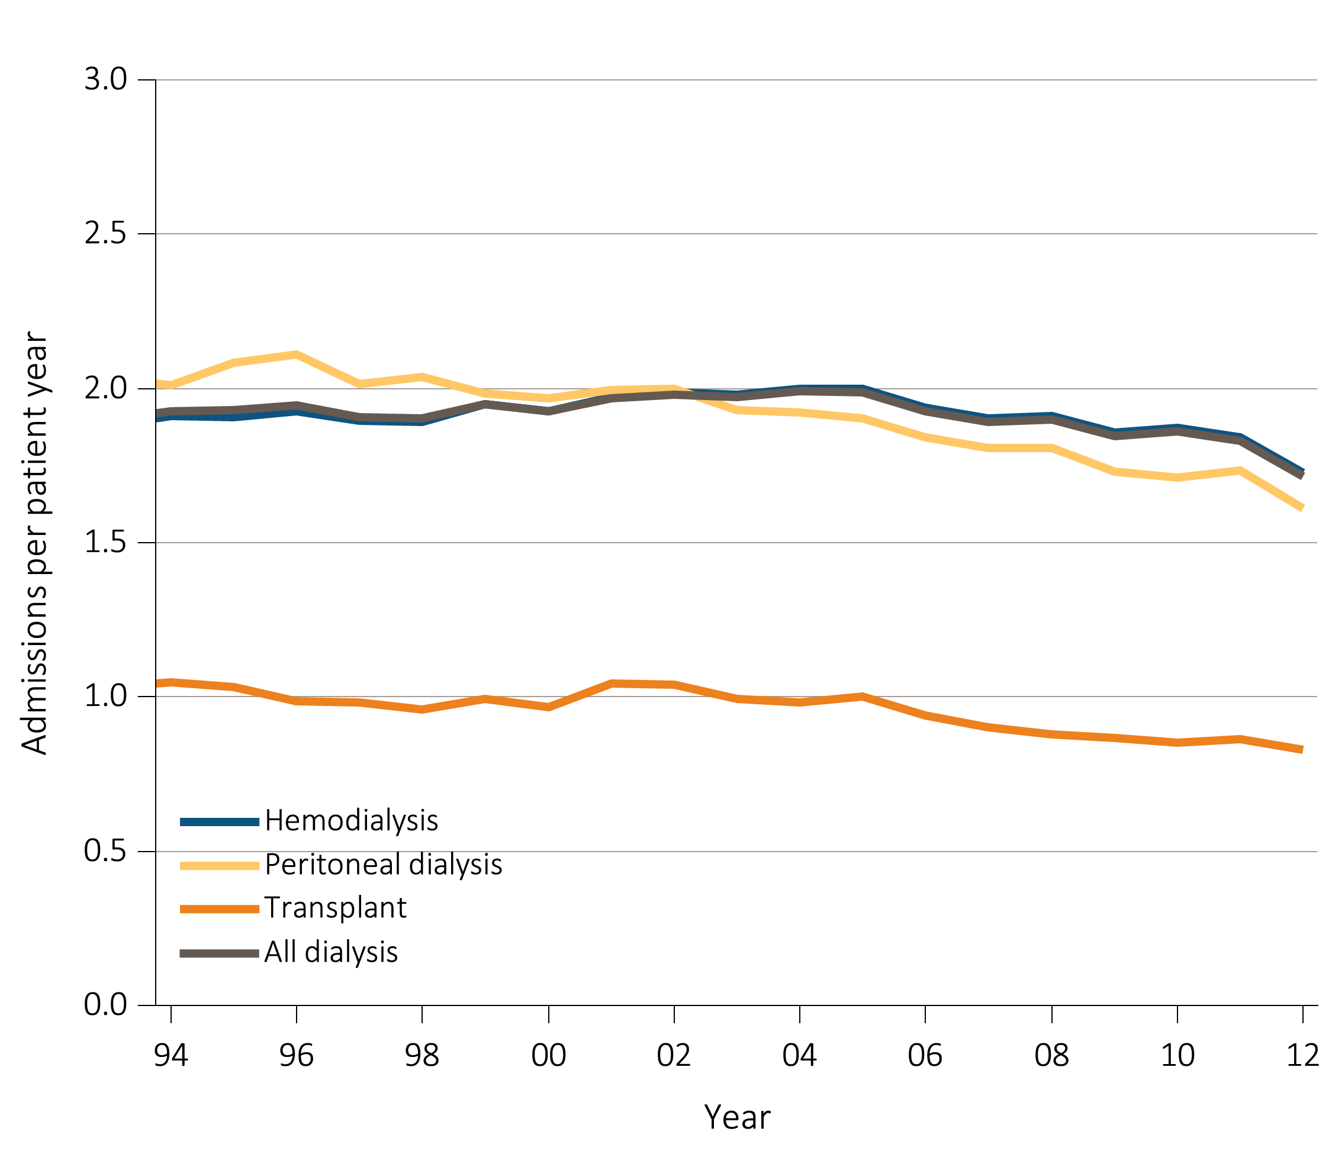
vol 2 Figure 4.2 Trends in adjusted hospitalization rates, by modality
Data Source: Reference tables: G.1, G.3, G.4, G.5, and special analyses, USRDS ESRD Database. Period prevalent ESRD patients; adjusted for age, sex, race, & primary diagnosis; ref: ESRD patients, 2010. Abbreviations: ESRD, end-stage renal disease.

Slide 7
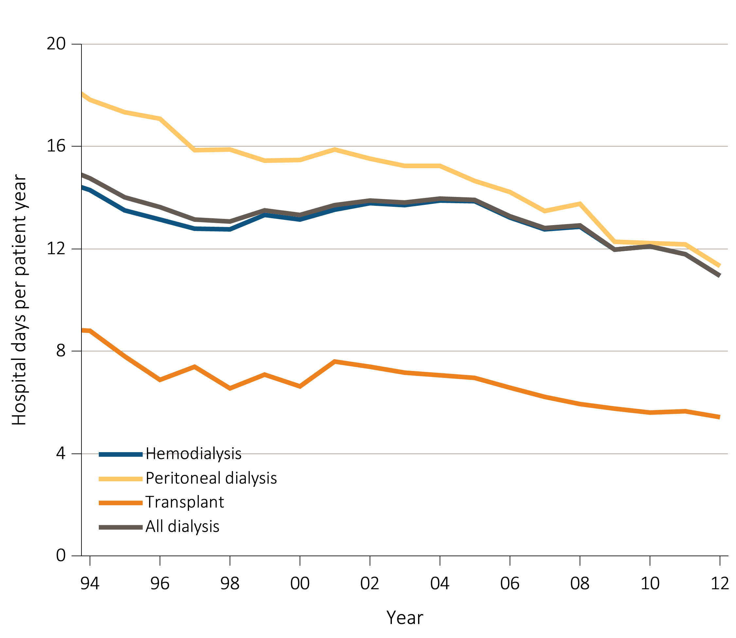
vol 2 Figure 4.2 Trends in adjusted hospital days, by modality
Data Source: Reference tables: G.6, G.8, G.9, G.10, and special analyses, USRDS ESRD Database. Period prevalent ESRD patients; adjusted for age, sex, race, & primary diagnosis; ref: ESRD patients, 2010. Abbreviations: ESRD, end-stage renal disease.

Slide 8
vol 2 Table 4.1 Adult hemodialysis patients: Unadjusted, adjusted all-cause, cause-specific hospitalization rates (per patient year)
 | All |  | Cardiovascular |  | Infection (any) |  | Vascular access infection
 | Unadjusted | Adjusted | Unadjusted | Adjusted | Unadjusted | Adjusted | Unadjusted | Adjusted
2001-2002 | 1.99 | 2.00 | 0.59 | 0.59 | 0.43 | 0.43 | 0.12 | 0.12
2003-2004 | 2.00 | 2.01 | 0.61 | 0.61 | 0.45 | 0.45 | 0.13 | 0.13
2005-2006 | 1.98 | 1.99 | 0.58 | 0.58 | 0.47 | 0.47 | 0.13 | 0.13
2007-2008 | 1.92 | 1.92 | 0.56 | 0.56 | 0.47 | 0.47 | 0.12 | 0.12
2009-2010 | 1.88 | 1.88 | 0.53 | 0.53 | 0.47 | 0.47 | 0.11 | 0.11
2011-2012 | 1.79 | 1.79 | 0.46 | 0.46 | 0.45 | 0.45 | 0.07 | 0.07
2011-2012
20-44 | 1.80 | 1.98 | 0.36 | 0.39 | 0.43 | 0.47 | 0.10 | 0.10
45-64 | 1.74 | 1.74 | 0.43 | 0.43 | 0.43 | 0.43 | 0.07 | 0.07
65-74 | 1.83 | 1.79 | 0.50 | 0.49 | 0.46 | 0.45 | 0.06 | 0.06
75+ | 1.85 | 1.85 | 0.52 | 0.51 | 0.50 | 0.49 | 0.06 | 0.06
Male | 1.66 | 1.66 | 0.43 | 0.44 | 0.42 | 0.42 | 0.06 | 0.06
Female | 1.96 | 1.96 | 0.49 | 0.49 | 0.49 | 0.49 | 0.08 | 0.08
White | 1.83 | 1.83 | 0.47 | 0.46 | 0.49 | 0.48 | 0.07 | 0.07
Black/African American | 1.79 | 1.82 | 0.47 | 0.47 | 0.41 | 0.43 | 0.08 | 0.08
Other race | 1.45 | 1.42 | 0.36 | 0.36 | 0.39 | 0.38 | 0.06 | 0.06
Hispanic | 1.68 | 1.68 | 0.42 | 0.42 | 0.44 | 0.44 | 0.07 | 0.07
Diabetes | 1.98 | 2.01 | 0.50 | 0.50 | 0.50 | 0.50 | 0.07 | 0.07
Hypertension | 1.67 | 1.67 | 0.47 | 0.47 | 0.40 | 0.40 | 0.07 | 0.07
Glomerulonephritis | 1.54 | 1.55 | 0.36 | 0.39 | 0.39 | 0.39 | 0.07 | 0.06
Other | 1.67 | 1.70 | 0.37 | 0.38 | 0.46 | 0.46 | 0.07 | 0.07
Data Source: Reference tables: G.3, G.13, and special analyses, USRDS ESRD Database. Period prevalent hemodialysis patients aged 20 & older; adjusted for age, sex, race, & primary diagnosis; rates by one factor adjusted for the remaining three; ref: hemodialysis patients, 2010. See Vol. 2, ESRD Analytical Methods for principal ICD-9-CM diagnosis codes included in each cause of hospitalization category. Abbreviations: ESRD, end-stage renal disease.

Slide 9
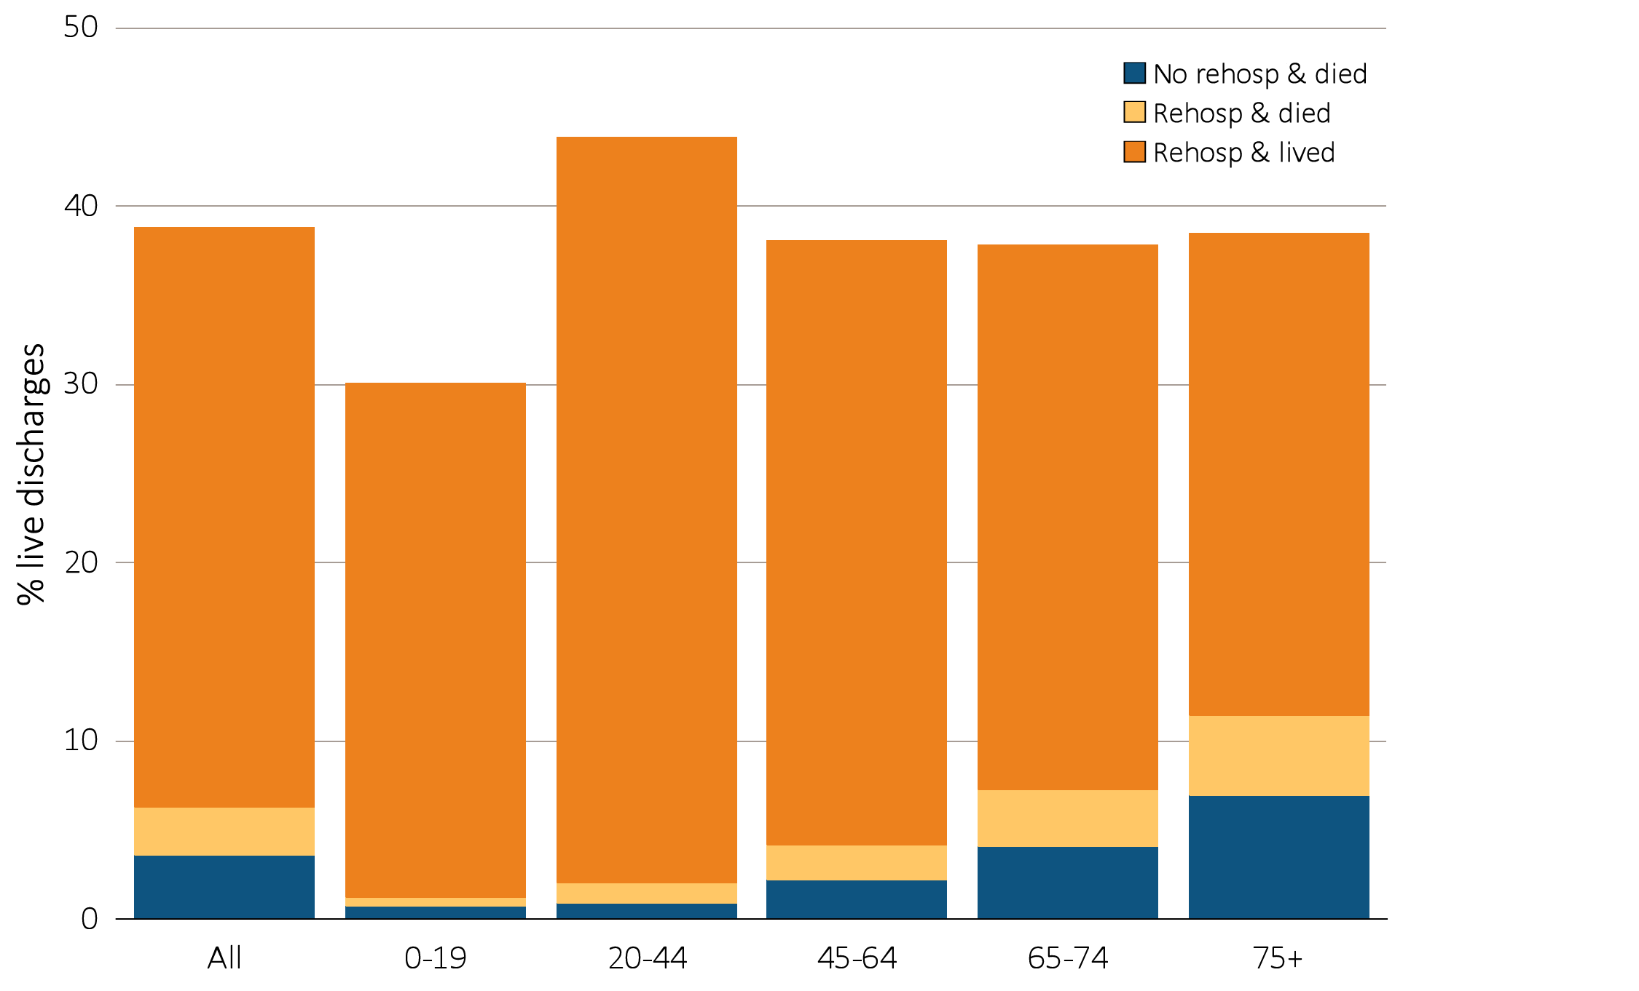
vol 2 Figure 4.3 Rehospitalization or death within 30 days from live hospital discharge, by age, 2012
Data Source: Special analyses, USRDS ESRD Database. Period prevalent hemodialysis patients, all ages, 2012; unadjusted. Includes live hospital discharges from January 1 to December 1, 2012. Cause-specific hospitalizations are defined by principal ICD-9-CM codes. See Vol. 2, ESRD Analytical Methods for principal ICD-9-CM diagnosis codes included in each cause of hospitalization category. Abbreviations: ESRD, end-stage renal disease; rehosp, rehospitalization.

Slide 10
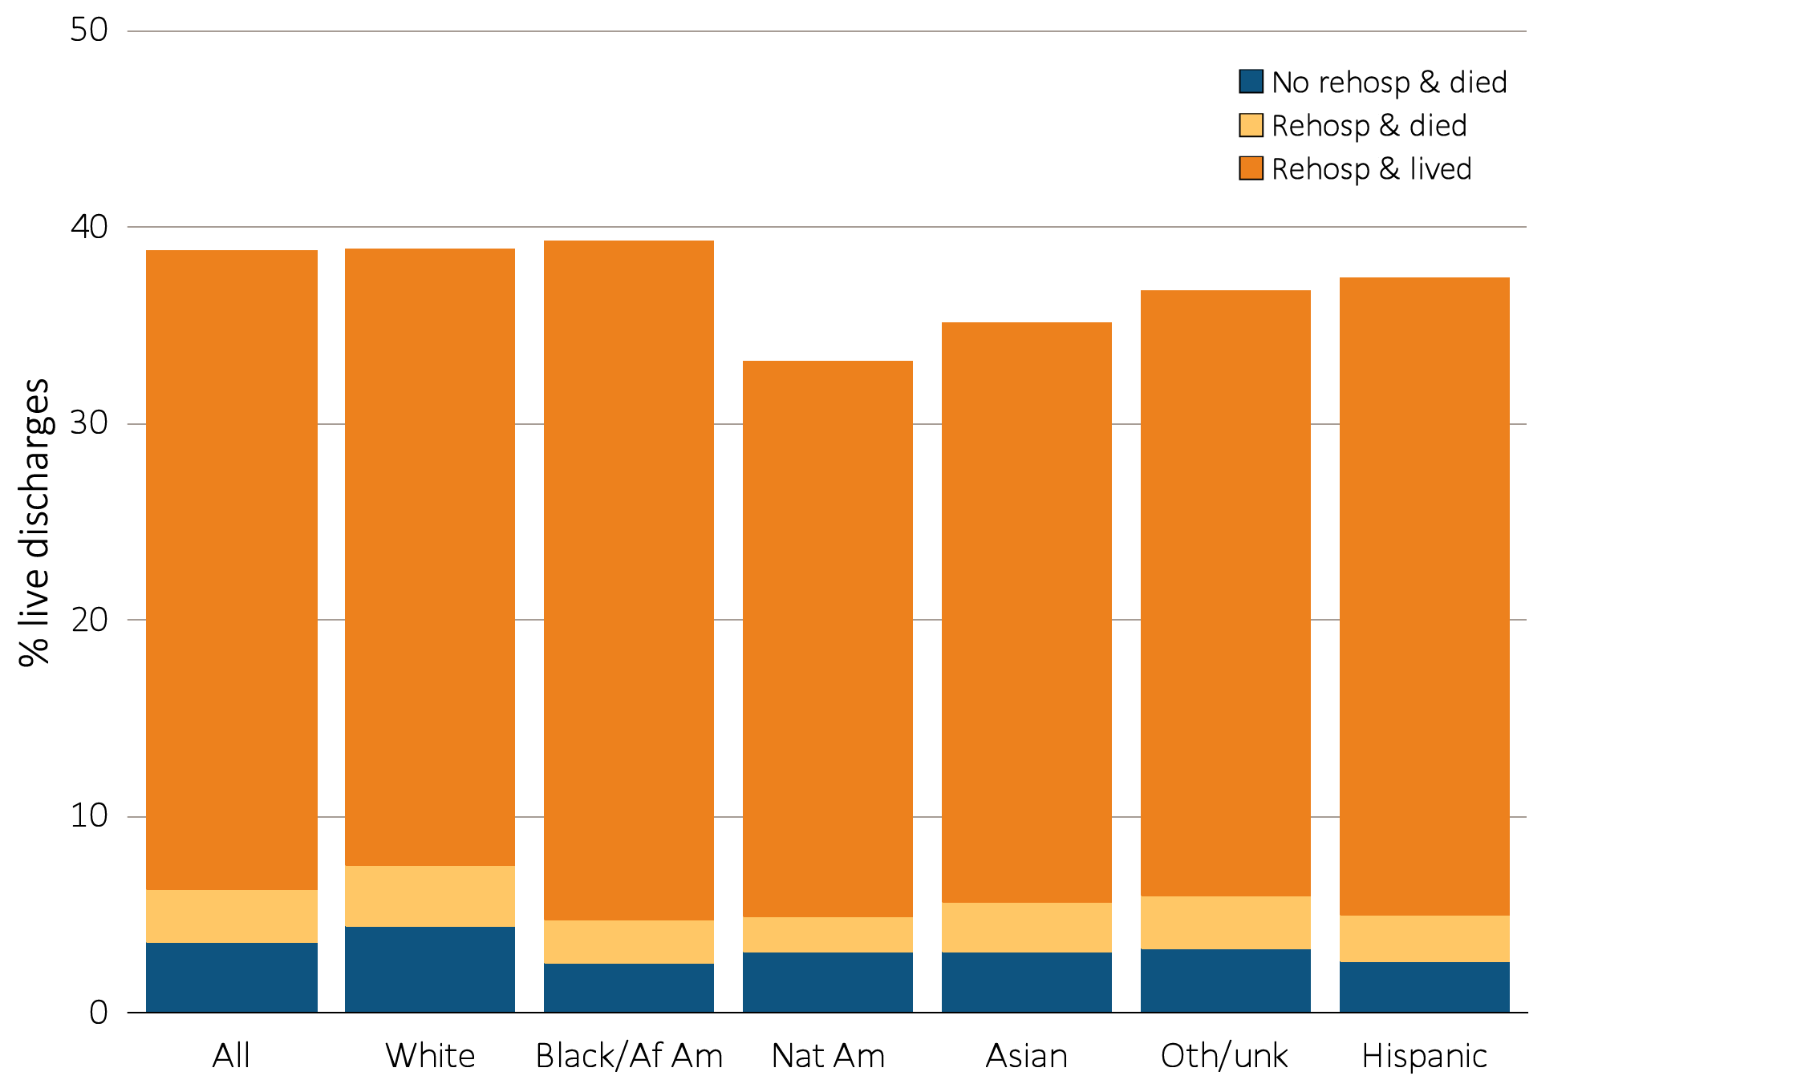
vol 2 Figure 4.4 Rehospitalization or death within 30 days from live hospital discharge, by race and ethnicity, 2012
Data Source: Special analyses, USRDS ESRD Database. Period prevalent hemodialysis patients, all ages, 2012; unadjusted. Includes live hospital discharges from January 1 to December 1, 2012. Cause-specific hospitalizations are defined by principal ICD-9-CM codes. See Vol. 2, ESRD Analytical Methods for principal ICD-9-CM diagnosis codes included in each cause of hospitalization category. Abbreviations: Af Am, African American; ESRD, end-stage renal disease; Nat Am, Native American; Oth/unk, other or unidentified race; rehosp, rehospitalization.

Slide 11
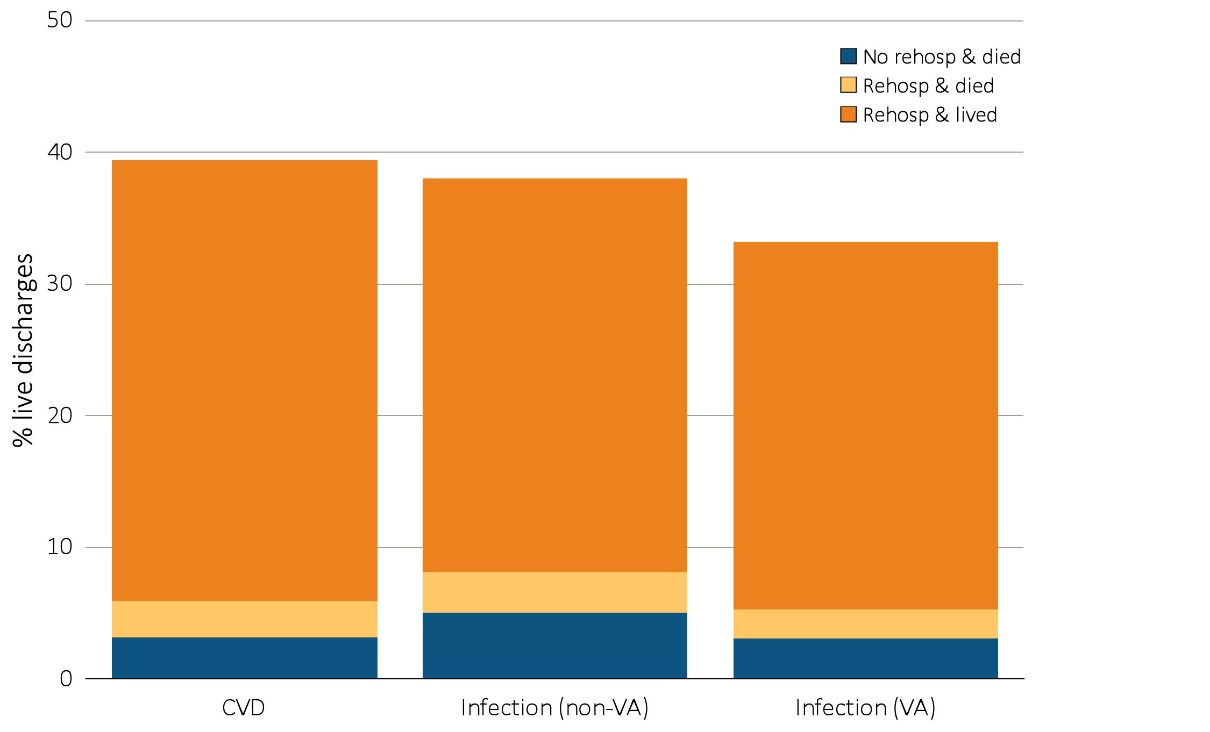
vol 2 Figure 4.5 Rehospitalization or death within 30 days from live hospital discharge, by cause of index hospitalization, 2012
Data Source: Special analyses, USRDS ESRD Database. Period prevalent hemodialysis patients, all ages, 2012, unadjusted. Includes live hospital discharges from January 1 to December 1, 2012. Cause-specific hospitalizations are defined by principal ICD-9-CM codes. See Vol. 2, ESRD Analytical Methods for principal ICD-9-CM diagnosis codes included in each cause of hospitalization category. Abbreviations: CVD, cardiovascular disease; ESRD, end-stage renal disease; rehosp, rehospitalization; VA, vascular access.

Slide 12
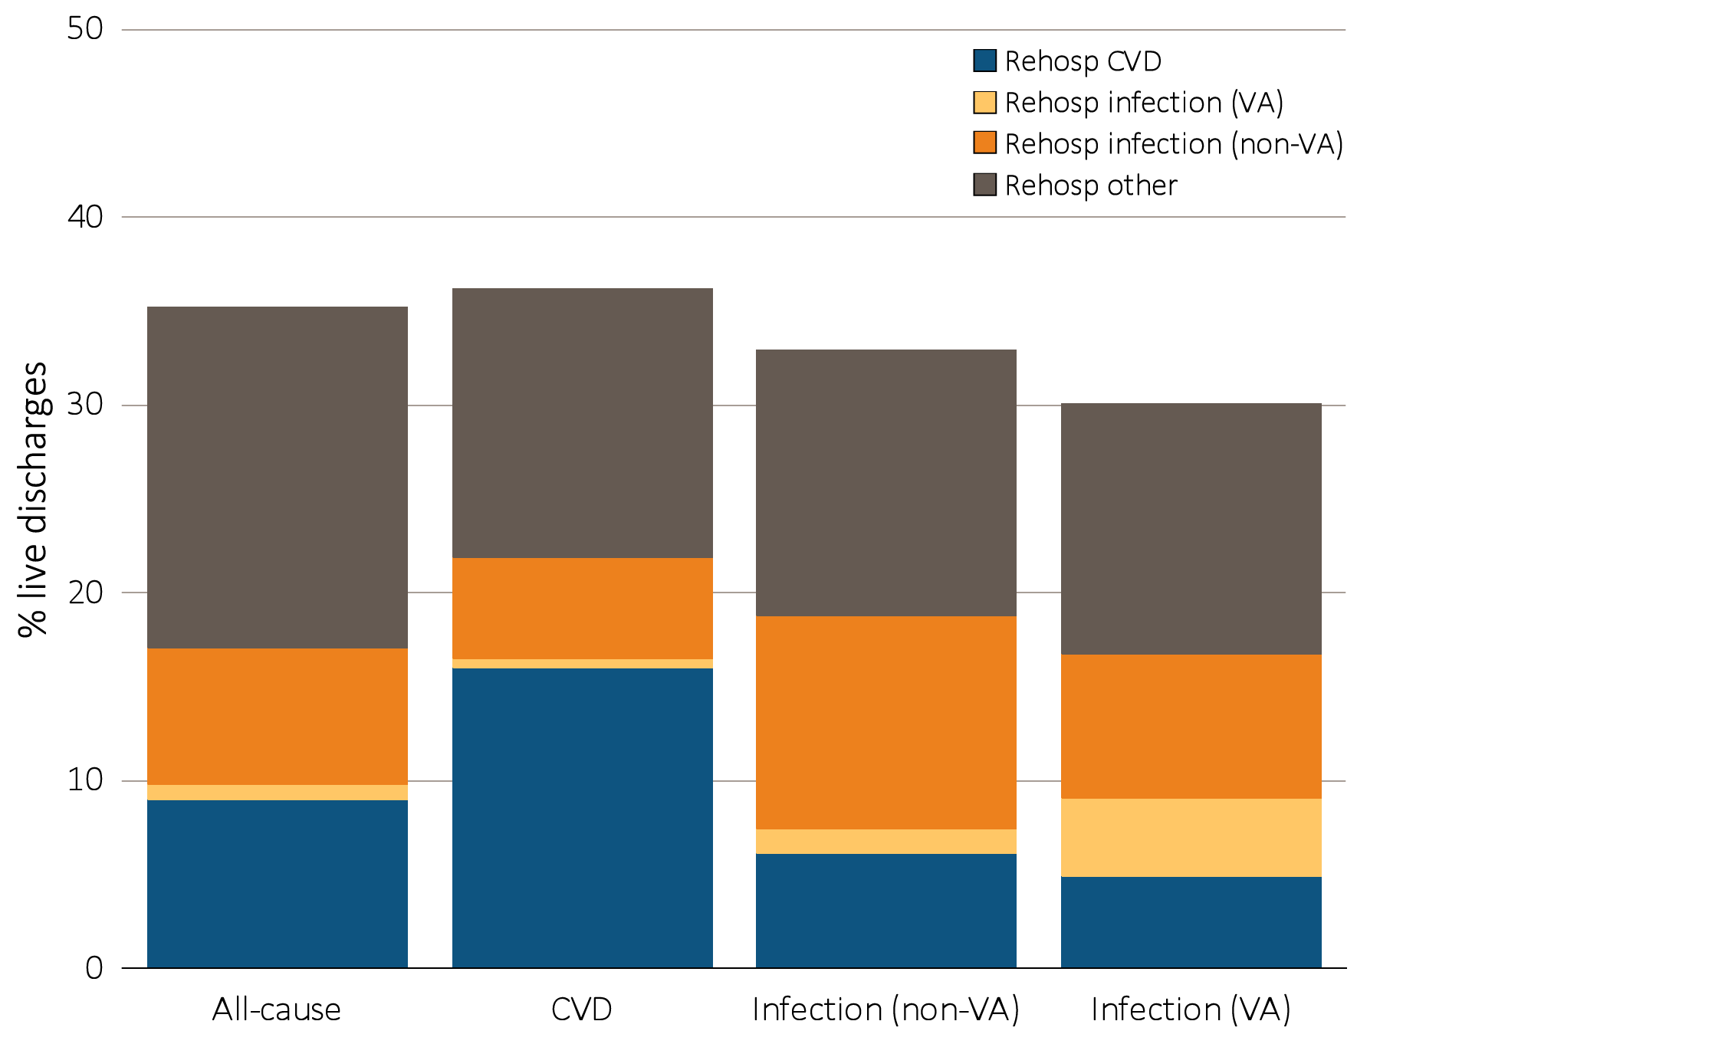
vol 2 Figure 4.6 Cause-specific rehospitalization within 30 days from live hospital discharge, by cause of index hospitalization, 2012
Data Source: Special analyses, USRDS ESRD Database. Period prevalent hemodialysis patients, all ages, 2012, unadjusted. Includes live hospital discharges from January 1 to December 1, 2012. Cause-specific hospitalizations are defined by principal ICD-9-CM codes. See Vol. 2, ESRD Analytical Methods for principal ICD-9-CM diagnosis codes included in each cause of hospitalization category. Abbreviations: CVD, cardiovascular disease; ESRD, end-stage renal disease; rehosp, rehospitalization; VA, vascular access.

Slide 13
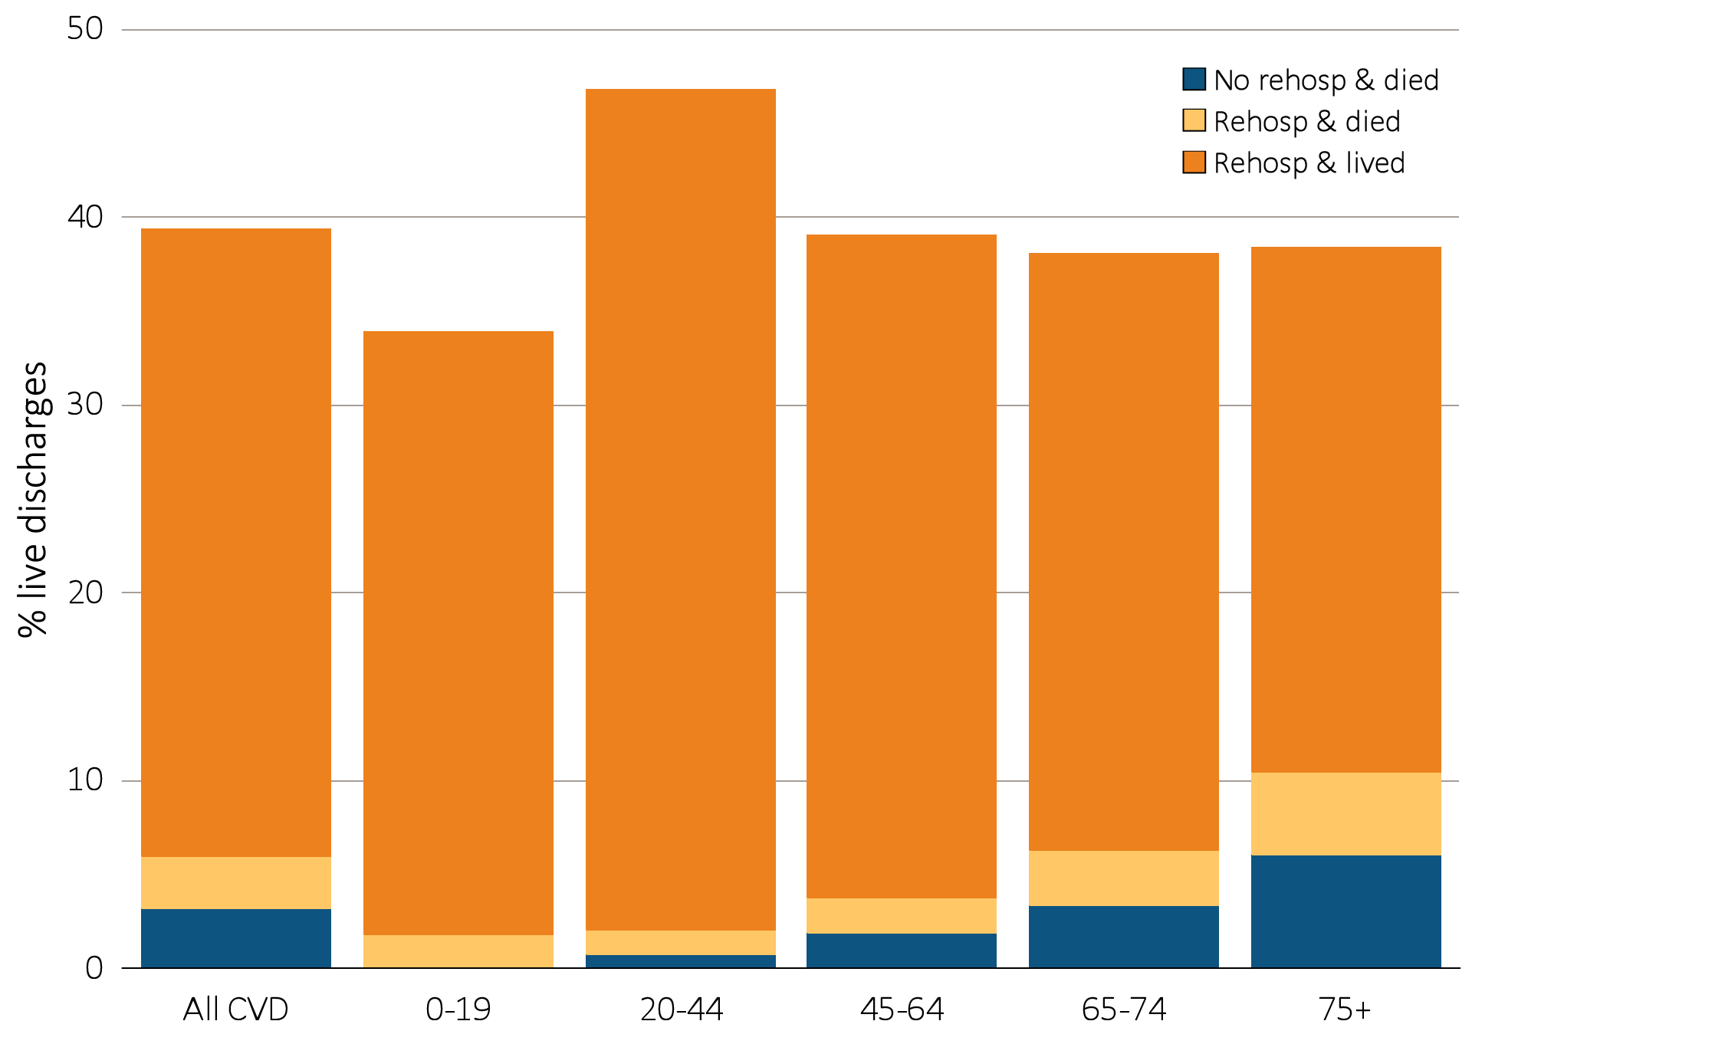
vol 2 Figure 4.7 Rehospitalization or death within 30 days from live hospital discharge for cardiovascular index hospitalization, by age, 2012
Data Source: Special analyses, USRDS ESRD Database. Period prevalent hemodialysis patients, all ages, 2012, unadjusted. Includes live hospital discharges from January 1 to December 1, 2012. Cause-specific hospitalizations are defined by principal ICD-9-CM codes. See Vol. 2, ESRD Analytical Methods for principal ICD-9-CM diagnosis codes included in each cause of hospitalization category. Abbreviations: CVD, cardiovascular disease; ESRD, end-stage renal disease; rehosp, rehospitalization.

Slide 14
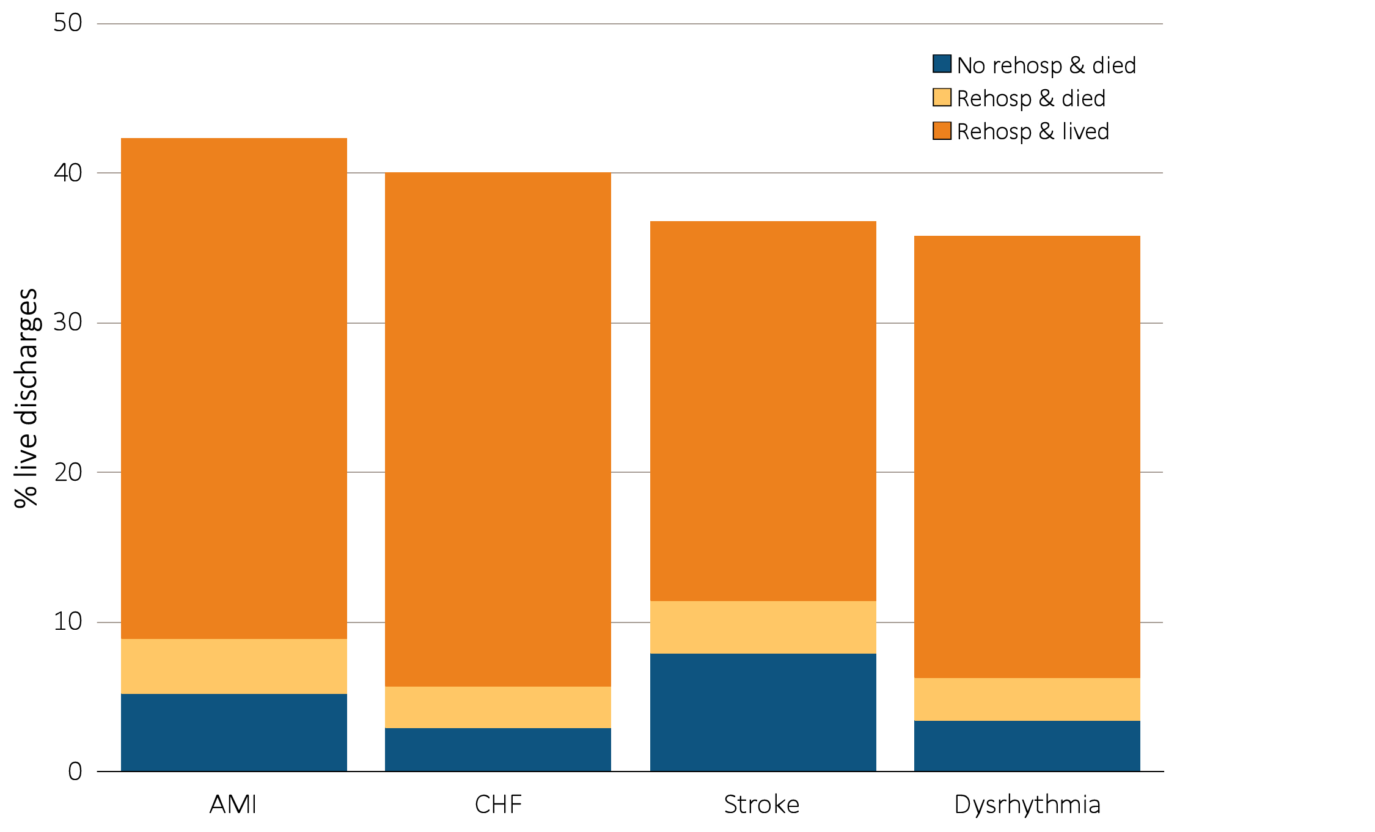
vol 2 Figure 4.8 Rehospitalization or death within 30 days from live hospital discharge, by cause-specific cardiovascular index hospitalization, 2012
Data Source: Special analyses, USRDS ESRD Database. Period prevalent hemodialysis patients, all ages, 2012, unadjusted. Includes live hospital discharges from January 1 to December 1, 2012. Cause-specific hospitalizations are defined by principal ICD-9-CM codes. See Vol. 2, ESRD Analytical Methods for principal ICD-9-CM diagnosis codes included in each cause of hospitalization category. Abbreviations: AMI, acute myocardial infarction; CHF, congestive heart failure; ESRD, end-stage renal disease; rehosp, rehospitalization.

Slide 15
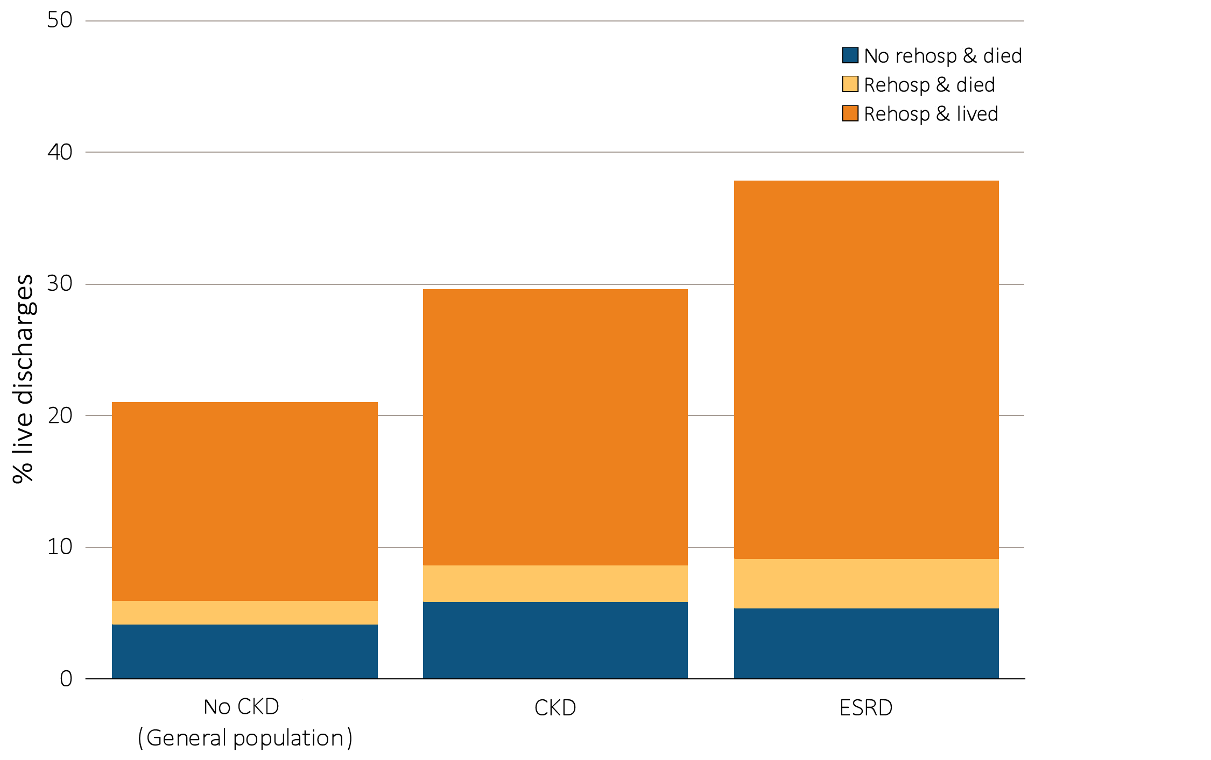
vol 2 Figure 4.9 Rehospitalization or death within 30 days from live hospital discharge in patients age 66 & older, by kidney function, 2012
Data Source: Special analyses, USRDS ESRD Database and Medicare 5 percent sample. January 1, 2012 point prevalent Medicare patients age 66 & older on December 31, 2011. For general Medicare: January 1, 2012 point prevalent, Medicare patients age 66 & older, discharged alive from an all-cause index hospitalization between January 1, 2012, and December 1, 2012, unadjusted. CKD determined using claims for 2011. Abbreviations: CKD, chronic kidney disease; ESRD, end-stage renal disease; rehosp, rehospitalization.

