Slide 2
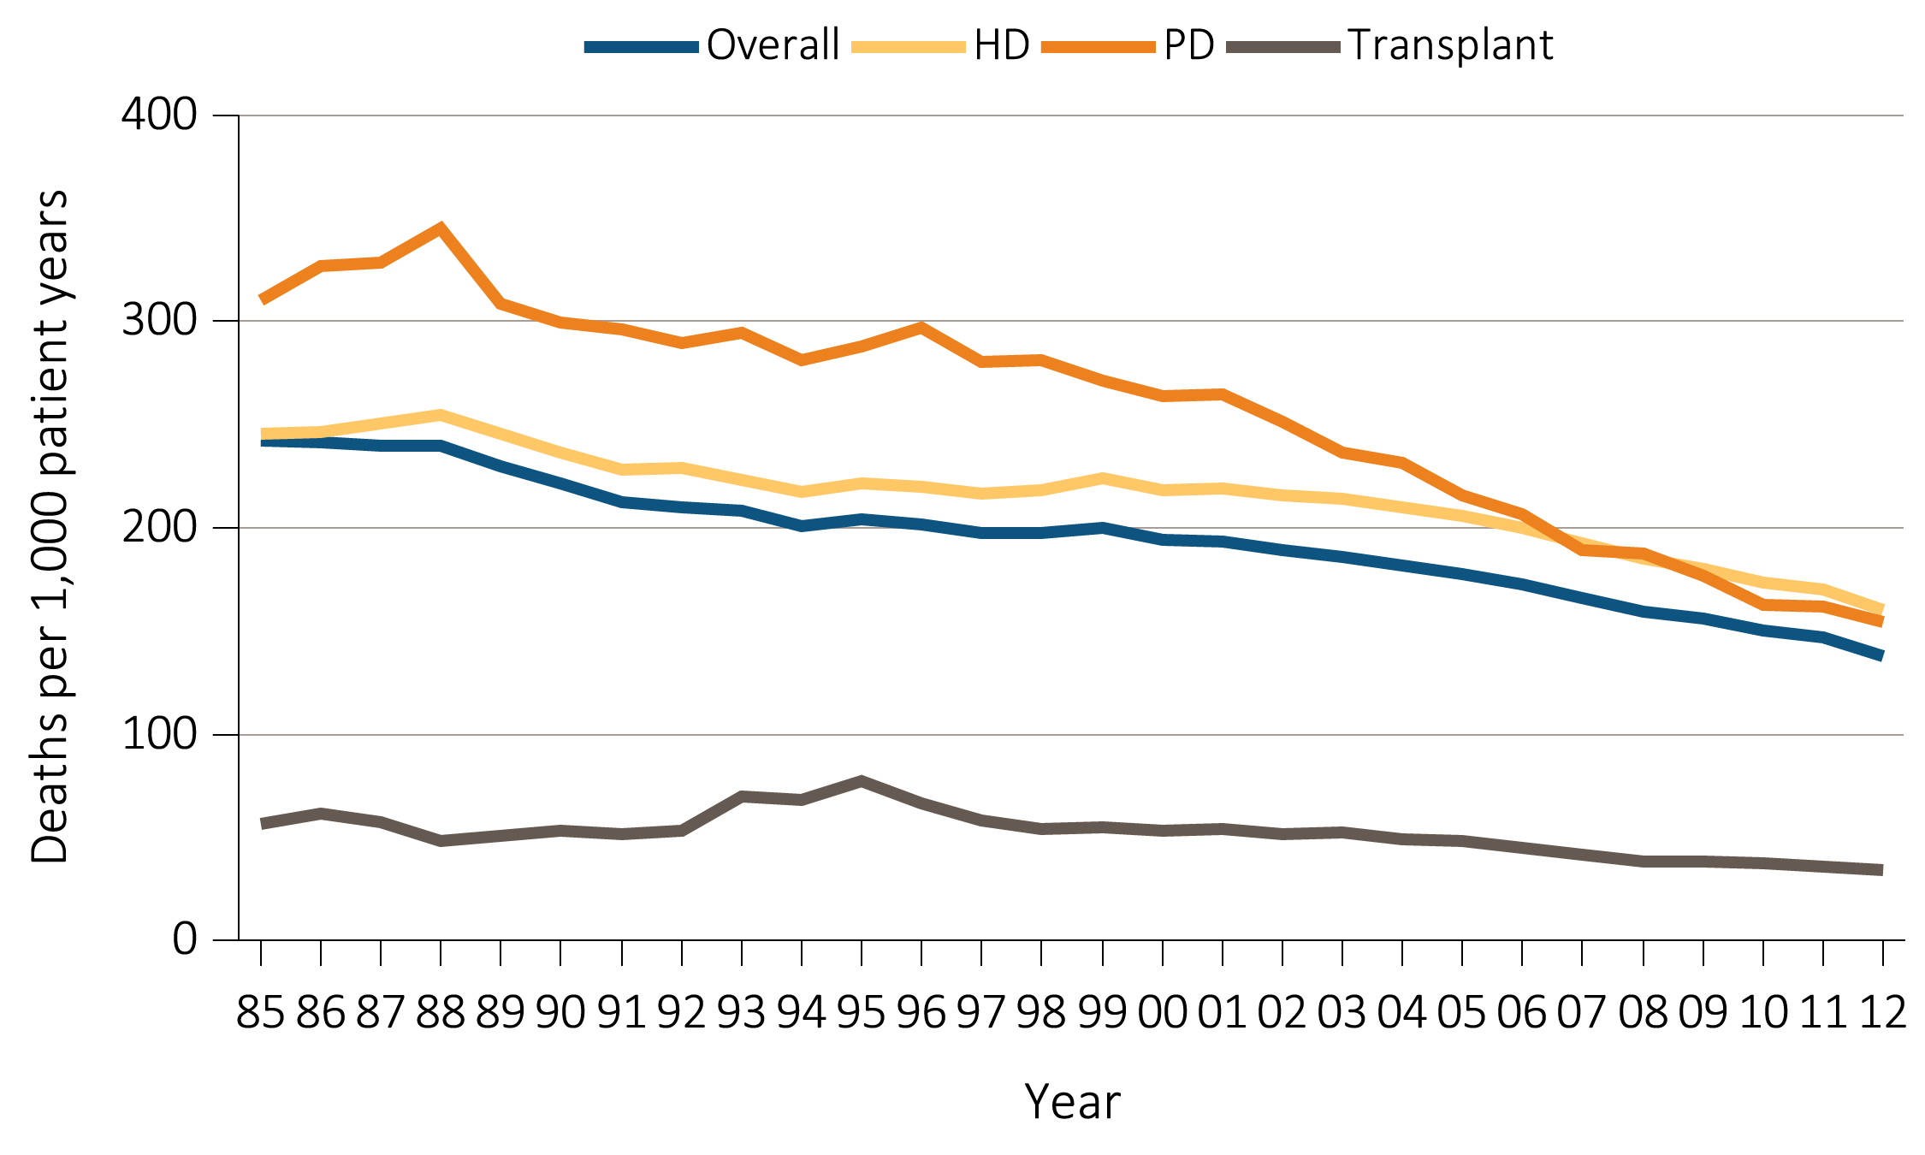
vol 2 Figure 5.1 Adjusted all-cause mortality rates, overall and by modality
Data Source: Reference Tables H.2, H.8, H.9, and H.10, and special analyses, USRDS ESRD Database. Adjusted for age, sex, race, and primary diagnosis. Ref: 2011 patients. Abbreviations: HD, hemodialysis; PD, peritoneal dialysis.

Slide 3
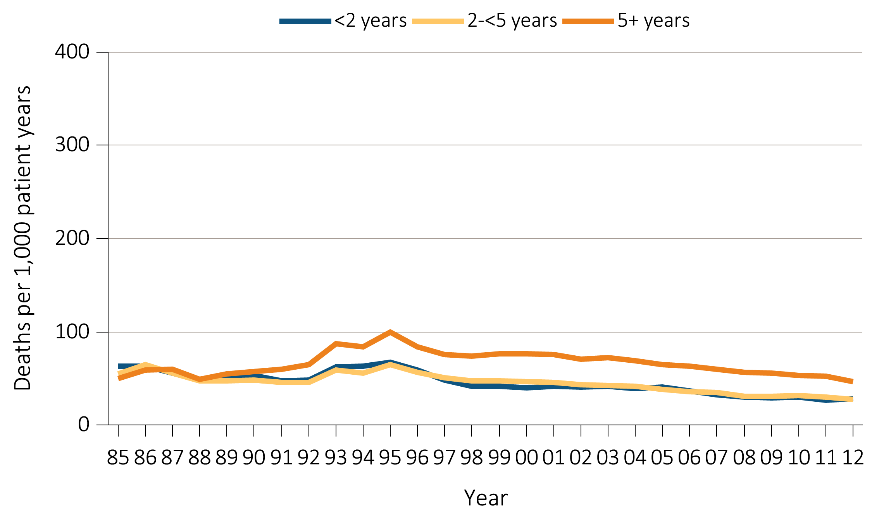
vol 2 Figure 5.2 Adjusted all-cause mortality rates, by ESRD vintage (a) Transplant
Data Source: Reference Tables H.4, H.8, H.9, and H.10, and special analyses, USRDS ESRD Database. Adjusted for age, sex, race, and primary diagnosis. Ref: 2011 patients. Abbreviation: ESRD, end-stage renal disease.

Slide 4
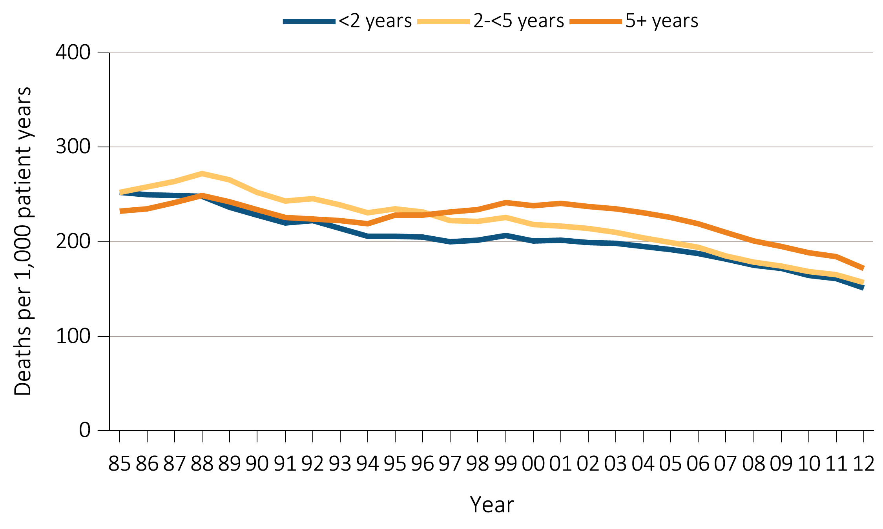
vol 2 Figure 5.2 Adjusted all-cause mortality rates, by ESRD vintage (b) Hemodialysis
Data Source: Reference Tables H.4, H.8, H.9, and H.10, and special analyses, USRDS ESRD Database. Adjusted for age, sex, race, and primary diagnosis. Ref: 2011 patients. Abbreviation: ESRD, end-stage renal disease.

Slide 5
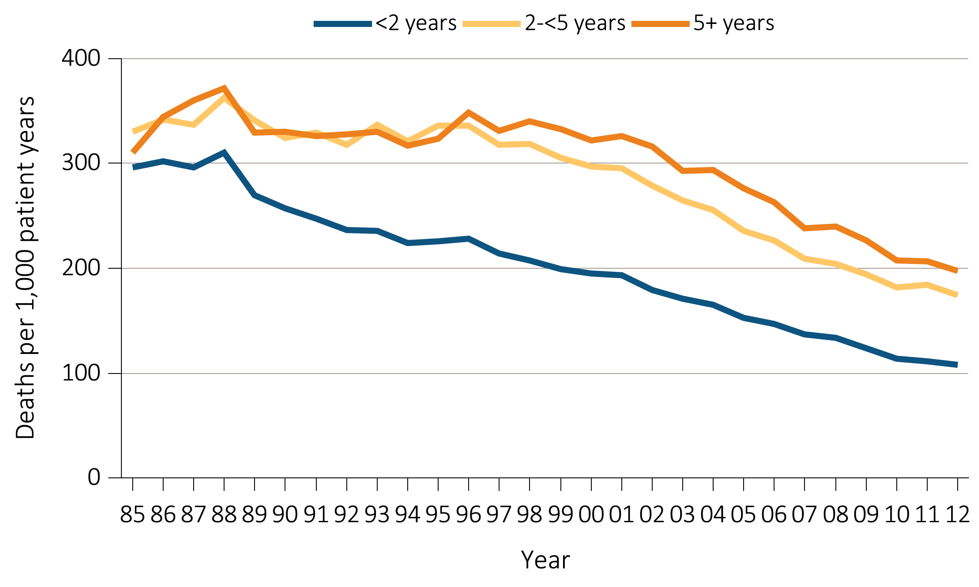
vol 2 Figure 5.2 Adjusted all-cause mortality rates, by ESRD vintage (c) Peritoneal dialysis
Data Source: Reference Tables H.4, H.8, H.9, and H.10, and special analyses, USRDS ESRD Database. Adjusted for age, sex, race, and primary diagnosis. Ref: 2011 patients. Abbreviation: ESRD, end-stage renal disease.

Slide 6
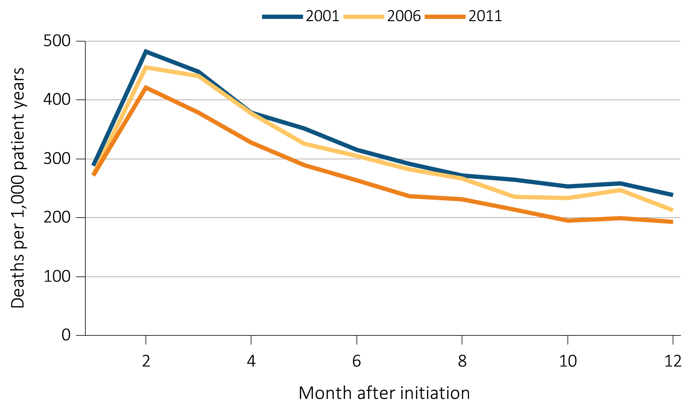
vol 2 Figure 5.3 Adjusted mortality in the first year of hemodialysis, by year of initiation of dialysis (a) All-cause mortality
Data Source: Special analyses, USRDS ESRD Database. Adjusted (age, race, sex, ethnicity, and primary diagnosis) all-cause and cause-specific mortality in the first year of hemodialysis. Ref: incident hemodialysis patients, 2011.

Slide 7
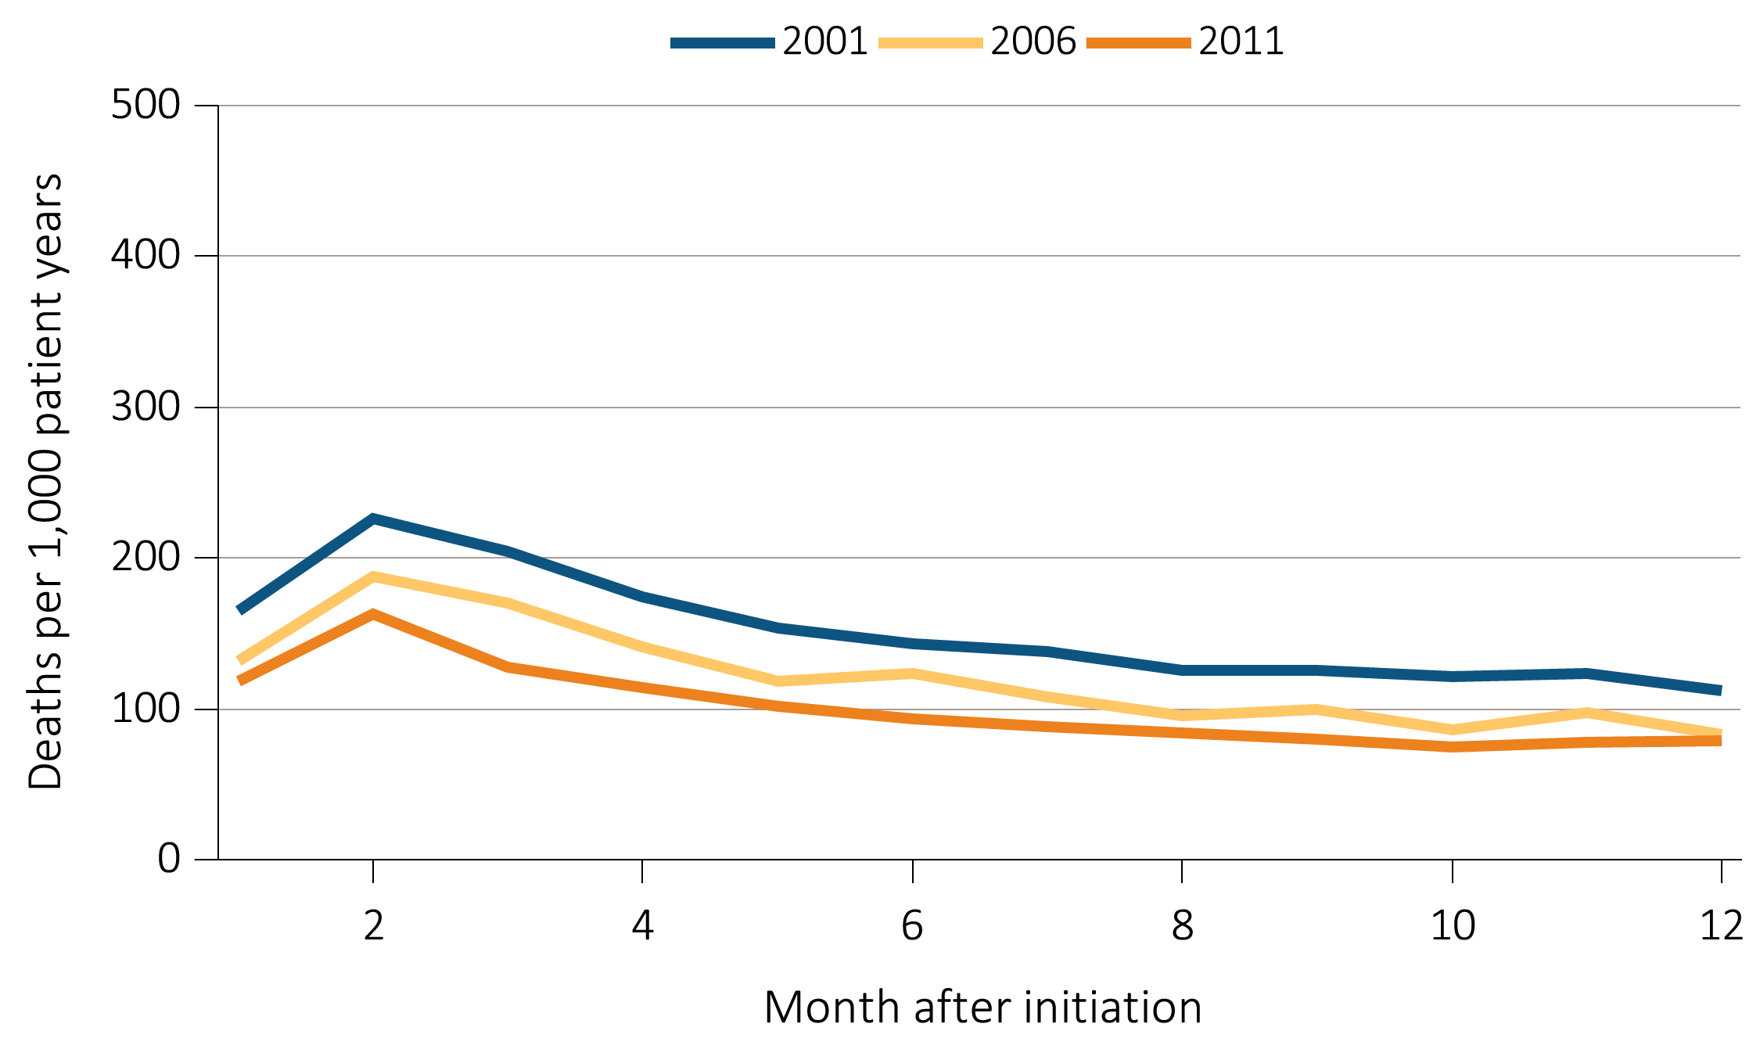
vol 2 Figure 5.3 Adjusted mortality in the first year of hemodialysis, by year of initiation of dialysis (b) Cardiovascular mortality
Data Source: Special analyses, USRDS ESRD Database. Adjusted (age, race, sex, ethnicity, and primary diagnosis) all-cause and cause-specific mortality in the first year of hemodialysis. Ref: incident hemodialysis patients, 2011.

Slide 8
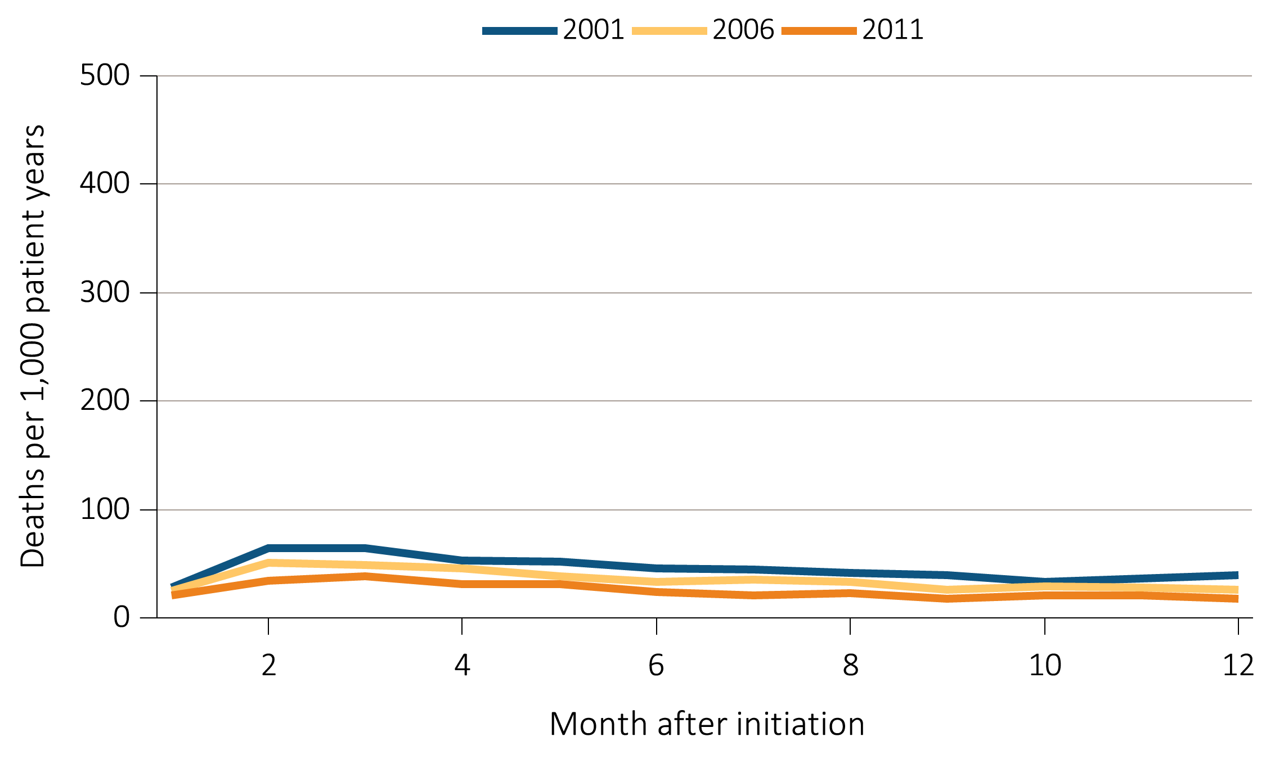
vol 2 Figure 5.3 Adjusted mortality in the first year of hemodialysis, by year of initiation of dialysis (c) Infection mortality
Data Source: Special analyses, USRDS ESRD Database. Adjusted (age, race, sex, ethnicity, and primary diagnosis) all-cause and cause-specific mortality in the first year of hemodialysis. Ref: incident hemodialysis patients, 2011.

Slide 9
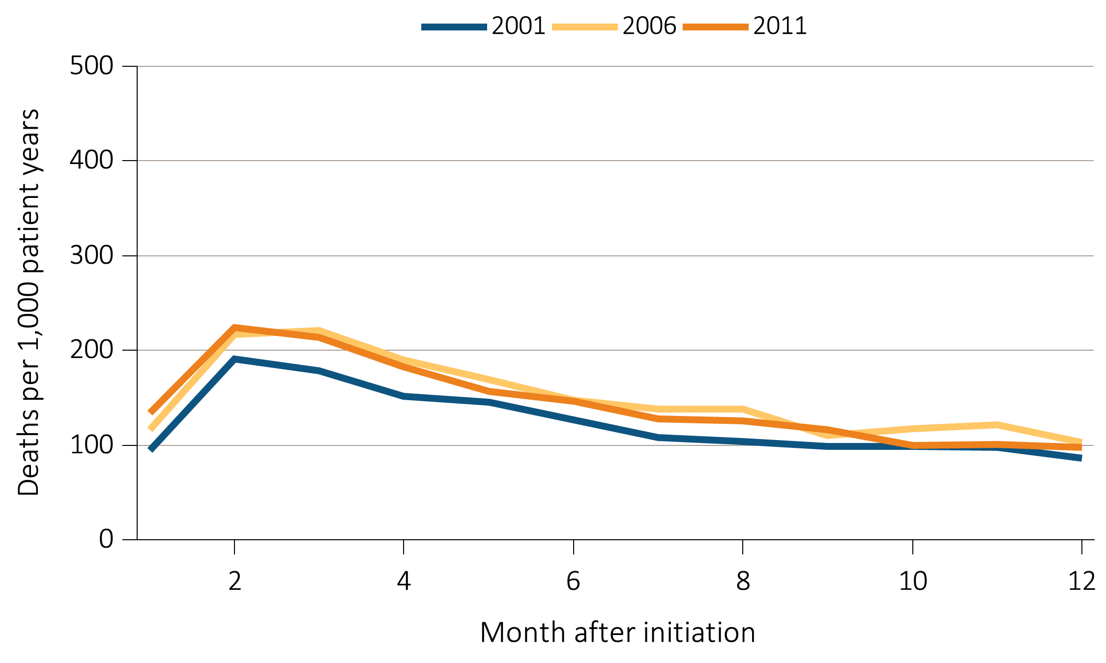
vol 2 Figure 5.3 Adjusted mortality in the first year of hemodialysis, by year of initiation of dialysis (d) Other mortality
Data Source: Special analyses, USRDS ESRD Database. Adjusted (age, race, sex, ethnicity, and primary diagnosis) all-cause and cause-specific mortality in the first year of hemodialysis. Ref: incident hemodialysis patients, 2011.

Slide 10
vol 2 Table 5.1 Adjusted survival probabilities among ESRD patients, by months after initiation of treatment 5.1.a By modality and year of initiation of treatment
 | 3 months | 12 months | 24 months | 36 months | 60 months
Dialysis
1999 | 91.2 | 74.9 | 61.0 | 50.0 | 34.5
2001 | 91.2 | 75.1 | 61.8 | 51.2 | 36.0
2003 | 91.2 | 75.1 | 62.2 | 51.8 | 37.1
2005 | 91.4 | 75.7 | 63.0 | 53.4 | 39.0
2007 | 91.7 | 76.4 | 64.4 | 54.9 | 40.4
Hemodialysis
1999 | 90.9 | 74.5 | 60.7 | 49.8 | 34.2
2001 | 90.9 | 74.6 | 61.2 | 50.7 | 35.6
2003 | 90.9 | 74.5 | 61.6 | 51.3 | 36.5
2005 | 91.1 | 75.1 | 62.4 | 52.7 | 38.4
2007 | 91.4 | 75.8 | 63.7 | 54.2 | 39.8
Peritoneal dialysis
1999 | 94.3 | 79.6 | 63.7 | 51.7 | 36.4
2001 | 95.5 | 82.0 | 67.2 | 55.5 | 39.3
2003 | 96.2 | 84.0 | 68.9 | 57.6 | 43.0
2005 | 96.4 | 85.8 | 72.5 | 61.9 | 45.9
2007 | 96.9 | 87.6 | 74.9 | 64.7 | 49.2
Deceased-donor transplant
1999 | 94.3 | 88.6 | 83.9 | 78.3 | 66.5
2001 | 95.0 | 89.6 | 83.3 | 77.8 | 65.9
2003 | 95.8 | 90.1 | 84.7 | 79.6 | 69.2
2005 | 95.8 | 90.0 | 85.3 | 80.7 | 71.3
2007 | 96.8 | 92.5 | 88.4 | 84.1 | 73.7
Living donor transplant
1999 | 97.3 | 94.2 | 90.7 | 85.5 | 76.3
2001 | 97.5 | 93.8 | 89.9 | 85.8 | 76.2
2003 | 98.3 | 95.8 | 92.2 | 88.2 | 79.9
2005 | 98.3 | 95.6 | 92.5 | 89.1 | 81.4
2007 | 99.2 | 97.6 | 95.5 | 93.0 | 87.0
Data Source: Reference Tables I.1-I.36, and special analyses, USRDS ESRD Database. Adjusted survival probabilities, from day one, without the 60 day rule, in the ESRD population. Ref: incident ESRD patients, 2011. Adjusted for age, sex, race, Hispanic ethnicity, and primary diagnosis. Abbreviation: ESRD, end-stage renal disease.

Slide 11
vol 2 Table 5.1 Adjusted survival probabilities among ESRD patients, by months after initiation of treatment 5.1.b By modality and age, sex, race, and primary cause of ESRD, for patients initiating ESRD treatment in 2007
 | 3 months | 12 months | 24 months | 36 months | 60 months
2007 cohort
Dialysis | 91.7 | 76.4 | 64.4 | 54.9 | 40.4
Hemodialysis | 91.4 | 75.8 | 63.7 | 54.2 | 39.8
Peritoneal dialysis | 96.9 | 87.6 | 74.9 | 64.7 | 49.2
Deceased-donor transplant | 96.8 | 92.5 | 88.4 | 84.1 | 73.7
Living donor transplant | 99.2 | 97.6 | 95.5 | 93.0 | 87.0
Age
0-19 | 98.4 | 95.5 | 91.9 | 89.7 | 87.0
20-44 | 97.7 | 91.9 | 85.9 | 81.0 | 73.0
45-64 | 95.4 | 85.0 | 75.7 | 67.3 | 53.3
65-74 | 91.0 | 74.2 | 60.8 | 49.9 | 33.0
75+ | 84.6 | 60.4 | 43.4 | 31.5 | 15.8
Sex
Male | 91.7 | 76.9 | 64.9 | 55.4 | 41.3
Female | 91.9 | 76.8 | 65.2 | 55.9 | 41.6
Race
White | 91.0 | 75.2 | 62.9 | 53.3 | 38.8
Black/African American | 93.2 | 79.1 | 68.0 | 59.0 | 45.3
Native American | 95.1 | 84.7 | 71.6 | 61.6 | 46.8
Asian | 94.6 | 83.8 | 74.9 | 66.9 | 53.7
Other | 91.1 | 72.1 | 55.4 | 44.2 | 26.1
Primary cause of ESRD
Diabetes | 92.7 | 77.6 | 64.4 | 53.7 | 37.2
Hypertension | 92.0 | 77.9 | 66.4 | 57.4 | 43.6
Glomerulonephritis | 94.3 | 83.4 | 73.9 | 66.3 | 53.8
Other | 88.2 | 70.0 | 59.6 | 52.0 | 41.6
Data Source: Reference Tables I.1-I.36, and special analyses, USRDS ESRD Database. Adjusted survival probabilities, from day one, without the 60 day rule, in the ESRD population. Ref: incident ESRD patients, 2011. Adjusted for age, sex, race, Hispanic ethnicity, and primary diagnosis. Abbreviation: ESRD, end-stage renal disease.

Slide 12
vol 2 Table 5.2 Expected remaining lifetime (years) of the general U.S. population, prevalent dialysis patients and transplant patients, by sex and age
 | ESRD patients, 2012 |  |  |  |  |  | General U.S. population, 2010
 | Dialysis |  |  | Transplant
Ages | All | M | F | All | M | F | All | M | F
0-14 | 22.3 | 23.2 | 21.3 | 61.0 | 60.1 | 62.5 | 72.9 | 70.5 | 75.3
15-19 | 19.9 | 20.6 | 19.0 | 48.7 | 47.9 | 50.0 | 59.5 | 57.1 | 61.7
20-24 | 17.0 | 17.7 | 16.1 | 44.7 | 44.0 | 45.9 | 54.7 | 52.4 | 56.9
25-29 | 14.9 | 15.5 | 14.1 | 40.7 | 40.0 | 41.8 | 50.0 | 47.8 | 52.0
30-34 | 13.4 | 13.8 | 12.7 | 36.8 | 36.1 | 37.9 | 45.2 | 43.1 | 47.2
35-39 | 12.0 | 12.3 | 11.5 | 32.8 | 32.1 | 33.9 | 40.5 | 38.5 | 42.4
40-44 | 10.5 | 10.6 | 10.2 | 28.9 | 28.2 | 30.0 | 35.9 | 33.9 | 37.7
45-49 | 8.9 | 9.0 | 8.7 | 25.1 | 24.4 | 26.2 | 31.4 | 29.6 | 33.2
50-54 | 7.6 | 7.6 | 7.6 | 21.6 | 20.9 | 22.7 | 27.2 | 25.4 | 28.8
55-59 | 6.5 | 6.4 | 6.5 | 18.3 | 17.7 | 19.3 | 23.1 | 21.5 | 24.5
60-64 | 5.5 | 5.4 | 5.6 | 15.4 | 14.8 | 16.4 | 19.1 | 17.7 | 20.3
65-69 | 4.6 | 4.5 | 4.8 | 12.9 | 12.4 | 13.8 | 15.5 | 14.2 | 16.5
70-74 | 3.9 | 3.8 | 4.1 | 10.8 | 10.4 | 11.5 | 12.1 | 11.0 | 12.9
75-79 | 3.3 | 3.2 | 3.5 | 9.1 | 8.7 | 9.7 | 9.1 | 8.2 | 9.7
80-84 | 2.7 | 2.6 | 2.9 | ª | ª | ª | 6.5 | 5.8 | 6.9
85+ | 2.2 | 2.1 | 2.4 | ª | ª | ª | 3.4 | 3.0 | 3.5
Overall | 6.6 | 6.6 | 6.6 | 18.6 | 18.0 | 19.5 | 22.2 | 20.7 | 23.4
Data Source: Reference Table H.13; special analyses, USRDS ESRDS Database; and Table 7 in National Vital Statistics Reports, Deaths: Final Data for 2010. Expected remaining lifetimes (years) of the general U.S. population and of prevalent dialysis and transplant patients. Prevalent ESRD population, 2012, used as weight to calculate overall combined-age remaining lifetimes. acell values combine ages 75-85 and over. Abbreviation: ESRD, end-stage renal disease.

Slide 13
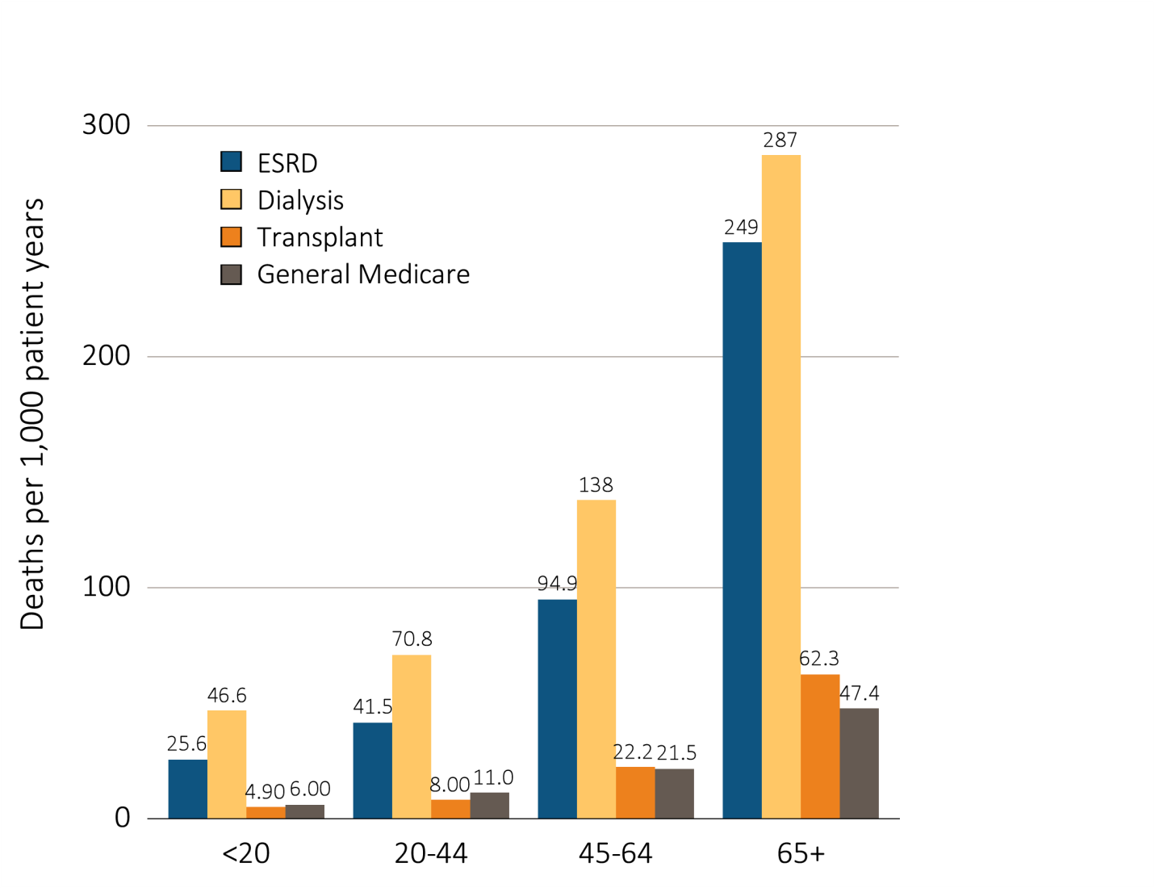
vol 2 Figure 5.4 Adjusted all-cause mortality in the ESRD & general populations, by age, 2012
Data Source: Special analyses, USRDS ESRD Database and Medicare 5 Percent Sample. Adjusted for sex and race. Medicare data limited to patients with at least one month of Medicare eligibility in 2012. Ref: Medicare patients, 2012. Abbreviation: ESRD, end-stage renal disease.

Slide 14
vol 2 Table 5.3 Unadjusted & adjusted mortality rates in the ESRD & comorbidity-specific Medicare populations, age 65 & older (per 1,000 patient years), by calendar year
 | 1996 | 1997 | 1998 | 1999 | 2000 | 2001 | 2002 | 2003 | 2004 | 2005 | 2006 | 2007 | 2008 | 2009 | 2010 | 2011 | 2012
Unadjusted
ESRD | 337 | 329 | 335 | 338 | 324 | 320 | 315 | 307 | 300 | 296 | 286 | 276 | 264 | 257 | 247 | 241 | 223
Dialysis | 354 | 347 | 354 | 359 | 344 | 342 | 338 | 332 | 327 | 326 | 317 | 308 | 298 | 291 | 281 | 277 | 258
Transplant | 97 | 89 | 97 | 92 | 93 | 91 | 91 | 90 | 83 | 80 | 77 | 79 | 72 | 75 | 74 | 72 | 66
General Medicare
Cancer | 150 | 146 | 142 | 139 | 138 | 132 | 128 | 125 | 121 | 122 | 119 | 117 | 115 | 113 | 111 | 109 | 109
Diabetes | 93 | 93 | 94 | 94 | 90 | 87 | 85 | 82 | 77 | 79 | 76 | 74 | 74 | 71 | 71 | 71 | 72
CHF | 205 | 209 | 208 | 206 | 208 | 202 | 197 | 196 | 189 | 192 | 191 | 190 | 196 | 183 | 189 | 188 | 191
CVA/TIA | 156 | 156 | 158 | 154 | 153 | 151 | 145 | 143 | 134 | 137 | 135 | 133 | 133 | 125 | 129 | 127 | 128
AMI | 149 | 149 | 155 | 155 | 157 | 156 | 152 | 153 | 149 | 149 | 148 | 145 | 155 | 146 | 153 | 153 | 163
Adjusted
ESRD | 350 | 341 | 346 | 345 | 329 | 324 | 318 | 309 | 300 | 294 | 284 | 274 | 263 | 255 | 246 | 240 | 223
Dialysis | 364 | 356 | 361 | 363 | 346 | 343 | 337 | 330 | 322 | 319 | 310 | 299 | 290 | 284 | 275 | 270 | 252
Transplant | 133 | 112 | 112 | 106 | 116 | 107 | 108 | 112 | 106 | 99 | 100 | 101 | 94 | 93 | 94 | 89 | 83
General Medicare
Cancer | 144 | 141 | 140 | 133 | 129 | 126 | 122 | 118 | 112 | 116 | 113 | 107 | 106 | 105 | 102 | 100 | 99
Diabetes | 87 | 89 | 88 | 86 | 82 | 80 | 78 | 76 | 70 | 72 | 69 | 66 | 66 | 63 | 63 | 62 | 64
CHF | 166 | 170 | 167 | 164 | 160 | 157 | 154 | 153 | 145 | 146 | 144 | 143 | 145 | 137 | 138 | 137 | 143
CVA/TIA | 130 | 130 | 128 | 124 | 122 | 124 | 117 | 116 | 109 | 111 | 108 | 107 | 106 | 100 | 101 | 100 | 103
AMI | 131 | 131 | 136 | 138 | 133 | 135 | 133 | 133 | 124 | 126 | 128 | 125 | 131 | 122 | 127 | 125 | 137
Data Source: Special analyses, USRDS ESRD Database and Medicare 5 percent sample. Unadjusted and adjusted (sex and race) mortality rates starting with January 1 point prevalent sample in the ESRD and general populations, age 65 and older (per 1,000 patient years at risk). Abbreviations: AMI, acute myocardial infarction; CHF, congestive heart failure; CVA/TIA, cerebrovascular accident/transient ischemic attack; ESRD, end-stage renal disease.

Slide 15
vol 2 Figure 5.5 Adjusted all-cause mortality in the ESRD, dialysis, transplant, and comorbidity-specific Medicare population, by sex, in 2012 (a) Ages 65-69
Data Source: Special analyses, USRDS ESRD Database and Medicare 5 percent sample, 2012. All-cause mortality in the ESRD and Medicare populations with specific comorbid conditions identified in the preceding year, by age and sex, point prevalent sample on January 1, 2012, adjusted for race. Ref: ESRD patients, 2012. Abbreviations: AMI, acute myocardial infarction; CHF, congestive heart failure; CVA/TIA, cerebrovascular accident/transient ischemic attack; ESRD, end-stage renal disease.

Slide 16
vol 2 Figure 5.5 Adjusted all-cause mortality in the ESRD, dialysis, transplant, and comorbidity-specific Medicare population, by sex, in 2012 (b) Ages 70-79
Data Source: Special analyses, USRDS ESRD Database and Medicare 5 percent sample, 2012. All-cause mortality in the ESRD and Medicare populations with specific comorbid conditions identified in the preceding year, by age and sex, point prevalent sample on January 1, 2012, adjusted for race. Ref: ESRD patients, 2012. Abbreviations: AMI, acute myocardial infarction; CHF, congestive heart failure; CVA/TIA, cerebrovascular accident/transient ischemic attack; ESRD, end-stage renal disease.

Slide 17
vol 2 Figure 5.5 Adjusted all-cause mortality in the ESRD, dialysis, transplant, and comorbidity-specific Medicare population, by sex, in 2012 (c) Age 80+
Data Source: Special analyses, USRDS ESRD Database and Medicare 5 percent sample, 2012. All-cause mortality in the ESRD and Medicare populations with specific comorbid conditions identified in the preceding year, by age and sex, point prevalent sample on January 1, 2012, adjusted for race. Ref: ESRD patients, 2012. Abbreviations: AMI, acute myocardial infarction; CHF, congestive heart failure; CVA/TIA, cerebrovascular accident/transient ischemic attack; ESRD, end-stage renal disease.

Slide 18
vol 2 Figure 5.6 Adjusted all-cause mortality in the ESRD, dialysis, transplant, and comorbidity-specific Medicare population, by sex, in 2012 (a) White
Data Source: Special analyses, USRDS ESRD Database and Medicare 5 percent sample, 2012. All-cause mortality in the ESRD and Medicare populations with specific comorbid conditions identified in the preceding year, by race and sex, point prevalent sample on January 1, 2012, adjusted for age group. ~ Estimates shown are imprecise due to small sample size and may be unstable over time. Abbreviations: AMI, acute myocardial infarction; CHF, congestive heart failure; CVA/TIA, cerebrovascular accident/transient ischemic attack; ESRD, end-stage renal disease.

Slide 19
vol 2 Figure 5.6 Adjusted all-cause mortality in the ESRD, dialysis, transplant, and comorbidity-specific Medicare population, by sex, in 2012 (b) Black/African American
Data Source: Special analyses, USRDS ESRD Database and Medicare 5 percent sample, 2012. All-cause mortality in the ESRD and Medicare populations with specific comorbid conditions identified in the preceding year, by race and sex, point prevalent sample on January 1, 2012, adjusted for age group. ~ Estimates shown are imprecise due to small sample size and may be unstable over time. Abbreviations: AMI, acute myocardial infarction; CHF, congestive heart failure; CVA/TIA, cerebrovascular accident/transient ischemic attack; ESRD, end-stage renal disease.

Slide 20
vol 2 Figure 5.6 Adjusted all-cause mortality in the ESRD, dialysis, transplant, and comorbidity-specific Medicare population, by sex, in 2012 (c) Native American
Data Source: Special analyses, USRDS ESRD Database and Medicare 5 percent sample, 2012. All-cause mortality in the ESRD and Medicare populations with specific comorbid conditions identified in the preceding year, by race and sex, point prevalent sample on January 1, 2012, adjusted for age group. ~ Estimates shown are imprecise due to small sample size and may be unstable over time. Abbreviations: AMI, acute myocardial infarction; CHF, congestive heart failure; CVA/TIA, cerebrovascular accident/transient ischemic attack; ESRD, end-stage renal disease.

Slide 21
vol 2 Figure 5.6 Adjusted all-cause mortality in the ESRD, dialysis, transplant, and comorbidity-specific Medicare population, by sex, in 2012 (d) Asian
Data Source: Special analyses, USRDS ESRD Database and Medicare 5 percent sample, 2012. All-cause mortality in the ESRD and Medicare populations with specific comorbid conditions identified in the preceding year, by race and sex, point prevalent sample on January 1, 2012, adjusted for age group. ~ Estimates shown are imprecise due to small sample size and may be unstable over time. Abbreviations: AMI, acute myocardial infarction; CHF, congestive heart failure; CVA/TIA, cerebrovascular accident/transient ischemic attack; ESRD, end-stage renal disease.

Slide 22
vol 2 Figure 5.6 Adjusted all-cause mortality in the ESRD, dialysis, transplant, and comorbidity-specific Medicare population, by sex, in 2012 (e) Other
Data Source: Special analyses, USRDS ESRD Database and Medicare 5 percent sample, 2012. All-cause mortality in the ESRD and Medicare populations with specific comorbid conditions identified in the preceding year, by race and sex, point prevalent sample on January 1, 2012, adjusted for age group. ~ Estimates shown are imprecise due to small sample size and may be unstable over time. Abbreviations: AMI, acute myocardial infarction; CHF, congestive heart failure; CVA/TIA, cerebrovascular accident/transient ischemic attack; ESRD, end-stage renal disease.

