Slide 2
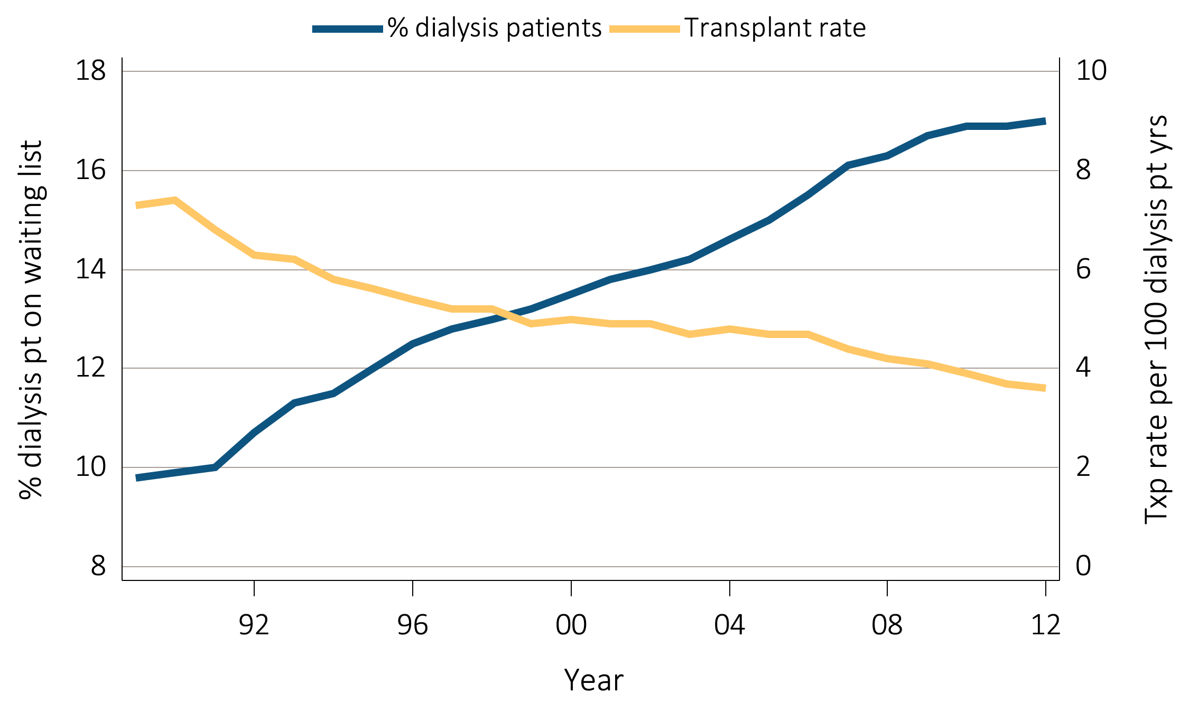
vol 2 Figure 6.1 Trends in transplantation: unadjusted rates, waiting list counts, waiting time, counts of transplants per year, & total functioning transplants
(a) Percent of dialysis patients wait-listed and unadjusted and transplant rates
Data Source: Reference Tables E4, E9. Percent of dialysis patients on the kidney waiting list is for all dialysis patients. Unadjusted transplant rates are for all dialysis patients.

Slide 3
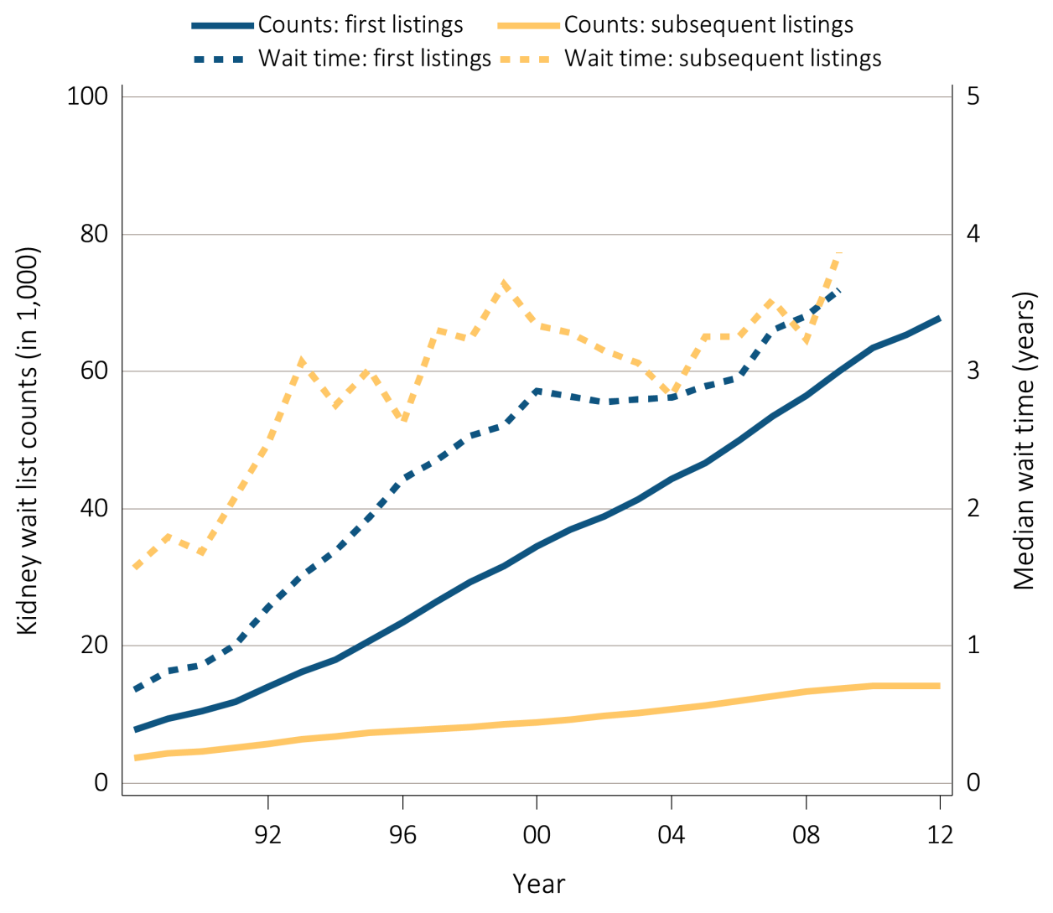
vol 2 Figure 6.1 Trends in transplantation: unadjusted rates, waiting list counts, waiting time, counts of transplants per year, & total functioning transplants
(b) Kidney waiting list counts and waiting time
Data Source: Reference Tables E2, E3. Waiting list counts include all candidates listed for a kidney transplant on December 31 of each year. Waiting time is calculated for all candidates enrolled on the waiting list in a given year.

Slide 4
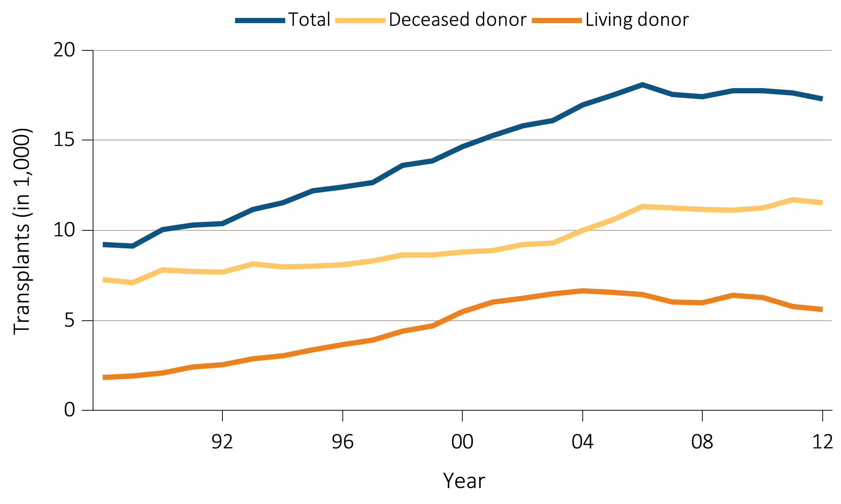
vol 2 Figure 6.1 Trends in transplantation: unadjusted rates, waiting list counts, waiting time, counts of transplants per year, & total functioning transplants
(c) Counts of transplants
Data Source: Reference Tables E8, E8(2), E8(3).

Slide 5
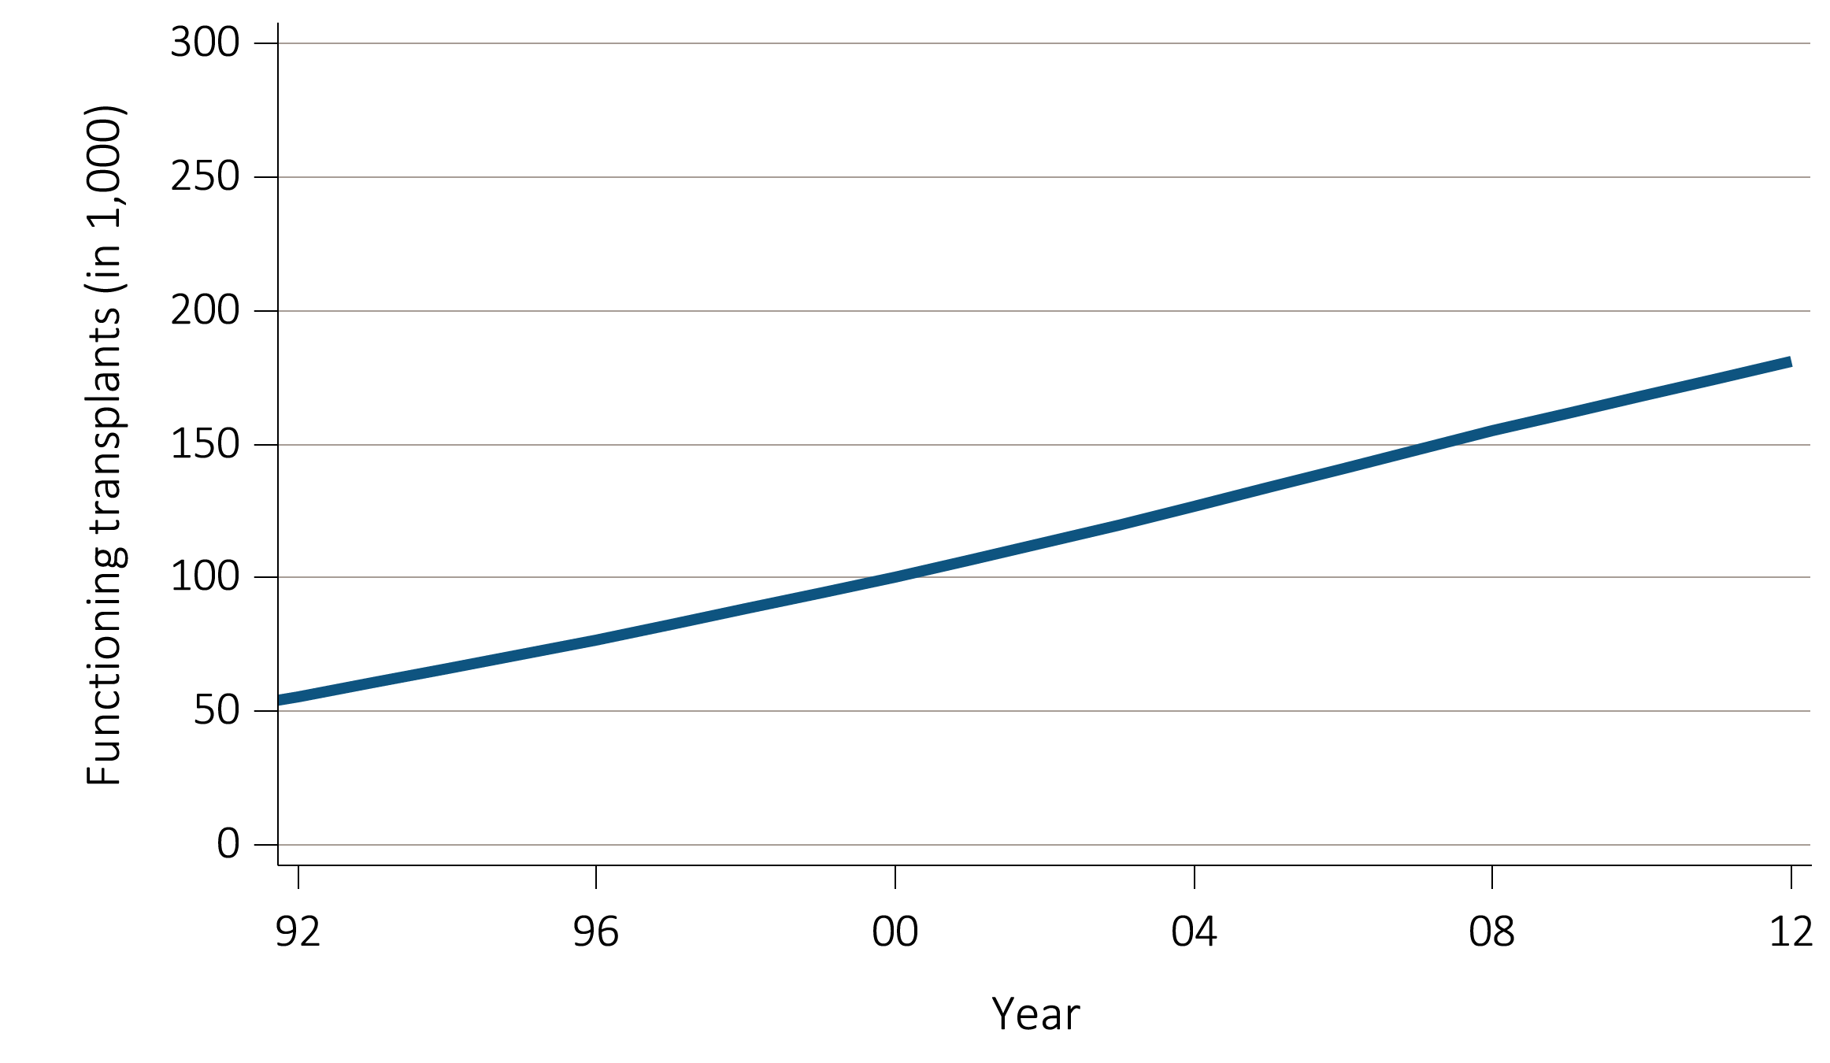
vol 2 Figure 6.1 Trends in transplantation: unadjusted rates, waiting list counts, waiting time, counts of transplants per year, & total functioning transplants
(d) Counts of total functioning transplants
Data Source: Reference Tables D9. Functioning transplant is the annual status on December 31 of each year of all patients who received a kidney transplant, regardless of transplant date.

Slide 6
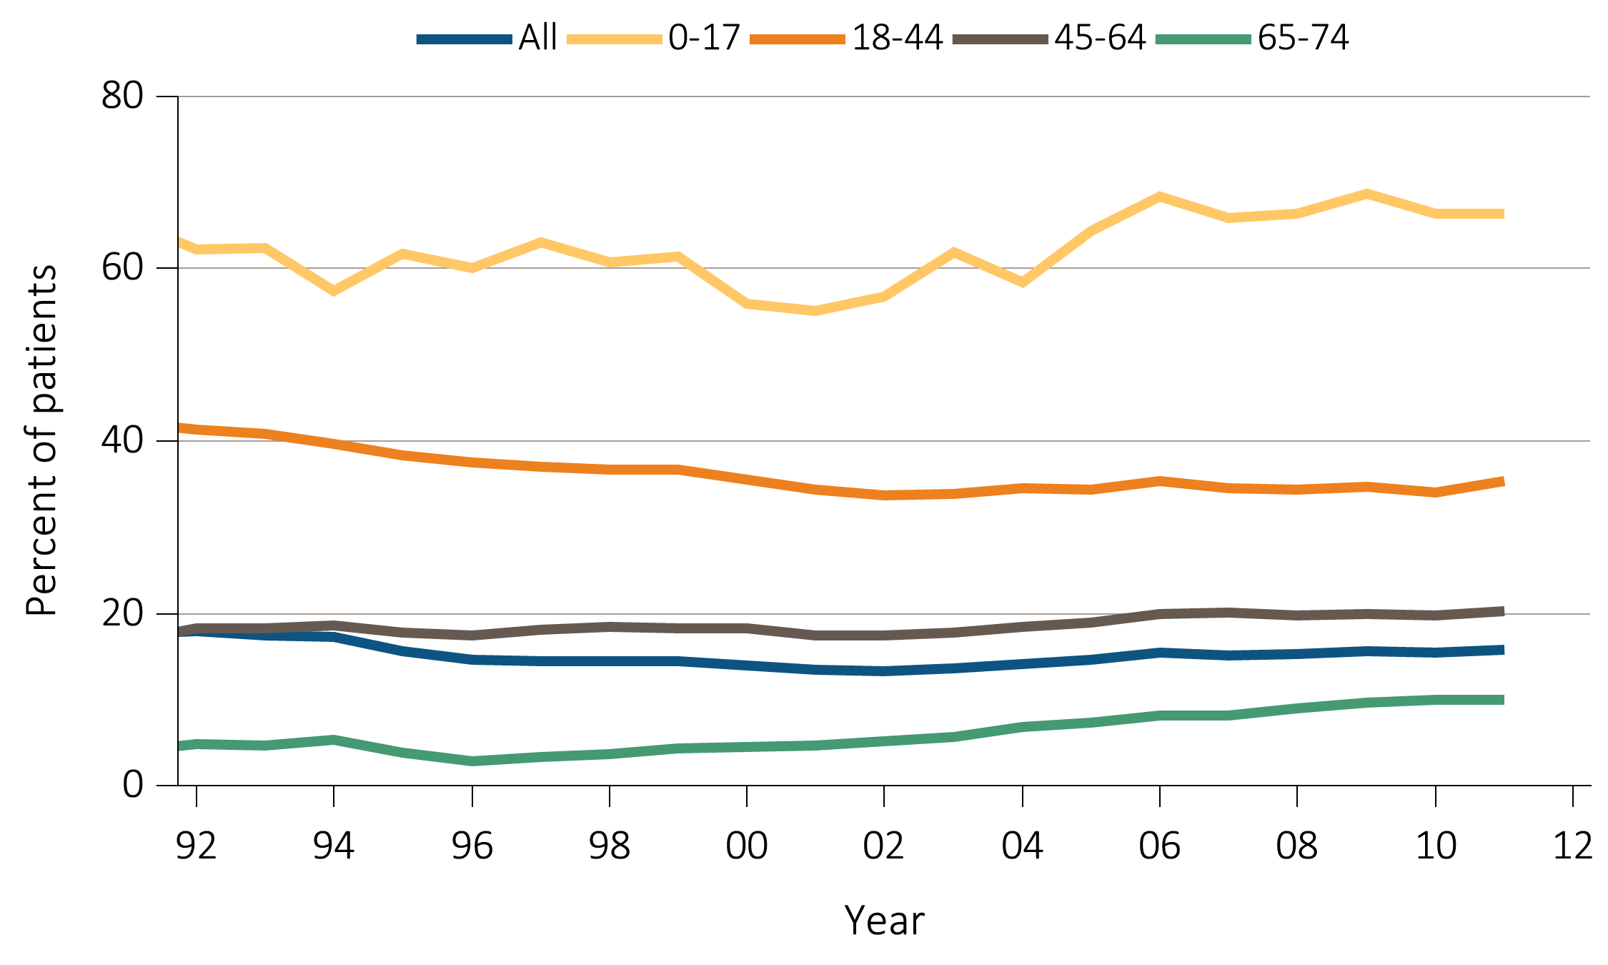
vol 2 Figure 6.2 Percent of incident patients being wait-listed or receiving a kidney transplant within one year of ESRD initiation, by age
Data Source: Reference Table E5(2). Waiting list or transplantation among incident ESRD patients by age (0-74 years).

Slide 7
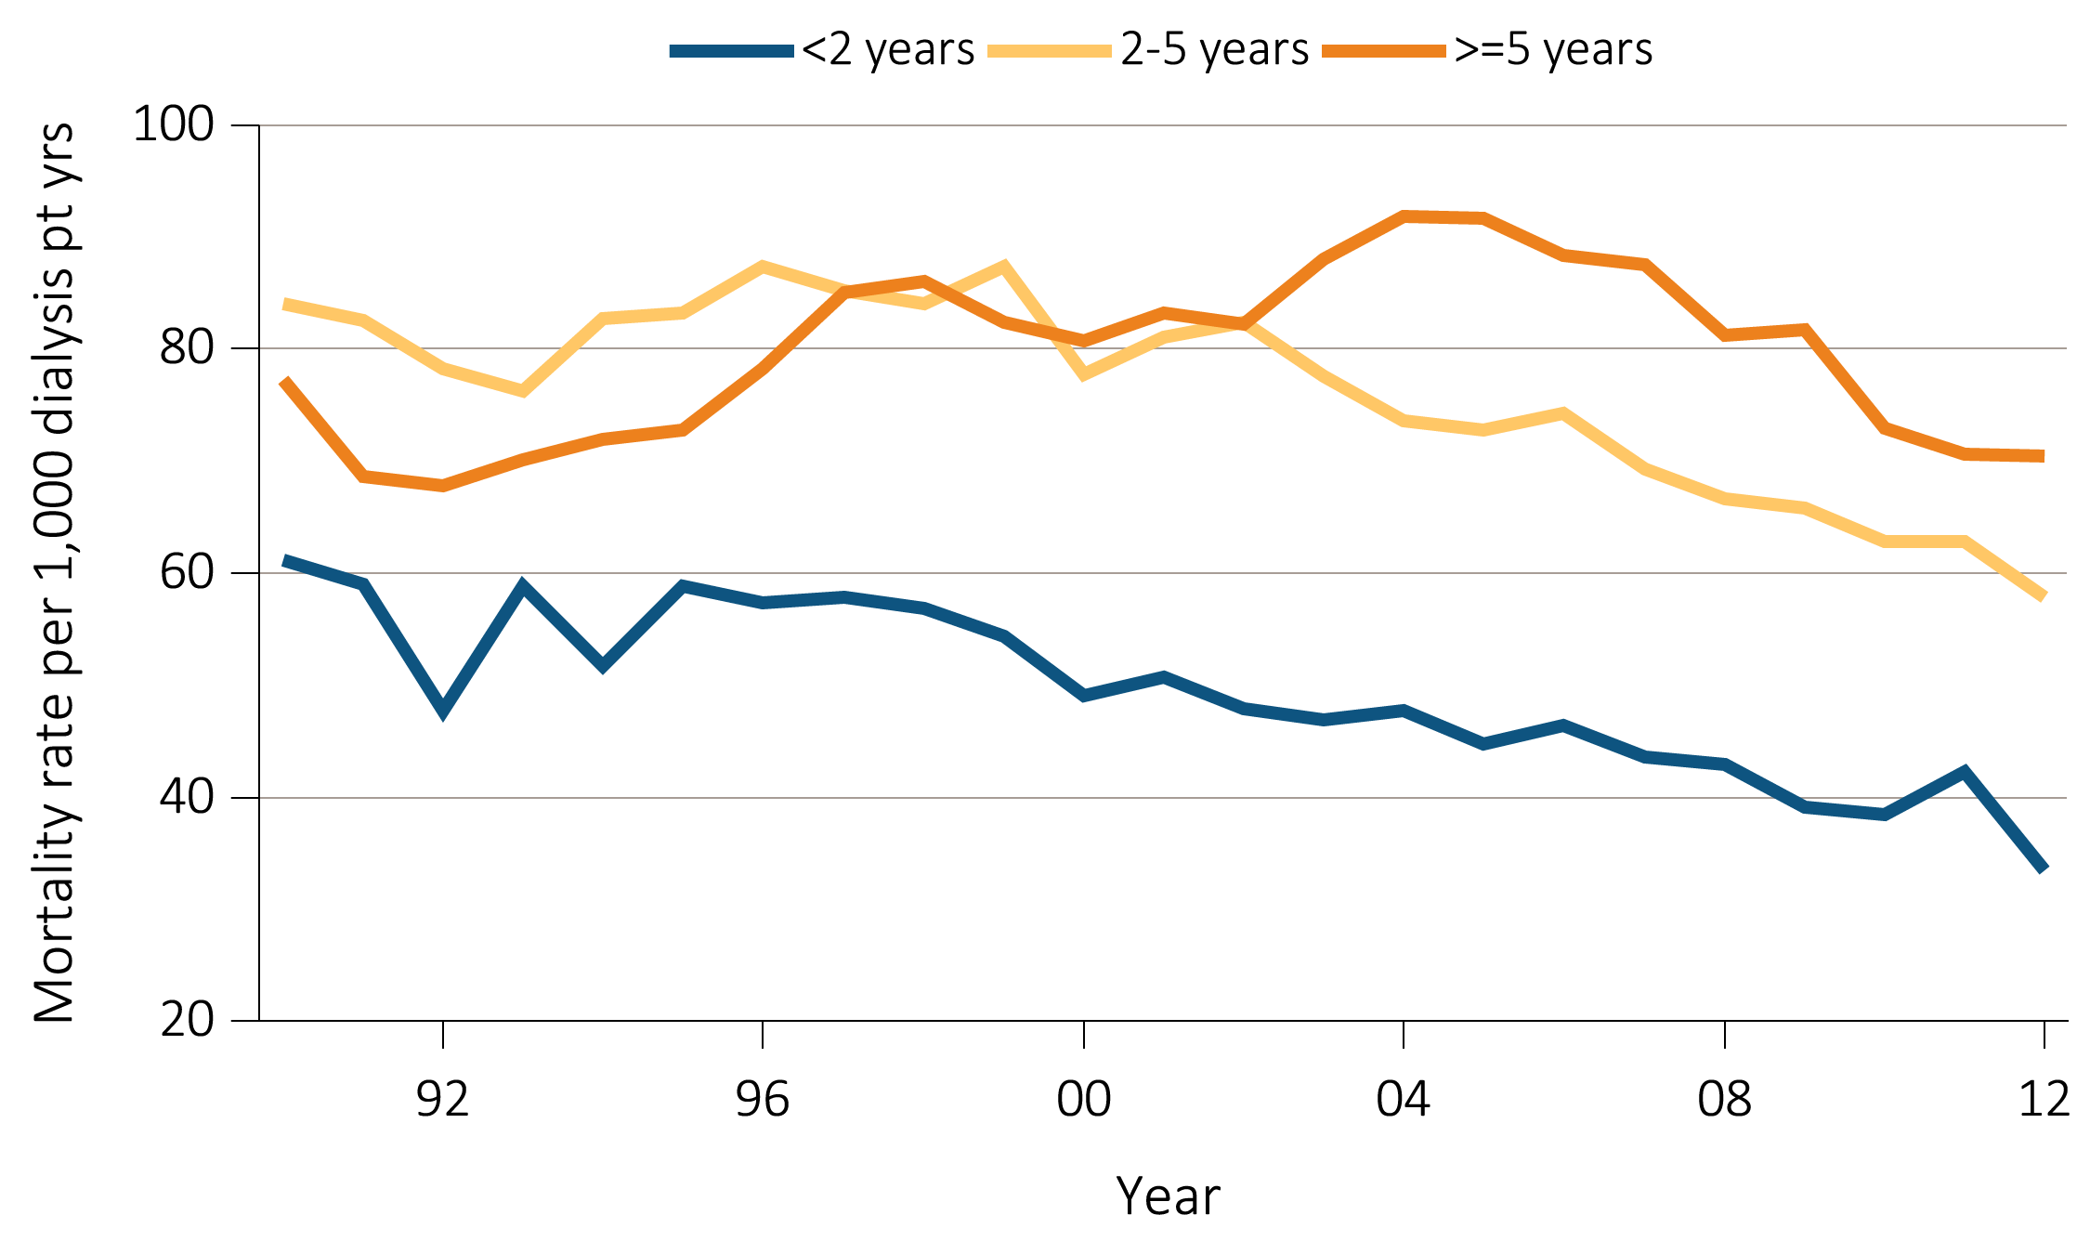
vol 2 Figure 6.3 Annual mortality rates while on the waiting list for dialysis patients from time of placement on the kidney transplant waiting list
Data Source: Reference Table H6. Annual mortality rates of dialysis patients on the kidney transplant waiting list per 1,000 dialysis patient years at risk, by patient vintage.

Slide 8
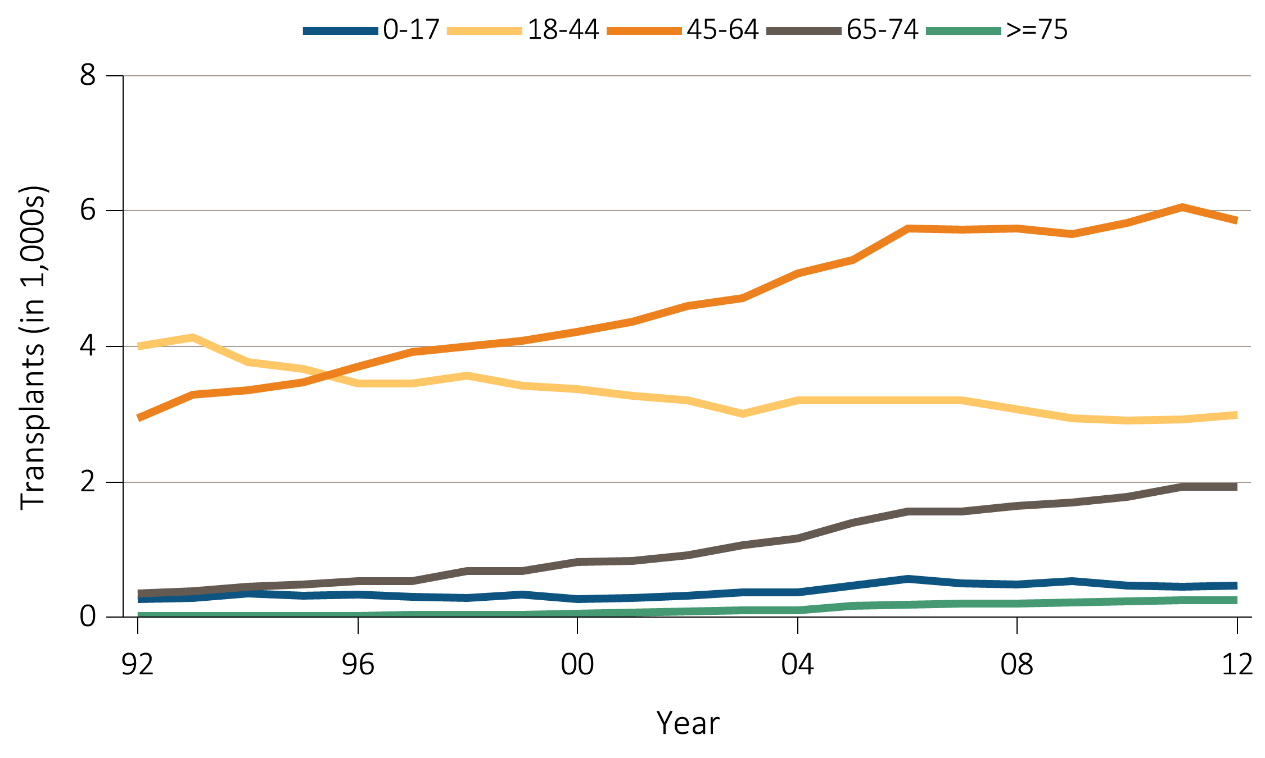
vol 2 Figure 6.4 Deceased donor transplant counts and trends, by recipient age, sex, race, & primary diagnosis
(a) Age
Data Source: Reference Table E8(2). Deceased donor kidney transplant counts by recipient age.

Slide 9
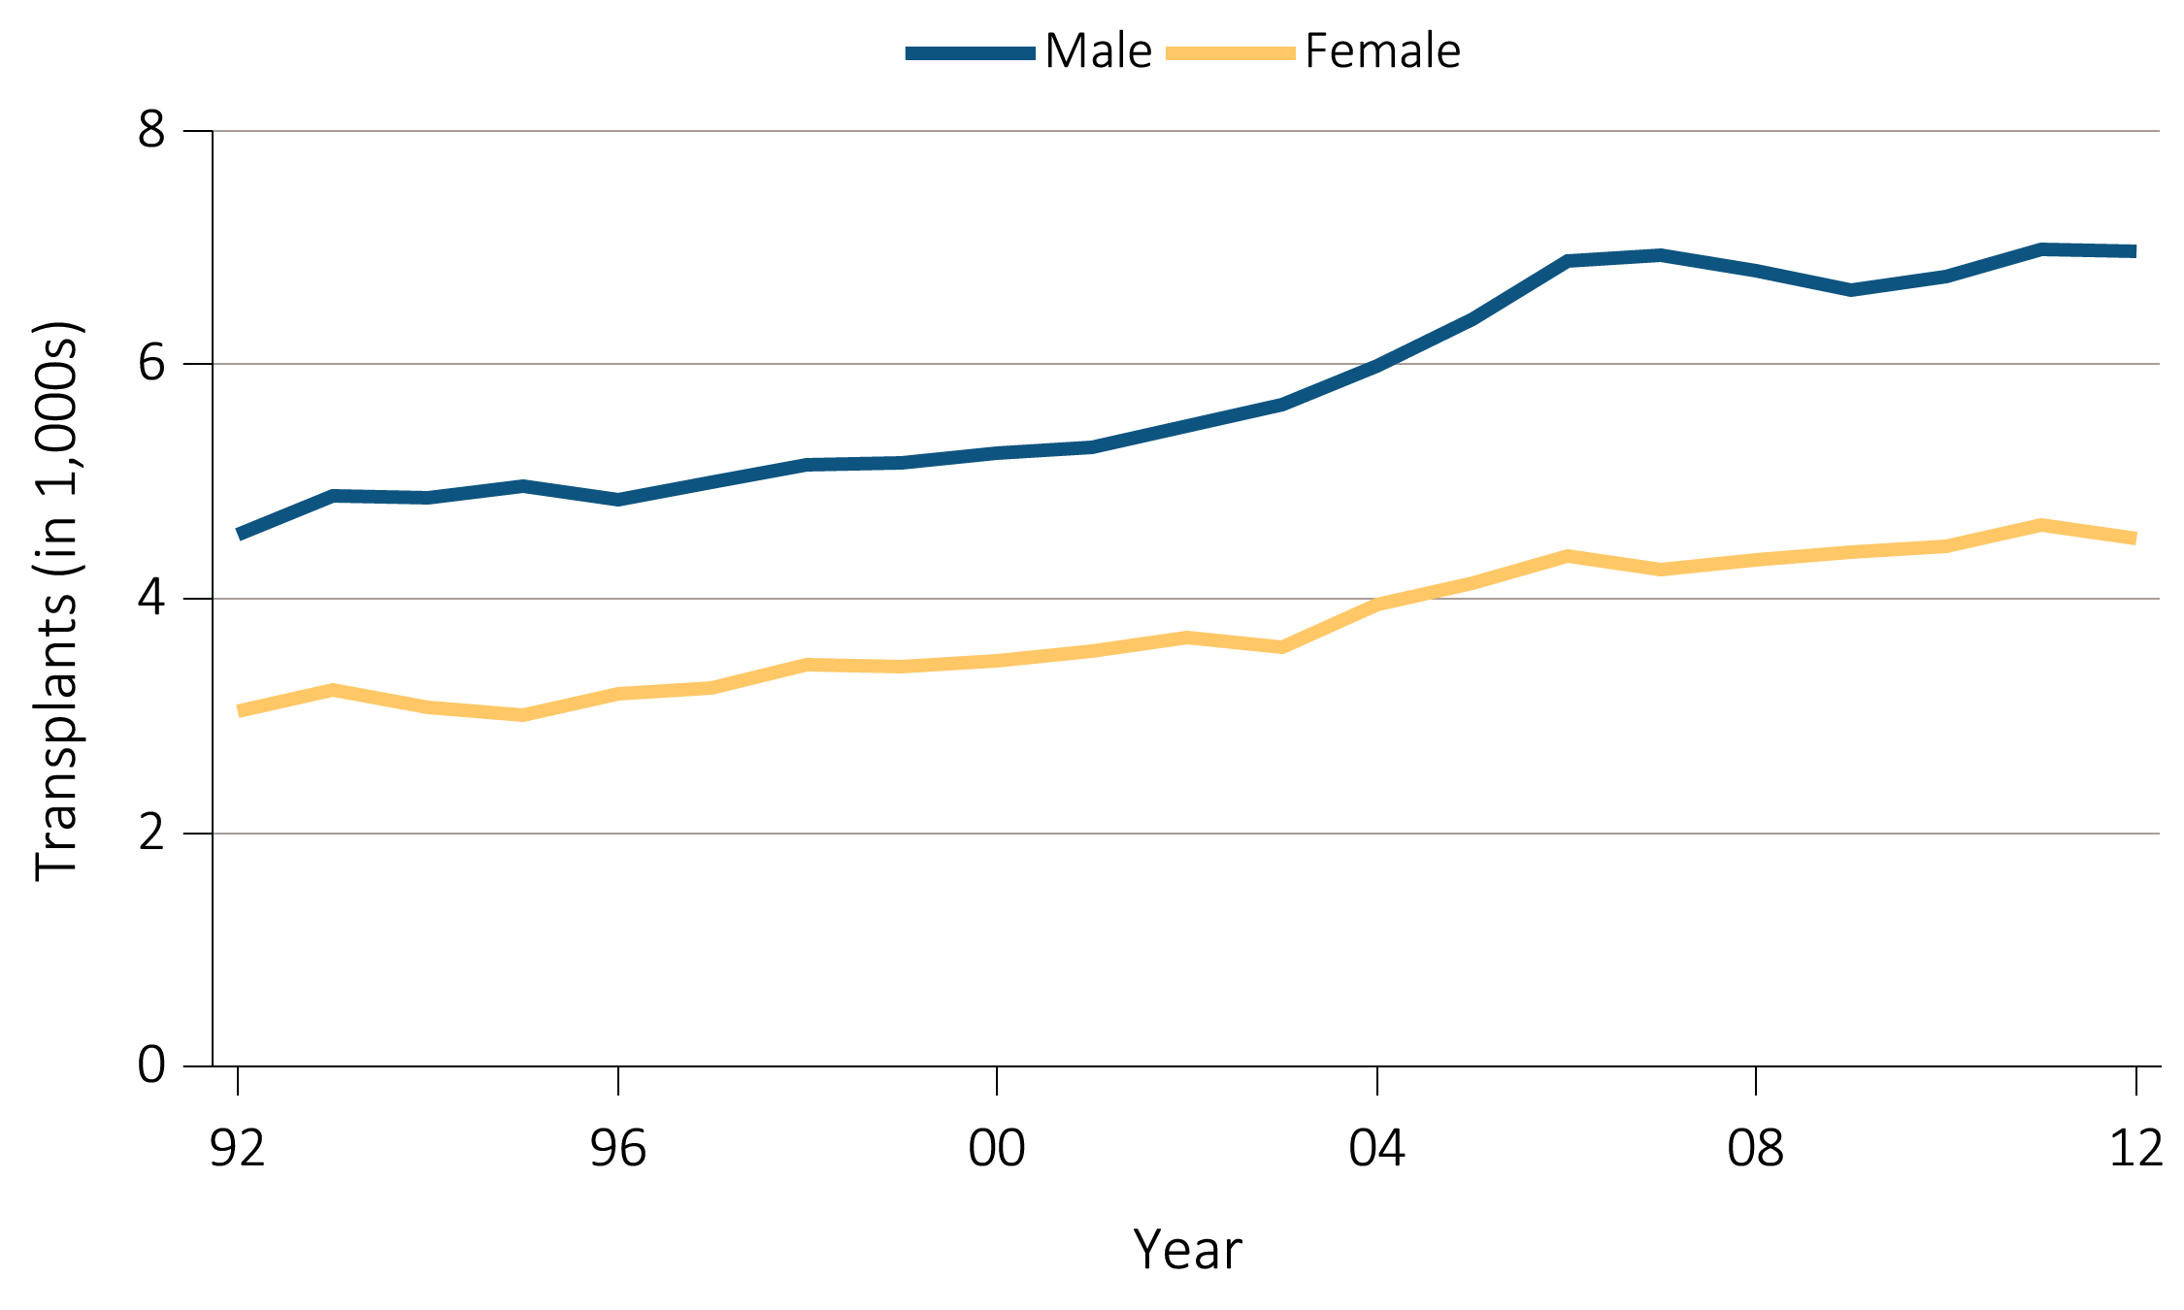
vol 2 Figure 6.4 Deceased donor transplant counts and trends, by recipient age, sex, race, & primary diagnosis
(b) Sex
Data Source: Reference Table E8(2). Deceased donor kidney transplant counts by recipient sex.

Slide 10
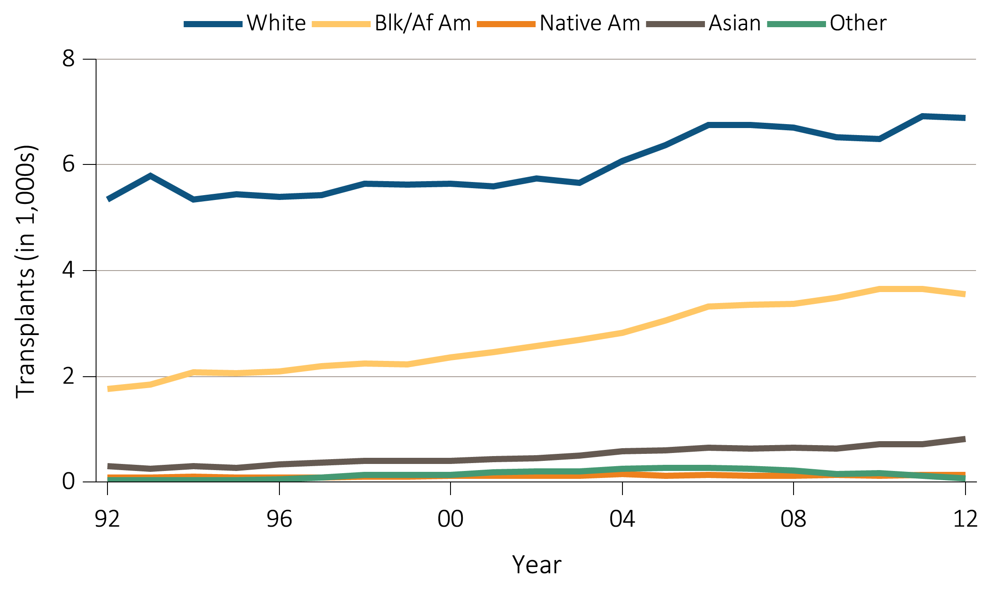
vol 2 Figure 6.4 Deceased donor transplant counts and trends, by recipient age, sex, race, & primary diagnosis
(c) Race
Data Source: Reference Table E8(2). Deceased donor kidney transplant counts by recipient race. Abbreviations: Blk/Af Am, Black/African American; Native Am, Native American.

Slide 11
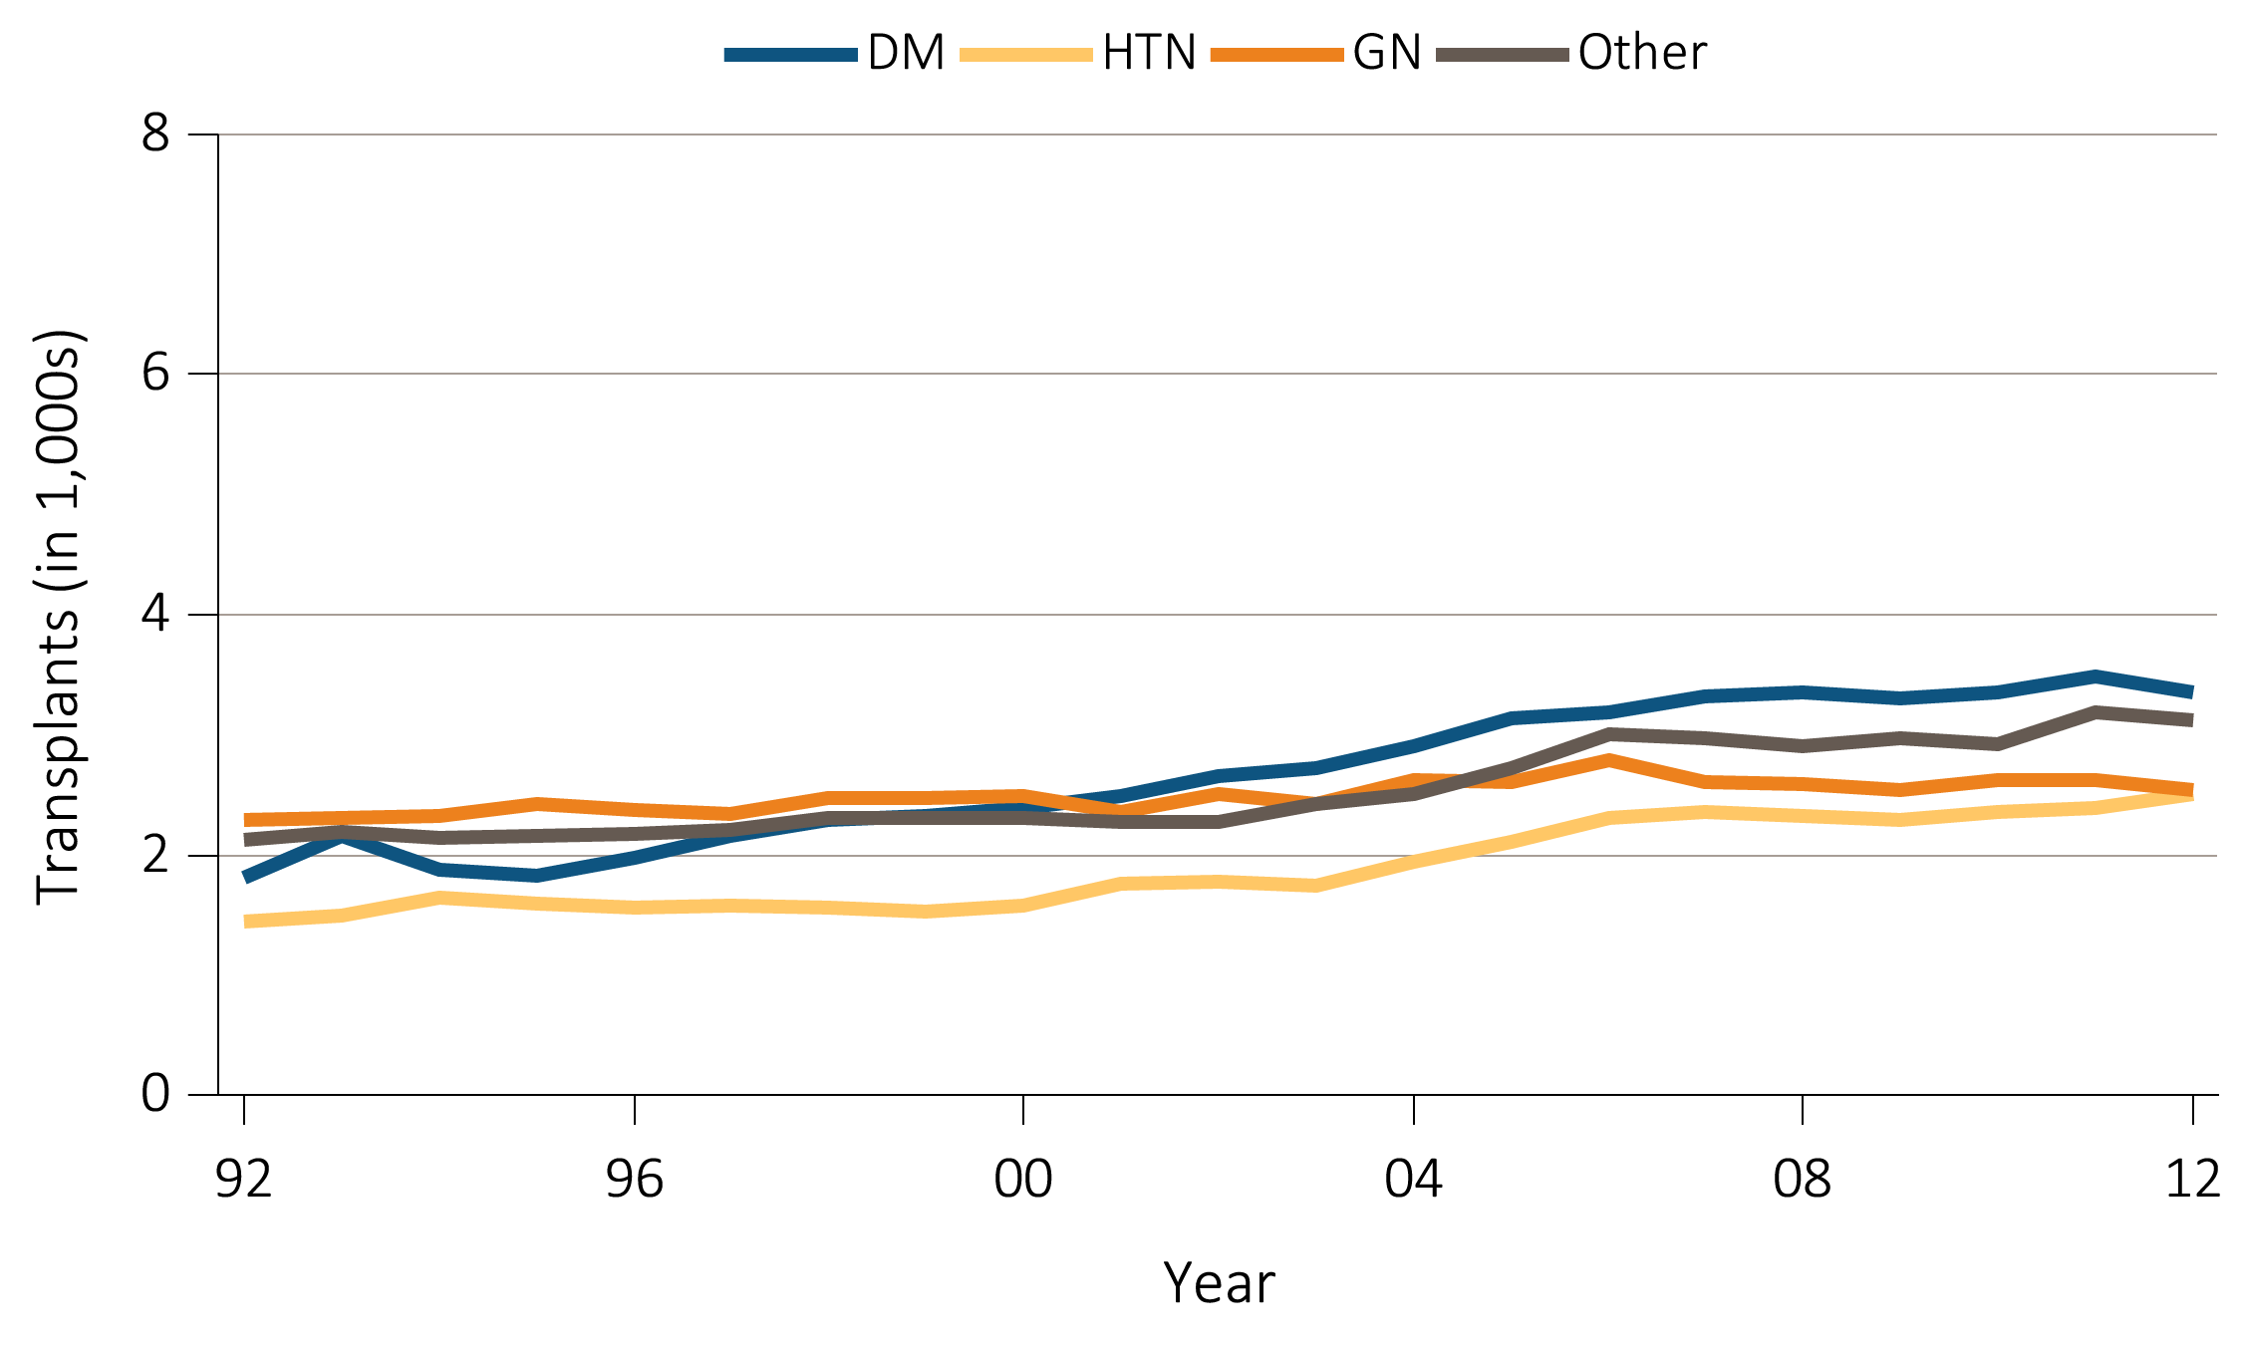
vol 2 Figure 6.4 Deceased donor transplant counts and trends, by recipient age, sex, race, & primary diagnosis
(d) Primary diagnosis
Data Source: Reference Table E8(2). Deceased donor kidney transplant counts by recipient primary diagnosis. Abbreviations: DM, Diabetes Mellitus; GN, glomerulonephritis; HTN, hypertension.

Slide 12
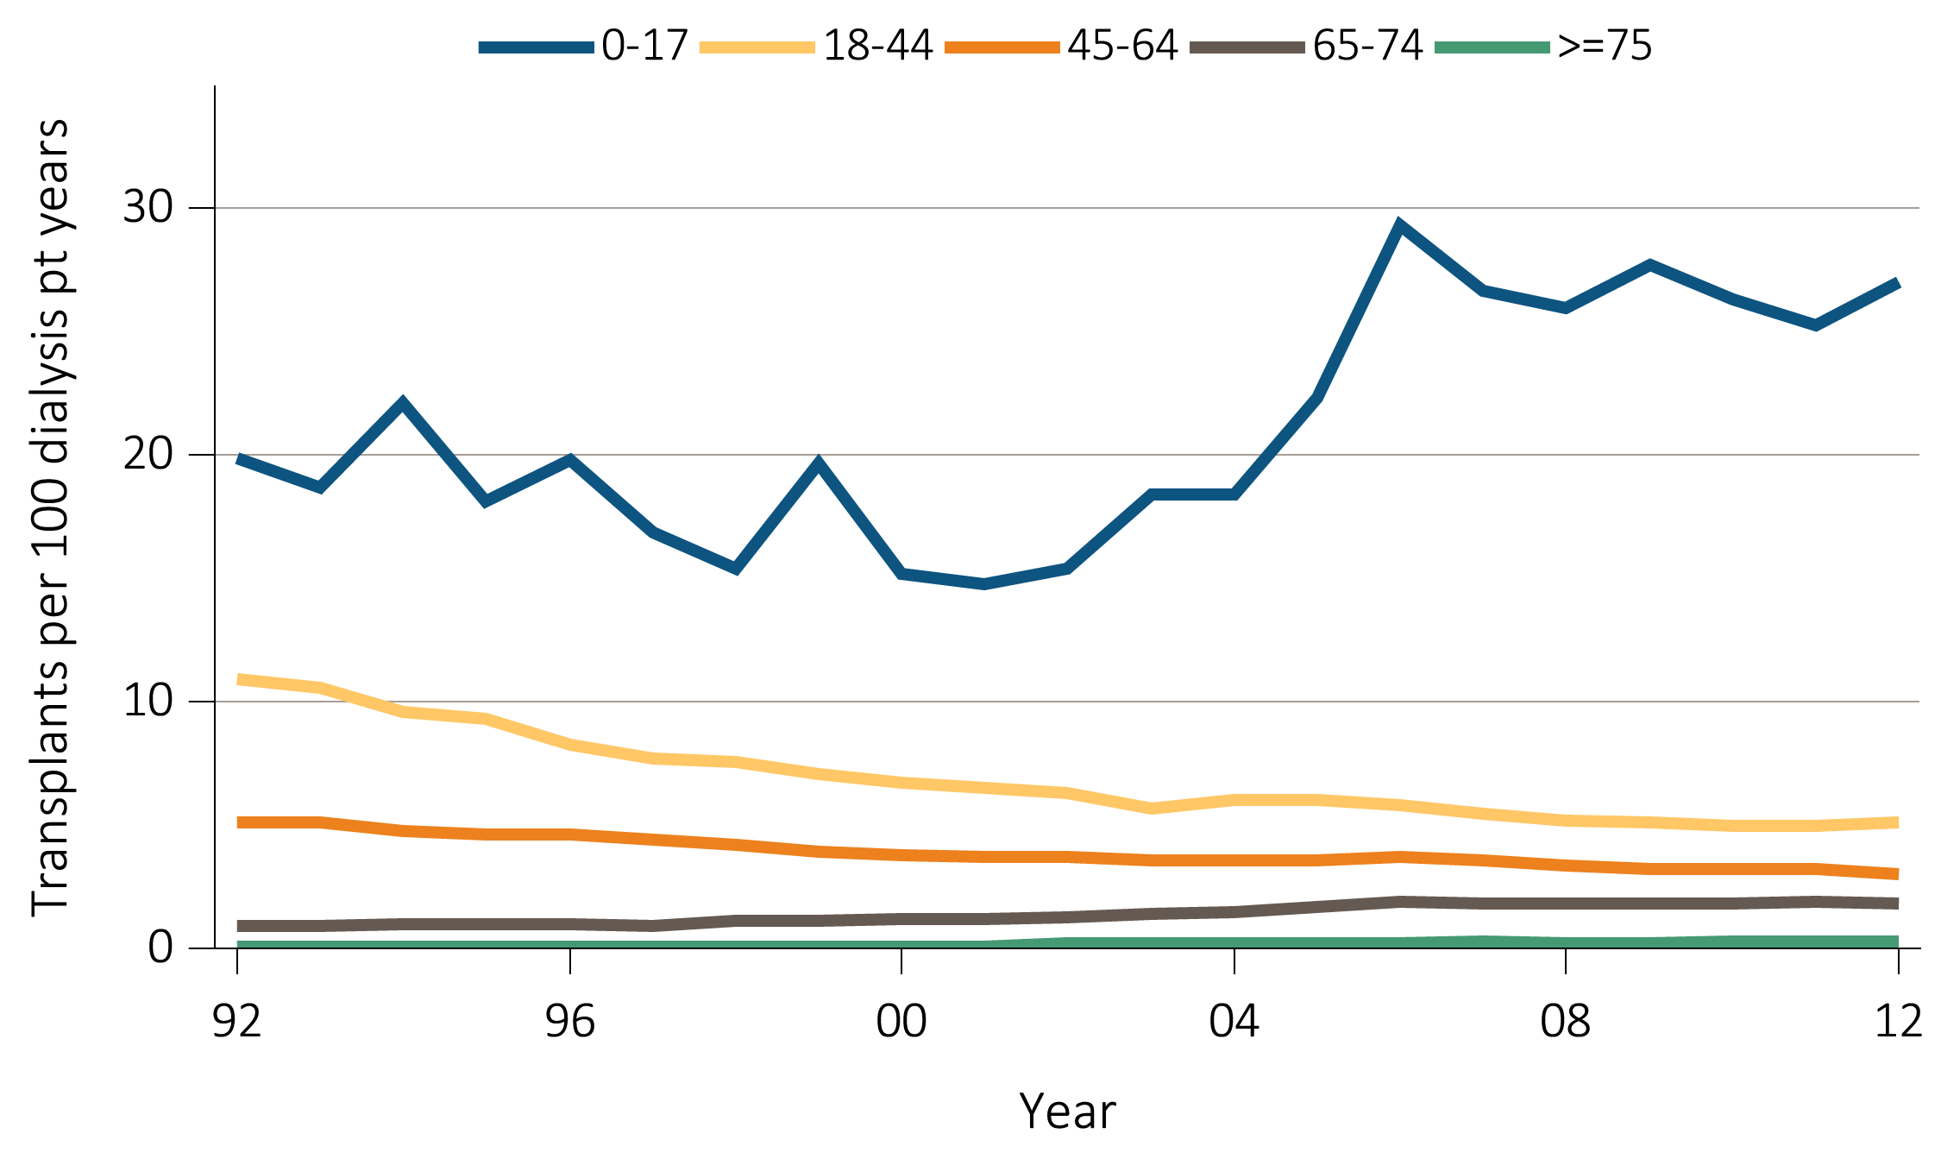
vol 2 Figure 6.5 Unadjusted transplant rates among deceased donors, by age, sex, race, & primary diagnosis
(a) Age
Data Source: Reference Table E9(2). Unadjusted deceased donor kidney transplant rates by recipient age.

Slide 13
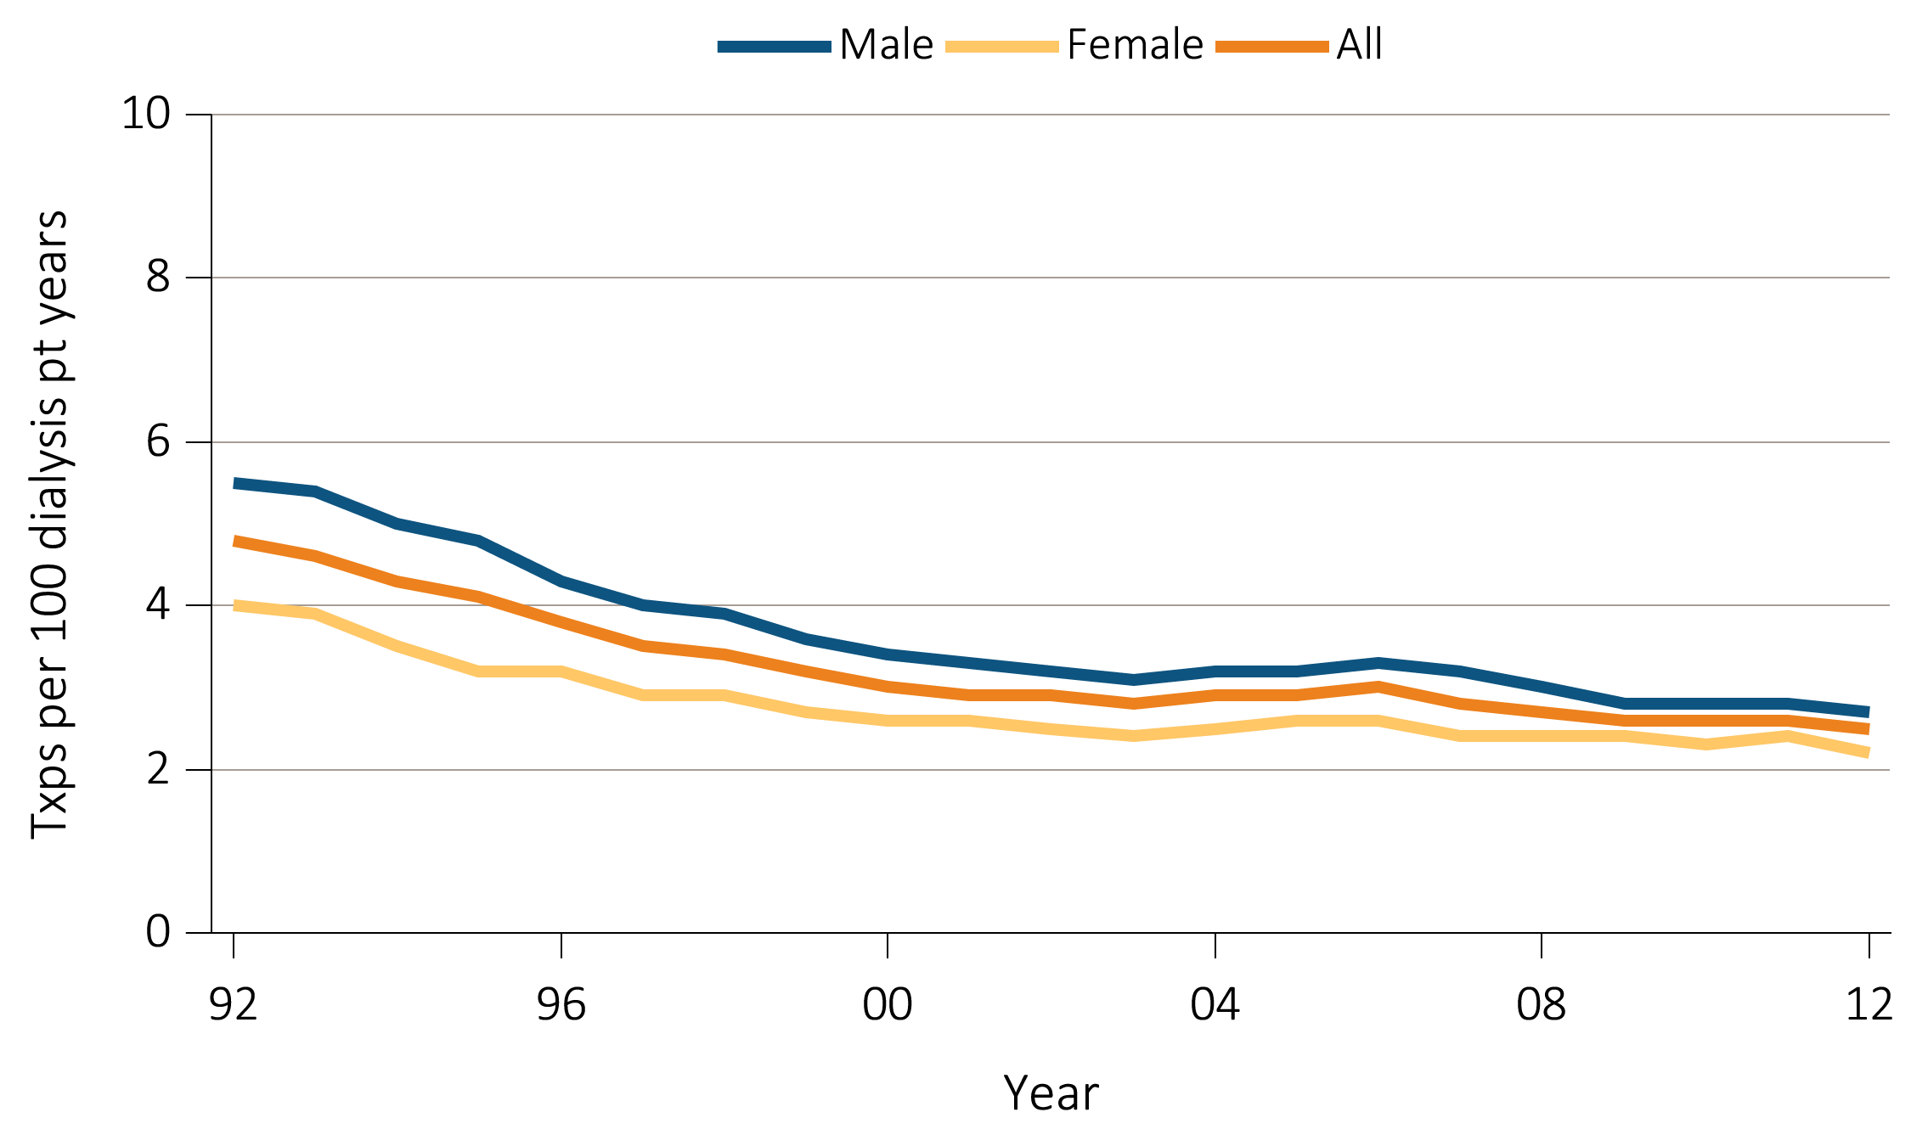
vol 2 Figure 6.5 Unadjusted transplant rates among deceased donors, by age, sex, race, & primary diagnosis
(b) Sex
Data Source: Reference Table E9(2). Unadjusted deceased donor kidney transplant rates by recipient sex.

Slide 14
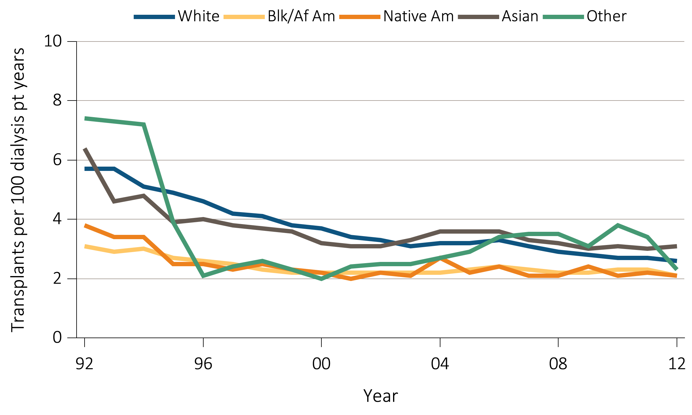
vol 2 Figure 6.5 Unadjusted transplant rates among deceased donors, by age, sex, race, & primary diagnosis
(c) Race
Data Source: Reference Table E9(2). Unadjusted deceased donor kidney transplant rates by recipient race. Abbreviations: Blk/Af Am, Black/African American; Native Am, Native American.

Slide 15
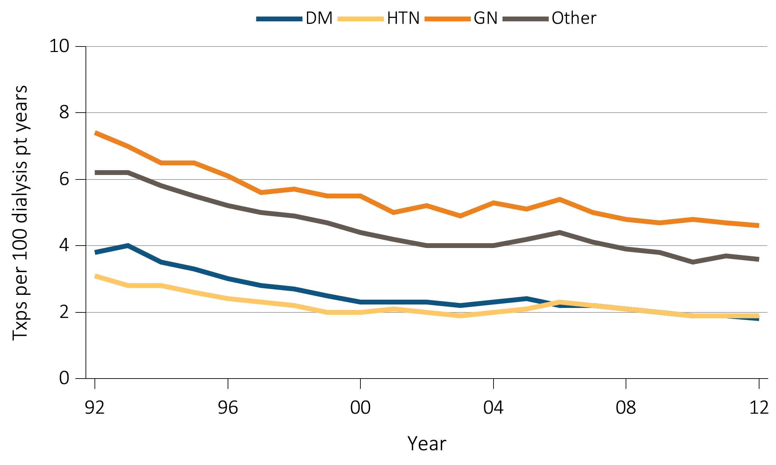
vol 2 Figure 6.5 Unadjusted transplant rates among deceased donors, by age, sex, race, & primary diagnosis
(d) Primary diagnosis
Data Source: Reference Table E9(2). Unadjusted deceased donor kidney transplant rates by recipient primary diagnosis. Abbreviations: DM, Diabetes Mellitus; GN, glomerulonephritis; HTN, hypertension.

Slide 16
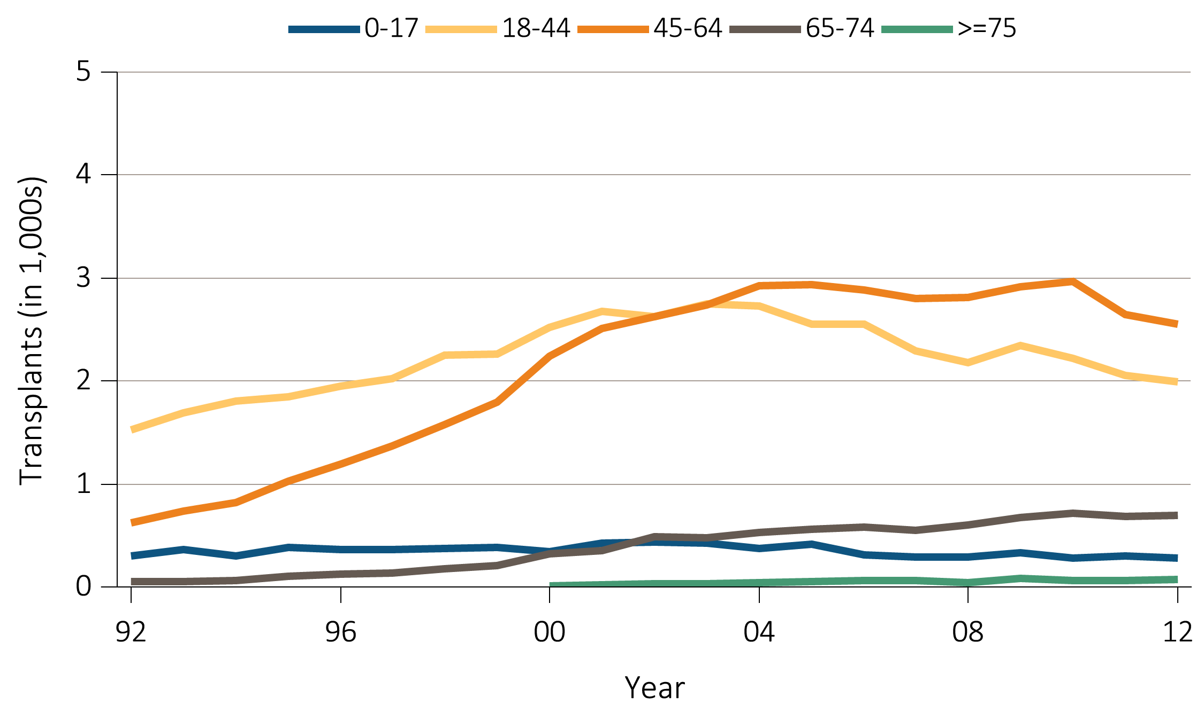
vol 2 Figure 6.6 Living donor transplant counts and trends by recipient age, sex, race, & primary diagnosis
(a) Age
Data Source: Reference Table E8(3). Live donor kidney transplant counts by recipient age.

Slide 17
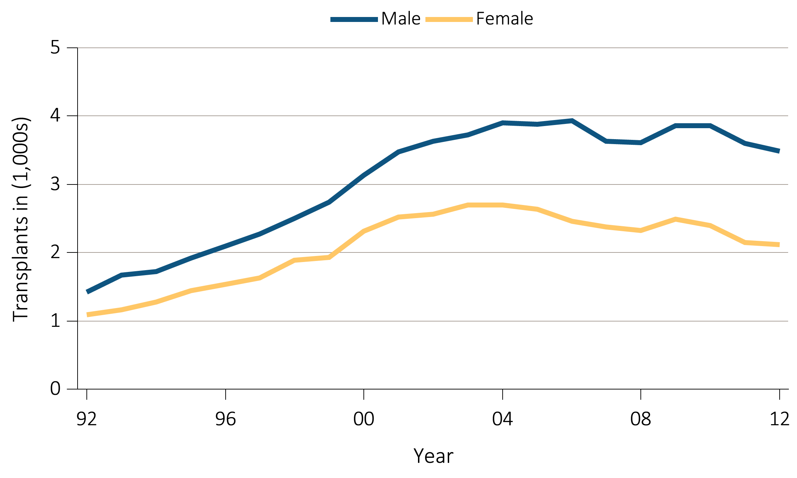
vol 2 Figure 6.6 Living donor transplant counts and trends by recipient age, sex, race, & primary diagnosis
(b) Sex
Data Source: Reference Table E8(3). Live donor kidney transplant counts by recipient sex.

Slide 18
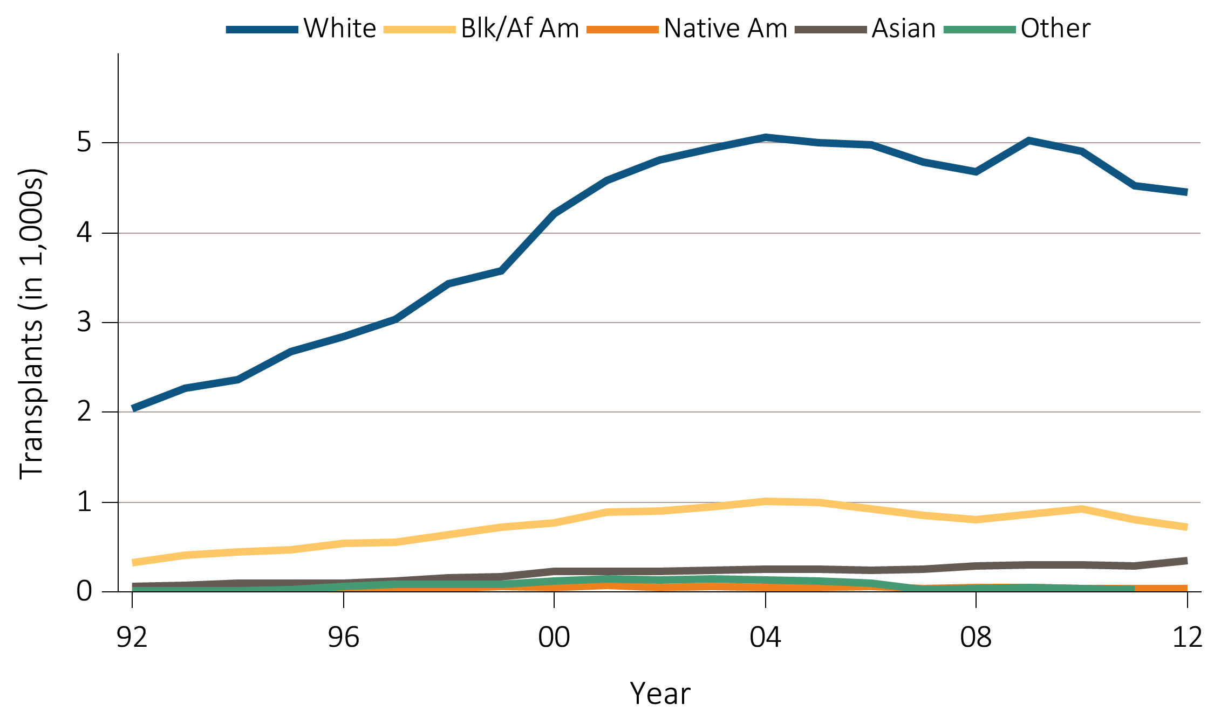
vol 2 Figure 6.6 Living donor transplant counts and trends by recipient age, sex, race, & primary diagnosis
(c) Race
Data Source: Reference Table E8(3). Live donor kidney transplant counts by recipient race. Abbreviations: Blk/Af Am, Black/African American; Native Am, Native American.

Slide 19
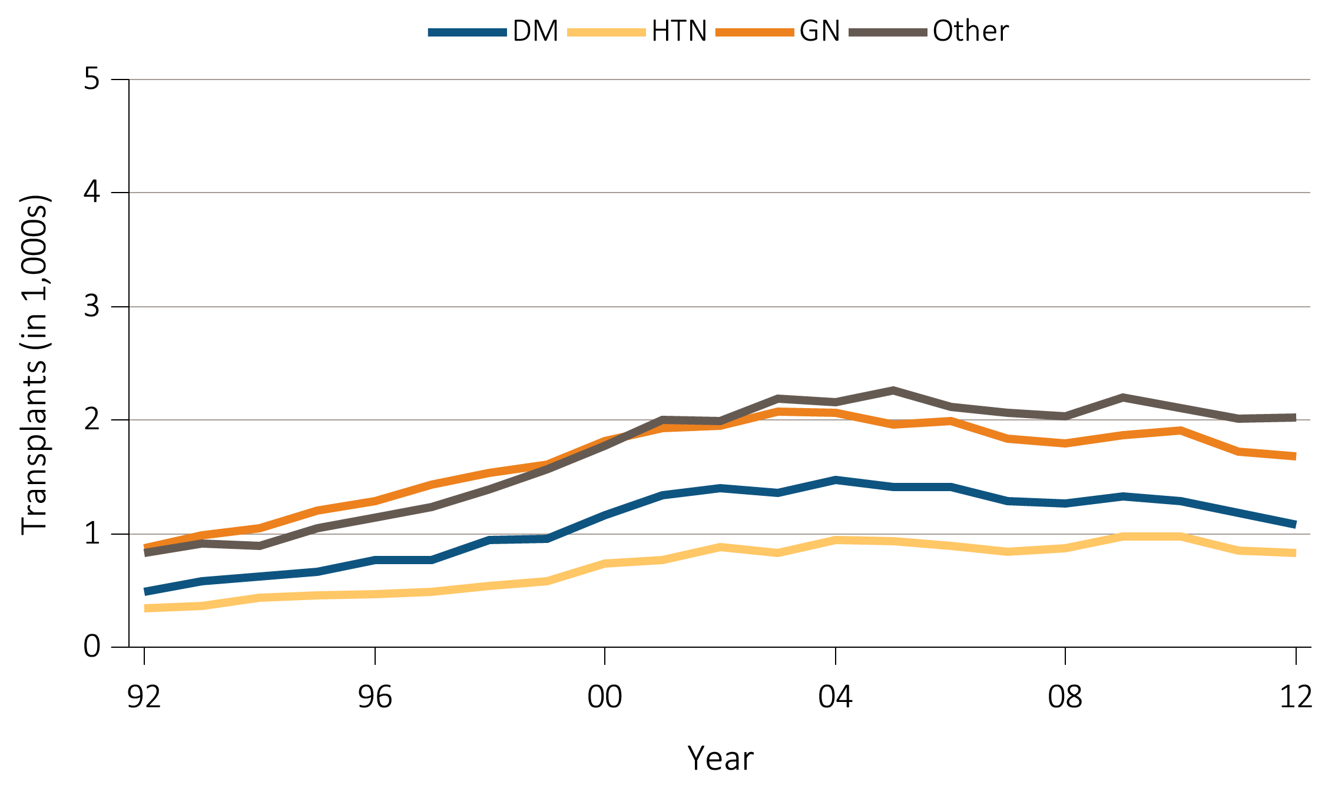
vol 2 Figure 6.6 Living donor transplant counts and trends by recipient age, sex, race, & primary diagnosis
(d) Primary diagnosis
Data Source: Reference Table E8(3). Live donor kidney transplant counts by recipient primary diagnosis. Abbreviations: DM, Diabetes Mellitus; GN, glomerulonephritis; HTN, hypertension.

Slide 20
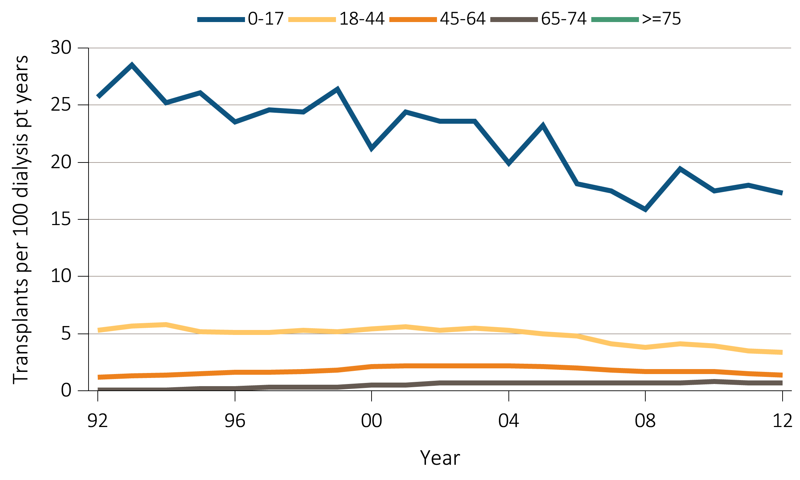
vol 2 Figure 6.7 Unadjusted transplant rates among living donors, by age, sex, race, & primary diagnosis
(a) Age
Data Source: Reference Table E9(3). Unadjusted live donor kidney transplant rates by recipient age.

Slide 21
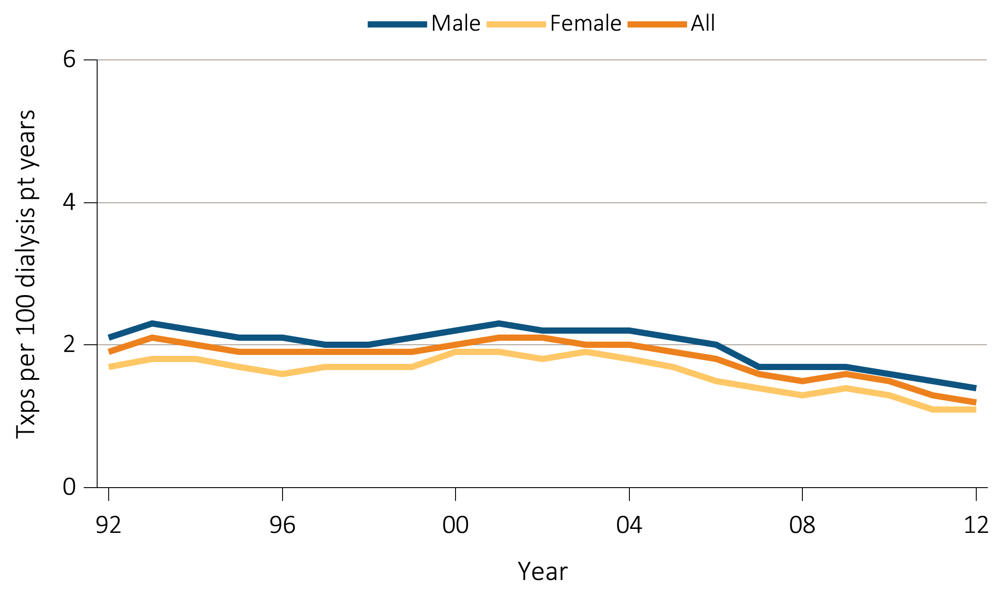
vol 2 Figure 6.7 Unadjusted transplant rates among living donors, by age, sex, race, & primary diagnosis
(b) Sex
Data Source: Reference Table E9(3). Unadjusted live donor kidney transplant rates by recipient sex.

Slide 22
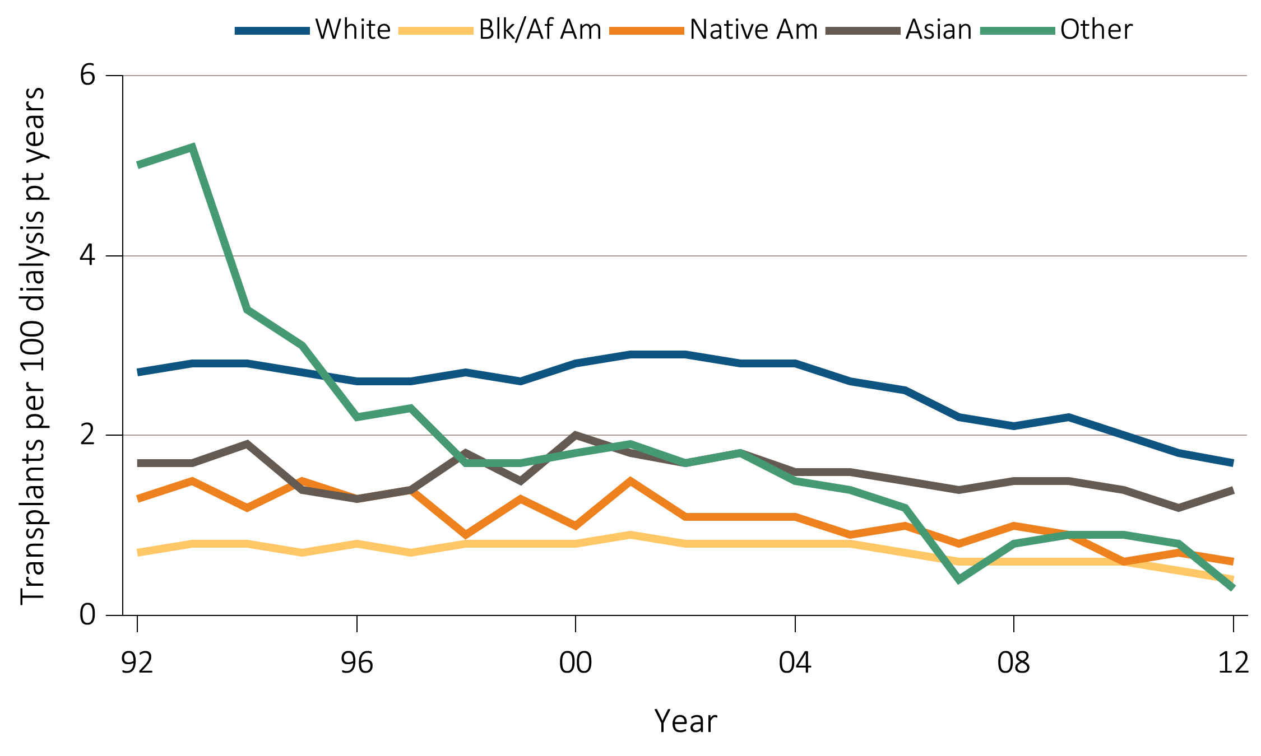
vol 2 Figure 6.7 Unadjusted transplant rates among living donors, by age, sex, race, & primary diagnosis
(c) Race
Data Source: Reference Table E9(3). Unadjusted live donor kidney transplant rates by recipient race. Abbreviations: Blk/Af Am, Black/African American; Native Am, Native American.

Slide 23
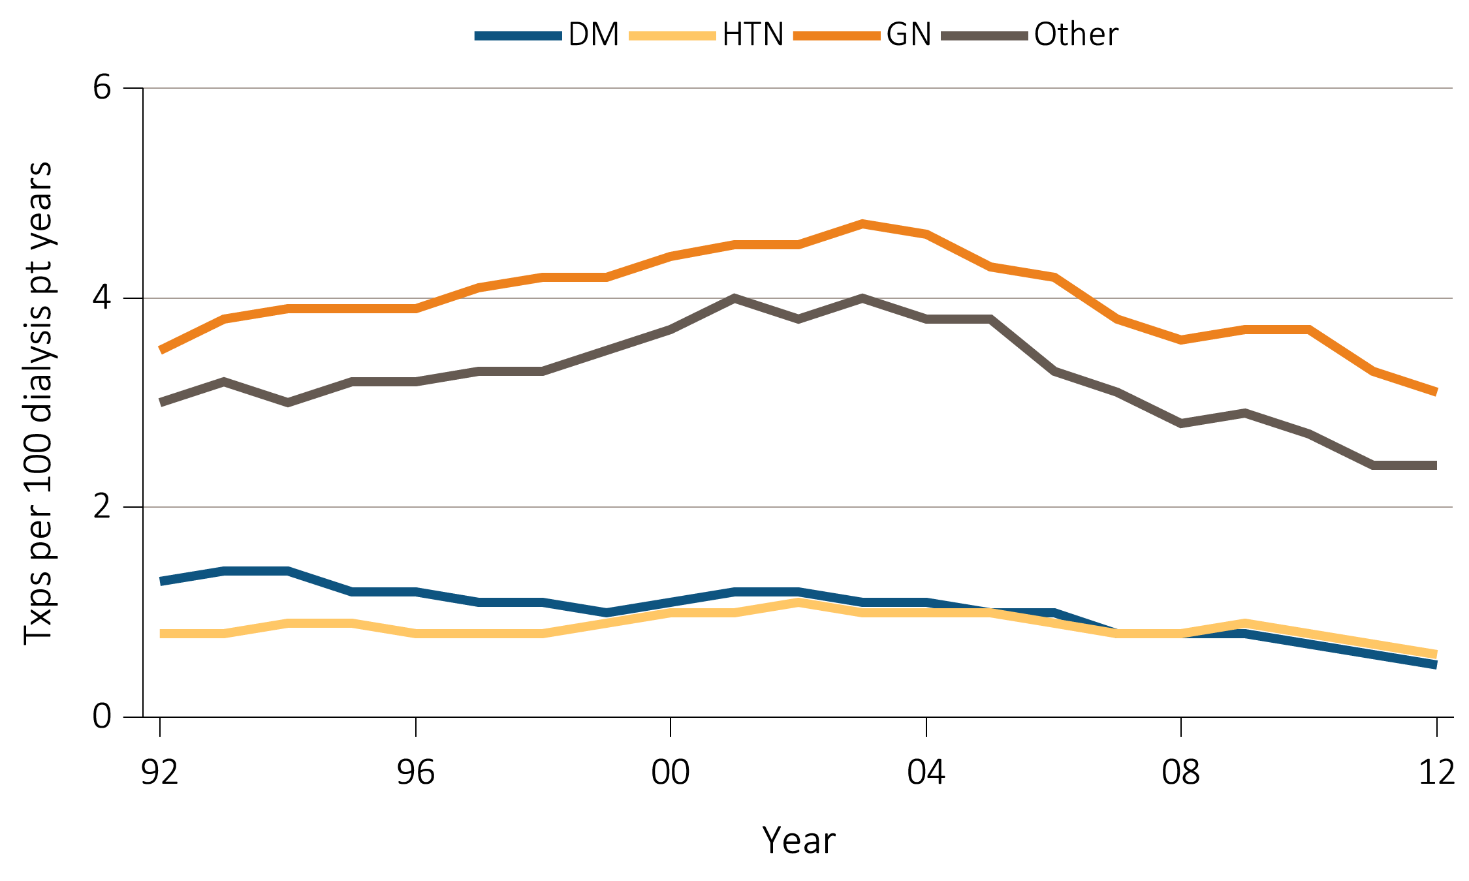
vol 2 Figure 6.7 Unadjusted transplant rates among living donors, by age, sex, race, & primary diagnosis
(d) Primary diagnosis
Data Source: Reference Table E9(3). Unadjusted live donor kidney transplant rates by recipient primary diagnosis. Abbreviations: DM, Diabetes Mellitus; GN, glomerulonephritis; HTN, hypertension.

Slide 24
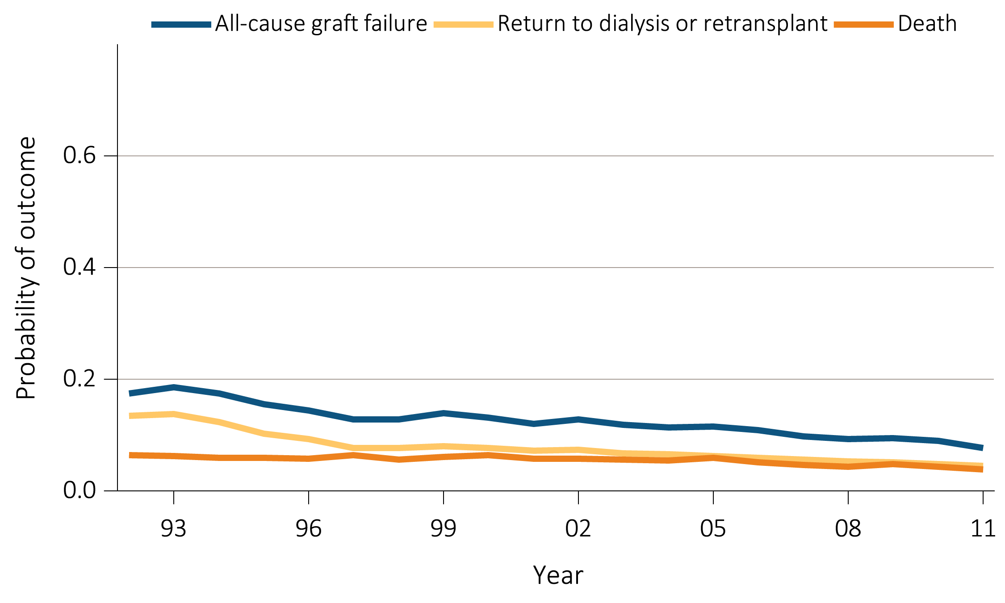
vol 2 Figure 6.8 Outcomes: deceased donor transplants
(a) One-year
Data Source: Reference Tables F2, F14, I26. Outcomes among recipients of a first-time deceased donor kidney transplant; unadjusted.

Slide 25
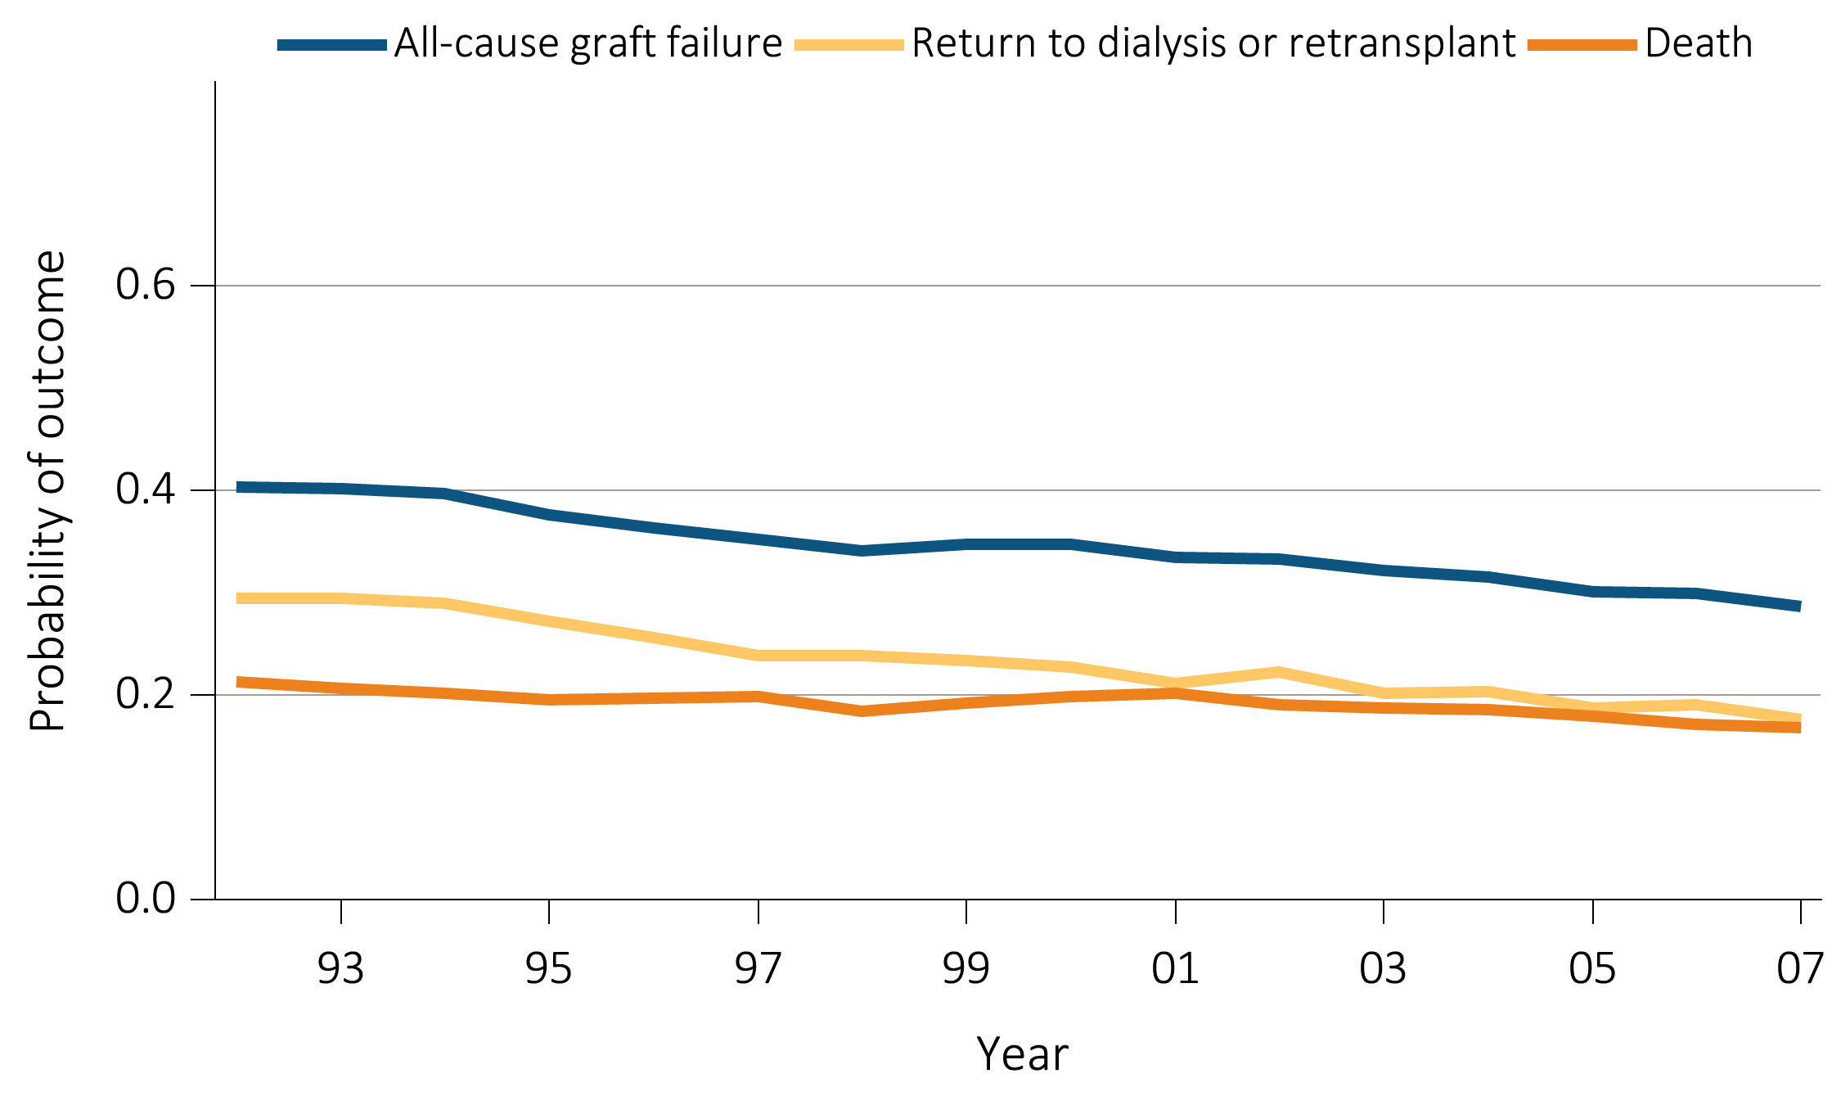
vol 2 Figure 6.8 Outcomes: deceased donor transplants
(b) Five-year
Data Source: Reference Tables F5, F17, I29. Outcomes among recipients of a first-time deceased donor kidney transplant; unadjusted.

Slide 26
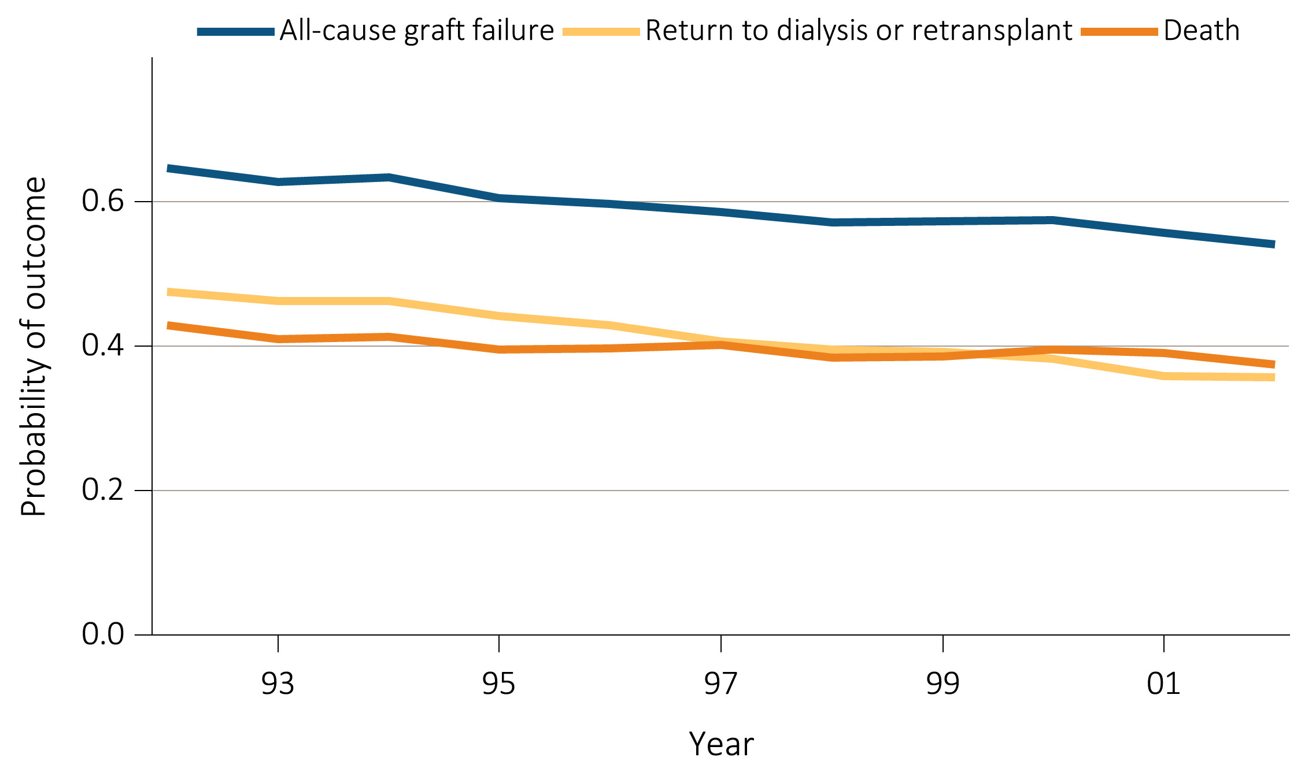
vol 2 Figure 6.8 Outcomes: deceased donor transplants
(c) Ten-year
Data Source: Reference Tables F6, F18, I30. Outcomes among recipients of a first-time deceased donor kidney transplant; unadjusted.

Slide 27
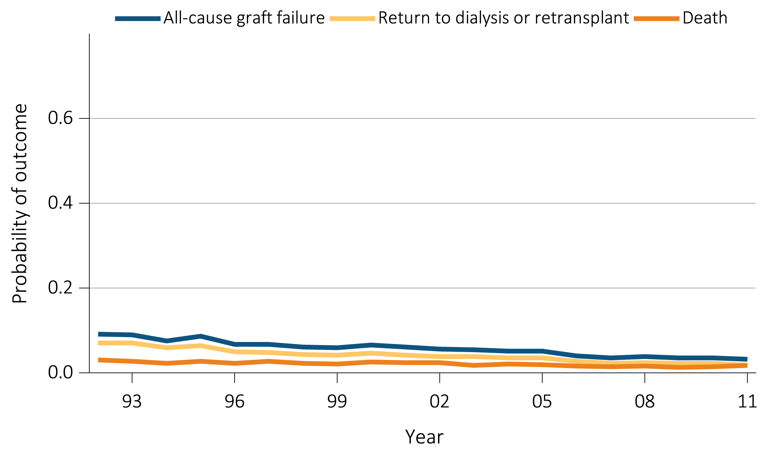
vol 2 Figure 6.9 Outcomes: living donor transplants
(a) One-year
Data Source: Reference Tables F8, F20, I32. Outcomes among recipients of a first-time live donor kidney transplant; unadjusted.

Slide 28
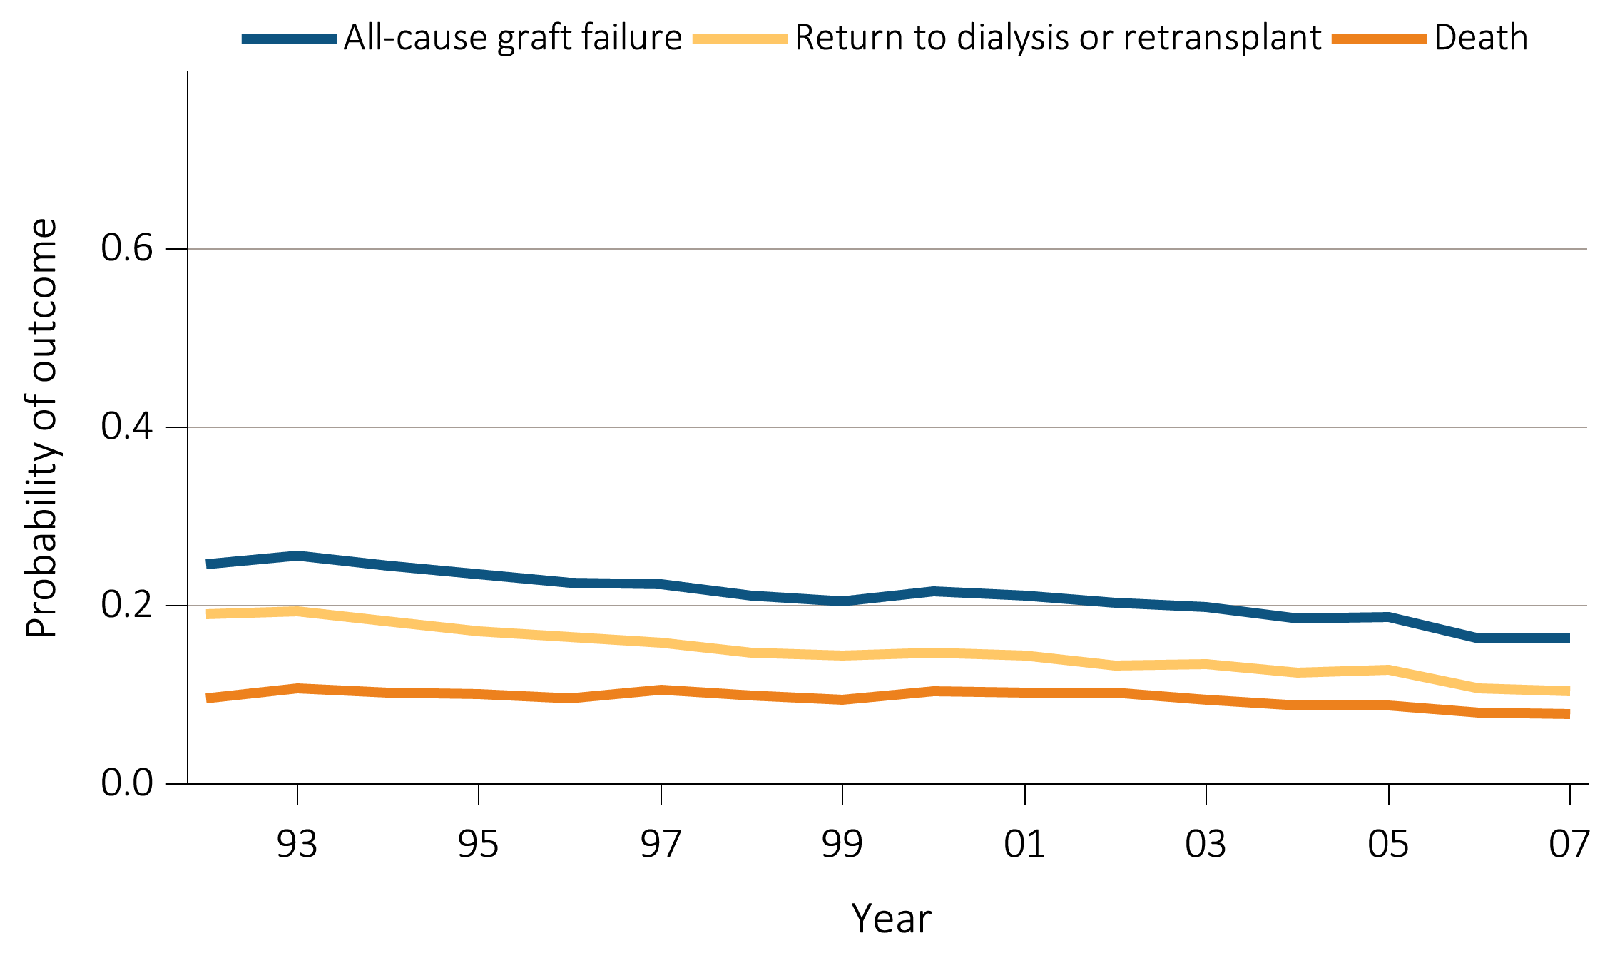
vol 2 Figure 6.9 Outcomes: living donor transplants
(b) Five-year
Data Source: Reference Tables F11, F23, I35. Outcomes among recipients of a first-time live donor kidney transplant; unadjusted.

Slide 29
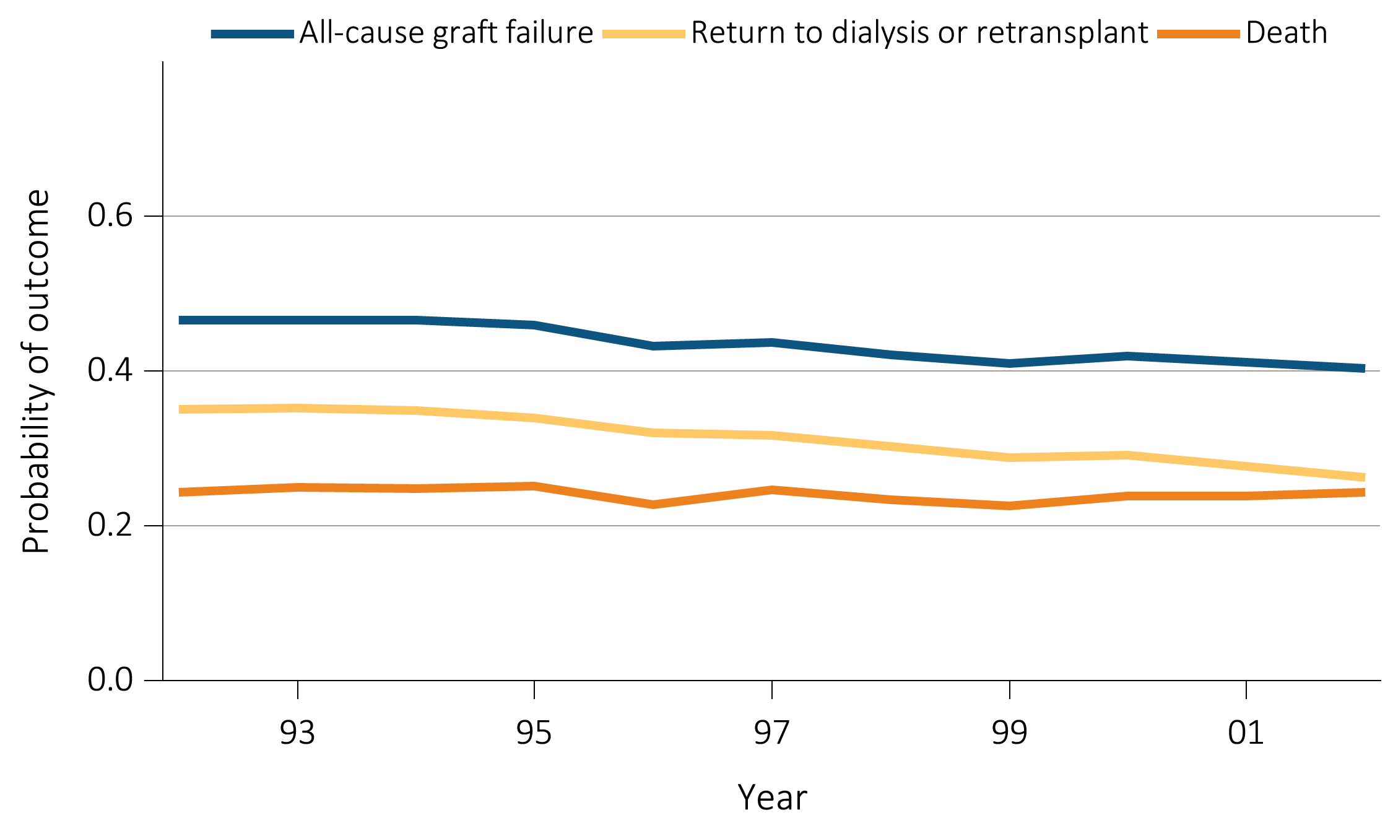
vol 2 Figure 6.9 Outcomes: living donor transplants
(c) Ten-year
Data Source: Reference Tables F12, F24, I36. Outcomes among recipients of a first-time live donor kidney transplant; unadjusted.

Slide 30
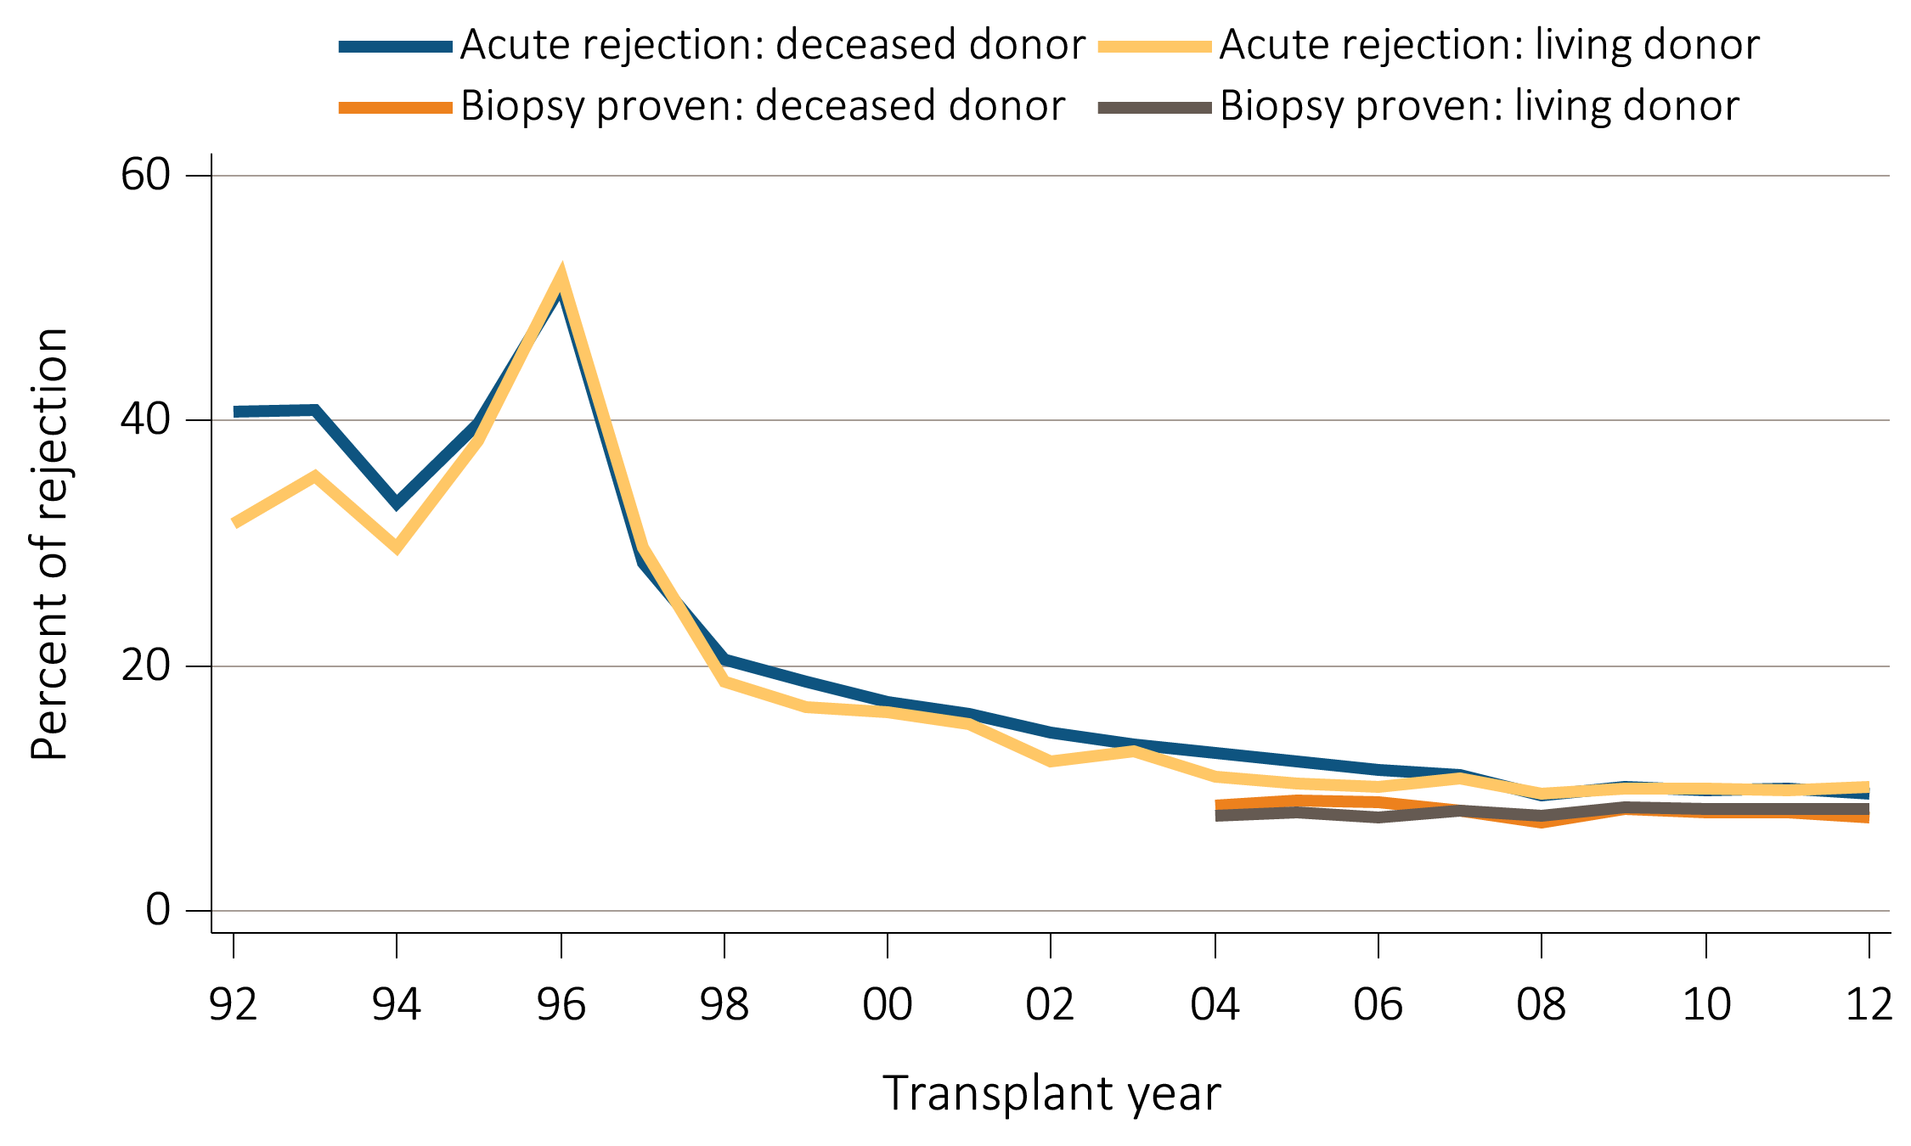
vol 2 Figure 6.10 Acute rejection within the first year post-transplant
Data Source: Special analyses, USRDS ESRD Database. Acute rejection rates during the first year post-transplant for recipients age 18 and older with a functioning graft at discharge.

Slide 31
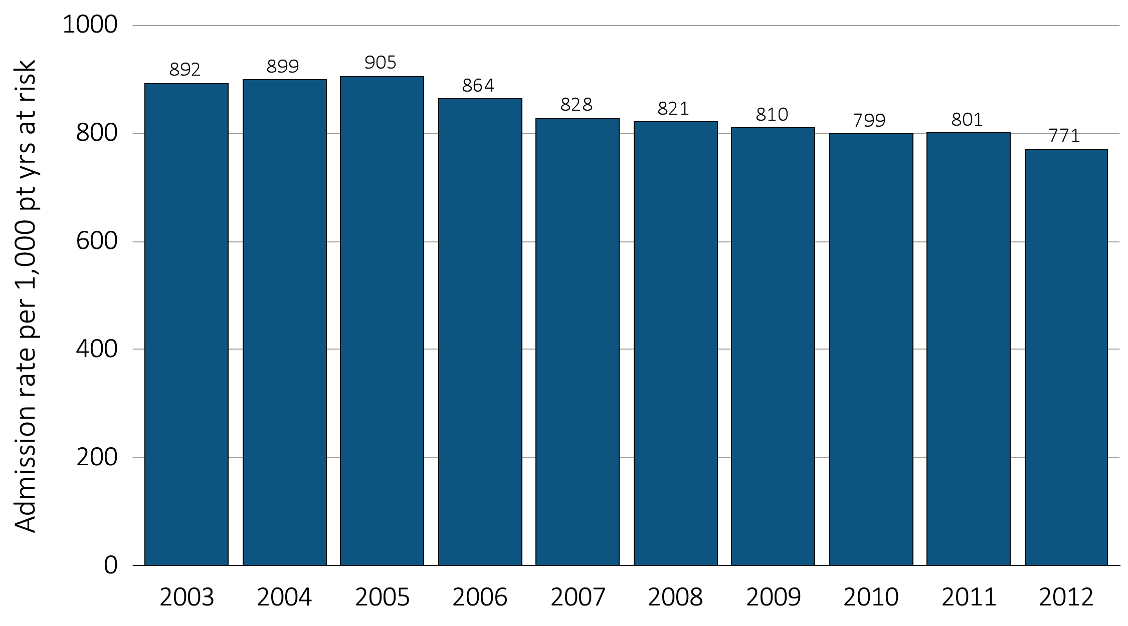
vol 2 Figure 6.11 Post-transplant total hospital admission rates
Data Source: Reference Table G5. All kidney transplant recipients.

Slide 32
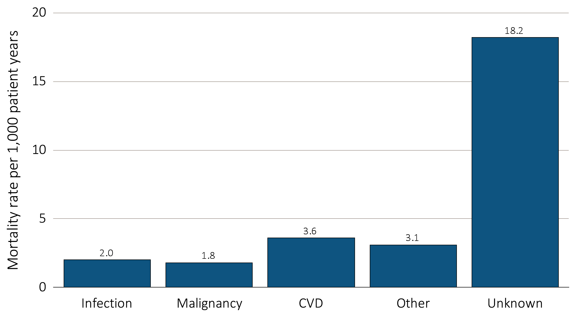
vol 2 Figure 6.12 Mortality rate by causes of death
Data Source: Reference Table H12. Kidney transplant recipients who died.

Slide 33
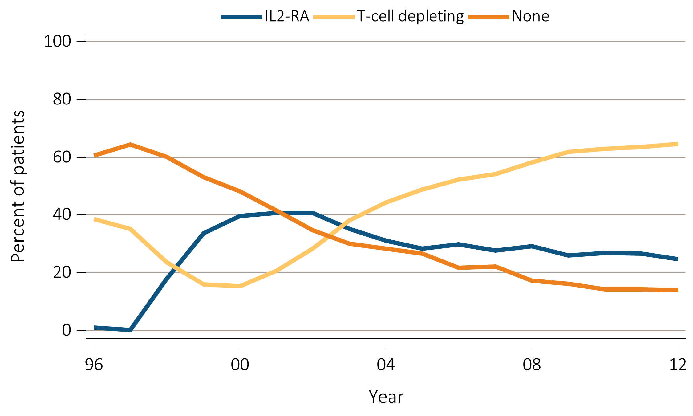
vol 2 Figure 6.13 Immunosuppression use at transplantation (and one year post-transplant)
(a) Induction agents
Data Source: Special analyses, USRDS ESRD Database. All adult kidney transplant recipients. Abbreviations: IL2-RA, interleukin 2 receptor antagonist.

Slide 34
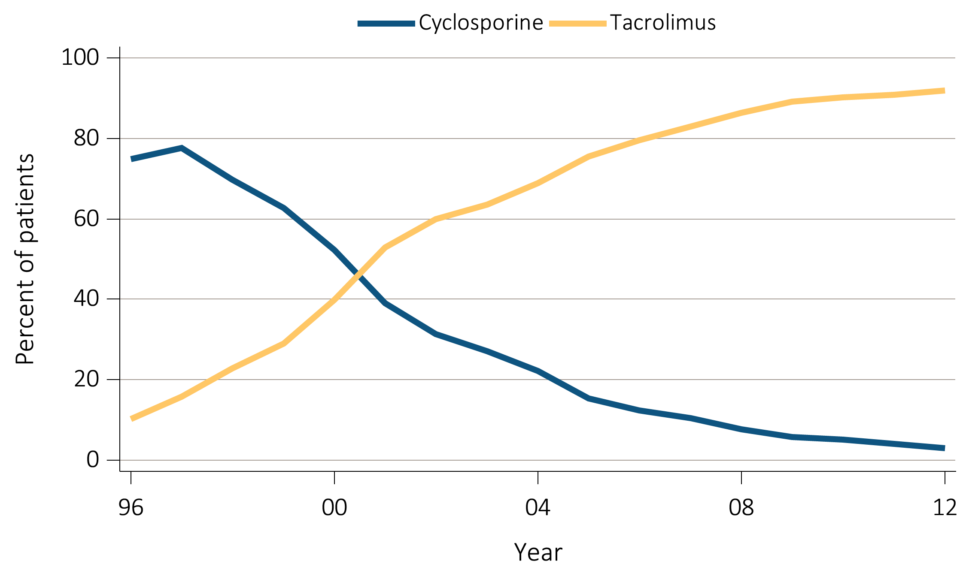
vol 2 Figure 6.13 Immunosuppression use at transplantation (and one year post-transplant)
(b) Calcineurin inhibitors at transplant
Data Source: Special analyses, USRDS ESRD Database. All adult kidney transplant recipients.

Slide 35
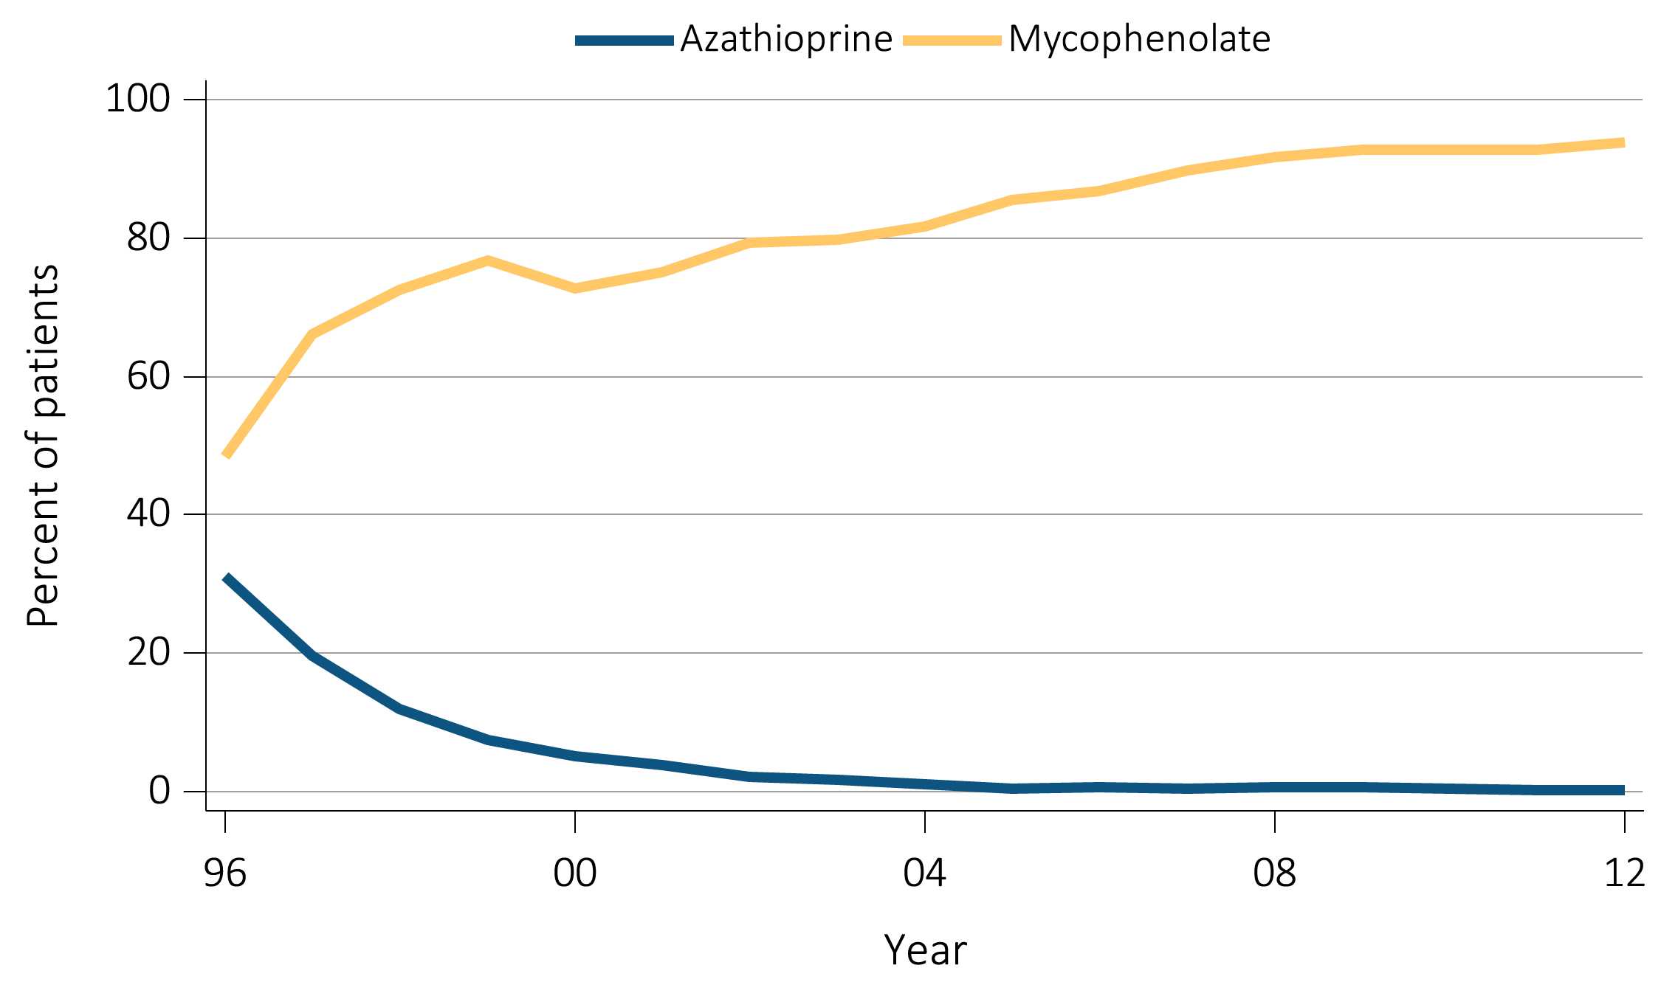
vol 2 Figure 6.13 Immunosuppression use at transplantation (and one year post-transplant)
(c) Anti-metabolites at transplant
Data Source: Special analyses, USRDS ESRD Database. All adult kidney transplant recipients.

Slide 36
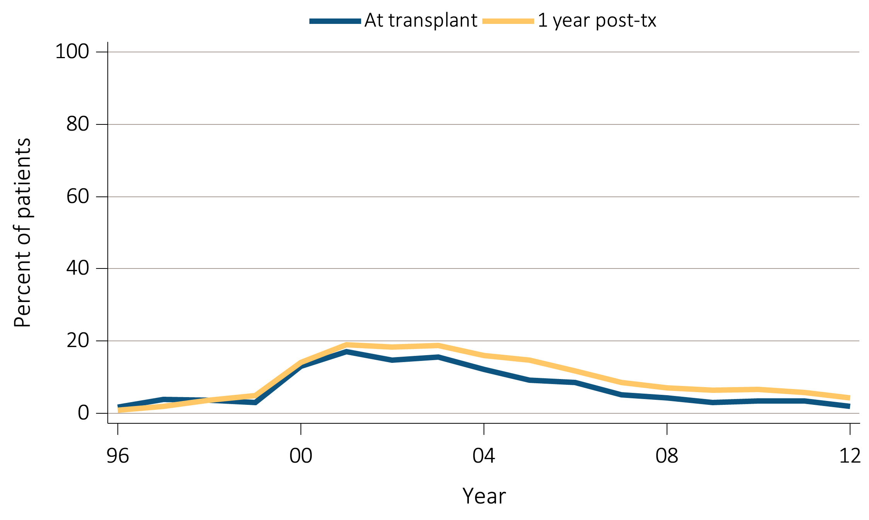
vol 2 Figure 6.13 Immunosuppression use at transplantation (and one year post-transplant)
(d) mTOR inhibitors
Data Source: Special analyses, USRDS ESRD Database. All adult kidney transplant recipients.

Slide 37
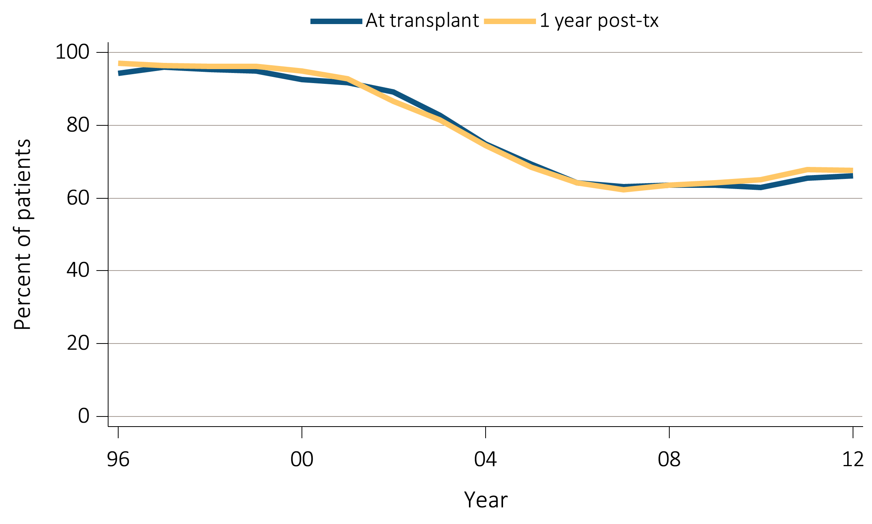
vol 2 Figure 6.13 Immunosuppression use at transplantation (and one year post-transplant)
(e) Steroids
Data Source: Special analyses, USRDS ESRD Database. All adult kidney transplant recipients.

