Slide 2
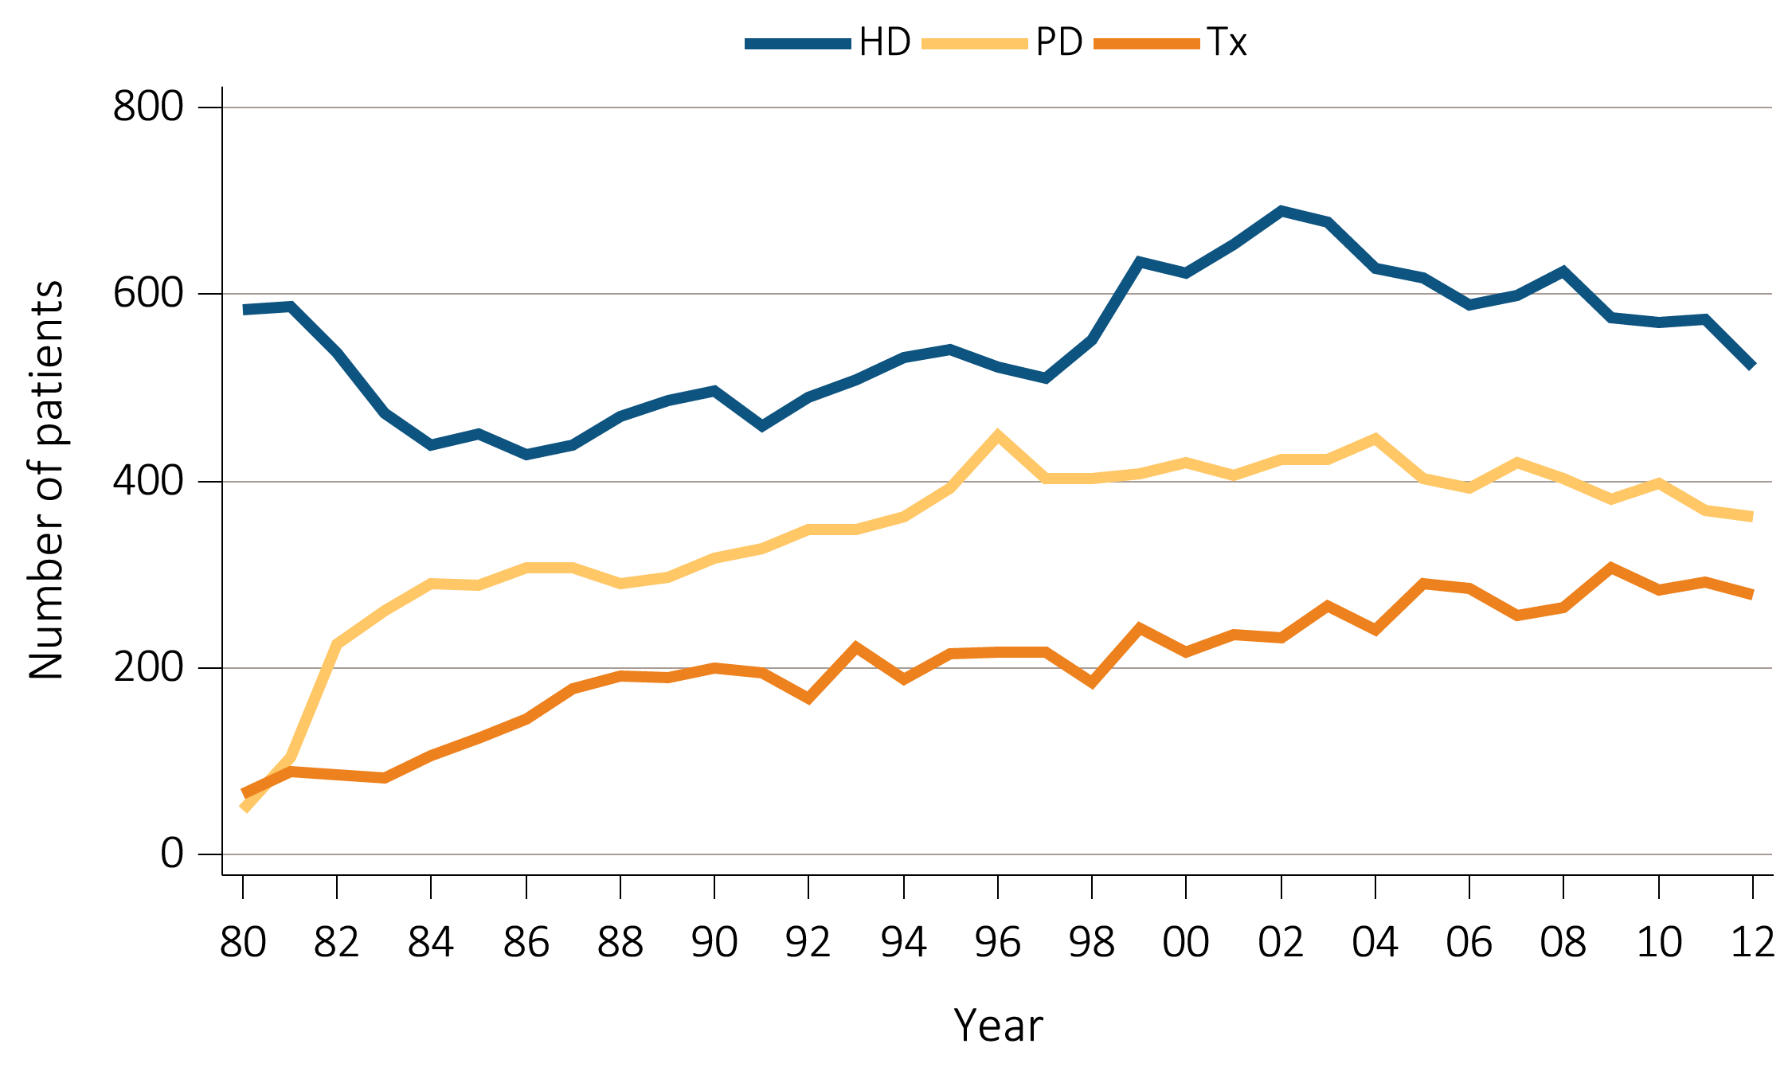
vol 2 Figure 7.1. Incident & December 31 point prevalent ESRD patients (aged 0-19 years) (a) Incidence of ESRD in children
Data Source: Reference tables D3-D5, D7-D9, and special analyses, USRDS ESRD Database. Peritoneal dialysis consists of continuous ambulatory peritoneal dialysis and continuous cycling peritoneal dialysis. Abbreviations: ESRD, end-stage renal disease; HD, hemodialysis; PD, peritoneal dialysis; Tx, transplant.

Slide 3
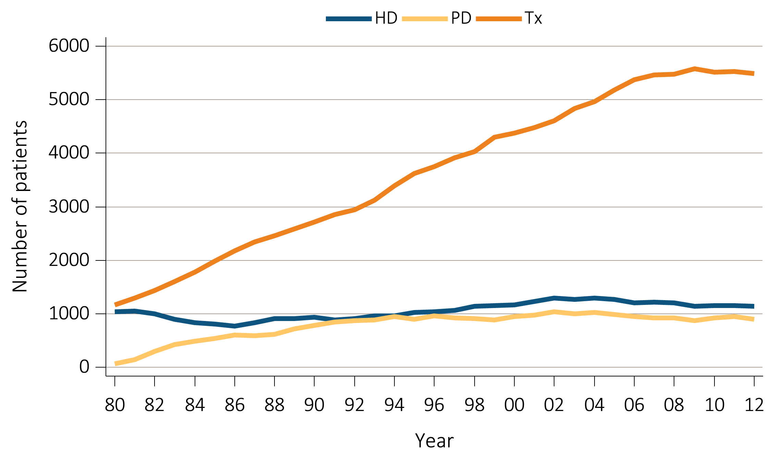
vol 2 Figure 7.1. Incident & December 31 point prevalent ESRD patients (aged 0-19 years) (b) Prevalence of ESRD in children
Data Source: Reference tables D3-D5, D7-D9, and special analyses, USRDS ESRD Database. Peritoneal dialysis consists of continuous ambulatory peritoneal dialysis and continuous cycling peritoneal dialysis. Abbreviations: ESRD, end-stage renal disease; HD, hemodialysis; PD, peritoneal dialysis; Tx, transplant.

Slide 4
vol 2 Table 7.1 : Distribution of reported incident pediatric ESRD patients by primary diagnosis, 2003-2007 (period A) and 2008-2012 (period B) (aged 0-19 years)
 |  |  |  |  |  |  |  |  |  |  |  |  |  |  | Transplant |  | Died
 | Total |  | Incident |  | Age |  | Male |  | White |  | African Am |  | Other Race |  | first year |  | first year
 | Patients |  | % |  | Median |  | % |  | % |  | % |  | % |  | % |  | %
 | A | B | A | B | A | B | A | B | A | B | A | B | A | B | A | B | A | B
All ESRD (reference) | 6,544 | 6,204 | 100.0 | 100.0 | 14 | 14 | 57.0 | 56.5 | 64.3 | 65.7 | 24.7 | 23.0 | 11.0 | 11.3 | 41.4 | 43.6 | 3.7 | 3.3
Diabetes | 58 | 57 | 0.9 | 1.0 | 18 | 16 | 46.6 | 52.6 | 55.2 | 57.9 | 37.9 | 36.8 | 6.9 | 5.3 | 8.6 | 15.8 | 12.1 | 12.3
Type 2 | 30 | 34 | 0.5 | 0.6 | 15 | 4 | 53.3 | 52.9 | 56.7 | 61.8 | 30.0 | 32.4 | 13.3 | 5.9 | 13.3 | 8.8 | 10.0 | 17.6
Type 1 | 28 | 23 | 0.4 | 0.4 | 19 | 19 | 39.3 | 52.2 | 53.6 | 52.2 | 46.4 | 43.5 | 0.0 | 4.3 | 3.6 | 26.1 | 14.3 | 4.3
Glomerulonephritis (GN) | 1,541 | 1,336 | 24.7 | 23.0 | 16 | 16 | 54.9 | 52.8 | 58.5 | 64.1 | 33.2 | 29.0 | 8.4 | 6.9 | 35.4 | 36.5 | 2.2 | 1.7
GN (histologically not examined) | 275 | 194 | 4.4 | 3.3 | 17 | 18 | 57.8 | 56.7 | 61.1 | 69.6 | 26.5 | 20.6 | 12.4 | 9.8 | 29.5 | 25.3 | 3.6 | 1.5
Focal glomerular sclerosis | 824 | 721 | 13.2 | 12.4 | 15 | 15 | 56.8 | 54.4 | 51.8 | 59.2 | 42.0 | 36.1 | 6.2 | 4.7 | 37.6 | 39.4 | 1.9 | 1.9
Membranous nephropathy | 31 | 34 | 0.5 | 0.6 | 15 | 17 | 48.4 | 58.8 | 58.1 | 47.1 | 32.3 | 44.1 | 9.7 | 8.8 | 35.5 | 41.2 | 0.0 | 0.0
MPGN GN type 1, diffuse MPGN | 77 | 75 | 1.2 | 1.3 | 15 | 16 | 48.1 | 48.0 | 76.6 | 66.7 | 14.3 | 24.0 | 9.1 | 9.3 | 40.3 | 42.7 | 2.6 | 4.0
Dense deposit disease, MPGN type 2 | 26 | 20 | 0.4 | 0.3 | 12 | 15 | 38.5 | 60.0 | 96.2 | 75.0 | 3.8 | 10.0 | 0.0 | 15.0 | 30.8 | 20.0 | 3.8 | 0.0
IgA nephropathy | 130 | 134 | 2.1 | 2.3 | 17 | 17 | 58.5 | 54.5 | 68.5 | 76.1 | 19.2 | 13.4 | 12.3 | 10.4 | 40.8 | 44.0 | 0.8 | 0.0
IgM nephropathy | * | 14 | 0.1 | 0.2 | 16 | 18 | 57.1 | 64.3 | 42.9 | 71.4 | 42.9 | 21.4 | 14.3 | 7.1 | 42.9 | 14.3 | 0.0 | 0.0
Rapidly progressive GN | 77 | 56 | 1.2 | 1.0 | 14 | 14 | 45.5 | 23.2 | 66.2 | 75.0 | 22.1 | 16.1 | 11.7 | 8.9 | 27.3 | 21.4 | 2.6 | 1.8
Post infectious GN, SBE | 14 | 21 | 0.2 | 0.4 | 14 | 16 | 64.3 | 52.4 | 57.1 | 71.4 | 28.6 | 23.8 | 14.3 | 4.8 | 21.4 | 14.3 | 0.0 | 4.8
Other proliferative GN | 80 | 67 | 1.3 | 1.2 | 15 | 16 | 41.3 | 43.3 | 66.3 | 65.7 | 26.3 | 26.9 | 7.5 | 7.5 | 31.3 | 43.3 | 2.5 | 1.5
Secondary GN/vasculitis | 708 | 656 | 11.4 | 11.3 | 16 | 16 | 31.8 | 29.3 | 54.0 | 57.8 | 36.7 | 35.2 | 9.3 | 7.0 | 14.7 | 18.1 | 4.5 | 4.3
Lupus nephritis | 405 | 332 | 6.5 | 5.7 | 17 | 18 | 22.7 | 21.7 | 38.3 | 32.8 | 50.4 | 59.0 | 11.4 | 8.1 | 6.9 | 7.2 | 5.9 | 4.5
Henoch-Schonlein syndrome | 23 | 28 | 0.4 | 0.5 | 15 | 14 | 65.2 | 53.6 | 87.0 | 85.7 | 4.3 | 7.1 | 8.7 | 7.1 | 43.5 | 39.3 | 0.0 | 3.6
Scleroderma | * | * | 0.1 | 0.1 | 18 | 18 | 25.0 | 66.7 | 50.0 | 66.7 | 50.0 | 33.3 | 0.0 | 0.0 | 0.0 | 33.3 | 25.0 | 33.3
Hemolytic uremic syndrome | 119 | 113 | 1.9 | 1.9 | 6 | 8 | 47.1 | 37.2 | 77.3 | 82.3 | 17.6 | 12.4 | 5.0 | 5.3 | 27.7 | 35.4 | 3.4 | 4.4
Polyarteritis | 11 | 21 | 0.2 | 0.4 | 14 | 13 | 18.2 | 19.0 | 72.7 | 85.7 | 9.1 | 4.8 | 18.2 | 9.5 | 9.1 | 19.0 | 0.0 | 0.0
Wegeners granulomatosis | 60 | 56 | 1.0 | 1.0 | 15 | 16 | 56.7 | 42.9 | 70.0 | 89.3 | 23.3 | 7.1 | 6.7 | 3.6 | 20.0 | 23.2 | 3.3 | 1.8
Other vasculitis and its derivatives | 58 | 54 | 0.9 | 0.9 | 15 | 13 | 25.9 | 33.3 | 69.0 | 72.2 | 25.9 | 16.7 | 5.2 | 11.1 | 24.1 | 29.6 | 1.7 | 5.6
Goodpasture syndrome | 14 | 33 | 0.2 | 0.6 | 16 | 17 | 28.6 | 27.3 | 85.7 | 93.9 | 7.1 | 3.0 | 7.1 | 3.0 | 21.4 | 18.2 | 0.0 | 3.0
Secondary GN, other | 14 | 16 | 0.2 | 0.3 | 14 | 17 | 42.9 | 37.5 | 78.6 | 81.3 | 7.1 | 18.8 | 14.3 | 0.0 | 21.4 | 25.0 | 0.0 | 6.3

Slide 5
vol 2 Table 7.1 : Distribution of reported incident pediatric ESRD patients by primary diagnosis, 2003-2007 (period A) and 2008-2012 (period B) (aged 0-19 years) (cont’d)
 |  |  |  |  |  |  |  |  |  |  |  |  |  |  | Transplant |  | Died
 | Total |  | Incident |  | Age |  | Male |  | White |  | African Am |  | Other Race |  | first year |  | first year
 | Patients |  | % |  | Median |  | % |  | % |  | % |  | % |  | % |  | %
 | A | B | A | B | A | B | A | B | A | B | A | B | A | B | A | B | A | B
Interstitial nephritis/pyelonephritis | 391 | 289 | 6.3 | 5.0 | 15 | 15 | 52.7 | 50.9 | 81.3 | 81.3 | 12.8 | 11.1 | 5.9 | 7.6 | 47.8 | 54.7 | 2.0 | 4.8
Nephropathy caused by other agents | 41 | 37 | 0.7 | 0.6 | 15 | 14 | 56.1 | 56.8 | 82.9 | 83.8 | 14.6 | 10.8 | 2.4 | 5.4 | 53.7 | 29.7 | 9.8 | 10.8
Nephrolithiasis | * | 11 | 0.1 | 0.2 | 12 | 16 | 44.4 | 27.3 | 100.0 | 90.9 | 0.0 | 0.0 | 0.0 | 9.1 | 100.0 | 81.8 | 0.0 | 9.1
Acquired obstructive uropathy | 48 | 30 | 0.8 | 0.5 | 15 | 14 | 77.1 | 76.7 | 66.7 | 80.0 | 22.9 | 16.7 | 10.4 | 3.3 | 45.8 | 46.7 | 0.0 | 0.0
Chronic pyelonephritis, reflux nephropathy | 201 | 143 | 3.2 | 2.5 | 15 | 15 | 44.3 | 45.5 | 88.6 | 84.6 | 6.5 | 7.0 | 5.0 | 8.4 | 48.3 | 60.8 | 0.5 | 2.8
Chronic interstitial nephritis | 75 | 60 | 1.2 | 1.0 | 14 | 16 | 57.3 | 46.7 | 73.3 | 73.3 | 20.0 | 16.7 | 6.7 | 10.0 | 46.7 | 56.7 | 2.7 | 3.3
Acute interstitial nephritis | * | * | 0.0 | 0.1 | 11 | 11 | 33.3 | 100.0 | 33.3 | 50.0 | 66.7 | 50.0 | 0.0 | 0.0 | 0.0 | 50.0 | 0.0 | 50.0
Disorders of calcium metabolism | * | . | 0.1 | . | 15 | . | 20.0 | . | 80.0 | . | 20.0 | . | 0.0 | . | 20.0 | . | 0.0 | .
Hypertensive/large vessel disease | 283 | 260 | 4.5 | 4.5 | 17 | 18 | 55.8 | 57.3 | 52.3 | 54.6 | 41.3 | 41.5 | 6.4 | 3.8 | 23.7 | 19.6 | 5.3 | 3.8
Unspecified with renal failure | 266 | 244 | 4.3 | 4.2 | 18 | 18 | 56.8 | 57.4 | 50.0 | 52.9 | 43.6 | 43.4 | 6.4 | 3.7 | 22.9 | 18.0 | 5.3 | 4.1
Renal artery stenosis | * | * | 0.1 | 0.2 | 14 | 14 | 57.1 | 66.7 | 85.7 | 77.8 | 14.3 | 11.1 | 0.0 | 11.1 | 42.9 | 55.6 | 0.0 | 0.0
Renal artery occlusion | * | * | 0.1 | 0.1 | 0 | 17 | 22.2 | 20.0 | 88.9 | 80.0 | 0.0 | 20.0 | 11.1 | 0.0 | 22.2 | 20.0 | 11.1 | 0.0
Cystic/hereditary/congenital diseases | 2,088 | 2,229 | 33.5 | 38.3 | 10 | 10 | 68.1 | 67.4 | 75.2 | 74.8 | 18.0 | 18.5 | 6.8 | 6.6 | 51.1 | 51.1 | 3.2 | 2.8
Polycystic kidneys, adult type (dominant) | 30 | 33 | 0.5 | 0.6 | 14 | 15 | 43.3 | 57.6 | 83.3 | 72.7 | 13.3 | 27.3 | 3.3 | 0.0 | 60.0 | 51.5 | 0.0 | 0.0
Polycystic, infantile (recessive) | 142 | 150 | 2.3 | 2.6 | 9 | 1 | 56.3 | 44.7 | 76.1 | 78.0 | 16.9 | 16.7 | 7.0 | 5.3 | 53.5 | 39.3 | 7.0 | 11.3
Medullary cystic disease, inc. nephronophthisis | 97 | 106 | 1.6 | 1.8 | 11 | 13 | 36.1 | 50.0 | 84.5 | 84.9 | 4.1 | 7.5 | 11.3 | 7.5 | 69.1 | 70.8 | 1.0 | 0.0
Tuberous sclerosis | * | * | 0.1 | 0.1 | 17 | 18 | 37.5 | 40.0 | 50.0 | 40.0 | 50.0 | 60.0 | 0.0 | 0.0 | 25.0 | 20.0 | 0.0 | 0.0
Hereditary nephritis, Alport's syndrome | 152 | 133 | 2.4 | 2.3 | 16 | 17 | 83.6 | 83.5 | 74.3 | 64.7 | 20.4 | 24.1 | 5.3 | 11.3 | 50.0 | 48.9 | 1.3 | 0.0
Cystinosis | 62 | 49 | 1.0 | 0.8 | 12 | 13 | 51.6 | 59.2 | 90.3 | 91.8 | 9.7 | 8.2 | 0.0 | 0.0 | 77.4 | 75.5 | 0.0 | 0.0
Primary oxalosis | 17 | * | 0.3 | 0.2 | 8 | 2 | 52.9 | 80.0 | 82.4 | 80.0 | 11.8 | 10.0 | 5.9 | 10.0 | 47.1 | 70.0 | 0.0 | 0.0
Congenital nephrotic syndrome | 136 | 131 | 2.2 | 2.3 | 2 | 3 | 55.9 | 54.2 | 71.3 | 80.2 | 19.9 | 12.2 | 8.8 | 7.6 | 50.7 | 48.9 | 8.1 | 4.6
Drash syndrome, mesangial sclerosis | 15 | 29 | 0.2 | 0.5 | 1 | 0 | 60.0 | 58.6 | 80.0 | 82.8 | 0.0 | 17.2 | 20.0 | 0.0 | 26.7 | 34.5 | 13.3 | 6.9
Congenital ureterpelvic junction obstruction | 31 | 43 | 0.5 | 0.7 | 11 | 13 | 80.6 | 86.0 | 77.4 | 60.5 | 16.1 | 39.5 | 6.5 | 0.0 | 51.6 | 48.8 | 0.0 | 2.3
Congenital uretrovesical junction obstruction | 25 | 50 | 0.4 | 0.9 | 13 | 11 | 88.0 | 86.0 | 72.0 | 70.0 | 28.0 | 20.0 | 0.0 | 10.0 | 52.0 | 50.0 | 0.0 | 2.0
Other congenital obstructive uropathy | 514 | 514 | 8.2 | 8.8 | 11 | 10 | 84.6 | 81.5 | 68.5 | 71.8 | 23.5 | 23.7 | 8.0 | 4.5 | 45.1 | 48.2 | 2.7 | 1.2
Renal hypoplasia, dysplasia, oligonephronia | 698 | 691 | 11.2 | 11.9 | 10 | 9 | 62.3 | 62.4 | 76.9 | 75.5 | 15.9 | 16.9 | 7.2 | 7.5 | 50.0 | 52.2 | 3.4 | 2.9
Prune belly syndrome | 82 | 80 | 1.3 | 1.4 | 7 | 5 | 97.6 | 98.8 | 75.6 | 67.5 | 22.0 | 27.5 | 2.4 | 5.0 | 56.1 | 55.0 | 0.0 | 1.3
Other (congenital malformation syndromes) | 79 | 204 | 1.3 | 3.5 | 14 | 12 | 50.6 | 56.4 | 83.5 | 78.9 | 13.9 | 10.3 | 2.5 | 10.8 | 55.7 | 51.0 | 2.5 | 4.4

Slide 6
vol 2 Table 7.1 : Distribution of reported incident pediatric ESRD patients by primary diagnosis, 2003-2007 (period A) and 2008-2012 (period B) (aged 0-19 years) (cont’d)
 |  |  |  |  |  |  |  |  |  |  |  |  |  |  | Transplant |  | Died
 | Total |  | Incident |  | Age |  | Male |  | White |  | African Am |  | Other Race |  | first year |  | first year
 | Patients |  | % |  | Median |  | % |  | % |  | % |  | % |  | % |  | %
 | A | B | A | B | A | B | A | B | A | B | A | B | A | B | A | B | A | B
Neoplasms/tumors | 161 | 122 | 2.6 | 2.1 | 14 | 14 | 50.9 | 50.8 | 71.4 | 68.0 | 21.1 | 22.1 | 7.5 | 9.8 | 32.3 | 32.0 | 14.3 | 15.6
Renal tumor (malignant) | 38 | 33 | 0.6 | 0.6 | 5 | 5 | 44.7 | 39.4 | 63.2 | 66.7 | 28.9 | 27.3 | 7.9 | 6.1 | 7.9 | 18.2 | 26.3 | 15.2
Renal tumor (unspecified) | * | * | 0.1 | 0.0 | 17 | 1 | 0.0 | 100.0 | 50.0 | 0.0 | 25.0 | 100.0 | 25.0 | 0.0 | 50.0 | 100.0 | 0.0 | 0.0
Transplanted organ complication, unspecified | 21 | * | 0.3 | 0.0 | 14 | 16 | 47.6 | 50.0 | 71.4 | 50.0 | 23.8 | 50.0 | 4.8 | 0.0 | 28.6 | 50.0 | 19.0 | 0.0
Transplanted kidney complication | 46 | 13 | 0.7 | 0.2 | 15 | 17 | 58.7 | 76.9 | 73.9 | 84.6 | 19.6 | 15.4 | 6.5 | 0.0 | 58.7 | 23.1 | 0.0 | 0.0
Transplanted liver complication | * | * | 0.1 | 0.1 | 17 | 15 | 62.5 | 25.0 | 62.5 | 62.5 | 25.0 | 12.5 | 12.5 | 25.0 | 50.0 | 87.5 | 0.0 | 0.0
Transplanted heart complication | 20 | 25 | 0.3 | 0.4 | 14 | 15 | 55.0 | 52.0 | 80.0 | 64.0 | 15.0 | 24.0 | 5.0 | 12.0 | 30.0 | 48.0 | 20.0 | 16.0
Bone marrow transplant complication | 12 | 25 | 0.2 | 0.4 | 12 | 17 | 50.0 | 60.0 | 91.7 | 64.0 | 8.3 | 28.0 | 0.0 | 8.0 | 8.3 | 12.0 | 33.3 | 12.0
Miscellaneous conditions | 406 | 389 | 6.5 | 6.7 | 13 | 13 | 55.4 | 55.3 | 66.7 | 73.8 | 28.1 | 18.3 | 5.2 | 8.0 | 36.2 | 36.2 | 8.9 | 6.9
Sickle cell disease/anemia | 14 | * | 0.2 | 0.2 | 18 | 18 | 64.3 | 90.0 | 0.0 | 10.0 | 100.0 | 90.0 | 0.0 | 0.0 | 14.3 | 10.0 | 21.4 | 0.0
Post partum renal failure | * | * | 0.1 | 0.1 | 17 | 19 | 11.1 | 0.0 | 66.7 | 71.4 | 33.3 | 14.3 | 0.0 | 14.3 | 33.3 | 0.0 | 0.0 | 0.0
AIDS nephropathy | 44 | 15 | 0.7 | 0.3 | 16 | 18 | 47.7 | 53.3 | 13.6 | 0.0 | 86.4 | 100.0 | 0.0 | 0.0 | 0.0 | 0.0 | 13.6 | 20.0
Traumatic or surgical loss of kidney(s) | 15 | * | 0.2 | 0.2 | 8 | 13 | 66.7 | 60.0 | 93.3 | 50.0 | 6.7 | 40.0 | 0.0 | 10.0 | 40.0 | 20.0 | 13.3 | 10.0
Hepatorenal syndrome | * | * | 0.1 | 0.1 | 11 | 16 | 25.0 | 50.0 | 75.0 | 66.7 | 25.0 | 0.0 | 0.0 | 33.3 | 0.0 | 50.0 | 75.0 | 16.7
Tubular necrosis | 114 | 131 | 1.8 | 2.3 | 2 | 11 | 51.8 | 60.3 | 78.9 | 79.4 | 14.0 | 14.5 | 7.0 | 6.1 | 15.8 | 20.6 | 9.6 | 10.7
Other renal disorders | 205 | 210 | 3.3 | 3.6 | 13 | 12 | 60.5 | 52.4 | 74.1 | 80.0 | 19.5 | 11.0 | 6.3 | 9.0 | 57.6 | 51.4 | 5.4 | 3.8
Etiology uncertain | 600 | 476 | 9.6 | 8.2 | 15 | 15 | 58.5 | 57.1 | 71.8 | 70.2 | 20.3 | 21.8 | 7.8 | 8.0 | 39.3 | 44.1 | 3.2 | 1.5
Missing | 308 | 390 | 4.9 | 6.7 | 13 | 14 | 62.0 | 59.2 | 13.0 | 14.9 | 3.9 | 7.7 | 83.1 | 77.4 | 96.4 | 90.5 | 1.3 | 2.3
Data Source: Special analyses, USRDS ESRD Database. Abbreviations: AIDS, acquired-immune deficiency syndrome; ESRD, end-stage renal disease; GN glomerulonephritis; IgA immunoglobulin A; IgM, immunoglobulin M; MPGN, membranoproliferative glomerulonephritis; SBE, sub-acute bacterial endocarditis.
*Suppressed due to inadequate sample size.
.Zero values in this cell.

Slide 7
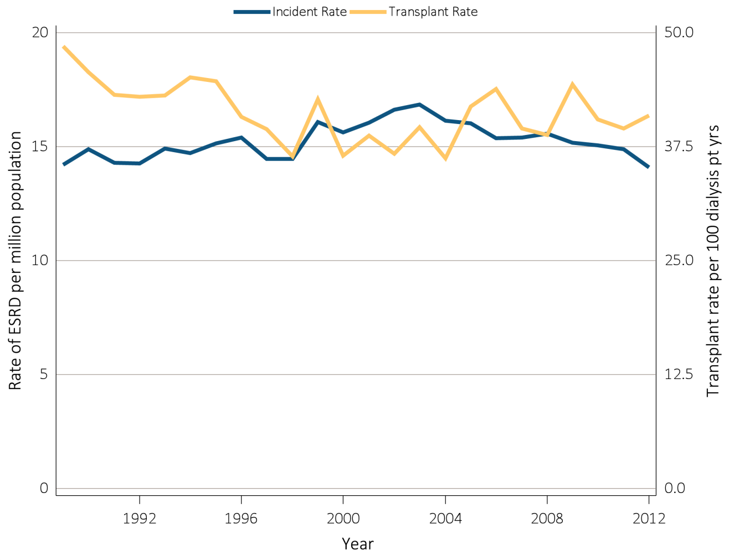
vol 2 Figure 7.2 Trends in pediatric transplantation (aged 0-19 years) (a) Incidence rate of ESRD and transplant rate in children
Data Source: Reference tables A1, E9, M1, and special analyses, USRDS ESRD Database. The rate of ESRD per million among the U.S. population age 0-19 and the rate of transplantation in dialysis patients age 0-19 at the time of transplant, 1989–2012. Abbreviations: ESRD, end-stage renal disease.

Slide 8
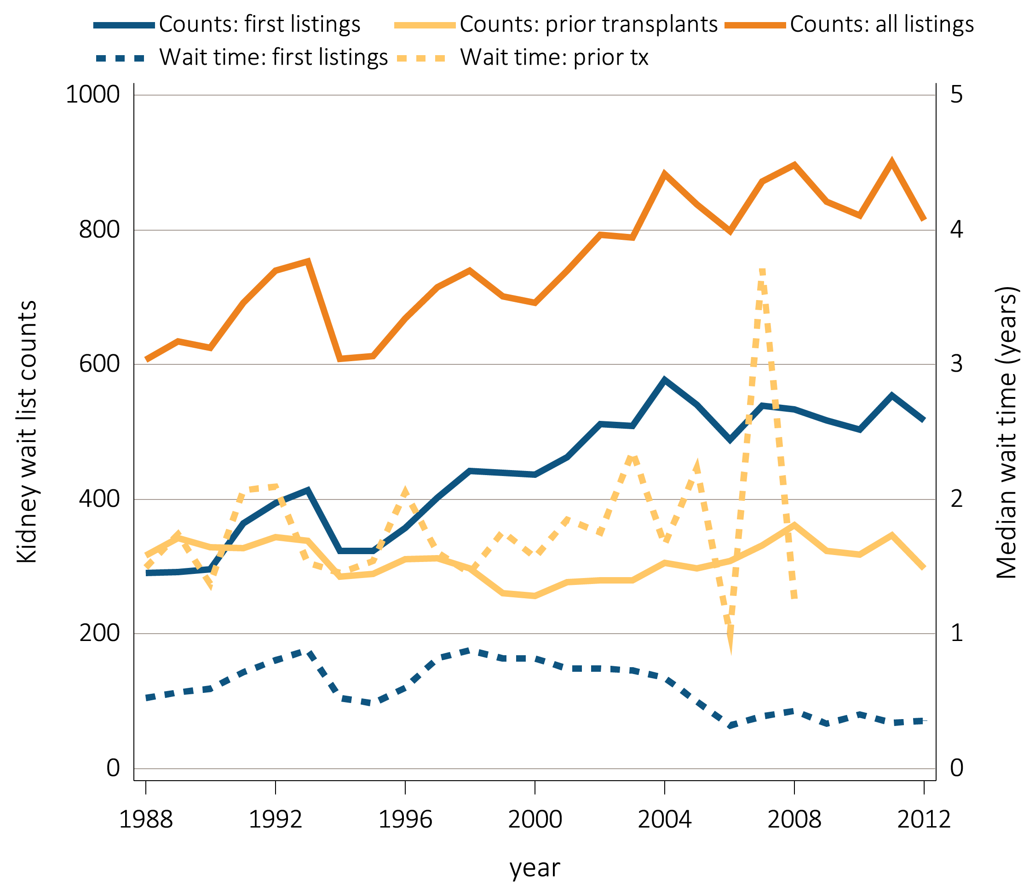
vol 2 Figure 7.2 Trends in pediatric transplantation (aged 0-19 years) (b) Waiting list count
Data Source: Reference tables E2, E3, and special analyses, USRDS ESRD Database. The waiting list count provides the number of pediatric candidates aged 0-19 years on the Organ Procurement and Transplantation Network kidney transplant waiting list on December 31 of each year for first and subsequent kidney alone or kidney plus pancreas transplantation. Candidates listed at more than one center on December 31 are counted only once. There are no data available for median waiting list time for patients with prior transplants listed after 2008. Abbreviations: Tx, transplant.

Slide 9
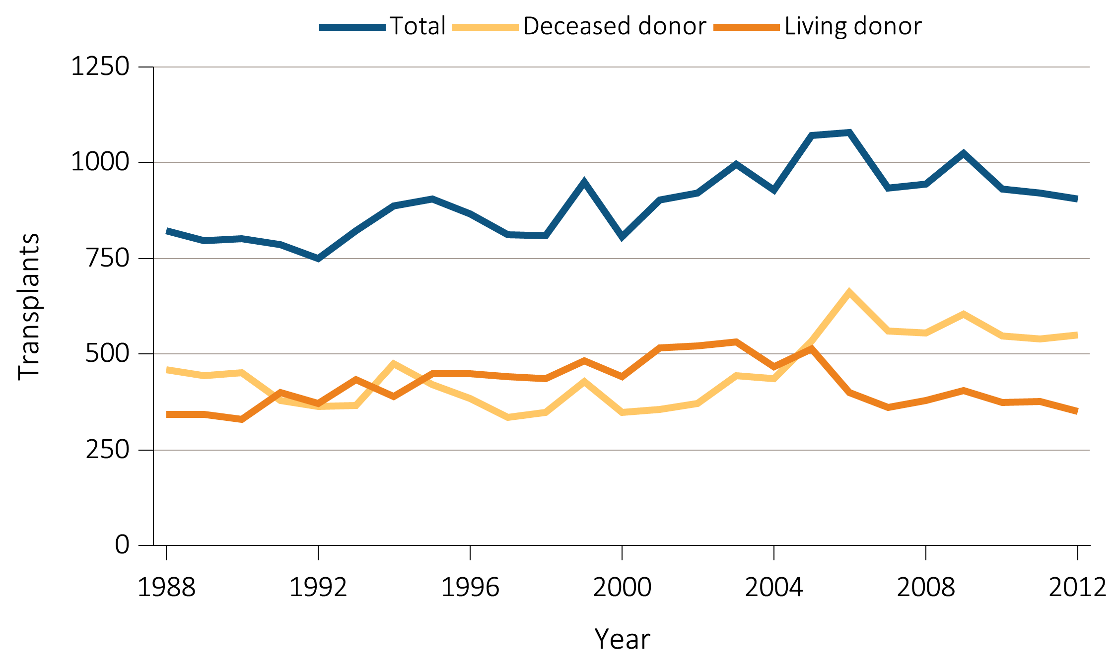
vol 2 Figure 7.2 Trends in pediatric transplantation (aged 0-19 years) (c) Total transplants
Data Source: Reference tables E8, E8(2), E8(3), and special analyses, USRDS ESRD Database. This figure represents kidney alone and kidney plus pancreas transplant counts for all pediatric candidates.

Slide 10
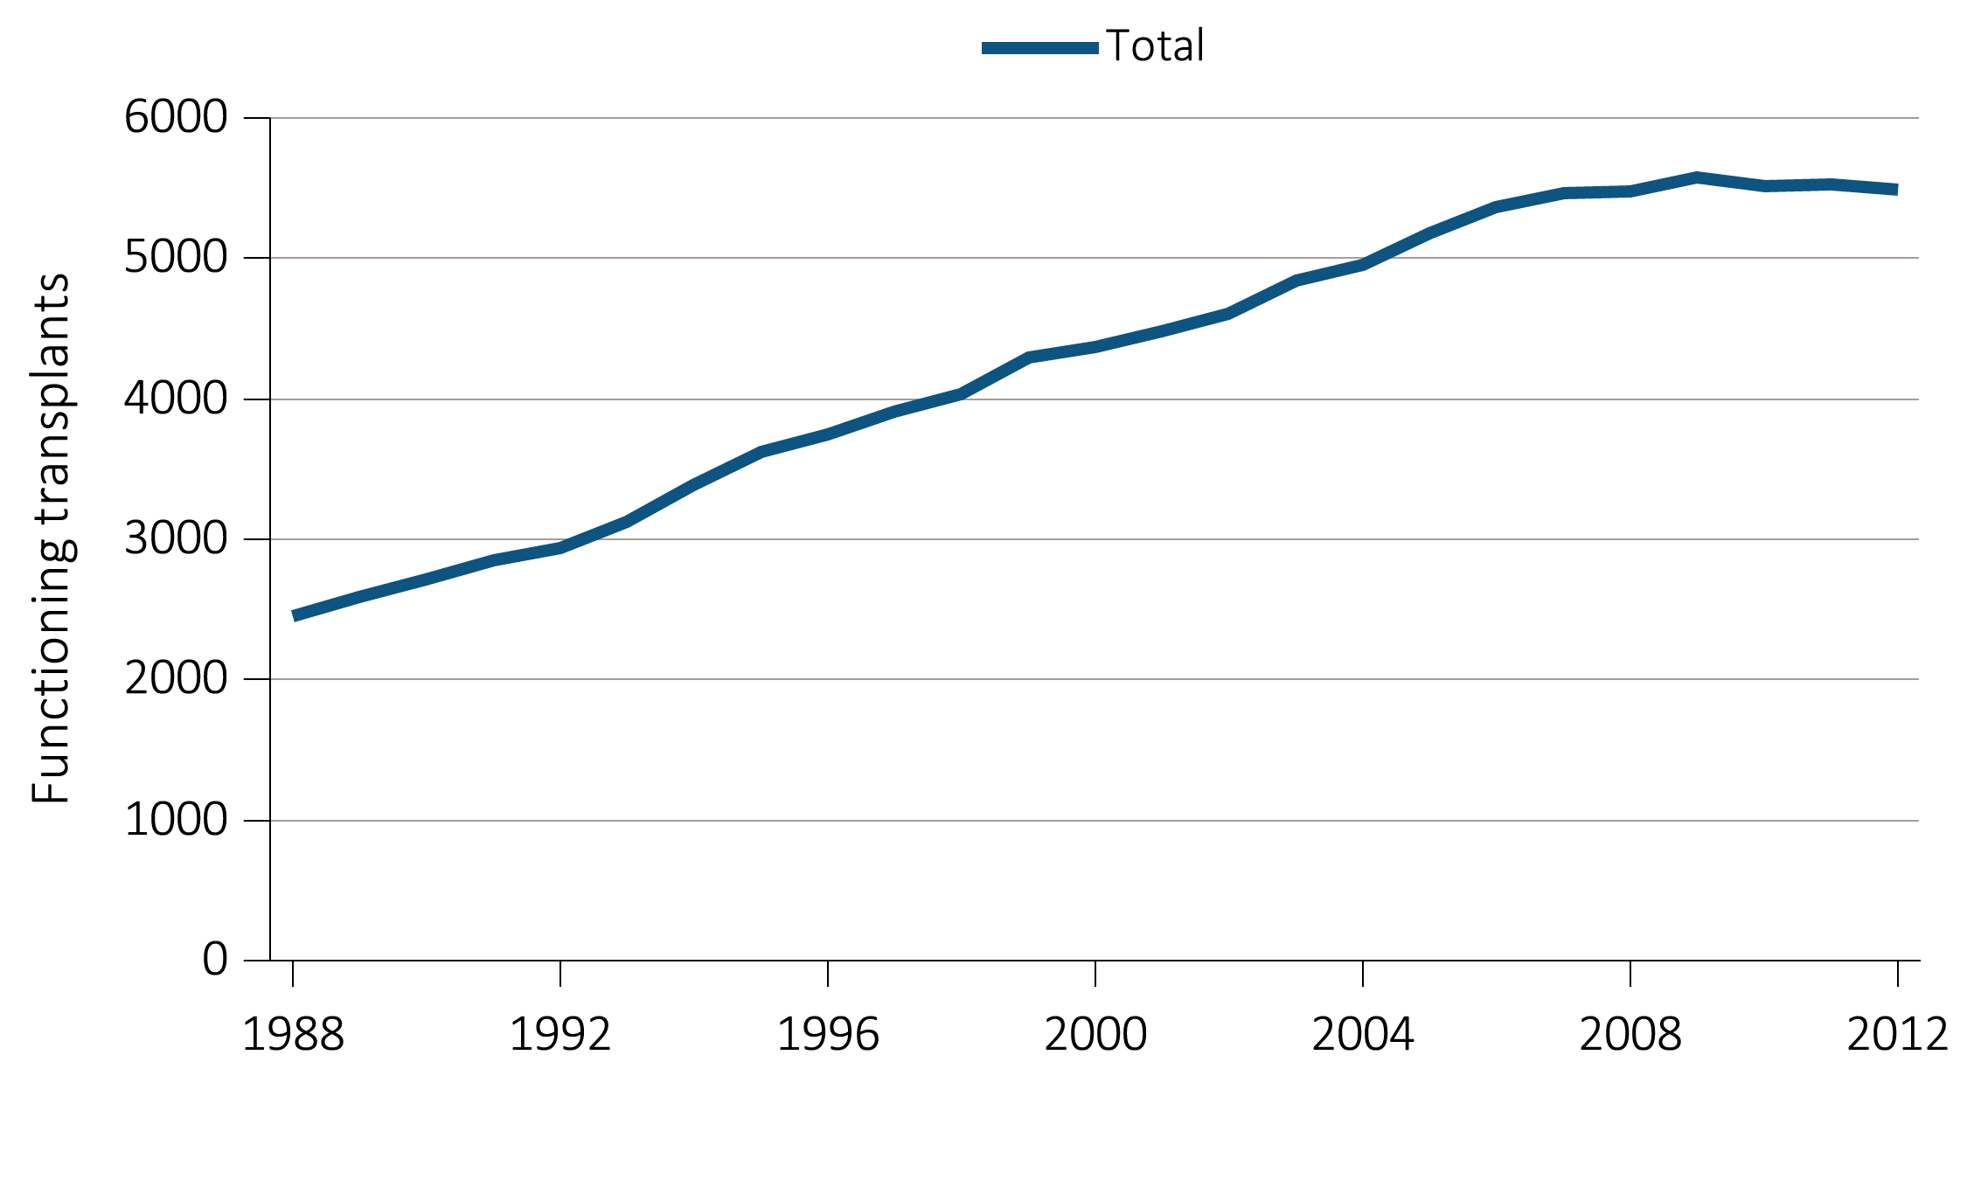
vol 2 Figure 7.2 Trends in pediatric transplantation (aged 0-19 years) (d) Total functioning transplants
Data Source: Reference table D9. This is the cumulative count of functioning pediatric kidney and kidney-pancreas transplants.

Slide 11
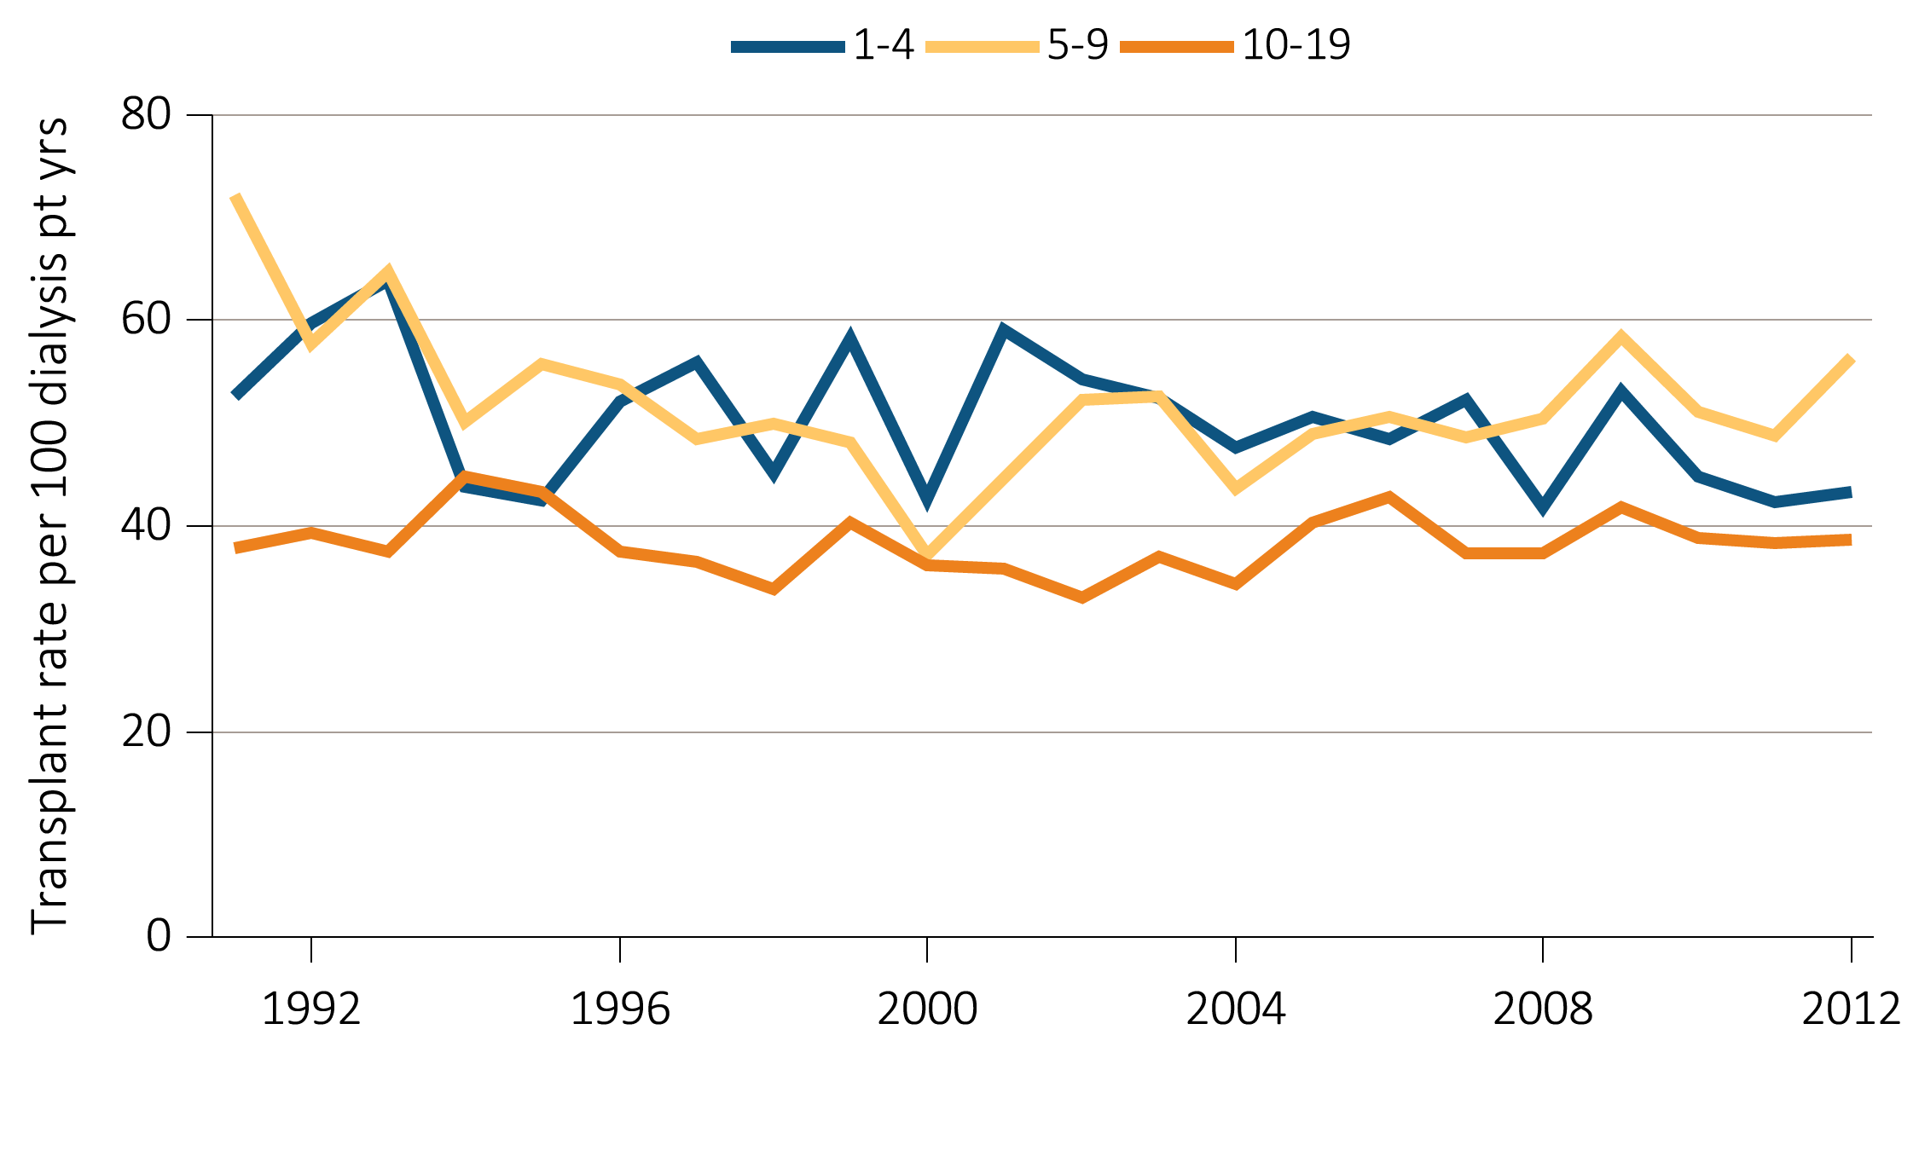
vol 2 Figure 7.3 Live and deceased donor transplants in pediatric patients (aged 0-19 years) (a) Transplant rate in pediatric dialysis patients by age
Data Source: Reference Table E9, and special analyses, USRDS ESRD Database. Includes transplant year between 1991–2012.

Slide 12
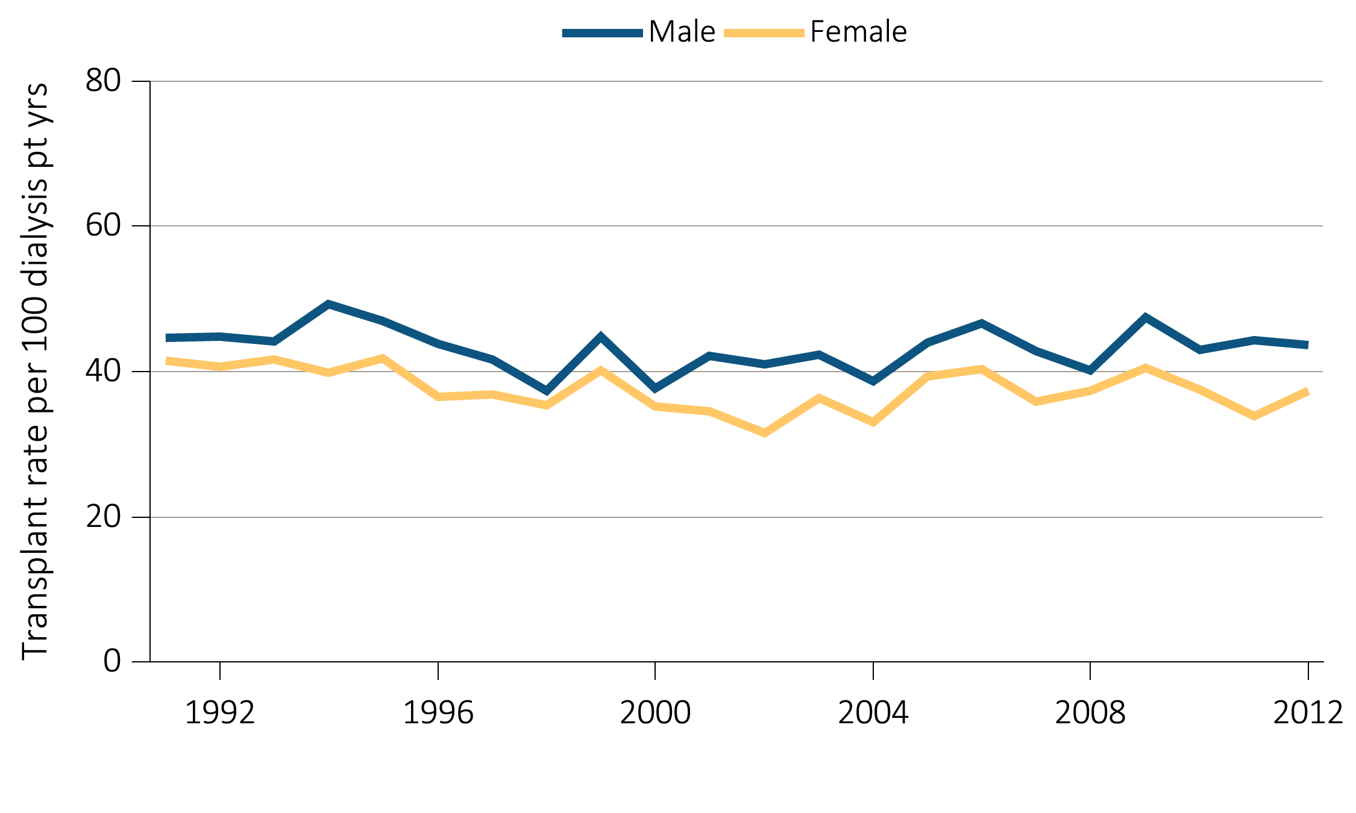
vol 2 Figure 7.3 Live and deceased donor transplants in pediatric patients (aged 0-19 years) (b) Transplant rate in pediatric dialysis patients by sex
Data Source: Reference Table E9, and special analyses, USRDS ESRD Database. Includes transplant year between 1991–2012.

Slide 13
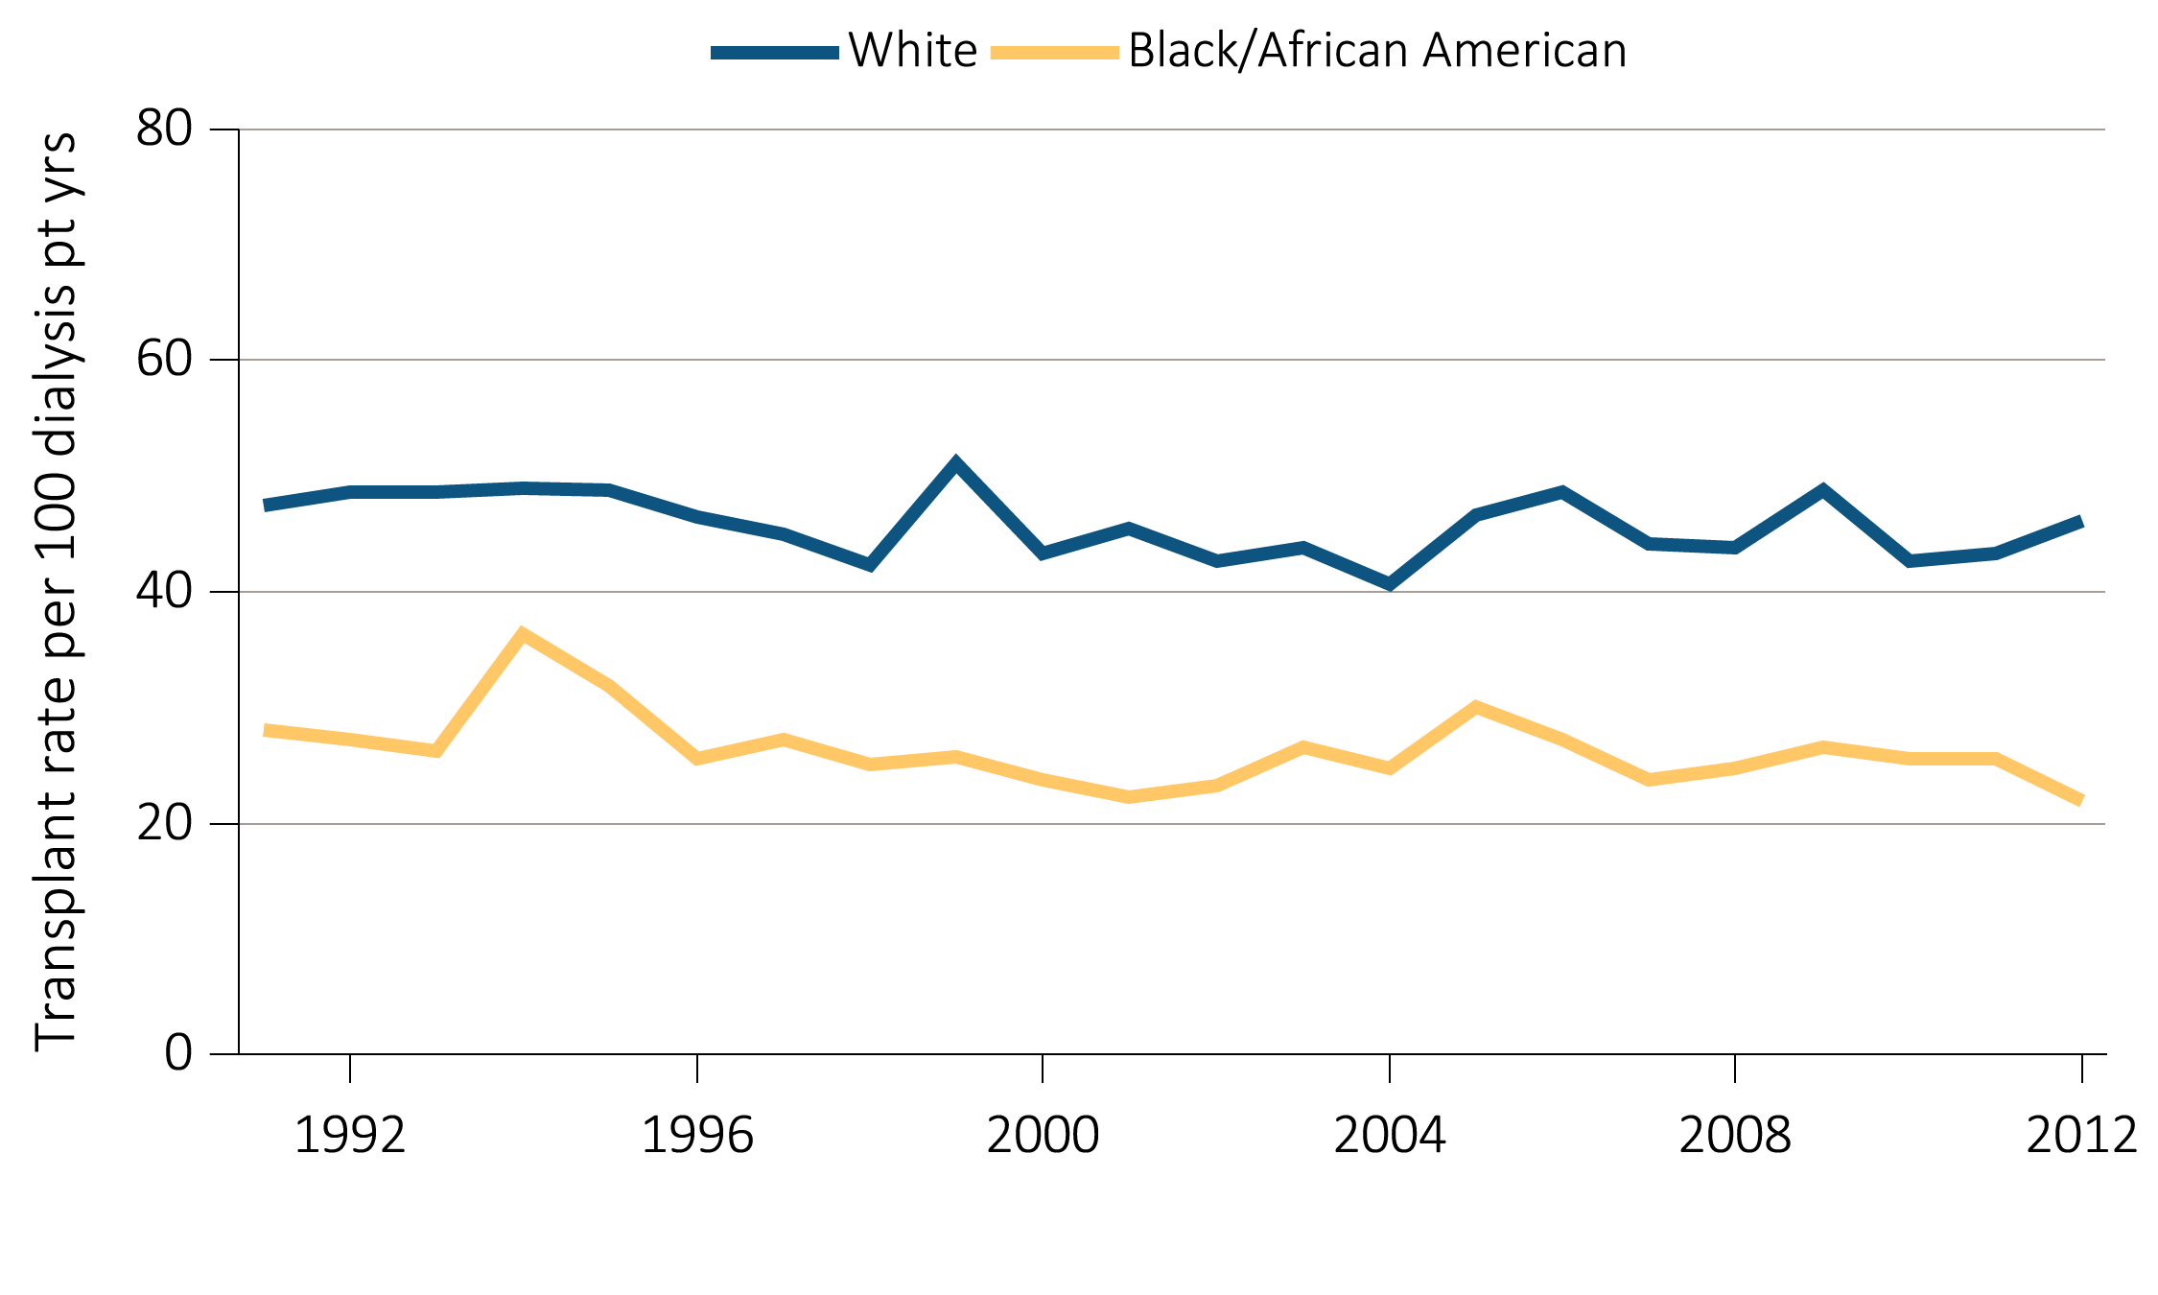
vol 2 Figure 7.3 Live and deceased donor transplants in pediatric patients (aged 0-19 years) (c) Transplant rate in pediatric dialysis patients by race
Data Source: Reference Table E9, and special analyses, USRDS ESRD Database. Includes transplant year between 1991–2012.

Slide 14
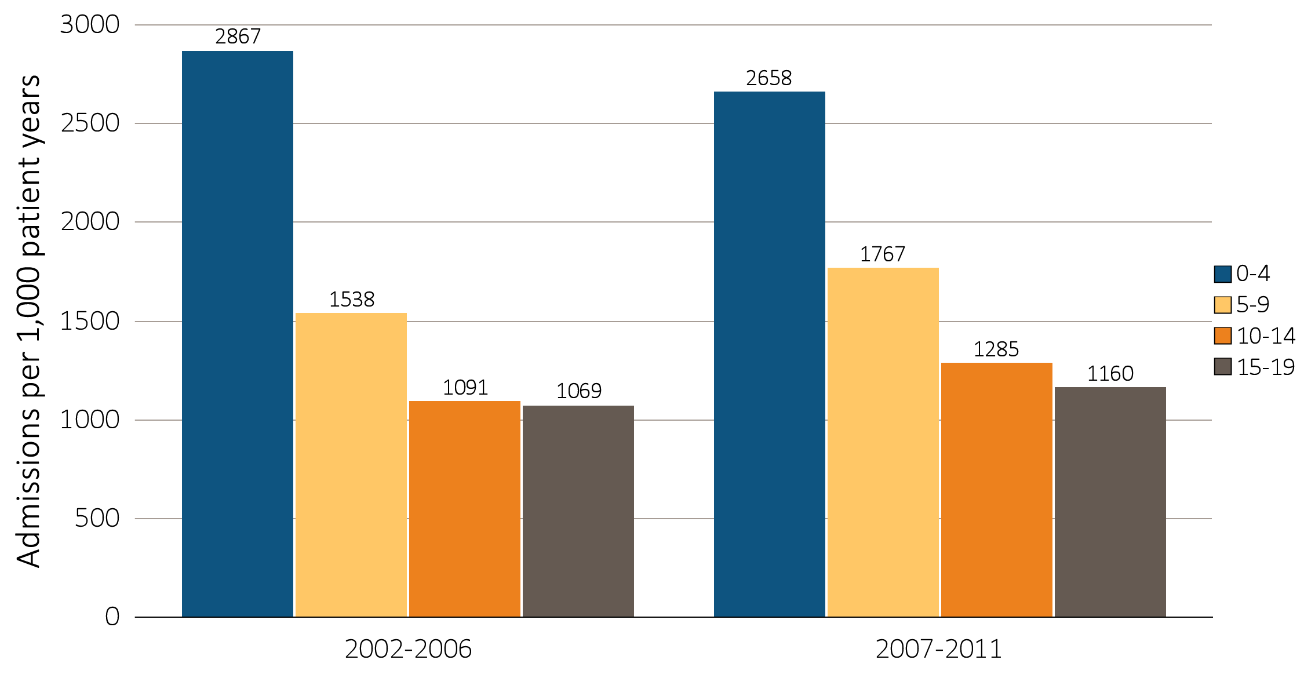
vol 2 Figure 7.4 Hospitalization rates in pediatric patients (aged 0-19 years) (a) One-year adjusted all-cause hospitalization rates in pediatric patients by age
Data Source: Special analyses, USRDS ESRD Database. Includes incident ESRD patients in the years 2002-2011, surviving the first 90 days after ESRD initiation and followed from day 90. Adjusted for sex, race, primary diagnosis and Hispanic ethnicity. Ref: incident ESRD patients age 0-19, 2010-2011. Abbreviations: HD, hemodialysis; PD, peritoneal dialysis; Tx, transplant.

Slide 15
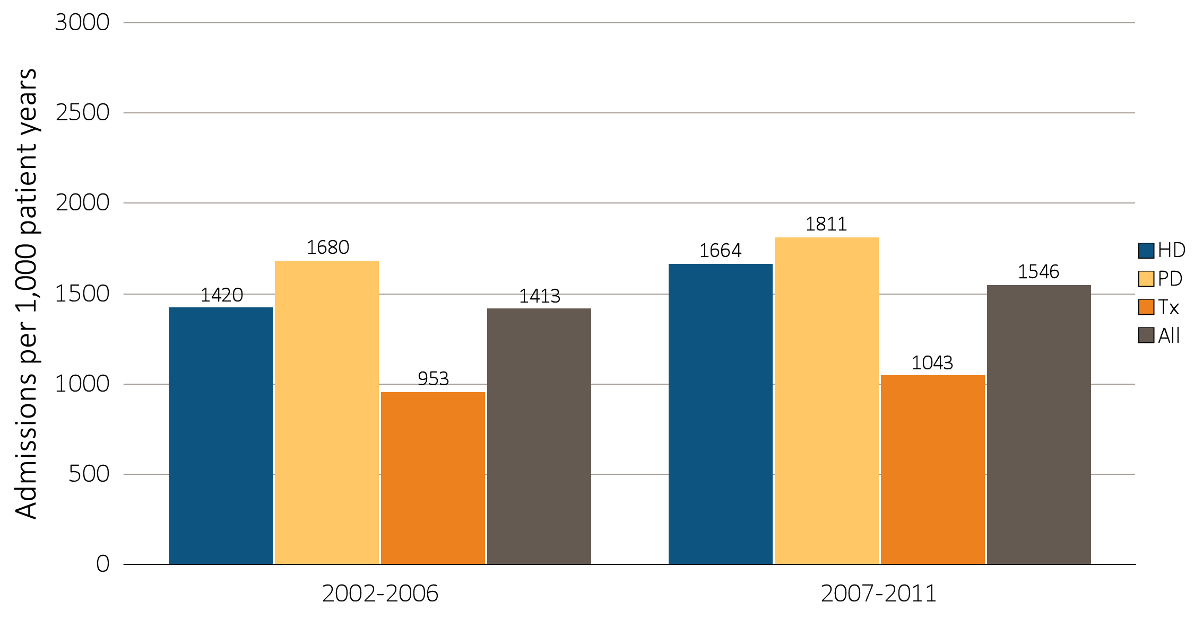
vol 2 Figure 7.4 Hospitalization rates in pediatric patients (aged 0-19 years) (b) One-year adjusted all-cause hospitalization rates in pediatric patients by modality
Data Source: Special analyses, USRDS ESRD Database. Includes incident ESRD patients in the years 2002-2011, surviving the first 90 days after ESRD initiation and followed from day 90. Adjusted for sex, race, primary diagnosis and Hispanic ethnicity. Ref: incident ESRD patients age 0-19, 2010-2011. Abbreviations: HD, hemodialysis; PD, peritoneal dialysis; Tx, transplant.

Slide 16
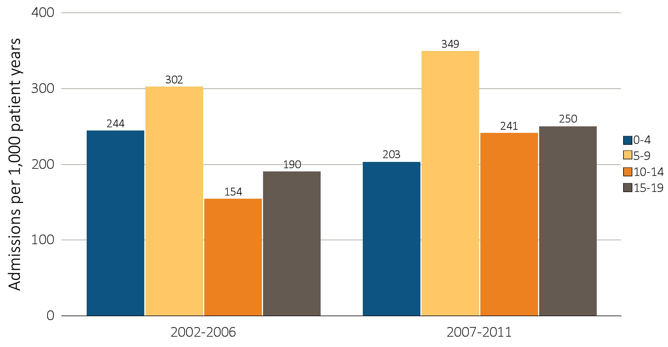
vol 2 Figure 7.5 Cardiovascular hospitalization rates in children (aged 0-19 years) (a) One-year adjusted cardiovascular hospitalization rates in pediatric patients by age
Data Source: Special analyses, USRDS ESRD Database. Includes incident ESRD patients in the years 2002-2011, surviving the first 90 days after ESRD initiation and followed from day 90. Adjusted for sex, race, primary diagnosis and Hispanic ethnicity. Ref: incident ESRD patients age 0-19, 2010-2011. Abbreviations: HD, hemodialysis; PD, peritoneal dialysis; Tx, transplant.

Slide 17
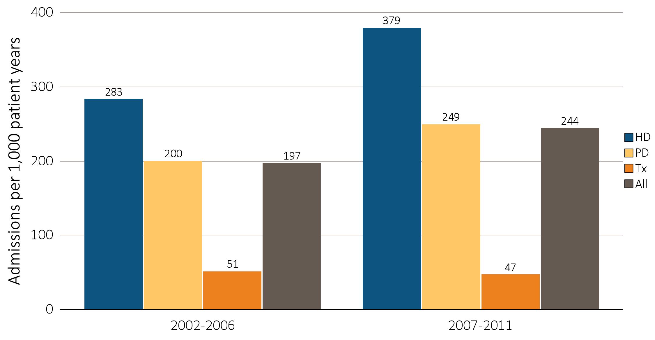
vol 2 Figure 7.5 Cardiovascular hospitalization rates in children (aged 0-19 years) (b) One-year adjusted cardiovascular hospitalization rates in pediatric patients by modality
Data Source: Special analyses, USRDS ESRD Database. Includes incident ESRD patients in the years 2002-2011, surviving the first 90 days after ESRD initiation and followed from day 90. Adjusted for sex, race, primary diagnosis and Hispanic ethnicity. Ref: incident ESRD patients age 0-19, 2010-2011. Abbreviations: HD, hemodialysis; PD, peritoneal dialysis; Tx, transplant.

Slide 18
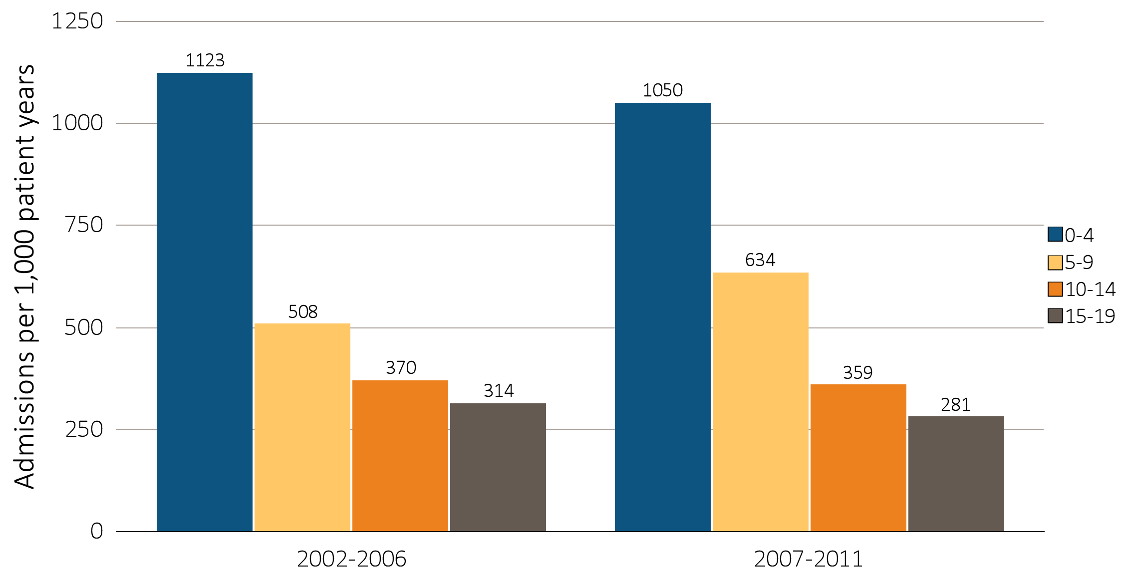
vol 2 Figure 7.6 Infection hospitalization rates in children (aged 0-19 years) (a) One-year adjusted hospitalization rates for infection in pediatric patients by age
Data Source: Special analyses, USRDS ESRD Database. Includes incident ESRD patients in the years 2002-2011, surviving the first 90 days after ESRD initiation and followed from day 90. Adjusted for sex, race, primary diagnosis and Hispanic ethnicity. Ref: incident ESRD patients age 0-19, 2010-2011. Abbreviations: HD, hemodialysis; PD, peritoneal dialysis; Tx, transplant.

Slide 19
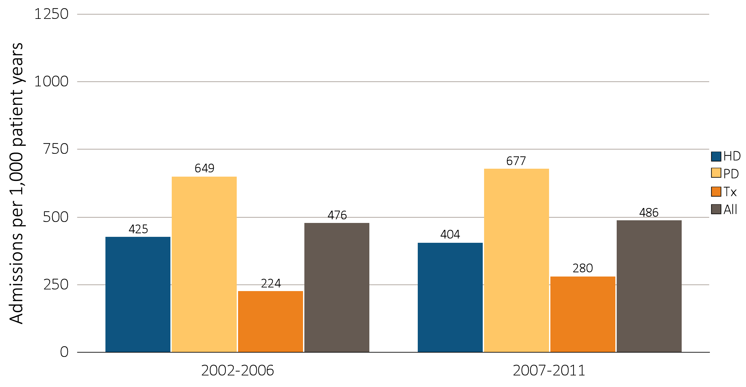
vol 2 Figure 7.6 Infection hospitalization rates in children (aged 0-19 years) (b) One-year adjusted hospitalization rates for infection in pediatric patients by modality
Data Source: Special analyses, USRDS ESRD Database. Includes incident ESRD patients in the years 2002-2011, surviving the first 90 days after ESRD initiation and followed from day 90. Adjusted for sex, race, primary diagnosis and Hispanic ethnicity. Ref: incident ESRD patients age 0-19, 2010-2011. Abbreviations: HD, hemodialysis; PD, peritoneal dialysis; Tx, transplant.

Slide 20
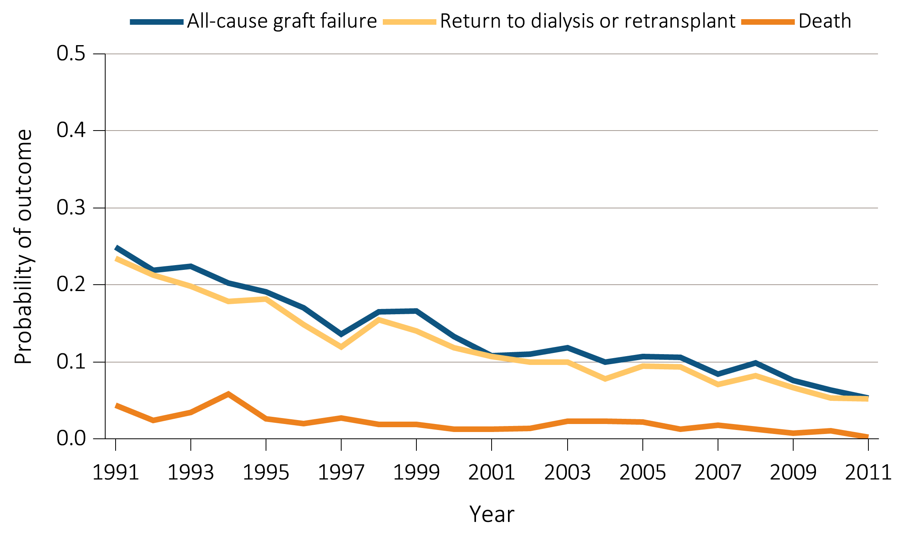
vol 2 Figure 7.7 One year transplant outcomes by donor type (aged 0-19 years) (a) Outcomes: deceased donor transplants in pediatric patients, adjusted
Data Source: Reference tables F2, F14, I26. Probabilities for all-cause graft failure and return to dialysis or retransplant are adjusted for age, sex, race, primary diagnosis, and first versus subsequent transplant. All-cause graft failure includes retransplant, return to dialysis, and death. The death outcome is not censored at graft failure, and includes deaths that occur after retransplant or return to dialysis. Probabilities of death are adjusted for age, sex, race, and primary diagnosis. The reference population for all-cause graft failure and return to dialysis or repeat transplantation is all pediatric patients receiving a kidney alone transplant in 2011. The reference population for death is incident pediatric ESRD patients in 2011.

Slide 21
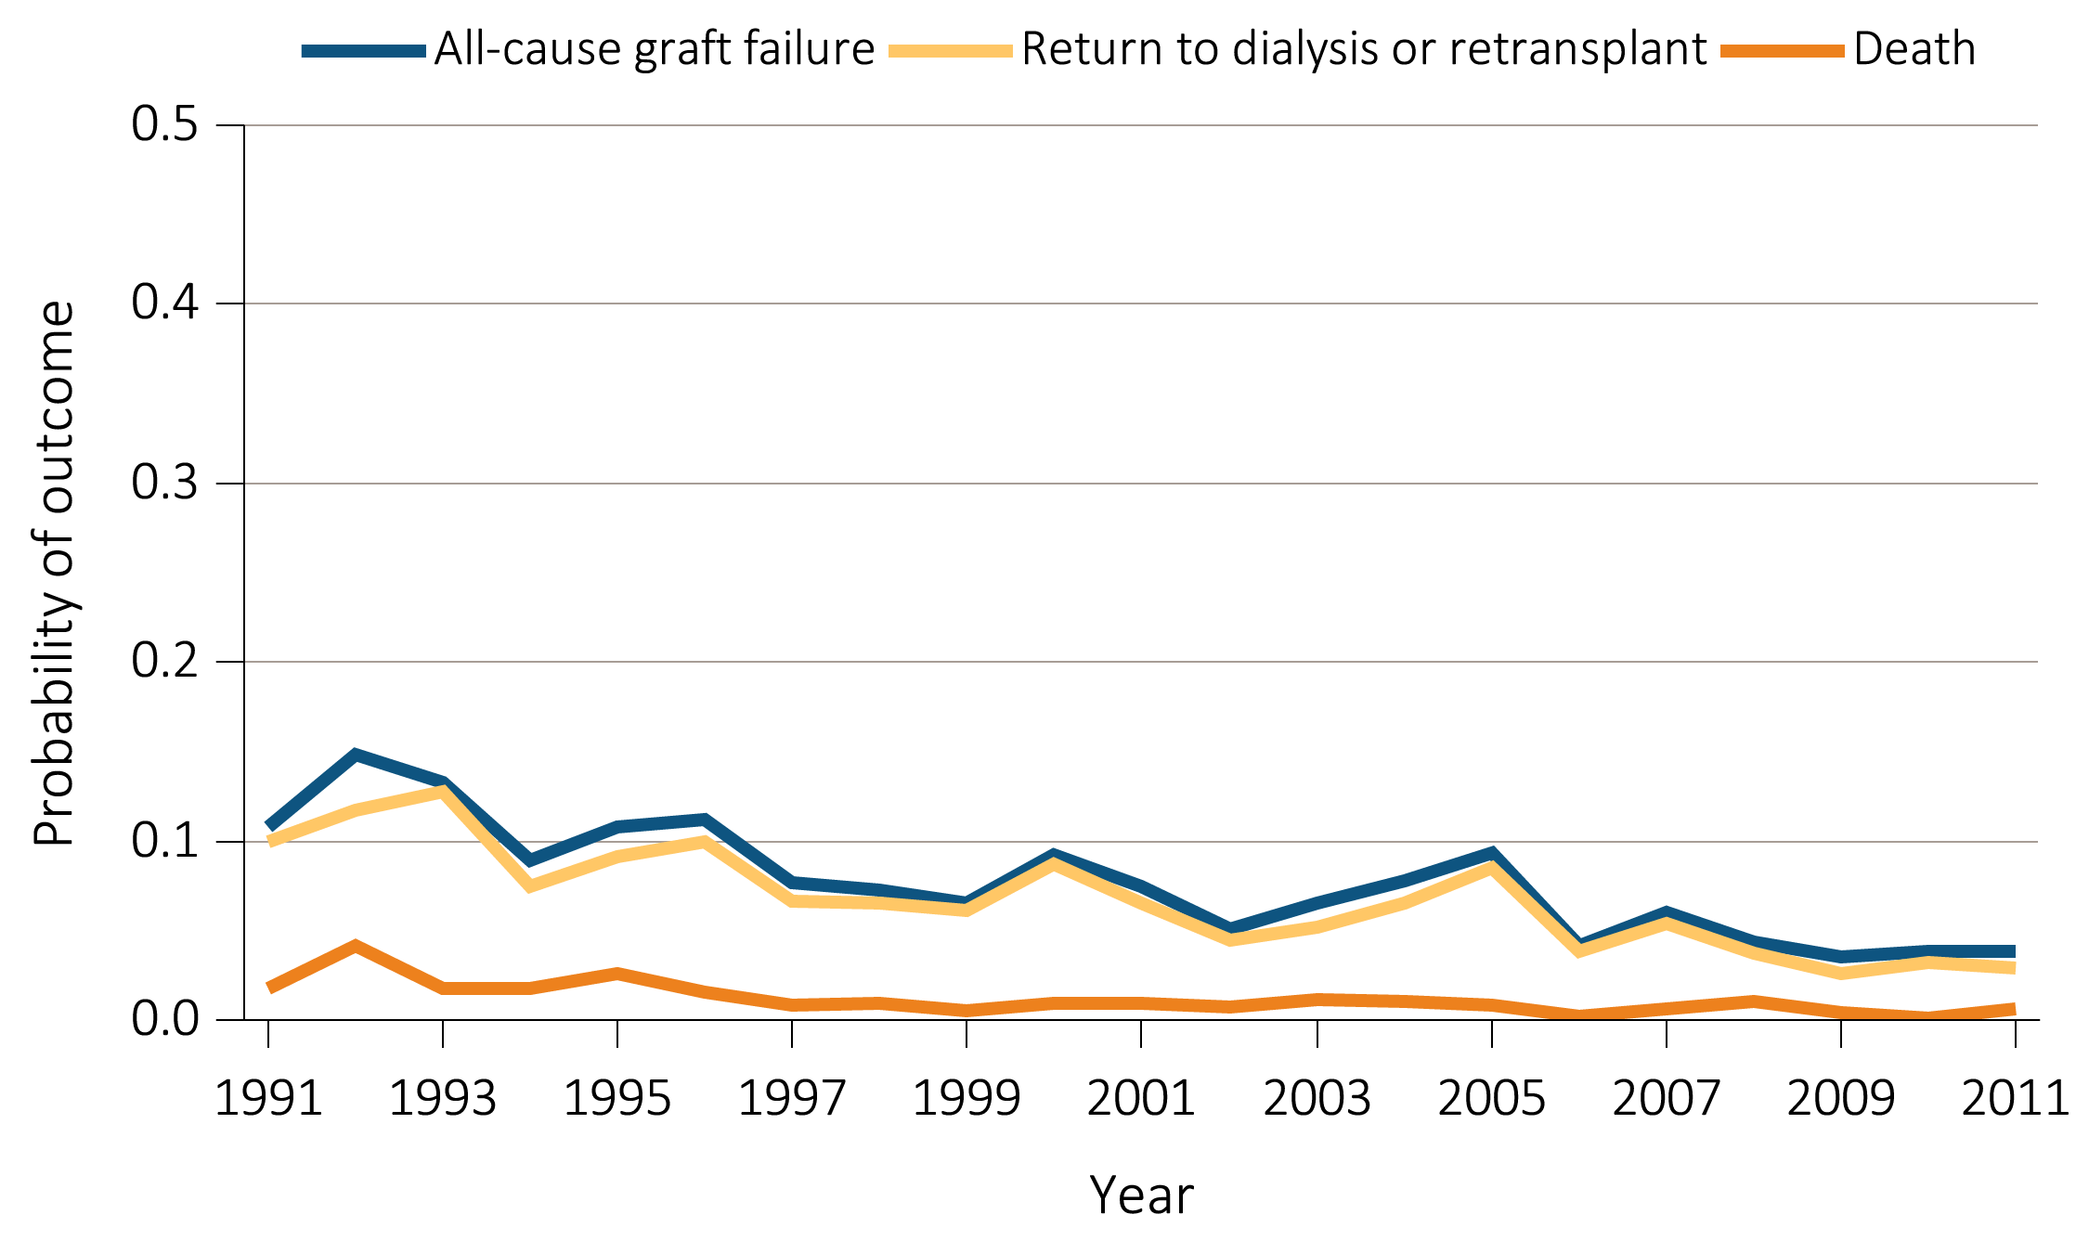
vol 2 Figure 7.7 One year transplant outcomes by donor type (aged 0-19 years) (b) Outcomes: live donor transplants in pediatric patients, adjusted
Data Source: Reference tables F8, F20, I32. Probabilities for all-cause graft failure and return to dialysis or retransplant are adjusted for age, sex, race, primary diagnosis, and first versus subsequent transplant. All-cause graft failure includes retransplant, return to dialysis, and death. The death outcome is not censored at graft failure, and includes deaths that occur after retransplant or return to dialysis. Probabilities of death are adjusted for age, sex, race, and primary diagnosis. The reference population for all-cause graft failure and return to dialysis or repeat transplantation is all pediatric patients receiving a kidney alone transplant in 2011. The reference population for death is incident pediatric ESRD patients in 2011.

Slide 22
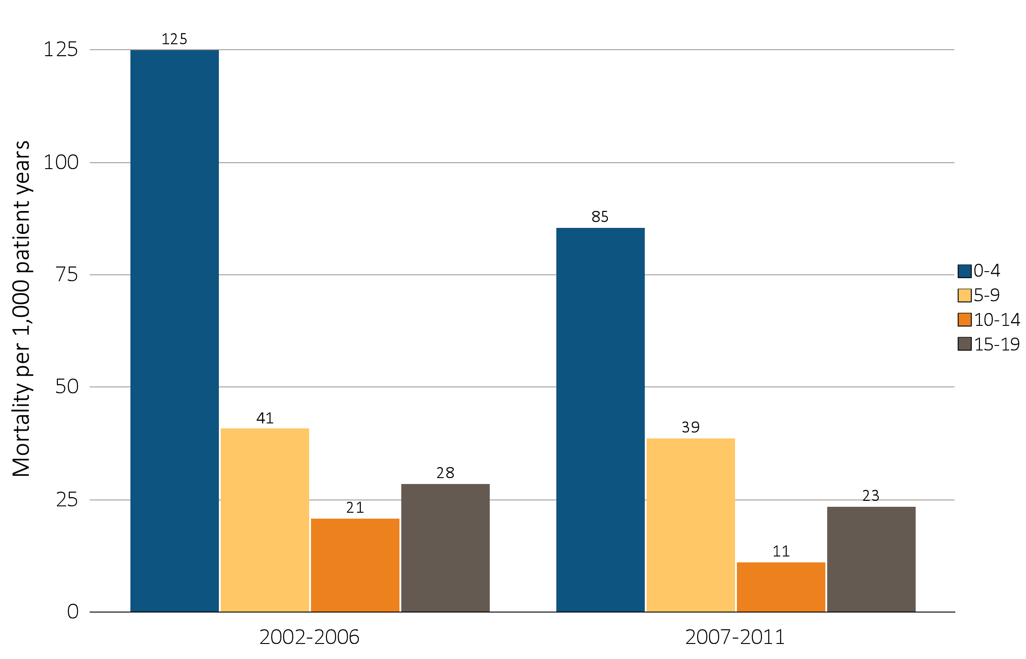
vol 2 Figure 7.8 Mortality rates in children with ESRD (aged 0-19 years) (a) One-year adjusted all-cause mortality rates in pediatric patients by age
Data Source: Special analyses, USRDS ESRD Database. Incident dialysis and transplant patients defined at the onset of dialysis or the day of transplant without the 60-day rule; followed to December 31, 2012. Adjusted for age, sex, race, Hispanic ethnicity, and primary diagnosis. Ref: incident ESRD patients age 0-19, 2010-2011. Abbreviations: HD, hemodialysis; PD, peritoneal dialysis; Tx, transplant.

Slide 23
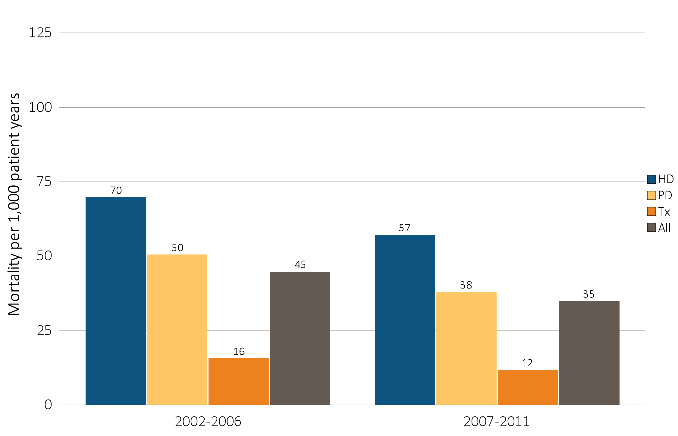
vol 2 Figure 7.8 Mortality rates in children with ESRD (aged 0-19 years) (b) One-year adjusted all-cause mortality rates in pediatric patients by modality
Data Source: Special analyses, USRDS ESRD Database. Incident dialysis and transplant patients defined at the onset of dialysis or the day of transplant without the 60-day rule; followed to December 31, 2012. Adjusted for age, sex, race, Hispanic ethnicity, and primary diagnosis. Ref: incident ESRD patients age 0-19, 2010-2011. Abbreviations: HD, hemodialysis; PD, peritoneal dialysis; Tx, transplant.

Slide 24
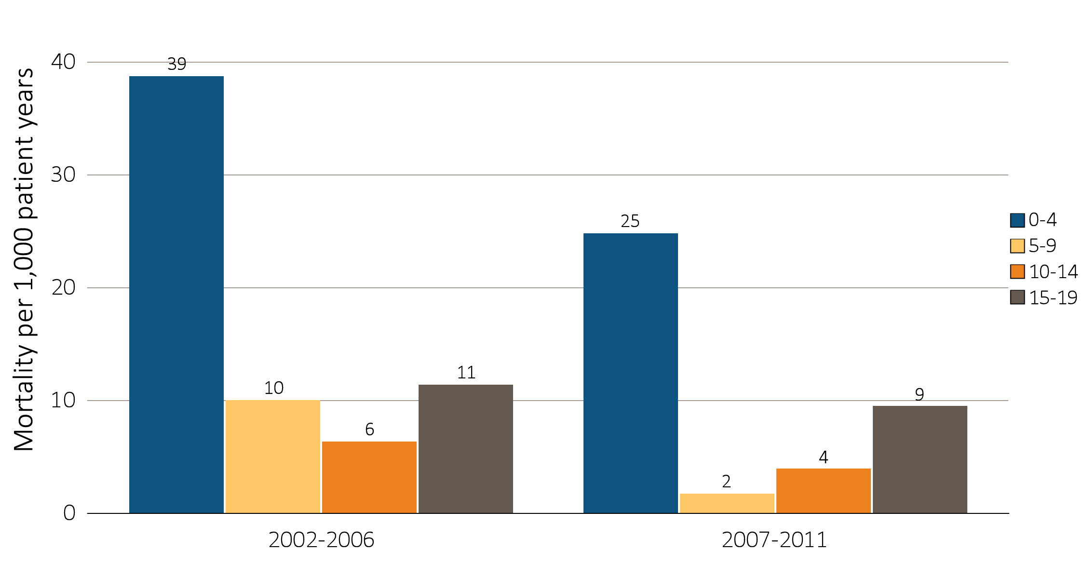
vol 2 Figure 7.9 Cardiovascular mortality in children with ESRD (aged 0-19 years) (a) One-year adjusted all-cause cardiovascular mortality rates in pediatric patients by age
Data Source: Special analyses, USRDS ESRD Database. Incident dialysis and transplant patients defined at the onset of dialysis or the day of transplant without the 60-day rule; followed to December 31, 2012. Adjusted for age, sex, race, Hispanic ethnicity, and primary diagnosis. Ref: incident ESRD patients age 0-19, 2010-2011. Abbreviations: HD, hemodialysis; PD, peritoneal dialysis; Tx, transplant.

Slide 25
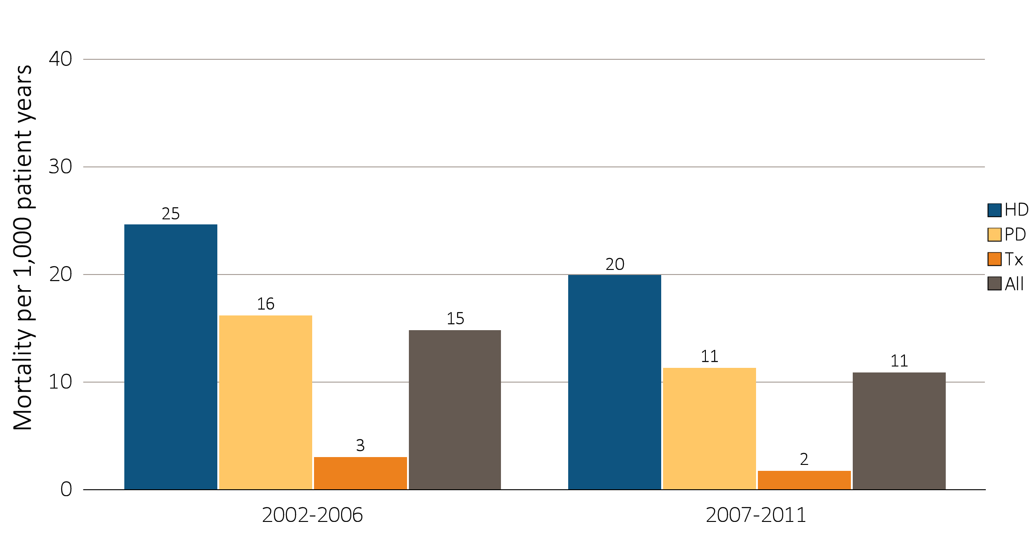
vol 2 Figure 7.9 Cardiovascular mortality in children with ESRD (aged 0-19 years) (b) One-year adjusted all-cause cardiovascular mortality rates in pediatric patients by modality
Data Source: Special analyses, USRDS ESRD Database. Incident dialysis and transplant patients defined at the onset of dialysis or the day of transplant without the 60-day rule; followed to December 31, 2012. Adjusted for age, sex, race, Hispanic ethnicity, and primary diagnosis. Ref: incident ESRD patients age 0-19, 2010-2011. Abbreviations: HD, hemodialysis; PD, peritoneal dialysis; Tx, transplant.

Slide 26
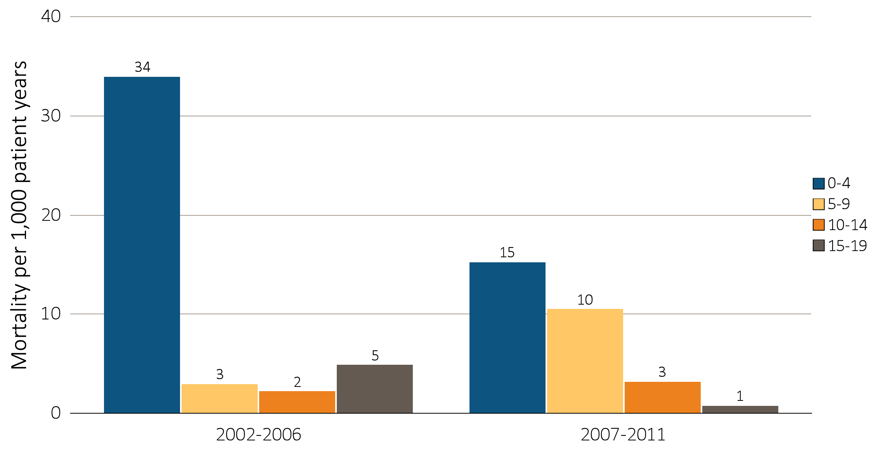
vol 2 Figure 7.10 Infection-related mortality in children with ESRD (aged 0-19 years) (a) One-year adjusted rates of mortality due to infection in pediatric patients by age
Data Source: Special analyses, USRDS ESRD Database. Incident dialysis and transplant patients defined at the onset of dialysis or the day of transplant without the 60-day rule; followed to December 31, 2012. Adjusted for age, sex, race, Hispanic ethnicity, and primary diagnosis. Ref: incident ESRD patients age 0-19, 2010-2011. Abbreviations: HD, hemodialysis; PD, peritoneal dialysis; Tx, transplant.

Slide 27
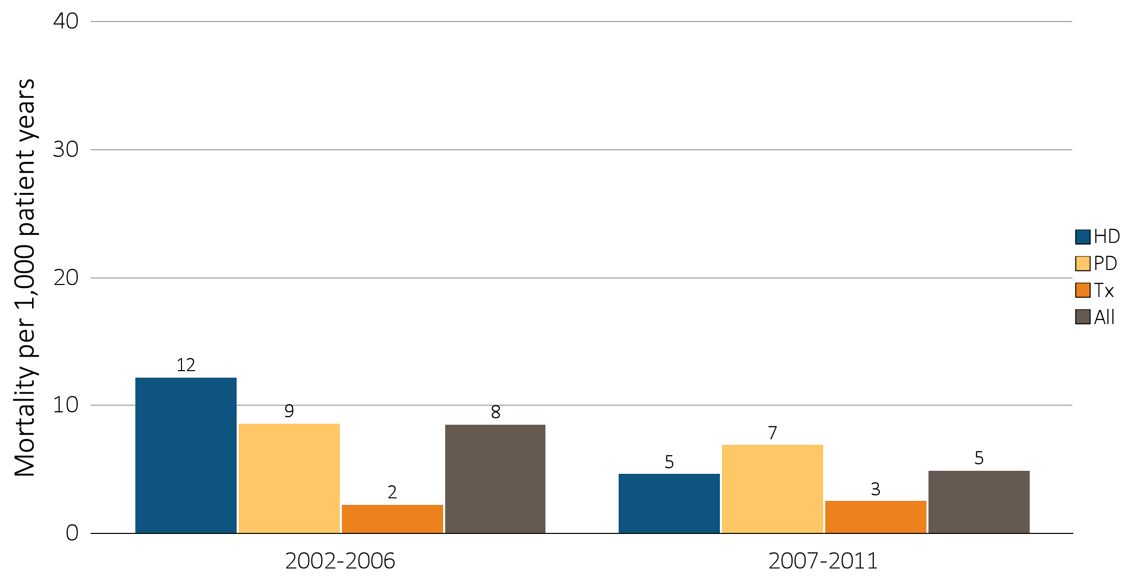
vol 2 Figure 7.10 Infection-related mortality in children with ESRD (aged 0-19 years) (b) One-year adjusted rates of mortality due to infection in pediatric patients by modality
Data Source: Special analyses, USRDS ESRD Database. Incident dialysis and transplant patients defined at the onset of dialysis or the day of transplant without the 60-day rule; followed to December 31, 2012. Adjusted for age, sex, race, Hispanic ethnicity, and primary diagnosis. Ref: incident ESRD patients age 0-19, 2010-2011. Abbreviations: HD, hemodialysis; PD, peritoneal dialysis; Tx, transplant.

Slide 28
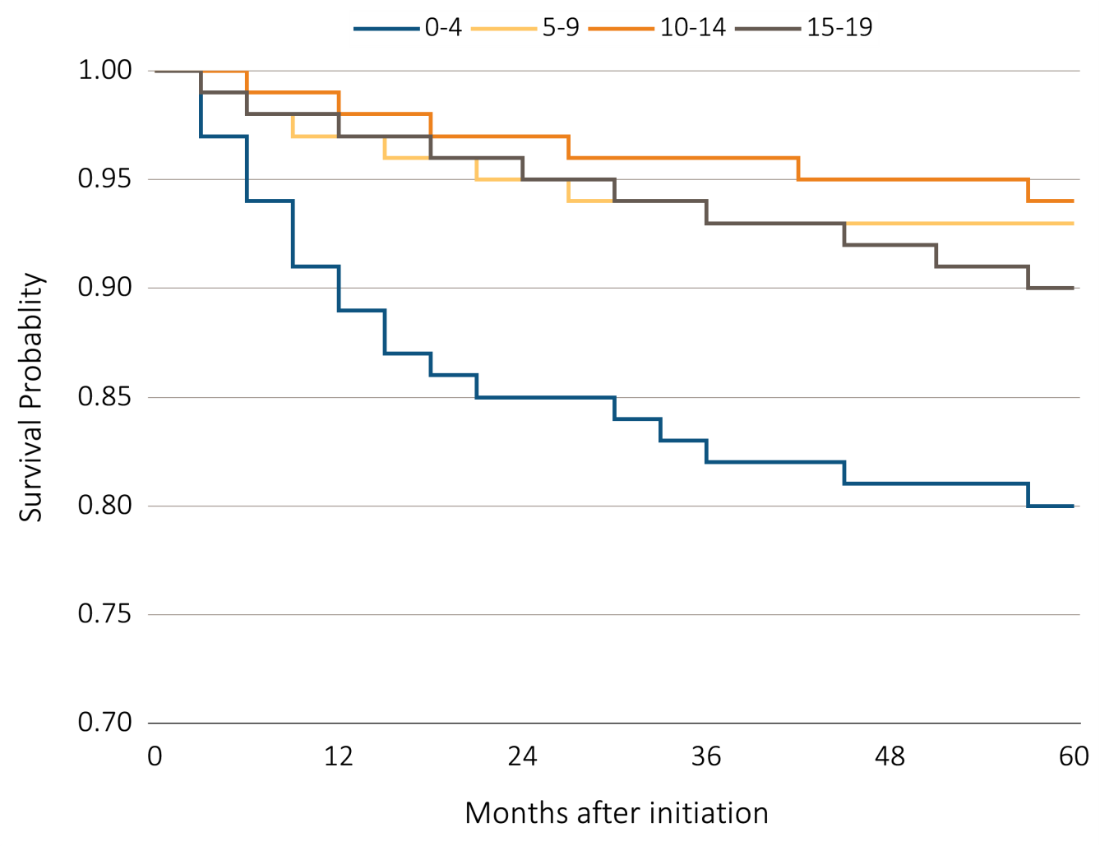
vol 2 Figure 7.11 Pediatric ESRD patient survival by age and modality (aged 0-19 years) (a) Adjusted 5 year survival in pediatric patients from day 1 by age, years 2003-2007
Data Source: Special analyses, USRDS ESRD Database. Incident dialysis and transplant patients defined at the onset of dialysis or the day of transplant without the 60-day rule; followed to December 31, 2012. Adjusted for age, sex, race, Hispanic ethnicity, and primary diagnosis. Ref: incident ESRD patients age 0-19, 2010-2011. Abbreviations: HD, hemodialysis; PD, peritoneal dialysis; Tx, transplant.

Slide 29
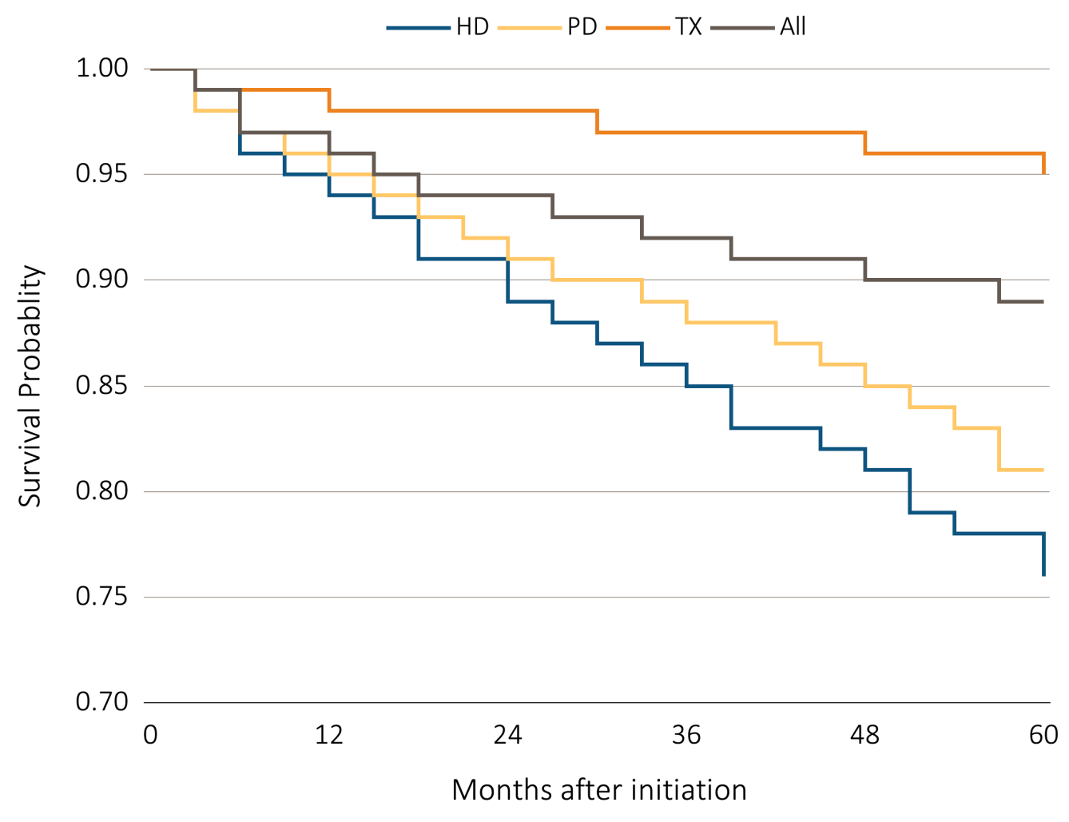
vol 2 Figure 7.11 Pediatric ESRD patient survival by age and modality (aged 0-19 years) (b) Adjusted 5 year survival in pediatric patients from day 1 by modality, years 2003-2007
Data Source: Special analyses, USRDS ESRD Database. Incident dialysis and transplant patients defined at the onset of dialysis or the day of transplant without the 60-day rule; followed to December 31, 2012. Adjusted for age, sex, race, Hispanic ethnicity, and primary diagnosis. Ref: incident ESRD patients age 0-19, 2010-2011. Abbreviations: HD, hemodialysis; PD, peritoneal dialysis; Tx, transplant.

