Slide 2
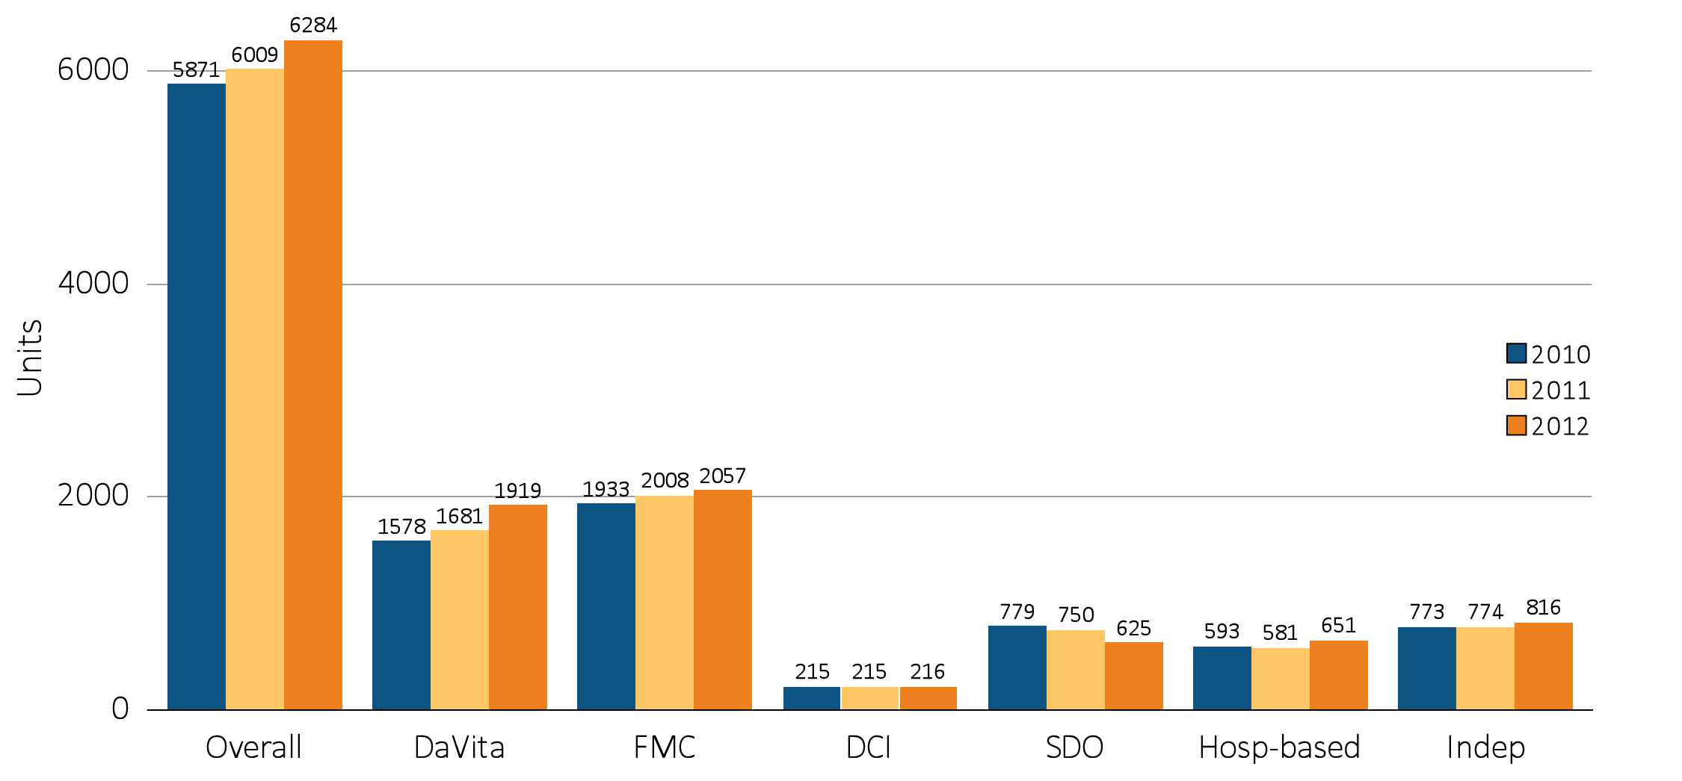
vol 2 Figure 8.1 Dialysis units & patient counts, by unit affiliation, 2010–2012:
Dialysis units
Data source: Special analyses, USRDS ESRD Database. Abbreviations: DCI, Dialysis Clinic, Inc.; FMC, Fresenius; Hosp-based, hospital-based dialysis centers; Indep, independent dialysis providers; SDO, small dialysis organizations.

Slide 3
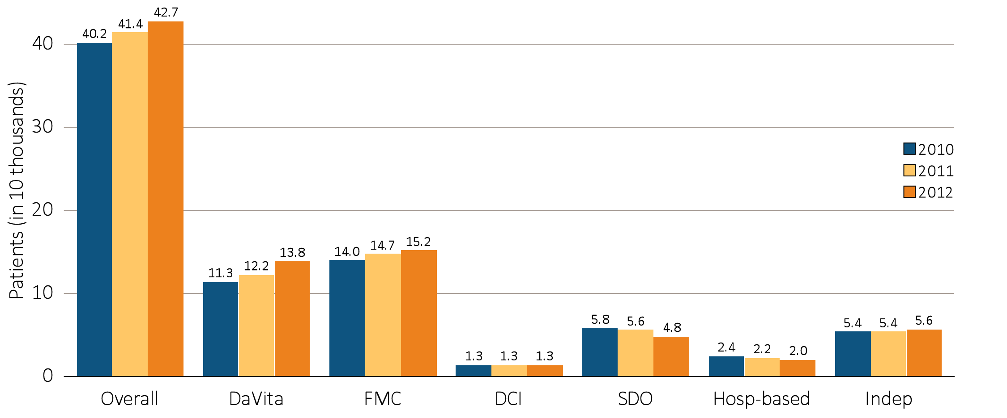
vol 2 Figure 8.1 Dialysis units & patient counts, by unit affiliation, 2010–2012:
Patient counts
Data source: Special analyses, USRDS ESRD Database. Abbreviations: DCI, Dialysis Clinic, Inc.; FMC, Fresenius; Hosp-based, hospital-based dialysis centers; Indep, independent dialysis providers; SDO, small dialysis organizations.

Slide 4
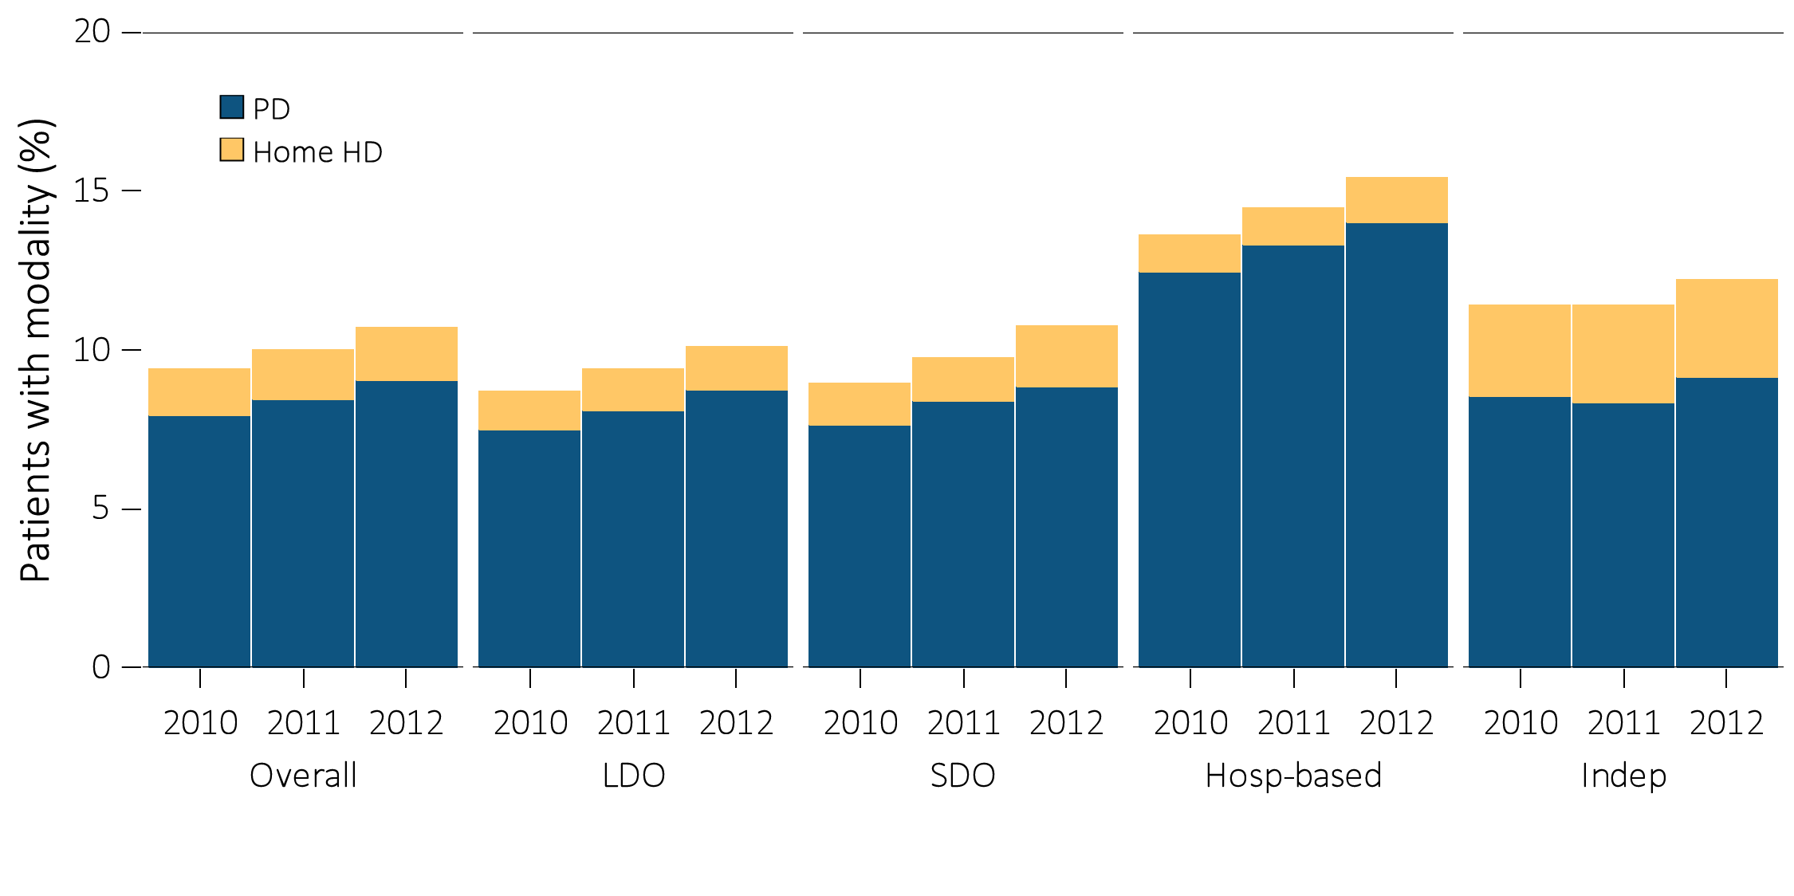
vol 2 Figure 8.2 Prevalence of dialysis modality, by unit affiliation, 2010–2012
Data source: Special analyses, USRDS ESRD Database. Abbreviations: HD, hemodialysis; Hosp-based, hospital-based dialysis centers; Indep, independent dialysis providers; LDO, large dialysis organizations; PD, peritoneal dialysis; SDO, small dialysis organizations.

Slide 5
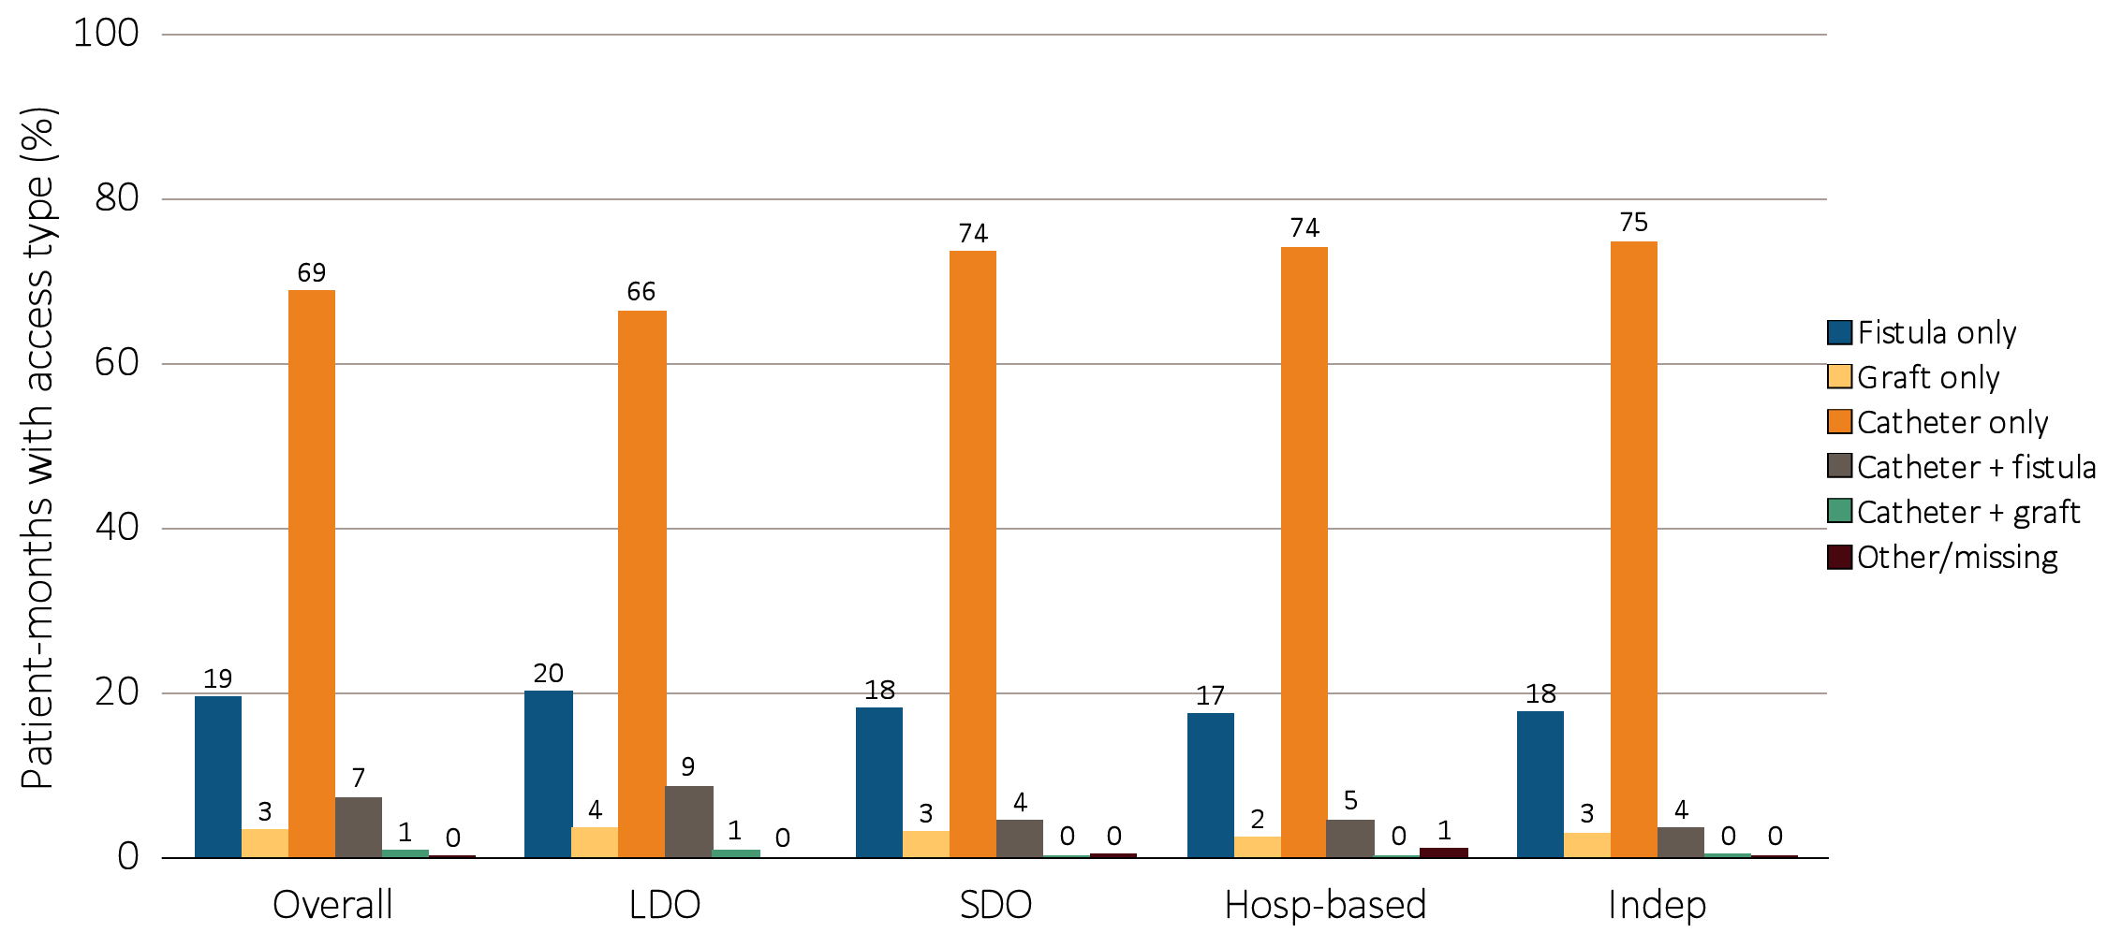
vol 2 Figure 8.3 Prevalence of vascular access type, by unit affiliation, 2012:
Among incident dialysis patients
Data source: Special analyses, USRDS ESRD Database. Period prevalent hemodialysis patients. Abbreviations: Hosp-based, hospital-based dialysis centers; Indep, independent dialysis providers; LDO, large dialysis organizations; SDO, small dialysis organizations.

Slide 6
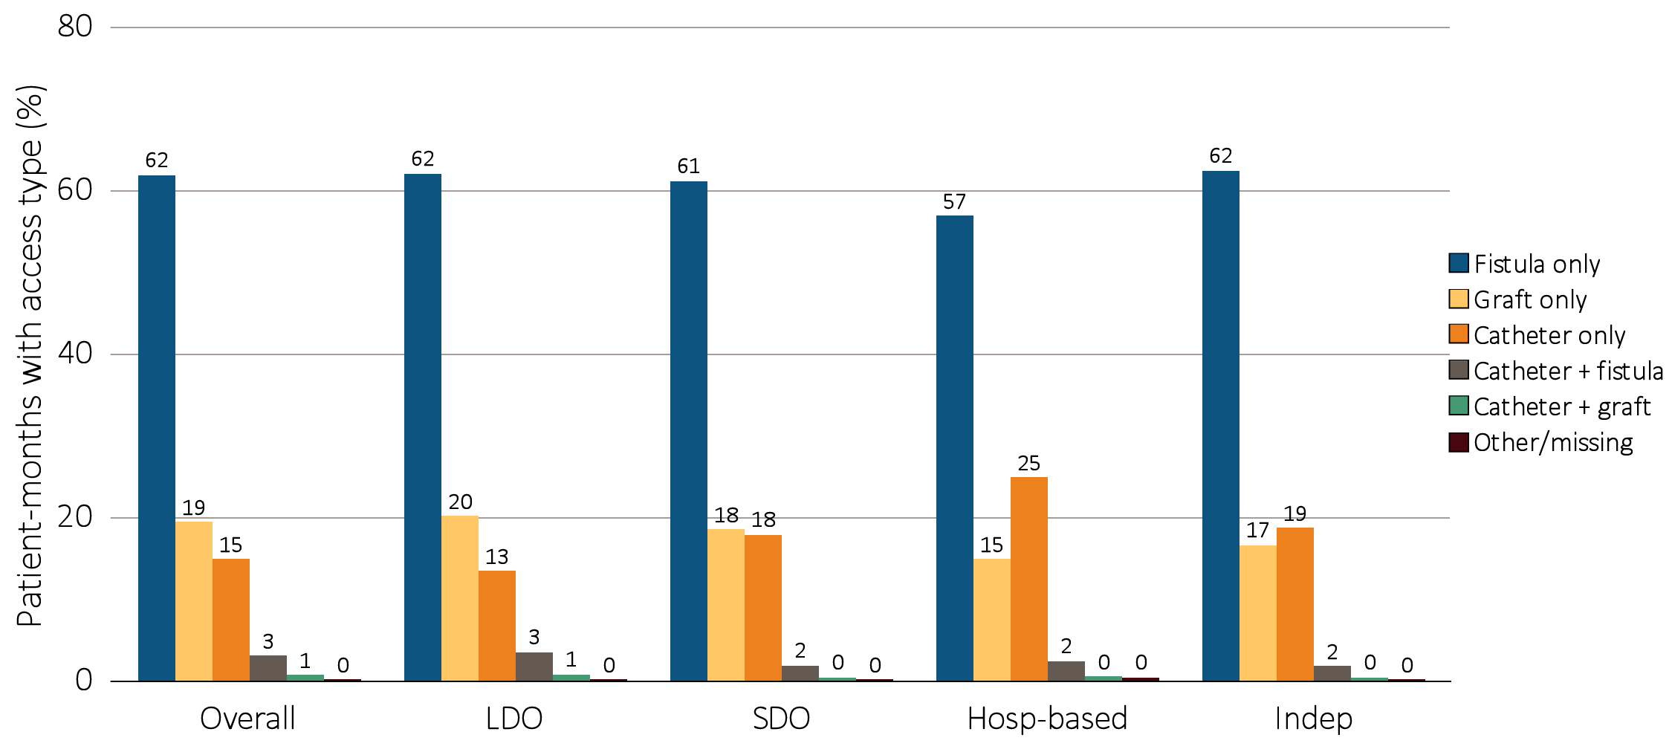
vol 2 Figure 8.3 Prevalence of vascular access type, by unit affiliation, 2012:
Among prevalent dialysis patients
Data source: Special analyses, USRDS ESRD Database. Period prevalent hemodialysis patients. Abbreviations: Hosp-based, hospital-based dialysis centers; Indep, independent dialysis providers; LDO, large dialysis organizations; SDO, small dialysis organizations.

Slide 7
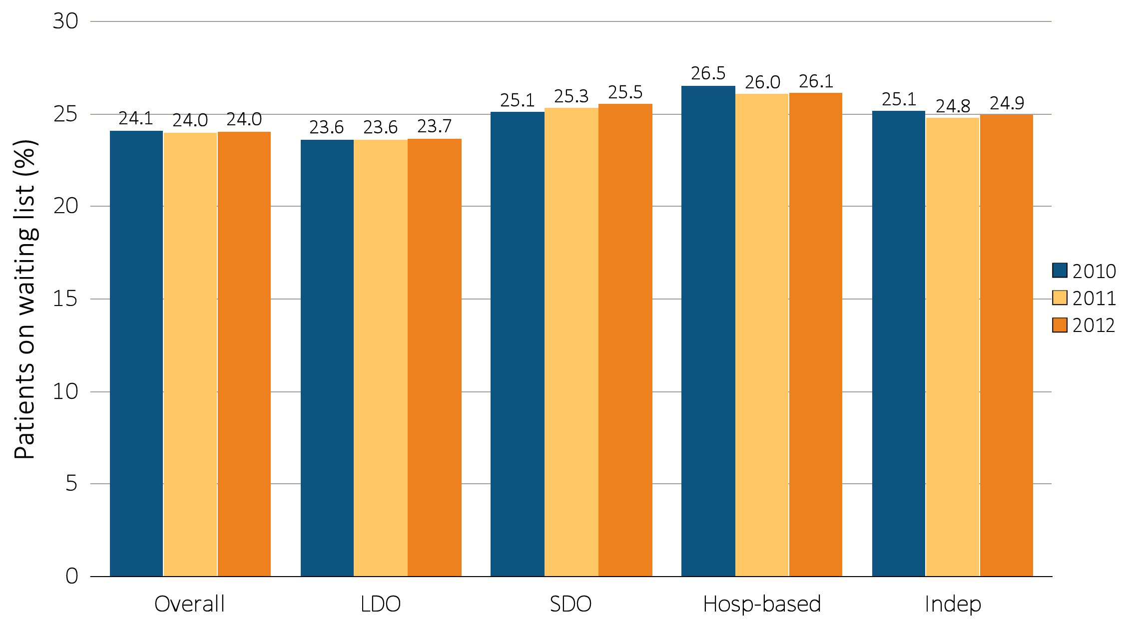
vol 2 Figure 8.4 Percentage of patients younger than 70 on a kidney transplant waiting list, by unit affiliation, 2010–2012
Data source: Special analyses, USRDS ESRD Database. Dialysis patients younger than 70 on December 31. Abbreviations: Hosp-based, hospital-based dialysis centers; Indep, independent dialysis providers; LDO, large dialysis organizations; SDO, small dialysis organizations.

Slide 8
vol 2 Table 8.1 All-cause standardized mortality ratio, by unit affiliation, 2010–2012
Affiliation | 2010 | 2011 | 2012
 | All patients
Overall | 1.02 (1.02-1.03) | 1.00 (1.00-1.01) | 0.97 (0.97-0.98)
LDO
Davita | 1.05 (1.03-1.06) | 1.02 (1.01-1.03) | 0.97 (0.96-0.98)
Fresenius | 1.03 (1.02-1.05) | 1.02 (1.01-1.03) | 0.98 (0.97-0.99)
DCI | 0.94 (0.91-0.98) | 0.92 (0.89-0.96) | 0.95 (0.91-0.98)
SDO | 1.02 (1.00-1.04) | 1.03 (1.01-1.04) | 1.00 (0.98-1.01)
Hospital-based | 0.93 (0.91-0.95) | 0.85 (0.83-0.87) | 0.86 (0.84-0.88)
Independent | 1.04 (1.02-1.05) | 1.01 (1.00-1.03) | 1.01 (0.99-1.02)
 | White patients
Overall | 1.14 (1.13-1.15) | 1.13 (1.12-1.14) | 1.10 (1.09-1.11)
LDO
Davita | 1.17 (1.15-1.19) | 1.15 (1.14-1.17) | 1.10 (1.08-1.11)
Fresenius | 1.15 (1.14-1.17) | 1.15 (1.14-1.17) | 1.11 (1.10-1.13)
DCI | 1.10 (1.05-1.15) | 1.09 (1.04-1.14) | 1.12 (1.07-1.17)
SDO | 1.14 (1.11-1.16) | 1.13 (1.11-1.16) | 1.10 (1.07-1.12)
Hospital-based | 1.05 (1.02-1.08) | 0.96 (0.94-0.99) | 0.96 (0.94-0.99)
Independent | 1.14 (1.12-1.17) | 1.12 (1.10-1.14) | 1.13 (1.11-1.16)
 | Black/African American patients
Overall | 0.88 (0.87-0.89) | 0.84 (0.83-0.85) | 0.81 (0.80-0.82)
LDO
Davita | 0.89 (0.88-0.91) | 0.84 (0.82-0.86) | 0.80 (0.78-0.82)
Fresenius | 0.87 (0.86-0.89) | 0.84 (0.83-0.86) | 0.81 (0.79-0.82)
DCI | 0.79 (0.74-0.84) | 0.75 (0.70-0.80) | 0.75 (0.70-0.80)
SDO | 0.87 (0.84-0.90) | 0.88 (0.85-0.91) | 0.85 (0.82-0.88)
Hospital-based | 0.89 (0.85-0.92) | 0.79 (0.75-0.82) | 0.85 (0.81-0.89)
Independent | 0.90 (0.87-0.93) | 0.88 (0.85-0.91) | 0.84 (0.81-0.87)
 | Hispanic patients
Overall | 0.80 (0.79-0.82) | 0.80 (0.78-0.81) | 0.75 (0.74-0.77)
LDO
Davita | 0.75 (0.73-0.78) | 0.76 (0.74-0.79) | 0.73 (0.71-0.75)
Fresenius | 0.85 (0.82-0.87) | 0.83 (0.81-0.86) | 0.77 (0.75-0.80)
DCI | 0.77 (0.65-0.91) | 0.67 (0.56-0.79) | 0.81 (0.69-0.95)
SDO | 0.84 (0.80-0.87) | 0.84 (0.81-0.88) | 0.81 (0.77-0.85)
Hospital-based | 0.67 (0.63-0.72) | 0.64 (0.59-0.69) | 0.61 (0.57-0.66)
Independent | 0.83 (0.79-0.87) | 0.81 (0.77-0.85) | 0.78 (0.74-0.81)
Data source: Special analyses, USRDS ESRD Database. Period prevalent dialysis patients; 95% confidence intervals are shown in parentheses. The overall measure is adjusted for patient age, race, ethnicity, sex, diabetes, duration of ESRD, nursing home status, patient comorbidities at incidence, body mass index (BMI) at incidence and population death rates. The white- and black-specific measures are adjusted for all the above characteristics except patient race. The Hispanic-specific measure is adjusted for all the above characteristics except patient ethnicity. Abbreviations: DCI, Dialysis Clinic, Inc.; LDO, large dialysis organizations; SDO, small dialysis organizations.

Slide 9
vol 2 Table 8.2 All-cause standardized hospitalization ratio, by unit affiliation, 2010–2012
Affiliation | 2010 | 2011 | 2012
 | All patients
Overall | 1.01 (1.01-1.02) | 1.00 (1.00-1.01) | 0.98 (0.98-0.98)
LDO
Davita | 1.02 (1.02-1.03) | 1.01 (1.00-1.01) | 0.98 (0.98-0.98)
Fresenius | 1.01 (1.01-1.02) | 1.00 (1.00-1.00) | 0.97 (0.97-0.97)
DCI | 0.91 (0.90-0.92) | 0.91 (0.90-0.92) | 0.89 (0.88-0.91)
SDO | 1.02 (1.01-1.02) | 1.02 (1.02-1.03) | 0.98 (0.98-0.99)
Hospital-based | 1.07 (1.06-1.08) | 1.05 (1.04-1.06) | 1.09 (1.08-1.10)
Independent | 1.00 (0.99-1.00) | 0.99 (0.99-1.00) | 0.98 (0.97-0.98)
 | White patients
Overall | 1.03 (1.03-1.03) | 1.02 (1.02-1.03) | 1.00 (1.00-1.01)
LDO
Davita | 1.04 (1.03-1.04) | 1.03 (1.02-1.04) | 1.01 (1.00-1.01)
Fresenius | 1.05 (1.04-1.05) | 1.04 (1.03-1.04) | 1.01 (1.00-1.01)
DCI | 0.97 (0.95-0.99) | 0.97 (0.95-0.99) | 0.96 (0.95-0.98)
SDO | 1.01 (1.00-1.02) | 1.01 (1.00-1.02) | 0.98 (0.97-0.99)
Hospital-based | 1.04 (1.03-1.05) | 1.02 (1.01-1.03) | 1.06 (1.05-1.08)
Independent | 1.00 (0.99-1.01) | 1.00 (0.99-1.00) | 0.99 (0.98-1.00)
 | Black/African American patients
Overall | 1.03 (1.02-1.03) | 1.01 (1.01-1.01) | 0.98 (0.97-0.98)
LDO
Davita | 1.04 (1.03-1.04) | 1.01 (1.00-1.01) | 0.98 (0.97-0.98)
Fresenius | 0.99 (0.99-1.00) | 0.98 (0.97-0.98) | 0.94 (0.94-0.95)
DCI | 0.87 (0.85-0.89) | 0.86 (0.84-0.88) | 0.85 (0.83-0.87)
SDO | 1.09 (1.08-1.10) | 1.09 (1.08-1.11) | 1.03 (1.02-1.04)
Hospital-based | 1.18 (1.16-1.19) | 1.18 (1.16-1.19) | 1.20 (1.18-1.22)
Independent | 1.02 (1.01-1.04) | 1.03 (1.01-1.04) | 1.00 (0.99-1.01)
 | Hispanic patients
Overall | 0.95 (0.94-0.96) | 0.91 (0.91-0.92) | 0.91 (0.90-0.91)
LDO
Davita | 0.92 (0.91-0.93) | 0.90 (0.89-0.91) | 0.89 (0.88-0.90)
Fresenius | 0.97 (0.96-0.98) | 0.91 (0.90-0.92) | 0.91 (0.90-0.92)
DCI | 0.87 (0.82-0.91) | 0.85 (0.80-0.89) | 0.84 (0.80-0.89)
SDO | 0.93 (0.91-0.94) | 0.89 (0.88-0.91) | 0.87 (0.86-0.88)
Hospital-based | 1.06 (1.03-1.09) | 1.05 (1.03-1.08) | 1.11 (1.08-1.14)
Independent | 0.97 (0.96-0.99) | 0.93 (0.92-0.95) | 0.94 (0.93-0.96)
Data source: Special analyses, USRDS ESRD Database. Period prevalent dialysis patients with Medicare as primary payer; 95% confidence intervals are shown in parentheses. Adjusted for patient age, race, ethnicity, sex, diabetes, duration of ESRD, nursing home status, patient comorbidities at incidence and body mass index (BMI) at incidence. The White- and Black-specific measures are adjusted for all the above characteristics except patient race. The Hispanic-specific measure is adjusted for all the above characteristics except patient ethnicity. Abbreviations: DCI, Dialysis Clinic, Inc.; LDO, large dialysis organizations; SDO, small dialysis organizations.

