Slide 1
Chapter 9:
Costs of ESRD
2014 ANNUAL DATA REPORT
VOLUME 2: END-STAGE RENAL DISEASE

Slide 2
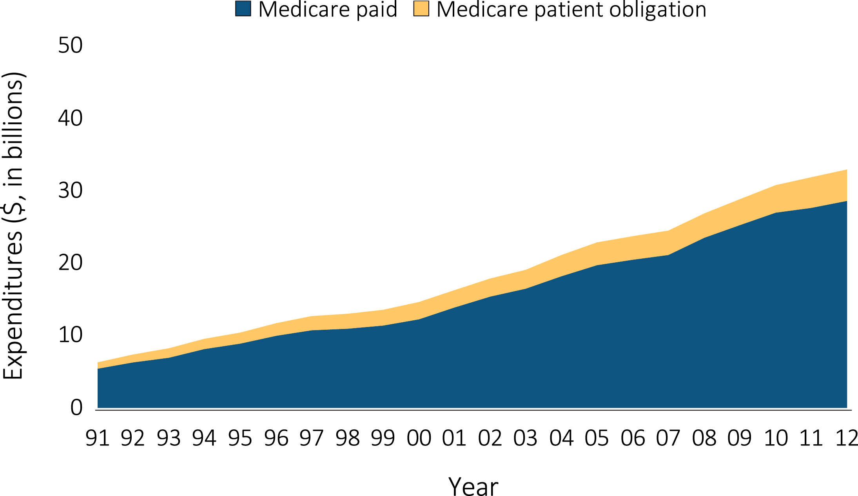
vol 2 Figure 9.1 Medicare ESRD expenditures, Medicare and patient obligation
Data Source: USRDS ESRD Database; Reference Table K.2. Abbreviations: ESRD, end-stage renal disease.

Slide 3
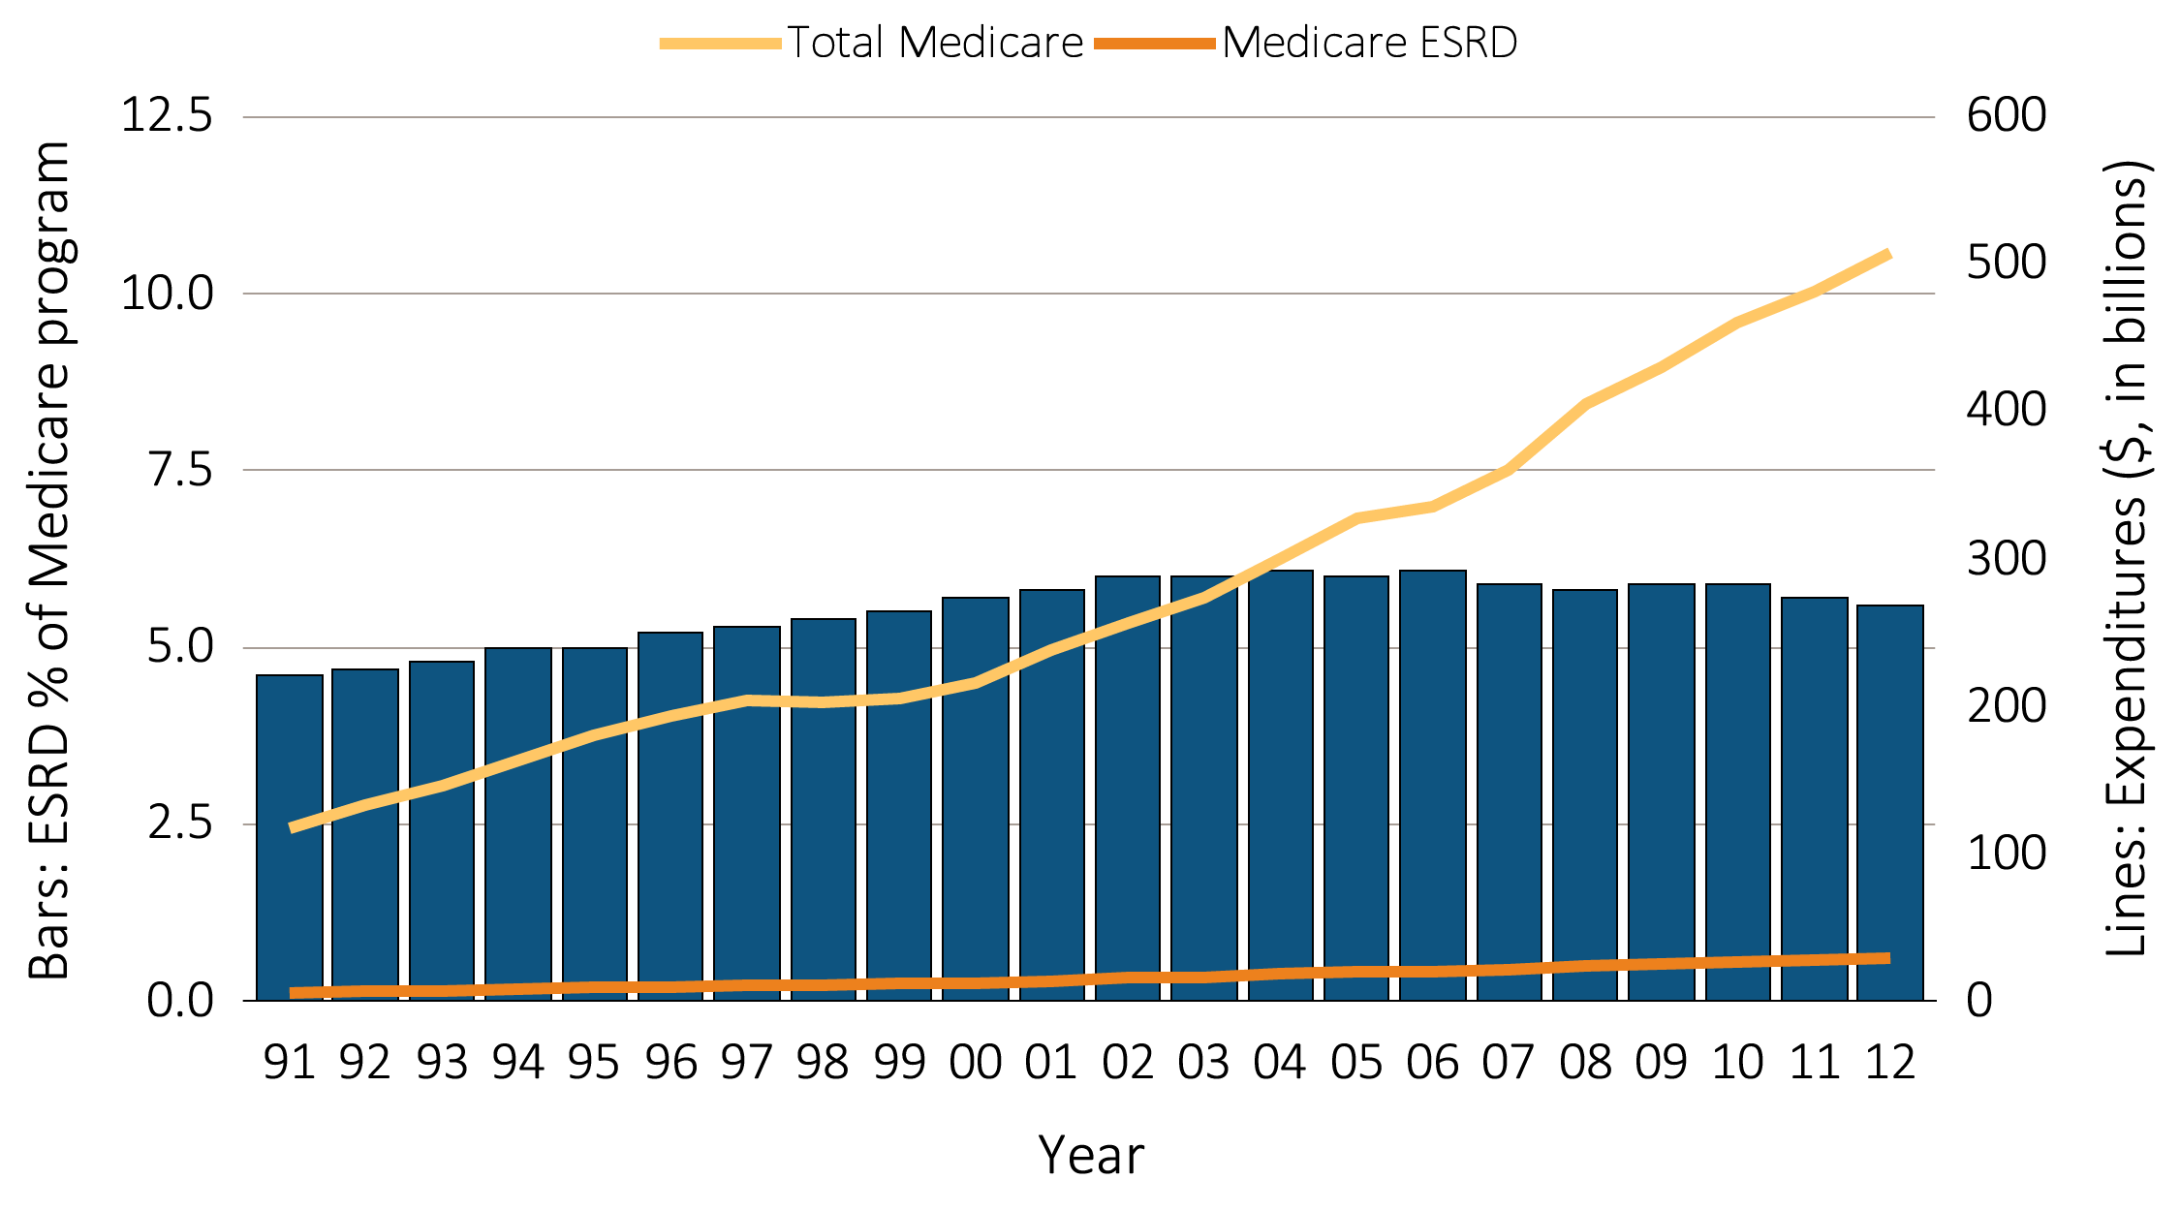
vol 2 Figure 9.2 Costs of the Medicare & ESRD programs (excluding Part D)
Data Source: USRDS ESRD Database. Total Medicare expenditures obtained from http://CMS.gov. Abbreviations: ESRD, end-stage renal disease.

Slide 4
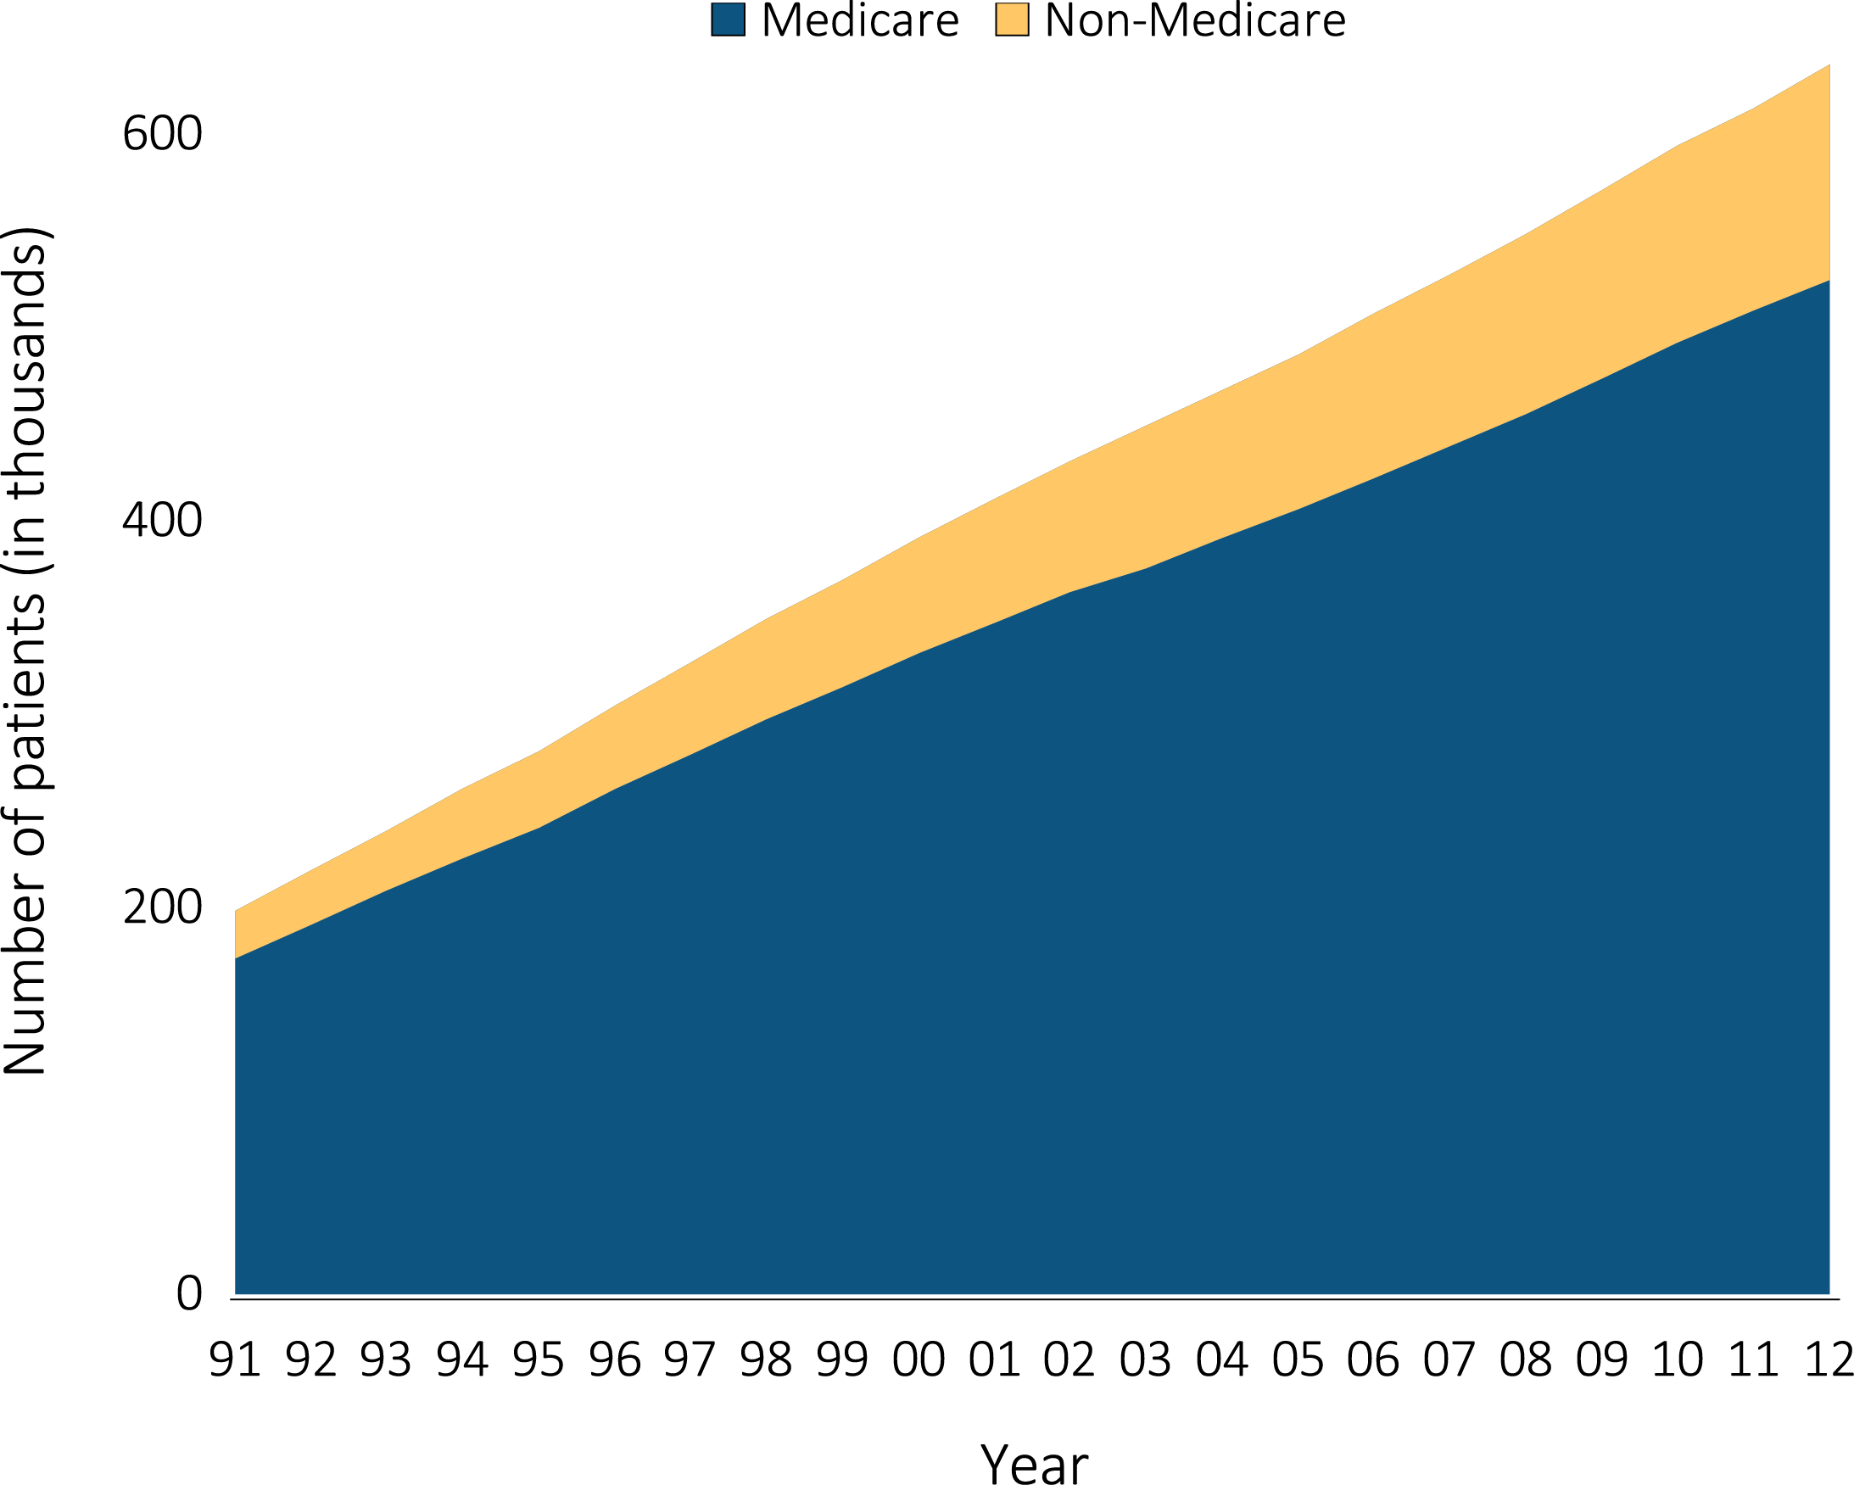
vol 2 Figure 9.3 Estimated numbers of point prevalent ESRD patients
Data Source: USRDS ESRD Database. December 31 point prevalent ESRD patients. Abbreviations: ESRD, end-stage renal disease.

Slide 5
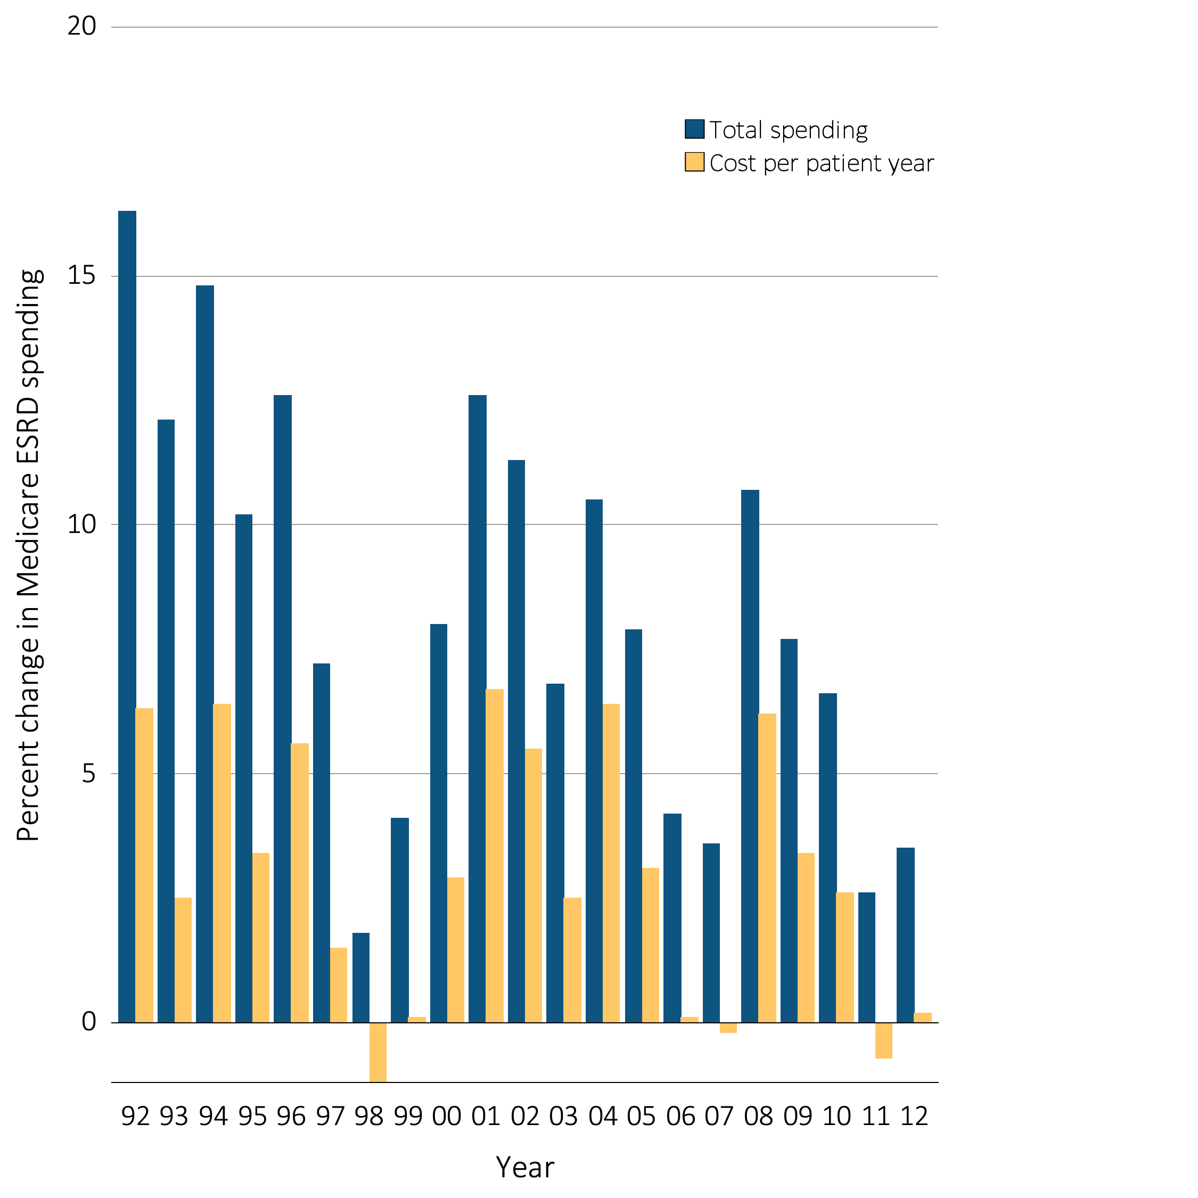
vol 2 Figure 9.4 Annual percent change in Medicare ESRD spending
Data Source: USRDS ESRD Database. Total Medicare ESRD costs from claims data; includes all Medicare as primary payer claims as well as amounts paid by Medicare as secondary payer. Abbreviations: ESRD, end-stage renal disease.

Slide 6
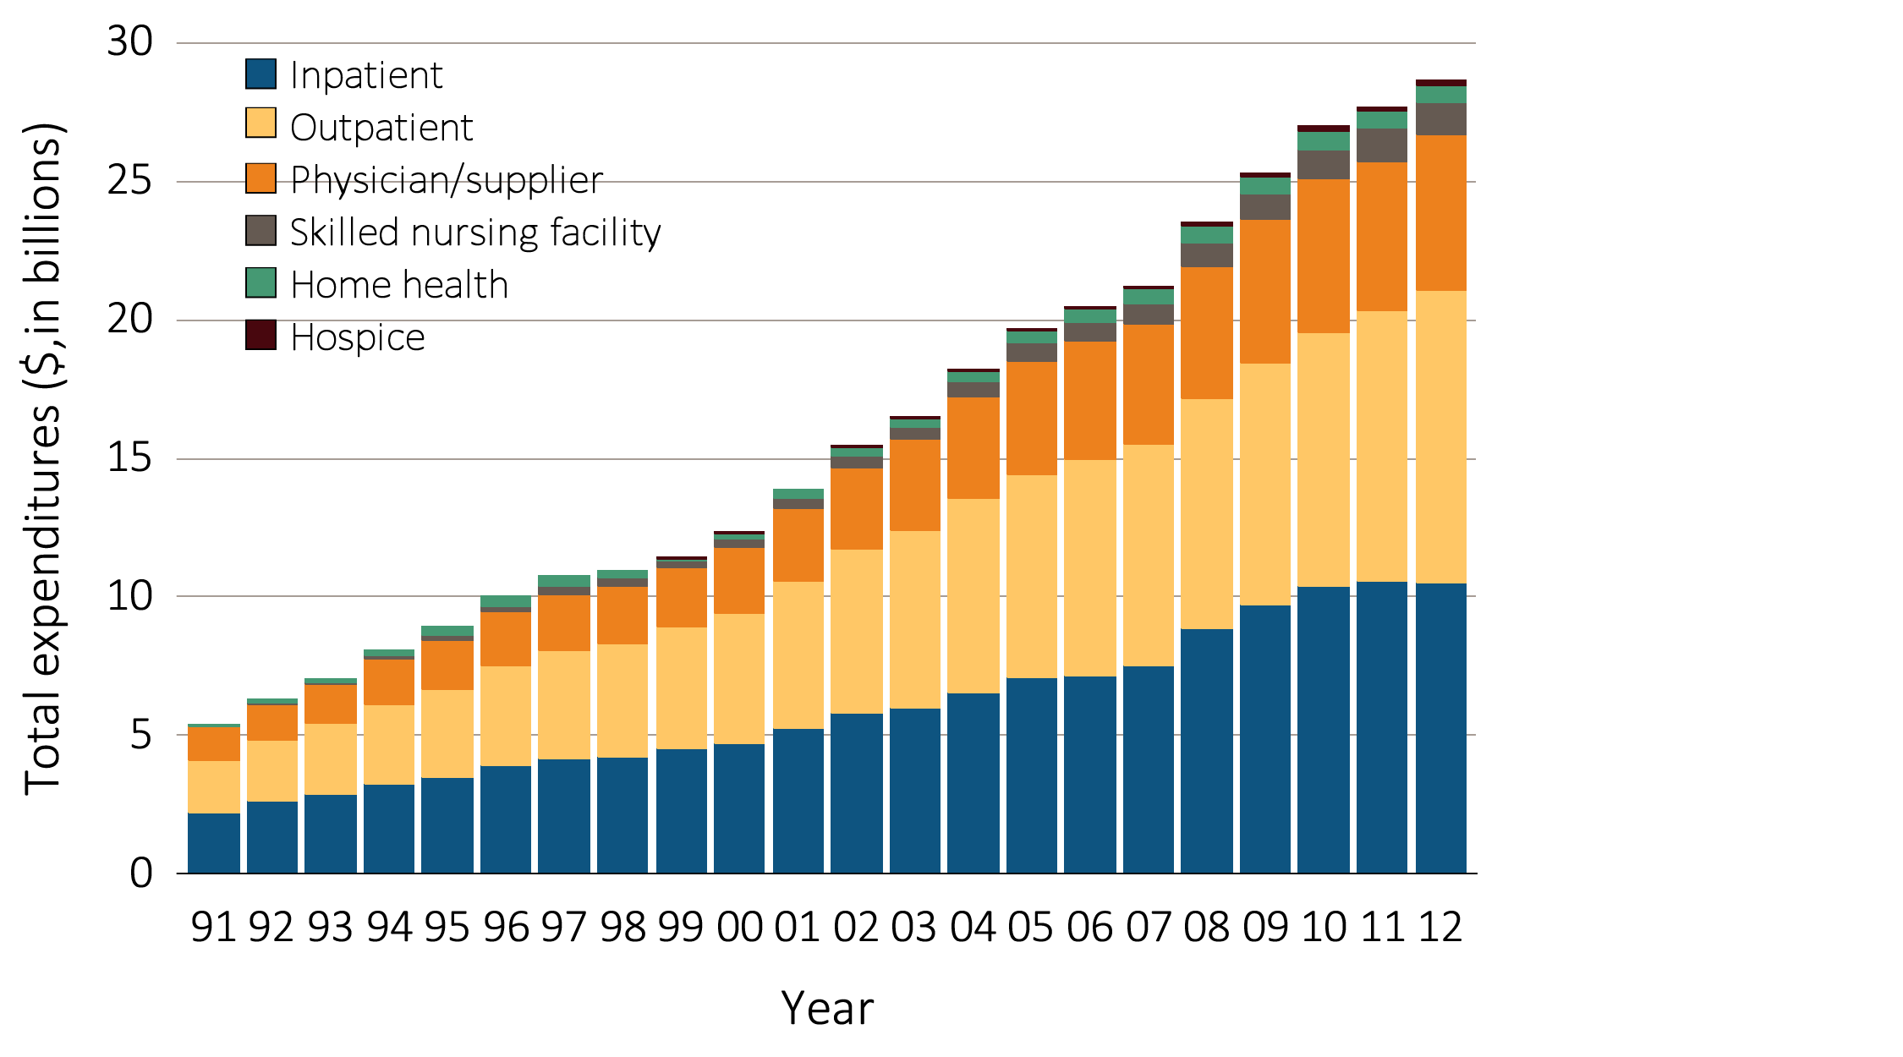
vol 2 Figure 9.5 Total Medicare dollars spent on ESRD, by type of service
Data Source: USRDS ESRD Database. Total Medicare costs from claims data; includes all Medicare as primary payer claims as well as amounts paid by Medicare as secondary payer. Abbreviations: ESRD, end-stage renal disease.

