Slide 1

Chapter 10:
International Comparisons
2014 ANNUAL DATA REPORT
VOLUME 2: END-STAGE RENAL DISEASE

Slide 2
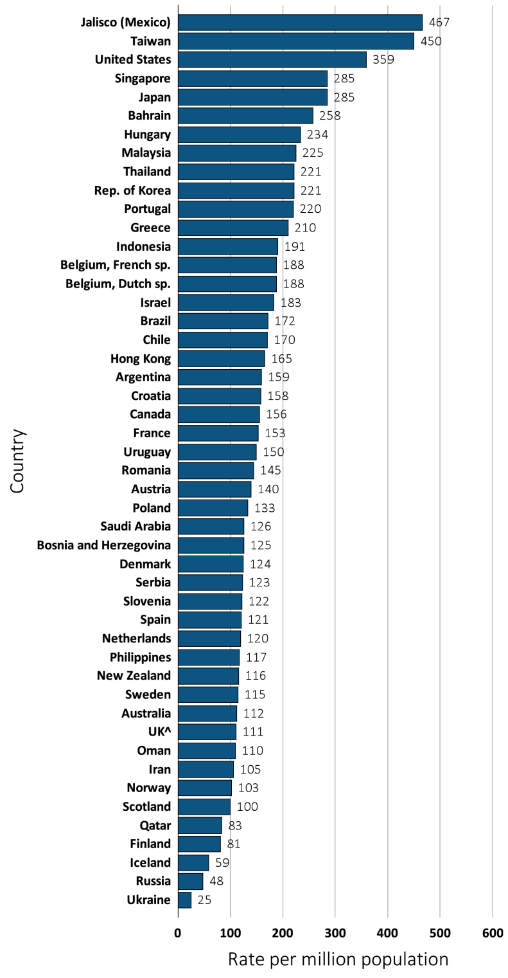
vol 2 Figure 10.1 Incidence rate of ESRD, per million population, by country, in 2012
Data presented only for countries from which relevant information was available. All rates are unadjusted. ^UK: England, Wales, & Northern Ireland (Scotland data reported separately). Japan and Taiwan are dialysis only. Data for Belgium do not include patients younger than 20. Data for Indonesia represent the West Java region. Data for France include 22 regions. Data for Spain include 18 of 19 regions.

Slide 3
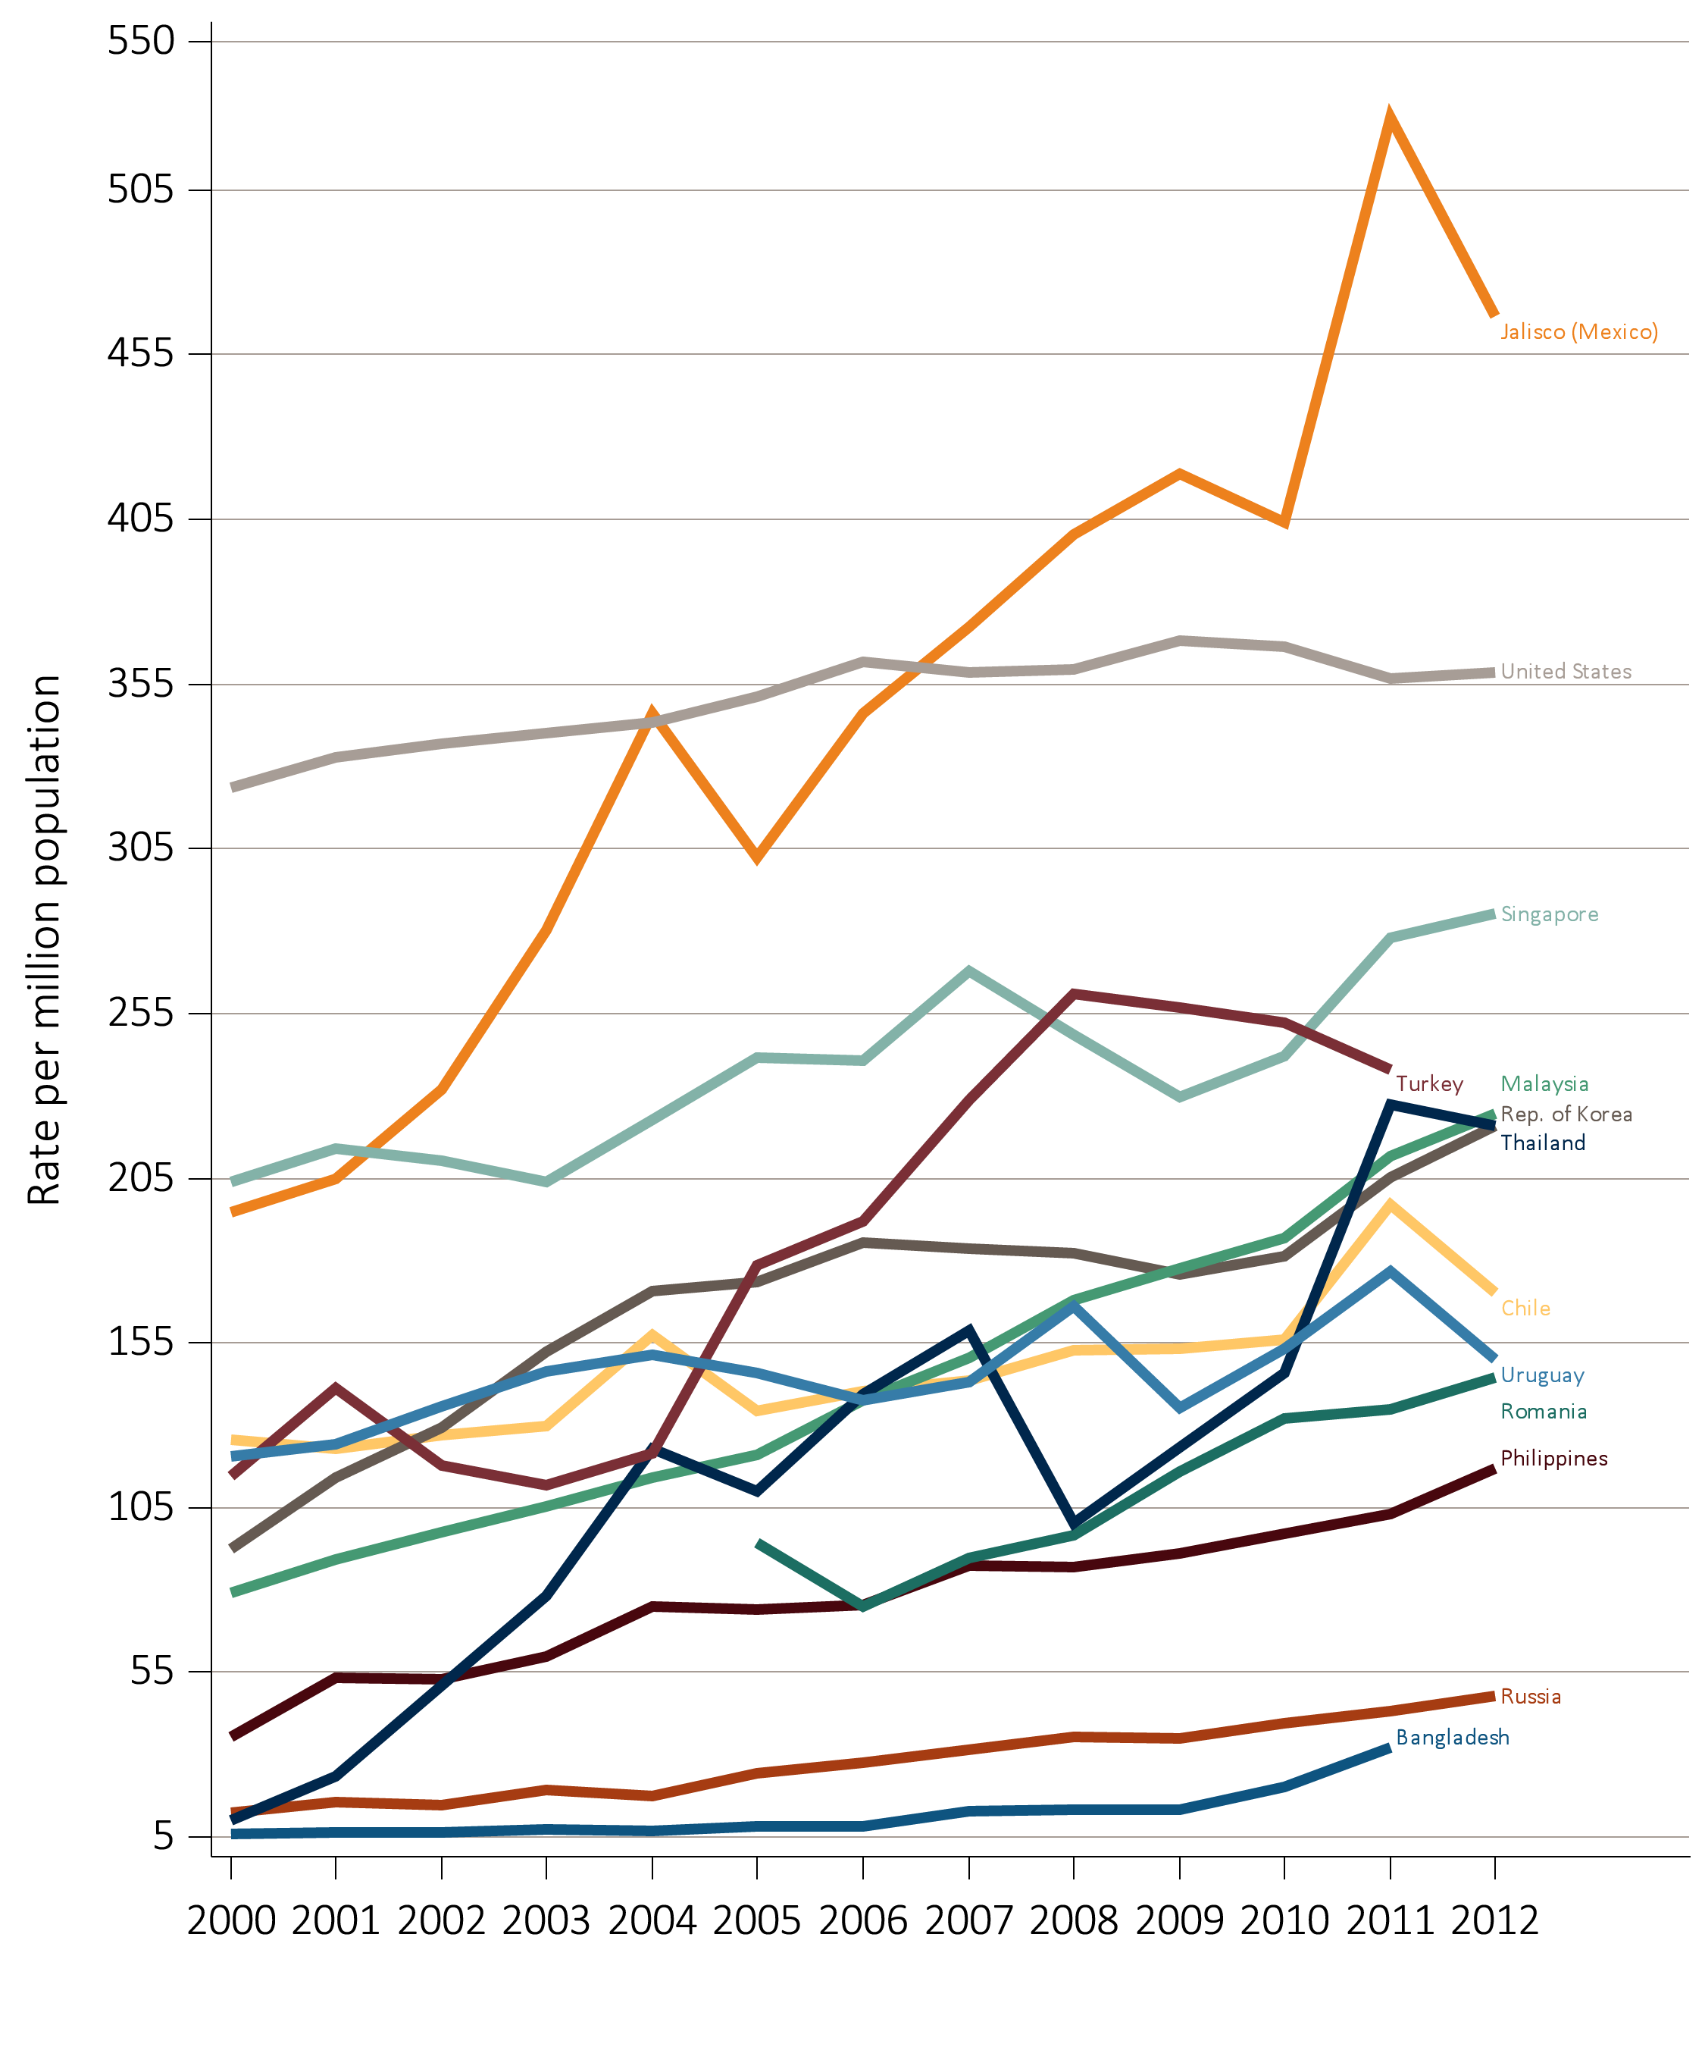
vol 2 Figure 10.2 Temporal trends in the incidence rate of ESRD, per million population, by country, years 2000-2012
(A) Countries in which the incidence rate of ESRD increased at least 10% from 2006-2012
Data source: Special analyses, USRDS ESRD Database. All rates are unadjusted. Data are shown for countries with incidence increase or decrease from 2006 to 2012 or 2011. Data for U.S. are shown for comparison purposes. Abbreviations: ESRD, end-stage renal disease.

Slide 4
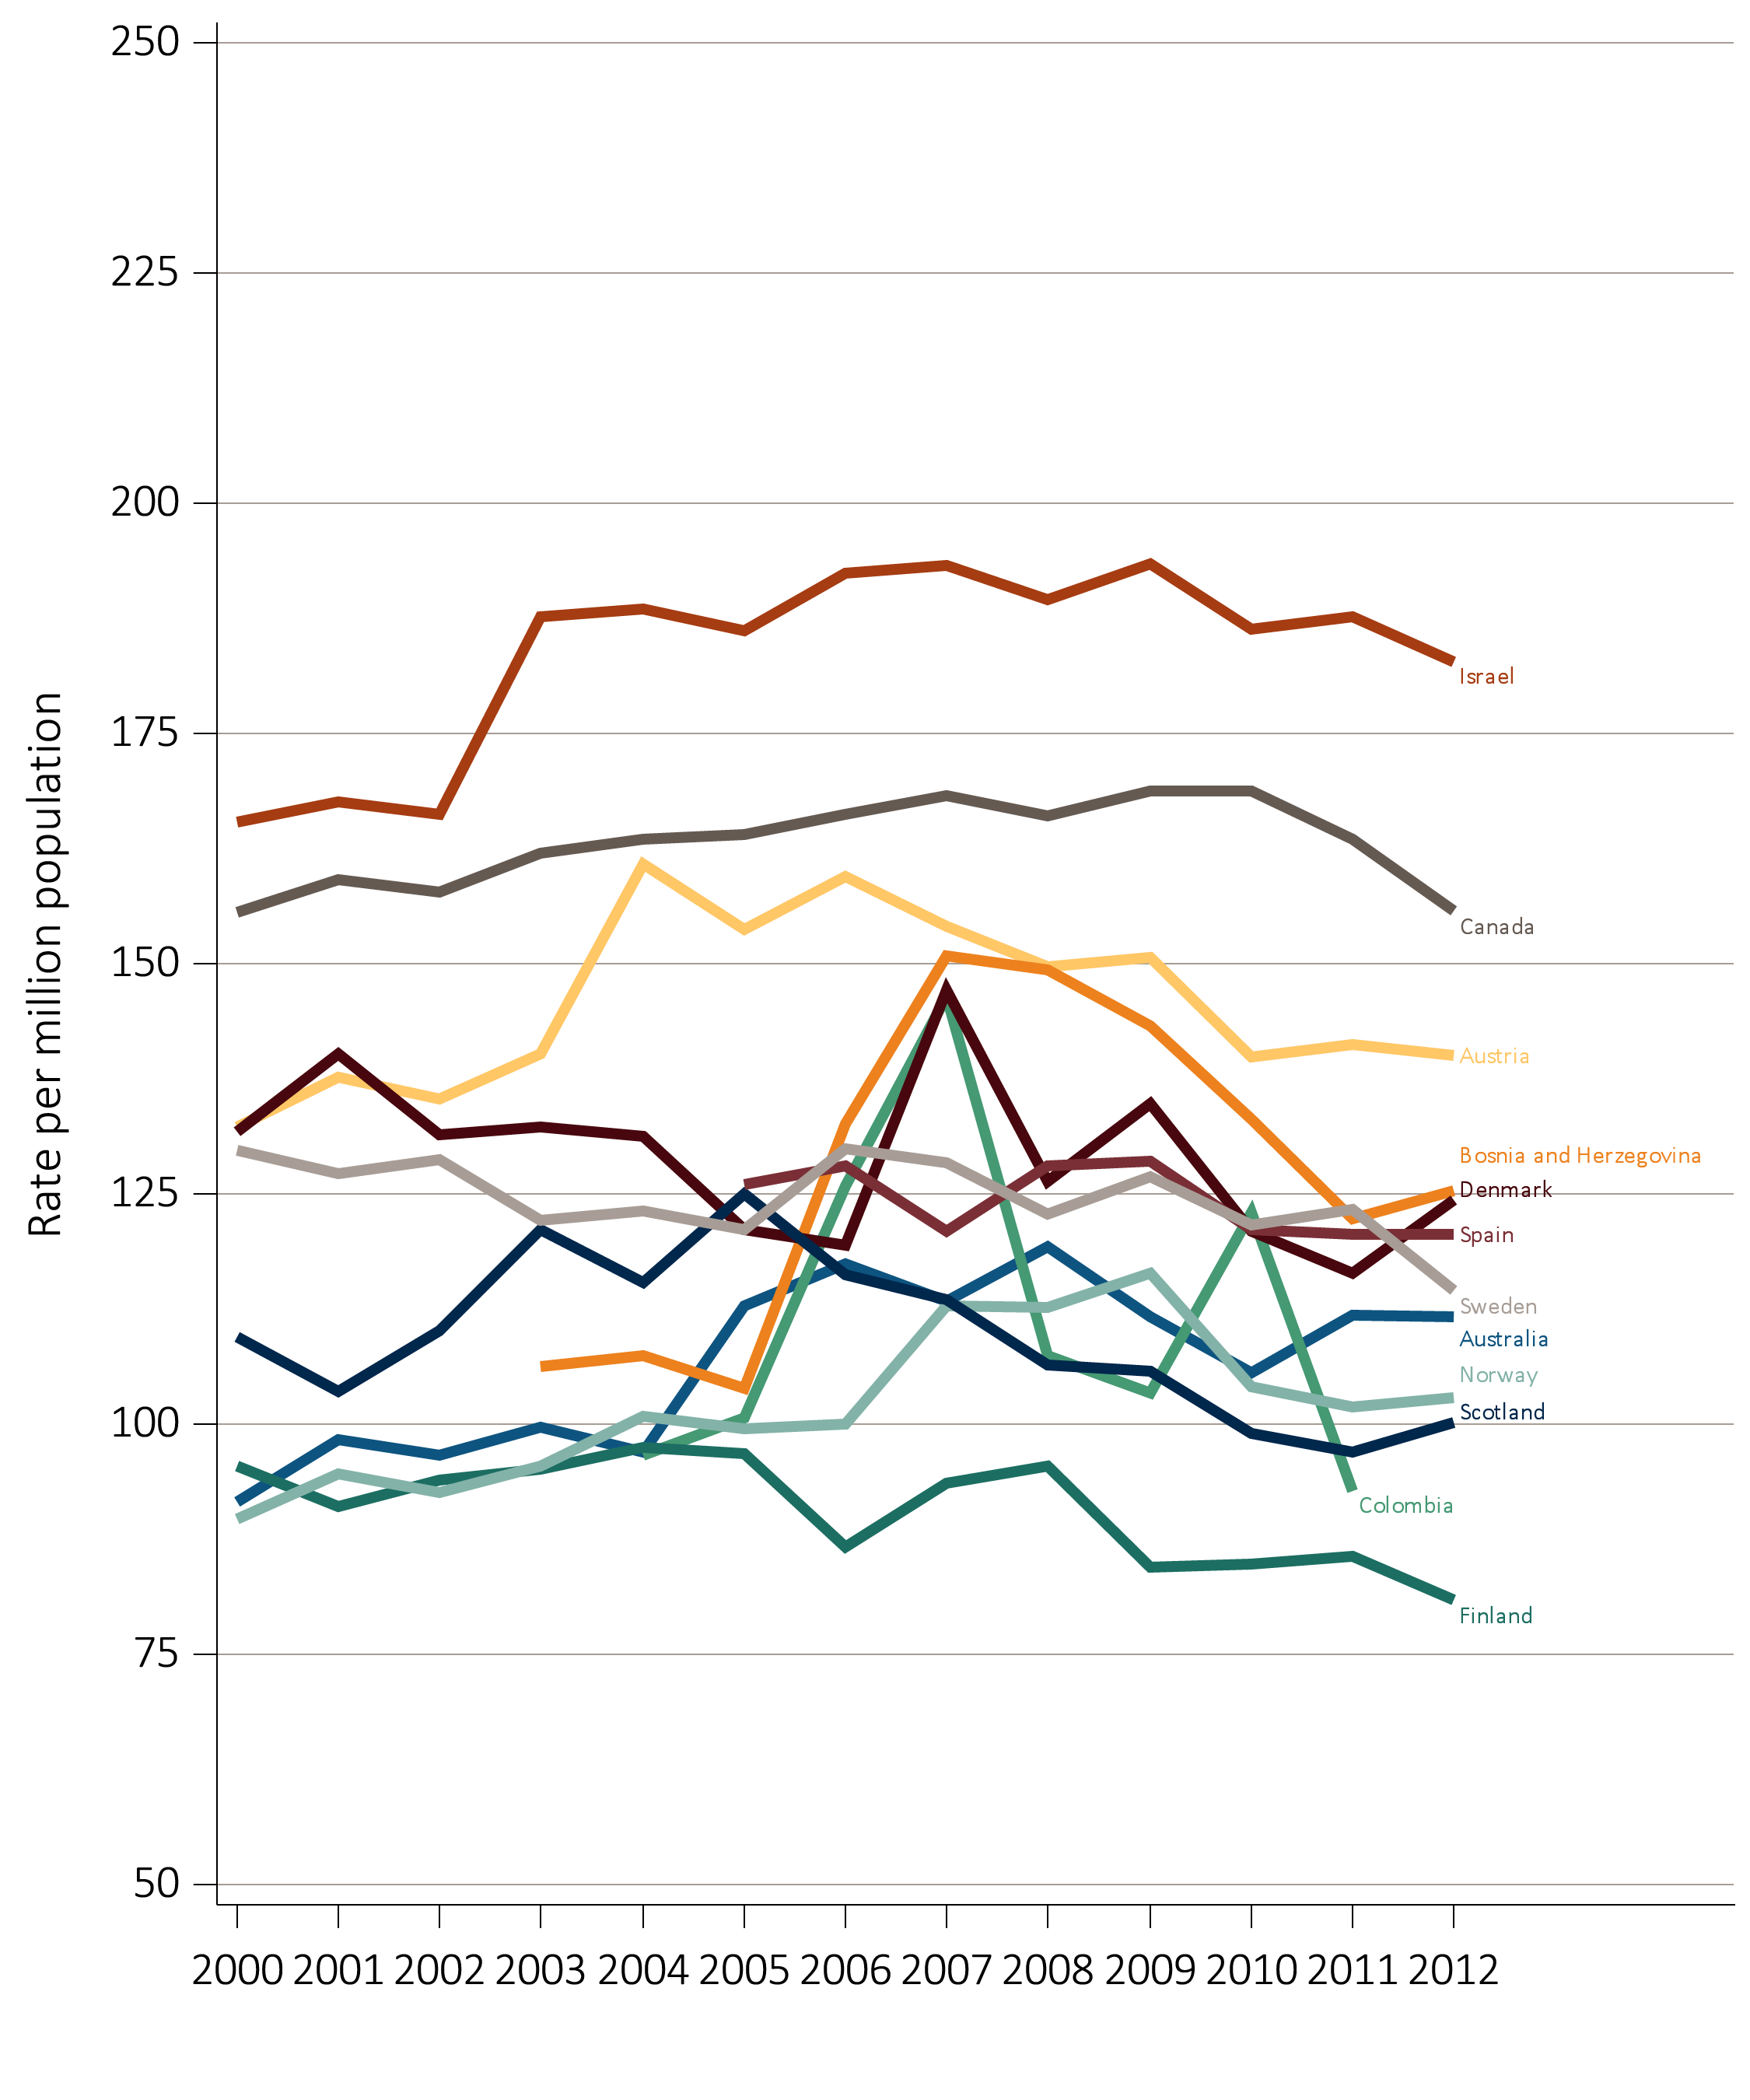
vol 2 Figure 10.2 Temporal trends in the incidence rate of ESRD, per million population, by country, years 2000-2012
(B) Countries in which the incidence rate of ESRD decreased at least 3% from 2006-2012
Data source: Special analyses, USRDS ESRD Database. All rates are unadjusted. Data are shown for countries with incidence increase or decrease from 2006 to 2012 or 2011. Data for U.S. are shown for comparison purposes. Abbreviations: ESRD, end-stage renal disease.

Slide 5
vol 2 Table 10.1 Trends in the incidence rate of ESRD, per million population, by country, years 2006-2012
Country | 2006 | 2007 | 2008 | 2009 | 2010 | 2011 | 2012 | % change from 2006-2012ª
Argentina | 141.0 | 151.1 | 144.4 | 152.6 | 154.0 | 155.0 | 159.0 | 7.5
Australia | 117.4 | 113.3 | 119.3 | 111.6 | 105.6 | 111.8 | 111.7 | -3.1
Austria | 159.5 | 154.0 | 149.7 | 150.7 | 139.8 | 141.2 | 140.0 | -10.3
Bahrain | . | . | 206.1 | 205.4 | 219.5 | 207.5 | 257.9
Bangladesh | 8.3 | 12.9 | 13.1 | 13.1 | 20.2 | 32.1 | . | 202.8
Belgium, Dutch sp. | 192.4 | 189.8 | 192.6 | 207.5 | 196.4 | 184.9 | 188.2 | -2.4
Belgium, French sp. | 187.0 | 187.0 | 191.8 | 197.1 | 191.1 | 186.1 | 188.2 | 0.1
Bosnia and Herzegovina | 132.6 | 150.8 | 149.3 | 143.3 | 133.1 | 122.3 | 125.4 | -12.6
Brazil | 184.9 | 140.1 | 145.4 | 98.9 | 150.3 | 176.0 | 171.5 | 6.9
Canada | 166.3 | 168.2 | 166.1 | 168.7 | 168.7 | 163.6 | 155.7 | -4.5
Chile | 140.5 | 143.8 | 152.8 | 153.1 | 155.9 | 197.2 | 170.1 | 29.2
Colombia | 125.9 | 146.4 | 107.4 | 103.4 | 122.9 | 92.8 | . | -31.8
Croatia | . | . | . | . | . | . | 158.1
Czech Republic | 185.7 | 184.6 | 181.9 | 180.5 | 197.8 | 171.9 | . | -7.2
Denmark | 119.4 | 147.2 | 126.3 | 134.8 | 121.0 | 116.4 | 124.3 | -9.7
Finland | 86.6 | 93.6 | 95.4 | 84.5 | 84.8 | 85.6 | 80.9 | -7.6
France | 144.0 | 140.8 | 148.2 | 151.3 | 152.4 | 151.0 | 153.4 | 6.9
Greece | 197.6 | 191.6 | 201.2 | 205.0 | 190.8 | 203.3 | 209.7 | 6.1
Hong Kong | 148.9 | 147.4 | 148.2 | 132.2 | 146.0 | 156.8 | 165.2 | 8.7
Hungary | . | . | 235.8 | 264.5 | 228.6 | 241.2 | 234.3
Iceland | 69.1 | 83.7 | 72.5 | 87.9 | 106.9 | 103.4 | 59.2 | 6.4
Indonesia | . | . | . | . | . | . | 190.7
Iran | . | . | 99.2 | 101.2 | 106.2 | 108.0 | 105.4
Israel | 192.4 | 193.2 | 189.5 | 193.4 | 186.4 | 187.6 | 182.8 | -3.9
Italy | . | . | . | . | 162.0 | . | .
Jalisco (Mexico) | 345.9 | 372.2 | 400.4 | 419.0 | 403.9 | 527.1 | 466.5 | 38.4
Japan | 275.4 | 285.2 | 287.7 | 287.5 | 290.6 | 294.6 | 285.3 | 3.4
Rep. of Korea | 185.3 | 183.5 | 182.1 | 175.9 | 181.5 | 205.3 | 221.1 | 15.6
Kuwait | . | . | . | . | . | . | .
Lebanon | . | . | . | . | . | . | .
Table 10.1 continued on next slide

Slide 6
vol 2 Table 10.1 Trends in the incidence rate of ESRD, per million population, by country, years 2006-2012
(continued)
Country | 2006 | 2007 | 2008 | 2009 | 2010 | 2011 | 2012 | % change from 2006-2012ª
Malaysia | 137.8 | 150.3 | 168.2 | 177.5 | 186.9 | 211.6 | 224.6 | 51.4
Morelos (Mexico) | . | 553.2 | 557.2 | 597.1 | . | . | .
Netherlands | 112.8 | 117.4 | 120.8 | 118.8 | 117.7 | 117.7 | 120.1 | 3.3
New Zealand | 119.5 | 110.9 | 116.4 | 135.3 | 117.9 | 110.1 | 115.7 | -2.0
Norway | 100.0 | 112.8 | 112.6 | 116.4 | 104.1 | 101.8 | 102.8 | -3.9
Oman | . | . | 102.1 | 103.0 | 106.1 | 108.0 | 110.0
Philippines | - | 87.5 | 87.2 | 91.1 | 97.3 | 103.0 | 116.8 | 35.0
Poland | . | . | 129.9 | 134.3 | 134.3 | 131.9 | 133.1
Portugal | . | . | 231.9 | 239.5 | 238.5 | 226.4 | 219.9
Qatar | . | . | . | . | 117.8 | 117.2 | 83.3
Romania | 74.9 | 89.9 | 96.7 | 115.9 | 132.3 | 134.9 | 144.5 | 69.5
Russia | 27.7 | . | 35.5 | 34.9 | 39.5 | 43.1 | 47.7 | 63.9
Saudi Arabia | . | . | 138.2 | 122.5 | 124.0 | 124.5 | 125.6
Scotland | 116.3 | 113.5 | 106.4 | 105.7 | 99.0 | 96.9 | 100.1 | -14.3
Serbia | . | . | . | . | . | 144.5 | 122.8
Singapore | 240.5 | 267.7 | 248.7 | 229.8 | 242.3 | 277.9 | 285.3 | 10.8
Slovenia | . | . | . | 129.9 | 120.6 | 117.9 | 122.0
South Africa | . | . | . | . | . | . | .
Spain | 128.0 | 120.9 | 128.1 | 128.5 | 121.1 | 120.7 | 120.6 | -3.1
Sweden | 129.9 | 128.4 | 122.8 | 126.9 | 121.7 | 123.4 | 114.5 | -7.9
Taiwan | 418.3 | 423.5 | 415.9 | 427.8 | 449.1 | 444.2 | 449.7 | 6.2
Thailand | 139.4 | 158.9 | 100.3 | 123.2 | 146.0 | 227.4 | 221.1 | 50.4
Turkey | 191.8 | 228.9 | 261.1 | 256.7 | 252.2 | 238.0 | . | 13.1
UK^ | 114.8 | 112.4 | 112.2 | 112.5 | 109.8 | 111.1 | 110.5 | -2.5
United States | 361.9 | 358.5 | 359.6 | 368.3 | 366.5 | 356.9 | 358.7 | -0.7
Ukraine | . | . | . | . | . | . | 24.8
Uruguay | 137.6 | 142.9 | 166.2 | 135.1 | 153.4 | 176.5 | 150.0 | 16.4
Data source: Special analyses, USRDS ESRD Database. Data presented only for countries from which relevant information was available. All rates are unadjusted. ^UK: England, Wales, Northern Ireland (Scotland data reported separately). Japan and Taiwan are dialysis only. Data for France include 15 regions in 2006, 18 regions in 2007, 20 regions in 2008, and 22 regions in 2009-2012. Data for Spain include 18 of 19 regions. Data for Belgium do not include patients younger than 20. Data for Indonesia represent the West Java region. ª % change is calculated as the percent difference between the average incidence in 2011 and 2012 and the average in 2006 and 2007. Abbreviations: ESRD, end-stage renal disease; sp., speaking; . signifies data not reported.

Slide 7
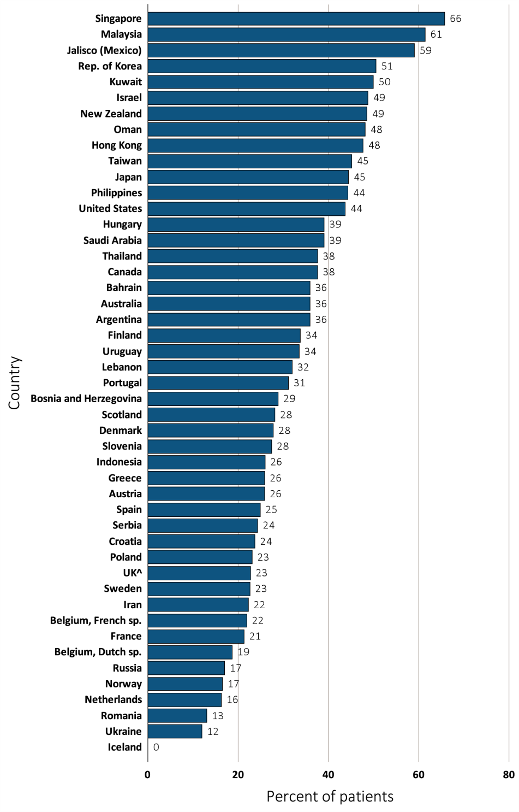
vol 2 Figure 10.3 Percentage of incident ESRD patients with diabetes as the primary ESRD cause, by country, in 2012
Data source: Special analyses, USRDS ESRD Database. Data presented only for countries from which relevant information was available. ^UK: England, Wales, & Northern Ireland (Scotland data reported separately). Data for Spain include 18 of 19 regions. Data for France include 22 regions. Data for Indonesia represent the West Java region. Data for Belgium do not include patients younger than 20. There were zero ESRD patients in Iceland with diabetes as the primary ESRD cause in 2012. Abbreviations: ESRD, end-stage renal disease; sp., speaking.

Slide 8
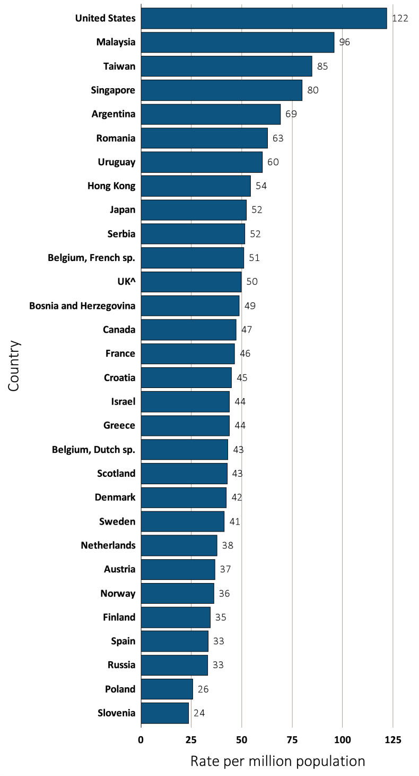
vol 2 Figure 10.4 Incidence rate of ESRD, per million population, by age group and country, in 2012
(A) 20-44 years old
Data source: Special analyses, USRDS ESRD Database. Data presented only for countries from which relevant information was available. ^UK: England, Wales, & Northern Ireland (Scotland data reported separately). Data for Belgium do not include patients younger than 20. Data for Spain include 18 of 19 regions. Data for France include 22 regions. Abbreviations: ESRD, end-stage renal disease; sp., speaking.

Slide 9
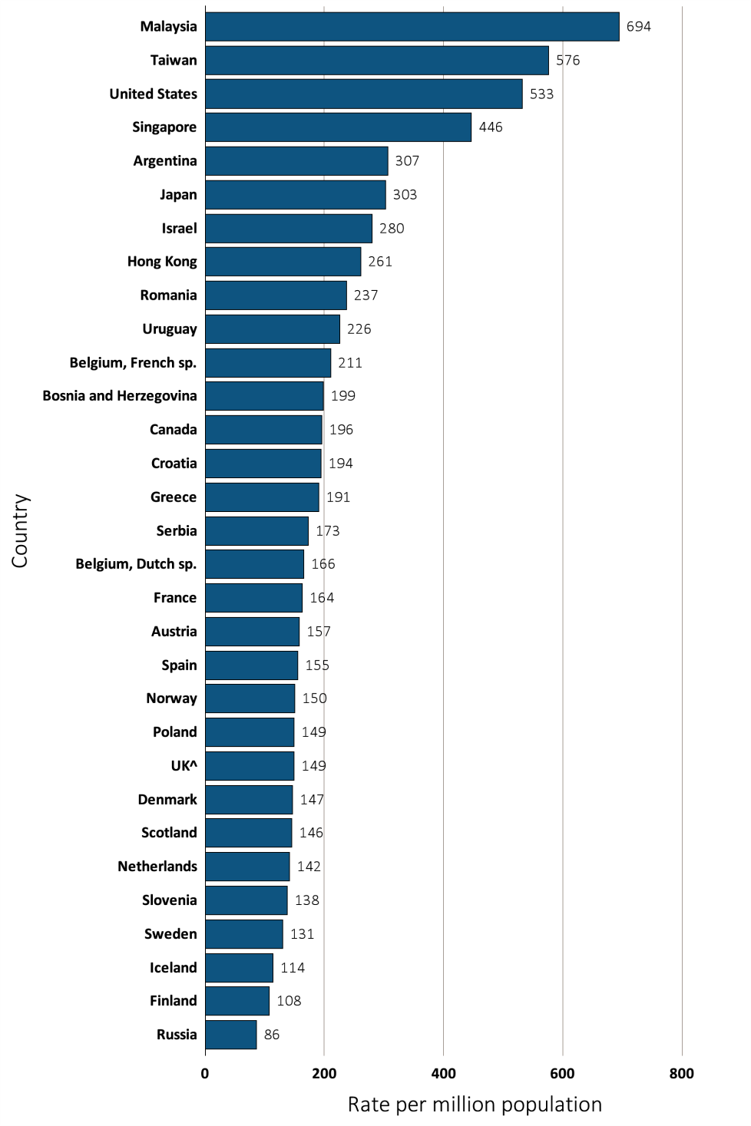
vol 2 Figure 10.4 Incidence rate of ESRD, per million population, by age group and country, in 2012
(B) 45-64 years old
Data source: Special analyses, USRDS ESRD Database. Data presented only for countries from which relevant information was available. ^UK: England, Wales, & Northern Ireland (Scotland data reported separately). Data for Belgium do not include patients younger than 20. Data for Spain include 18 of 19 regions. Data for France include 22 regions. Abbreviations: ESRD, end-stage renal disease; sp., speaking.

Slide 10
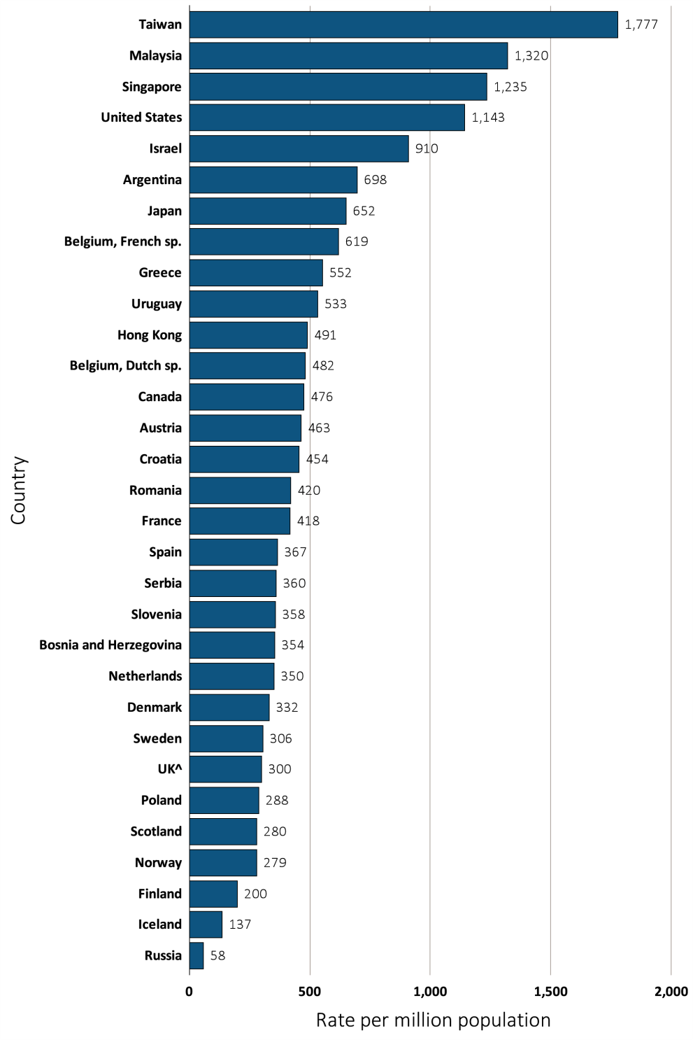
vol 2 Figure 10.4 Incidence rate of ESRD, per million population, by age group and country, in 2012
(C) 65-74 years old
Data source: Special analyses, USRDS ESRD Database. Data presented only for countries from which relevant information was available. ^UK: England, Wales, & Northern Ireland (Scotland data reported separately). Data for Belgium do not include patients younger than 20. Data for Spain include 18 of 19 regions. Data for France include 22 regions. Abbreviations: ESRD, end-stage renal disease; sp., speaking.

Slide 11
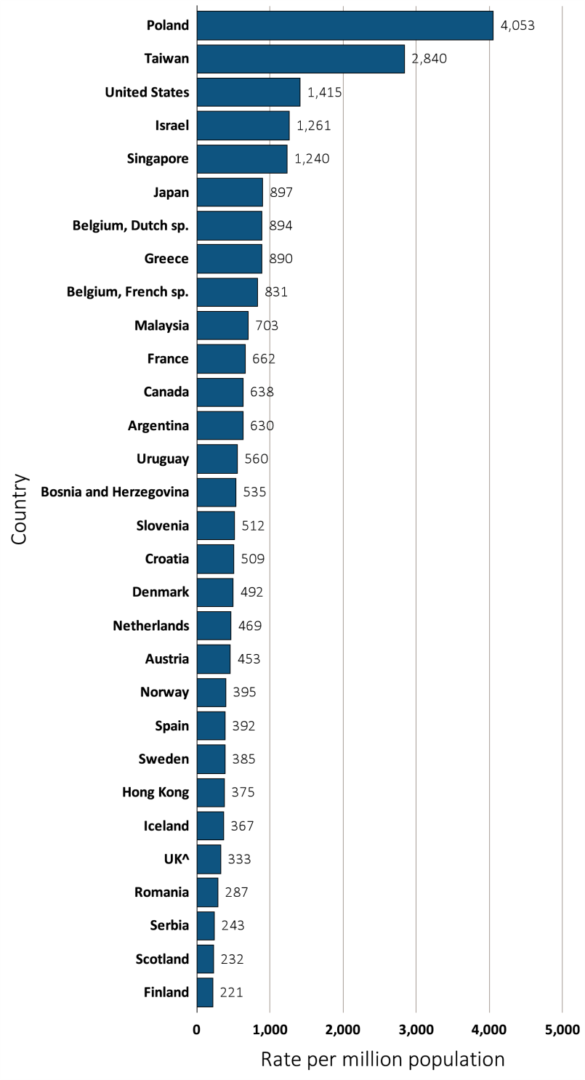
vol 2 Figure 10.4 Incidence rate of ESRD, per million population, by age group and country, in 2012
(D) ≥75 years old
Data source: Special analyses, USRDS ESRD Database. Data presented only for countries from which relevant information was available. ^UK: England, Wales, & Northern Ireland (Scotland data reported separately). Data for Belgium do not include patients younger than 20. Data for Spain include 18 of 19 regions. Data for France include 22 regions. Abbreviations: ESRD, end-stage renal disease; sp., speaking.

Slide 12
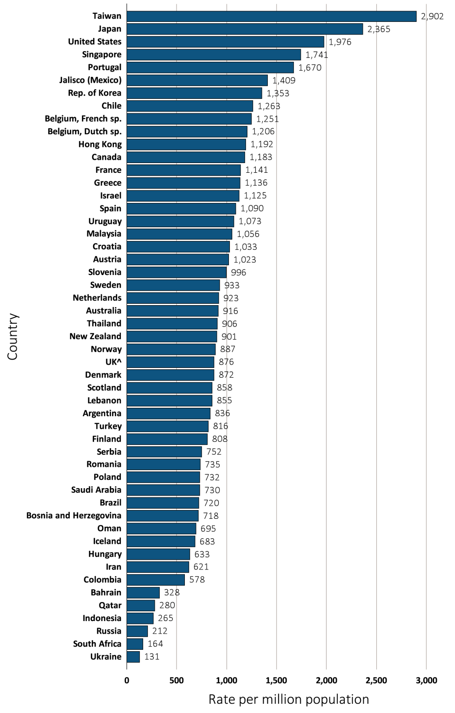
vol 2 Figure 10.5 Prevalence of ESRD, per million population, by country, in 2012
Data source: Special analyses, USRDS ESRD Database. Data presented only for countries from which relevant information was available. All rates are unadjusted and reflect prevalence at the end of 2012; rates for Colombia and Lebanon reflect prevalence at the end of June 2012. ^U.K: England, Wales, & Northern Ireland (Scotland data reported separately). Japan and Taiwan include dialysis patients only. Data for Belgium do not include patients younger than 20. Data for Indonesia represent the West Java region. Data for Spain include 18 of 19 regions. Data for France include 22 regions. Data for Turkey in 2012 was collected with the collaboration of the Ministry of Health, which collects patient-based data; however, in previous years center-based data were reported. Abbreviations: ESRD, end-stage renal disease; sp., speaking.

Slide 13
vol 2 Table 10.2 Number of ESRD prevalent patients and prevalence of ESRD, per million population, by country, years 2006-2012
 | Prevalence rate, per million population |  |  |  |  |  |  |  | Prevalent patients, counts
Country | 2006 | 2007 | 2008 | 2009 | 2010 | 2011 | 2012 | % change from 2006-2012ª | 2006 | 2007 | 2008 | 2009 | 2010 | 2011 | 2012
Argentina | 598.0 | 615.4 | 755.7 | 761.9 | 794.8 | 790.6 | 835.7 | 34.0 | 23,306 | 24,218 | 30,035 | 30,580 | 31,885 | 31,975 | 34,218
Australia | 778.3 | 801.3 | 833.6 | 850.1 | 870.7 | 892.1 | 915.6 | 14.4 | 16,112 | 16,842 | 17,824 | 18,512 | 19,210 | 19,913 | 20,766
Austria | 908.6 | 933.5 | 947.9 | 980.1 | 991.7 | 1000.6 | 1022.7 | 9.8 | 7,512 | 7,731 | 7,898 | 8,189 | 8,320 | 8,429 | 8,635
Bahrain | . | . | 291.0 | 300.4 | 280.3 | 339.7 | 328.4 |  | . | . | 322 | 354 | 346 | 406 | 410
Bangladesh | 87.8 | 101.3 | 112.8 | 137.1 | 157.7 | 191.5 | . | 102.5 | 12,864 | 15,089 | 17,068 | 21,067 | 24,618 | 28,729 | .
Belgium, Dutch sp. | 1033.1 | 1063.8 | 1096.0 | 1136.4 | 1160.8 | 1183.2 | 1206.2 | 13.9 | 6,300 | 6,531 | 6,779 | 7,080 | 7,289 | 7,488 | 7,679
Belgium, French sp. | 1071.5 | 1110.7 | 1145.7 | 1142.1 | 1180.0 | 1211.2 | 1251.3 | 12.8 | 4,768 | 4,983 | 5,184 | 5,215 | 5,447 | 5,650 | 5,883
Bosnia and Herzegovina | 551.9 | 601.8 | 637.0 | 646.4 | 675.1 | 709.0 | 718.1 | 23.7 | 2,115 | 2,306 | 2,441 | 2,477 | 2,587 | 2,487 | 2,519
Brazil | 398.3 | 466.0 | 408.5 | 480.2 | 478.7 | 678.6 | 720.2 | 61.8 | 73,605 | 87,044 | 77,589 | 92,091 | 91,314 | 132,491 | 143,497
Canada | 1039.1 | 1071.1 | 1094.1 | 1124.3 | 1142.3 | 1166.1 | 1182.7 | 11.3 | 33,898 | 35,274 | 36,465 | 37,934 | 38,981 | 40,209 | 41,252
Chile | 929.6 | 985.7 | 1065.2 | 1108.8 | 1161.1 | 1235.7 | 1263.4 | 30.5 | 15,353 | 16,360 | 17,856 | 18,849 | 19,854 | 21,007 | 21,730
Colombia | . | . | 455.3 | 441.3 | 544.2 | 536.3 | 578.4 |  | . | . | 20,239 | 19,846 | 24,760 | 24,692 | 26,942
Croatia | . | . | . | . | . | . | 1033.0 |  | 3,799 | 3,932 | 4,009 | 4,124 | 4,257 | 4,348 | 4,410
Czech Republic | 461.9 | 499.9 | 538.1 | 907.6 | 970.1 | 974.4 | . | 102.6 | 4,752 | 5,190 | 5,633 | 9,536 | 10,218 | 10,236 | .
Denmark | 781.8 | 832.2 | 832.1 | 843.8 | 847.8 | 857.0 | 872.3 | 7.1 | 4,295 | 4,592 | 4,619 | 4,708 | 4,751 | 4,823 | 4,927
Finland | 727.1 | 747.4 | 769.2 | 782.2 | 796.0 | 805.5 | 807.7 | 9.4 | 3,829 | 3,953 | 4,087 | 4,176 | 4,269 | 4,340 | 4,373
France | 962.6 | 953.9 | 993.1 | 1053.4 | 1089.7 | 1118.6 | 1141.3 | 17.9 | 34,835 | 49,679 | 54,627 | 62,070 | 64,225 | 66,245 | 68,350
Greece | 986.1 | 1013.4 | 1038.9 | 1069.1 | 1083.0 | 1103.1 | 1135.7 | 12.0 | 10,994 | 11,343 | 11,674 | 12,062 | 12,246 | 12,466 | 12,598
Table 10.2 continued on next slide

Slide 14
vol 2 Table 10.2 Number of ESRD prevalent patients and prevalence of ESRD, per million population, by country, years 2006-2012 (continued)
 | Prevalence rate, per million population |  |  |  |  |  |  |  | Prevalent patients, counts
Country | 2006 | 2007 | 2008 | 2009 | 2010 | 2011 | 2012 | % change from 2006-2012ª | 2006 | 2007 | 2008 | 2009 | 2010 | 2011 | 2012
Hong Kong | 1003.0 | 1031.4 | 1067.4 | 1077.7 | 1106.3 | 1152.5 | 1191.7 | 15.2 | 6,930 | 7,171 | 7,460 | 7,580 | 7,857 | 8,197 | 8,549
Hungary | . | . | 578.1 | 605.3 | 620.0 | 626.2 | 632.8 |  | . | . | 5,807 | 6,072 | 6,209 | 6,253 | 6,285
Iceland | 483.9 | 518.5 | 523.0 | 543.2 | 600.6 | 667.7 | 682.8 | 34.7 | 147 | 161 | 166 | 173 | 191 | 213 | 219
Indonesia | . | . | . | . | . | . | 265.0 |  | . | . | . | . | . | . | .
Iran | . | . | 490.6 | 528.8 | 556.4 | 585.5 | 621.2 |  | . | . | 35,248 | 38,575 | 41,192 | 43,969 | 47,336
Israel | 1010.1 | 1040.7 | 1070.8 | 1086.6 | 1101.9 | 1120.2 | 1125.4 | 9.5 | 7,125 | 7,472 | 7,826 | 8,134 | 8,400 | 8,699 | 8,902
Italy | . | . | . | . | . | . | . |  | . | . | . | . | . | . | .
Jalisco (Mexico) | 928.9 | 986.2 | 1029.6 | 1314.3 | 1332.3 | 1381.5 | 1408.8 | 45.7 | 6,357 | 6,865 | 7,218 | 9,222 | 9,916 | 10,421 | 10,769
Japan | 1954.5 | 2058.1 | 2126.0 | 2205.4 | 2277.4 | 2313.8 | 2365.2 | 16.6 | 249,718 | 262,968 | 271,471 | 281,212 | 289,415 | 295,706 | 301,545
Rep. of Korea | 941.7 | 972.8 | 1031.7 | 1113.6 | 1144.4 | 1224.8 | 1353.3 | 34.7 | 46,730 | 48,675 | 51,989 | 56,396 | 58,860 | 63,341 | 70,211
Kuwait | . | . | . | . | . | . | . |  | . | . | . | . | . | . | .
Lebanon | . | . | . | . | . | . | 855.0 |  | . | . | . | . | . | . | 4,100
Malaysia | 626.3 | 692.5 | 769.4 | 840.1 | 905.3 | 987.1 | 1056.4 | 55.0 | 16,805 | 18,825 | 21,191 | 23,435 | 25,574 | 28,184 | 30,991
Morelos (Mexico) | . | 877.8 | 939.3 | 978.0 | . | . | . |  | . | 1,447 | 1,561 | 1,638 | . | . | .
Netherlands | 772.2 | 802.5 | 820.2 | 852.1 | 875.6 | 897.5 | 923.4 | 15.6 | 12,623 | 13,146 | 13,488 | 14,086 | 14,549 | 14,982 | 15,472
New Zealand | 775.5 | 793.2 | 809.6 | 853.8 | 876.4 | 879.0 | 900.7 | 13.5 | 3,245 | 3,354 | 3,456 | 3,685 | 3,828 | 3,872 | 3,993
Norway | 753.1 | 784.0 | 816.9 | 844.3 | 859.4 | 875.0 | 887.3 | 14.7 | 3,510 | 3,692 | 3,895 | 4,077 | 4,202 | 4,334 | 4,453
Oman | . | . | 463.5 | 492.1 | 615.3 | 649.3 | 694.8 |  | . | . | 1,535 | 1,682 | 1,826 | 1,966 | 2,147
Philippines | 80.6 | 84.6 | 109.8 | 114.0 | 132.9 | 159.4 | . | 93.0 | 7,437 | 7,967 | 10,552 | 11,172 | 13,275 | 16,230 | .
Poland | . | . | 647.5 | 672.5 | 665.5 | 706.6 | 732.2 |  | . | . | 24,783 | 25,665 | 25,635 | 27,236 | 28,226
Portugal | . | . | 1406.8 | 1505.1 | 1589.5 | 1662.0 | 1670.3 |  | . | . | 14,965 | 16,011 | 16,788 | 17,553 | 17,641
Qatar | . | . | . | . | 244.3 | 267.2 | 280.1 |  | . | . | . | . | 419 | 463 | 511
Romania | 304.7 | 368.3 | 422.4 | 533.2 | 599.9 | 666.4 | 735.2 | 108.3 | 6,578 | 7,935 | 9,088 | 10,859 | 12,146 | 13,410 | 14,747
Table 10.2 continued on next slide

Slide 15
vol 2 Table 10.2 Number of ESRD prevalent patients and prevalence of ESRD, per million population, by country, years 2006-2012 (continued)
 | Prevalence rate, per million population |  |  |  |  |  |  |  | Prevalent patients, counts
Country | 2006 | 2007 | 2008 | 2009 | 2010 | 2011 | 2012 | % change from 2006-2012ª | 2006 | 2007 | 2008 | 2009 | 2010 | 2011 | 2012
Russia | 130.1 | . | 158.0 | 173.1 | 185.5 | 196.4 | 211.7 | 56.8 | 18,486 | . | 22,234 | 24,246 | 26,327 | 27,989 | 30,349
Saudi Arabia | . | . | 797.5 | 792.7 | 763.9 | 731.7 | 730.3 |  | . | . | 19,334 | 20,113 | 20,731 | 20,764 | 21,321
Scotland | 783.9 | 812.0 | 809.9 | 827.7 | 836.8 | 842.1 | 857.6 | 6.5 | 4,011 | 4,177 | 4,186 | 4,299 | 4,370 | 4,424 | 4,557
Serbia | . | . | . | . | . | 722.4 | 752.0 |  | . | . | . | . | . | 5,244 | 5,414
Singapore | 1400.1 | 1441.8 | 1494.8 | 1526.9 | 1578.6 | 1661.8 | 1741.4 | 19.8 | 4,936 | 5,165 | 5,445 | 5,701 | 5,954 | 6,297 | 6,648
Slovenia | . | . | . | 980.6 | 986.5 | 984.5 | 995.5 |  | . | . | . | 2,000 | 2,021 | 2,021 | 2,048
South Africa | . | . | . | . | . | . | 163.7 |  | . | . | . | . | . | . | 8,559
Spain | 961.0 | 956.2 | 994.8 | 1033.5 | 1045.5 | 1074.7 | 1090.4 | 12.9 | 35,462 | 41,546 | 44,067 | 39,708 | 47,632 | 50,614 | 50,837
Sweden | 850.7 | 866.7 | 875.7 | 893.5 | 912.2 | 931.1 | 933.0 | 8.5 | 7,725 | 7,929 | 8,074 | 8,308 | 8,555 | 8,798 | 8,882
Taiwan | 2196.8 | 2285.1 | 2432.0 | 2554.4 | 2685.2 | 2785.9 | 2902.1 | 26.9 | 50,255 | 52,462 | 56,025 | 59,056 | 62,196 | 64,702 | 67,665
Thailand | 286.0 | 419.8 | 496.9 | 552.8 | 639.3 | 749.8 | 905.9 | 134.6 | 17,967 | 26,457 | 31,496 | 35,112 | 40,845 | 47,987 | 58,385
Turkey | 589.2 | 711.5 | 753.1 | 819.2 | 847.4 | 868.2 | 815.6 | 29.5 | 42,992 | 50,221 | 53,859 | 59,443 | 62,471 | 64,877 | 61,677
UK^ | 722.9 | 737.6 | 773.2 | 804.3 | 830.1 | 850.6 | 875.8 | 18.2 | 40,101 | 41,188 | 43,478 | 45,519 | 47,347 | 49,321 | 51,140
United States | 1645.1 | 1697.9 | 1751.1 | 1809.6 | 1867.5 | 1918.0 | 1975.5 | 16.5 | 490,879 | 511,465 | 532,502 | 555,145 | 577,675 | 597,620 | 620,136
Ukraine | . | . | . | . | . | . | 131.3 |  | . | . | . | . | . | . | 5,985
Uruguay | 927.1 | 963.9 | 1016.5 | 1018.6 | 1033.2 | 1074.9 | 1072.6 | 13.6 | 3,073 | 3,204 | 3,389 | 3,407 | 3,468 | 3,532 | 3,525
Data source: Special analyses, USRDS ESRD Database. Data presented only for countries from which relevant information was available. ^UK: England, Wales, & Northern Ireland (Scotland data reported separately). Data for France include 15 regions in 2006, 18 in 2007, 20 in 2008, and 22 in 2009-2012. Data for Spain include 18 of 19 regions. Data for Belgium do not include patients younger than 20. Data for Indonesia represent the West Java region. ª % change is calculated as the percent difference between the average prevalence in 2011 and 2012 and the average in 2006 and 2007. Abbreviations: ESRD, end-stage renal disease; sp., speaking; . signifies data not reported.

Slide 16
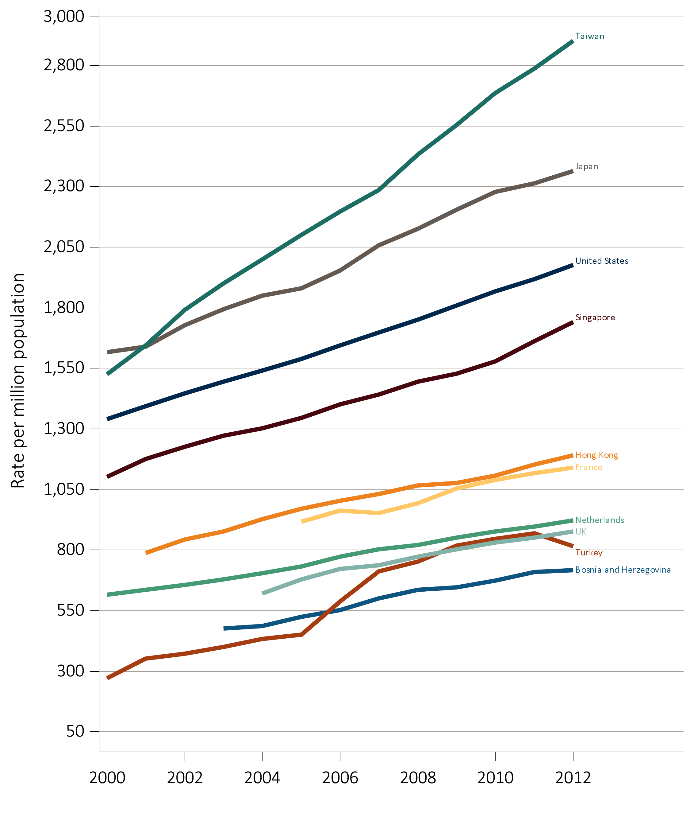
vol 2 Figure 10.6 Trends in the prevalence of ESRD, per million population, by country, years 2000-2012
(A) Countries in which the prevalence of ESRD increased by 15-31 % from 2006-2012
Data source: Special analyses, USRDS ESRD Database. All rates are unadjusted. Data for U.S. are shown for comparison purposes. Abbreviations: ESRD, end-stage renal disease.

Slide 17
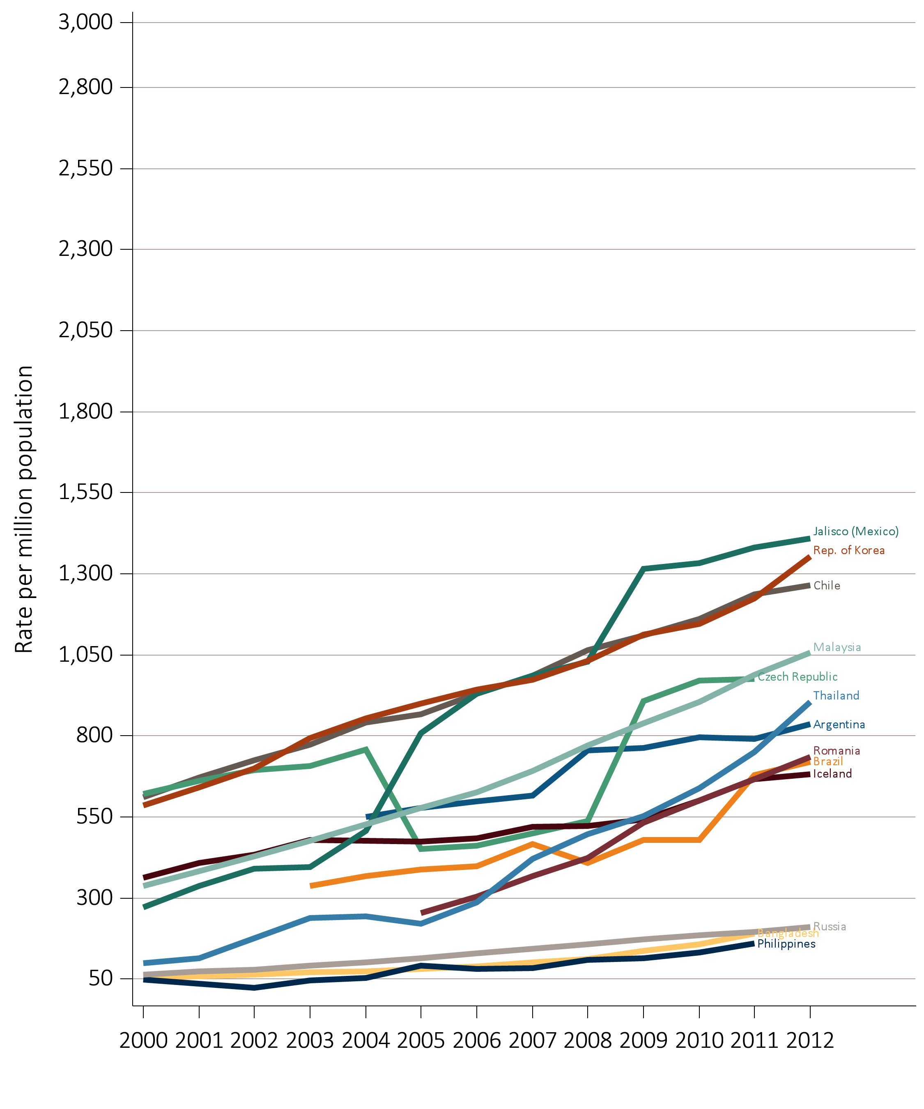
vol 2 Figure 10.6 Trends in the prevalence of ESRD, per million population, by country, years 2000-2012
(B) Countries in which the prevalence of ESRD increased by greater than 31 % from 2006-2012
Data source: Special analyses, USRDS ESRD Database. All rates are unadjusted. Data for U.S. are shown for comparison purposes. Abbreviations: ESRD, end-stage renal disease.

Slide 18
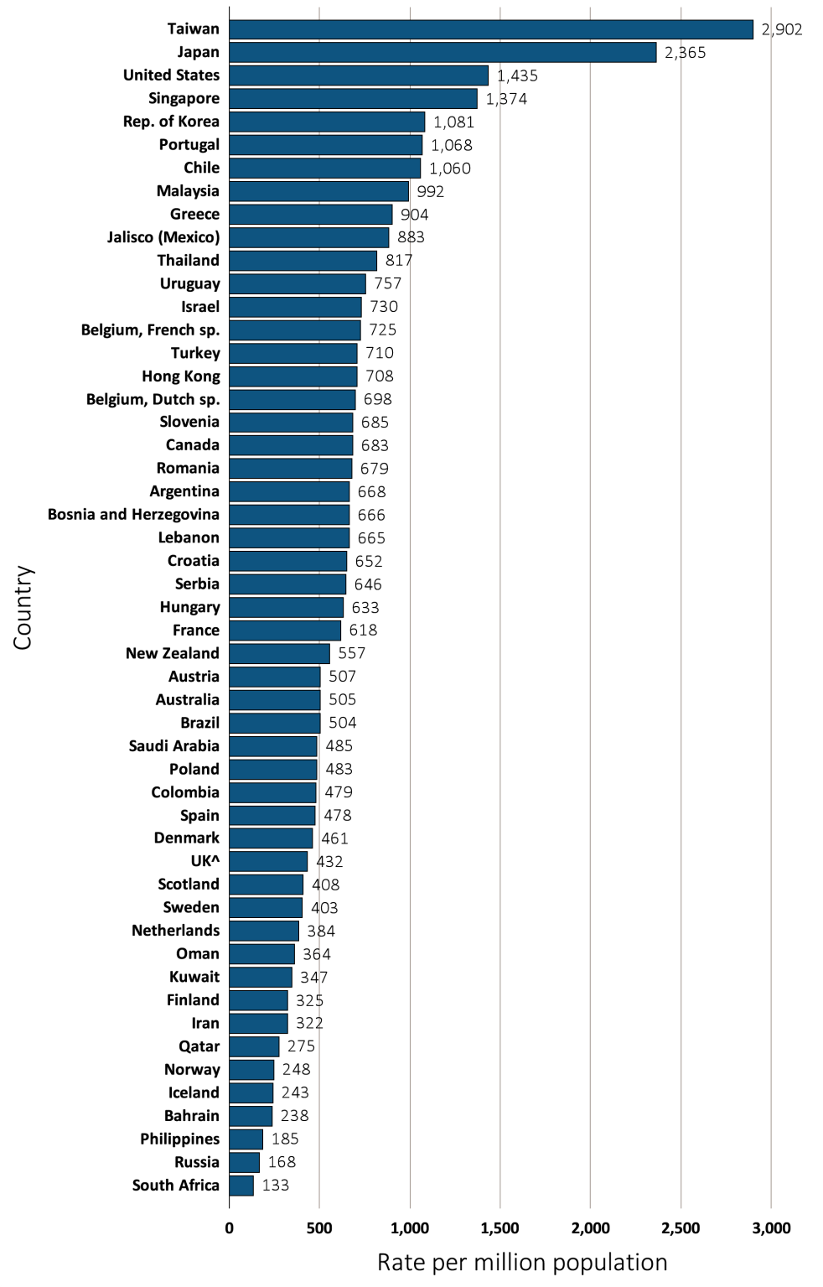
vol 2 Figure 10.7 Prevalence of dialysis, per million population, by country, in 2012
Data source: Special analyses, USRDS ESRD Database. All rates are unadjusted and reflect prevalence at the end of 2012. Japan and Taiwan include dialysis patients only. ^UK: England, Wales, & Northern Ireland (Scotland data reported separately). Data for Spain include 18 of 19 regions. Data for France include 22 regions. Data for Belgium do not include patients younger than 20. Abbreviations: sp., speaking.

Slide 19
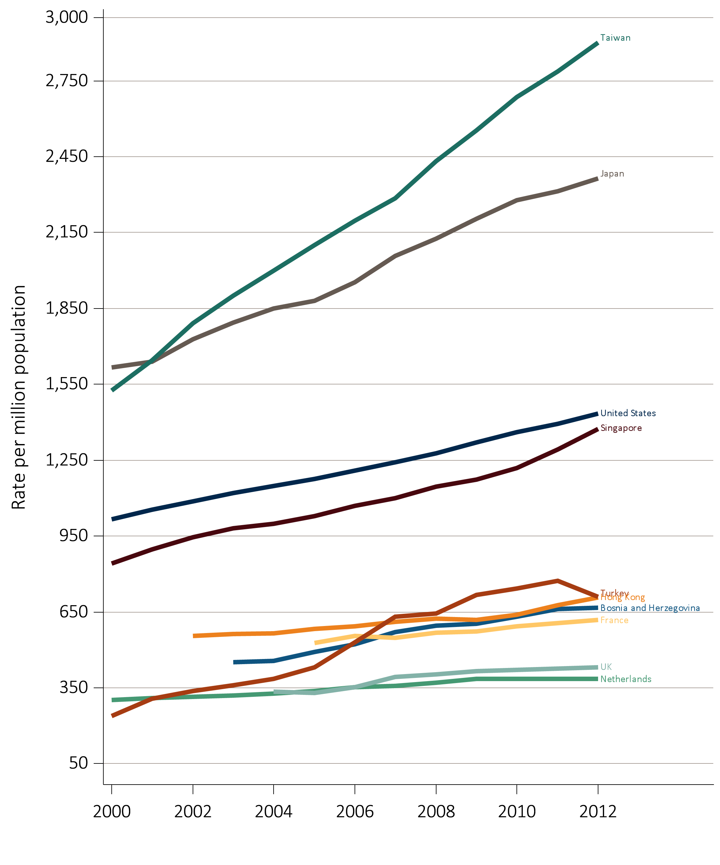
vol 2 Figure 10.8 Trends in the prevalence of dialysis, per million population, by country, years 2000-2012
(A) Countries in which the prevalence of ESRD increased by 15-31 % from 2006-2012
Data source: Special analyses, USRDS ESRD Database. All rates are unadjusted and reflect prevalence of dialysis at the end of each year. Japan includes dialysis patients only. Abbreviations: ESRD, end-stage renal disease.

Slide 20
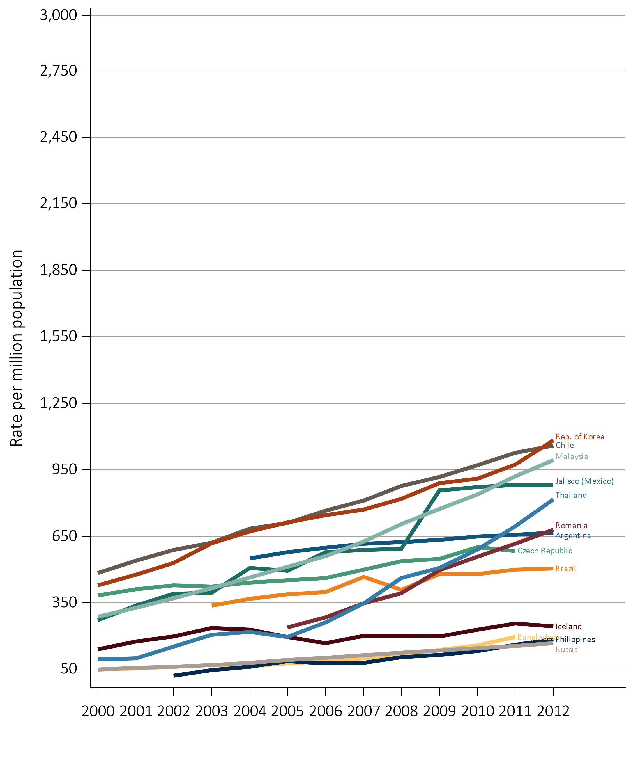
vol 2 Figure 10.8 Trends in the prevalence of dialysis, per million population, by country, years 2000-2012
(B) Countries in which the prevalence of ESRD increased by greater than 31% from 2006-2012
Data source: Special analyses, USRDS ESRD Database. All rates are unadjusted and reflect prevalence of dialysis at the end of each year. Japan includes dialysis patients only. Abbreviations: ESRD, end-stage renal disease.

Slide 21
vol 2 Table 10.3 Trends in the prevalence of dialysis, per million population, by country, years 2006-2012
Country | 2006 | 2007 | 2008 | 2009 | 2010 | 2011 | 2012 | % change from 2006 – 2012ª
Argentina | 598.0 | 615.4 | 623.4 | 634.1 | 647.6 | 657.0 | 667.8 | 9.2
Australia | 447.1 | 462.9 | 475.6 | 480.6 | 485.2 | 494.4 | 504.7 | 9.8
Austria | 469.6 | 477.7 | 487.9 | 505.4 | 507.5 | 502.5 | 506.5 | 6.5
Bahrain | . | . | 212.4 | 221.5 | 196.8 | 250.2 | 237.9
Bangladesh | 87.3 | 99.3 | 112.1 | 138.2 | 157.1 | 194.8 | . | 108.8
Belgium, Dutch sp. | 609.9 | 624.3 | 644.4 | 672.5 | 686.2 | 692.7 | 698.4 | 12.7
Belgium, French sp. | 637.8 | 657.6 | 673.0 | 671.5 | 690.8 | 699.5 | 724.9 | 10.0
Bosnia and Herzegovina | 521.1 | 569.9 | 596.5 | 602.8 | 630.7 | 661.6 | 666.2 | 21.7
Brazil | 398.3 | 466.0 | 408.5 | 480.2 | 478.7 | 499.8 | 503.9 | 16.1
Canada | 629.9 | 643.1 | 652.4 | 667.5 | 671.3 | 680.9 | 682.7 | 7.1
Chile | 764.9 | 810.2 | 876.3 | 917.9 | 969.6 | 1025.6 | 1059.9 | 32.4
Colombia | 377.6 | 403.1 | 412.7 | 408.2 | 455.4 | 447.9 | 478.7 | 18.7
Croatia | . | . | . | . | . | . | 651.7
Czech Republic | 461.9 | 499.9 | 538.1 | 548.7 | 599.8 | 584.1 | . | 21.5
Denmark | 463.8 | 498.4 | 490.0 | 487.3 | 470.7 | 461.0 | 460.8 | -4.2
Finland | 292.4 | 302.0 | 319.8 | 322.9 | 327.6 | 331.1 | 325.3 | 10.4
France | 554.0 | 546.7 | 567.4 | 573.8 | 592.8 | 606.0 | 617.7 | 11.2
Greece | 793.6 | 811.1 | 824.0 | 851.5 | 867.6 | 881.9 | 904.4 | 11.3
Hong Kong | 593.2 | 611.0 | 624.6 | 617.9 | 638.8 | 677.5 | 707.6 | 15.0
Hungary | . | . | 578.1 | 605.3 | 620.0 | 626.2 | 632.8
Iceland | 167.9 | 199.7 | 201.6 | 197.8 | 229.5 | 257.0 | 243.2 | 36.1
Indonesia | . | . | . | . | . | . | .
Iran | . | . | 245.0 | 260.8 | 277.0 | 297.5 | 322.3
Israel | 652.4 | 668.4 | 684.8 | 703.8 | 721.2 | 728.3 | 730.2 | 10.4
Italy | . | . | . | . | 792.7 | . | .
Jalisco (Mexico) | 576.9 | 586.9 | 593.4 | 856.1 | 872.1 | 881.1 | 883.0 | 51.6
Japan | 1954.5 | 2058.1 | 2126.0 | 2205.4 | 2277.4 | 2313.8 | 2365.2 | 16.6
Rep. of Korea | 746.0 | 770.6 | 818.9 | 888.7 | 910.2 | 972.4 | 1081.0 | 35.4
Kuwait | . | . | . | . | . | . | 346.6
Lebanon | . | . | . | . | . | . | 665.4
Table 10.3 continued on next slide

Slide 22
vol 2 Table 10.3 Trends in the prevalence of dialysis, per million population, by country, years 2006-2012 (continued)
Country | 2006 | 2007 | 2008 | 2009 | 2010 | 2011 | 2012 | % change from 2006–2012ª
Malaysia | 560.8 | 627.1 | 703.8 | 773.7 | 838.7 | 920.5 | 992.2 | 61.0
Morelos (Mexico) | . | 835.9 | 905.0 | 946.4 | . | . | .
Netherlands | 353.4 | 356.3 | 369.5 | 384.3 | 384.8 | 384.8 | 384.2 | 8.4
New Zealand | 477.5 | 489.8 | 493.3 | 528.5 | 546.7 | 542.3 | 557.0 | 13.6
Norway | 216.5 | 232.3 | 243.7 | 252.0 | 249.9 | 245.9 | 248.1 | 10.1
Oman | . | . | 231.0 | 250.7 | 318.8 | 333.9 | 363.7
Philippines | 75.8 | 79.4 | 104.6 | 114.0 | 132.9 | 159.4 | 184.7 | 121.7
Poland | . | . | 417.5 | 432.8 | 446.3 | 466.1 | 483.2
Portugal | . | . | 922.6 | 960.5 | 1023.7 | 1052.2 | 1068.2
Qatar | . | . | . | . | 239.1 | 262.0 | 275.2
Romania | 285.0 | 346.2 | 393.8 | 497.1 | 557.7 | 616.5 | 679.4 | 105.3
Russia | 101.6 | . | 124.4 | 135.4 | 144.3 | 154.8 | 168.3 | 59.0
Saudi Arabia | . | . | 460.7 | 474.5 | 465.5 | 470.7 | 485.4
Scotland | 414.1 | 424.4 | 415.2 | 418.7 | 418.6 | 411.2 | 407.8 | -2.3
Serbia | . | . | . | . | . | 619.9 | 645.5
Singapore | 1070.5 | 1101.0 | 1145.9 | 1173.6 | 1218.5 | 1291.8 | 1373.6 | 22.7
Slovenia | . | . | . | 715.3 | 702.9 | 688.3 | 685.4
South Africa | . | . | . | . | . | . | 132.9
Spain | 515.6 | 503.6 | 489.8 | 651.7 | 529.4 | 537.1 | 477.6 | -0.4
Sweden | 396.1 | 397.1 | 388.6 | 393.4 | 404.5 | 410.7 | 403.1 | 2.6
Taiwan | 2196.8 | 2285.1 | 2432.0 | 2554.4 | 2685.2 | 2785.9 | 2902.1 | 26.9
Thailand | 261.2 | 346.5 | 460.7 | 506.8 | 589.5 | 693.8 | 817.0 | 148.6
Turkey | 530.8 | 631.5 | 643.7 | 717.6 | 742.9 | 772.8 | 709.8 | 27.6
UK^ | 352.7 | 391.8 | 402.8 | 415.1 | 420.1 | 426.0 | 431.7 | 15.2
United States | 1210.0 | 1242.8 | 1278.0 | 1319.1 | 1360.1 | 1393.7 | 1435.4 | 15.3
Ukraine | . | . | . | . | . | . | .
Uruguay | 716.9 | 729.3 | 760.9 | 745.9 | 749.0 | 762.0 | 757.1 | 5.0
Data source: Special analyses, USRDS ESRD Database. Data presented only for countries from which relevant information was available. All rates are unadjusted. ^UK: England, Wales, & Northern Ireland (Scotland data reported separately). Data for France include 15 regions in 2006, 18 in 2007, 20 in 2008, and 22 in 2009-2012. Data for Belgium do not include patients younger than 20. Data for Spain include 18 of 19 regions. ª % change is calculated as the percent difference between the average prevalence in 2011 and 2012 and the average in 2006 and 2007. Abbreviations: sp., speaking; . signifies data not reported.

Slide 23
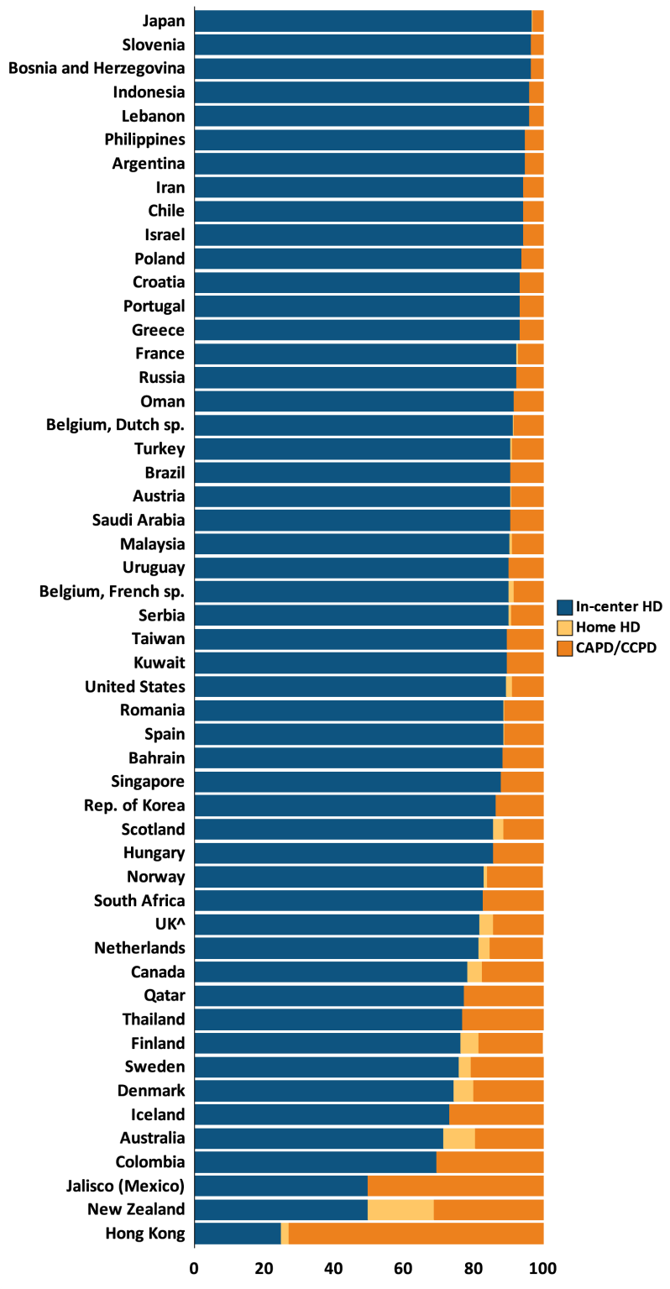
vol 2 Figure 10.9 Distribution of the percentage of prevalent dialysis patients using in-center HD, home HD, and CAPD/CCPD, in 2012
Data source: Special analyses, USRDS ESRD Database. Denominator is calculated as the sum of patients receiving HD, PD, and Home HD; does not include patients with other/unknown modality. ^UK: England, Wales, & Northern Ireland (Scotland data reported separately). Data for Spain include 18 of 19 regions. Data for France include 22 regions. Data for Indonesia represent the West Java region. Data for Belgium do not include patients younger than 20. Abbreviations: CAPD, continuous ambulatory peritoneal dialysis; CCPD, continuous cycling peritoneal dialysis; ESRD, end-stage renal disease; HD, hemodialysis; PD, peritoneal dialysis; sp., speaking.

Slide 24
vol 2 Table 10.4 Distribution of the percentage of prevalent dialysis patients using in-center HD, home HD, and CAPD/CCPD, years 2006-2012
 | In-center HD |  |  |  |  |  |  | CAPD/CCPD |  |  |  |  |  |  | Home HD
Country | 2006 | 2007 | 2008 | 2009 | 2010 | 2011 | 2012 | 2006 | 2007 | 2008 | 2009 | 2010 | 2011 | 2012 | 2006 | 2007 | 2008 | 2009 | 2010 | 2011 | 2012
Argentina | 96.0 | 96.1 | 96.0 | 96.0 | 95.8 | 95.1 | 94.8 | 4.0 | 3.9 | 4.0 | 4.0 | 4.2 | 4.9 | 5.2 | 0.0 | 0.0 | 0.0 | 0.0 | 0.0 | 0.0 | 0.0
Australia | 68.2 | 68.3 | 68.6 | 69.6 | 71.3 | 72.2 | 71.4 | 22.1 | 22.0 | 22.0 | 21.0 | 19.5 | 18.8 | 19.5 | 9.6 | 9.8 | 9.4 | 9.3 | 9.2 | 9.0 | 9.2
Austria | 90.8 | 91.2 | 91.0 | 91.0 | 91.0 | 91.6 | 90.8 | 9.0 | 8.7 | 8.9 | 8.9 | 8.9 | 8.4 | 9.1 | 0.2 | 0.1 | 0.1 | 0.0 | 0.0 | 0.1 | 0.1
Bahrain | . | . | 95.7 | 95.8 | 95.5 | 95.3 | 88.4 | . | . | 4.3 | 4.2 | 4.5 | 4.7 | 11.6 | . | . | 0.0 | 0.0 | 0.0 | 0.0 | 0.0
Bangladesh | 99.6 | 98.4 | 98.3 | 98.3 | 98.3 | 98.3 | . | 0.4 | 1.6 | 1.7 | 1.7 | 1.7 | 1.7 | . | 0.0 | 0.0 | 0.0 | 0.0 | 0.0 | 0.0 | .
Belgium, Dutch sp. | 89.1 | 89.2 | 89.7 | 89.8 | 90.6 | 90.9 | 91.5 | 10.7 | 10.6 | 10.1 | 9.9 | 9.1 | 9.0 | 8.2 | 0.2 | 0.2 | 0.3 | 0.3 | 0.3 | 0.1 | 0.3
Belgium, French sp. | 89.2 | 90.5 | 90.7 | 90.3 | 89.8 | 90.1 | 90.3 | 9.5 | 8.3 | 8.0 | 8.4 | 8.7 | 8.3 | 8.2 | 1.3 | 1.2 | 1.3 | 1.3 | 1.4 | 1.6 | 1.5
Bosnia and Herzegovina | 95.3 | 95.2 | 95.1 | 94.9 | 95.2 | 96.0 | 96.5 | 4.7 | 4.7 | 4.9 | 5.0 | 4.8 | 4.0 | 3.5 | 0.0 | 0.1 | 0.0 | 0.0 | 0.0 | 0.0 | .
Brazil | 90.8 | 89.4 | 89.6 | 92.3 | 90.6 | 91.6 | 90.8 | 9.2 | 10.6 | 10.4 | 7.7 | 9.4 | 8.4 | 9.2 | 0.0 | 0.0 | 0.0 | 0.0 | 0.0 | 0.0 | .
Canada | 78.9 | 78.6 | 78.4 | 78.4 | 78.5 | 78.9 | 78.4 | 18.4 | 18.4 | 18.4 | 18.1 | 17.8 | 17.1 | 17.5 | 2.8 | 3.0 | 3.3 | 3.5 | 3.7 | 3.9 | 4.1
Chile | 95.0 | 95.2 | 95.3 | 95.3 | 95.1 | 94.6 | 94.5 | 5.0 | 4.8 | 4.7 | 4.7 | 4.9 | 5.4 | 5.5 | 0.0 | 0.0 | 0.0 | 0.0 | 0.0 | 0.0 | 0.0
Colombia | 63.9 | 63.4 | 68.0 | 68.2 | 68.7 | 69.1 | 69.4 | 36.1 | 36.6 | 32.0 | 31.8 | 31.3 | 30.9 | 30.6 | 0.0 | 0.0 | 0.0 | 0.0 | 0.0 | 0.0 | 0.0
Croatia | 91.6 | 92.8 | 91.8 | 91.0 | 91.5 | 92.1 | 93.5 | 8.4 | 7.2 | 8.2 | 9.0 | 8.5 | 7.9 | 6.5 | 0.0 | 0.0 | 0.0 | 0.0 | 0.0 | 0.0 | .
Czech Republic | 92.4 | 92.3 | 91.8 | 92.0 | 92.1 | 91.7 | . | 7.6 | 7.7 | 8.2 | 8.0 | 7.9 | 8.3 | . | 0.0 | 0.0 | 0.0 | 0.0 | 0.0 | 0.0 | .
Denmark | 72.0 | 71.8 | 72.9 | 73.4 | 73.7 | 74.9 | 74.5 | 23.9 | 24.5 | 22.9 | 21.6 | 20.8 | 19.5 | 19.8 | 4.1 | 3.7 | 4.2 | 5.1 | 5.5 | 5.6 | 5.7
Finland | 76.0 | 75.8 | 74.3 | 75.0 | 77.1 | 77.4 | 76.4 | 21.2 | 20.4 | 21.7 | 21.3 | 19.0 | 18.4 | 18.2 | 2.9 | 3.8 | 3.9 | 3.7 | 4.0 | 4.1 | 5.3
France | 85.4 | 87.4 | 87.8 | 91.9 | 92.1 | 92.5 | 92.4 | 12.6 | 11.1 | 10.9 | 7.3 | 7.2 | 6.9 | 7.0 | 2.0 | 1.6 | 1.4 | 0.8 | 0.7 | 0.6 | 0.6
Greece | 91.5 | 91.7 | 91.7 | 92.0 | 92.3 | 92.8 | 93.4 | 8.4 | 8.3 | 8.3 | 7.9 | 7.7 | 7.2 | 6.6 | 0.0 | 0.0 | 0.0 | 0.0 | 0.0 | 0.0 | 0.0
Hong Kong | 18.8 | 19.8 | 20.4 | 21.5 | 23.5 | 24.4 | 25.0 | 81.1 | 80.0 | 79.2 | 77.9 | 75.6 | 74.1 | 72.9 | 0.0 | 0.2 | 0.4 | 0.6 | 0.9 | 1.5 | 2.1
Hungary | . | . | 88.3 | 87.2 | 86.5 | 85.8 | 85.7 | . | . | 11.7 | 12.8 | 13.5 | 14.2 | 14.3 | . | . | 0.0 | 0.0 | 0.0 | 0.0 | 0.0
Table 10.4 continued on next slide

Slide 25
vol 2 Table 10.4 Distribution of the percentage of prevalent dialysis patients using in-center HD, home HD, and CAPD/CCPD, years 2006-2012 (continued)
 | In-center HD |  |  |  |  |  |  | CAPD/CCPD |  |  |  |  |  |  | Home HD
Country | 2006 | 2007 | 2008 | 2009 | 2010 | 2011 | 2012 | 2006 | 2007 | 2008 | 2009 | 2010 | 2011 | 2012 | 2006 | 2007 | 2008 | 2009 | 2010 | 2011 | 2012
Iceland | 70.6 | 72.1 | 76.6 | 87.3 | 83.6 | 80.5 | 73.1 | 29.4 | 26.2 | 21.9 | 12.7 | 16.4 | 19.5 | 26.9 | 0.0 | 1.6 | 1.6 | 0.0 | 0.0 | 0.0 | .
Indonesia | . | . | . | . | . | . | 96.1 | . | . | . | . | . | . | 3.9 | . | . | . | . | . | . | 0.0
Iran | . | . | 93.8 | 93.6 | 93.7 | 93.6 | 94.5 | . | . | 6.2 | 6.4 | 6.3 | 6.4 | 5.5 | . | . | 0.0 | 0.0 | 0.0 | 0.0 | 0.0
Israel | 91.9 | 92.9 | 93.6 | 93.3 | 93.8 | 94.1 | 94.3 | 8.1 | 7.1 | 6.4 | 6.7 | 6.2 | 5.9 | 5.7 | 0.0 | 0.0 | 0.0 | 0.0 | 0.0 | 0.0 | 0.0
Italy | . | . | . | . | 90.0 | . | . | . | . | . | . | 10.0 | . | . | . | . | . | . | . | . | .
Jalisco (Mexico) | 29.5 | 34.2 | 40.4 | 41.5 | 48.7 | 50.6 | 49.8 | 70.5 | 65.8 | 59.6 | 58.5 | 51.3 | 49.4 | 50.2 | 0.0 | 0.0 | 0.0 | 0.0 | 0.0 | 0.0 | 0.0
Japan | 96.8 | 96.7 | 96.8 | 96.7 | 96.7 | 96.8 | 96.9 | 3.2 | 3.3 | 3.1 | 3.2 | 3.2 | 3.1 | 3.0 | 0.1 | 0.1 | 0.1 | 0.1 | 0.1 | 0.1 | 0.1
Rep. of Korea | 78.4 | 80.2 | 81.0 | 83.1 | 84.4 | 84.7 | 86.5 | 21.6 | 19.8 | 19.0 | 16.9 | 15.6 | 15.3 | 13.5 | 0.0 | 0.0 | 0.0 | 0.0 | 0.0 | 0.0 | 0.0
Kuwait | . | . | . | . | . | . | 89.7 | . | . | . | . | . | . | 10.3 | . | . | . | . | . | . | 0.0
Lebanon | . | . | . | . | . | . | 96.0 | . | . | . | . | . | . | 4.0 | . | . | . | . | . | . | .
Malaysia | 90.2 | 89.9 | 90.0 | 90.3 | 90.6 | 90.8 | 90.4 | 8.7 | 9.1 | 9.0 | 8.7 | 8.4 | 8.3 | 8.8 | 1.1 | 1.0 | 1.0 | 1.0 | 1.0 | 1.0 | 0.9
Morelos (Mexico) | . | 40.6 | 43.2 | 42.4 | . | . | . | . | 59.4 | 56.8 | 57.6 | . | . | . | . | 0.0 | 0.0 | 0.0 | . | . | .
Netherlands | 74.8 | 76.0 | 77.4 | 79.0 | 79.5 | 81.5 | 81.7 | 22.9 | 21.7 | 20.1 | 18.5 | 17.8 | 15.8 | 15.2 | 2.3 | 2.3 | 2.5 | 2.5 | 2.7 | 2.7 | 3.0
New Zealand | 45.5 | 48.2 | 48.1 | 48.4 | 47.4 | 48.8 | 49.7 | 38.3 | 36.0 | 36.2 | 35.1 | 34.8 | 33.2 | 31.3 | 16.1 | 15.8 | 15.7 | 16.6 | 17.8 | 18.1 | 19.0
Norway | 80.5 | 80.6 | 83.4 | 80.7 | 81.3 | 84.2 | 83.1 | 19.1 | 19.1 | 16.4 | 18.8 | 18.0 | 15.3 | 15.8 | 0.4 | 0.3 | 0.3 | 0.5 | 0.7 | 0.6 | 1.0
Oman | . | . | 95.7 | 96.1 | 95.8 | 95.9 | 91.8 | . | . | 4.3 | 3.9 | 4.2 | 4.1 | 8.2 | . | . | 0.0 | 0.0 | 0.0 | 0.0 | 0.0
Philippines | 94.5 | 87.3 | 93.3 | 95.6 | 95.9 | 96.4 | 94.9 | 5.5 | 12.7 | 6.7 | 4.4 | 4.1 | 3.6 | 5.1 | 0.0 | 0.0 | 0.0 | 0.0 | 0.0 | 0.0 | .
Poland | . | . | 93.1 | 93.3 | 93.5 | 94.1 | 94.0 | . | . | 6.9 | 6.7 | 6.5 | 5.9 | 6.0 | . | . | 0.0 | 0.0 | 0.0 | 0.0 | 0.0
Portugal | . | . | 94.8 | 94.4 | 93.9 | 93.7 | 93.4 | . | . | 5.2 | 5.6 | 6.1 | 6.3 | 6.6 | . | . | 0.0 | 0.0 | 0.0 | 0.0 | .
Qatar | . | . | . | . | 70.9 | 73.5 | 77.4 | . | . | . | . | 29.1 | 26.5 | 22.6 | . | . | . | . | 0.0 | 0.0 | 0.0
Romania | 80.6 | 81.8 | 82.8 | 84.5 | 86.4 | 87.7 | 88.8 | 19.4 | 18.2 | 17.1 | 15.5 | 13.5 | 12.2 | 11.1 | 0.0 | 0.0 | 0.0 | 0.0 | 0.0 | 0.1 | 0.1
Russia | 91.0 | . | 91.0 | 91.3 | 91.4 | 91.6 | 92.3 | 9.0 | . | 9.0 | 8.7 | 8.6 | 8.4 | 7.7 | 0.0 | . | 0.0 | 0.0 | 0.0 | 0.0 | 0.0
Saudi Arabia | . | . | 92.2 | 90.8 | 90.5 | 90.7 | 90.6 | . | . | 7.8 | 9.2 | 9.5 | 9.3 | 9.4 | . | . | . | . | . | . | .
Scotland | 79.0 | 80.7 | 82.6 | 83.8 | 84.8 | 85.3 | 85.7 | 19.3 | 17.5 | 15.1 | 13.7 | 12.8 | 12.0 | 11.2 | 1.7 | 1.9 | 2.2 | 2.5 | 2.4 | 2.7 | 3.1
Table 10.4 continued on next slide

Slide 26
vol 2 Table 10.4 Distribution of the percentage of prevalent dialysis patients using in-center HD, home HD, and CAPD/CCPD, years 2006-2012 (continued)
 | In-center HD |  |  |  |  |  |  | CAPD/CCPD |  |  |  |  |  |  | Home HD
Country | 2006 | 2007 | 2008 | 2009 | 2010 | 2011 | 2012 | 2006 | 2007 | 2008 | 2009 | 2010 | 2011 | 2012 | 2006 | 2007 | 2008 | 2009 | 2010 | 2011 | 2012
Serbia | . | . | . | . | . | 90.5 | 90.2 | . | . | . | . | . | 8.8 | 9.1 | . | . | . | . | . | 0.7 | 0.7
Singapore | 81.1 | 82.5 | 85.6 | 86.3 | 87.4 | 87.2 | 87.9 | 18.8 | 17.4 | 14.4 | 13.6 | 12.5 | 12.8 | 12.0 | 0.1 | 0.1 | 0.1 | 0.1 | 0.1 | 0.1 | 0.1
Slovenia | . | . | . | 95.7 | 96.5 | 96.7 | 96.7 | . | . | . | 4.3 | 3.5 | 3.3 | 3.3 | . | . | . | 0.0 | 0.0 | 0.0 | 0.0
South Africa | . | . | . | . | . | . | 82.7 | . | . | . | . | . | . | 17.3 | . | . | . | . | . | . | .
Spain | 90.1 | 89.4 | 90.6 | 90.6 | 89.8 | 89.3 | 88.7 | 9.7 | 10.5 | 9.2 | 9.2 | 10.0 | 10.6 | 11.1 | 0.2 | 0.1 | 0.3 | 0.2 | 0.2 | 0.2 | 0.2
Sweden | 75.5 | 73.0 | 73.3 | 73.6 | 74.7 | 75.6 | 76.0 | 21.9 | 24.2 | 23.9 | 23.6 | 22.5 | 21.3 | 20.6 | 2.6 | 2.9 | 2.8 | 2.8 | 2.8 | 3.1 | 3.4
Taiwan | 92.4 | 91.5 | 90.7 | 90.5 | 90.3 | 90.1 | 89.7 | 7.6 | 8.5 | 9.3 | 9.5 | 9.7 | 9.9 | 10.3 | 0.0 | 0.0 | 0.0 | 0.0 | 0.0 | . | .
Thailand | 95.8 | 94.5 | 90.5 | 84.1 | 81.9 | 78.6 | 76.9 | 4.2 | 5.5 | 9.5 | 15.9 | 18.1 | 21.4 | 23.1 | 0.0 | 0.0 | 0.0 | 0.0 | 0.0 | 0.0 | 0.0
Turkey | 88.7 | 88.1 | 87.4 | 89.6 | 90.4 | 91.8 | 90.8 | 11.3 | 11.9 | 12.5 | 10.4 | 9.6 | 8.2 | 8.9 | 0.0 | 0.0 | 0.0 | 0.0 | 0.0 | 0.0 | 0.3
UK | 78.6 | 78.9 | 81.1 | 82.0 | 82.2 | 82.1 | 81.8 | 19.4 | 19.1 | 16.8 | 15.5 | 14.9 | 14.4 | 14.2 | 2.0 | 2.0 | 2.1 | 2.5 | 2.9 | 3.4 | 4.0
United States | 91.4 | 91.4 | 91.5 | 91.4 | 90.9 | 90.3 | 89.4 | 8.0 | 7.8 | 7.6 | 7.6 | 7.9 | 8.4 | 8.9 | 0.6 | 0.7 | 0.9 | 1.0 | 1.2 | 1.3 | 1.7
Ukraine | . | . | . | . | . | . | . | . | . | . | . | . | . | . | . | . | . | . | . | . | .
Uruguay | 92.6 | 90.6 | 91.1 | 90.8 | 90.1 | 90.1 | 90.3 | 7.4 | 9.4 | 8.9 | 9.2 | 9.9 | 9.9 | 9.7 | 0.0 | 0.0 | 0.0 | 0.0 | 0.0 | 0.0 | 0.0
Data source: Special analyses, USRDS ESRD Database. Denominator is calculated as the sum of patients receiving HD, PD, and Home HD; does not include patients with other/unknown modality. ^UK: England, Wales, & Northern Ireland (Scotland data reported separately). Data for France include 15 regions in 2006, 18 in 2007, 20 in 2008, and 22 in 2009-2012. Data for Spain include 18 of 19 regions. Data for Belgium do not include patients younger than 20. Data for Indonesia represent the West Java region. Abbreviations: CAPD, continuous ambulatory peritoneal dialysis; CCPD, continuous cycling peritoneal dialysis; HD, hemodialysis; PD, peritoneal dialysis; sp., speaking; . signifies data not reported.

Slide 27
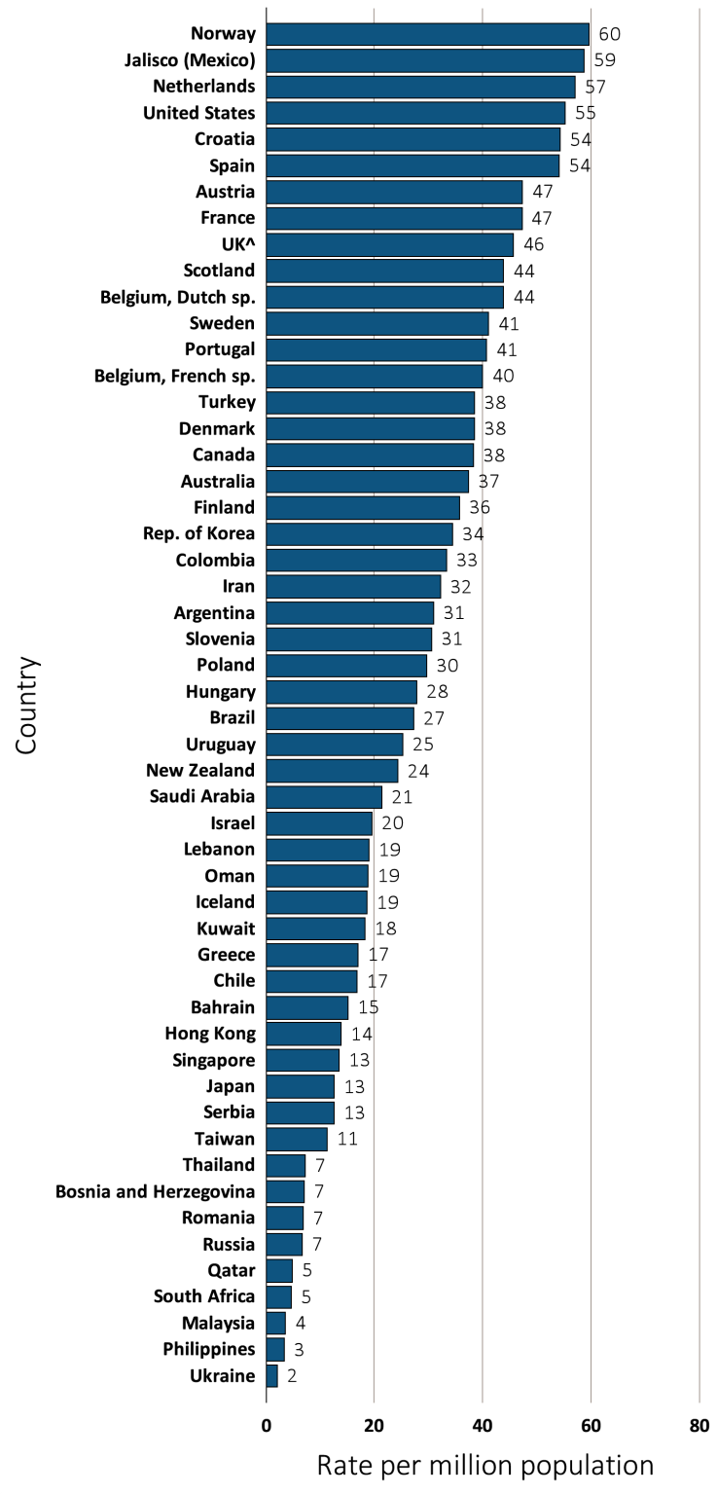
vol 2 Figure 10.10 Kidney transplantation rate, per million population, by country, in 2012
Data source: Special analyses, USRDS ESRD Database. Data presented only for countries from which relevant information was available. All rates are unadjusted. ^UK: England, Wales, & Northern Ireland (Scotland data reported separately). Data for Belgium do not include patients younger than 20. Data for France include 22 regions. Data for Spain include all regions. There is underreporting of prevalent transplant patients in Turkey. Abbreviations: sp., speaking.

Slide 28
vol 2 Table 10.5 Kidney transplantation rates, per million population, by country, years 2006-2012
Country | 2006 | 2007 | 2008 | 2009 | 2010 | 2011 | 2012 | % change from 2006 – 2012ª
Argentina | 21.7 | 23.0 | 25.1 | 26.4 | 28.4 | 28.9 | 30.9 | 33.8
Australia | 31.0 | 29.3 | 38.0 | 35.5 | 38.3 | 37.0 | 37.3 | 23.2
Austria | 47.9 | 43.7 | 39.5 | 47.4 | 44.6 | 45.0 | 47.3 | 0.8
Bahrain | . | . | 10.8 | 18.7 | 11.3 | 6.7 | 15.2
Bangladesh | 0.2 | 0.5 | 0.5 | 0.6 | 0.6 | 0.8 | . | 128.6
Belgium, Dutch sp. | 39.7 | 43.3 | 40.3 | 39.6 | 38.4 | 41.1 | 43.8 | 2.3
Belgium, French sp. | 39.3 | 40.8 | 37.4 | 37.7 | 37.3 | 43.1 | 40.0 | 3.7
Bosnia and Herzegovina | 6.8 | 8.4 | 9.1 | 7.0 | 6.0 | 6.3 | 7.1 | -11.8
Brazil | 17.8 | 18.5 | 20.1 | 22.3 | 24.4 | 25.5 | 27.2 | 45.2
Canada | 38.4 | 39.5 | 38.3 | 37.7 | 37.9 | 37.7 | 38.3 | -2.4
Chile | 18.5 | 17.1 | 16.8 | 15.1 | 13.5 | 15.6 | 16.7 | -9.3
Colombia | 29.8 | 29.5 | 16.1 | 18.9 | 38.9 | 34.9 | 33.3 | 15.0
Croatia | . | . | . | . | . | . | 54.3
Czech Republic | 41.6 | 38.0 | 31.9 | 34.0 | 27.2 | 31.6 | . | -20.6
Denmark | 30.8 | 31.4 | 34.9 | 40.7 | 41.2 | 44.2 | 38.4 | 32.8
Finland | 39.7 | 32.3 | 28.0 | 33.0 | 32.8 | 33.0 | 35.8 | -4.4
France | 39.9 | 45.1 | 44.9 | 44.8 | 45.7 | 46.4 | 47.2 | 10.1
Greece | 22.2 | 21.9 | 24.0 | 15.0 | 11.1 | 17.8 | 16.9 | -21.3
Hong Kong | 9.6 | 9.5 | 11.0 | 13.4 | 11.3 | 9.3 | 13.8 | 20.9
Hungary | . | . | 25.7 | 27.1 | 30.7 | 25.1 | 27.8
Iceland | 26.3 | 22.5 | 25.2 | 31.4 | 31.4 | 50.2 | 18.7 | 41.2
Indonesia | . | . | . | . | . | . | .
Iran | . | . | 26.7 | 28.3 | 31.4 | 30.5 | 32.2
Israel | 43.2 | 37.7 | 33.1 | 28.6 | 23.7 | 36.7 | 19.5 | -30.5
Italy | . | . | . | . | . | . | .
Jalisco (Mexico) | 52.2 | 59.3 | 54.3 | 58.1 | 60.1 | 62.2 | 58.7 | 8.4
Japan | . | . | . | . | 11.7 | 12.5 | 12.6
Rep. of Korea | 18.8 | 18.5 | 22.7 | 24.5 | 25.1 | 31.7 | 34.4 | 77.2
Kuwait | . | . | . | . | . | . | 18.3
Lebanon | . | . | . | . | . | . | 19.0
Table 10.5 continued on next slide

Slide 29
vol 2 Table 10.5 Kidney transplantation rates, per million population, by country, years 2006-2012 (continued)
Country | 2006 | 2007 | 2008 | 2009 | 2010 | 2011 | 2012 | % change from 2006 – 2012ª
Malaysia | 11.1 | 8.2 | 4.7 | 5.1 | 4.5 | 4.3 | 3.6 | -59.1
Morelos (Mexico) | . | 54.6 | 44.5 | 41.8 | . | . | .
Netherlands | 41.0 | 51.0 | 47.3 | 50.0 | 52.5 | 51.6 | 57.1 | 18.2
New Zealand | 21.5 | 29.1 | 28.6 | 28.0 | 25.2 | 26.8 | 24.4 | 1.2
Norway | 45.5 | 55.2 | 58.3 | 60.5 | 53.8 | 61.0 | 59.6 | 19.8
Oman | . | . | 14.8 | 17.8 | 18.5 | 20.1 | 18.8
Philippines | 7.5 | 11.1 | 7.1 | 5.2 | 4.0 | 3.8 | 3.3 | -61.8
Poland | . | . | 21.2 | 20.6 | 25.9 | 27.0 | 29.7
Portugal | . | . | 49.4 | 55.7 | 54.3 | 50.2 | 40.6
Qatar | . | . | 2.1 | 1.2 | 5.2 | 5.2 | 4.9
Romania | 5.3 | 2.8 | 7.3 | 6.6 | 6.5 | 8.6 | 6.8 | 90.1
Russia | 2.9 | . | 5.6 | 5.9 | 7.3 | 6.8 | 6.6 | 131.0
Saudi Arabia | . | . | 16.3 | 15.1 | 18.6 | 19.5 | 21.4
Scotland | 26.4 | 37.7 | 41.0 | 40.6 | 35.4 | 37.5 | 43.8 | 26.8
Serbia | . | . | . | . | . | 15.6 | 12.5
Singapore | 24.1 | 23.2 | 20.0 | 18.5 | 16.2 | 17.7 | 13.4 | -34.2
Slovenia | . | . | . | 22.6 | 31.2 | 23.4 | 30.6
South Africa | . | . | . | . | . | . | 4.7
Spain | . | . | 48.3 | 49.8 | 47.3 | 52.9 | 54.0
Sweden | 40.5 | 42.3 | 45.6 | 42.3 | 39.3 | 45.3 | 41.0 | 4.2
Taiwan | . | . | 12.5 | 13.6 | 12.1 | 14.0 | 11.2
Thailand | 3.6 | 5.9 | 5.4 | 4.8 | 5.5 | 6.3 | 7.2 | 42.1
Turkey | 11.6 | 18.6 | 18.1 | 26.3 | 34.5 | 39.3 | 38.4 | 157.3
UK^ | 34.1 | 38.3 | 40.3 | 42.4 | 44.4 | 44.2 | 45.7 | 24.2
United States | 60.8 | 58.4 | 57.5 | 58.0 | 57.6 | 56.7 | 55.2 | -6.1
Ukraine | . | . | . | . | . | . | 2.1
Uruguay | 42.8 | 28.9 | 37.5 | 35.0 | 25.6 | 39.0 | 25.3 | -10.3
Data source: Special analyses, USRDS ESRD Database. Data presented only for countries from which relevant information was available. All rates are unadjusted. ^UK: England, Wales, & Northern Ireland (Scotland data reported separately). Data for France include 15 regions in 2006, 18 in 2007, 20 in 2008, and 22 in 2009-2012. Data for Belgium do not include patients younger than 20. There is underreporting of prevalent transplant patients in Turkey.
ª % change is calculated as the percent difference between the average rate in 2011 and 2012 and the average in 2006 and 2007. Abbreviations: sp., speaking; . signifies data not reported.

Slide 30
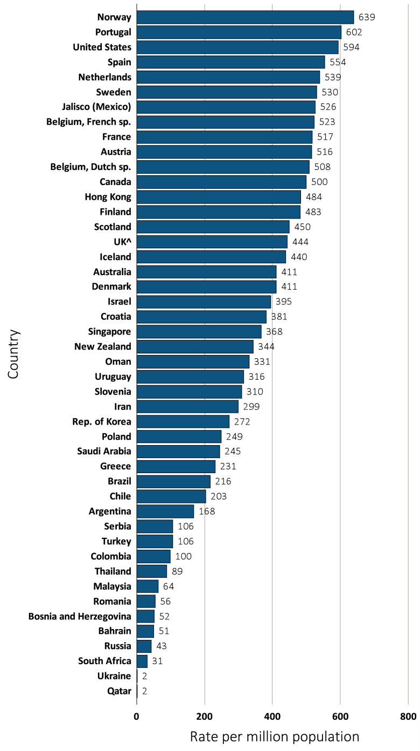
vol 2 Figure 10.11 Prevalence of ESRD patients with a functioning kidney transplant, per million population, by country, in 2012
Data source: Special analyses, USRDS ESRD Database. Data presented only for countries from which relevant information was available. All rates are unadjusted. ^UK: England, Wales, & Northern Ireland (Scotland data reported separately). Data for Spain include 18 of 19 regions. Data for France include 22 regions. Data for Belgium do not include patients younger than 20. Abbreviations: ESRD, end-stage renal disease; sp., speaking.

Slide 31
vol 2 Table 10.6 Trends in the prevalence of ESRD patients with a functioning kidney transplant, per million population, by country, years 2006-2012
Country | 2006 | 2007 | 2008 | 2009 | 2010 | 2011 | 2012 | % change from 2006 – 2012ª
Argentina | . | . | 132.3 | 127.9 | 147.2 | 133.6 | 168.0
Australia | 331.2 | 338.4 | 358.0 | 369.5 | 385.5 | 397.7 | 410.9 | 20.8
Austria | 438.9 | 455.8 | 460.0 | 474.7 | 484.2 | 498.0 | 516.3 | 13.4
Bahrain | . | . | 62.4 | 57.7 | 53.5 | 52.7 | 50.5
Bangladesh | 3.5 | . | . | . | . | . | .
Belgium, Dutch sp. | 423.3 | 439.4 | 451.6 | 463.9 | 474.6 | 490.5 | 507.8 | 15.7
Belgium, French sp. | 433.7 | 453.2 | 471.4 | 467.4 | 486.1 | 507.4 | 523.0 | 16.2
Bosnia and Herzegovina | 31.6 | 31.8 | 40.4 | 43.6 | 42.3 | 47.0 | 51.6 | 55.5
Brazil | . | . | . | . | . | 178.8 | 216.3
Canada | 409.2 | 428.1 | 441.7 | 456.8 | 471.0 | 485.1 | 499.9 | 17.6
Chile | 164.8 | 175.4 | 188.9 | 190.8 | 191.5 | 210.1 | 203.4 | 21.5
Colombia | . | . | 60.6 | 59.8 | 88.8 | 88.3 | 99.7
Croatia | . | . | . | . | . | . | 381.3
Czech Republic | . | . | . | 358.9 | 370.3 | 390.3 | .
Denmark | 318.0 | 333.6 | 341.6 | 355.8 | 376.5 | 395.4 | 410.7 | 23.7
Finland | 434.5 | 445.5 | 449.4 | 459.3 | 468.4 | 474.4 | 482.5 | 8.7
France | 408.6 | 407.3 | 425.7 | 466.5 | 485.5 | 503.2 | 517.3 | 25.1
Greece | 192.5 | 202.3 | 214.8 | 217.6 | 215.4 | 221.2 | 231.3 | 14.6
Hong Kong | 409.7 | 420.4 | 442.8 | 459.8 | 467.5 | 474.9 | 484.1 | 15.5
Hungary | . | . | . | . | . | . | .
Iceland | 316.0 | 318.8 | 321.3 | 345.4 | 371.0 | 410.6 | 439.6 | 33.9
Indonesia | . | . | . | . | . | . | .
Iran | . | . | 245.7 | 268.0 | 279.4 | 288.0 | 298.9
Israel | 357.5 | 372.1 | 386.0 | 382.9 | 380.7 | 391.9 | 395.2 | 7.9
Italy | . | . | . | . | . | . | .
Jalisco (Mexico) | 352.0 | 399.4 | 436.2 | 458.2 | 460.2 | 500.4 | 525.8 | 36.6
Japan | . | . | . | . | . | . | .
Rep. of Korea | 195.7 | 202.2 | 212.8 | 224.8 | 234.1 | 252.4 | 272.3 | 31.9
Kuwait | . | . | . | . | . | . | .
Lebanon | . | . | . | . | . | . | .
Table 10.6 continued on next slide

Slide 32
vol 2 Table 10.6 Trends in the prevalence of ESRD patients with a functioning kidney transplant, per million population, by country, years 2006-2012 (continued)
Country | 2006 | 2007 | 2008 | 2009 | 2010 | 2011 | 2012 | % change from 2006 – 2012ª
Malaysia | 65.6 | 65.3 | 65.6 | 66.4 | 66.6 | 66.6 | 64.2 | -0.1
Morelos (Mexico) | . | 41.9 | 34.3 | 31.6 | . | . | .
Netherlands | 418.9 | 446.1 | 450.5 | 467.7 | 490.8 | 512.6 | 539.1 | 21.6
New Zealand | 298.0 | 303.4 | 316.2 | 325.3 | 329.7 | 336.7 | 343.8 | 13.2
Norway | 536.6 | 551.7 | 573.2 | 592.3 | 609.5 | 629.1 | 639.2 | 16.5
Oman | . | . | 232.5 | 241.4 | 296.5 | 315.4 | 331.1
Philippines | 4.8 | 5.3 | 5.2 | . | . | . | .
Poland | . | . | 240.8 | 210.4 | 208.8 | 240.6 | 249.0
Portugal | . | . | 484.2 | 544.7 | 565.8 | 609.8 | 602.1
Qatar | . | . | 2.1 | 1.2 | 5.2 | 5.2 | 1.6
Romania | 19.7 | 22.0 | 28.6 | 36.0 | 42.2 | 49.8 | 55.6 | 152.8
Russia | 28.5 | . | 33.7 | 37.7 | 41.2 | 41.6 | 43.4 | 49.1
Saudi Arabia | . | . | 336.8 | 318.2 | 298.4 | 261.1 | 244.9
Scotland | 369.0 | 386.5 | 394.7 | 408.9 | 418.2 | 431.0 | 449.8 | 16.6
Serbia | . | . | . | . | . | 102.2 | 106.4
Singapore | 329.6 | 340.8 | 348.9 | 353.3 | 360.0 | 370.0 | 367.8 | 10.1
Slovenia | . | . | . | 265.2 | 283.6 | 296.2 | 310.1
South Africa | . | . | . | . | . | . | 30.7
Spain | 445.4 | 452.7 | 505.0 | 495.3 | 516.1 | 537.6 | 553.5 | 21.5
Sweden | 454.5 | 469.5 | 487.1 | 500.1 | 507.8 | 520.4 | 530.0 | 13.7
Taiwan | . | . | . | . | . | . | .
Thailand | 20.5 | 57.4 | 36.3 | 46.0 | 49.8 | 56.0 | 88.9 | 86.0
Turkey | 58.4 | 80.0 | 109.4 | 101.6 | 104.4 | 95.4 | 105.8 | 45.4
UK^ | 287.5 | 345.8 | 370.4 | 389.2 | 410.0 | 424.6 | 444.1 | 37.2
United States | 490.9 | 509.7 | 527.0 | 543.9 | 560.8 | 577.3 | 593.5 | 17.0
Ukraine | . | . | . | . | . | . | 2.1
Uruguay | 210.3 | 234.7 | 255.5 | 272.7 | 284.2 | 312.9 | 315.6 | 41.2
Data source: Special analyses, USRDS ESRD Database. Data presented only for countries from which relevant information was available. All rates are unadjusted. ^UK: England, Wales, & Northern Ireland (Scotland data reported separately). Data for France include 15 regions in 2006, 18 in 2007, 20 in 2008, and 22 in 2009-2012. Data for Belgium do not include patients younger than 20. There is underreporting of prevalent transplant patients in Turkey . ª % change is calculated as the percent difference between the average prevalence in 2011 and 2012 and the average in 2006 and 2007. Abbreviations: ESRD, end-stage renal disease; sp., speaking; . signifies data not reported.

