Slide 2
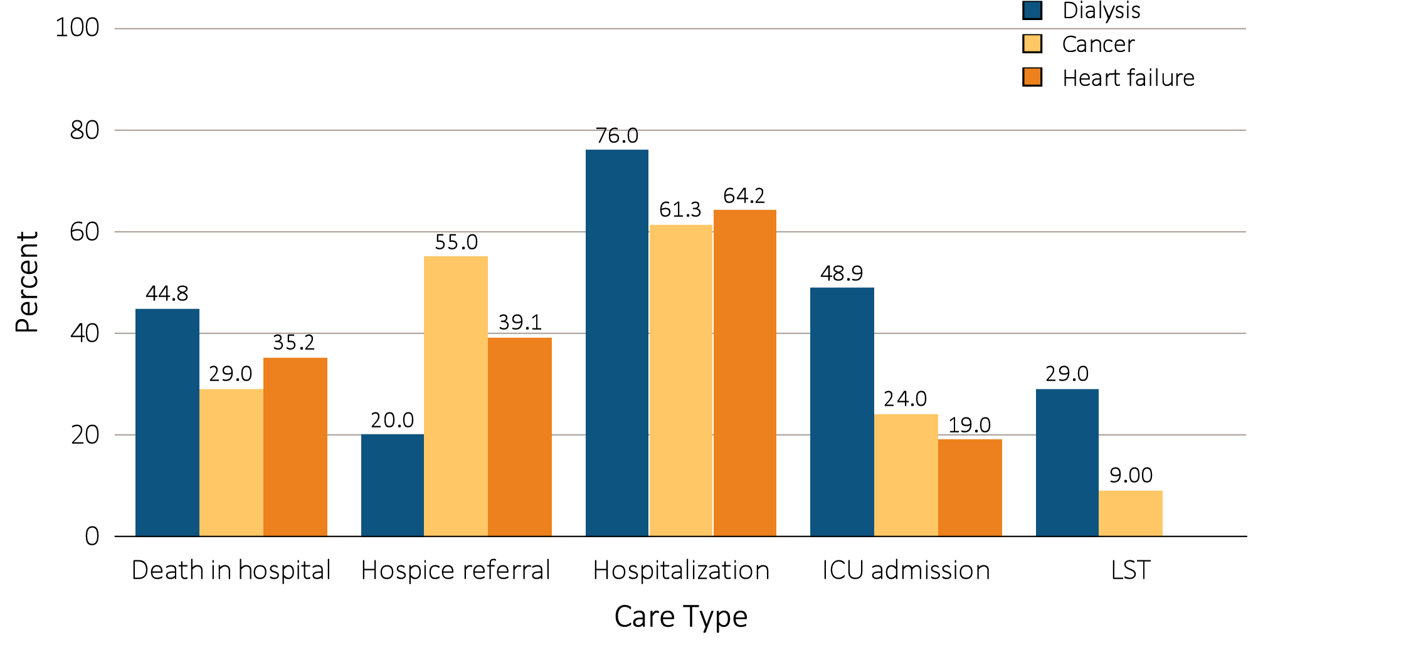
vol 2 Figure 11.1 Patterns of health care utilization during the last month of life among older Medicare beneficiaries with ESRD vs. other conditions
Data Source: Adapted from Wong et al, 2012. Abbreviations: ICU, intensive care unit; LST, life-sustaining treatment.

