Slide 2
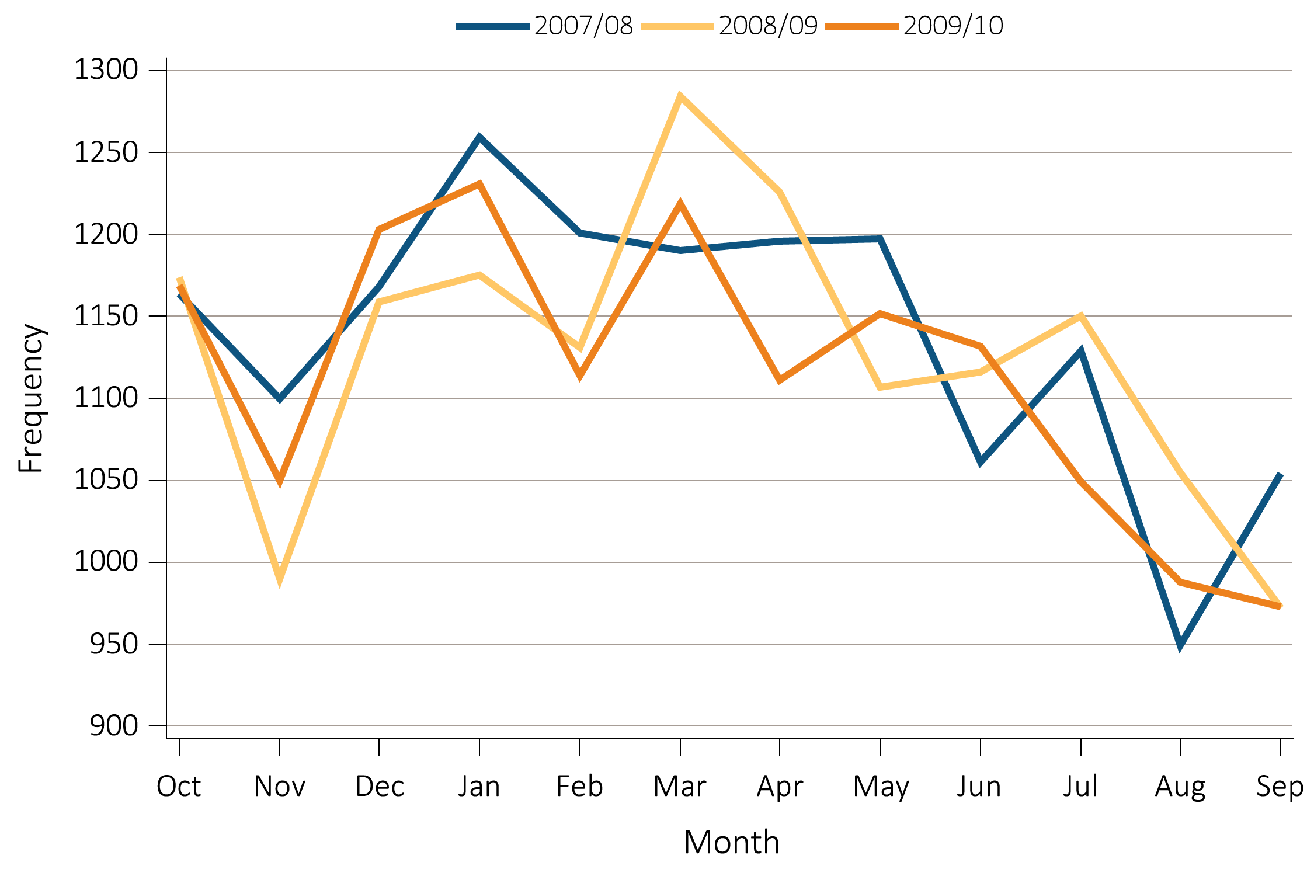
vol 2 Figure 12.1 Monthly variation in patient enrollment in 52,172 incident ESRD veterans 10/1/2007-9/30/2011
Transition rates are reported for each month Abbreviations: ESRD, end-stage renal disease.

Slide 3
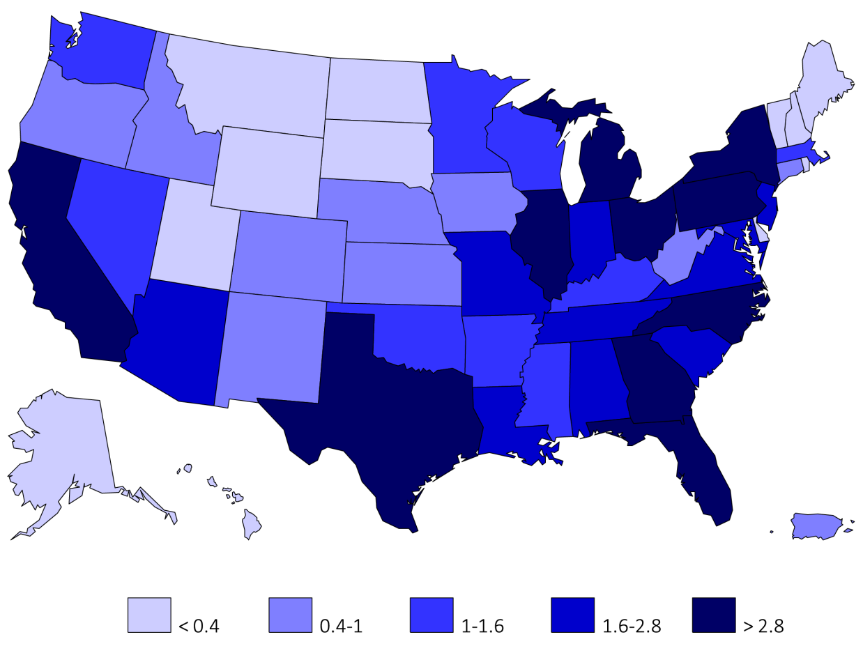
vol 2 Figure 12.2 Distribution and density of the 52,172 incident ESRD veterans across states and territories of the United States 10/1/2007-9/30/2011
States and territories of the United States of America. Abbreviations: ESRD, end-stage renal disease.

Slide 4
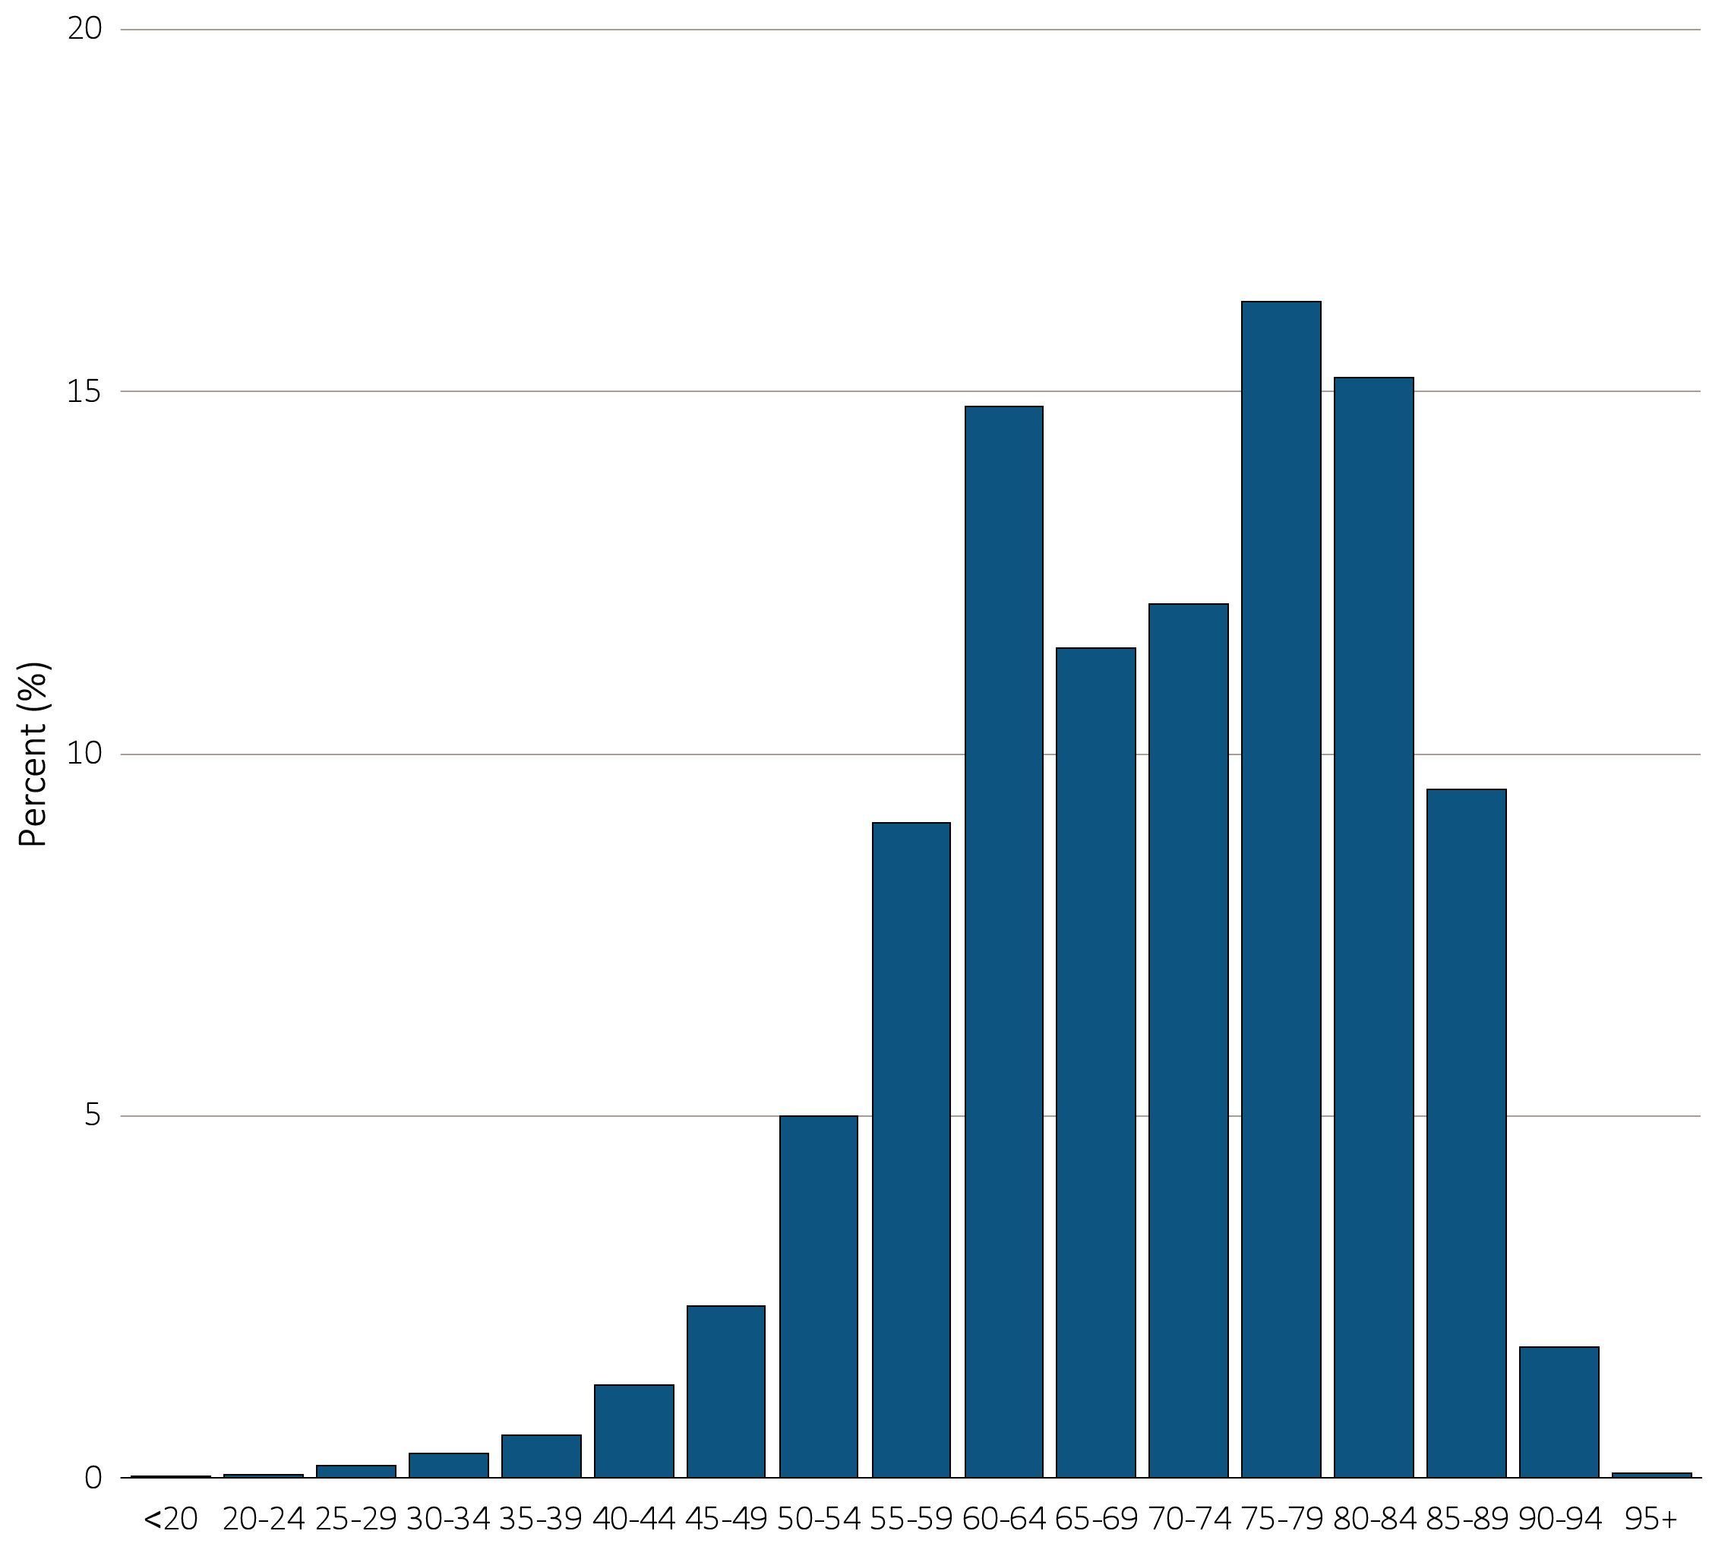
vol 2 Figure 12.3 Age in 5-year increments at first ESRD service in 52,172 incident ESRD veterans, 10/1/2007-9/30/2011
Age groups are in 5-year increments except for <20 and >95 years or older. Abbreviations: ESRD, end-stage renal disease.

Slide 5
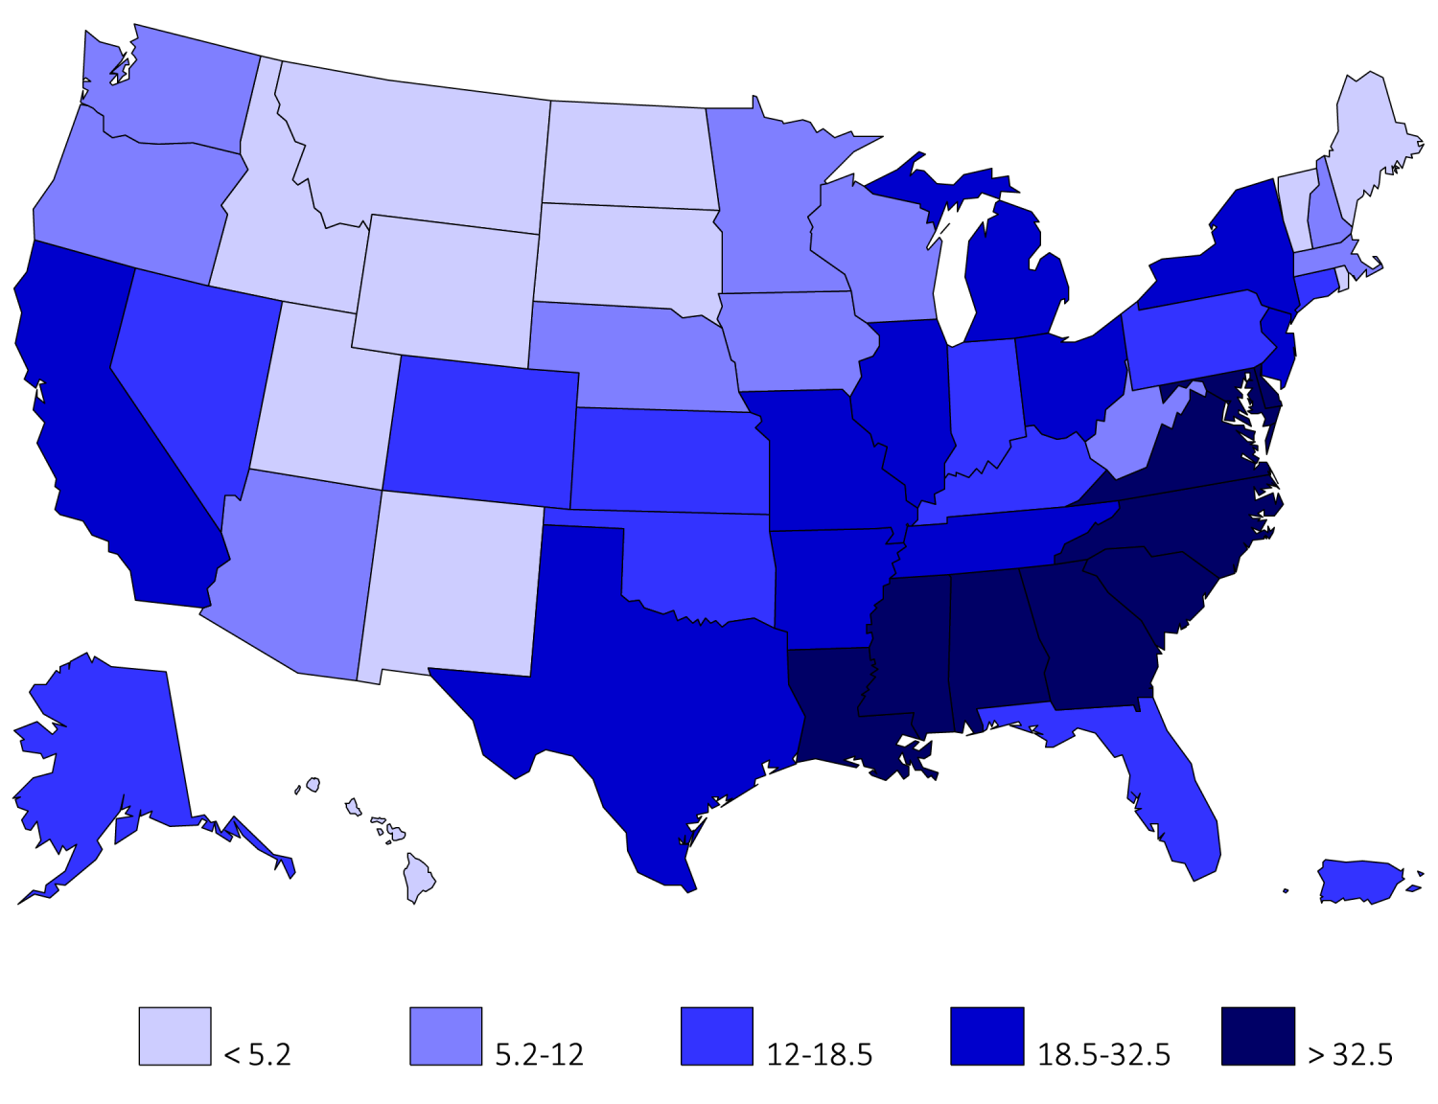
vol 2 Figure 12.4 Distribution of Black incident ESRD veterans in the United States, 10/1/2007-9/30/2011
States and territories of the United States of America. Abbreviations: ESRD, end-stage renal disease.

Slide 6
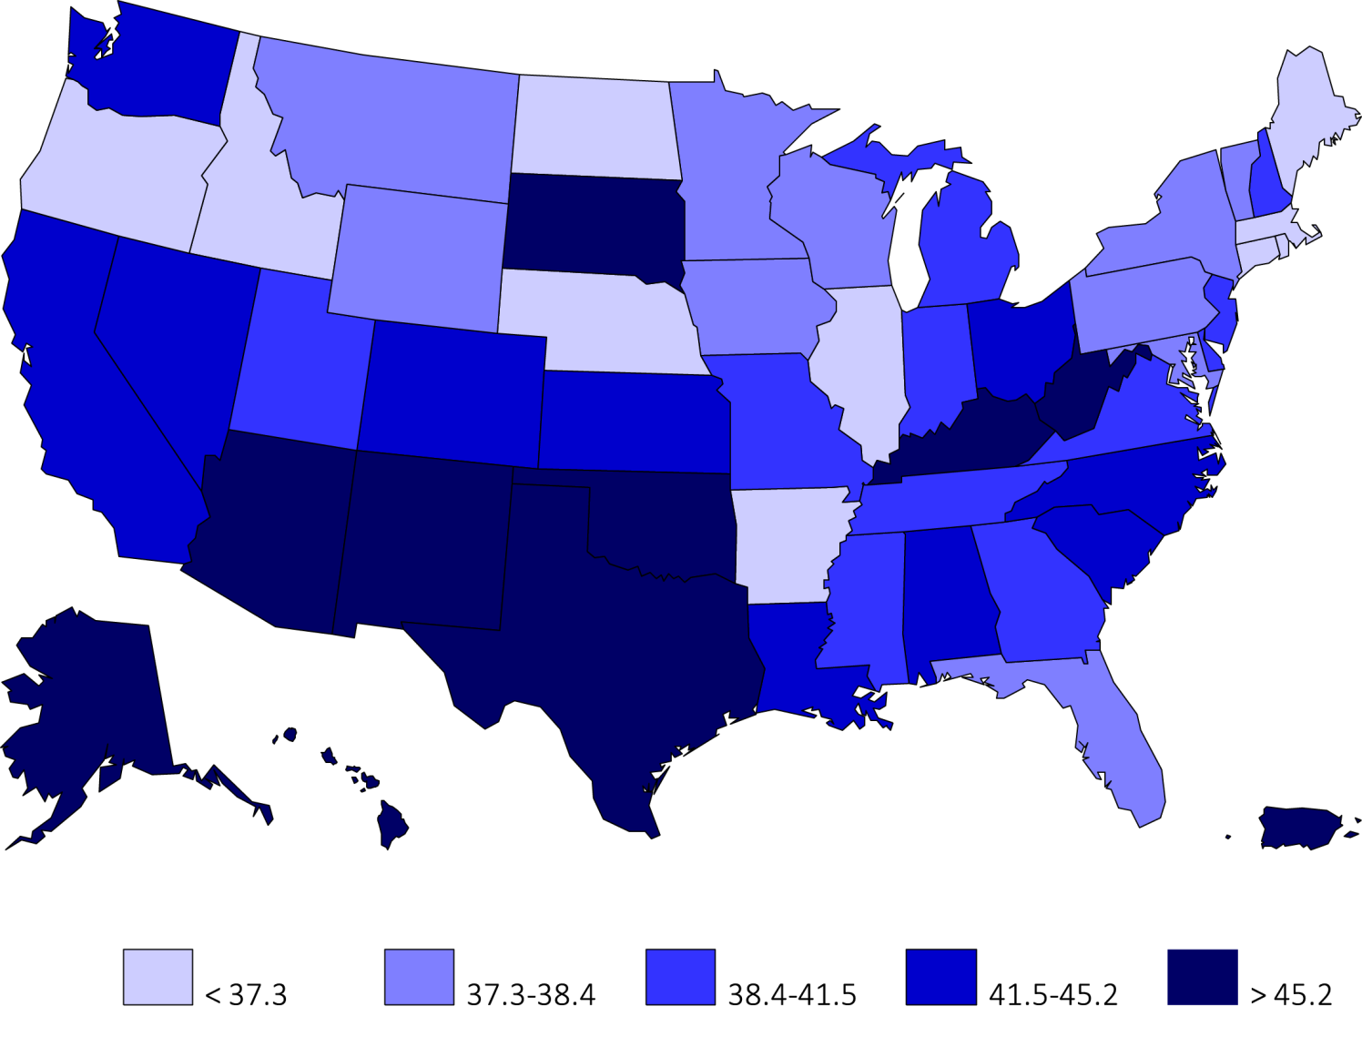
vol 2 Figure 12.5 Distribution of diabetes mellitus as the primary cause of kidney disease among incident ESRD veterans in the United States, 10/1/2007-9/30/2011
States and territories of the United States of America. Abbreviations: ESRD, end-stage renal disease.

Slide 7
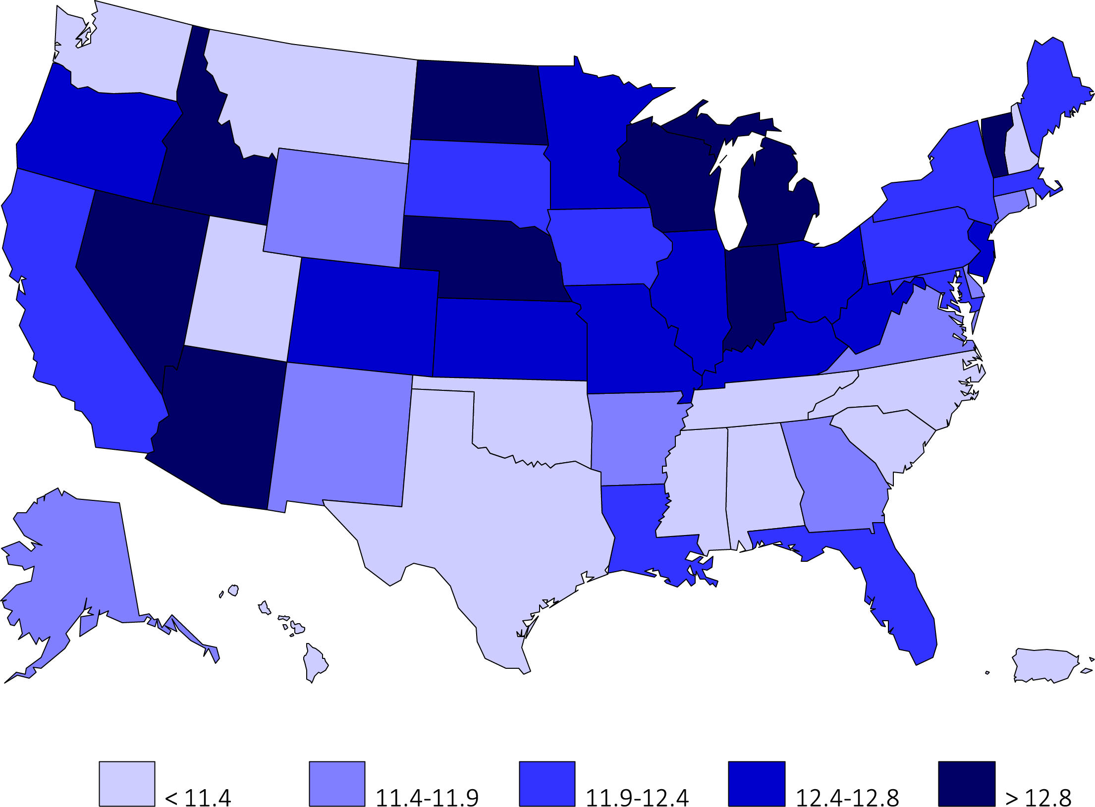
vol 2 Figure 12.6 Distribution of eGFR upon KRT in 52,172 incident ESRD veterans in the United States, 10/1/2007-9/30/2011
States and territories of the United States of America. Abbreviations: ESRD, end-stage renal disease.

Slide 8
vol 2 Table 12.1 Status of 52,172 incident ESRD veterans during the first 90 days after transition to KRT, 10/1/2007-9/30/2011
 | Day 1 |  | Day 30 |  | Day 60 |  | Day 90
 | n | % | n | % | n | % | n | %
Dialysis modality
In-center | 43,256 | 82.9 | 43,258 | 82.9 | 43,163 | 82.7 | 40,918 | 78.4
Home HD | 260 | 0.5 | 260 | 0.5 | 259 | 0.5 | 258 | 0.5
CAPD | 1,405 | 2.7 | 1,405 | 2.7 | 1,398 | 2.7 | 1,302 | 2.5
CCPD | 1,174 | 2.2 | 1,174 | 2.2 | 1,182 | 2.3 | 1.395 | 2.7
Uncertain* | 5287 | 10.1 | 3,495 | 6.7 | 612 | 1.2 | 447 | 0.9
Outcomes**
Death | 201 | 0.4 | 1,561 | 3 | 3,672 | 7 | 5,348 | 10.3
Transplant | 589 | 1.1 | 654 | 1.3 | 679 | 1.3 | 701 | 1.3
Lost to follow-up | n/a | . | 3 | <0.1 | 3 | <0.1 | 5 | <0.1
Recovered | n/a | . | 362 | 0.7 | 1,204 | 2.3 | 1,798 | 3.5
Total | 52,172 | 100 |  | 100 |  | 100 | 52,172 | 100
* Uncertain groups have no known dialysis modality. ** n for outcomes is cumulative for subsequent periods after Day 1.Abbreviations: ESRD, end-stage renal disease; HD hemodialysis; CAPD, continuous ambulatory peritoneal dialysis; CCPD, continuous cycling peritoneal dialysis.

Slide 9
vol 2 Table 12.2 Day 1 of ESRD service in 52,172 incident ESRD veterans upon transition to KRT, 10/1/2007-9/30/2011
 | All veterans | VHA | FMC | DVT | Other Chains | Non-Chain | Provider not known
Veterans, n (%) | 52,172 (100%) | 5,157 (9.9%) | 14,380 (27.6%) | 12,766 (24.5%) | 6,850 (13.1%) | 11,007 (21.1%) | 2,010 (3.9%)
Number of facilities | 5504 | 68 | 1686 | 1352 | 793 | 1425
Age, year (SD) | 70.3 (12.1) | 64.6 (11.4) | 70.7 (11.8) | 70.3 (12.1) | 71.2 (11.9) | 72.1 (11.8) | 68.3 (13.6)
Older than 85 yrs (%) | 11.4 | 4.6 | 11.1 | 11.3 | 12.2 | 14.3 | 12.3
Females (%) | 5.7 | 2.5 | 6.1 | 6 | 6.1 | 5.7 | 7.6
Race/ethnicity
Native American (%) | 1 | 0.7 | 0.8 | 1.1 | 0.8 | 1.5 | 1.1
Asian (%) | 1.8 | 1.8 | 1.3 | 1.7 | 3.4 | 1.2 | 5
Black (%) | 24.1 | 41.3 | 23.4 | 24.9 | 22.1 | 18.5 | 18.3
White (%) | 72.6 | 55.7 | 74.3 | 72.1 | 73.6 | 78.6 | 69.9
Hispanic (%) | 6 | 8.8 | 5.9 | 5.4 | 6.1 | 5.3 | 6.7
Primary cause of ESRD
Diabetes (%) | 41.7 | 47 | 42.6 | 42.7 | 41.7 | 40.1 | 23.7
Hypertension (%) | 31.4 | 22.2 | 34.2 | 32.8 | 32.6 | 32.3 | 18.2
GN (%) | 5.5 | 7.8 | 5.1 | 4.9 | 5.6 | 5 | 7.8
Cystic kidney (%) | 1.5 | 1.6 | 1.5 | 1.5 | 1.3 | 1.4 | 3.7
Percentages and standard deviation values are in parentheses. Abbreviations: BMI, body mass index; DVT, DaVita; eGFR, estimated glomerular filtration rate; ESRD, end-stage renal disease; FMC, Fresenius Medical Care; GN, glomerulonephritis; HD, hemodialysis; KRT, kidney replacement therapy; PD, peritoneal dialysis; SD, standard deviation; VHA, Veterans Health Administration.

Slide 10
vol 2 Table 12.2 Day 1 of ESRD service in 52,172 incident ESRD veterans upon transition to KRT, 10/1/2007-9/30/2011
(continued)
 | All veterans | VHA | FMC | DVT | Other Chains | Non-Chain | Provider not known
Veterans, n (%) | 52,172 (100%) | 5,157 (9.9%) | 14,380 (27.6%) | 12,766 (24.5%) | 6,850 (13.1%) | 11,007 (21.1%) | 2,010 (3.9%)
KRT modality
HD (%) | 82.9 | 90.6 | 84.8 | 84.6 | 84.9 | 78.2 | 51.6
PD (%) | 4.9 | 3.6 | 4.9 | 5.1 | 4.9 | 5.7 | 3.2
Mortality (%) | 0.4 | 0 | 0 | 0 | 0 | 0 | 10
Transplant (%) | 1.1 | 1.1 | 0 | 0 | 0 | 0 | 26.4
Recovered function | n/a | n/a | n/a | n/a | n/a | n/a | n/a
Laboratory data
Hemoglobin, g/dL | 10.0 (1.6) | 9.8 (1.6) | 10.0 (1.6) | 10.0 (1.6) | 10.1 (1.6) | 10.1 (1.5) | 10.5 (1.7)
Albumin (d/dL) | 3.2 (0.7) | 3.2 (0.7) | 3.2 (0.7) | 3.2 (0.7) | 3.2 (0.7) | 3.2 (0.7) | 3.4 (0.7)
Creatinine (mg/dL) | 6.0 (2.9) | 6.9 (3.1) | 6.0 (2.9) | 6.0 (2.9) | 5.9 (2.9) | 5.8 (2.8) | 5.4 (2.6)
eGFR (ml/min/1.73m²) | 12.1 (5.1) | 10.9 (4.4) | 12.1 (5.1) | 12.2 (5.1) | 12.3 (5.2) | 12.4 (5.2) | 13.1 (5.3)
BMI (kg/m²) (SD) | 28.3 (6.7) | 28.6 (6.8) | 28.6 (6.9) | 28.2 (6.6) | 28.0 (6.6) | 28.0 (6.6) | 28.6 (5.8)
Percentages and standard deviation values are in parentheses. Abbreviations: BMI, body mass index; DVT, DaVita; eGFR, estimated glomerular filtration rate; ESRD, end-stage renal disease; FMC, Fresenius Medical Care; GN, glomerulonephritis; HD, hemodialysis; KRT, kidney replacement therapy; PD, peritoneal dialysis; SD, standard deviation; VHA, Veterans Health Administration.

Slide 11
vol 2 Table 12.3 Status of ESRD service after 3 months among 44,220 ESRD veterans after transitioning to KRT, including selected outcomes over the first 3 months in veterans who transitioned to KRT during 10/1/2007-9/30/2011
 | All veterans | VHA | FMC | DVT | Other chains | Non-chain | Provider not known
Veterans, n (%) | 44,220 (100.0%) | 4,714 (10.7%) | 12,313 (27.8%) | 10,900 (24.6%) | 5,838 (13.2%) | 9,339 (21.1%) | 1,116 (2.5%)
Number of facilities | 5494 | 68 | 1686 | 1530 | 792 | 1418 | .
Age, year (SD) | 69.8±12.0 | 64.4±11.2 | 70.2±11.8 | 69.8±12.0 | 70.7±12.0 | 71.6±11.8 | 69.6±12.6
Older than 85 yrs (%) | 10.3 | 4.2 | 10 | 10.1 | 11.5 | 13.1 | 11.2
Female (%) | 5.7 | 2.5 | 6.3 | 6.1 | 6.2 | 5.9 | 6
Race/ethnicity
Native American (%) | 1.1 | 0.6 | 0.9 | 1.2 | 0.9 | 1.6 | 0.6
Asian (%) | 1.9 | 1.6 | 1.5 | 1.8 | 3.6 | 1.2 | 3.9
Black (%) | 25.9 | 42.6 | 24.9 | 26.6 | 23.8 | 19.6 | 22
White (%) | 70.8 | 54.7 | 72.5 | 70.2 | 71.7 | 77.4 | 65.4
Hispanic (%) | 6.3 | 9.1 | 6.2 | 5.8 | 6.1 | 5.5 | 8
Primary cause of ESRD
Diabetes (%) | 44 | 49.1 | 44.3 | 44.9 | 43.7 | 42 | 30.6
Hypertension (%) | 31.9 | 22.5 | 34.4 | 33.2 | 33 | 32.3 | 21.5
GN (%) | 5.7 | 8 | 5.5 | 5.2 | 6 | 5.4 | 4.1
Cystic kidney (%) | 1.6 | 1.6 | 1.6 | 1.6 | 1.5 | 1.6 | 0.8
KRT modality
HD (%) | 92.3 | 96.1 | 93.5 | 92.8 | 93.3 | 91 | 65.1
PD (%) | 6.1 | 3.9 | 5.9 | 6.4 | 6.2 | 7.3 | 4.7
Mortality (%) | 10.4 | 5.9 | 10.3 | 10.3 | 10.7 | 4 | 48.8
Transplant (%) | 1.4 | 1.2 | 0.1 | 0.2 | 0.1 | 0.1 | 24.6
Recovered function | 3.5 | 0.9 | 4.1 | 4.3 | 4 | 3.1 | 0.8
Percentages and standard deviation values are in parentheses. Abbreviations: DVT, DaVita; ESRD, end-stage renal disease; FMC, Fresenius Medical Care; GN, glomerulonephritis; HD, hemodialysis; KRT, kidney replacement therapy; PD, peritoneal dialysis; VHA, Veterans Health Administration.

Slide 12
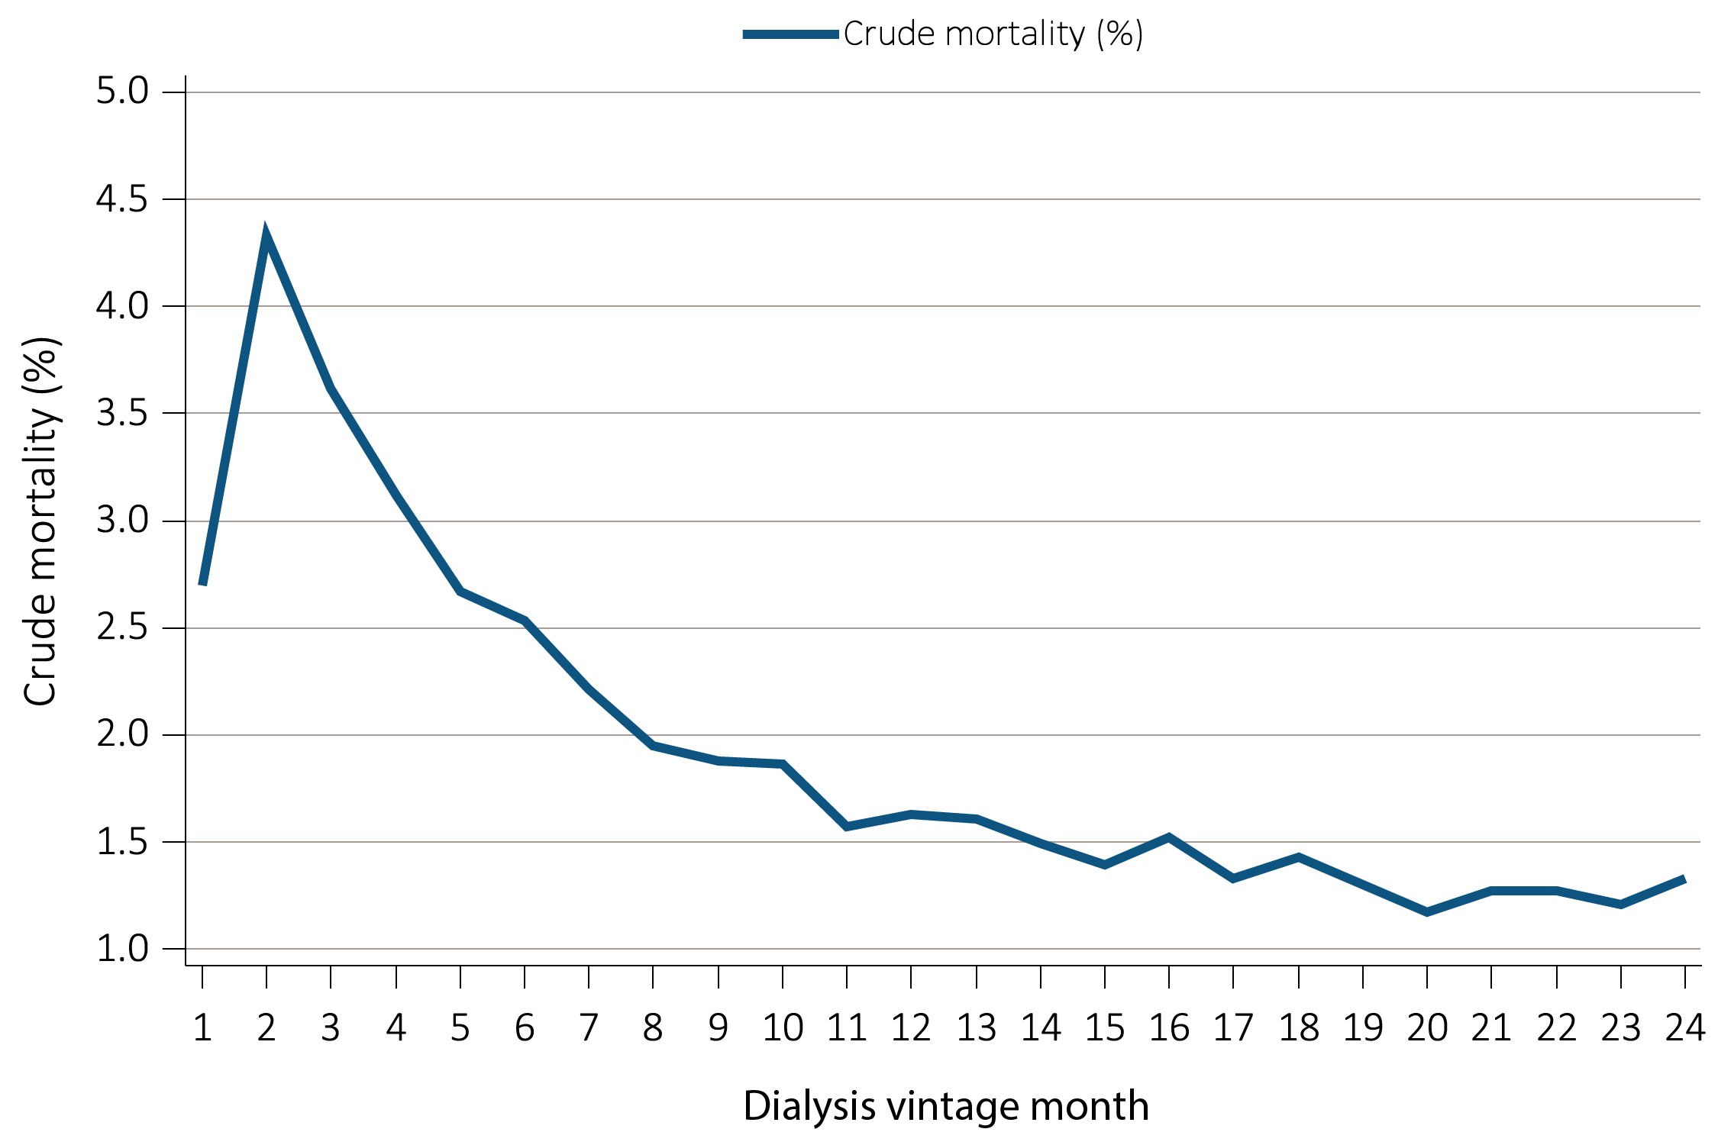
vol 2 Figure 12.7 Monthly crude mortality among 52,172 incident ESRD veterans who transitioned to KRT during 10/1/2007-9/30/2011 and who were followed for up to 24 months post-KRT
All mortality rates are crude and without any adjustment. Abbreviations: ESRD, end-stage renal disease; KRT, kidney replacement therapy.

Slide 13
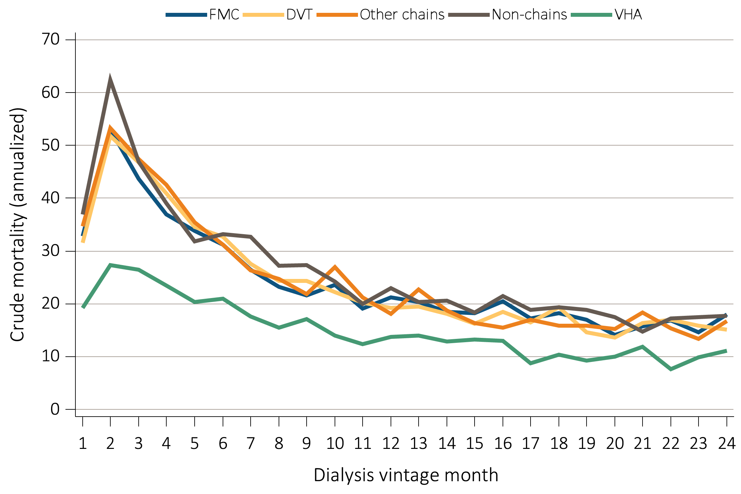
vol 2 Figure 12.8 Annualized monthly crude mortality of incident ESRD veterans who transitioned to KRT during 10/1/2007-9/30/2011 and who were followed for up to 24 months, by dialysis provider.
All mortality rates are crude and without any adjustment. Abbreviations: ESRD, end-stage renal disease; KRT, kidney replacement therapy.

Slide 14
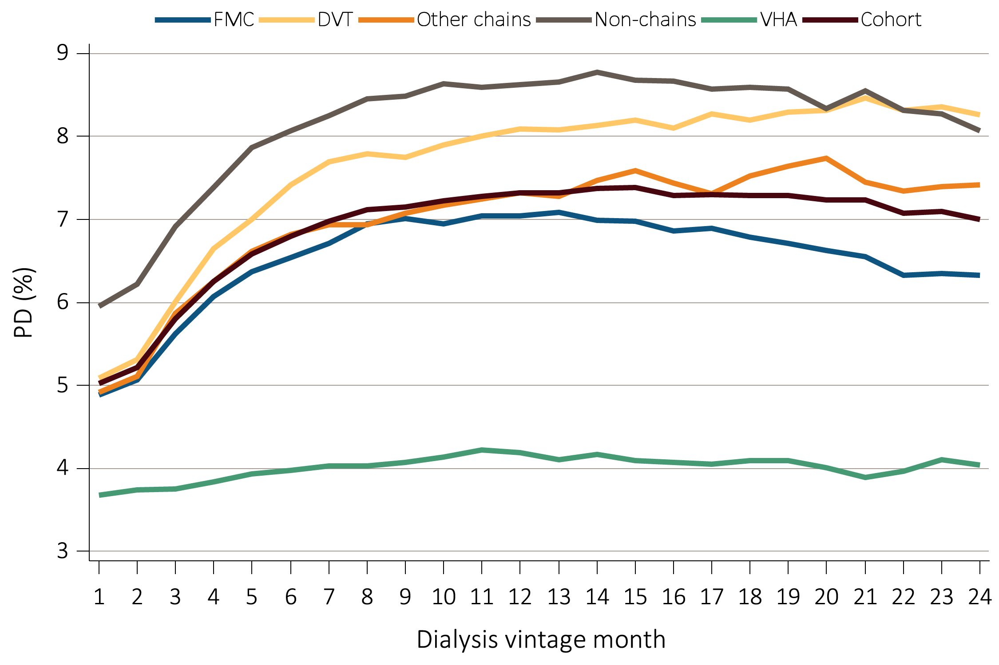
vol 2 Figure 12.9 Peritoneal dialysis among incident ESRD veterans who transitioned to KRT during 10/1/2007-9/30/2011 and who were followed for up to 24 months according to dialysis provider.
All rates are crude and without any adjustment. Abbreviations: ESRD, end-stage renal disease; KRT, kidney replacement therapy.

Slide 15
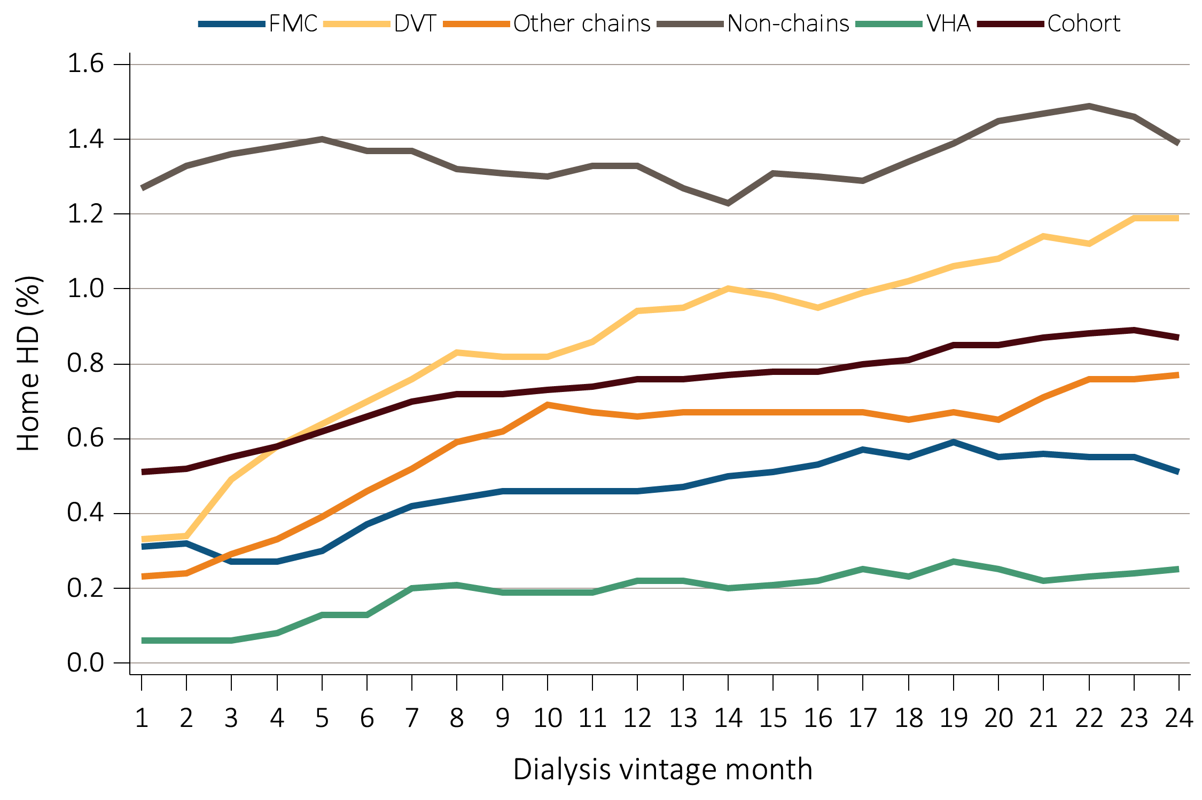
vol 2 Figure 12.10 Home hemodialysis among incident ESRD veterans who transitioned to KRT during 10/1/2007-9/30/2011 and who were followed for up to 24 months according to dialysis provider.
All rates are crude and without any adjustment. Abbreviations: ESRD, end-stage renal disease; KRT, kidney replacement therapy.

Slide 16
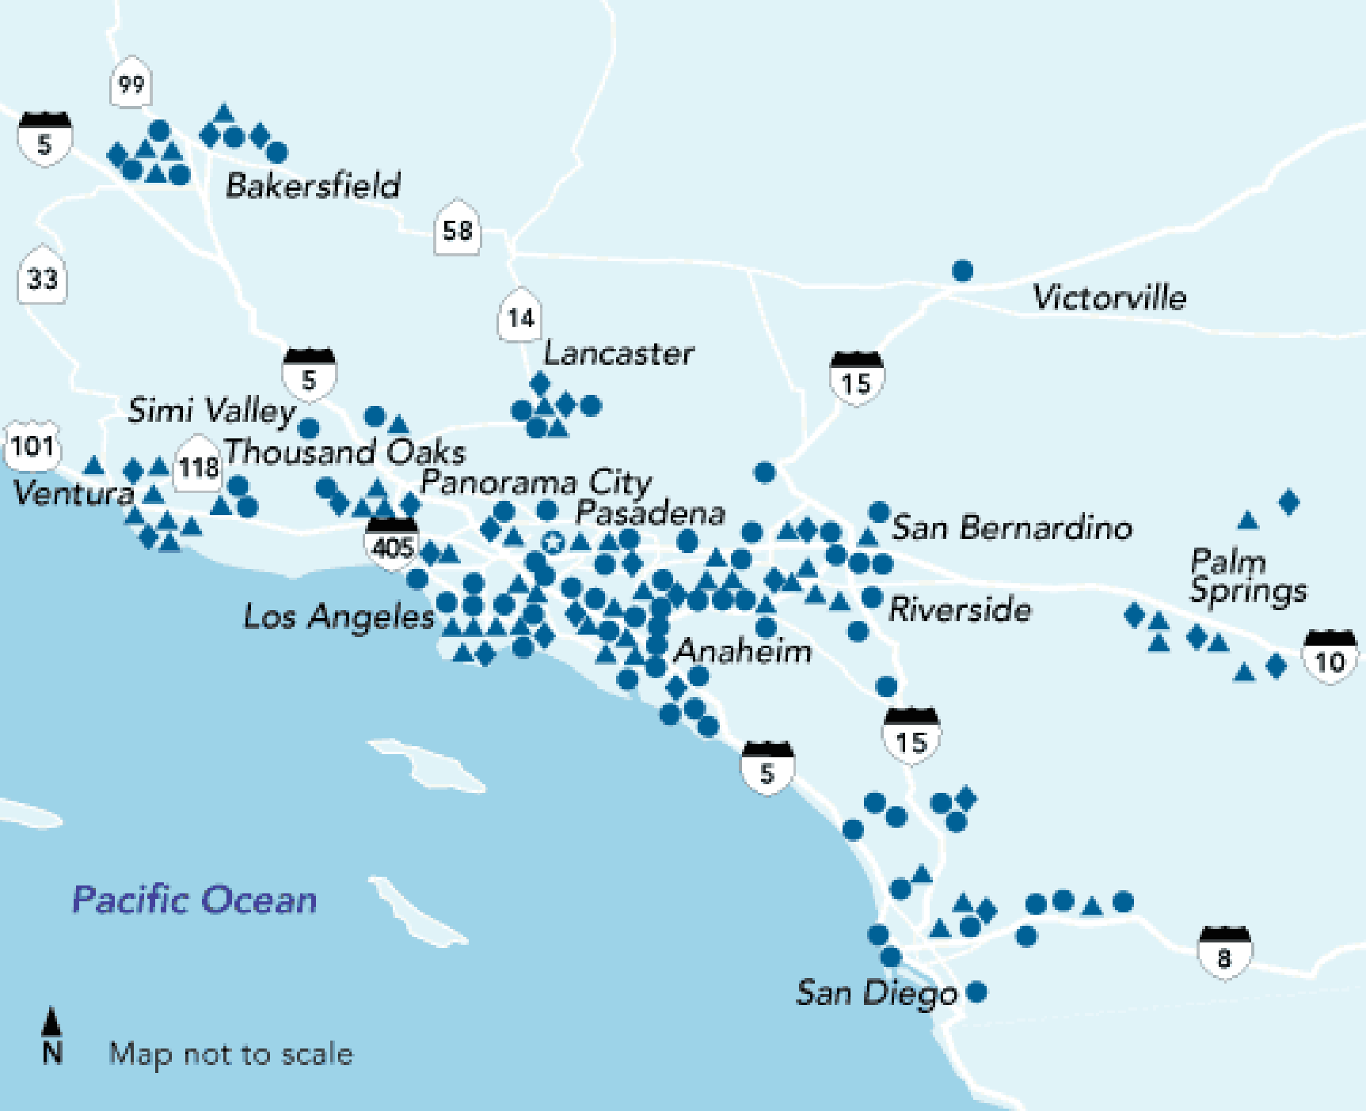
vol 2 Figure 12.11 Kaiser Permanente of Southern California (KP-SC) centers

Slide 17
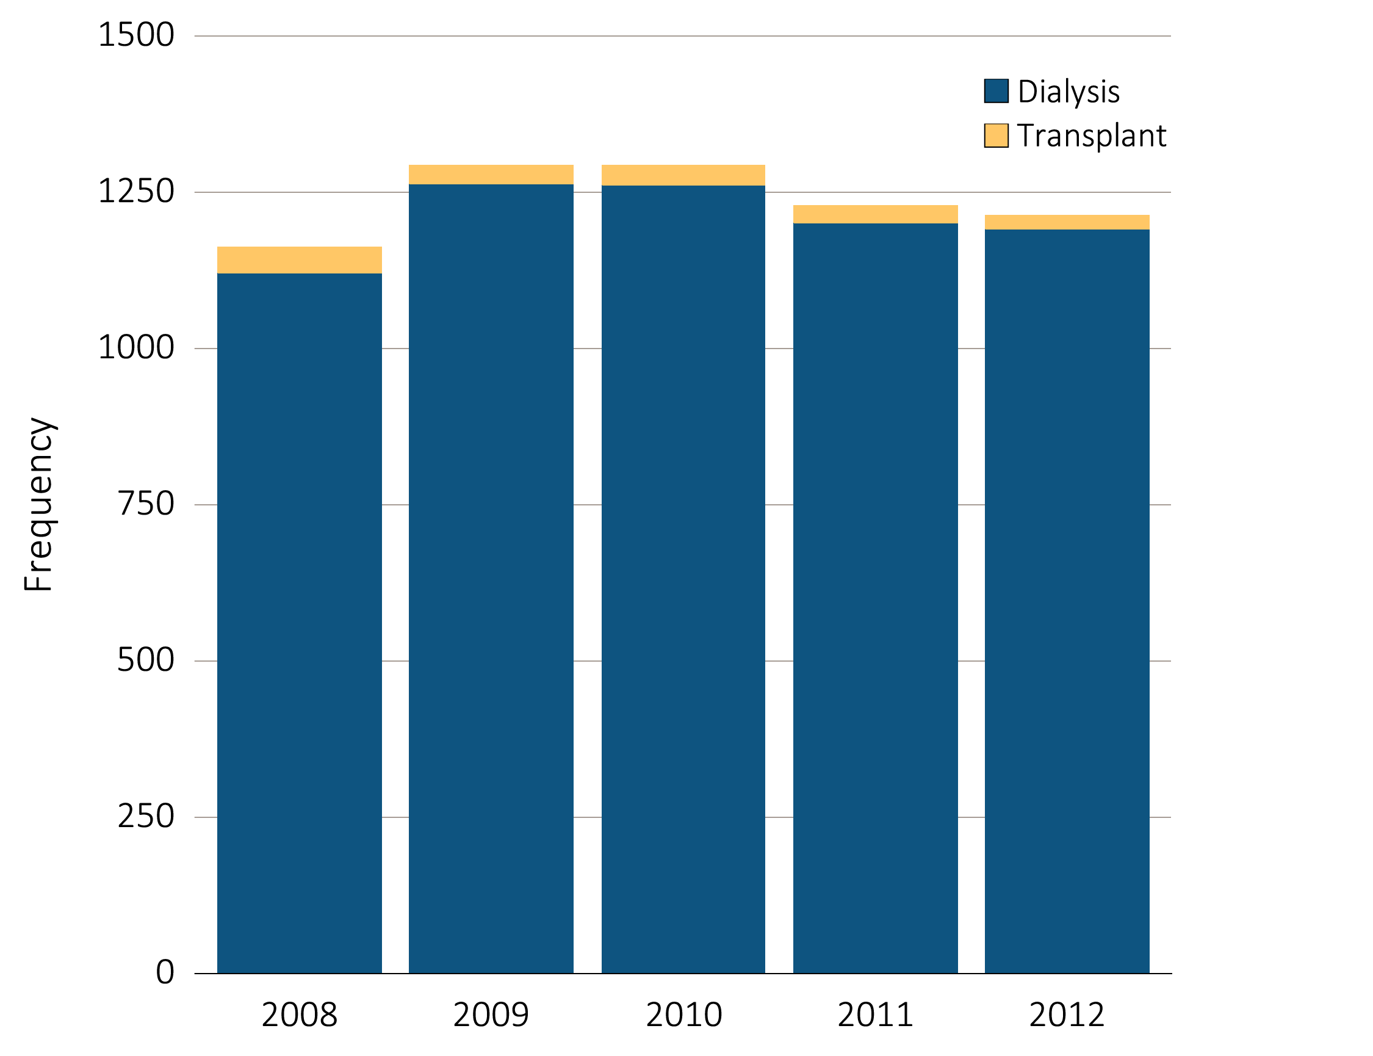
vol 2 Figure 12.12 Frequency of transition to KRT among 6,189 KP-SC patients, 1/1/2008-12/31/2012
Abbreviations: KP-SC, KRT, kidney replacement therapy; Kaiser Permanente of Southern California.

Slide 18
vol 2 Table 12.4 Demographics of 6,189 KP-SC patients who transitioned to KRT, 1/1/2008-12/31/2011
 | Dialysis | Pre-emptive Transplant | Total
n | 6,038 | 151 | 6,189
Age (mean ± SD) | 62.8 ± 14.5 | 45.1 ± 15.6 | 62.4 ± 14.8
Gender
Female | 2522 (41.8%) | 65 (43.0%) | 2587 (41.8%)
Male | 3516 (58.2%) | 86 (57.0%) | 3602 (58.2%)
Race/ethnicity
White | 1852 (30.7%) | 55 (36.4%) | 1907 (30.8%)
Black | 1267 (21.0%) | 11 (7.3%) | 1278 (20.7%)
Hispanic | 2126 (35.2%) | 56 (37.1%) | 2182 (35.3%)
Asian | 708 (11.7%) | 23 (15.2%) | 731 (11.8%)
Other | 39 (0.6%) | 2 (1.3%) | 41 (0.7%)
Unknown | 46 (0.8%) | 4 (2.7%) | 50 (0.8%)
Abbreviations: KP-SC, KRT, kidney replacement therapy; Kaiser Permanente of Southern California; SD, standard deviation.

Slide 19
vol 2 Table 12.5 Number of serum creatinine tests and the eGFR prior to transition to KRT in 6,189 KP-SC patients, 1/1/2008-12/31/2012
Years prior to KRT transition | Number of incidence ESRD patients having serum creatinine test | Mean number of tests per patient | Mean serum creatinine (ml/min) | Mean eGFR (ml/min/1.73m²)
1 | 5,693 (92.0%) | 7.2 | 4 | 20.9
2 | 5,076 (82.0%) | 5.3 | 2.6 | 31.1
3 | 4,754 (76.8%) | 4.6 | 2.2 | 38.1
4 | 4,429 (71.6%) | 4.1 | 1.9 | 43.5
5 | 4,104 (66.3%) | 3.8 | 1.8 | 48
Abbreviations: eGFR, estimated glomerular filtration rate; ESRD, end-stage renal disease; KRT, kidney replacement therapy.

